Slide 1
Electropolishing for SPL cavities
L. Ferreira
TE-VSC-SCC

Slide 2
OUTLINE
CERN Niobium electropolishing set-up
SPL #1
Measured data from SPL #1
Crosscheck with data from simulation (SPL #1)
SPL #2
New cathode and working procedure
Measured data from SPL #2

Slide 3
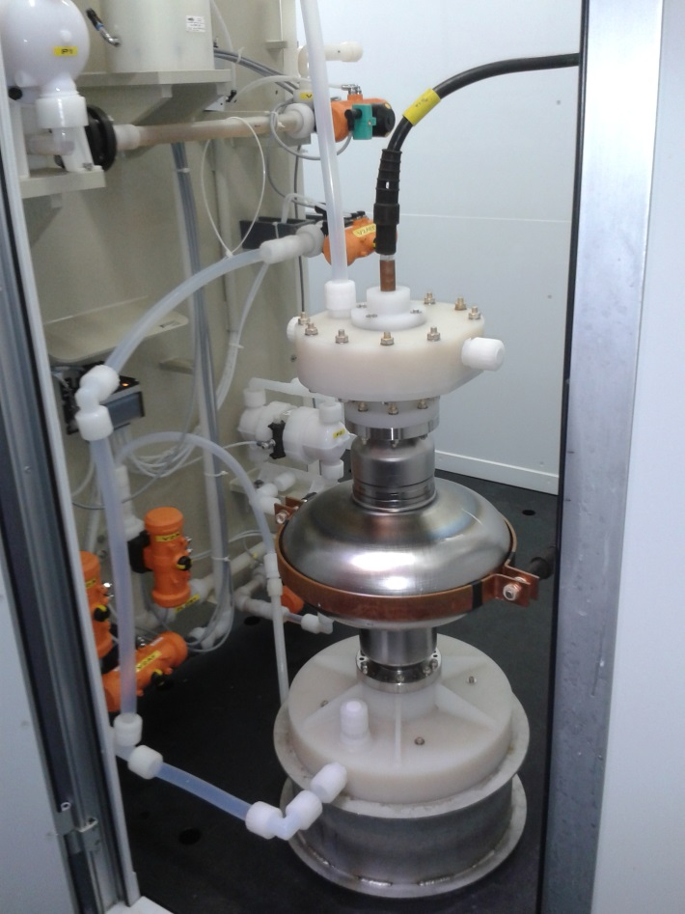
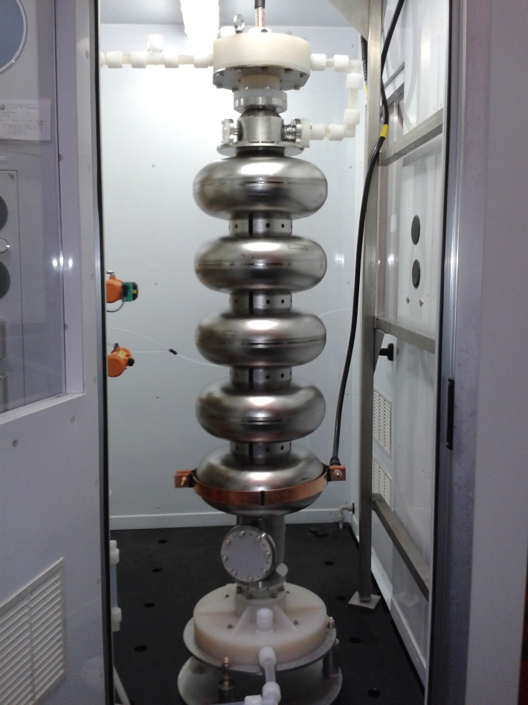
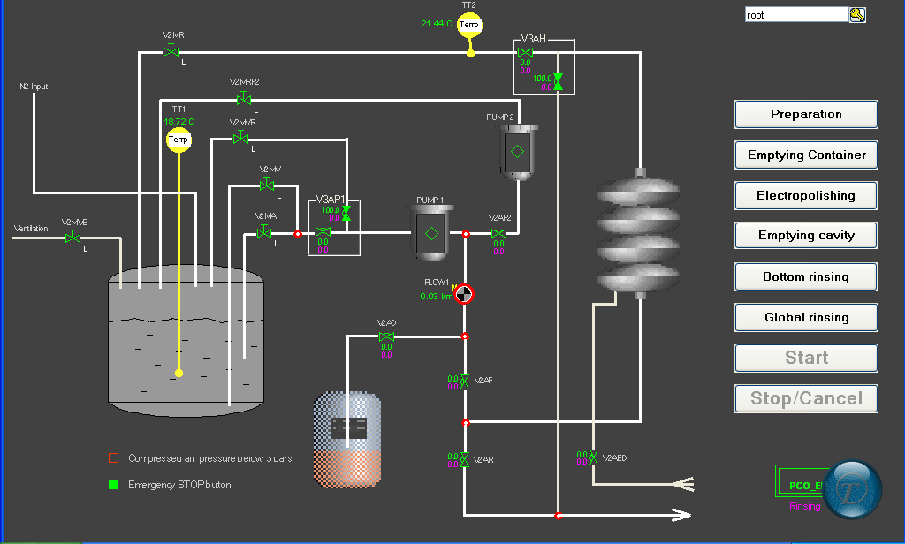
CERN Nb electropolishing set-up
- Vertical electropolishing (& no rotating parts)
Touch screen control panel

Slide 4
SPL #1
Polishing speed fit between simulation and wall thickness data
Wall thickness data
Simulation
Notes:
Reverse engineering

Slide 5
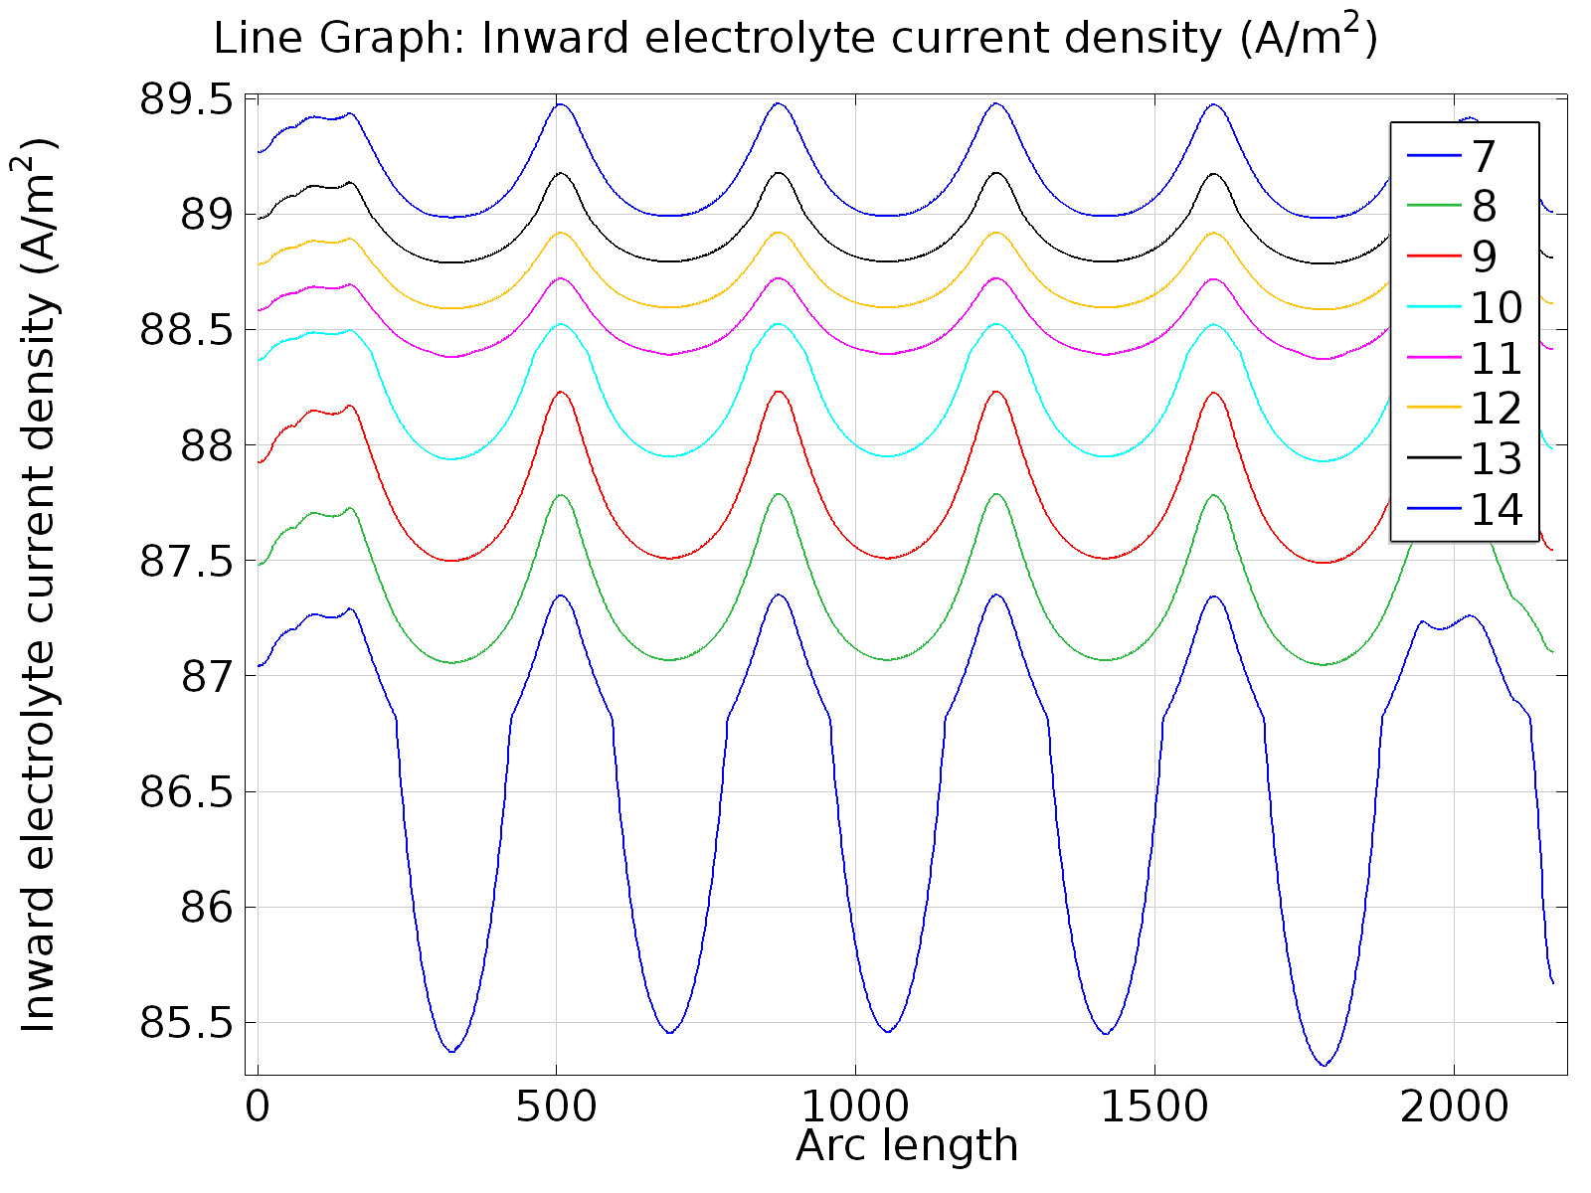
SPL #1
7.2 µm/h
6.9 µm/h

Slide 6
Bath temperature & speed vs polishing speed

Slide 7
SPL #1
Direction of flow

Slide 8
Surface finishing on SPL #1
Top-Down
SPL #1 cell after 200 µm: bright but grooves and pinholes

Slide 9
Surface finishing on SPL #1
Origin of lines and pits
Origin of grooves
Origin of pinholes

Slide 10
Surface finishing on SPL #1
Direction of flow
Notes:
Only use 1,3,5mm curves, colour graph, scale for cavity shape.
Nice way to identify radial flow

Slide 11
SPL #2
New Cathode:
Reduce cathode section:
Decrease bath speed at the iris.
Promote flow uniformity (less vortex):
Allow hydrogen to flow preferentially upwards.
Restrict the hydrogen path:
Avoid or at least hinder the amount of hydrogen that reaches the cavity wall.

Slide 12
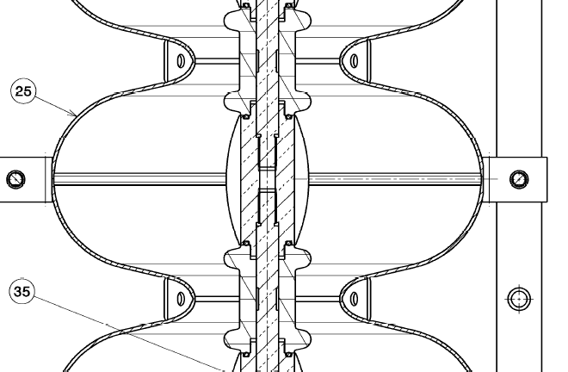
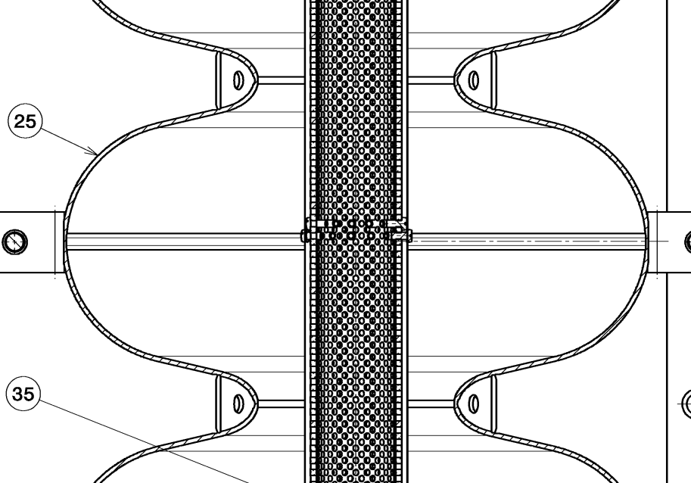
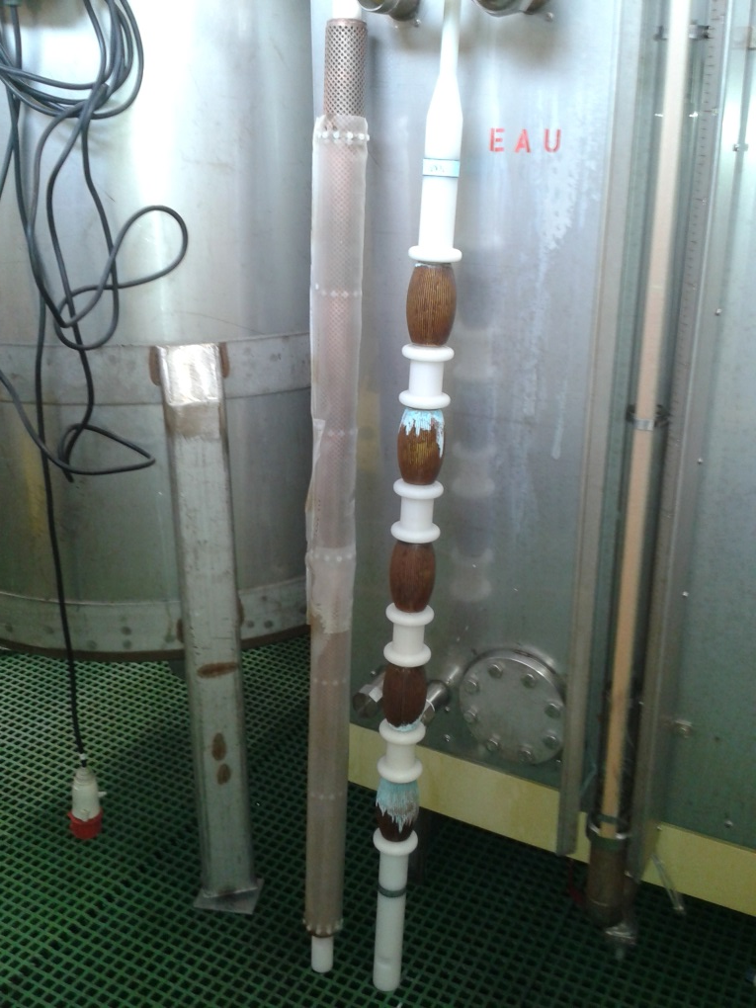
SPL #2
Old Cathode
New Cathode
Reduce cathode section: Hollow cathode
Promote flow uniformity (less vortex): Simple geometry and free flow.
- Restrict the hydrogen path: PFE membrane (70 µm).

Slide 13
SPL #2
Old cathode
New cathode
Decrease bath speed at the iris

Slide 14
SPL #2
Old cathode
New cathode
Less vortex

Slide 15
Measured data from SPL #2
10.03.2015 | 12.03.2015
11 µm | 24 µm
10 to 15 lpm
Tavg = 7.6 °C

Slide 16
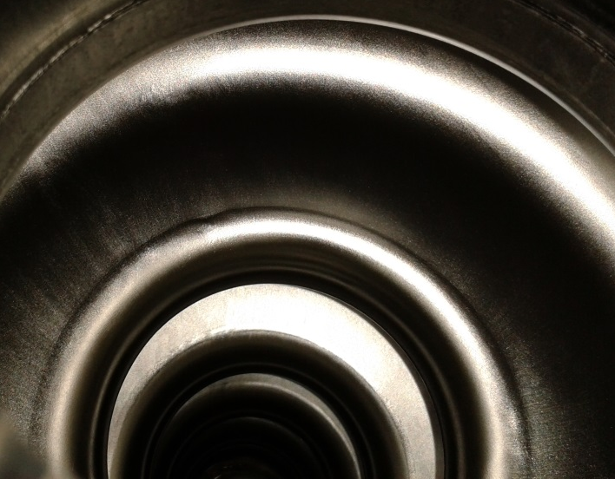
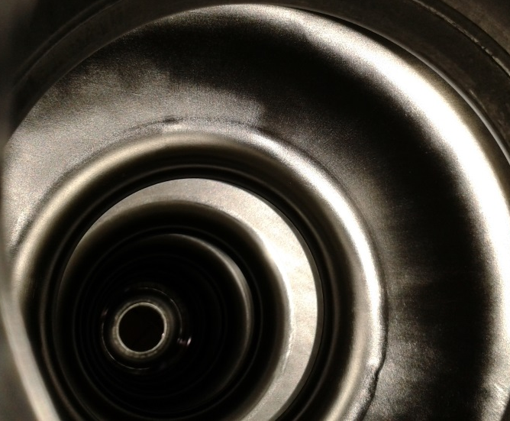
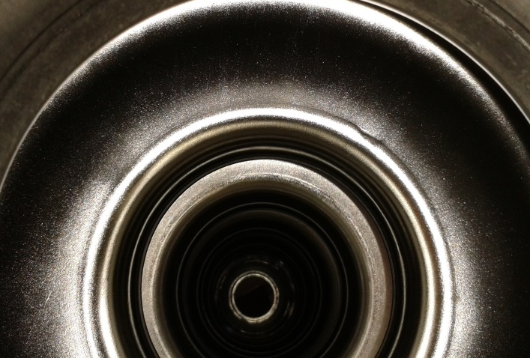
Measured data from SPL #2
 | Top half-cell | Bottom half-cell
10.03.2015
12.03.2015

Slide 17
Questions?

