Slide 2
ESS klystron modulator: tests at CERN
David Nisbet (CERN)
Sven Putz (CERN, now GSI)

Slide 3
Introduction
Project outline
Design & construction
Results
Feedback
Conclusion

Slide 4
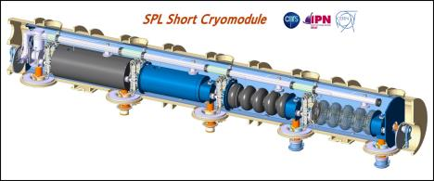
Project Description
Modulator requirement identified for a high power 704MHz teststand at CERN
Deliver 2.8MW electrical pulsed power to a klystron
Flexible enough to adapt to several specifications, including ESS and SPL parameters
Modulator supplied by ESS through superconducting cavity collaboration
Contract prepared and managed by ESS with some CERN input
Selection of best offer which was based on simple LR bouncer topology
Contract placed in 2011

Slide 5
Modulator specifications
Parameter | SM18 / ESS | SPL | LINAC4
U_{k} | -115 | -110 | -110 | kV
I_{k} | 25 | 25 | 50 | A
P_{pulse} | 2.88 | 2.6 | 5.5 | MW
P_{avg} | 161 |  | 20 | kW
PRR | 20 | 50 | 2 | Hz
Z_{k} | 4.6 | 4.4 | 2.2 | kΩ
τ_{pulse} / τ_{flat-top} | 2.8 / 2.5 | 1.0 / 0.8 | 1.8 / 1.5 | ms
droop | 3 | 1 | 1 | %
droop compensation type | LR |  | LC
Design / Production | AMPEGON PPT GmbH |  | CERN / JEMA sa
Average Power | 161 | 138 | 20 | kW
Load
Average power specification
$$P_{k,avg}=U_{k}∙I_{k}∙τ_{p}∙PRR≤161kW$$
$$Z_{k}<14 kΩ$$

Slide 6
Project execution
2012
2013
2014
2011
07 - call for tender
09 - TDR presentation
10 - dummy load revised TDR
03 - reception @25% (PPT)
05 - reception @100% (CERN)
09 - commissioning SM18
12 - contract start
10 - TDR approval (except dummy load)
10 - approval of dummy load TDR

Slide 7
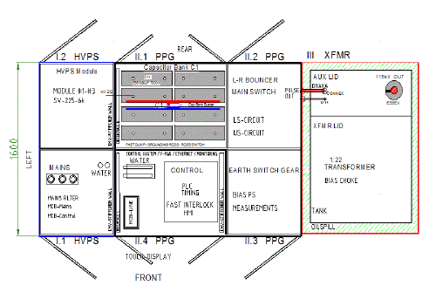
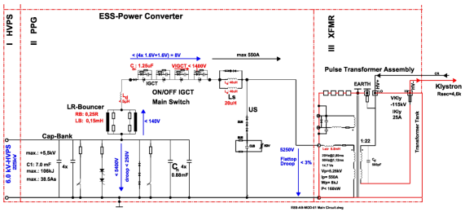
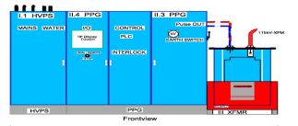
Electrical Schematic & Layout

Slide 8
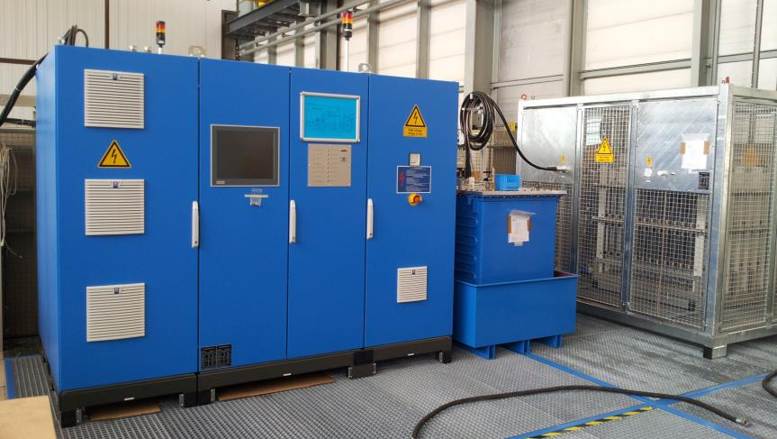
Modulator testing at CERN

Slide 9
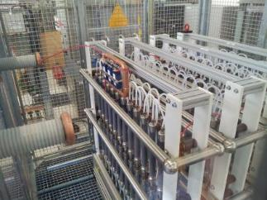
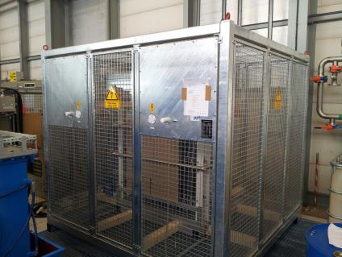
Resistive Dummy Load
2400
2300
2000
11 m³ / 6 m²
air insulated
water cooled
P_{avg} 161 kW
Load resistors and rating plate

Slide 10
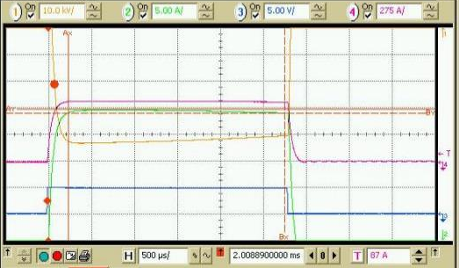
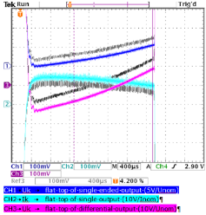
Uk measurements
Operation at [115kV, 25A, 2.8ms]
Droop meets specification (3% of nominal)
Rise time ~250us
Slow change of Uk during 24hr period of ~0.5%, to be compensated by RF Low Level
~250us
3% of Uk

Slide 11
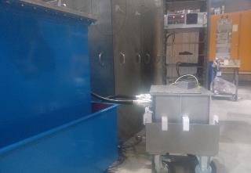
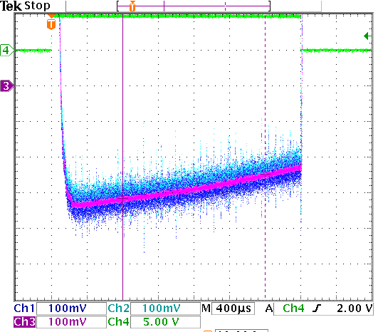
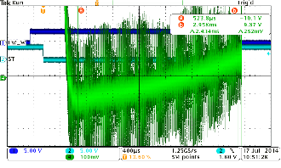
Uk measurements
Delivered system had very noisy signals leading to difficulties to validate performance
Diagnosis of HV measurement issues is not easy!
Dedicated external voltage divider in oil with additional HV connections
Evolution of Uk measurement improvements

Slide 12
AC Power Quality
Constant power operation was not a requirement
The non-balanced AC supply can be clearly seen
Should there be many systems on the same network, the problem will be more severe

Slide 13
Project feedback
Overall the modulator is of a high quality design and construction
The supplier chose a sub-system design concept
High dependence on sub-contractors
Can be an issue when problems are encountered, due to lack of detailed expertise and issues of information flow
Contract / design
Important that all employed technologies are understood by both contractor and client!
Load design and delivery
Essential for contract execution; required design input from CERN to ensure an acceptable and successful solution

Slide 14
Project feedback
Electronics implementation
Takes a long time to implement and debug software
PLC software is user friendly, however not yet stable or definitive
Some design decisions on electronics execution could be better (grounding, noise)
Difficult to correct some hardware problems if only discovered during reception
Recommend a thorough specification that includes progressive testing program including interfacing in final software environment
Acoustic Noise
75dB measured. Issue not to be ignored if there are many systems in a confined space
Water
This is a reliability and availability driver. Recommend large margins between nominal and trip settings.
Transport
Although clearly specified, not implemented correctly. Check maintenance procedures carefully.

Slide 15
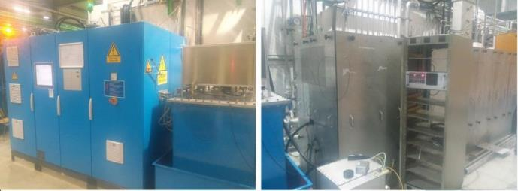
Status
Modulator is fully commissioned and operational on a LEP klystron in SM18
Recently used for LINAC4 CCDTL cavity conditioning
Soon to be commissioned with a 704MHz klystron
Still some issues to be definitively resolved
Software updates to be implemented and fully tested
Definitive measurement hardware update to be implemented and fully tested

Slide 16
Conclusion
Proven topology and design chosen to minimize contract risk
In the end it was the details that mattered (controls, load, sub-contractors, …)
Highest average pulsed power system at CERN has been successfully commissioned
Valuable contribution for long pulse experience
Useful experience for subsequent strategy
Testing of long pulse high rep rate RF systems now possible
Many thanks to the ESS team for the support and perseverance to bring the system from concept to teststand reality

Slide 17
Acknowledgements
ESS
Carlos de Almeida Martins
Karin Rathsman
David McGinnis
CERN
Sven Putz
Julien Parra-Lopez
Azmat Tanvir

