Slide 1
HNOSS: first results and FREIA status
Rocío Santiago Kern
FREIA Laboratory, Uppsala University
19th of March 2015

Slide 2
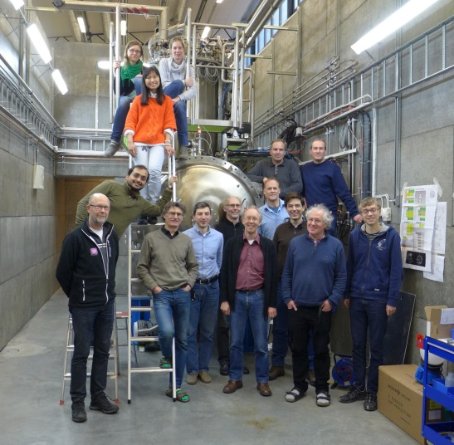
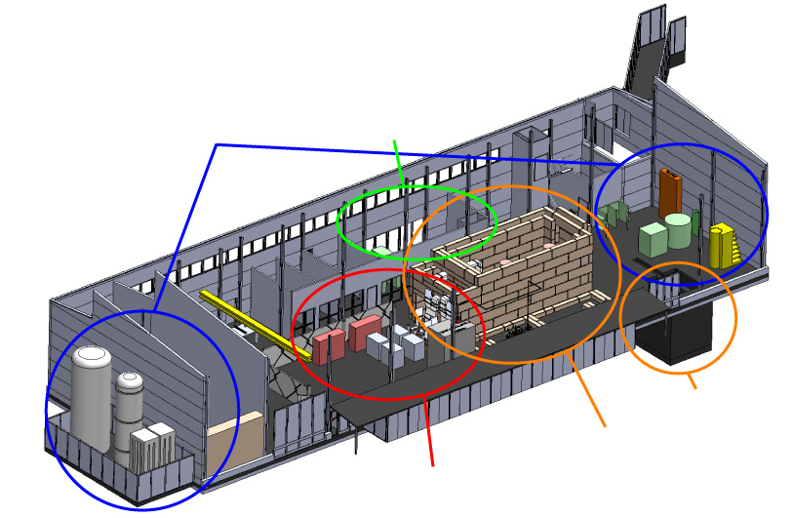
What and Whom?
Facility for Research Instrumentation and Accelerator Development
State-of-the-art Equipment
cryogenics
- liquid helium
- liquid nitrogen
control room
- equipment controls
- data acquisition
Competent and motivated staff
collaboration with physics (IFA), engineering (Teknikum), TSL
and Ångström workshop
Funded by KAWS, Government, Uppsala Univ.
vertical cryostat
3 bunkers
with test stands
horizontal cryostat
RF power sources

Slide 3
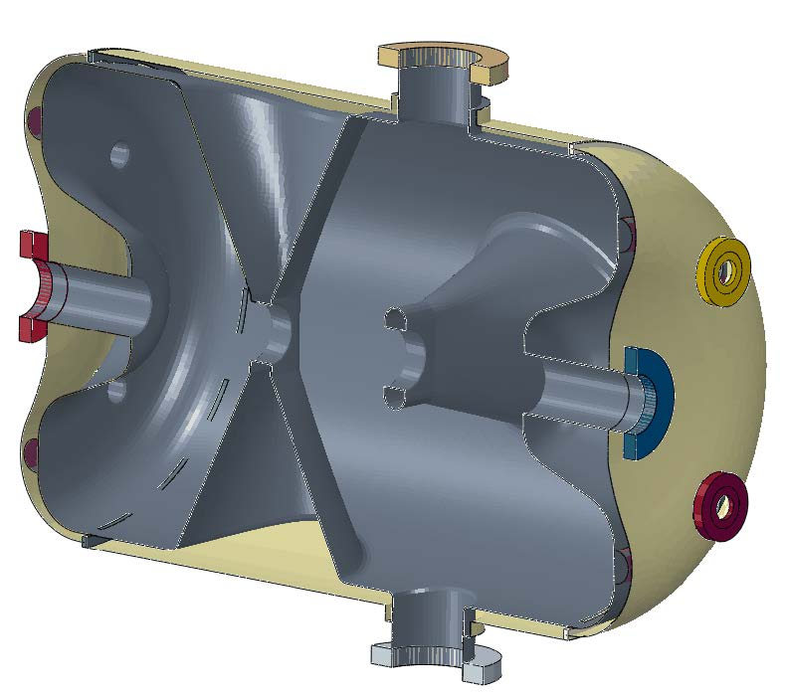
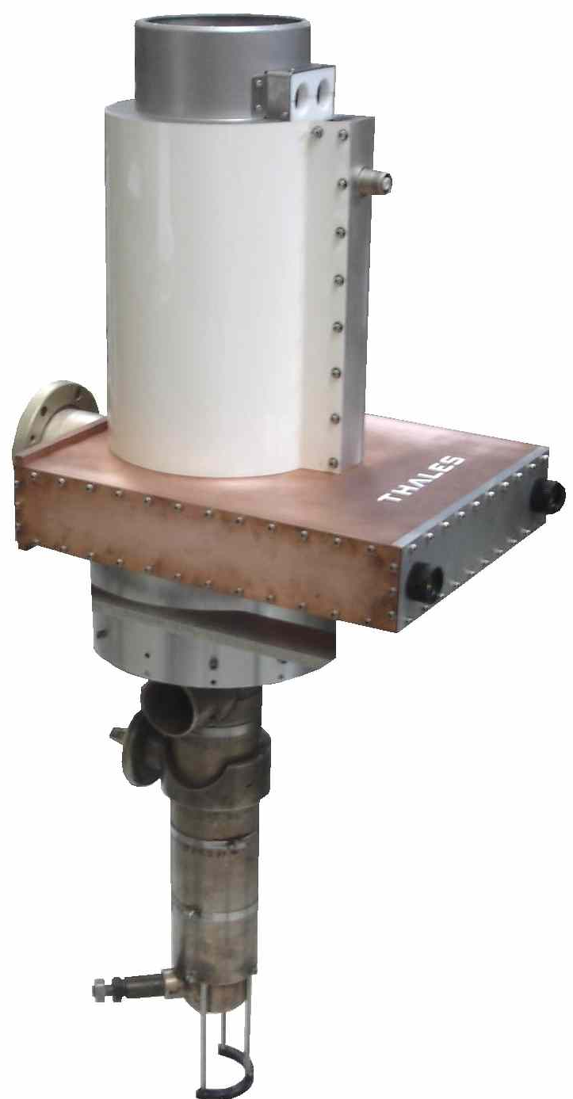
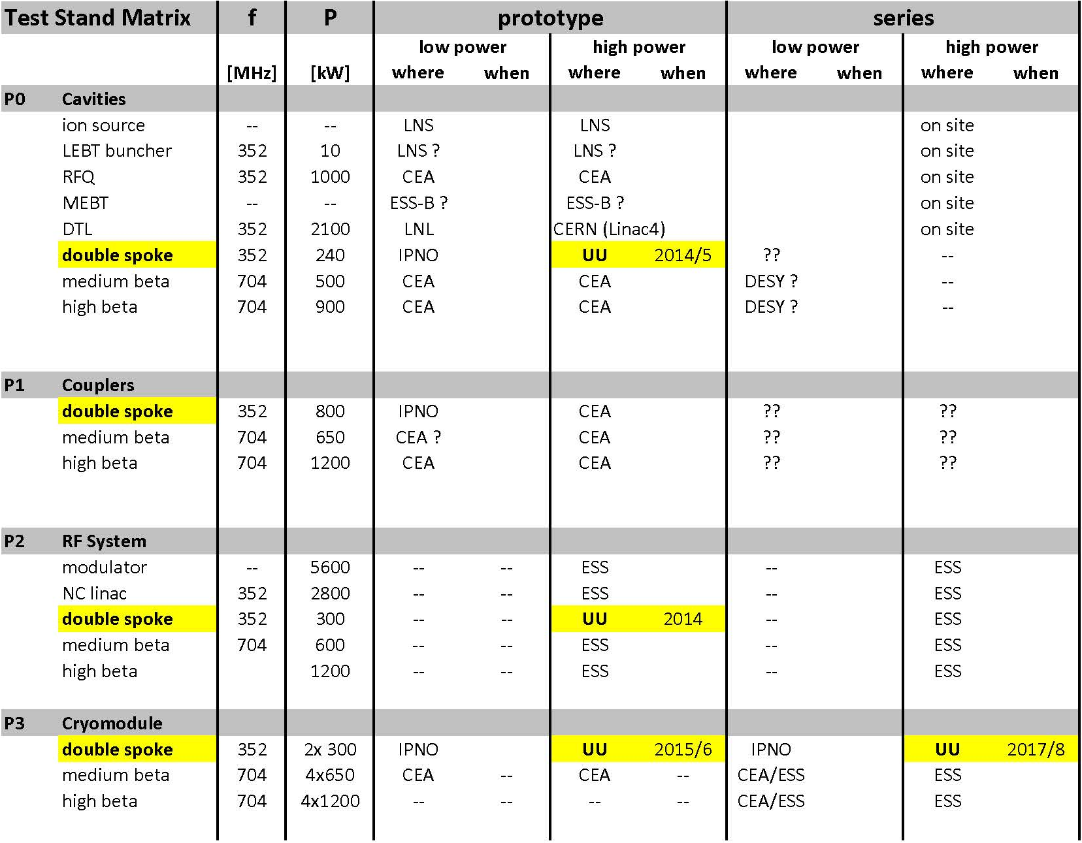
Responsibility for ESS Accelerator
Funded by ESS
Development power station for spoke cavities
soak test with water cooled load, then accelerating cavity, incl. controls
collaboration with industry to develop vacuum tube and solid-state based prototypes
System test, power station with spoke cavity and cryostat-module
fully dressed prototype cavity (in test cryostat)
complete prototype module (2 spoke cavities)
test of switch-on procedures & LLRF
Acceptance test spoke cryostat-modules
all spoke cryomodules before installation
Test of 704 MHz modulator and klystron
prototype and pre-series

Slide 4
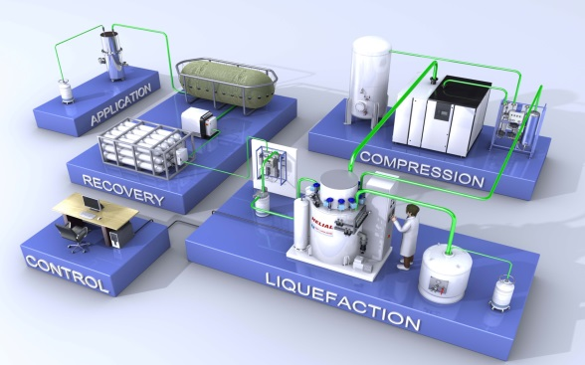
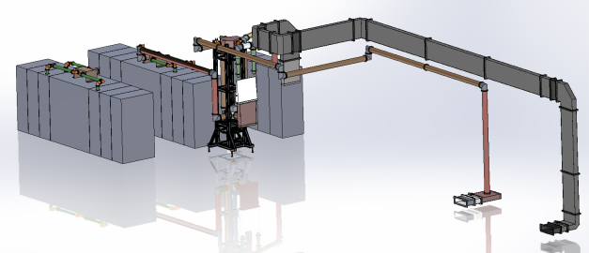
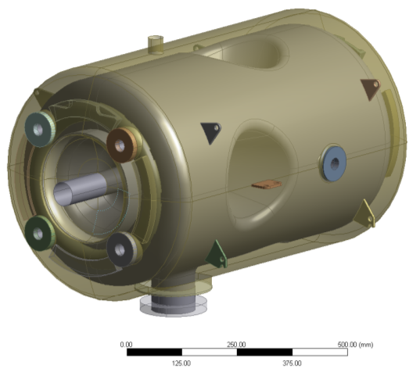
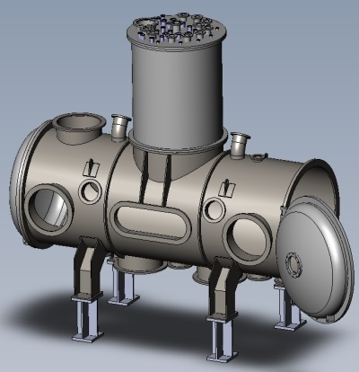
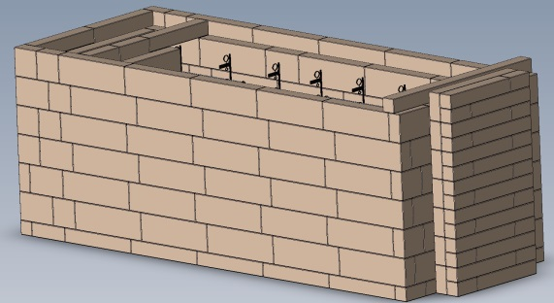
The Test Stand
Three main subsystems needed
RF Power Station
Cryogenics
Courtesy of P. Duthil
To avoid radiation in public areas:
Spoke Cavity
(superconducting)
Cryostat
Bunker

Slide 5
HNOSS: 1st Results

Slide 6
Flow Scheme & Vacuum Barriers
Cold Box
Storage Dewar
Bunker
LN2 80K 1.4 bar
Supercritical Circulation
Outside
building
He 4 K 1.2bar
N2 300 K
1.1 bar
He 300 K
3 bar
Inter
Connection
Box
Valve box
He 5 K
16 mbar
2K and 10 K
Heater
2K pumps
He 300 K
17 mbar
He 10 K 1.1bar
He 300 K
1.1 bar
Horizontal Cryostat
Valve box &
Cryomodule
Gasbag
300 K
1.1 bar

Slide 7
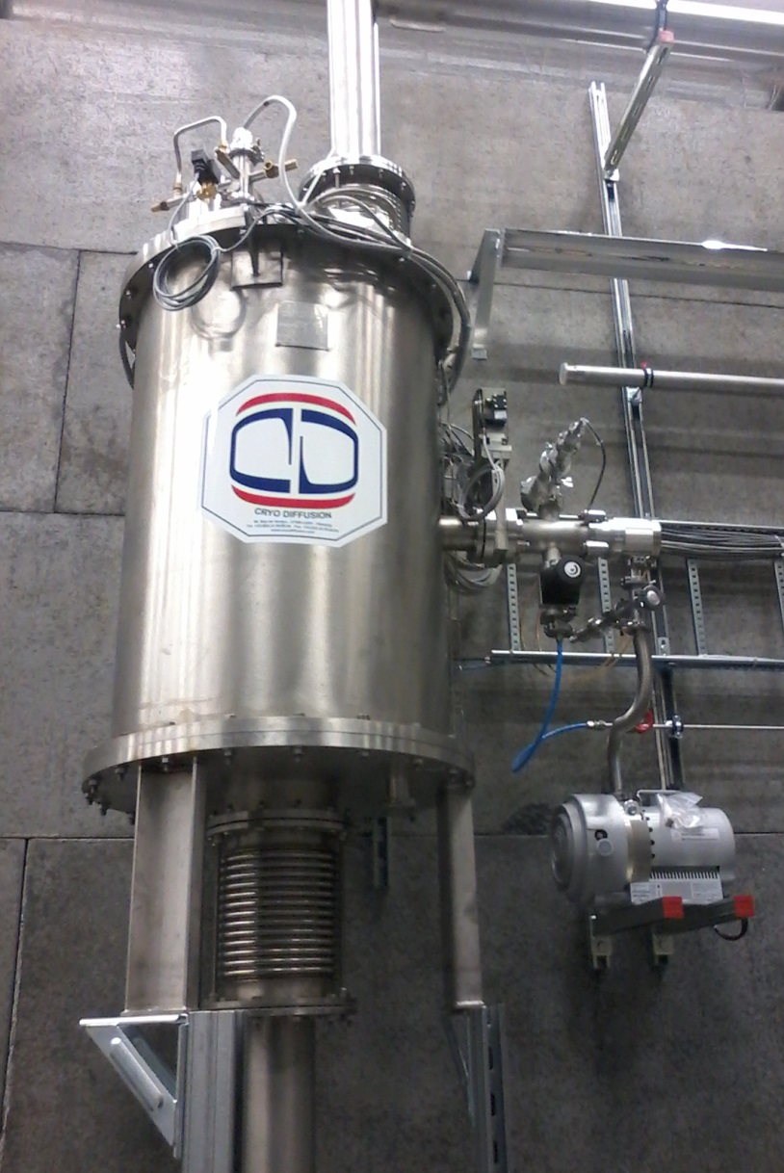
ICB
The interconnection box (ICB) is to switch cryogens between HNOSS and the cryomodule.
The ICB has a thermal shield cooled by LN₂
The ICB vacuum includes also the transfer line (TL) to the VB
Total volume ICB+ TL < 1 m³

Slide 8
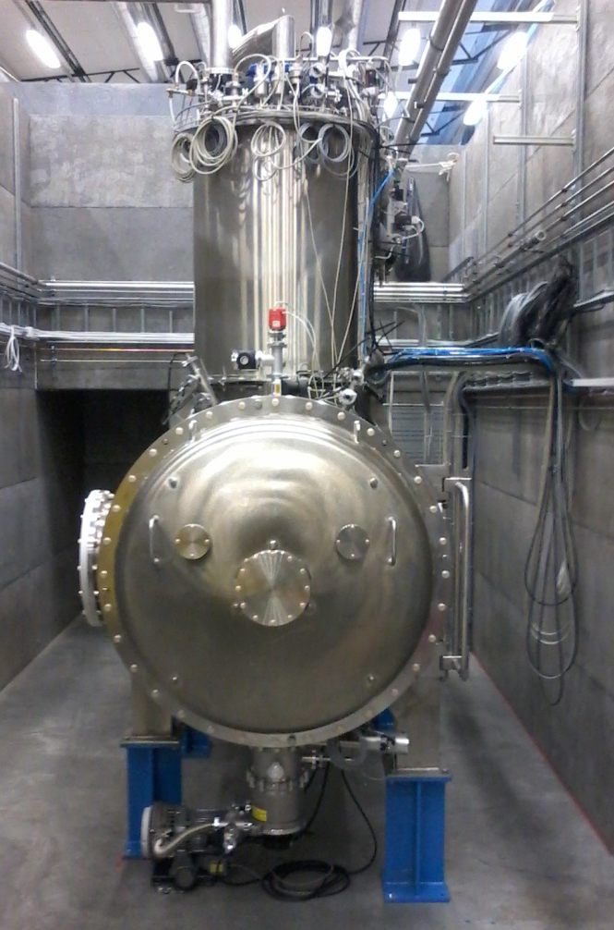
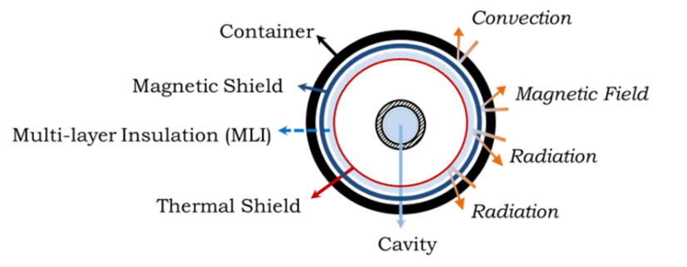
HNOSS
Has two parts:
Valvebox (VB): contains all the valves and tanks and most of the piping
The cryostat itself (HCS): houses the cavities and the table
Both parts have:
Magnetic shield (room temperature)
Thermal shield (LN₂ temperature)
The GHe outputs (low and high pressure), can be independently connected to:
The main compressor of the LHe plant
The gasbag
Total volume ca. 7 m³

Slide 9
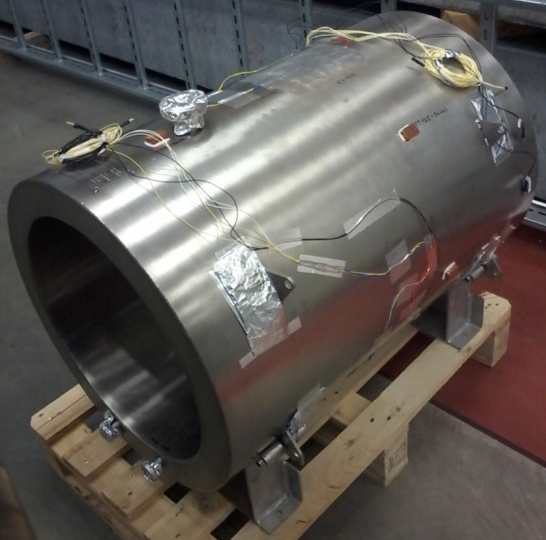
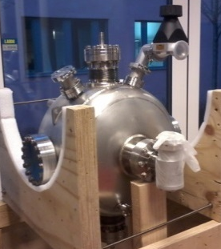
Cavities
Simple double-wall cylinder
Approx. same LHe volume as double spoke
No beam vacuum
CF 40 connection for 2K tank
CF16 connections for cooling and LHe level probe
3 heaters installed for RF power simulation
Dummy Cavity
Single spoke
Courtesy of IPNO
With beam vacuum
Two RF antennas
Preparing for tests
Hélène

Slide 10
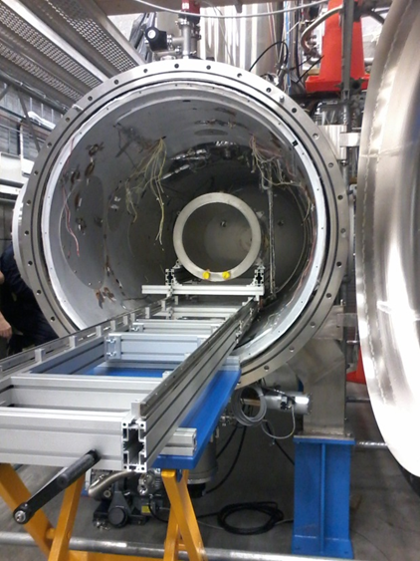
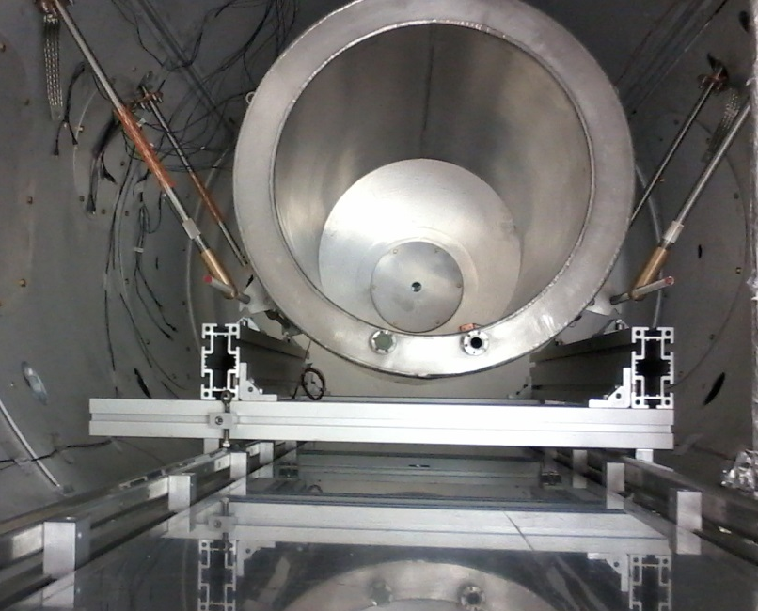
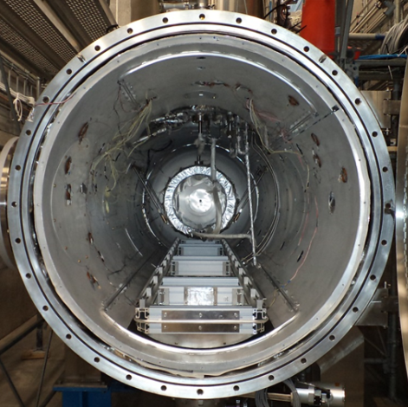
Dummy Cavity Installation
Connect tie-beams, lift and remove table
Connect rest of cryogenic piping
Insert cavity with support table

Slide 11
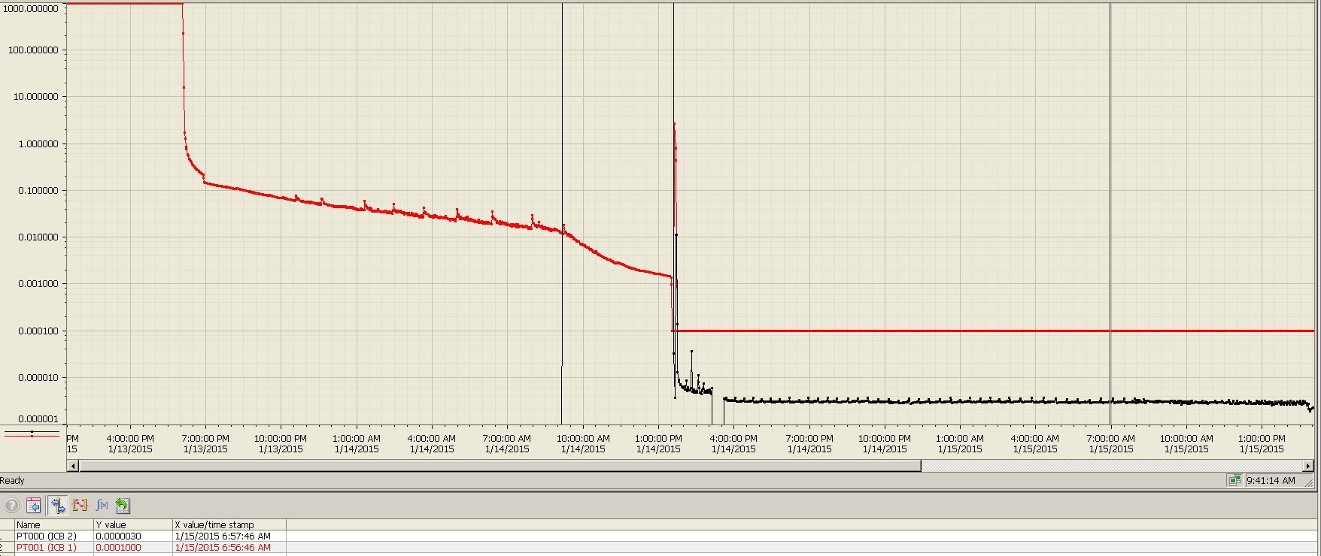
ICB Vacuum
P [mbar]
LN₂ cooling start
LN₂ leak in ICB
Outgassing?
Pumping group: 80 l/s turbo pump backed by a 5 m³/h scroll
Pump down time from 1000 mbar to 1x10⁻³ mbar : 15h

Slide 12
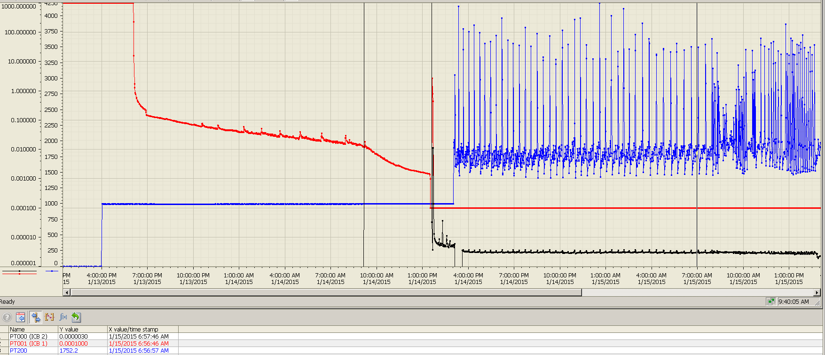
ICB Vacuum
Pressure bursts from LN₂
P [mbar]
Pressure bursts between 1.5 and 4.5 bar generated in the phase separator
For next run: regulated pressure between 1.5 bar and 2 bar

Slide 13
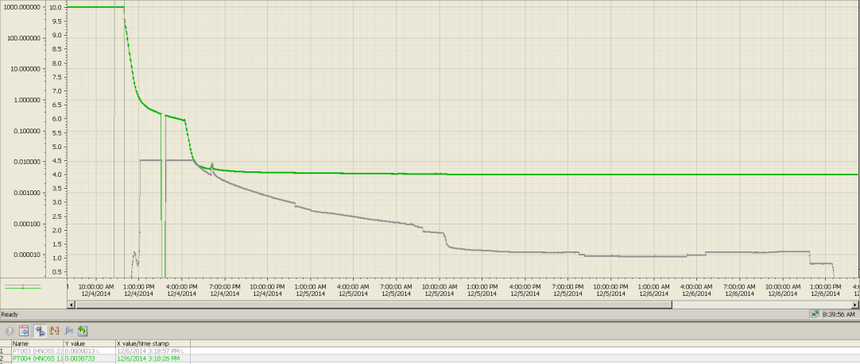
HNOSS Vacuum
P [mbar]
LN₂ cooling start
Pumping group: 1000 l/s turbo pump backed by a 30 m³/h scroll
Pump down time from 1000 mbar to 1x10⁻⁴ mbar : 24h

Slide 14
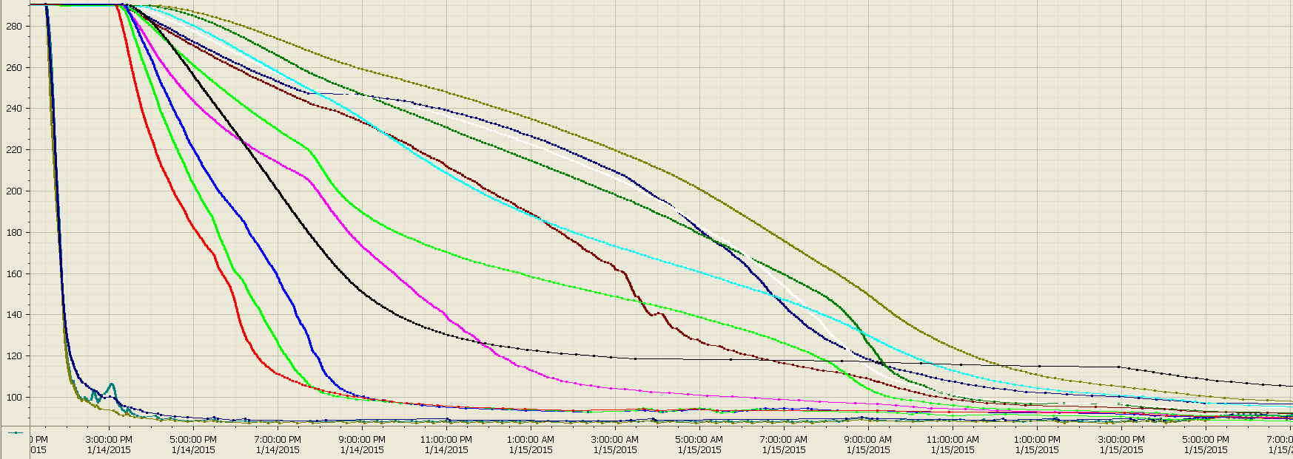
Thermal Shields
HNOSS
HNOSS’ doors
T [K]
ICB
VB top flange
VB
Cool down time for ICB (290K to 100K) : 1.5h
Cool down time for HNOSS (290K to 100K): 26h
BUT to be reduced once there are no pressure bursts in the LN₂ circuit

Slide 15
Heat loads
Validating sequences of the control system for HNOSS → not possible to give proper values.
A very coarse approximation: 10h from LN₂ temperatures to the steady state.
The steady state is defined as:
Table temperature stable,
Flow from the 2K tank < 5 m³/h and
Dummy cavity, 4K and 2K tanks filled with LHe at 4.5K
Preliminary values for the heat loads:
7.2 W for the 4K tank,
4 W from table (at 4K),
1 W at 2K for the 2K tank and dummy cavity

Slide 16
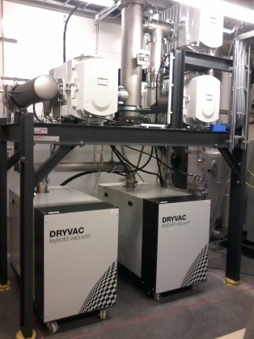
2K pumps
Two modes of operation
Pressure regulation: not used (butterfly valve in place)
”Maximum speed”: normal mode of operation
Have reached 2K in the dummy cavity
Pumping speeds
7250 m³/h at 10 mbar (required 7180 m³/h, 3.2 g/s)
6747 m³/h at 15 mbar (required 5900 m³/h, 4 g/s)
1120 m³/h at P > 200 mbar
(required, not measured, 10 g/s)
Ultimate pressure 0.19 mbar
Maximum capacity at 2K: 110W
(by means of power applied to the heaters)

Slide 17
Details to Consider
Loss of temperature sensors at low T
Redundancy is neccesary
Long cooling times
Hopefully to be solved by the pressure changes in the LN₂ phase separator
Problems with pressure regulation of the 2K tank coming from Taconis effect
Most probably due to the safety valve of the 2K tank. Will add a heater close to 2K tank, where the safety valve line starts

Slide 18
FREIA Status

Slide 19
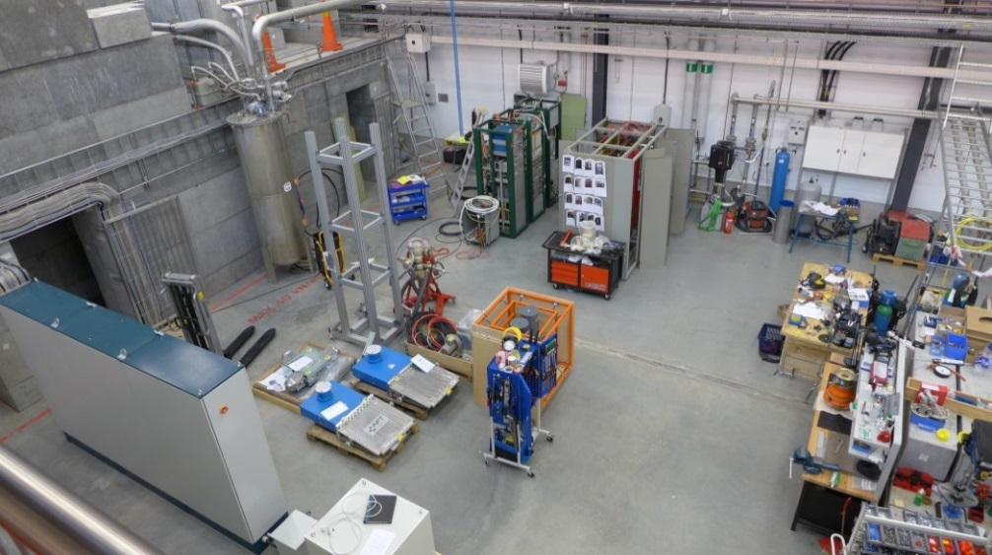
High Power RF Amplifiers
4 systems foreseen to come in operation during 2015
1st contract with Electrosys (target delivery end May)
long delays (bankrupt Spring 2014)
company has finally restarted (new name: Itelco Broadcast)
legal problems regarding ownership of Thales tubes (could again delay project)
2nd contract with DB Electronica (target delivery end May)
different concept regarding power supplies: in-house design as compared to Electrosys using standard catalogue items from sub-contractors
same solid-state pre-amplifier as CERN Linac 4 design
Borrowed 50 kW amplifier from CERN (arrived 18-Feb-2015)
commissioning start next week
to test RF equipment & procedures
Siemens solid-state (target delivery end May)
R&D by Siemens itself
4 racks of 100 kW amplifiers
testing start foreseen in April

Slide 20
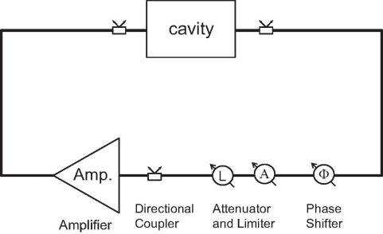
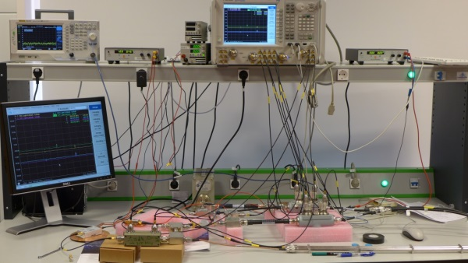
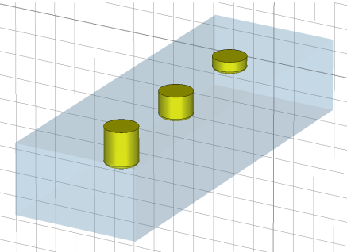
RF Measurements
Typical measurements with the bare cavity:
Loaded Q-factor,eigen and external Q, Q0=f(E)curve
Lorentz detuning and microphonics
Sensitivity to helium pressure fluctuations
Achieve nominal gradient and nominal Q0
RF measurements with self-excited loop
Complete the design and setting up of the self exited loop
(now hooked to a home-made copper cavity)
Calibration and digital phase shifter under development
Stub-Tuner
To reduce required RF power by increasing Q_{ext} : present RF source is 50 kW compared to min. required 100kW (large Q₀)
A matching network in the form of a waveguide-based stub tuners is under development
from a source
L
L
L = lambda/8
2R
to cavity

Slide 21
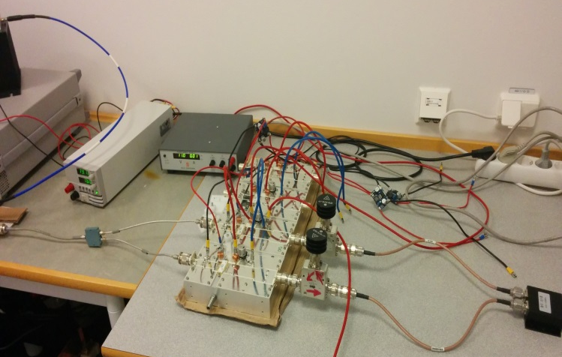
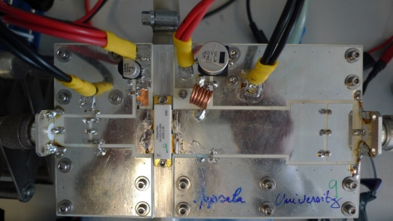
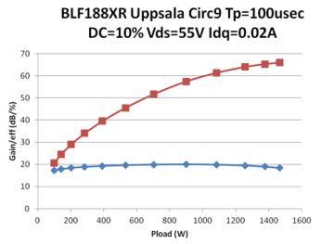
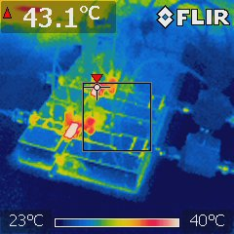
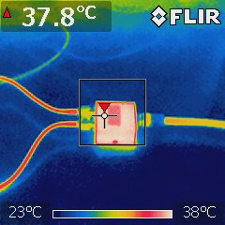
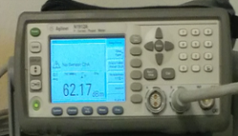
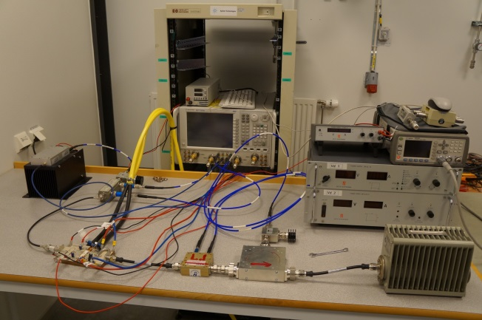
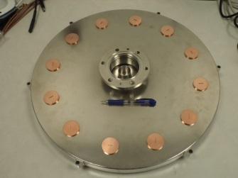
Solid State Amplifier
Single ended RF Power Amplifier (BLF188XR) tested in pulsed mode at 14 Hz and 3.5 ms
Individually: delivering up to 1500 W
Two combined: Delivering up to 1700 W
amplifier slightly modified on RO3003 for series production
Max efficiency: 67% (pulsed)
Gain: 19 dB
Independent measurements at NXP
Max efficiency: 50% (1 dB IL in the output combiner)
Working on improving values
100 kW radial power combiner
output coupler connected to 3-1/8 inch coaxial line
30 mm
500 mm
7/16 inch input connector
1 kW level hot-S
parameter measurements

Slide 22
Control Systems
Control system and interlock development ongoing
EPICS as main interface
Siemens PLC and Nat.Instr. cRIO hardware
connects all sub-systems to one user interface and archive database
safety interlocks for all sub-systems
(Radiation) safety system installation ongoing
Rotem MediSmarts hardware
LLRF
in-house development LLRF (Nat. Instr. PXI based with LabVIEW)
digital phase control of Self-excited Loop
RF power measurement and control
complementary to Lund Univ./ESS LLRF (minimal system as required in accelerator)

Slide 23
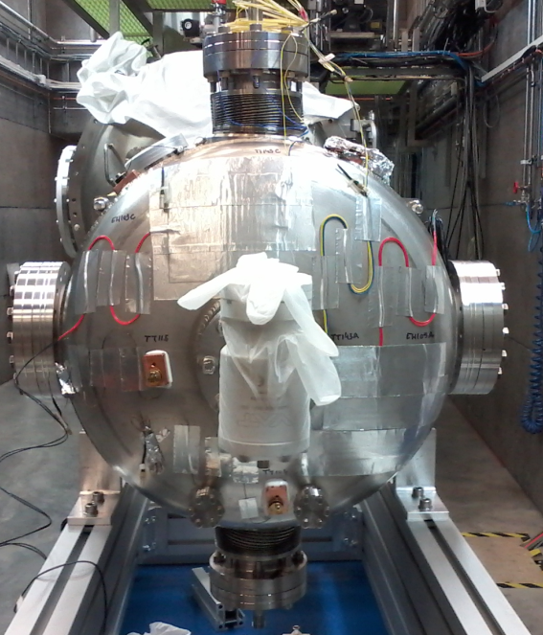
Conclusions
Received single spoke cavity Hélène (courtesy of IPNO)
To test our procedures until the double spoke comes to FREIA
RF measurements at room temperature: resonance frequency at 360.04 MHz and bandwidth of 100 KHz = IPNO measurements
Right now:
Hélène almost ready to be cooled and tested next week
Planning:
Bare double spoke prototype : approx. mid April
Dressed double spoke prototype: approx. end May
Double spoke cryomodule: approx. end of the year
This means that:
We won’t be bored

