Slide 1
RF Local Protection System
Rafael Montaño
www.europeanspallationsource.se
15-03-18

Slide 2
Contents
Interlock concepts
RF-LPS architecture
LPS Prototype design
RF-LPS Block diagram
RF-LPS DAQ

Slide 3
Interlock concepts
Interlock system, main tasks
Prevent any damage related to the RF Station equipment
Prevent also any damage to other equipment related to the RF systems
Provide a secure operation on the startup and operation modes
Notes:
The RF-Interlock System is in charge of preventing damage to the RF equipment within each cell and RF chain and will also prevent any damage to other equipment related to the RF station where agreed

Slide 4
Interlock concepts
Sources of Interlock error signals
Hardware failure (an intervention is required)
  i.e. components broken or malfunction, etc.
Fault interrupt (an operator reset is required)
  i.e. Arcing detection, power detection, cooling interlocks, etc.
General safety conditions (status changing)
  i.e. Emergency push button, PSS permissions, Klystron safety conditions, etc.

Slide 5
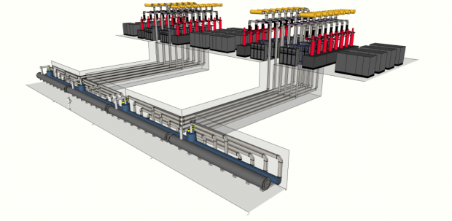
RF Systems
Modulator Converts conventional AC power into pulse power
RF Power Amplifier takes pulse power from modulator and converts the power into RF waves at 352 or 704 MHz. Klystron are typically RF power amplifier.
RF Distribution transports the RF from power amplifier to cavity coupler, which are typically waveguides with other components (circulators, directional couplers, etc..)
Low Level RF LLRF takes the cavity field from probe, control it in digital domain with feedback and feed-forward, and generates an input signal to the amplifier.

Slide 6
RF-LPS architecture
Notes:
The signals considered in terms of the required time-of-response are divided two systems, Fast Interlock Module (FIM) and Slow Interlock Module (SIM). The Fast Interlock functions are critical and should be performed in a FPGA module, in order to get the reaction time requirements, the system should be deterministic and reliable.

Slide 7
ESS RF-LPS
SC cavities
26 – Spokes
36 – Medium β
84 – High β
NC cavities
1 – RFQ
3 – MEBT
5 – DTL
According to this information, the total system would be installed at ESS are155 RF-LPS.
Notes:
There is a brief summarize about the total system to be installed at ESS

Slide 8
Klystron protective interlocks
Intermediate protection – The Klystron beam voltage must be interrupted within 100 ms, of following conditions:
  Beam voltage
  Beam current
  Ion-pump current
  Collector flow rate
  Body flow rate
  Window air flow rate
RF Drive Interruption – The RF Drive must be removed within 10 μs under any of the conditions listed below:
  Arc detectors
  Reflecting power
Filament interruption – In order to protect the filament from poor vacuum conditions, a protective circuit shall switch off the filament.
Notes:
There are some conditions about the Klystron protective interlocks.

Slide 9
RF-LPS prototype design
Two FIM (Fast Interlock Module) are being designing in parallel:
Siemens FM352-5 Fast Boolean Processor (FPGA based) – 12 Inputs / 8 outputs per module. Only 24VDC digital inputs/outputs are available.
NI cRIO like fast interlock module connected to the main controller PLC CPU. Different signal types I/O are available.
Notes:
Siemens FM352-5, CPUS7 compatible and 24VDC supported with 1 us of execution time.
NI cRIO FPGA based with many I/O types, different internal clocks may be configured

Slide 10
RF-LPS prototype design – signal types
The PLC shall collect and process more than 40 signals according to the preliminary signal list requirements
  Temperature
  Cooling flow-rates
  Cooling water pressure
  Solenoid PS interlock signals
  Vacuum
  Cryomodule system ready
Fast Interlock Module (FIM)
  Power forward/reflecting
  Arc detectors
  Modulator remote interlocks
  LLRF monitor alarm
  Pin diode

Slide 11
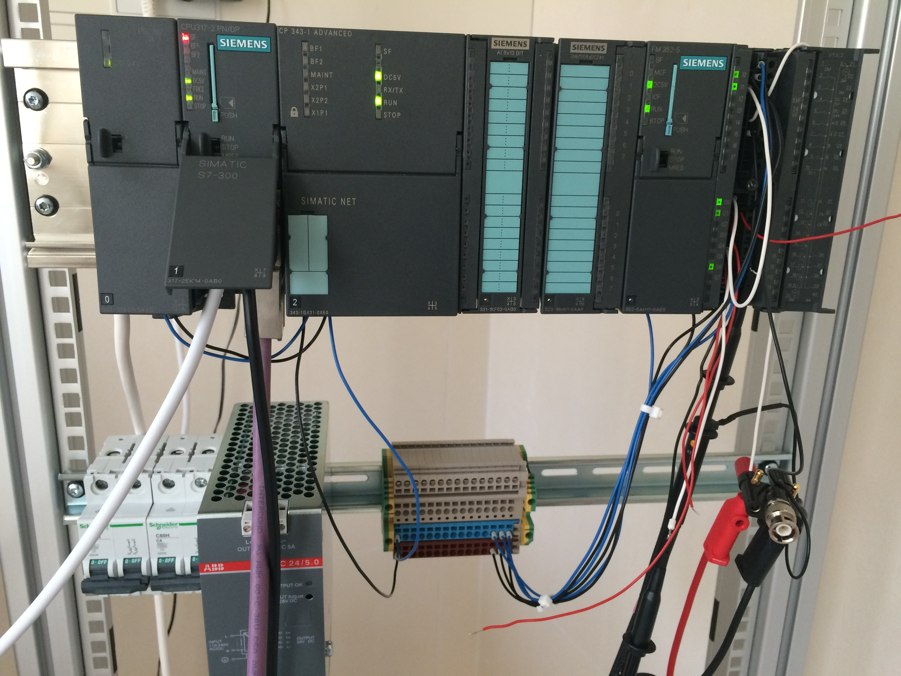
RF-LPS prototype design

Slide 12
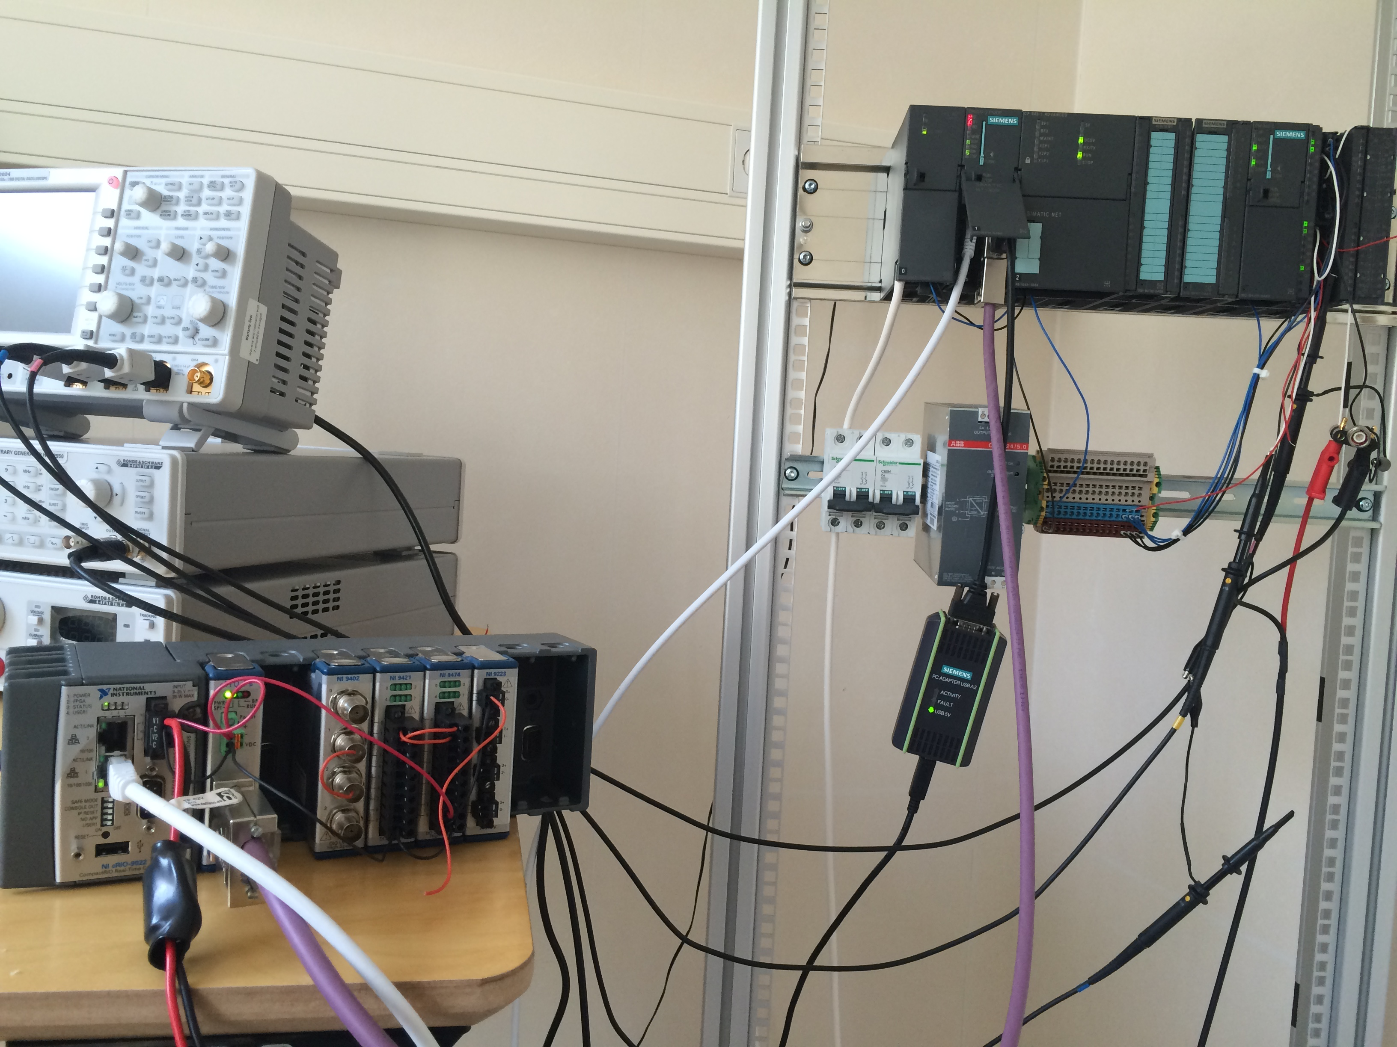
RF-LPS prototype design

Slide 13
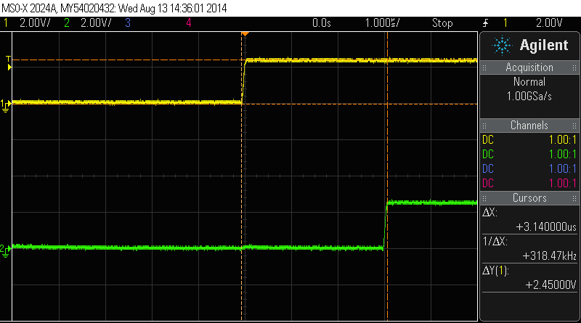
Siemens FM352-5 response time – 3.14 us

Slide 14
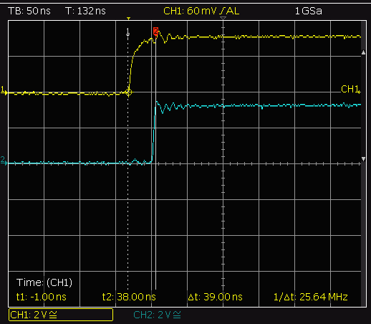
NI cRIO TTL response time – 39 ns

Slide 15
RF-LPS prototype design
To protect the RF system efficiently it is necessary to design the protection system by focusing on the following facts:
The PLC and FPGA program should be flexible for the future upgradeability.
It should be modular, in order to debugging easily with less time.
The post-mortem data should be archived on EPICS for future analysis.

Slide 16
Block diagram

Slide 17

RF-LPS DAQ
Signal conditioning interfaces (digital/analogue).
FIM analogue/digital signal processing (RF-LPS interlock logic).
EPICS IOC DAQ interface (up to 100MHz).
All AI/DI signals shall be connected through the conditioning box to the IOC DAQ on EPICS adding the time-stamp when a fault is detected.
3
2
1

Slide 18

Thanks!!!

