Slide 1
WP4 – Future plans and issues
November 29 – 2021 F2F meeting, Copenhagen (& Zoom)
Fabio Dall'Antonia
Notes:
Original title: "access challenge" – technical meaning: authentication and authorization aspects
more generic meaning : granting data and computation - but also knowledge - access to whom, to which extent and for which purpose?

Slide 2
The main tasks 2022
VISA deployment
completion
Federated Search Portal
EOSC integration
Use case transformation to example data sets

Slide 3
PaN portal original vision
PaN portal front page with search UI
federated search API
Local metadata
catalogues
exp case 1
exp case 2
...
OID connect
Software

Slide 4
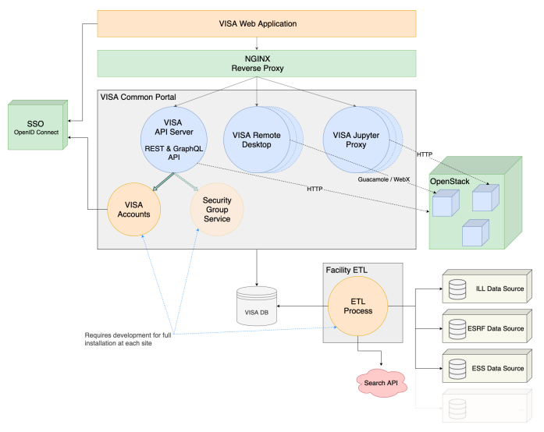
Architectural simplification
Client UI
NGINX/Apache
reverse proxy
API
Service
Desktop
Service
Notebook
Service
K8S
Provider API
K8S
Provider
Image
Flavour
Account
Service
Cloud
Service
Open
Stack
Provider
OpenStack
User
Provider
Image
Instance
Flavour

Slide 5
PaN portal change of plan
PaN portal front page with search UI
federated search API
Local metadata
catalogues
exp case 1
exp case 2
...
OID connect
Software

Slide 6
PaN portal change of plan
PaN portal front page with search UI
federated search API
Local metadata
catalogues
exp case 1
exp case 2
...
OID connect
Software

Slide 7
Complementary data access and usage
User office
RI user
PaN user
Catalogue
Fed PaN (open-data) search portal front page
fed search API
OID connect
ETL
EuXFEL
ESRF
ESS
DLS
ALBA
...
exp 1
User data
exp 2
...
VISA
select
redirect
(OID connect)
User/ Eperiment DB
Open data
HPC
Slurm

Slide 8
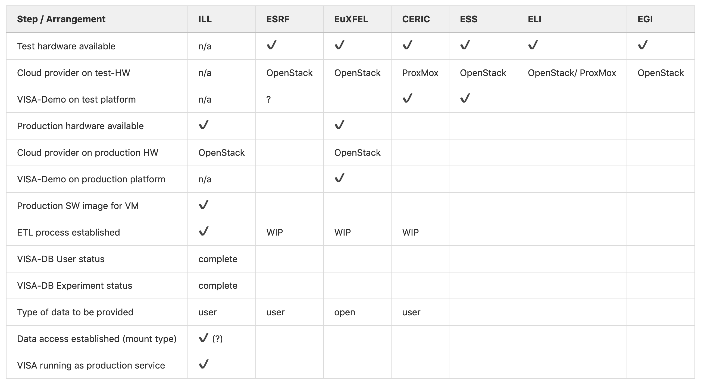
VISA deployment – progress dashboard

Slide 9
The VISA platform – challenges
Data access / user scope / authorization
User office
RI user
distinguish embargoed from open user data
declaring data as open as per meta-data
separate volumes or partitions?
tagging files?
ETL: mapping user office data to VISA DB
expand existing authentification to allow community users (on open data)
Do all partners want to include PaN users?
utilize OpenIDConnect token information for discriminative authorization
OID connect
ETL
User data
VISA
User/ Eperiment DB

Slide 10
FAIR data: a federated PaN Search portal
Challenges
PaN user
WP3 / WP4 coordination including ExPaNDS
Getting local data catalogues ready, authorization issues
Communication between web-UI and search API – open technical questions
account for federation: merging, scoring, pagination – important but do we want/need simplifications?
include re-direction endpoints (DOIs?)
fed search API
Fed PaN (open-data) search portal front page
exp 1
EuXFEL
ESRF
ESS
DLS
ALBA
...
exp 2
...
select
redirect
(OID connect)
Open data
HPC
(Slurm)
Local facility services (existing)

Slide 11
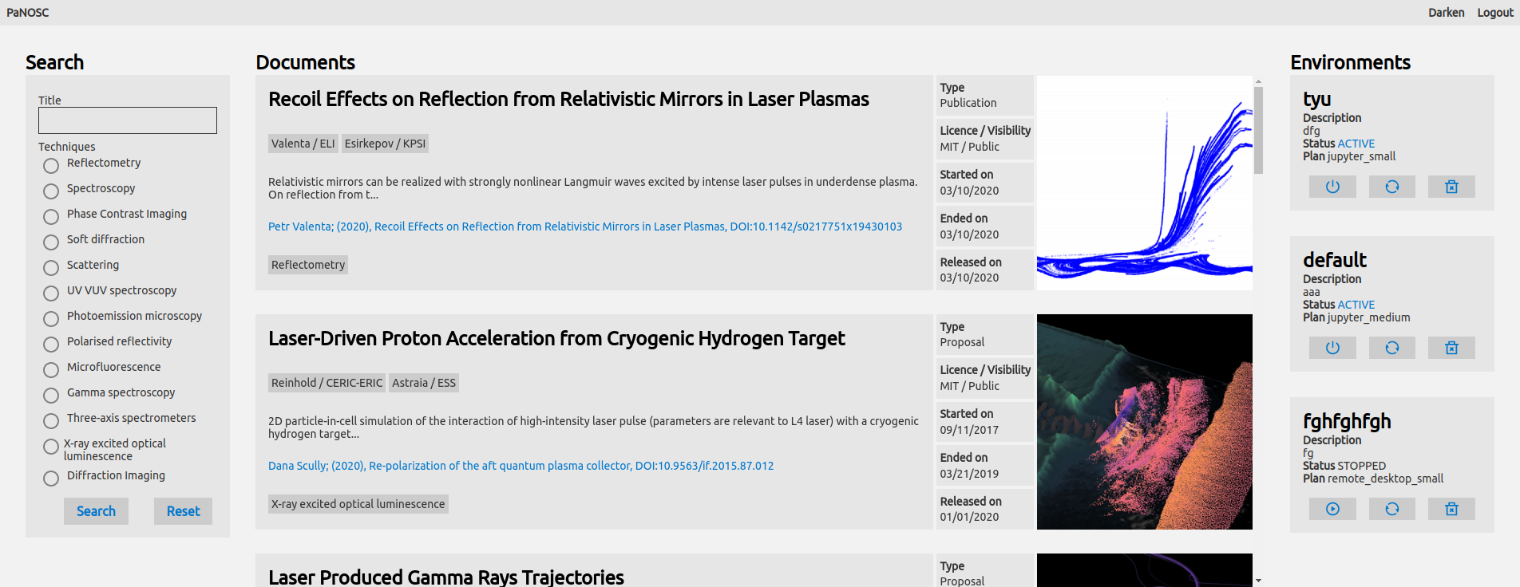
PaN search portal building blocks
Web-UI (WP4, ELI)
exp 1
exp 2
...
Adapter layer (WP4, ELI)
Federated Search API
(WP3, ESS)
meta-search
score hits
sort
return list of items

Slide 12
EOSC integration and WP6 linkage
What are the plans to integrate solutions developed and/or tested within WP6?
CVMFS for software mounting / Singularity containers
OneData to share data
What is the EOSC registration strategy?
every partner will register their VISA instance separately?
will there be a sustainable federated instance to register at EOSC?

Slide 13
Other open questions (issues)
KPIs
projections on final numbers exist for WP4
but heterogeneous formalism wrt. how these are defined!
do we have target numbers in the sense of what is desired?
Use cases and example/reference data
transforming data belonging to use-cases into open "reference" datasets makes much sense
how shall this be shared? How does it fit into the VISA usage scheme?

Slide 14
Thank you

