Slide 1
European XFEL and PaNOSC
November 29 – 2021 F2F meeting, Copenhagen (& Zoom)
Fabio Dall'Antonia

Slide 2
User office
Data department
Electronics
(EEE)
IT & Data Management
Data Analysis
Detector Operation
Controls
FXE
HED
MID
SPB/SFX
SCS
SQS

Slide 3
User office
Data department
Electronics
(EEE)
IT & Data Management
Data Analysis
Detector Operation
Controls
FXE
HED
MID
SPB/SFX
SCS
SQS

Slide 4
Mapping to PaNOSC WPS
ITDM
DA
SPB/SFX
Issue: imbalance/"neglection" of certain WPs

Slide 5
Data management overview
user
register
UPEX
DAQ
Beamtime
EuXFEL user
Keycloak
raw
Allocated resources
migration/
correction
Max-Jhub
usr
scratch
raw / proc
download

Slide 6
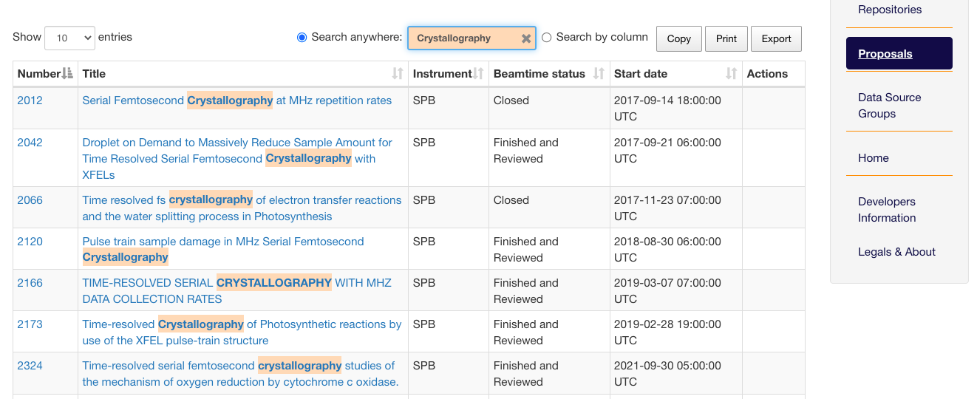
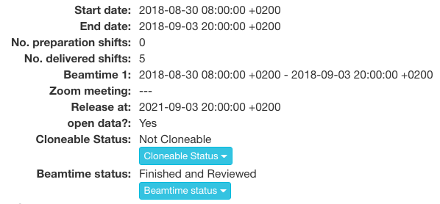
Metadata catalogue: myMDC

Slide 7
Metadata catalogue: myMDC
ETL
Search portal
VISA-DB
fed search API
Issues:
anonymous access in conflict with EuXFEL scientific data policy
no concrete plan to register in EOSC

Slide 8
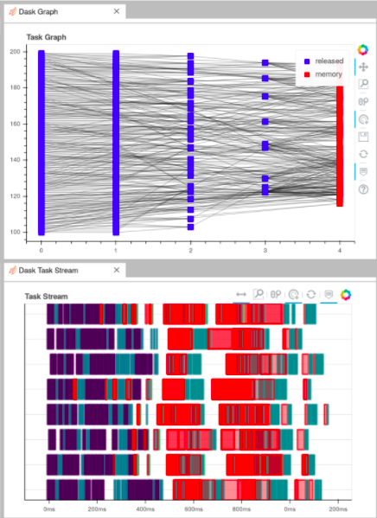
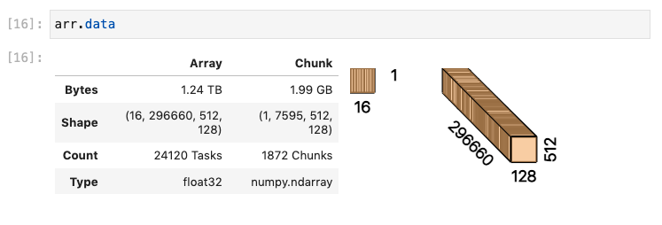
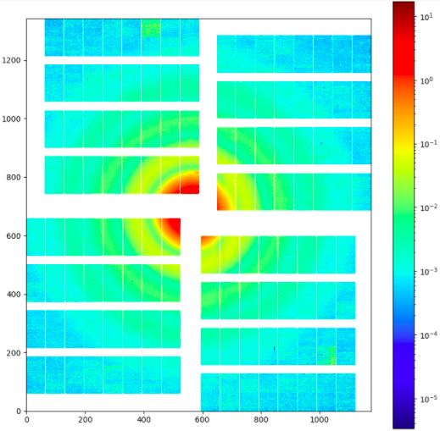
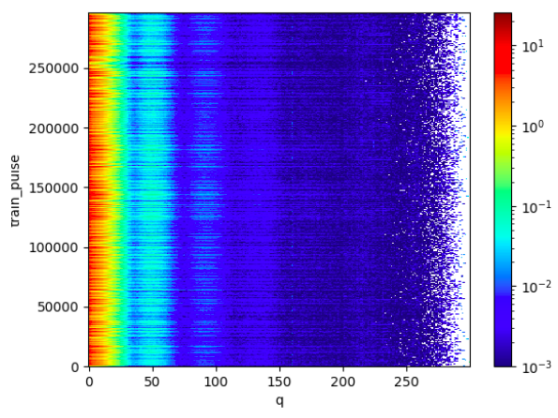
HPC from a notebook: Dask
Use case: SAXS at the MID instrument (not yet pusblished in PaNOSC)

Slide 9
European XFEL contributions to WP5
WP5 Management
SIMEX platform (SimEx and SimEx-Lite)
libpyvinyl development

Slide 10
General issues for EuXFEL
Several open questions concerning feasibility (or at least time frame) for the implementation of services due to pending clarification/decisions for DMPs from legal and directoral point of view:
Anonymous access to metadata catalogue by e. g. search API
Provision of VISA as user/own-data service, exposing the embargoed data
Due to lack of involvement in WP6, there is not enough awareness in ITDM about the considered technologies like CVMFS and OpenData
Imbalance of WP involvement in general
Plans for EOSC registration, both as a provider and for actual services (in particular metadata catalogue) have not been addressed yet.
No concrete sustainability plans (yet) for maintenance of services beyond PaNOSC

Slide 11
Thank you

