Slide 2
LoKI PSS Safety Analysis
(ESS-3731373 and ESS-3731374)
LoKI PSS PDR
PRESENTED BY Denis Paulic on behalf of Fan YE

Slide 3
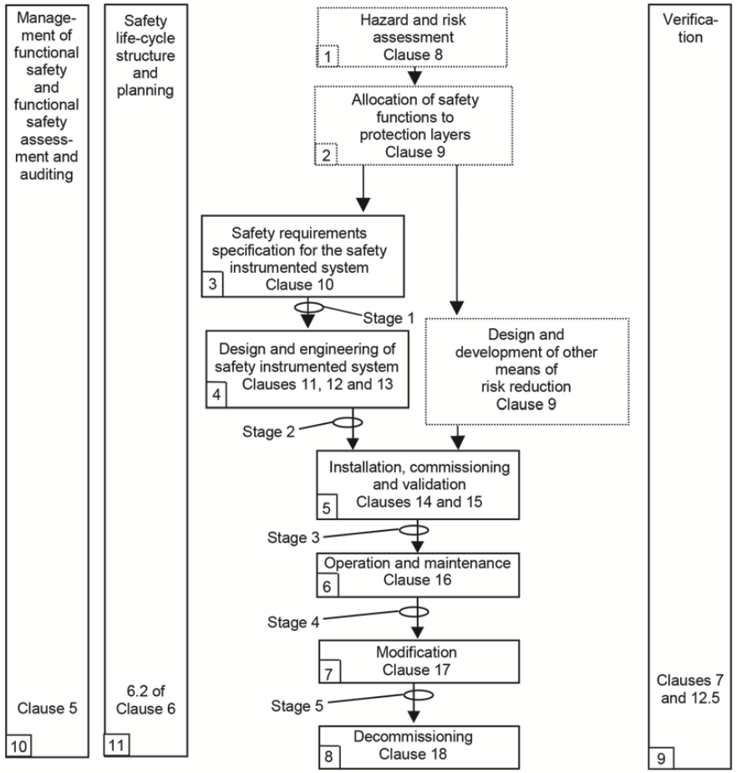
Agenda
IEC 61511
1 Hazards
2 Safety Instrumented Functions (SIFs)
3 Safety Integrity Level (SIL) Determination
4 Safety Requirements Specification (SRS)
5 SIL Verification

Slide 4
LoKI PSS Safety Analysis
Inputs
  Hazard identification (ESS-1084771)
    This includes Required information for LoKI PSS safety analysis
  Concepts of Operations (ESS-2698795)
Outputs
  LoKI PSS SIL Assessment Report (incl. SIL Determination and Verification) (ESS-3731373)
  LoKI PSS Safety Requirements Specification (SRS) (ESS-3731374)

Slide 5
LoKI Hazards and Initiating Events
Radiation
  Intrusion (RadHaz2, RadHaz6, RadHaz7, RadHaz11, RadHaz15)
    Sample area (door, roof hatch) (RadHaz6, RadHaz7)
    Detector vessel (shielding door) (RadHaz15)
    Bunker to cave area (RadHaz2) – not considered credible
    Cave crawl space (RadHaz11) – not considered credible
  Instrument shutter inadvertent opening (RadHaz4, RadHaz9, RadHaz13, RadHaz17)
  Off normal beam (RadHaz19, RadHaz20, RadHaz21)
  Failure of formalised search
Vacuum
  Damage to sapphire window (rows 171-174)
  Inadvertent operation of vacuum pump (row 439)
  Entrapment within detector vessel (row 438)

Slide 6
LoKI PSS Safety Instrumented Functions (SIFs)
SIFs
  LOKIPSS_SIF1 Emergency Switch-Off Button
  LOKIPSS_SIF2 Access Door Instrument Shutter and Proton Beam Interlock
  LOKIPSS_SIF3 LoKI PSS Main Key Instrument Shutter Interlock
  LOKIPSS_SIF4 LoKI Sample Area Access Doors Lock
  LOKIPSS_SIF5 High Radiation Instrument Shutter and Proton Beam Interlock
  LOKIPSS_SIF6 LoKI Window Guard Interlock
  LOKIPSS_SIF7 LoKI Detector Vessel Shielding Door Lock
Access Door Instrument Shutter and Proton Beam Interlock:
If any of the following is TRUE:
the sample area door is detected open OR
the sample area roof hatch is detected open OR
the detector vessel shielding door is detected open;
close the Instrument Shutter.
Additionally, if the instrument shutter is detected open and bending magnets are detected energised 500ms after any of the above listed doors is detected open, de-energise the following SAE:
ISrc HVPS,
RFQ/DTL1 RF system and RFQ LLRF system.

Slide 7
SIL Determination and Verification
SIL Determination
  To determine the required SIL target (and reliability target PFD/PFH) for each SIF
  Layers of Protection Analysis (LOPA) used for SIL determination
  Guideline for SIL Assessment for Personnel Safety Systems (ESS-1408224)
SIL Verification
  To verify the proposed SIF design will meet the corresponding SIL (and PFD/PFH) target
  Reliability Block Diagram (RBD) used for SIL verification
  Event Tree Analysis (ETA) used to confirm frequency of individual hazardous scenarios meet the risk target
PFD = Probability of Failure on Demand
PFH = Average frequency of a dangerous failure per hour

Slide 8
Layers of Protection
9. Community Emergency Response
8. Plant Emergency Response
7. Fire & Gas System
6. Physical Containment (Bunds)
5. Physical Protection (Relief Devices )
4. E/E/PE safety-related
3. Alarms & Operator Intervention
2. Basic Process Control System
1. Process
8
Protection Layers: 1,2,3,4,5
Mitigation Layers: 6,7,8,9
E/E/PE = Electrical/Electronic/Programmable Electronic

Slide 9
SIL Determination
Target Risk
Risks arising from dangerous failures in the process & in the BPCS
Demands
Risk
Risk reduction achieved by Conditional Modifiers
Risk reduction achieved by Other Risk Reduction Measures
Risk reduction
achieved by SIS/SIF

Slide 10
SIL Determination
Target Risk
Risks arising from dangerous failures in the process & in the BPCS
Demands
Risk
Risk reduction achieved by Conditional Modifiers
Risk reduction achieved by Other Risk Reduction Measures
SILs
4
3
2
1

Slide 11
LoKI PSS SIL Determination
Low Demand SIFs (demands <1/yr)
High Demand SIFs (demands >1/yr)
SIF ID | SIF Description | Risk Target (/yr) | PFD Target | SIL Target
LOKIPSS_SIF1 | Emergency Switch-Off Button | N/A | N/A | SIL 1
LOKIPSS_SIF5 | High Radiation Instrument Shutter and Proton Beam Interlock | 1.0E-6 | 1.0E-2 | SIL 2
SIF ID | SIF Description | Risk Target (/hr) | PFH Target | SIL Target
LOKIPSS_SIF2 | Access Door Instrument Shutter and Proton Beam Interlock | 1.1E-10 | 2.1E-7 | SIL 2
LOKIPSS_SIF3 | LoKI PSS Main Key Instrument Shutter Interlock | 1.1E-10 | 5.0E-7 | SIL 2
LOKIPSS_SIF4 | LoKI Sample Area Access Doors Lock | 1.1E-10 | 2.1E-6 | SIL 1
LOKIPSS_SIF6 | LoKI Window Guard Interlock | 1.1E-10 | 2.1E-6 | SIL 1
LOKIPSS_SIF7 | LoKI Detector Vessel Shielding Door Lock | 1.1E-10 | 2.1E-6 | SIL 1

Slide 12
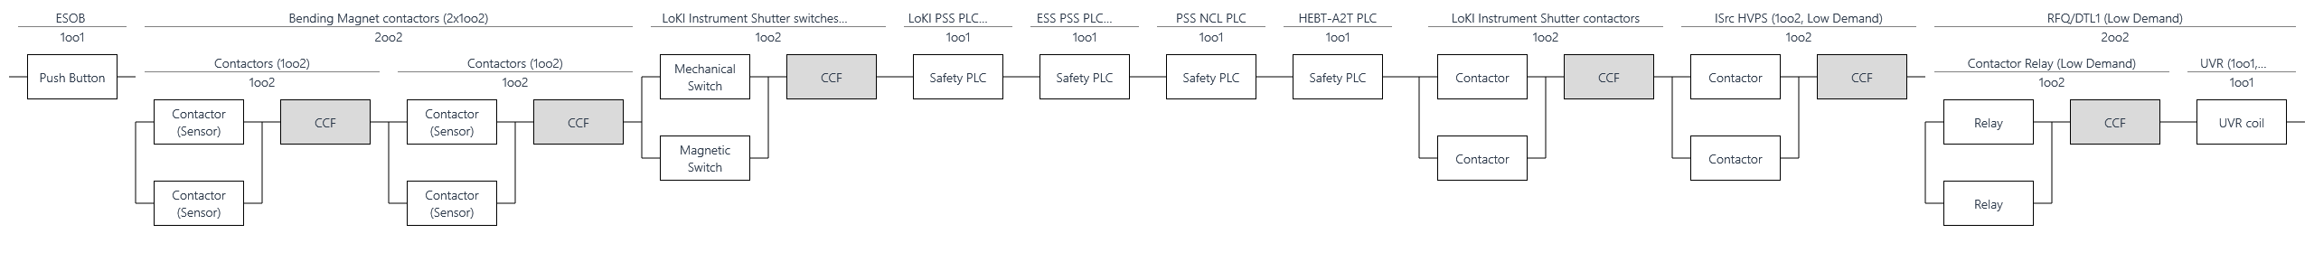
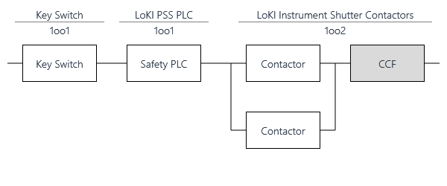
LoKI PSS SIF RBDs 1/3
LOKIPSS_SIF1 – Emergency Switch-Off Button
LOKIPSS_SIF2 – Access Door Instrument Shutter and Proton Beam Interlock
LOKIPSS_SIF3 – LoKI PSS Main Key Instrument Shutter Interlock

Slide 13
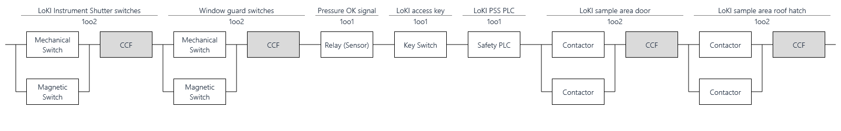
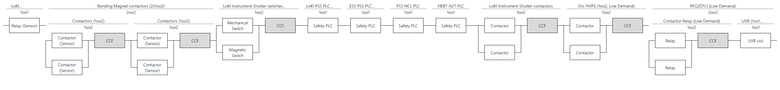
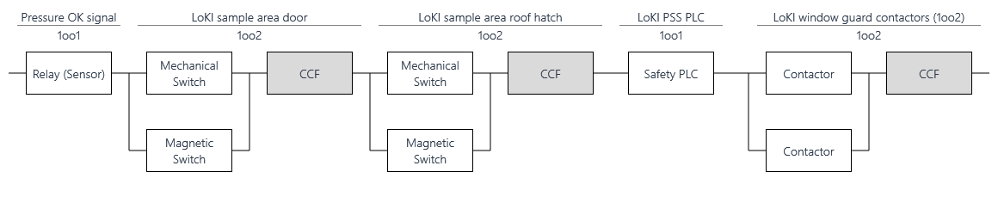
LoKI PSS SIF RBDs 2/3
LOKIPSS_SIF4 – LoKI Sample Area Access Doors Lock
LOKIPSS_SIF5 – High Radiation Instrument Shutter and Proton Beam Interlock
LOKIPSS_SIF6 – LoKI Window Guard Interlock

Slide 14
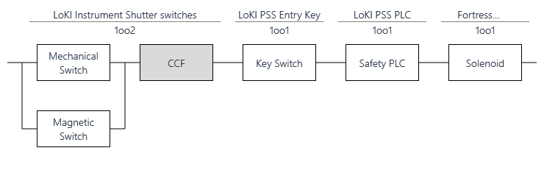
LoKI PSS SIF RBDs 3/3
LOKIPSS_SIF7 – LoKI Detector Vessel Shielding Door Lock

Slide 15
LoKI PSS SIL Verification – Preliminary Results
Low Demand SIFs
High Demand SIFs
SIF ID | SIF Description | Risk Target (/yr) | PFD Target | SIL Target | PFD Achieved | SIL Achieved
LOKIPSS_SIF1 | Emergency Switch-Off Button | N/A | N/A | SIL 1 | 1.6E-3 | SIL 2
LOKIPSS_SIF5 | High Radiation Instrument Shutter and Proton Beam Interlock | 1.0E-6 | 1.0E-2 | SIL 2 | 1.8E-3 | SIL 2
SIF ID | SIF Description | Risk Target (/hr) | PFH Target | SIL Target | PFH Achieved | SIL Achieved
LOKIPSS_SIF2 | Access Door Instrument Shutter and Proton Beam Interlock | 1.1E-10 | 2.1E-7 | SIL 2 | 1.7E-7 | SIL 2
LOKIPSS_SIF3 | LoKI PSS Main Key Instrument Shutter Interlock | 1.1E-10 | 5.0E-7 | SIL 2 | 2.7E-8 | SIL 2
LOKIPSS_SIF4 | LoKI Sample Area Access Doors Lock | 1.1E-10 | 2.1E-6 | SIL 1 | 7.2E-8 | SIL 2
LOKIPSS_SIF6 | LoKI Window Guard Interlock | 1.1E-10 | 2.1E-6 | SIL 1 | 4.8E-8 | SIL 2
LOKIPSS_SIF7 | LoKI Detector Vessel Shielding Door Lock | 1.1E-10 | 2.1E-6 | SIL 1 | 1.1E-7 | SIL 2

Slide 16
LoKI PSS ETAs 1/4
ETA1 – RadHaz6, Intrusion via sample area door (motion control failure)
ETA2 – RadHaz6, Intrusion via sample area door (override key)

Slide 17
LoKI PSS ETAs 2/4
ETA3 – RadHaz7, Intrusion via sample area roof hatch
ETA4 – RadHaz15, Intrusion into detector vessel shielded area

Slide 18
LoKI PSS ETAs 3/4
ETA5a – RadHaz4 / RadHaz9 / RadHaz13 / RadHaz17, Inadvertent opening of Instrument Shutter (motion control failure)
ETA5a – RadHaz4 / RadHaz9 / RadHaz13 / RadHaz17, Inadvertent opening of Instrument Shutter (missed by search)

Slide 19
LoKI PSS ETAs 4/4
ETA6 – RadHaz19 / RadHaz20 / RadHaz21, Off-normal beam
ETA7 – Damage to vacuum window

Slide 20
Questions to the committee
Have all safety requirements from the LoKI Instrument Hazard Analysis (IHA) been addressed and all initiating events sufficiently evaluated in the LoKI PSS SIL assessment?
    Should LoKI PSS have an interface with radiation monitor next to the instrument shutter? If yes, would it be sufficient to connect it directly to the warning lights (e.g. blue lights) or it needs to be included in one of the interlock functions? (see RadHaz4)
Is the approach for the initiating event where a person is missed by search and operation initiated acceptable?
Are the presented set of identified Safety Instrumented Functions (SIFs) properly formulated, and do they fulfil the overall safety functions derived from the LOKI IHA?
    Should LoKI PSS interface the radiation monitors in occupancy area? Is LoKI LOKIPSS_SIF5 necessary considering the consequences (dose) in case of the off-normal beam?

Slide 21
Thank you for your attention!

