Slide 2
ODH Detection Systems Technical Description and Architecture
PRESENTED BY Donya daryadel

Slide 3
Agenda
ESS ODH Detection System Architecture
ESS ODH Detection System Technical Description

Slide 4
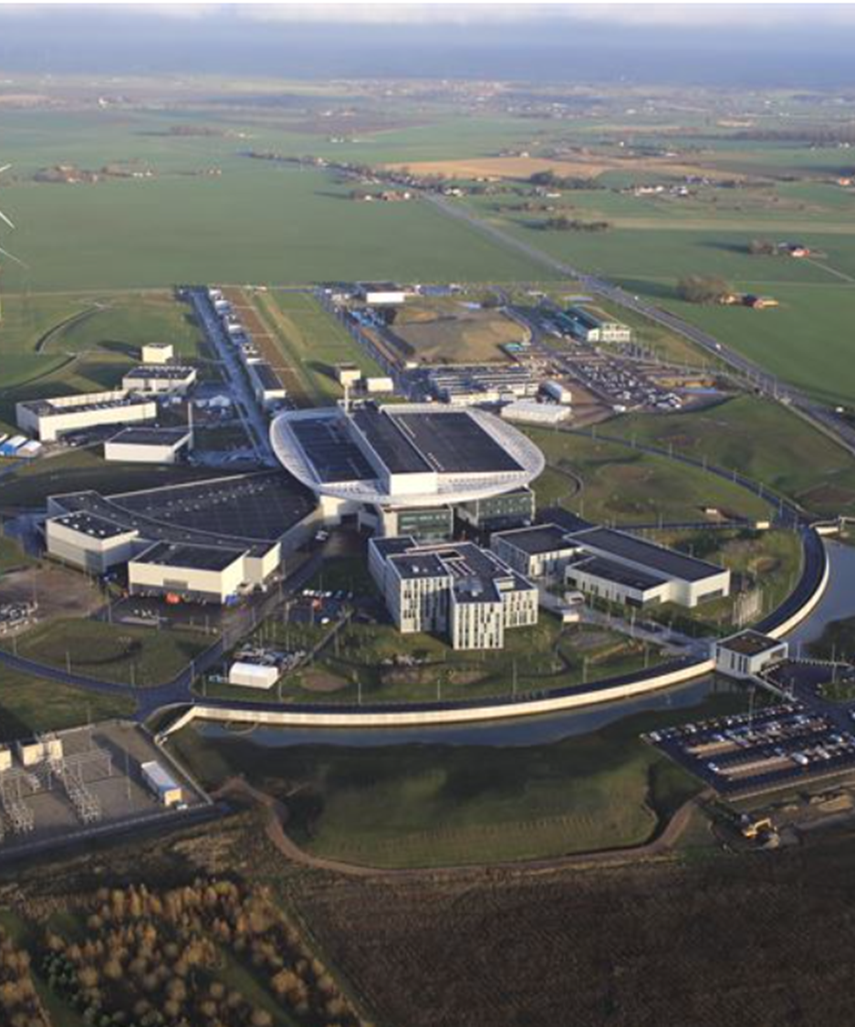
1
ESS ODH Detection System Architecture

Slide 5
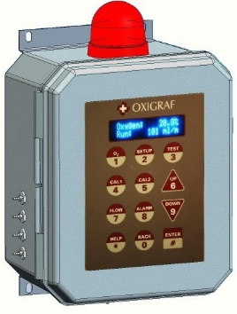
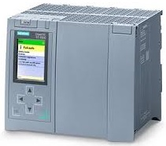
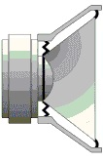
A basic architecture for ODHDS
Oxygen Level > 19.5 %
Oxygen Level ≤ 18 %
Oxygen Level ≤ 19.5 %
Sensor
Logic Solver
Audiovisual Alarms
Prevent access to hazardous area

Slide 6
ODHDS Architecture Requirements
ESS ODHDS comprises several separate ODH Detection Systems.
Each ODHDS includes a PLC, distributed I/O modules, an HMI, and network switches.
The network switches and I/O modules of each ODHDS will be connected to each other via Fiber Optics ring.
There is a connection to the technical network from each ODHDS PLC cabinet to integrate ODHDS with EPICS.
The connection between each ODHDS and technical network will be through a gateway PLC in the future.

Slide 7
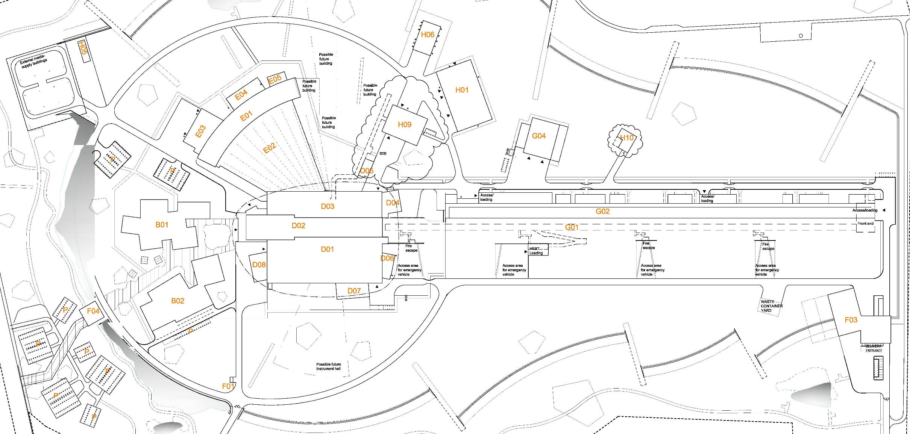
ESS ODHDS Overview
NSS ODHDS
Cryobuildings+TS2 ODHDS
CXB&CTLG
TS2 Bunker
Target ODH Detection System
Accelerator ODHDS

Slide 8
ODHDS Functional Architecture

Slide 9
Cryobuilding+TS2 ODHDS Architecture

Slide 10
Accelerator ODHDS Architecture

Slide 11
Target ODHDS Architecture
An ODH assessment was performed for the Target Station, based on the ESS ODH guideline [2].
The areas which need to be equipped with ODHDS for the target are according to the below list:
D02.115.4001 Connection cell
D02.085.3064 Utility rectangular 085a
D02.085.3067 Utility rectangular 085b
D02.090.3051 Installation gallery 090 *
D02.103.3064 Utility rectangular 103a
D02.103.3067 Utility rectangular 103b
D02.115.3064 Utility rectangular 115a
D02.115.3067 Utility rectangular 115b
D02.090.4024 Installation gallery 090 *
D02.100.4011 Passage *
D02.115.4005 Target/A2T access area
D02.120.4014 Technical supply routing
D02.140.4015 CF HVAC 140
D02.150.4018 Hydrogen room
D02.150.4017 Hydrogen control

Slide 12
Target ODHDS Architecture

Slide 13
NSS ODHDS Architecture
There is no approved ODH risk assessment for NSS areas [3].
Based on the preliminary list received from NSS, there could be an ODH risk in below areas:
D01: Bunker, experimental hall (Neutron instruments)
D03: Bunker, experimental hall (Neutron instruments)
D04
D08
E01, E02: Experimental Hall, Pathway, Guide Hall (Neutron instruments)
E03
E04

Slide 14
NSS ODHDS Architecture
There were two options for designing NSS ODHDS architecture.
Option1: Merge each ODHDS with relevant PSS system, e.g. for Neutron instruments.
In this case separate ODHDS needs to be considered for the areas without PSS.
ODHDS will be dependent to PSS, and it won’t be operational during PSS maintenance period.
There won’t be consistency in ODHDS design, since some of them are part of PSS and some of them will be standalone.
It is more cost efficient.
The design is not scalable.

Slide 15
NSS ODHDS Architecture
Option 2: Design ODHDS separate from PSS system
In this case one separate RIO will be considered for ODHDS in each neutron instruments or LAB areas.
One common CPU will be considered to cover ODHDS of adjacent buildings.
ODHDS will be independent from PSS, and it will be operational during PSS maintenance period.
There will be consistency in ODHDS design, since all of them are independent from PSS.
The cost is more than Option 1.
The design is scalable.
Considering above items, second option has been selected for NSS areas’ ODHDS to achieve scalability in design and independency from PSS.

Slide 16
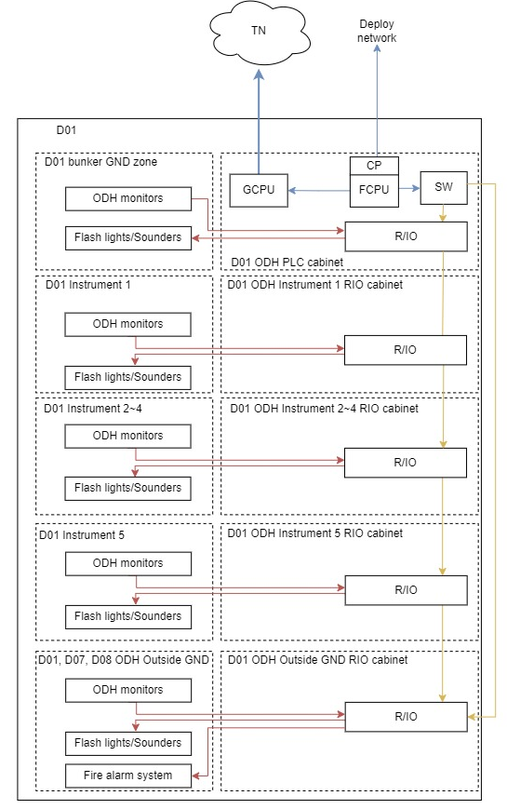
NSS ODHDS Architecture

Slide 17
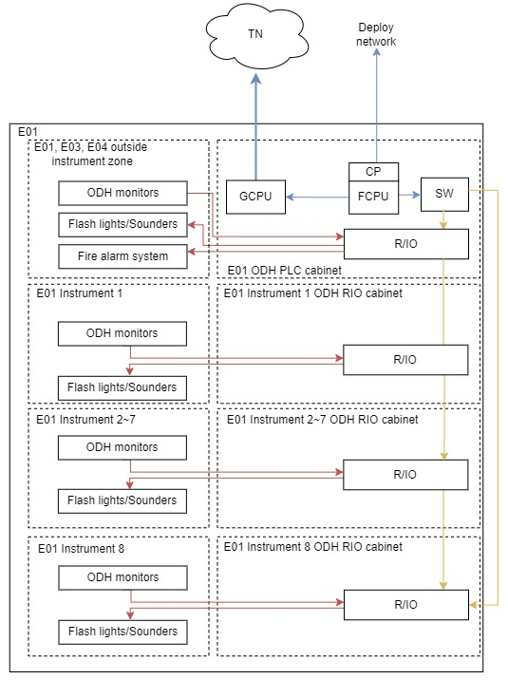
NSS ODHDS Architecture

Slide 18
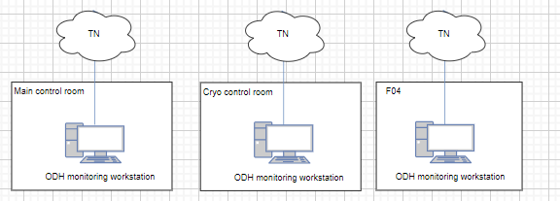
OPI Supervision

Slide 19
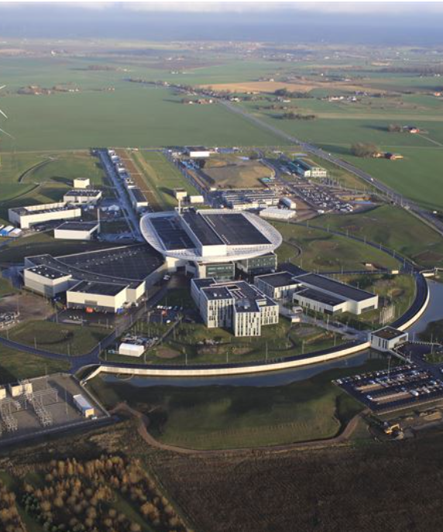
1
ESS ODHDS Technical Description
2
ESS ODHDS Technical Description

Slide 20
ESS ODHDS Technical Description
Hardware Specifications
Software Specifications
Supervision Specification
Stakeholders
External Interfaces

Slide 21
Hardware Specifications
ODH Monitors
ODH sampling Micropipes
Logic solver
Human Machine Interface (HMI)
Alarm devices
Cables
Infrastructure

Slide 22
ODH Monitors
The O2iM monitors are manufactured by Oxigraf.
They had already been installed and operated successfully in similar facilities.
The maintenance works foreseen for the O2iM monitors are generally limited to the manual calibration of monitors and changing filters.
Measure and display the O2 concentration in a gas sample drawn through the monitor.
The O2iM monitor uses laser diode absorption technology to measure O2 concentration in the gas sample.

Slide 23
ODH Monitors
Oxigraf O2iM single port and four port monitors are used to implement the ESS ODH Detection Systems.
The single port provides a faster sampling of O2, while the four-port provides a wider area coverage.
Both O2iM models are fitted with a warning horn and strobe.
An internal filter in the input line prevents contamination of the sensor.

Slide 24
ODH Monitors
The O2iM enclosure is NEMA 4X (IP66) rated for exposure to water and dust, which is suitable for indoor and outdoor installations. However, we don't have any monitors which are installed outdoors.
In general, the ambient temperature in Lund ( -10 °C as the lowest temperature) has been considered for ODH monitors installation.
The ambient temperature for the valid ODH monitor performance is -10º to 50º C operating; -20 º to 60 º C storage. Therefore, no extra measures to warm the area of ODH monitors are needed to be taken.
ODH monitors are not installed in the radiation areas so there is no need to be radiation resistant.

Slide 25
ODH sampling Micropipes
Urethane tubes, PTFE tubes, DOT Nylon Tubes, aluminum and Stainless steel materials were investigated for ODH sampling micropipes.
1/8” Stainless steel has been selected due to its good radiation resistance, high temperature tolerance (because of high temp. inside the accelerator tunnel stubs), hardness and low smoke, zero halogen feature.
For the areas covered by ODHDS where there is a risk of air activation, the ODH monitors exhausts the potentially activated sampled air back to the area.
1/4“ Stainless steel has also been considered for return Micropipes.

Slide 26
Logic Solver
To achieve a modular design distributed Input/Output (I/O) modules are installed in different racks.
CPU Type: Siemens S7 1500 series PLC
Interface module: SIMATIC ET 200SP PROFINET

Slide 27
Human Machine Interface (HMI)
An HMI is installed at one of the ODHDS's rack in each ODHDS.
This HMI provides detailed information about ODHDS status and is also used to reset the alarms.
HMI Type: SIMATIC HMI TP1500 COMFORT

Slide 28
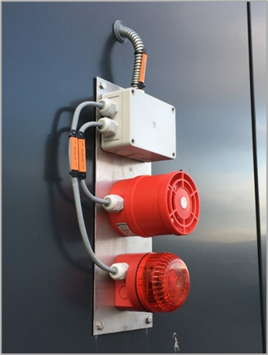
Alarm Devices
The alarm devices comprise red beacons (flashing or rotating) and multi-tone sounders.
They are installed to be seen and heard from almost any position inside the hazardous area and at each entrance leading to that area.
The maximum sound output of the selected sounders is 115 dB.

Slide 29
Alarm Devices
The lights and sounders are suitable for indoor and outdoor installation in terms of their protection class (IP65) and operating temperature (-25º to 50º C), which covers the Lund ambient temperature range.
Material of the lights and sounders is PC/ABS.
Acc. to the CERN article regarding Compilation of the radiation damage test data [5], the maximum radiation level for mild to moderate damage of PC/ABS material is around 10^6 Gy, which provides longer radiological life expectancy than the lifetime of the facility.
There is no data regarding the tolerance of the alarm devices’ electronic circuits in the radiation areas.

Slide 30
Alarm Devices
Question to the committee:
Is there any experience of alarm devices functionality in similar radiation environment?
What type of alarm devices has been used in these areas?
How long can be the lifetime of these equipment in radiation areas?

Slide 31
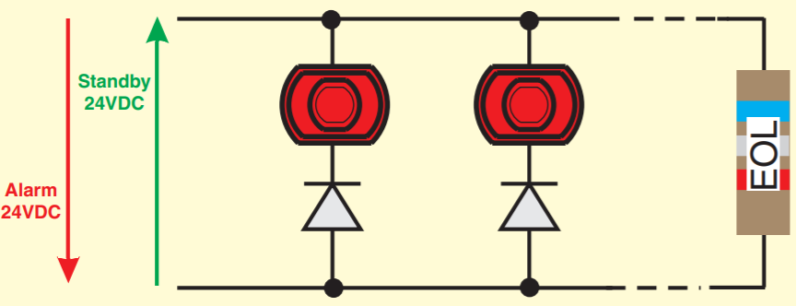
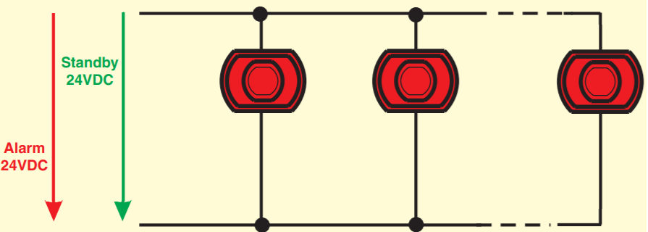
Alarm Circuits
Monitoring Function
Conventional fire alarm system monitoring
ODHDS monitoring (SIEMENS DQ module)

Slide 32
Infrastructure
The ODHDS cables run in dedicated cable trunks and conduits.
Exceptions can be made if there are redundant circuits for the ODH alarm devices.

Slide 33
Cables
ÖLFLEX CLASSIC 135 CH cable has been used for ODHDS alarm circuits.
The cables are Low smoke, flame retardant, and zero halogen.
They are not radiation resistant.
Question to the committee:
Is there any experience with type of cables used for ODHDS alarm circuit or similar services in radiation areas?

Slide 34
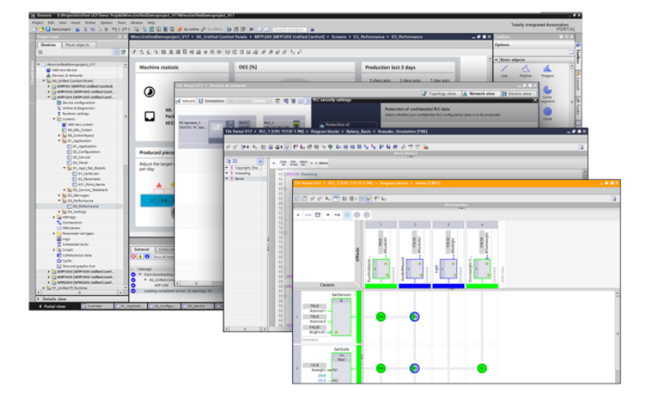
Software
The ODH Detection Systems software is developed using Siemens TIA Portal.
The software follows the activation matrix, which characterizes the operational logic of the relevant ODHDS.
The Graphical User Interface (GUI) hosted on the HMI is developed using TIA Portal.

Slide 35
Supervision
OPI
The status of each ODHDS can be supervised through the OPI in Local Control Room (LCR), Main Control Room (MCR), and gate guard (F04) through OPI.
Currently, the operator can see the status of cryogenic buildings and TS2 ODHDS as part of Cryogenics operator screens (OPI) in LCR. The connection of ODHDS to the OPI in MCR and F04 will be provided in the future.
The information provided for current ODH Detection Systems in LCR is as below:
Warning notification in case O2 level is below 19.5% in each ODH area
Alarm in case O2 level is below 18% in each ODH area
O2 percentage value from ODH monitor.
Status of each ODH monitor.
It should be noted that the operator has only "read" access to the ODHDS's widgets, and there is no possibility to modify widgets or acknowledge the ODHDS's alarms from operator screens in LCR.

Slide 36
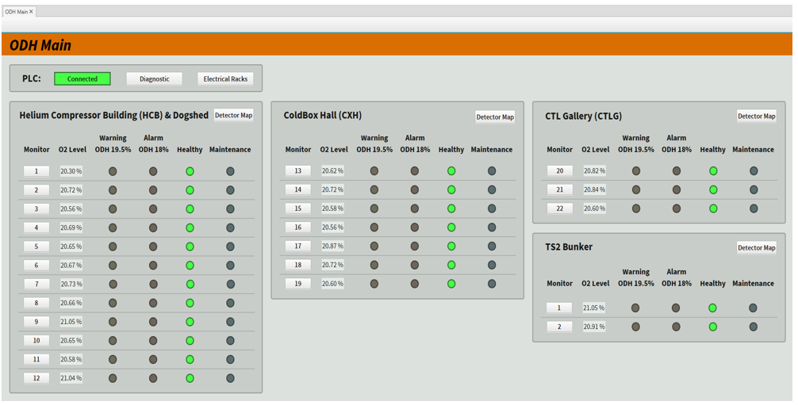
Supervision
OPI screenshots

Slide 37
Supervision
HMI
The ODHDS HMI provides the following information and functionalities for ODH Detection systems:
Warning notification in case O2 level is below 19.5% in each ODH area
Alarm in case O2 level is below 18% in each ODH area
O2 percentage value from ODH monitor.
Status of each ODH monitor.
ODHDS Status (PLC alarms and errors, ODH monitors status, etc.).
The transition of ODH monitors between operation and maintenance mode.
Manual trigger of lights and sounders during periodic tests of ODHDS.
Reset the ODH alarms.

Slide 38
Supervision
HMI Screenshots

Slide 39
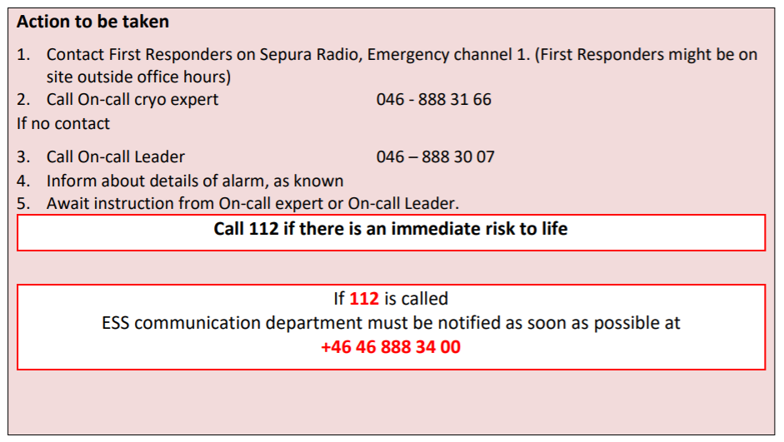
Supervision
Action for guards on warning, fault or alarm of ODH monitors
In addition to through ODHDS OPIs, there is also an interface between each ODHDS and the fire alarm system, which enables communication with an external alarm service and it informs the Gate guard at F04 about the status of that ODHDS including ODH alarm, warning and ODHDS fault signals.

Slide 40
Stakeholders
ICS division
PSG
Control System Infrastructure (CSI) group
Hardware & Integration (HWI) group
Environment, Safety & Health (ES&H) division
Occupational Health and Safety (OHS) group
ESS first responders
Cryogenic group
Area responsible
Target division
Accelerator division
Neutron Scattering Systems (NSS) division
Facility Management (FM)

Slide 41
External Interfaces
Interface with the data archiving service
ODHDS interface with the EPICS IOC, which are then used as a basis for implementing the operator interfaces in the control room and to archive data via the EPICS archiver
Interface with the Alarm Service
ESS uses the EPICS alarm service to provide automated notifications for ODHDS related events.
Interface with the Technical Network
The Technical Network is the Ethernet based high performance network of the ESS.
It enables all data transfers between the ODHDS and the services listed above.
The Technical Network also provides the secure infrastructure to allow for the deployment of ODHDS PLC code to the production environment.

Slide 42
External Interfaces
Interface with fire alarm system and off-site alarm and security service
There is an interface between each ODHDS and the fire alarm system, which enables communication with an off-site alarm and security service
It informs the status of that ODHDS to the gate guard at SMR .
The status below will be sent to the gate guard, which will be activated in the mentioned conditions:
ODH alarm in each area: This will be triggered if the oxygen level drops to ≤18% for any ODH monitors in the area.
ODH warning: This will be triggered if the oxygen level drops to ≤19.5% for any ODH monitors.
ODH fault: This will be triggered if any ODH monitors fail, e.g. due to pipe obstruction, etc.
All the above signals will be triggered together in case of power loss in any ODH monitor or PLC cabinet.

Slide 43
Finish presentation

Slide 44
References
Literature, Publications, Presentations
[1] ESS-3739365 - ESS ODH Detection Systems Functional Architecture
[2] ESS-0220202 - ODH analysis in Target Station
[3] NSS - ODH DRAFT report 20210505
[4] ESS-3137044 - Technical Description of ESS ODH Detection Systems
[5] Compilation of Radiation Damage Test Date, Part II, 2nd Edition: Thermoset and Thermoplastic Resins, Composite Materials, CERN 98-01, 18th May 1998

