Slide 2
Experience with O2iM operation at ESS¶
ODH Phase 2 PDR
PRESENTED BY Mattias Eriksson

Slide 3
Agenda
Presentation of hardware and faults during operation 2018-2021
Maintenance perspective
Documentation
Lessons learned

Slide 4
ODH monitors in operation at ESS
TS 2 and ACC ODH phase 1
TS2
2 pcs - 02iM monitors, high flow (300ml/min)1port
ACC ODH phase 1
10 pcs -02iM monitors low flow 1 port (150ml/min)
12 pcs -02iM monitors 4 port high flow 150ml/min)

Slide 5
Issues experienced with O2iM monitors
Summarised issues of the monitors.
Monitor sampling port failure due to low pump pressure, 4 port monitors.
02iM 5
02iM 6
02iM 2
Calibration issues (a-alarm during calibration) monitor 20 (one port)

Slide 6
Issues experienced with O2iM monitors
Explanation of the specific issues with the monitors.
02iM 2,5,6 - We get alerted by the cryo team that one monitor is making regular “beeps” (20s apart).
When investigating the issue there seems to be a issue with one of the sampling ports that are experiencing a very low pump flow on one specific sampling port). We deactivate that channel and the monitor is behaving ok again.
Work is scheduled for later and monitor is replaced and sent to Oxigraf for repairs.
Replacement of solenoid valve/main circuit board and/or pump at Oxigraf.
02iM 2
- During yearly calibration we notice that during the calibration the monitor goes into A alarm when doing the low cal.
Investigation with Oxigraf, and we tried a reset procedure, this did not help. Monitor was replace and sent for maintenance. Main circuit board was updated and issue was resolved.

Slide 7
Maintenance during ACC ODH phase 1.
-yearly maintenance of the entire system -6 months replacement of filters in G04 -yearly replacements of the rest of the filters
Alarm units
Some minor effect from UV on the units outside
Yearly maintenance of cleaning is testing
Monitors
Depending on the environment filters need to get exchanged with different intervals
Yearly/6 months filter replacement
Yearly maintenance of monitors (cleaning/testing functions/calibration)
Cabinets
Depending on the environment filters need to get exchanged with different intervals
Yearly cabinet filter replacement
Yearly maintenance of cabinets (cleaning/testing function)

Slide 8
Maintenance during ACC ODH phase 1.
-yearly maintenance of the entire system -6 months replacement of filters in G04 -yearly replacements of the rest of the filters
Monitors
Depending on the environment filters need to get exchanged with different intervals
Yearly or 6 months filter replacement, re-evaluated after each maintenance.
Yearly maintenance of monitors (cleaning/testing functions/calibration)
After each maintenance we are looking through the filters of the monitors and checking them visually how dirty they are and then we re-evaluate if we are doing a 6m or 12m maintenance interval.
We are working to get a EAM solution for the reports but atm. we are using chess.

Slide 9
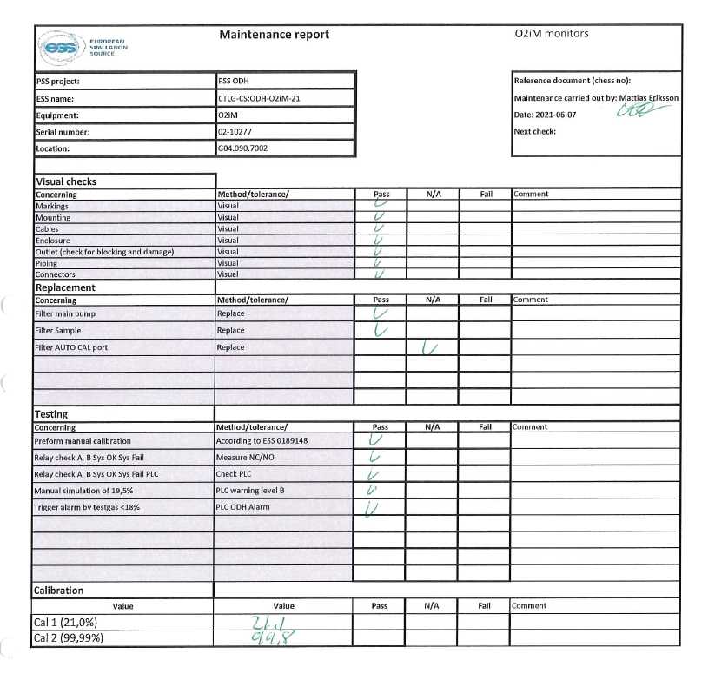
Maintenance during ACC ODH.
Documentation process
Test/Verification/configuration of monitor according to ESS-0189148
Verification test according to ESS-0189148

Slide 11
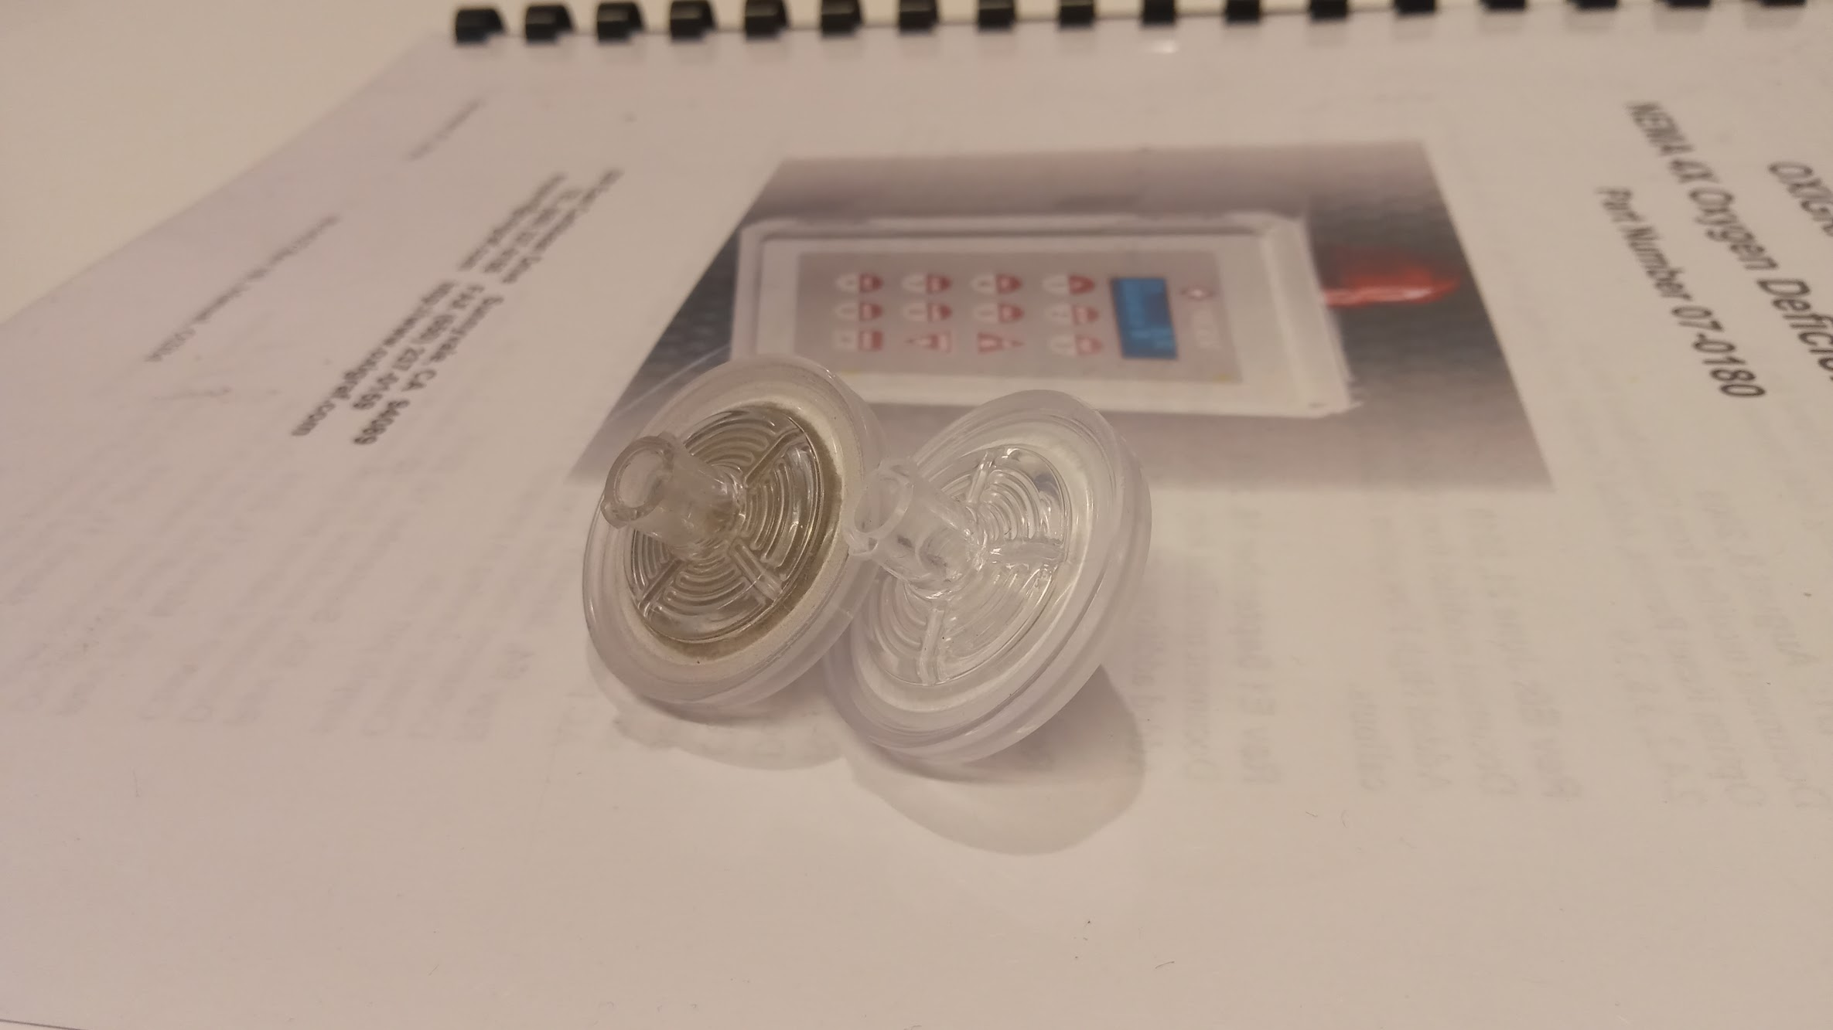
Filters
1 year intervall(left) from G04, vs New Filter (right)

Slide 12
Calibration gases
Calibration set up and gases used
Calibration gases used: High cal 99.99% O2 in N2 Tolerance +-2% rel. Shelf life 60 month's Low cal 20,70% O2 in N2 Tolerance +-2% rel. Shelf life 120 month's
Test and verification gas 15% O2 in N2 Shelf life 120 month's
We are using a setup with a Douglas bag (the monitor draws the gas from the bag) Both for calibration and tests.
Estimated 2 year cost:
15%O2 test gas
 | Gasprodukter (rent cylinder)
Gas mixture percentage | 15%O2+N2
Price | 4800 SEK+1 year prepaid - 1750 SEK/cylinder/year alt. Daily - 6 SEK/cylinder/day (default if not agreed otherwise)
Shipping cost | 1230 SEK
Total price | 9530 SEK *Calculated for 2 years rental period *Responsibility of pressure test during rental period is with supplier
20.7%O2 calibration gas
 | Gasprodukter (rent cylinder)
Gas mixture percentage | 20.7%O2+N2
Price | 4800 SEK+1 year prepaid - 1750 SEK/cylinder/year alt. Daily - 6 SEK/cylinder/day (default if not agreed otherwise)
Shipping cost | 1230 SEK
Total price | 9530 SEK *Calculated for 2 years rental period *Responsibility of pressure test during rental period is with supplier
99.99%O2 calibration gas
 | Gasprodukter (rent cylinder)
Price | 5 450 SEK+ Rent: 1 year prepaid - 1750 SEK/cylinder/year alt. Daily - 6 SEK/cylinder/day (default if not agreed otherwise)
Shipping cost | 1230 SEK
Total price | 10180 SEK *Calculated for 2 years rental period *Responsibility of pressure test during rental period is with supplier
Price summary
Total price | 29240 SEK

Slide 13
Manual calibration accuracy
2020-2021

Slide 14
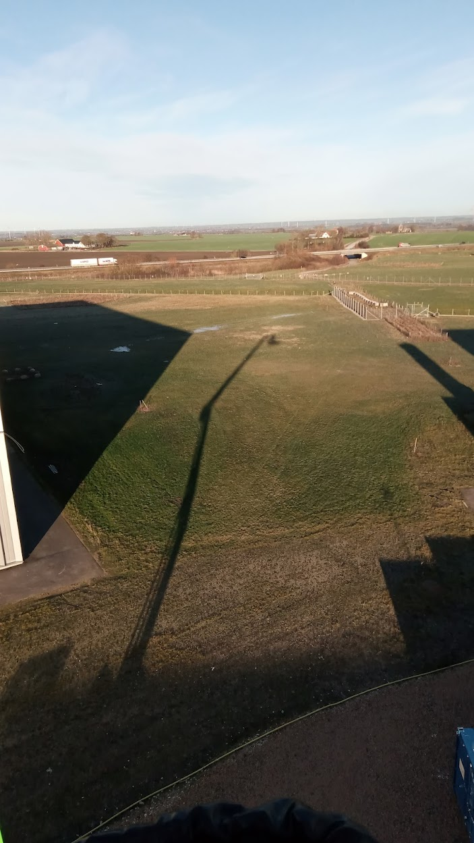
Overall experience of the Oxigraf 02iM monitors.
Overall:
Easy to maintain
Easy installation and configuration.
Fast and reliable support from supplier
We have had a few ”incidents” where the system have detected low O2, with very high accuracy and early when there has been a leak.
Reflection from the maintenance perspective:
More attention into filter placement is needed (you got to be able to reach them)
A long test period before you go ”live” with the system is good.
A ”maintenence with filterswap and calibration just befor you go live, so you have a good idea when this was done.

Slide 15
Finish presentation

