Slide 1
Experience from INFN in IFMIF/EVEDA
INFN LNL

Slide 2
Index
IFMIF/EVEDA RFQ commissioning:
Commissioning line layout
Steps of RFQ commissioning
Input beam distribution effects onto RFQ transmission
Electrode damage study
The study for the IFMIF/EVEDA case
Beam loading measurement and experience in IFMIF/EVEDA

Slide 3
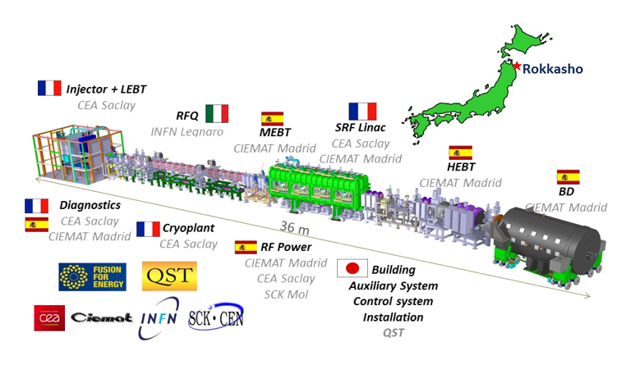
IFMIF/EVEDA RFQ commissioning
125 mA CW deuteron at 9 MeV

Slide 4
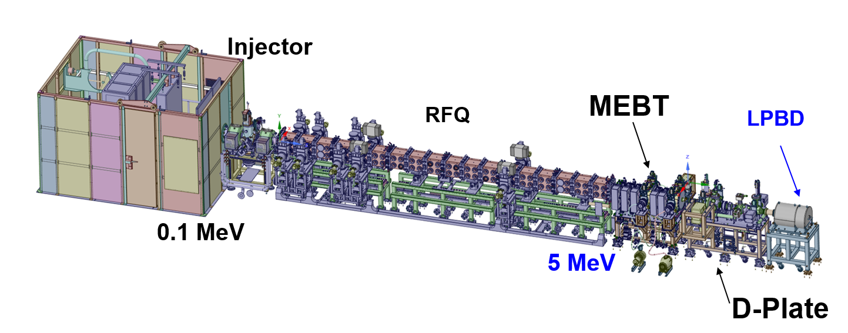
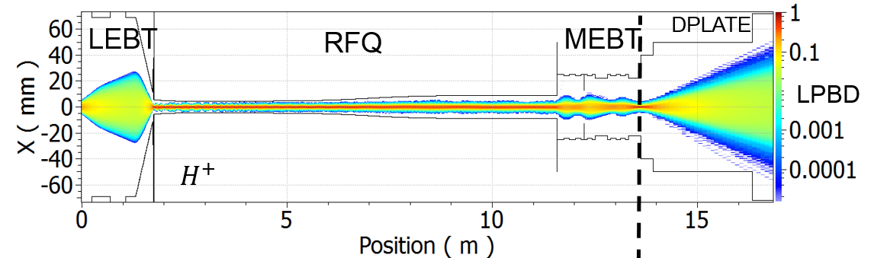
Commissioning layout
Limit at which no H2+ are transmitted anymore

Slide 5
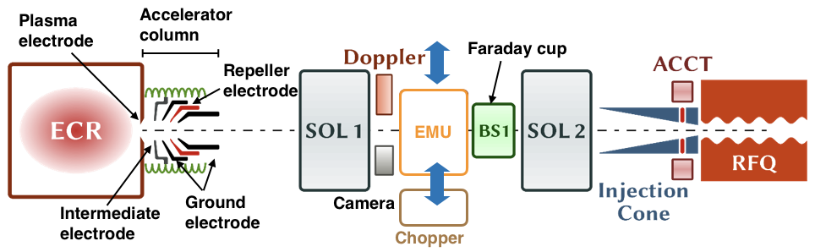
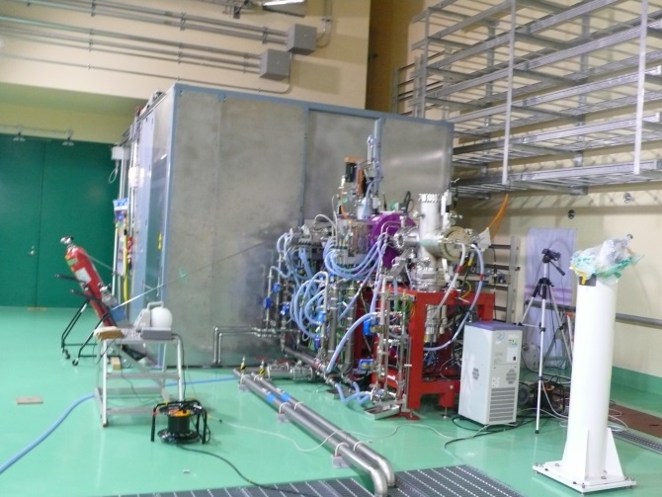
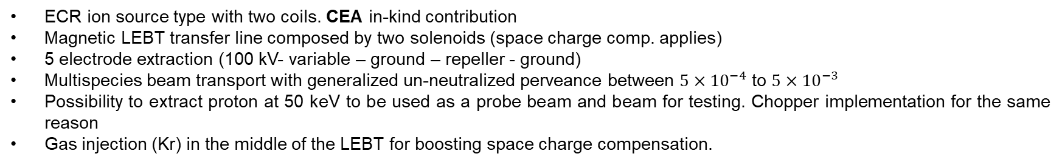
Injector
No slits
ECR ion source type with two coils. CEA in-kind contribution
Magnetic LEBT transfer line composed by two solenoids (space charge comp. applies)
5 electrode extraction (100 kV- variable – ground – repeller - ground)
Multispecies beam transport with generalized un-neutralized perveance between $5×{10}^{−4}$ to $5×{10}^{−3}$
Possibility to extract proton at 50 keV to be used as a probe beam and beam for testing. Chopper implementation for the same reason
Gas injection (Kr) in the middle of the LEBT for boosting space charge compensation.
To supply the required current beam at the RFQ entrance, below $ε_{rms,t, max}<0.3 mm mrad$ (125 mA beam), with ideally 0% mismatch.

Slide 6
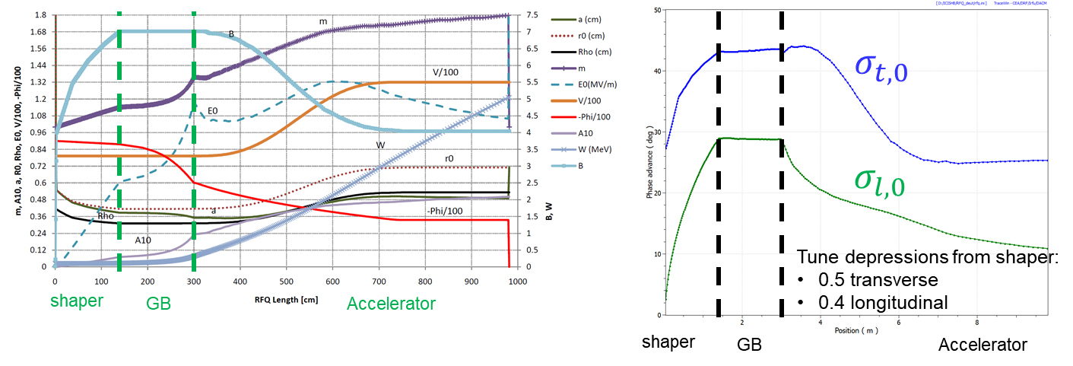
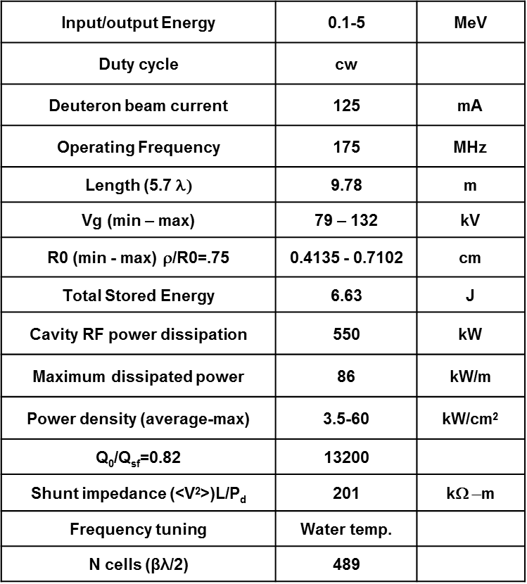
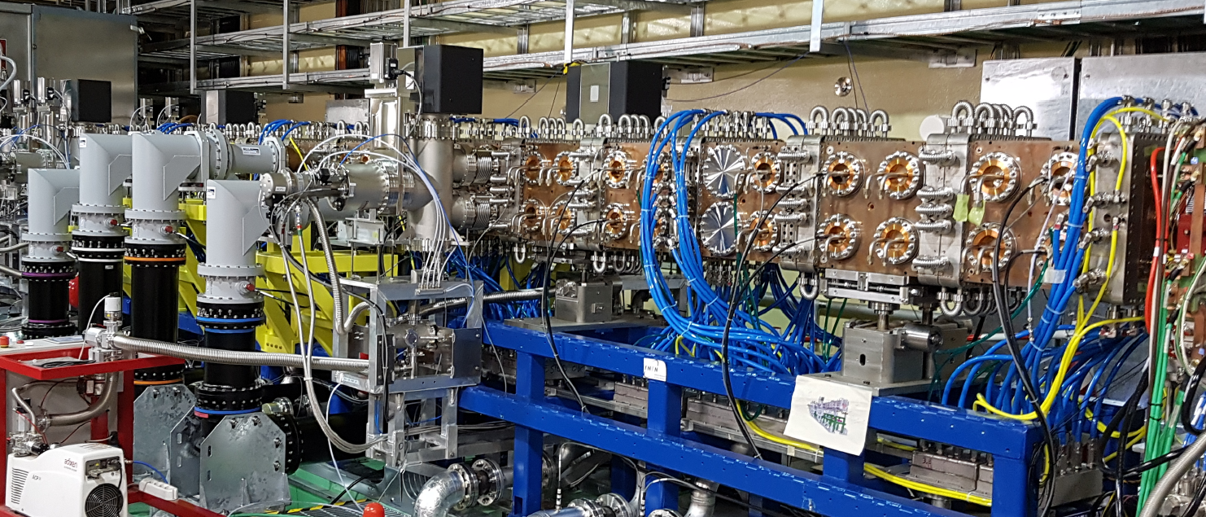
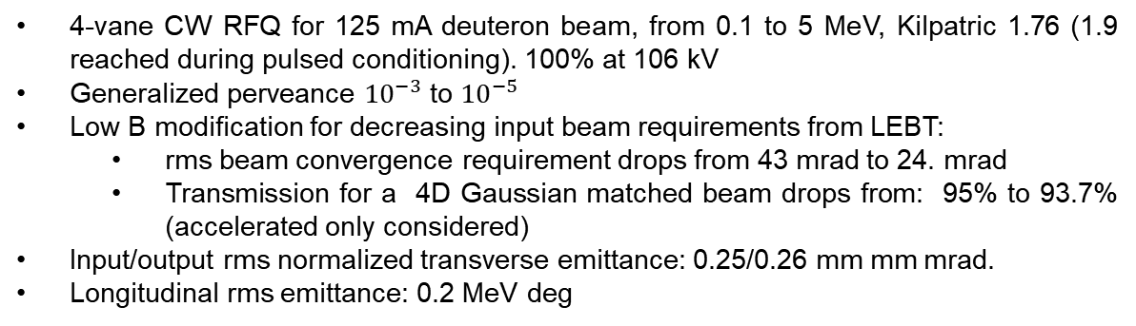
IFMIF/EVEDA RFQ
4-vane CW RFQ for 125 mA deuteron beam, from 0.1 to 5 MeV, Kilpatric 1.76 (1.9 reached during pulsed conditioning). 100% at 106 kV
Generalized perveance ${10}^{−3}$ to ${10}^{−5}$
Low B modification for decreasing input beam requirements from LEBT:
rms beam convergence requirement drops from 43 mrad to 24. mrad
Transmission for a 4D Gaussian matched beam drops from: 95% to 93.7% (accelerated only considered)
Input/output rms normalized transverse emittance: 0.25/0.26 mm mm mrad.
Longitudinal rms emittance: 0.2 MeV deg

Slide 7
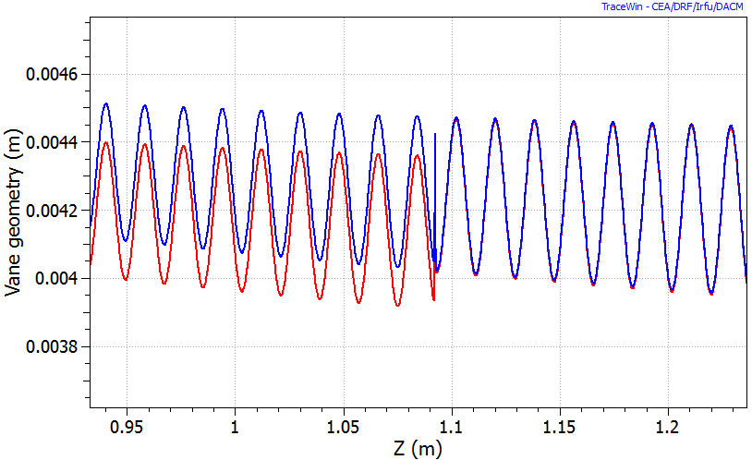
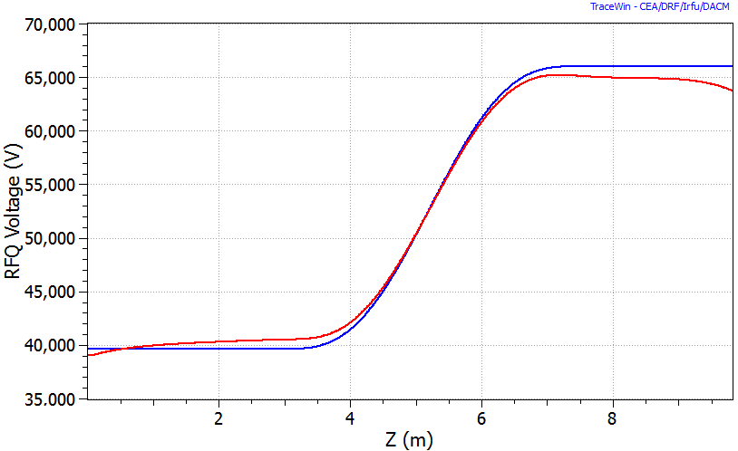
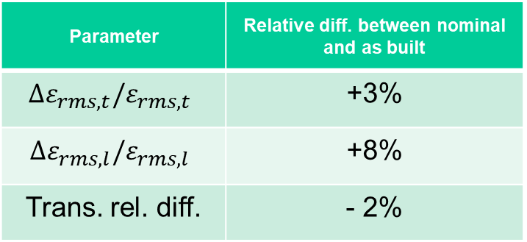
IFMIF/EVEDA RFQ 2
The RFQ was integrated in the simulation via the software Toutatis
The model integrated was the as-built model.
As built model:
particular
Parameter | Relative diff. between nominal and as built
$${∆ε}_{rms,t}/ε_{rms,t}$$ | +3%
$${∆ε}_{rms,l}/ε_{rms,l}$$ | +8%
Trans. rel. diff. | - 2%
±2%
Mechanical errors
Post bead-pull vane voltage profile

Slide 8
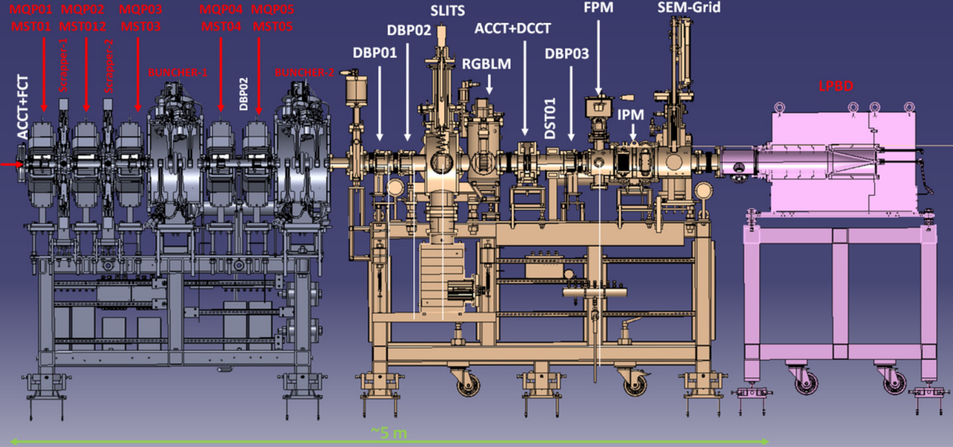
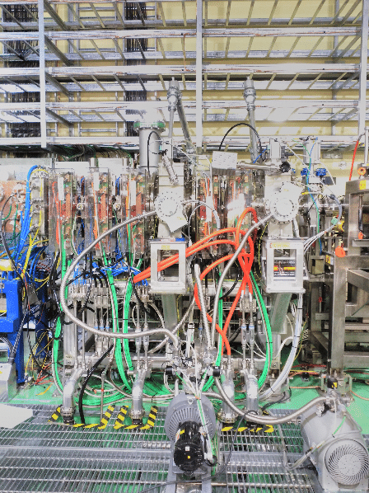
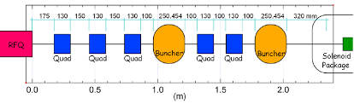
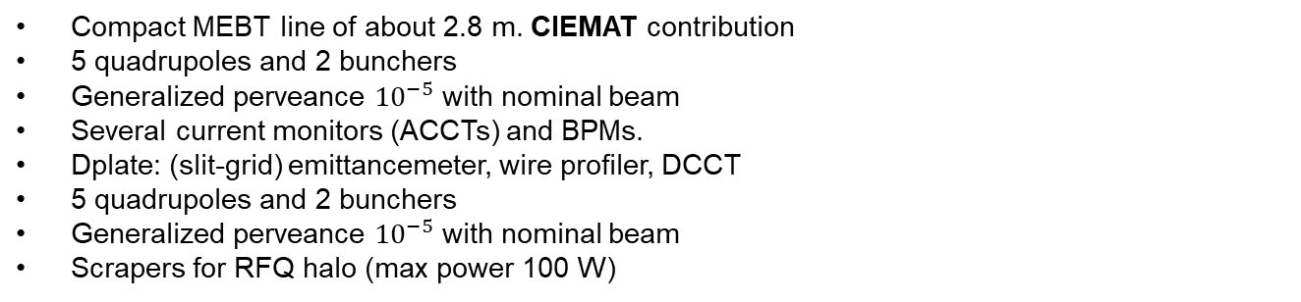
The MEBT in RFQ commissioning stage
Compact MEBT line of about 2.8 m. CIEMAT contribution
5 quadrupoles and 2 bunchers
Generalized perveance ${10}^{−5}$ with nominal beam
Several current monitors (ACCTs) and BPMs.
Dplate: (slit-grid) emittancemeter, wire profiler, DCCT
5 quadrupoles and 2 bunchers
Generalized perveance ${10}^{−5}$ with nominal beam
Scrapers for RFQ halo (max power 100 W)

Slide 9
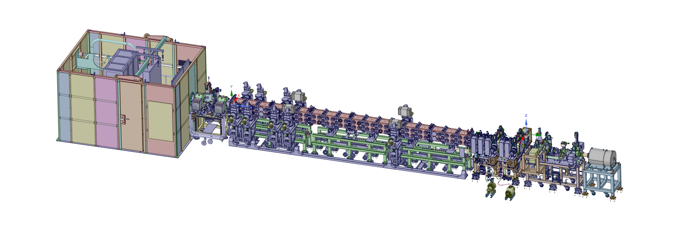
Main characteristics
Main characteristics of the pulse commissioning:
Pulsed beam commissioning: 1 s repetition rate, 1 ms beam pulse (limits from LPBD and interceptive diagnostics)
Mainly the work related with the RFQ confirmation of performances involved coasting beam, but buncher tested successfully during separate.
Voltage calibration curve calculated from transmission given by the ratio: ILPBD/LEBT ACCT
Emittance meter and profilers
LEBT EMU
MEBT ACCT
Injector
DPlate ACCT
LEBT ACCT
MEBT
RFQ
LPBD
FC
0.1 MeV
5 MeV
D-Plate
BPMs:

Slide 10
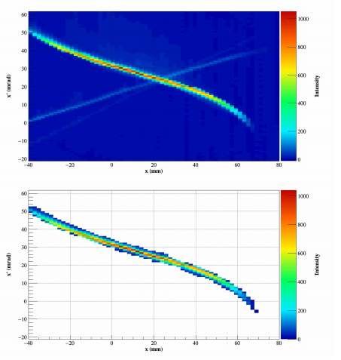
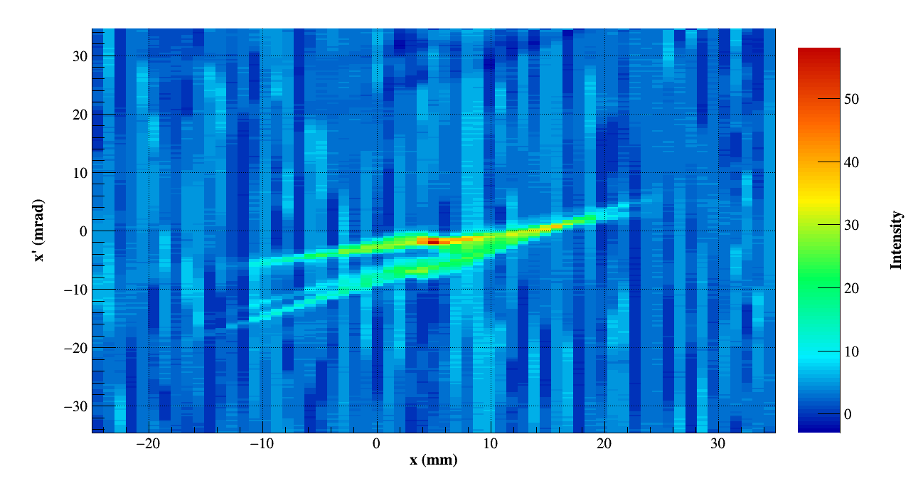
Steps of RFQ commissioning
Automatic matching procedure: [sol1, sol2, (st1H, st1V, st2H, st2V)], MEBT quads adapted depending on the current from RFQ. Generally left fixed from simulations
Low power commissioning (H+):
Probe beam: LEBT is not equipped with IRIS. -> Usage of smaller PE and depowered source in order to decrease the power of a factor of 25. The perveance can be comparable instead.
Example of pulse structure: 300 us pulse length (needed for s.c.c. time and ) 1 s repetition rate.
Some basics check on the general behaviour of the accelerator. Uncertainties on estimations, contaminants, matching routines.
Average perveance beam: powered source with smaller PE.
11 mm PE and max power and RF gas injected
6 mm PE, large gas injected but low RF power
10 mA proton beam @ 50 keV
85 mA proton beam @ 50 keV

Slide 11
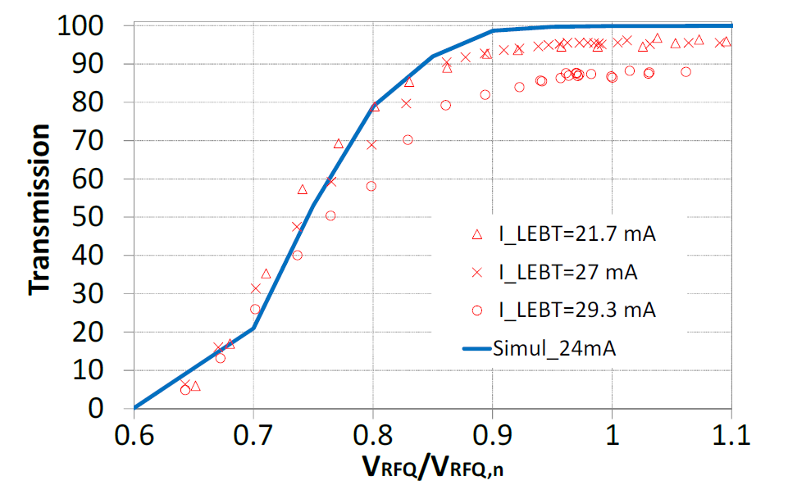
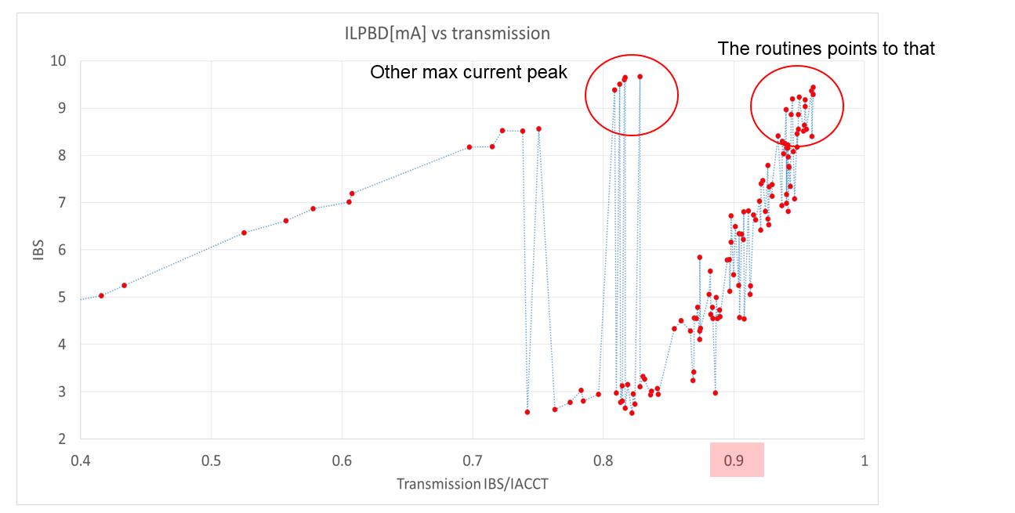
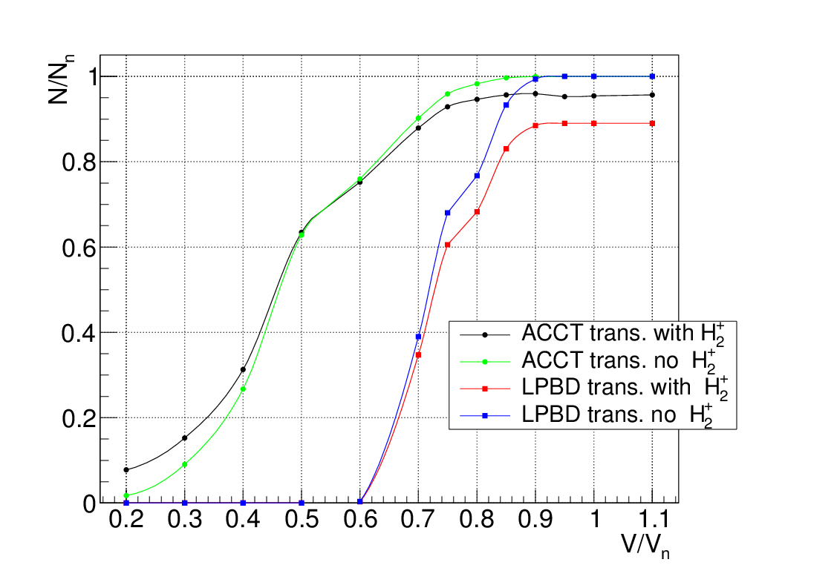
Results from average perv. Beam 11
measurement
measurement
simulation
Calibration curves at intermediate perveance:
Contaminants effect on transmission
Emittance limit test for “good” transmission through the RFQ. Test of semi-empirical criteria.

Slide 12
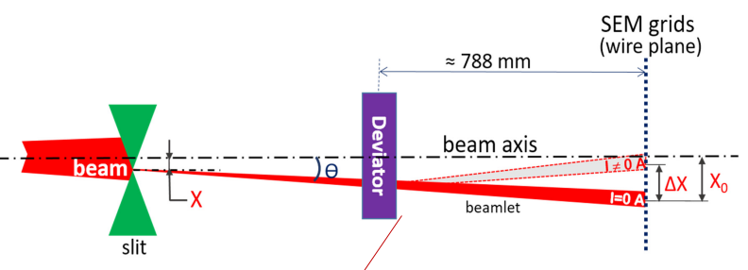
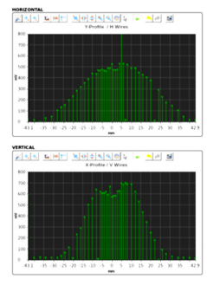

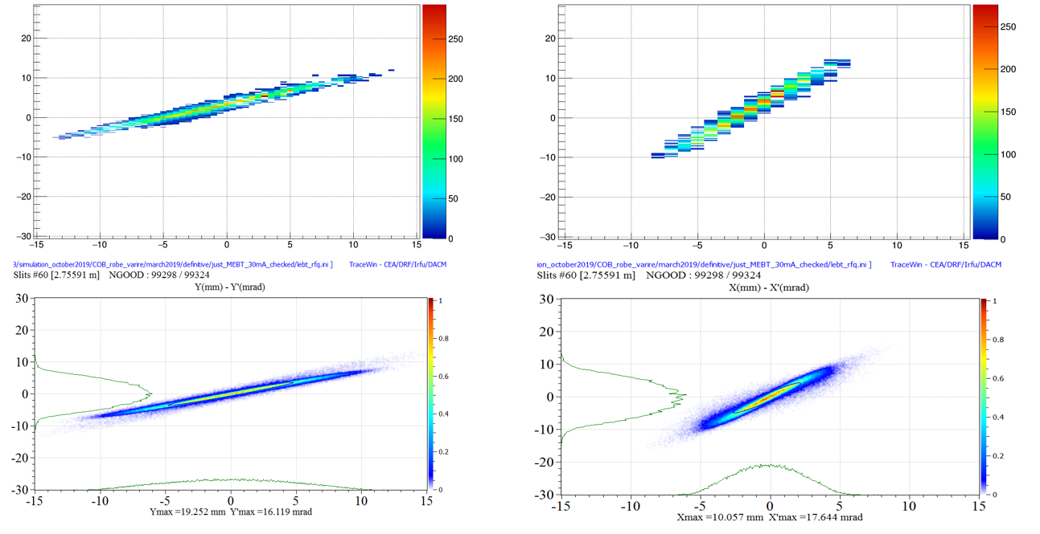
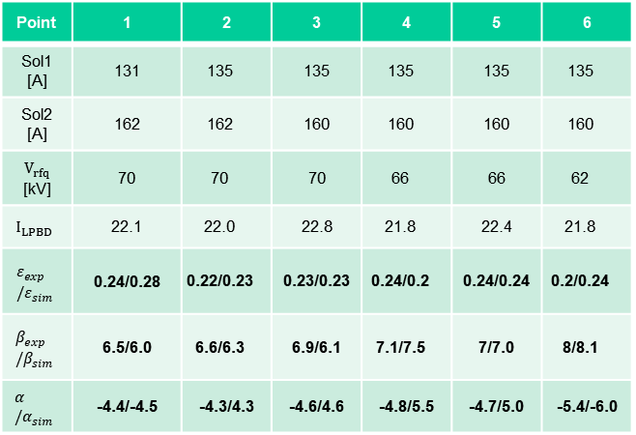
Results from average perv. beam 2
EMU measurement with slits and grid: CEA-Saclay and CIEMAT contributions. RFQ transverse emittance in MEBT.
Point | 1 | 2 | 3 | 4 | 5 | 6
Sol1 [A] | 131 | 135 | 135 | 135 | 135 | 135
Sol2 [A] | 162 | 162 | 160 | 160 | 160 | 160
$V_{rfq}$ [kV] | 70 | 70 | 70 | 66 | 66 | 62
$$I_{LPBD}$$ | 22.1 | 22.0 | 22.8 | 21.8 | 22.4 | 21.8
$$ε_{exp}/ε_{sim}$$ | 0.24/0.28 | 0.22/0.23 | 0.23/0.23 | 0.24/0.2 | 0.24/0.24 | 0.2/0.24
$$β_{exp}/β_{sim}$$ | 6.5/6.0 | 6.6/6.3 | 6.9/6.1 | 7.1/7.5 | 7/7.0 | 8/8.1
$$α/α_{sim}$$ | -4.4/-4.5 | -4.3/4.3 | -4.6/4.6 | -4.8/5.5 | -4.7/5.0 | -5.4/-6.0
Measurement YY’
Measurement XX’
Simulation YY’
Simulation XX’

Slide 13
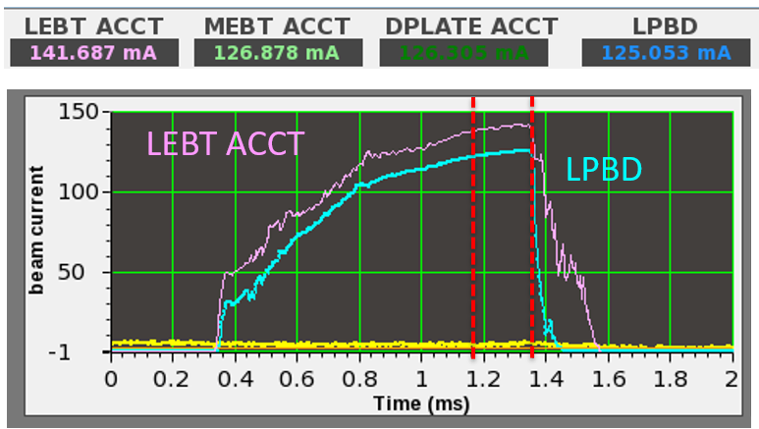
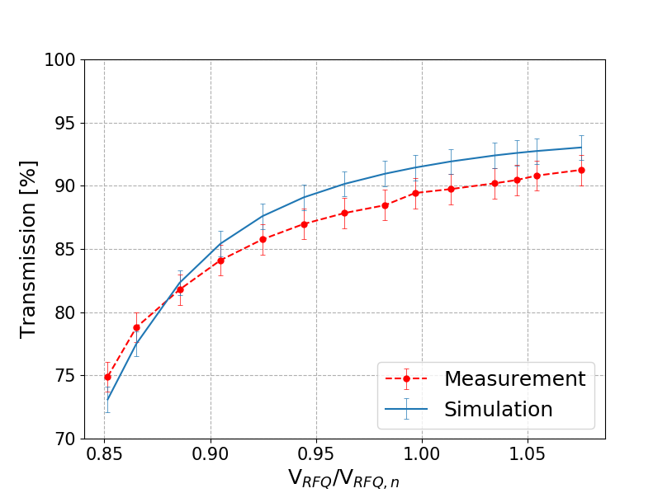
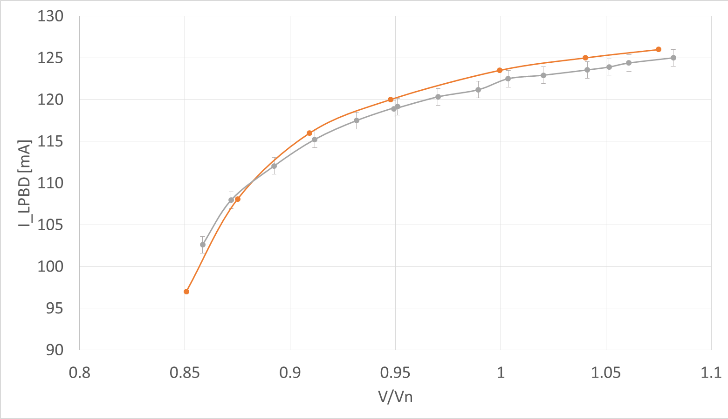
Steps of RFQ commissioning 2
Nominal perveance: 125 mA 1 Hz 1 ms deuteron beam
Chopper out of order. Full un-cutted beam pulse from ISRC.
Transmission I_{LPBD}/I_{LEBT} at V/Vn=1 | Values and uncertainties [%]
Experimental | 89.7 ± 1.2
Sim. D⁺ and D₂⁺ | 91.5 ± 1.0
Sim. D⁺ | 92.5 ± 1.0
Transmission estimation w.r. contaminant presence

Slide 14
Further results on measurement at high perveance
The ToF energy from different pair of BPM of the D-Plate and MEBT as function of the RFQ voltage: 5 MeV ± 1%
Possibility to fine tune the extraction voltage

Slide 15
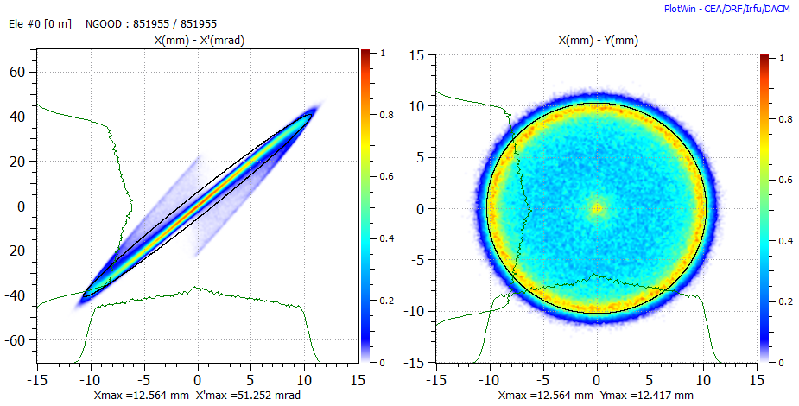
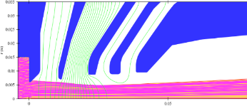
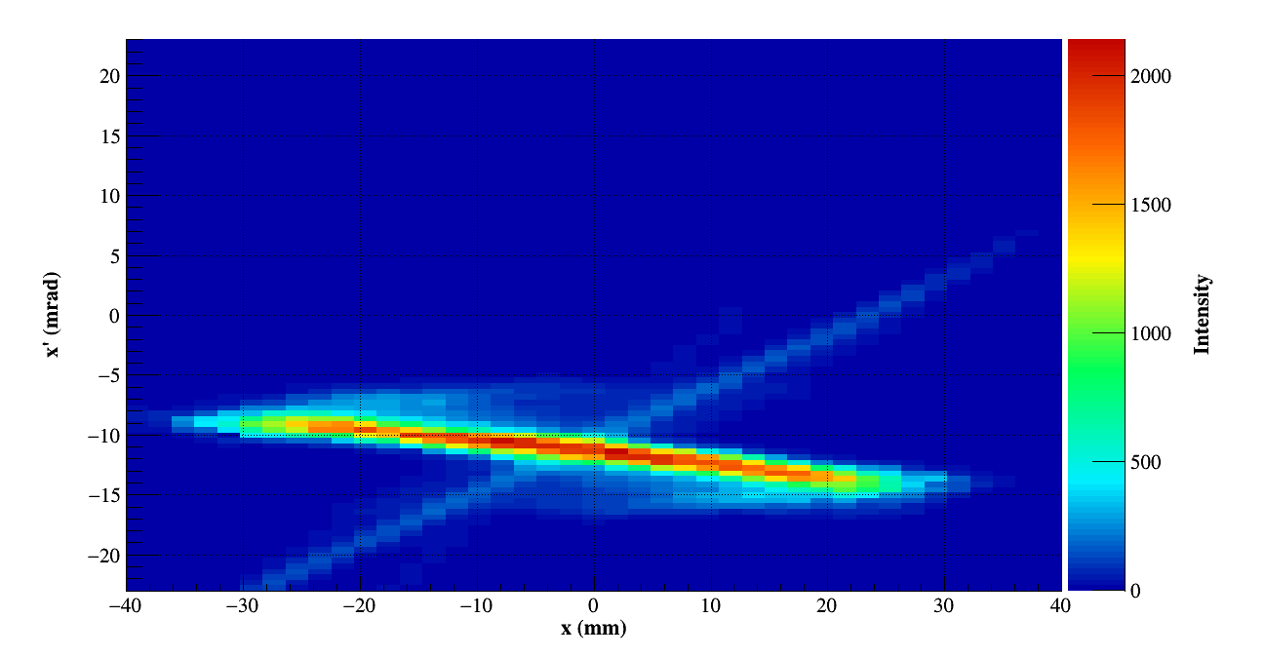
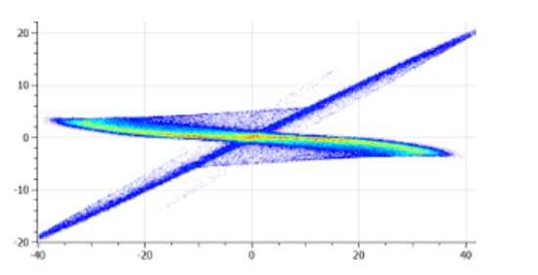
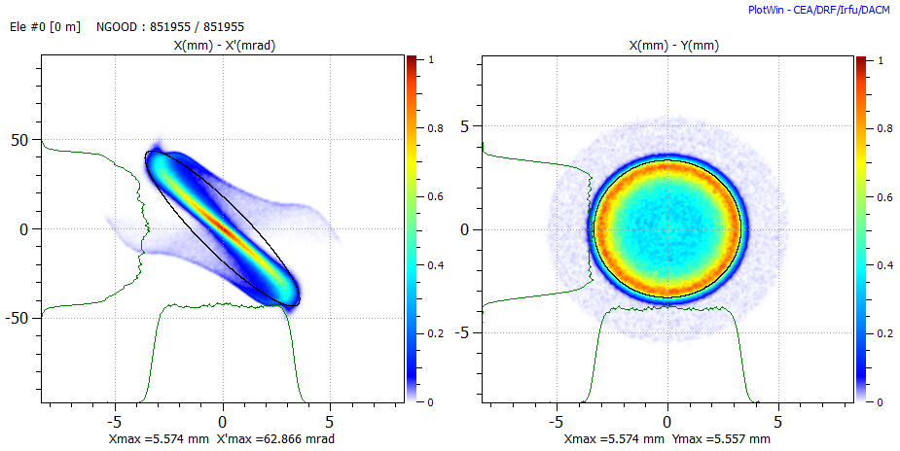
RFQ input beam distribution effect
Simulation
EMU measurement
EMU between solenoids
RFQ input

Slide 16
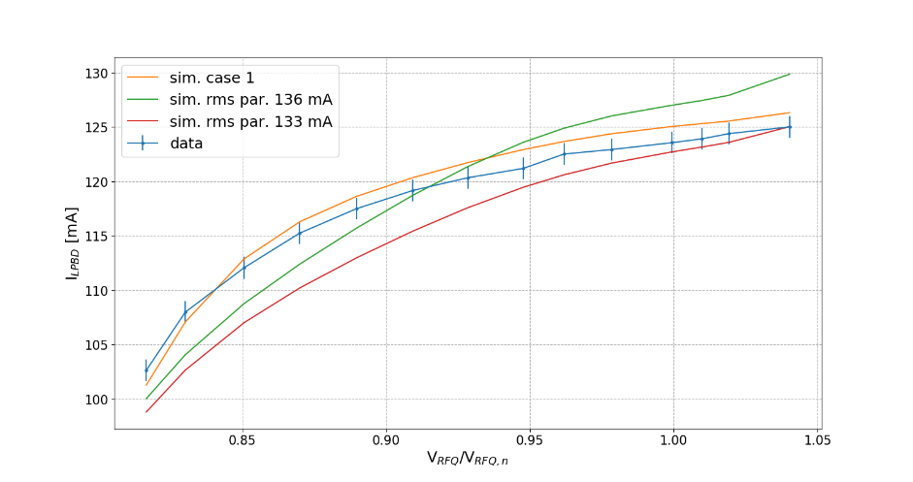
RFQ input beam distribution effect - 2
Close to realistic dist.
Gaussian dist. Trace-forward
RFQ input
The RFQ may be used to probe the input beam distribution
The Gaussian cut at 4 sigma seems to be the closer one

Slide 17
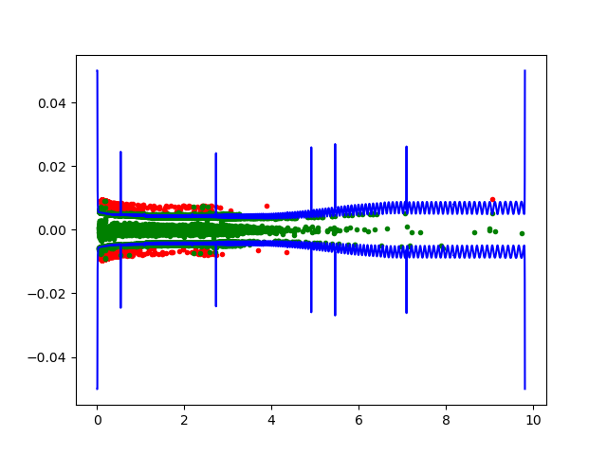
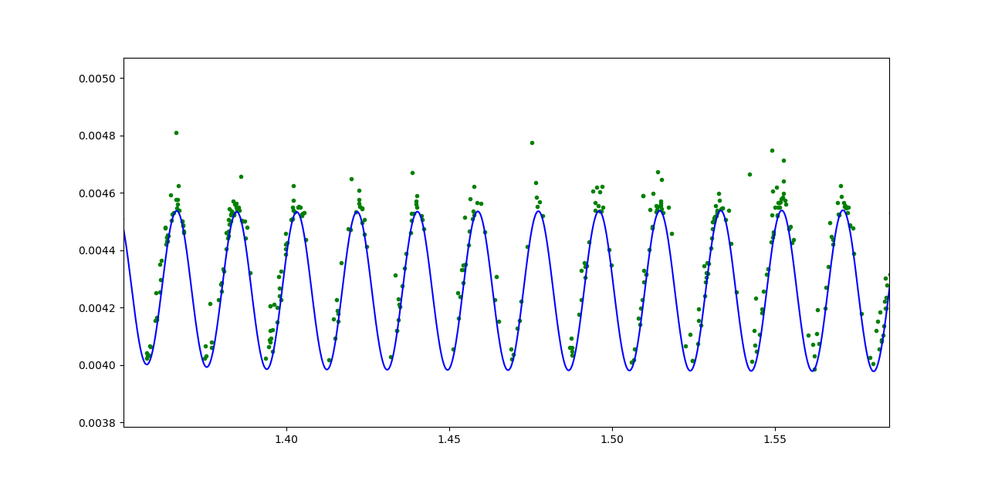
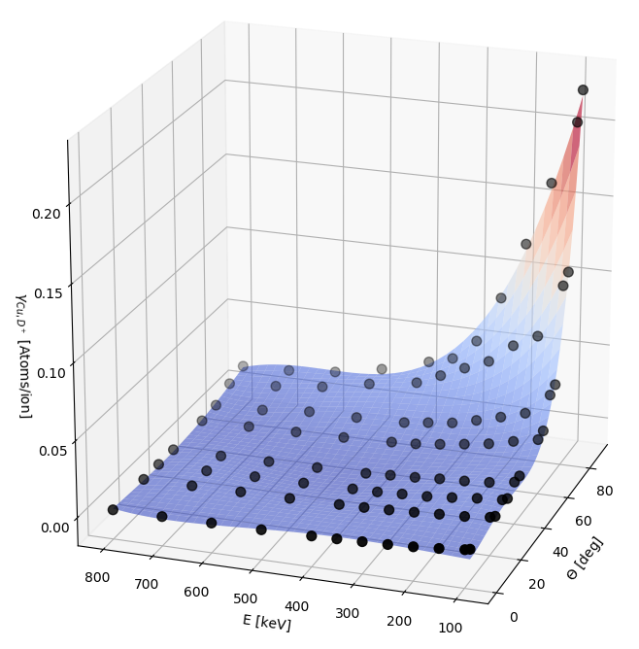
Electrode damage study
Electrode erosion is driven by sputtering phenomena
x [m]
z [m]

Slide 18
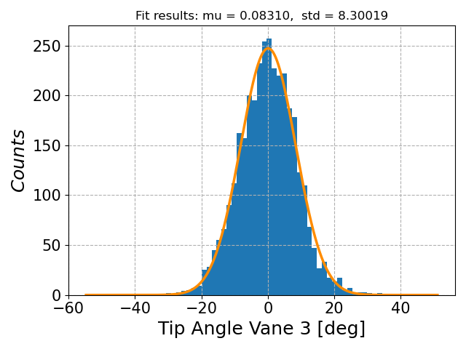
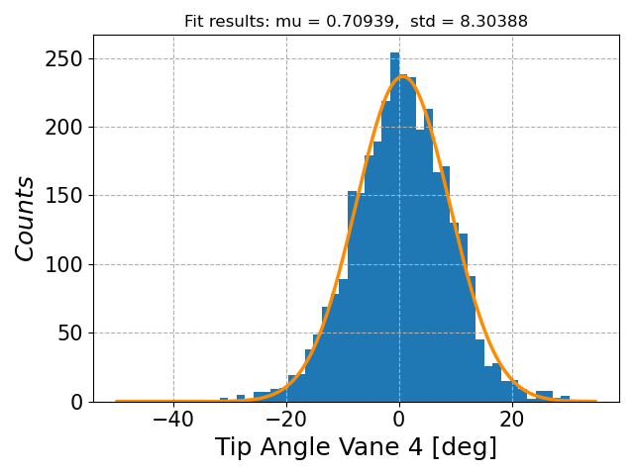
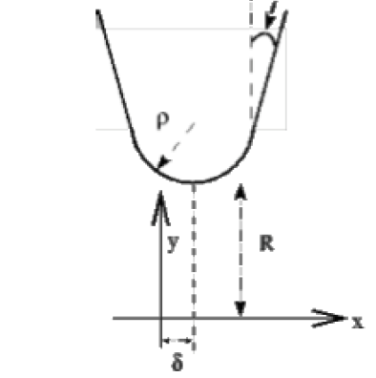
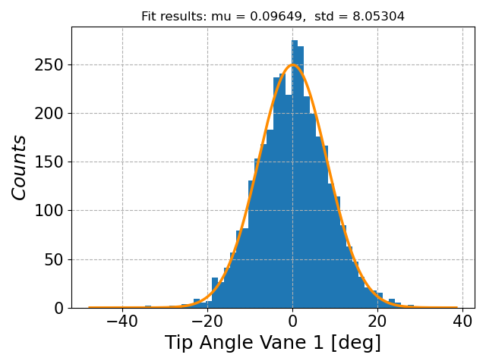
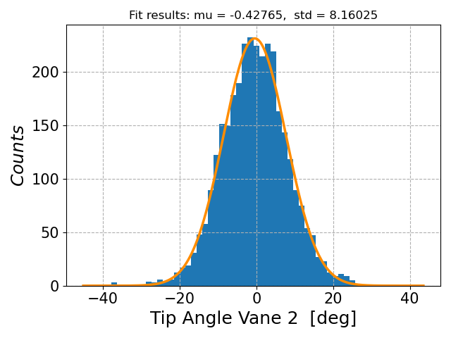

Distributions on the RFQ macro-region
$$ξ$$
For centered beam, the particle distribution with respect the tip angle is similar

Slide 19
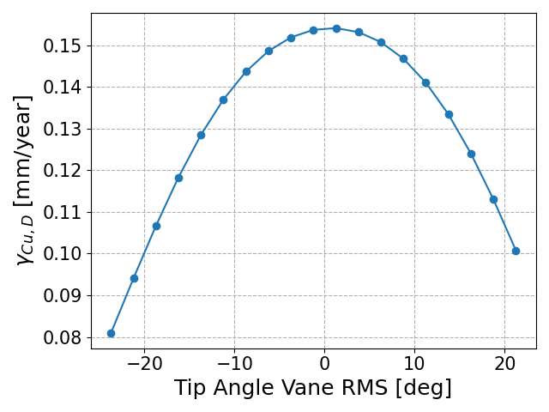
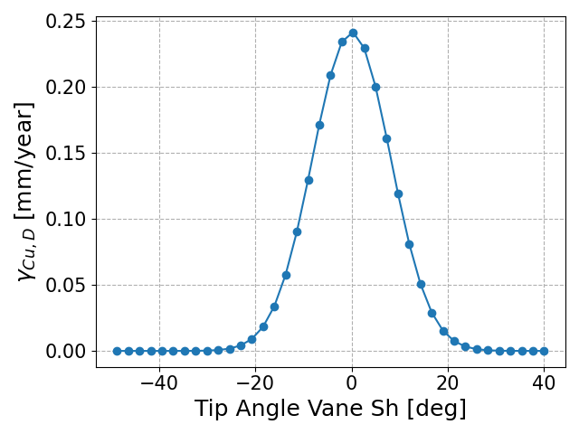
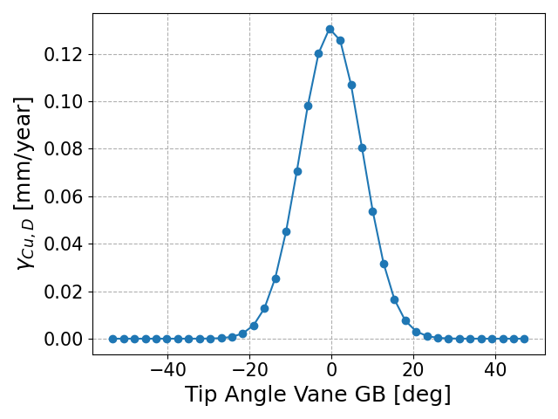
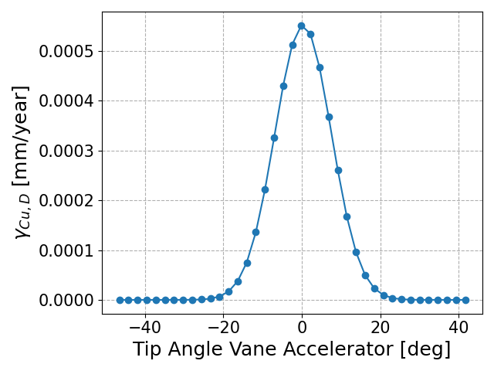
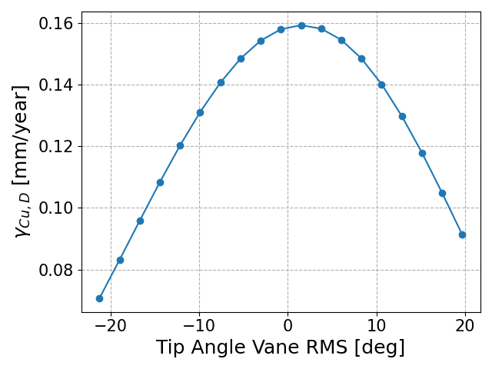
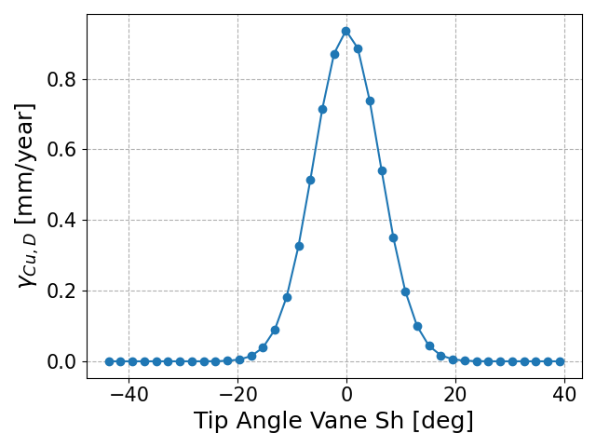






100%
85%
105%

Slide 20

Translation to RF observable

Slide 21

Work ongoing

Slide 22
Beam loading measurement and experience in IFMIF/EVEDA

Slide 23







Beam loading
How the RF generator sees the multi-cell accelerating cavity and beam?
In particular, which is the effective synchronous phase between Vc and ib?
$P_{b}=\frac{1}{2}\left|\tilde{V_{c}} \right|\left|\tilde{i_{b}} \right|cosφ=I\sum_{i}{V_{i}T_{i}{cosφ}_{i}}$ beam active power
$Q_{b}=\frac{1}{2}\left|\tilde{V_{c}} \right|\left|\tilde{i_{b}} \right|sinφ=I\sum_{i}{V_{i}T_{i}{sinφ}_{i}}$ beam reactive power
Effective sync.phase
Effective accelerating voltage
Effective shunt impedance
$$φ=atan\frac{\sum_{i}{V_{i}T_{i}{sinφ}_{i}}}{\sum_{i}{V_{i}T_{i}{cosφ}_{i}}}$$
$$\left|\tilde{V_{c}} \right|=\frac{\sum_{i}{V_{i}T_{i}{cosφ}_{i}}}{cosφ}$$
$$r_{s}=\frac{{\left|\tilde{V_{c}} \right|}^{2}}{P_{Cu}}$$

Slide 24

Beam Loading
The beam loading calculation, applied to the RFQ as a multicell cavity for 125 mA D+ (or 62.5 mA H+), gives +8.1 kHz detuning to be at resonance with beam.
IFMIF RFQ is feed by 8 tetrode amplifiers organized in 1 master + 7 slaves hierarchy
Only amplitude feedback control impossible
Beam operation is only possible at fRF=175 MHz, thus we measured the beam loading through two indirect effects on the forward phase and cavity phase, compared with calculations based on design data.
The experimental steps were:
Tuning of the cavity (fRF=fCAV=175 MHz), adjusting the cooling water temperature to maximize the cavity voltage at 175 MHz;
In close loop (fRF=fCAV=175 MHz), measurement of FWD phase correction required at beam entrance, to be compared with $∆φ=atan\left(\frac{V_{c}sin(φ)}{V_{c}\cos\left(φ\right)+V_{b}}\right)−φ$;
In amplitude and phase open loop (fRF=fCAV=175 MHz), measurement of the beam induced phase in cavity voltage, compared with $∆ψ=atan\left(−\frac{I_{beam}r_{s} sin(φ)}{V_{c}(1+β)}\right)$

Slide 25

Beam Loading
First we checked the cavity resonance as function of temperature → sensitivity = -3kHz/°C

Slide 26



Meas @ 7.5mA
Open loop
Close loop
beam
beam
$$\frac{V_{beam}}{V_{nobeam}}=0.95$$
Note: Y scale not synch.

Slide 27



Meas @ 27.5 mA(→26mA out)
Open Loop Phase
Close loop phase
beam
beam
$$\frac{V_{beam}}{V_{nobeam}}=0.87$$
Note: Y scale not synch.

Slide 28

Beam Loading
Beam loading induced de-phase for different H+ currents (Sim/Meas).
In open loop it was difficult to measure the 55 mA H+ current because of the significant RFQ voltage drop induced by the beam.
The results are satisfactory in a large range of currents.
It would be interested to test this method in another RFQ.

Slide 29


Some picture from TRASCO RFQ after conditioning (CW-352 MHz)
After TRASCO experience we decided to equip RFQ IFMIF end plates with arc detector view port. After CW conditioning at LNL premise we did not see any mark of breakdown. IFMIF RFQ has not been opened in Rokkasho up to now.
Input RMS trasco
Output of 1 segment trasco

Slide 30

One more question about output energy

