Slide 1
RFQ Mini-Workshop
Cavity & Beam Dynamics and Strategies for Higher Beam Current Commissioning
Alan Letchford, ISIS
25th February 2022

Slide 2
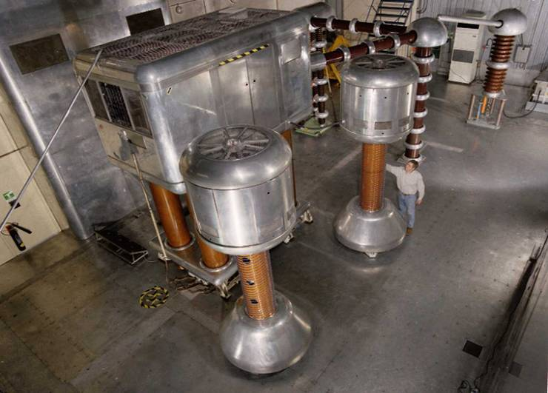
ISIS RFQ
The ISIS RFQ is a 4-rod, 665 keV RFQ operating at 202.5 MHZ, 30 mA and 2.5% duty factor.
Replacement for DC pre-injector.
Installed in 2004.

Slide 3
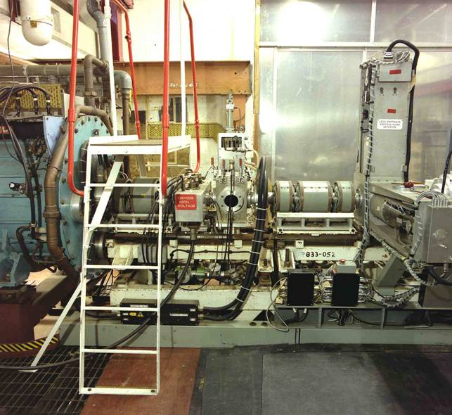
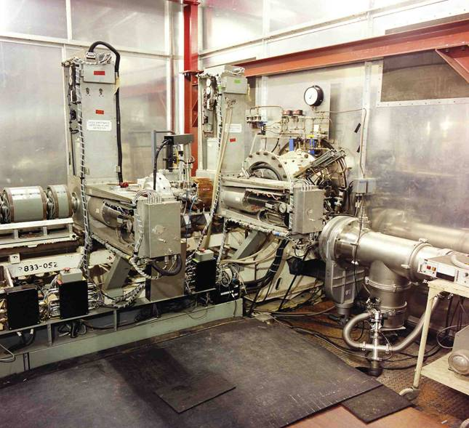
Due to the very conservative approach at ISIS the DC pre-injector wasn’t decommissioned until the RFQ had been proven.
This placed severe constraints on the new pre-injector design.

Slide 4
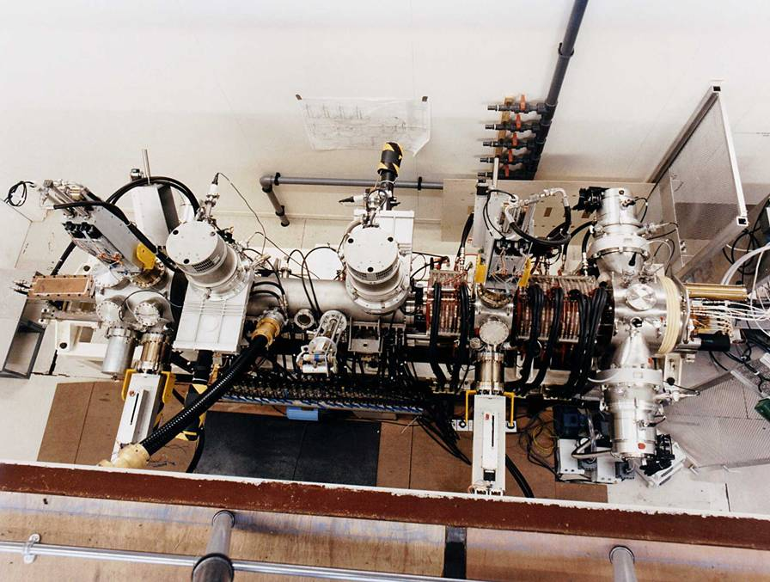
A complete, full power beam test stand was constructed to condition and beam commission the RFQ.
The RFQ was operated for >2000 hours, 24/7 for several weeks at a time on the test stand.

Slide 5
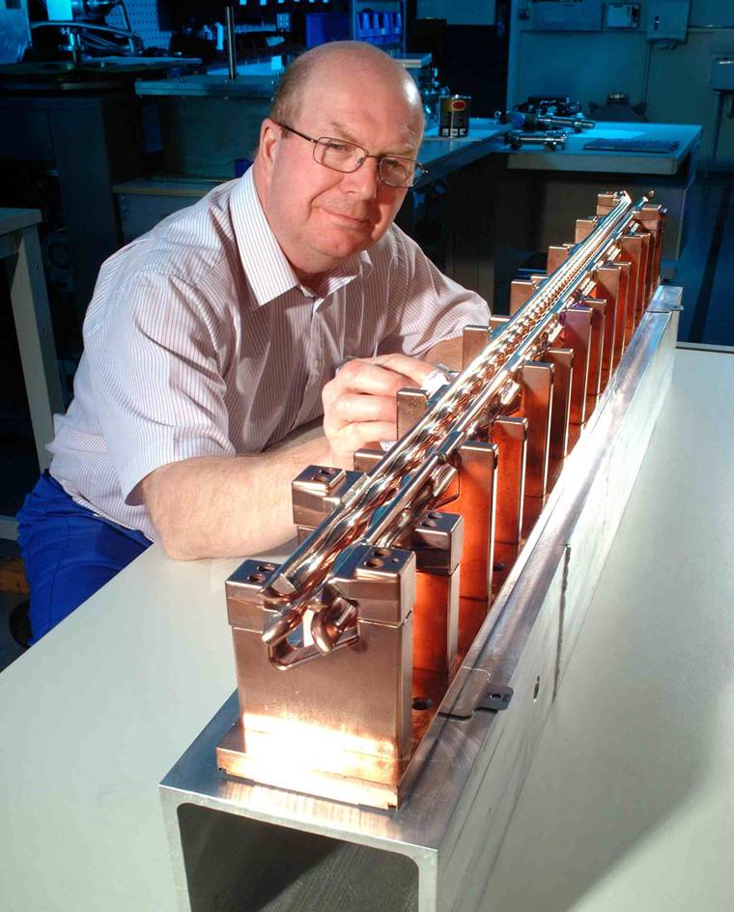
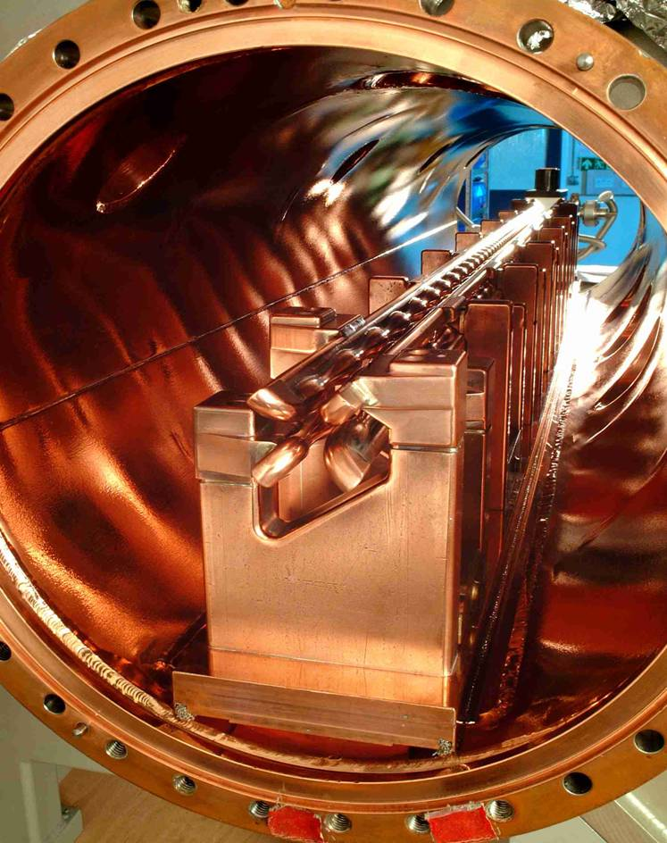
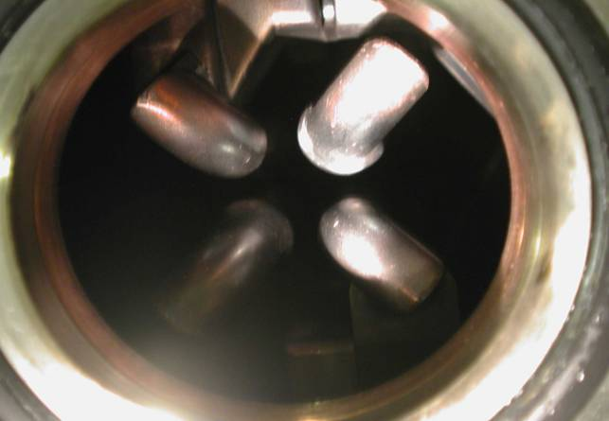
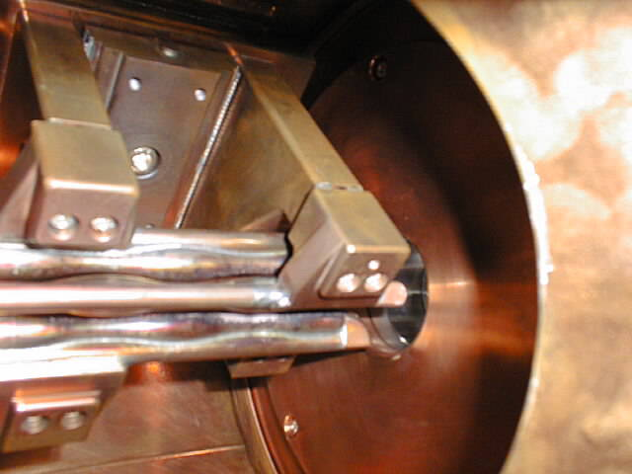
The RFQ performance deteriorated during initial conditioning due to poor preparation of the cavity, necessitating a complete disassembly and cleaning.
Following cleaning the RFQ conditioned to full power and duty factor in 8 hours.

Slide 6
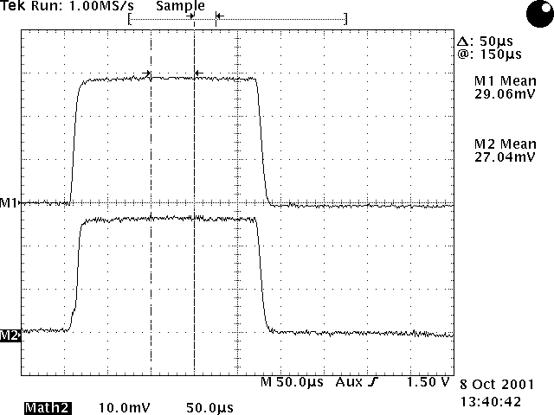
First beam at 50/32 pps was achieved very easily.
93% transmission for 29 mA
Slowly increased to >95% transmission for >30mA at 50 pps over the course of a day.

Slide 7
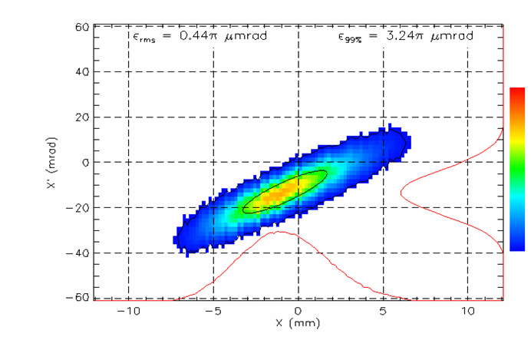
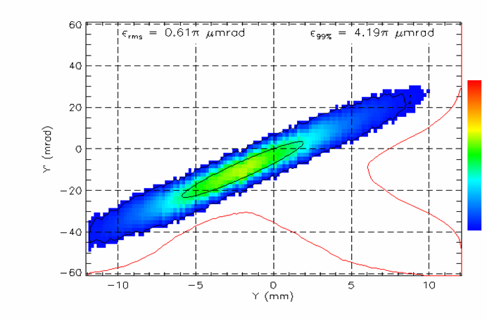
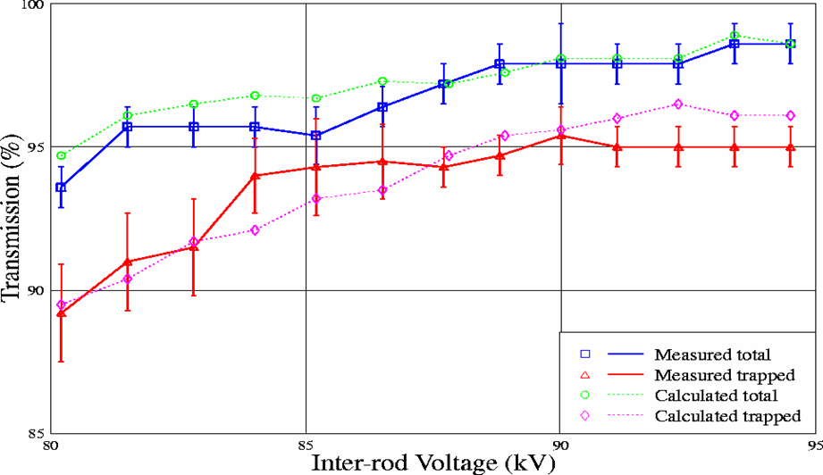
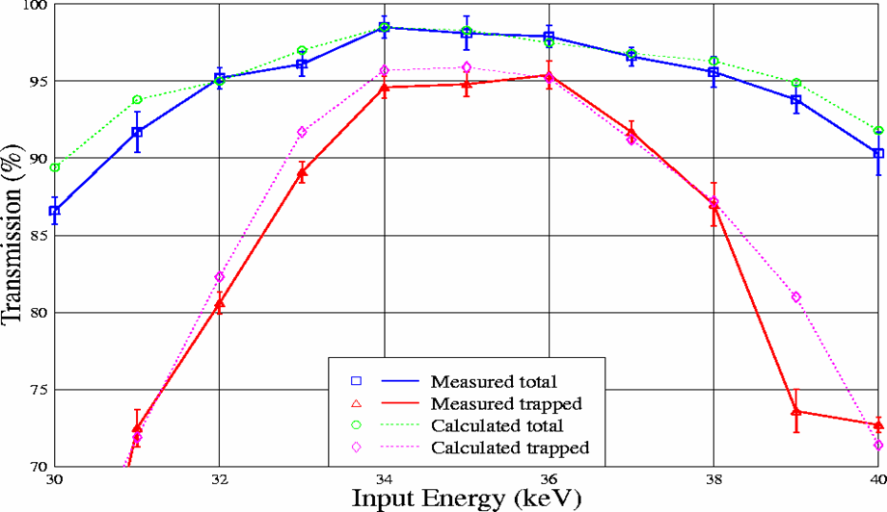
As well as long term testing of reliability an extensive experimental campaign was undertaken.

Slide 8
The new pre-injector was installed during a long shutdown.
No RF reconditioning was necessary.
19 mA at 70 MeV achieved within ~half hour
24 mA at 70 MeV achieved within a day.

Slide 9
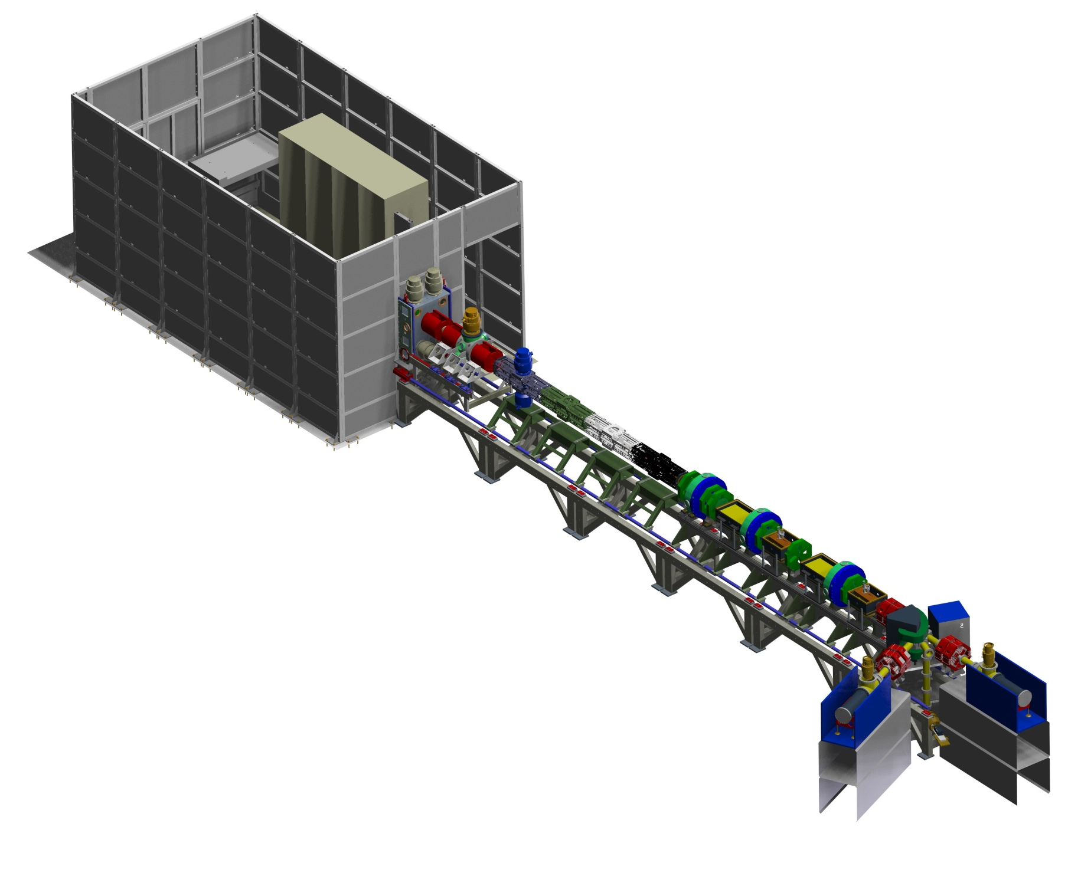
The Front End Test Stand (FETS) RFQ
FETS is a generic, offline test stand for technology development.
The RFQ is a 4-vane, 3 MeV RFQ operating at 324 MHZ, 60 mA and 10% duty factor.
Low Energy Beam Transport
Three-solenoid configuration
Space-charge neutralisation
5600 Ls⁻¹ total pumping speed
High brightness H– ion source
4 kW peak-power arc discharge
60 mA, 0.25 π mm mrad beam
2 ms, 50 Hz pulsed operation
Radio Frequency Quadrupole
Four-vane, 324 MHz, 3 MeV
4 m bolted construction
High power efficiency
Beam Dumps
Defocussing quads
Water cooled cones
Pure Al

Slide 10
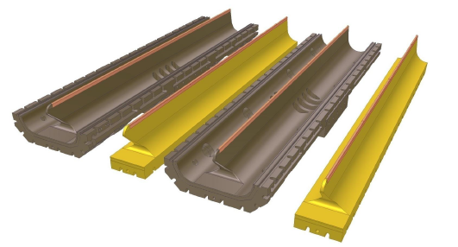
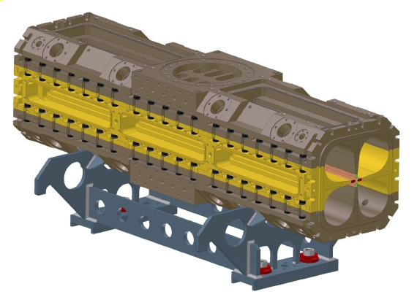
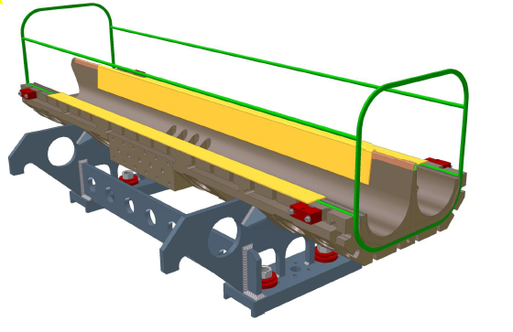
The main USP of the FETS RFQ is the lack of brazing and a completely bolted, dissembleable design.
Sections made of 2 major and 2 minor vanes
Vanes bolted together to make 1 m sections
3D o-ring
4 x 1 m long sections bolted together

Slide 11
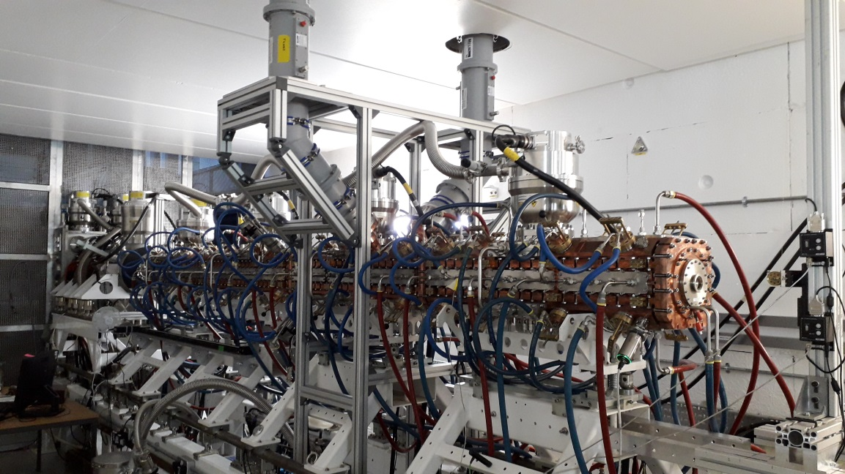
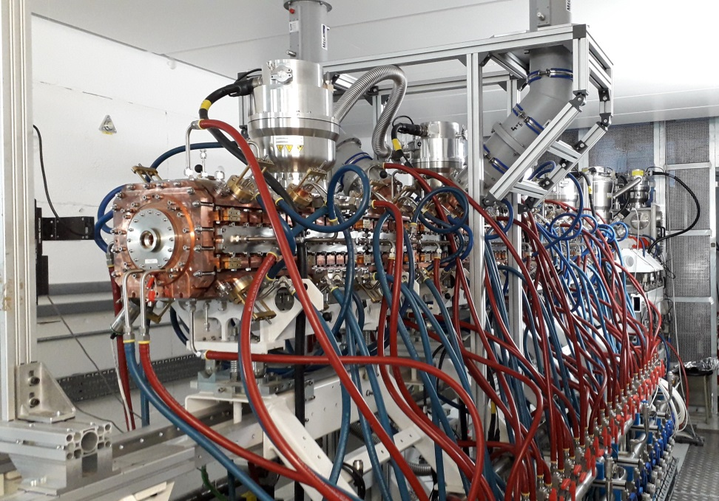
The RFQ is 4 m long with 4 x 800 l/s turbo pumps, 2 x RF power couplers, 4 motorised dynamic tuners and 58 slug tuners for field flattening.

Slide 12
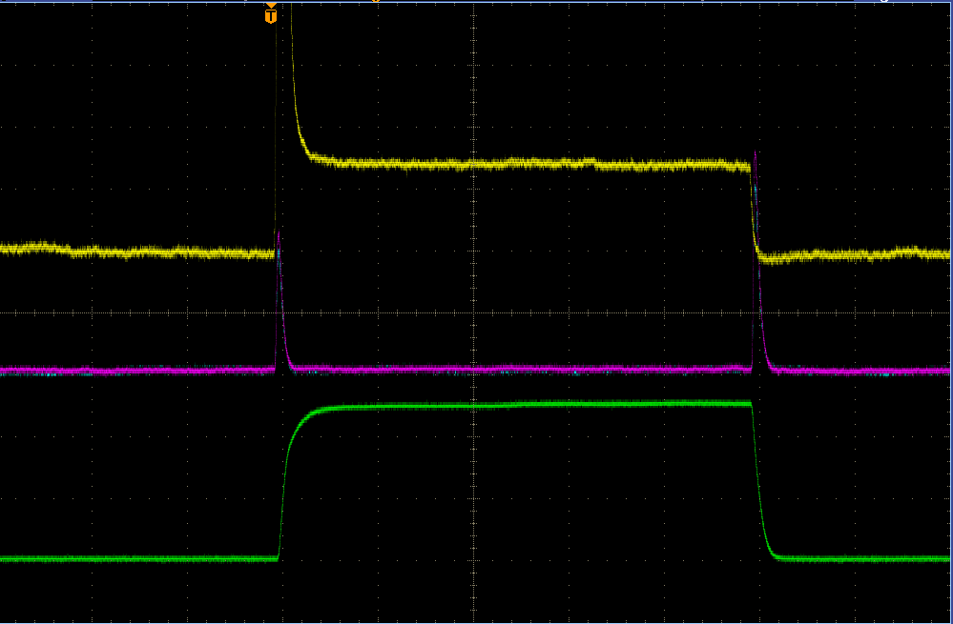
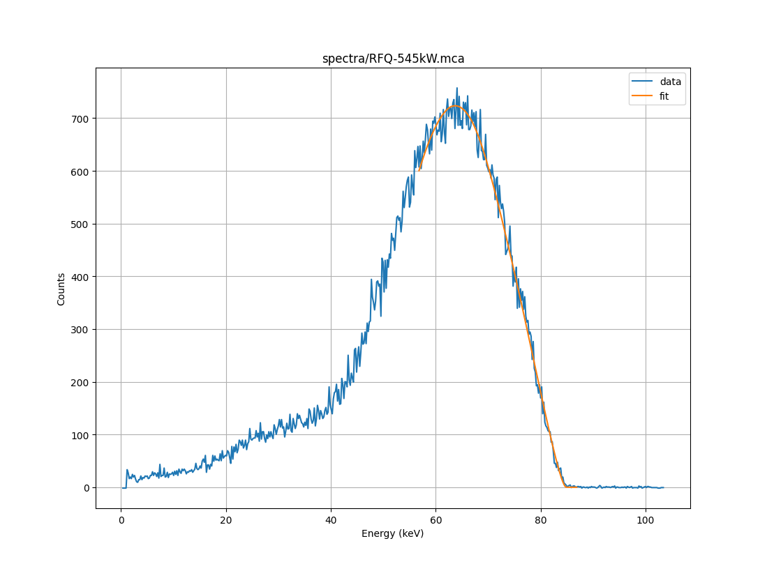
RF conditioning took 7 days (< 8 hours per day) to achieve 50 pps and 2.5% duty factor. Peak power of 545 kW confirmed by x-ray measurements.
Cold vacuum pressure was 2e-7 mbar and didn’t rise above 5e-7 during conditioning.

Slide 13
Initial beam commissioning will commence on 25th March.
Radiation protection measures* will initially limit us to 50/32 pps @ 100 us.
Beam ramp up will be dictated by radiation protection assuming no issues with the RFQ.
* Primarily due to any radiation from the beam dump.

