Slide 1
“Phase” Becomes Important
Rihua Zeng 2021-Feb-25

Slide 2
Outline
During conditioning/early commissioning, Open Loop Operations are also crucial to identify problems and get insight into RF/Cavity/Beam dynamics!
Phase information becomes more and more important and Features required to support this
Some more to Consider
Summary

Slide 3
Phase Becomes Important
Perturbations in the cathode voltage results in the change of the beam velocities, and then led to the variations of the RF output phase
1% error in cathode voltage leads to more than 10 deg. variation in RF output phase
High frequency ripple with larger amplitude is hard to be eliminated by feedback, especially in normal conducting cavity
SNS
JPARC
Further reading: R. Zeng et, al. The Droop and Ripple’s Influence on Klystron Output, ESS tech-note.
https://docdb01.esss.lu.se/DocDB/0001/000173/001/InfluenceOfTheRippleOnKlystronOutput.pdf

Slide 4
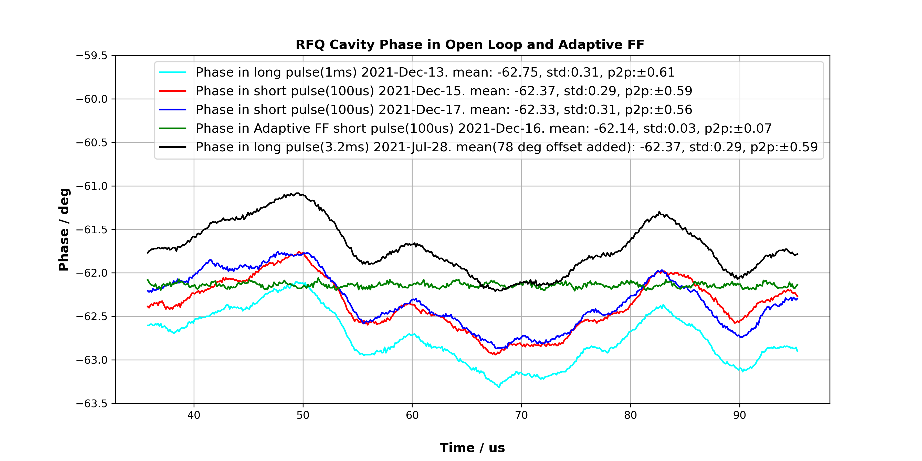
Phase@Open Loop and AFF at ESS

Slide 5
The ideal case
Consider an ideal beam current inject into an ideal cavity at ideal time
Ideal beam current: no synchronous phase, continuous current during pulse
Ideal cavity: optimized Q_{L} for beam current, no reflection power at beam duration, no Lorentz Force Detuning.
Ideal injection time
V_{ref}, I_{ref}
QL optimizing:
Ideal injection time:
V_{for}, I_{for}
V_{cav}
Further reading:
D. McGinnis, A Simple Model for a Superconducting RF cavity with a Vector Phase Modulator, 2007.
T. Schilcher, Vector Sum Control of Pulsed Accelerating Fields in Lorentz Force Detuned Superconducting Cavities. Ph. D. Thesis of DESY, 1998
https://bib-pubdb1.desy.de/record/291638/files/schilcher.pdf

Slide 6
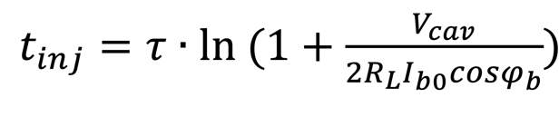
Flat Field @Open Loop with Synchronous Phase(by optimizing beam injection time)

Slide 7
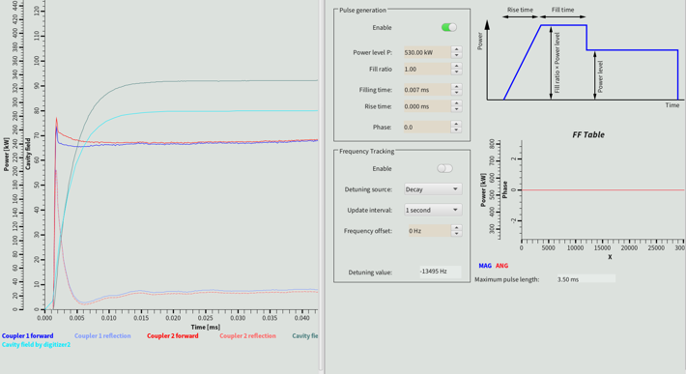
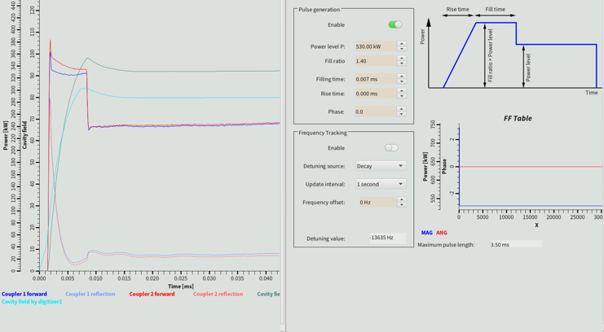
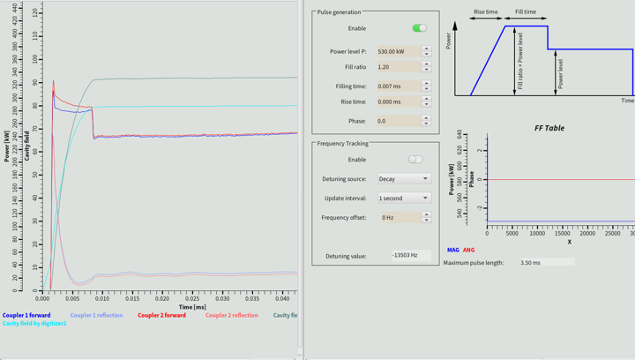
Flat field @ Open Loop(by optimizing beam injection time.)
Tested in RFQ without beam and works well.
To be tested with beam soon
Further reading: R. Zeng, Field Stability Issue for Normal Conducting Cavity under Beam Loading, ESS tech-note.
https://docdb01.esss.lu.se/DocDB/0002/000298/001/Field%20Stability%20Issue%20for%20Normal%20Conducting%20Cavity%20under%20Beam%20Loading.pdf

Slide 8
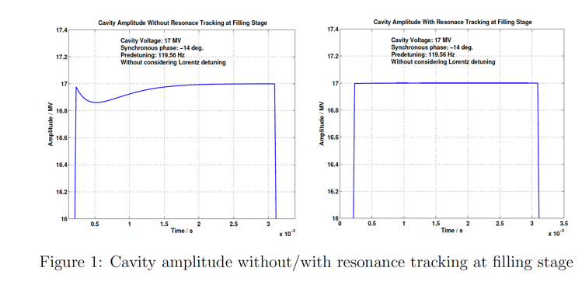
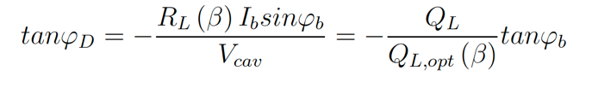
Flat Field @ Open Loop(with Pre-detuning)
The purpose of beam off-crest acceleration by a sync. phase is to minimize the energy spread resulted from wake fields.
By pre-detuning the cavity with motor tuner, the effect of the sync. phase acceleration is compensated. However, field gets disturbed in this case.
Tracking the frequency in filling stage!
Also need to consider non-optimal beam velocity in cavity(topic for massive commissioning)
Further reading: Electroacoustic instabilities in the LEP-2 superconducting cavities, D. Boussard, et, al. 7th RF superconducting workshop, 1995
Some Considerations on Predetuning for Superconducting Cavity, R.Zeng, S. Molley, ESS tech note.
https://docdb01.esss.lu.se/DocDB/0001/000174/001/SomeConsiderationOnPredetuning.pdf

Slide 9
Lorentz Force Detuning
If no control on RF cavity, the cavity detuning will cause the RF field to change, which then will in turn impact further on the cavity detuning.
Such a closed feedback system between the electromagnetic mode and the mechanical modes can lead to instabilities.
K=0, -1,-2, -3, -5 Hz/(MV)²
Further reading: J.R. Delayen, Ponderomotive instabilities and microphonics—a tutorial, 12th SRF workshop, 2006.

Slide 10
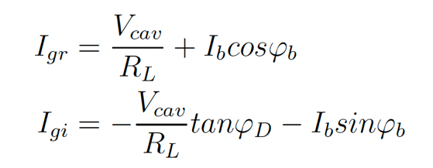
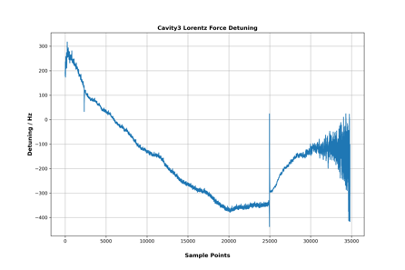
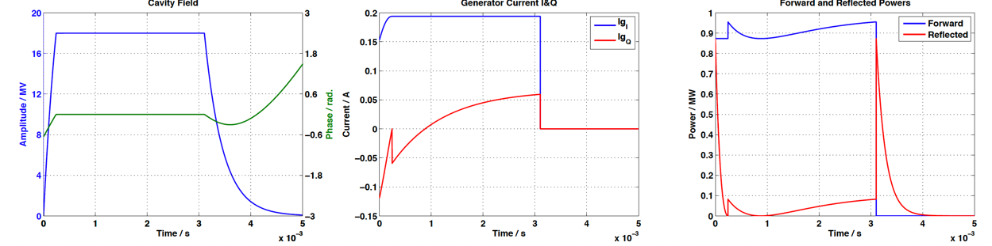
Flat Field @ Open Loop(with Lorentz Force Detuning)
Measured Dynamic Detuning

Slide 11
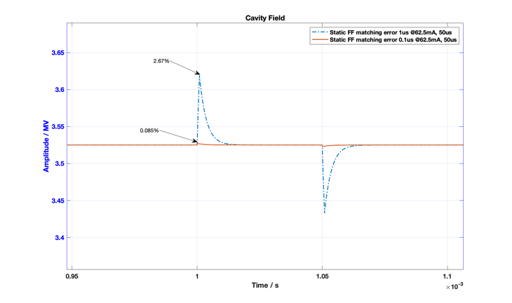
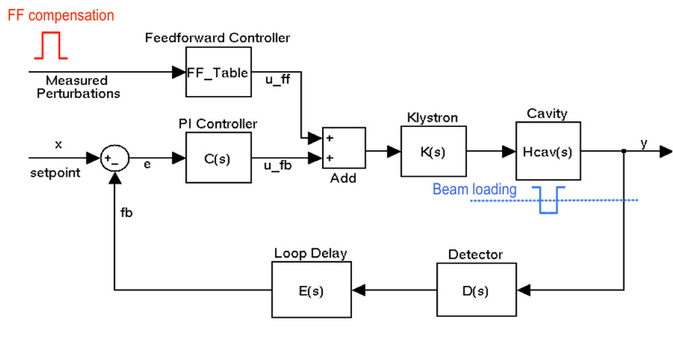
Flat Field @ Open Loop (with Beam Loading)
To do for RFQ at first beam commissioning and also later commissioning
RF parameters: 100us(or 3200us), 1Hz
Beam parameters: 50us, 6~62.5mA
Further reading: R. Zeng, Power Overhead Reduction Considerations in Beam Commissioning, ESS tech-note.
https://docdb01.esss.lu.se/cgi-bin/public/DocDB/ShowDocument?docid=263

Slide 12
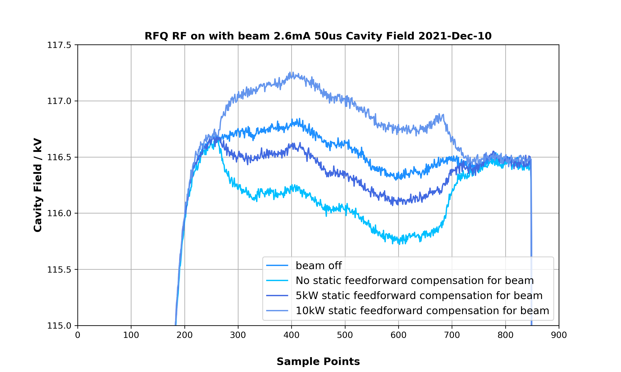
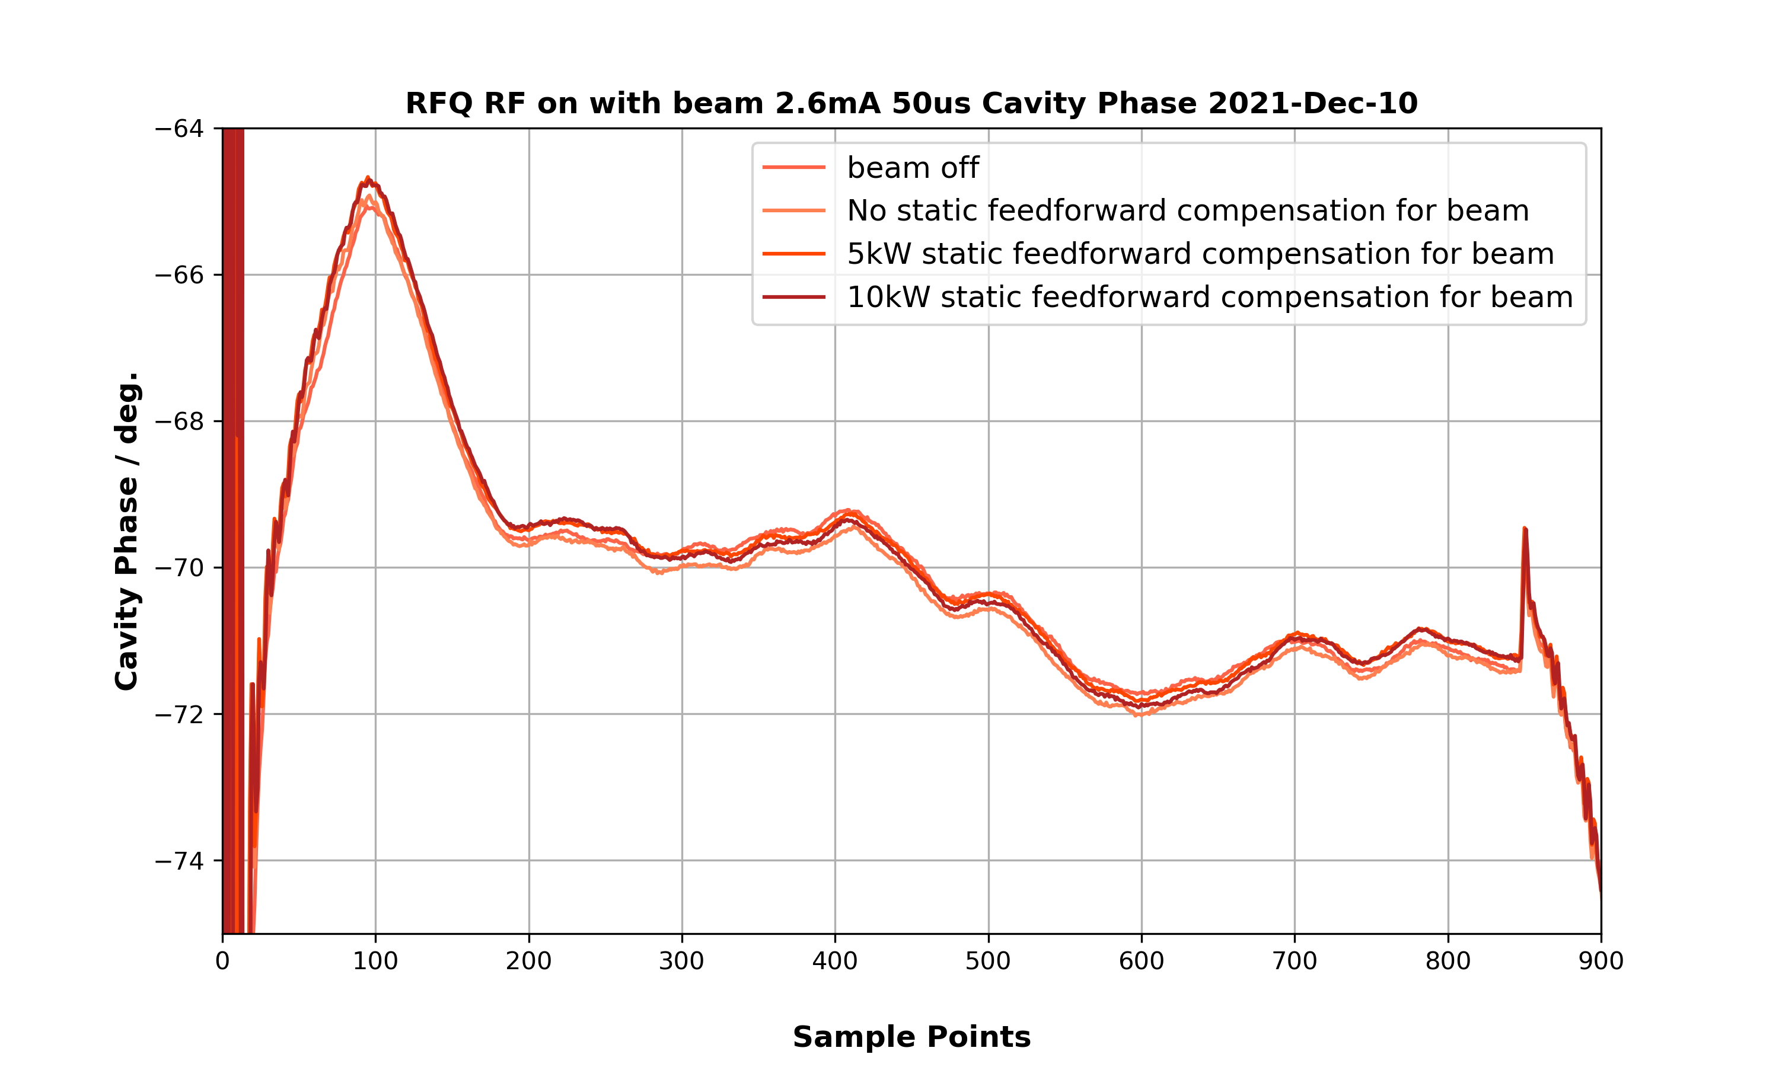
Static Feedforward in RFQ with Beam
Required FF power: 9kW
8kW from forward and 1kW from reflect power

Slide 13
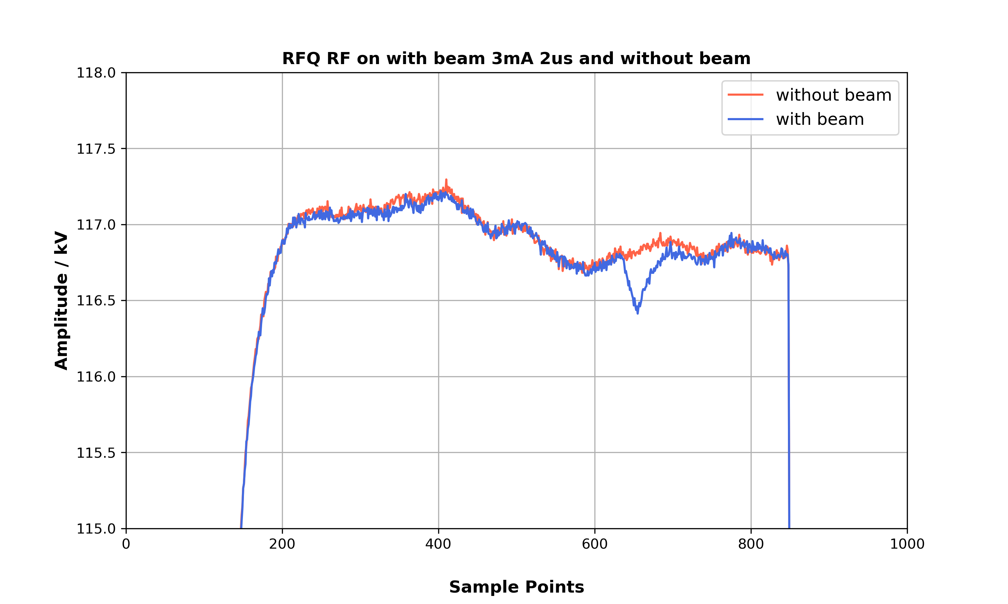
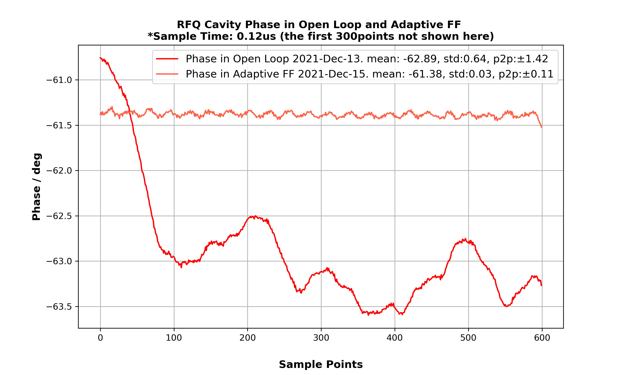
Beam loading and Adaptive Feedforward

Slide 14
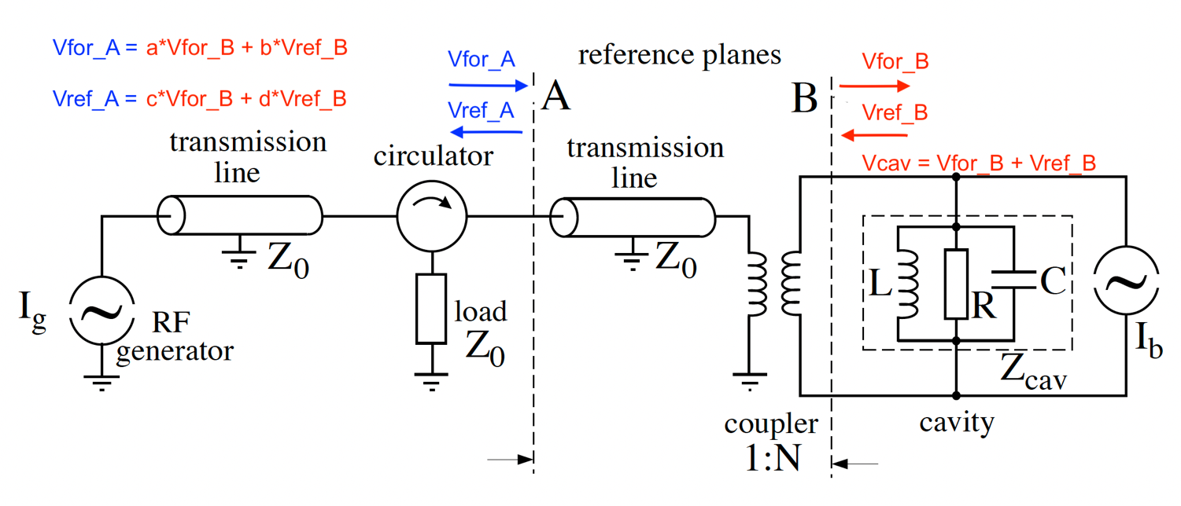
Advanced features to consider
RF calibration including phase
Further reading:
T. Schilcher, Vector Sum Control of Pulsed Accelerating Fields in Lorentz Force Detuned Superconducting Cavities. Ph. D. Thesis of DESY, 1998
https://bib-pubdb1.desy.de/record/291638/files/schilcher.pdf

Slide 15
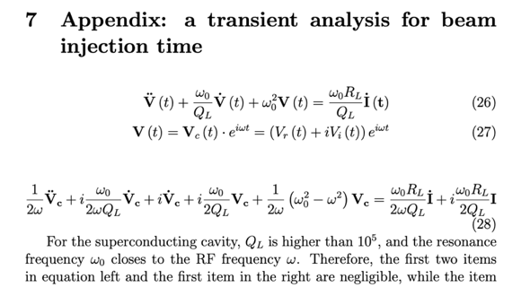

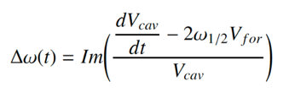
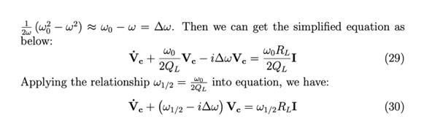

Some basics about Cavity Equation
Further reading:
R. Zeng, ESS tech note, “Some Considerations on Predetuning for Superconducting Cavity”.
T. Schilcher. Vector Sum Control of Pulsed Accelerating Fields in Lorentz Force Detuned Superconducting Cavities. Ph. D. Thesis of DESY, 1998

Slide 16
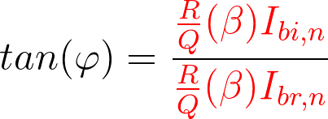
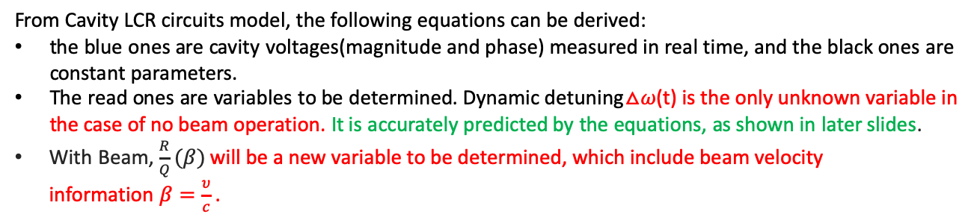
Dynamic Detuning, Beam Phase& Beam Velocity Calibration by Cavity Equations
From Cavity LCR circuits model, the following equations can be derived:
the blue ones are cavity voltages(magnitude and phase) measured in real time, and the black ones are constant parameters.
The read ones are variables to be determined. Dynamic detuning△𝜔(t) is the only unknown variable in the case of no beam operation. It is accurately predicted by the equations, as shown in later slides.
With Beam, $\frac{R}{Q}(β)$ will be a new variable to be determined, which include beam velocity information$β=\frac{υ}{c}$.
Beam phase:
Further reading: Transient Beam Loading Based Calibration for Cavity Phase and Amplitude Setting, R.Zeng, O. Troeng. HB2016.
https://accelconf.web.cern.ch/hb2016/papers/mopl025.pdf

Slide 17
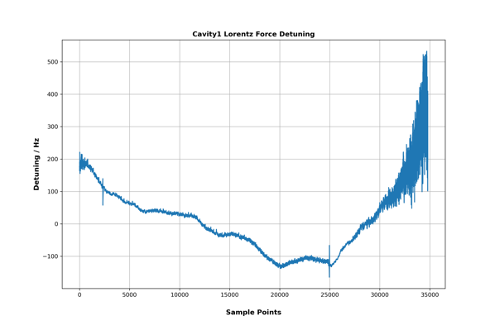
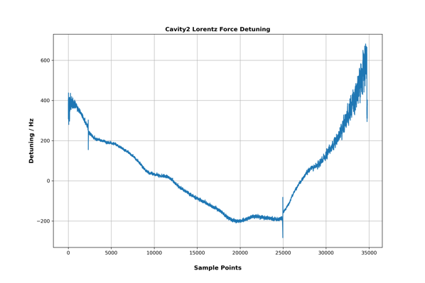
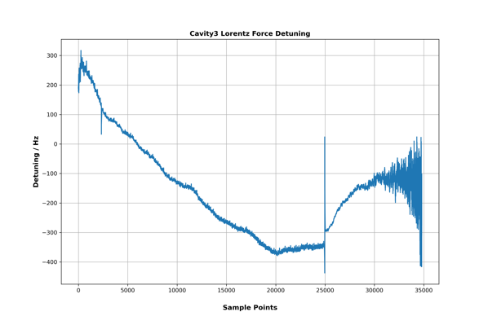
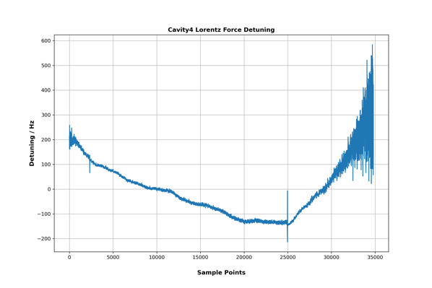
Lorentz Force Detuning for CM03: Cavity 1, Cavity 2, Cavity 3 and Cavity 4
After Phase Correction of Forward Power
Dynamic Detuning Calculated by Cavity Equations (without beam)
phase corrected: 154 deg
K = 1.04
(to be checked)
phase corrected: 58 deg
K = 1.88
(to be checked)
phase correction: 1 deg
K = 1.79
(to be checked)
phase corrected: 230 deg
K = 1.05
(to be checked)

Slide 18
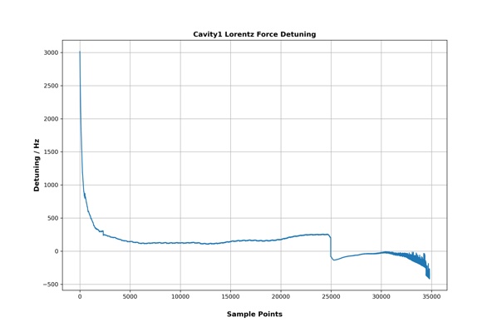
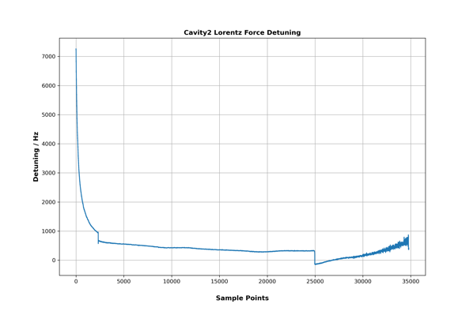
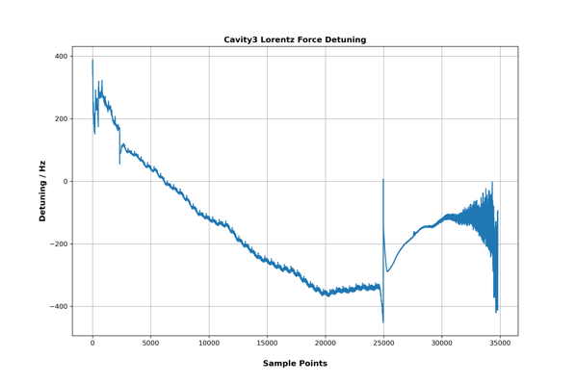
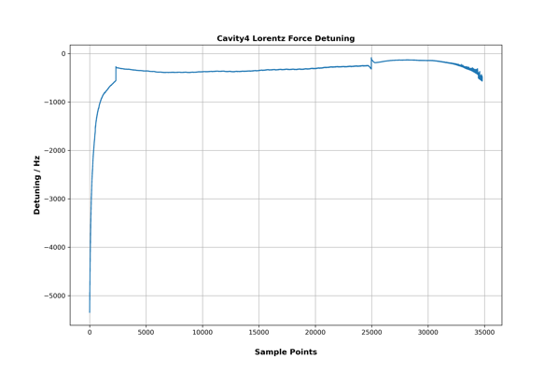
Lorentz Force Detuning for CM03: Cavity 1, Cavity 2, Cavity 3 and Cavity 4
Before Phase Correction of Forward Power
Dynamic Detuning Sensitive to Forward Phase
(without phase correction)

Slide 19
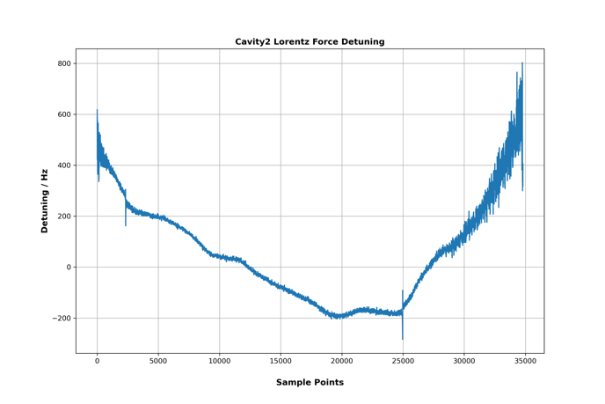
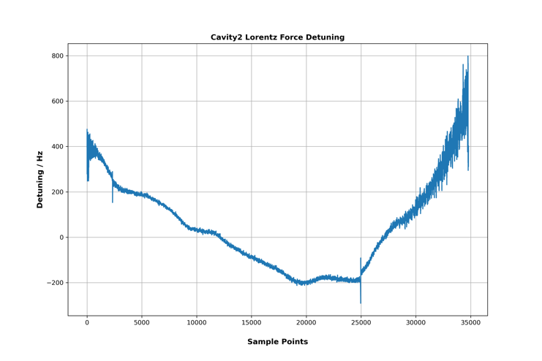
Dynamic Detuning Sensitive to Forward Phase
Forward phase moves only 1 deg, but different detuning measured, especially at filling time already 100Hz difference!!
Caclulated K can be 16% difference due to 1 deg drift!
phase corrected: 59 deg
K = 2.18 (to be checked)
phase corrected: 58 deg
K = 1.88 (to be checked)

Slide 20
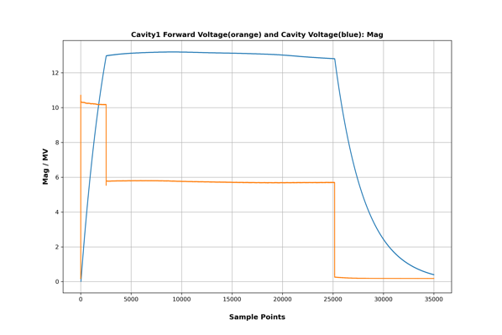
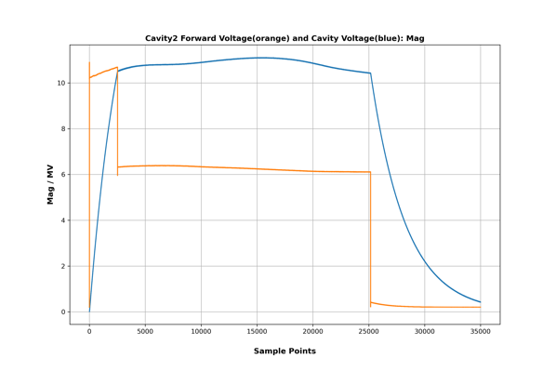
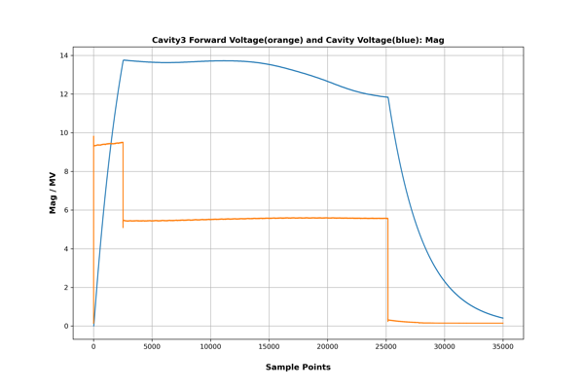
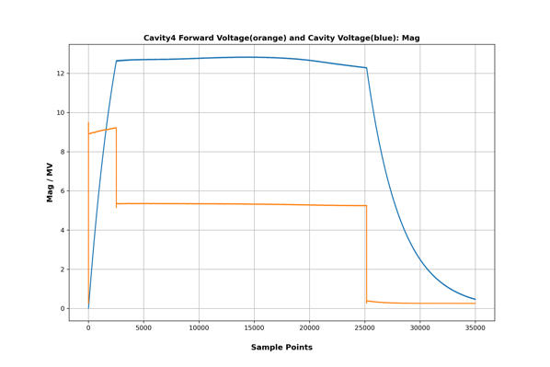
Forward & Cavity Voltage: Magnitude(voltage number are not well calibrated, to be continue next text. Eacc =18MV/m)

Slide 21
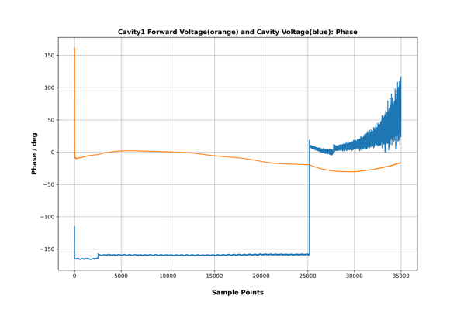
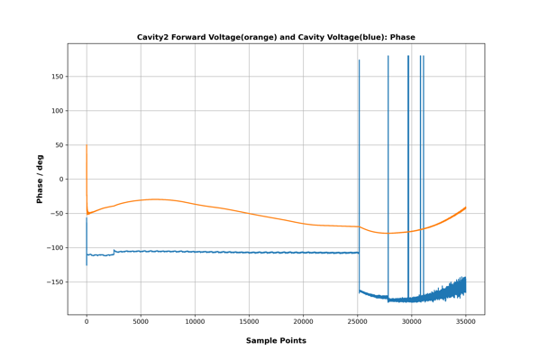
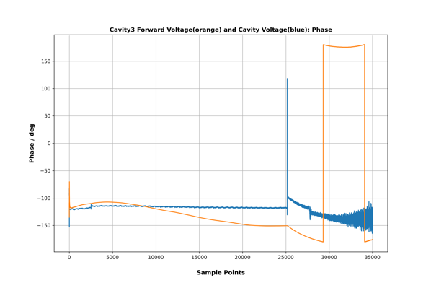
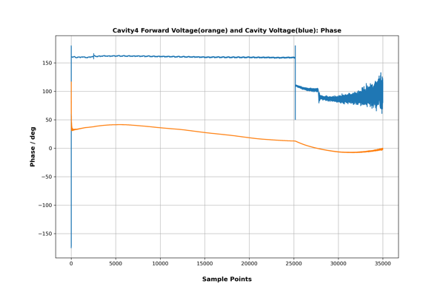
Forward & Cavity Voltage: Phase

Slide 22
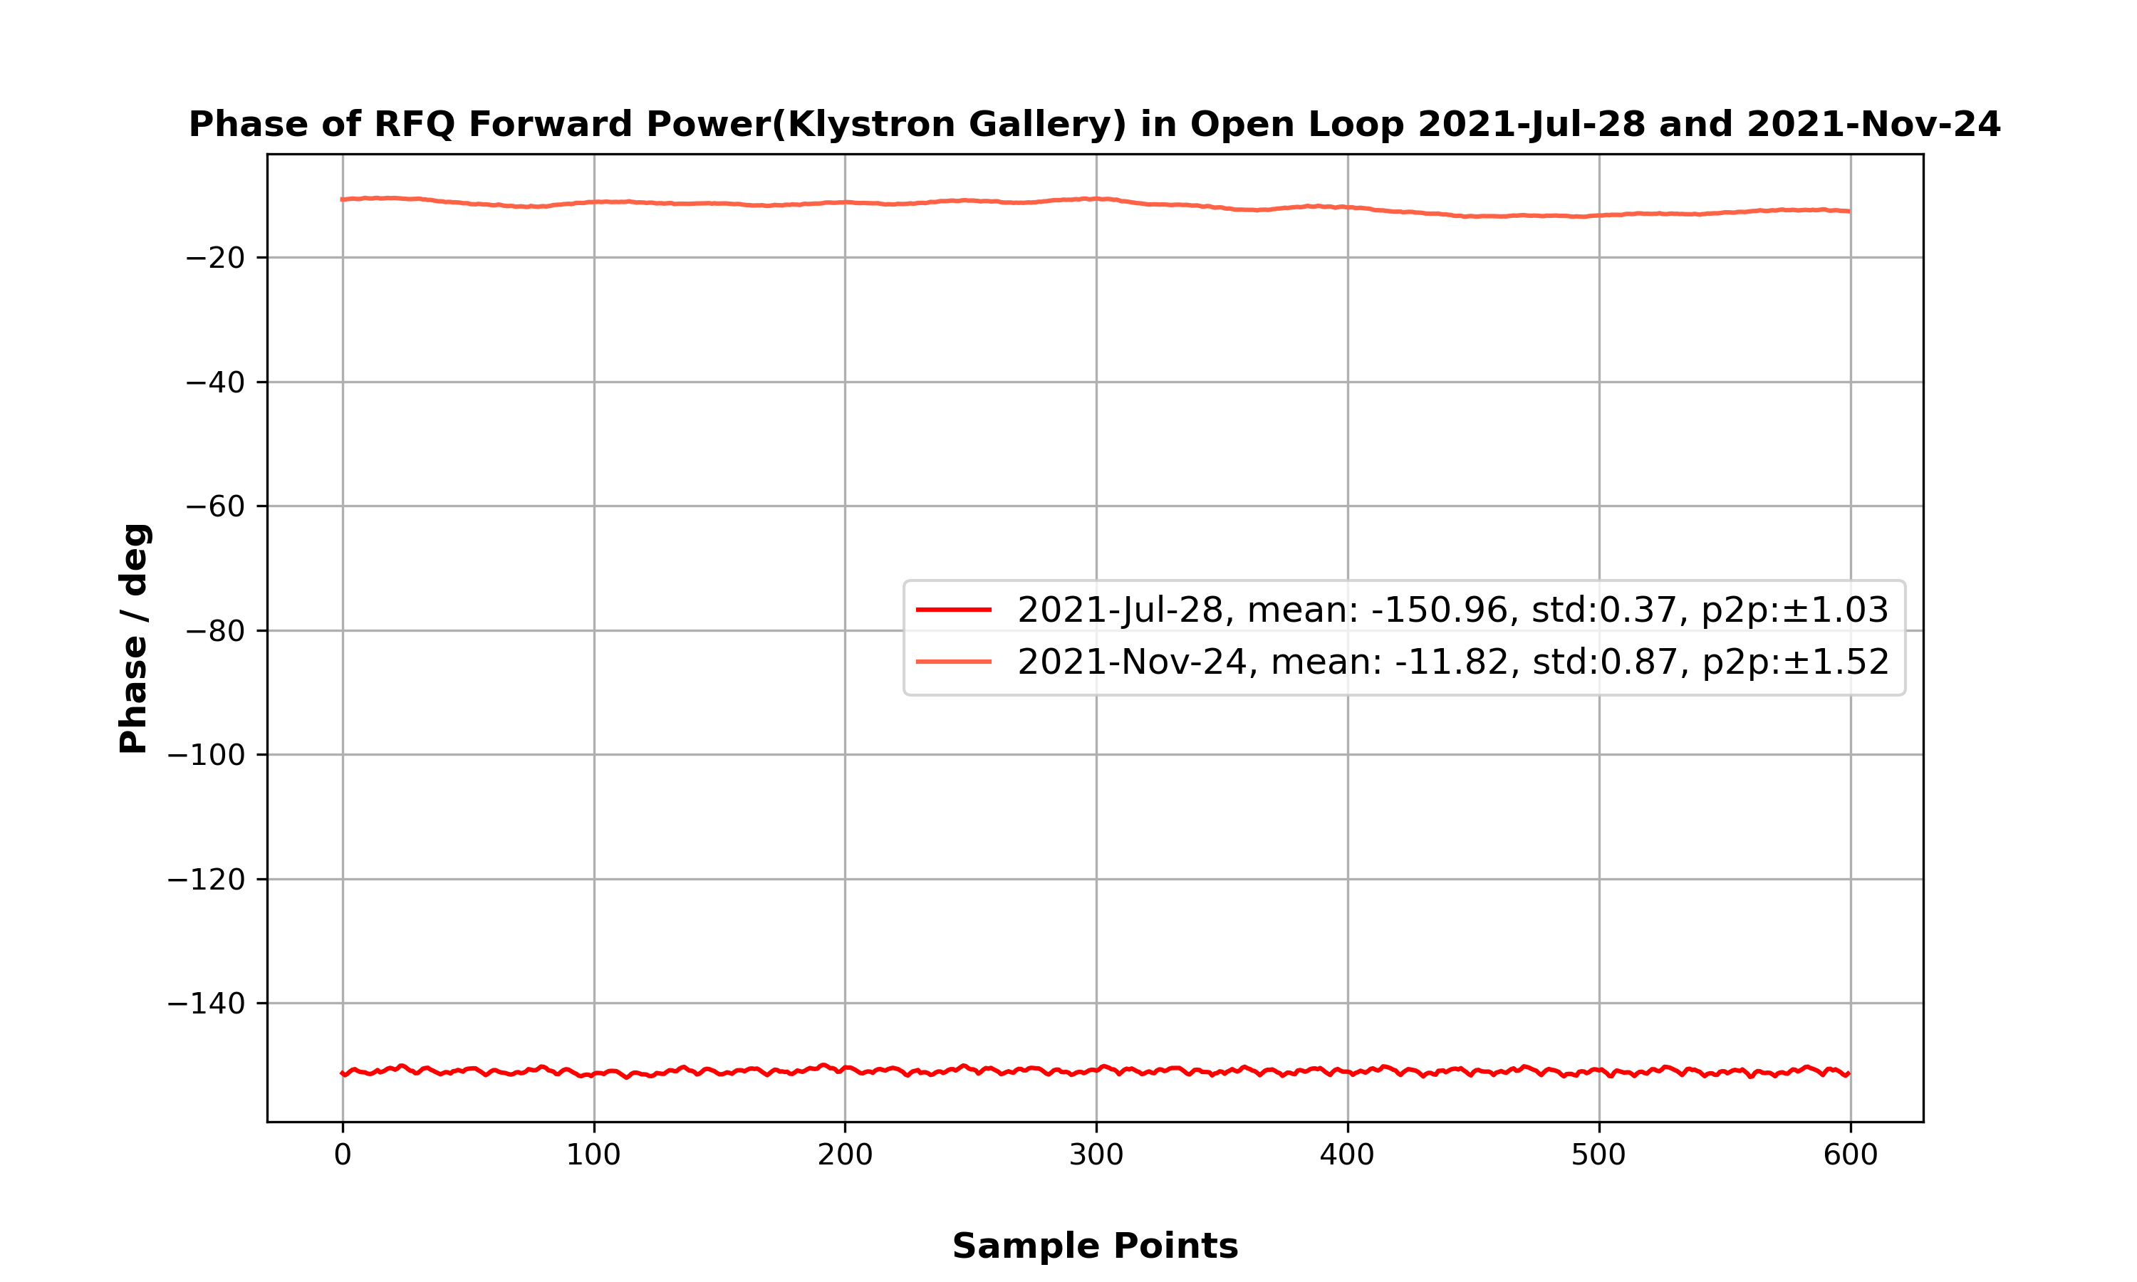
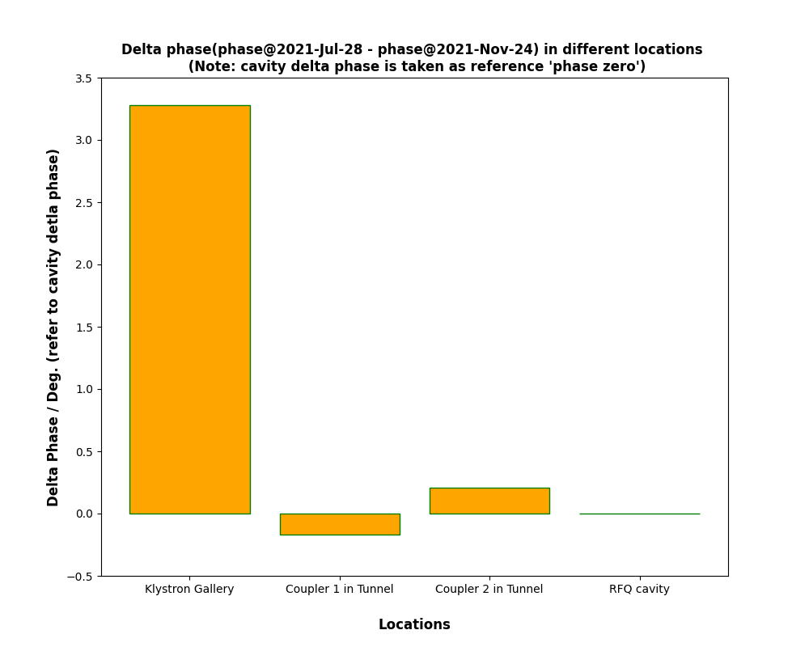
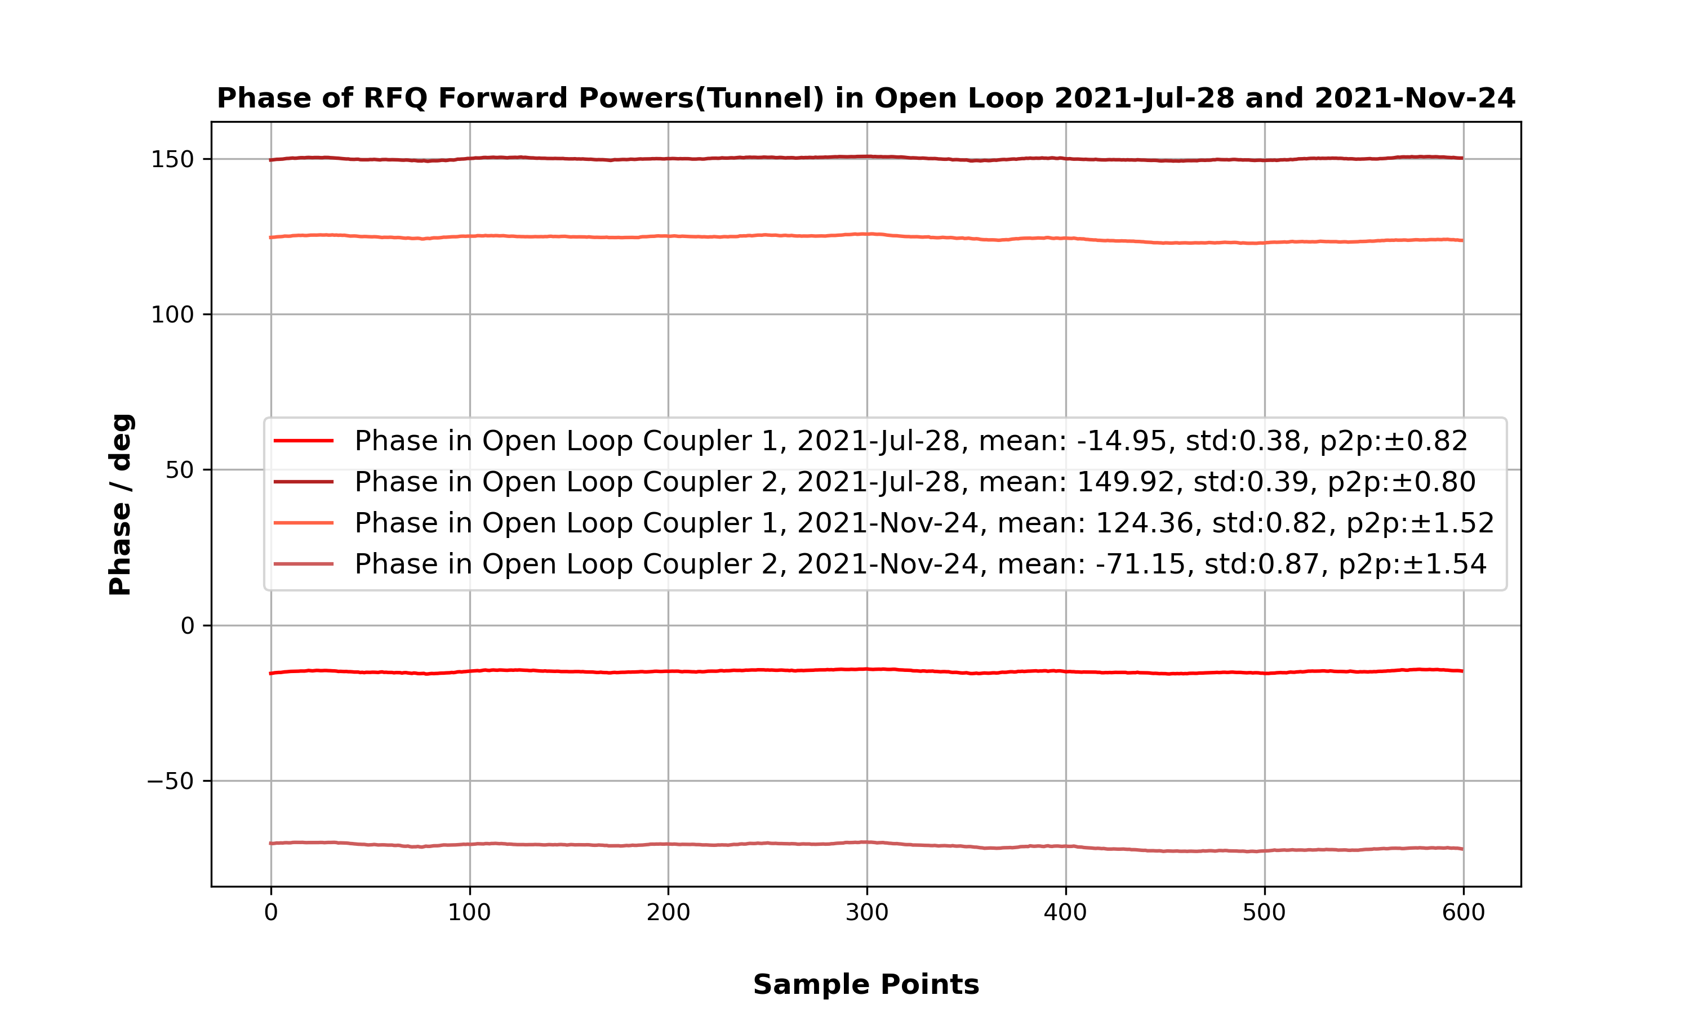
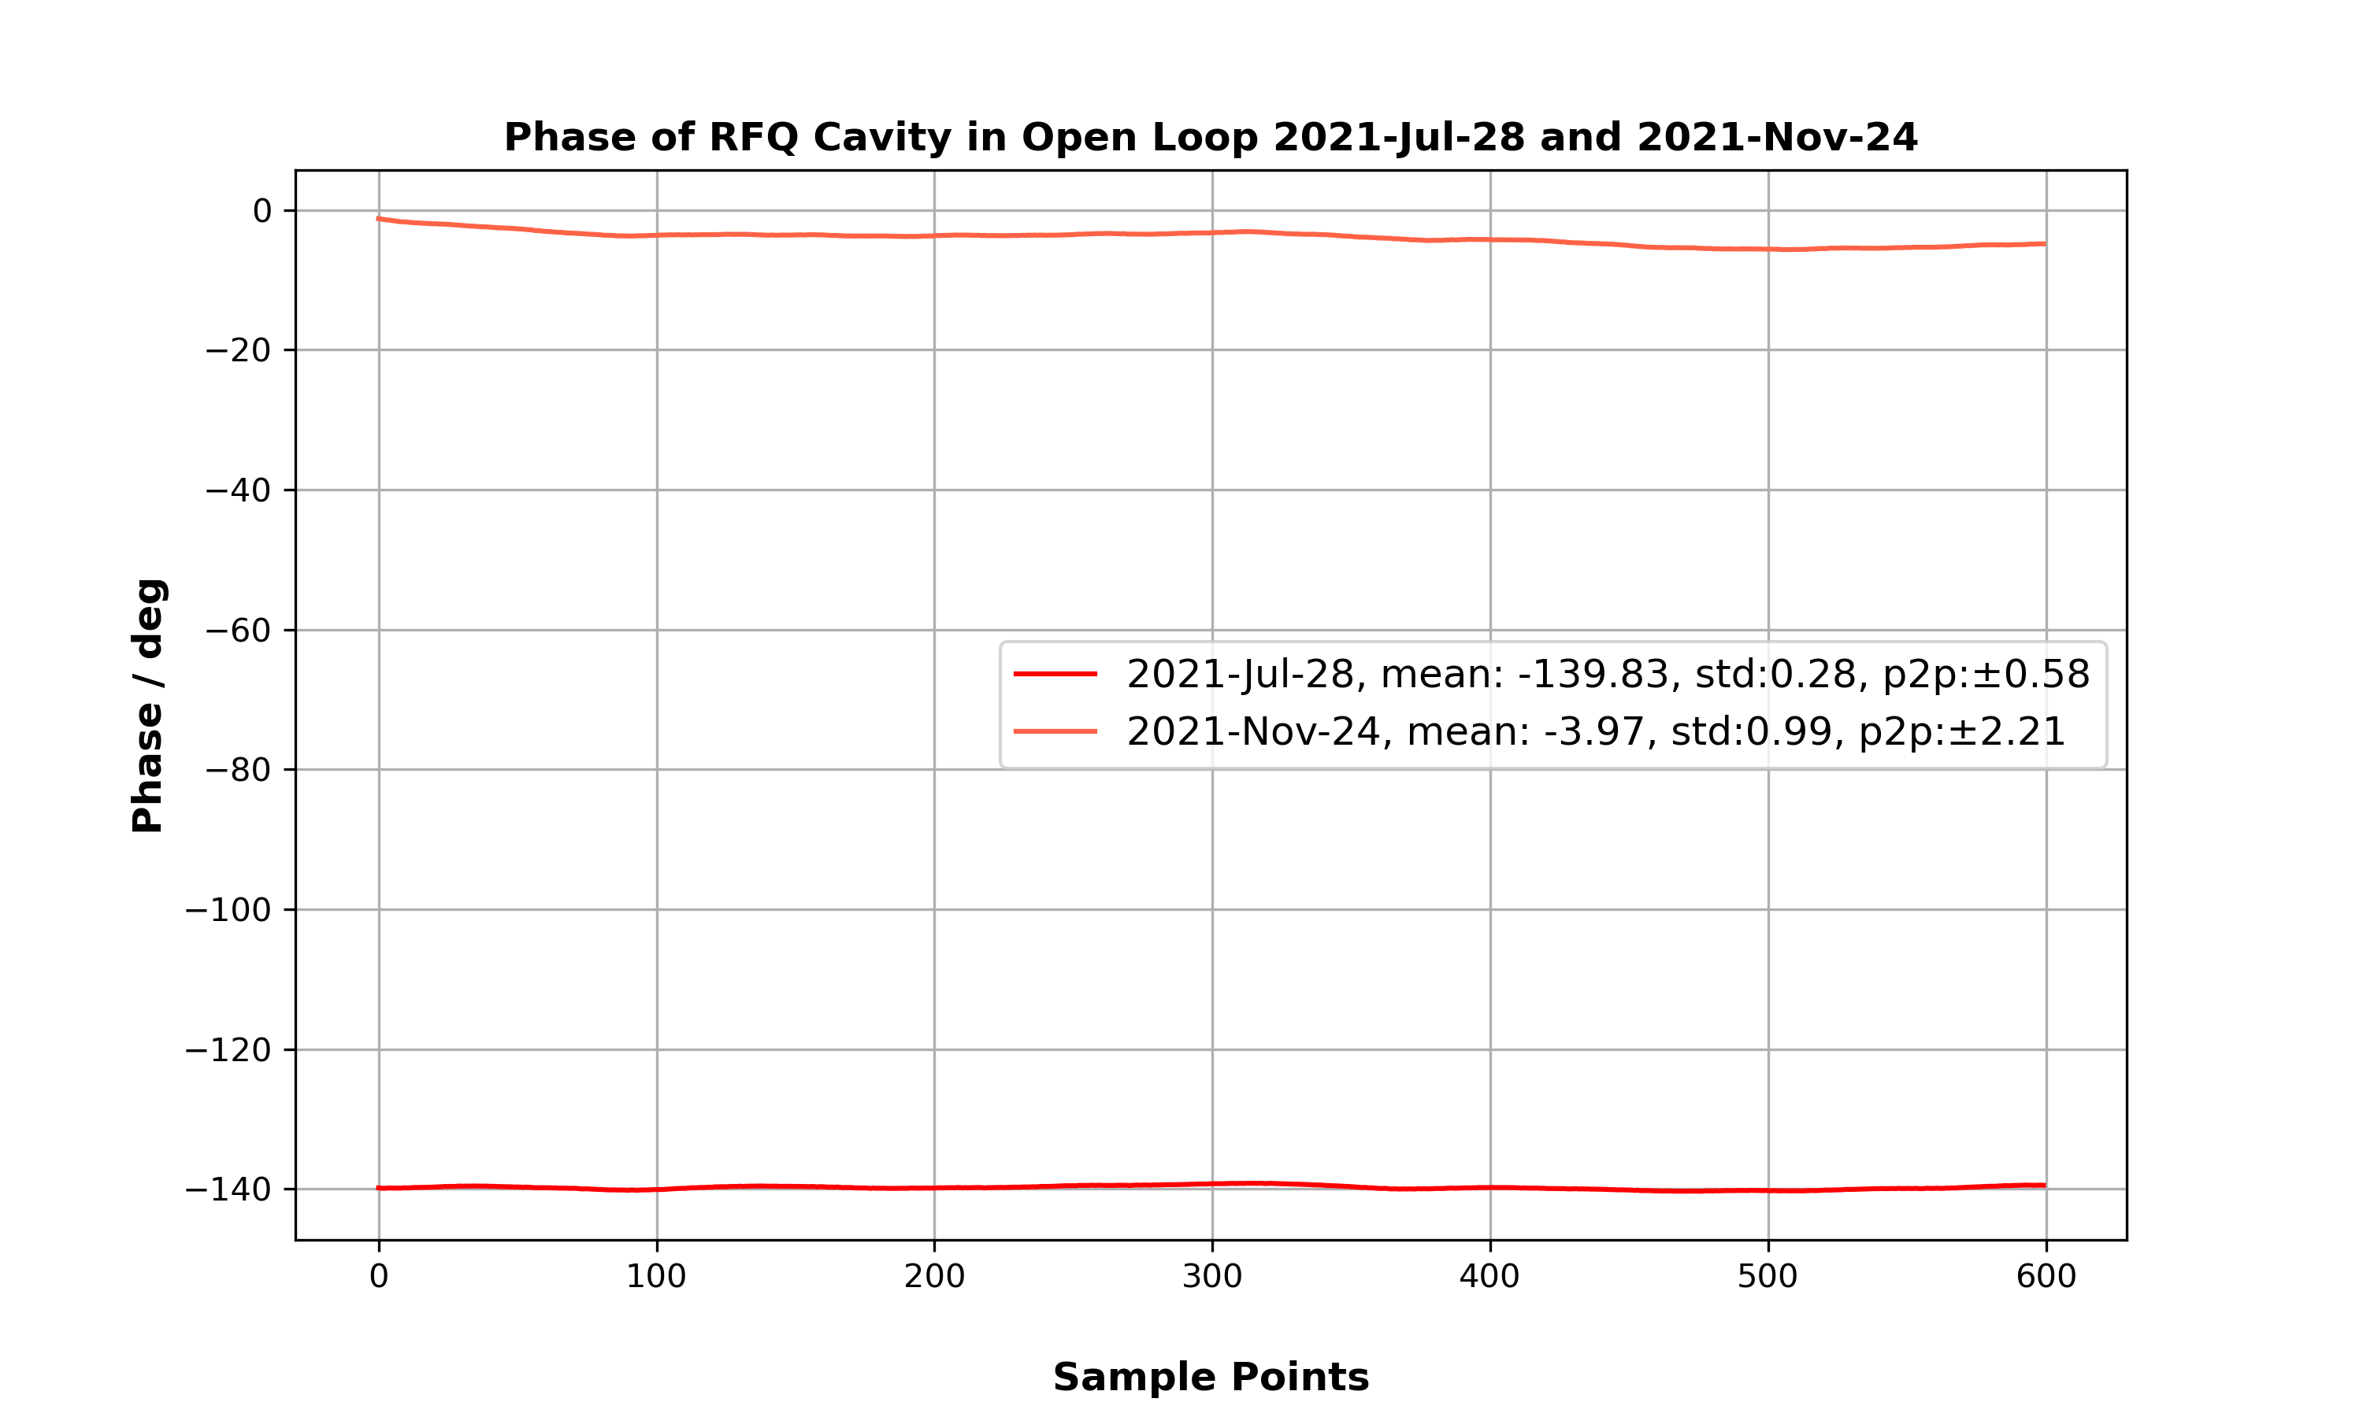
Delta phase: phase1(2021-Jule-28)-phase2(2021-Nov-24)
Delta phase in KG: -139.14
Delta phase in Tunnel:
  coupler 1: -139.31
  coupler 2: -138.93(-360)
Delta phase in Cavity: -135.86

Slide 23
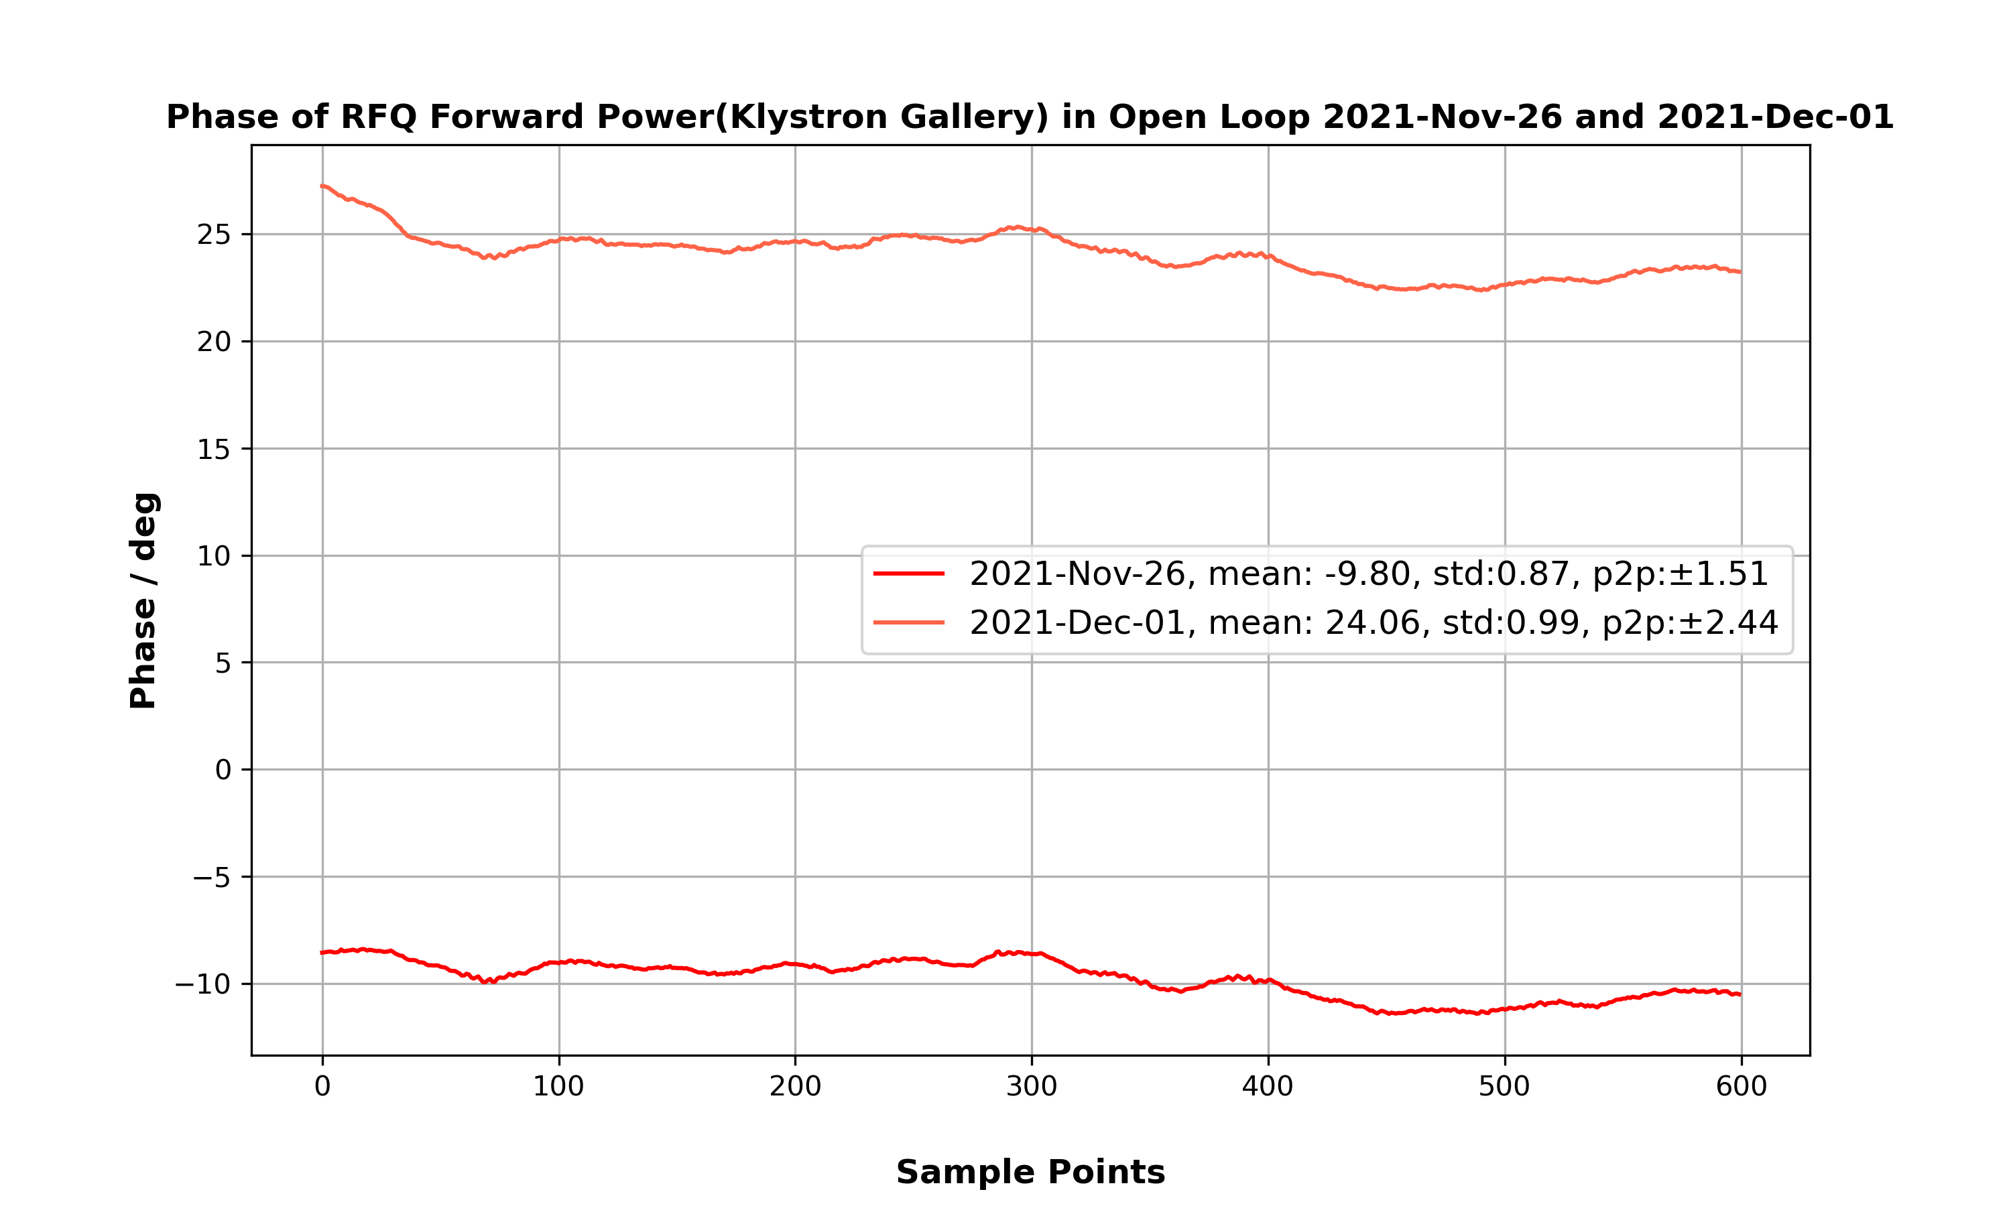
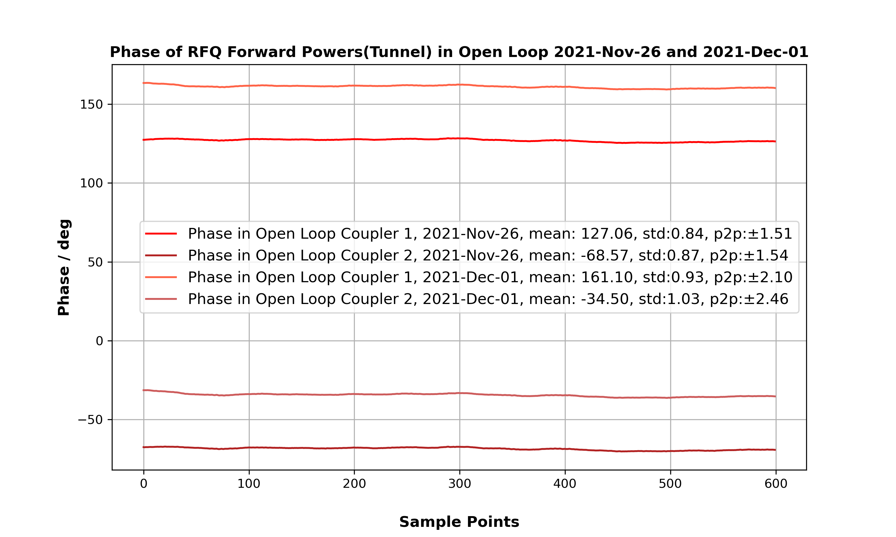
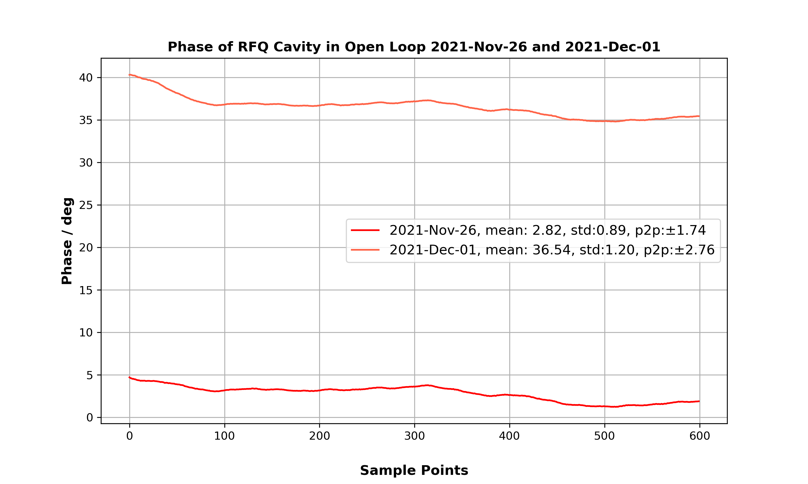
Delta phase: phase1(2021-Nov-26)-phase2(2021-Dec-01)
Delta phase in KG: -33.86
Delta phase in Tunnel:
  coupler 1: -34.04
  coupler 2: -34.07(-360)
Delta phase in Cavity: -33.72

Slide 24
Delta phase: phase1(2021-Jule-28)-phase2(2021-Nov-24)
Delta phase in KG: -2.02
Delta phase in Tunnel:
  coupler 1: -2.7
  coupler 2: -2.58(-360)
Delta phase in Cavity: -6.79

Slide 25
Summary

