Slide 1
Investigation of the ESS – Ion source emittance and studies of positive RFQ electron erosion
Luca Bellan - INFN LNL

Slide 2
Index
Investigation of the ESS – source
The background
Investigation of the discrepancies found in the emittances
Experimental tests and results
Conclusions
RFQ electron erosion phenomena
RFQ erosion electrode process for positive ions
The approach to the problem
Results applied on the IFMIF/EVEDA RFQ
Conclusions

Slide 3
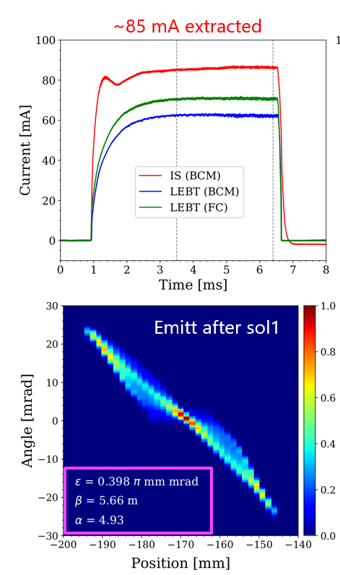
The collaboration framework
In summer 2020 we started the collaboration with the ESS Beam Physics group in order to collaborate to characterize the NCL front end in the perspective of the DTL commissioning:
  The idea was to use our experience in commissioning high intensity beam to support the commissioning and simulations
    The experience gain in the IFMIF/EVEDA and the exchange of the experience with ESS was evaluated extremely precious
  During the 4 years of the IFMIF/EVEDA experience, we studied and optimized the source with CEA-Saclay, benchmarking the simulation codes various accelerator sections (one of the mandates of the project), starting from the extraction.
  The source of the IFMIF is a positive deuteron/proton source with a comparable high perveance w.r. the ESS source.
Larger emittance compared to the off-site commissioning
  Was 0.2-0.3 π mm mrad for ~85 mA extraction
  Now ~0.4 π mm mrad
Result not well reproducible with the extraction code.
  Large initial divergence?
  Effort ongoing to understand (in collaboration with INFN-LNL).
In IFMIF/EVEDA: large beam divergence -> small (solenoid bore)/(beam radius) at solenoid 1 -> Large emittance due to solenoid field and s.c. non-linearities.
Curtesy of Ryoichi
Off-Site commissioning at INFN-LNS
Emittance (rms): 0.18 π.mm.mrad
Emittance (99%): 1.32 π.mm.mrad << 2.25 π.mm.mrad (ESS requirement)

Slide 4
Possible sources of discrepancies:
Three macro - areas were found to investigate:
  Extraction
    geometry implemented in the model
    electrode damage
    model differences (there are no common BD model of such part)
  Overestimation of the emittancemeter measurement
    geometry differences with respect calibration
    acquisition system issues
    analysis routine
  Solenoid
    large misalignment (order of mm)

Slide 5
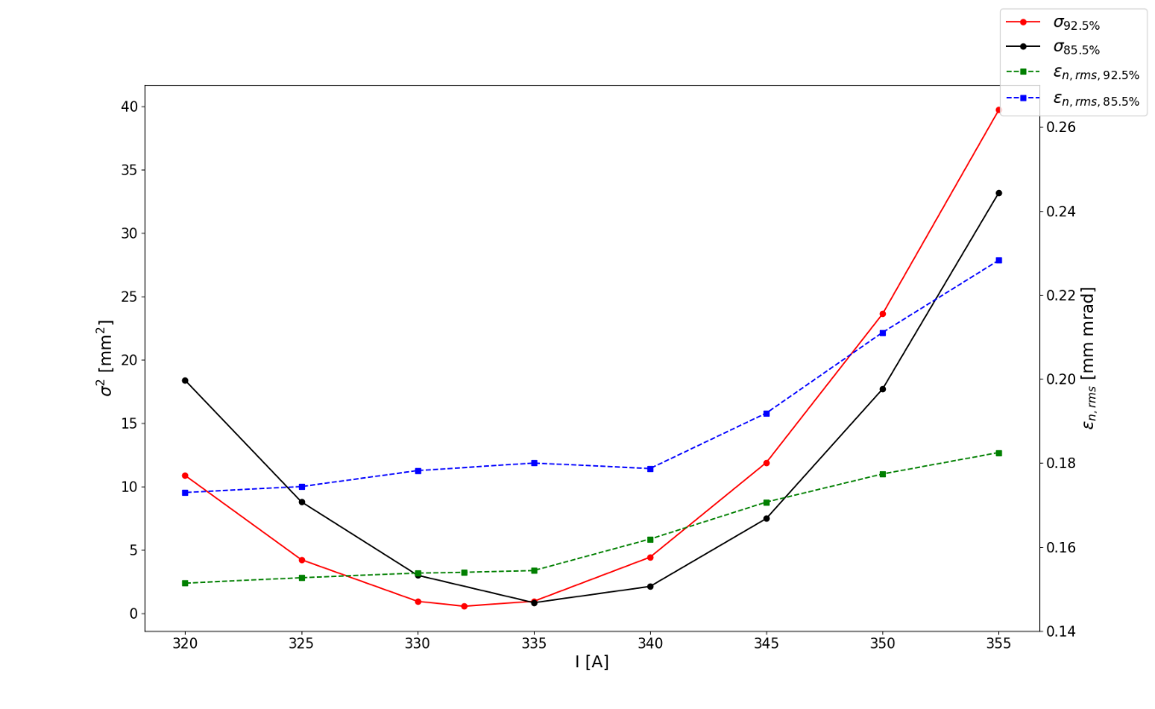
LEBT transfer model result
During the remaining 2020 I implemented the ESS line into the model, with the fundamental support of ESS Beam Physics and Linac groups (Ryoichi, Alejandro, Yngve, Daniel, Bryan, Mohammad, Ciprian, Natalia) and INFN-LNS (Lorenzo).
Trend of emittances and sigma w.r. different solenoid 1 measurement and gas levels
$ε_{rms,n}=\text{0.}\text{18}\text{−0.}\text{23} \text{mm} \text{mrad}$ range obtained in sim.
The result: the model could not explain the very large emittance measured. Simulations compatible with what was simulated and measured in Catania.
$ε_{rms,n}=\text{0.4−0.45 }\text{mm} \text{mrad}$ measured emittance
First outcome: something is preventing the source to reach again the nominal performances, that are not taken into account by the model.

Slide 6
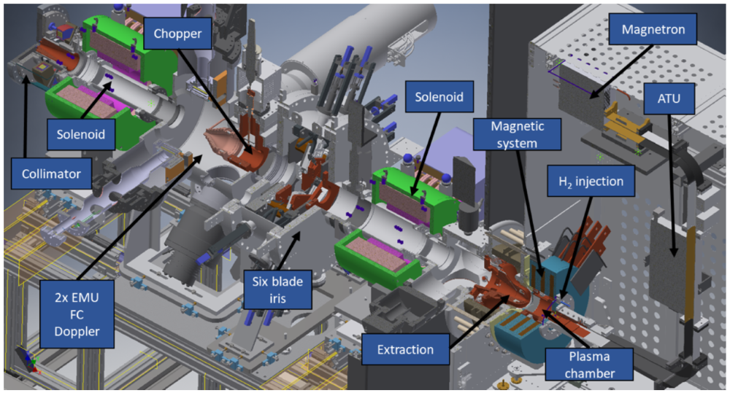
Divergence experiment
beam direction

Slide 7
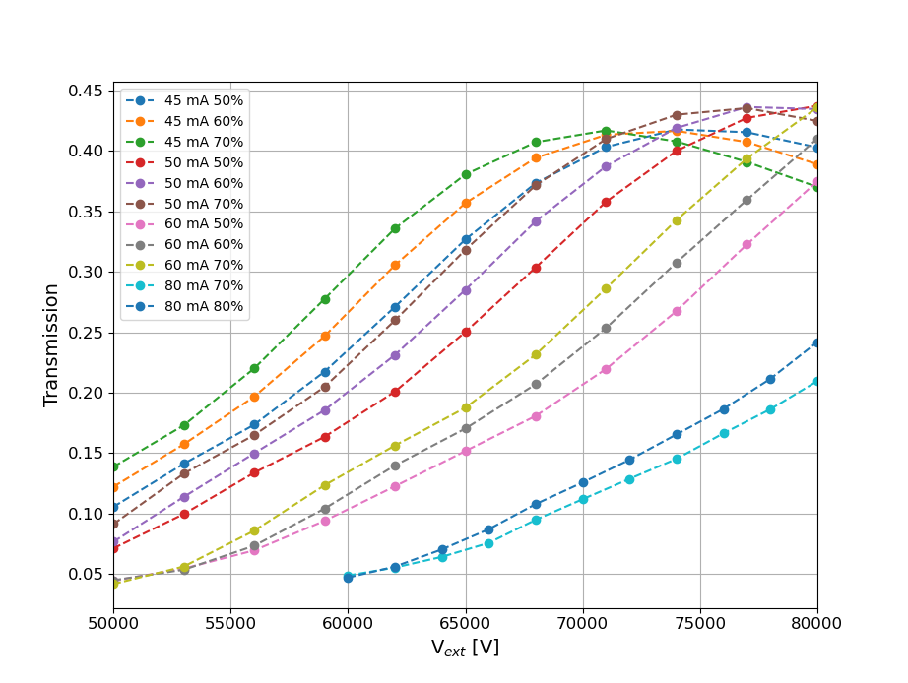
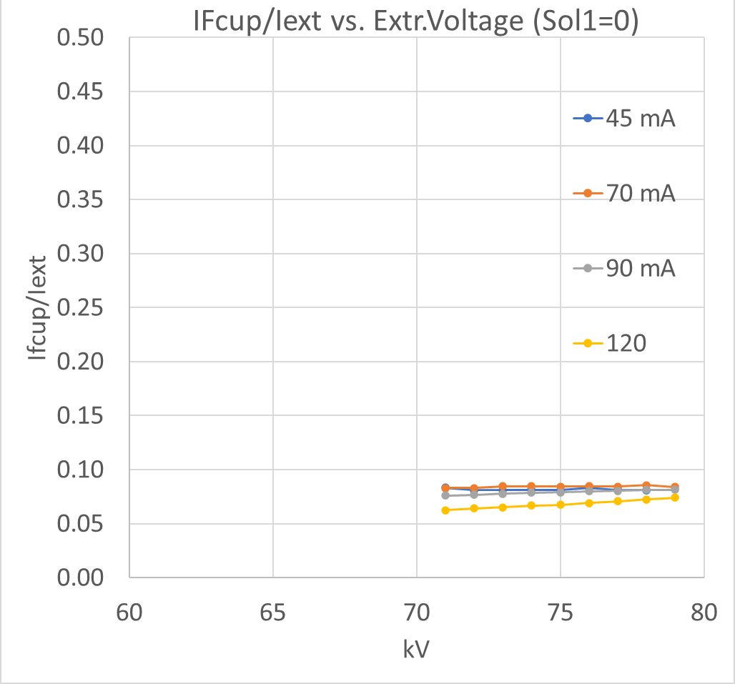

Results in November 2021 (INFN visit)
Not compatible at all with the expected behaviour of the extraction:
One of the problem is located in the extraction region.
Very high divergence prevent the expected transmission at the FC.
It was not a matter of electrode geometry

Slide 8
Possible sources of discrepancies:
Three macro - areas were found to investigate:
  Extraction
    geometry implemented in the model
    electrode damage
    model differences (there are no common BD model of such part)
  Overestimation of the emittancemeter measurement
    geometry differences with respect calibration
    acquisition system issues
    analysis routine
  Solenoid
    large misalignment (order of mm)
Found differences but could not explain the large divergence
Design in agreement with what was simulated and measure before

Slide 9
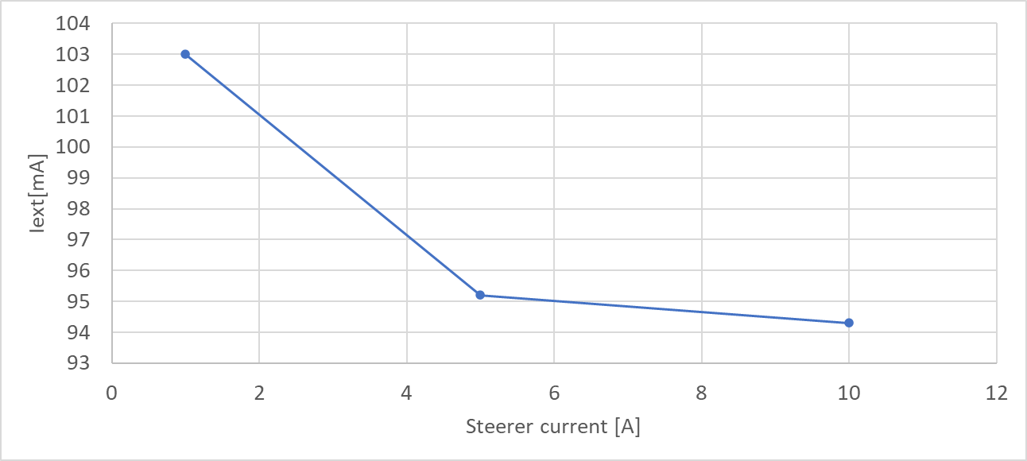
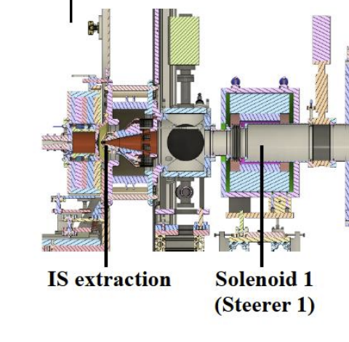
Evidences found during the experiment
Difficulties to identify the actual current extracted
Not negligible sensibility of the extracted current w.r. steerer field and solenoid 1:
  Strong hint of not normal behaviour of the extraction.
If the problem was located on the repeller, important problem on the s.c.c. may occur. Larger divergence possible t.b.c.
Larger quantity of backstreaming electrons at 75 keV may change the plasma conditions t.b.c

Slide 10
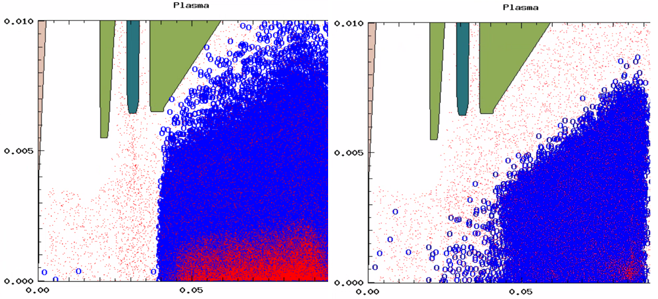
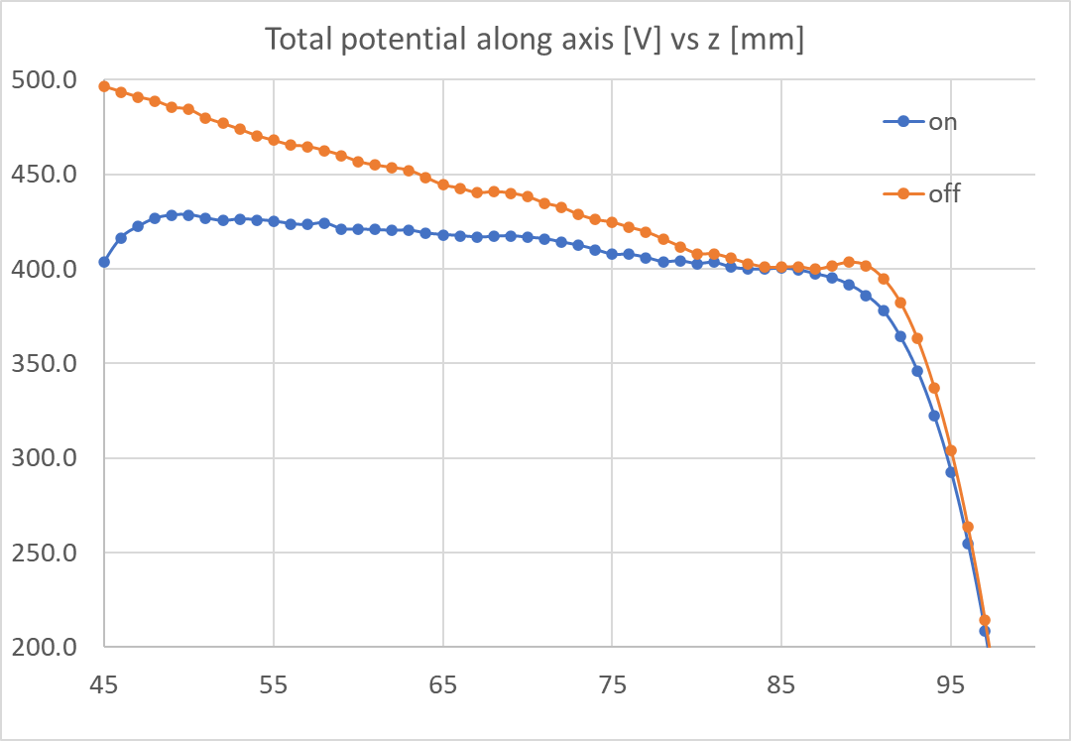
Analysis
The effect of the steerer (solenoid 1) onto the extracted current and the small transmission, may be fitted by the not working repeller.
We suggested to check the repeller in the next inspection.
The repeller plug in was found disconnected in February 2022.
on
off
Situation at 1 us (over 20 us), simulation ongoing

Slide 11
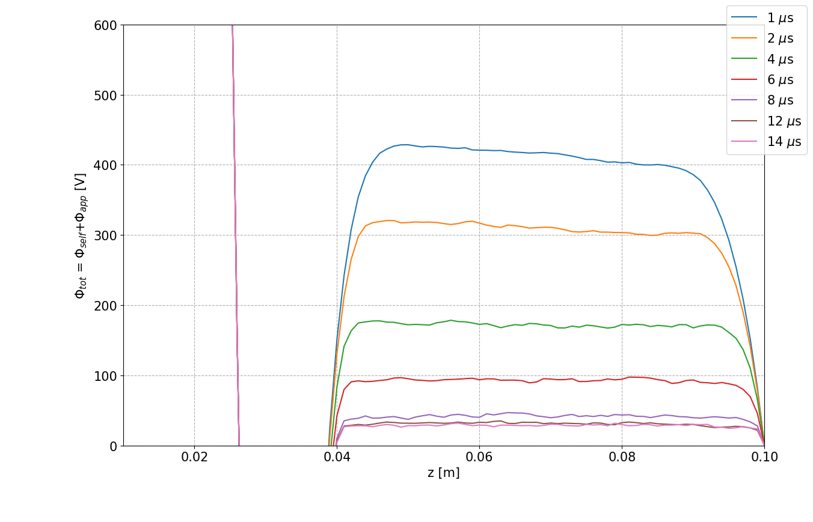
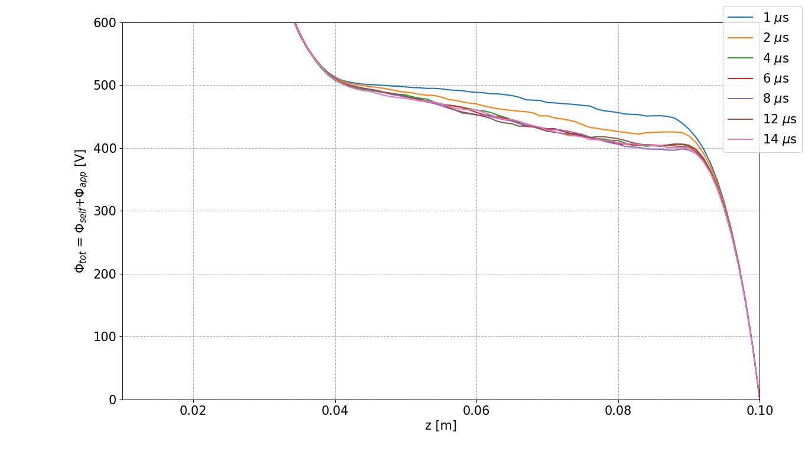
Potential along axis w.r. the time: s.c.c compensation build up
ON
OFF
Difference @ steady state: $\frac{φ_{tot, rep. on}}{φ_{tot, rep. off}}=20$

Slide 12
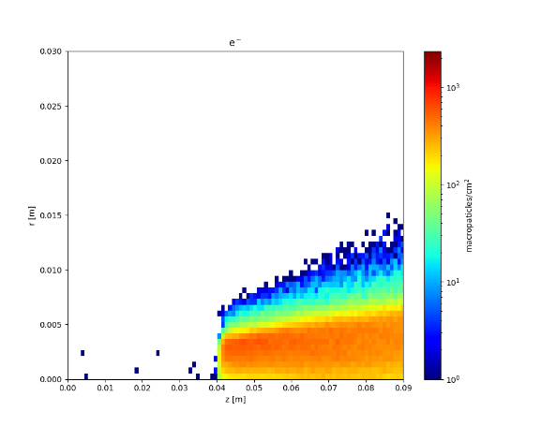
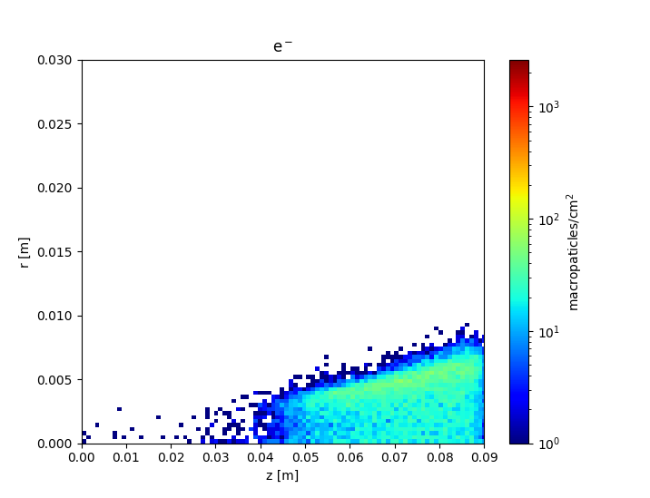
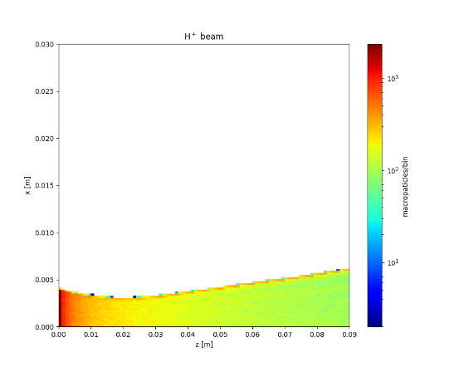
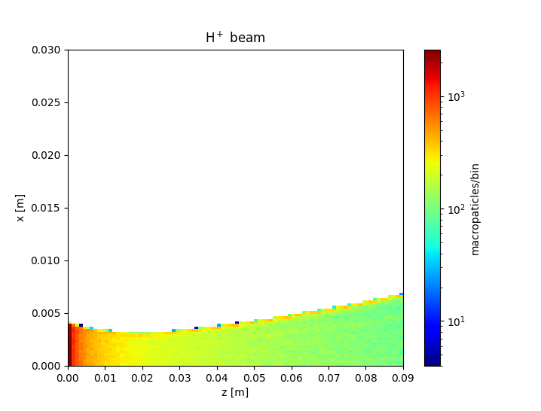
At steady state
ON
OFF
Quantities @ 100 mm | Rep. switched off | Rep. switched on
R’_{max} [mrad] | 73.1 | 51.0
R’_{rms} [mrad] | 23.3 | 16.1
R_{max} [mm] | 7.4 | 6.6
R_{rms} [mm] | 2.3 | 2.0
This is an estimate at 10 cm. Normally the effect increases considering the interface between extraction and LEBT at 20 cm.
i.e. the decompensation effect continues for several cm. after 10 cm.

Slide 13
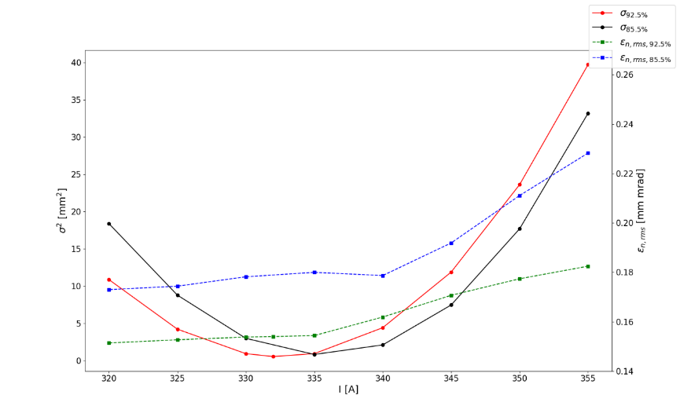
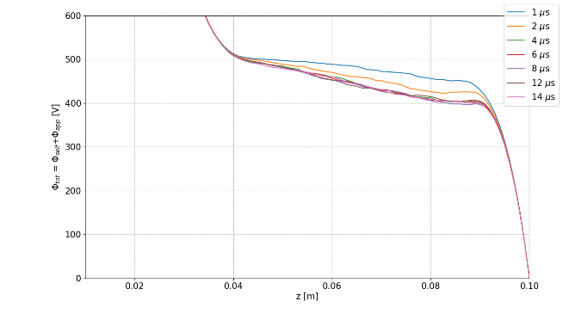
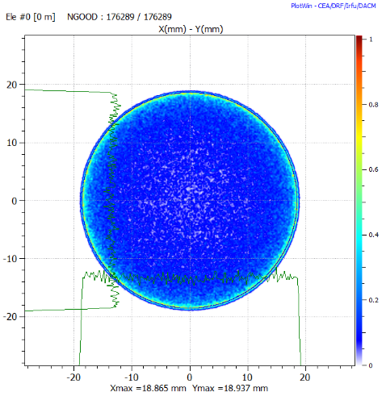
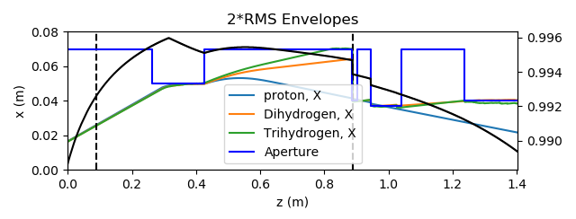
Rough estimation impact on the LEBT transport
Low s.c.c. in the extraction region
Not obtained more than 0.23-0.25 mm mrad with a normal pattern of s.c.c.
A rough estimation: 10% s.c.c. in the extraction region (20 cm from extraction electrode). Model of s.c.c.from residual gas up to the FC.
  The emittance can reach 0.4-0.5 mm mrad emittance due to the solenoid aberrations, when solenoid 1 around 320 A (almost twice the emittance)
  The emittance and transmission becomes sensitive to the solenoid strength.
Beam phase space for 300 A at the emittancemeter pos.

Slide 14
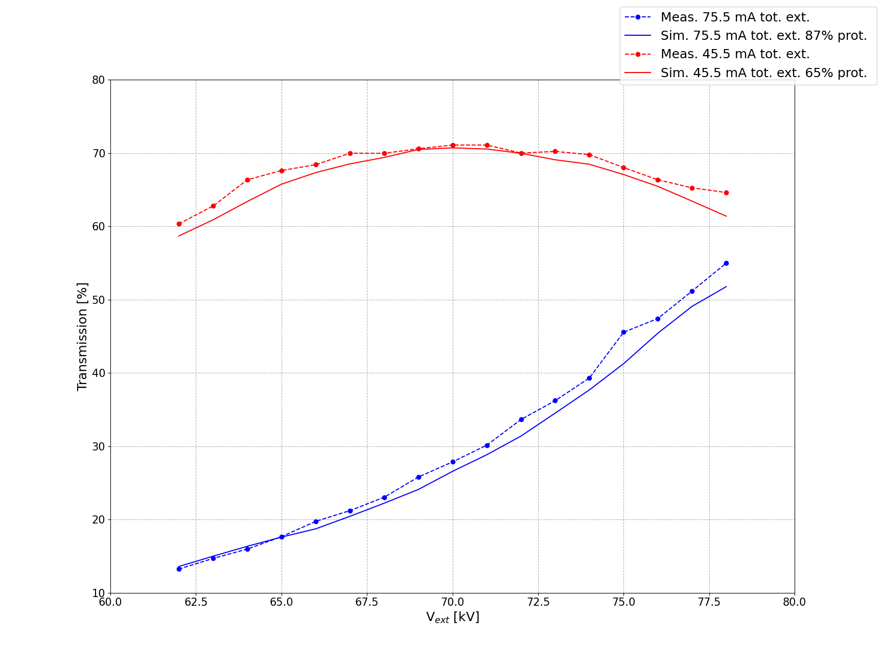
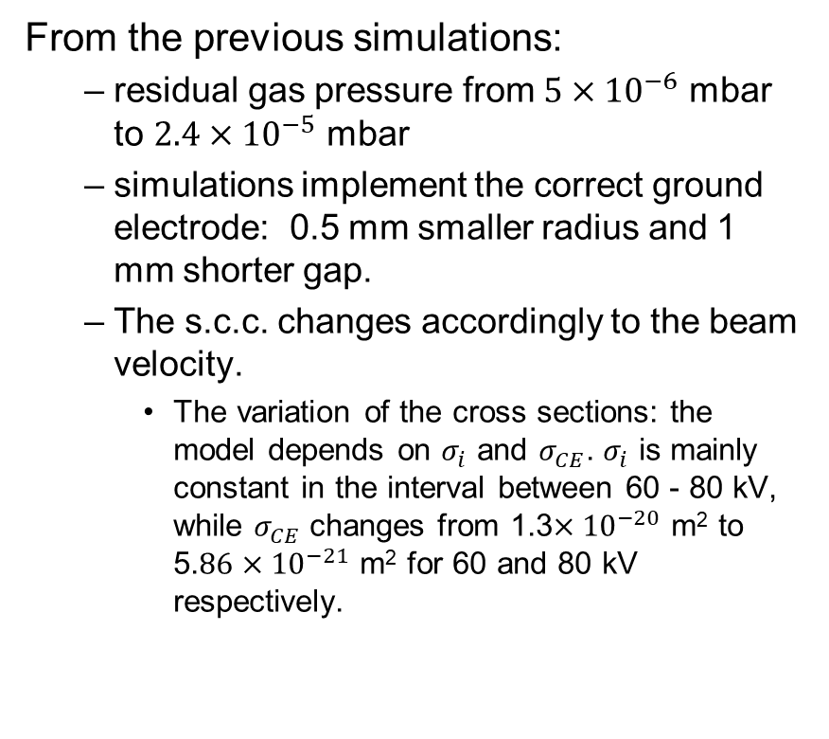
Benchmark of the results of the experiments
From the previous simulations:
  residual gas pressure from $5×{10}^{−6}$ mbar to $2.4×{10}^{−5}$ mbar
  simulations implement the correct ground electrode: 0.5 mm smaller radius and 1 mm shorter gap.
  The s.c.c. changes accordingly to the beam velocity.
    The variation of the cross sections: the model depends on $σ_{i}$ and $σ_{CE}$. $σ_{i}$ is mainly constant in the interval between 60 - 80 kV, while $σ_{CE}$ changes from 1.3$×{10}^{−20}$ m² to 5.$86×{10}^{−21}$ m² for 60 and 80 kV respectively.

Slide 15
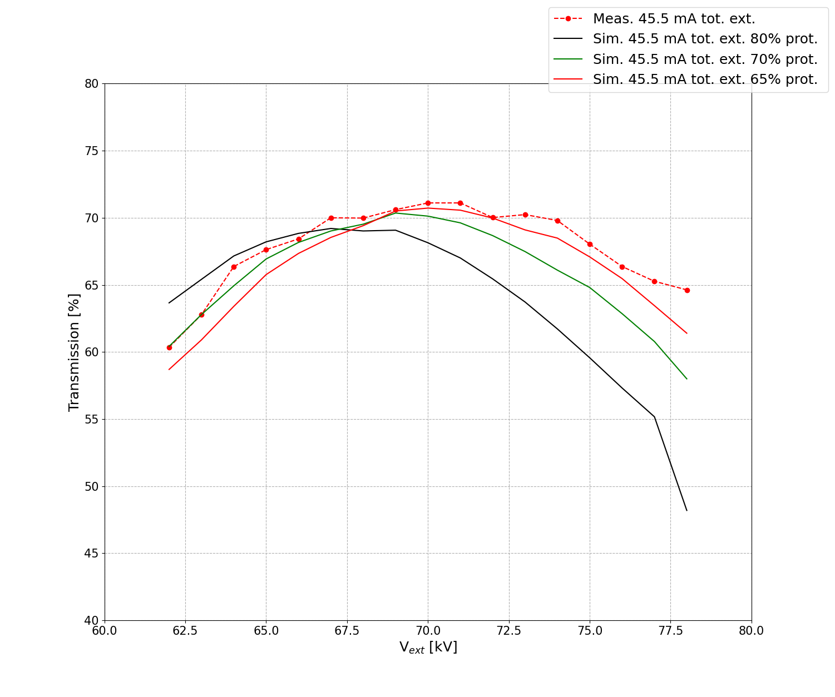

Trend w.r. the proton fraction and different geometries
$2.4×{10}^{−5}$ mbar, as-built

Slide 16
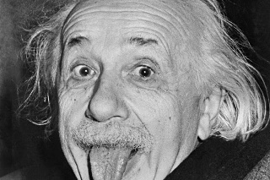
Conclusions
We started the investigation onto the injector trying to sort out the reason of the discrepancy between the result obtained in Catania and those ones obtained in ESS.
  The investigation was mainly focused on the optics within the LEBT and extraction
From the results obtained up to here, the problem was located in the extraction region.
The repeller issue proved both from simulations and measurements point of view to be compatible with the excessive large emittances measured during the campaigns.
Now the road is open for the fine tuning.
The collaboration within ESS groups and INFN has been very productive. We look forward for the collaboration to continue!
I would like to thank all the people involved in this work from INFN and ESS
TRUST your simulations, and check the hardware ;)

Slide 17

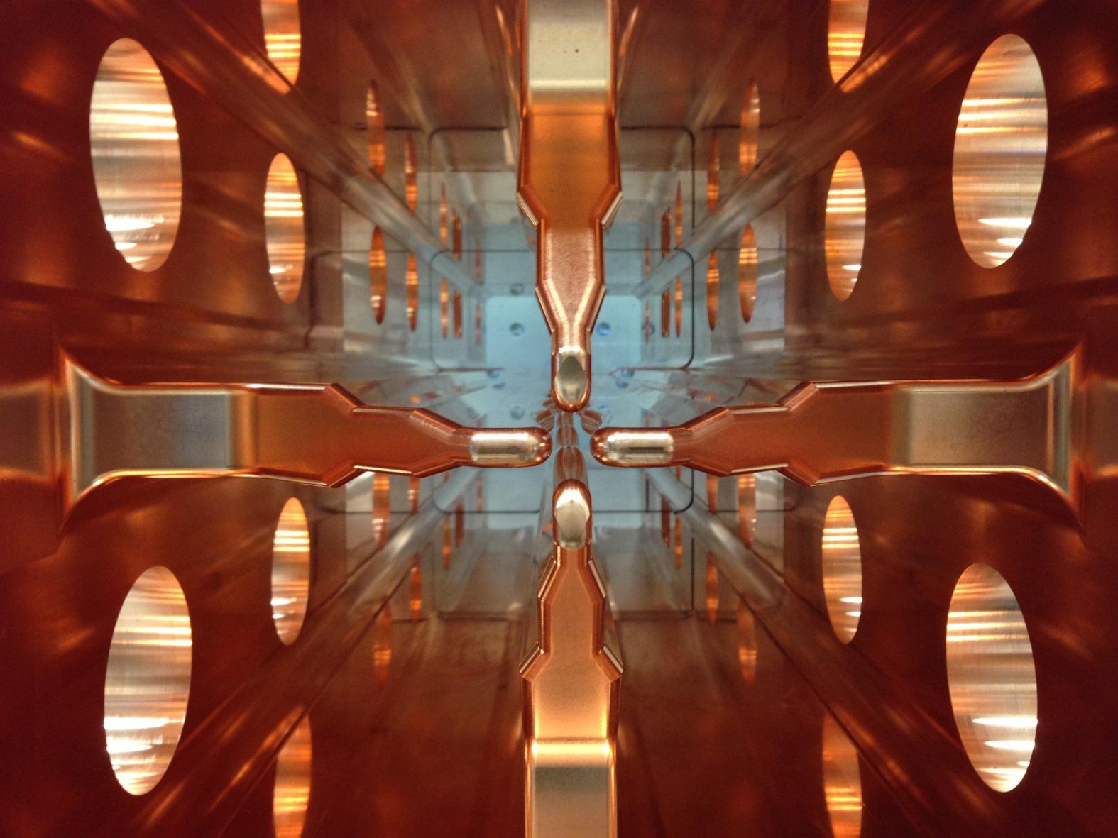
The electrode erosion phenomena on the RFQ due to positive beam collisions
NB: the result here presented needs to be verified by the IFMIF/EVEDA CW commissioning. As a matter of fact, this is a work in progress.

Slide 18
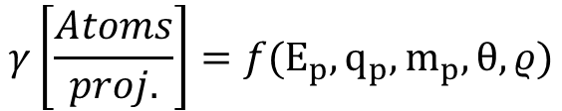
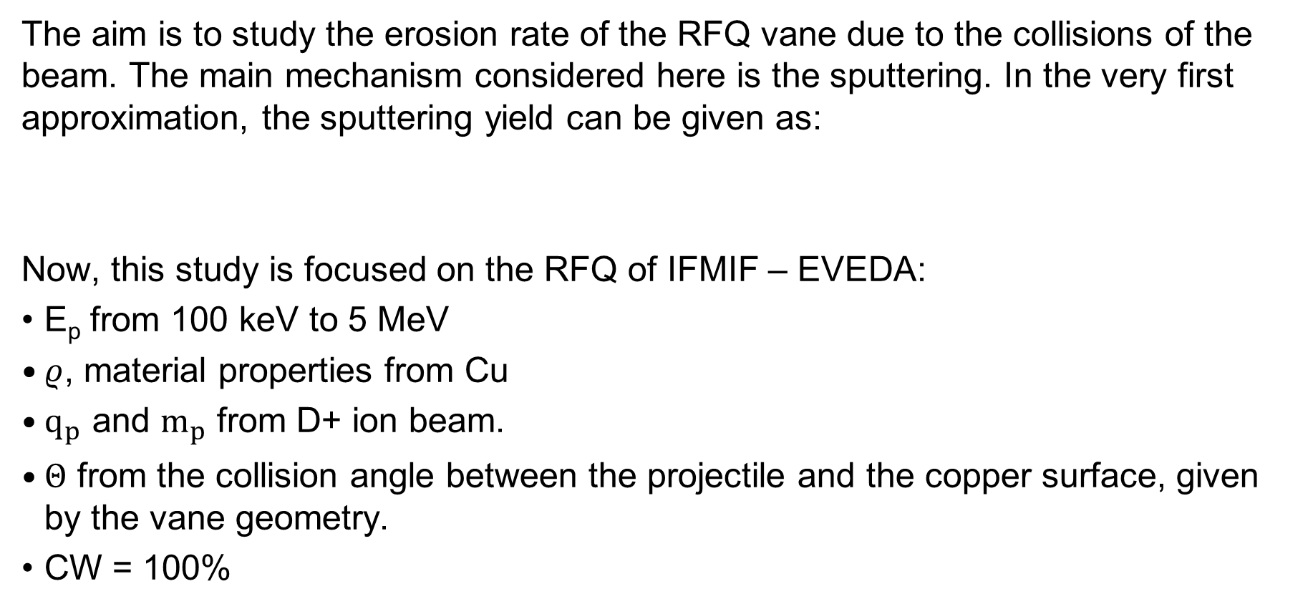
Introduction
The aim is to study the erosion rate of the RFQ vane due to the collisions of the beam. The main mechanism considered here is the sputtering. In the very first approximation, the sputtering yield can be given as:
Now, this study is focused on the RFQ of IFMIF – EVEDA:
E_{p} from 100 keV to 5 MeV
$ρ$, material properties from Cu
$q_{p}$ and $m_{p}$ from D+ ion beam.
$Θ$ from the collision angle between the projectile and the copper surface, given by the vane geometry.
CW = 100%
$$γ\left[\frac{Atoms}{proj.}\right]=f(E_{p}, q_{p},m_{p}, θ, ρ)$$

Slide 19
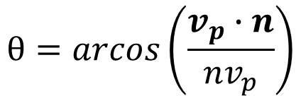



Final optimization – calc. speed
Pari
Parallelized, factor 3 gain in calculation speed
vane
Geometry:
$$γ_{D^{+}, Cu}$$
X, Y, Z, $γ_{D^{+}, Cu}$
$$θ=arcos\left(\frac{v_{p}∙n}{nv_{p}}\right)$$
for each macro-particle
Particles lost
outputs
Toutatis
SRIM / SDSrimSP
$$γ_{D^{+}, Cu}(θ, E)$$

Slide 20
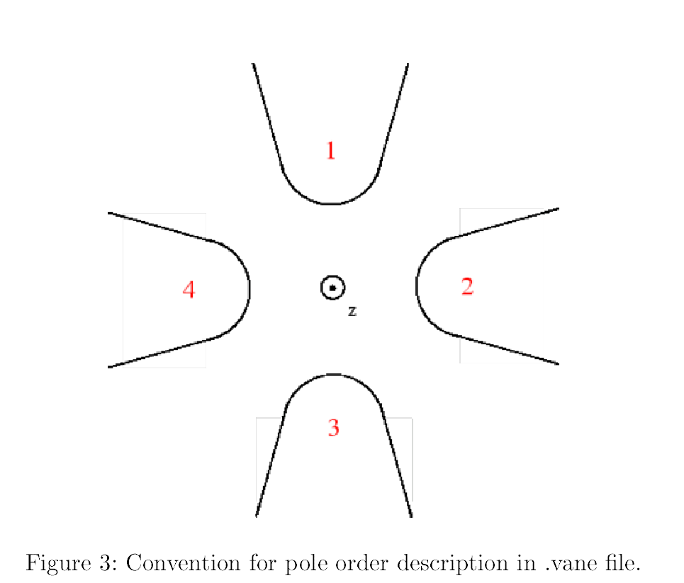
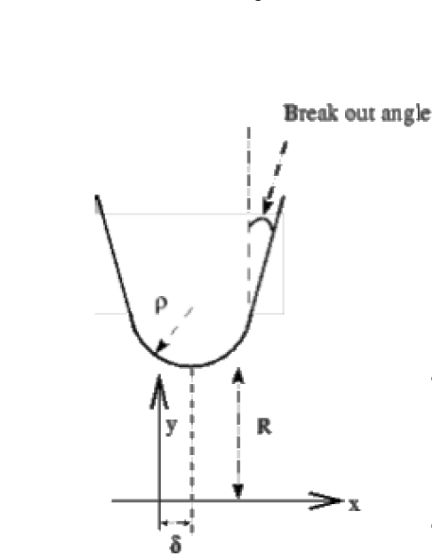
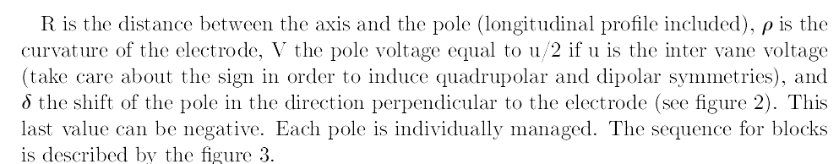

Geometry
Main aim of this module is to calculate the normal vector $n\left(x_{i},y_{i},z_{i}\right)$ on the vanes at the estimated impact point of the macroparticles. Following we have

Slide 21
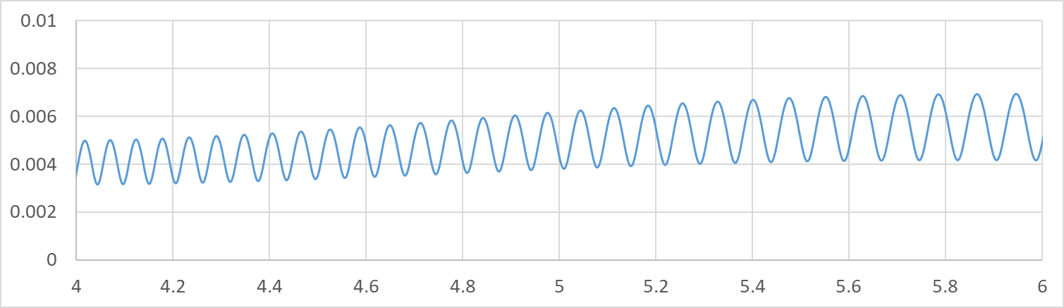
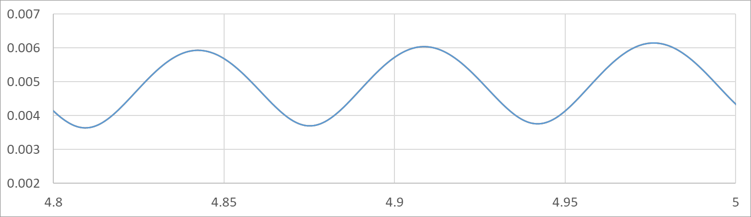



Geometry
$$n$$
Surface approximated by right cylinder
$$ρ$$
$$R$$

Slide 22
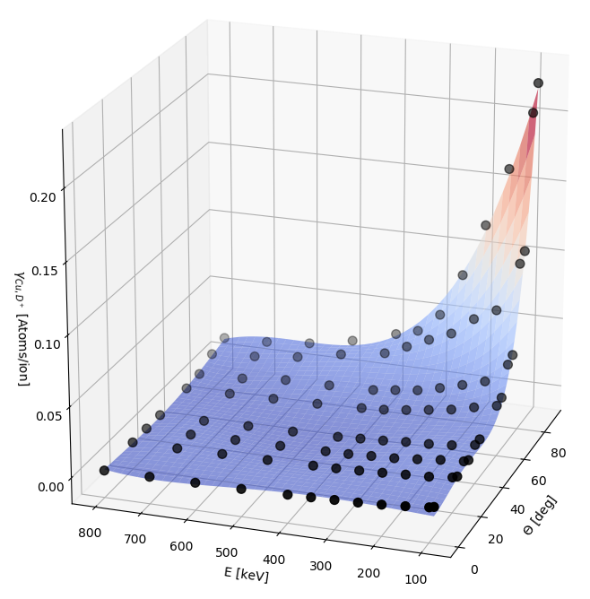
Sputtering yield - 4
SRIM sputtering yield
0° – 90°,
90 – 800 keV
Deuteron onto copper

Slide 23
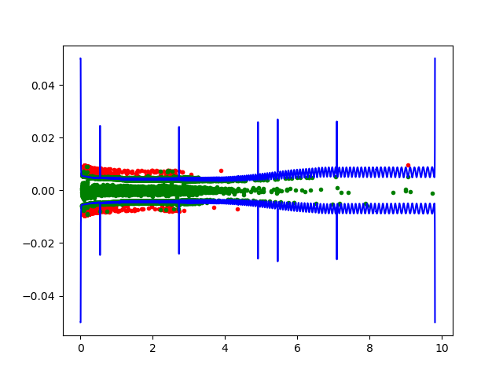
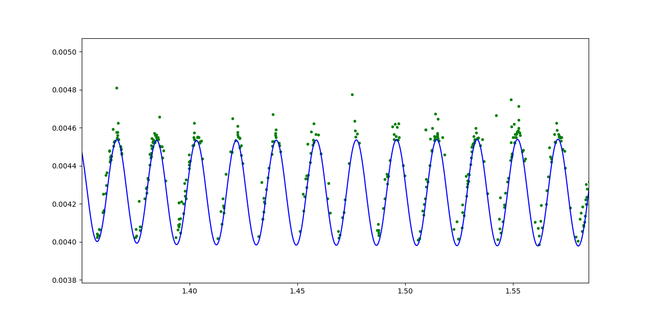
Example of losses at RFQ
zoom
beam
x [m]
z [m]

Slide 24
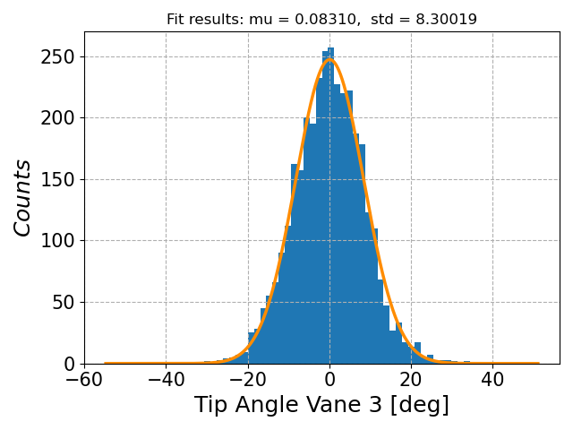

Tip angle particle distribution
$$ξ$$
For centered beam, the particle distribution with respect the tip angle is similar on the four vanes.
The erosion applies radially, removing the Cu radially.
The RFQ was divided in the 4 beam dynamics sections: RMS, shaper, GB and acceleration.
  The yield was averaged on these segments.

Slide 25
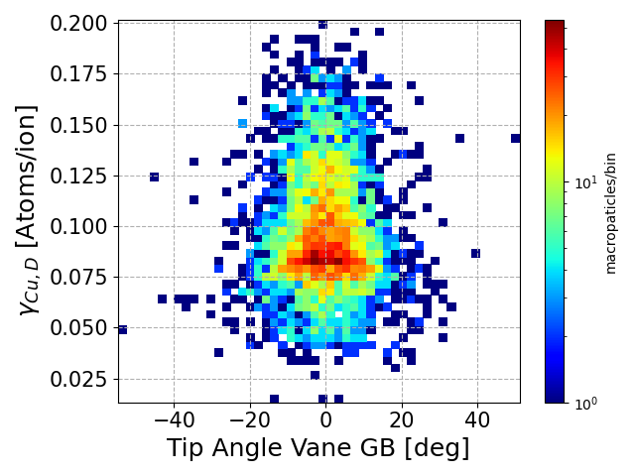
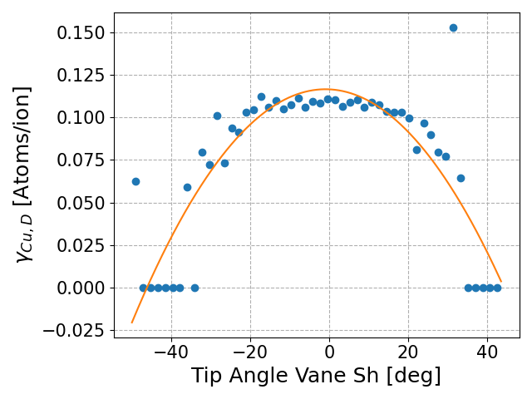
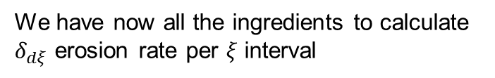
Average for each angle interval
We have now all the ingredients to calculate $δ_{dξ}$ erosion rate per 𝜉 interval
Average yield

Slide 26
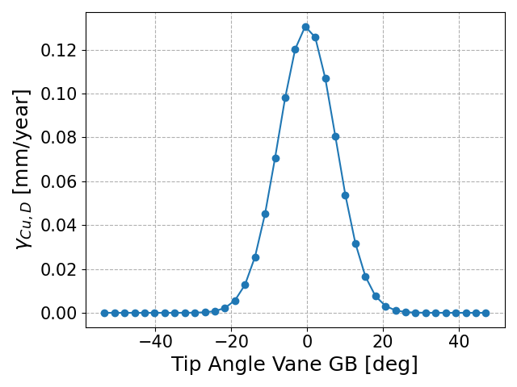
Erosion Rate [mm/year]

Slide 27
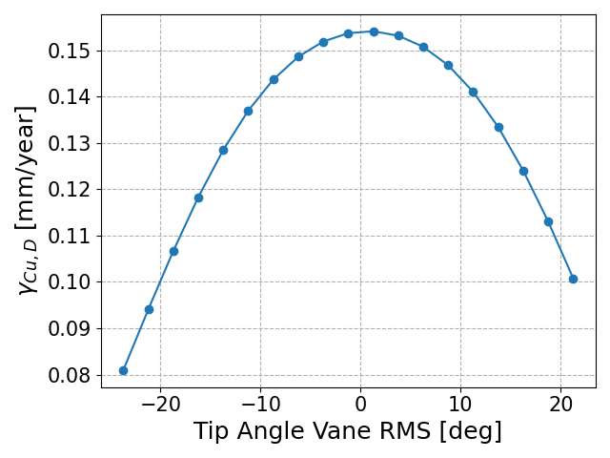
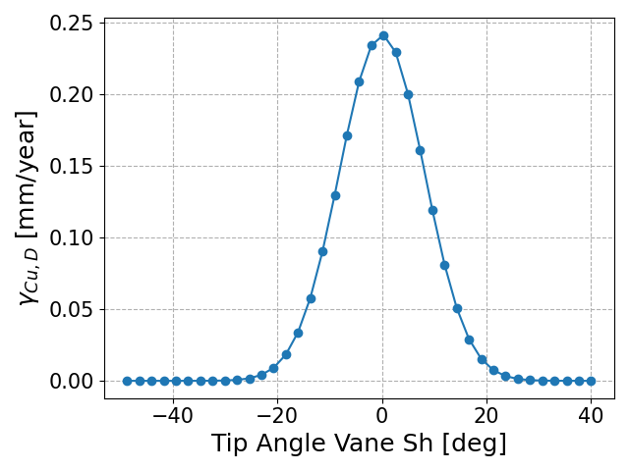
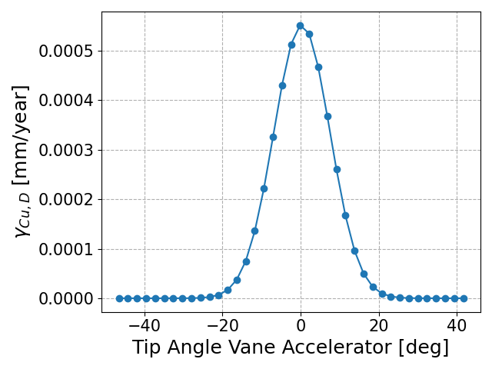
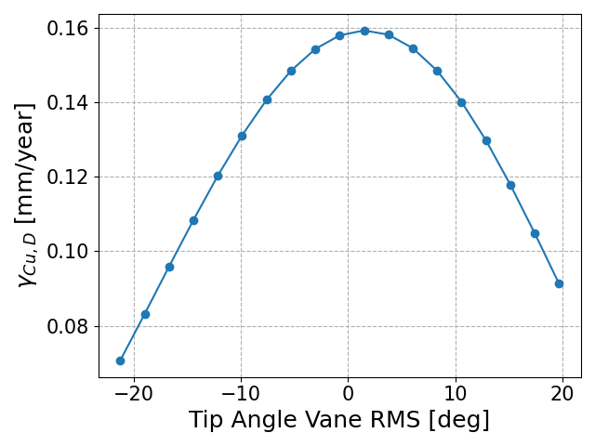
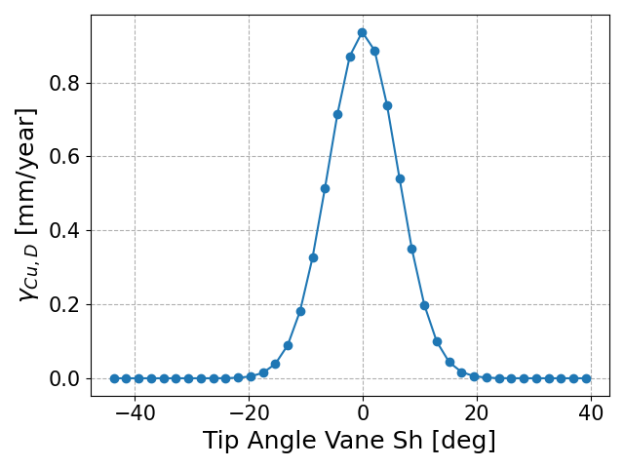
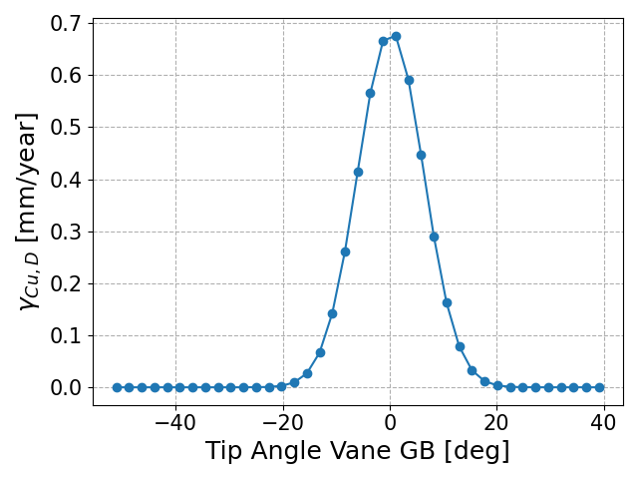
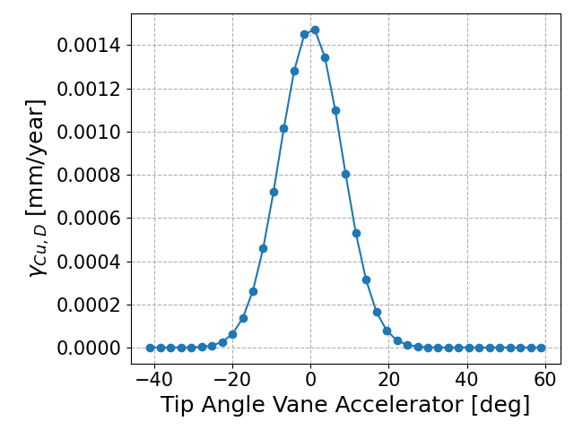




Vn
x-axis is changing
0.85*Vn
1.1*Vn

Slide 28





The RF- (black) side of the force
The erosion rate data in terms of mm/year can be introduced in the perturbative model of the RFQ in order to evaluate the frequency shift and the voltage perturbation due to such phenomenon. For a given average yield in each RFQ section, it is possible to determine the associated frequency shift with the approximated Slater formula
$$∆f=f\frac{ε_{0}{\left|E\right|}^{2}ΔS}{4u_{em}}$$
$$ΔS=2ρ\sin\left(<α>\right)<y_{Cu,D}>$$
${∆f}_{tot}$ =120 kHz/year
$±20\%$

Slide 29



The dynamic study
The previous study uses a quite large step as integration of the effect (1 y). In this year we obtain a large variation of the RFQ voltage. We trayed to check if smaller time integration can show us different behavior, such as an exponential decrease of lifetime.
What is the minimum time interval to explore
losses pattern
and analysis
beam dynamics simulation
$$<y_{Cu,D}>$$
$Δt$ = 3 months
RFQ voltage and TOUTATIS vane modifications (R0 and $ρ$)

Slide 30

Some preliminary results from dynamic study
The IFMIF RFQ is divided in 3 sections called SM supermodules. Each supermodule can have different temperature w.r. each other: this allows more efficient water tuning. It can be used to counteract the thermal deformation of the potential. In this case can be used to mitigate the erosion phenomena.

Slide 31

Minimum temperature reached. Start to use SM 2 and 3 for keeping in frequency the RFQ. From here, deformations of the voltage profile start to apply.
V not nominal
Vn
SM 1 water temp. is used to counteract the erosion effect on the SM1
Counter-measures
The voltage profile deformation increases the Kp too much. The whole voltage profile is lowered. Increased effect on the transmission and longitudinal emittance. STOP

Slide 32

Conclusion
This is an estimation of the effect of pure erosion due to knock out of the Cu atoms. Of course, several approximations are considered in a tentative to simplify the problem. As an example, especially when the hole is formed, the impact angle may change due the roughness of the surface.
Part of them are justify by the very low fluence of the losses (between 4-3 order of magnitude less then normal sputtering fluence)
It will be mandatory to compare the rate with the experiments: not so easy to find out high current CW RFQ nowadays. That’s why we are looking forward to the IFMIF/EVEDA RFQ CW beam.
In the meanwhile, we will improve the software, investigating more in details the effect on the material.

Slide 33
Thank you!

