Slide 1
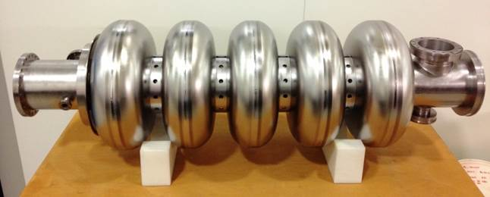
High-Beta Cavity Delivery
P McIntosh ASTeC, STFC Daresbury Laboratory
ESS Technical Advisory Committee
Lund
1 – 2 April 2015

Slide 2
Outline
Cavity Delivery Objectives
Delivery Schedule
QA Processes
Excluded activities
Project Governance
Preparation Steps
Project Approval Steps
Conclusions

Slide 3
Outline
Cavity Delivery Objectives
Delivery Schedule
QA Processes
Excluded activities
Project Governance
Preparation Steps
Project Approval Steps
Conclusions

Slide 4
Deliverables I
Niobium procurement: STFC to procure the high RRR Niobium for the high-β elliptical dressed cavities in agreement with the SRF collaboration for the ESS linac.
Cavity fabrication of the 84 (+4 spare) high-β elliptical dressed cavity in industry including:
Cavity fabrication.
Chemical processing.
Heat treatment.
Vacuum processing.
High pressure rinsing.
Field flatness and frequency tuning.
Assembly of RF antenna and isolation valve in cleanroom.
Shipment of dressed cavities to STFC.
Procedure Qualification and Training:
A qualified test procedure to be developed and implemented.
A QA/QC system for individual tests in accordance with ESS policies.
Trial tests to be performed and performance targets verified.
Staff training in procedures and processes.

Slide 5
Deliverables II
Vertical Test (VT) of SRF cavities:
VT stand to be qualified to meet ESS cavity requirements including new cryogenic and RF system, along with a suitable controls system.
A QA/QC system for individual tests in accordance with ESS policies.
Testing of the high-β dressed cavities to 22.9 MV/m at 704 MHz, with a Q_{o} better than 5 x 10⁹.
Documented test results provided to ESS.
Preparation and shipping of cavities to cryomodule integration site:
STFC to design and procure shipping fixtures for SRF dressed cavities for transport from industry.
STFC to transport SRF cavities from STFC to the cryomodule integration site.
STFC to support transport cost in accordance with ESS transportation policy.

Slide 6
Outline
Cavity Delivery Objectives
Delivery Schedule
QA Processes
Excluded activities
Project Governance
Preparation Steps
Project Approval Steps
Conclusions

Slide 7
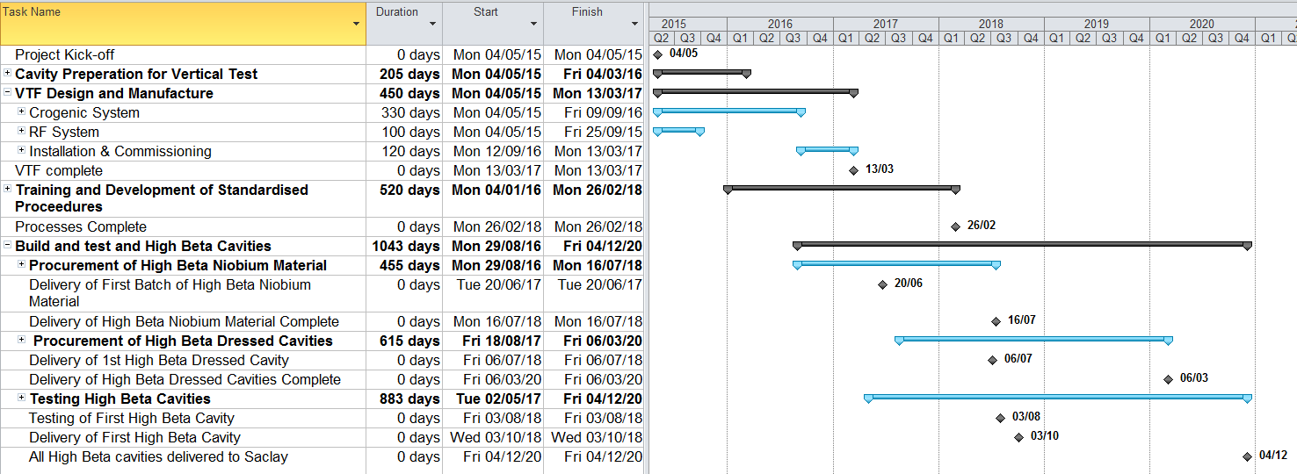
Project Delivery
Procurement cycles assume 4 months for both Nb and cavity fabrication.
Timescale uncertainties associated with risks of completing procedural training of new staff.
Have assumed that STFC will have to qualify new vendors for cavity delivery – confidence in HOM management QC controls uncertain.
Cavity testing includes production tooling, fixture preparation and qualification.

Slide 8
Provisional Milestones
Milestone | Description | Date
1 | Infrastructure preparation start | 4/5/15
2 | Infrastructure preparation finish | 13/3/17
3 | Niobium procurement start | 29/8/16
4 | Niobium procurement finish | 16/7/18
5 | Cavity testing procedure training start | 4/1/16
6 | Cavity testing procedure training finish | 26/2/18
7 | Cavity procurement start | 18/8/17*
8 | Cavity procurement finish | 6/3/20
9 | Cavity testing start | 3/8/18
10 | Cavity testing finish | 25/11/20
11 | Cavity shipment start | 3/10/18
12 | Cavity shipment finish | 4/12/20
 | HBCM Assembly at CEA start | 5/4/19
 | HBCM Assembly at CEA finish | 11/11/21
* Driven by HBCM qualification at CEA

Slide 9
Outline
Cavity Delivery Objectives
Delivery Schedule
QA Processes
Excluded activities
Project Governance
Preparation Steps
Project Approval Steps
Conclusions

Slide 10
Quality Assurance
STFC Technology Department at Daresbury Laboratory operates a quality system that meets the requirements of ISO 9001:2008.
The quality system defines how a project will be coordinated and documented.
The management of a project is based on an agreed Project Specification and a series of reviews at key stages in the work.
The detailed implementation of the Quality Management system is described in standardised group procedures, processes and local instructions.
These provide the core of the Quality Management System and provide the detail required to operate the system.
The processes and procedures are followed by STFC staff undertaking specified activities.
The work undertaken will be defined under an agreed series of bespoke processes and procedures based on existing Daresbury Laboratory vacuum and cleanroom procedures, in association with procedures developed by ESS/CEA-Saclay.
These procedures and processes would then be followed and tracked by the technicians assembling the equipment to ensure a repeatable, auditable standard is achieved.

Slide 11
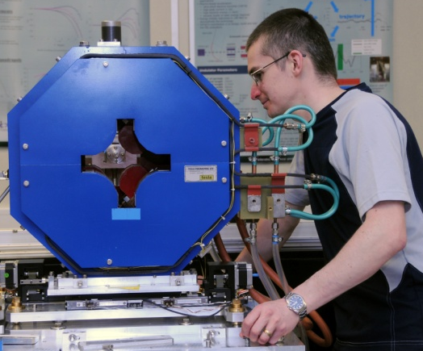
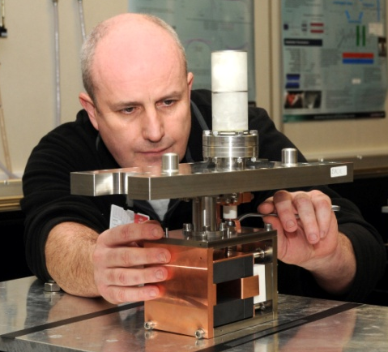
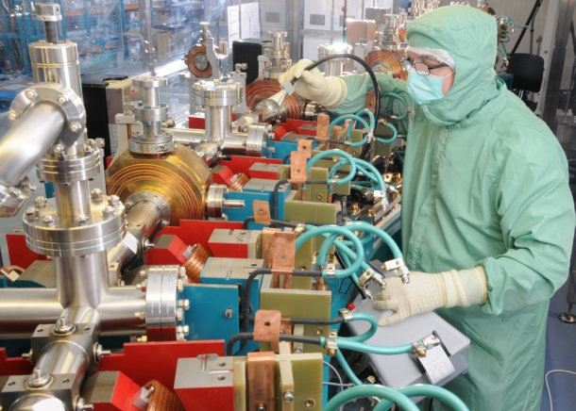
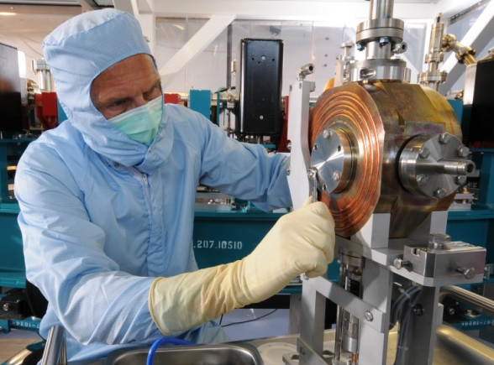
Accelerator Technology
Mechanical Engineering
Electrical Engineering
Advanced power supplies
Motion control
Control & Personnel safety
Survey & Alignment
Vacuum processing & Testing
Lasers
Magnets
RF
Cryogenics
Diagnostics
High Voltage
Vacuum Science
100 Engineering & Scientific Staff

Slide 12
Quality Management
QUALITY MANAGEMENT SYSTEM – ISO 9001:2008
Registered Activities
Design, development and project management of mechanical engineering components. The manufacture, procurement, installation, testing, commissioning, repair, assembly and development of mechanical engineering components and systems including survey and alignment

Slide 13
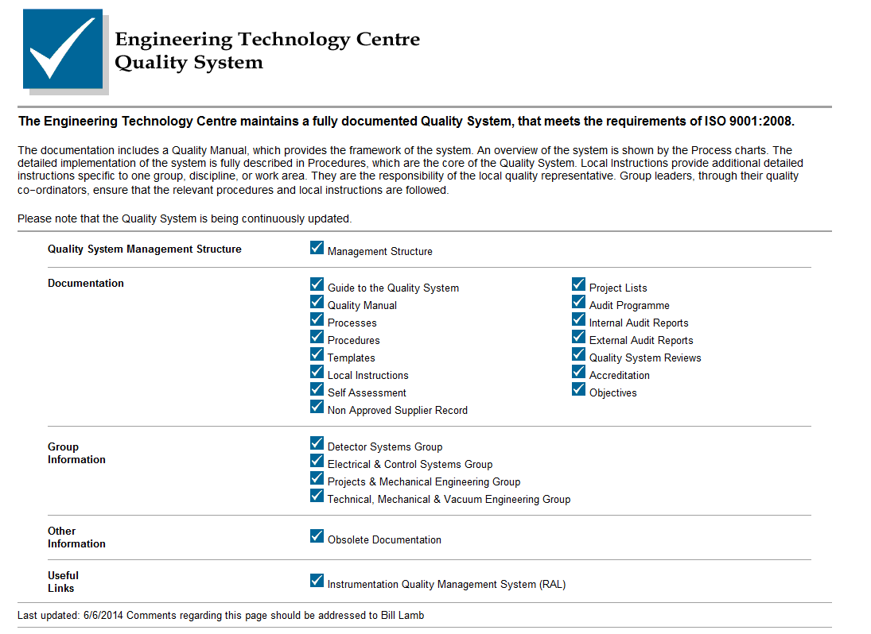
http://engserve.dl.ac.uk/Tqm/index.html
Internal Webpage

Slide 14
Assembly Procedures
Assembly Procedures
Cavity Specific Procedures
Cryostat Procedures
Buffer Chemical Polishing (BCP) procedure
Vertical Test Facility Procedures
Cryostat assembly procedure
Cryostat cooldown procedure
Cryogenic test procedure
Cavity String Specific Procedures
Generic Procedures
Unpacking procedures
Inspection procedures
Storage procedures
Cleaning procedures
Particulate counting procedures
Baking procedures
Transportation procedures
Leak-checking within cleanroom procedures
Cavity string assembly procedures
General specifications for UHV equipment
Cleaning of vacuum items
Leak Testing of vacuum vessels
Acceptance Tests for vacuum vessels
Material for vacuum flanges

Slide 15
Outline
Cavity Delivery Objectives
Delivery Schedule
QA Processes
Excluded activities
Project Governance
Preparation Steps
Project Approval Steps
Conclusions

Slide 16
Excluded Activities
Cavities failing to achieve gradient requiring BCP rework:
BCP will not be performed by STFC.
Any requirements for BCP re-processing will be returned to the manufacturer for rework – outside of STFC scope
No Eddy current scanning is to be performed:
Gradient level perceived to be low enough not to be required by ESS
If required, timescales and costs will need to be factored into the STFC SoW
DESY have the capability currently
No cavity or tooling design work is included:
Finalised engineering drawings are required from ESS
Cavity processing requirements to be defined by ESS

Slide 17
Outline
Cavity Delivery Objectives
Delivery Schedule
QA Processes
Excluded activities
Project Governance
Preparation Steps
Project Approval Steps
Conclusions

Slide 18
Project Governance
STFC ESS-IKC Project Board
Project Manager (Technology)
Material/Cavity Procurement (Technology)
Vendor Monitoring
(Technology)
SRF Cavity Testing (ASTeC)
Cleanroom Assembly (Technology)
Quality Assurance (Technology)
SRF Infrastructure (Technology)
Project Sponsor (ASTeC)
Vertical Testing (ASTeC)
Cleanroom/HPR/VTF Preparation (Technology)
Production Preparation/Training
(Technology/ASTeC)
Preparation/Shipment (Technology)
QA Documentation Preparation
(Technology)
Project Management Committee (PMC)
(Technology & ASTeC)
Project Management Board
(ASTeC, Technology & Independent)
TMVE/T@DL Programme Management (Technology)
ESS/CEA Elliptical Cavity Collaboration Board
Stakeholder planning
Financial reporting
Project planning (& current R,A,G status)
Change Management
Risk Register

Slide 19
Outline
Cavity Delivery Objectives
Delivery Schedule
QA Processes
Excluded activities
Project Governance
Preparation Steps
Project Approval Steps
Conclusions

Slide 20
Procurement Priorities
Niobium material
Provisional Nb quotes received from Wah Chang, Tokyo Denkai & Ningxia:
Based upon drawings supplied by CEA Saclay
Inflation costs of Nb uncertain
Nb specification needs to be clarified by ESS to allow procurement to commence urgently!
Prefer two suppliers for Nb
Minimise delivery timescales
Ensure timescales can be achieved
Minimise risk against other known external procurements for Nb over this period (e.g. SLAC – LCLS-II)
Cavity Fabrication
Refined quotes obtained from RI and AES:
Processing requirements to be agreed
Finalised engineering drawings required from ESS
Cavity process requirements to be defined by ESS
ESS to provide tolerance requirements to aid HOM management
Cavity suppliers need to be qualified
Formal ESS/CEA/STFC/INFN coordination process is critical to ensure specifications/drawings/procedures are collectively agreed and utilised.

Slide 21
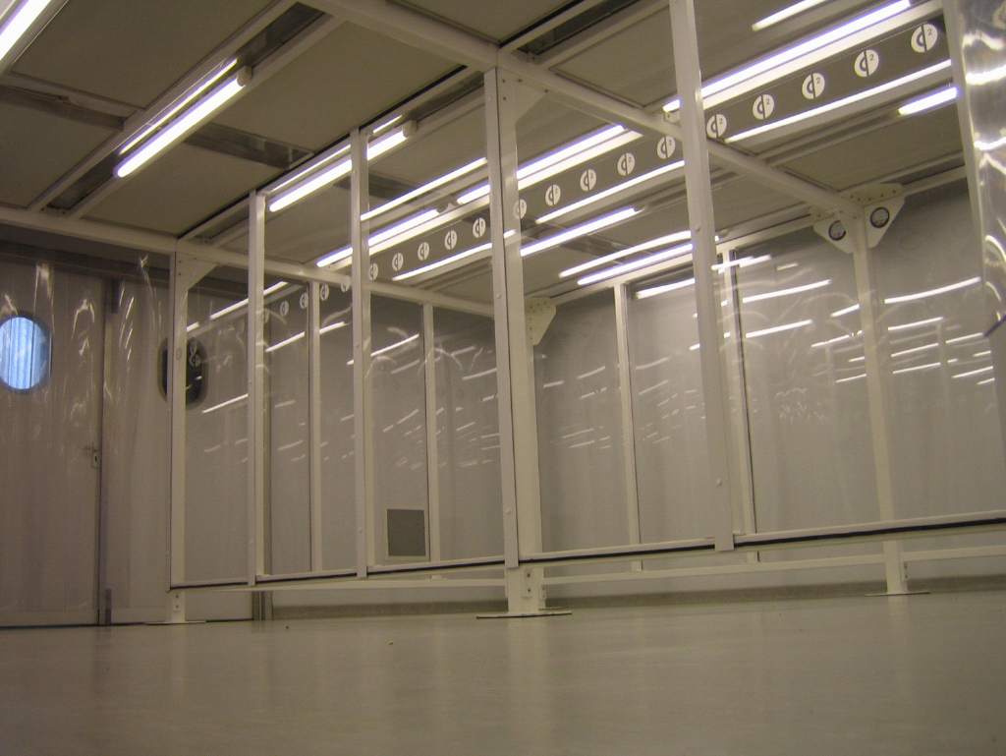
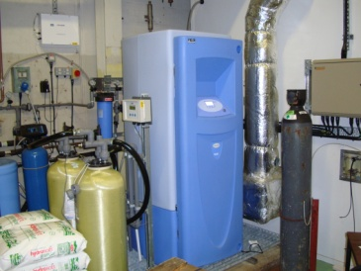
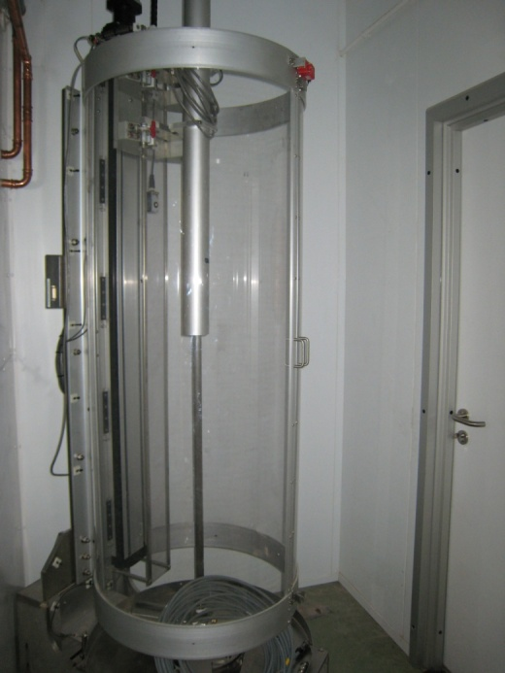
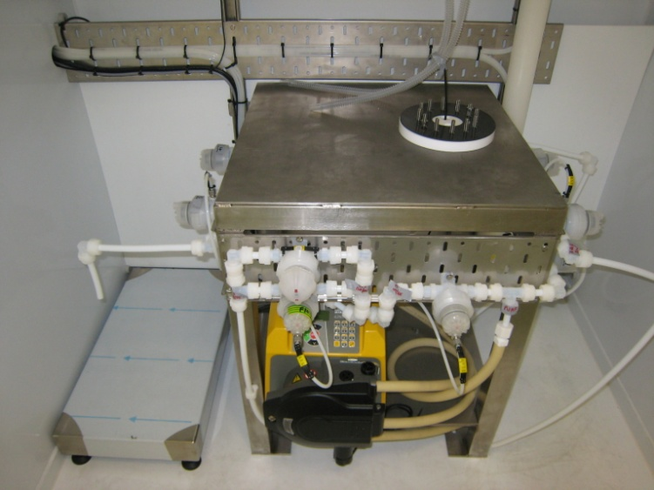
Existing SRF Facilities
UPW Facility:
>18 MΩ/cm
Cleanroom:
ISO 4 (5.7 m x 2.8 m)
ISO 5 (8.5 m x 3.5 m)
ISO 6 (2.8 m x 2.8 m)
BCP Facility:
A full sized walk-in laminar flow booth
Fully automated
Acid mixture - HF (49%), HNO₃ (65%), H₃PO₄ (85%), 1:1:1 mixture
HPR:
Fully automated
1350 psi HP water supply
Rinse nozzle wand 2RPM max
Linear rail 60 inches/min max
Motions are slow
No pinch points

Slide 22
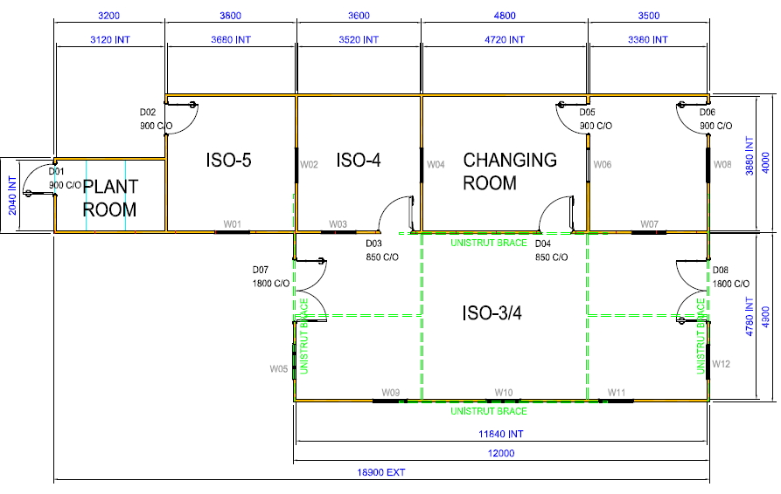
Relocated Cleanroom
HPR
ISO 4
ISO 5
(partial HEPA
MAC10)
ISO 5
8m
Cryostat Iinsert
ISO 3/4 (ULPA MAC10)
ISO 5 (partial HEPA MAC10)
18.9m

Slide 23
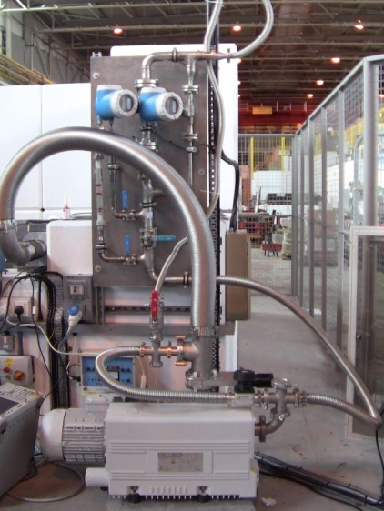
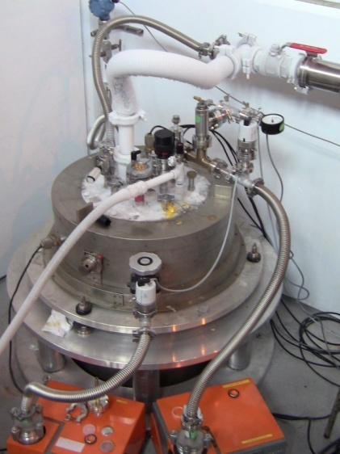
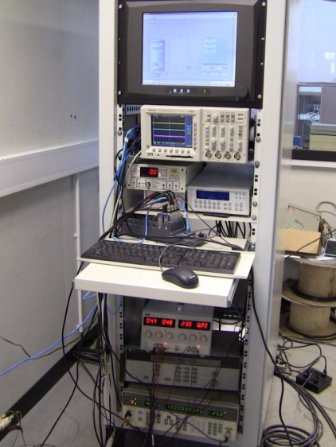
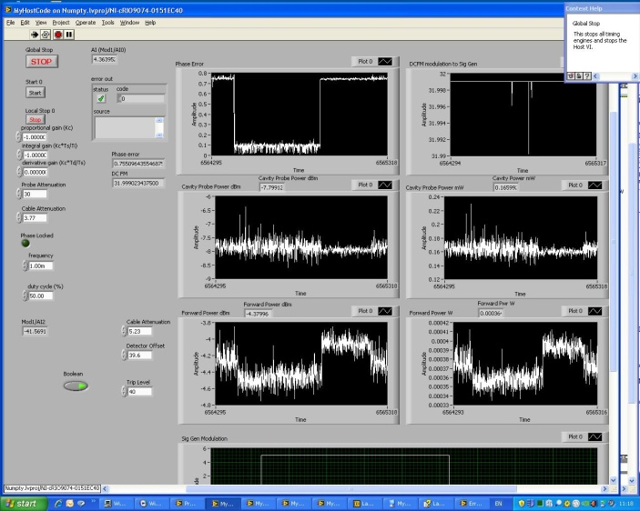
Current VTF System
Existing VTF test facility is installed in the old SRS Outer Hall
RF source frequency matched to the cavity frequency utilising a phase lock loop system.
Works both pulsed and CW.
Capable of performing high gradient validation tests on 1.3 GHz Tesla cavities.
Cryostat internal diameter limited to 395mm:
Larger diameter cryostat required for ESS multi-cavity testing.
System presently being upgraded to improve its operational status.

Slide 24
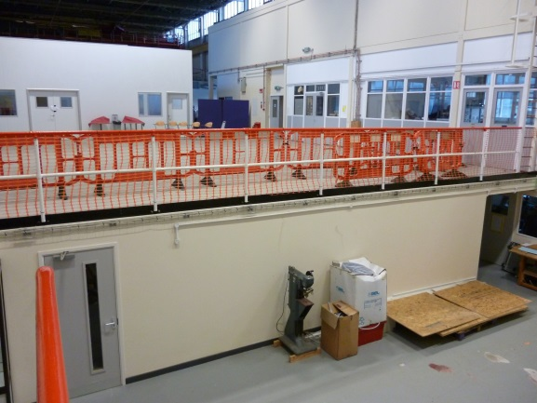
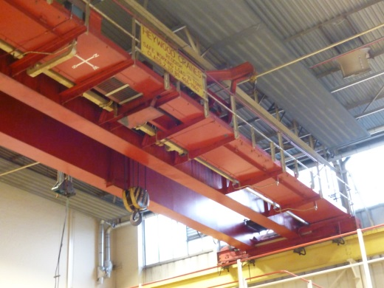
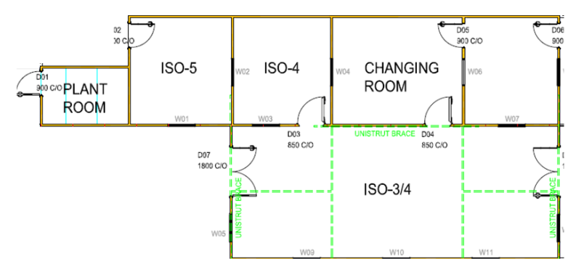
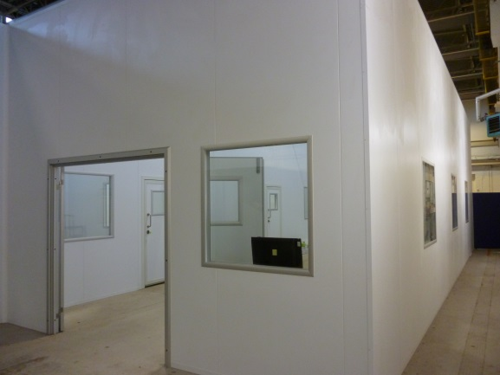
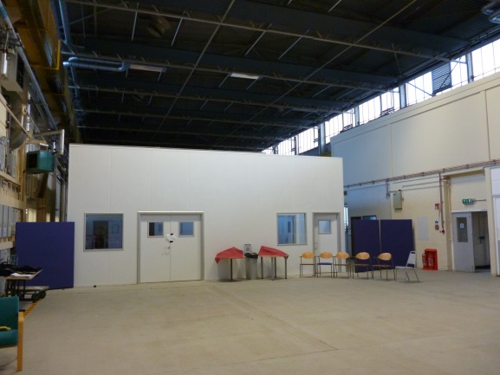
Facility Consolidation
Old Machine Workshop
Full crane coverage
VTF

Slide 25
Cavity Testing
Project Management:-
Project Team Management
Resource Planning & Management
Scheduling
Risk Planning & Management
Monitoring progress of timescales, budgets, and quality
Stakeholder Management - Key point of contact with ESS
Project reporting
Procurement:-
Tender documentation
Procurement of material for 84 +4 high-β cavities.
Procurement of dressed 84 +4 high-β cavities from industry.
Quality assurance to be managed
Vendor qualification
Processes and Procedures:-
Documentation for all the processes and procedures to be defined and agreed
Training on the processes to be performed and monitored
Process trials to be performed
Cavity preparation and final test QC documentation prepared.
Cavity Qualification:-
Installation of cavities onto vertical insert
Installation into VTF cryostat
Qualification in a vertical test facility of cavities at 2K to the required gradients of 22.9MV/m for the high-β cavities.
Assessment and provision of test data
Test data to be reviewed and approved
Removal of cavities from VTF Cryostat and vertical insert.
Complete final sealing, leak checks and QC processes.
Sealing and packing of cavities
Arrangement for delivery of cavities to cryomodule integration team (CEA Saclay).
Maintenance of the equipment
Cavity Rework:-
HPR of cavities
Repeat qualification

Slide 26
Outline
Cavity Delivery Objectives
Delivery Schedule
QA Processes
Excluded activities
Project Governance
Preparation Steps
Project Approval Steps
Conclusions

Slide 27
UK Project Approval Steps
STFC ESS Project Board to approve defined programme – April 2015:
UK contingency level to be understood and how it is to be centrally managed.
Need to resolve 15/16 funding issue caused by expected UK funding timescales.
UK-IKC Technical Annex to be defined and agreed.
Formal UK – IKC agreement to be agreed and approved:
Date - TBD

Slide 28
Conclusions
TAC Charge:
Is the plan for designing/prototyping and constructing/testing the elliptical cavities sufficiently advanced to permit timely construction?
How could it be improved?
STFC has a plan for the provision of the high-β elliptical cavities which meets the timescales for the ESS schedule.
STFC needs to have strong coordination with ESS/CEA & INFN to ensure requirements and timescales are fully integrated:
Specifications, drawings, procedures, QA processes and project management integration is critical for successful delivery.

