Slide 1
Medium Beta Cavities
Paolo Michelato, Paolo Pierini, and Carlo Pagani
INFN Milano - LASA

Slide 2
INFN IN-kind contribution proposal
Medium beta and high beta cavities prototyping
  Procurement contract NOT included in the proposal.
Medium beta series cavities
  Niobium procurement for the fabrication of 36 medium beta cavities.
  Cavity fabrication of 36 (*) medium beta cavities in the industry, including treatments, tuning, Helium tank integration, etc, accomplishing the ESS requirements in terms of performances, functional interfaces.
  Certification activities, documentation, ancillaries (flanges, vacuum valves, antennas, frames, etc.)
  Cold test in a qualified infrastructure.
  Transportation in special boxes and delivery at the cryomodule assembling facility.
  Man power for the above activities.
  (*) INFN Design, plug compatible with CEA boundary condition

Slide 3
INFN - LASA strategy for prototypes
Built prototypes of both medium and high beta cavities.
  INFN design, using LG Nb, plug compatible with ESS cryomodule.
Design process in progress.
  Optimization to include LG option.
LG Nb ingots procurement started.
  Slicing process ordered.
Full treatment (BCP, HPR, clean room) done in industry.
Final handling and test will be done at LASA in the qualified infrastructure.

Slide 4
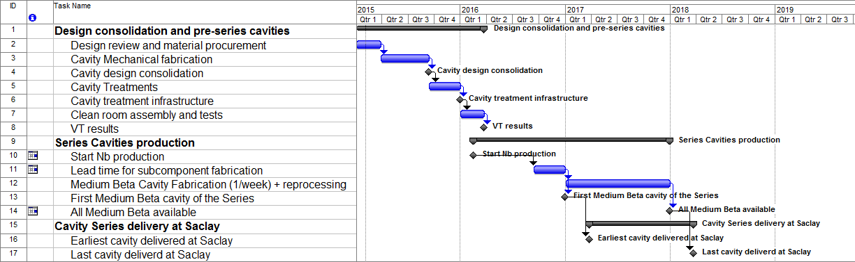
INFN proposal time plan (Feb 2015)

Slide 5
CEA revised scheduling proposed

Slide 6
INFN – LASA experience on SC cavities
SNS cavities
TRASCO cavities
PDS-XADS cavities
EUROTRANS/MAX Elliptical test cryomodule
TTF/Tesla & FLASH cavities and modules
European XFEL series production of 1.3 GHz cavities
European XFEL 3.9 GHz system

Slide 7
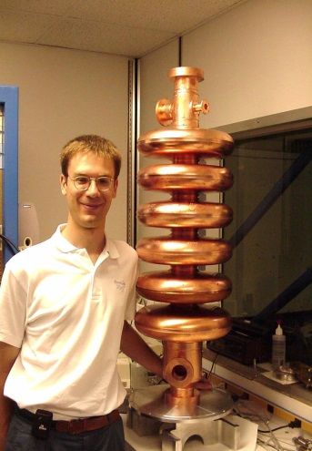
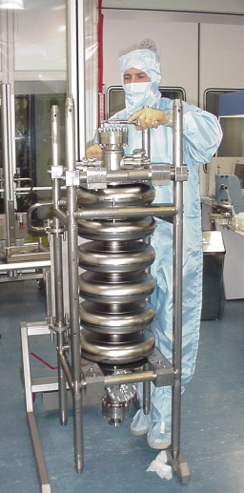
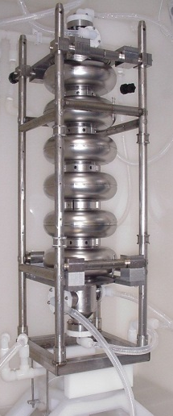
From TTF Experience, INFN Contribution to SNS
INFN Cavity Design
TJNAF Fabrication
Based on INFN Design & TTF Technology
Experimental Results
1st Prototypes
G. Ciovati, former student of mine,
working at TJNAF on SNS cavities
MoU between INFN and TJNAF
“for thr Development of low β Superconducting Cavities for Proton Accelerators”

Slide 8
XFEL 1.3 GHz SC Cavities:
Overview
Two Companies committed for the 400 + 400 1.3GHz cavities production:
E. Zanon (EZ) and Research Instruments (RI).
Up to now 630 cavities have been produced.
Main steps at the Companies:
  Mechanical fabrication & RF measurements and Tuning
  Surface treatments (BCP/EP, HPR, thermal treatments, etc.)
  He-tank integration
  Shipment to DESY for cold RF test (cavity equipped with all ancillaries)
Cavities integrated in the He-Tanks and ready to be cold RF tested at DESY (foreseen production rate: 3.5-4 cav/week):
INFN-DESY supervise the full cavities production:
  Technology transfer to industry
  Infrastructures ramp-up and qualification (clean room, UP water, EP/BCP systems, HPR, thermal treatments, vacuum, etc.)
  Quality control of the on-going production

Slide 9
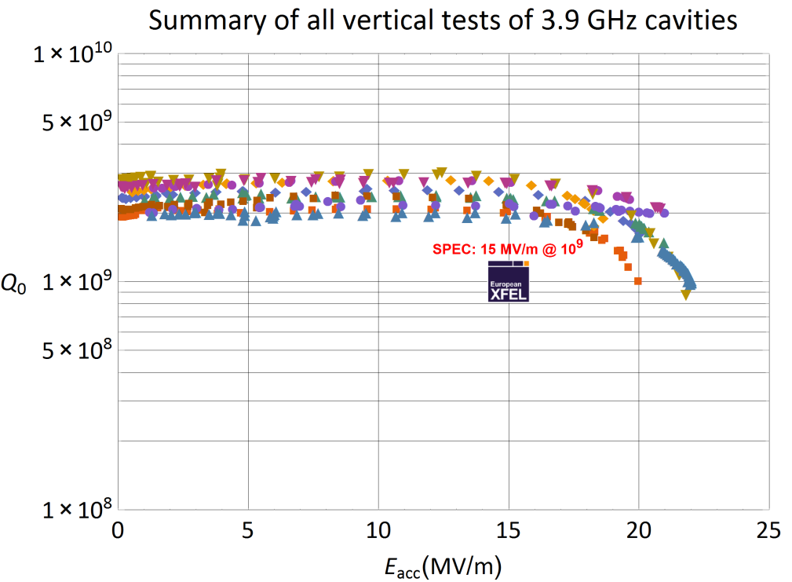
XFEL 3.9 GHz third Harmonic SC Cavities:
Vertical RF Test Results
INFN has the full responsibility (design and production) of the
3.9 GHz Cryomodule
(8 cav + 2 spares)
10 cavities produced, with all accessories: He-tank, Blade Tuner, magnetic shield.
Cryomodule already at DESY
All cavities successfully tested at LASA above specs.
Module in tunnel Summer 2015
T = 2 K
1st Test!
Cav 3HZ010
Horizontal Test

Slide 10
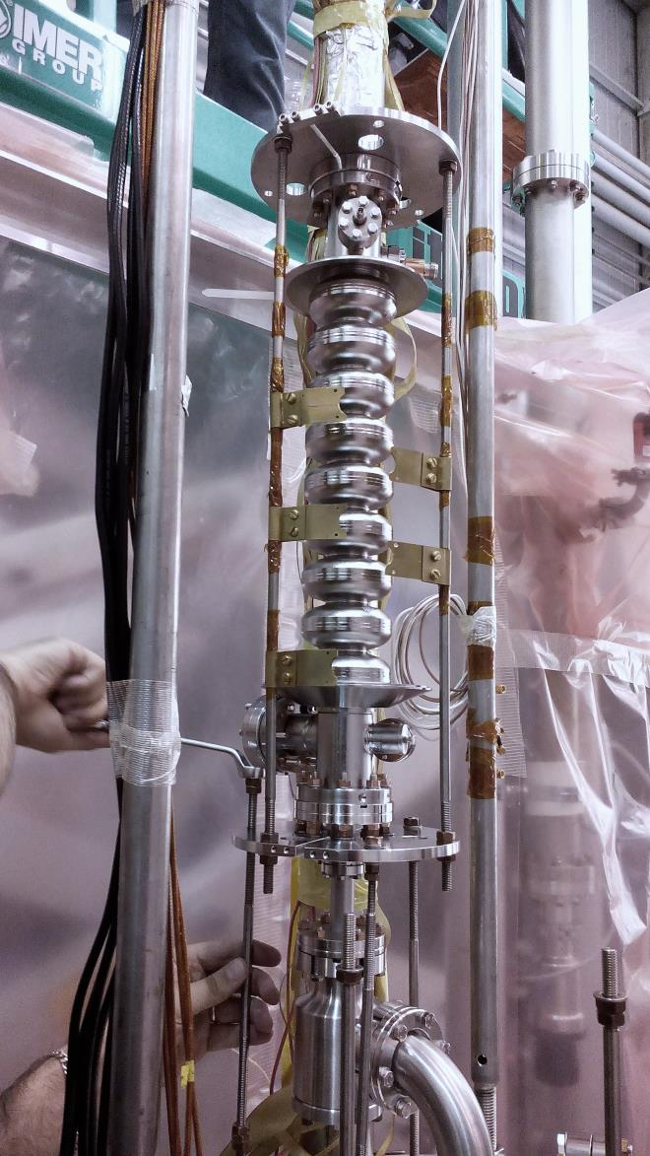
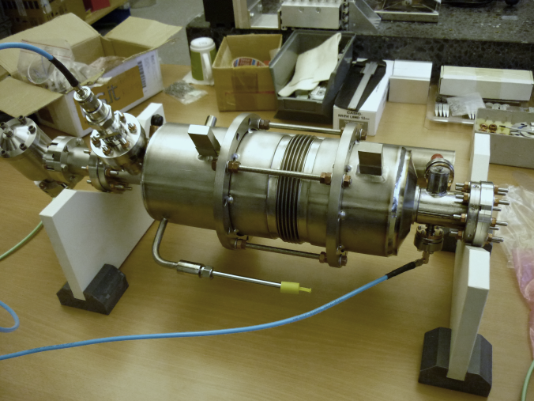
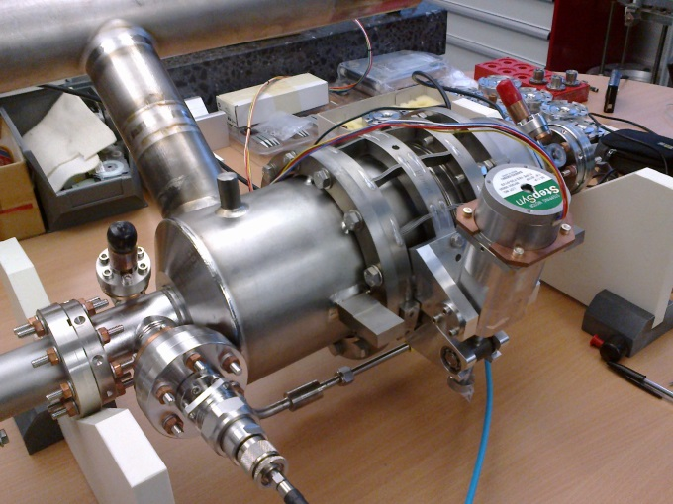
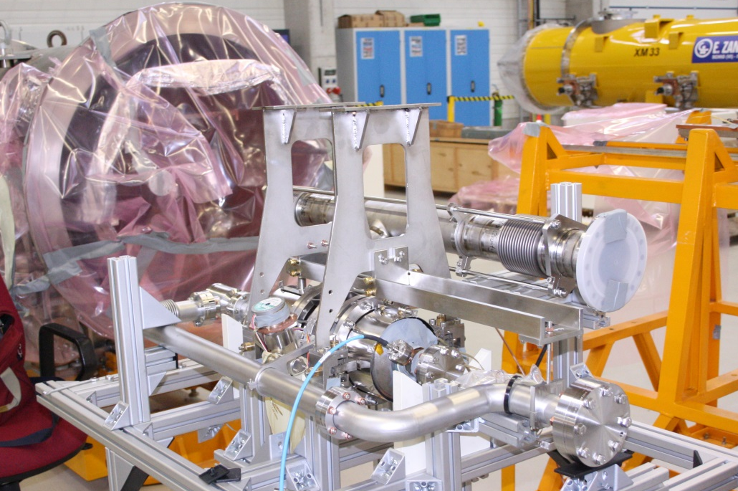
XFEL 3.9 GHz third Harmonic SC Cavities
Preparation for vertical test

Slide 11
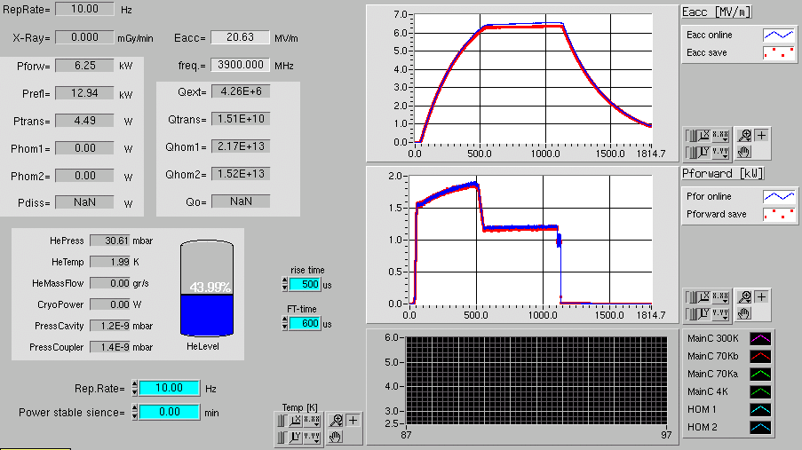
3HZ010: successful horizontal test at DESY Eacc: up to 23.8 MV/m at 1st test
Stable operation for > 48 h at >20 MV/m with nominal EXFEL beam parameters
27/03/2015

Slide 12
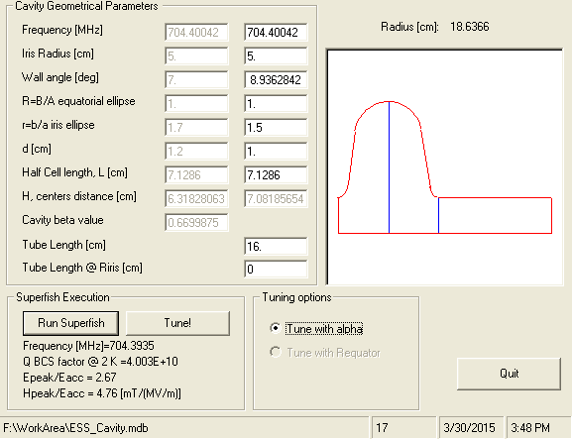
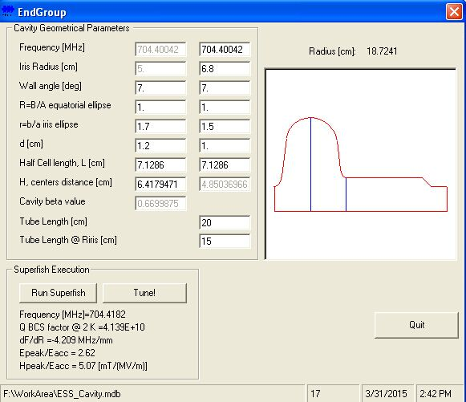
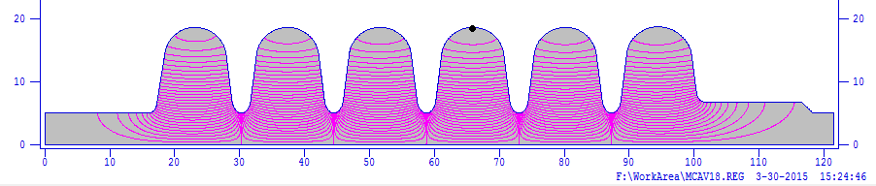
INFN Plug-compatible design just started but well in progress - 1

Slide 13
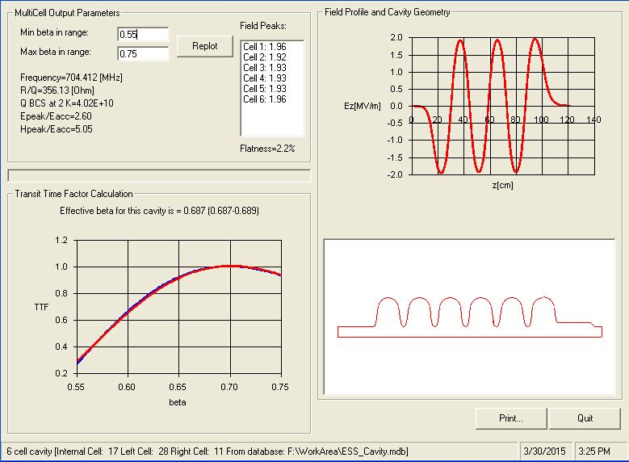
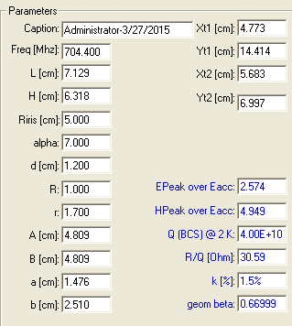
INFN Plug-compatible design just started but well in progress - 2
Inner cell parameters

Slide 14
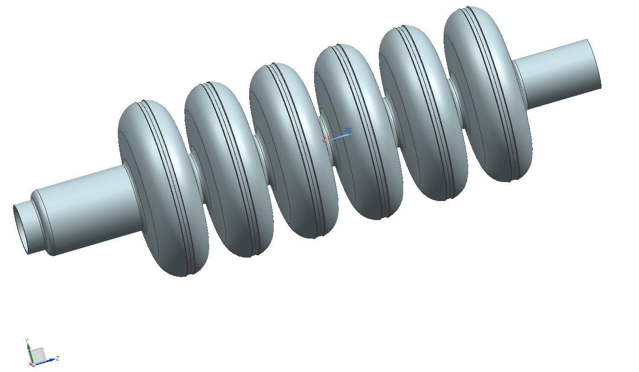
INFN Plug-compatible design
3D model for ANSYS HFSS

