Slide 1
Status and Plans for the Target Safety System
Linda R. Coney
Group Leader – Target Safety and Controls
www.europeanspallationsource.se
April 1-2, 2015

Slide 2
Outline
Intro
Hazard Analyses Update
Pilot TSS Design Development
Conclusions

Slide 3
TSS – Purpose
TSS is a safety critical system designed to protect the public, workers, and environment from radioactive release
Active control and monitoring system
It is likely that the TSS will need to be able to shut down the proton beam
Actions not necessarily limited to beam shut down
Safety-credited system
Essential to the licensing process for the ESS

Slide 4
Target Controls & Safety Group – TSS Activities
Define requirements for the TSS
Hazard analyses
New ESS classification of safety functions & safety important components
Review of SSM documentation
Design Pilot-TSS
Complete system – logic, sensors, cable paths, PLCs, shutdown methods
Defining interfaces for Pilot-TSS – CF , Accelerator, Target systems, ICS
Participate in safety activities at ESS
Attend Safety Advisory Group meetings, safety classification from System Engineering, engage with SSM regarding safety controls

Slide 5
Hazard Analyses – TSS Requirements Determination
Continuing Hazard Analyses on Target Station systems
Review and update HA information for all systems
include design changes & involve new personnel
Connect systems g comprehensive analysis of chain of events
Identify enveloping events for quantitative analysis
Qualitative Hazard Analysis
Events evaluated for risk of radiologic release
Design recommendations for Target Station systems
Inputs and outputs for TSS
TSS logic design
Quantitative Hazard Analysis – dose rates & analyses
MPS risk analyses separate (within ICS Division responsibility)
ICS collaboration with Zurich University of Applied Sciences (ZHAW)
For machine protection only – not a safety system

Slide 6
Hazard Analyses – Scope
Comprehensive analysis of all Target station systems
Within Monolith (Target wheel, moderators, reflector, PBW) relevant primary cooling systems are included
Analysis of Active Cells Facility (remote handling, ventilation)
p⁺
Beam Dump
Utility rooms
Monolith
Wheel, Cold Moderator, Water Moderator,
Reflector, PBW, Instrumentation plugs
Active Cells Facility
Utility rooms
no access for operations
133 m

Slide 7
Hazard Analysis – Procedure
System definition | Hazards List | Postulated Initiating events (PIE) | Top Event | Unmitigated Consequences, Time scale to destroy | Probability Occur & Severity | Unmitigated Risk Ranking | Protection/safety system equipment | Triggers | Probability Occur & Severity | Mitigated Risk Ranking | Design Recommend-ations List | Recommendations list for studies and investigations
Step 1:
What is the system?
System owner prepares a short definition. Presented at the first HA session.
Step 2:
What could happen?
What are the reasons?
Begun offline & discussed during a HA session.
Step 3:
What are the hazard scenarios? What are the consequnces?
Step 4:
Risk ranking. What is the probability? What is the severity?
Step 5:
How to detect? How to mitigate?
Step 6:
Risk ranking after mitigations.
Step 7:
Recommendation for design.
Request for studies for quantification of consequences.
Done offline by HA expert and system group. Discussed in next HA session.
Done offline by HA expert and system group. Discussed in next HA session(s).
HA session
HA session(s)
HA session(s)
(or more depending on progress)
HA session

Slide 8
Hazard Analyses – Radiation Exposure Limits
FROM ESS GSO (General Safety Objectives) |  |  | FROM SSM
ESS Safety Objectives
Operating conditions Initiating event likelihood | Workers limit (effective dose) | Public limit (effective dose) | Public limit
Normal operation - H1 | 10 mSv/year | 0,05 mSv/year | 0,1 mSv 0,1 mSv 1 mSv
Incidents – H2 F > 10⁻² Ex : loss of external power or target cooling | 20 mSv/event | 0,5 mSv/occurrence
Unexpected events - H3 10⁻⁴ < F < 10⁻² | 50 mSv/event | 5 mSv/occurrence
Design Basis Accident – H4 10⁻⁶ < F < 10⁻⁴ | 50 mSv/event | 20 mSv/occurrence | 20 mSv
Highly improbable events – H5 10⁻⁷ < F < 10⁻⁶ Ex : plane crashes, major earthquake |  |  | 100 mSv
5
5
8

Slide 9
Hazard Analyses – Status
Completed review of HA for:
Water Moderator, Cold Moderator, Reflector
Ongoing
Active Cells (Process Cells, Remote Handling)
Ventilation systems (Active Cells, Utility Rooms, High Bay)
Target system (Wheel & He cooling)
Monolith (Proton Beam Window (PBW), Beam Dump)
Bring in events initiated in other systems
Moderators/Reflectors/Target wheel/Beam Events/Choppers
Next
Active Liquid & Gaseous Storage
Intermediate water systems
Move into Quantitative HA
Start with Target wheel events – wheel stop & loss of He cooling
Incorporate design recommendations & results from studies
Identify significant events g refine TSS logic

Slide 10
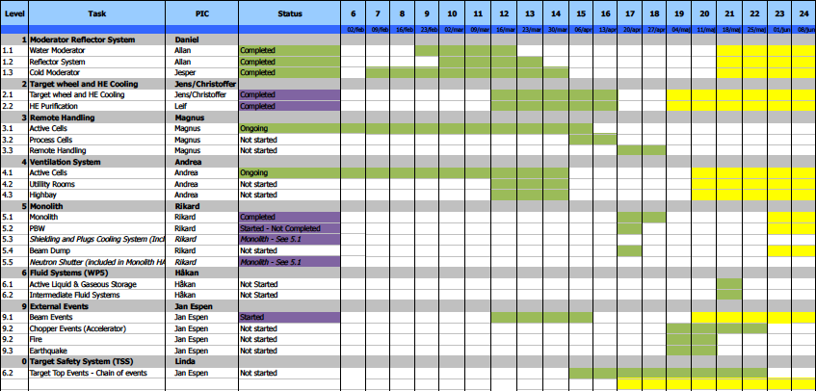
HA schedule
March
April
May
June
Initial analysis: Initial HA on Subsystem
HA review: HA Review, Internal and external PIE identified, Top Events identified, Qualitative risk assessment, SaF identified/proposed, Study recommendations identified
Quantitative Assessment: Studies are performed, Dose calculations, Quantitative risk ranking

Slide 11
TSS Design & Development – Pilot TSS
Hazard analysis process is on-going & long term
Moving forward with the TSS design
Make assumptions based on the information currently available from the HAs
Incorporate appropriate redundancy & diversity
Assume TSS needs to:
Detect stopped wheel rotation
Detect loss of He cooling in wheel
Shut down proton beam when these conditions are present
Note: no quantitative results from Hazard Analysis yet. Possibility that requirements on TSS will change is understood.

Slide 12
Pilot TSS – Implementation
Identify need for action by TSS for events from Hazard Analysis
Define safety functions (SaF)
First attempt to implement ESS safety function categorization
Define TSS portion of safety functions
Evaluate severity – determine SaF classification & requirements for design
Design complete Pilot-TSS system to fulfil safety functions
Logic design – requirements from classification, release limits, SSM
Trigger mechanisms, sensors, PLCs, shutdown methods
Interfaces – Accelerator, CF, Target Station systems, ICS
TSS Test Stand
Prototype of TSS – safety PLCs, programming, implement design
Automated test program for TSS logic

Slide 13
Pilot TSS – Safety Function Classification
ESS-0016468
Severity Scale | Criteria
High | Radiological consequences for the public > 20 mSv (H4) Radiological consequences for workers > 50 mSv (H4)
Medium | Radiological consequences for the public > 1 mSv (H3) Radiological consequences for workers > 20 mSv (H2)
Low | Radiological consequences for the public > 0.1 mSv (H2) Radiological consequences for workers > 10 mSv
Apply ESS safety function classification scheme
Note: Safety function severity is different from the mild/moderate/severe scale for the original event from which a safety function need was defined.
Ex. Consider a top event from the Hazard Analysis that is H3 with an dose of 3 mSv to the public
This is above the allowed limit – Risk Ranking of “Severe” and requires mitigation by a safety function
Identify safety function Severity Scale from table: 3 mSv = Medium severity g SaF C2
C2 requires: redundancy, independence of redundant train, physical separation, qualification to environment, verification
Does not require diversity

Slide 14
Pilot TSS – Design Concepts
Monitor target systems
Target cooling system – He flow, He temperature or pressure
Target wheel – shaft speed, drive load, wheel motion (monitoring plug?)
Defining optimal detection methods & interfaces with system owners
Two shutdown mechanisms to stop beam
Ion source and possibly RFQ
Direct access/priority to shutdown mechanisms
Defining interfaces with accelerator and MPS/PSS
Use safety-rated PLCs
Two separate TSS rooms in Target building –
Identified in CF plan
Independent paths to each beam shut-off system
Defining cable paths with CF
Separate from ICS controls – cable-trays, UPS, shutdown mechanisms
Satisfy requirements & protect public with as-simple-as-possible system

Slide 15
Pilot TSS – Logic
Read
Evaluate
Act
Target wheel cooling
He temp
< TBD deg C
Target wheel cooling
He flow
> TBD g/s
All conditions
satisfied
Allow proton beam
Target wheel motion
> TBD rpm

Slide 16
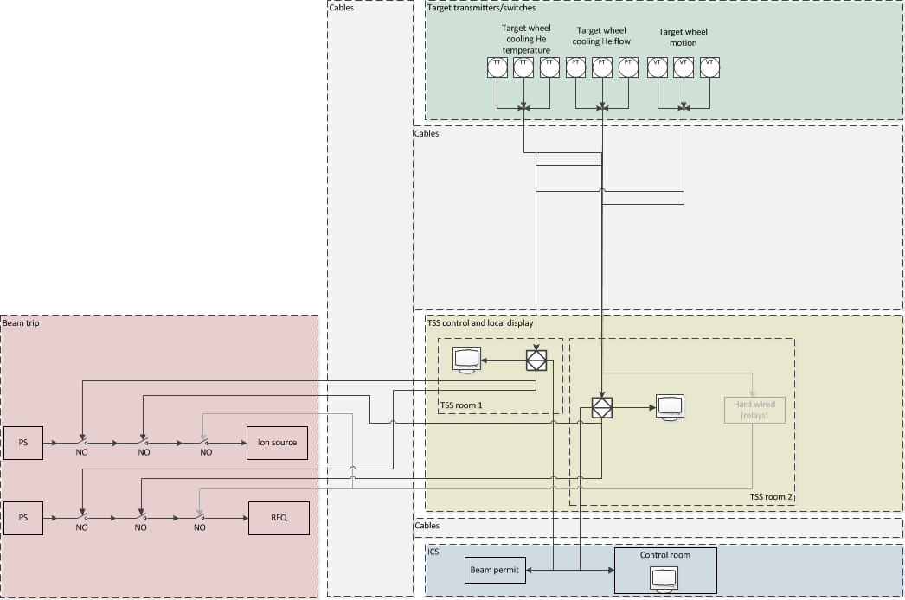
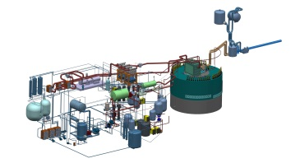
Pilot TSS – Draft Overall Layout
2oo3
1oo2

Slide 17
Plan for TSS Development
Qualitative Hazard Analyses Q1-Q2 2015
Quantitative Hazard Analyses Q1 2015 – Q1 2016
Description of Pilot TSS – logic & interfaces Q1 - Q4 2015
MS: PDR of TSS (Pilot) November 2015
Test Stand 2015 – 2016
Design of TSS Architecture
Includes documentation, finalization of interfaces, & safety analysis of system architecture
MS: CDR of TSS System Summer 2016
Manufacturing 2017
Supplier chosen Mar 2017
Delivery to site Feb 2018
Installation/Testing Feb 2018 g Jan 2019

Slide 18
TSS – Conclusions
Hazard Analyses process moved into high gear
New resources in place
Qualitative analysis scheduled to finish by June
Next:
Quantitative analyses to clarify TSS and target system requirements
Connect HA results with safety function classification
Moving forward with Pilot-TSS design
Enables progress without requiring completion of Hazard Analyses
Define: requirements, interfaces, details
Next: understand safety function classification implications for TSS design
Aim for PDR late 2015
TSS group directly involved in safety activities at ESS
Participate in Safety Advisory Group meetings, safety classification from System Engineering, engaged with SSM on safety controls

Slide 20
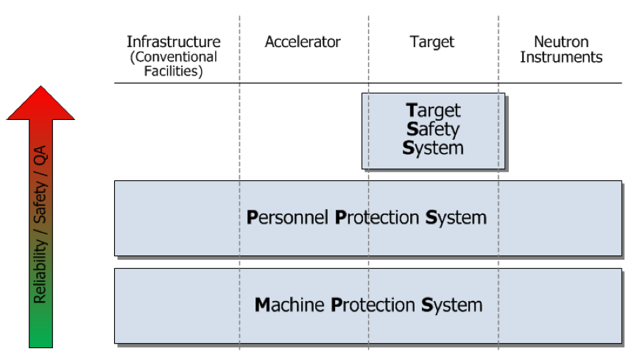
TSS Context – ESS Control Systems
TSS - Limit transfer of radioactive contamination to the public, workers, and environment
PSS - Suppress radiologic hazards by switching off the proton beam
Control access to restricted areas during operations
MPS – Protect investment from damage due to beam losses and malfunctioning equipment
Optimize integrated machine performance
Stop beam – Beam Interlock System
Personnel Safety System
TSS – Independent safety-qualified system
g Not tied into other ICS systems

Slide 21
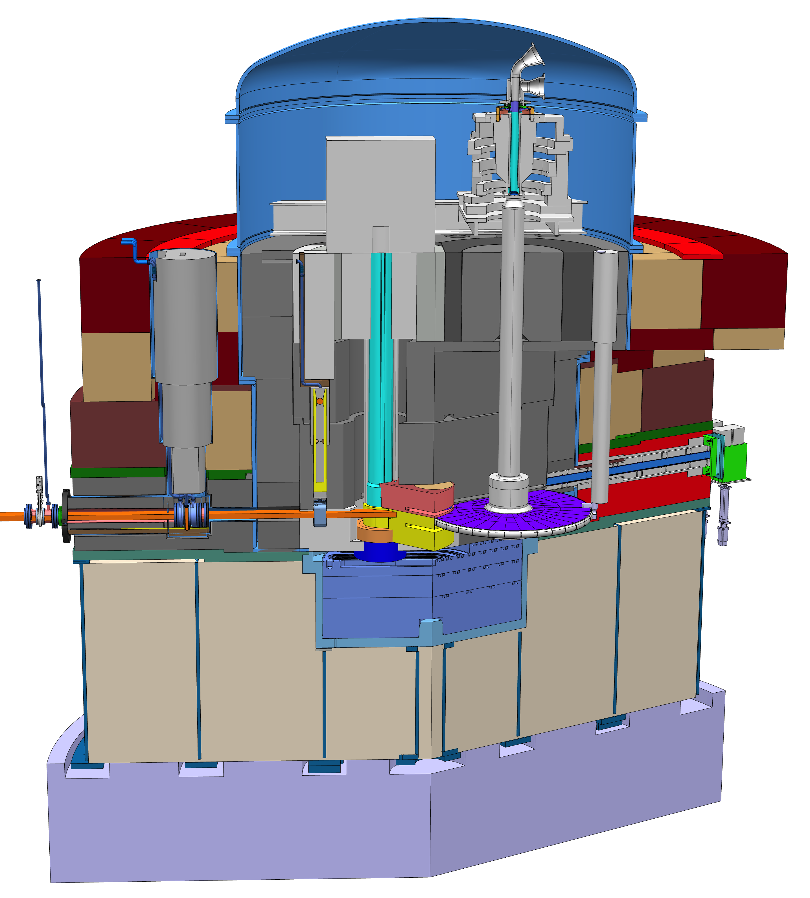
Hazard Analyses – Target Station Components
10 m
Systems evaluated during Hazard Analyses – including relevant primary fluid systems
Cold Moderator
Water Moderator
Reflector
Monolith
PBW
Target (wheel, drive, He cooling system)
Ventilation, Intermediate cooling systems, Remote Handling, Beam Dump
Instrumentation
proton beam and target monitoring
Proton beam
11 m

Slide 22
Hazard Analyses – Risk Ranking
Categories for probability & consequences
Severity Probability | Minor | Moderate | Severe | Dose Limit
H1 (Normal Operation) | Tolerable | Risk reduction recommended | Unacceptable | 0.1 mSv/year 10 mSv/year
H2 (Incidents) | Tolerable | Risk reduction recommended | Unacceptable | 0. 1 mSv/event 20 mSv/event
H3 (Unexpected events) | Tolerable | Risk reduction recommended | Unacceptable | 1 mSv/event 50 mSv/event
H4 (Design basis Accident) | Tolerable | Risk reduction recommended | Unacceptable | 20 mSv/event 50 mSv/event
 | < 10% of limit | 10 % to 100% of limit | > limit
 | Actual numbers depend on the probability category of the event – H1 through H4

Slide 23
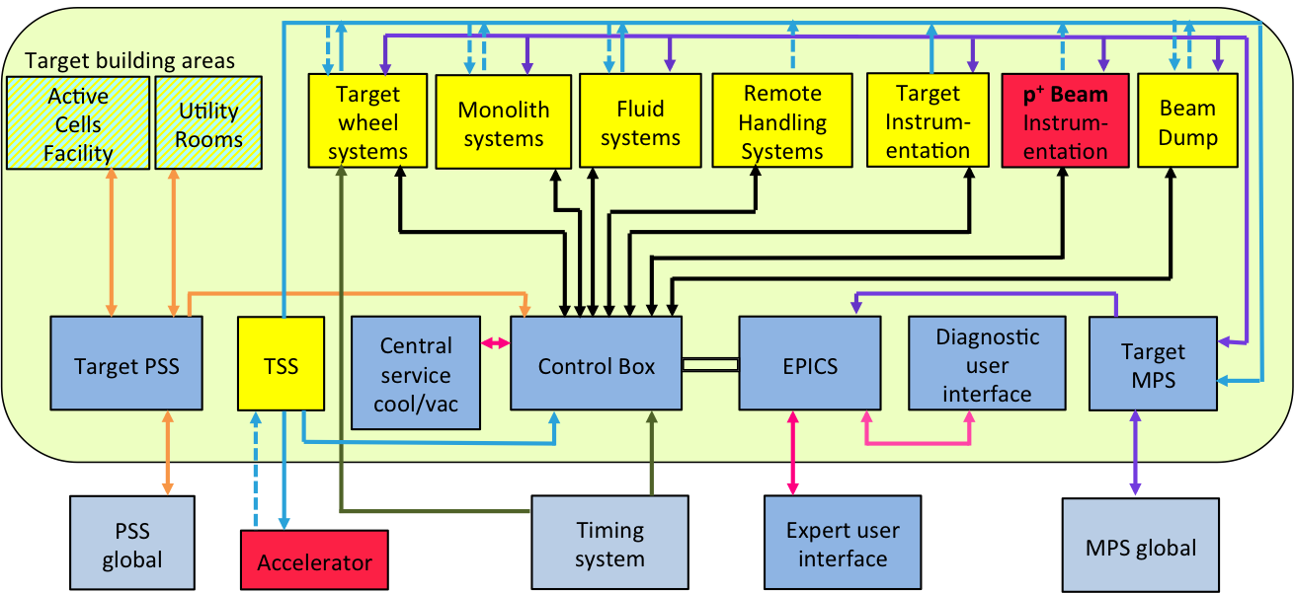
Pilot TSS – Interfaces with ICS systems
TSS signal to Target MPS verifying that it is functional
TSS may send data into EPICS via ICS control box
Interface under evaluation
Independent sensors, actuators, cables, cable trays, etc.
Ex. MPS and TSS both capable of beam shut off at ion source

Slide 24
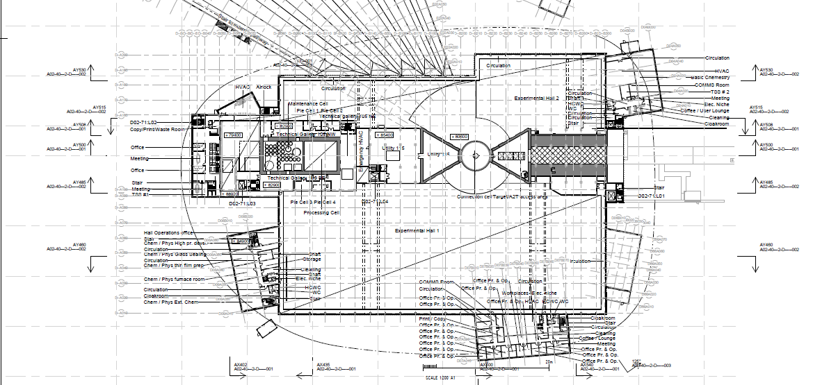
Pilot TSS – CF Interfaces
TSS Rooms in Target Building (D02 & D04)
Cable paths – sensors to rooms, rooms to accelerator front end
24

