Slide 1
Plans for the RF systems
Anders Sunesson, RF group leader
Carlos Martins, Morten Jensen
WP 8 & 17 staff
2015-04-01

Slide 2
Overview
RF general points
Plans modulators
Plans LLRF
Plans phase reference line
Plans high power amplifiers
Plans distribution systems
Plans interlock systems
Plans installation

Slide 3
RF System Challenges
To deliver 71 high power RF systems on a greenfield site with a new team by 2019 (stage I), and another 84 by 2022 (stage II)
Staffing up the RF group to a satisfactory level in a timely fashion
Installation/Commissioning of equipment in time
Cavity field/phase regulation accuracy
A large portion of the RF systems are planned as in-kind and managing this is/will be very challenging

Slide 4
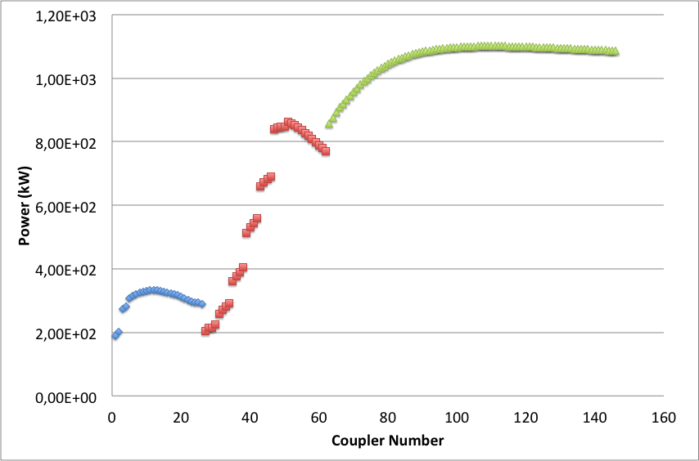
The ESS Superconducting Power Profile
> 150 cavities/couplers
1 RFQ and 5 DTL tanks
352 MHz 2.8 MW Klystrons
84 High Beta
704 MHz (5 cell)
1.2 MW IOT
MB Klystron as backup
26 Cavities
352 MHz
2*200 kW Tetrodes
36 Medium Beta
704 MHz (6 cell)
1.5 MW Klystrons

Slide 5
In Kind discussions
NC RF systems and Spoke LLRF provided by ESS-Bilbao
Spoke RF transmitters provided by Elettra
Spoke, medium/high beta interlock systems provided by Hungary
704 MHz LLRF provided by Poland
Phase reference line provided by Warsaw Technical University
Distribution systems spoke, medium and high beta provided by Huddersfield University
Installation services provided by IFJ PAN Krakow
Ongoing discussions on design of dry HV HF transformers with Technical University Tallinn, Estonia
Covers all of WP 8 for the linac except Master oscillator, medium/high beta amplifiers
Covers WP 17 except medium/high beta modulators

Slide 6
Master Schedule – WP08 & WP17

Slide 7
Plans Modulators Strategy A
ESS internal development of a new topology (SML – Stacked Multi-Level)
Construction and validation of a Reduced Scale prototype rated for 120 kVA (115kV / 20A, 3.5ms / 14Hz) in collaboration with Lund University (LTH). Can power one 704MHz 1.2MWpk klystron
Project has started in June 2013. Completion and demonstration of technology are foreseen for fall 2015
Upgrade to the full scale system 660kVA (115kV / 100A, 3.5ms / 14Hz) is a matter of thermal re-design and selection of higher current components. The full scale modulator is able to power 4x 704MHz 1.2MWpk klystrons in parallel. Straightforward approach with low risks

Slide 8
Plans Modulators Strategy B
ESS has launched an Invitation To Tender for the design and construction of one 330kVA modulator
  Contract awarded to Ampegon on June 2014
  Technical Design Report under review
  Delivery foreseen for Feb 2016
  Soak testing in Uppsala RF test stand, from March to May(?) 2016
CEA / Saclay has launched an Invitation To Tender for the design and construction of another 330kVA modulator for their RFQ test stand. It can also serve as a technology demonstrator for ESS
  Contract awarded to DTI on Oct 2014
  Delivery foreseen for Jan 2016
  Soak testing at CEA/Saclay RFQ test stand from January to April(?) 2016

Slide 9
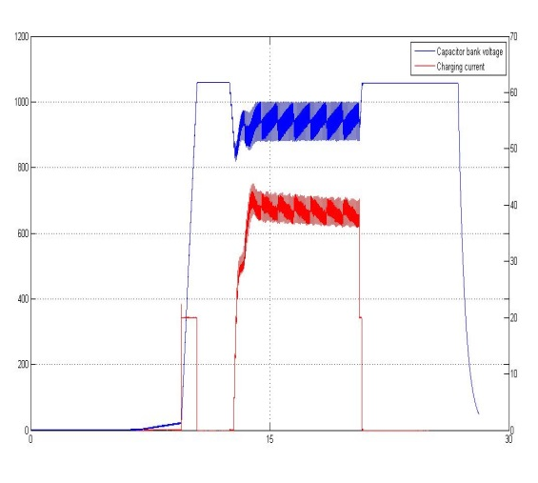
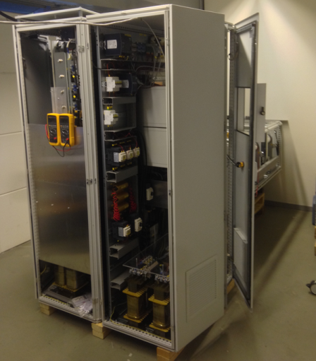
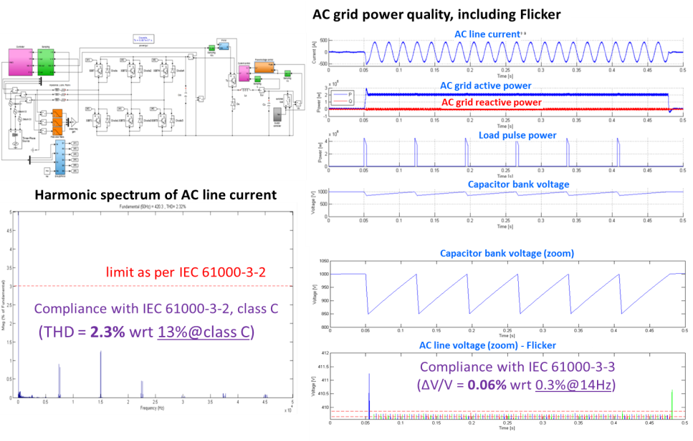
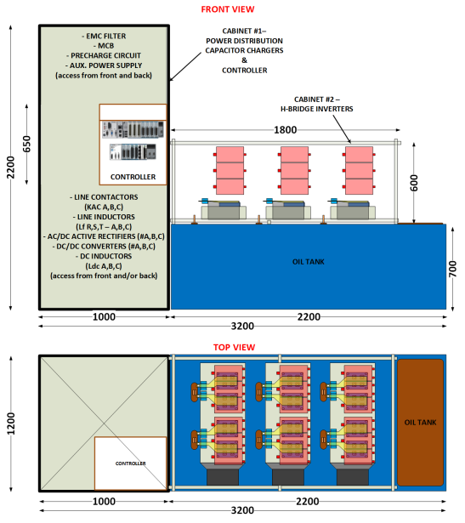
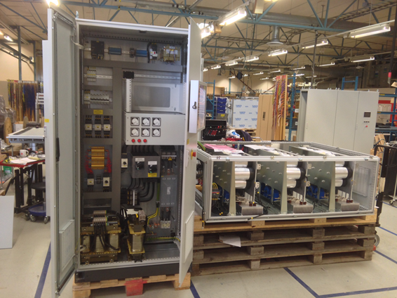
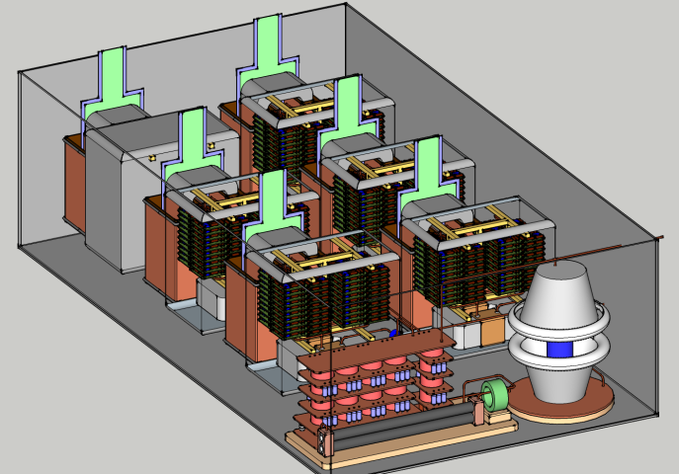
From a conceptual design to reality…
The Stacked Multi-Level (SML) modulator:
– Development roadmap
Construction and testing of High Voltage Oil tank assembly
Feb’15 to Sept’15
Jun ’13
Experimental results, low voltage stage
Sept ’13 – May ’14
Jan ’15
Apr ’14
May ’14
Aug ’14
9

Slide 10
Modulator decision chart (to medium β)
Strategy | Ready/Delivery | Validated | Decision point | Outcome
A - SML | Fall 2015 | End 2015 | If A: SML fully validated, Q1 2016 If B: July 2016 | Strategy A: Launch call for tender for 660 kVA units medium beta. ESS Bilbao similar action for NC linac
B:1- Ampegon | Q1 2016 | Mid 2016
 |  |  |  | Strategy B: Launch call for tender for 330 kVA units for medium beta. ESS Bilbao similar action for NC linac Note: higher cost (≈6 M€ Mβ), schedule challenges
B:2 - DTI | Q1 2016 | Mid 2016

Slide 11
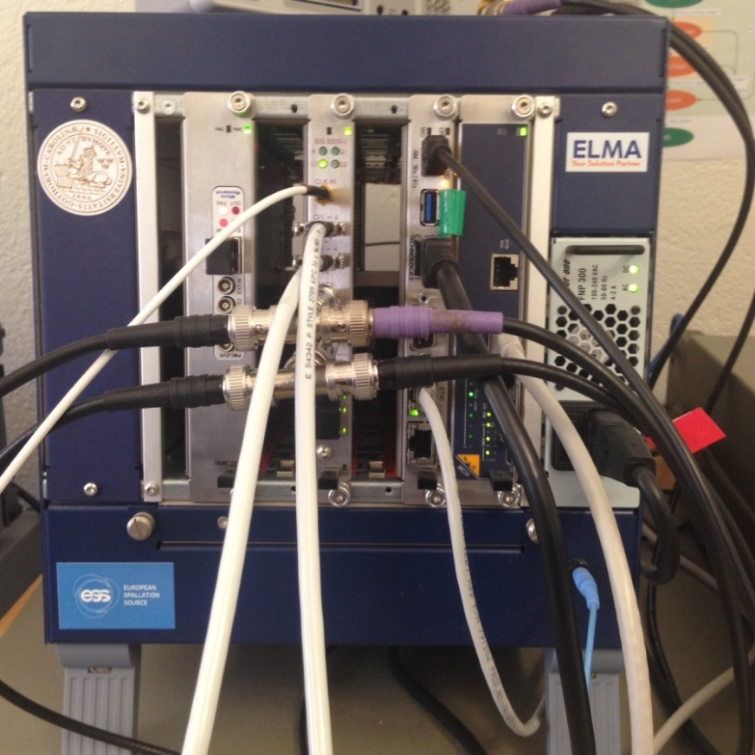
ESS LLRF prototype (in LU lab)
  mTCA 4 standard
  Digital implementation of fast control in FPGA
  Modular design for simple maintenance and large volume procurement
  Regulation 352 tested
  704 function tested
  One cavity/crate, two possible
  Control via EPICS/GUI working

Slide 12
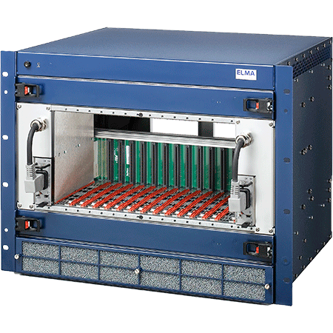
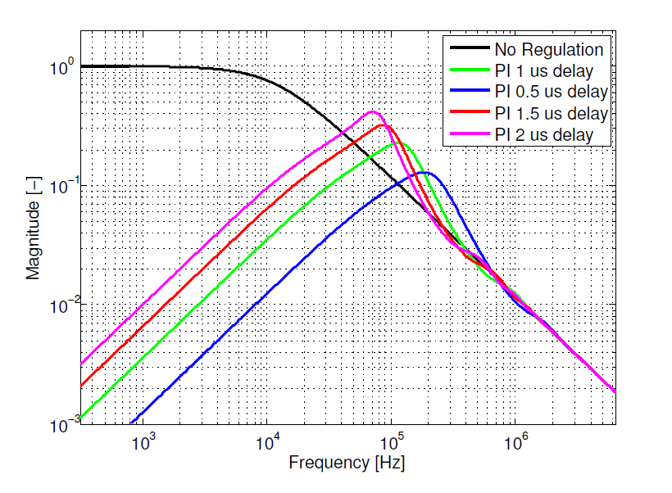
Efforts LLRF
  Adaptive feedforward learning
  Lorentz force detuning compensation
  Tests (352 @ FREIA, 704 @ Saclay)
  Klystron linearisation
  Requirements on precision (workshop May)
    Control/cavity system modeling
    Beam physics (loss) modeling
    Regulation system set-up
    Handling beam current variations
    Handling modulator ripple
Note all LLRF provided in kind

Slide 13
Plans Phase ref line
First design prepared
Prototyping 2015-2016, scaled down version to test
    Phase reference signal delivery system
    Air pressure system
    Temperature control system
    Data acquisition, drift calibration, EPICS interface
Phase reference line provided in-kind

Slide 14
Prototype Block Diagram
Temperature controlled within ±0.1°C
MO
Data Acquisition and EPICS interface
20dBm,352.21MHz
20dBm, 704.42MHz
CPU
~40dBm, 352.21MHz
~50dBm, 704.42MHz
Data Communication Bus
Data Acquisition Board
Input from temperature sensors, air pressures, amplifier protection signals
7/8’’ Coaxial cable
Temperature controlled within ±0.1°C
352.21MHz, 1 5/8’’ rigid line
Drift Calibration
704.42MHz, 1 5/8’’ rigid line
Digital Domain
…
…
3/8’’ coaxial
cable
ADC
ADC
ADC
ADC
ADC
ADC
ADC
ADC
ADC
16dBm at each tap point for LLRF, BPMs, and BSMs
Total 12 taps in prototyping
SNR at each output shall be >70dB in single side bandwidth1MHz
Integral phase noise 1Hz~100kHz shall be >70dB
Input from 6 taps and 2 MO outputs

Slide 15
Plans High power amplifiers
Section | Power /kW | Baseline | Status
Normal conducting RFQ and DTL | 2800 | Klystron | In kind
Normal conducting bunchers | 30 | Solid State | In kind
Spoke linac | 400 | Tetrode | In kind
Medium beta linac | 1500 | Klystron | Prototyping
High beta linac | 1200/1500 IOT/klystron | MB-IOT (decision end 2017) | Prototyping

Slide 16
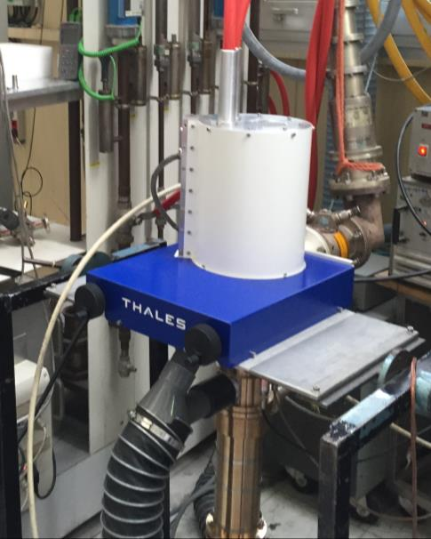
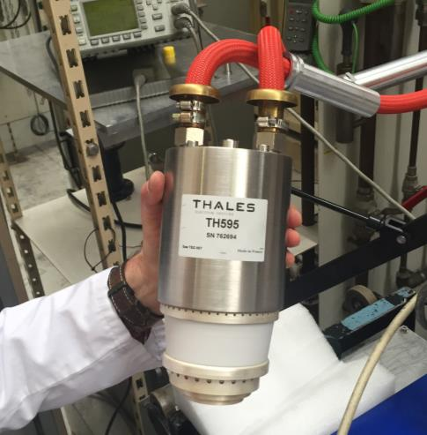
Spoke power sources
400 kW tetrode-based solution
Two complete stations to Uppsala University FREIA facility (Proof of concept)
FAT of tube recently (Thonon)
Results
Peak power | 200 kW
Efficiency | 66%
Gain | 15 dB
Duty | 4.6%

Slide 17
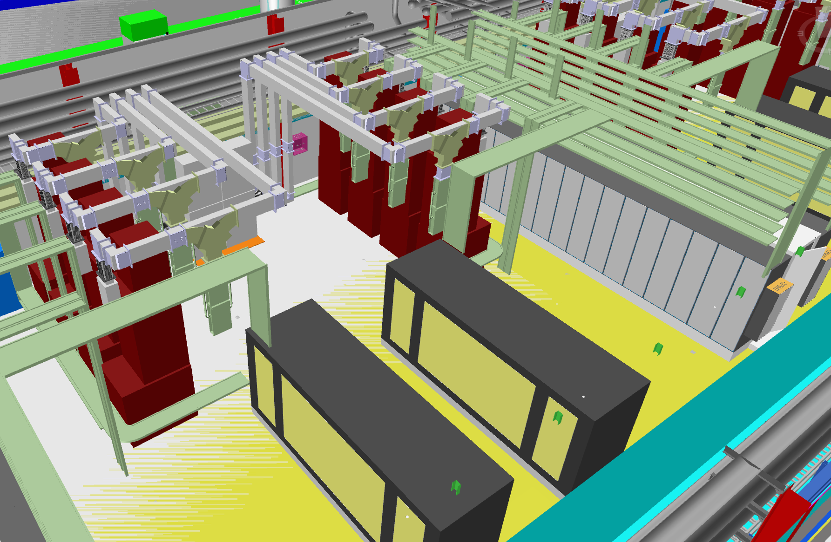
Medium and high beta (klystron option)
36 Medium beta elliptical cavities: 704.42 MHz, input power from 207 kW to 866 kW (plus 30% for losses compensation and overhead) → saturated power from klystrons up to 1.15 MW
84 High beta elliptical cavities: 704.42 MHz, input power from 835 kW to 1.1 MW (plus 30% with klystrons); 1.2 MW MB IOTs (or klystrons as backup)
Racks
Klystron specs
Nominal output power | 1.5 MW
Frequency | 704.42 MHz
BW | ≥ +/- 1 MHz
Pulse width | 3.5 ms
Repetition rate | 14 Hz
Perveance | 0.6*10⁻⁶
Efficiency | >60%
VSWR | Up to 1.2
Power Gain | ≥ 40 dB
Group Delay | ≤ 250 ns
Harmonic Spectral content | ≤ -30 dBc
Spurious Spectral content | ≤ -60 dBc
Klystrons
Modulators
4.5 Cells of 8 klystrons for Medium Beta
10.5 Cells of 8 klystrons (IOTs) for High Beta

Slide 18
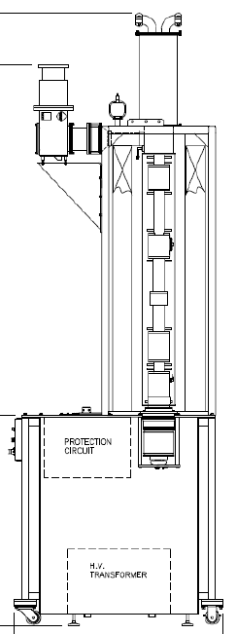
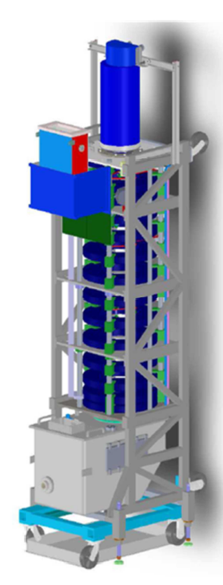
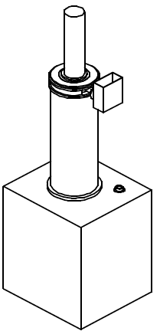
Medium and high beta (klystron option)
Three klystron prototypes are being procured, from three different manufacturers (Thales, Toshiba and CPI)
 | Status of the contract | Expected delivery date
Thales | Contract started in January 2015 (Kickoff meeting held at the end of January) Klystron design based on the TH2182 for Cern with minor modifications Design review in one month | March 2016
Toshiba | Contract started at the beginning of March 2015 (Kickoff meeting held on March 17th) Design review next May | May 2016
CPI | Contract in place | July 2016
Preliminary drawings
Toshiba
E37504
CPI
Thales
TH 2180

Slide 19
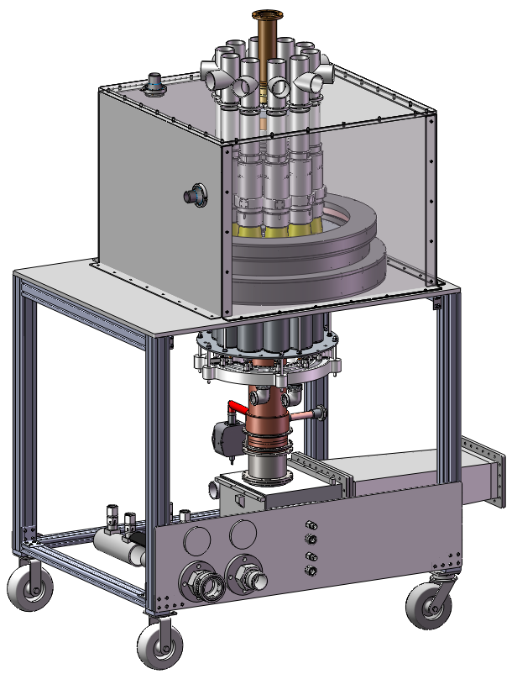
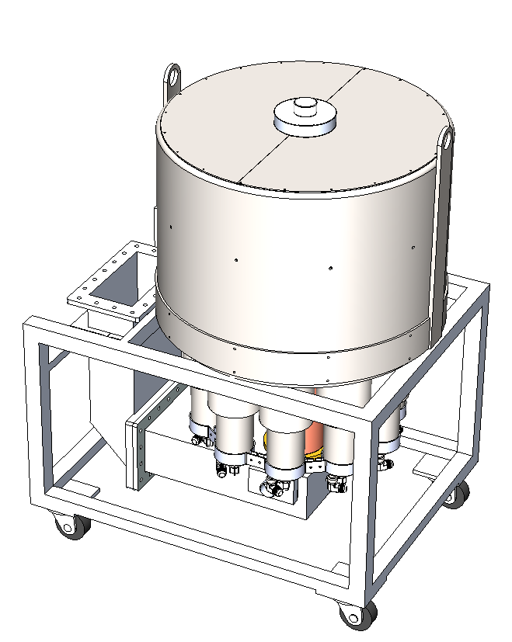


Multi-Beam IOT for ESS (High beta baseline)
10 Beam Multi-Beam IOT
1.2 MW
704 MHz

Slide 20
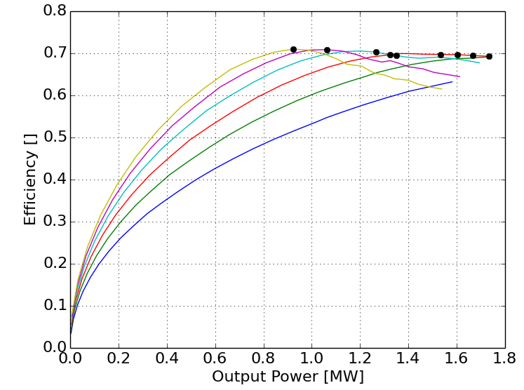
Operational Optimisations
Courtesy of L3 Communications
1.3 MW
70% eff
Power and Efficiency
Impact of HV
Plot shows maximum achievable efficiency for various operating points
Increased beam voltage provides for better performance
  Increases gain
  Increases efficiency
  Decreases body current
Simulations are for 10 beams

Slide 21
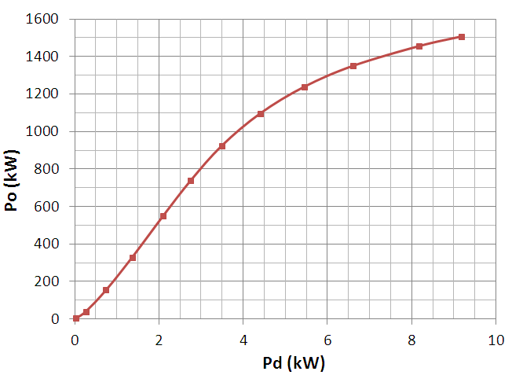
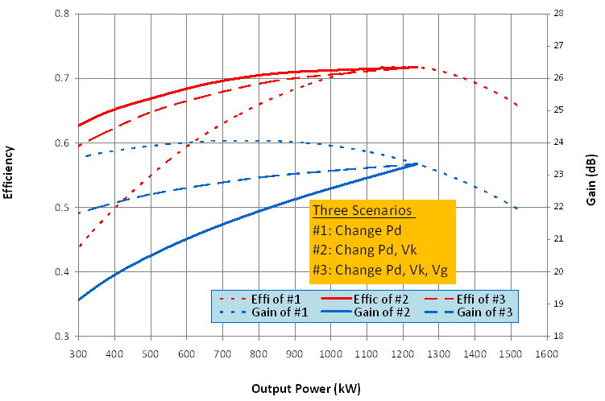
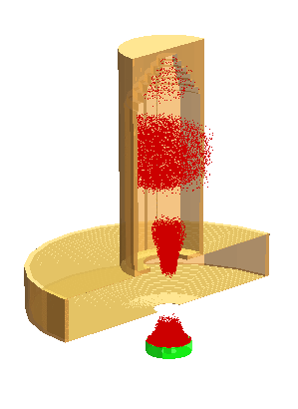

MAGIC Prediction of MB-IOT Performance
Courtesy of Thales and CPI
Power Transfer Curve
Efficiency & Gain vs Output Power
1.2 MW
Efficiency
Gain
V_{k} = 48 kV
Class-C
MAGIC-3D simulation of one beam with MB-IOT off-axis B-field
At 1.2 MW, η = 72% with V_{k} = 48 kV
At 600 kW
  η = 59% with V_{k} = 48 kV
  η = 68% with V_{k} = 34 kV

Slide 22
Plans distribution systems
Section | Type | Status | Partner
Normal conducting RFQ and DTL | Waveguide | In kind | ESS Bilbao
Normal conducting bunchers | Transmission line | In kind | ESS Bilbao
Spoke linac | Waveguide | In kind +Prototype UU | Huddersfield University
Medium beta linac | Waveguide | In kind +Prototype Lund | Huddersfield University
High beta linac | Waveguide | In kind +Prototype Lund | Huddersfield University
Issues: high temperature cooling water in loads – new external development needed

Slide 23
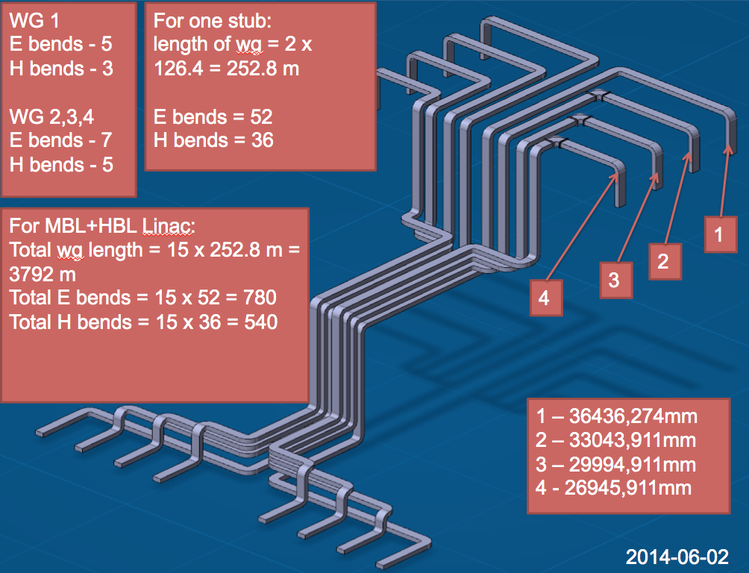
Distribution system layout example MB
ESS needs waveguides in
Huge quantity

Slide 24
Interlock: Prototype design
  PLC module plus fast module.
  PLC monitors slowly varying signals (temperatures etc)
  Two FIM (Fast Interlock Module) are being designed in parallel (arc detectors, pin diodes, etc)
    Siemens FM352-5 Fast Boolean Processor (FPGA based) – 12 Inputs / 8 outputs per module. Only 24VDC digital inputs/outputs are available.
    Fast Interlock Module NI cRIO connected via Fieldbus to the main controller PLC CPU. Different signal types I/O are available.

Slide 25
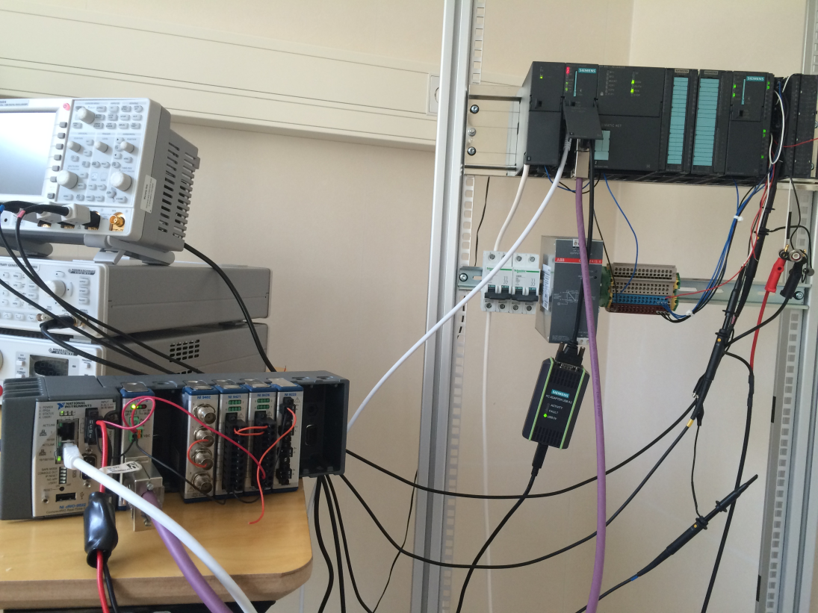
Prototyping in lab

Slide 26
Installation
Installation includes
  Mounting waveguides in stubs
  Mounting distribution systems in gallery and tunnel
  Installing modulators and klystrons
  Installing all systems
  Hooking up to power, cooling, and cabling
  Testing/commissioning all systems and subsystems
Discussions with IFJ PAN Krakow for many of these services

Slide 27
IOTs and power supplies for high beta
2 prototypes will be delivered end 2016
Testing at CERN complete mid 2017
Technology decision for high beta end 2017
  If IOT looks successful PSU development needed
    Proof of concept start 2017
    Start of series contract 2018
    Delivery first unit 2020
  If Klystron is the choice
    Start of series contract 2018
    Delivery first unit 2020

Slide 28
Thank you

Slide 29
Spare slides

Slide 30
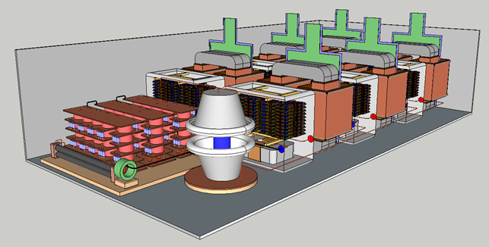
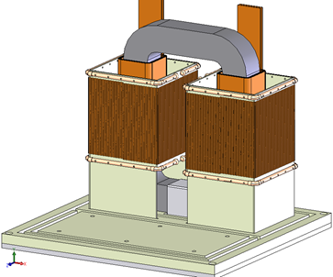
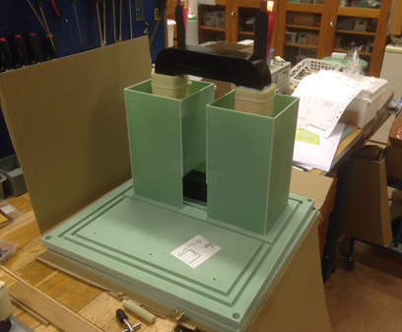
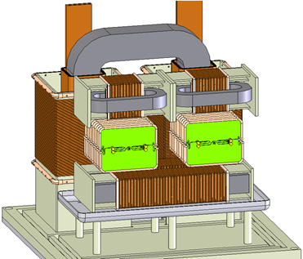
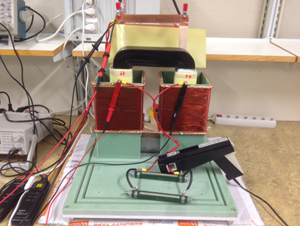
High Voltage oil tank assembly:
Design in view of construction . Collaboration with LU
HV module
HV oil tank assembly
(Collaboration between ESS and LTH)
Design of the whole system undergoing;
HV module (HV transformer + HV rectifier)
Construction and validation of one HV module prototype is undergoing:
  - HV transformer assembled (first test results obtained two weeks ago);
  - HV rectifier is under construction (PCB’s delivered last Tuesday)
control signal
primary voltage
secondary voltage
secondary current

Slide 31
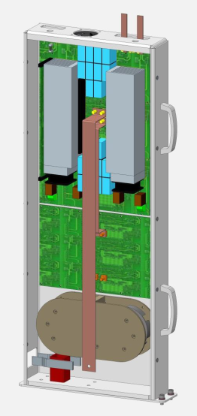
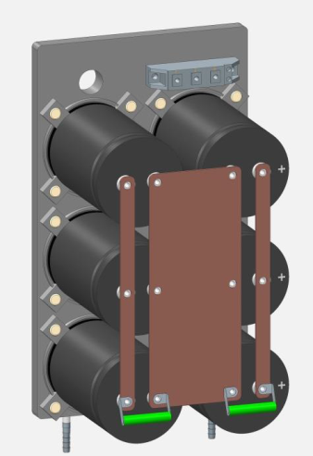
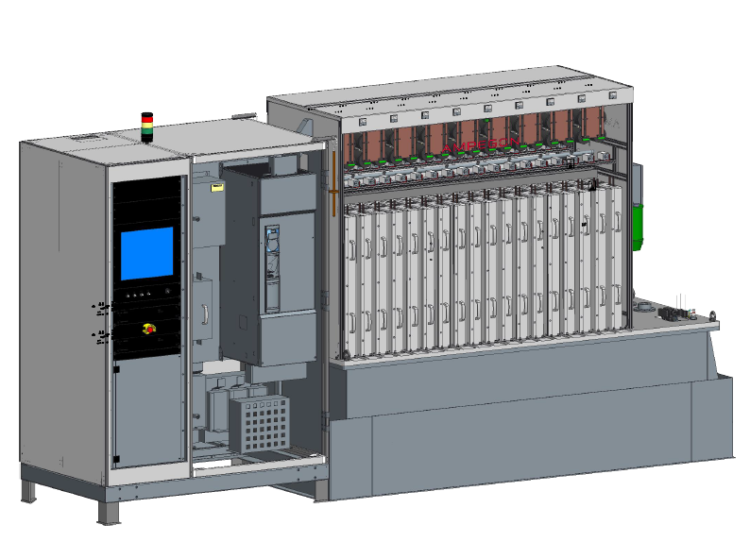
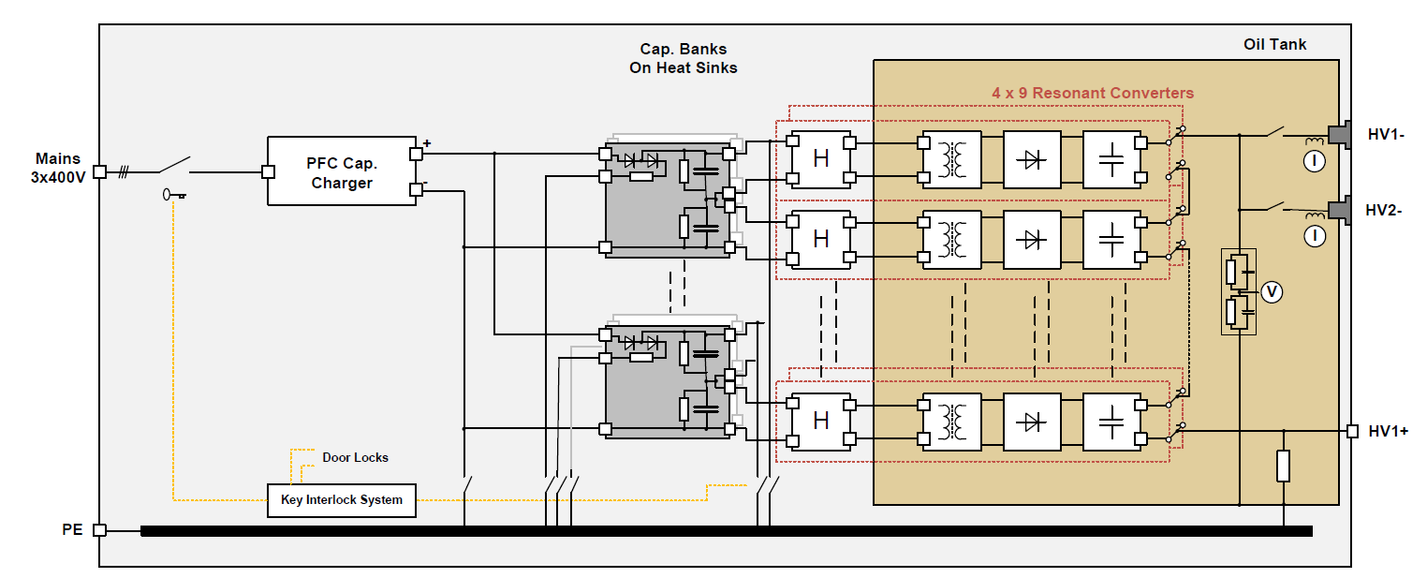
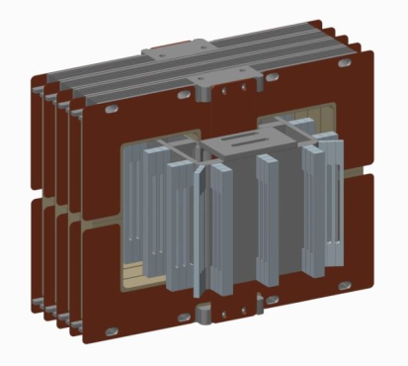
330 kVA modulator, strategy B1
AMPEGON AG
H-bridge inverters (x36) based on MOSFET’s (x720)
Electrolythic capacitors
(x108)
HVHF transformers (x36 units)

Slide 32
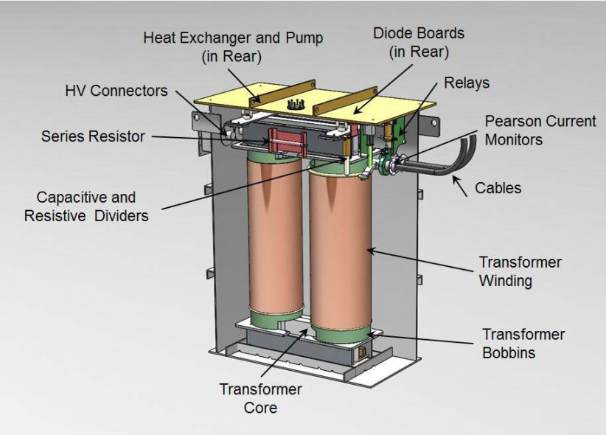
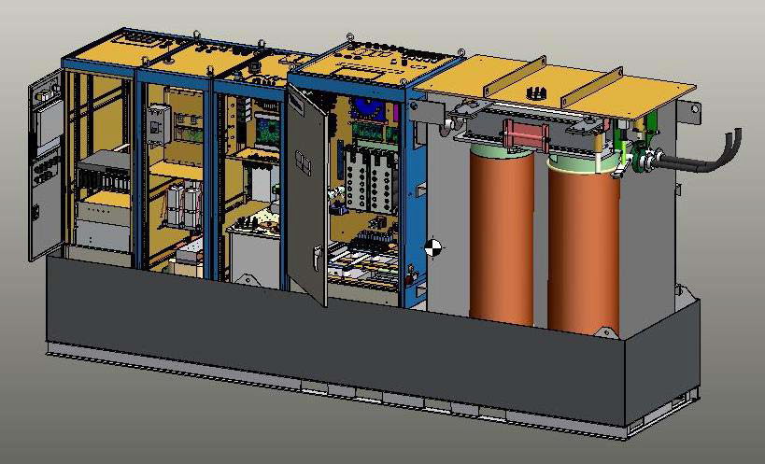
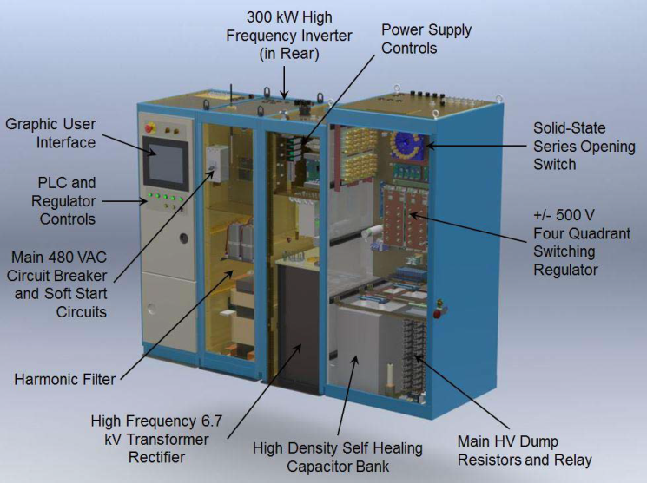
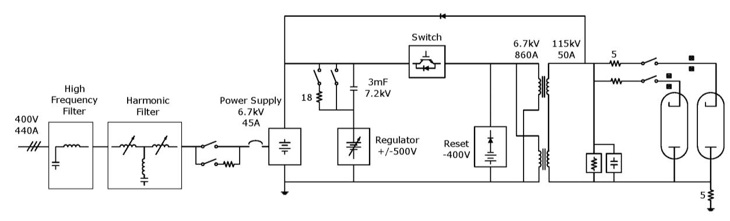
330 kVA modulator, strategy B2
Pulse Transformer (7.4tons; 1’850 liters of oil)
Diversified Technologies Incorporated, DTI
Primary pulse generator (weigth = 5 tons)

Slide 33
LLRF system NC

Slide 34
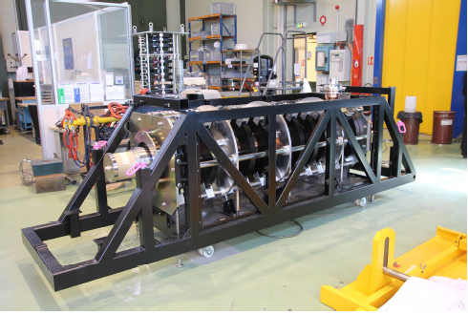
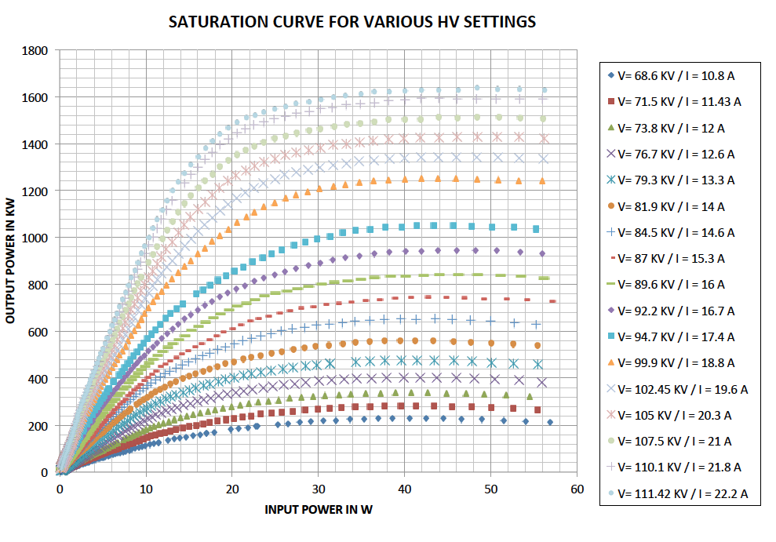
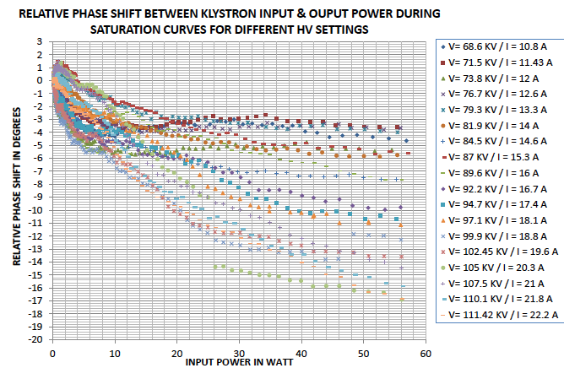
Some results from the TH2182 klystron testing at CERN
The klystron TH2182 has also been tested at ESS parameters
Nominal output power | 1.5 MW
Frequency | 704.42 MHz
Beam Voltage | 111.4 kV
Beam current | 22.2
Repetition rate | 2 Hz
Pulse length | 1.8 ms
Efficiency | 66%
Saturated Gain | 45.15 dB
Group Delay | 130 ns
Courtesy of Thales ED and CERN

