Slide 1
Monolith design update – Emphasis on Neutron beam extraction design
Rikard Linander
Monolith and Handling Group
ESS Target Division
www.europeanspallationsource.se
TAC 11, Lund, Apr 1, 2015

Slide 2
Outline
Monolith/building interface
  Lower support cylinders
  Seismic load specification
Neutron beam extraction
  Modified angular separation
  Adjusted focal points
  Double decker flexibility
  Neutron beam port dimensions
Non-scattering science opportunities
  ECHIR – ESS chip irradiation
  nnbar – neutron/anti-neutron oscillation experiment
External light shutters
  Vertical shutter concept
  Rotating shutter concept

Slide 3
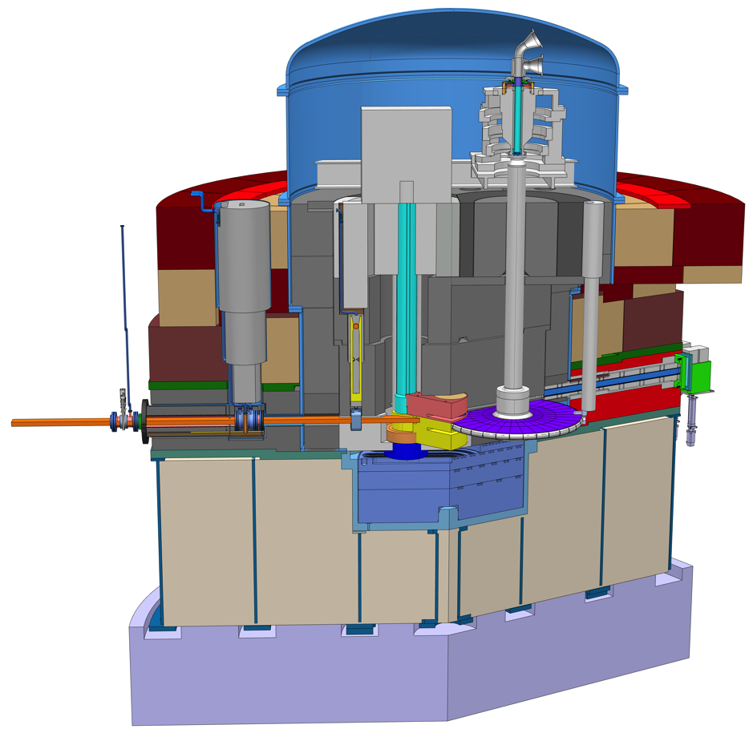
Monolith layout - recap
Proton beam instrumentation plug
Neutron beam extraction
Proton beam window
Light shutters
Proton beam envelop
representation
Target monitoring plug
Upper and lower
moderator and reflector
Target wheel

Slide 4
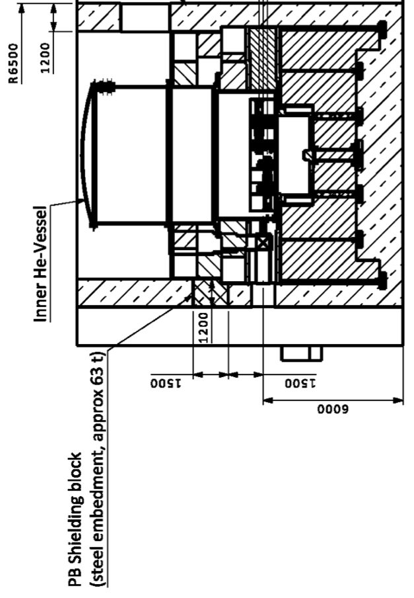
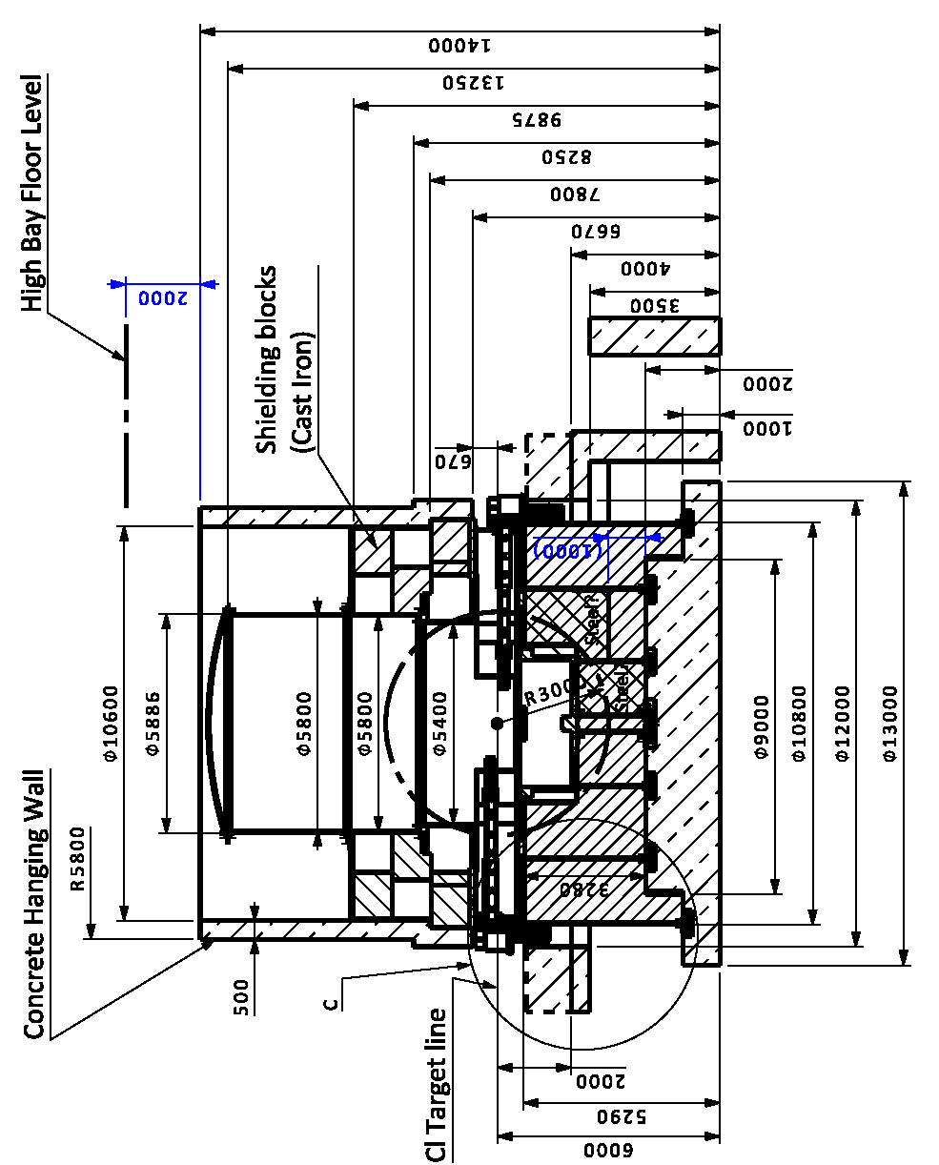
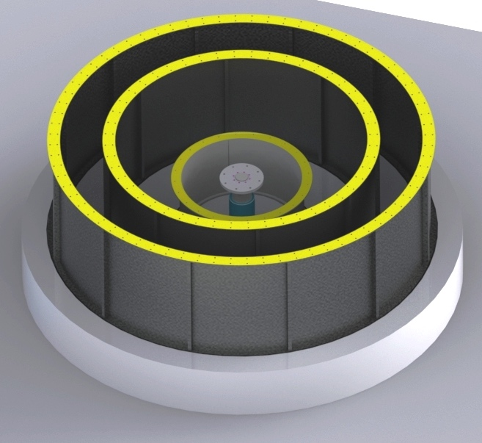
Monolith/building interface
Design, manufacturing and delivery of the lower support cylinders by November 2015
Development of plan for installation and anchoring of the support cylinders into the concrete foundation

Slide 5
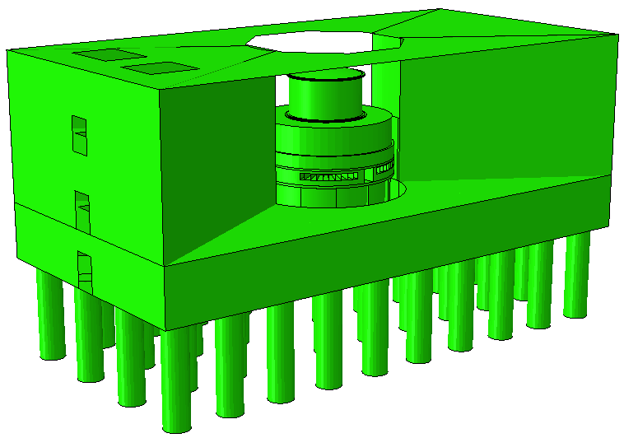
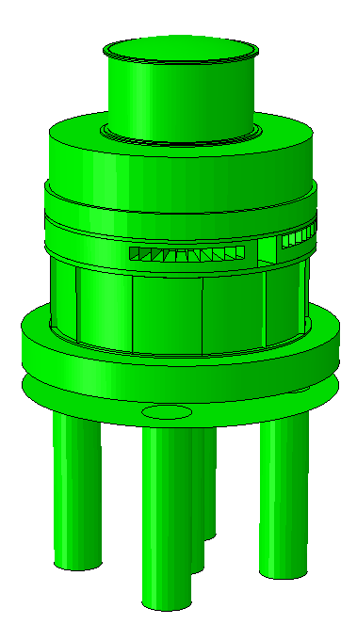
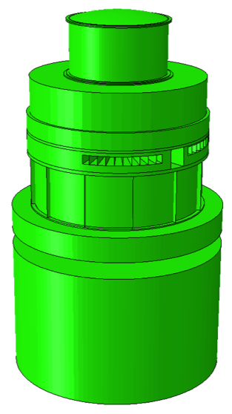
Monolith/building interface
Seismic load specification
Total weight of 40000 tons for the Monolith and adjacent concrete structures
Different locations of necessary dilatation joints between monolith and experimental halls were evaluated
Interaction effects between the Monolith and the structures

Slide 6
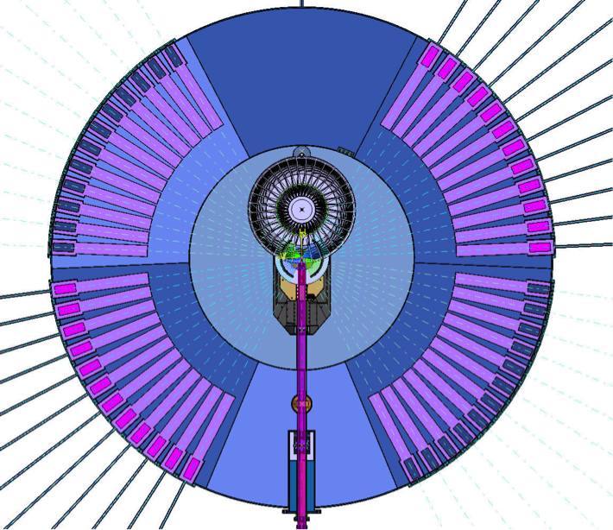
Neutron beam extraction
Modified angular separation
TDR baseline design
  48 beam ports arranged in four sectors
  Upper volume moderator serving N(60°)
  and S(60°) sectors
  Lower volume moderator serving E(60°)
  and W(60°) sectors
  Uniform 5° angular spacing
  Extra spacing between sectors for structural
  reasons
Change to flat moderators and twister
handling concept
  Made possible to serve all 2x120° for both
  upper and lower moderator
But recent review of the neutron beam extraction
layout has concluded on need to modify the angular
separation, taking the following considerations into account
  Maximising the total number of instruments
  Minimising background
  Allowing good access for installation and maintenance of instrument components
  Allowing sufficient space and access for instrument operation
  Minimising disruption and work associated with the replacement of beam guide inserts
  Allowing a good shielding bunker design
Four 60 degree sectors, each with 12 ports for potential neutron beam positions

Slide 7
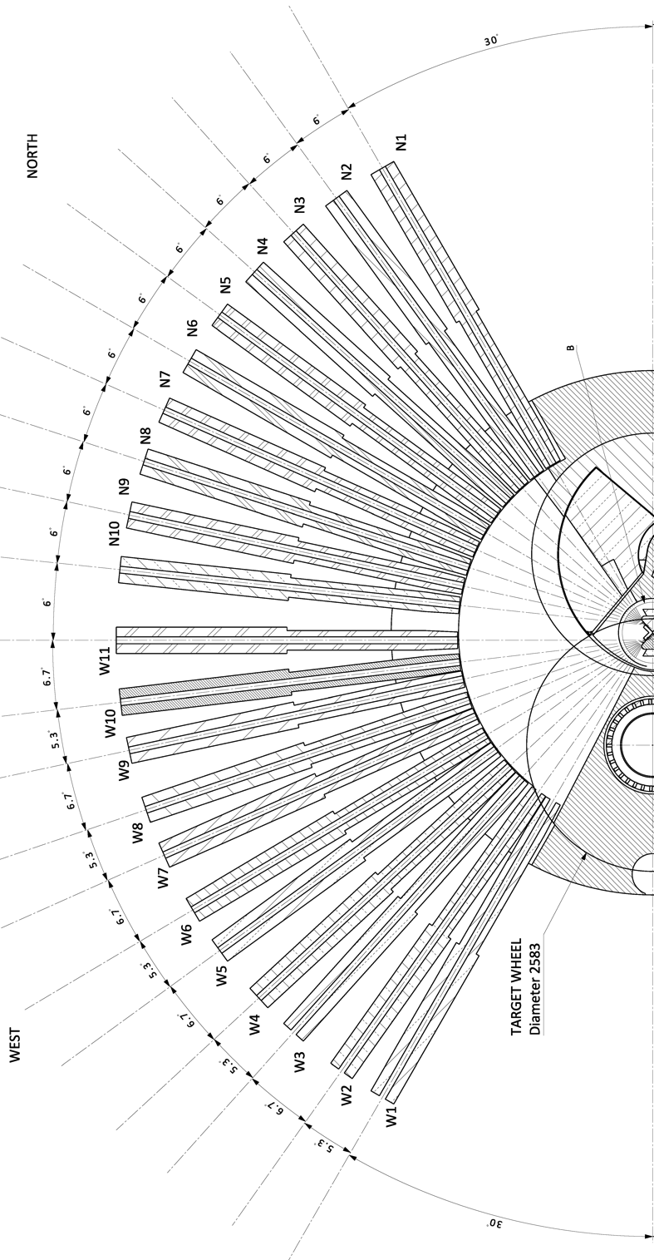
Neutron beam extraction
Modified angular separation
One additional central beam port between north and west sectors, perpendicular to the proton beam, grouped with the west sector
Corresponding central beam port on the other side, grouped with the south sector
10 beam ports
with alternating
5.3°/6.7° angular spacing for S and W sectors
10 beam ports with uniform 6° angular spacing for N and E sectors

Slide 8

Instrument layout
C-SPEC
HEIMDAL
CAMEA
BEER
NMX
FREIA
LOKI
VOR
ESTIA
ODIN
SKADI
In 2014 programme
Placeholders for last 10
DREAM

Slide 9
Instrument construction plan
Instrument | 2014 | 2015 | 2016 | 2017 | 2018 | 2019 | 2020 | 2021 | 2022 | 2023 | 2024 | 2025 | 2026 | 2027 | 2028 | 2029 | 2030
Instrument 1
Instrument 2
Instrument 3
Instrument 4
Instrument 5
Instrument 6
Instrument 7
Instrument 8
Instrument 9
Instrument 10
Instrument 11
Instrument 12
Instrument 13
Instrument 14
Instrument 15
Instrument 16
Instrument 17
Instrument 18
Instrument 19
Instrument 20
Instrument 21
Instrument 22
Construction Project
Hot Commissioning
Beam on Target
version 2015-03-10

Slide 10
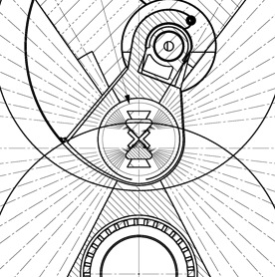
Neutron beam extraction
Adjusted focal points
Corner extraction scheme with four different centre line origins, one for each sector, to adapt to optimised moderator design
Facilitates viewing of either cold or thermal moderator as well as bi-spectral beam extraction

Slide 11
Neutron beam extraction
Double decker flexibility
Can be equipped for view of either or both (e.g. HEIMDAL) the upper and the lower moderator
Can serve instrument with specific requirements on beam extraction, such as inclined (e.g. FREJA) or elliptical beam guides

Slide 12
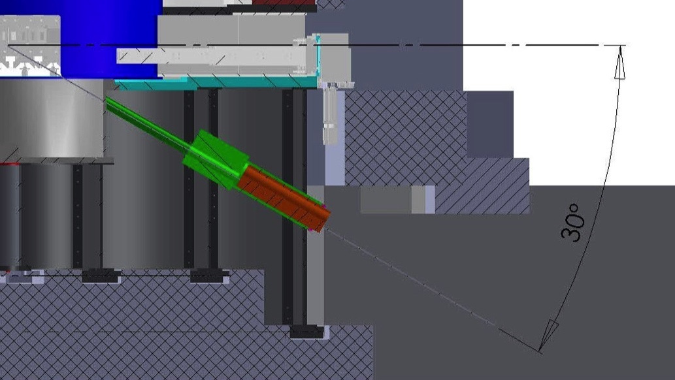
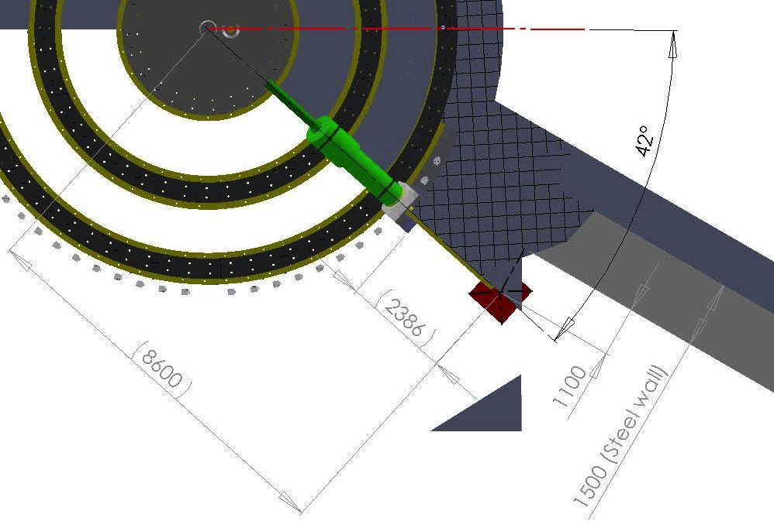
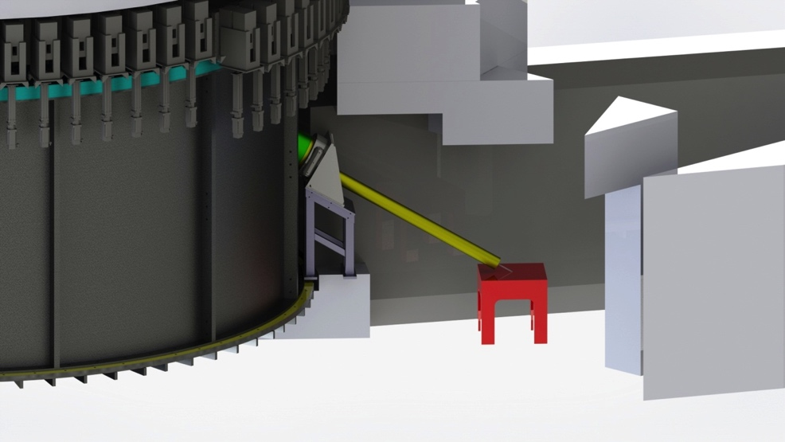
Non-scattering science opportunities
ECHIR – ESS chip irradiation
Dimensions
  Originates from the downstream side of the target wheel sector
  30° downward relative the horizontal plane
  42° sideward relative the proton beam trajectory
  Open channel 120 mm x 120 mm
Location
  Irradiation cabinet, provisionally a cube with 1 m sides, placed in basement room

Slide 13
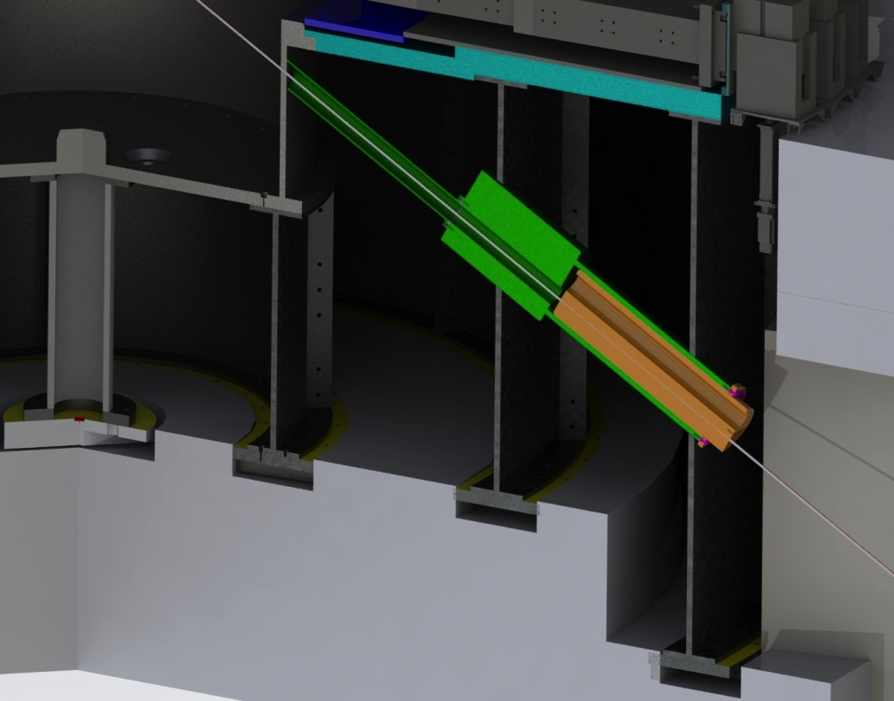
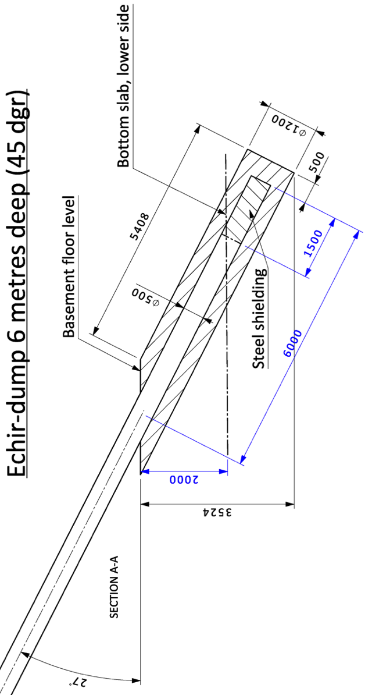
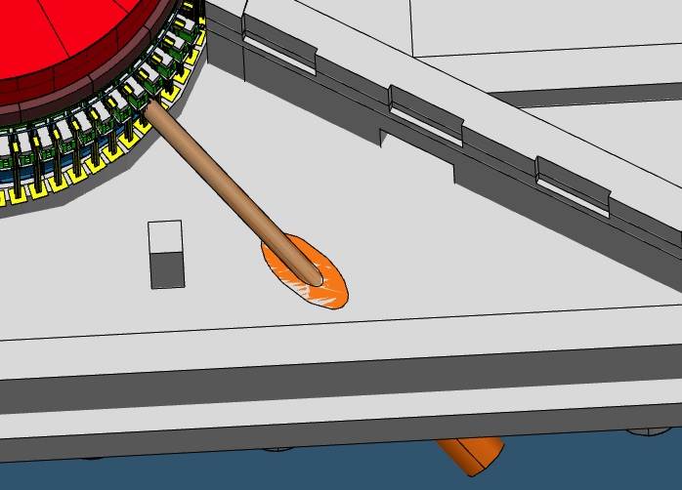
Non-scattering science opportunities
ECHIR – ESS chip irradiation
Necessary preparations to allow future pursuit of ECHIR
  Channel structure mounted within the monolith support cylinders
  Channel plug to make up the required shielding
  Embedment of a dump line into the basement floor slab
  Reservation of space for additional steel shielding and irradiation cave

Slide 14
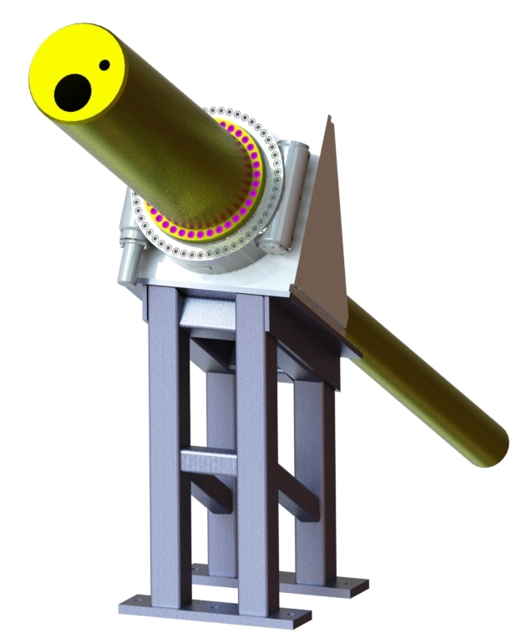
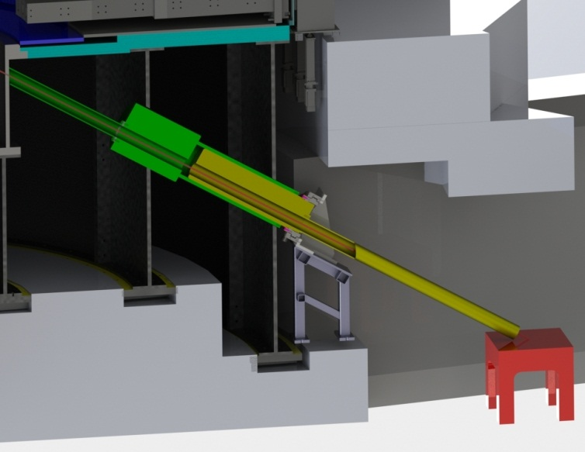
Non-scattering science opportunities
ECHIR – ESS chip irradiation
Provisional ECHIR shutter mechanism
  Metal framework with guide rails for installation and handling
  Slewing drive and bearing unit for rotation of the shutter drum (yellow)
  No mechanisms internal to the monolith or the
  support cylinder structure
  Weight approx. 2 ton
  Shutter length approx. 1.7 m
  Outer diameter 450 mm providing room for
  several irradiation apertures

Slide 15
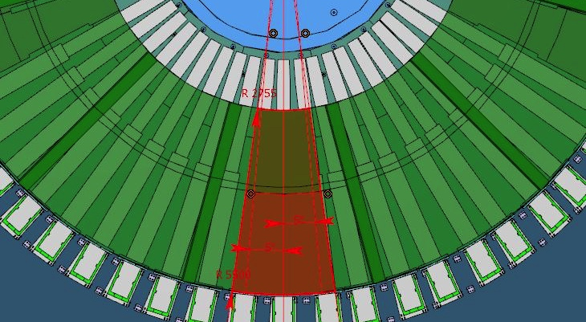
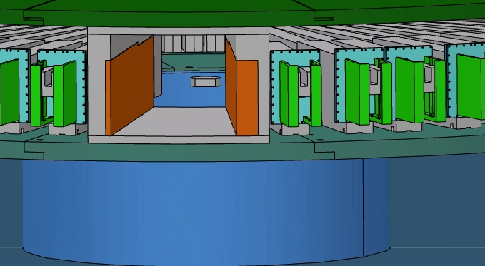
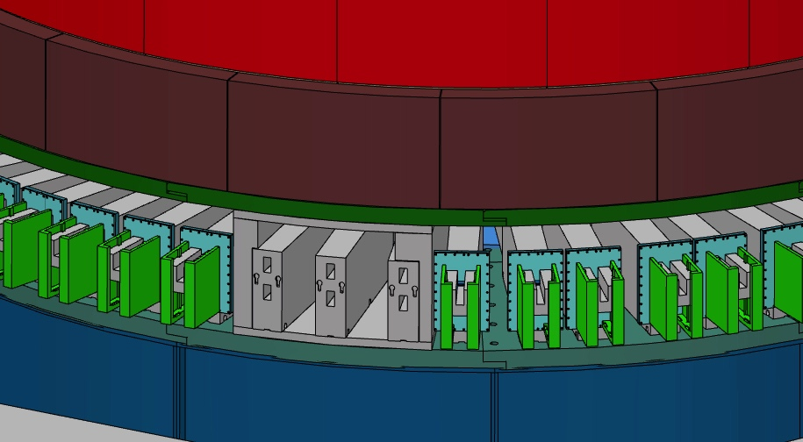
Non-scattering science opportunities nnbar – neutron/anti-neutron oscillation experiment
nnbar concept
  If realised the nnbar experiment will need to occupy up to 15°, i.e. three beam lines
  Requires a hole, 1 m by 1 m, at the surface of the monolith, at R=5.5 m
Necessary preparations to allow pursuit of nnbar
  Fitting a frame into the beam extraction structures allowing the port dimensions needed for the experiment
  The nnbar experiment need to be installed prior to using any of the three normal beam ports
  The frame can be re-fit for three normal beam ports after finalising the nnbar experiment

Slide 16
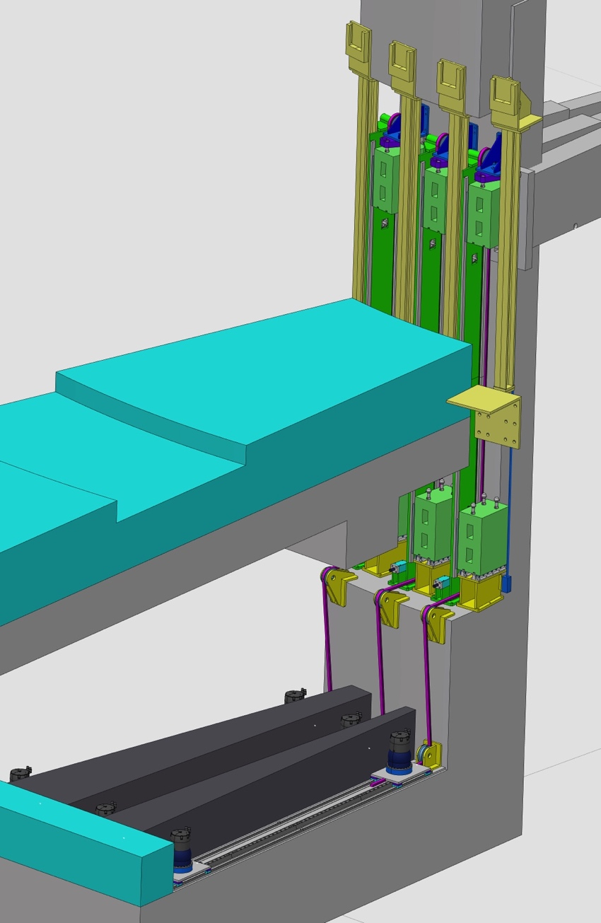
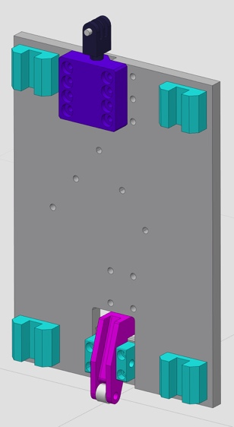
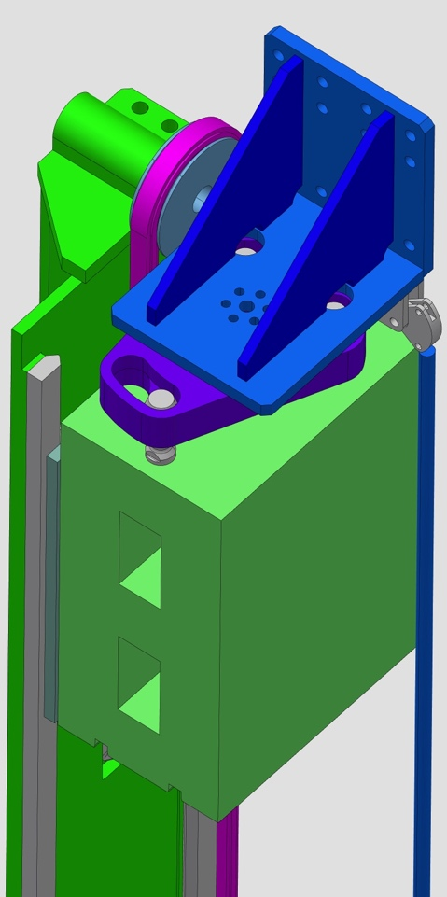
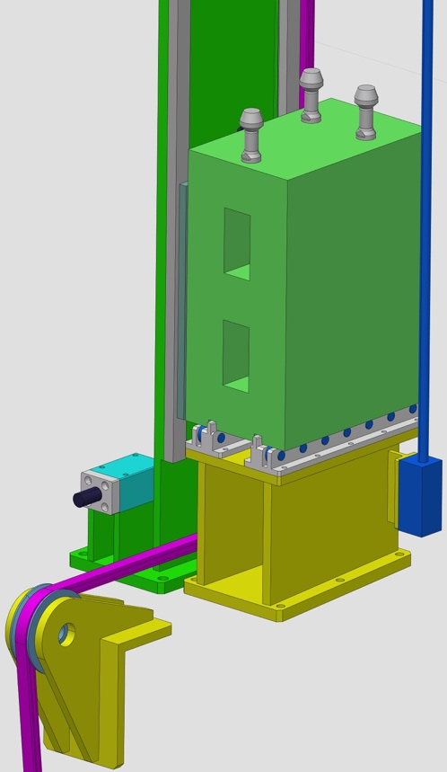
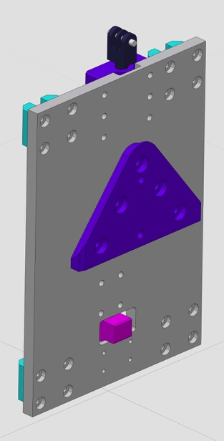
Light shutter design concepts
Vertical shutter
Shutter support bracket fully aligned to the neutron beam guide inserted in the monolith
Shutter in lower
replacement position
Instrument bunker base
Shutter carrier plate
Experimental hall floor
TS basement
Shutter in upper operation
(open) position

Slide 17
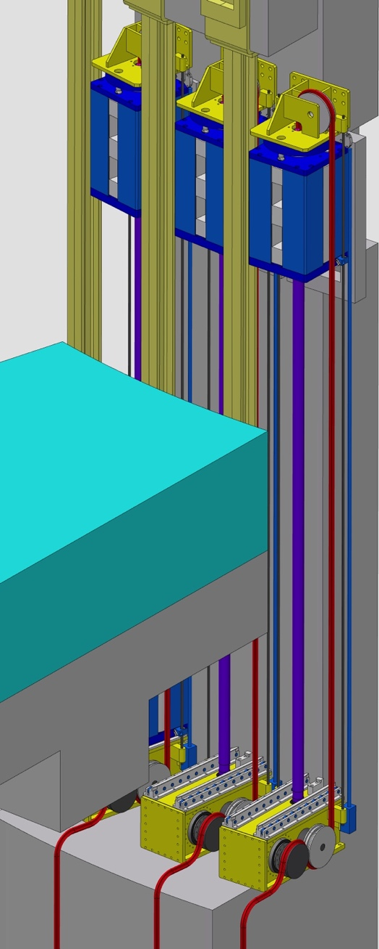
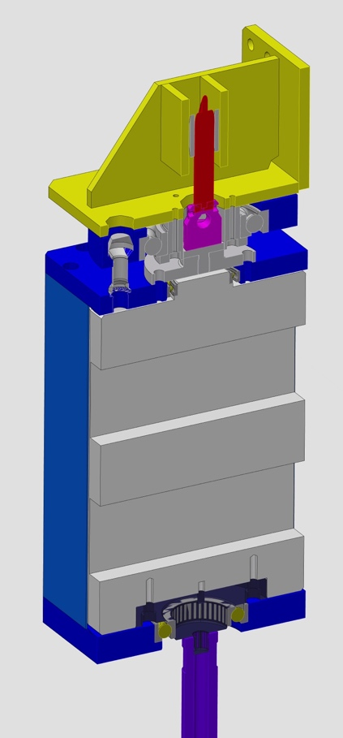
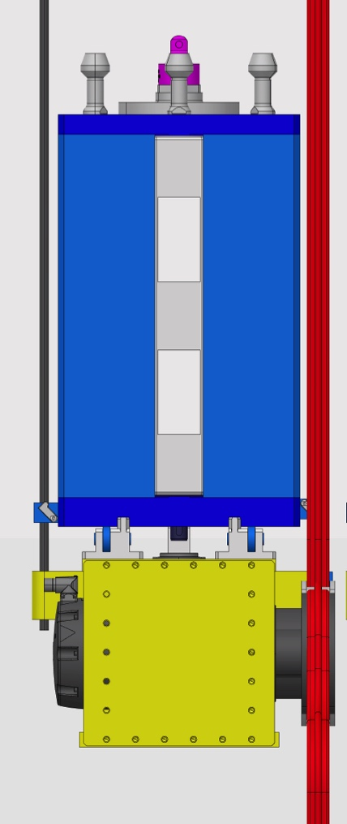
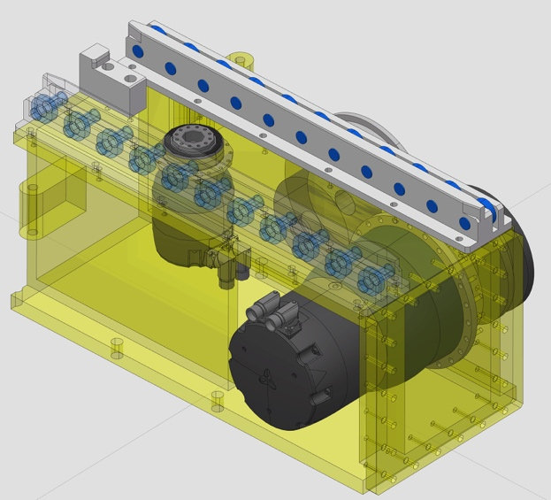
Light shutter design concepts
Rotating shutter
Shutter support bracket fully aligned to the neutron beam guide inserted in the monolith
Shutter in lower
replacement position
Shutter drive box with servo motor for rotation (left) and chain drive motor for lifting (right)
Instrument bunker base
Experimental hall floor
Shutter in upper operation
(open) position
TS basement

Slide 18
Near term activities for the monolith design work
Hand-over and start-up of identified in-kind packages
Performing PDRs for several work units
Tests of different alternatives for lower shielding material
Continued basic analysis work to justify and qualify the preliminary design to specified load cases
Finalising the design of structures that need to be procured and delivered to site by end of 2015
  Lower monolith support cylinders
  Potentially preparatory structures for later implementation of ECHIR
Beam extraction
  Adaption to the chosen moderators designs and MR plug(s) configuration
  Decision of light shutter concept and finalising the preliminary design
  Feasibility studies of future implementation of a fast neutron irradiation port and nnbar

