Slide 1
Helium Purification
Håkan Carlsson
WP Manager Fluid Systems
Per Nilsson, Leif Emås
www.europeanspallationsource.se
1 April 2015

Slide 2
Outline
Purposes
Old (TDR) baseline
New system design (for Target Change Control)
Conclusions

Slide 3
Purposes of chemical purification
Remove spallation products, e.g. ³H and ¹²⁵I (mainly produced in target, ~ 2, 0.3 g/year )
Remove moist air leaking into monolith, N₂, O₂, Ar, H₂O
Particles / dust is removed by filters, mechanical purification - not detailed here!

Slide 4
TDR baseline
Target
PCS
Target Loop
20 m³, 3.6 bar
9 kg Helium
3 g/s He
0.1 mg/s He
Target
Purification
3 g/s He
Seal
3.8 bar
Contaminants
(mainly spallation products form target)
7 g/s He
Monolith
Purification
Monolith Loop
40 m³, 1 bar
6 kg Helium
Monolith
PCS
7 g/s He
18 mg/s Air

Slide 5
TDR Baseline features
Conservative seal and leak flow estimates
Some H₂ chemistry (mainly for steel), ~ 10 ppm
Separate purification systems Target & Monolith - Target: CuO + Mol.-Sieves + Cryotrap - Monolith: Mol.-Sieves
ppm levels of impurities

Slide 6
New system principle
Circulating and cooling system
Target
20 m³, 10 bar
23 kg Helium
0.23 mg/s
(6.58 kg/year)
3 kg/s
1 g/s
Contaminants
PCool
He purification
(getter)
He purity in
Helium loops: >99.9%
30 mg/s
Mix
Target wheel rotary seal
Purity performance
I₂
H₂
O₂
N₂
CO₂
H₂O
< 1 ppb
< 1 ppb
< 1 ppb
< 1 ppb
< 1 ppb
< 1 ppb
80 mg/s
Monolith
95 m³, 1 bar
15 kg Helium
Contaminants
MonAtm
40 g/s
Circulating and cooling system
4 μg/s Air
(72 g/year)

Slide 7
Important parameters for sizing the system
Leakage Out of Target Cooling Loop = 0.23 mg / s
Based on (ESS-0012524):
Data from two different valve suppliers
Sum of leakage from all flange joints
Leakage In to the Monolith Helium Tank = 4 μg/s Air
Based on (ESS-0025649) and largest value of:
Sum of leakage from all flange joints
SNS data scaled to ESS (size & pressure)
No H₂ chemistry needed for the steel pipes and components
(Literature study, Target Material Group)

Slide 8
New system features
Improved designs (seals) and estimates
Only one purification system, much smaller (waste!)
Removed H₂ chemistry, not needed
Orders of magnitude less impurities (ppb) after getter purification
Can operate in batch, can be out for one week, good for availability
Sizing depends on leak rates out of Target (beneficial) and into Monolith (demanding) not so much on rotary seal flows
Notes:
H2 chemistry – Material group ESS, no problem with corrosion

Slide 9
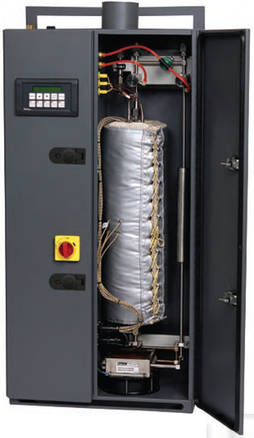
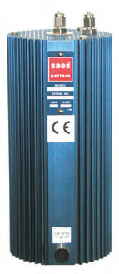
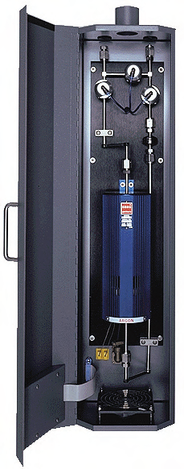
Example equipment (off the shelf)
Heated getters

Slide 10
Preliminary Results
Can maintain 99.9 % purity
Can keep releases below ~ 10 TBq / year (all species)
Can stay below dose limit, 3,5 µSv/year
Detailed calculations of all species will be made

Slide 11
Conclusions/Questions
Natural improved development, going for Best Available Technique (BAT)
Decreased risks, costs and release/waste
Relies on reasonable tightness requirements
Maintenance & Accidents to be studied
t-TAC
Are the new design developments for the helium purification system sound and do they represent a reasonable balance between system performance and other parameters, e.g. manufacturability, operability, maintainability, cost, schedule, upgradeability, and flexibility?

