Slide 1
Target Project Progress and Plans
John Haines
Head of Target Division
www.europeanspallationsource.se
April 1, 2015

Slide 2
Outline
Target organization and staffing
Update on all work packages
EVMS performance
Near-term plans
Concluding remarks

Slide 3
Target Organization – Core team is in place and org is aligned with project deliverables
TARGET DIVISION
John Haines
Head of Division
Eric Pitcher
Deputy Head of Division
Carina Blixt
Team Assistant
Target Controls Group
Linda Coney (GL)
Atefeh Adeghzadeh
Mikael Olsson (C)
Jan Espen Presteng (C)
Monolith & Handling Group
Rikard Linander (GL)
Magnus Göhran
Daniel Lyngh
Ulf Odén
Naja de la Cour
Marc Kickulies
Kristoffer Sjögreen
Markus Andersson (C)
Lennart Åström (C)
Reinhard Blum (C)
Paul Erterius (C)
Jens Harborn (C)
Thomas Hedlund (C)
Rickard Holmberg (C)
Bengt Jönsson (C)
Johan Kalmteg (C)
Jarich Koning (C)
Federico Massi (C)
Mikael Möller (C)
Anders Olsson (C)
Mateusz Pucilowski (C)
Jesper Ringnér (C)
Mats Schmidt (C)
Srdjan Vareskic (C)
Aydin Ibraimi (S)
Filip Olsson (S)
Jesper Olsson (S)
Materials Group
Yongjoong Lee (GL)
Monika Hartl
Jemilia Habainy (S)
Andreas Lövberg-Tserpelis (S)
Neutronics Group
Luca Zanini (GL)
Konstantin Batkov
Alan Takibayev
Esben Klinkby (C)
Troels Schoenfeldt (C)
NIcolo’ Borghi (S)
Zsofia Kokai (S)
Giuseppe Scionti (S)
Fluid Systems Group
Håkan Carlsson (GL)
Per Nilsson
Andrea Polato
Klaudiusz Dybowski (C)
Leif Emås (C)
Robin Jansson (C)
Per-Ola Larsson (C)
Allan Lundgren (C)
Ingvar Olsson (C)
Olof Persson (C)
Carl Wilhelmsson (C)
Target Physics Group
Günter Muhrer (GL)
Riccardo Bevilacqua
Daniela Ene
Johannes Kazantzidis (C)
12.1 Management and Administration
12.7 Controls
Linda Coney (WPM)
12.8 Physics
Günter Muhrer (WPM)
12.5 Fluid Systems
Håkan Carlsson (WPM)
12.2 Target System
Ulf Odén (WPM)
All Group Leaders and Work Package Managers in place
12.3 Moderator & Reflector Systems
Daniel Lyngh (WPM)
12.4 Monolith Systems
Rikard Linander (WPM)
(C) Contractor or Consultant
(S) Student
12.6 Remote Handling Systems
Magnus Göhran (WPM)

Slide 4
Staffing plan shows transition to In-Kind partnerships is underway
Design
Current Non In-Kind FTE Level including employees, consultants, contractors, post-docs, etc.
Procure
Install & Test
Current In-Kind FTE Level
ESS Target Division staffing level remains stable (23-30) throughout project
  Supplemented by In-Kind Partners, contractors, etc.

Slide 5
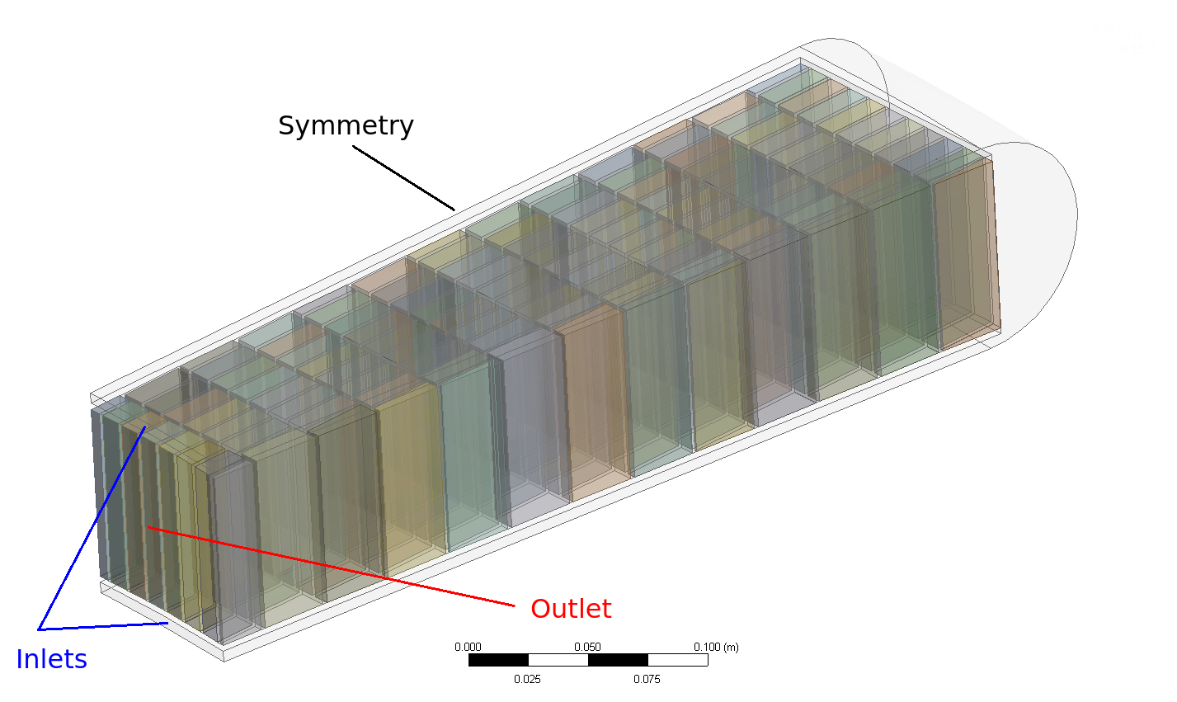
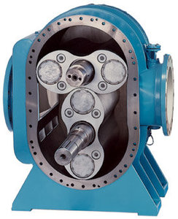
WP2: Target Systems
Preliminary Design Reviews (PDRs) held for (1) Helium Cooling System, and (2) Target Wheel, Drive & Shaft
ESS-Bilbao team has taken responsibility for Target Wheel, Drive & Shaft scope
Design continues to evolve:
  New wheel design has improved manufacturability as well as thermal and structural performance
  Helium Compressor - Process gas blower (robust, few rotating parts)

Slide 6
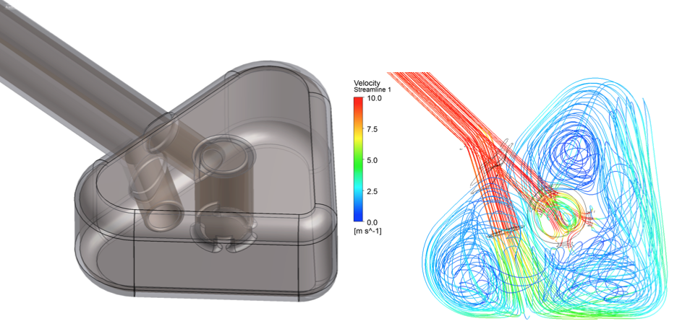
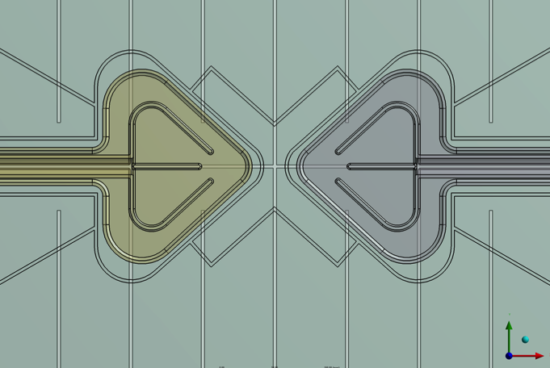
WP3: Moderator and Reflector Systems
Final moderator configuration approved by ESS Change Control Board in March 2015
  3 cm tall butterfly on top
    Cold neutron brightness same as pancake, thermal brightness x 1.6
  6 cm tall butterfly on bottom
    Flexibility -> viewable at all locations (2 x 120° vs. 2 x 60°)
  LH2 and He cryoplant heat loads and cost increased (20 -> 35 kW, 4 M€ increase)
Butterfly V2 Design
Liquid H2
6 cm-tall Design
H20

Slide 7
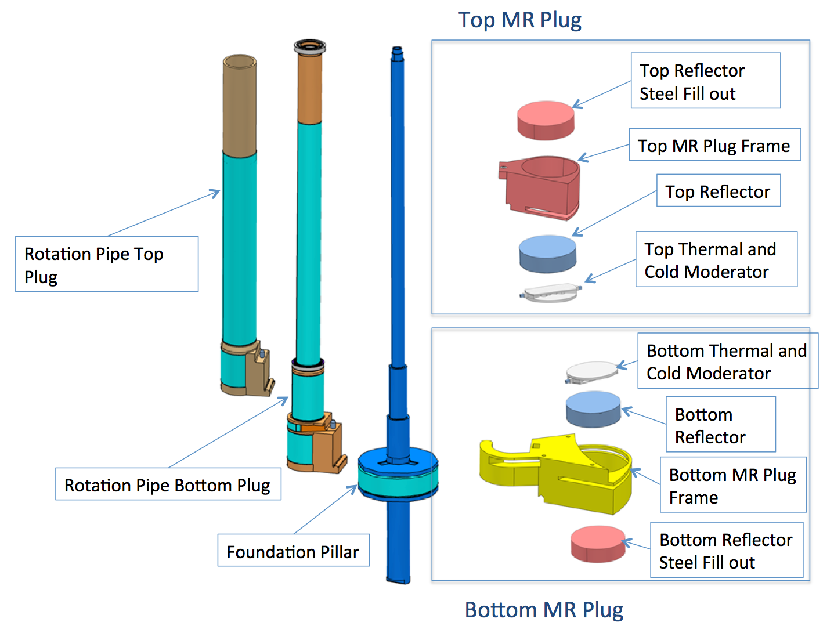
WP3: Further Developed Twister Moderator Handling Concept
Twister concept significantly improves maintainability
Seeking In-Kind Partner for three IKC packages:
  Moderator & Reflector Plugs
  Cryogenic Moderator System (LH2)
  He Cryoplant
Notes:
What is the message to be delivered with this slide? Suggest it serve as the slide title, e.g. , “Instrument performance is …”. Three options have higher averages than the one selected. Looks to me like we’ve picked a lower performing option.

Slide 8
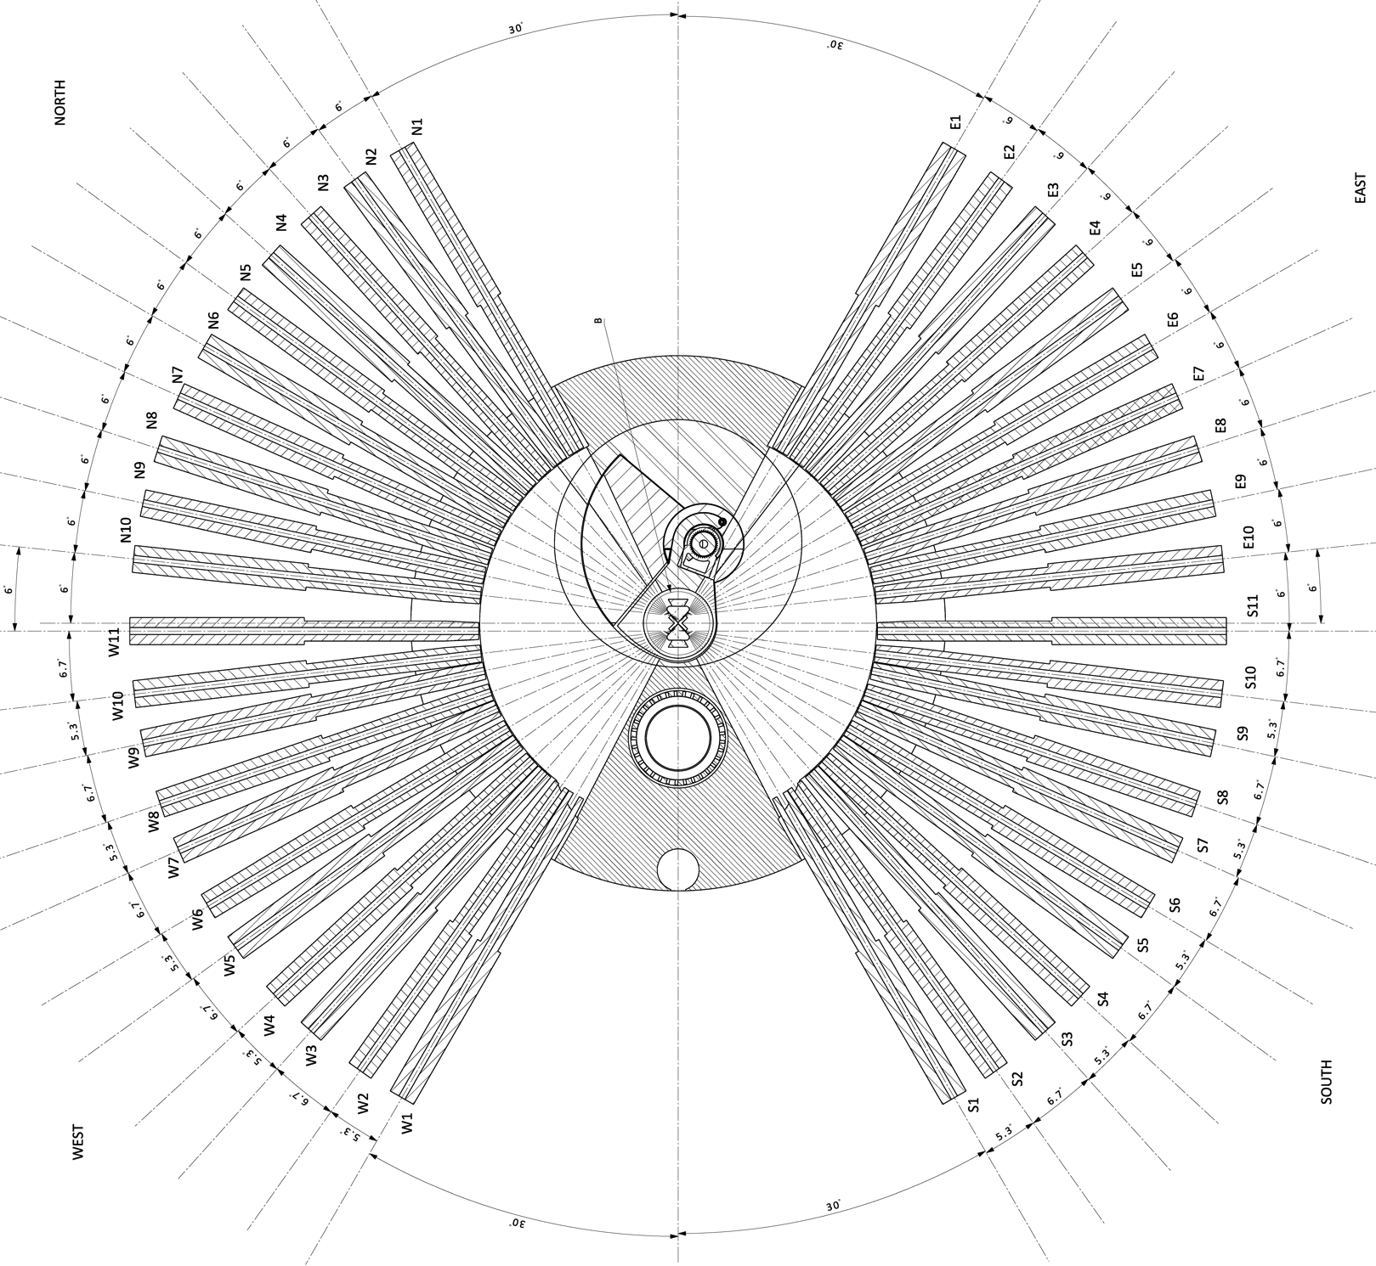
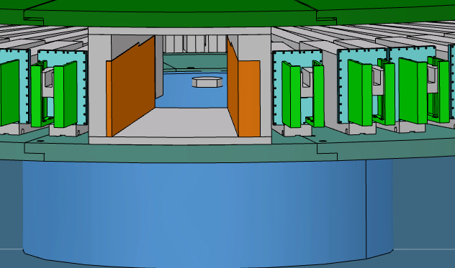
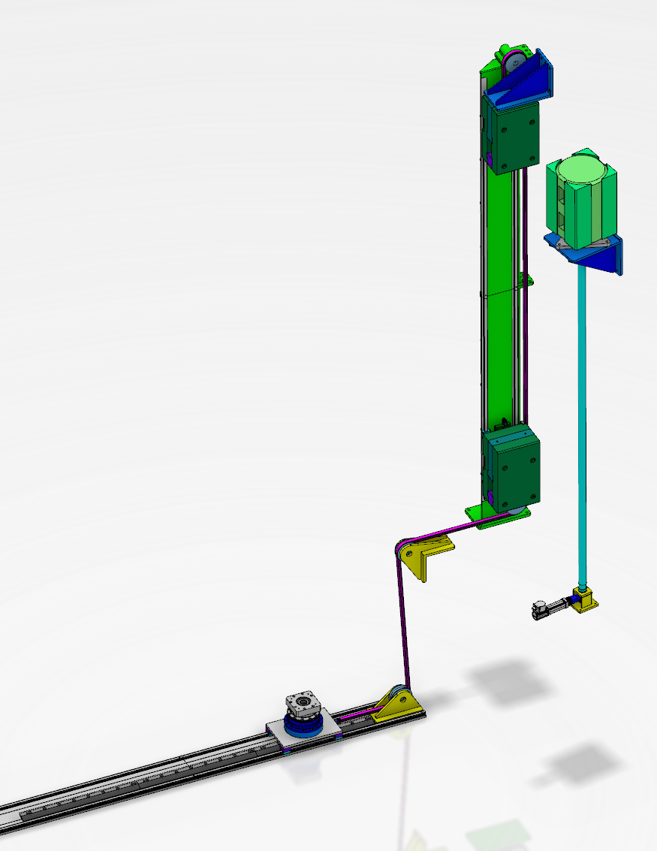
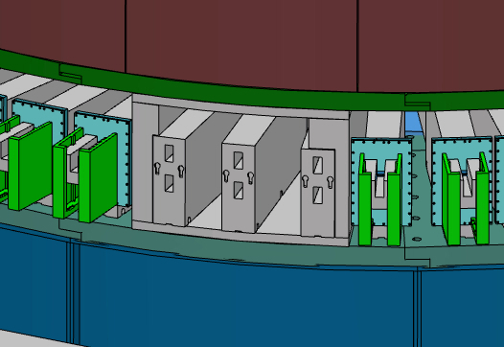
WP4: Monolith Systems
Fixed the beam port layout with NSS
  42 beam port based on engineering evaluations
  Some variation in angular spacing, but average of 6°
  Double-decker arrangement to view either moderator
Advancing design concept for external light shutters
Feasibility studies for non-scattering science opportunities
  ECHIR
  n-nbar
Secured partner for five In-Kind Contributions
  ESS-Bilbao has PBW, Proton Beam Instrumentation Plug, Monolith Vessel, and Tuning Beam Dump
  CNR (Italy) has Irradiation Module

Slide 9
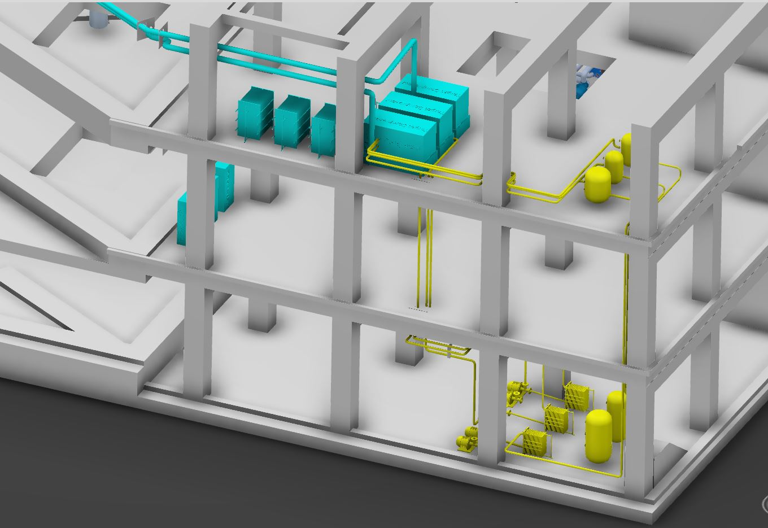
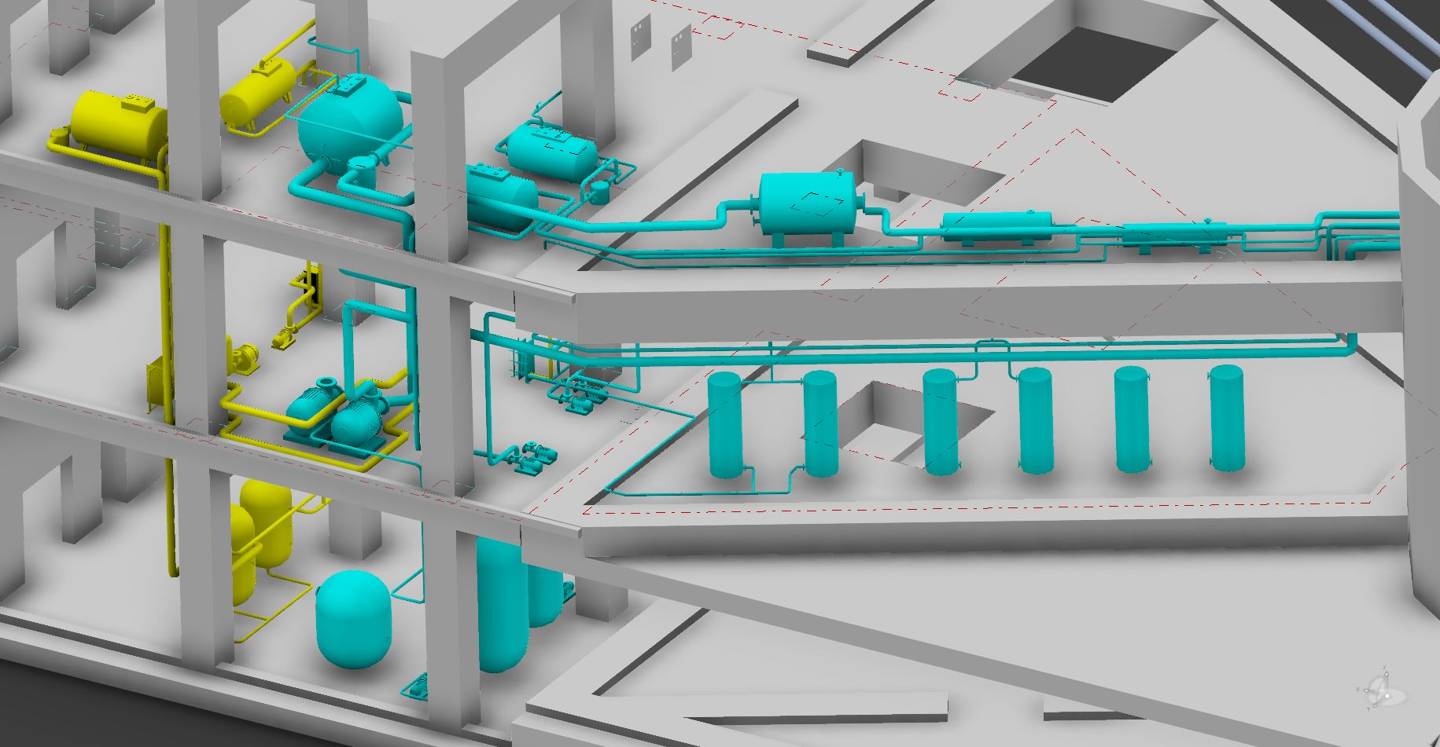
WP5: Fluid Systems
Completing Preliminary Designs
  PDR for Primary Water Cooling Systems held in January
  PDRs planned for near term:
    Target HVAC – April
    He Purification - May
    Intermediate Cooling Systems - May

Slide 10
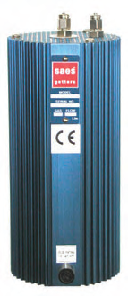
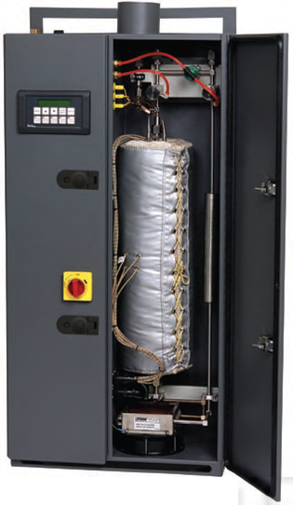
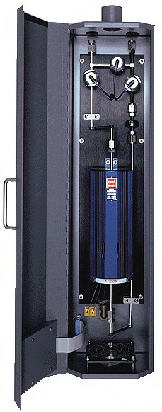
WP 5 - Helium Purification System(s) have been simplified
One purification system (instead of separate systems for monolith and target cooling loop)
Removing H₂ (including tritium), I₂, O₂, N₂, CO₂ and H₂O
Off-the-shelf equipment
Circulating and cooling system
Target
20 m³,
10 bar
(23 kg) Helium
0.23 mg/s
(6.58 kg/year)
3 kg/s
1 g/s
Contaminants
He purification
(getter)
He purity in
Helium loops: >99.99%
30 mg/s
Purity
Target wheel rotary seal
I₂
H₂
O₂
N₂
CO₂
H₂O
< 1 ppb
< 1 ppb
< 1 ppb
< 1 ppb
< 1 ppb
< 1 ppb
80 mg/s
Monolith
95 m³,
1 bar
(15 kg) Helium
Contaminants
40 g/s
Circulating and cooling system
4 μg/s Air
(72 g/year)

Slide 11
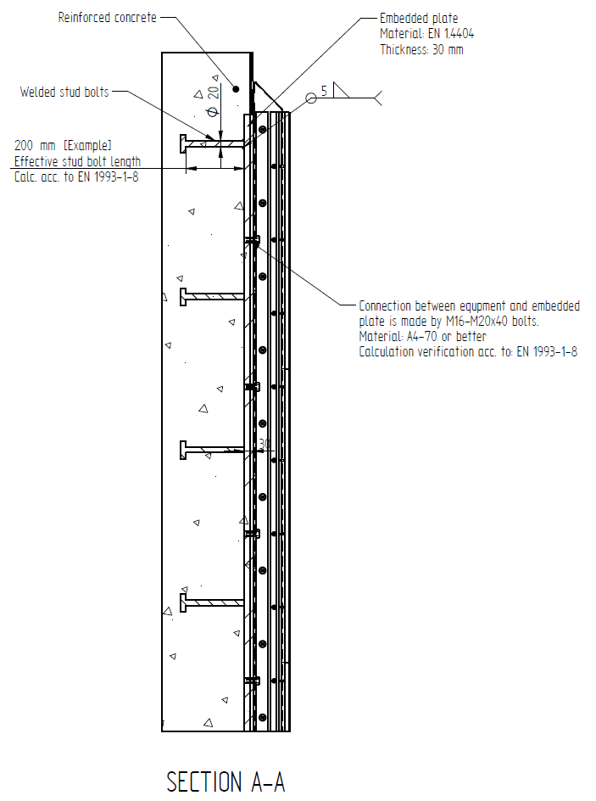
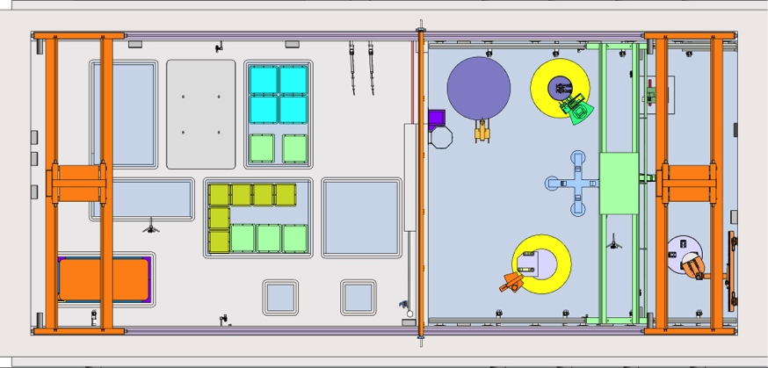
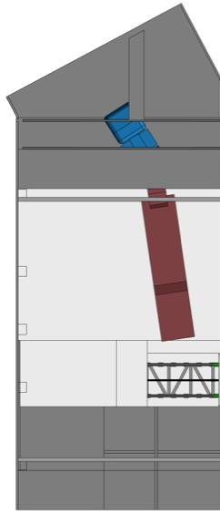
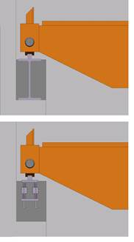
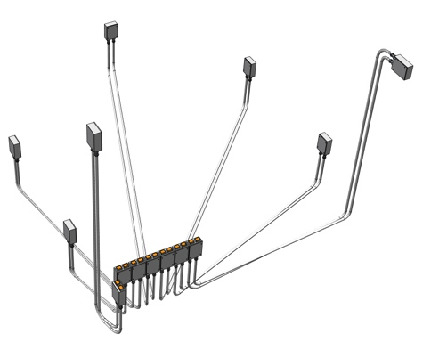
WP6: Remote Handling Systems
PDR for Active Cells Confinement Systems held in December 2014
Working to define concrete embedments and other building interfaces to meet building construction schedule demands
Visits to vendors and other facilities has strengthened our plans for using cameras for the operator viewing interface instead of shielded glass windows
Waste shipment
Utility Penetrations
Concepts for embedded parts
Concepts for Electrical Penetrations
Options for Crane Rails

Slide 12
WP7: Controls
Path forward to develop Target Safety System (TSS) design assuming safety-credited beam shutoff required for two events:
  Loss of target rotation
  Loss of He flow to target
Allows TSS team to work with others to develop critical interfaces
  Work with Accelerator team to define beam shut-off approach
  Work with other Target team members to define details of credited systems (sensors, set points, …)
  Work with CF to define facility needs
  Work with ICS to avoid MPS/PSS/TSS conflicts
PDR for TSS planned for Nov 2015
Meanwhile we will conduct Hazards and Accident Analyses to systematically define the required safety credited systems
  Contracted safety expert to lead hazards analysis
  Qualitative hazards analysis in work
  Started quantitative analysis for Target Wheel and some postulated global events (e.g. water leak from reflector with breech of target shroud exposing W)

Slide 13
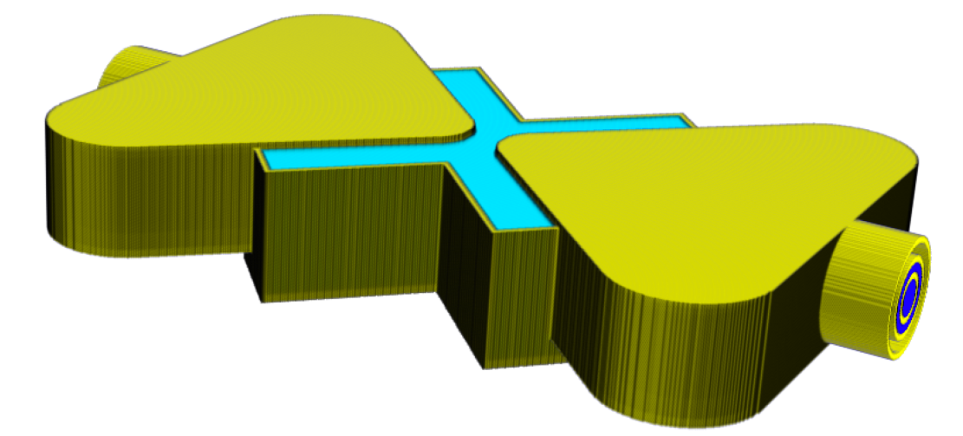
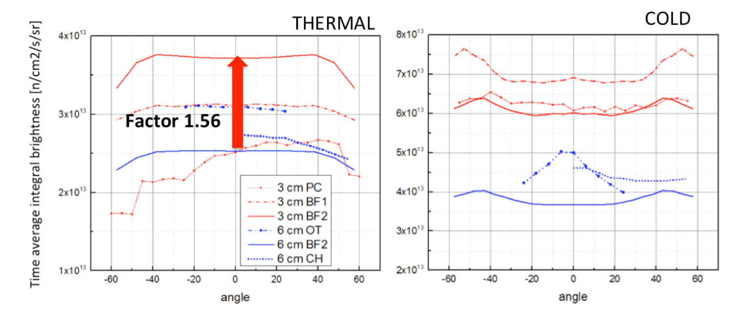
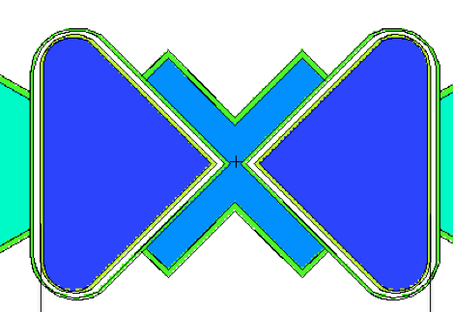
WP8: Physics (Neutronics and Shielding)
“Butterfly” moderators show significant increase of thermal brightness while keeping the cold brightness equal to the pancake
Issued “ESS Procedure for Designing Shielding for Safety” document to apply appropriate rigor to shielding analysis across ESS
Supporting EIA update
  Partnering with DTU on W Release factors experiment
13

Slide 14
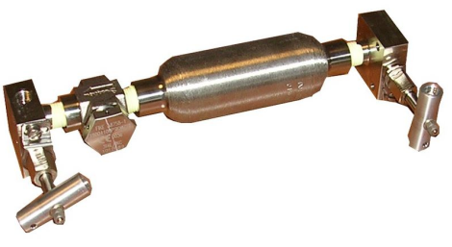
WP8: Physics (Materials)
Collaborating with PSI on STIP-V tungsten PIE
Specimen cutting plan submitted
Tensile, bending, and thermal conductivity measurements and microscopy planned for end of 2015
Ortho-to-para converter project support plan developed
Plan to collaborate with SNS on experiment
Working with Lund University on evaluating tungsten samples from different suppliers
Engineering support
Target
MR Systems
Fluid systems
Monolith systems
ESS Target Materials Handbook
    1st Edition to be released soon

Slide 15
EV Performance
Cum SV | -0.88 M€
Cum CV | -0.52 M€
Cum SPI | 0.91
Cum CPI | 0.95
Value (M€) | Dec-13 | Dec-14 | Jan-15 | Feb-15 | Mar-15 | Apr-15 | May-15 | Jun-15 | Jul-15 | Aug-15 | Sep-15 | Oct-15 | Nov-15 | Dec-15
Earned | 2.976 | 7.941 | 8.534 | 8.953
Actuals | 2.976 | 8.536 | 8.827 | 9.473
Scheduled | 2.976 | 8.538 | 9.109 | 9.835 | 10.818 | 11.951 | 13.497 | 14.861 | 15.886 | 16.732 | 18.428 | 19.896 | 21.159 | 22.403

Slide 16
Variances Primarily Caused By Extended Moderator Optimization Studies
Schedule:
Cumulative SV of -0.88 M€ (SPI = 0.91) is due to:
  Slower than planned hiring and diversion of resources to bring new hires up to speed
  Delays in finalizing moderator to gain significant enhancement in ESS performance
Focusing on recovering delays on schedule critical activities – no slippage in Target completion date
Cost:
Cumulative CV of -0.52 M€ (CPI = 0.95) is primarily due to breakage in moderator and associated monolith design work caused by prolonged optimization studies
Work Package | Cum SV (M€) | Cum CV (M€)
1 - Management | +0.01 | +0.14
2 - Target Systems | -0.16 | +0.00
3 - Moderator and Reflector Systems | -0.34 | -0.31
4 - Monolith Systems | -0.17 | -0.20
5 - Fluid Systems | -0.03 | -0.06
6 - Remote Handling Systems | -0.05 | -0.02
7 - Target Controls | -0.01 | -0.03
8 - Target Physics | -0.13 | -0.06

Slide 17
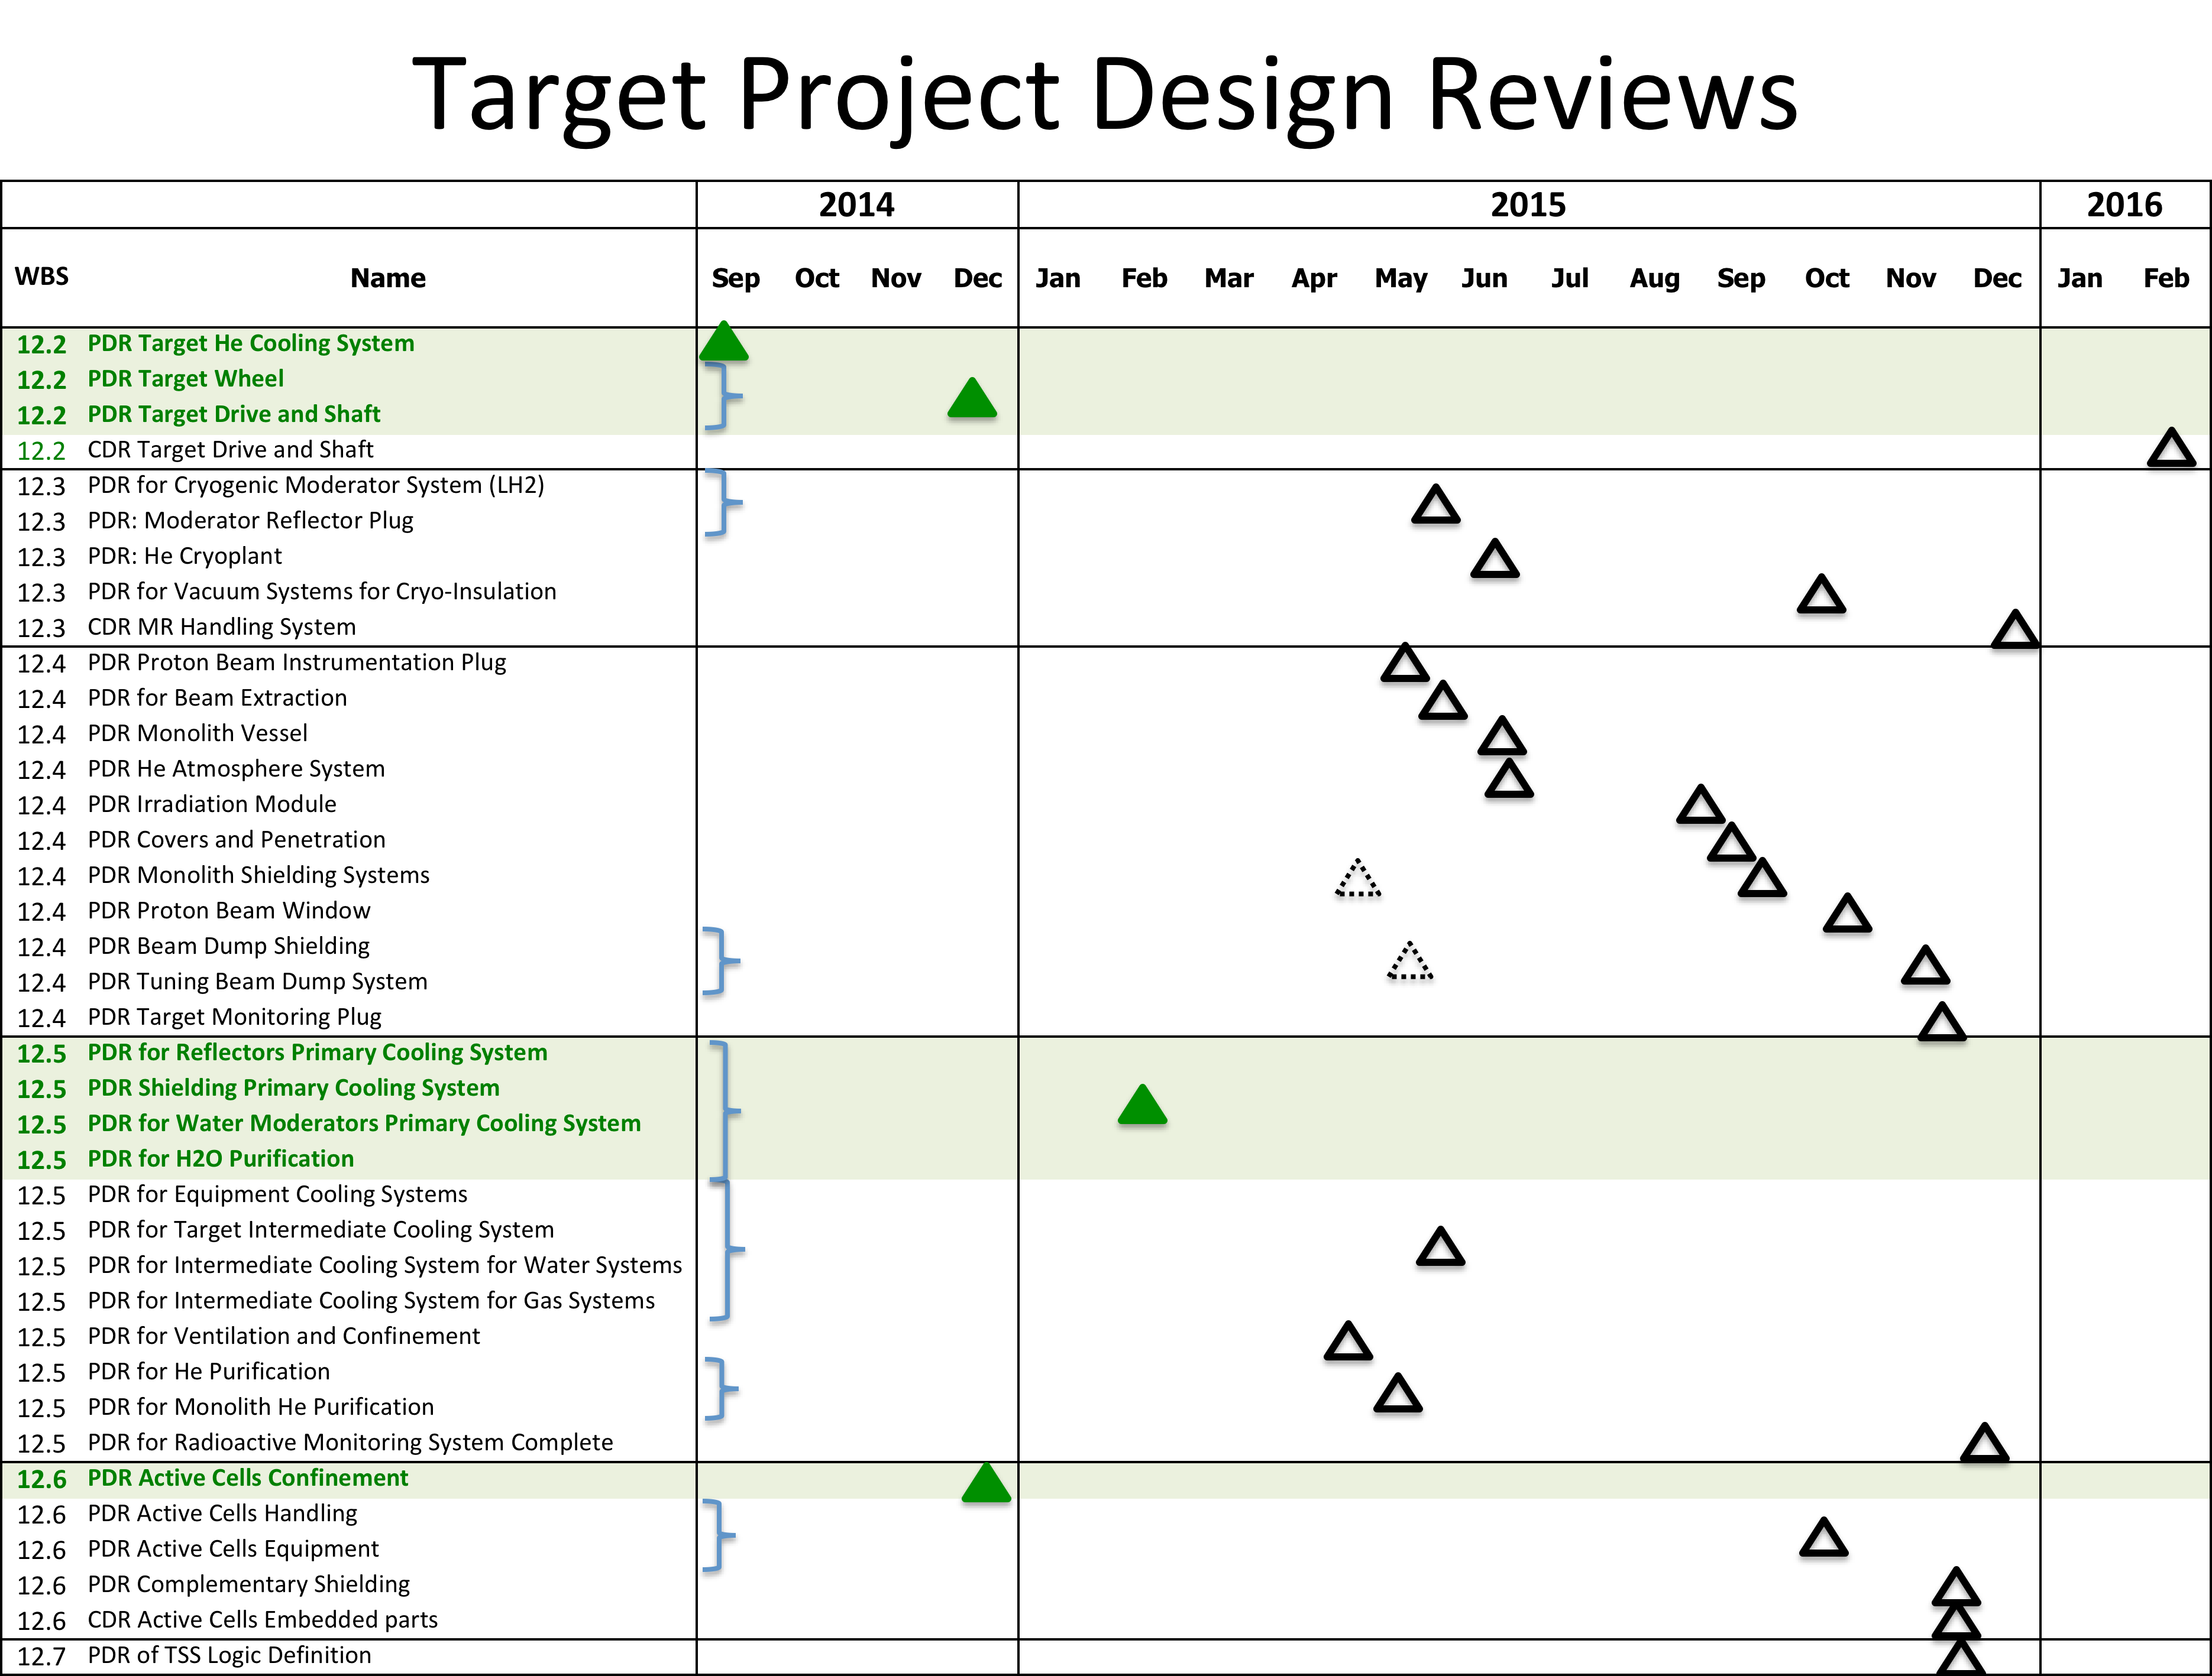

Slide 18
Status of Target Project IKCs
Target Project has 27 in-kind work elements
  Partner selection date driven by schedule need and readiness to partner
Partner selected for eight work elements
Soliciting partners for two others
Released five more in March

Slide 19
Awarded packages with cost book value and partner
In-Kind ID | WBS # | In-Kind Contribution | Cost Book Value (M€) | Partner
TIK.2.1 | 12.2.2 | Target Wheel | 8.4 | ESS Bilbao
TIK.4.2 | 12.4.2.2 | Proton Beam Instrumentation Plug | 0.5 | ESS Bilbao
TIK.4.3 | 12.4.2.3 | Irradiation Module | 0.2 | CNR - Italy
TIK.4.4 | 12.4.3.1 | Proton Beam Window | 0.9 | ESS Bilbao
TIK.4.5 | 12.4.3.2 | Monolith Vessel | 4.6 | ESS Bilbao
TIK.4.9 | 12.4.5 | Tuning Beam Dump | 2.5 | ESS Bilbao
TIK.6.1 | 12.6.2 | Active Cells | 21.5 | STFC/UKAEA
TIK.8.1 | 12.8.5.1 | Tungsten Release Factors | 0.2 | DTU - Denmark
Four partner institutes so far
Value of awarded packages = 38.8 M€

Slide 20
Substantial progress in securing partners

Slide 21
Substantial progress in securing partners

Slide 22
Concluding Remarks
Target Division organization in place
Worked with Science Directorate to finalize moderator and reflector and beam extraction configurations
  Promise of high performance and flexibility, but suffered schedule delays
Path forward established and being exercised for safety classification/requirements and active safety system (TSS)
Holding steady on cost and schedule
  Re-plan with detailed work breakdown for 2015 maintains budget and schedule for project completion
  Plan relies on securing in-kind partners in near term
    Dates for each work element identified and being tracked
    Partner for first eight work elements selected; work has begun
    Option to self-perform if partner is not secured
Preliminary Design completion is the focus of our near term efforts

