Slide 1
Machine Protection @ ESS
Status Report for TAC11
Annika Nordt et al.
ICS/Protection Systems
www.europeanspallationsource.se
30 March 2015

Slide 2
Overview
Protection Team
Scope of Machine Protection
Functional Architecture Concept for Machine Protection
Local Protection and Beam Monitoring
Target Protection System
Actuators for Machine Protection
Operational Mode concept
Degraded Mode Operation concept
Configuration Management
Organization
Requirements
Timelines for the Project
Commissioning Plans
Teams we work with
Beam Interlock System: hw development
Summary
Backup Slides

Slide 3
The Team
Protection Systems Group
Group Leader: Annika Nordt
Machine Protection ICS/WP5:
Manuel Zaera-Sanz (PLC expert: 08/14)
Angel Monera-Martinez (FPGA expert:10/14)
Riccard Andersson (PhD student: 06/14)
To be recruited:
Senior Engineer (hw/EPICS),
PhD student (hw)
Personnel Safety Systems ICS/WP9:
Stuart Birch (Senior PSS expert: 08/14)
Denis Paulic (PLC expert: 03/15)
Morteza Sharifabad (Technician: 05/15)
To be recruited:
IEC61508 Controls Engineer (ongoing),
1-2 Technicians
Goal: Build a flexible team, sharing & extending the different skill sets,
Everyone has knowledge relevant for both MPS and PSS!
Notes:
Describe group structure briefly and emphasize that everyone has knowledge in both areas, PSS and MPS! Otherwise the 2 teams are too small to get the job done.

Slide 4
Scope of Machine Protection @ ESS
Machine Protection helps in achieving the operational availability requirements for ESS. High availability is achieved through high system reliability, through short preventive and corrective maintenance times and short recovery times after stopping/inhibiting beam operation.
The right strategy to avoid damage leading to long corrective maintenance times, will involve a mix of:
dedicated technical systems stopping operation (not only of beam) to prevent and mitigate damage,
dedicated operational and maintenance procedures to fix things before real damage can occur.
Machine Protection needs to reliably do the following:
protect the “machine” from damage, be it beam-induced or resulting from any other source,
protect the “machine” from unnecessary beam-induced activation.
Machine protection will be implemented in a way to:
minimize unnecessary down-time due to spurious trips,
provide optimal support for failure localization,
support all operational modes of the facility,
support operation in degraded mode.
Notes:
Text according to slide

Slide 5
Functional Architecture Concept
Notes:
In addition to all the systems associated with protection and beam permit at the lower “machine” level, there are Higher-Level Operation Critical Systems.
The diagrams represent the system in terms of a hierarchical control structure. Horizontal layers indicate layers of hierarchy.
The Higher-Level Operation Critical Systems (e.g. PSS, TSS) are those additional systems that are essential for operation and that need to work properly. If not, there should be no permission to produce beam.
Some of those Higher-Level Operation Critical Systems might have a direct impact on the beam and some of them might need to know the beam state.
Local Protection and Beam Permit Systems are in charge of
monitoring a specific segment of the “machine” and detecting non-nominal states that could lead to damage,
taking any necessary actions for preventing damage to equipment in that segment in such a case,
confirming that everything in their segment is ready for beam production.
Turning beam on, knowing that something is wrong, needs to be avoided. This would unnecessarily increase the demand rate for Proton Beam Monitoring or other protection related systems.
Note that Local Protection and Beam Permit Systems do not monitor beam parameters themselves to protect their segment from beam-induced damage. Doing that is the job of Proton Beam Monitoring.
Local Systems do focus on local equipment of their segment and protect from locally detectable threats.

Slide 6
Local Protection and Beam Monitoring
As the beam itself is a potential source of damage and the source for activation, Machine protection has to make sure that the beam parameters are as they should.
This involves detecting off-nominal losses, currents, position and maybe other parameters.
Local Protection Systems and Beam Monitoring will be composed of specialized subsystems. Hence the responsibility to specify those systems must lie with the corresponding expert groups.
Reaching the required availability levels will however only be achievable if some degree of standardization in implementation and documentation is achieved.
Even though documentation does not impact on the function of the systems, it is crucial to allow for a sensible review of the planned implementations and to allow for a realization of optimization potential with respect to availability before going live.
Notes:
Text according to slide

Slide 7
Local Protection and Beam Permit
There might be many different concrete designs for Local Protection and Beam Permit Systems, but all of them will fit this generic structure:
The Local State is what is being monitored.
Specific sensors are needed to detect off-nominal states.
The sensor readings are processed in a controller (this is a functional view).
Actuation systems are needed to take local protection actions.
Aggregation of signals is needed as well as propagation of this information to the Beam Interlock System (BIS).
Notes:
Note that there might be special cases that need to be addressed.
For example: certain types of beam monitoring devices might get damaged if beam is turned on (in a certain mode) while they are inserted in the beam line.
Hence, there needs to be some protection preventing this from happening.
The way would be to allocate this job to a dedicated protection system, that would prevent damage by
checking whether the sensor is inserted or not;
telling the BIS that it’s local state does not allow for beam if the sensors are inserted.
This job would not be allocated to Proton Beam Monitoring, since it’s job is a completely different one:
to check the beam parameters while the beam is on,
to trigger a beam switch-off in case of deviations from the nominal expectations.

Slide 8
Target Protection ≠ Target Safety System
The Target Safety System is there to prevent/mitigate accidents that might lead to harm for people or the environment.
Local Target Protection and Beam Permit Systems are in charge of
protecting the target equipment from damage that might lead to operational unavailability.
Confirm that the target is ready for beam production.
Notes:
Text according to slide

Slide 9
Beam Permit and Beam Switch-Off
The findings of all higher-level and local systems need to be combined into a single BEAM PERMIT. This is the job of the Beam Interlock System.
The beam needs to be switched-off by a reliable actuation system that’s fast enough for the purpose.
There are four candidates for reliable (redundant) and fast Beam Switch-Off Actuation.
Notes:
Text according to slide

Slide 10
Actuators for Machine Protection
Remove RF signal from the magnetron of proton source:
  100 μs until there is no plasma being created anymore
Energize electrodes of LEBT chopper and deflect beam into LEBT absorber:
  300 ns until beam is fully deflected.
  BUT: The absorber can only withstand 2 full pulses before being damaged!!!
Energize electrodes of MEBT chopper and deflect beam into MEBT absorber:
  10 ns until beam is fully deflected
  BUT: The absorber can only withstand 100-200 μs of beam before being damaged!!!
Decrease electrical field of the RFQ:
  20 μs until field is decreased (i.e no beam transmitted & accelerated through the RFQ)
Other options (not investigated yet):
  Remove field from Solenoids in the LEBT
  Cut 400 V line of Proton source using a contactor like TSS and PSS
None of these mitigation techniques can be used by itself, we have to use a combination
→ trigger 1) + 2) + 3) simultaneously
Notes:
Text according to slide

Slide 11
Operational Mode Concept
The operational mode concept at ESS is based on:
Machine Modes, defining the “final intended destination” of the proton beam,
Beam Modes, defining the properties of the proton beam.
Setting an operational mode is clearly a control system job!
→ Machine Protection & Beam Permit systems need to be configurable by the control system.
However, mode confusion could lead to potentially harmful behavior.
→ There is a clear need for some kind of “operational mode sanity checking”.
This would not only include checking if every protection related system agrees on the same mode, it would also include checking if all those systems have correctly adopted the right configuration related to that mode.
Notes:
Text according to slide

Slide 12
Degraded Mode Operation
Things will fail.
Some of these things might not be so critical to operation to require an immediate shutdown when they fail.
→ There is a clear need for some kind of a “masking feature” at the level of the BIS.
It should be possible to force the system to ignore certain inputs (eg when injecting a pilot beam with almost no damage potential, etc). It is however critical to define what should be allowed per operational mode.
And if you define rules, you better check if they are being followed.
Masked BIS inputs should be cross-checked to confirm that they are in agreement with the rules defined by the selected operational mode.
Degraded mode operation includes other features, such as lowering the repetition rate upon detection of specific failures that are not very critical or changing beam current, etc. rather than stopping beam operation.
Notes:
Text according to slide

Slide 13
Configuration Management
There is a third potential source of damage that is closely related to mode confusion and inadequate mode dependent configuration of elements.
This would be the use of elements having a “version” that does not match the system configuration version requirements.
There has to be a clear definition of what versions of what are expected to be there in order to allow operation. And of course, this should be checked.
The version of critical hardware and software configuration items should be checked with respect to system version requirements.
These last three potential sources of problems might lead to add two functional entities to machine protection and beam permit:
This concept shall include validation
as well and not be restricted to
Monitoring only
Notes:
Text according to slide

Slide 14
Organization for ESS Machine Protection
Machine Protection Panel (MPP):
Existing since June 2012 (coordinated by A. Nordt)
~ 55 members (20 very active) from AD, ICS, Target, NSS, PSS, TSS
Meeting on a regular basis (bi-tri-weekly)
Discussing, gathering and communicating machine protection relevant information
Machine Protection Committee (MPC):
Approved by EPG in Oct 2014, 1st meeting on 31st of March 2015
Existing throughout the complete ESS lifecycle
T. Korhonen, D. McGinnis, E. Pitcher, R. Connatser, A. Nordt, Operations-representative (?)
Empowered to take and approve major decisions, take on responsibility
Notes:
Text according to slide

Slide 15
How to derive MP relevant Requirements
Approval of concept, overall scope,
Coordination of hazard risk analysis,
Approval of overall machine protection requirements,
Coordination of machine protection requirements allocation
MPC domain/
responsibilities:
(Corresponding to IEC61508 Lifecycle)
Operations
Accelerator
ICS
Target
CF
NSS
PSS
TSS
- Requirements on work procedures, maintenance planning, checklists, training for personnel
…
- Provide systems suitable for allocated machine protection functions
….
- Provide systems suitable for allocated machine protection functions
- Provide systems suitable for machine protection functions
XY,……
XY,……
Provide run permit signal according to MP interface specification
(constraint)
Provide run permit signal according to MP interface specification
(constraint)
Verification, Validation
Stakeholder
Requirements
- Requirements for Proton Source
- Requirements for LEBT chopper
- ….
- Requirements for Beam Interlock System
- ….
Specification of signal, cable, connector type
Specification of signal, cable, connector type
System
Requirements
Notes:
Text according to slide

Slide 16
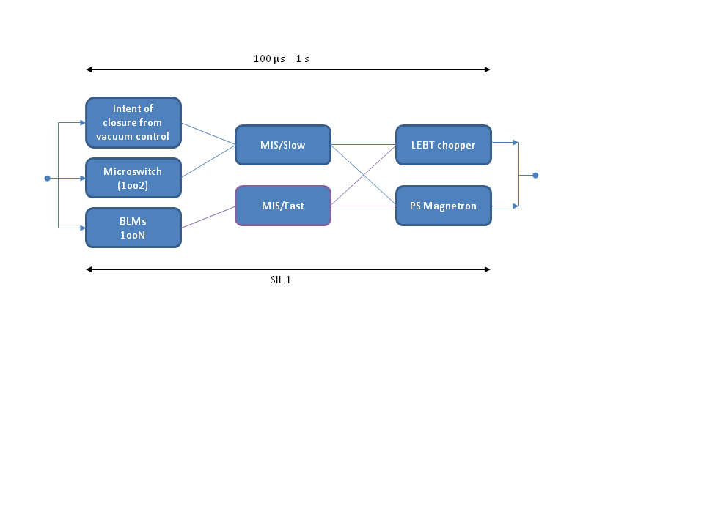
Example for a Protection Function
  Example: unintentional closure of a vacuum valve during beam operation due to malfunctioning of valve control system or erroneous operator action or spurious signal of valve closure.
MEBT chopper
LPS/Slow
BIS/Fast
Protection Integrity Level 1
  Around 166 protection functions defined for LINAC systems (based on preliminary risk analysis) including a preliminary protection integrity level & response time per protection function, an allocation of protection integrity level quota towards the LPS and beam permit systems, the BIS and the actuators. Update according to latest design changes of some LINAC systems is required.
Notes:
Top level requirements currently under approval by MPC
Preliminary set of systems requirements based on results from a PHA (Preliminary Hazard Analysis) done for all LINAC systems

Slide 17
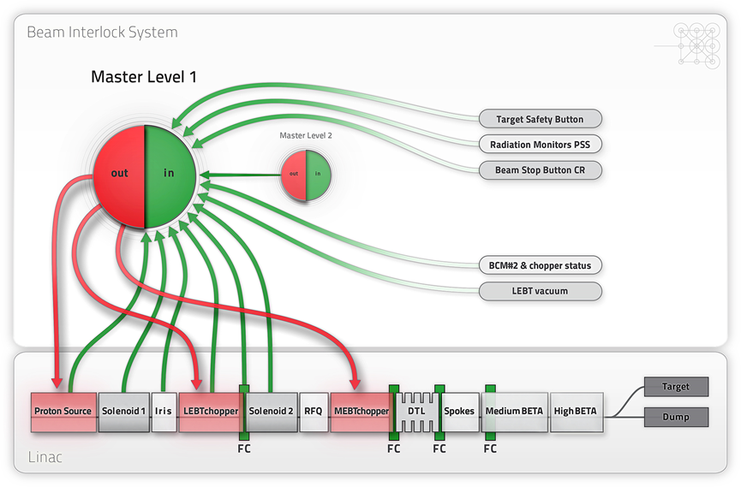
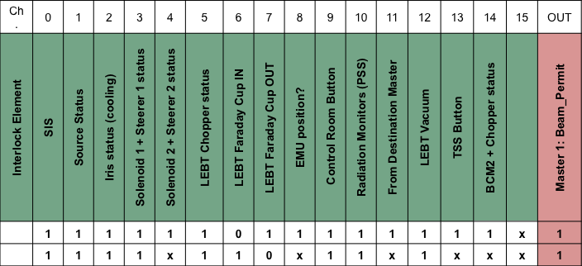
Inputs to the Beam Interlock System
SIS: software interlock system (EPICS)
LEBT chopper: powering must be verified; in case of failure, redundancy is guaranteed by switching OFF the RF magnetron of PS & triggering MEBT chopper.
Control Room Button: stop beam manually.
BCM#2 + Chopper status: status of the LEBT chopper (voltage) +presence of beam detected by BCM#2 to monitor beam losses in LEBT: if the HV of the LEBT chopper is OFF and the BCT#2 measures no beam current, the beam must have been lost somewhere in between.
EMU position: The positions of the 2 Allison scanners have to be interlocked to avoid insertion at the same time, but this could be implemented locally at EMU electronics.
Notes:
Text according to slide

Slide 18
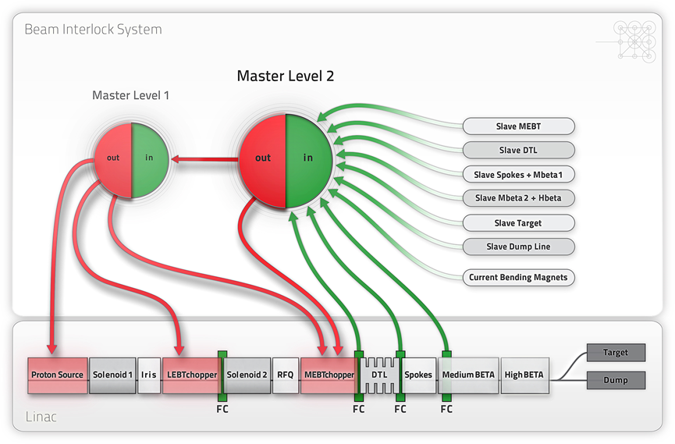
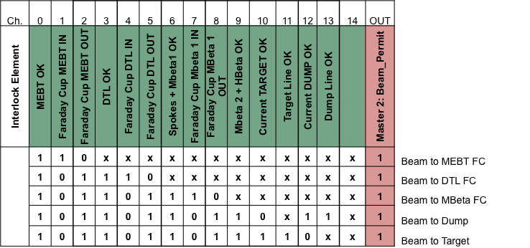
Destinations of Proton Beam
Beam will always be sent to 1 destination only. During normal operation, the destination is the target. For commissioning, machine experiments (and non-nominal conditions), several beam destinations have been identified:
Beam up to the Faraday Cup of the LEBT
Beam up to the end of the RFQ: the destination is a Faraday Cup downstream the RFQ.
Beam up to the end of the DTL section: the destination is a Faraday Cup between DTL and spokes.
Beam up to the 4th (??) cryo-module of the Medium Beta section: Faraday Cup or beam stop.
Beam to the tuning beam dump (up to 10kW are allowed only)
Beam to the target
Notes:
Full power beam can only be sent to the high power target (and to the LEBT beam stop/absorber). All other destinations can only operate with limited beam power
The logic used by the Beam Interlock System depends on the current applied to the bending magnets in the dogleg and the status of the Faraday Cups.
If the bending magnets operate with a current deflecting the beam towards the target, interlock signals from the tuning dump line are ignored.
If the bending magnets operate with no current effectively sending the beam towards the tuning beam dump, interlock signals from the accelerator to target (A2T) line and the target station are ignored.
If one of the Faraday Cups in the LINAC is inserted into the beam path, the interlock signals from further downstream parts are ignored.
If 90 MeV beam (out of the DTL) could arrive to the tuning dump without causing damage even with off-normal cavity settings in the spokes during the phase scan, then it may not be needed to implement this beam stop. It should be investigated, if this beam stop is useful in other ways. However the distance from the Medium Beta section to the Target or tuning dump line is large and during cavity tuning the beam can significantly debunch and BPMs might not be able to measure the beam position, especially further downstream.

Slide 19
Teams We Work With
CERN (Collaboration): TE/MPE (Technology department/Machine Protection & Electrical Integrity group), contact: R.Schmidt, A.Siemko, B.Puccio/development BIS hw, concept, sw development
ZHAW (Collaboration): School of engineering Winterthur/Switzerland/IAMP/SKS (Institute of Applied Mathematics and Physics/safety critical systems group), contact: C. Hilbes, M. Rejzek/help on BIS design, development of MP requirements, hw in the loop testing, Target Protection
embeX (Collaboration): Company, Freiburg/Germany/covers development of safety critical electronic systems/realization of E/E/PE-safety related systems (phase 10), incl. development of safety related hw and sw according to IEC61508-2010/hw development
ITER (Collaboration): Controls Department/contact: R. Lange/A. Wallander/A. Vergara/currently for a project regarding predictive interlocks with focus on target protection
Notes:
Text according to slide

Slide 20
BIS Hardware and Software
Hardware:
Interface between input systems and BIS
BIS Processing unit/ FPGA based
Interface between BIS and actuator systems
Cables, connector types to connect to interface modules and between processing units
Powering and UPS of BIS and interface modules
Interface of BIS to timing system for time stamping, beam mode propagation
Propagation of “masking information”
Architecture (dependability analysis)
Software:
How to connect to outside world, several layers (sw FPGA, middleware EPICS, GUI, databases)
Operator layer (e.g. low/high repetition rate)
Notes:
Highest priority in terms of hw development is currently given to the interface modules:
Interfacing local protection systems and beam permit system with the Beam Interlock System
Interfacing actuating systems and Beam Interlock System/detailed analysis of protection integrity level on level of the Proton source (magnetron) and LEBT chopper (this interface can be used for the MEBT chopper as well)

Slide 21
Test Environment and Analysis
Test environment for Beam Interlock System (BIS):
Test bench for hardware: interface modules, BIS
Test bench for firmware (and masking): BIS (incl. timing system)
Test bench for software: diagnostics on BIS level, software verification
Management of hardware, firmware and software changes: change procedures, verification and validation procedures, tools, tests, requirements, traceability, measurability, etc.
Dependability and other related analysis methods:
Sw on FPGA level
Hw of BIS incl. interfaces
Verification of sw, hw
Risk analysis methods
RAMI/Dependability analysis of sw and hw
Event analysis
What standards should be applied for what functions/systems/how consequent?

Slide 22
Configuration Management
Management of critical configuration settings & functions:
Requirements management (traceability, verification, validation, tools, etc.)
Guidelines for management of conf. settings on database level, HMI level, electronics/hw level, sw level, role based access, failure catalogues managements,
Alarm management system
Post mortem system and analysis methods
Early fault detection strategies (preventing foreseeable beam stops)
Issue tracking tools

Slide 23
Commissioning Plans
Staged approach/modular design of the BIS allows for flexibility for early commissioning and increase the protection integrity level in parallel with increasing the beam power.
Commissioning and operation of parts of the accelerator should be supported by the BIS, with no or minimum required changes of the parameters in the hardware or configuration of the BIS during these 2 phases. It should be possible to operate one part of the accelerator, while other parts are not ready to receive beam.
Examples:
Send beam to the beam dump (TBD max. power of a few 10s of kW), even if the target is not ready to receive beam.
Send beam to a Faraday Cup in the warm LINAC, even if the parts further downstream are not ready for beam operation (e.g. after a failure of the cryo plant).

Slide 24
Timelines
2015
Prototyping of BIS (interface modules: LPS → BIS, BIS → actuators and master module), Magnet Powering Protection System, Bending Magnets Interlock System, Interlock system for Raster magnets, Target protection system, Interlock system for positions of vacuum valves
Preliminary set of requirements for Run Permit System (operational mode checker)
Implementation of local protection functions for Proton Source and LEBT chopper
Completion of Failure Catalogue (focus on accelerator)
Audit on preliminary technical design of BIS
2016
Prototyping (continued)
Requirements for Post Mortem System and Software Interlock System ready
Test of BIS prototype with Proton Source
Audit with focus on Proton Source test results

Slide 25
Timelines
2017
Final prototyping and procurement
Delivery and installation of BIS and other relevant interlock systems in tunnel
Start with hardware commissioning of BIS and other relevant interlock systems
2018
Hardware and beam commissioning of interlock systems and accelerator equipment using the BIS
Start installation and hardware commissioning of target protection system
Audit on status of all MP related systems
Start performance optimization
2019
Machine Protection relevant systems commissioned and ready for beam operation
Ongoing performance optimization

Slide 26
Design Concept for BIS Hardware
“We will base the design of the Beam Interlock System for ESS on the CERN concept!”
CERN has put a lot of effort into their BIS design (>>10FTE’s development time).
Very well thought through concept, very robust, very simple (KISS principle).
The CERN-BIS is up and running since a few years with very good operational experience, ie proof of concept [in real world].
There was never a blind failure.
Only 3 false trips over a period of almost 5 years coming from the BIS (LHC).
The BIS developed for LHC (circular machine) is deployed also in LINAC4 (pulsed linac, similar to ESS) and other machines at CERN
Extensive reviews with external experts
Design has been permanently optimized.
CERN is interested in collaborating with us and in helping!
Modular approach: eg 1 common interface module, allowing any type of signal to connect to the BIS. This has many advantages: clear separation between input systems and BIS incl. responsibilities, but also by designing this module first, the input system experts can start testing their connection without having to wait for the BIS to be ready)

Slide 27
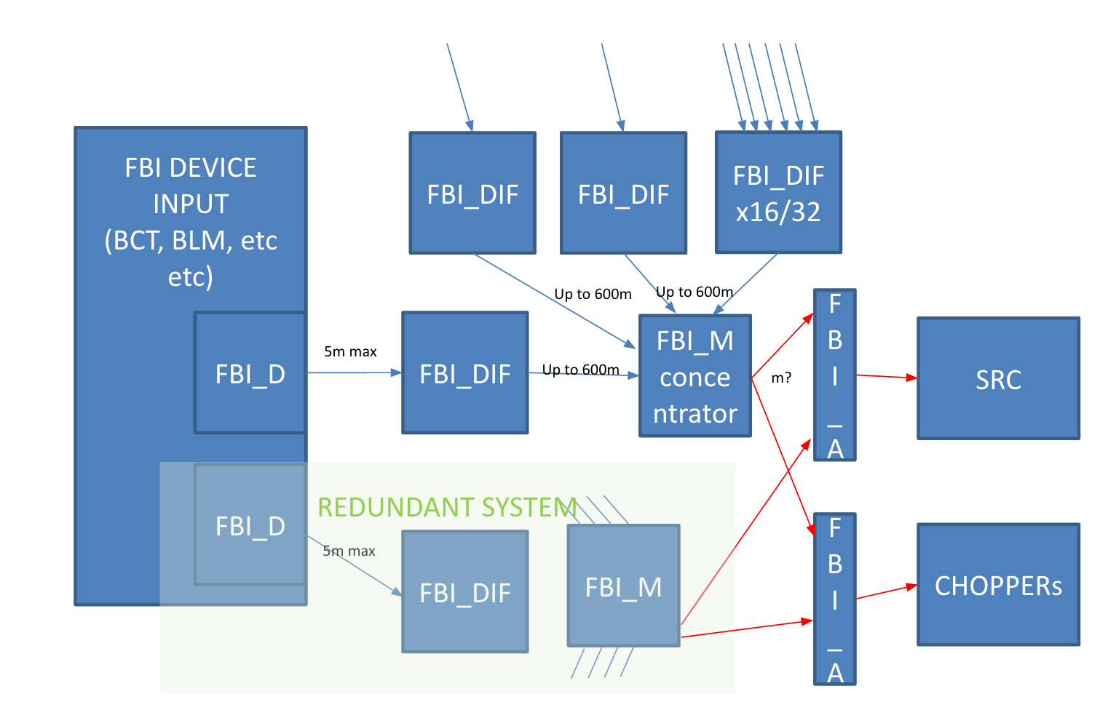
ESS BIS Hardware Design
Responsibility of Systems experts
Responsibility of ICS/Protection Group
Responsibility of Systems experts
Only 1 requirement for fast systems that connect:
implement driver which is defined by MP
It is very easy to implement the driver
FBI: Fast Beam Interlock
FBI_D: Driver
FBI_DIF: Device interface
FBI_M: Master
FBI_A: Interface to actuators

Slide 28
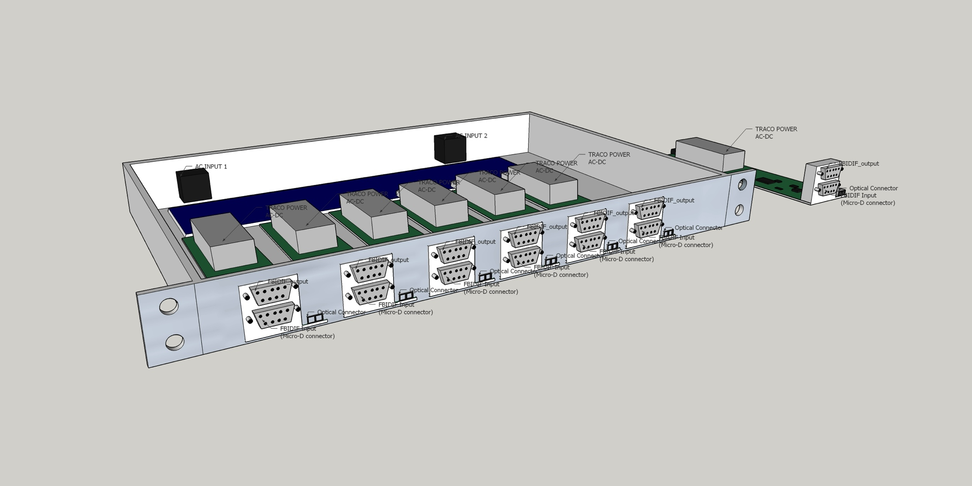
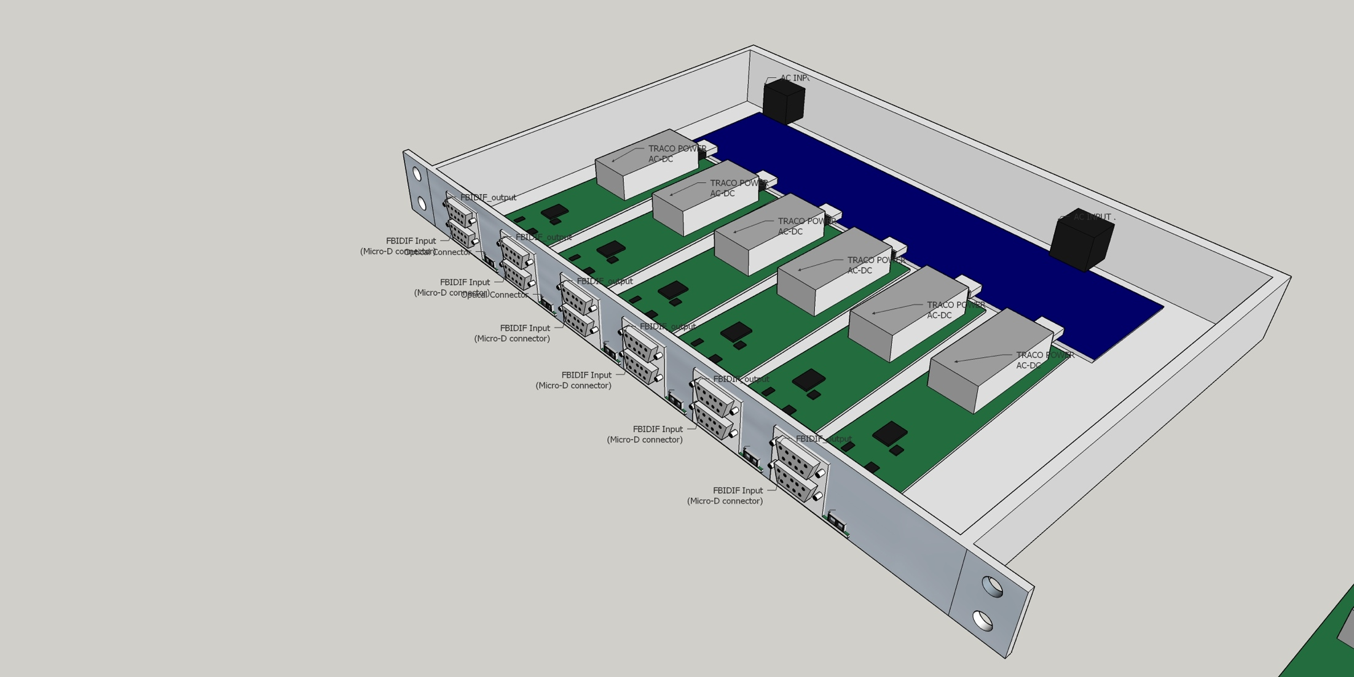
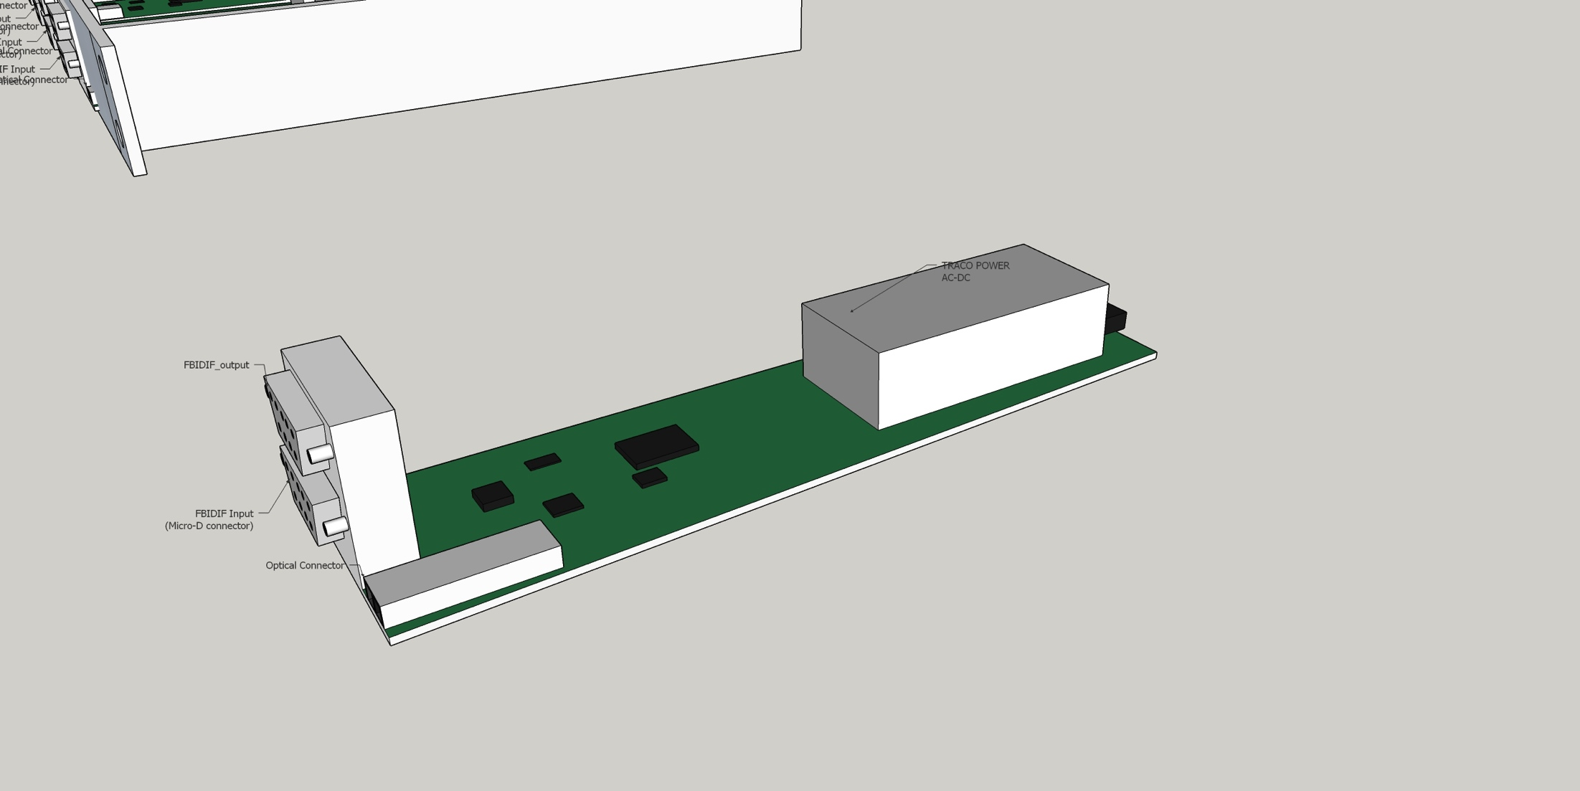
Interface Module (FBI_DIF) - Box
One module per MP connection
Wide input range allowed: at least 3.3V – 36V (ie almost any type of signal can be connected)
Full link test capabilities: thus redundancy required
Redundant power supply per module
Unique serial number and remote monitoring
Multiple modules per box
Box 19” standard width but low profile (1U)

Slide 29
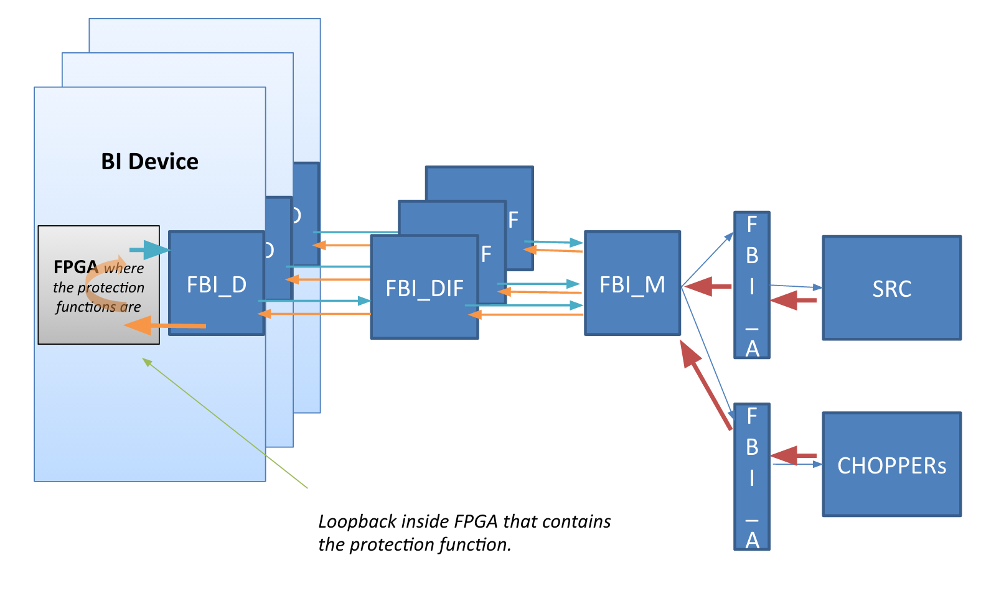
Testing the Links
FBI: Fast Beam Interlock System
FBI_D: Driver
FBI_DIF: Device interface module
FBI_M: Master
FBI_A: Interface module to actuators
4% duty cycle machine: use long (68ms) time in between pulses efficiently! Always test links between master and interface module (takes less than 20μs), assuring that everything is up and functioning on BIS level. This increases availability, reliability and the protection integrity level. Links between fast devices (such as from BI) and the related interface module can be tested too in between pulses. Links between slower devices (PLC based) and the interface module cannot be tested in between pulses but will be tested (on different time scales/tbd).

Slide 30
BIS Master Module
Based on Pizza Box, 19” width with 2/3 U height:
Two systems in a box (main and redundant system):
Dual ESS standardized controller (power PC + big FPGA)
Attachment board made specifically for machine protection including an FPGA where the protection functions will be implemented
Dual PSU
16-32 inputs per system
Monitoring, test and control is done inside the big FPGA (ie don’t touch and never mess with the protection functions!)
Physical separation between diagnostic part and protection part!

Slide 31
Links
Mainly copper cable will be used:
Cable: 9/8 wire twisted cables in pairs with double shielding (by pair and around the whole cable)
Low capacitance and low impedance will be required to minimize rising and fall time
Connectors chosen will be Micro-D from the input device systems to the interface modules and from BIS Master to Actuator
Optic fibers will be used for at least the communication with the magnetron of the proton source (pre-defined by Proton Source set up)

Slide 32
Summary
Presented scope and concept for ESS machine protection
First designs of hw components done (to be permanently optimized)
Prototyping started
First audit with external experts by the end of this year
Excellent and great team in many aspects with very high expertise in the fields required to build this system!!!

Slide 33
Backup Slides

Slide 34
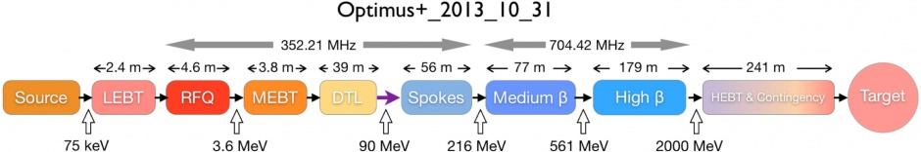
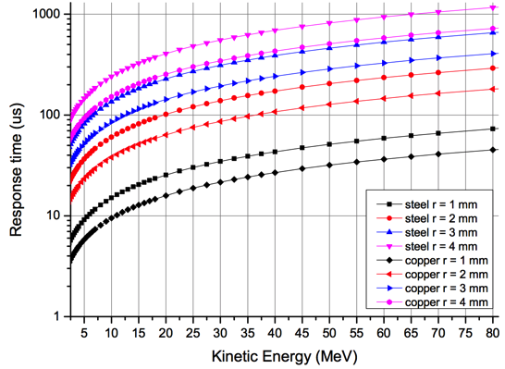
Damage Potential and Timescales for LINAC
After the DTL, the energy of the proton beam is 90 MeV. In case of a beam size of
2 mm radius/and direct impact, melting would start after about 200 μs. Inhibiting beam should be in about 10% of this time.
Examples for required response times to avoid melting of equipment (2mm/10%):
@ 1 MeV: 1 μs
@ 3.6 MeV: 2 μs
@ 90 MeV: 20 μs
@ 216 MeV: 40 μs ….

Slide 35
Project Risks/Concerns
Interface to Beam Instrumentation systems (BLMs, BCMs)
Failure catalogue is not complete/support from beam physics group required
Failures due to pulsed magnets: can failures be captured by BLMs? (simulation campaign + report summarizing results needed)
Risk matrix used for the preliminary risk analysis still not approved by management
Sprinkler system in klystron gallery: do we need to build water proof cases for BIS electronics? How to assure fail-safe state if in contact with water?
Delay with having defined some of the detailed requirements for MP relevant systems, however there is a very good communication with the teams in charge of the most critical systems

Slide 36
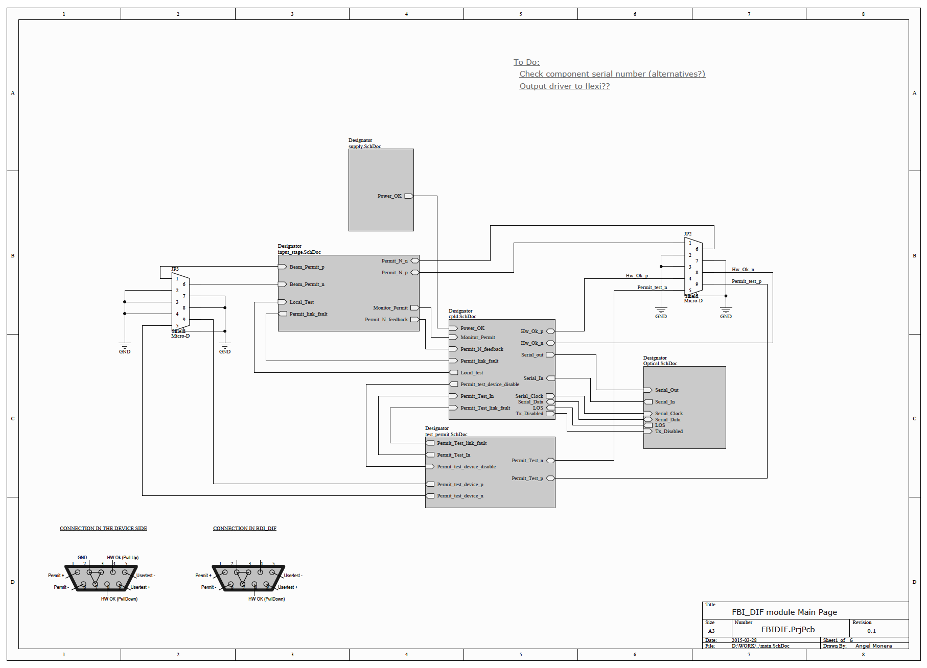
Schematics Interface Module (FBI_DIF)

Slide 37
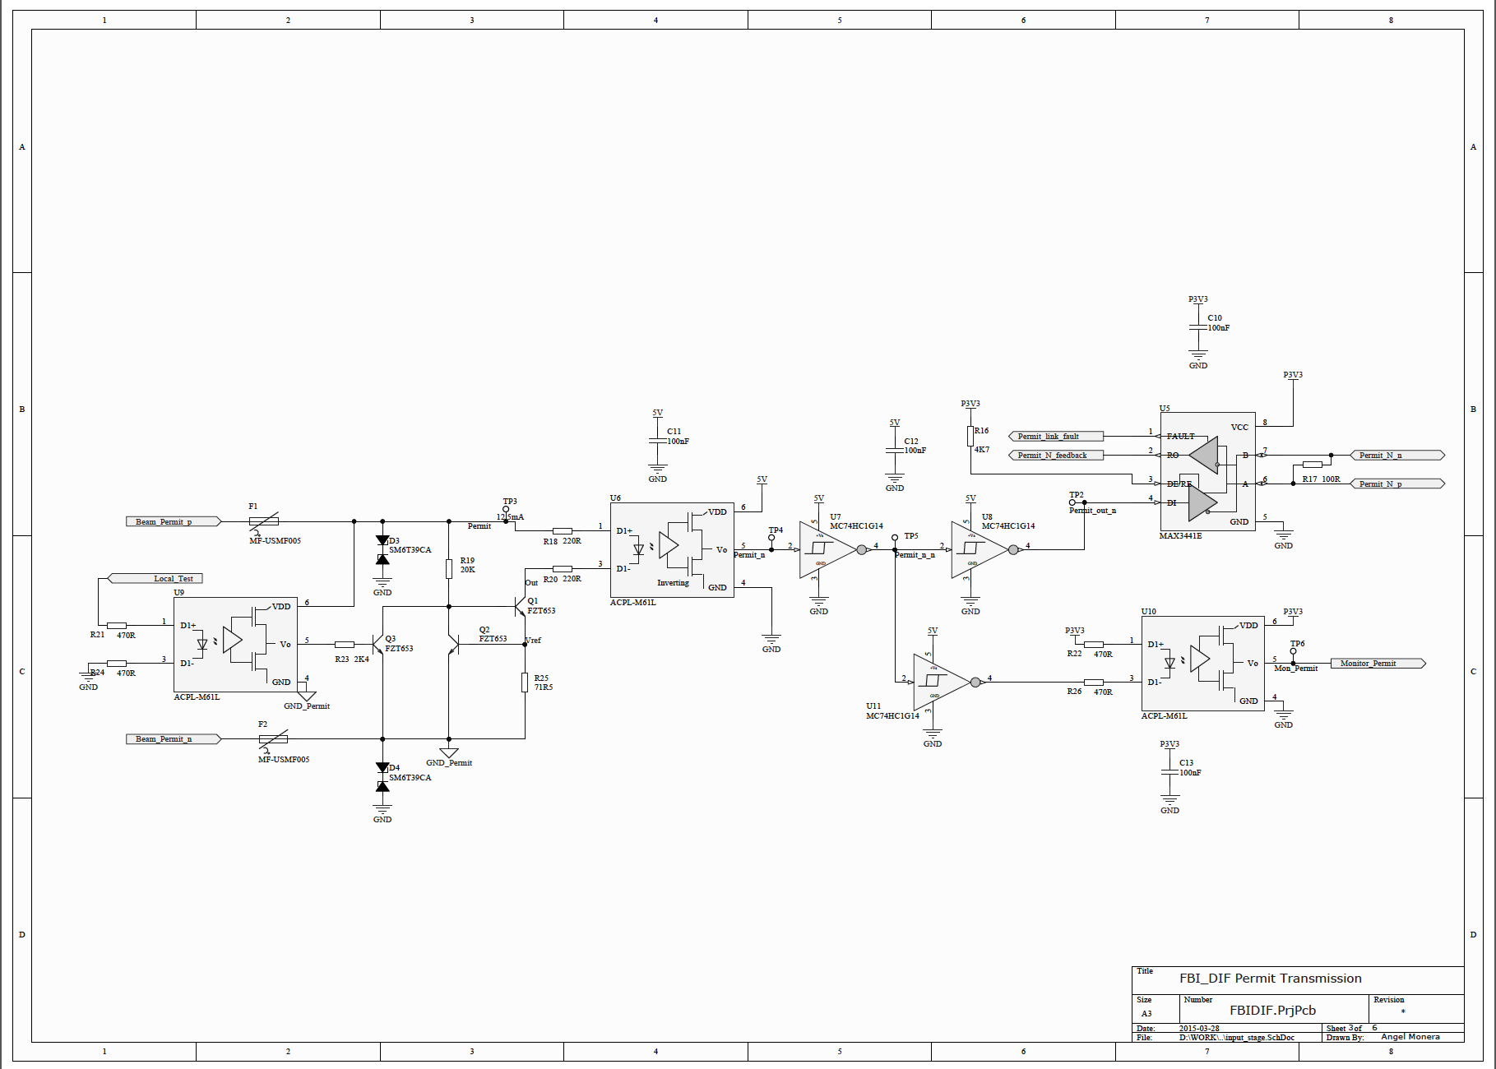
Schematics FBI_DIF Permit Transmission

Slide 38
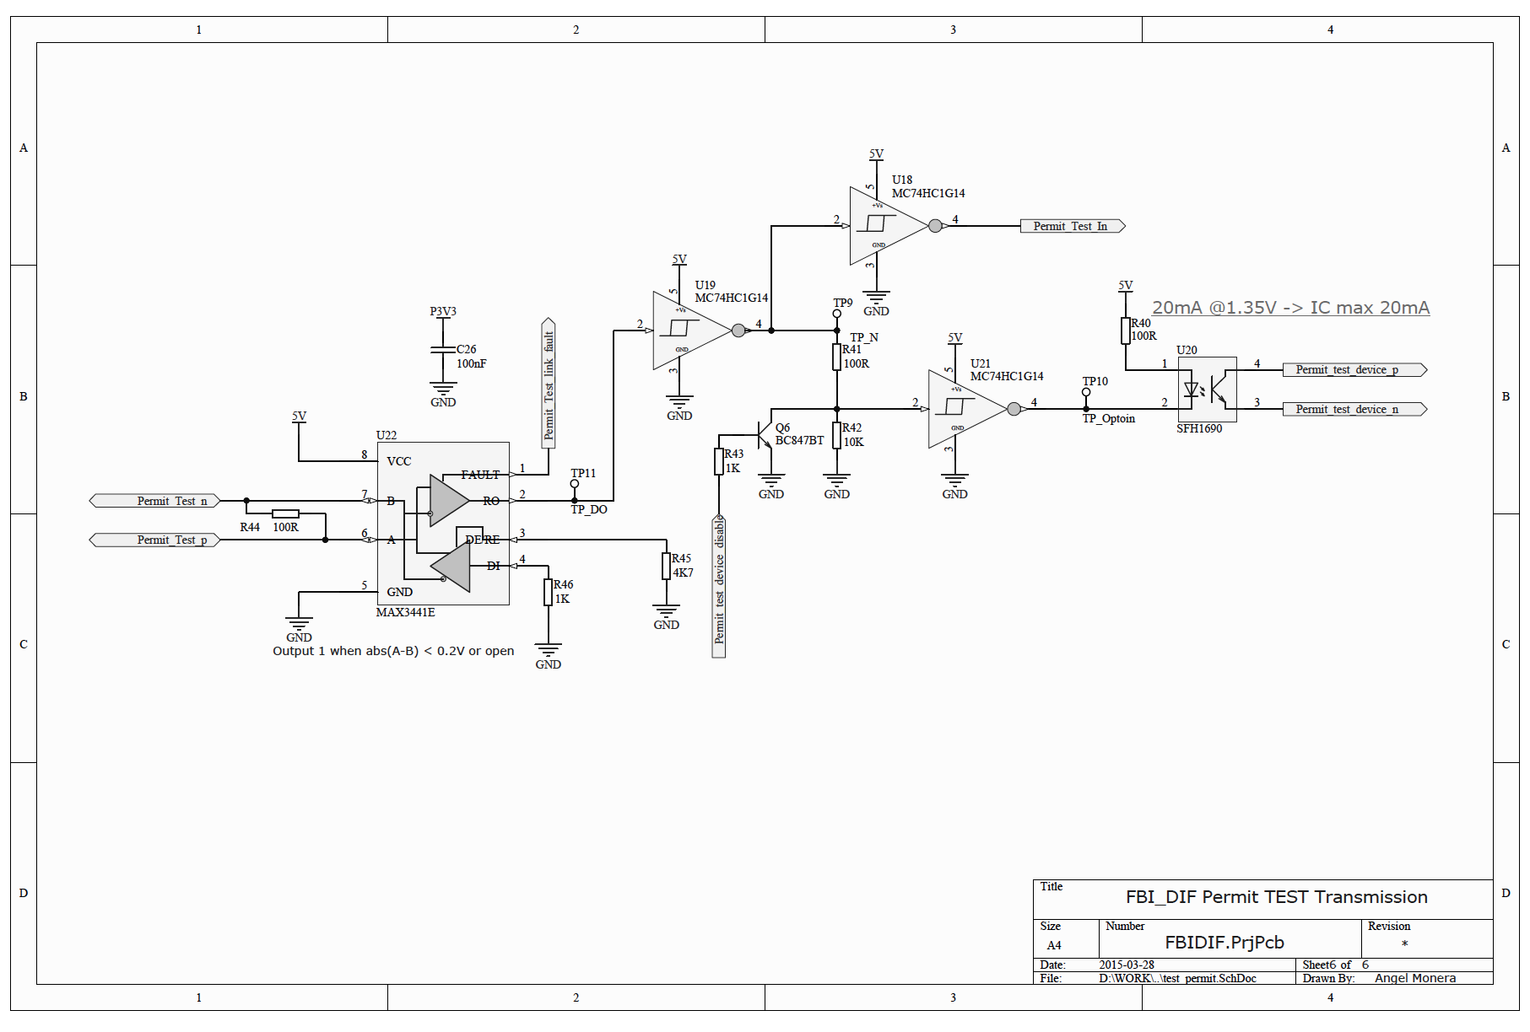
Schematics FBI_DIF Permit Test Transmission

Slide 39
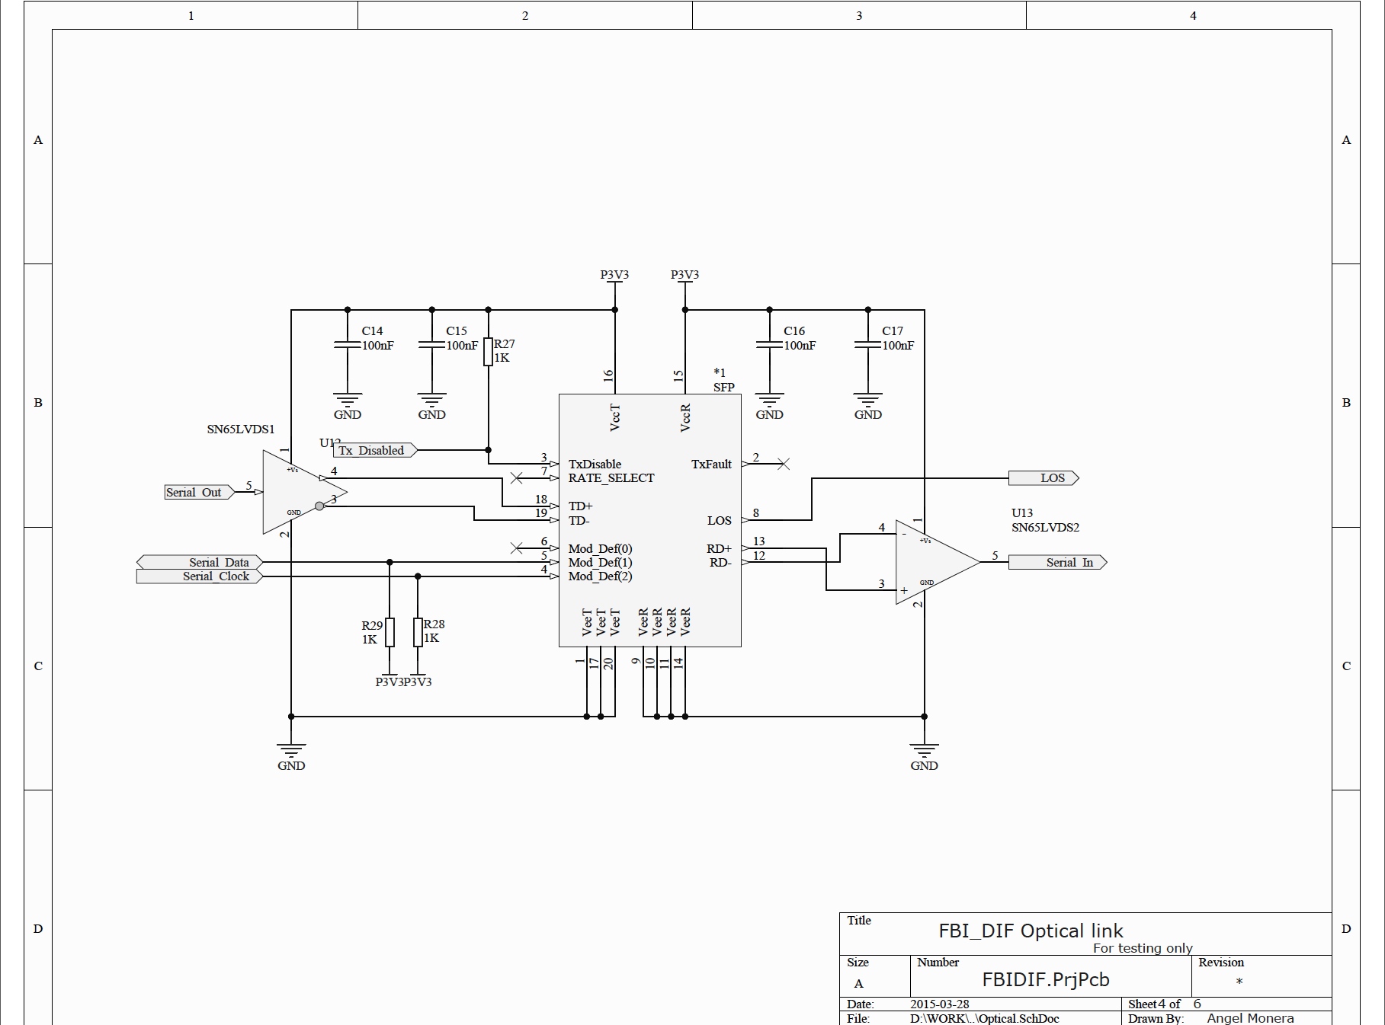
Schematics FBI_DIF Optical Link

Slide 40
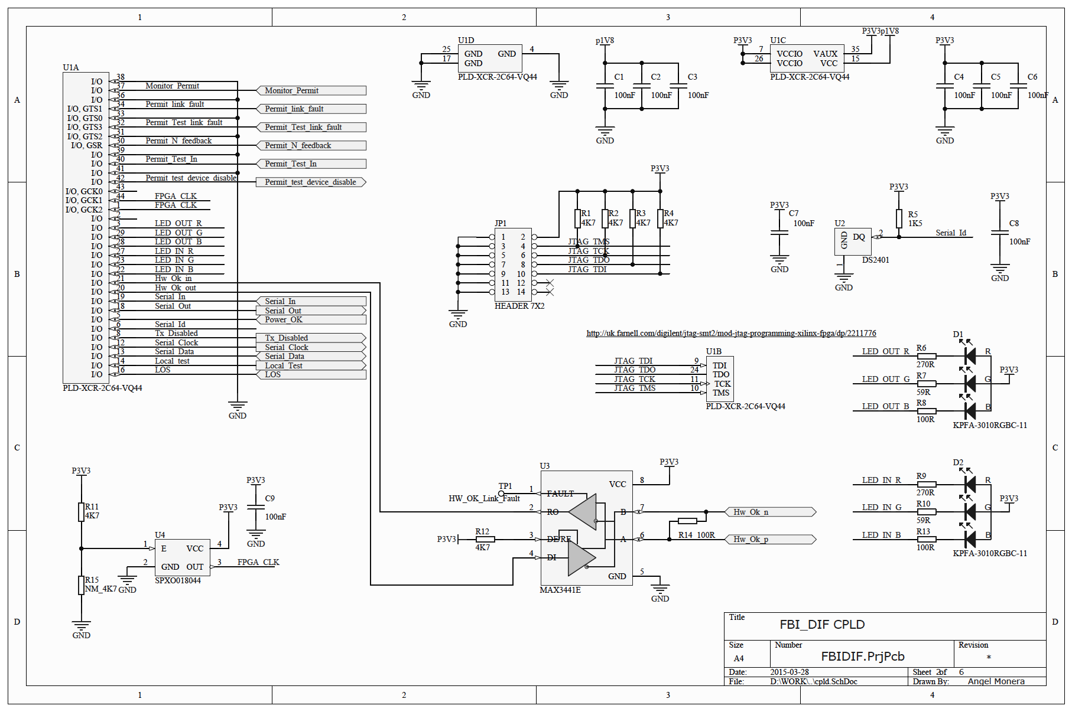
Schematics FBI_DIF CPLD

Slide 41
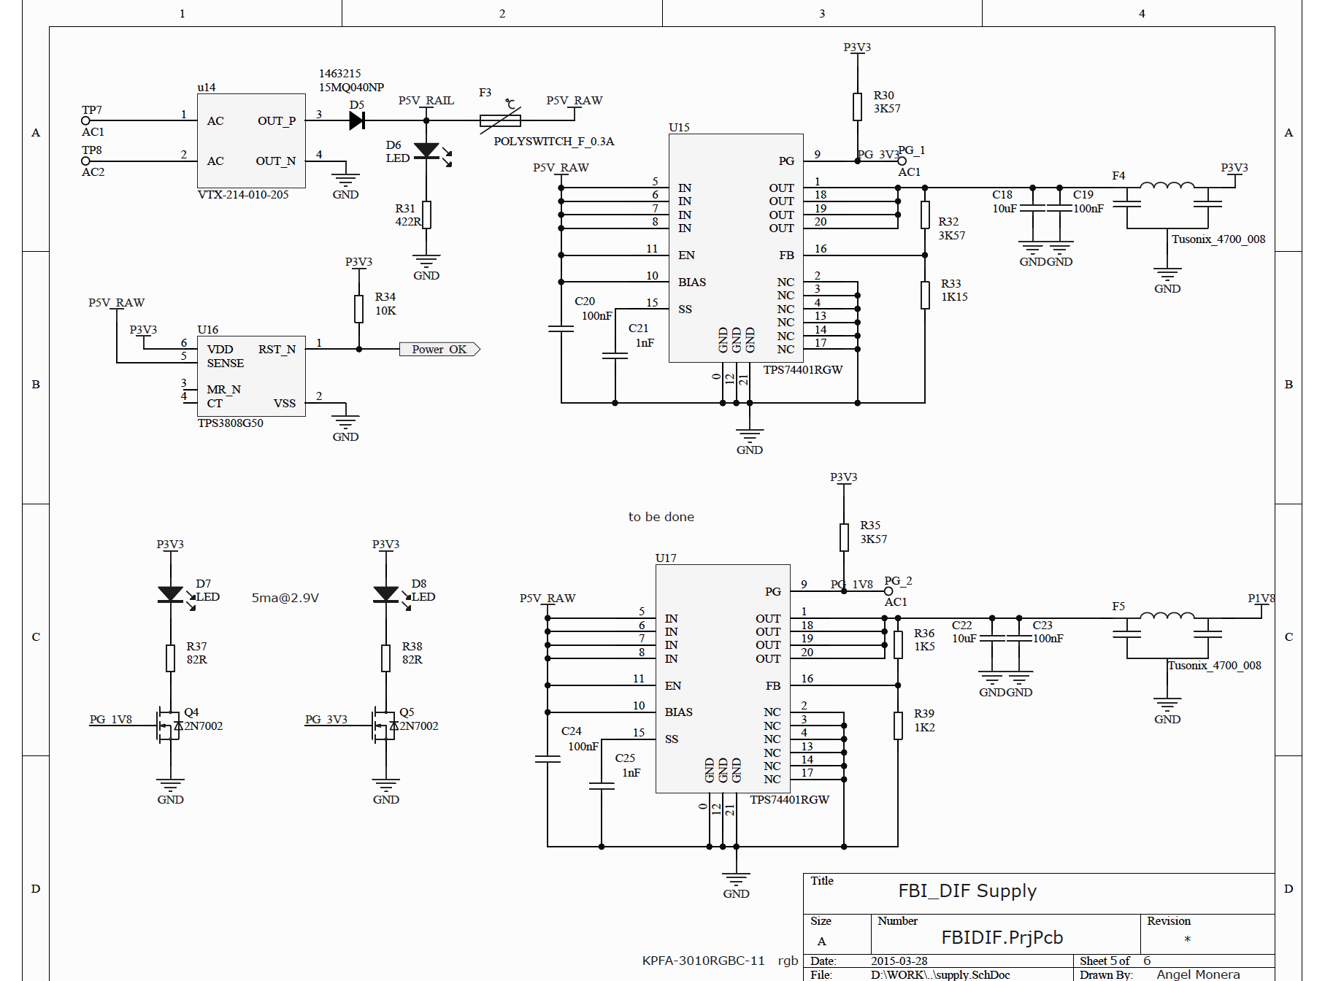
Schematics FBI_DIF Supply

Slide 42
Magnet & Power Supply Protection
Protection functions related to magnet/beam protection (quadrupoles, dipoles):
  Loss of power supply: deflected beam,
  Loss of water cooling: magnets overheating,
  Malfunction of power supply: deflected beam,
  Malfunction of local sensors (temperature, flow switch),
  Water leaking: stop magnet powering by short circuiting,
  Unstable power supply: fluctuating magnetic field

Slide 43
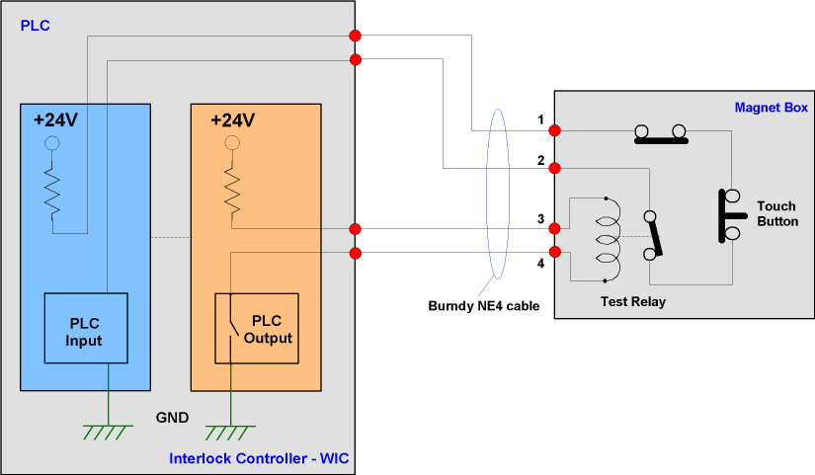
Design based on current loops
HW signals between PLC – PS - Magnets:
  PLC and Magnets including remote testing loops
  Additional current loop for cable connection evaluation

Slide 44
Design based on current loops
  PLC to Power Supply: Powering Permit/Stop powering loop
Power Supply
+15 ,,, 24 V
PLC relay output
Powering Permit:
Switch closed: permission
for powering
Switch open: no permission for powering or stop powering
Signal present: Powering permitted
Signal to FALSE: Powering not permitted or stop powering

Slide 45
Design based on current loops
  Power Supply to PLC: Powering failure loop
Additional current loop for cable connection evaluation
PLC
+15 ,,, 24 V
Power Supply
PLC input
Switch closed: operation OK
Switch open: internal failure
Powering failure

Slide 46
Design based on current loops
  HW signals between Magnet Powering Interlock–Beam Interlock system
Warm magnets status
Essential/Auxiliary
circuits signals
Magnet Powering
Interlock (PLC)
OK/NOK
Beam Interlock System
(FPGA)
Stop Beam
Beam status
Powering Permit/Stop
Powering Failure
Power Supply

Slide 47
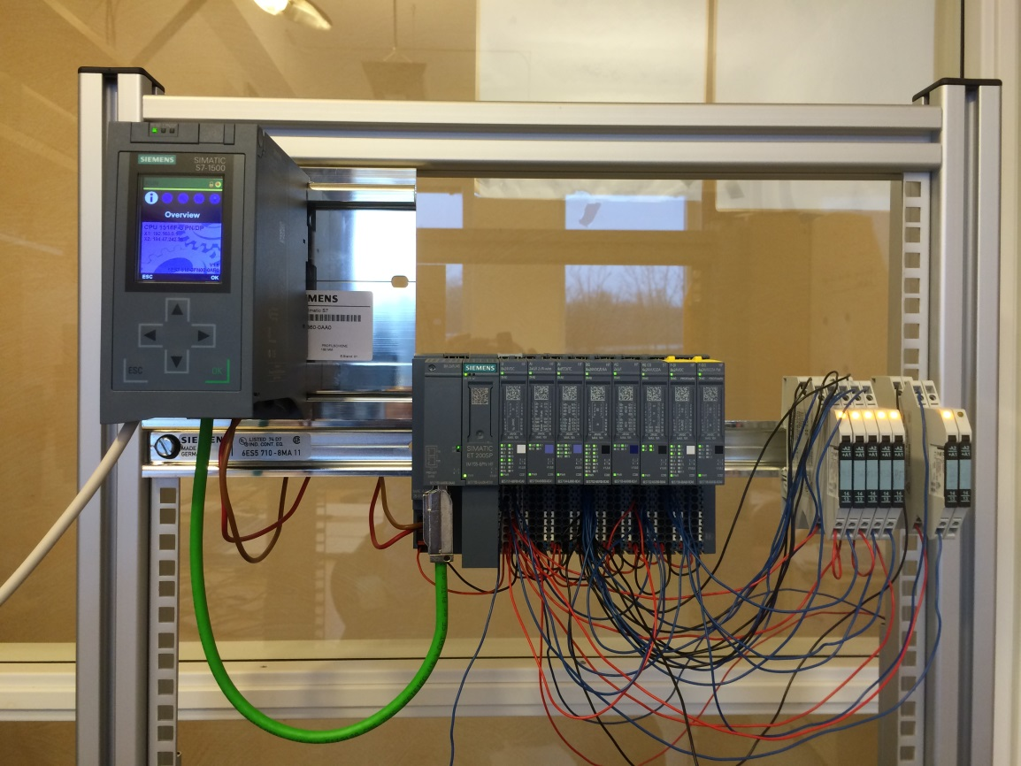
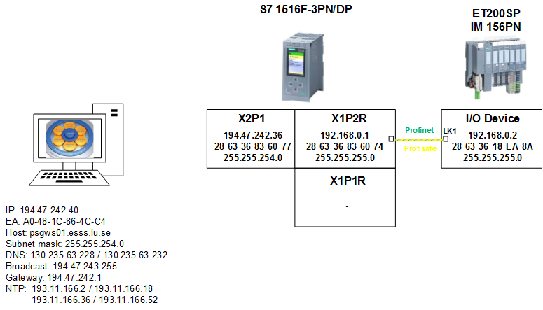
Prototype implementation
  HW prototype and networking

Slide 48
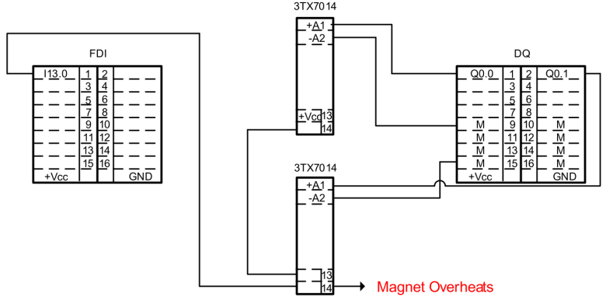
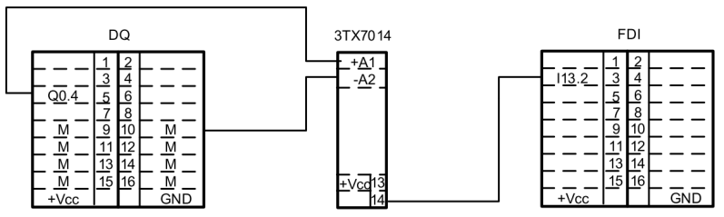
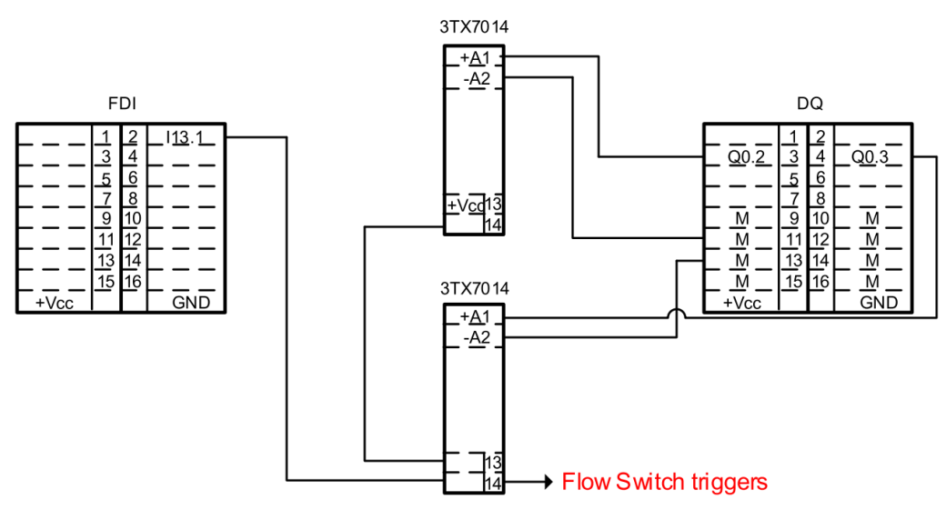
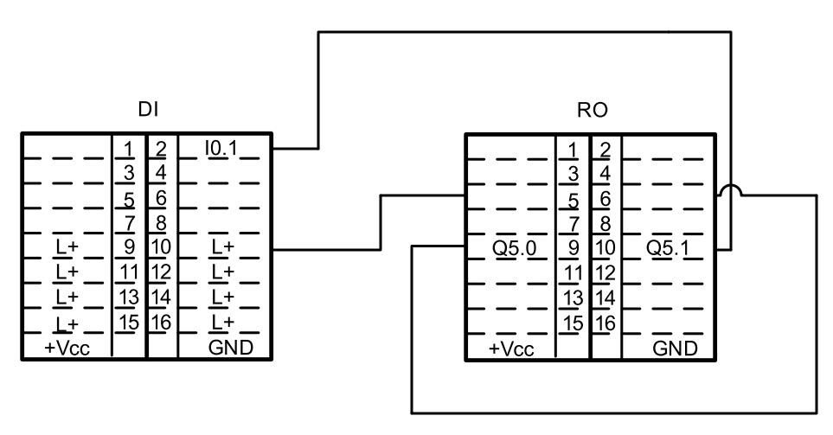
Prototype implementation
  Current loop for magnet overheating
  Current loop for Powering Failure
  Current loop for flow switch triggering
  Current loop for Powering Permit/Stop Powering

Slide 49
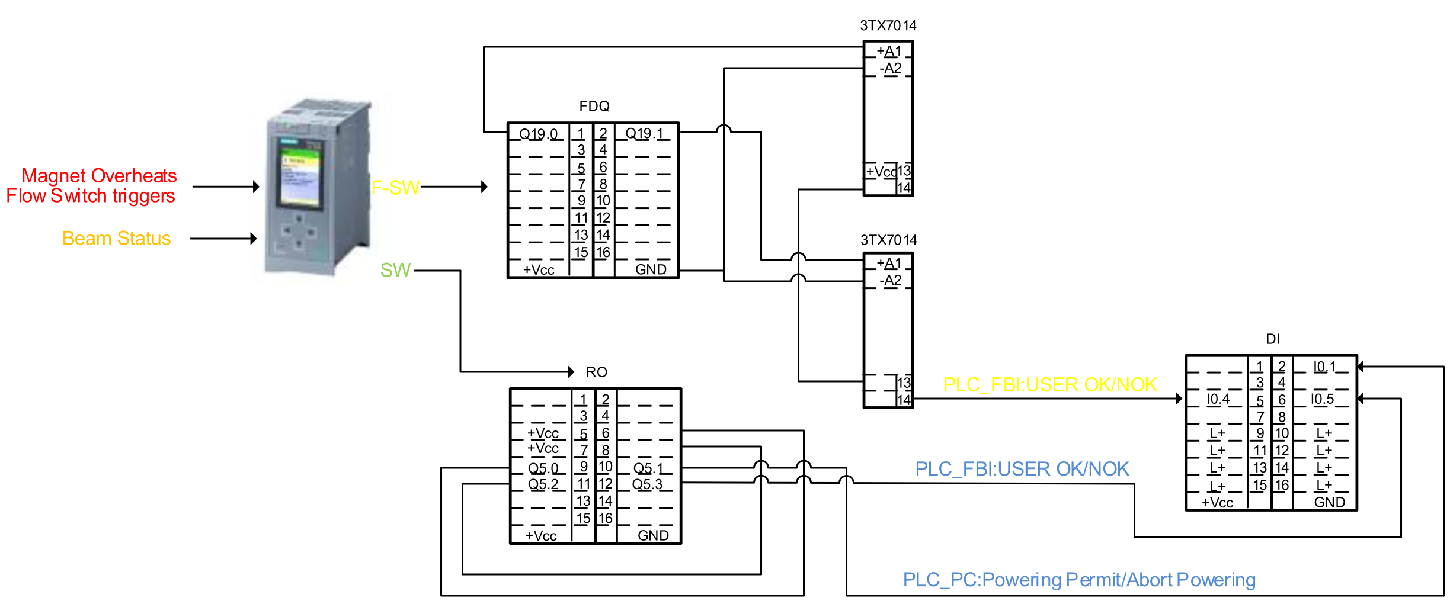
Prototype implementation
  Generation of Beam Permit signal to the FBI and Powering Permit/Stop Powering to the Power Supply using failsafe and standard programming

Slide 50
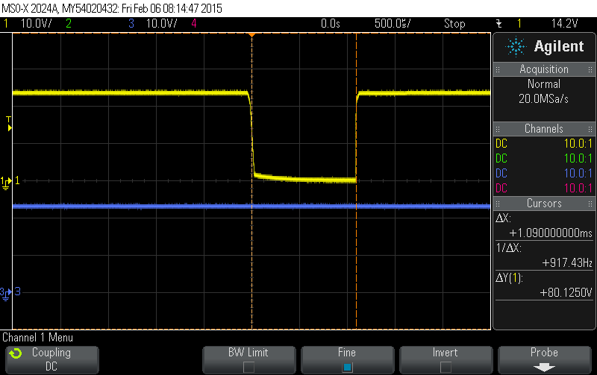
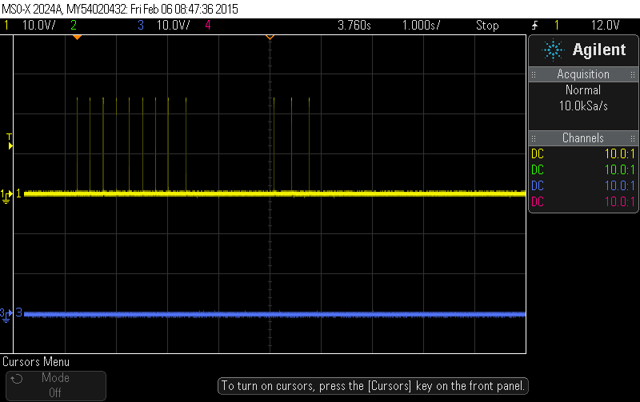
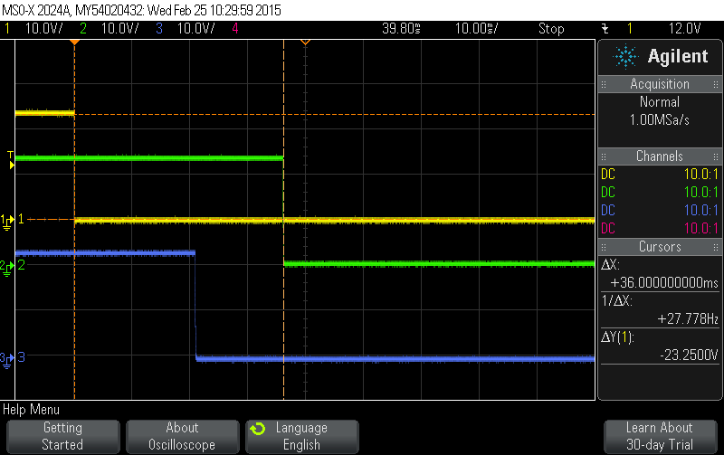
Response time evaluation
  Dark Test (1ms microcut)
  Switch pattern test (9+ 3 microcuts)
  Magnet powering interlocks

