Slide 1
Target Project Progress and Plans
Eric Pitcher
Deputy Head of Target Division
11th TAC Meeting
April 1, 2015
www.europeanspallationsource.se

Slide 2
Outline
Schedule
  Preliminary Design Reviews
  First hardware
Changes in the Target Baseline since TAC-10
Current design assessments
Committee comments from Preliminary Design Reviews
Development of a safety classification process

Slide 3
Schedule of Preliminary Design Reviews

Slide 4
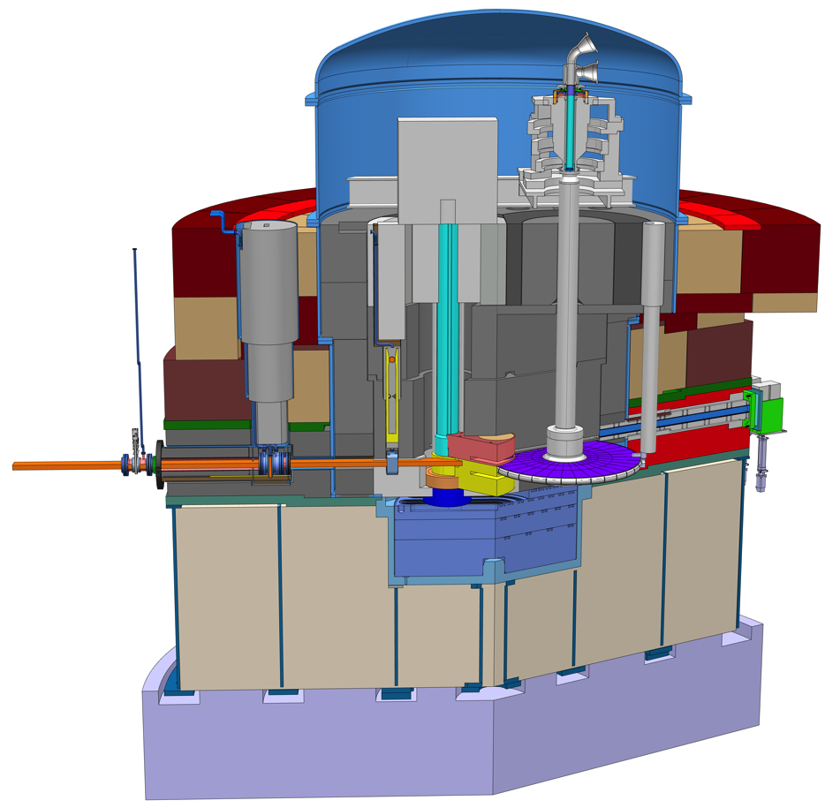
First Target hardware to be delivered to the site in October
Concrete embedments for connecting all support rings to be delivered in October and installed in November
Outer ring to be delivered in November and installed in December
Embedments for active cells scheduled to be delivered to the site in February

Slide 5
Changes approved to date by Target CCB
Number | Proposed Change | Status | Further Action | Outcome
TC-1 | Monolith diameter and position of light shutters | Approved | Take to Programme CCB | Approved
TC-2 | Lower monolith bulk shielding and support structures | Approved | None
TC-3 | Monolith helium vessel diameter and upper dome | Rework | Rework
TC-4 | Cooling medium for intermediate target cooling | Approved | None
TC-5 | Active Cells layout and waste package logistics inside the target station | Approved | Take to Programme CCB | Approved
TC-6 | Modified MR plug configuration and handling concept (Twister) | Approved | Take to Programme CCB | Approved
TC-7 | Operation Pressure Primary Target Cooling System | Approved | None
TC-8 | Target Wheel Shroud | Approved | Take to Programme CCB | Approved
TC-9 | Target Shaft Dimension | Approved | None
TC-10 | Tuning beam dump installation logistics | Approved | Take to Programme CCB | Approved
TC-11 | Tungsten Configuration | TBA
TC-12 | Butterfly Moderator Set | Approved | Take to Programme CCB | Approved
TCs since last TCM

Slide 6
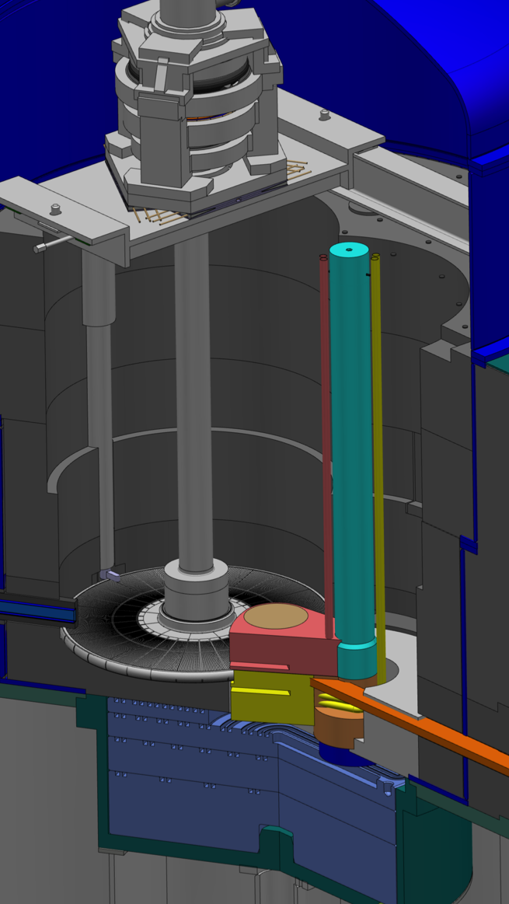
TC-6: “Twister” configuration for the Moderator-Reflector Plug
Relative to the TDR design, Twister offers these advantages:
No direct view of the target during MR-Plug change
Much less material to change (and dispose) each year
Casks reduced in size and weight, simplifying handling
Features of the Twister:
All steps in the replacement sequence can be monitored visually
Several simple contingency options are available in case of problems
The plugs offer flexibility for future arrangements
Up to 2×120° flight path openings for both moderators
The support pillar and pipes will need active cooling

Slide 7
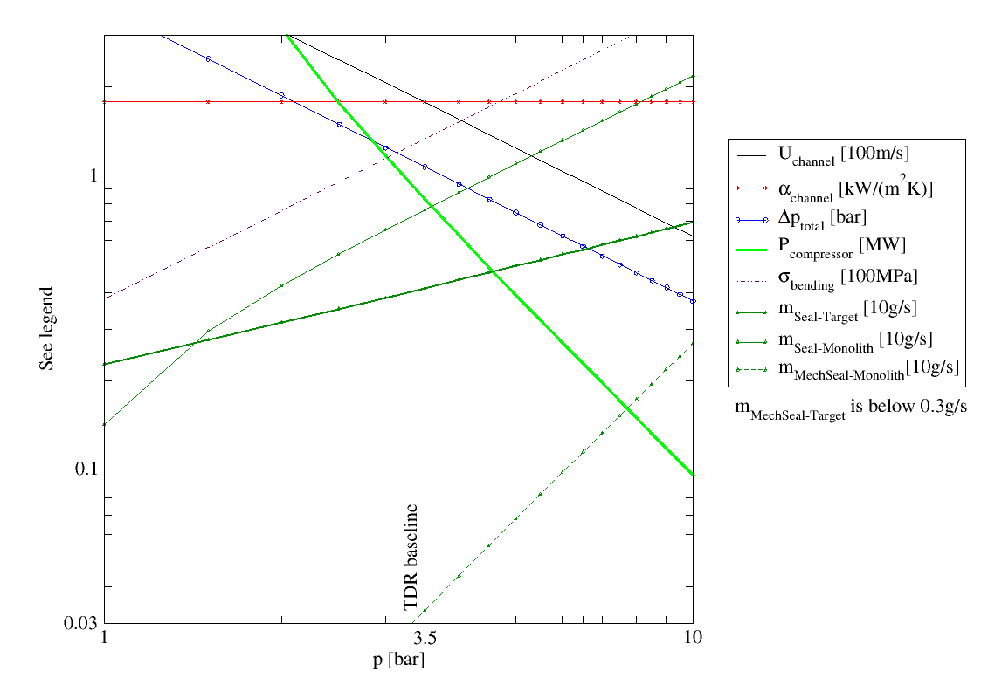
TC-7: Helium coolant pressure for target increased from 3.5 to 10 bar
Benefits:
Reduced helium compressor power and cost
Reduced pressure drop
Reduced helium velocity
Detriments:
Increased helium leakage
  from flanges, valves, etc.
  from shaft seal to helium vessel
Increased stress in shroud

Slide 8
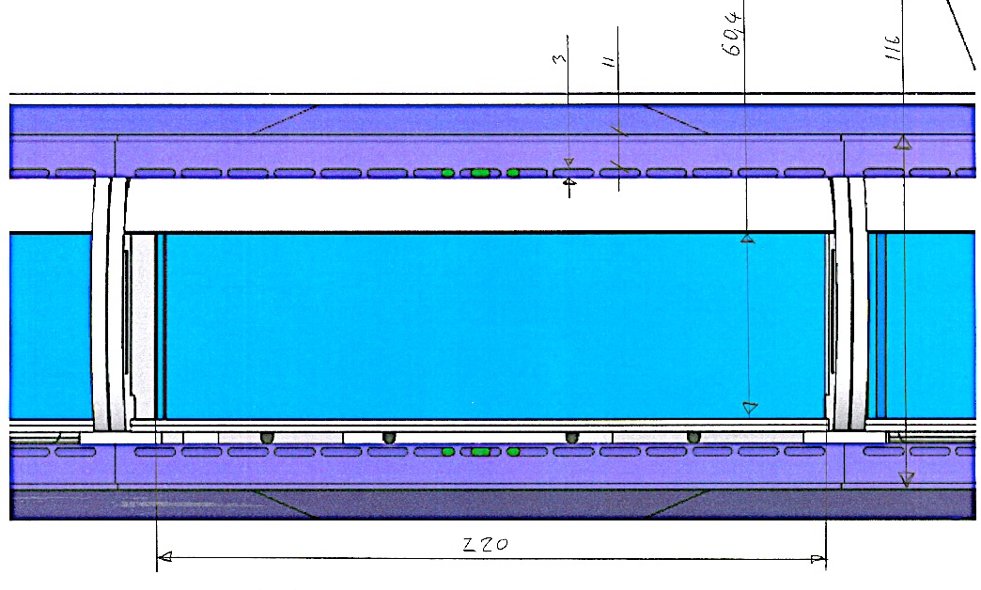
TC-8: Target wheel shroud thickened and internal helium flow channels added
Top and bottom walls thickened from 5 to 14 mm to accommodate higher internal helium pressure
Flow to the Beam Entrance Window rerouted from the side walls to the top and bottom shroud walls
  Eliminates “hot spots”
  present in the TDR
  design
4% neutronic
penalty

Slide 9
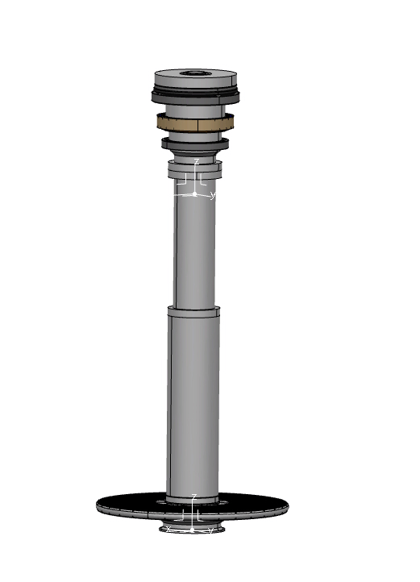
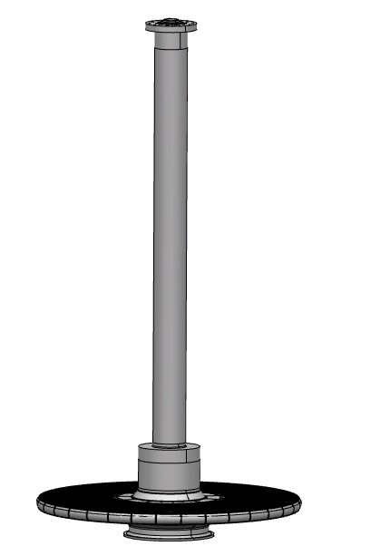
TC-9: Target shaft diameter reduced
Higher helium operating pressure allows the shaft diameter to be reduced while maintaining low pressure drops through the shaft
Shaft mass reduced by 6 tons
  Lower torque load on motor
  Less load on bearings
Step to address radiation
streaming increased from
50 to 135 mm
TDR design
17 ton
PDR design
11 ton

Slide 10
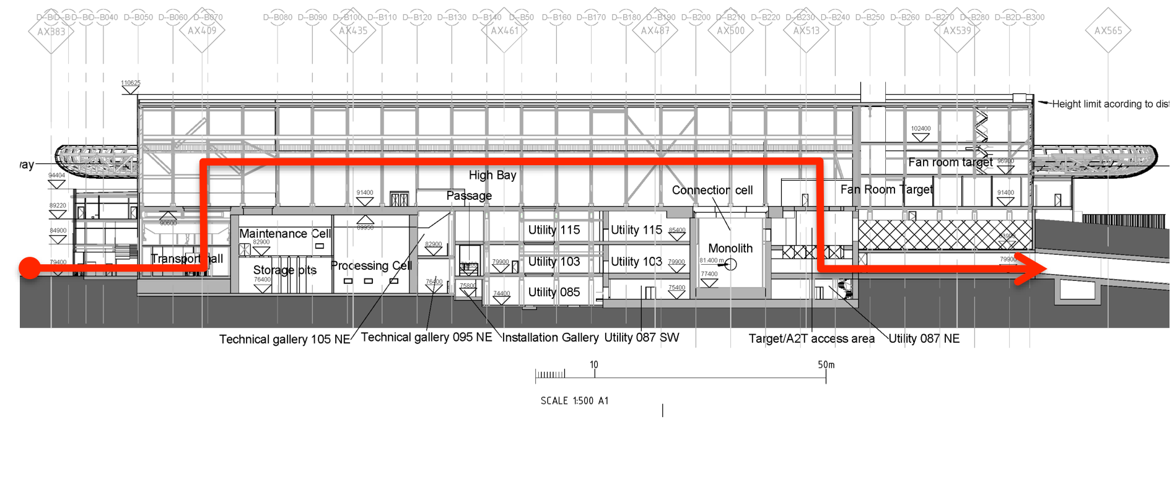
TC-10: Tuning beam dump installation
Proposed installation path for the tuning beam dump shielding
  Blocks enter via the transport hall, provisionally 60 pieces of 10 tons ea.
  Blocks lifted up to the high bay, transferred to the hatch upstream of the monolith, and lowered to the floor of the A2T
  A trolley transfers the blocks to the tuning beam dump pit
  A temporary overhead crane lowers blocks into the beam dump pit

Slide 11
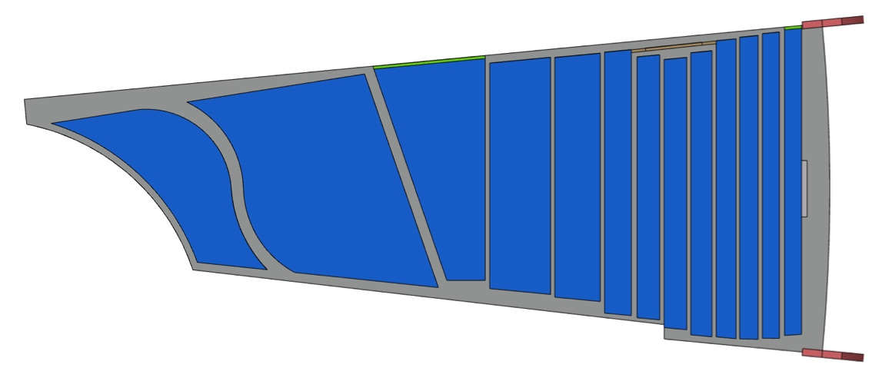
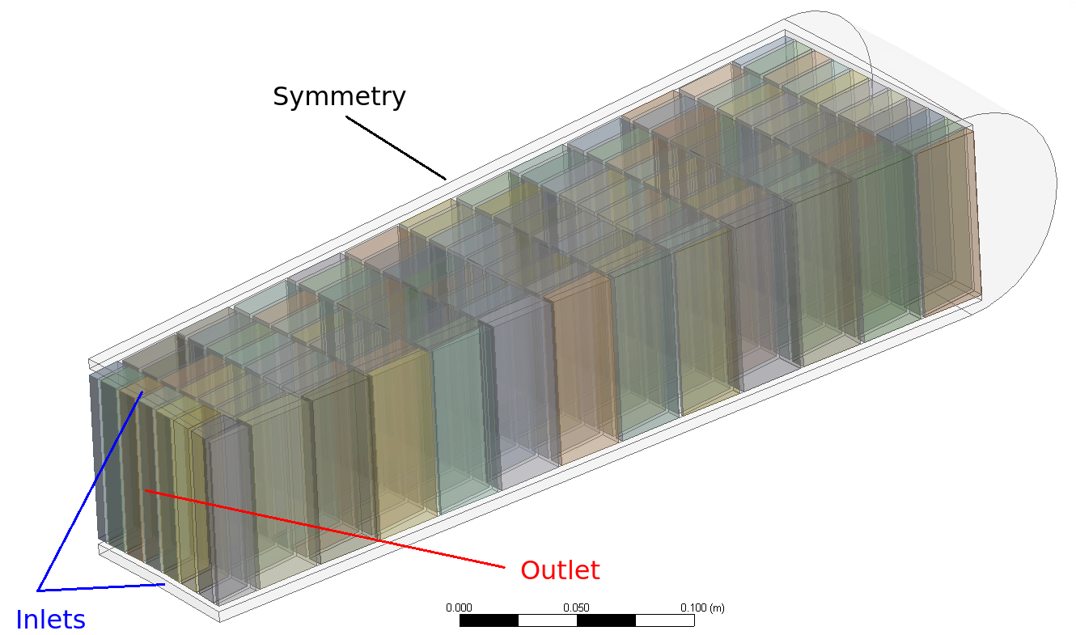
TC-11: Tungsten Configuration
Proposal:
  Change the tungsten geometry from plates to bricks of uniform dimensions, 10 × 30 × 80 mm³
  Change the number of sectors from 33 to an even number
Benefits:
  Reduced stress in tungsten
  Easier to manufacture
Number of bricks in wheel in the range of 7 800 to 6 300
Neutronic penalty of 1.7 – 4%
TDR design: Plate geometry
with “S” flow
Proposed design: Brick geometry
with highly parallel flow

Slide 12
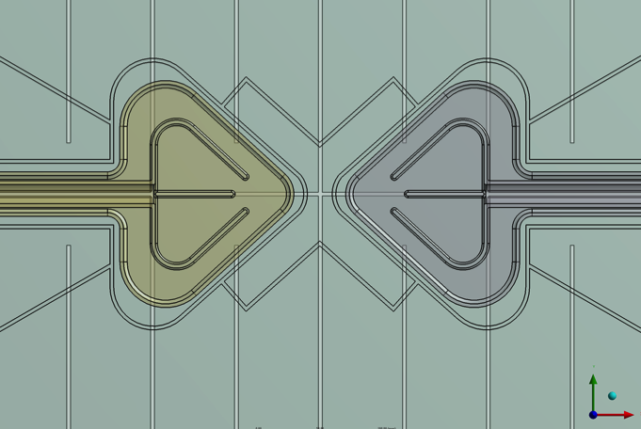
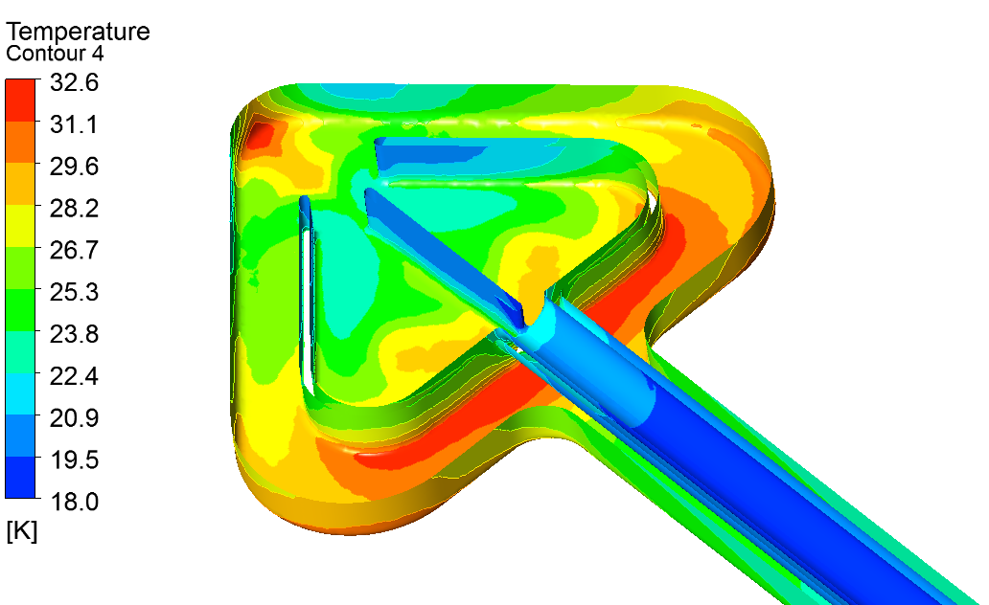
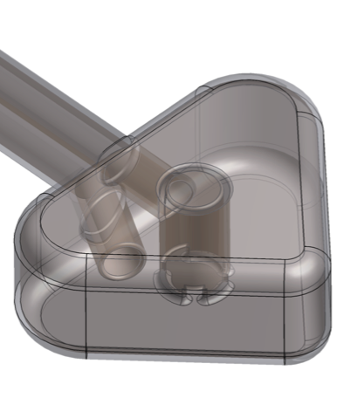
TC-12: Butterfly Moderators
Baseline design now consists of two butterfly moderators
  3 cm height
  6 cm height
Enhanced thermal brightness with equal cold brightness relative to the pancake design
Liquid H2
H20
3cm Design
6cm Design

Slide 13
Highlight of current design assessments
Neutron beam extraction
Target HVAC system
Helium purification
Monolith vessel atmosphere

Slide 14
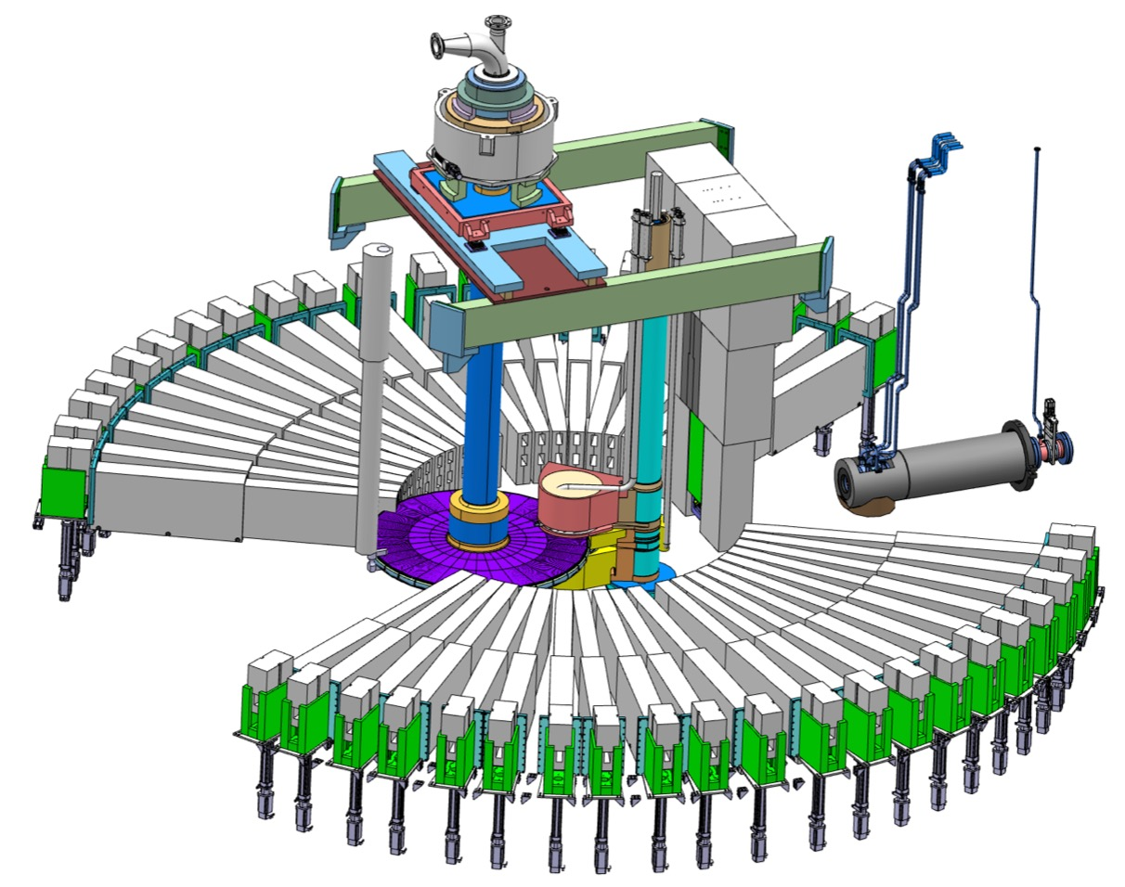
Monolith systems
Modification of neutron beam extraction system
Uniform 6° angular spacing for N and E sectors
Alternating 5.3°/6.7° angular
spacing for S and W sectors
Corner extraction scheme with
four different centerline
origins, one for each
sector, to adapt to
optimised moderator
design
Double decker inserts
for possibility to view
either of the upper and
lower moderator

Slide 15
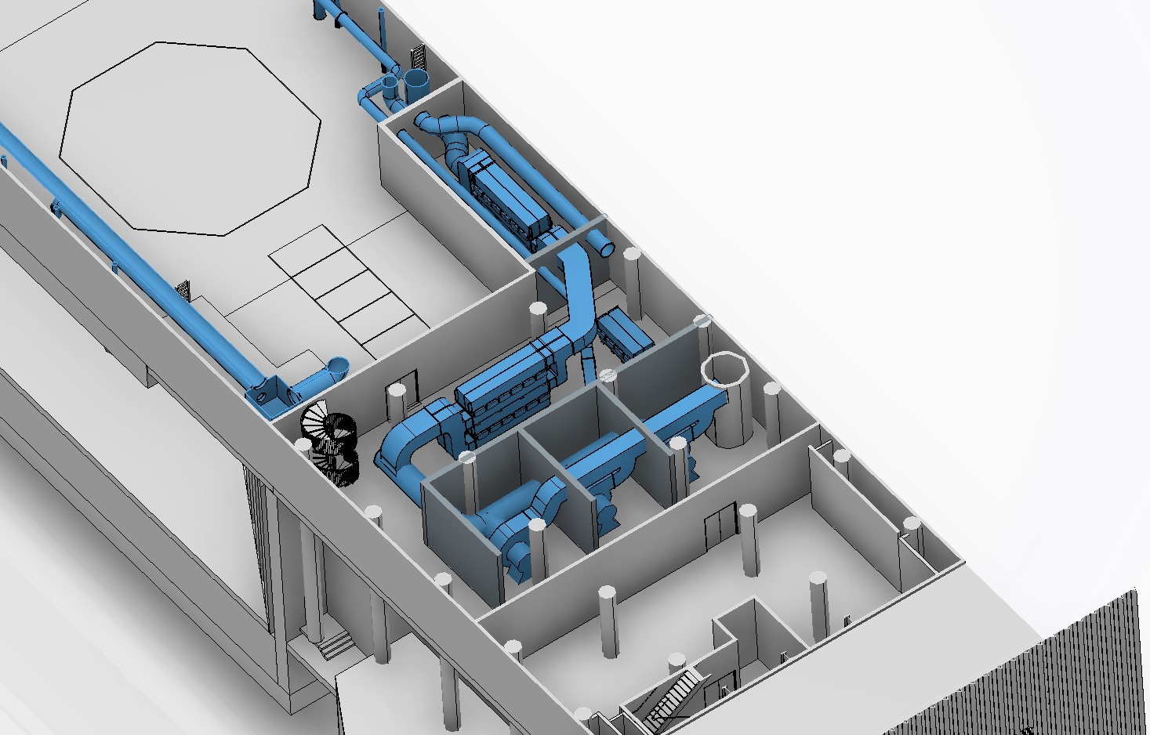
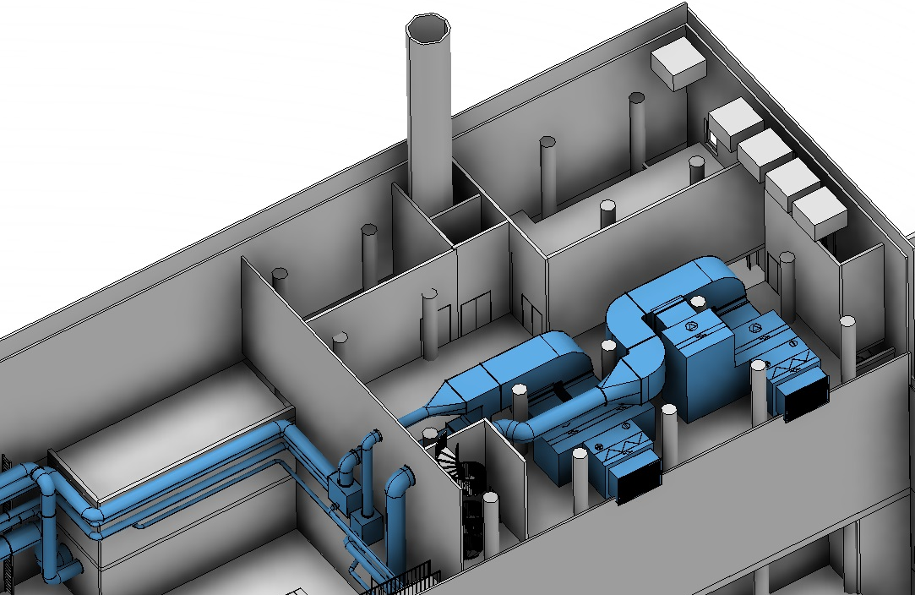
Progress on the Target HVAC System
Hazards analyses are under way, leading to requirements in terms of redundancy and safety function
          Expected levels of airborne contamination in
          the active cells used to classify zones
          according to ISO 17873
                Space allocated in the Target
                Building for supply, extraction
                and filtering

Slide 16
Helium purification system will likely be much simpler than the current baseline
Circulating and cooling system
Target
20 m³, 10 bar
23 kg Helium
0.23 mg/s
(6.58 kg/year)
3 kg/s
1 g/s
Contaminants
PCool
He purification
(getter)
He purity in
Helium loops: >99.99%
30 mg/s
Purity performance
Target wheel rotary seal
I₂
H₂
O₂
N₂
CO₂
H₂O
< 1 ppb
< 1 ppb
< 1 ppb
< 1 ppb
< 1 ppb
< 1 ppb
80 mg/s
Monolith
95 m³, 1 bar
15 kg Helium
Contaminants
MonAtm
40 g/s
Circulating and cooling system
4 μg/s Air
(72 g/year)

Slide 17
Operating the monolith atmosphere in vacuum may eliminate the need for a PBW
Benefits
  No need to replace the Proton Beam
  Window (PBW) twice per year
    Lower operating costs
    Higher availability
    Reduced radioactive waste stream
    Reduced dose to personnel
  Potentially offers passively safe beam
  shutdown for target LOCA & LOFA,
  and stopped wheel
  Lower beam losses on the way to the
  target
    Potentially reduced neutron
    background for instruments
    Potentially lower heat load to
    in-monolith structures surrounding
    the beamline
As a contingency, PBW and helium atmosphere designs and procurements will proceed regardless of the decision on the monolith atmosphere
monolith
vessel

Slide 18
Summary of Review Committee comments received from first four PDRs
Present a more complete technical description of the design solution
Summarize the value engineering exercises performed to reach the selected design
In some cases important interface requirements have yet to be established
Safety classification of systems and sub-systems must be further developed and integrated into a global approach at the target or ESS project level
Schedule appears to be aggressive

Slide 19
Safety classification process is under development
No established regulatory framework in Sweden for licensing a high-power spallation source
            ESS is developing a framework
            to provide clear guidance for
            the selection of codes
            and standards to apply
Systems/
Components
Design/define the systems and context
Risks - Events
Define (enveloping) events
and frequency (H1-H5)
Event
Consequences
Calculate dose consequences
of events (H1-H5)
Safety
Function
Determine and categorize
safety functions to prevent events (SaF)
Actions:
(QA, Procedures)
Analysis
Materials
Manufacturing
Installation
Inspection
Testing
etc
Safety
Class
Determine safety classification
of equipment (SIC)
Quality
Class
Determine quality classification of equipment in disciplines, e.g. mechanical
Code
Class
Choose classification in the codes and standards within the disciplines
19

Slide 20
Concluding remarks
Project is on schedule to complete the preliminary design of all target systems by Feb 2016
First target hardware to be delivered and installed this year
The change control process is working smoothly and the project is realizing changes in the baseline
Preliminary Design Reviews are providing useful feedback to the project
Development of a safety classification process is under way

