Slide 1

Status and schedule of warm linac front end
S. Gammino

Slide 2
Warm Linac
3,6 MeV
90 MeV
2000 MeV
Change of energy and current, as well as the request of variable current with steps of 10% of the maximum one, obliged to revise the design of some component to be sure that it was compliant with the requirements. In the case of the LEBT the need of variable currents made necessary to add an iris and to evaluate the effects on beam dynamics.
This phase was satisfactorily completed and since 2014 a significant progress towards the construction have been visible.

Slide 3

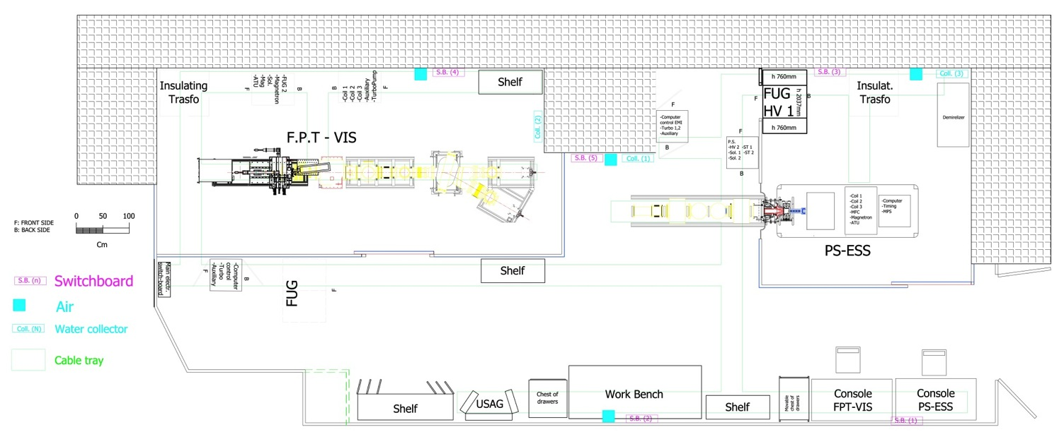
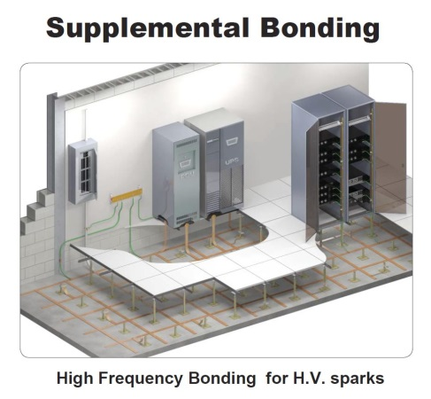
Ion Source & LEBT:
ESS test area at LNS
A careful preparation of the site has just been completed, with particular attention to grounding to minimize the effects of sparks

Slide 4
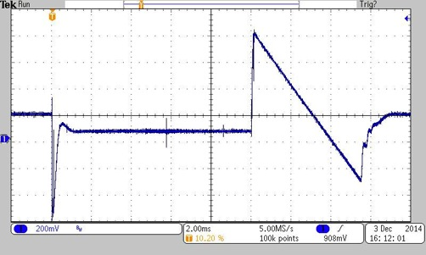
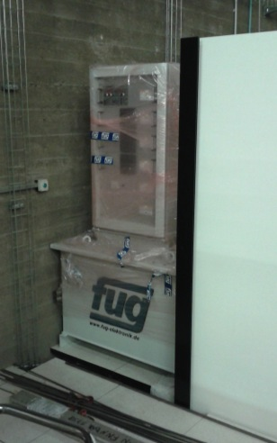
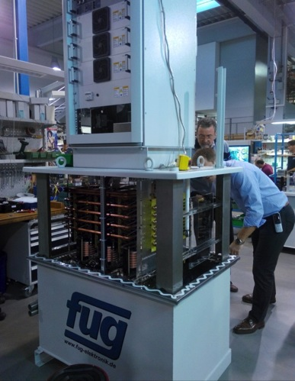
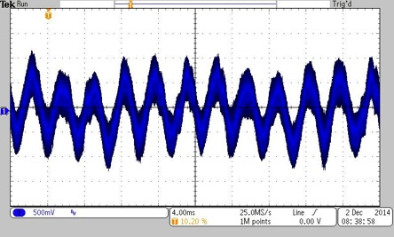
High Voltage power supply tested and delivered
Custom design to satisfy performance and stability request.
Factory Acceptance Test with the contribution of INFN technicians featured the fulfillment of specifications
Pulse of 100 mA and 10 ms @ 14 Hz
Ripple 2.5 V < 10 V requirements
@INFN-LNS

Slide 5
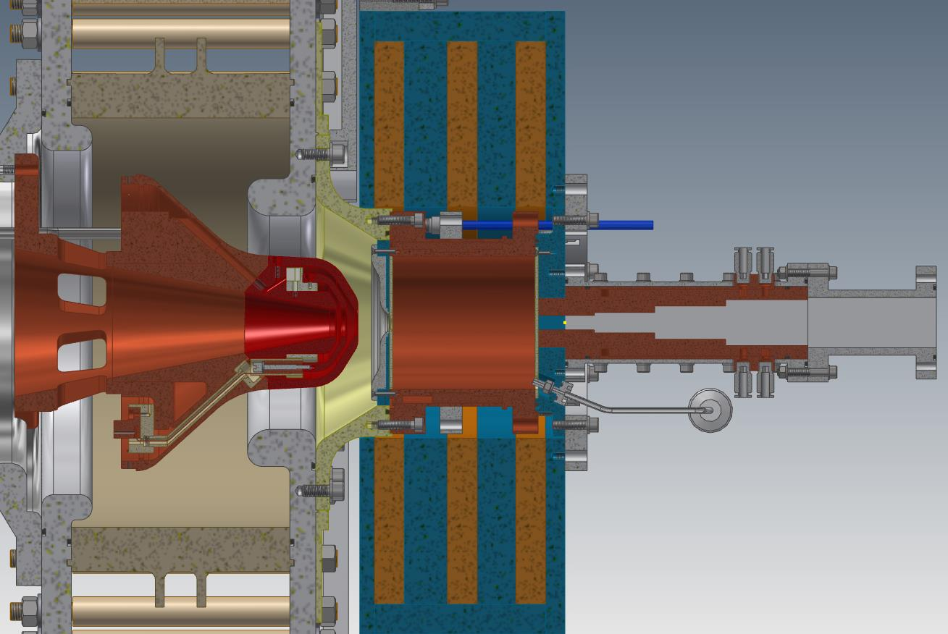
The Proton Source for ESS (PS-ESS)
Flexible magnetic system + improved RF injection-Plasma coupling + increased reliability + easy assembly procedure
CDR on Feb.10th
Positive evaluation
Needs to improve the interfacing with other WUs-WPs (solutions addressed)
Under procurement

Slide 6
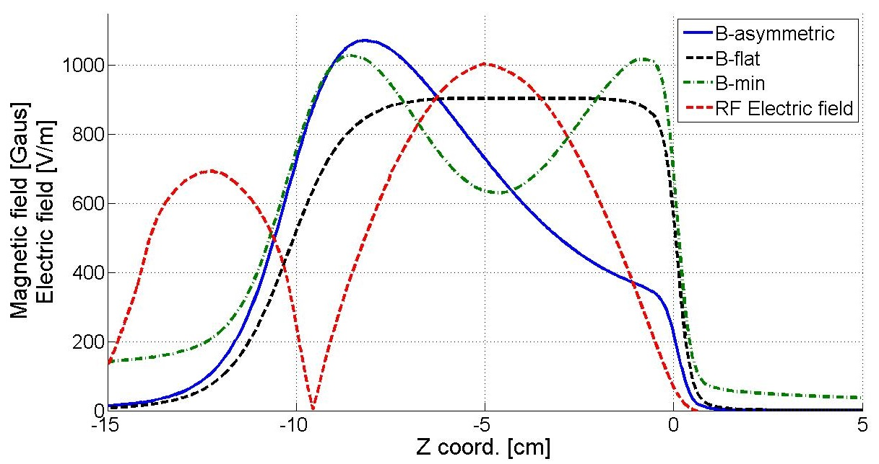
Flexible magnetic system
Low magnetic field in the RF inj. region
to prevent plasma formation inside wave guide
Low magnetic field in the extraction region
to prevent emittance growth
Classical MDIS flat profile (B-flat)
Simple-mirror (B-min) for the prolongation of H₂⁺ molecule lifetime, thus increasing ionization efficiency and proton fraction
Magnetic beach (B-asymmetric) making possible Bernstein Waves (BWs) formation through inner-plasma conversion of the input electromagnetic waves.

Slide 7
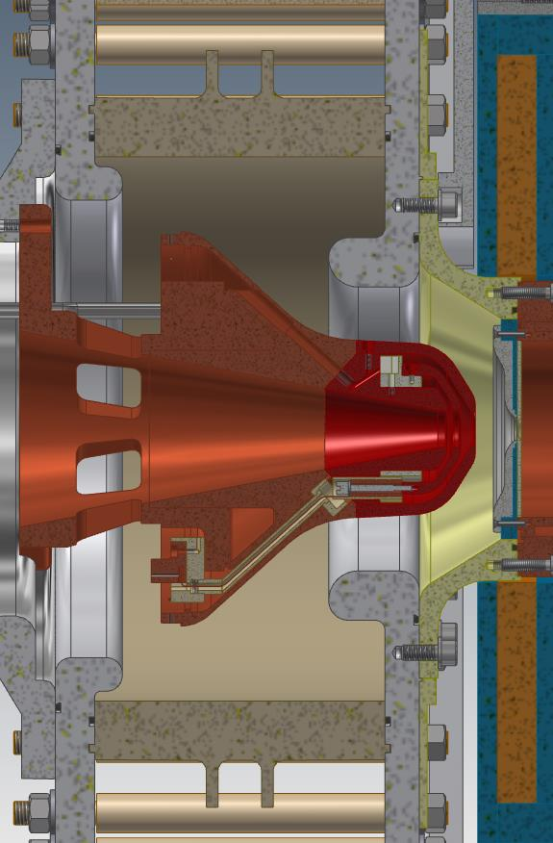

Final version of the extraction system
- Single alumina
- New alumina metallization
- New triple point design
- Completely new opening strategy
- Interchangeable electrodes head
- Cooling of all electrodes
- New X-ray shielding
- Improved emptying cavity gap
- New voltage shielding of the beam
- Detailed study to be ready for different plasma heating strategies

Slide 8
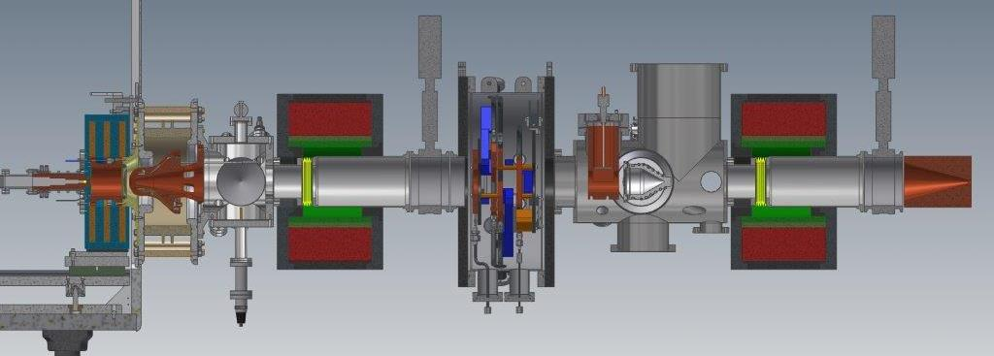
LEBT Layout
2654 mm from plasma electrode to LEBT collimator
540 mm Iris utilities + Diagnostics + Vacuum + Chopper
239 mm Vacuum + Utilities
128 mm Gate valve
128 mm Gate valve
234 mm Extraction
425 mm Solenoid
425 mm Solenoid
210 mm Collimator
325 mm Iris

Slide 9
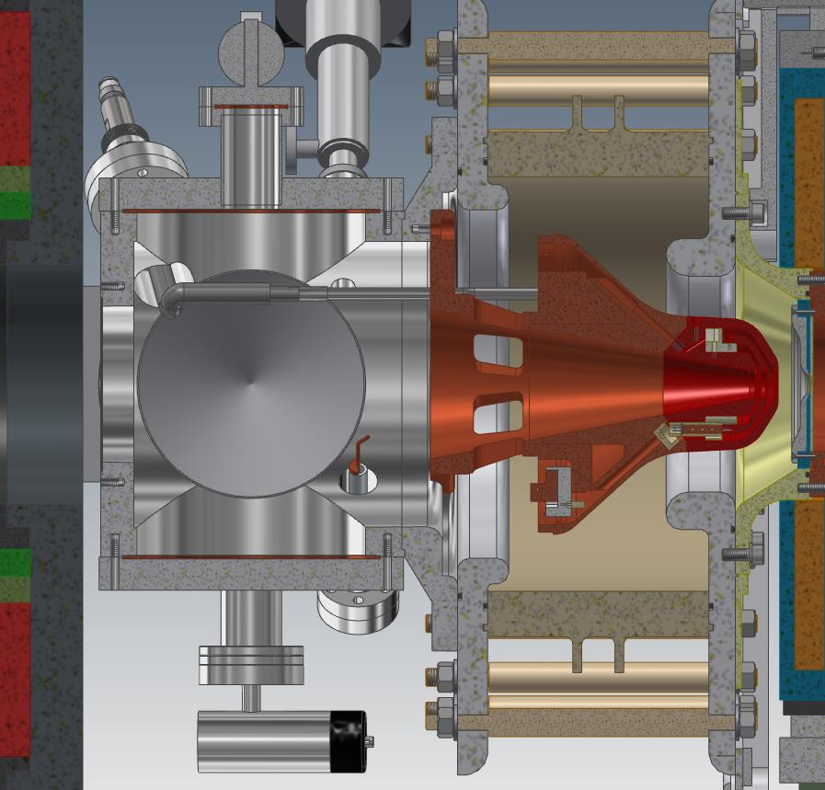
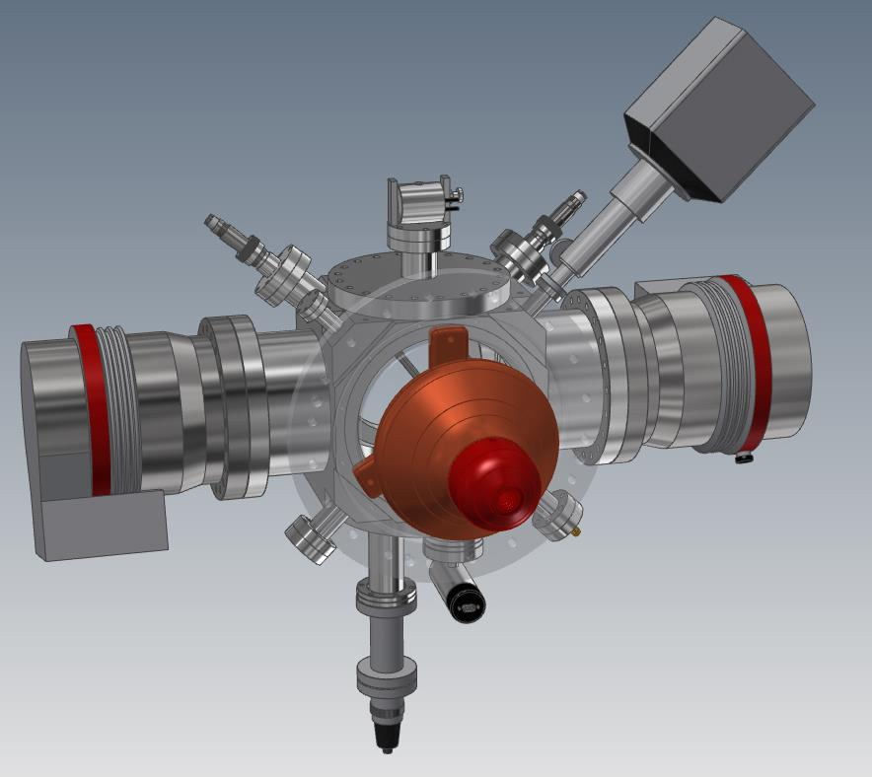
First LEBT element with two TMP
2 x TMP
Cooling water
HV repelling cable
Pirani/penning
Spinning rotor gauge
Gas inlet
RGA
483 mm

Slide 10
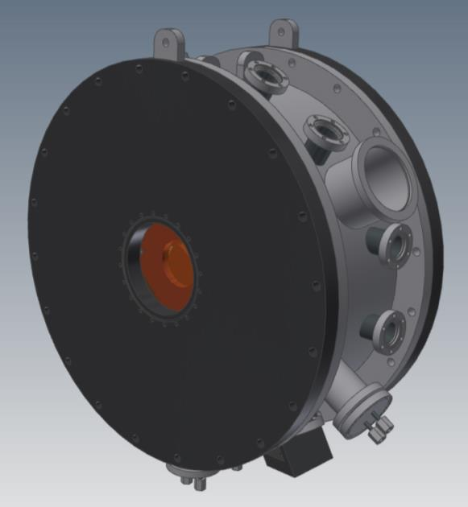
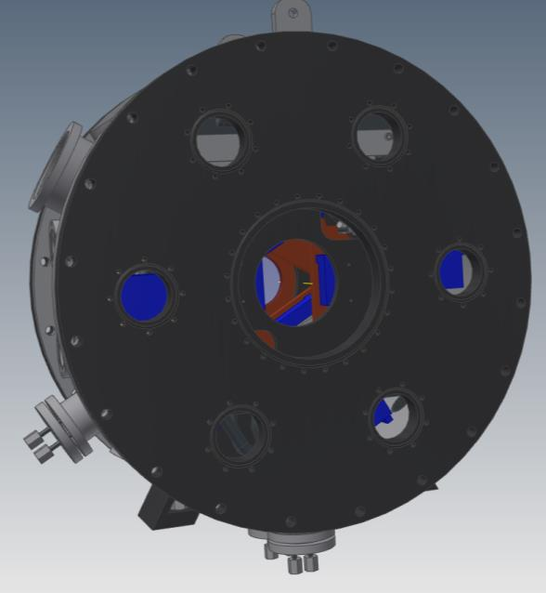
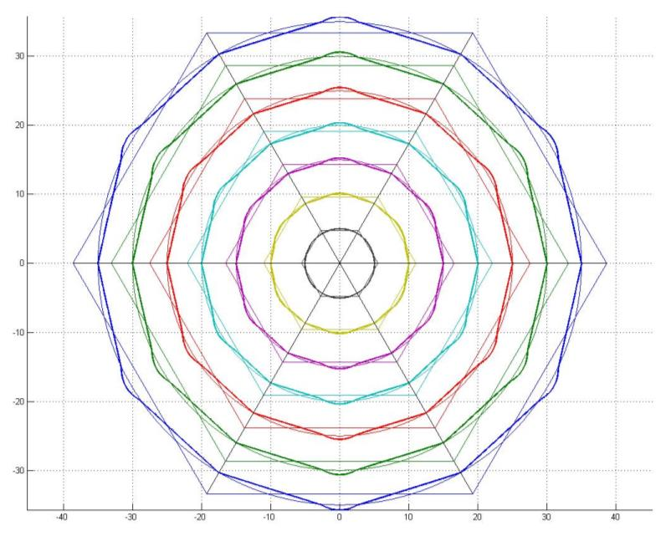
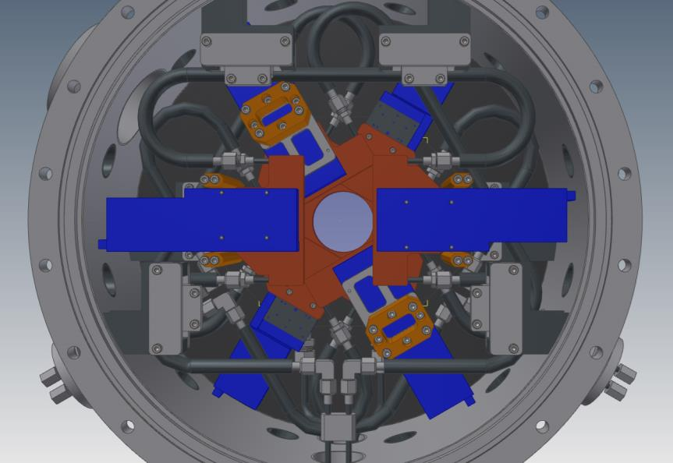
Iris: two possible configurations
Length 300 mm
Beam aperture from 5 mm to 70 mm with dodecagonal shape or from 1 mm to 80 mm with hexagonal shape

Slide 11
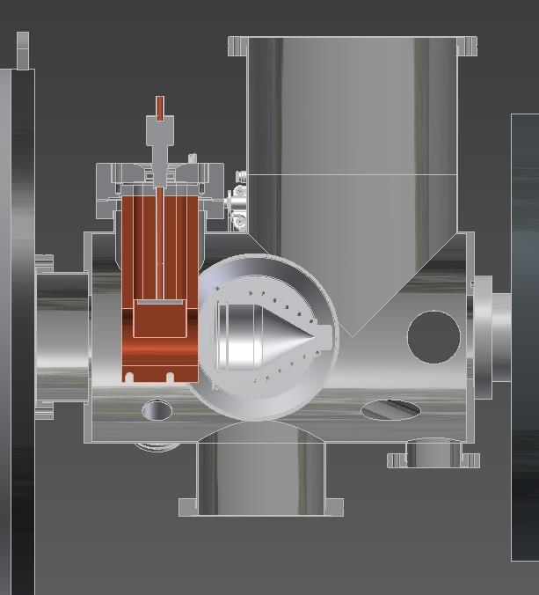
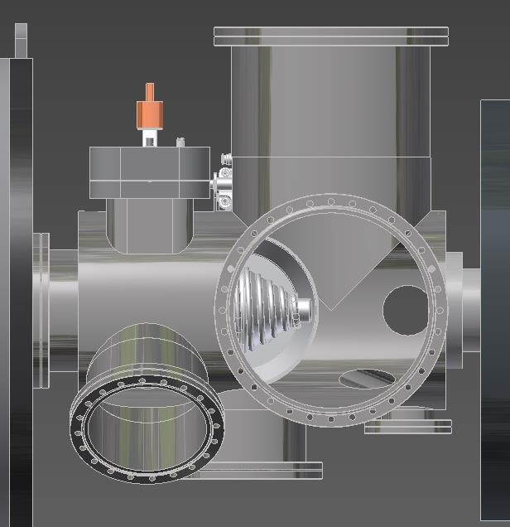
Diagnostic box with chopper
Length 540 mm
Chopper
EMUx
EMUy
View_{y}
FC
Beam
DS
TMP₁
TMP₂
View_{x}
Note: 1) Intense collaboration with ESS diagnostic group; 2) Two diagnostic boxes will be used for the commissioning

Slide 12
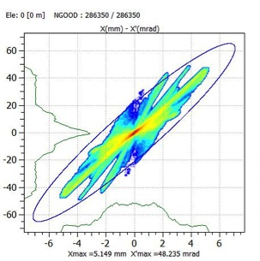
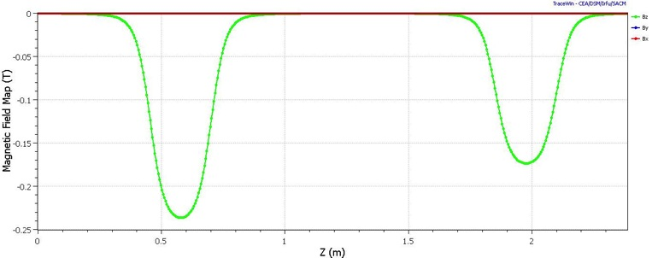
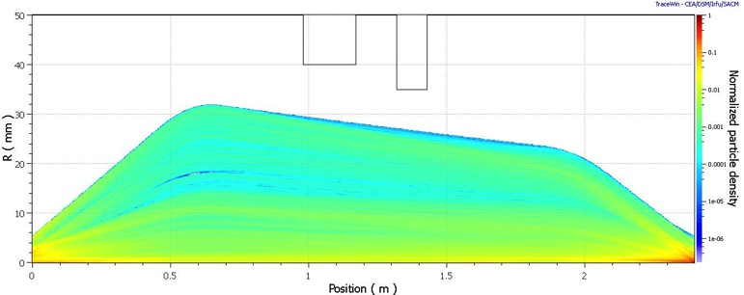
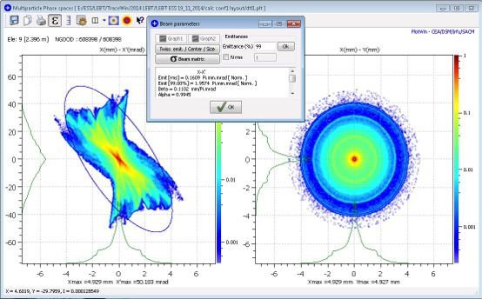
LEBT beam transport
2 x
Solenoids
Iris
SCC > 95 % is needed to preserve low emittance
Chopper
Protons
The beam satisfy the RFQ focusing parameters:
Emit [rms] = 0.161 ( < 0.25 ) Pi.mm.mrad [Norm]
Emit [99%]= 1.957 ( < 2.25 ) Pi.mm.mrad [Norm]
α = 0.995 ( -2.5 % < ±20 % )
β = 0.1102 ( +0.2 % < ±10 % ) mm/Pi.mrad

Slide 13
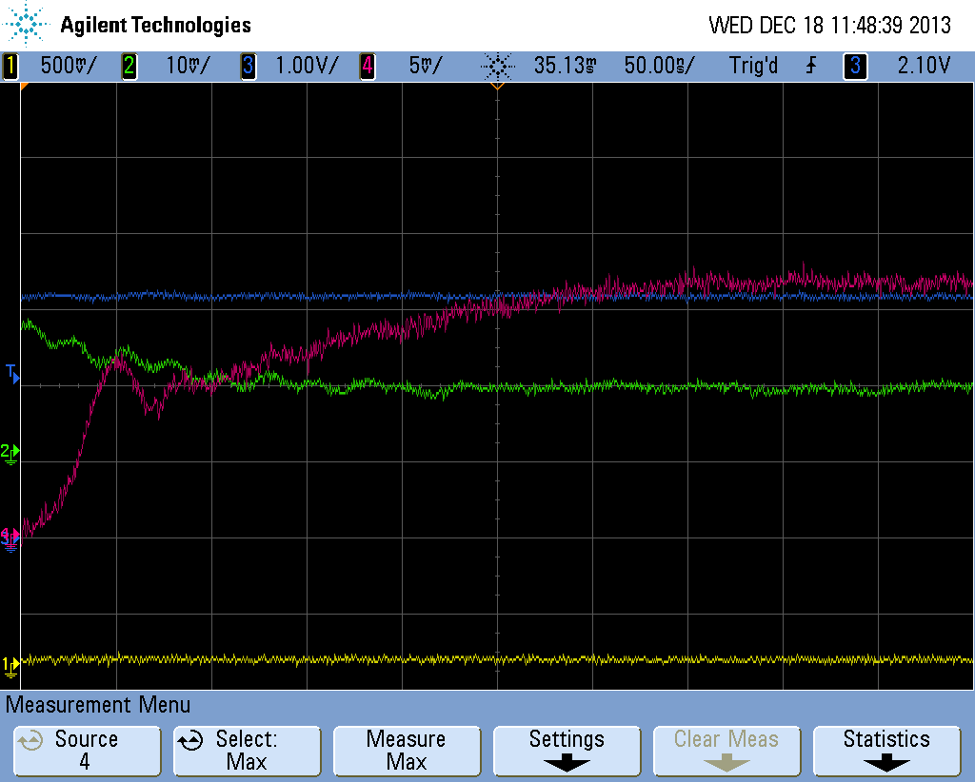
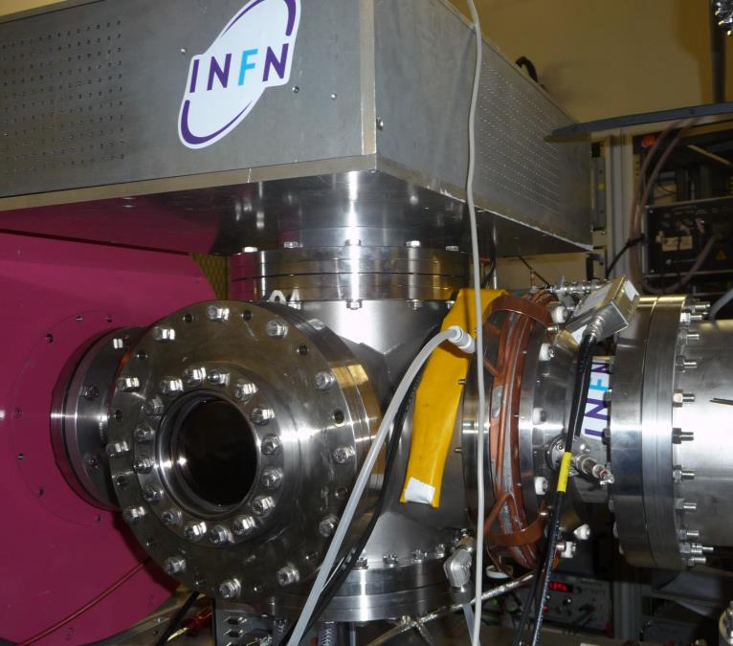
Chopping strategy
Beam Pulse rise time
Chopper
Slow transition ≈ 250 ns
Chopper HV
Fast transition ≈ 50 ns
Chopping strategy tested at CEA: result not conclusive because of the lower current and voltage, but many criticalities have been solved
Ch4: Beam Stop (Rτ = 5,5 ohm; C = 183 pf ; Rτ * C = 1 ns)
Ch2: Collimatore (Rτ = 5,5 ohm; C = 534 pf ; Rτ * C = 2,9 ns)

Slide 14
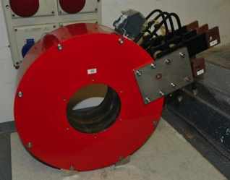
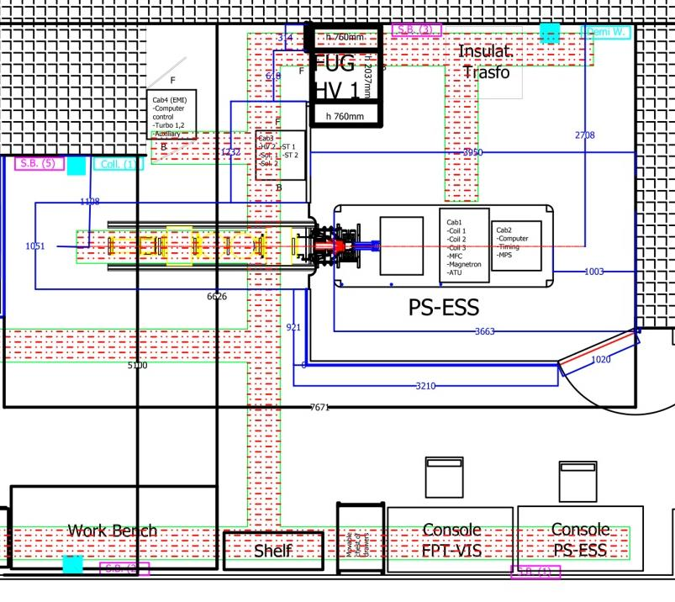
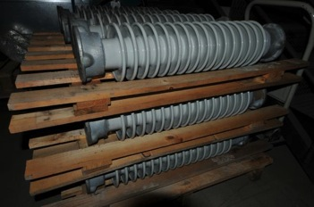
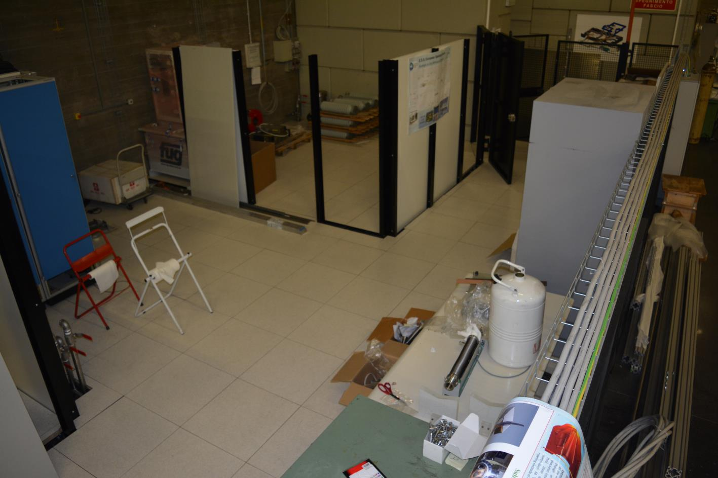
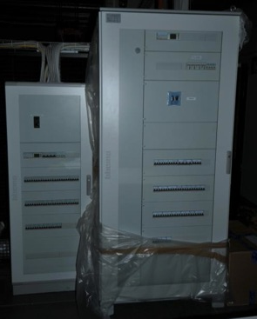
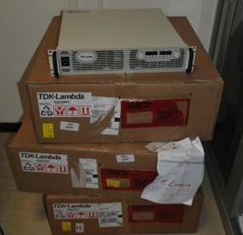
ESS site @ INFN-LNS
Notes:
È possibile attuare 100ns con il chopper all’rfq, far vedere la simulazione dello spazio svuotato alla scc corrispondente a 10ns

Slide 15
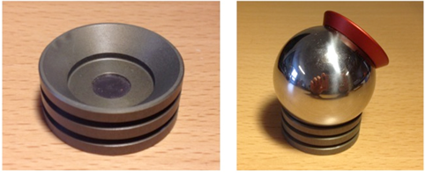
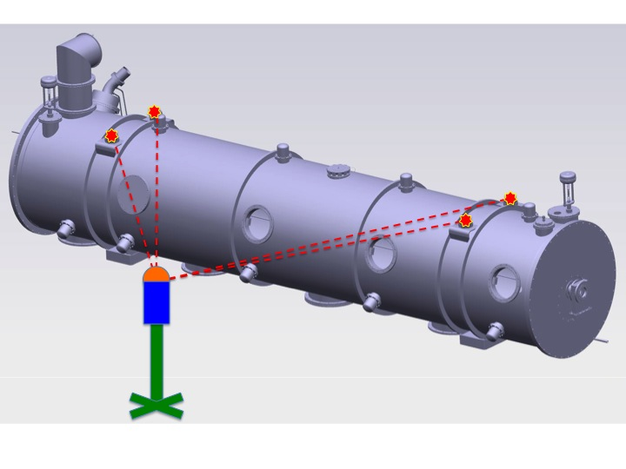
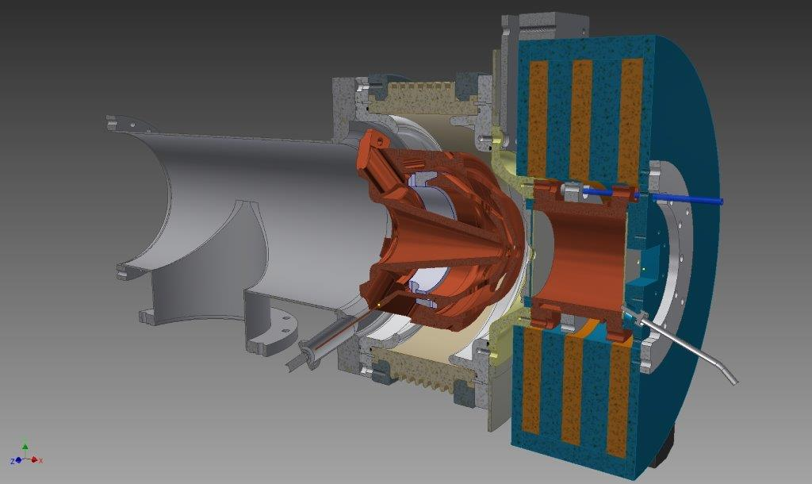
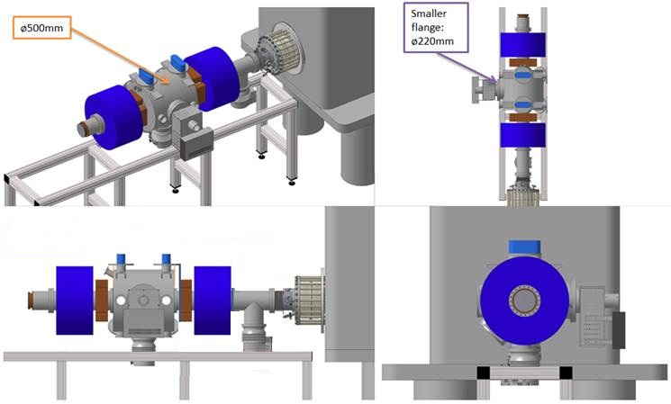
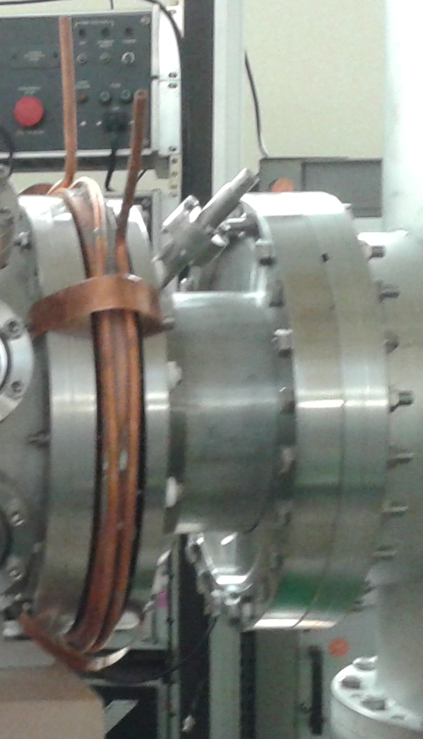
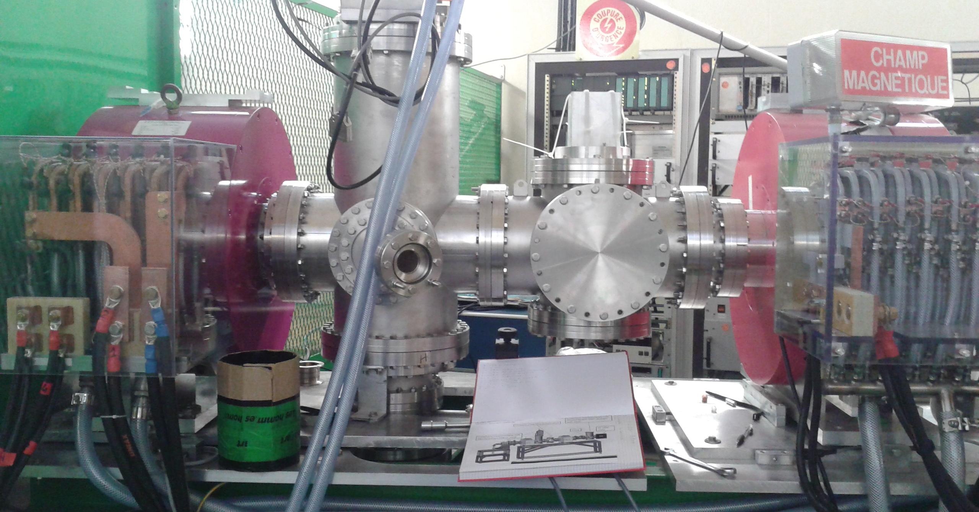
Alignment
Alignment strategy inside the ESS accelerator tunnel
Main important element for the alignment:
Plasma electrodes
Extraction electrodes
Two solenoids
RFQ entrance collimator
2
1
3
4

Slide 16
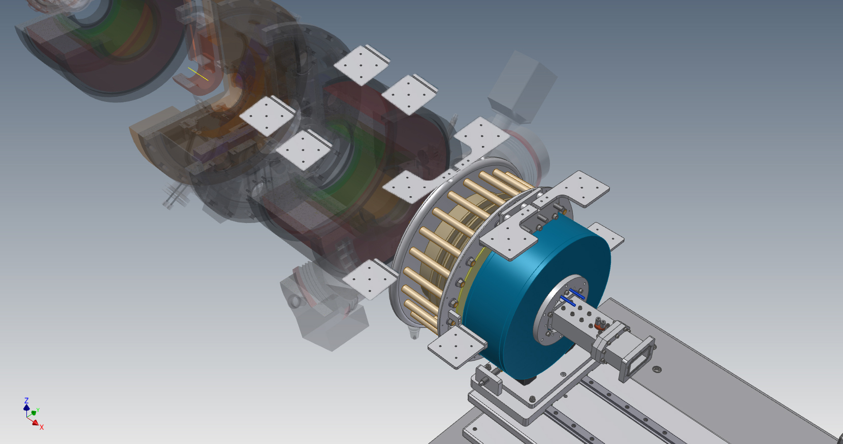
Alignment strategy in progress
Notes:
È possibile attuare 100ns con il chopper all’rfq, far vedere la simulazione dello spazio svuotato alla scc corrispondente a 10ns

Slide 17
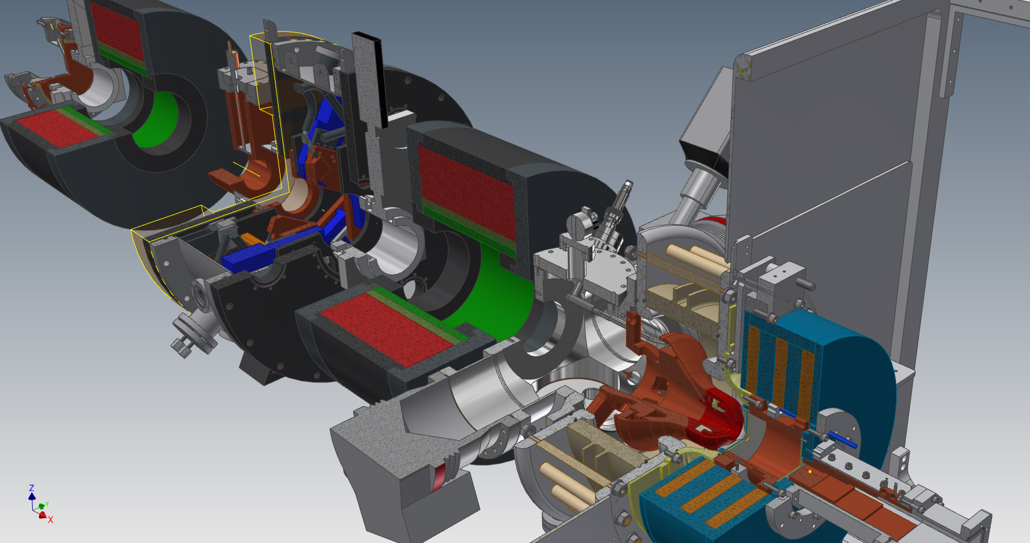
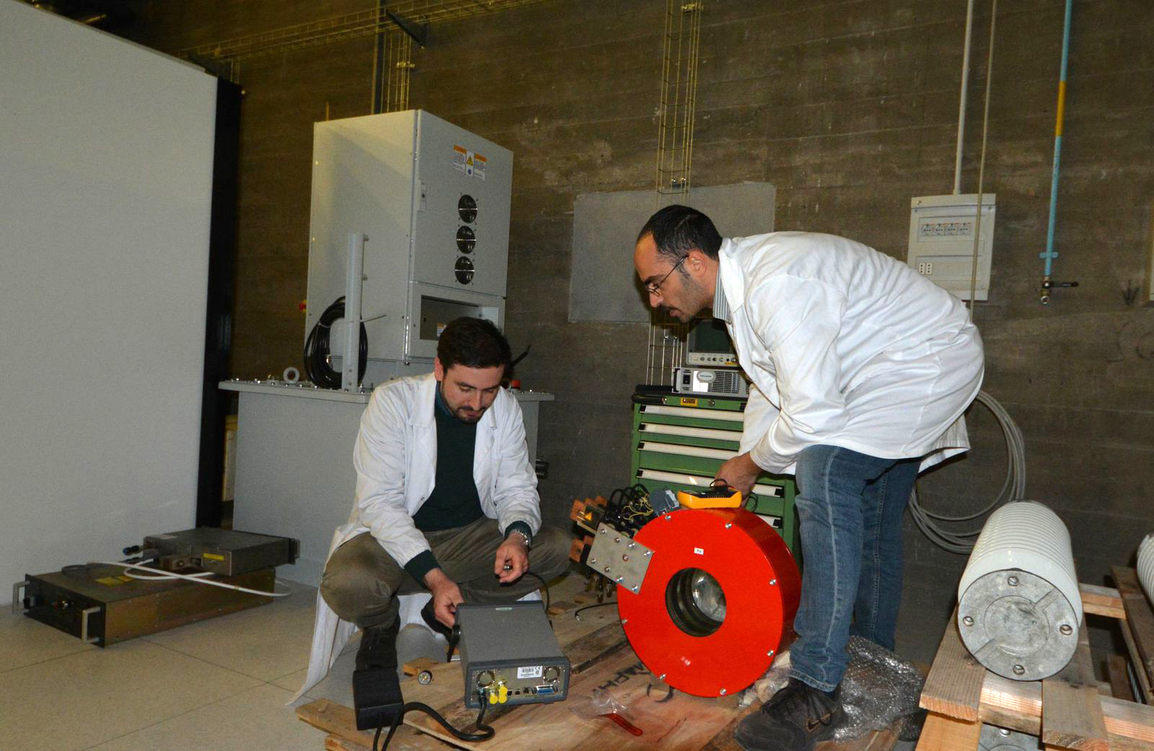
PS-ESS and LEBT layout

Slide 18
Status and open items
Sites
LNS site | Complete except for interlocks
ESS-Lund site | in progress, interaction supp. by Lead Engineer
Proton source (PS-ESS) and accelerator column
HV platform | Few details to be revised
Power supplies (High current, High voltage) | Delivered
Microwaves equipment | Ordered
Magnetic system | Delivered
Plasma chamber | Ordered
Mechanical integration | already defined
Extraction system | Ordered
Interfaces
MPS | definition in progress
Control interface | definition in progress

Slide 19
Status and open items
Low Energy Beam Transport line (LEBT)
Solenoids & Steerers | Delays in administrative procedures, order to be issued in April, not critical because of short delivery time (3 months)
Chopper mechanics | Revised after tests in 2014, material partially available, order of remaining parts in process
LEBT collimator | Delivery time not critical
Diagnostics box | definition with Beam Diagnostics WP done, delivery time not critical
Mechanical integration | Work in progress
IRIS | ordered

Slide 20

ESS RFQ :
Processes for RFQ manufacture
The ESS RFQ:
  5 x Sections (L= 0.92m) for a total length = 4.58m
  2 x Vacuum ports per quadrant and per section except on S3 (hosting the 2 RF couplers) → 38
  3 x 80mm-diameter pistons per quadrant and per section acting as tuners → 60
  End plates with 4 x rods →2
  8 x 10mm-diameter cooling channels per section (variable length)
  RFQ in CuC2 and Flanges in stainless steel

Slide 21
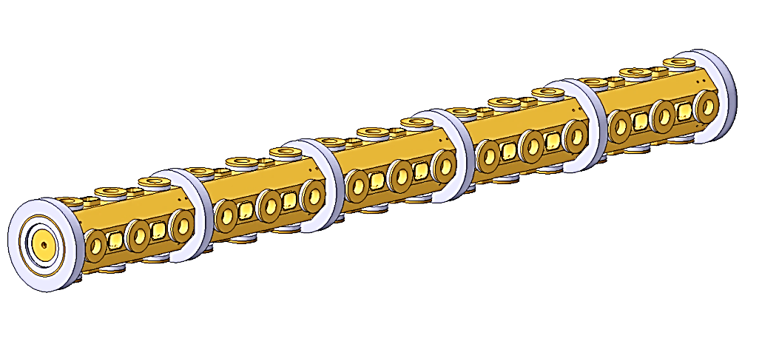
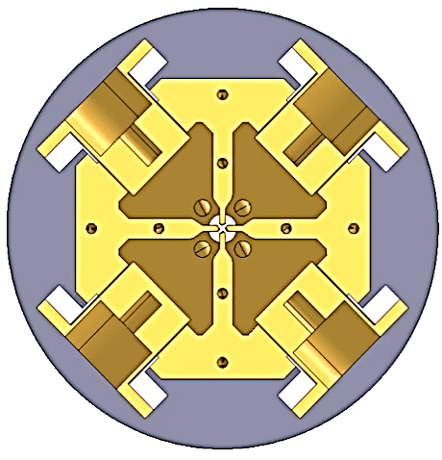
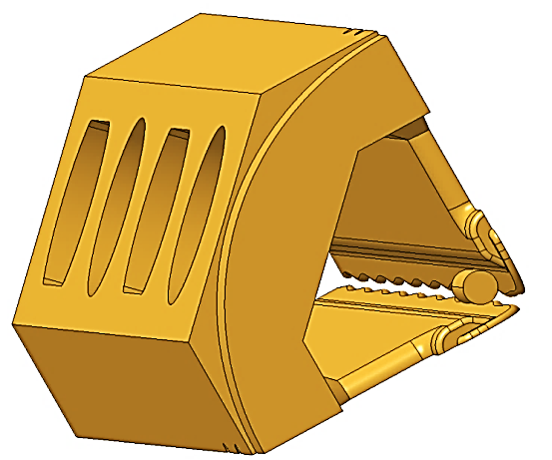
THE ESS RFQ MECHANICAL DESIGN
S5
S4
S3
S2
S1
40mm
Global Schematic view of
ESS RFQ
Cooling channels
Transversal view of the RFQ across the tuners
View of the end section of the RFQ with the tuning rod for a quadrant

Slide 22

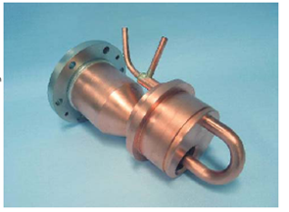
MAIN TECHNOLOGICAL CHOICES
The design was done with consideration of machining and assembly by brazing possibilities
Assembly precision: (construction « easier »)
    IPHI : machining +/-10µm; brazing +/-10µm
    LINAC4: machining +/-20µm; brazing +/-30µm
    ESS : machining +/-20µm; brazing +/-30µm
RF loops (coupler : window + loop)
      Same technology like SPIRAL2 (just adaptation)
      Possible use of simple disk coaxial RF window smaller and lighter than waveguide window (installation)
      RF losses smaller than iris+ridge (power budget)
      V0 ripple smaller than iris+ridge
      Use of standard tuner port brazed on a vacuum aperture (brazing success)
      Faster adjustment and adjustment flexibility (RF tuning success)
    Unsegmented RFQ (tuning easier and faster)
« A beautiful design is not useful if it will be impossible to build »
SPIRAL2

Slide 23
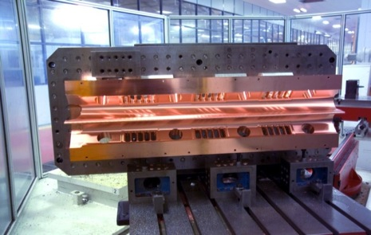
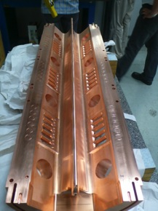
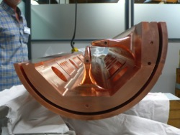
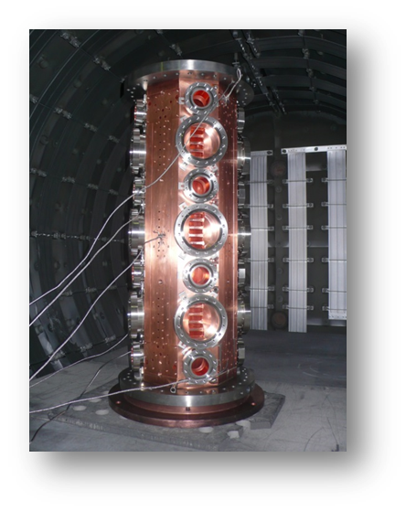
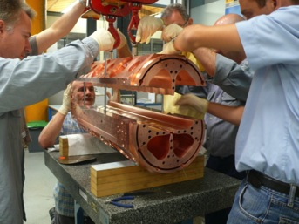
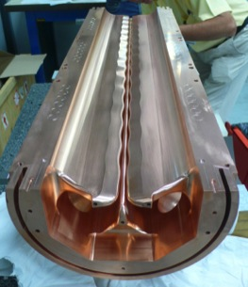
MAIN TECHNOLOGICAL CHOICES
  IPHI’s project : 4 copper parts per module → chosen for ESS
Machining
Assembly
Brazing copper parts and ancillaries

Slide 24
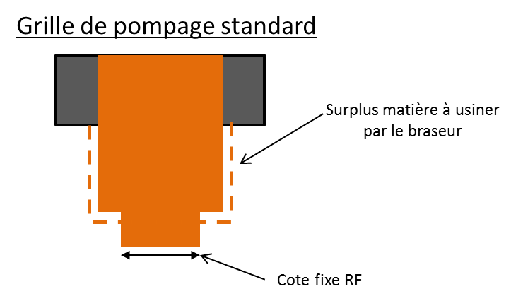





MAIN TECHNOLOGICAL CHOICES
IPHI
ESS
  Ancillaries :
      Tuner ports
      Module flanges
  Stainless steel with copper coating
  Technological problem to braze the stainless steel ports on the copper module
  Brazing copper to copper and stainless steel to copper in 1 step
  2 brazing steps :
    Stainless steel to copper for ancillaries
    Copper to copper for module + ancillaries
  Ancillaries :
    pumping grids
    tuner ports
    pick up ports
    module flanges
  All sketches are identical for all modules
    (except RF size of pumping grids)
  Final adjustment for brazing on copper

Slide 25



MAIN TECHNOLOGICAL CHOICES
  Sections similar to the IPHI ones :
  4 electrodes with modulation and
  apertures for ancillaries
  One step of copper-copper
  brazing in vertical position
  Length <1m to limit the risk for brazing
  Pumping grids brazed
  To avoid machining of the grids on the vanes
  It’s possible to have a first correction of the error on the machining of the vanes before brazing by adjusting the penetration of the pumping port
    “minor mechanical uncertainties may result in significant detuning”
  Adjustable tuners → prototyping plan
  Same geometry during adjustment and operation (same perturbation)
  Definitive position just after adjustment
  No delay of machining between adjustment and final position
  Adjustment possible in operation or after a transport

Slide 26




SECTION MANUFACTURING
Machining
Brazing
Vacuum leak test validation
RF validation

Slide 27
What do we need
The material for a RFQ needs specifications according to :
Radio-Frequency requirements
Vacuum requirements
Thermo-mechanics effect
Cooling process
Manufacturing procedure

Slide 28
Needs for use
Needs for RF, beam losses and vacuum:
High electrical conductivity
  Electromagnetic field from RF
High thermal conductivity:
  To keep RFQ’s temperature as stable as possible
Low outgassing rate: for Ultra High Vacuum
  Low pressure needed for RF and beam dynamics

Slide 29

Needs for manufacturing
Good properties of RFQ depend on the reliability and precision of manufacturing
High precision machining
  Machining tolerance: +/- 20 µm
Brazing
We will braze 4 parts of copper
  Brazing tolerance: +/- 30 µm
  Perfect brazing is essential for:
      Vacuum: no leak is allowed
      Thermal dissipation
Final tolerances : +/- 50µm

Slide 30

Choosen material: Cu-OFE
Cu-OFE is chosen for our application (NF EN 13604)
  Has all required properties
      Low outgassing rate: 1,0e-6 Pa.m.s⁻¹(after 10h)
      High electrical conductivity: 101 % IACS
      High thermal conductivity: 390 W.m.K⁻¹
  Already used for other RFQ (IPHI, LINAC4, Spiral2)
Cu-OFE can be machined and brazed « easily »
Addition of a prevention step: HIP (High Isostatic Pressing)
  To avoid porosity / casting defects
  After copper delivery and before to start machining
  Not cheap, but cheaper than a RFQ part of copper
  machined for severals month
NF EN 13604
=
ASTM B170 Grade 1

Slide 31

Copper specifications
Copper OFE (CW009A – NF EN 13604) with following specifications…
  3D hot forging (800/800/400°C)
  Annealing (400°C / 1h)
  Grain size < 500 µm
  Hardness: Hv = 45 +/- 5
… and following characterization and control tests:
  Initial analysis of the chemical composition
  Metallurgical tests (grain size and hardness)
  Ultrasonic testing

Slide 32
Copper tender
Copper list: 5 sections + 1 spare
Optional:
  1 section (2 major parts + 2 minor parts)
  Ancillaries for 1 section
      « under » option for each kind of auxiliaries: can be bought separatly
Piece | Quantity | Dimensions | Weight
Major part | 12 | 320x160x1000 mm | 7 T
Minor part | 12 | 160x80x1000 mm
Pumping port | 40 | φ120 x 80 mm | 1 T
Tuner | 62 | φ90 x 70 mm
 | 62 | φext 90 x φint 60 x 100 mm
Tuner port | 62 | φext 90 x φint 75 x 100 mm
Pick-up port | 24 | φ50 x 20 mm
Section flange | 12 | φext 300 x φint 250 x 50 mm
End plate | 3 | φ300 x 50 mm

Slide 33
Copper providing process
Copper OFE
Chemical composition analysis
3D forging
5 mm peeling
Annealing
Grain size
Hardness
Ultrasonic testing
Call for tender n°1 in progress
Results at the end of March
Call for tender n°2
HIP
High Isostatic Pressing
Call for tender n°3
Manufacturing

Slide 34

SECTION MANUFACTURING
One RFQ section manufacturing’s steps process
ANCILLARIES PROCESS
RF MEASUREMENTS
COPPER PROCESS
HEAT TREATMENT
BRAZING
Saclay
Assembly

Slide 35



PROTOTYPING PLAN
A cavity with 2 RF loops + 1 pumping grid + 1 adjustable tuner
RF loop: validation by manufacturing and conditioning with a new RF source @ CEA→ definitive ESS RF loop → RFQ conditioning faster (RF loop already conditioned)
Adjustable Tuners: the same geometry during tuning of the RFQ and in operation (same perturbation)
To validate the assembly process for tuners and pumping grids

Slide 36


RFQ coupler
New modification of the design
to minimize the manufacturing risks
No impact on the delay because of the future ESS klystron schedule : operational in January next year

Slide 37

PROTOTYPING TEST BENCH

Slide 38
RFQ SCHEDULE
Prototyping
2nd part of 2015 : Prototyping test bench assembly
(cavity, couplers and tuners)
1st part of 2016 : coupler conditioning
Interfaces
- Clarification as soon as possible
RFQ
Call for tender : summer 2015
Start of manufacturing : beginning of 2016
Assembly on support : 2nd part of 2017
Conditioning and test with beam : 1st part of 2018

Slide 39

RFQ INTERFACE
RF Network studies

Slide 40

RFQ INTERFACE
RF Network studies

Slide 41


RFQ INTERFACE
LEBT-RFQ interface within a beam current measurement

Slide 42


MEBT provides the required matching from RFQ to DTL and it serves as:
•Halo scraping section.
•Fast chopping section
•Diagnostic section

Slide 43


Beam Physics
WP2
Lattice design (IPAC14 THPME045)
Basic beam physics (IPAC14 THPME045, LINAC14 THPP045) – Matching to the DTL (tracking based)
Lattice error tolerances (IPAC’14 THPME044)
– Partially-chopped bunches (LINAC14 MOPP039, HB14 MOPAB18)
The fast chopper rise/fall time specified as ~10 ns vs 2.84 ns of RF (352.21 MHz)
– Scrapers (IPAC14 THPME045, HB14 MOPAB18)
WP3
Best inputs for MEBT
Available space for diag box, input and output

Slide 44





QUAD
Magnetic Design: in-house
Manufacturing: (Detailed quotation in progress) as soon as requirements are fixed
50MeV prototype
Mech. Assembly
ø42mm
ø41mm

Slide 45





BUNCHER lifecycle
Design
Machining
RF
Metrology
Cu platting

Slide 46



BUNCHER bead-pull
The measured figures of merit of the buncher cavity show a good agreement with those provided by full-wave electromagnetic simulations.
Simulated Tuner Freq. Range (0-25 mm) = 0.63 MHz
Measured Tuner Freq. Range (0-25 mm) = 0.6 MHz
Simulated Sensitivity = 25.2 kHz/mm (2 tuners at the same time)
Measured Sensitivity = 24 kHz/mm (2 tuners at the same time)

Slide 47


Coupler
Wide frequency band (300-400 MHz), covering both ESS and ISIS. operating frequencies
Peak power: 15-20 kW
Low reflection
Low insertion loss
Parametric study to find the optimal loop size inside the cavity, to minimize ^{S}11
Insertion loss of 0.015 dB was obtained.
PEEK: pure, stable, easily machinable, chemically resistant, radiation resistant, has relatively low outgassing values.
First vacuum tests: 1.03x10-7 mbar
RF Coupler: magnetic loop type
Mechanical interface: EIA 1-5/8 in CF
Coupler parts machined/turned, welded (TIG), assembled and Cu plated
ESS-B coupler
Coupler coupling factor (β)
Specification | Measurement
β=1 (Qo=23477) | βmax=1.08 (Qomeas=3000)

Slide 48

Pick-up
To sample the field in the cavity, with minimal effect on the cavity
Magnetic loop type probe (CERN design)
CERN pick up
Mechanical interface:
N(f) type connector
Pick-up coupling factor (β)
Specification | Measurement
β < 0.5 (Qo=23477) | βmax= 0.02 (Qo= 3000)

Slide 49
Scrappers
The use of scrapers before entering DTL tanks is strongly recommended to avoid emittance growth and halo development in high-intensity linacs.
By limiting the acceptance, the scrapers effectively clean the halos in the RFQ output
The 2nd and 3rd scrapers drastically improve the situation of the partially-chopped bunches (see also HB14 MOPAB18)
Identify the best possible locations to scrape halo particles maximising core particles transmission.
8
mad
x
mad /mad
7
mad
2.6
hx x
Halo Population
y
mad /mad
hy y
6
2.4
₁ ÿ
n
5
2.2
MAD = |x_{i} x¯|, n
i=1
2
4 Core Population
1.8
Ratio of Populations
3
1.6
2
1.4
1
1.2
0
1
2
Longitudinal position (m)
3
4
0
1
2
Longitudinal position (m)
3
4

Slide 50
Scrappers
100 MPa stress limit (tungsten)
For σ≈1mm, scrapped beam ≥ 2.8 x σ, or ≥0.15% beam scrapped per blade.
For σ≈3.5mm, scrapped beam ≥ 2.1 x σ
7000
70
6000
σ≈3.5mm
60
Max heat flux (W/cm²)
5000
σ≈7mm
50
Max stress (MPa)
4000
40
3000
30
2000
σ≈1mm
20
1000
1.8
2
2.2
2.4
2.6 2.8
Insertion distance (a)
3 3.2
3.4
10
3.6
ibon.bus(nduy@essbilbao.org 12

Slide 51





Chopper
Chopper workshop held in Bilbao Jan-2015 with a world-wide experts panel selection. (https://indico03.esss.lu.se/indico/event/285/)
Strip-line approach ∆V~ 5kV; 450mm; ø20mm; 10ns rise-time; 20µs steady
Scrapers at the entrance
of the chopper to protect
the plates from the beam
losses are recommended
Q1 Q2 B1 Q3
Q4
B2 Q5 Q6
Q7
Q8 B3 Q9 Q10 Q11
EMU
CHOPPER
BD
WS FC NPM
2968,574
WS
CO
WS NPM
1585,205
CO BSM
CO BCT
172,750 372,750 486
722,750 810 890
1426,024
1826
2062,750
2462,750
3322,850
3532,527
3863,830

Slide 52







Beam Dump
Nominal conditions (20µs / 14Hz / 3.6MeV / 62.5mA) + ( 200µs single pulse )
Different materials are under study
  GLIDCOP AL60-LOX seems best candidate.
  AISI 304 holders.
AISI 304
Beam deposition is very shallow.
Small fraction (0.13%) beam (~keV) scattered downstream
The higher the cone semi-angle is, the lower are the leakages of protons from the beam dump. Beam footprint more concentrated.
GLIDCOP AL60-LOX

Slide 53
Drift Tube Linac
Inter-tank connections
Interfaces between the RF system and the electromagnetic resonator
Water-cooling skid, manifold and interfaces
Requirements for reception, assembly and test space in Lund

Slide 54



Inter-tank connections
No valve between Tank1-Tank2
wire scanner (flange at 45 deg.) the same flange for all inter tank
Faraday cup flange, the dimensions shall be as large as possible, the shape can be rectangular or round
two extra viewports for “camera” on all the inter tanks, these flanges shall be round and the diameter shall be as large as possible
Presently:
dimension of the rectangular ports in the intertanks is 110x36 mm;
beam box (i.e. the cylinder that houses all the ports) has a constant width for all intertanks, 60 mm, driven by the intertank n.1, that width can be increased for intertanks 3 and 4, if needed;
the circular port which is in the present design is a CF40, and, for IT1 and IT2, this dimension can not be increased (nor for IT3 and IT4 if the beam box remains the same...);
there is no problem for an additional circular port, if it is a CF40.

Slide 55


Interfaces between the RF system and the electromagnetic resonator
2 flanges at the RF windows point per each tank.
Balance in amplitude and phase provided by ESS RF Group
Coupling Coefficient β of RF couplers provided by INFN
N° of pick-ups per tank to be confirmed by LLRF: combination of the signals necessary to filter out the higher TM modes (CERN uses 9 pick-ups per tank)
3 movable tuners per tank. Up to the motor controller in charge of INFN (TCP/IP protocol)
RF windows and supports
Pick-up and movable tuners

Slide 56
Water-cooling skid, manifold and interfaces
1 cooling skid, 1 pump, 5 three-ways valves
But:
5 temperatures are not independent
Could be a solution 1 skid with 1 pump per tank?
For each tank at least 1 Flow meter in the return manifold and Flow regulators for the DTL channels

Slide 57
Requirements for reception, assembly and test space in Lund
From a rough planning we discussed here (with Tzero of the in-kind contribution decided and operational 1 Jan 15) the workshop should be ready for June 17
"Clean" and quite environment, temperature controlled.
About 13x 10 m for the assembly of the tank, separate space for storing the assembled tank.
It should be a closed part of a larger building, or in any case there should be a convenient entry space (for structures) before exiting outdoor (at least 10x8 m) can be shared with other labs, it is useful sometimes the possibility to enter with small vans or tracks.
a small vestibule for people (about 2x2 m)
Slow crane at least 3 tons inside the workshop for the assembly of
the tank.
The workshop should be not far from the tunnel, strategy to move the
8 tons tank into the tunnel should be decided (CERN has the
possibility to open the roof and using a large building crane)
mechanical workshop for small interventions and adjustments
Electrical supply for vacuum tests, compressed air, RF low power....

Slide 58





Prototyping
Test of Cu-plating on Stainless steel Stem order to be placed. It will make them more rigid compared and will allow for a larger bore for the BPM and corrector cables.
BPM: feedthrough to be welded on the BPM stripline
EBW on Brazing: DT brazed and EB-welded. Vacuum test ok. Next step: section and micrography
PMQ fully tested

Slide 59
WP03 Master Schedule

Slide 60

WP03 Isrc & LEBT P6 plan

Slide 61

WP03 RFQ P6 plan

Slide 62

WP03 MEBT P6 plan

Slide 63

WP03 DTL P6 plan

Slide 64
Comments to the schedule
The schedule has a limited amount of contingency, unless it is not to be excluded that some phases may have been completed in shorter time, e.g. the construction of a second source or administrative times for procurements
Up to now the delay to IK contract signatures have been absorbed and the path toward the construction has been smoother than I expected
There are still some (expected) debts in interfacing of different WU within the WP and w.r.t. other WPs. We expected that and we are tackling (visit to each WU of WP leader, deputy leader and Lead Engineers have been carried out in the last 4 weeks)
The number of actions that have been defined for the next few weeks is really huge (15 for the RFQ only) but the team is reacting adequately to solicitations.
Further delays in definition of IK contracts may slow down the run.
Staff training and expertise transfer are considered in the schedule; a better definition of support to commissioning by IK partner is to be done
The possibility to test Isrc+LEBT+RFQ with beam in Saclay for about 6 weeks is compliant with the schedule, if no major delays will occur. Long run of the Isrc+LEBT will be crucial to make that time shorter

Slide 65
Thanks for your attention

Slide 66


Beam transport with Iris
From 30 mm to 20 mm of radius
we obtain 85 % of the current
Emit [rms] = 0.126 ( < 0.25 ) Pi.mm.mrad [Norm]
Emit [99%]= 1.392 ( < 2.25 ) Pi.mm.mrad [Norm]
α = 0.984 ( -3.5 % < ±20 % )
β = 0.1107 ( +0.6 % < ±10 % ) mm/Pi.mrad

Slide 67





New defocusing chopper
Design phase finished.
Improved SCC inside the LEBT
Reduced HV power
Improved defocusing electric field
Reduced beam propagation delay
Only one flange
OLD
NEW
On axis total length is 162 mm

Slide 68

One module manufacturing steps

Slide 69

One module manufacturing steps
Cal for tender in progress
Results at the middle of April

Slide 70



Scrappers
Cu
Cooling Chanels
Temp
Tungsten
Stress

Slide 71
Chopper
Scrapers at the entrance of the chopper to protect the plates from the beam losses are recommended.
Based on SNS real experience the major loss mitigation factor came from the correct use of MEBT scrapers instead of shortening chopper rise/fall time.
The length of cable between chopper structure and its pulser rack should be reconsidered to a shorter value than <10 m (from current foreseen 25 m)

