Slide 1
WP 12.3 Moderator & Reflector Systems D. Lyngh, M. Kickulies, J. Ringnér, J. Jurns, M. Andersson, M. Pucilowski, T. Hedlund, A. Olsson
TAC11
Lund, 1st of April 2015
Presenter: Daniel Lyngh, Lead Engineer
Notes:
20+10min

Slide 2
Outline
Schedule & Cost Update
Recent Progress
Schedule (PDR & CDR)
Technical Developments
Twister
Foundation Pillar and Rotation Pipes Development
Butterfly
Increased Heat Deposition, Flow Pattern
Questions
Double or split plug design
Beam through twister shaft

Slide 3
Recent Progress
Moderator & Reflector Plugs (MR Plugs)
Preliminary Design Ongoing
PDRs planned for June -15
Detail Engineering, Make Phase and Testing issued for In-Kind Contribution (startup June)
TC-8 Twister Handling – Approved
TC-12 2x Butterfly Moderators - Approved
Cryogenic Cooling System
Preliminary Design Ongoing
PDRs planned for June -15

Slide 4
Schedule
2014
Q3 Q4
2015
Q1 Q2 Q3 Q4
2016
Q1 Q2 Q3 Q4
2017
Q1 Q2 Q3 Q4
2018
Q1 Q2 Q3 Q4
2019
Q1 Q2
Concept Phase
Final Design
Make Phase
Site Work
MR Plugs
Cold Moderators
Thermal Moderators
Reflectors
Handling System
Structure & Shielding
PDR
PDR
PDR
PDR
PDR
PDR
SAT
PDR
PDR
PDR
PDR
PDR
PDR
PDR
PDR
PDR
PDR
Cryogenic Cooling System
Liquid Hydrogen System
PDR
PDR
PDR
He Cryoplant
PDR
PDR
PDR
PDR
PDR
CDR
PDR
Delivery
Site Inst. & Testing

Slide 5
Technical Developments Twister Handling
Developed design of twister moderator handling system
Water Cooling of Shafts
Piping Arrangement
Proton Beam Path
Double Plug

Slide 6
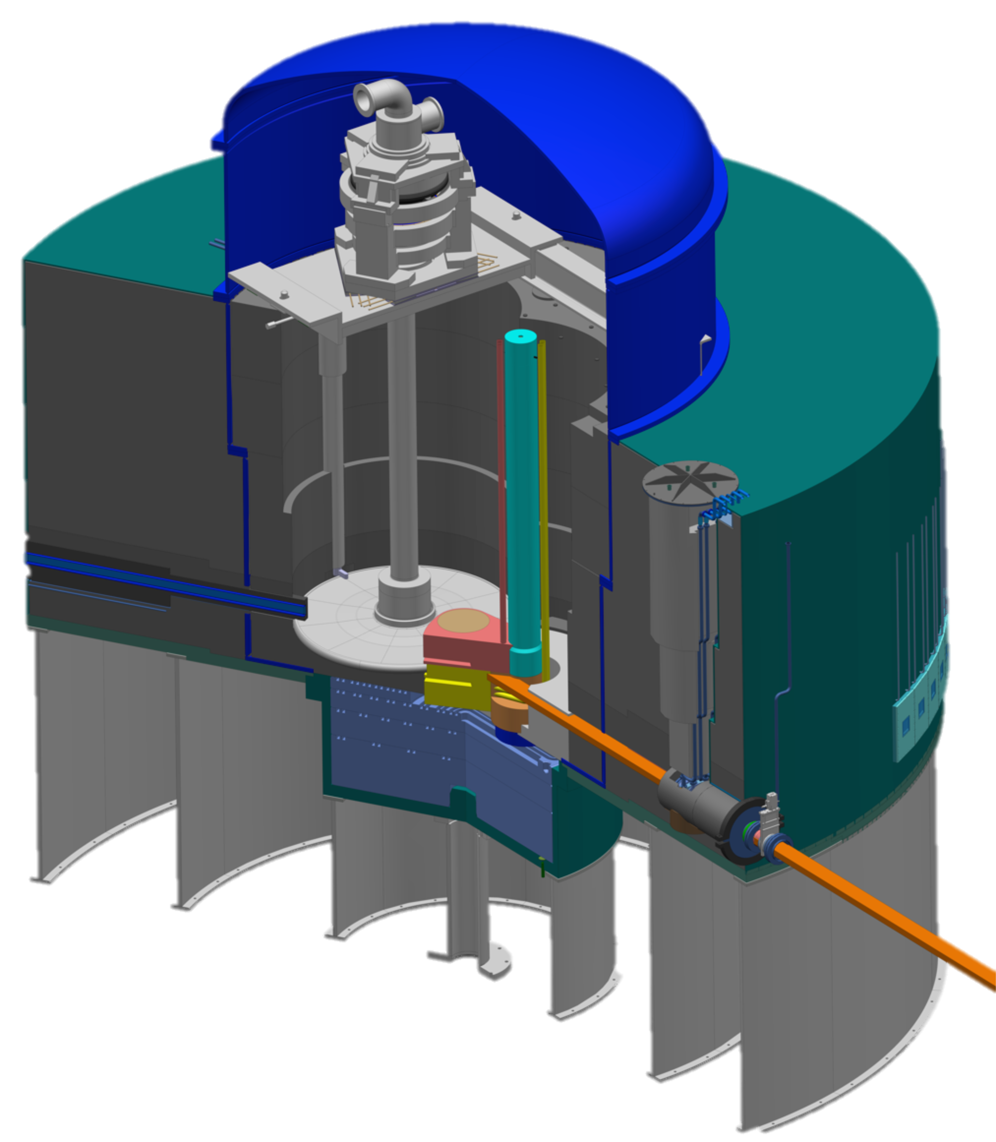
Overview
Neutron beam extraction
Target wheel
Moderator and reflector plugs
Proton beam window
Neutron beam windows
6

Slide 7
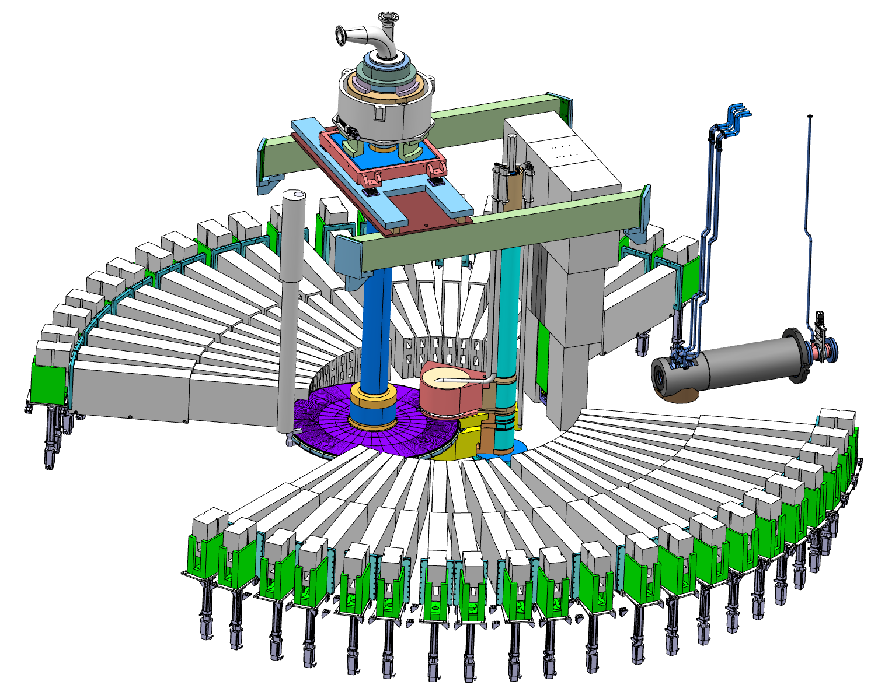

Slide 8
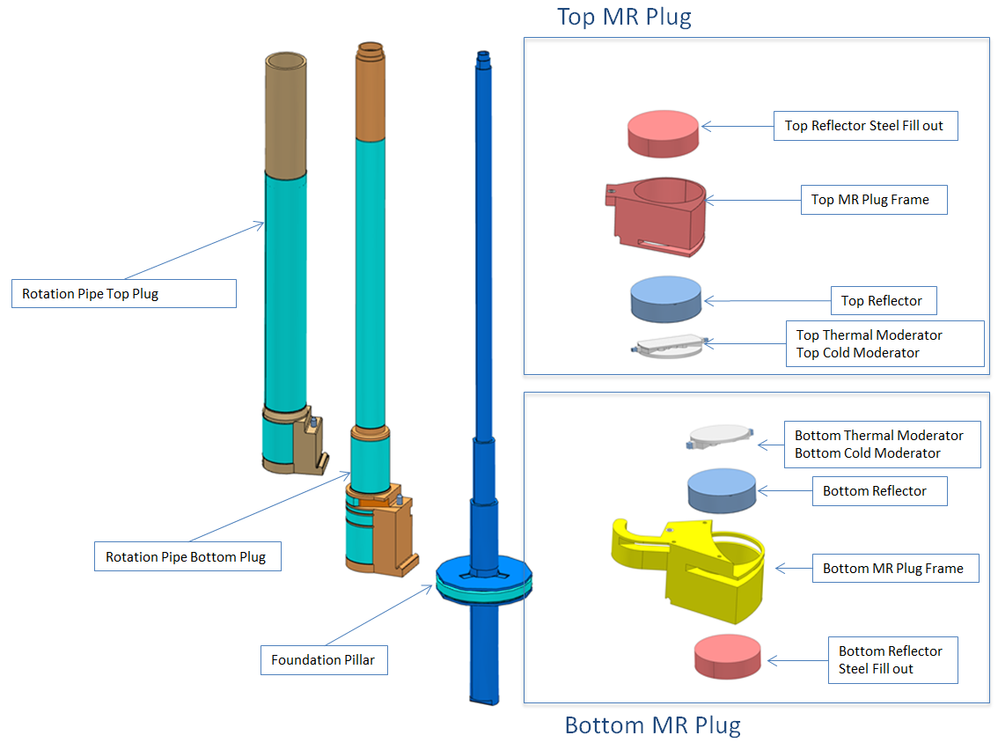
Technical Developments Twister Handling Component Overview

Slide 9
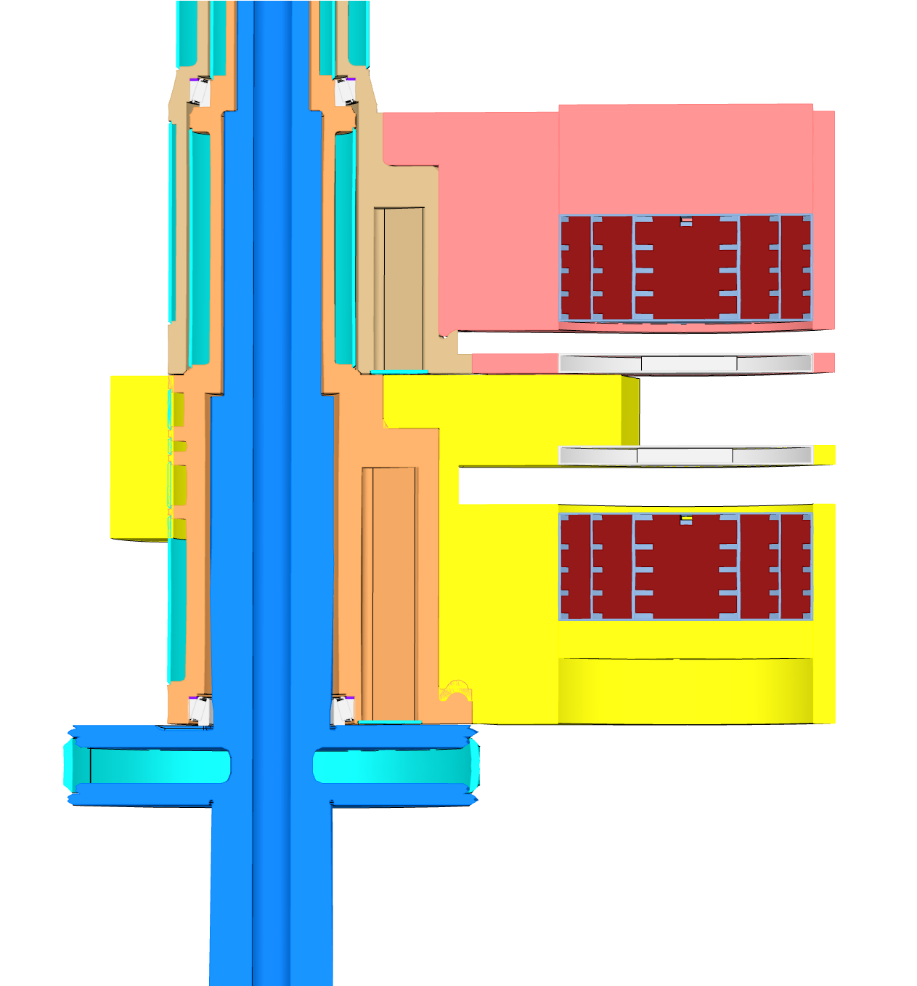
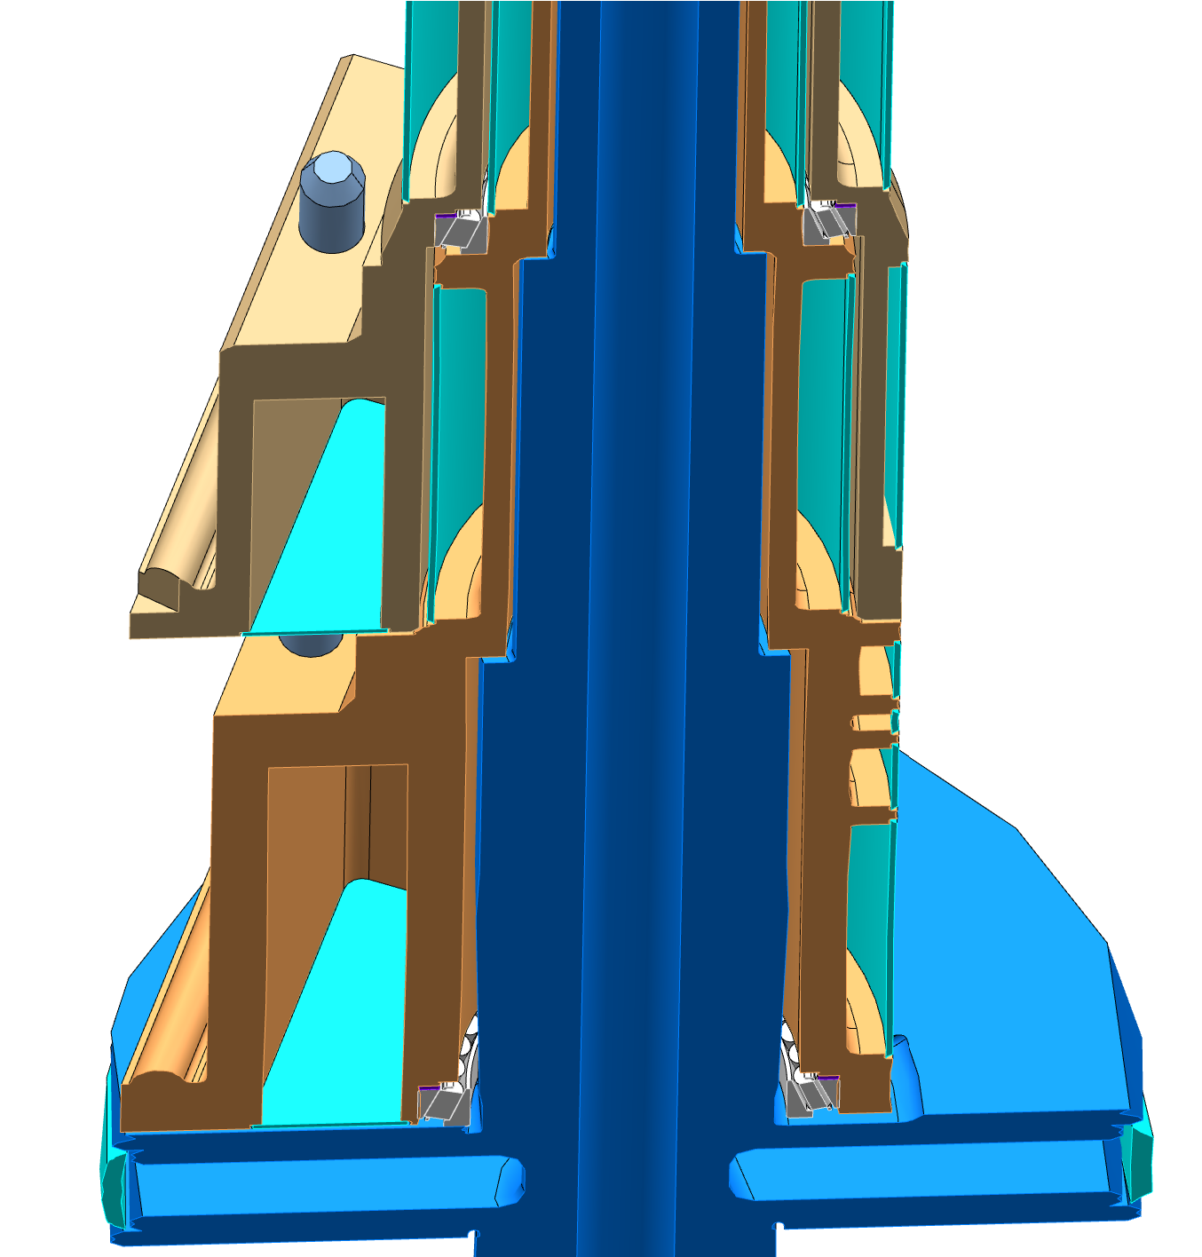
Technical Developments Twister Handling Shaft Cooling
Bearing
Cavities
water

Slide 10
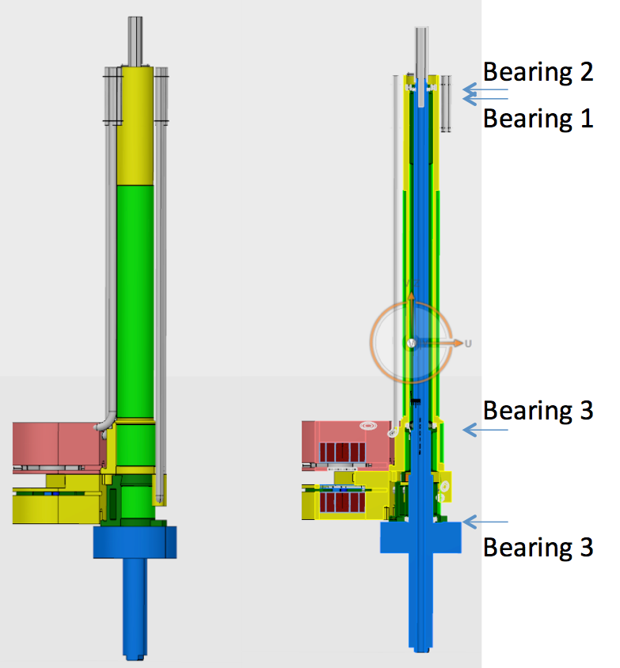
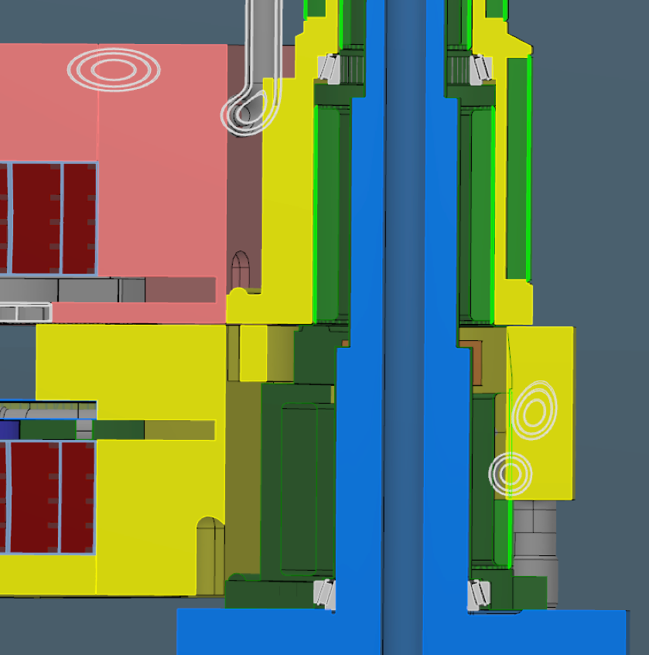
Technical Developments Twister Handling Bearings

Slide 11
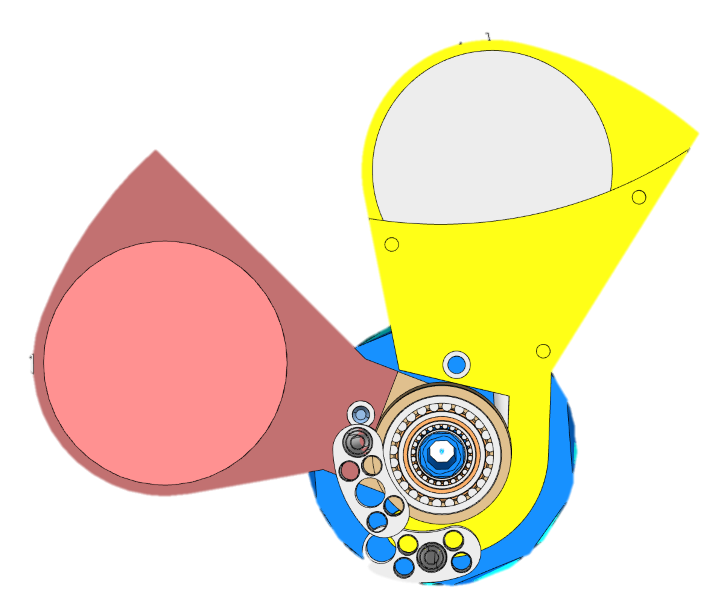
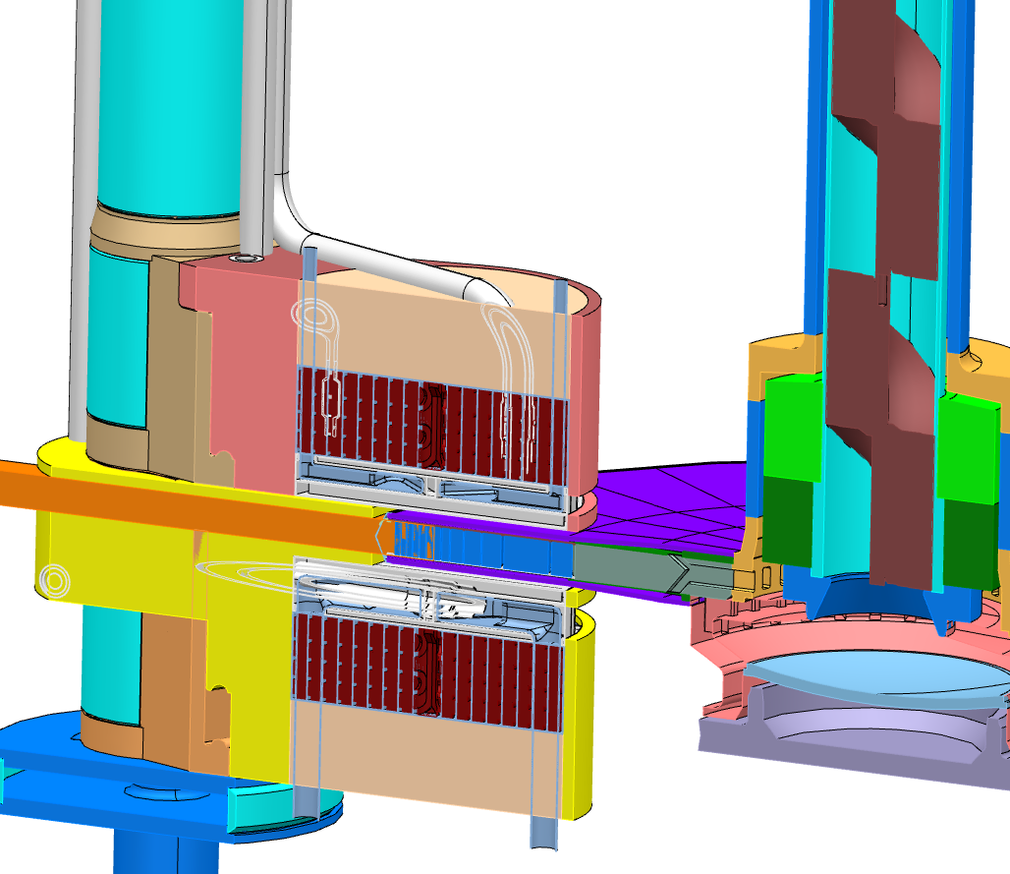
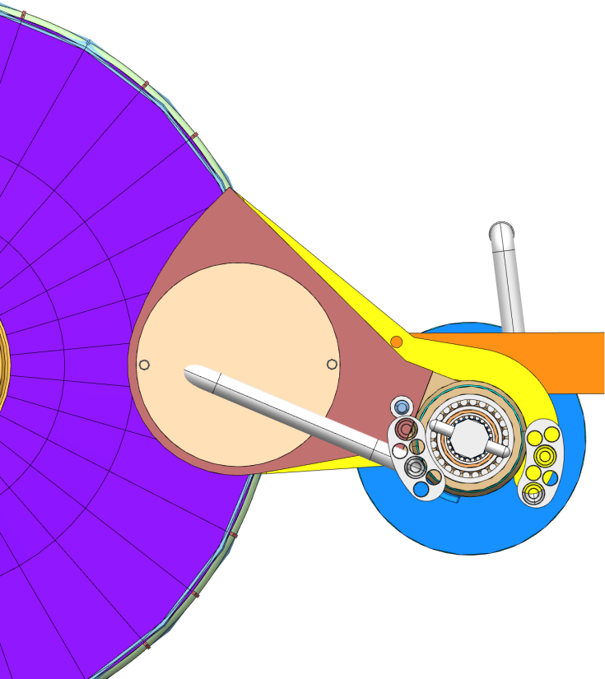
Technical Developments Twister Handling Piping Arrangement
Operating Position
Service Position
OperatingPosition

Slide 12
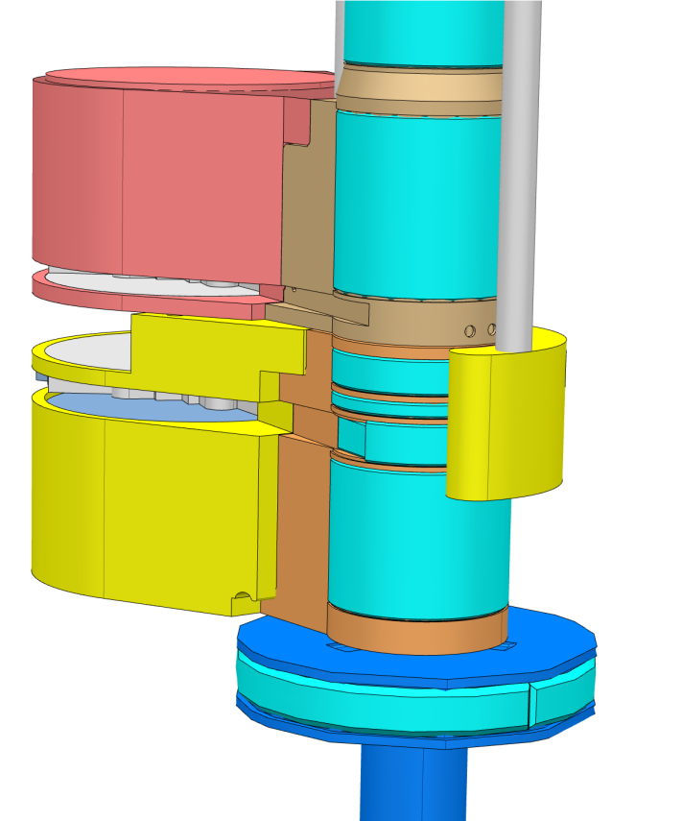
Technical Developments Twister Handling

Slide 13
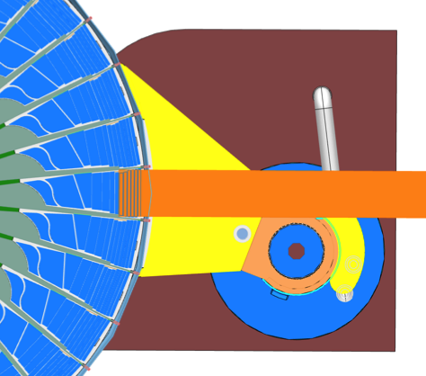
Twister Option Proton Beam Path
Beam Cut-out
Beam Through Foundation Pillar
- Complex Pipe Routing for Bottom Plug
+ Smaller impact on Foundation Pillar design
- Asymmetric Thermal Stresses
- Asymmetric Proton Radiation
- Limited design margins as shaft is restricted between proton beam and neutron extraction path
- Asymmetric and therefore more challenging to manufacture
+Simpler Pipe Design
-Penetrates Foundation Pillar
+Symmetric Thermal Stresses
-Bigger Plugs
(+) Beneficial for 1 double plug (1 rotating shaft)
+Larger flexibility for beam footprint changes
Proton Beam
Proton Beam

Slide 14
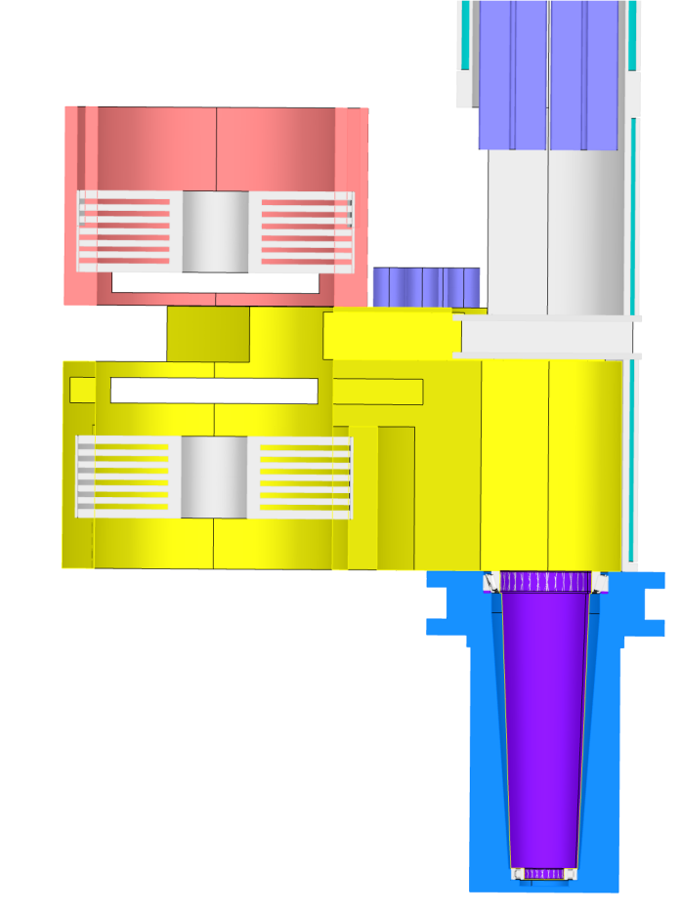
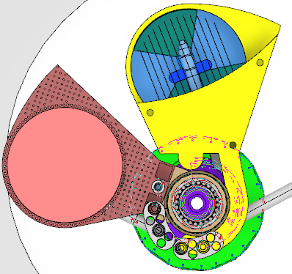
Twister Option Independent or double Plugs
Split Independent Plugs
Double Integrated Plug
+ Independent Replacement
Complicated Piping arrangement for bottom moderator
+ Higher future mission flexibility
+ Simplified Piping Arrangement
+ Simplified Plug Structure & Shielding
+ Simplified Rotation Device
Bigger Cask and Handling System
+ Reduced number of moving parts and bearings

Slide 15
Technical Developments
Butterfly Moderator Implementation
3cm Top Moderator
6cm Bottom Moderator
Increased Cryoplant size 20->35 Kw
Increased Liquid Hydrogen System
Increased WP Budget (18%) and delayed schedule.

Slide 16
Butterfly Moderators TC-12 Instrument Performance
Abstract
Three new moderator assemblies are evaluated and compared to the baseline configuration. Two make use of the new “butterfly” concept, resulting in a significantly higher thermal brightness compared to the water wings of the pancake moderator. The third is a variant of the Optimised Thermal configuration, changing one of the viewed sectors from East to South.
The preferred solution is to replace the top pancake moderator with a butterfly assembly of the same height. This will have a negligible impact on the cold-neutron instruments, while substantially improving the performance of the bi-spectral instruments. Replacing the bottom “optimised thermal” moderator with a butterfly assembly of the same height, viewable in all instrument sectors, will have little effect on the performance of the individual instruments, but will dramatically increase the flexibility of the instrument layout, allowing all instruments to freely choose the optimum moderator for their needs.
[4] K. Andersson, Pancake and Butterfly Moderators, 4-3-2015.

Slide 17
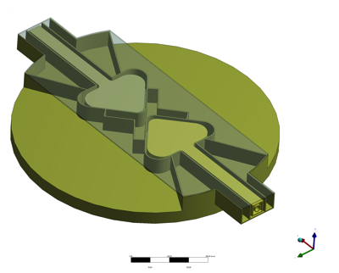
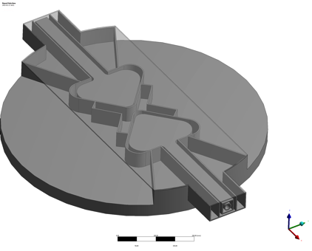
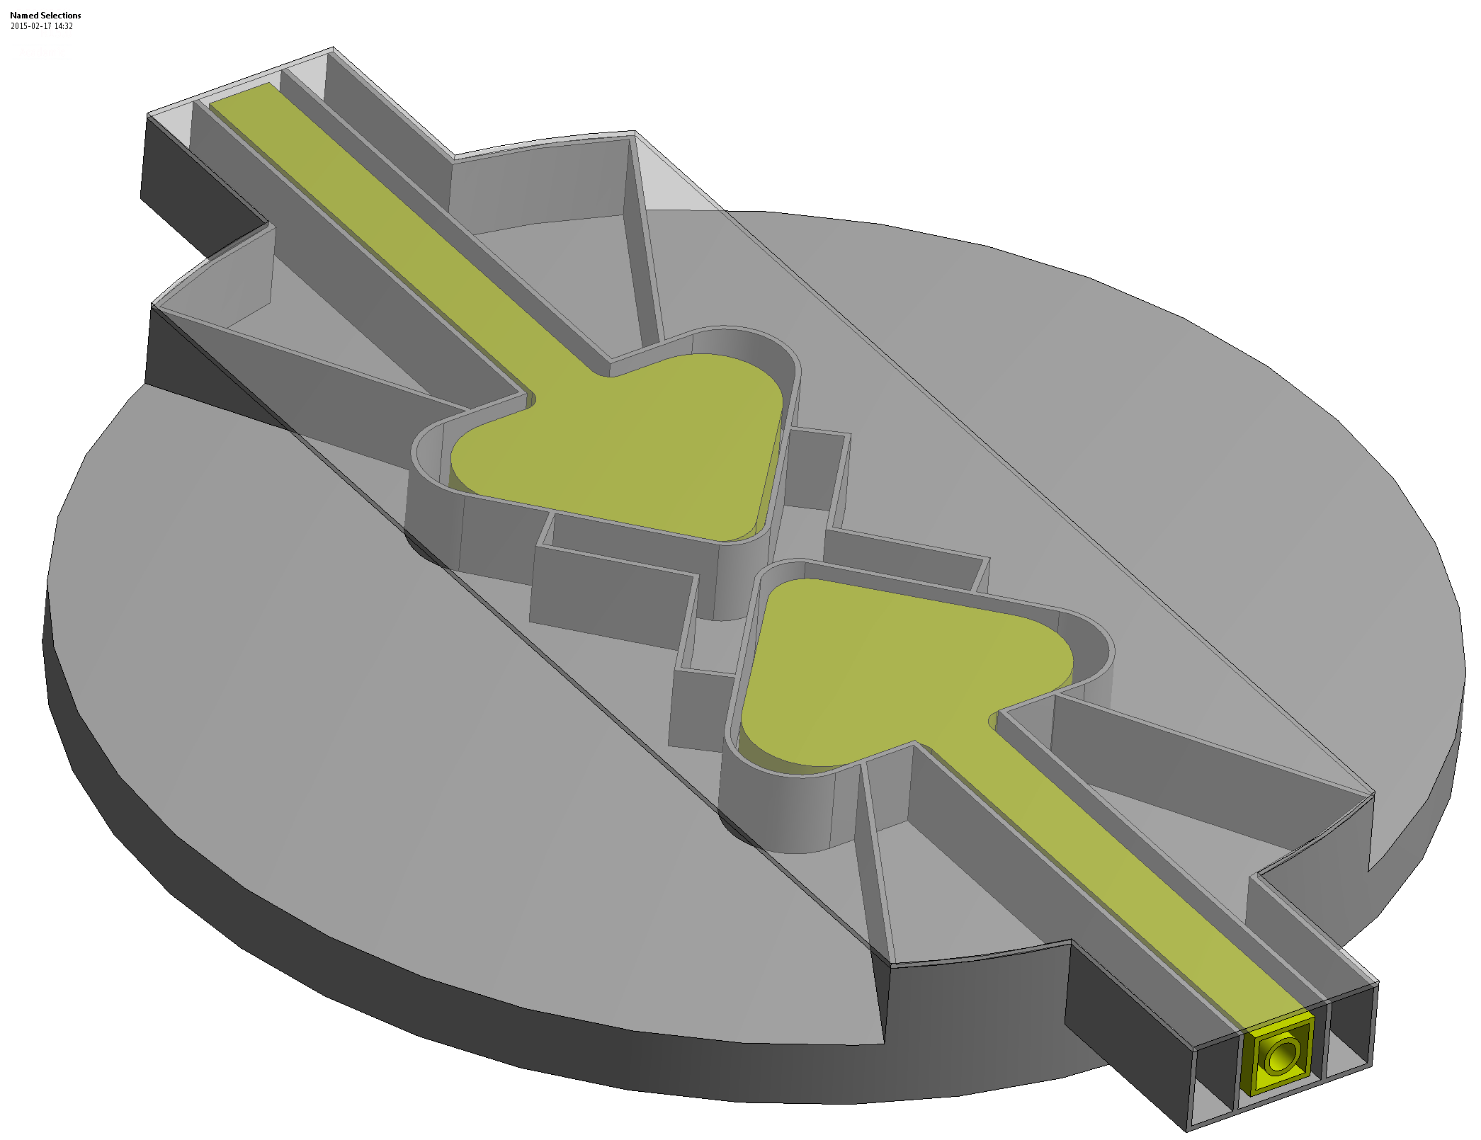
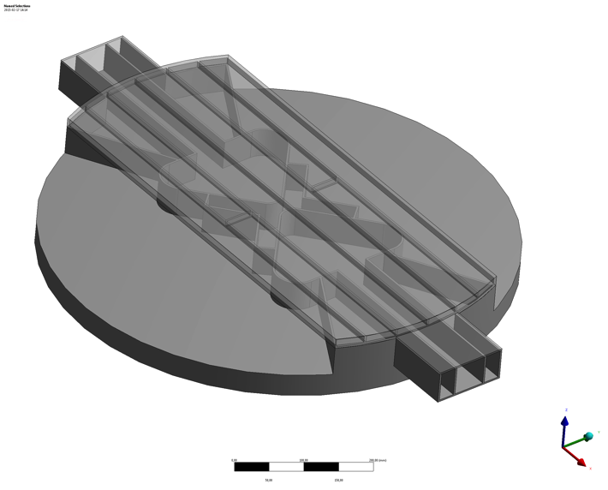
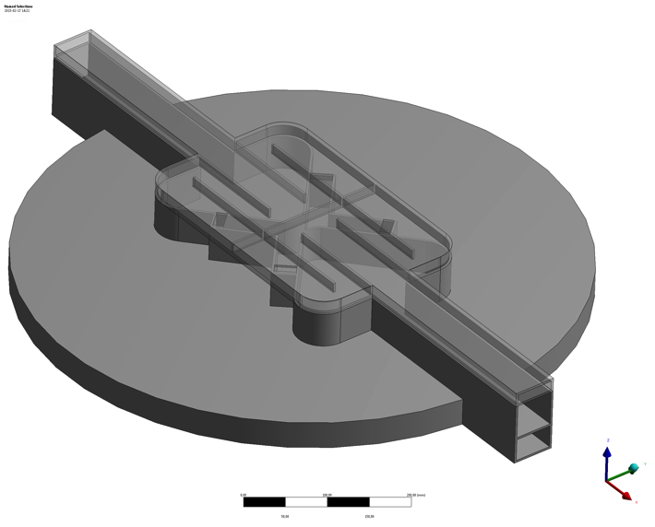
Technical Development Butterfly Moderator Implementation
Top Pre Moderator Alternatives:
Water Wing
Vacuum Gap
Water Cross
Cold Moderator
Water Disc

Slide 18
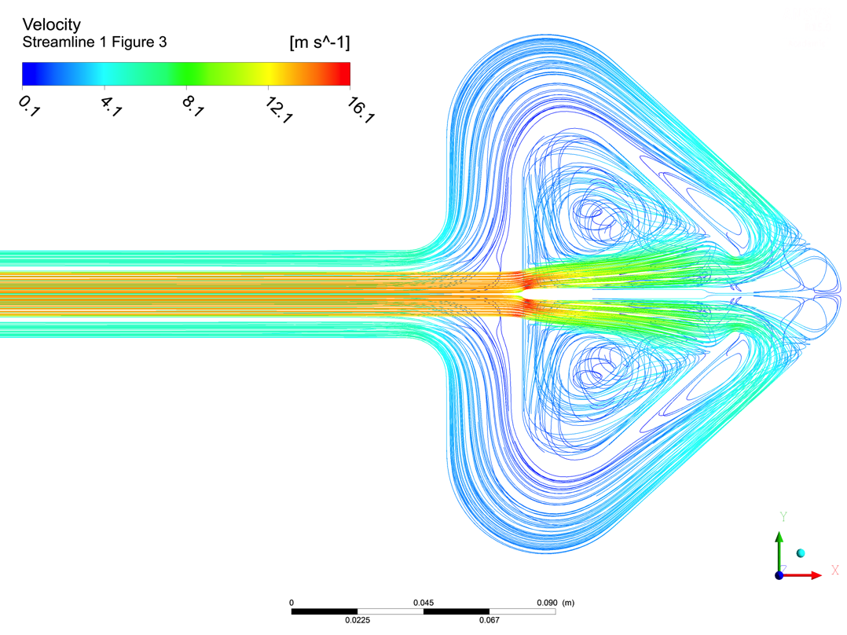
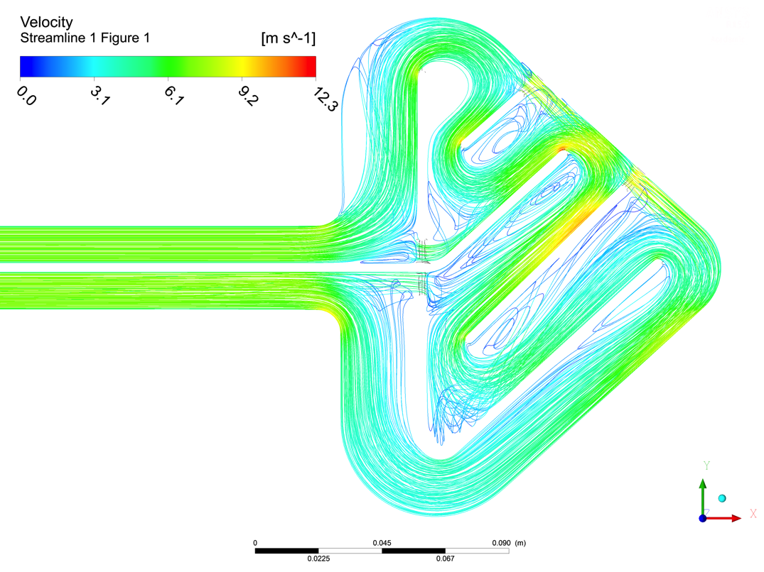
Technical Development Butterfly Design
2
3 Designs for Hydrogen Flow
Parallel Flow with Jet
Serial Star Flow
Serial Zeus
1
3

Slide 19
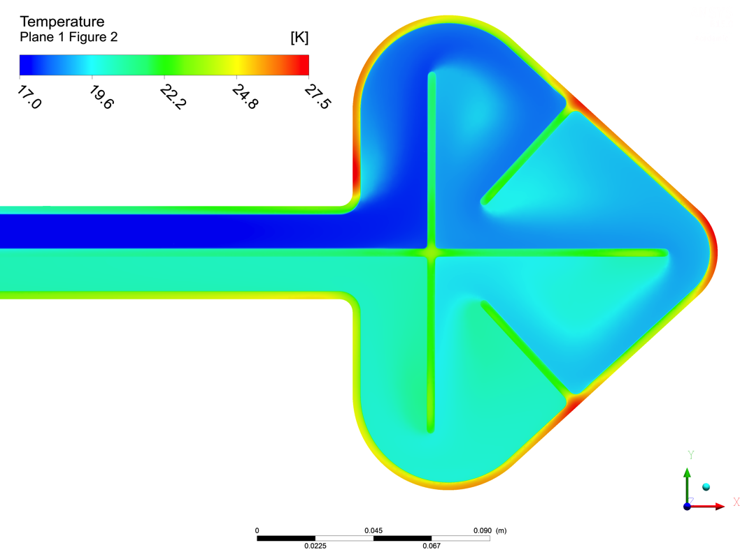
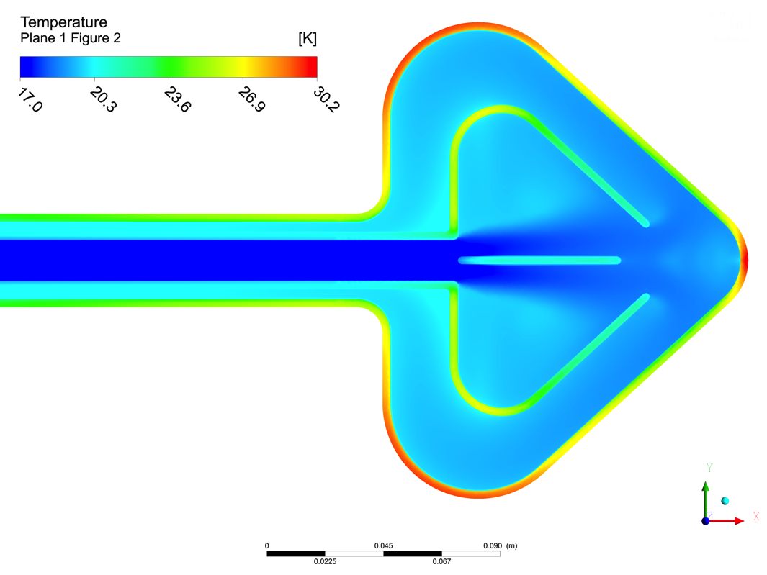
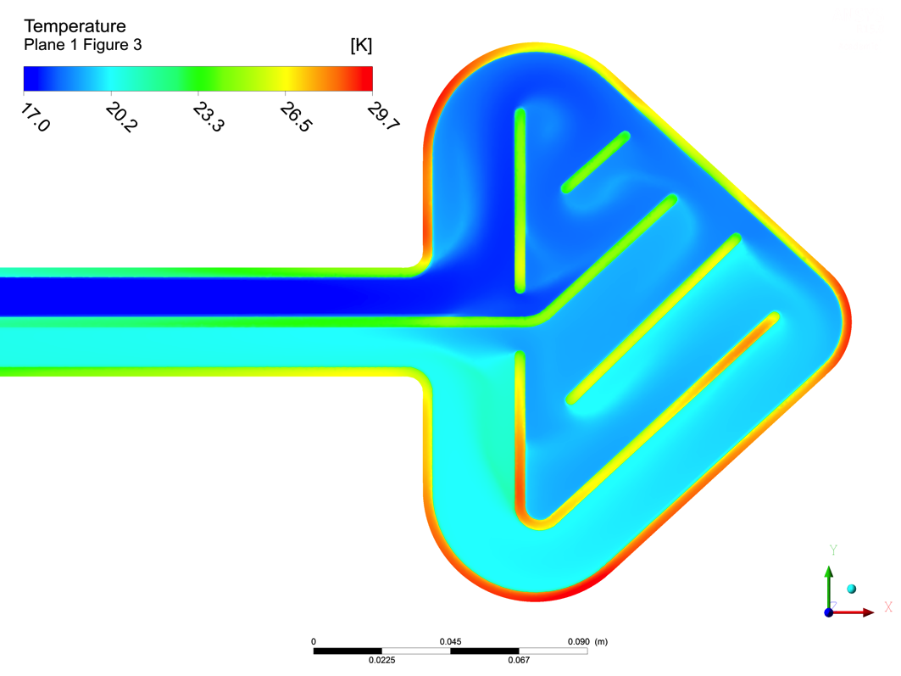
Technical Development Butterfly Design
2
3 Designs for Hydrogen Flow
Parallel Flow with Jet
Serial Star Flow
Serial Zeus
1
3

Slide 20
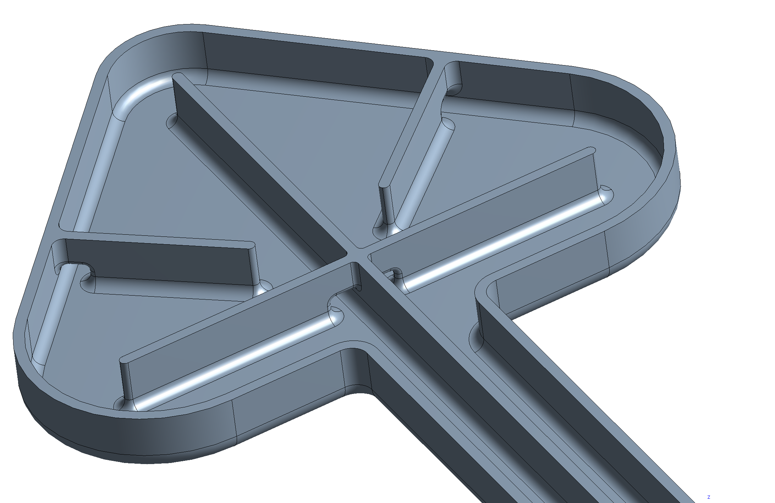
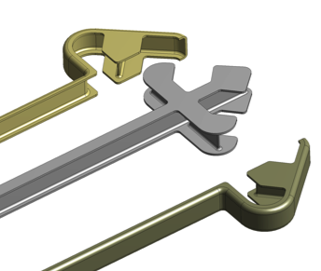
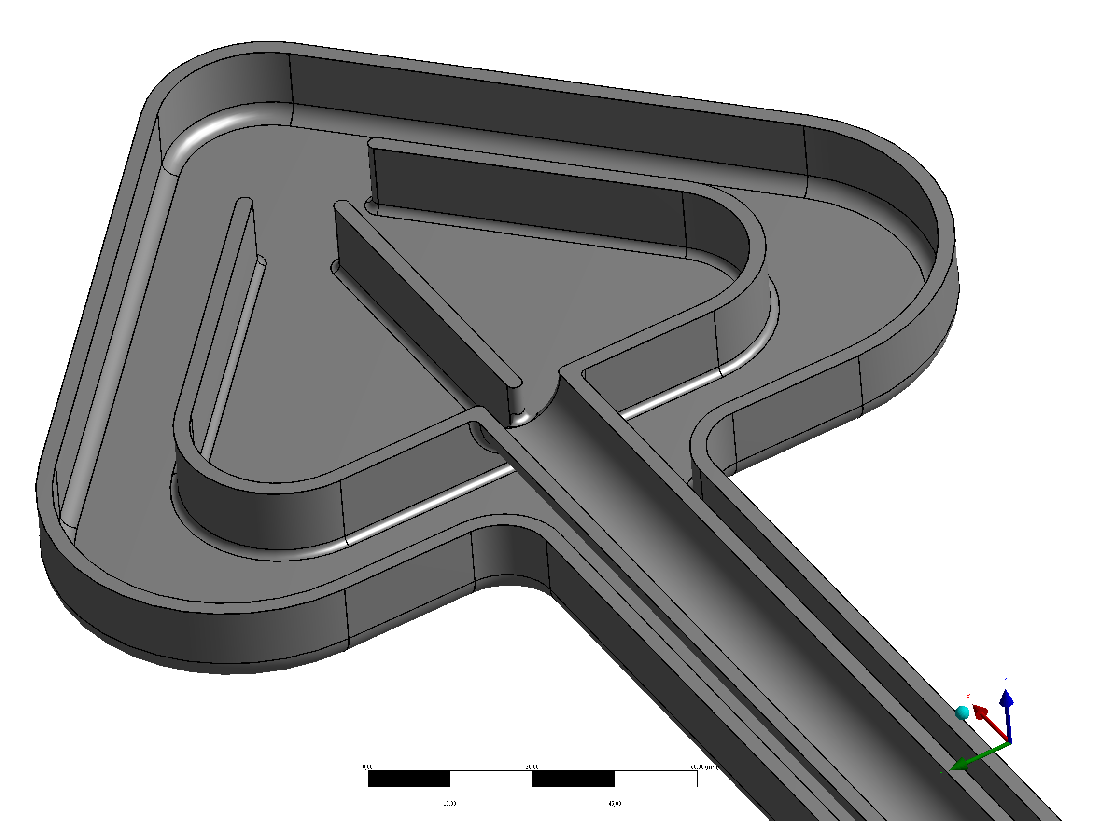
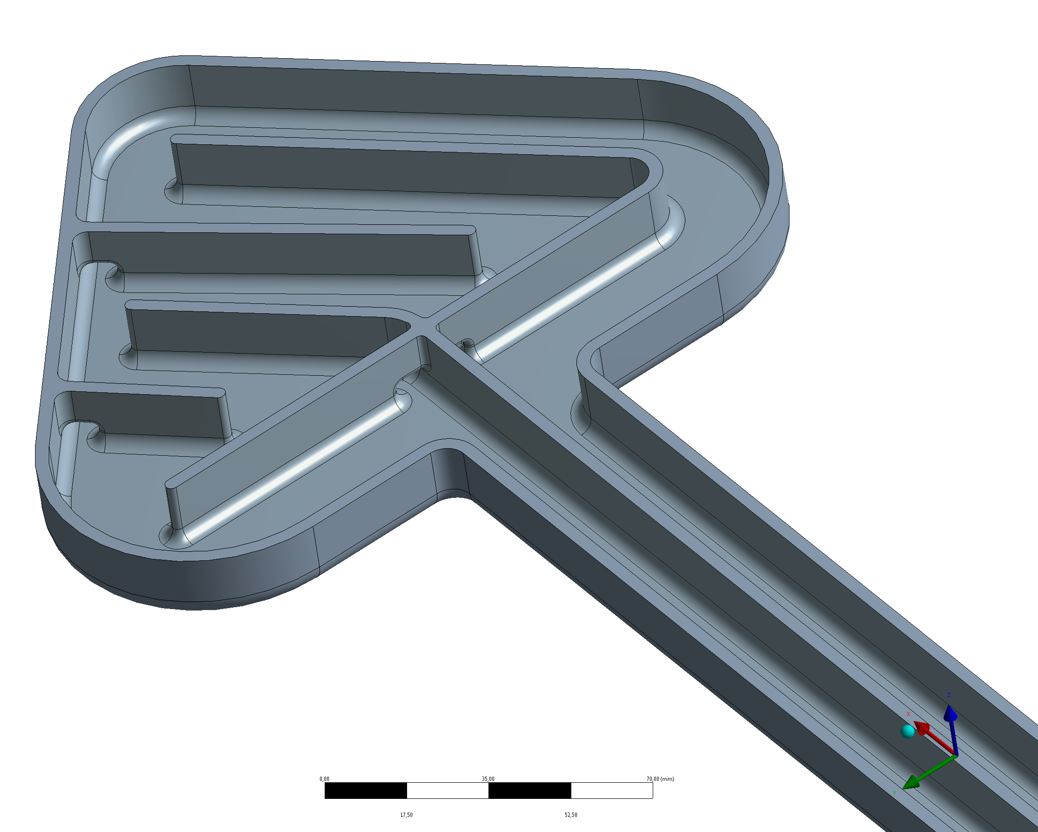
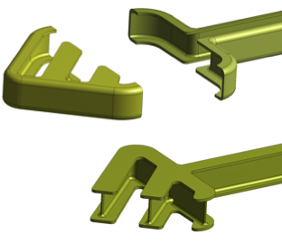
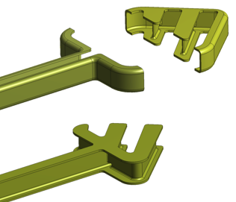
Technical Development Butterfly Design
2
3 Designs for Hydrogen Flow
Parallel Flow with Jet
Serial Star Flow
Serial Zeus
1
3

Slide 21
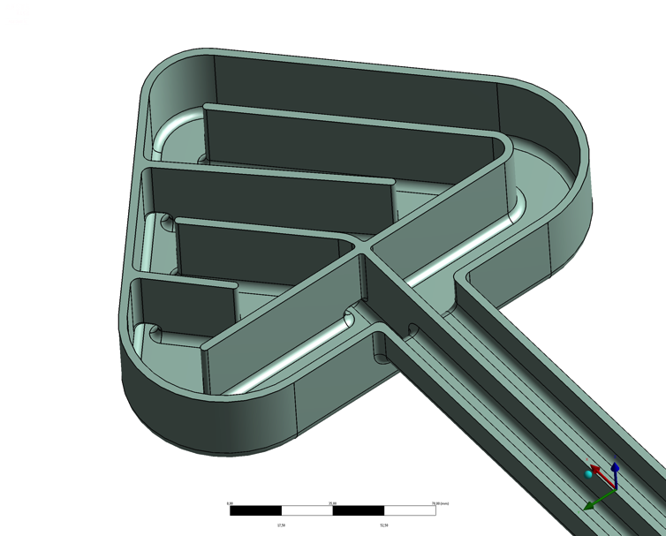
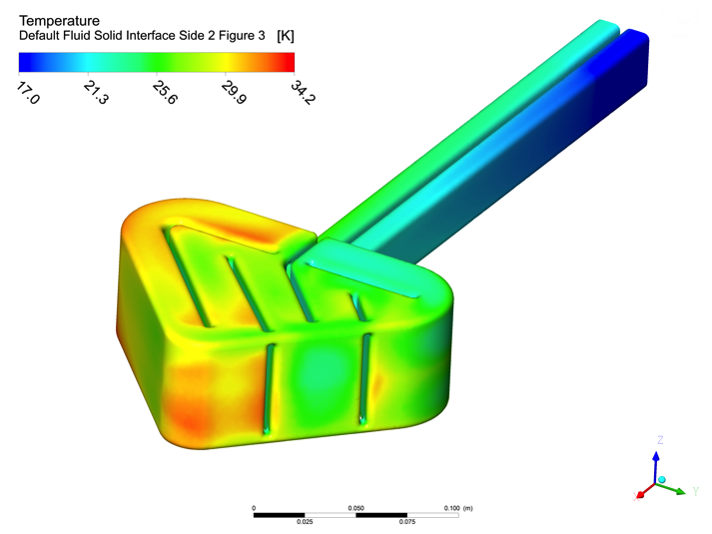
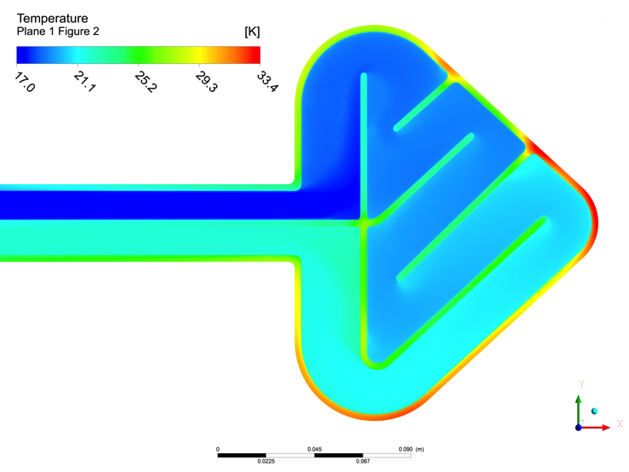
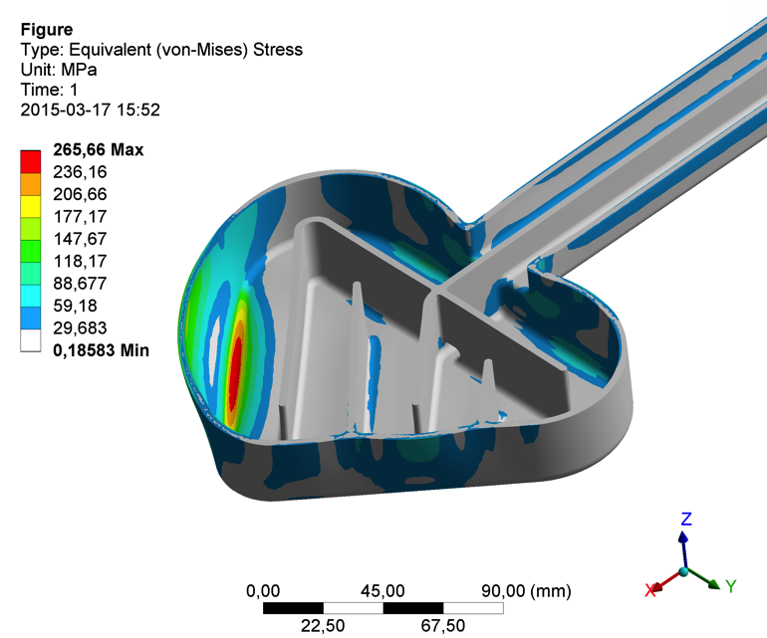
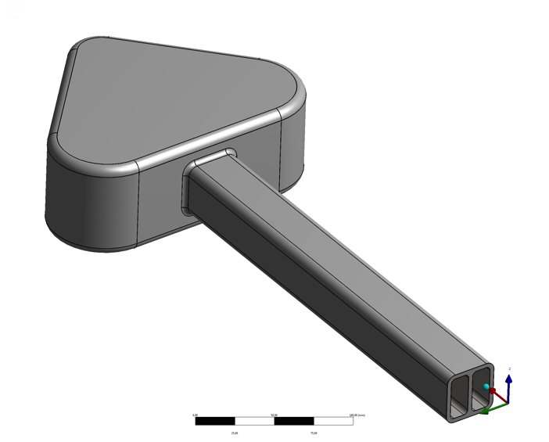
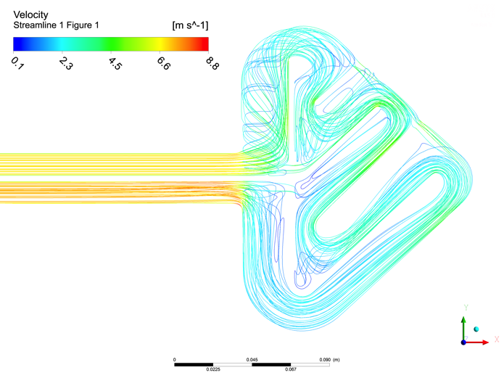
Technical Development Butterfly Design
60mm Bottom Moderator

Slide 22
Technical Development Butterfly Thermal Moderator

Slide 23
Technical Development Butterfly Design

Slide 24
Technical Development Butterfly Design

Slide 25
Technical Development Butterfly Design

Slide 26
Technical Development Butterfly Design

Slide 27
Technical Development Butterfly Design

Slide 28
Technical Development Butterfly Design

Slide 29
Technical Development Butterfly Design

Slide 30
Technical Development Butterfly Design

Slide 31
Technical Development Butterfly Design

Slide 32
Technical Development Butterfly Design

Slide 33
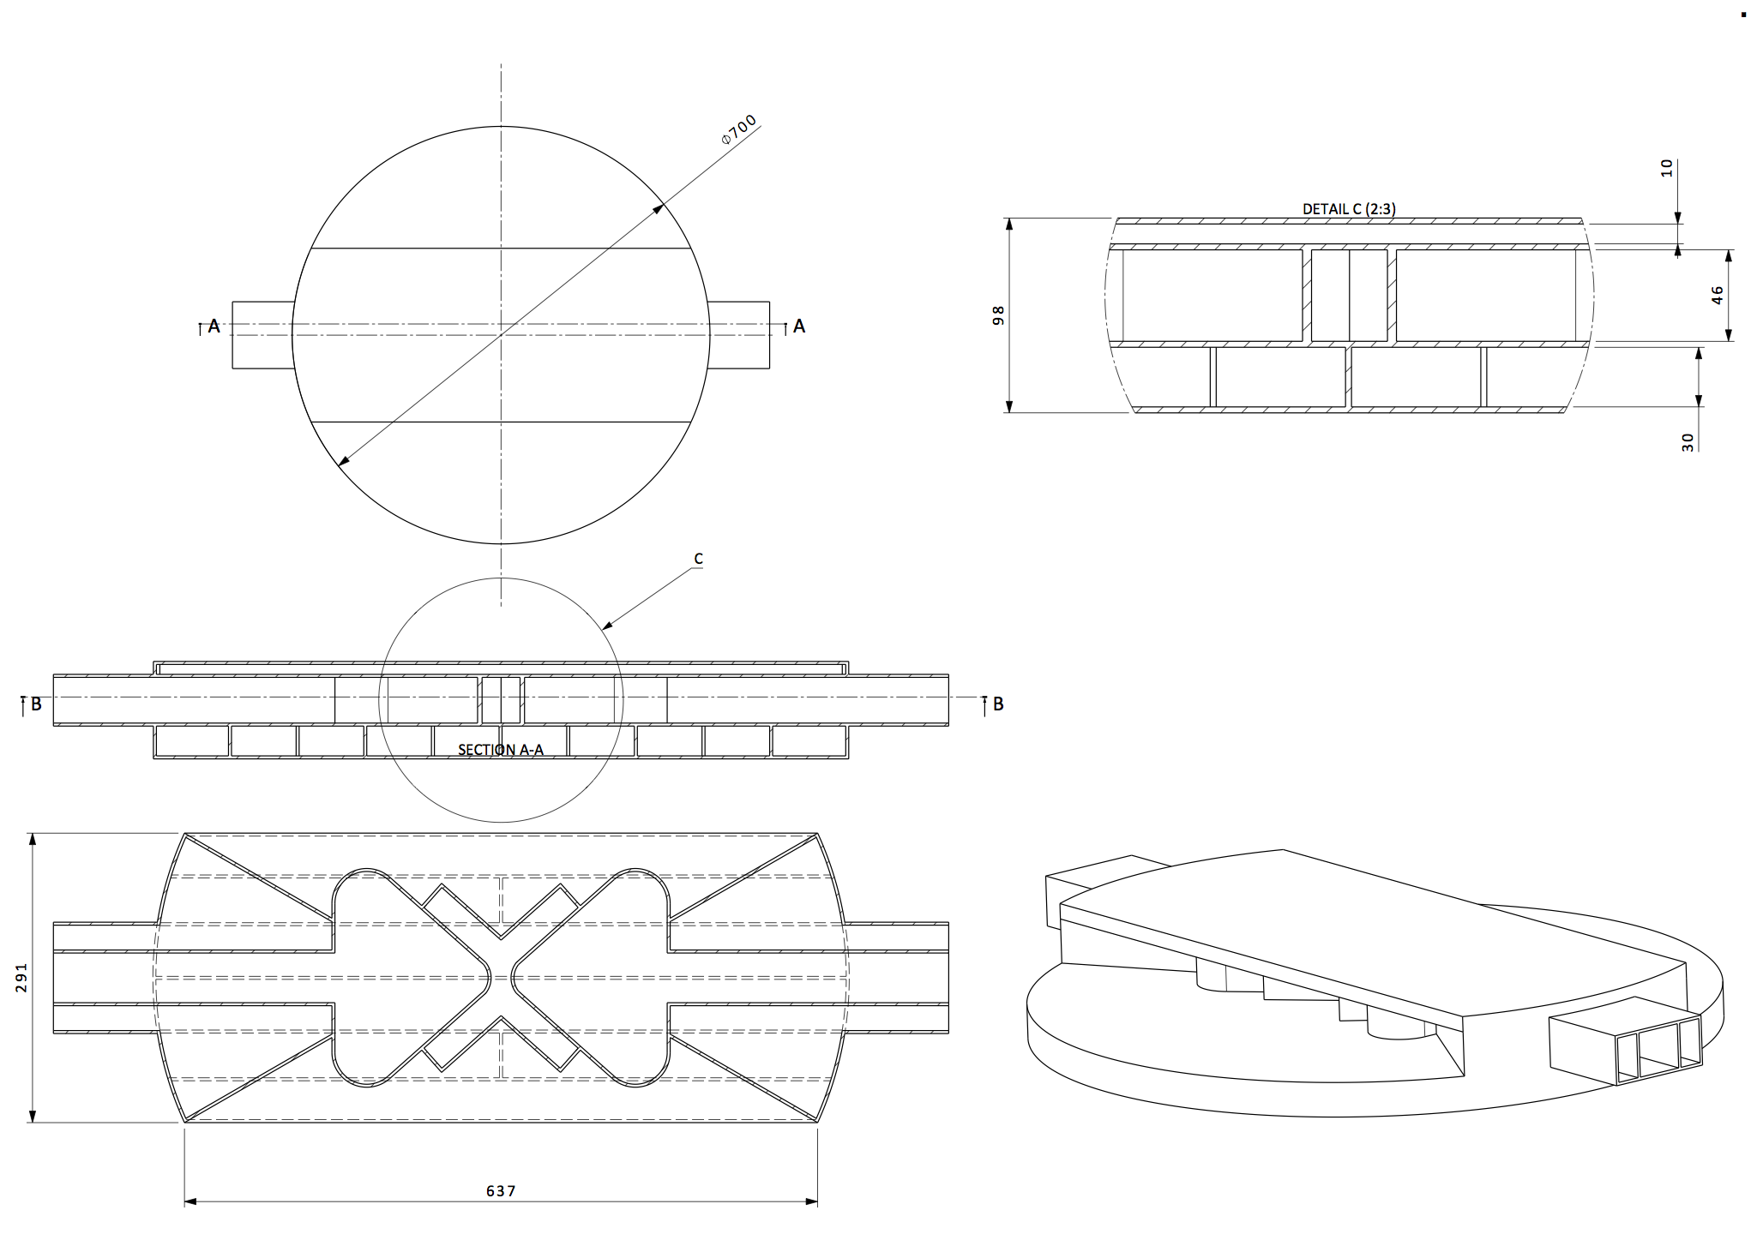
Technical Development Butterfly Weld Tests

Slide 34
Technical Development Butterfly Weld Tests
Ebeam welding
eBeam
eBeam
eBeam
guide
Filler wire
“blindfolded”
2 lines
“blindfolded”
but clear position

Slide 35
Summary
Changes/Developments:
Twister Change
Butterfly Change
Questions/request for comments:
Proton Beam Path
Double Plug
Upcoming Activities:
Weld Tests
PDRs in June

