Slide 1
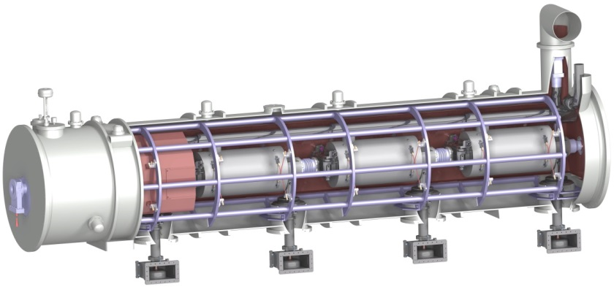
Elliptical Cavities Cryomodules
WP5
Pierre BOSLAND, CEA Saclay
External WP5 leader
Christine Darve,
ESS deputy WP leader
TAC11 1^{rst} April 2015

Slide 2
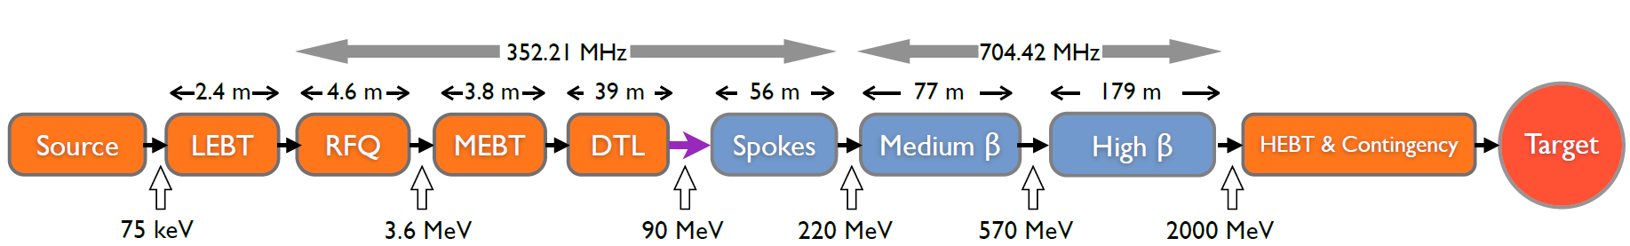
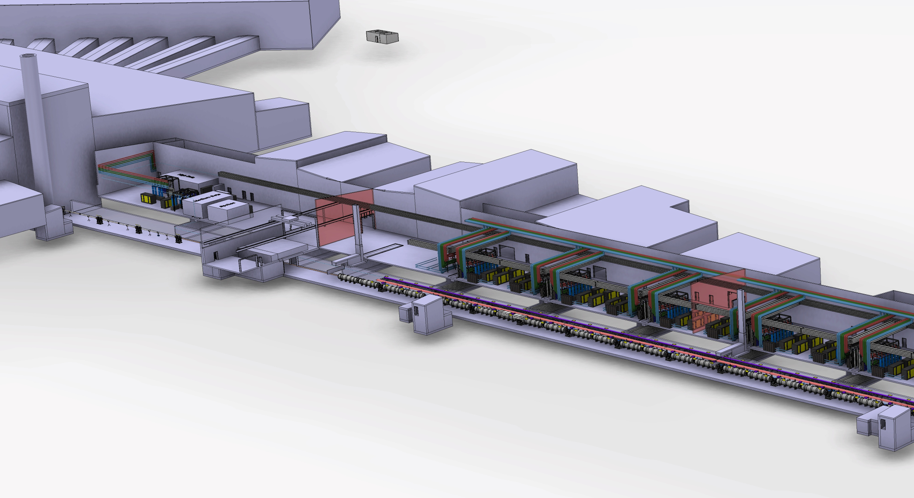

The elliptical cavity cryomodules in the ESS linac
Klystron gallery
 | MEDIUM-β | HIGH-β
β | 0.67 | 0.86
# CM | 9 | 21
Cav. /CM | 4 | 4
# Cav. | 36 | 84
CM L [m] | 6.584 | 6.584
Sector L [m] | 77 | 179
Proton Beam
Elliptical cavities Cryomodules
Medium-β and high-β

Slide 3
Framework of the cryomodules development and production
Two prototype cryomodules:
medium beta: M-ECCTD <= FR-SW agreement
High beta: H-ECCTD <= CEA FR In Kind Contribution
Production of cavities of the series with RF tests:
medium beta cavities <= LASA - IT In Kind Contribution
High beta cavities <= STFC - UK In Kind Contribution
Production of all other components: <= CEA FR In Kind Contribution
(including coupler production with RF power processing)
Cryomodule assembling : <= CEA FR In Kind Contribution
RF power tests of the cryomodules <= ESS Lund

Slide 4
FR in kind activities starting at Saclay (“early in kind”)
ESS - AB
ESS - AB
Technique :
Technical
Board
ACCSYS WP 3
ACCSYS WP 5
ACCSYS WP 7
ICS WP 6
ICS WP 10
Management :
Coordination C.
Collaboration C.
In Kind Review C.
IRFU reorganization on the 1rst of June 2015:
  Florence Ardellier: Project Manager
  Pierre Bosland : Scientific Director
ESS - IRFU
Cellule Qualité
A Bruniquel
C. Cloué
Projet ESS / IRFU
CdP: P. Bosland
Adjoint: A. Daël
Responsables
Scientifiques
G. Devanz
D. Uriot
O. Piquet
Project Office
planning: X. Hanus
ressources: L. Lecourt
secrétaire: XX
Sécurité
O. Kuster
WP
Tests IPHI
B. Pottin
WP
Bunker 352 MHz
JP. Charrier
WP ECCTD
F. Peauger
WP
Cryomodules
de série
P. Bosland/XXX
WP RFQ
B. Pottin
WP
Diagnostics
F. Sénée
WP
Contrôle
Commande
F. Gougnaud
WP
Test
injecteur
B. Pottin
M-ECCTD
Design RFQ
IKC
H-ECCTD
IKC
RFQ
ACCSYS WP5
ACCSYS WP3
ACCSYS WP7
ICS WP 6 / 10
ACCSYS WP3

Slide 5
Overview of the design of the cryomodules and components
First results on prototype high beta cavities
On behalf of the CEA Saclay, IPN Orsay team and ESS team:
C. Arcambal, G. Devanz, P. Bosland, E. Cenni, P. Hardy, F. Leseigneur, J. Plouin, G. Ferrand, F. Eozenou, C. Servouin,
D. Roudier, L. Maurice, X. Hanus, C. Madec, JP. Poupeau, N. Bazin, N. Berton, V. Hennion, JP. Charrier, O. Piquet,
P. Carbonnier, B. Renard, P. Sahuquet, A. Hamdi, CEA Saclay
G. Olivier, JP. Thermeau, IPN Orsay
C. Darve, N. Elias, G. Costanza ESS

Slide 6

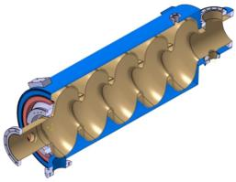
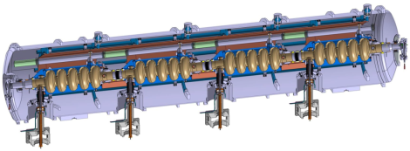
Cryomodule design and prototyping
Fr-SW agreement
G. Olivier
Collaboration IPNO – IRFU
IRFU in charge of the “cavity package”, the cryomodule assembly and RF power tests:
    Cavities + helium tank
    Power coupler
    Piezo tuner
    Magnetic shield
    Tooling: field flatness, cavity preparation, cryomodule assembling, …
    Cryomodule assembly
    Tests stand for cryogenic and RF power tests
    Tests of the ECCTD cryomodule
IPNO in charge of the cryostat – design and fabrication
    Vacuum vessel
    Space frame – cavity supports
    Thermal screen
    Superinsulation
    Internal cryogenic pipes
    Instrumentation
Medium beta prototype cryomodule M-ECCTD
Generic design for medium & high beta cryomodules
The level-4 requirements for the medium and high beta cryomodules are listed in the DOORS management system (Dynamic Object-Oriented Requirements System).
Conformance of the design with these requirements has been presented at a-TAC (October 2013).

Slide 7
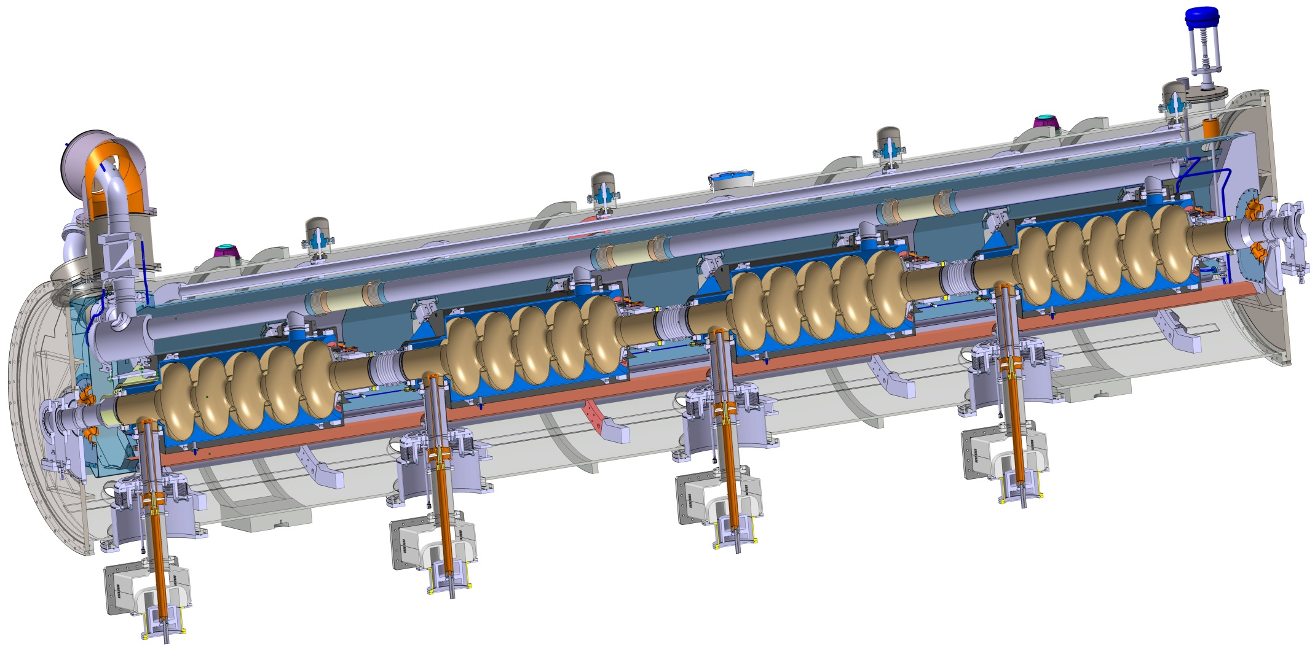
Cryomodule design
G. Olivier
Similar to CEBAF/SNS cryomodule concept with 4 cavities per cryomodule
Common design for medium (6 cells) and high beta (5 cells) cavities
Regulation He valve
Thermal shielding
Alignement fiducial
Vacuum valve
Jumper connection
Magnetic shielding
Spaceframe support
Heat exchanger
Diphasic He pipe
Proton Beam
Cavity with Helium tank
Intercavities belows
Power coupler
Cold to warm transition

Slide 8
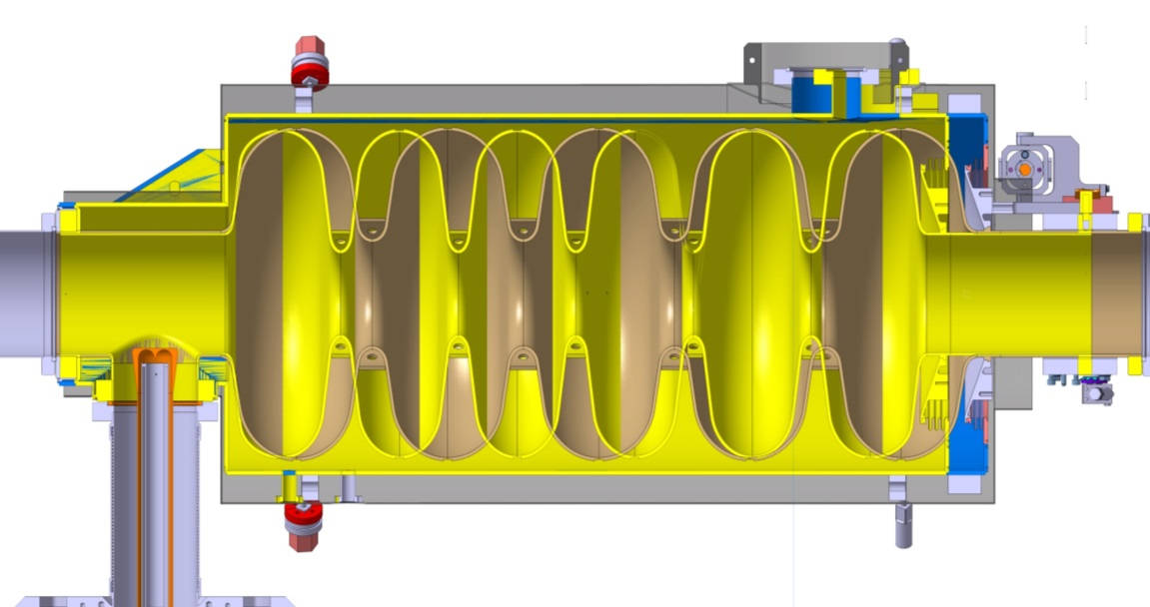
Cavities design
Magnetic shielding
Tank (Ti)
Cold tuning system
 | Medium | High
Geometrical beta | 0.67 | 0.86
Frequency (MHz) | 704.42
Operating temperature (K) | 2
Maximum surface field in operation (MV/m) | 44 | 44
Nominal Accelerating gradient (MV/m) | 16.7 | 19.9
Nominal Accelerating Voltage (MV) | 14,3 | 18,2
Q₀ at nominal gradient | > 5e9
Cavity dynamic heat load (W) | 4,9 | 6,5
Q_{ext} | 7.5 10⁵ | 7.6 10⁵
High beta (0,86):
5 cells
Length 1316,91mm
Medium beta (0,67):
6 cells
Length 1259,40mm
57,5 mm
 | Medium | High
Iris diameter (mm) | 94 | 120
Cell to cell coupling k (%) | 1.22 | 1.8
π and 5π/6 (or 4π/5) mode separation (MHz) | 0.54 | 1.2
E_{pk}/E_{acc} | 2.36 | 2.2
B_{pk}/E_{acc} (mT/(MV/m)) | 4.79 | 4.3
Maximum. r/Q (Ω) | 394 | 477
Optimum β | 0.705 | 0.92
G (Ω) | 196.63 | 241
Challenging accelerating gradients and Q₀
No HOM couplers
  HOM frequencies and internal cavity shape must be carefully controlled
G. Devanz, J. Plouin,
G. Constanza

Slide 9
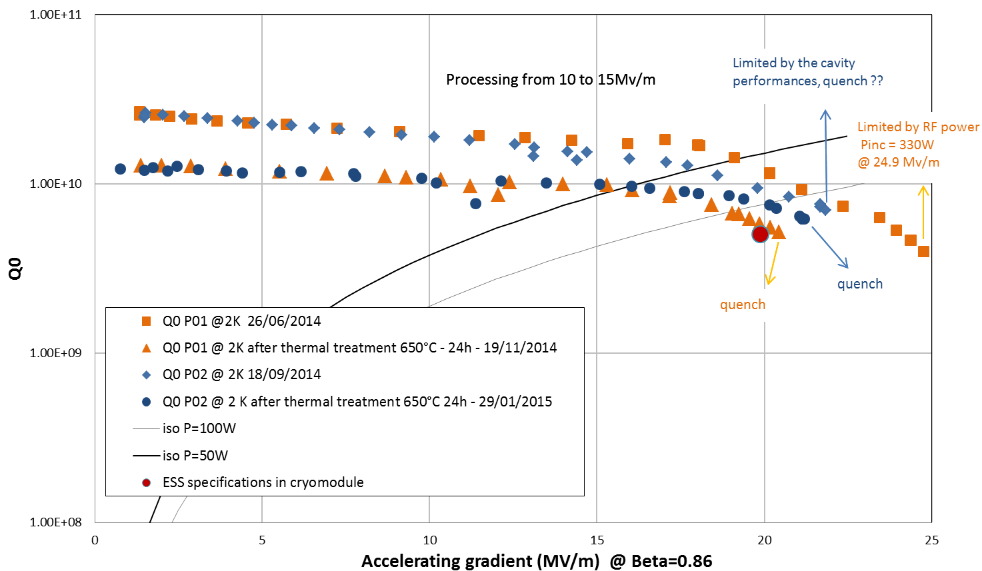
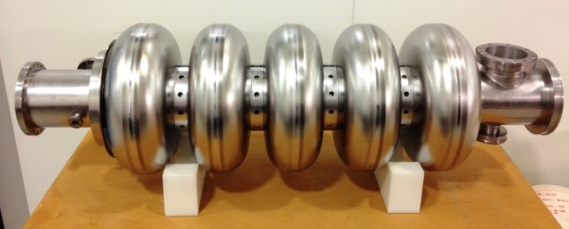
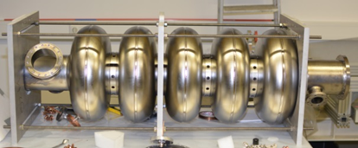
Tests of the 2 prototype cavities in vertical cryostat
P01 - E. ZANON
P02 - RI
Protypes with HOM ports for RF measurement
Both prototype cavities met the ESS requirements after the first test: very encouraging results!
Slight degradation of performances after thermal treatment for hydrogen removing (pollution)

Slide 10
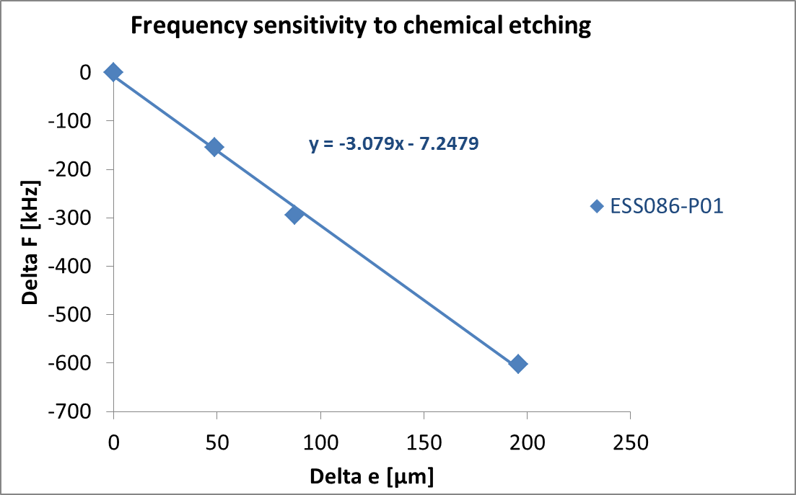
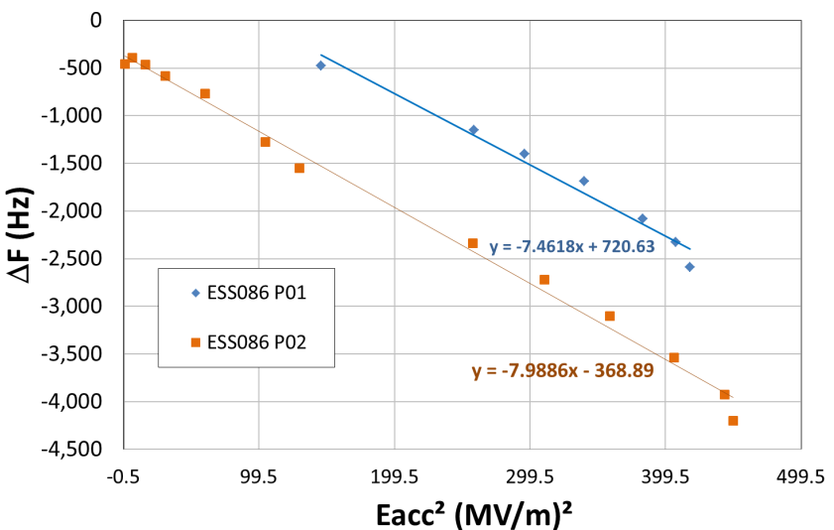
Tests of the 2 prototype cavities in vertical cryostat
EFFECT of BCP on the frequency
Tuning sensitivity ΔF/Δz (kHz/mm) | ESS067 | ESS086
Calculated | 214.8 | 197
Measured |  | 190
Stiffness (kN/mm) | ESS067 | ESS086
Calculated | 1.286 | 2.59 (3.6 mm thick) 3.3 (4.5 mm thick)
Measured |  | 3
Measured LFD coefficient: KL = -7.65 Hz/(MV/m)²
Close to the calculated value of -8.9 Hz/(MV/m)² in free ends conditions
Frequency shift ΔF due to cooldown and vacuum (kHz) |  | ESS067 | ESS086
Calculated | 300K to 4.2 K | +1.0067 | +1.00138
 | Ɛr to Ɛo | +0,211 | +0.211
Measured | 300K to 4.2K |  | ~ +1.08
 | Ɛr to Ɛo |  | +0.015
Frequency shift ΔF due to cooldown and pressure (kHz) |  | ESS067 | ESS086
Calculated | 4.2 K to 2 K
Measured |  |  | ~ + 0.207

Slide 11
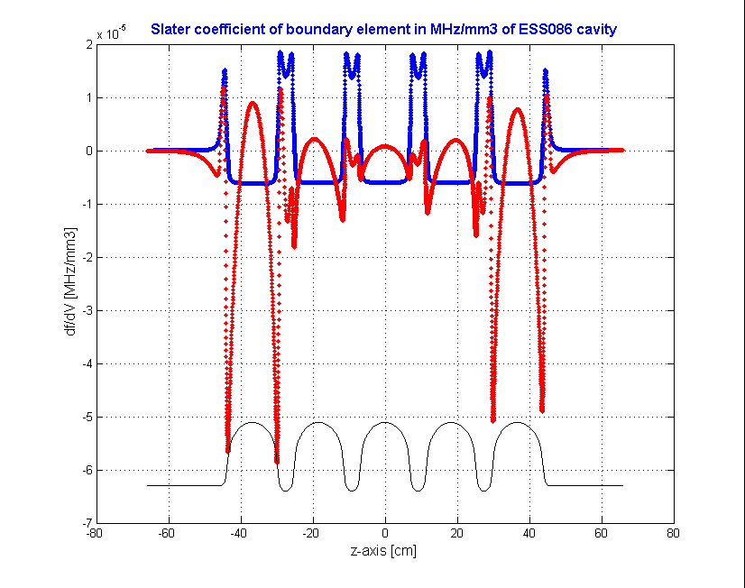
Dangerous Higher Order Mode
close to 1408.8 MHz
Both high beta prototype cavities are not conform with the ESS HOM Requirement
Reminder: « All higher order modes (HOMs) shall be at least 5 MHz away from integer multiples of the beam-bunching frequency (352.21 MHz) for any HOMs whose resonant frequencies are below the cut-off frequency of the beam-pipe.”
3D measurements of the cavity shape have been performed
Shape reconstructed in the simulation software HFSS
Slater coefficient analysis which represents frequency sensitivity to volume changes:
Design (at 300K) | Measured on ESS086-P01 | Calculated with measured shape (HFSS) | Measured on ESS086-P02 | Calculated with measured shape (HFSS)
1418.178 | 1402.254 | 1403.8 | 1407.848
1418.674 | 1404.666 | 1406.8 | 1408.258
704 MHz
1421,32 MHz
On P01 cavity (from ZANON), a strong internal shape deviation in this dome region (more than 1 mm instead of 0.3 mm) explains very well the frequency decrease of the two dangerous HOM
Study under progress on P02 cavity (from RI)
Cells reshaping has to be implemented in the fabrication process of future cavities

Slide 12
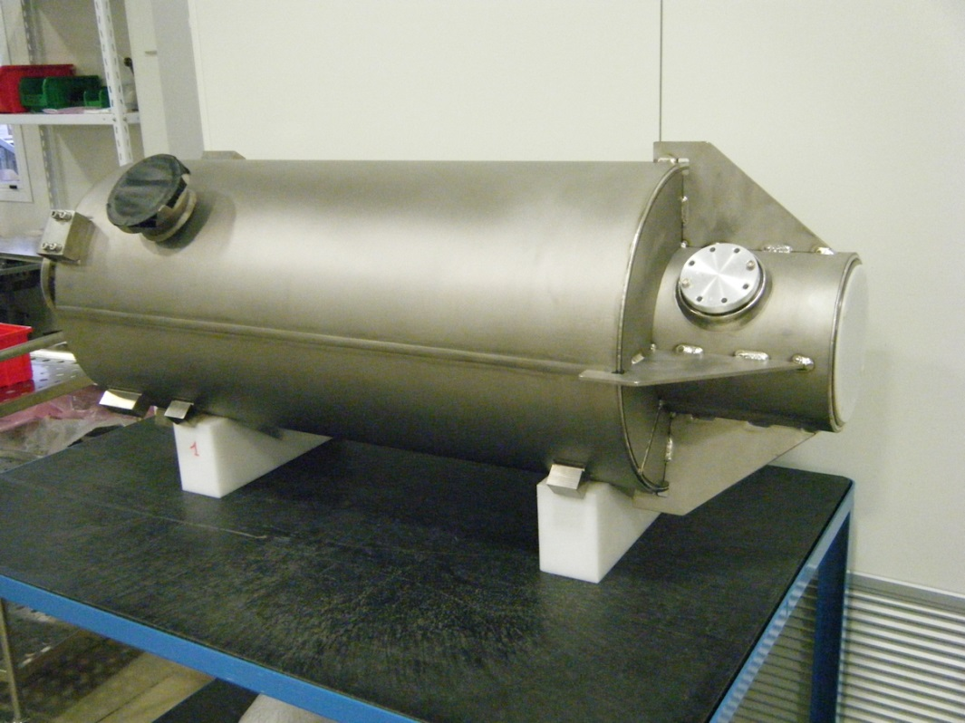
Titanium Helium tank of ESS086-P01 welded (ZANON)
ΔF = +9 kHz only due to tank welding
Pressure and leak test done successfully
Delivery at CEA in 1 or 2 weeks for CV test only (not compatible with the cryomodule)

Slide 13
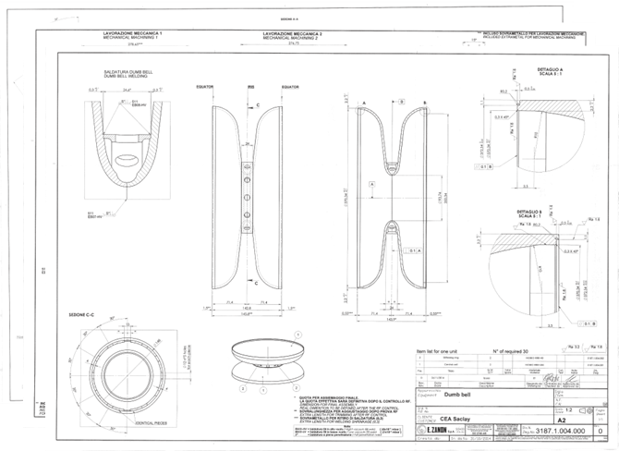
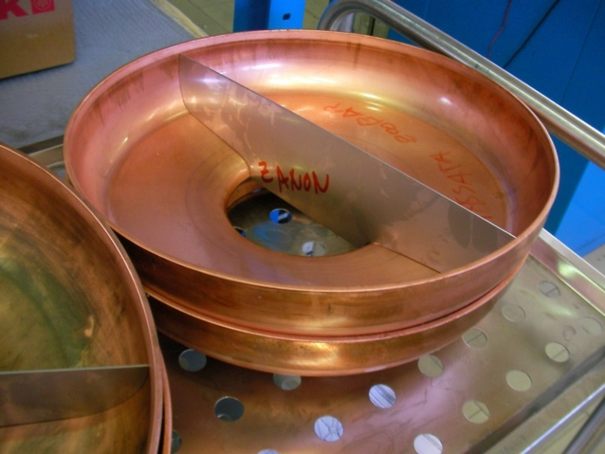
Start of production of the ½ cell for 6 medium beta cavities
6 cavities ordered at ZANON, 4 of them will be integrated into the M-ECCTD cryomodule
Niobium received and sent to ZANON
Deep drawing tests on copper plates
Preparation of RF measurement equipements for half cells and dumbbells

Slide 14
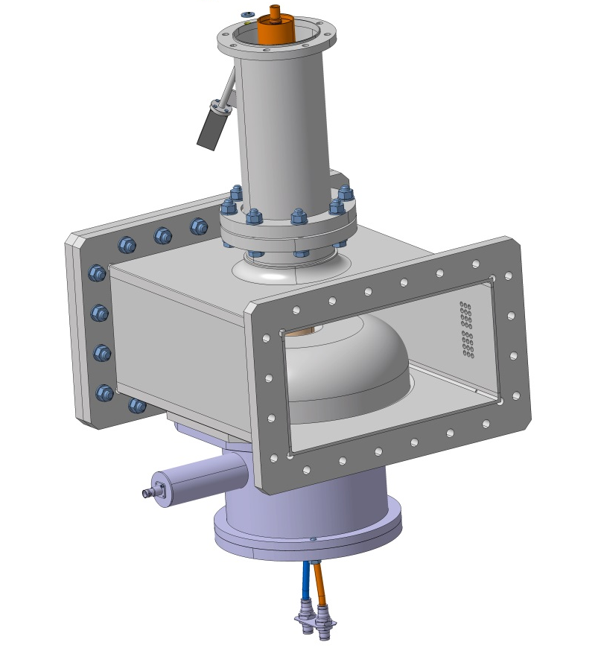


Power coupler procurement in progress
→ For the prototype cryomodules, the coupler procurement is divided into three parts
6 x double wall external conductor
→ 2 companies in tender
8 x RF window+antenna
→ TOSHIBA
6 x Door Knob
→ Spec. in progress

Slide 15
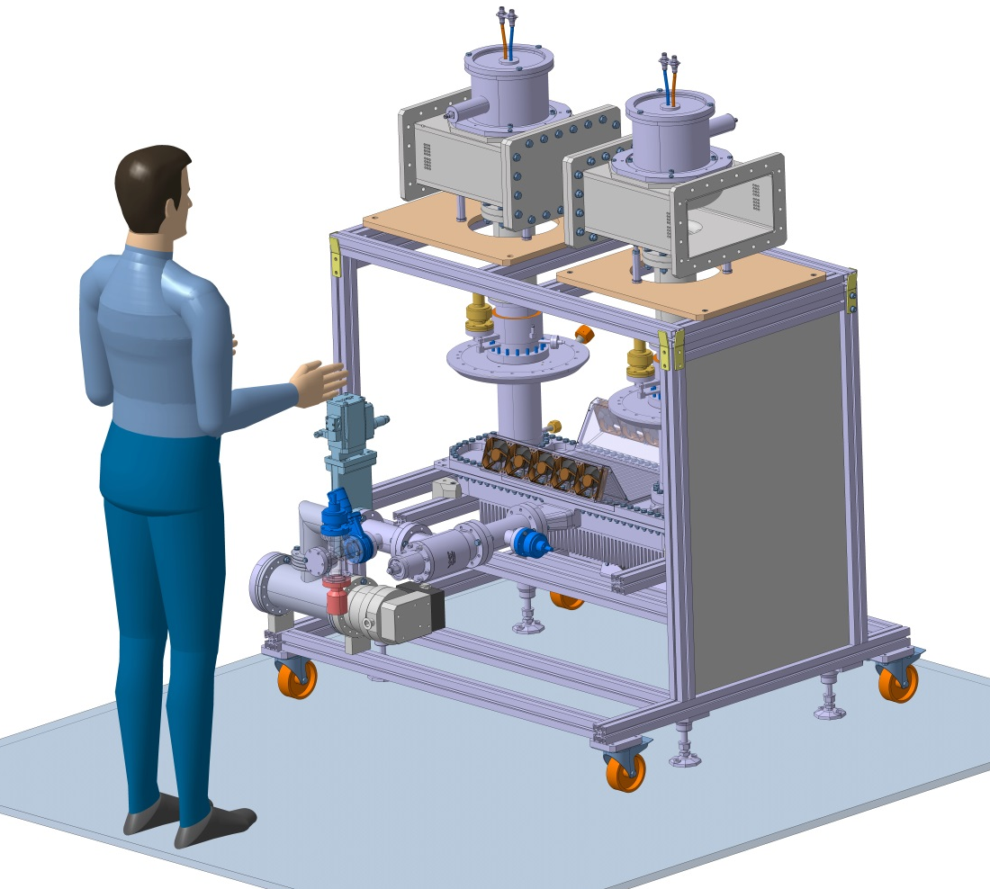
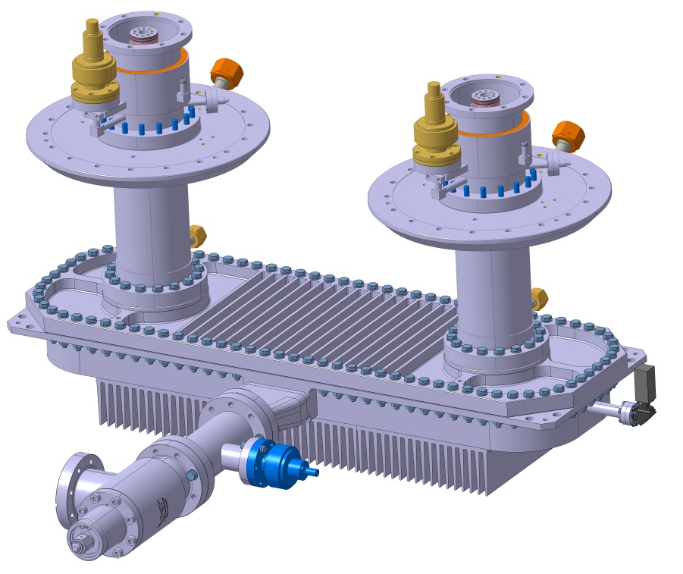
Power coupler conditioning set-up
Assembled in clean room
Tested with a 1.1 MW klystron and variable short circuit / matched load

Slide 16
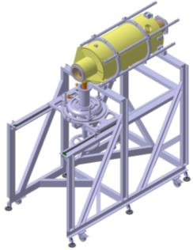
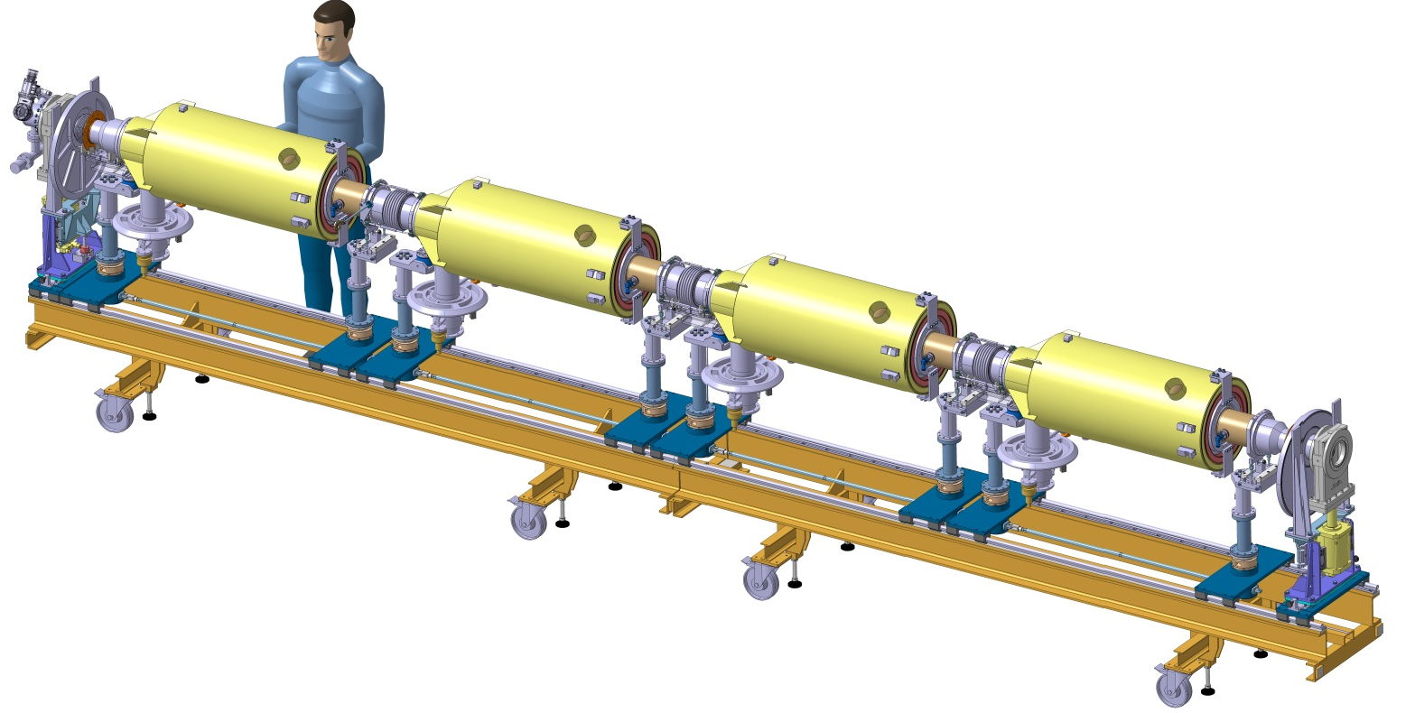
Tooling design finalized for the assembly of the cavity string clean room
Coupler / cavity assembly vertically
Tooling compatible for both cavity types
Adjustment of the coupler position relative to the cavity flange
Cart in two parts with clean room rails
Each cavity is supported by two posts and beam valves on one post
Cavity string put under vacuum for the first prototype
N. Bazin, C. Madec, JP Poupeau, Ph. Hardy, F. Leseigneur

Slide 17
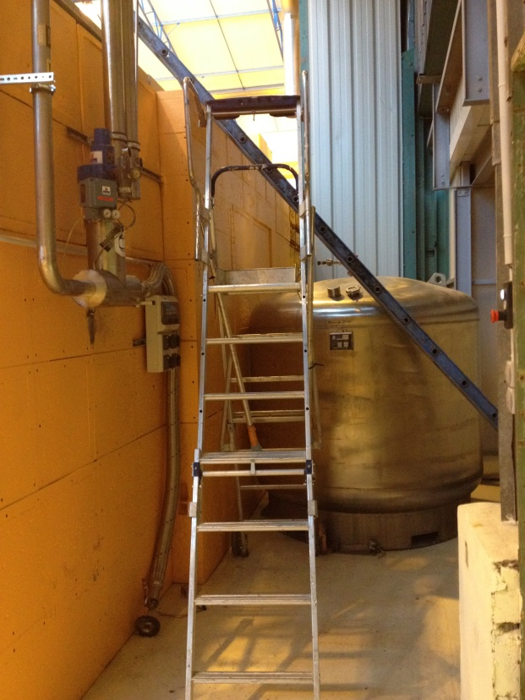
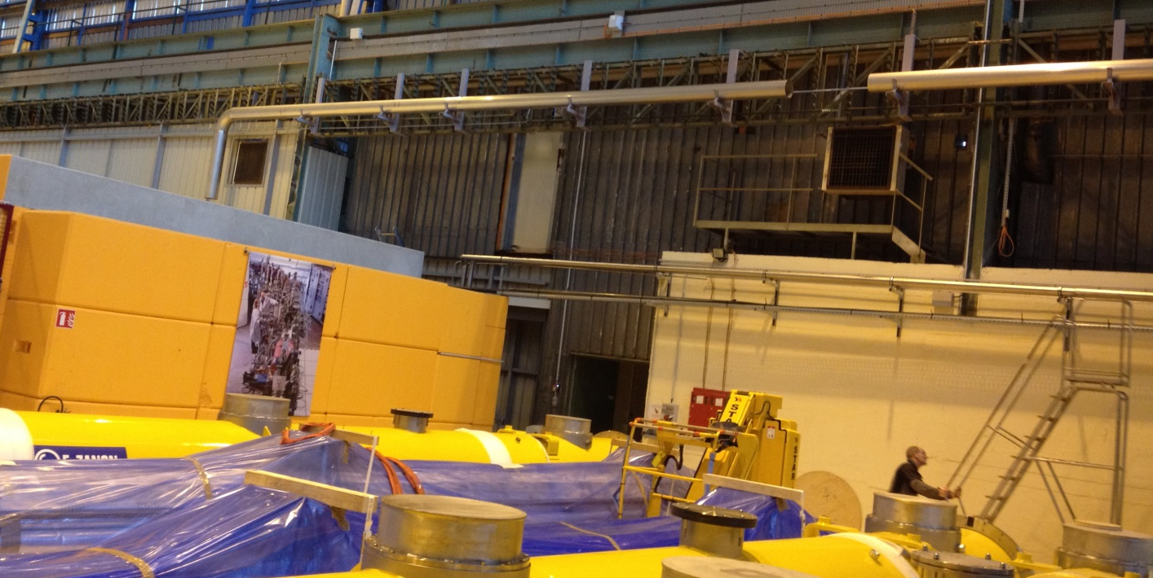
Test stand new cryolines installation
Dewar LHe
2000 L
Test bunker
(cryomodule will be installed inside)
Pumping line DN250
He return line
Cryogenic line
He Supply, 50 m long
(from CERN)
JP Charrier,
P. Sahuquet,
B. Renard

Slide 18
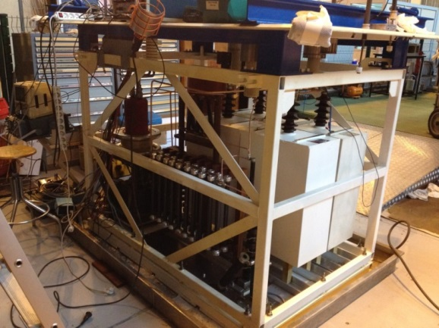
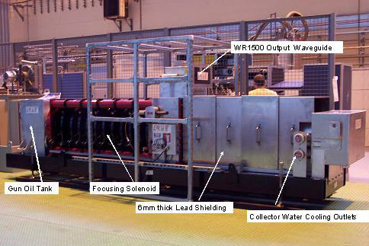
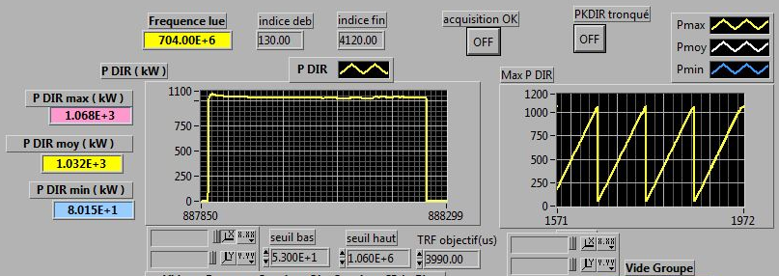
704 MHZ - 1 MW RF power source upgrade
A. Hamdi, M. Desmons, F. Ballester
increase the pulse length from 2 ms to 3.5 ms
C//C’=10µF
(Energie=60,5kJ)
R’//R2=25 Ohms
(tenue: 84kJ)
C’
R’
Additional capacitors and resistances in parrallel on the HV modulator
Conditionning of the CPI 1.15 MW klystron up to the ESS duty cycle was done with success
18

Slide 19

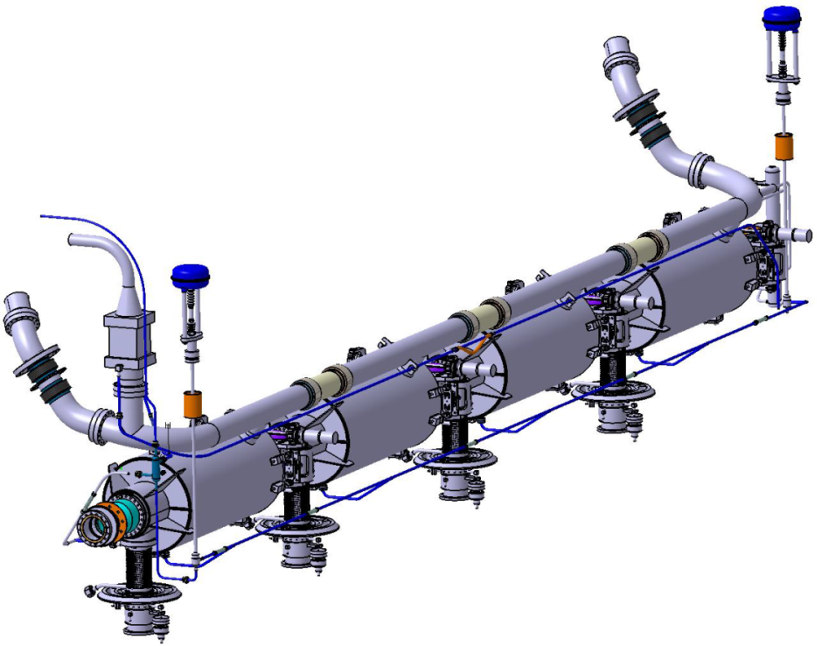
    Compliance with European
    PED 97/23/EC
Cryo pipes designed to reduce the overpressure in case of beam vacuum failure
    TUV Nord analysis report:
    The elliptical cryomodules are classified according to PED article 3.3
2 Φ=100 bursting disks at each extremity
continuous diphasic pipe Φ=100 with large curvatures
    Volumes of the helium circuits and vessels < 50 l
    1,431 bars< Working pressure
    Ps = 1,9 bars

Slide 20
Overall WP5 planning

Slide 21
WP5 planning compliant with RFI dates
P. Michelato Mb cavities
P. McIntosh Hb cavities

Slide 22
Milestones for tendering
Cavity test in vertical cryostat (Nominal performances E_{acc} & Qo)
  Required prior tendering for niobium production for series
    Test of the 1st medium beta cavity scheduled on 01 October 2015
    OK for High beta cavities: 2 prototypes already tested
RF power tests at 2K of the ECCTD + Critical Design Review
  Required prior tendering cavities , couplers and all components of the cryostats
    M-ECCTD: CDR on the 23/12/2016 => Mβ cavities + couplers + cryostats
    H-ECCTD: CDR on the 13/10/2017 => Hβ cavities only needed
CDR (Critical Design Review) ~ Production Readiness Review

Slide 23
Planning main assumptions made to reach the goal of the RFI dates for MBL
Success oriented planning to match the ESS schedule: no margin, assumed no non-conformity for all cavities, couplers and components;
The first results of the M-ECCTD are successful and the series production of Mβ cavities, power-couplers and cryostat components are launched 2 weeks later (CDR). This implies that the tendering is finalized, the contracts are awarded at the time of CDR and the series fabrication starts;
Rate of cavities production and delivery at Saclay after RF test: 3/month (Mβ & Hβ cavities);
Delivery of the 1st serial cavity tested and qualified 6 months after the start of the cavity production; (required previous preparation by LASA and STFC of the industry and labs for cavity production, cavity treatments and cavity tests)
Rate of the coupler RF processing = 4 couplers/month will be confirmed end of 2015 (ECCTD couplers);
Rate of the cryomodules assembly:
    1st cryomodule: 4 months
    2nd & 3rd : 2 month / CM
    4th to 9th: 1 month/CM
The RF test stand at Lund shall be fully operational for the 1st cryomodule (Q1 2018) and the testing rates are:
    1st cryomodule: 2 months
    2nd & 3rd : 1,5 month / CM
    4th to 9th: 1 month/CM
    The cryomodule assembly in Saclay by the new industrial team is qualified after the test of the 1st cryomodule.
    The 2nd and 3rd cryomodules need to be assembled before the end of the tests of the 1st cryomodule.

Slide 24
Overall WP5 planning
M-ECCTD CDR review decision
H-ECCTD CDR review decision
1) Mb cavities contract awarded
1) Hb cavities contract awarded
RF power source ready for coupler processing
2) Power couplers contract awarded
Cryomodule components contract awarded
Planning Ready For Installation OK with ESS schedule:
03/09/18 => 02/05/19 1CM/month
Planning Ready For Installation OK with ESS schedule:
Q1 + Q2 2021: installation of HBL n° 1 to 11
Q1 + Q2 2022: Installation of HBL n° 12 to 21

Slide 25
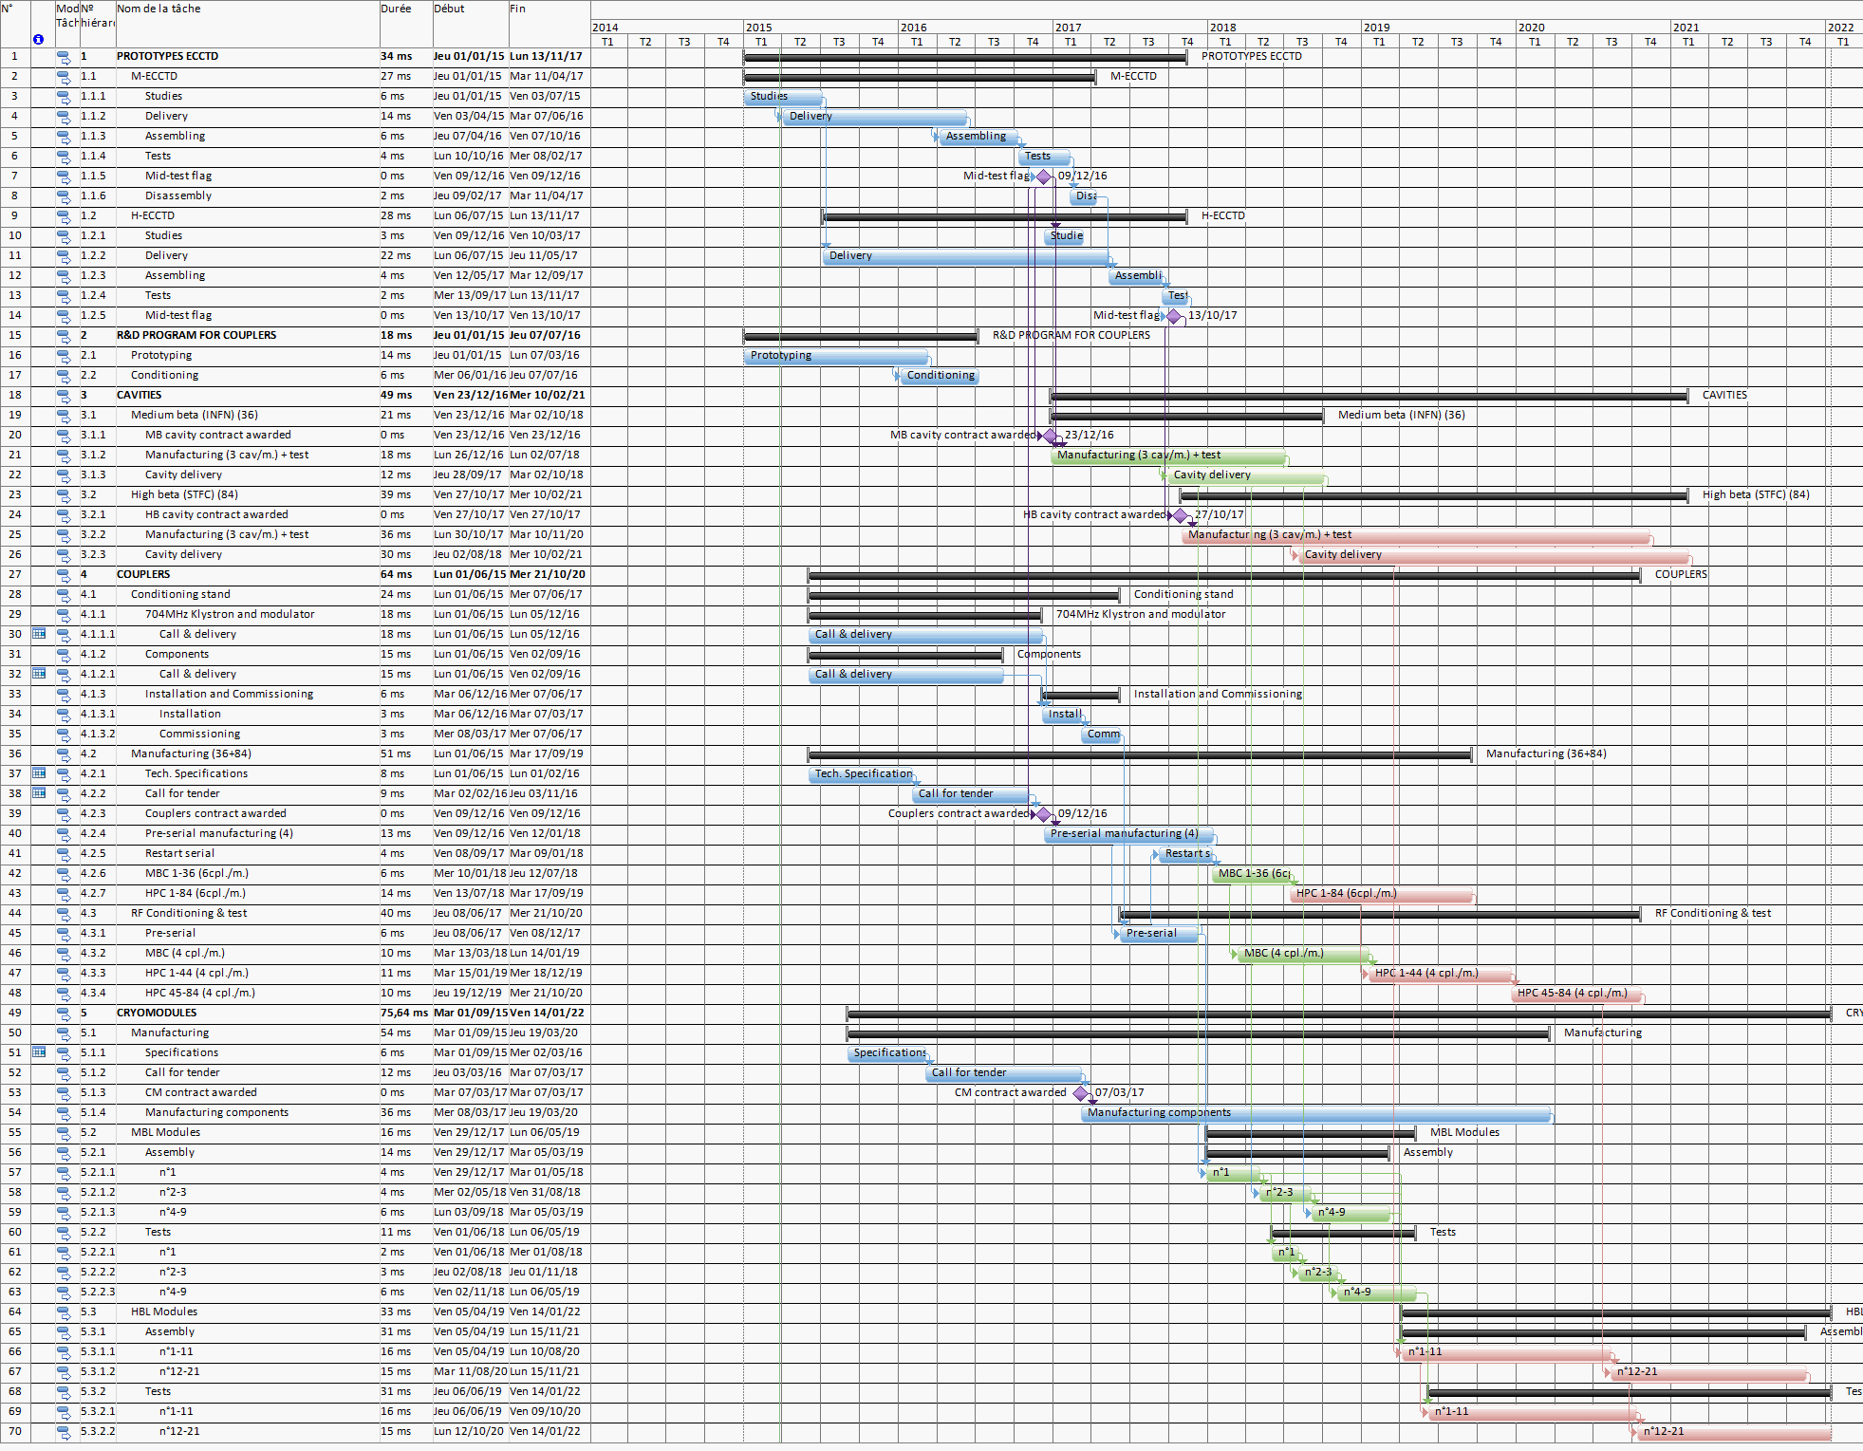

Slide 26
Conclusion
The design of the elliptical cavities and cryomodules complies with the ESS requirements.
The prototype cryomodules M-ECCTD and H-ECCTD will validate the design.
The preliminary planning for the design/prototyping and for the production of the elliptical cryomodules has been proposed in compliance with the RFI dates.
This planning is success oriented with major risks identified
The coordination between the In-Kind partners has to be quickly placed to start the work as soon as possible:
  Coordination between CEA, CNRS, INFN, STFC and ESS
We have to established a "partnership of ESS with INFN and STFC, which will permit to make use of the best European competences in the field of SRF".

