Slide 1
Classification
Primary Water Systems
Sorting Equipment to Ensure Adequate Quality for Radiologic Safety
Per Nilsson
Håkan Carlsson
www.europeanspallationsource.se
Apr 01, 2015

Slide 2
Classification
Actions;
We have to …
Requirements
System/Component
Classes
Req 1
Req 2
…
Action 1
Action 2
…
Sys X
Class A
Req 1
Req 2
…
Action 1
Action 2
…
Sys Y
Class B
Sys Z
Class C
Req 1
Req 2
…
Action 1
Action 2
…
Classification
Process
Criteria
References
to standards
Iterations

Slide 3
Safety Classification / Quality Classification
SSMFS 2008:17
This explains the sub-classification: Quality Class
SSM 133285 Special conditions for ESS
This is the requirement for
Mechanical Quality Class
Notes:
SSMFS 2008:17 - Application from ESS to SSM

Slide 4
ESS Safety Functions - ESS-0016468

Slide 5
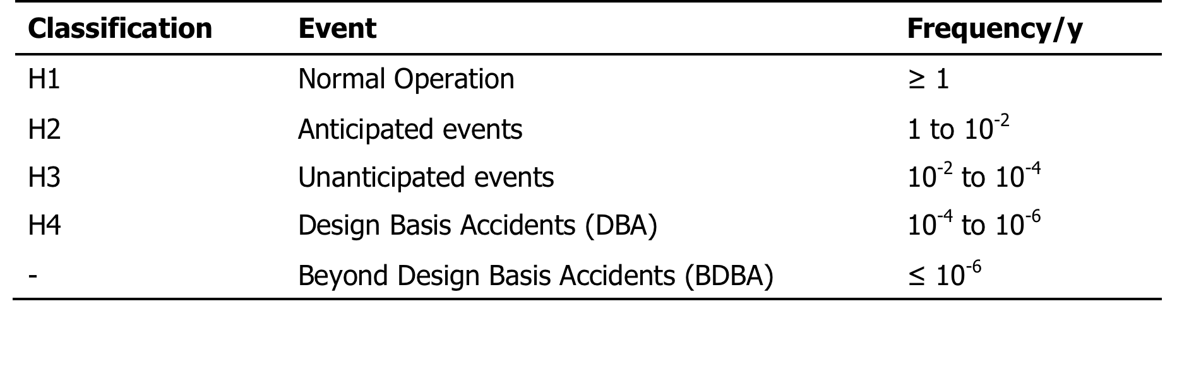
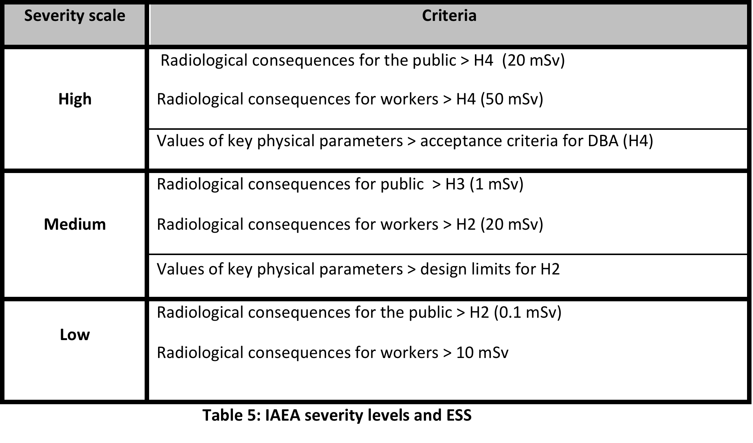
ESS Severity Scale & Event Classification

Slide 6
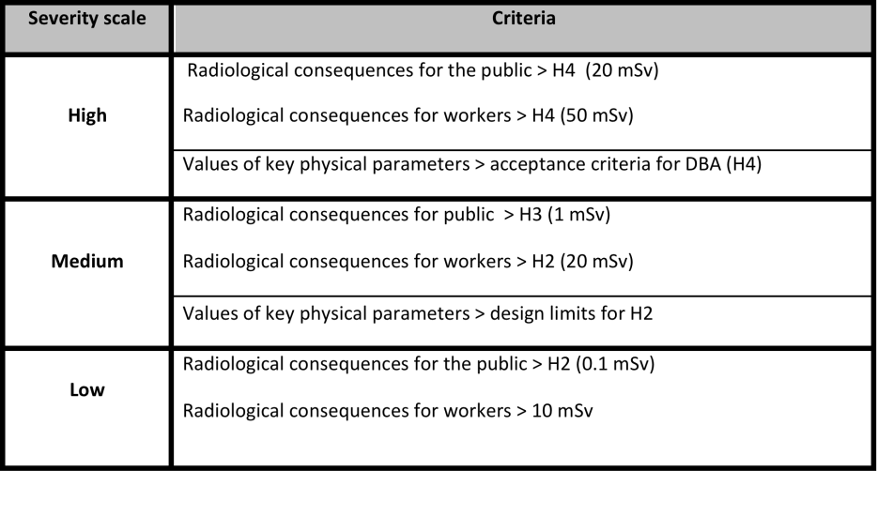
Function categorization example
Events relating to
e.g. Reflector
Water Cooling
Safety function Category
Event 1
ESS-0016468 Classification Guide
SaF C2
Event 2
Event 3
This is a category of a function,
not the system!
Event N

Slide 7
Deriving (nuclear safety) requirements for classes
Systems/
Components
Design/define the systems and context
Risks - Events
Define (enveloping) events
and frequency (H1-H5)
Event
Consequences
Calculate dose consequences
of events (H1-H5)
Safety
Function
Determine and categorize
safety functions to prevent events (SaF)
Actions:
(QA, Procedures)
Analysis
Materials
Manufacturing
Installation
Inspection
Testing
etc
Safety
Class
Determine safety classification
of equipment (SIC)
Quality
Class
Determine quality classification of equipment in disciplines, e.g. mechanical
Code
Class
Choose classification in the codes and standards within the disciplines

Slide 8
Classification: Deriving (nuclear safety) requirements for each system
Systems/
Components
Design/define the systems and context
PBS
Modes
We have the green
Blue are in work
Risks - Events
Define (enveloping) events
and frequency (H1-H5 probab.)
HAZOP
GSO
Event
Consequences
Calculate dose consequences
of events (H1-H5 criteria)
Inventories
Release
Factors
Conversion
Factors
Safety
Function
Determine and categorize
safety functions to prevent events (SaF)
Rules for SaF & SIC
Actions:
(QA, Procedures)
Analysis
Materials
Manufacturing
Installation
Inspection
Testing
etc
Safety
Class
Determine safety classification
of equipment (SIC)
SSM
Conditions
Quality
Class
Determine quality classification of equipment in disciplines, e.g. mechanical
Codes, e.g. RCC-MRx
Code
Class
Choose classification in the codes and standards within the disciplines

Slide 9
From Events to Code Classes
Severity of Event
(at failure
of function)
Safety Function
(for system
to fulfill)
Safety Class
(of system
or part)
Quality Class
(of part in
discipline)
Code Class
(requirements
on part)
Preventing
loss of integrity
> H4
SaF C1
SIC 1
1
N1_{MR}
> H3 public
> H2 workers
SaF C2
SIC 2
2
N2_{MR}
> H1
SaF C3
SIC 3
3
N3_{MR}
This figure is simplified!
There are other additional criteria, requirements and options
Notes:
Explain Criteria, Requirements, Options

Slide 10
From Events to RCC-MRx Code Classes
Severity of Event
(at failure
of function)
Safety Function
(for system
to fulfill)
Safety Class
(of system
or part)
Mechanical
Quality Class
RCC-MRx
Code Class
> H4
SaF C1
SIC 1
1
Preventing
loss of integrity
> H3 public
> H2 workers
SaF C2
SIC 2
2
N2_{MR}
> H1
SaF C3
SIC 3
3
N3_{MR}
This figure is simplified!
There are other additional criteria, requirements and options
Notes:
Diversifying, Redundancy ….?

Slide 11
From Events to Ventilation Quality Class
Severity of Event
(at failure
of function)
Safety Function
(for system
to fulfill)
Safety Class
(of system
or part)
Ventilation
Safety Quality
> H4
SaF C1
SIC 1
VSQ
> H3 public
> H2 workers
SaF C2
SIC 2
Code?
> H1
SaF C3
SIC 3
VNQ
Code?

Slide 12
Deriving (nuclear safety) requirements for classes
Plant Breakdown Structure (PBS) and Modes exist
HAZOP exist (for moderators and reflectors,
shielding is planned, purification will be)
→ Events can soon be postulated
Release Factors and Inventories in water are only estimated
Conversion Factors exist
→ Consequences can soon be calculated

Slide 13
Deriving (nuclear safety) requirements for classes
SaFs and SICs cannot be stringently derived
without events and consequences.
→ The SICs do however
depend strongly on the severity of the events.
That can be estimated before the derivation.
It means taking a risk to make a wrong classification!

Slide 14
Deriving (nuclear safety) requirements for classes
RCC-MRx chosen for safety components Choosing code class (in RCC-MRx) gives range of requirements, e.g. QA, in European framework
RCC-MRx does not guide, but points up to a French order for reactors and European directives for pressure equipment.
The French order points explicitly to some specific parts of reactors, but also contains some qualitative and actually one quantitative criterion!

Slide 15
Conclusion:
Code Class for Primary Water Systems
Class not decided yet
RCC-MRx:
  Many procedures and documents are the same as PED
  (Pressure Equipment Directive, Swedish Law)
→ No waste (yet) in applying RCC-MRx N3_{MR}
Notes:
Bra hjälp med dokumentation, analyser etc, men QC-krav kan bli omfattande ! AK styrs mest av SSM krav !!

Slide 16
RCC-MRx
General Documents
General Section III:
RA 3000 Documents to be Prepared in application of Section III
RA 3100 Equipment Specification
RA 3200 General Technical Documents
RA 3210 Comprehensive Layout and Referencing Documents
RA 3220 Components Part List
RA 3230 Description of Fabrication Shops
RA 3300 Documents Relating to the Design
RA 3310 Design and Calculation Reports – Design Report
RA 3400 Documents Relating to Procurement
RA 3410 Technical Part and Product Manufacturing Programme
RA 3420 Part or Product Sub-Purchase
RA 3430 Part or Product Procurement Test Report
RA 3500 Documents Relating to Fabrication Processes
(other than welding)
RA 3510 Fabrication Procedures or Instructions
RA 3600 Welding Documents
RA 3610 Welding Data Package
RA 3620 Filler Materials Acceptance Documents
and Welding Procedure Documents
RA 3630 Welding Reports
RA 3700 Documents Relating to Examinations and Tests
RA 3710 Examination and Test Procedures or Instructions
RA 3720 Examination and Test Reports
RA 3730 Hydrostatic Test Reports
RA 3800 Non-Conformance Report and Deviation Report
RA 3900 Technical Preparation, Follow-Up
and Final Report Documents
RA 3910 Follow-Up Documents
RA 3920 Certificate of Compliance
RA 3930 End-of-Manufacturing Report
Section I General RCC-MRx:
RDG 3000 Documents to be Prepared
RDG 3100 Equipment Specification
RDG 3200 General Technical Documents
RDG 3210 Comprehensive Layout
and Referencing Documents
RDG 3220 Components Part List
RDG 3230 Description of Fabrication Shops
RDG 3300 Non-Conformance Report and Deviation Report
RDG 3310 Non-Conformance Report
RDG 3320 Deviation Report
RDG 3400 Technical Preparation, Follow-Up
and Final Report Documents
RDG 3410 Follow-Up Documents
RDG 3420 Certificate of Compliance
RDG 3430 End-of-Design and Manufacturing Report

Slide 17
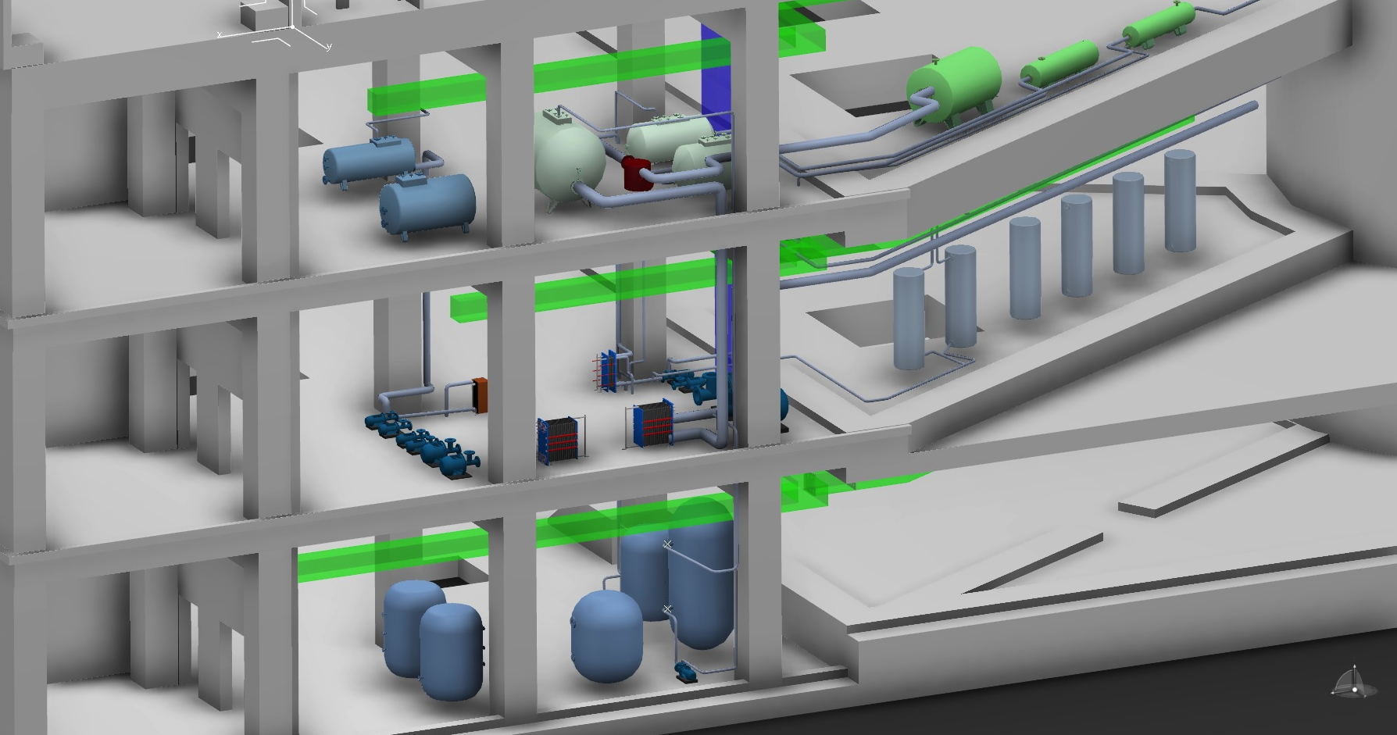
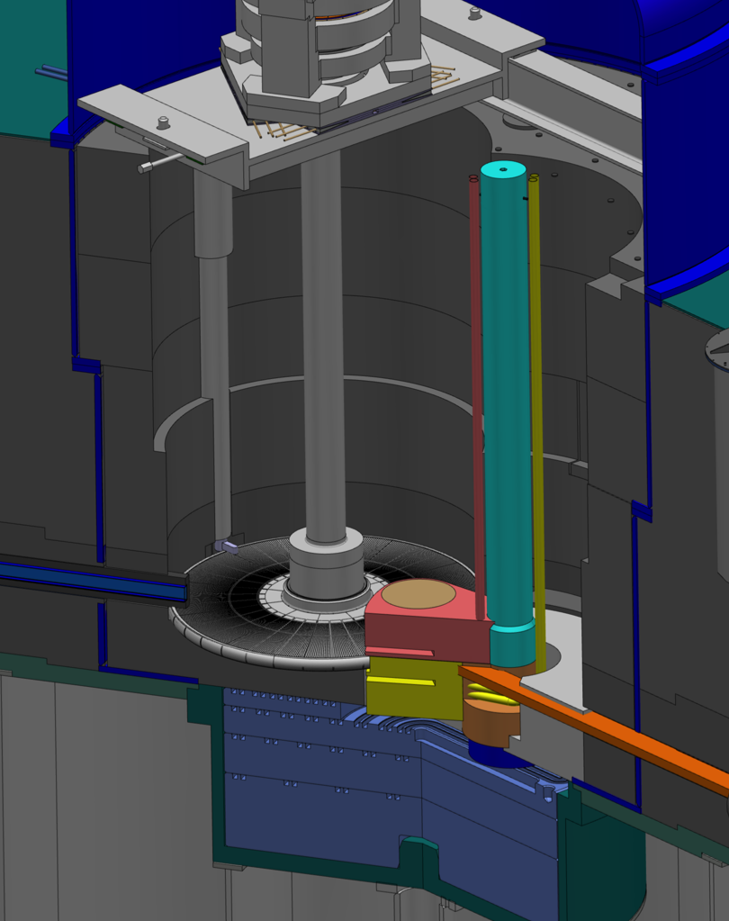
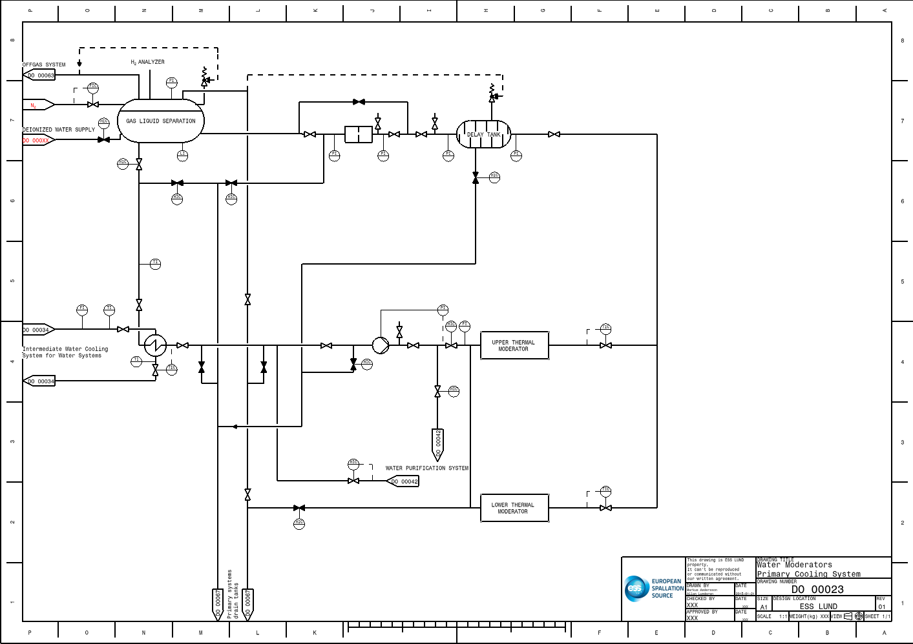
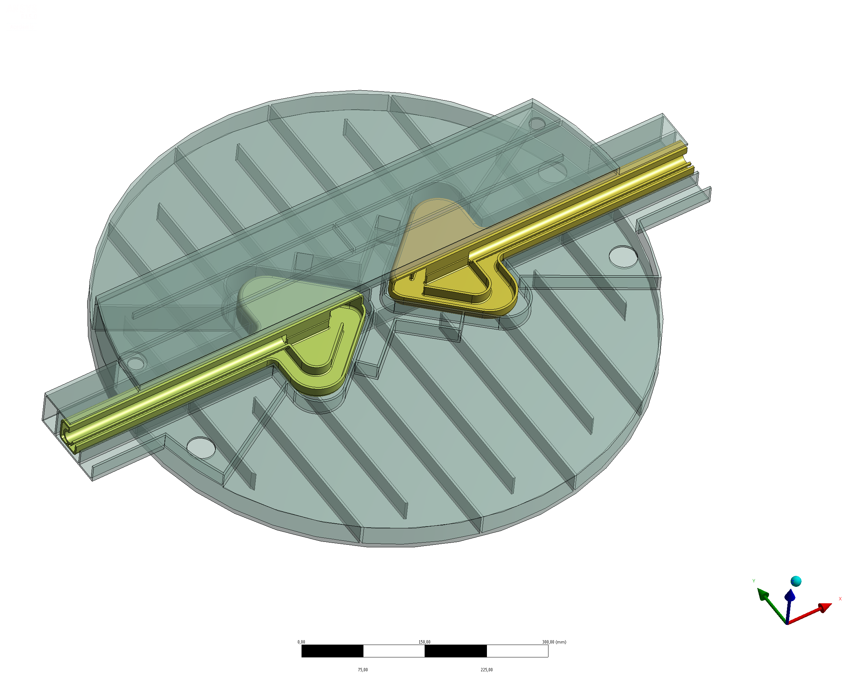
Water moderator system

Slide 18
Risk Analysis

Slide 19
Events with unmitigated consequences
Event
T1.4.1 circuit rupture inside the monolith
T1.4.2 circuit rupture inside the connection and utility rooms
T1.2.5 leak into/from the intermediate cooling loop
T1.2.5 leak into radioactive effluent circuit and into N2 supply
T2.2 stoichiometric combustion of (H2/D2)-O2
T2.3. temperature decrease

Slide 20
Events with unmitigated consequences
Event
T1.4.1 circuit rupture inside the monolith
T1.4.2 circuit rupture inside the connection and utility rooms
‘T1.2.5 leak into/from the intermediate cooling loop
T1.2.5 leak into radioactive effluent circuit and into N2 supply
T2.2 stoichiometric combustion of (H2/D2)-O2
T2.3. temperature decrease
Chain of events:
Complete break before heat exchanger
Water (~30C) runs out from GLS-tank and Delay-tank (~1m3)
Most runs to floor drains
Smaller fraction (adiabatic saturation in air ~4g/m3) is ventilated
The room is ventilated (300m3/h -> 1.2 kg/h) for one hour -> 1.2 kg

Slide 21
Release for that specific event
Inventory 5 GBq ³H / kg (SNS & SINQ ~1 GBq / kg)
Release 1.2 kg -> 6 GBq
ESS-0003690 (unplanned) / ³H :
0.44mSv/3.2PBq * 6 GBq = 0.8 nSv
< 0.1 mSv -> No SaF!
Have to check other events and worker impact too!

Slide 22
t-TAC Committee
“Are the proposed safety classification and TSS approaches sensible and likely to define a path towards safe operation of the ESS Target Station?”

