Slide 1

European Spallation Source
Overview and Status
Technical Advisory Committee
1-2 April 2015
James H. Yeck
ESS CEO & Director General
www.europeanspallationsource.se

Slide 2
















Financing includes cash and deliverables
Host Countries of Sweden and Denmark
47,5% Construction
15% Operations
In-kind Deliverables ~3%
Cash Investment ~97%
Non Host Member Countries
52,5% Construction
85% Operations
In-kind Deliverables ~ 70%
Cash Investment ~ 30%

Slide 3
Construction contributions (2015)
Sweden | 35.0 %
Denmark * | 12.5 %
Germany * | 11.0 %
United Kingdom | 10.0 %
France | 8.0 %
Italy | 6.0 %
Spain * | 5.0 %
Switzerland | 3.5 %
Norway | 2.5 %
Poland | 2.0 %
Czech Republic | 2.0 %
Hungary | 1.5 %
Estonia | 0.25 %
Latvia | tbd (0.25)
Netherlands | tbd (3.0)
Lithuania | tbd (0.25)
Iceland | tbd (0.25)
Belgium | tbd (3.0)
Greece | tbd (1.0)
Total | 100.0 %
* Includes Pre-construction Costs

Slide 4
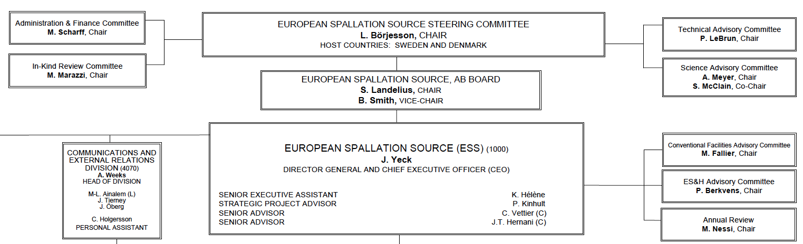
ESS AB to transition into European Research Infrastructure Consortium (ERIC)
European Spallation Source
Council
Hosts Sweden and Denmark, Spain, Hungary, and Norway (observer) applied to establish a European Research Infrastructure Consortium (ERIC) for ESS. Member countries will join. EC approval expected in May 2015. ESS STC meeting planned for 7-8 April and ERIC Council 2-3 July 2015.
ERIC Council will replace Steering Committee in mid 2015. ESS AB (Swedish Corporation) assets and liabilities transfer to the ERIC.

Slide 5
2015 priorities
  Establish In-kind agreements
  Complete transition from ESS AB to the ERIC organisation
  Recruit directors for neutron scattering systems and administration
  Demonstrate that schedule drives decision-making (project culture)
  Complete successful Annual Review (21-24 April)
  Resolve open design requirements and establish effective technical coordination activity
  Prepare application for regulatory license required for installation

Slide 6
Project execution strategy
Deliver on the Technical Design Report performance and Steering Committee commitments
  5 MW accelerator capability
  Construction cost of 1,843 B€₂₀₁₃
  Operations cost target of 140 M€₂₀₁₃ per year
  22 “public” instruments
Technical schedule with credible execution plans unconstrained annual funding profile
Comprehensive annual project reviews assessing progress against the baseline and execution plans
Secure funding and resources to maintain schedule

Slide 7
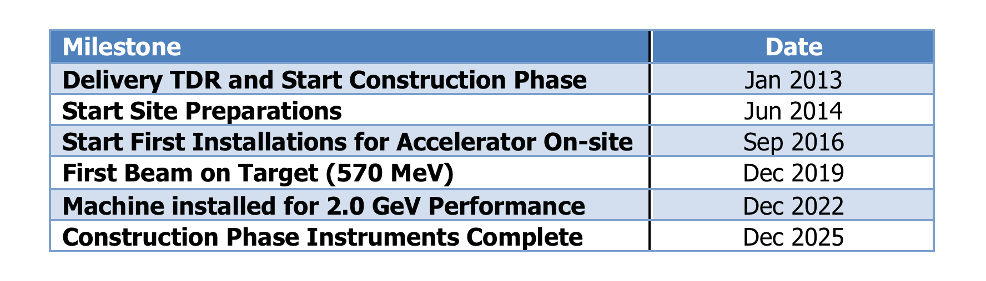
ESS Schedule Baseline – External Milestones

Slide 8
Risk and project execution strategies (1)
Project execution strategies are primarily motivated by the goal of delivering the facility in line with the construction and operations cost targets
Green field site leads to an emphasis on schedule and in-kind goals
Construction schedule driven by goals of producing neutrons by the end of 2019, completing the installation of the facility by end of 2022, and installing/commissioning instruments on a technically limited schedule
  Resource loaded schedule used for planning and schedule tracking
  Aggressive schedule with six months float on the critical path milestone of neutrons by the end of 2019
  Major schedule risks are delivery of contributions by In-kind partners and installation, integration, and commissioning uncertainties
  Schedule performance today protects schedule flexibility tomorrow!

Slide 9
Risk and project execution strategies (2)
Cost derived from defined scope, cost book values, and completion milestones
  Resource loaded schedule used for cost performance tracking and measurement, excluding In-kind
  10% contingency budget on cost book values is obviously low, requiring additional strategies to increase flexibility for addressing risk of additional costs (CF risk w/ host countries, NSS fixed budget, Machine scope contingency)
  Major cost risk factors include cost of schedule delays (green field site) and maintaining a shared commitment by member countries to partners to cost goals and cost book values
Major emphasis on schedule performance and reserving contingency and flexibility
  Establishing contracts for in-kind “deliverables” at cost book values and schedule
  Securing funding and resources to maintain schedule

Slide 10
ESS In-kind Goals
Construction cost: € 1,84 Billion
In-kind: € 750 Million
€ 509 M
€ 350 M
75%
65%
€ 155 M
€ 71 M
65%
59%
Controls
Target
Instruments
Accelerator

Slide 11
ESS Neutron Scattering Systems Instruments Delivery Organization
Science Advisory Committee
STC / ERIC Council
In-kind Review Committee
ESS Director General
Director for Science
NSS Project Leader
Instruments Collaboration Board
Chair: Director for Science
STAP / TAPs
In-kind contracts
NSS Project
Management and Project Reporting
Collaboration Management and Reporting
In-kind contract workflow
Advisory
Key
Science Support (SS)
Instrument
Technologies (IT)
DMSC
Instrument
Projects
Instrument Consortium 1
Instrument Consortium 2
Instrument Consortium n
In-Kind SS
In-Kind IT
In-Kind DMSC

Slide 12
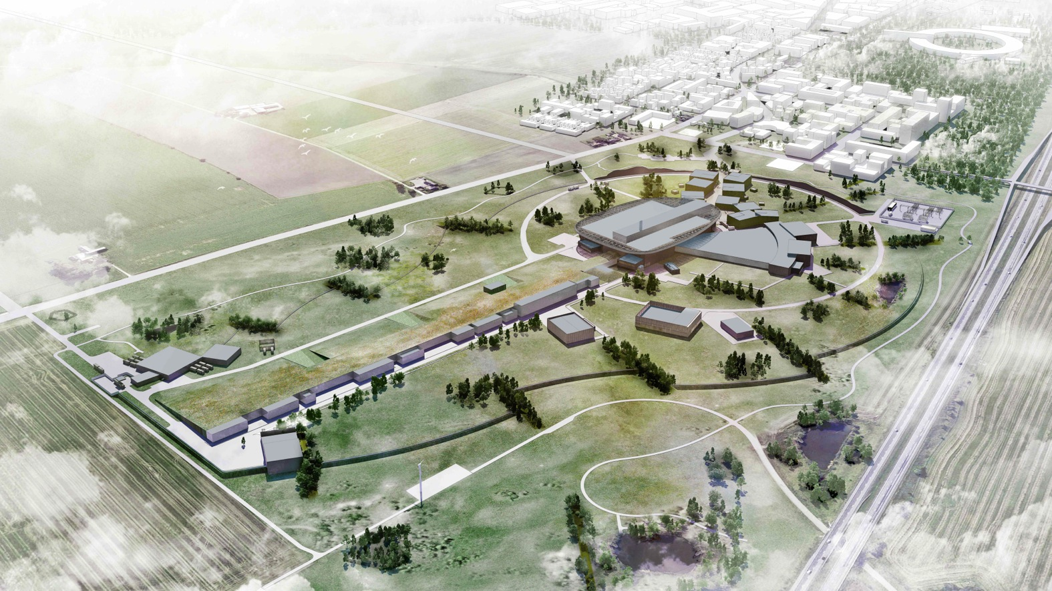
ESS looking towards MAX IV

Slide 13
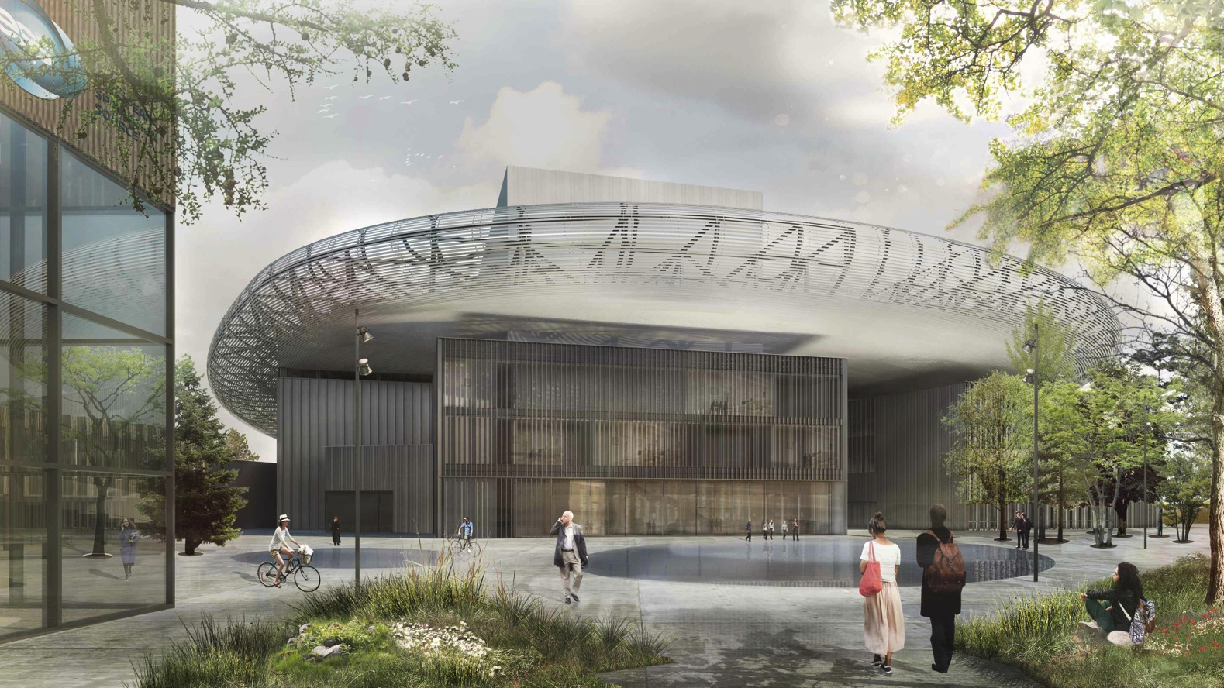
ESS target building

Slide 14
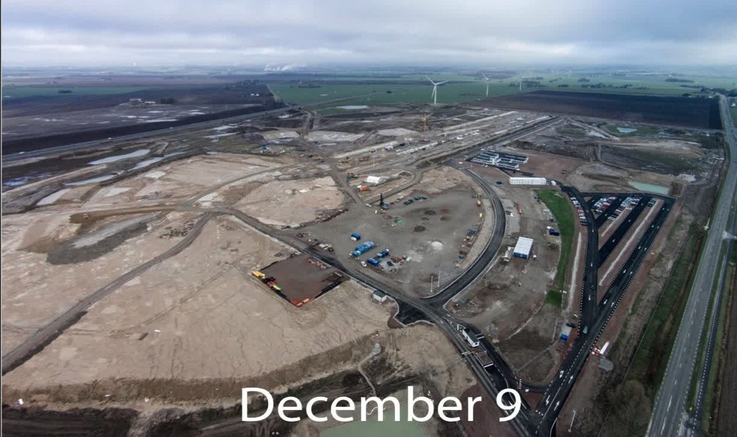

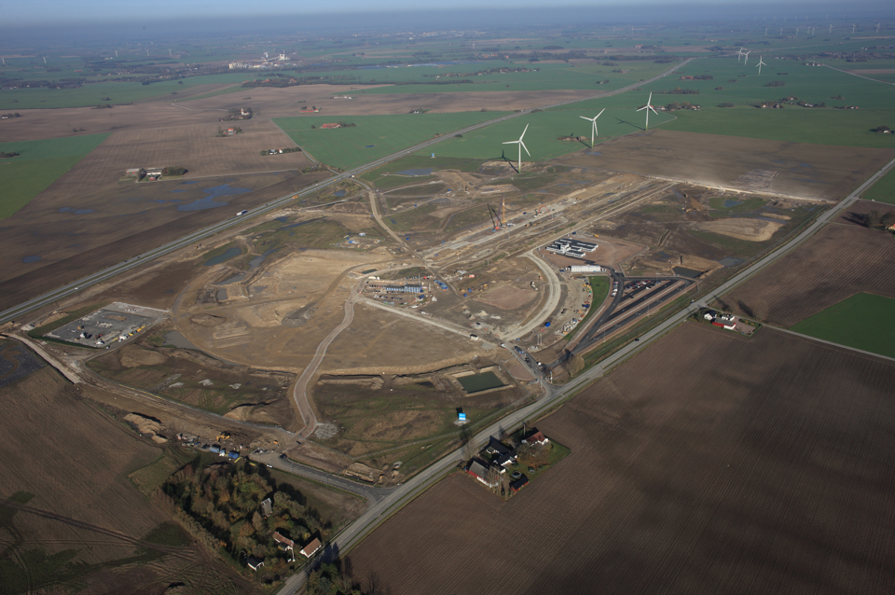
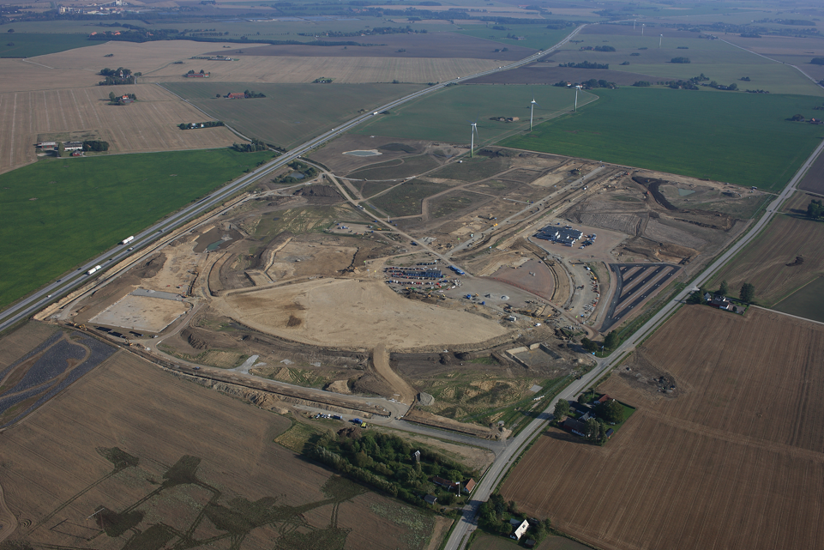
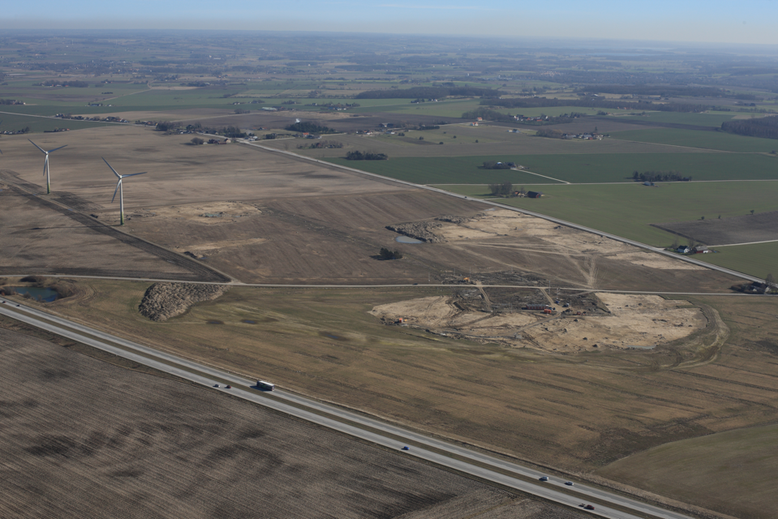
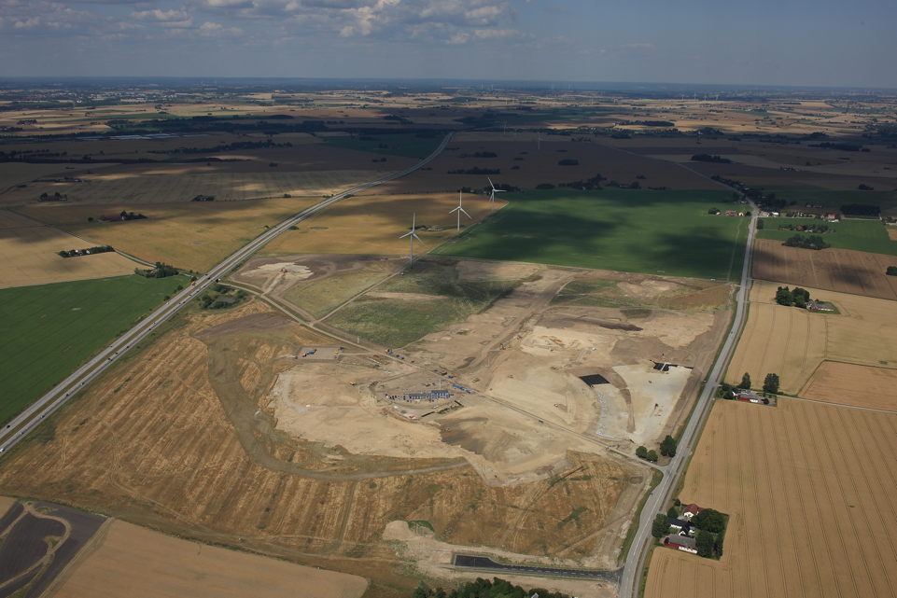
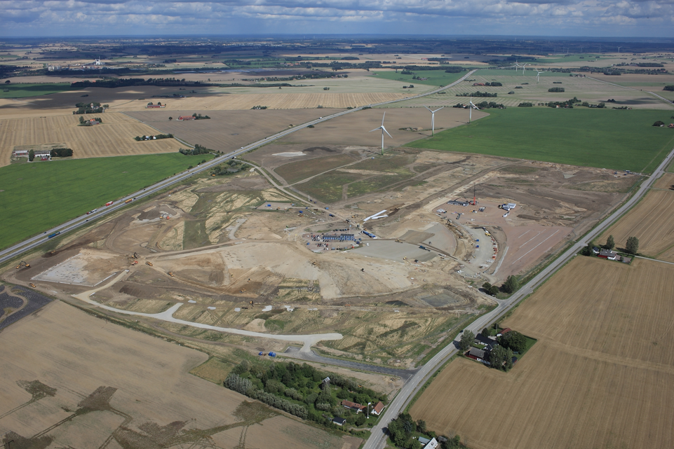
Civil construction progressing on schedule
August
July
November
October
September
First Casting December 2

Slide 15
ESS construction project status

Slide 16
ESS – Planned value vs potential (gap)

Slide 17
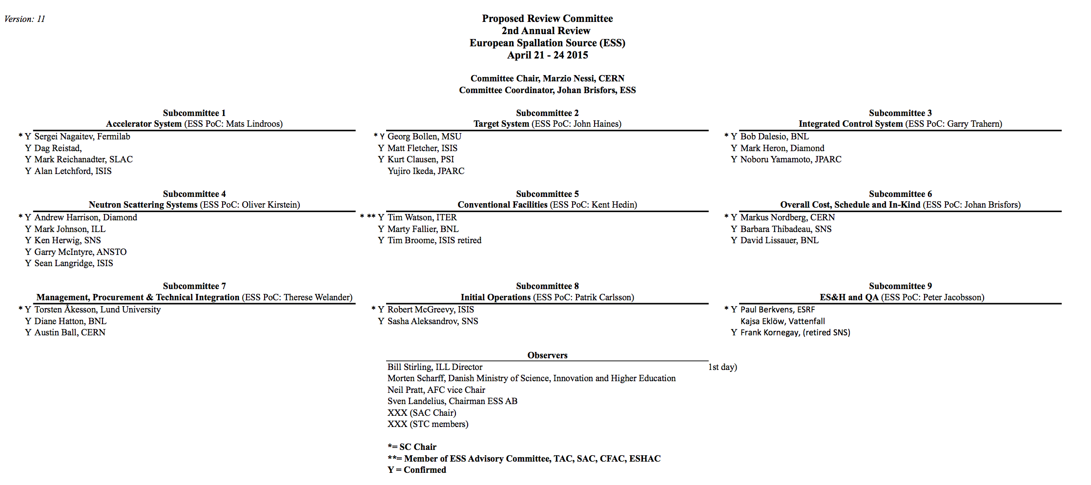
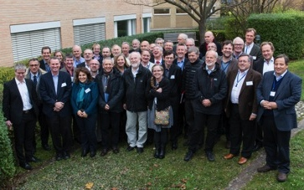
2nd annual project review 21-24 April 2015

Slide 18
2nd annual project review committee charge
The review will assess general progress with increased emphasis on the project schedule.
Committee Charge
1.1 Is the scope of work adequately defined and do plans include activities necessary to deliver the facility, including a reasonable breakdown of requirements and provision for design reviews and verification activities?
1.2 Is the schedule consistent with the major construction project external delivery dates* and are the assumptions used for the schedule complete and reasonable?
1.3 Are in-kind deliverables and procurement contracts, including long lead items and procurements requiring R&D, properly identified and sufficiently planned and managed?
1.4 Is the transition from the Construction Phase into the Initial Operations Phase clearly and appropriately defined?
1.5 Are the risks and risk responses relevant and complete?
1.6 Does the organization match the needs of the construction project? Is the current staffing level and competencies appropriate to support the construction project?
1.7 Identify major issues that must be addressed in order to successfully deliver ESS and take the facility into operation. Are there clear definitions of the project completion milestones describing a minimum level of performance?
1.8 Are the plans for host laboratory support functions (HR, IT, Legal, Finance, etc.) adequate to support the construction project? Is the transition from the ESS AB to ESS ERIC organisation sufficiently planned and managed?
1.9 Are the plans for managing the regulatory permitting adequate for this stage of the project?
1.10 Are the Safety, Health and Environment and Quality Assurance aspects being properly addressed given the project’s current stage of development?

Slide 19
Summary
  Excellent progress informed by advisory committees and reviews
  Major emphasis continues on in-kind, both framework (process and contracts) and collaboration (substance and partnerships)
  Conventional facilities design and construction requirements continuing to set the overall pace of the project
  Progress hiring experienced staff with over 300 employees representing 40 nationalities
  Keeping to the schedule is the most cost effective means to constructing the facility and is a major emphasis for the project teams

