Slide 1
Introduction and Charge
for the 11th TAC meeting
1-2 April 2015, Lund
Roland Garoby
https://indico03.esss.lu.se/indico/event/298/

Slide 2
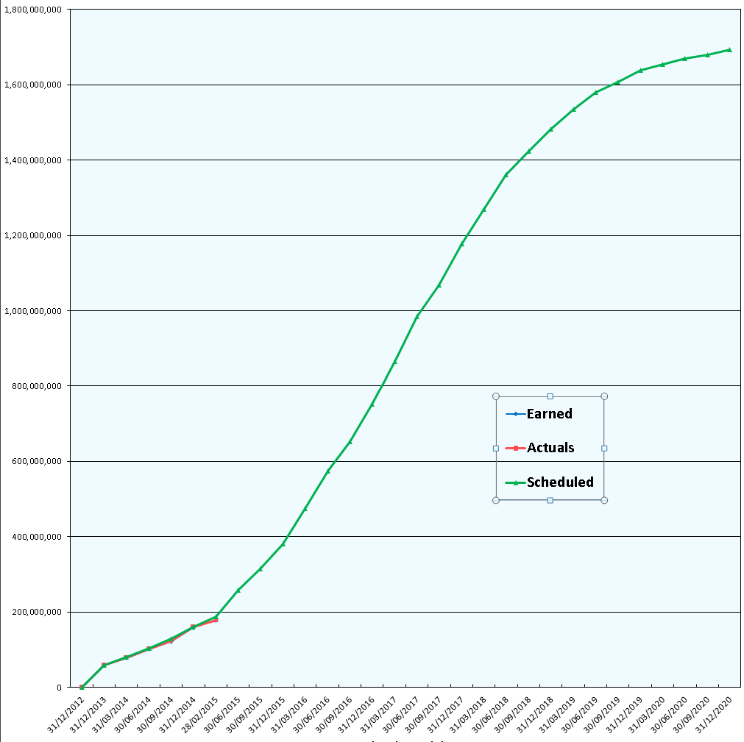
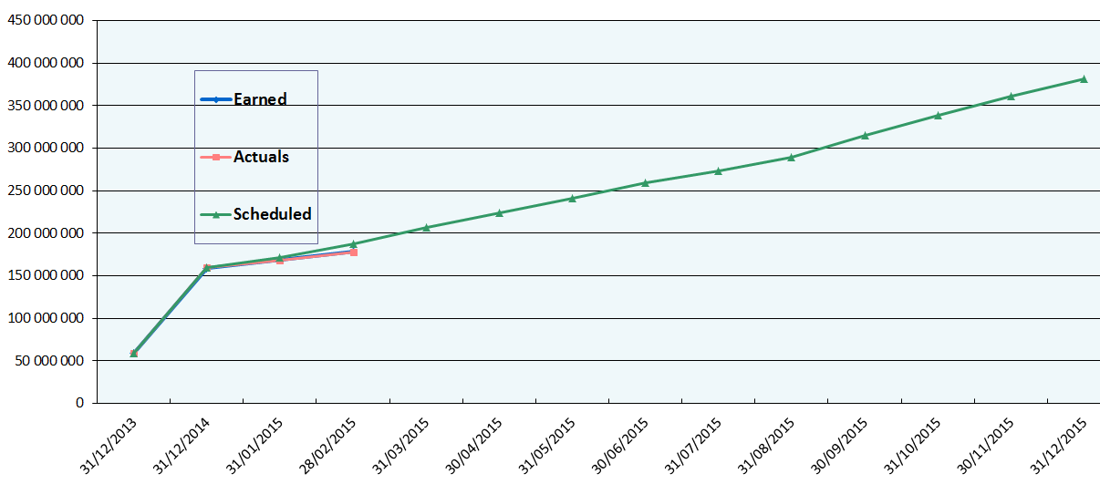
ESS is progressing in EVM…
Scheduled: 187.8
Earned: 178.5
Actuals: 177.8

Slide 3
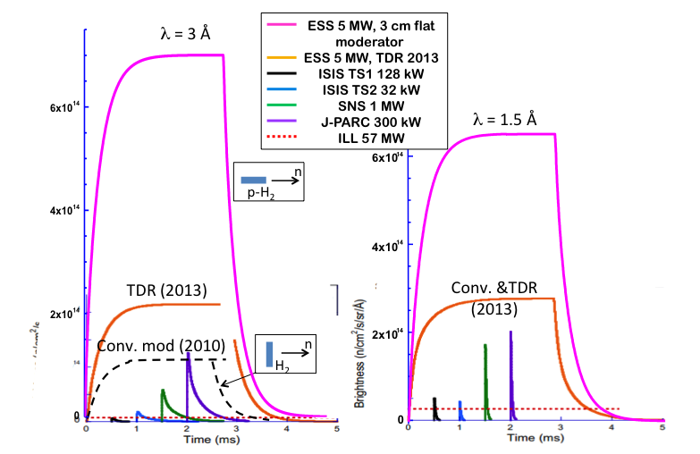
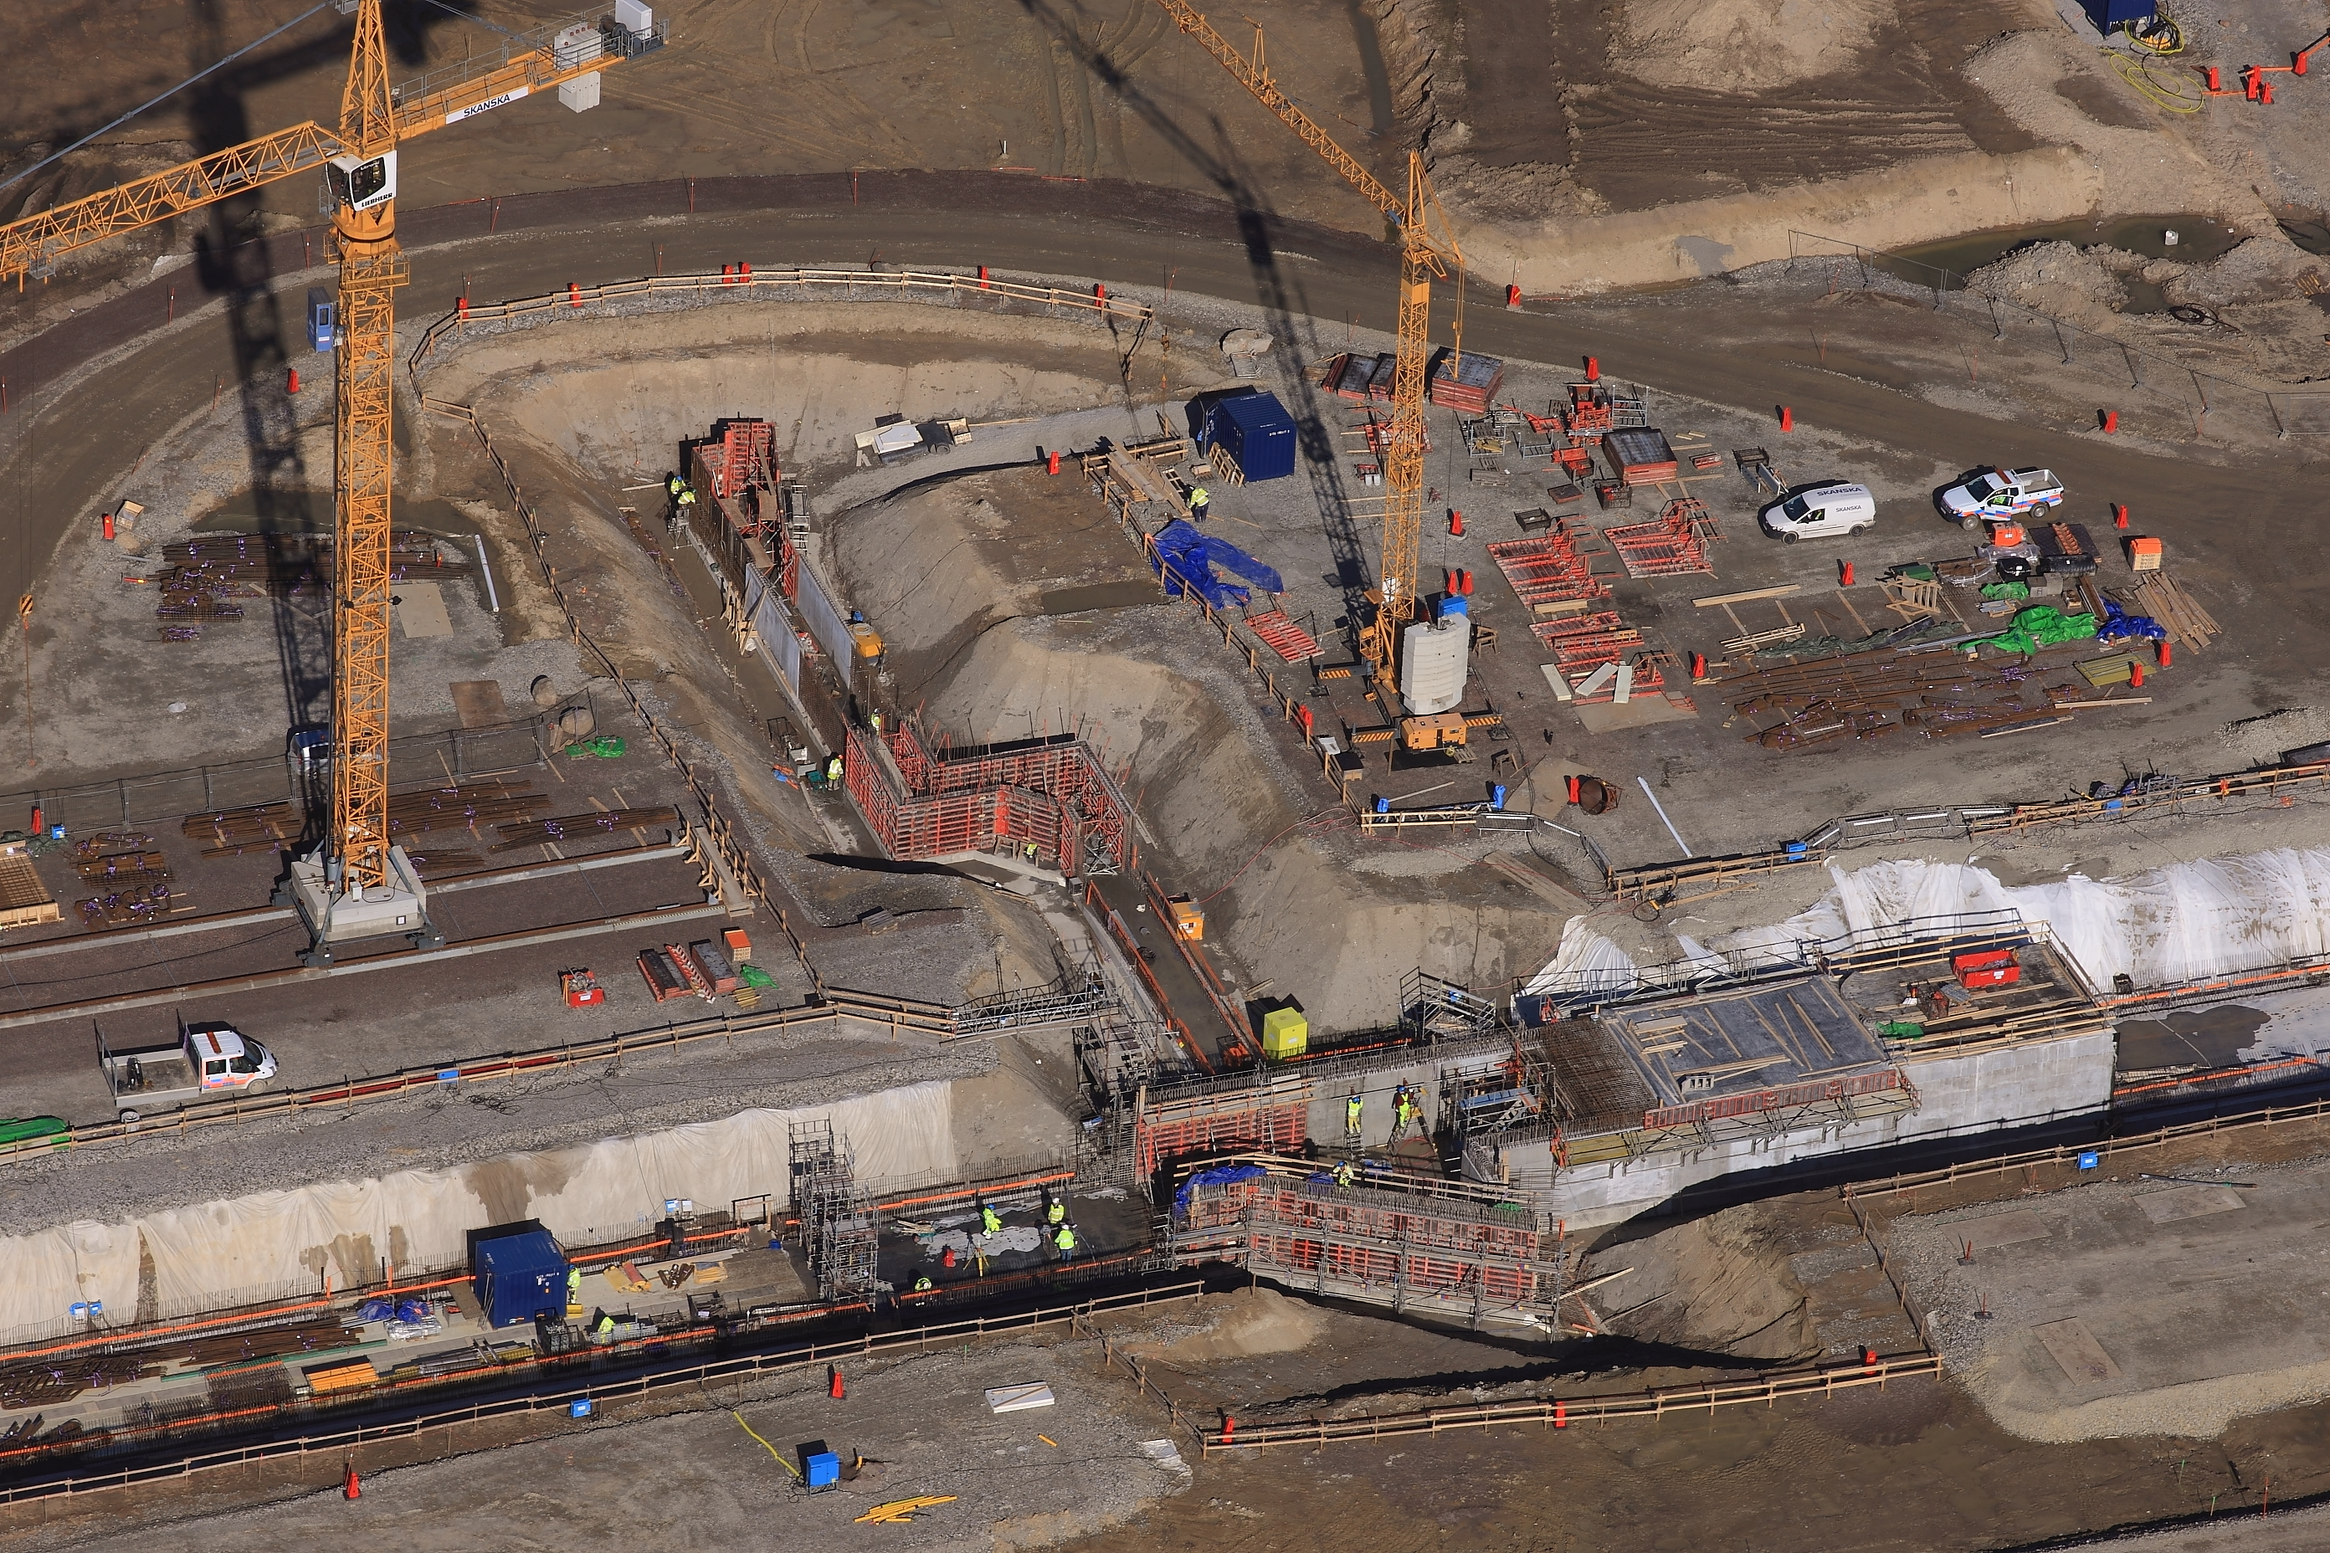
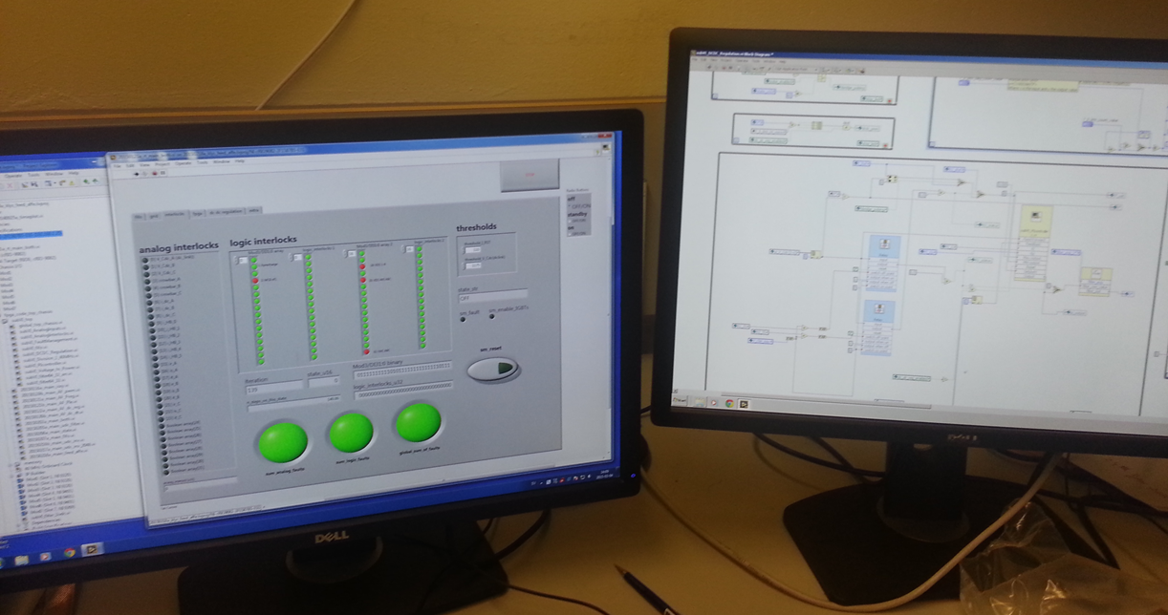
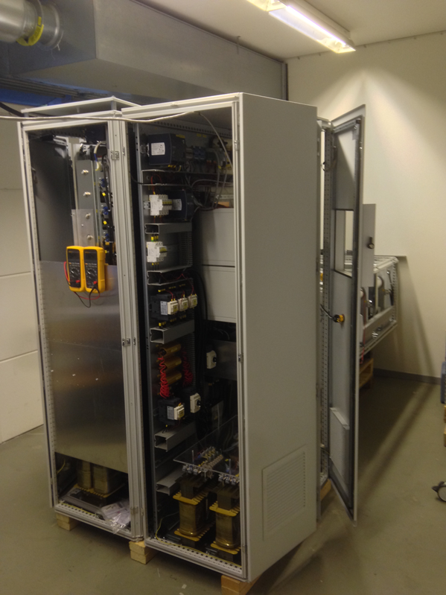
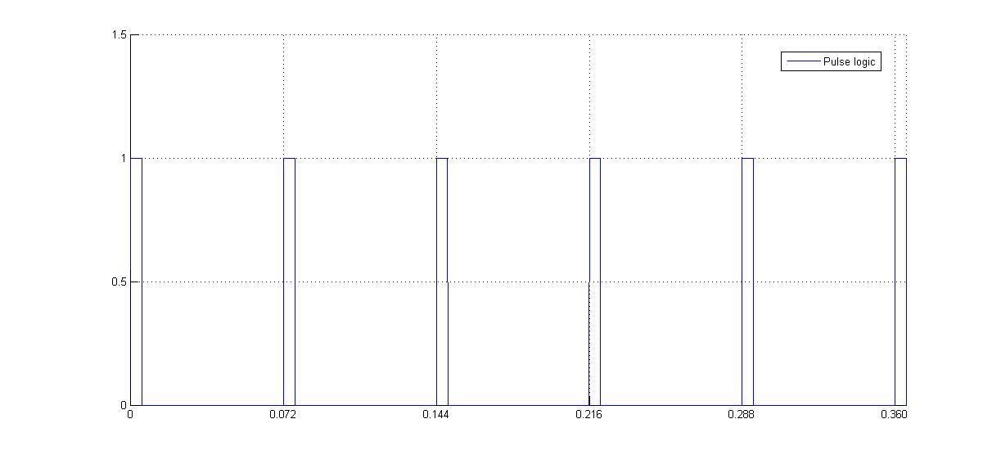
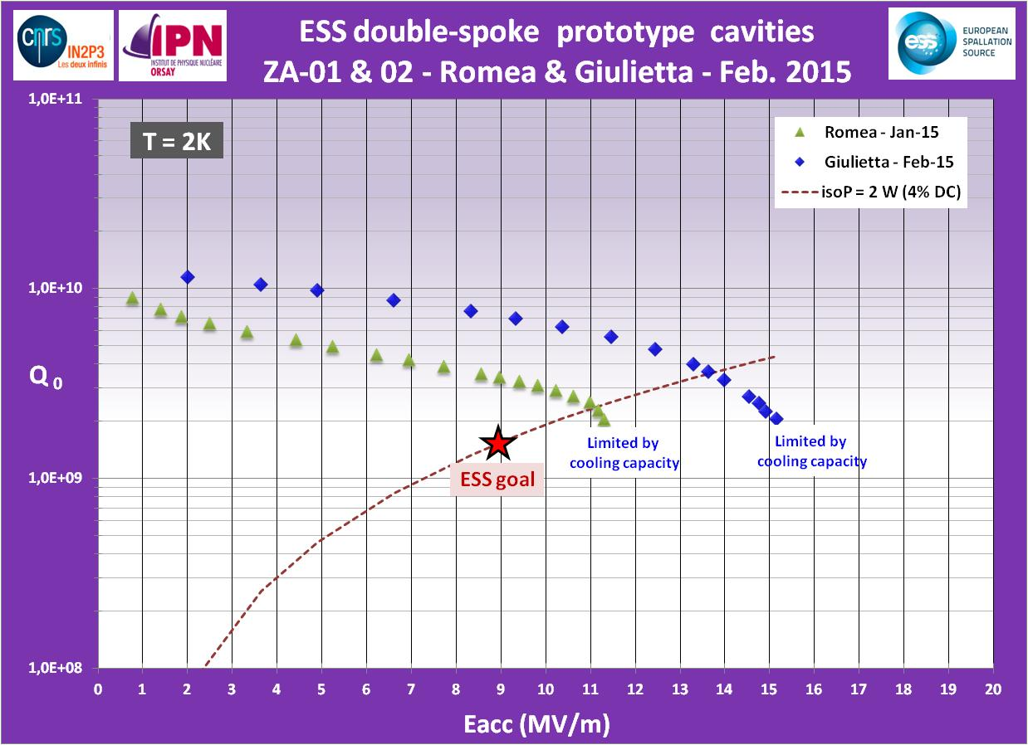
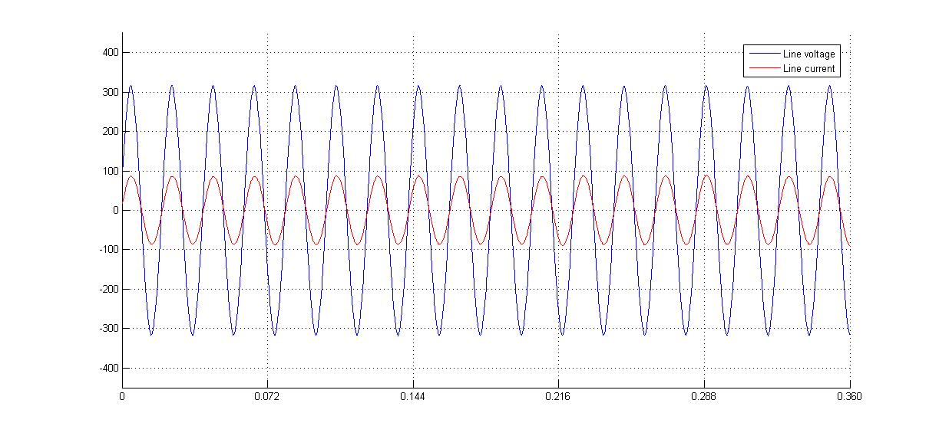
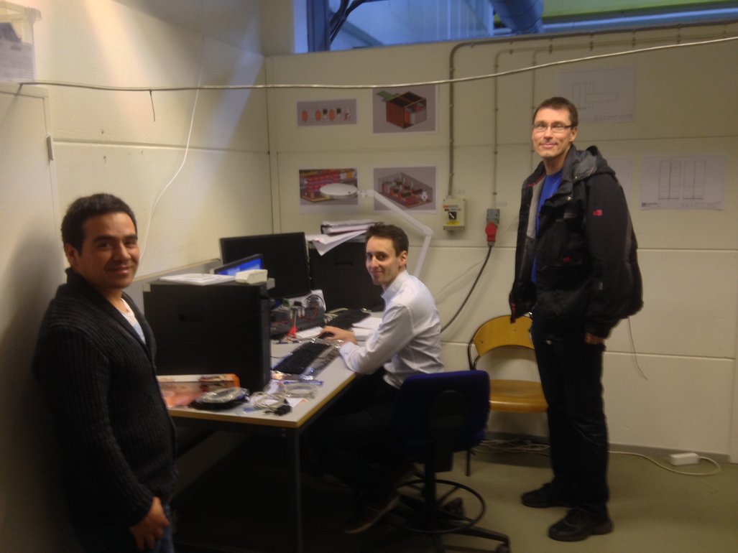
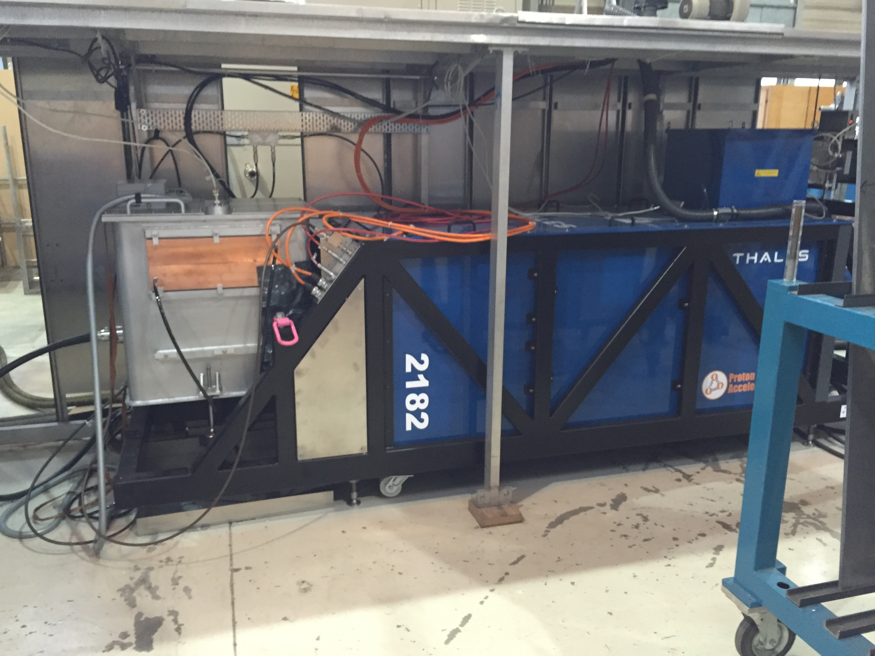
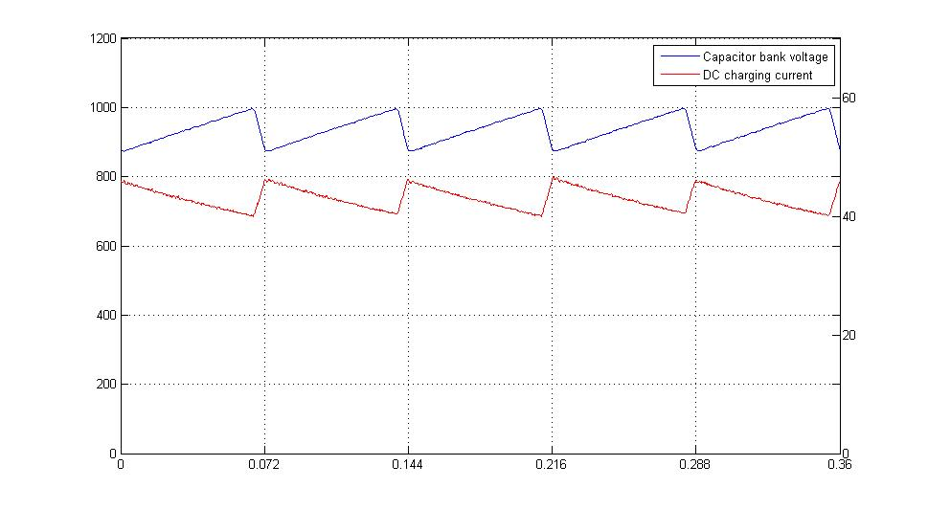
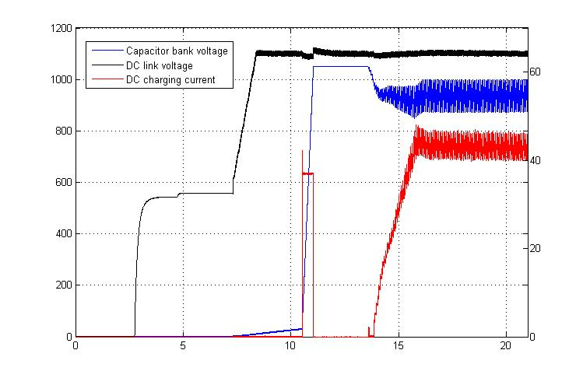
Progress in practice…
Controls & Human Machine Interface (labview)
704 MHz klystrons
Open call for tenders started in October 2014 for two prototypes
Four candidates (Thales, Toshiba, L3 and CPI)
First contract (Thales) signed in December: Thales design is based on the TH2182 successfully built for CERN (but operating in horizontal position)
Second contract (Toshiba) almost in place
A third prototype will be purchased from CPI in the next weeks
Pulse (1kV)
AC line voltage
AC line current
Low voltage power converter stage
Unitary power factor;
Sinusoidal line current, constant amplitude -> No flicker
Capacitor bank voltage
Capacitor bank charging current
Automatic start-up sequence
(state machine)
Unitary power factor;
Sinusoidal line current, constant amplitude -> No flicker
Jun ’13
Design and specifications:
ESS and LTH;

Slide 4
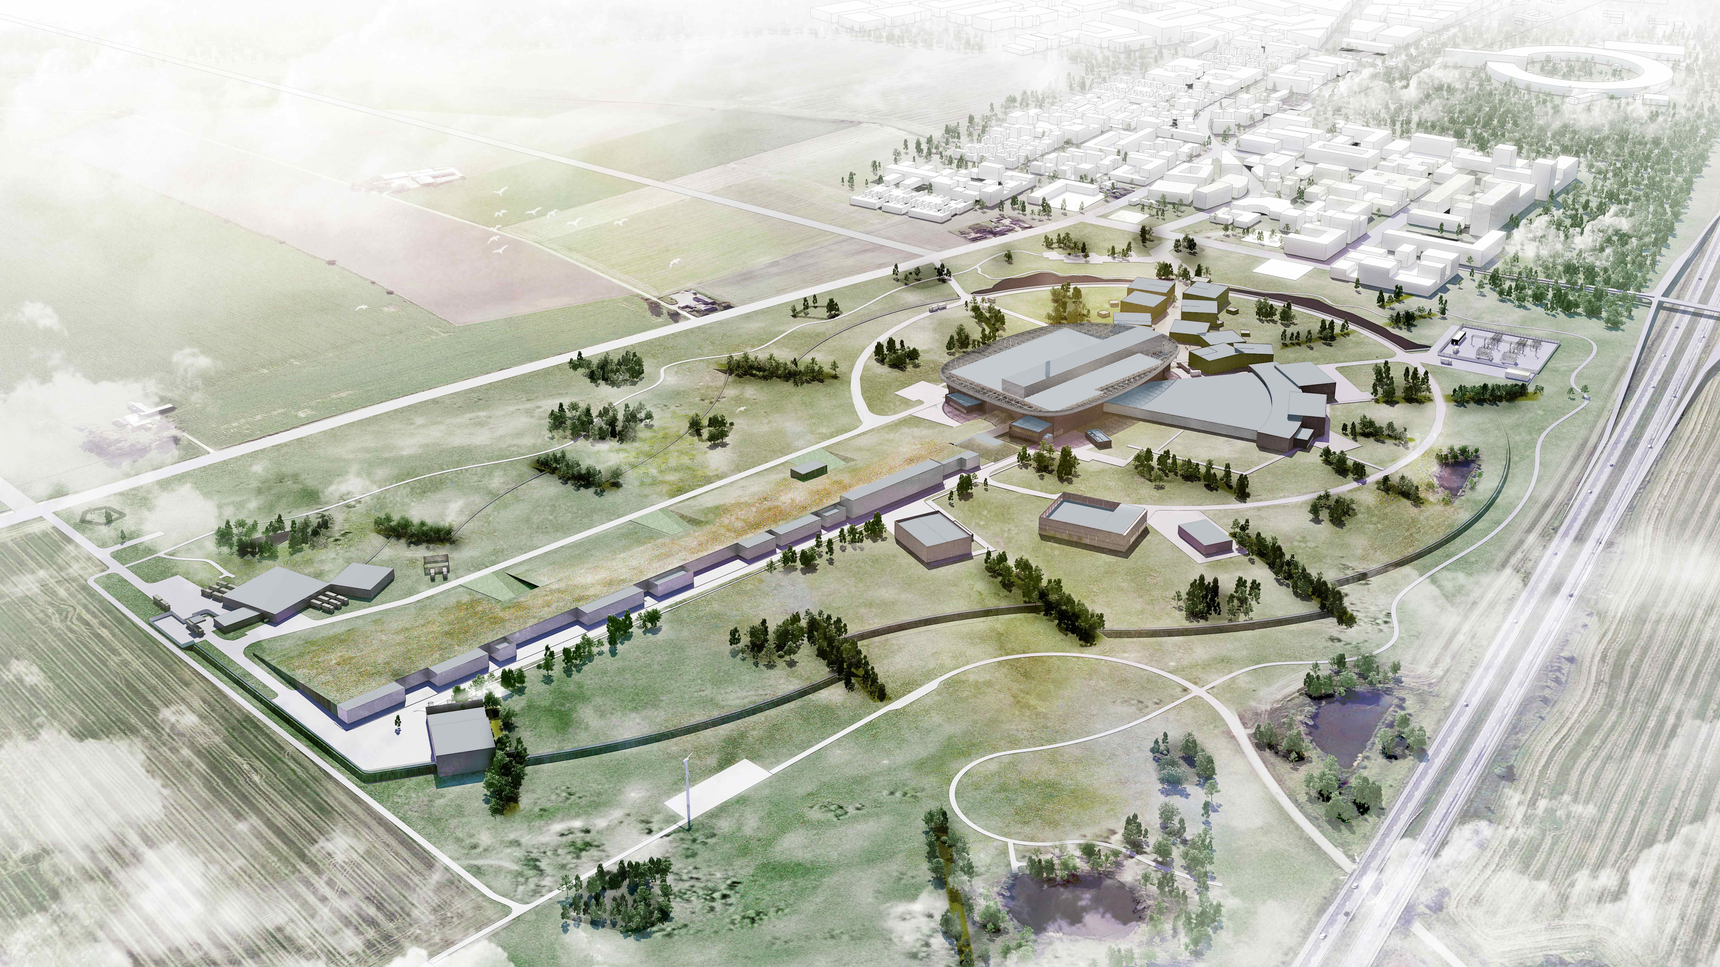
We need your help!

Slide 5
Questions to the TAC for its 11th meeting
Accelerator
a1) Is the plan for designing/prototyping and constructing the room temperature part of the linac satisfying ? Is the schedule feasible / How could it be improved?
a2) Is the plan for designing/prototyping and constructing the elliptical cavities linac sufficiently advanced to permit timely construction? How could it be improved?
a3) Is the plan for the RF sources properly addressing all the needs? Is the schedule feasible / How could it be improved?

Slide 6
Questions to the TAC for its 11th meeting
Target
t1) Are the new design developments for the following systems sound and do they represent a reasonable balance between system performance and other parameters, e.g. manufacturability, operability, maintainability, cost, schedule, and flexibility?
Moderator and reflector
Neutron beam extraction from monolith
Helium purification
t2) Are the proposed safety classification and TSS approaches sensible and likely to define a path towards safe operation of the ESS Target Station?
t3) Comments on progress towards completion of Preliminary and Final Designs in all areas are most welcome.

Slide 7
Questions to the TAC for its 11th meeting
ICS
c1) Is the subject of Machine Protection satisfyingly addressed? Are the technical solutions proposed for implementing the MPS appropriate?

Slide 8
Questions to the TAC for its 11th meeting
General
Have the recommendations and concerns of the previous TAC meeting been properly addressed?
Additional suggestions/comments and recommendations?

Slide 9
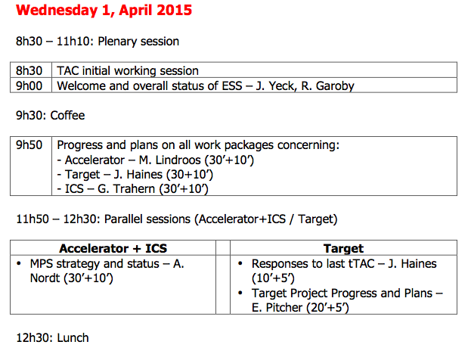
Agenda TAC#11

Slide 10
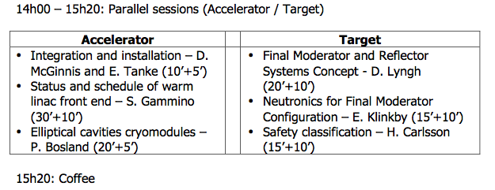
Agenda TAC#11

Slide 11
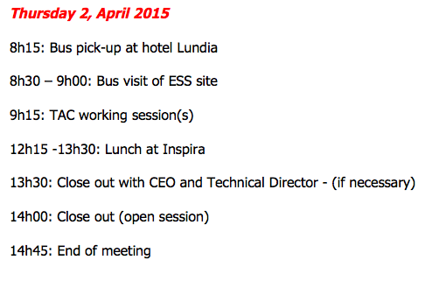
Agenda TAC#11

