Slide 1
BIFROST – a multiplexing indirect
ToF spectrometer for extreme environments
Progress by May 2022
PRESENTED BY Rasmus Toft-petersen (DTU/ESS),

Slide 2
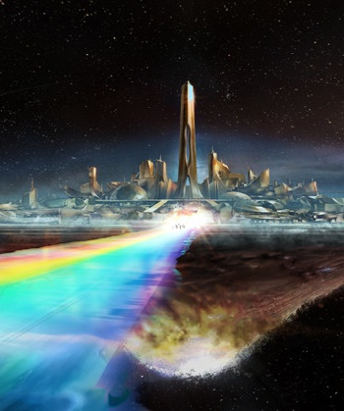
Recent progress

Slide 3
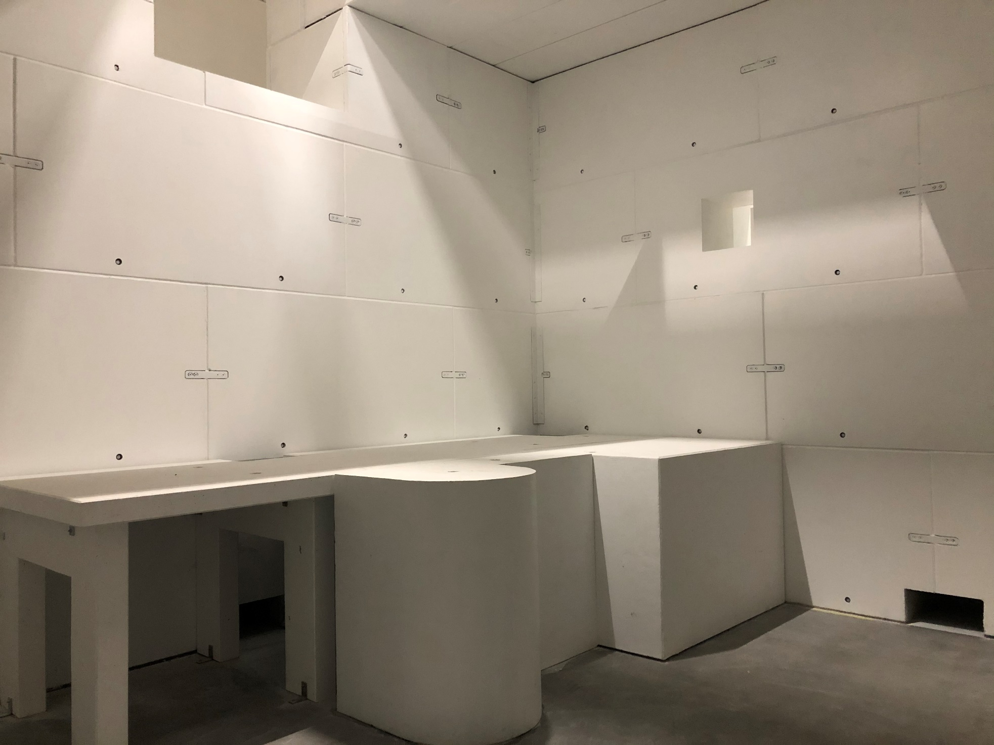
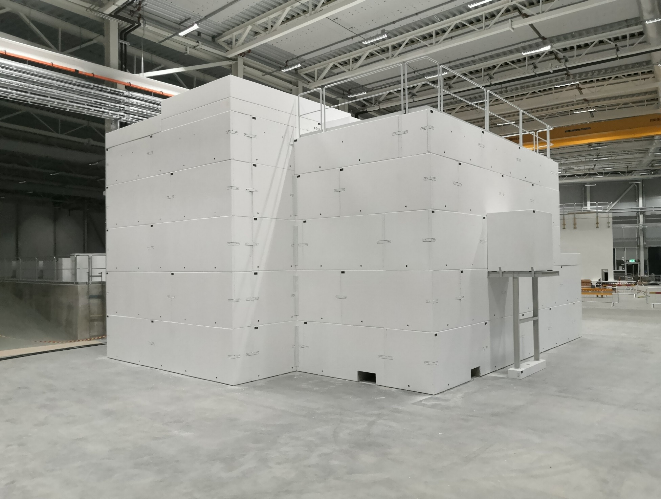
Cave before installation work

Slide 4
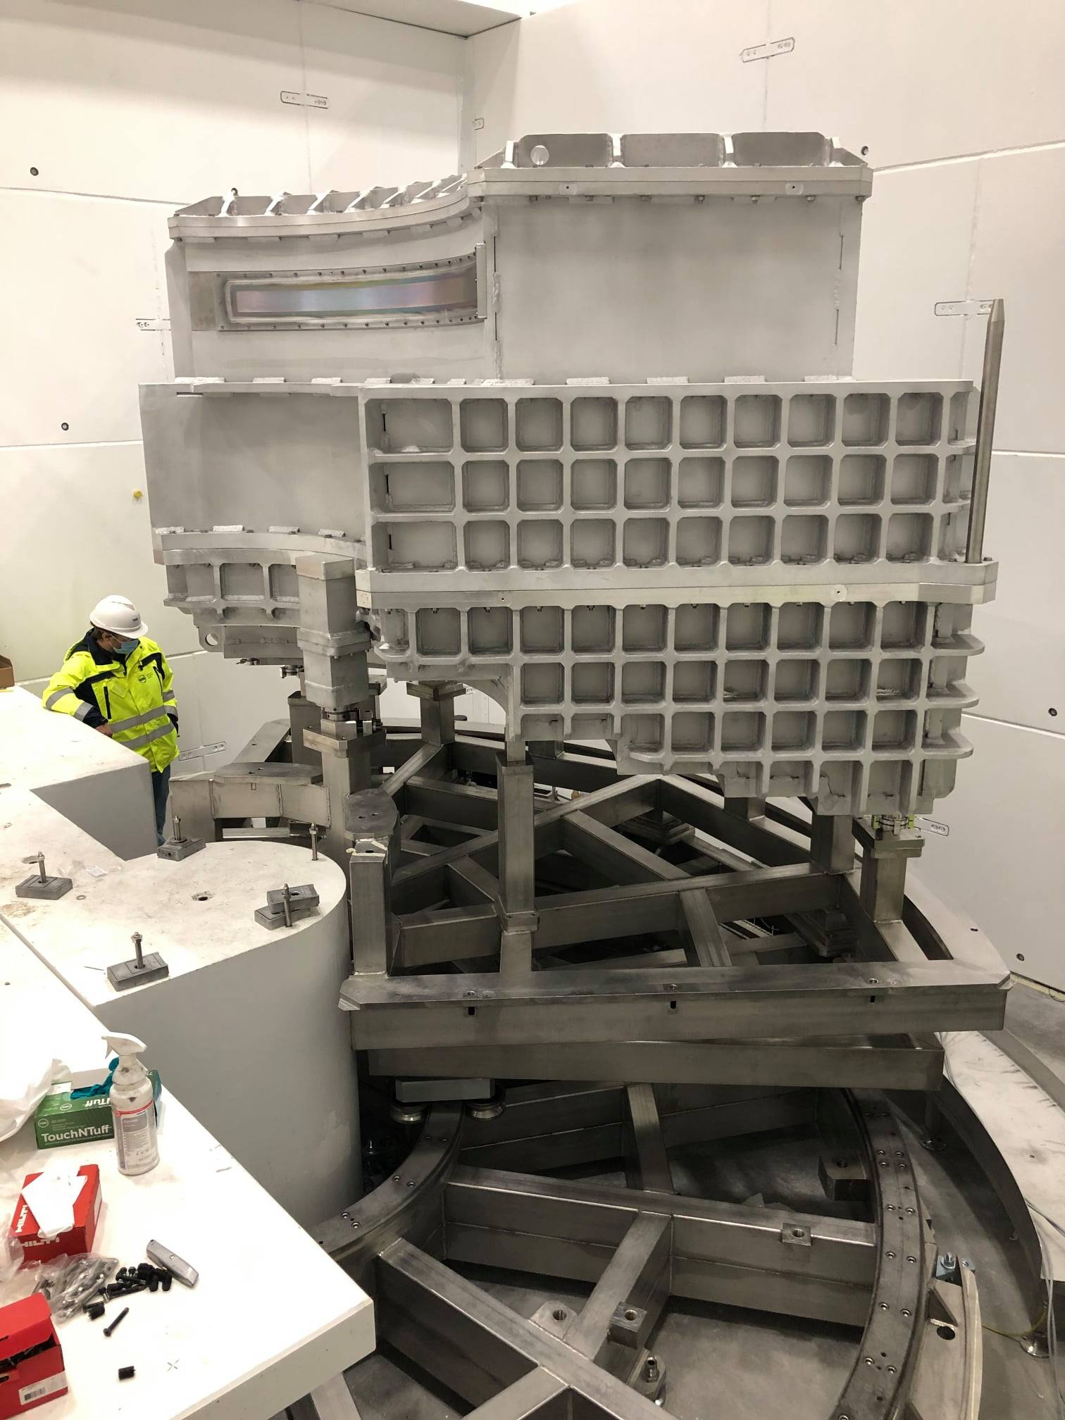
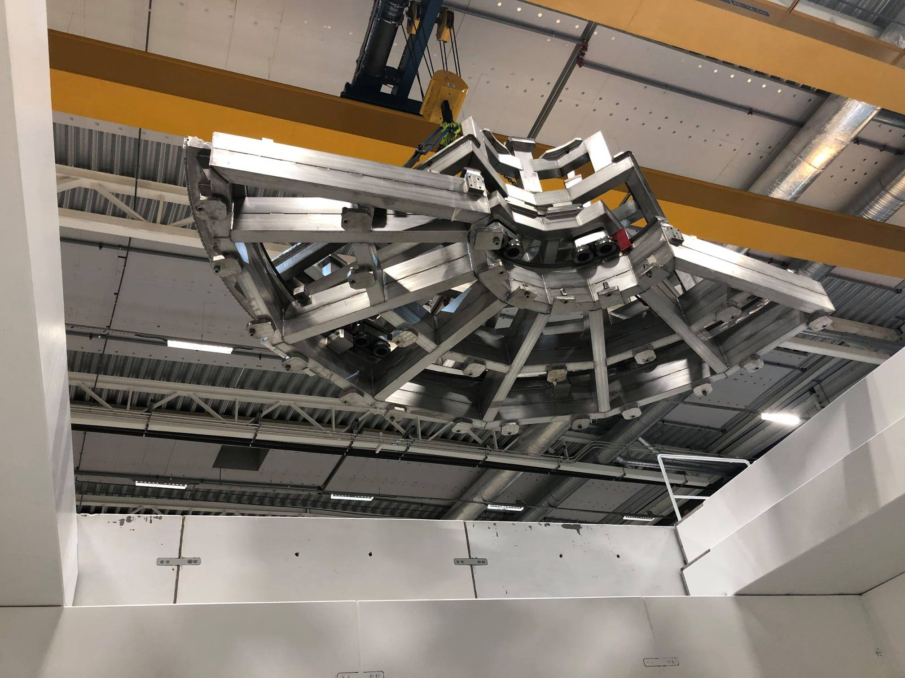
Tank installed
SAT completed in autumn 21.
A major milestone, and both FAT and SAT were
very time demanding

Slide 5
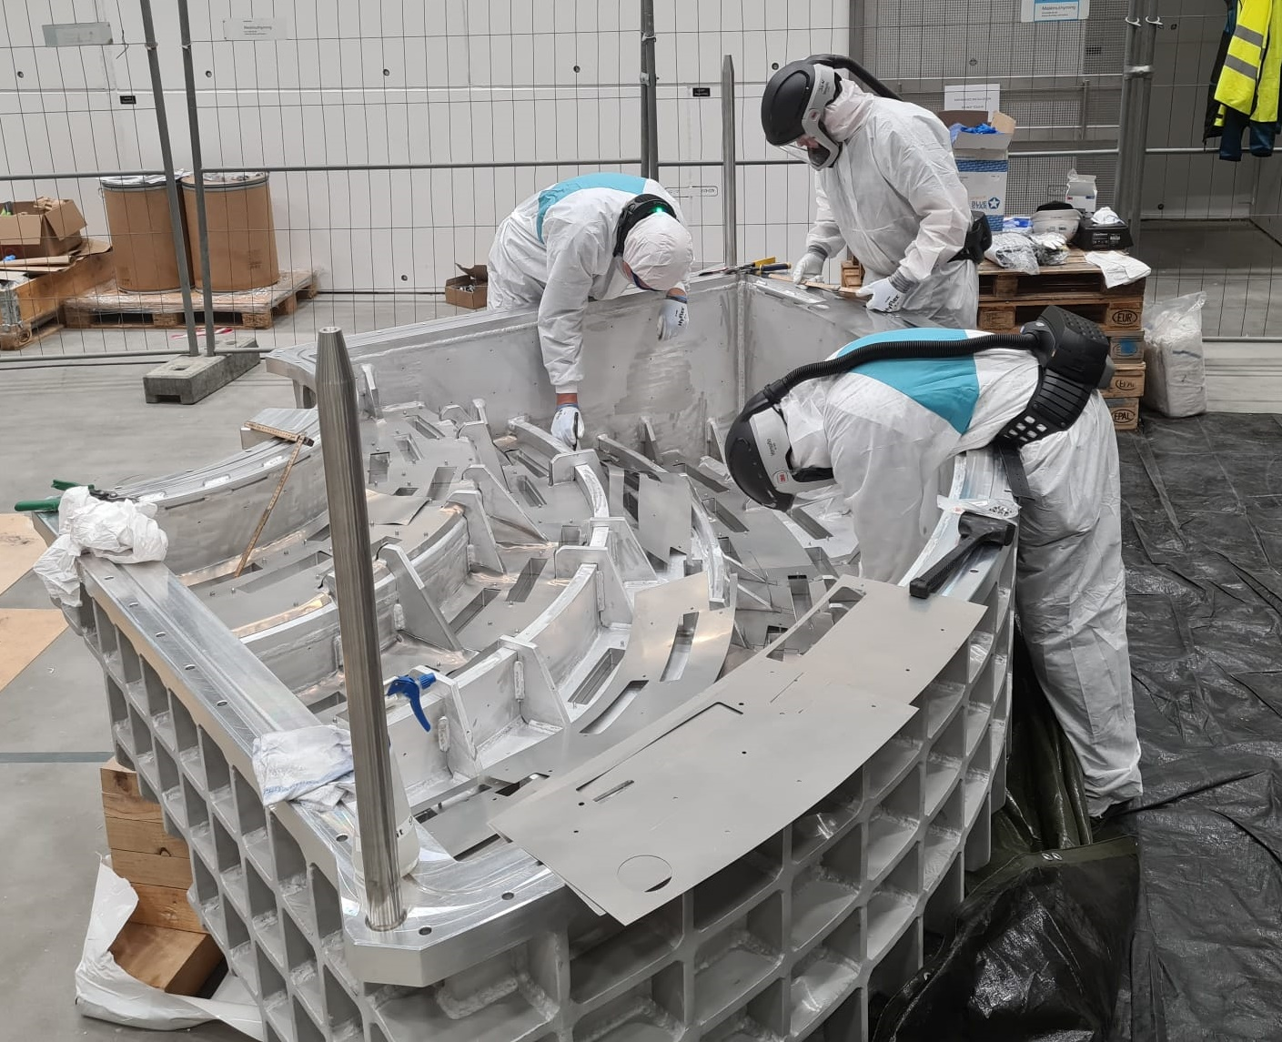
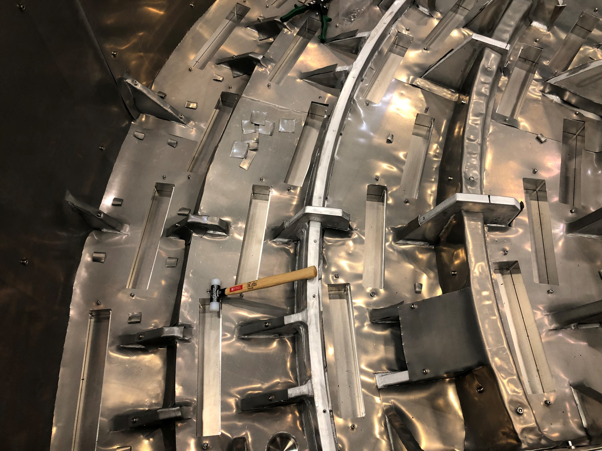
Cadmium installation ongoing
Tedious and toxic work, but necessary. A lot of safety gear,
but ultimately doable in a pragmatic manner

Slide 6
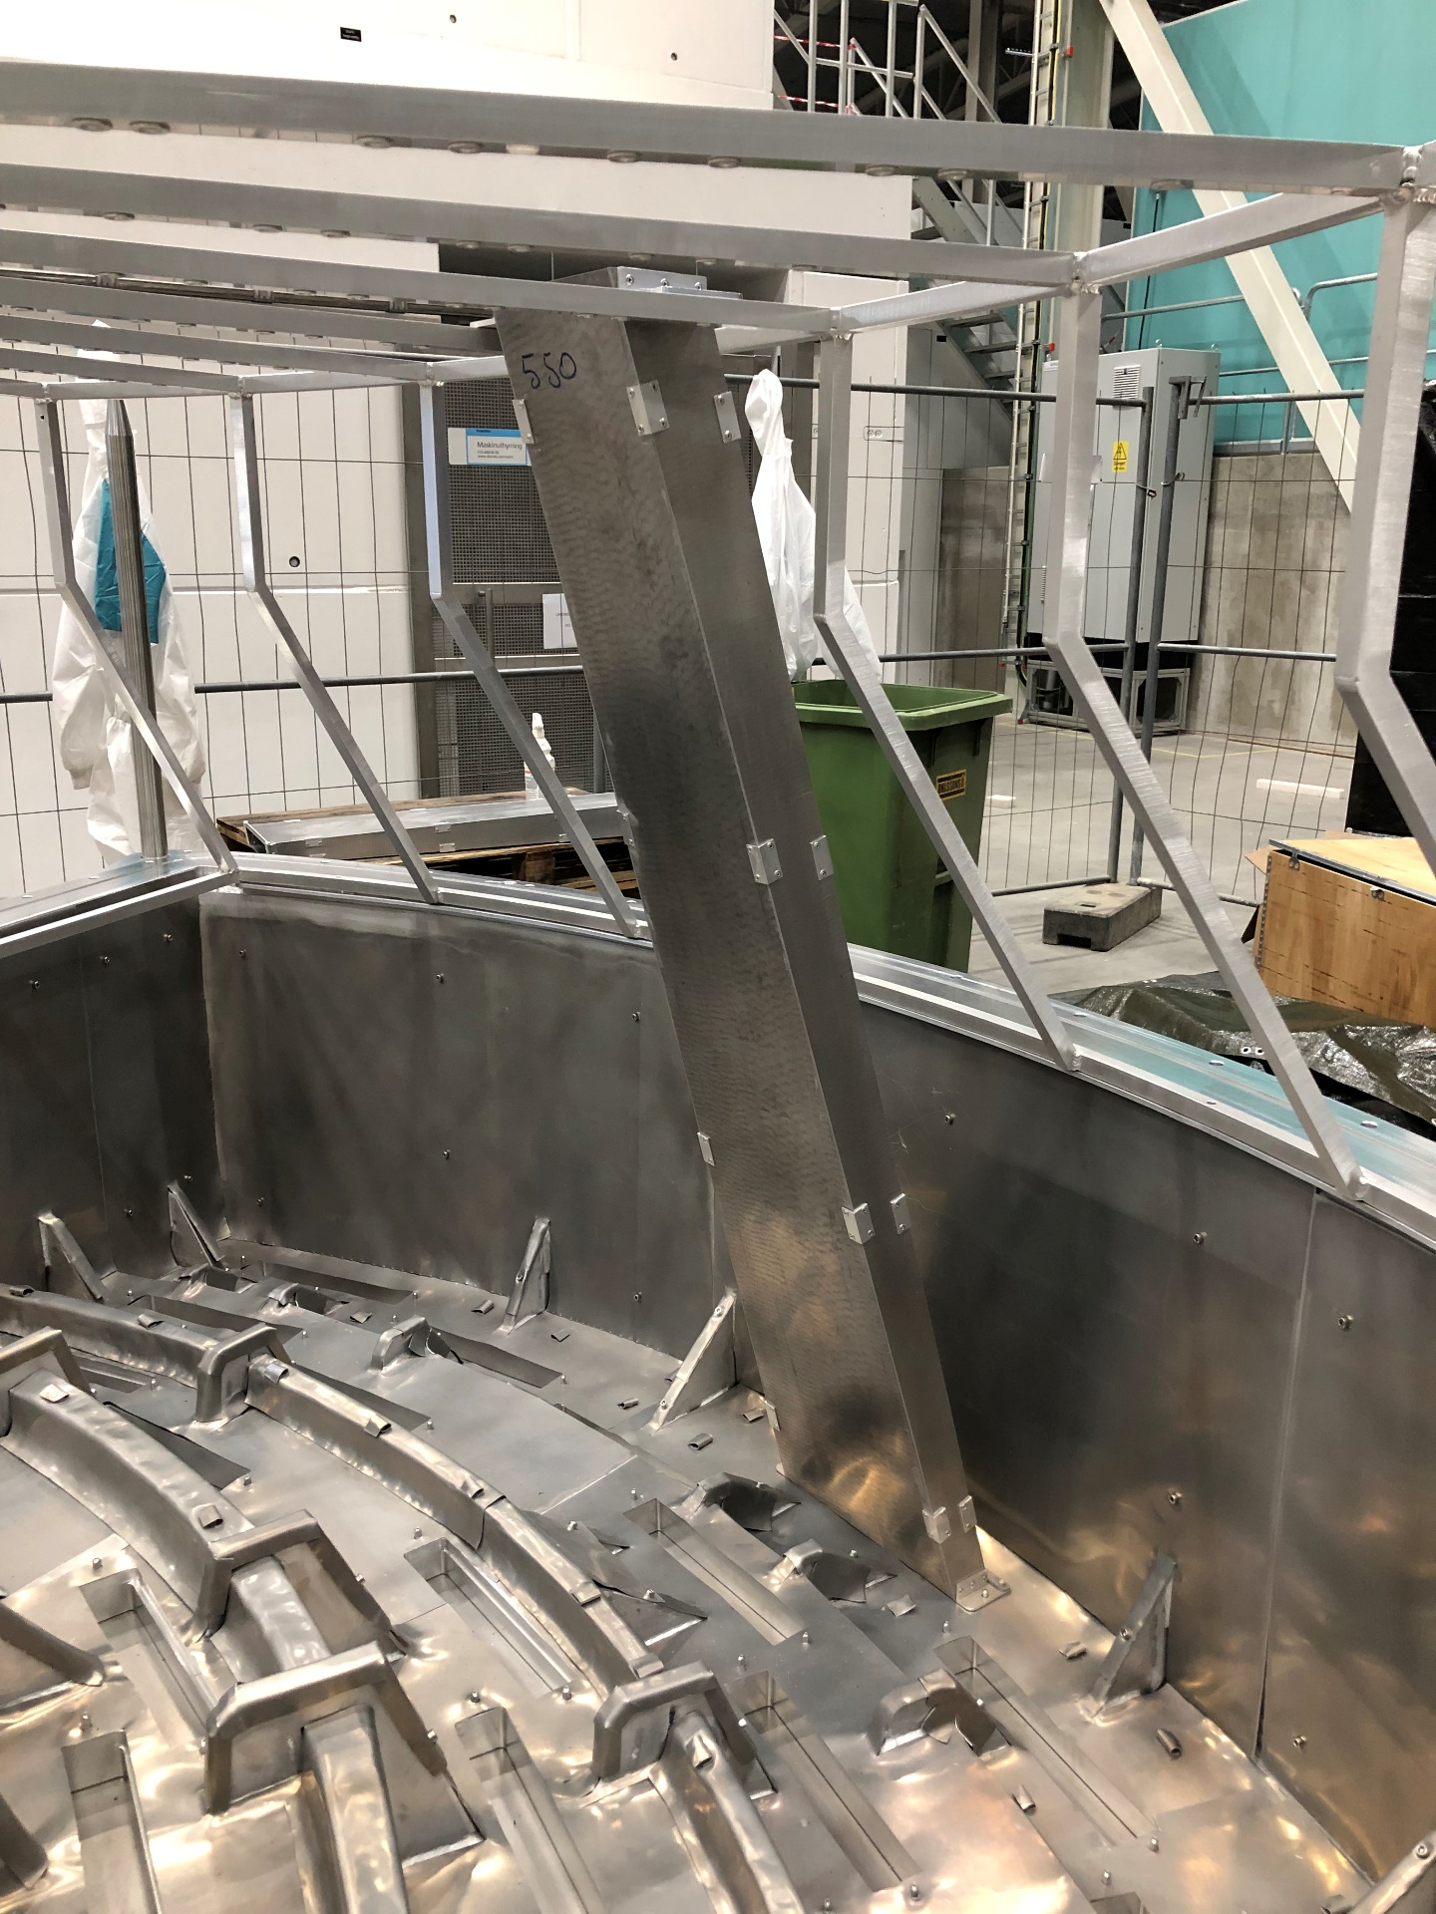
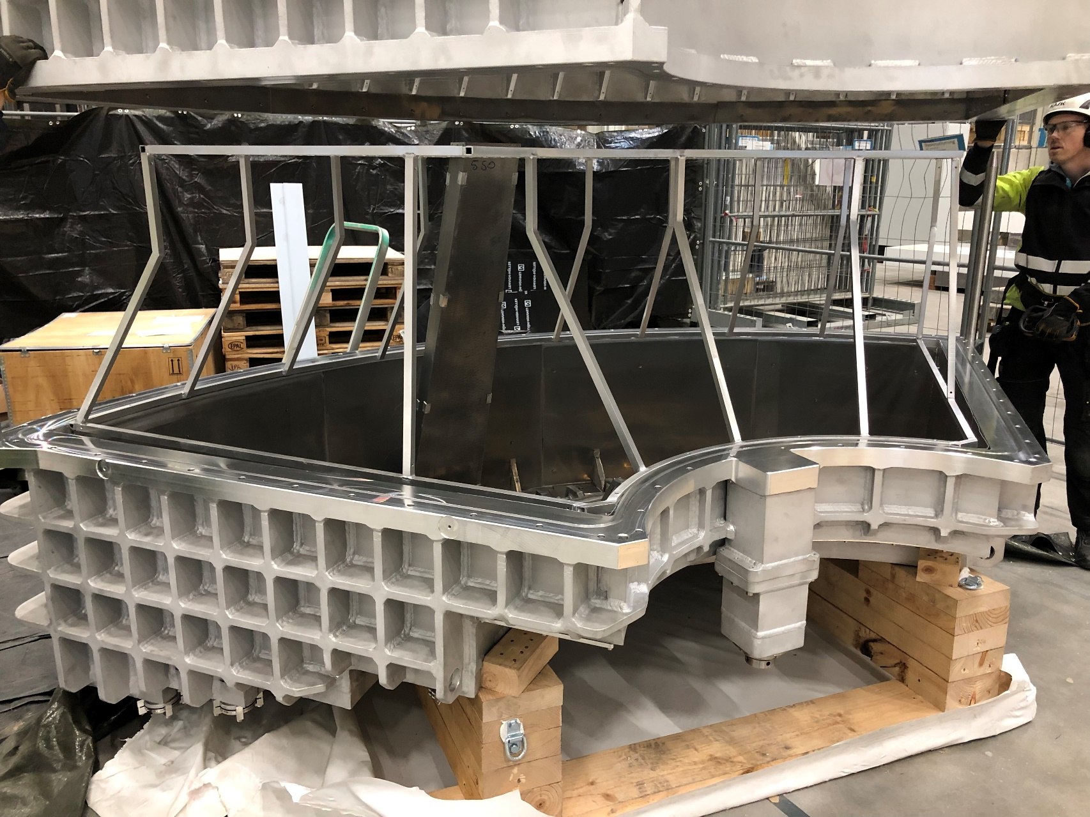
Cross talk shielding is next
Once we are done with cadmium, we will install the
borated aluminum cross talk shields. A man-sized
jigsaw puzzle, and our first test suggested that our
frame tolarances are too tight. Time to ad hoc adjust!

Slide 7
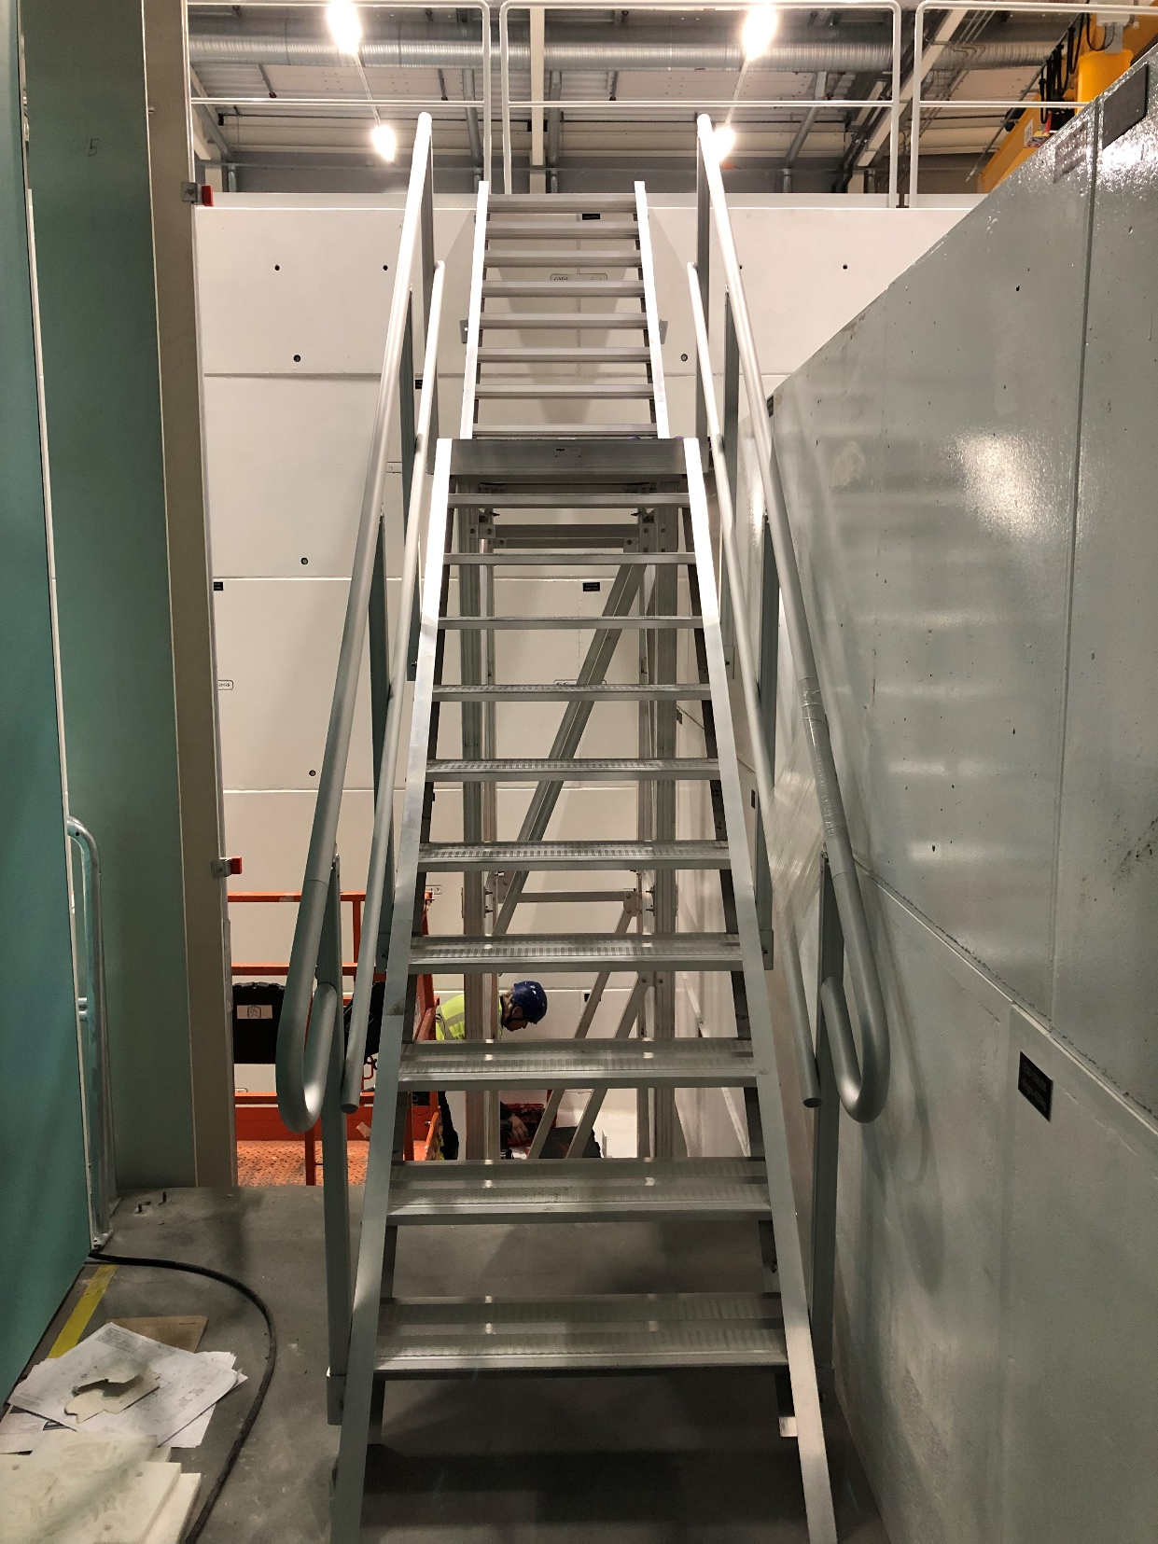
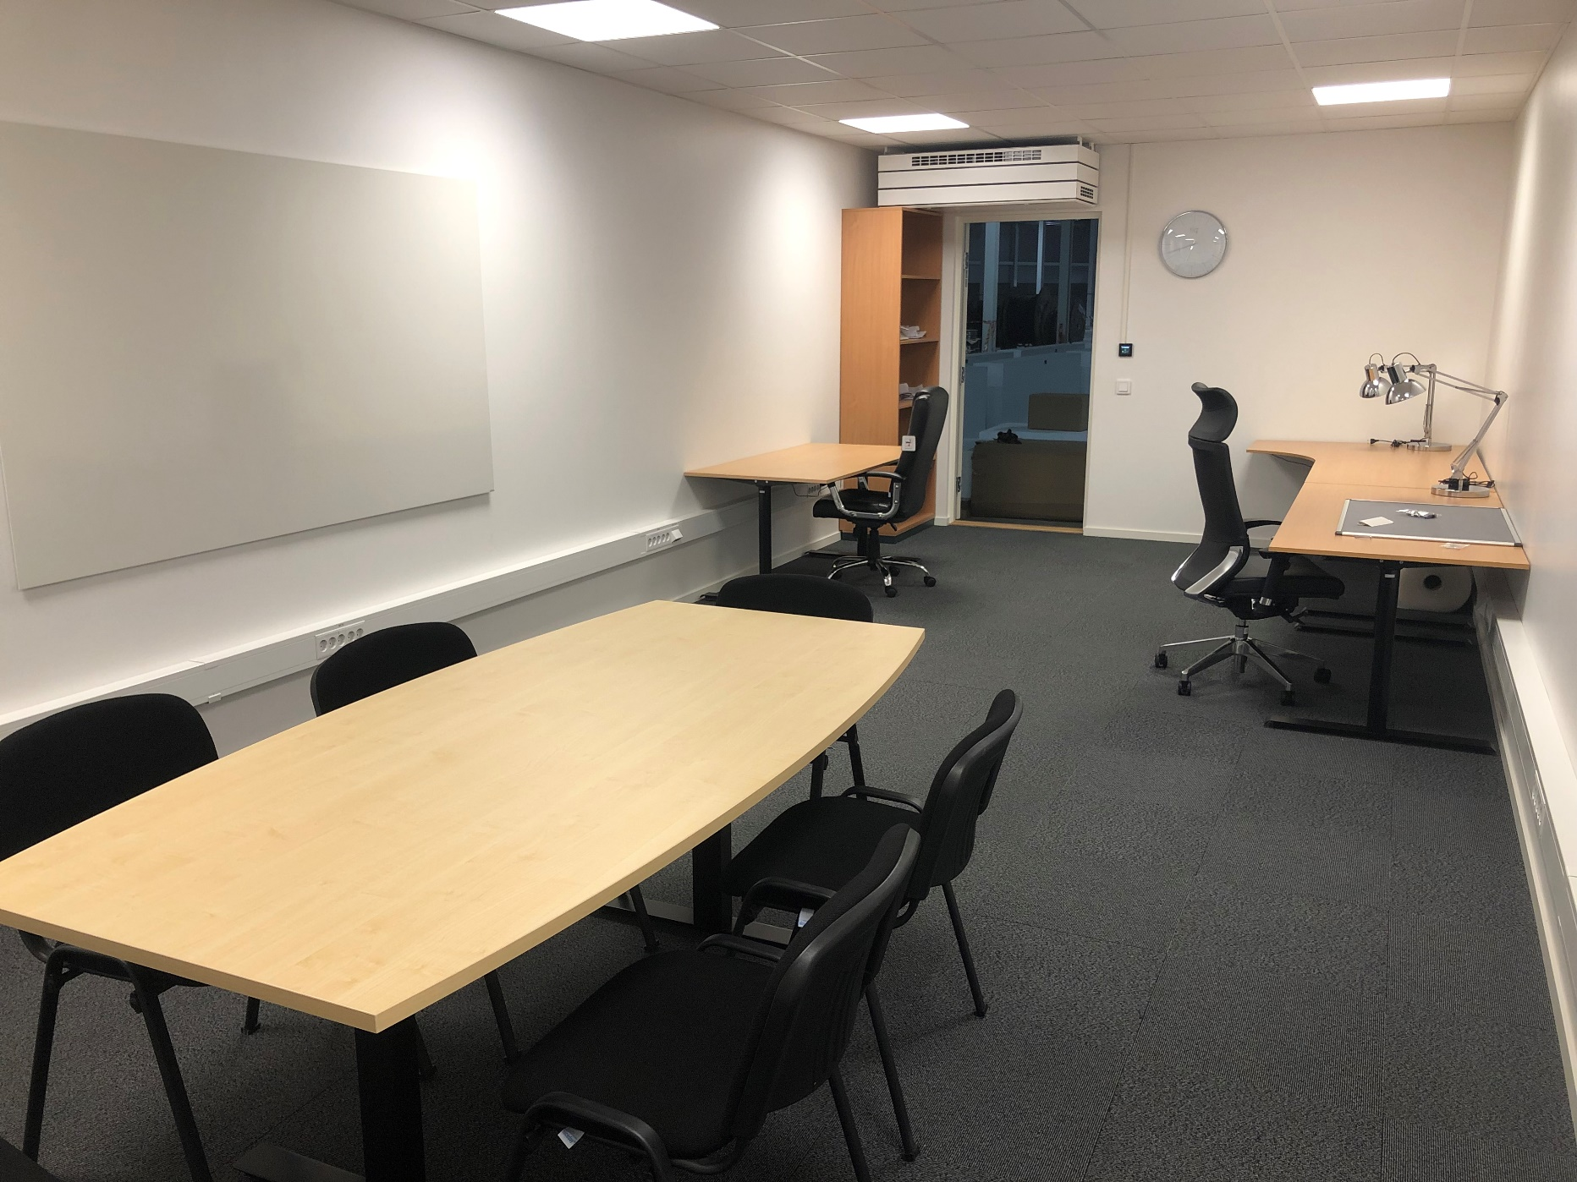
’Minor’ tick marks (I)
Hutch furnished
Stair to cave roof installed

Slide 8
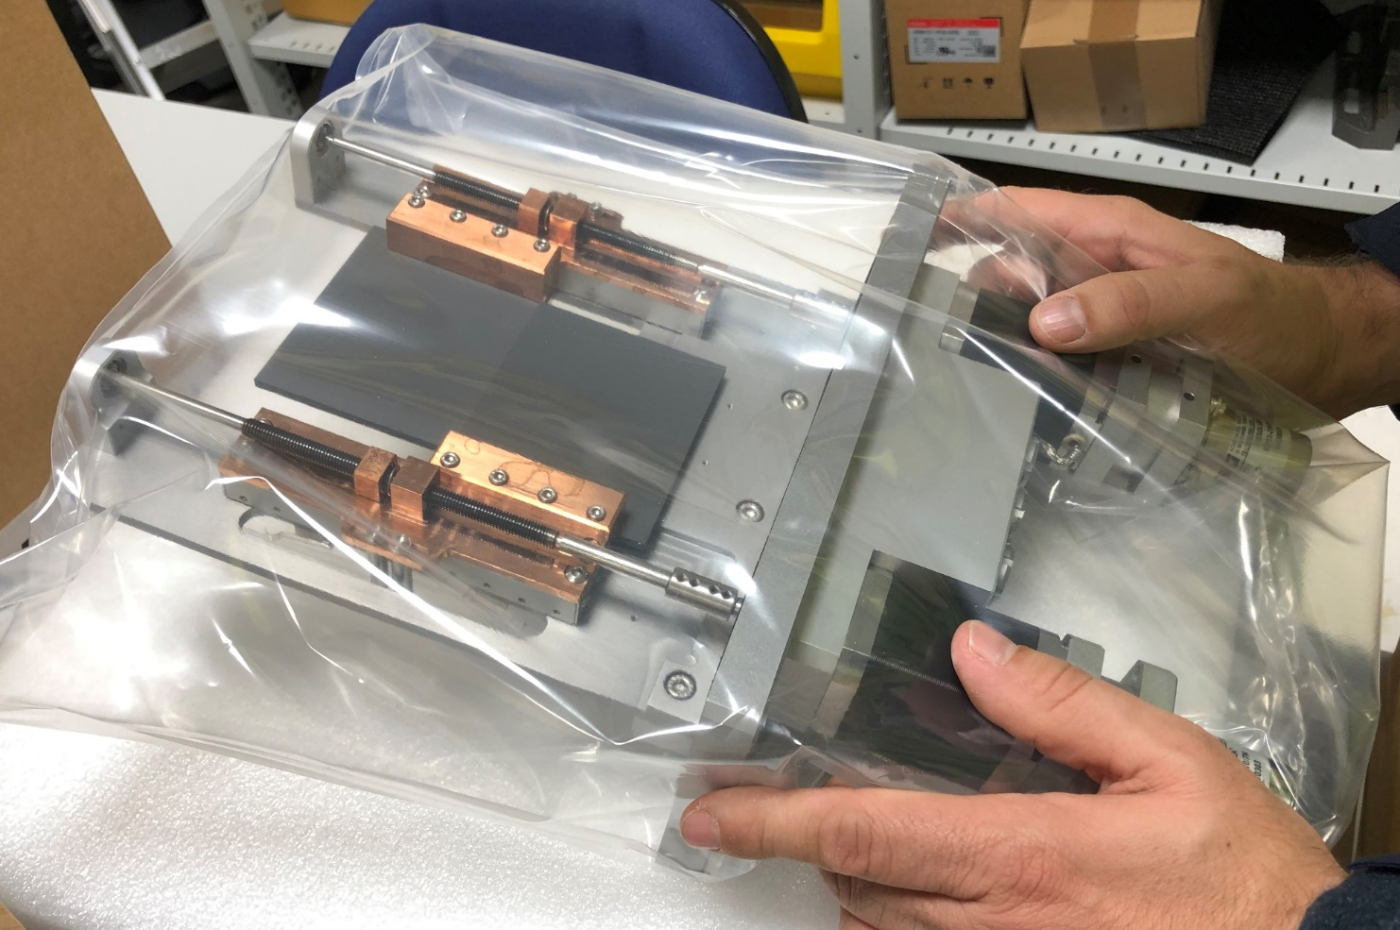
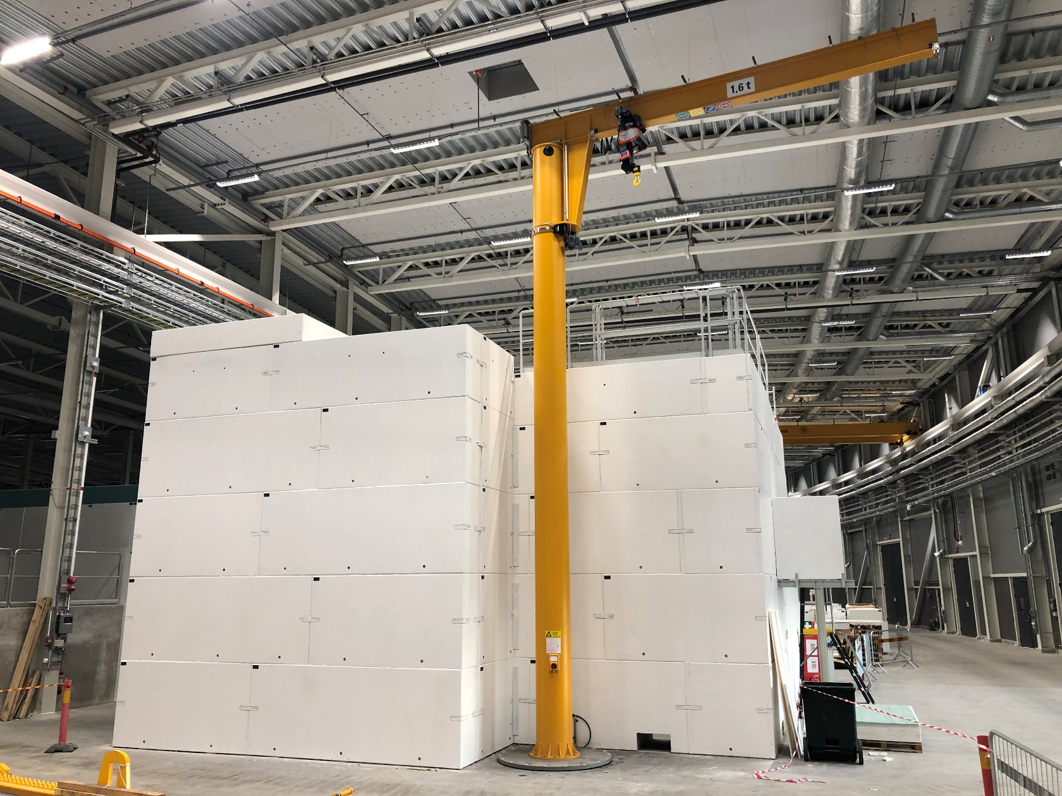
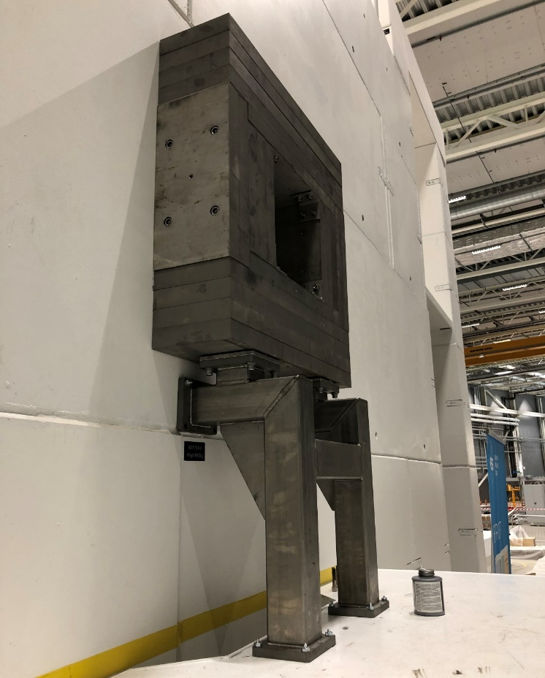
’Minor’ tick marks (II)
Divergence Slits SAT Complete
Crane installed
Gamma plug
installed
It proved prudent to get some of the minor things done early, plenty of minor things stopped us in our tracks:
Divergence jaw motors didn’t fulfill specs
Crane power supply phases were flipped (!)
Tolerances on tank frame too tight
Didn’t order enough cadmium

Slide 9
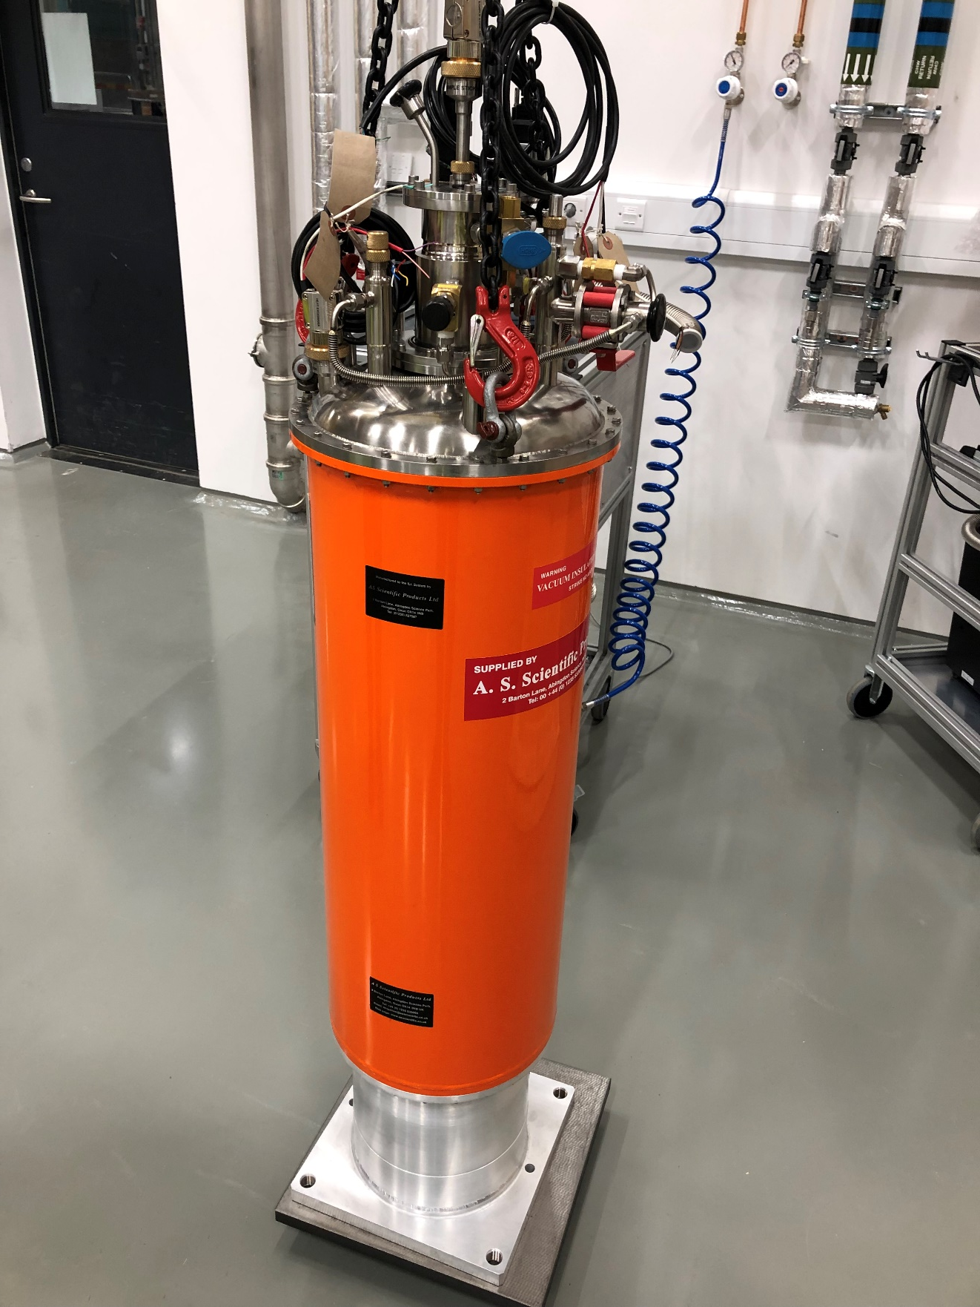
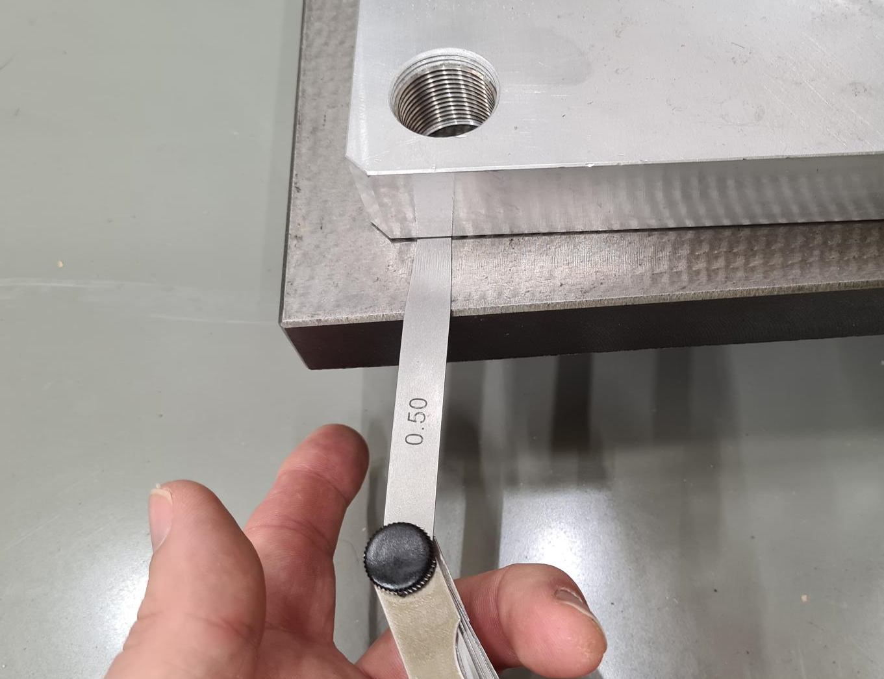
Orange cryostat delivered
Orange cryostat outer vacuum can was not post-machnined.
We had to send the can back – causing a SAT delay of 3 months
including Christmas). FAT was done remotely, and this slipped through
the cracks

Slide 10
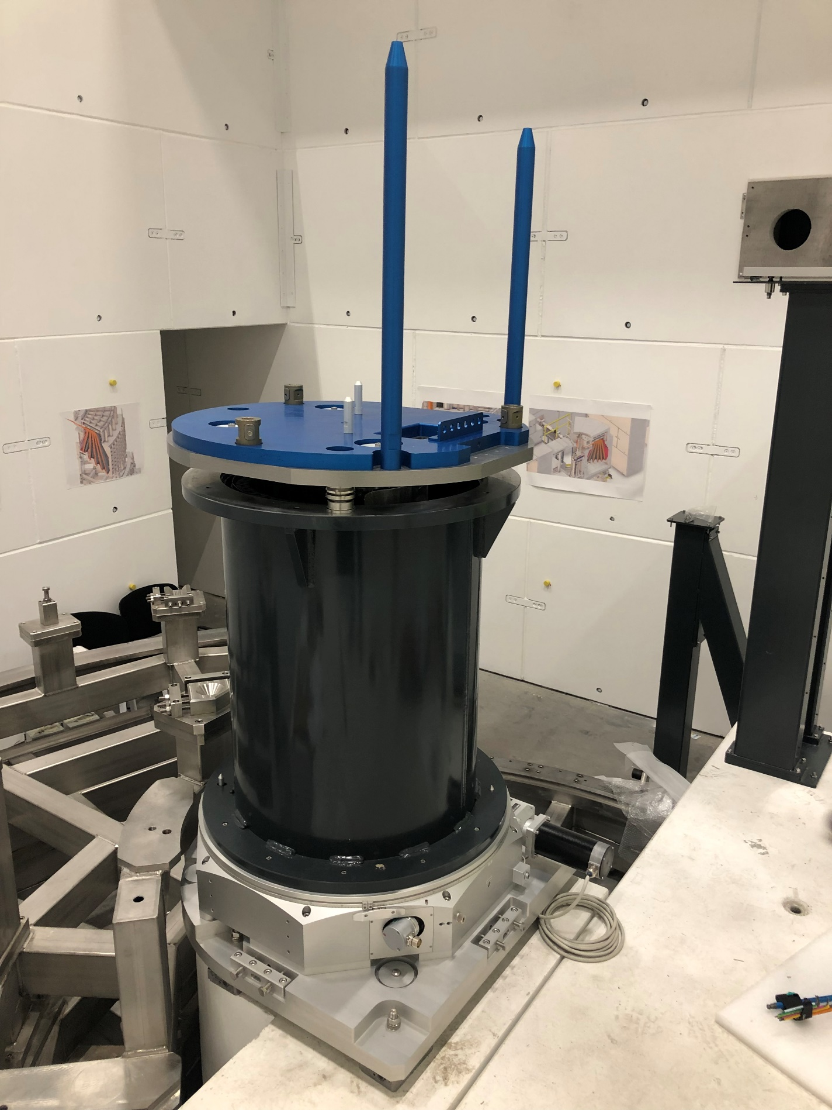
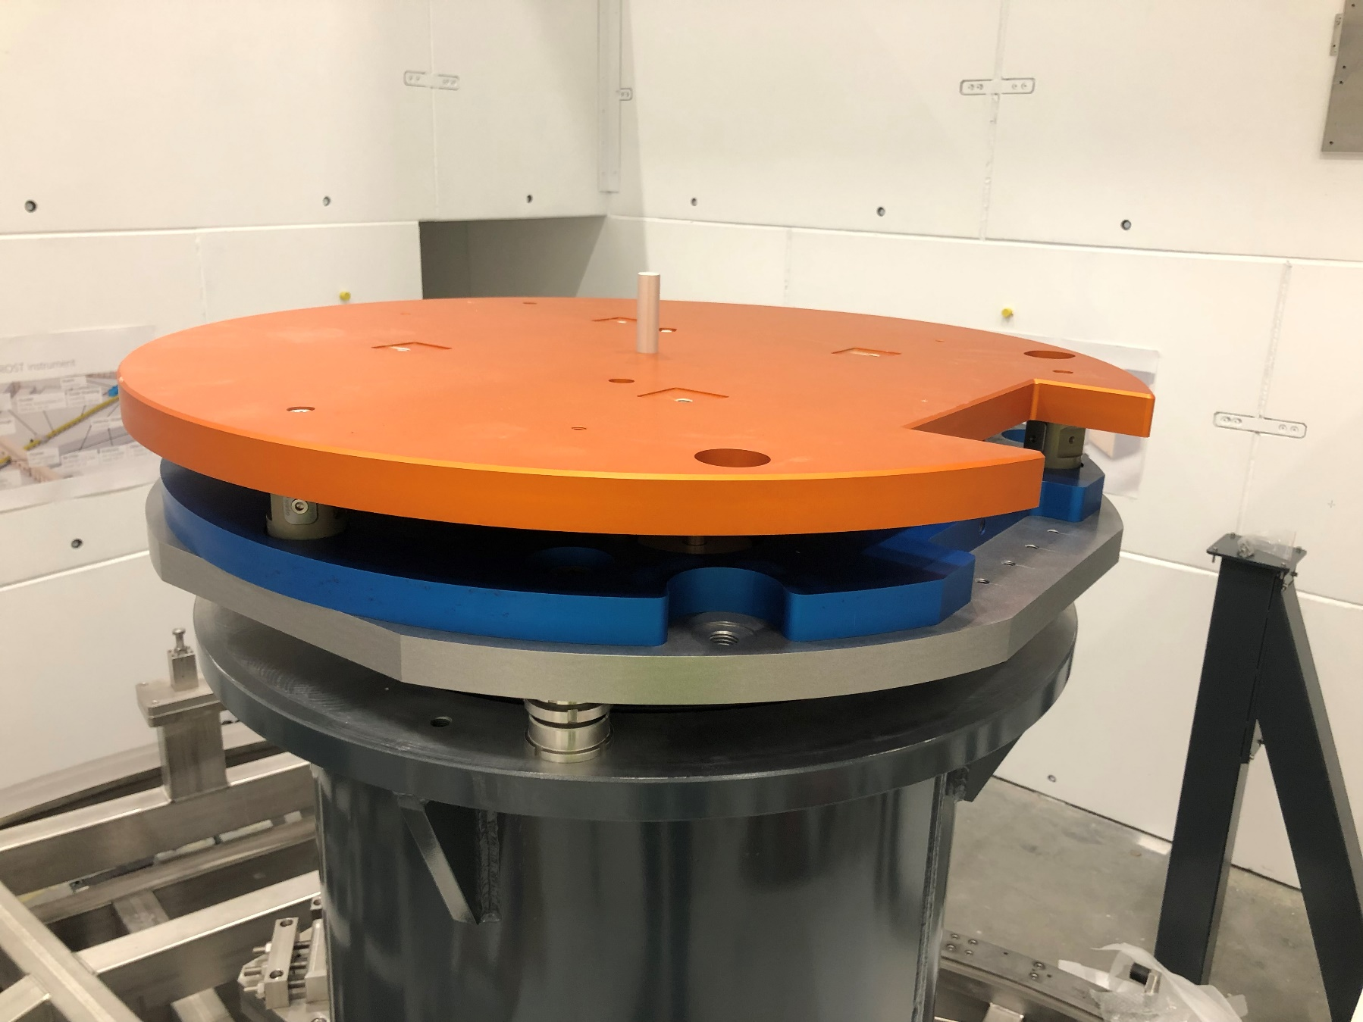
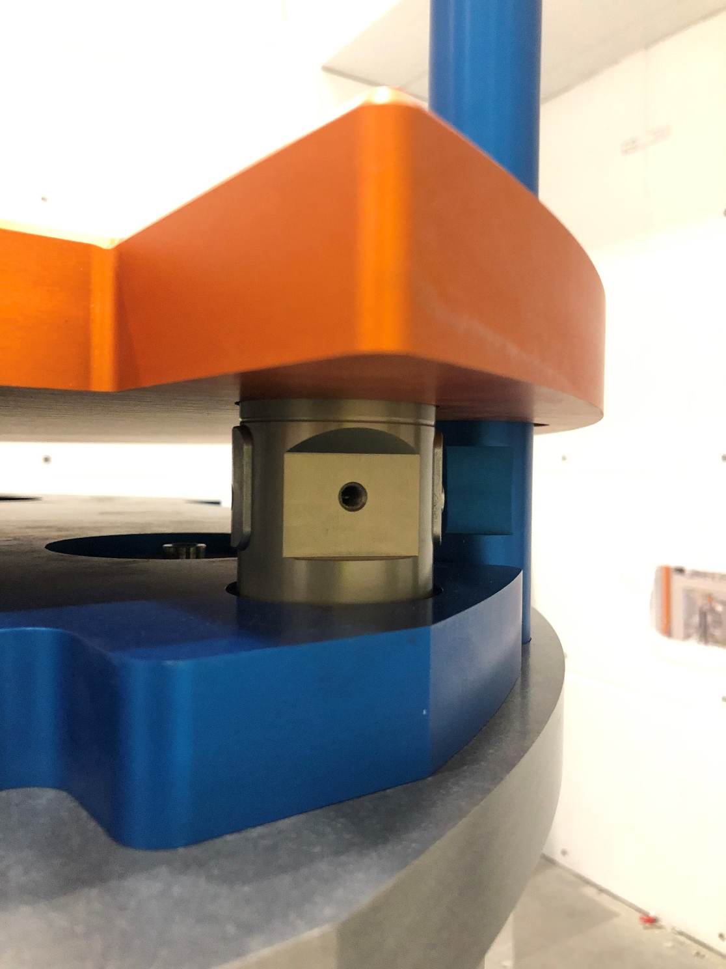
Sample stack
Sample stack almost installed. The goniometer will soon be mounted on
the orange plate, and once we get the orange cryostat, we can start testing the workflow. Once mounted, the goniometer, sample table and tank motor can be connected to motion control rack

Slide 11
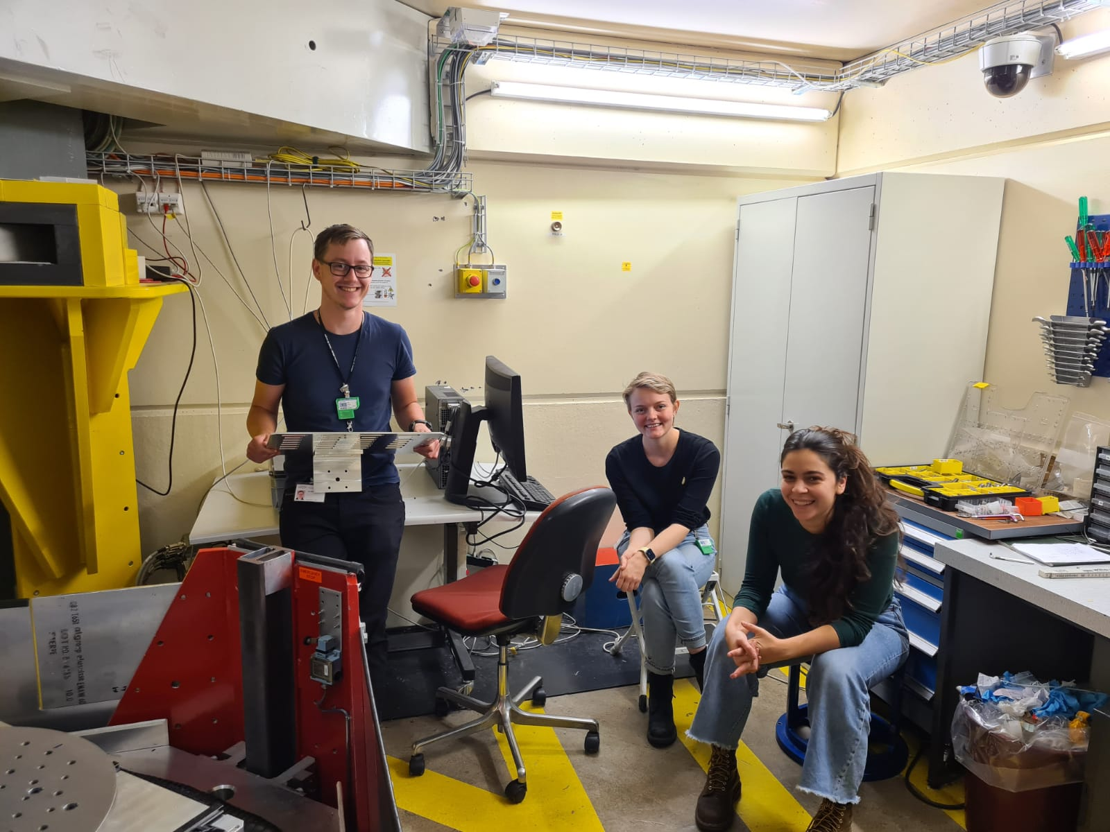
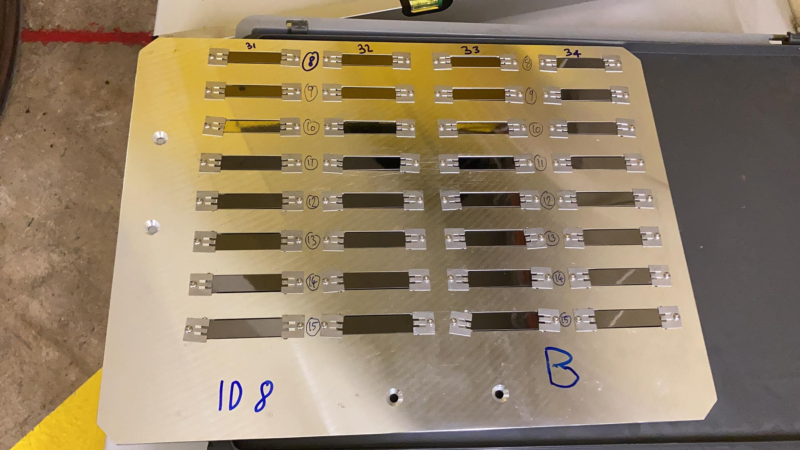
Analyzer SAT test
Tested graphite on a ToF diffractometer at PSI.
Students are happy before they realized why
we needed to be 4-5 people on a neutron beamtime
A single plate can be measured in 2 hours – reflectivity
is close to 1

Slide 12
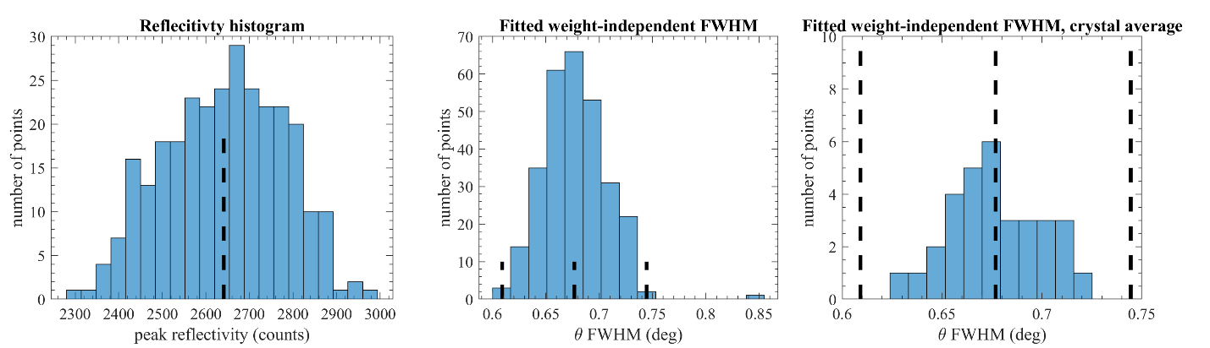
Analyzer SAT test
Strict requirements on mosaicity are actually fulfilled. Panasonics HOPG crystals are the best i have seen. We tested 300 / 1000 crystals, and deemed this sufficient.

Slide 13
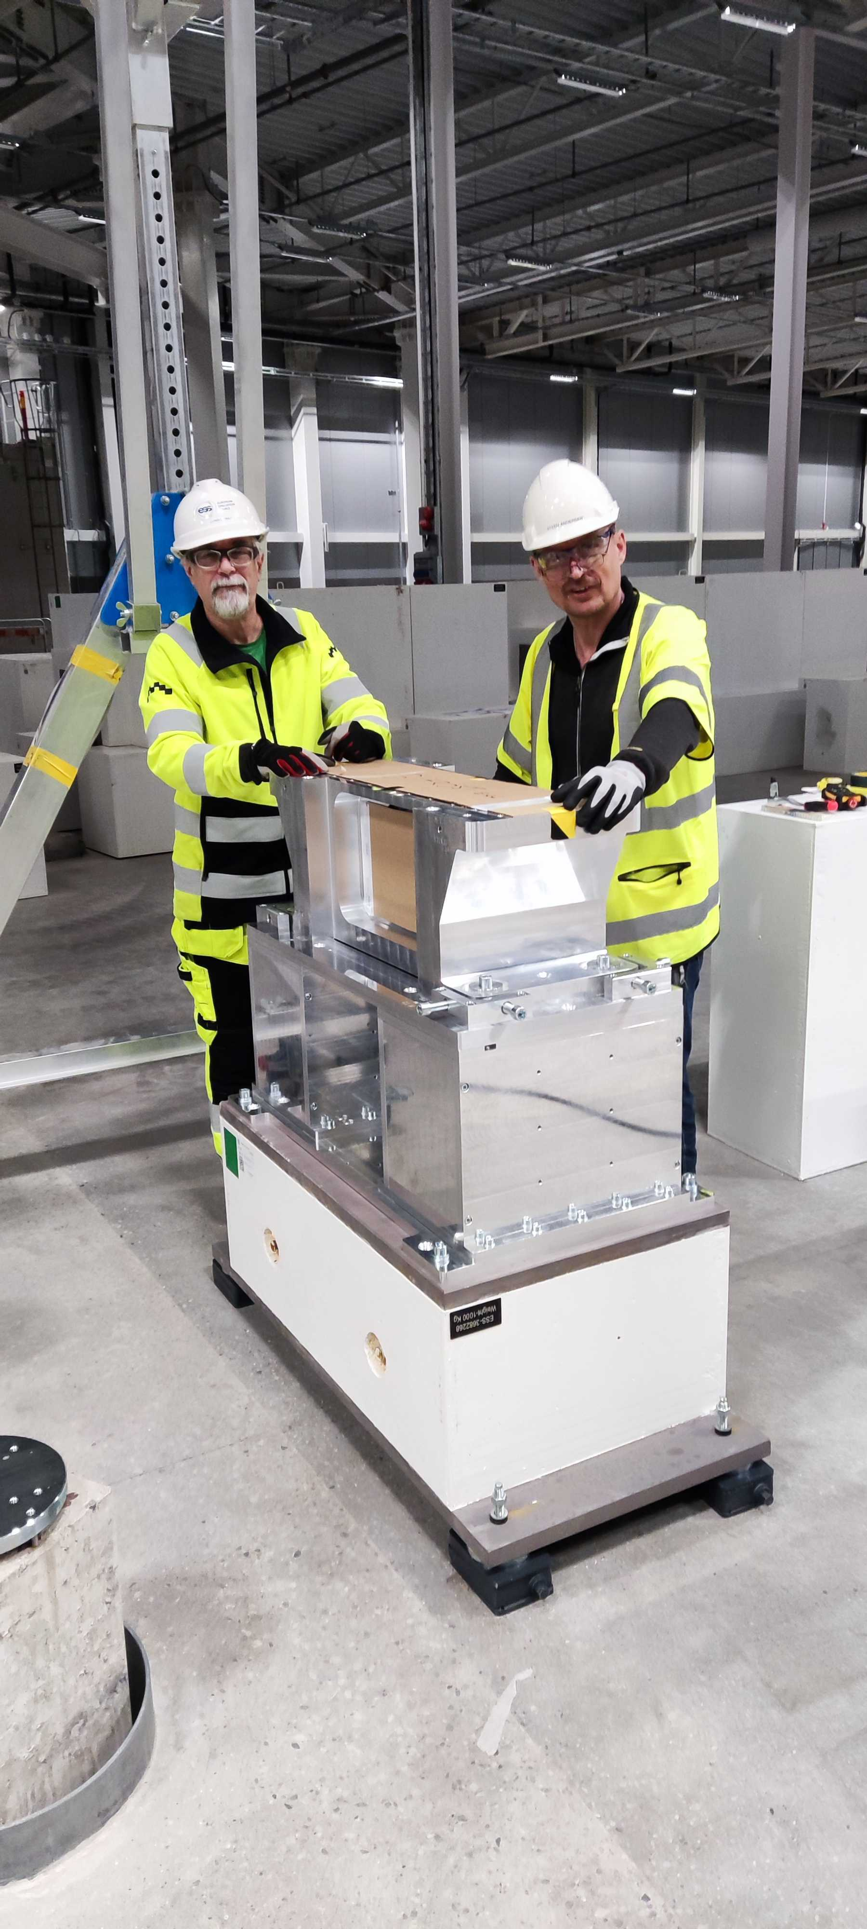
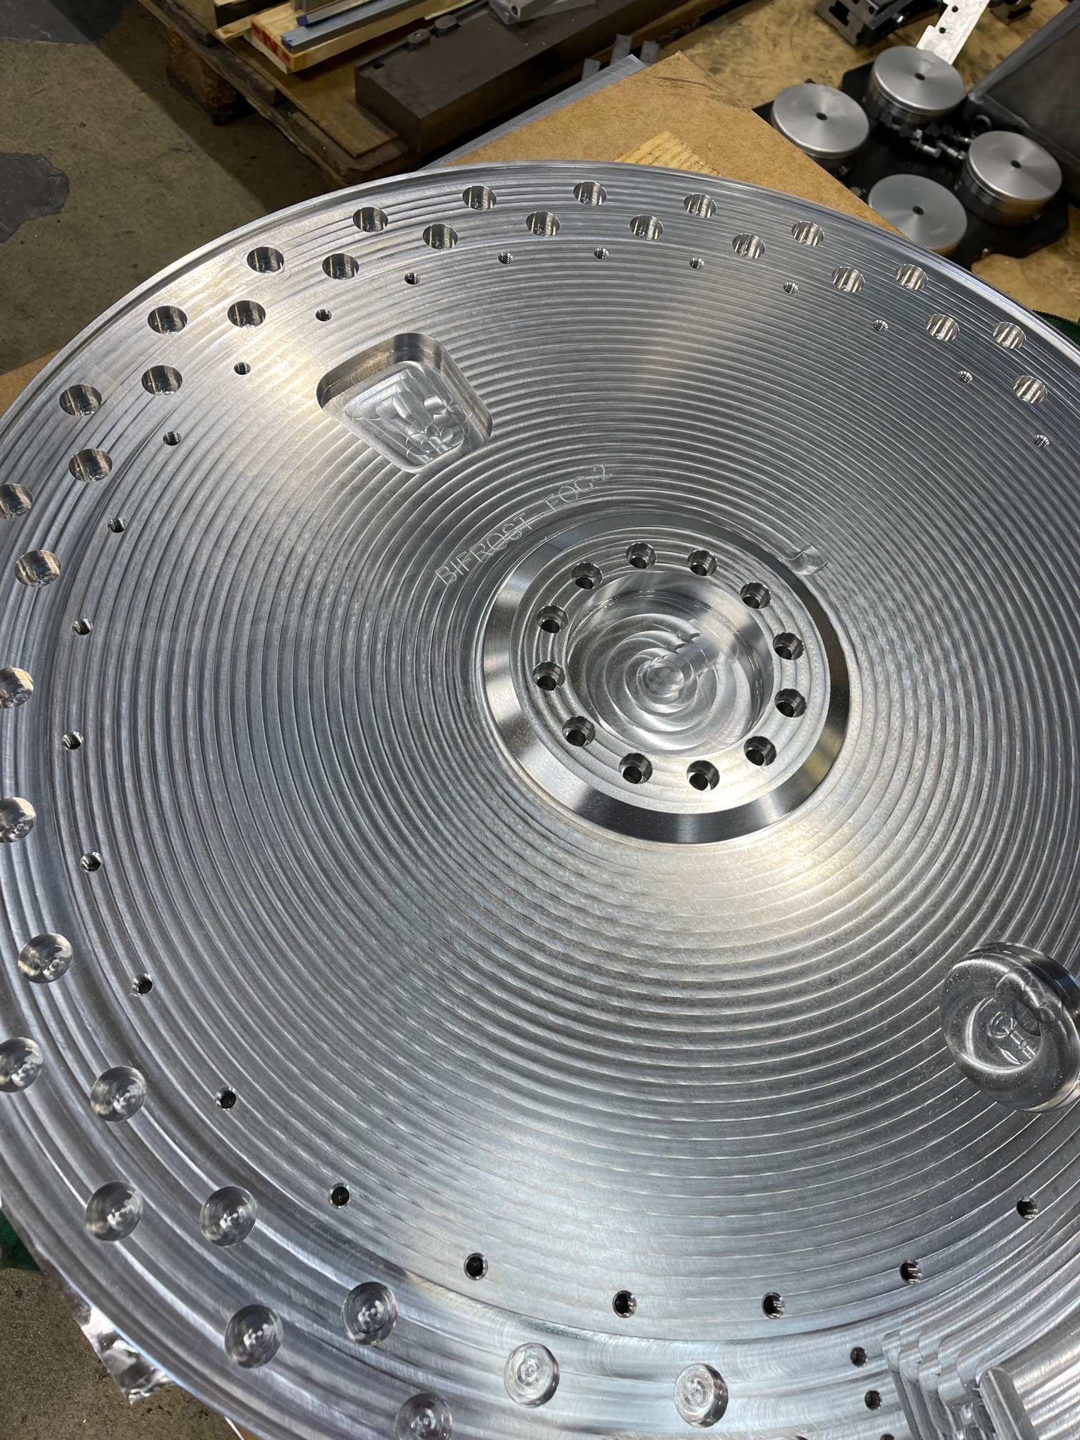
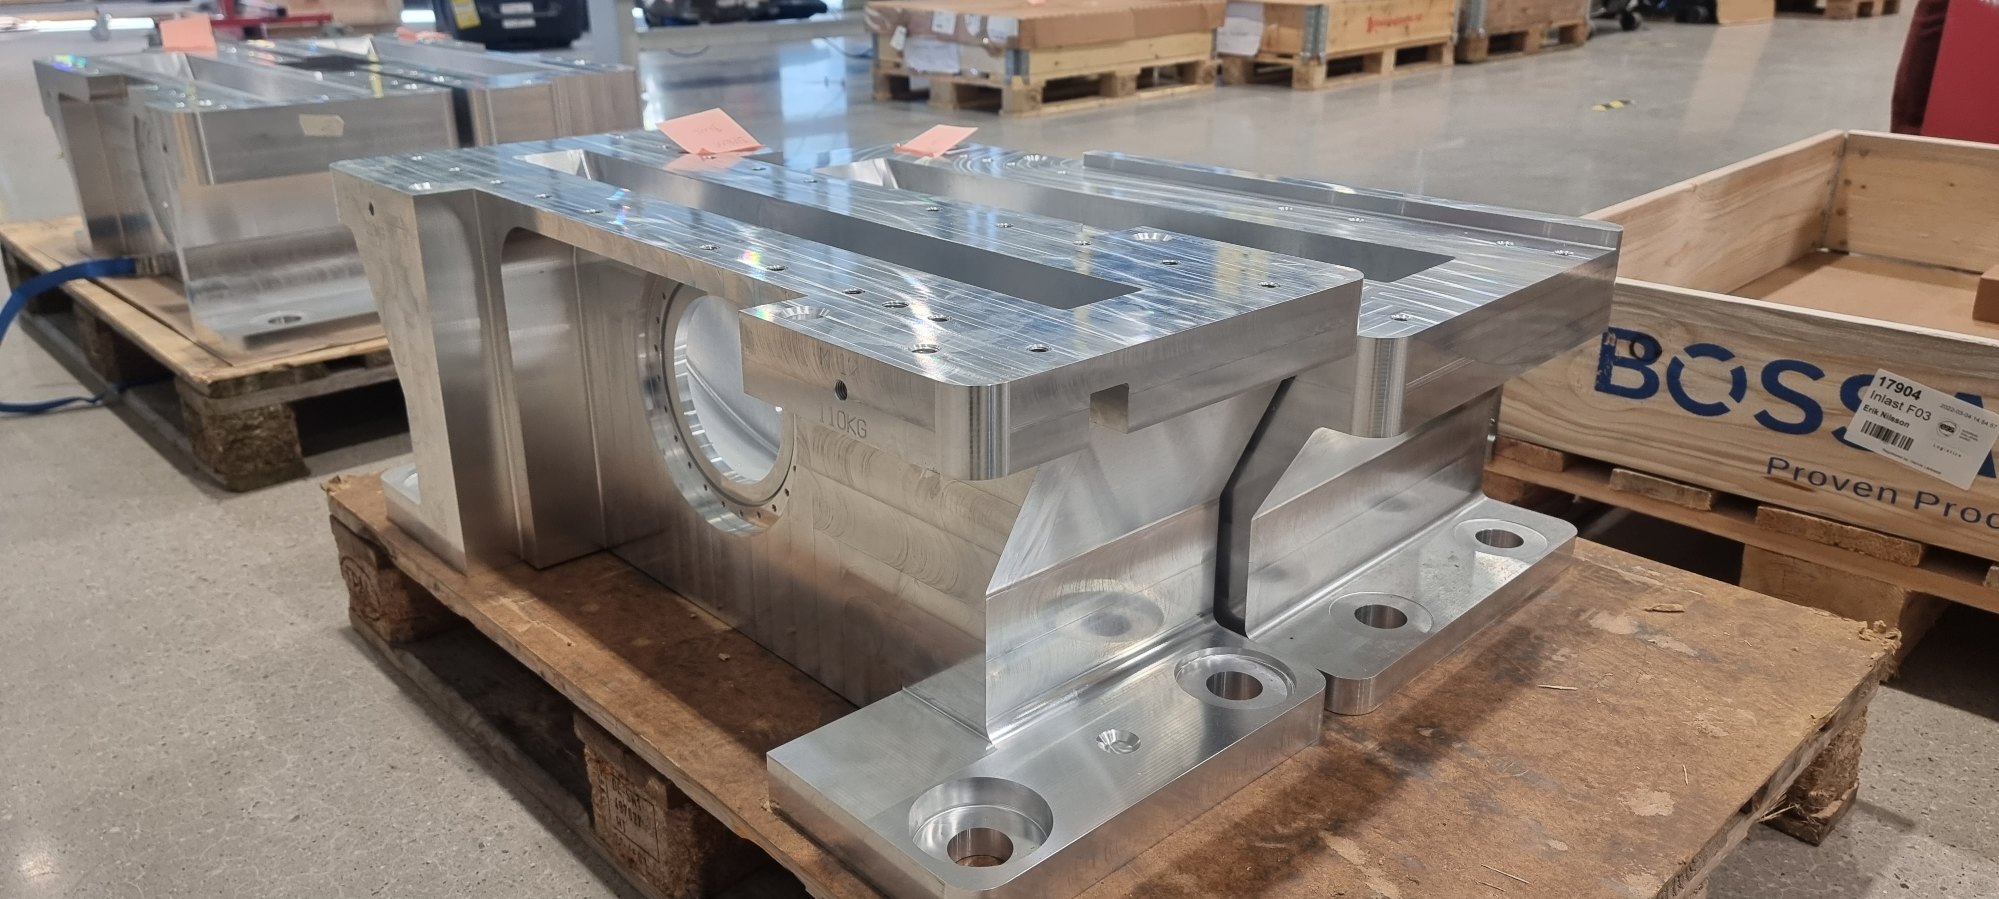
Common chopper project
Common chopper project progressing nicely
slow choppers are done in summer time
medium-speed PSC chopper is scheduled for
installation in Q3 this year

Slide 14
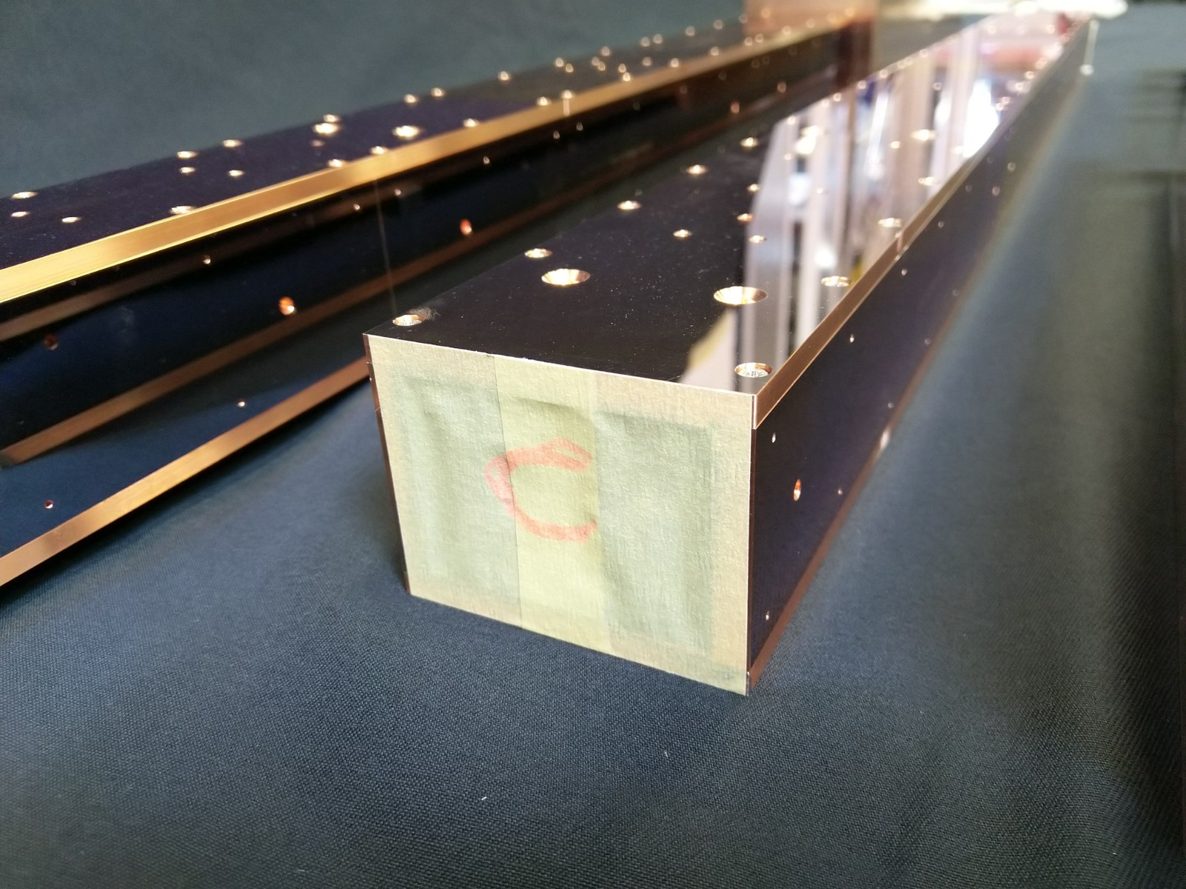
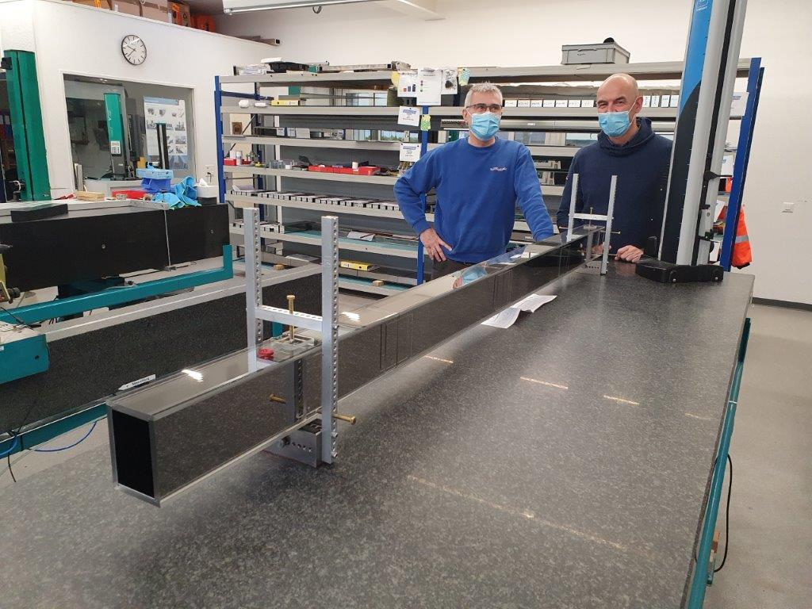
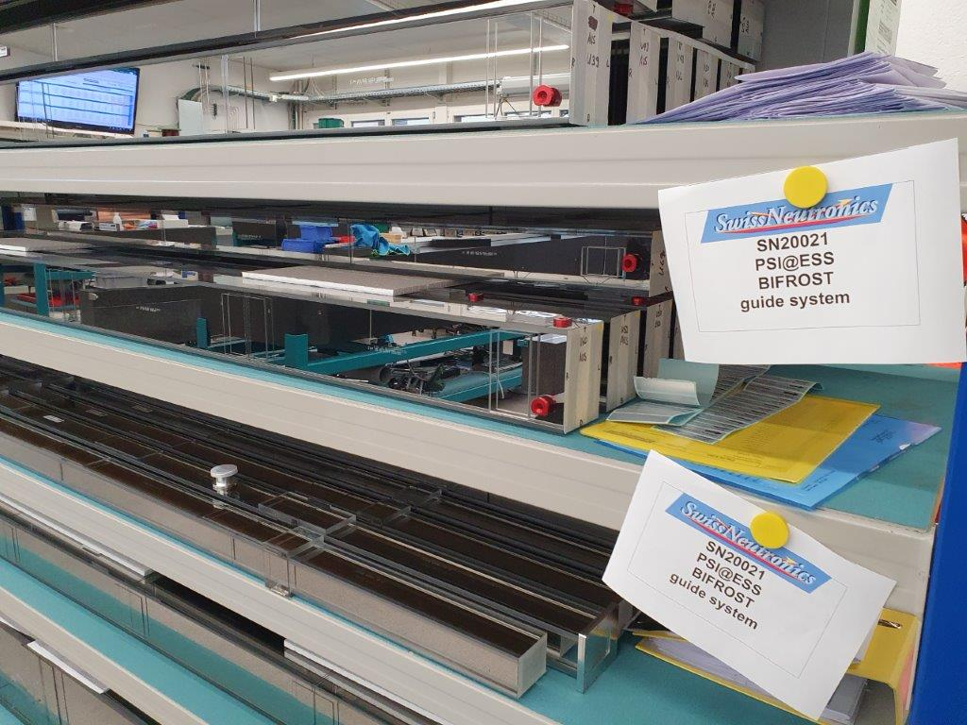
Guide
Guide manufactured, the first shipments of guide housing
and crossbeams have arrived.
Interesting times ahead, installation of the entire primary spectrometer this year.

Slide 15
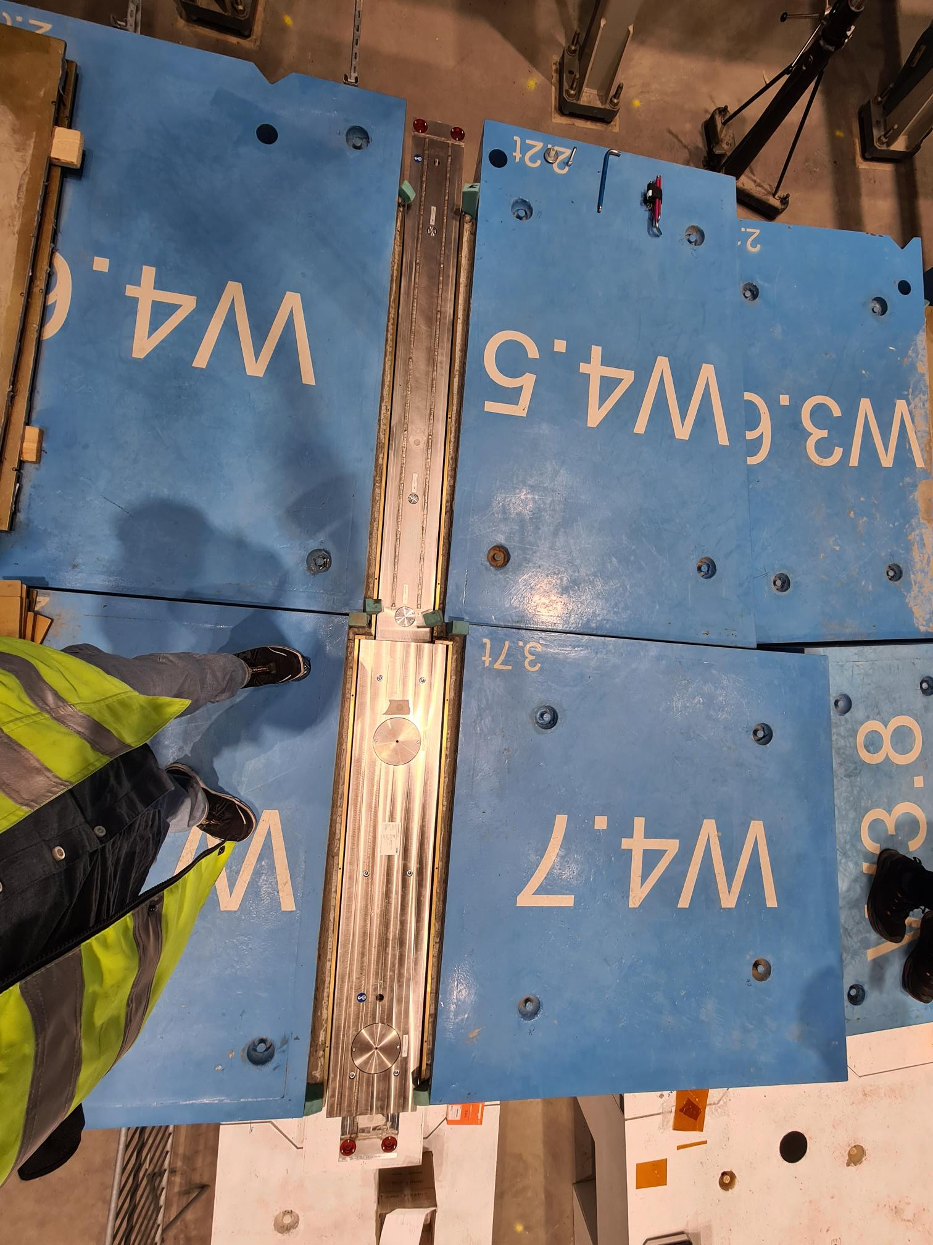
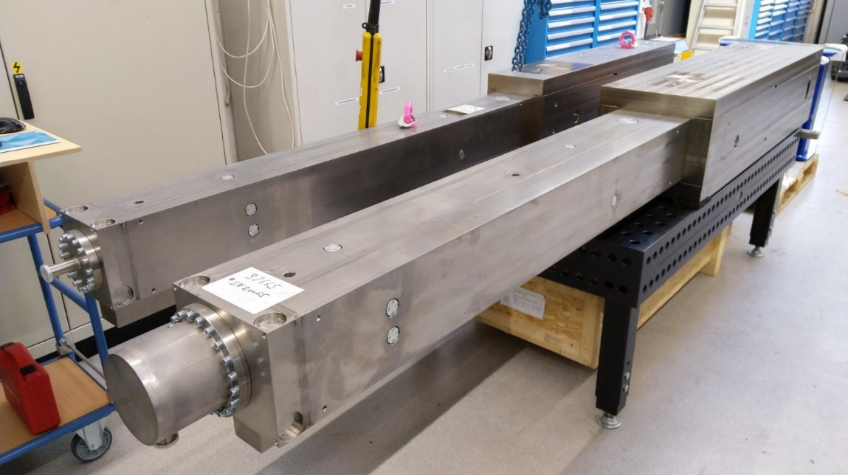
BWI installation done
In-bunker guide installation is scheduled for May
Chopper bases will follow
Bandwidth chopper (E02) and the rest of the
guide to be installed over summer
Fast PSC chopper is planned to be installed at the end
of the year

Slide 16
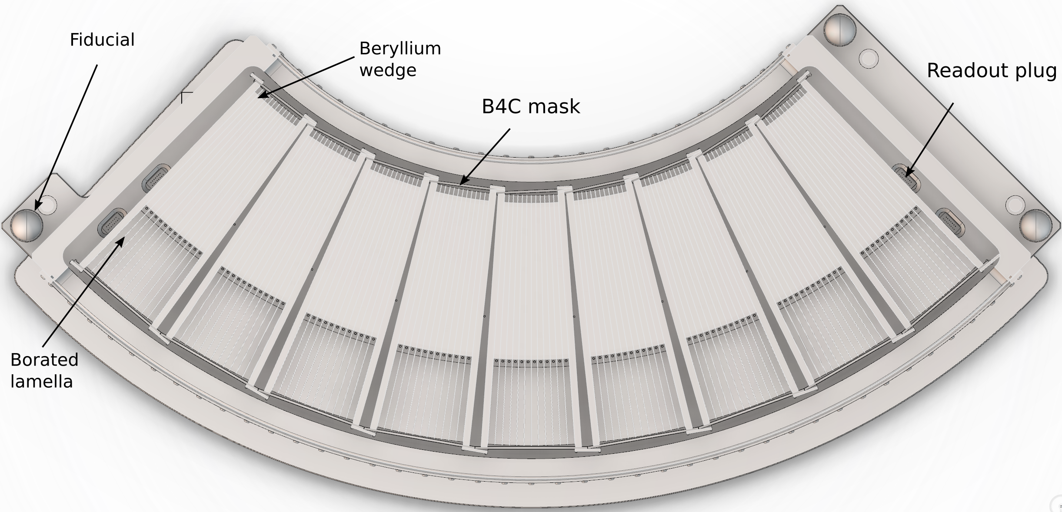
Beryllium filter
Produced in Denmark by the company JJ Xray
Material ordered, including premachine beryllium which is delivered
Copper base plates delivered
Sub-project to be finalized in September 2022

Slide 17
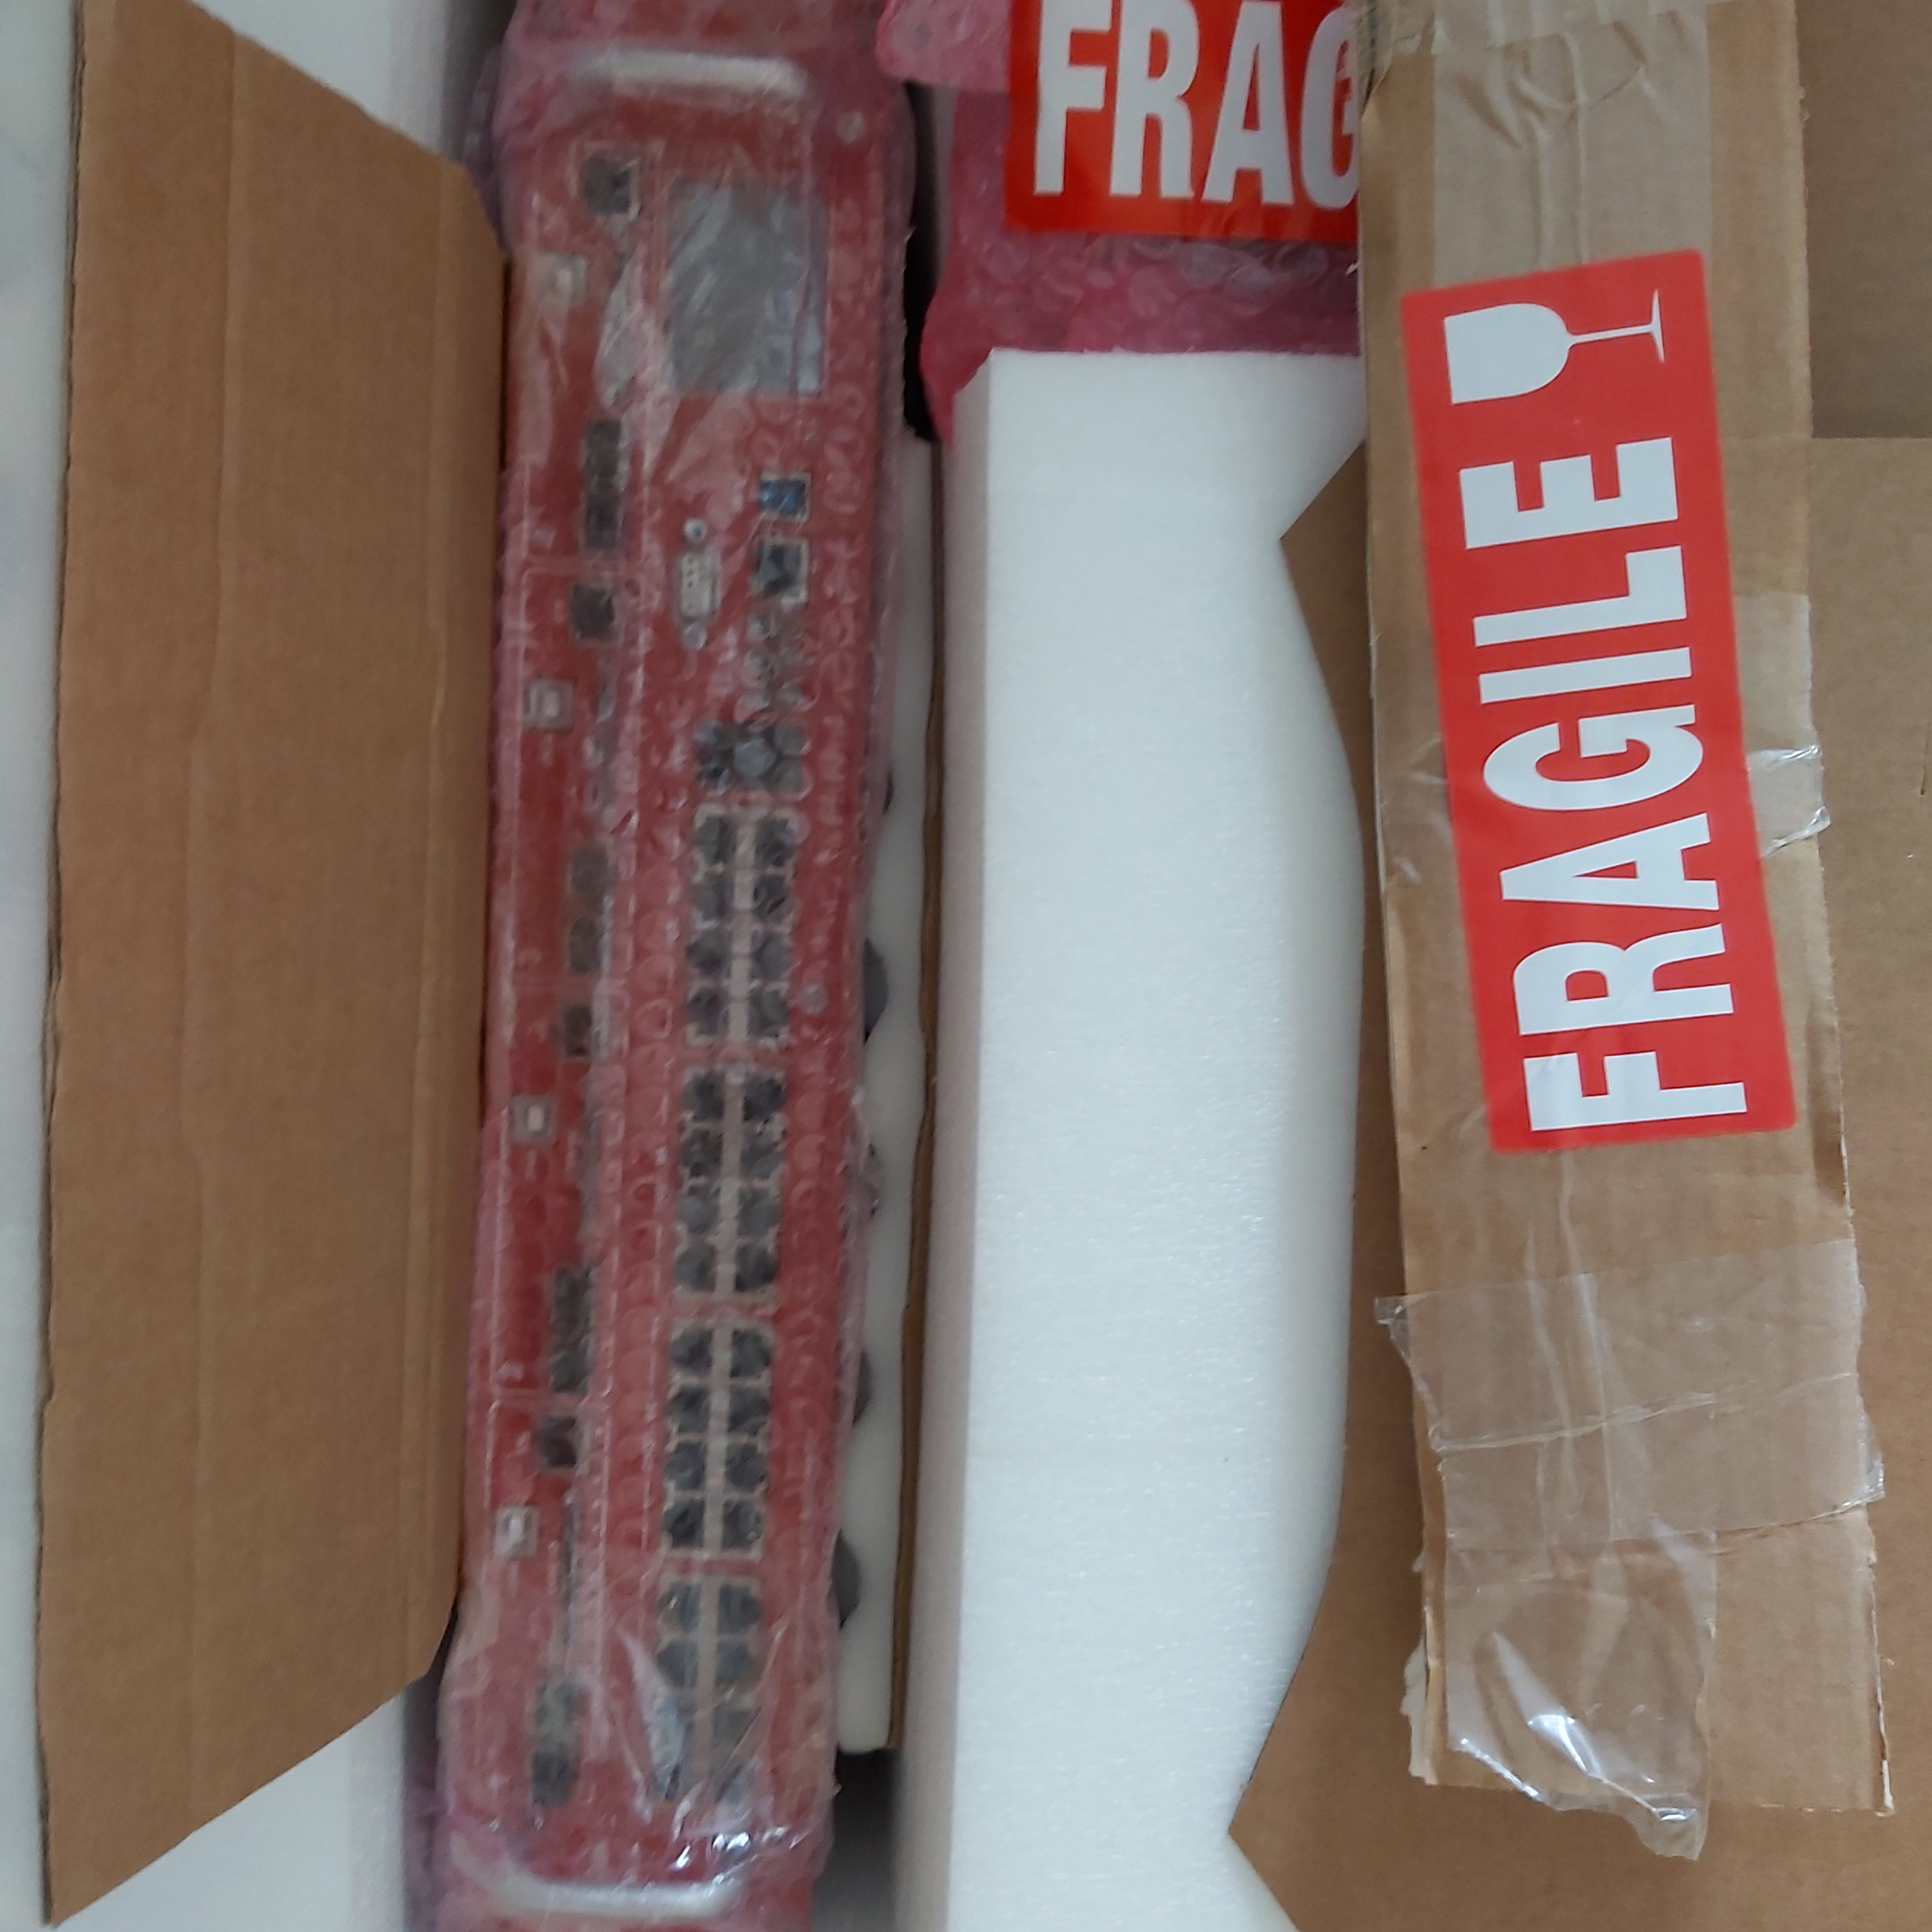
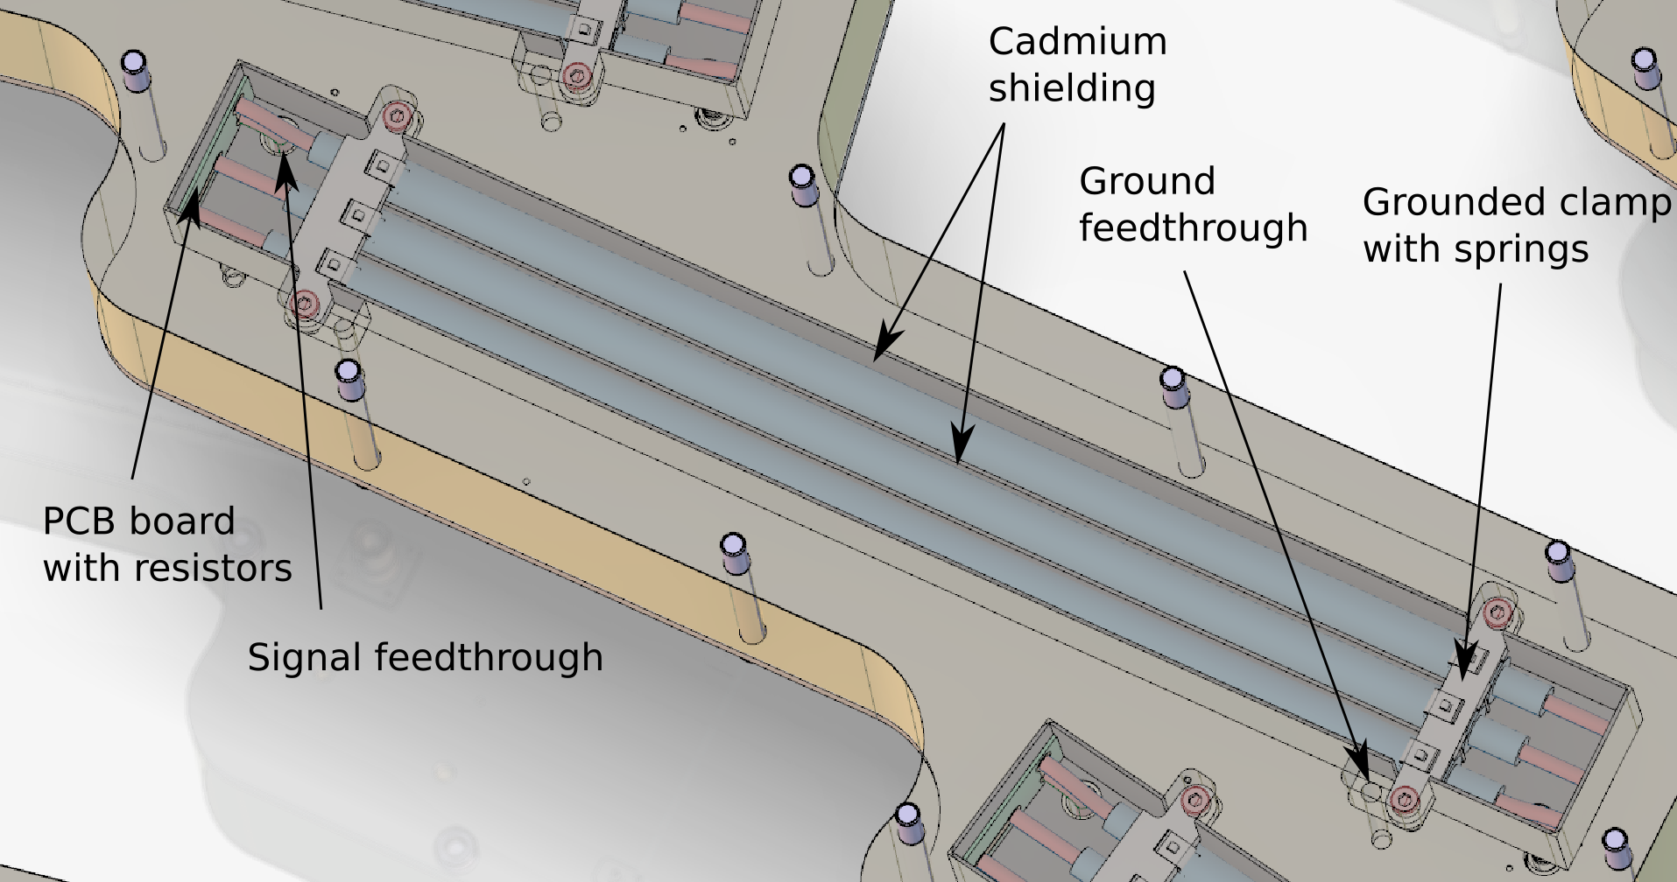
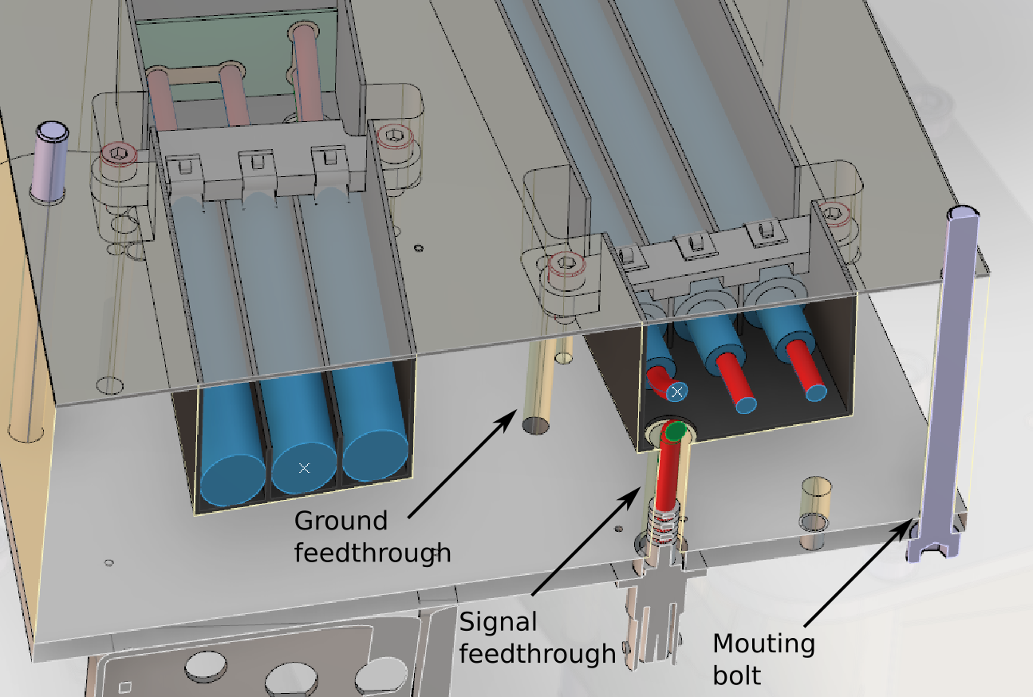
Detectors
The firmware has been agreed upon and
is being finalized by CAEN
Detector design is finalized and order ready to be placed
What remains is cabling design
ADC module is already procured

Slide 18
Very rough schedule
Bunker guide installation is planned to occur in May.
Chopper installation will be intertwined with guide installation, with CHIMS being connected and coaligned with guide housing
The slow chopper discs (FOC) and the bandwidth chopper will be installed in the summer and PSC in Q4 this year
Analysers will be assembled in late summer, installed in autumnm
Detectors: TG-3 is passed and construction can begin. The main digitizer has been bought and the preamplifiers ordered. Expected late 2022, early 2023.
Main schedule dependencies are in the primary spectrometer (bunker crane, other instruments). Once tank is back in place, detector installation is a local affair.
Interfaces with the ESS are relatively clear at this point.
Common projects are currently not on track, we have requirements but no budget and project start.

Slide 19
Financials & collaborations
DTU = 19.2% = €2,522,700
CEA/CNRS (LLB) = 11.7% = €1,532,920
PSI = 28.0% = €3,670,600
IFE = 7.3% = €954,341
KU = 2.7% = €351,500
ESS = 31.2% = €4,090,539
Currently, we seem to be on budget.
The major risks to financials are
Common electrical
Component failure
Detector modules (production
cabling and installation)
We have shifted enough scope to the ESS to make ESS the largest partner:
Choppers
Beamline shielding
Electrical work
Detector integration
Utilities
PSS
Cave (for procurement reasons)

Slide 20
Simulation work
New student to work 50 % on BIFROST for 4 years
Possible topics:
  Polarization upgrade
  Simulating resolution meausurements
  for hot commissioning
  Simulating magnons in the
  as-built design (or close to)
  Kristine Marie Løfgren Krighaar

Slide 21
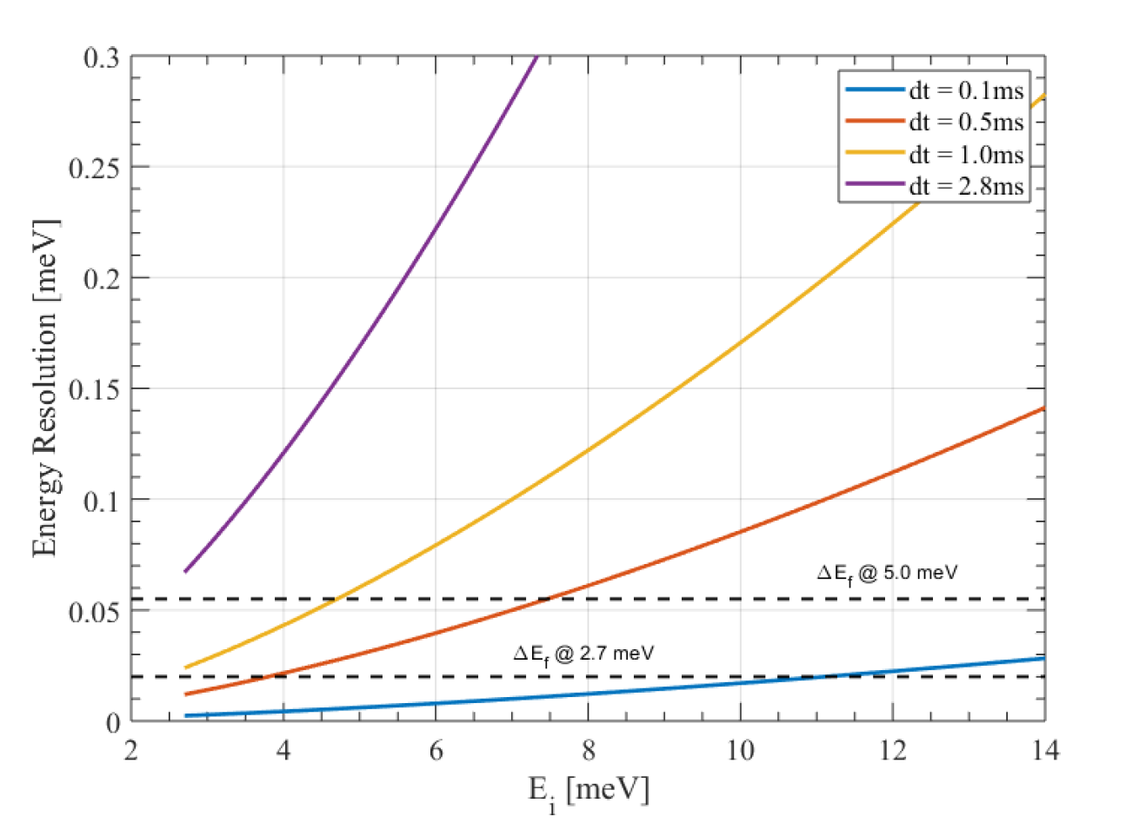
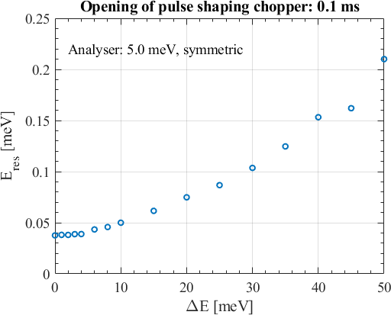
Simulation work
  Students at DTU started simulating ‘flat’ modes (using an incoherent virtual scatterer)
  Simulated resolution corresponds to what we expect
  A plan would be using 1 – 1,5 FTE on simulating resolution for hot commissioning comparison, and to simulate magnons to have an event mode data set for the data reduction algoritm

Slide 22
Early science will be at low flux
Low flux scenario: 50 kW - 10⁸ n/s/cm² (low resolution) 10⁶ n/s/cm² (high resolution)
  The currently agreed model is that the instrument consortium leads the early science program before user operation – possibly with external friendly users.
Flux. Round robin MnF2 sample, but then going to a well known more complex system and see similar fits
Mapping: Frustrated systems with large moment and broad features
Resolution in Q and E : MnF2, more recently studied samples. Test deep inelastic resolution on a strong scatterer could be a very good demonstration
Signal noise background: Round robin, but also closing a gap would demonstrate elastic line performance. Both high resolution and low resolution for all analyser energies

Slide 23
Thank you for your attention
Liam Whitelegg (Lead engineer & IPL)
Sylvain Rodrigues (LLB engineer)
Rasmus Toft-Petersen (lead scientist)
Finn Saxild (Technician DTU)
Keld Theodor (Technician KU)
Special thanks to:
ESS chopper group (Erik, Ioannis and Nico)
Common shielding project (Senad and Marie-Louise)
Detector group (Steven, Richard & Kelly)
Common electrical (Stuart Birch)
PSS (Morteza)
Common utilities (who?)

