Slide 2
Sample Environment group general update
Organisation
Labs & workshop
PRESENTED BY Caroline Curfs

Slide 3
Agenda
1 The Team
2 Planning
3 Labs and workshops

Slide 4









1
The Team

Slide 5
The Team
Members and field of expertise
Mechanical design
Tobias Quispe
Interface with ECDC
and control integration
Anders Petersson
Sample Environment Group
Caroline Curfs Group Leader
Cryogenics and Magnetic Fields
Alex Holmes
High Pressure
Mechanical Processing and High Temperatures
covered by Group Leader,
Soft Matter, Surfaces, Interfaces
Physical Chemistry (Alice Corani) (maternity leave)
Control Integration
Niklas Ekström, Andreas Hagelberg
Support Technicians Richard Ammer Lauritz Saxtrup

Slide 6
The Team
Members and field of expertise
Mechanical design
Tobias Quispe
Interface with ECDC
and control integration
Anders Petersson
Sample Environment Group
Caroline Curfs Group Leader
Cryogenics and Magnetic Fields
Alex Holmes
High Pressure
Basic coverage by Group Leader and Lauritz Saxtrup
Mechanical Processing and High Temperatures
covered by Group Leader,
Soft Matter, Surfaces, Interfaces
Basic coverage by Group Leader and Anders Pettersson
Physical Chemistry (Alice Corani) (maternity leave)
Control Integration
Niklas Ekström, Andreas Hagelberg
Support Technicians Richard Ammer Lauritz Saxtrup

Slide 7
The future Team
Planned recruitment
BOT
SOUP
2022 : 3 engineers/scientists
  Cryo/magnets
  High Pressure
  Soft matter and surface/interface
2023 : 1 engineers or 1 technician
  Mechanical processing/high temperature?
  Technician for cryo?
: 1 technician
2027 : 1 technician

Slide 8
2
Planning

Slide 9
Planning
Magnets
 | Budget | 2022 | 2023 | 2024 | 2025 | 2026 | 2027 | >2027
2.5 T WBM | 300 |  |  | X
8 T magnet | IK |  |  | X
5 T WBM(reflecto) | 480 |  |  |  |  |  |  | X
17 T Horizontal | ?
2.5 T WBM | 300 |  |  |  |  |  |  | X
15 T magnet | 240 |  | X |  | X
15 T magnet | 120 |  | X |  | X
6.5 T magnet | 180 |  |  | X
Spectro magnet | IK |  |  |  | X
Preparation CFT
Design
CFT
Construction
Procurement
Tests
Control and mechanical
integration
X
Tests on the
instrument
Specifications

Slide 10
Planning
Cryo provided by instruments and IK
 | Inst | 2022 | 2023 | 2024 | 2025 | 2026 | 2027 | >2027
Cryofurnace 20 ch | DREAM |  |  |  |  |  | X
Fow cryostat | ESTIA |  | X
Wet cryostat | BIFROST | X
Cryofurnace | CSPEC |  |  | X
Sample changer 6 | CSPEC |  |  | X
He3 insert | CSPEC |  |  | X
Wet cryostat | MAGIC
Dry cryostat | VESPA
HP cryostat | IK
Preparation CFT
Design
CFT
Construction
Procurement
Tests
Control and mechanical
integration
X
Tests on the
instrument
Specifications

Slide 11
Planning
Pool cryo
 | Budget | 2022 | 2023 | 2024 | 2025 | 2026 | 2027 | >2027
Wet cryo HEIMDAL | 60
Cryofurnace DIFF 2nd hand | 60
Sample rot sticks x6 | 120
Dil. fridge (2nd hand) | 90
Wet cryo SANS | 60 |  |  |  |  |  | X
Dilution fridge with 8T | 300 |  |  |  | X
He3 sorption insert | 180
Wet cryo BIFROST | 60
Wet cryo MAGIC OC#1 | 60
Dry cryo HEIMDAL | 120
Wet cryo MIRACLES | 60
Wet Cryo TREX | 60
Dry Cryo SANS | 120 |  |  |  |  | X
Dry Cryo SPECTRO | 120
Dry Cryo DIFF EC | 120
Cryofurnace HEIMDAL | 120
Cryofurnace TREX | 120

Slide 12
Planning
High Pressure
 | Budget | 2022 | 2023 | 2024 | 2025 | 2026 | 2027 | >2027
Clamps | IK |  |  |  |  | X
Gas cells | IK |  |  |  |  | X
PE | IK |  |  |  |  | X
Gas loading for PE | IK |  |  |  |  | X
DAC | 50
Preparation CFT
Design
CFT
Construction
Procurement
Tests
Control and mechanical
integration
X
Tests on the
instrument
Specifications

Slide 13
Planning
High temperature & mechanical processing
 | Budget | 2022 | 2023 | 2024 | 2025 | 2026 | 2027 | >2027
Induction furnace | 90
Cryostream/hot air blower | 90
ILL-type furnace x2 | 75
Rig 60-100 kN + joule heating | 120
50 kN tortion/rotation rig | 420
5-10 kN rig | 0
Dilatometer | 480
Gleeble | 0
Mirror furnace | ext
Preparation CFT
Design
CFT
Construction
Procurement
Tests
Control and mechanical
integration
X
Tests on the
instrument
Specifications

Slide 14
Planning
Soft matter, Surfaces/Interfaces, In-situ and physical-chemistry
 | Budget | 2022 | 2023 | 2024 | 2025 | 2026 | 2027 | >2027
SANS sample ch thermalised | LOKI
SANS sample ch tumbler | LOKI
Flow cell | LOKI
Stopped flow cells | IK
Rheometer | IK
Solid/liquid cells | ext
Solid/air cells | ext
Fluo + UV | ext
TGA | ext
Laser Pump and Probe | IK
Electrochemical cell | IK
Gas handling | IK
Electrochemicalk cells | ext
Humidity chamber | IK

Slide 15
Planning
Rough estimation of engineering resources needed (FTE) and actual resources
To start and follow projects, and perform tests
 | Eng | 2022 | 2023 | 2024 | 2025 | 2026 | 2027
Magnets |  | 0,68 | 0,89 | 0,41 | 0,36 | 0,20 | 0,28
Cryo |  | 0,89 | 0,98 | 1,17 | 1,01 | 0,46 | 0,08
High Pressure |  | 0,19 | 0,17 | 0,00 | 0,00 | 0,00 | 0,00
Mechanical processing |  | 0,10 | 0,22 | 0,00 | 0,00 | 0,08 | 0,00
High temperature |  | 0,35 | 0,35 | 0,13 | 0,00 | 0,00 | 0,00
Soft matter |  | 0,55 | 0,04 | 0,00 | 0,04 | 0,04 | 0,00
Surface interfaces |  | 0,00 | 0,00 | 0,00 | 0,00 | 0,00 | 0,00
In situ |  | 0,10 | 0,15 | 0,00 | 0,00 | 0,00 | 0,00
Physical chemistry |  | 0,28 | 0,29 | 0,00 | 0,00 | 0,00 | 0,00

Slide 16
Summary
SES for 2022 and status expected by the end of year
Magnets | 2.5 T WBM | 8 T magnet | 15 T magnet | Spectro magnet
Cryo Instr. & IK | Fow cryostat ESTIA | Wet cryostat BIFROST | Cryofurnace CSPEC | Sample changer 6 CSPEC | He3 insert CSPEC | HP cryostat
Cryo pool | Sample rot sticks | Dry Cryo DIFF EC
High Pressure | Clamps | Gas cells | PE | Gas loading for PE
Mechanical processing | Rig 60 kN | Tortion/rot. rig | Dilatometer
High temperature | ILL-type furnace
Soft matter | SANS SC therm. | SANS SC tumbler | Stopped flow cells | Rheometer
Surface interfaces | Solid/liquid cells
In situ | Laser P&P
Physical chemistry | Electrochem. cell | Gas handling | Humidity
Preparation CFT
Design
CFT
Construction
Procurement
Tests
Control and mechanical
integration
X
Tests on the
instrument
Specifications

Slide 17
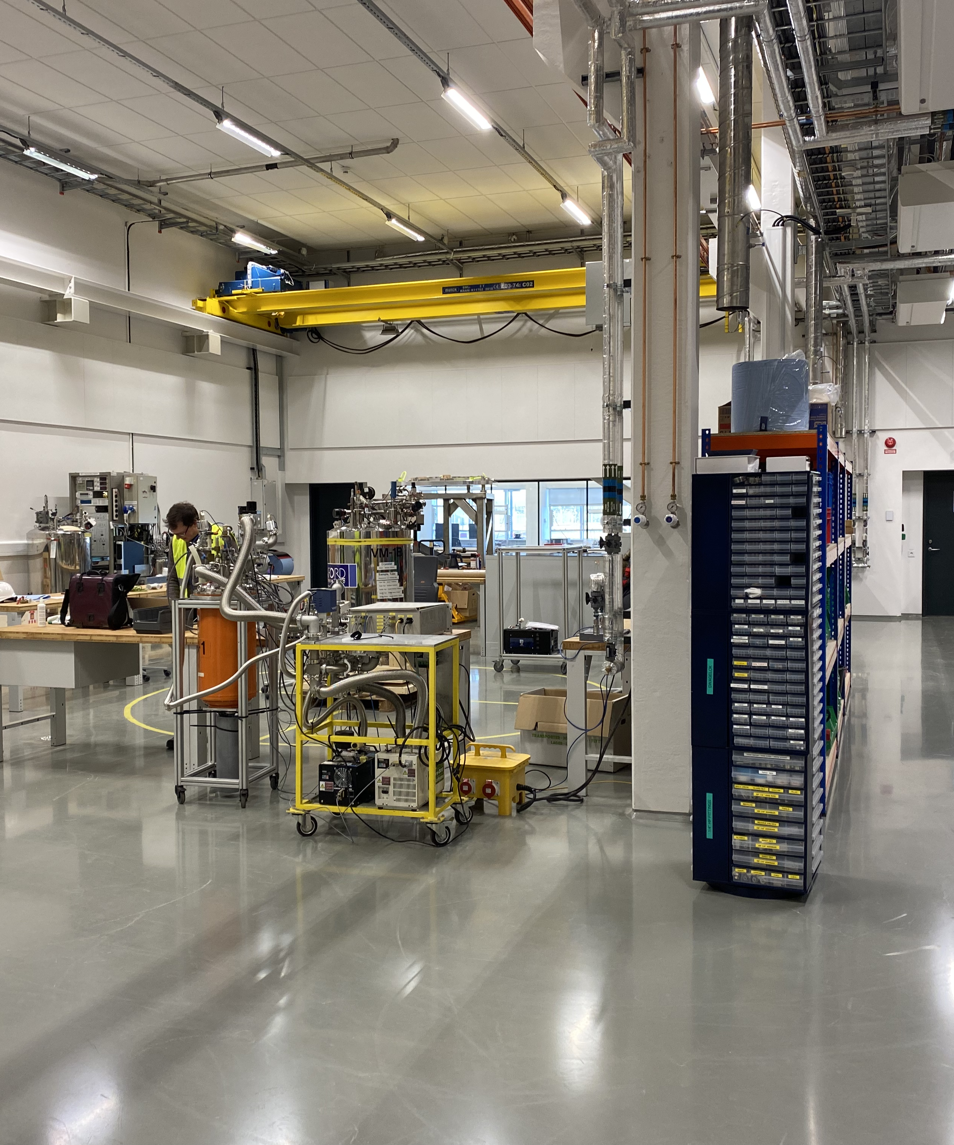
3
Labs and workshops

Slide 18
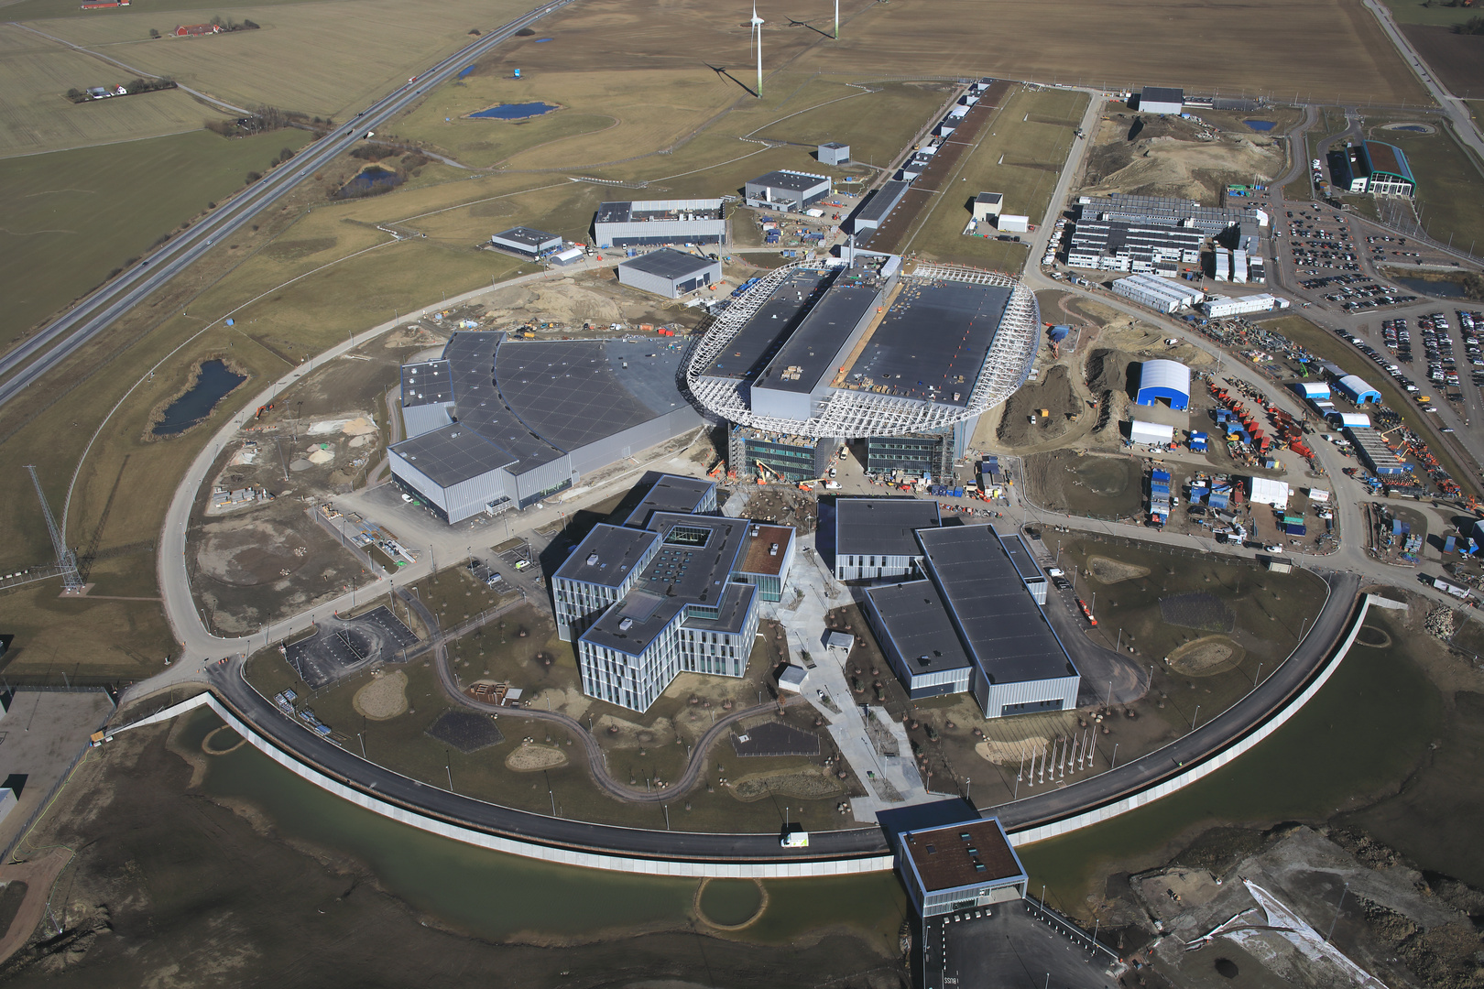
SE Labs and workshops
Overview
D04
57 sqm
Close to LOKI and FREIA
Not far from ESTIA, SKADI and VESPA
E03
Ground floor:
65 m² (quiet area)
257 m² (labs and workshops)
1st floor:
65 m² (quiet area)
267 m² (labs and workshops)
D08
Ground floor : 115 sqm
1st floor: 45 sqm
close to ODIN and DREAM
B02
SE space outside the restricted zone
currently shared with ECDC and MCA (and Chopper and detectors) for collaborative projects

Slide 19
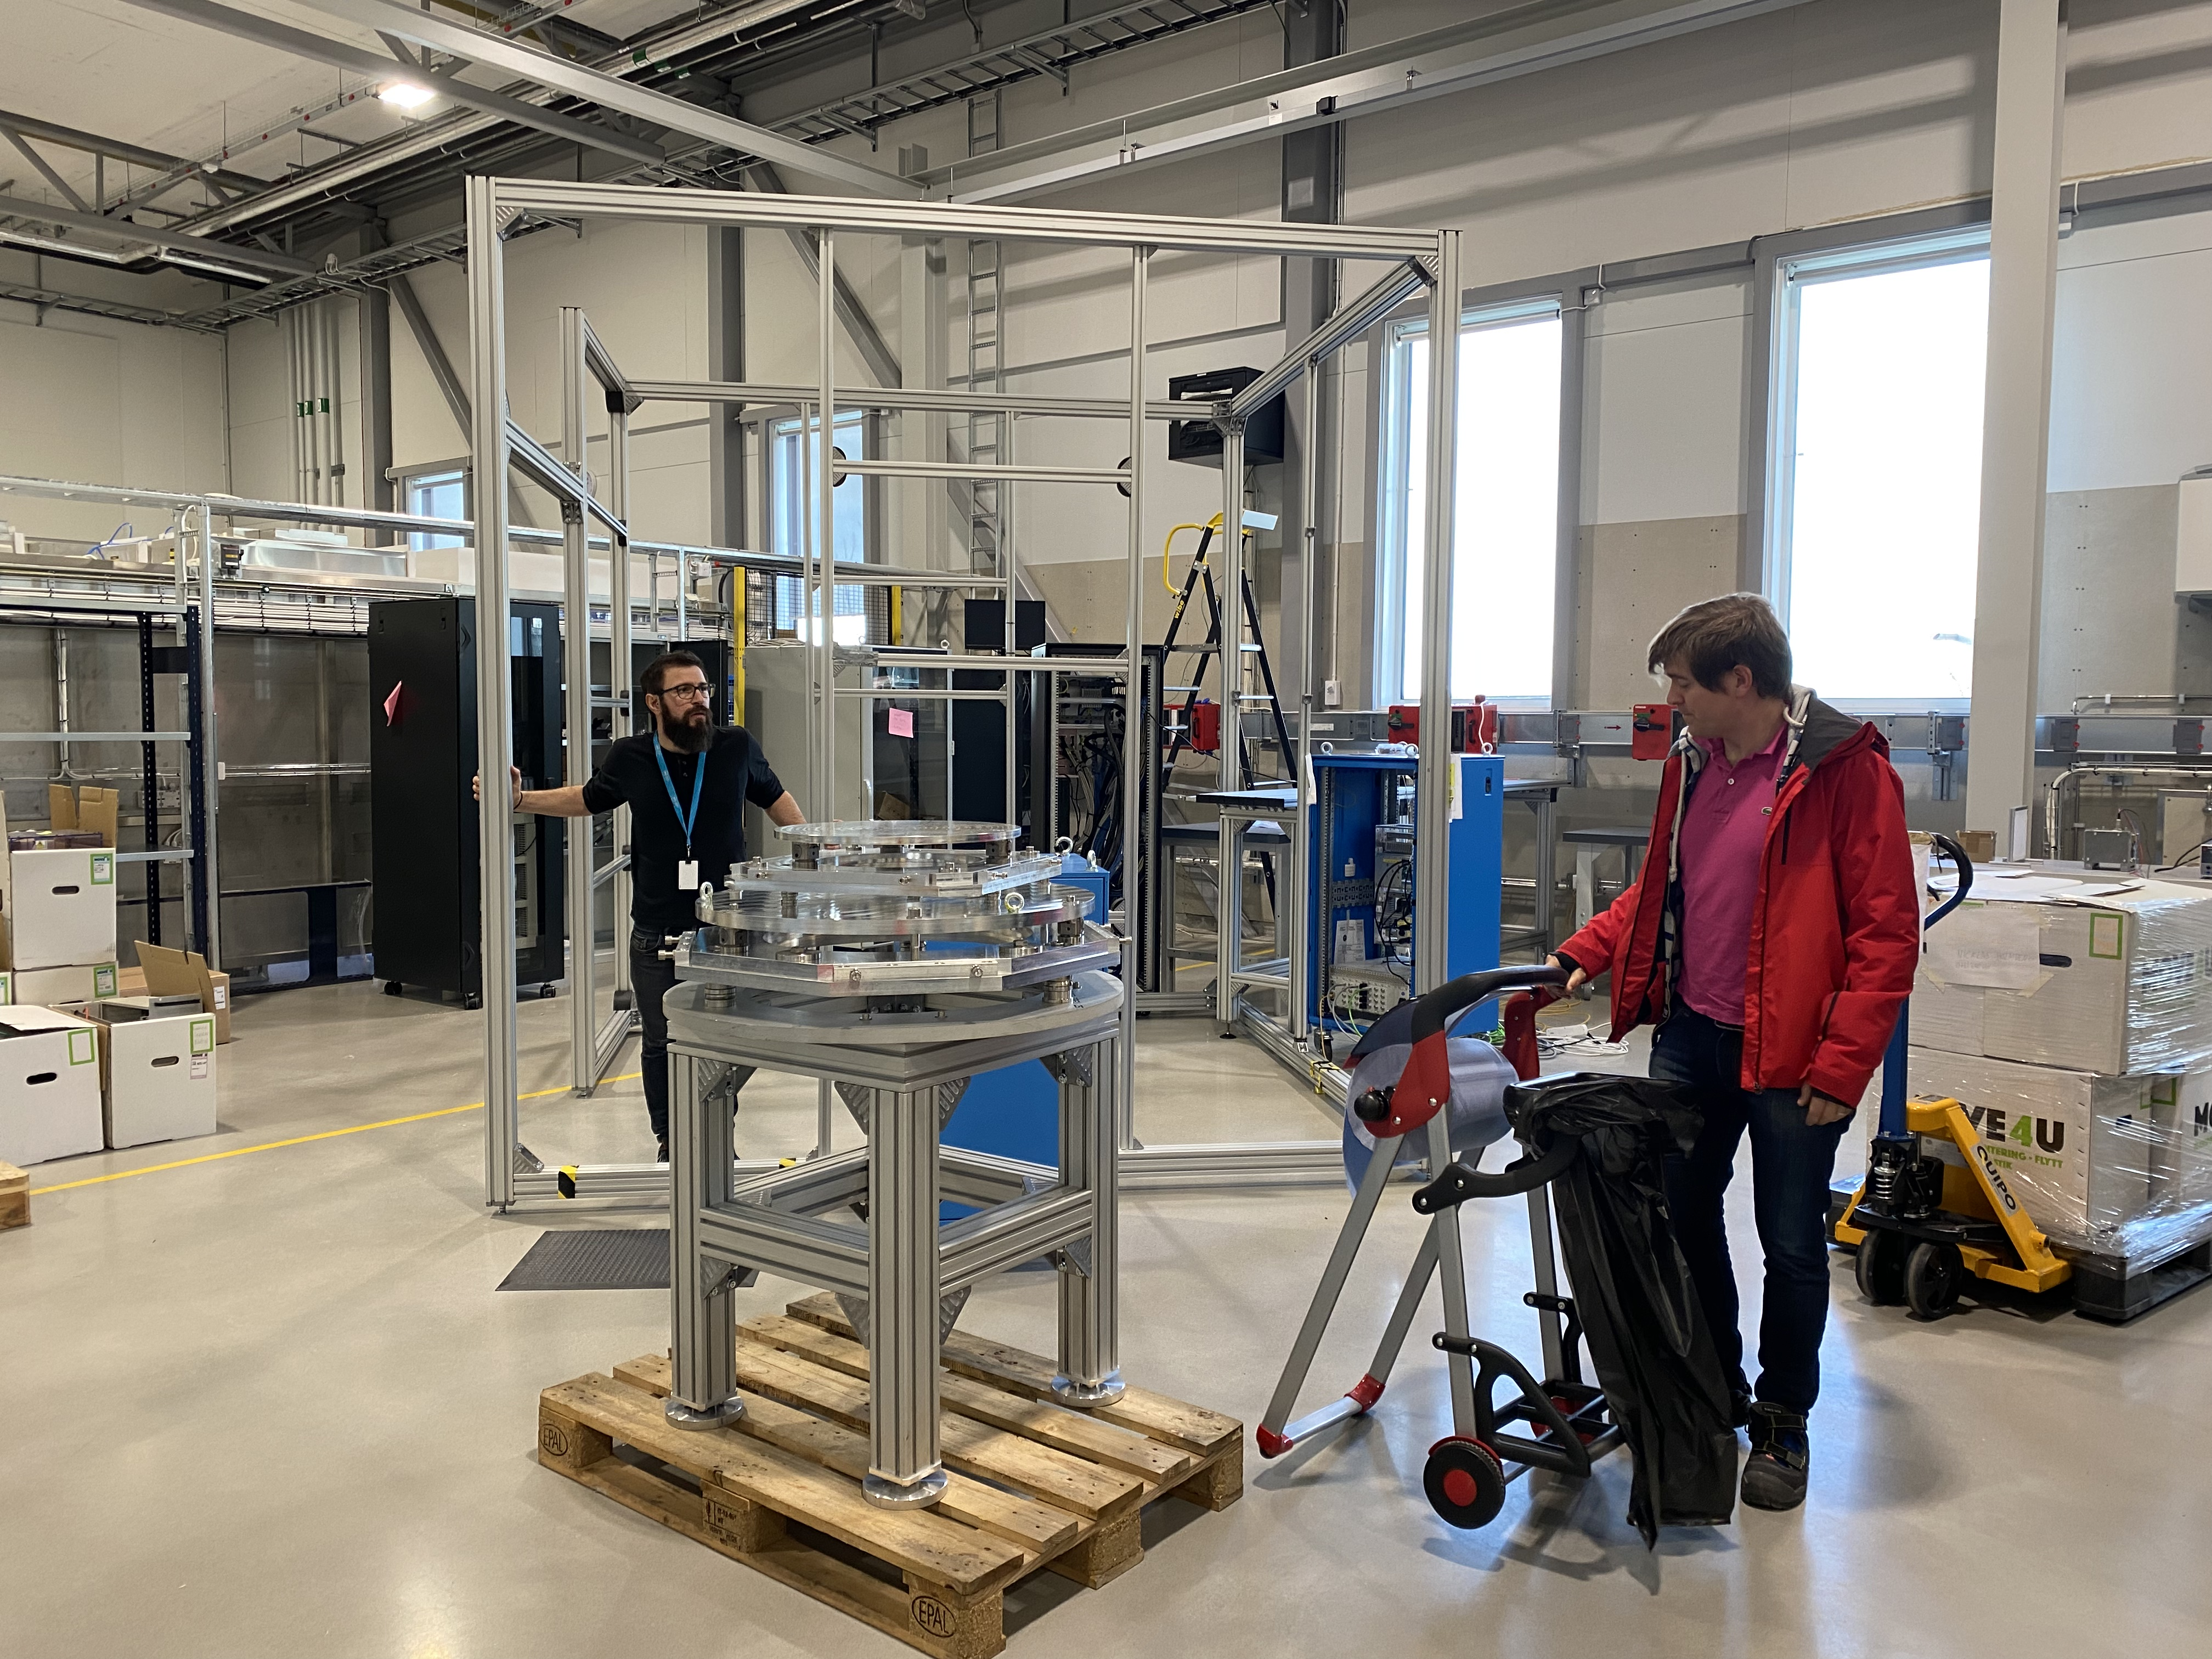
B02 : the share space
SE-ECDC-MCA-CHOPPER-DETECTOR-ICS-….
A place where you can test your equipment as if you were on a neutron instrument
More on the tour

Slide 20
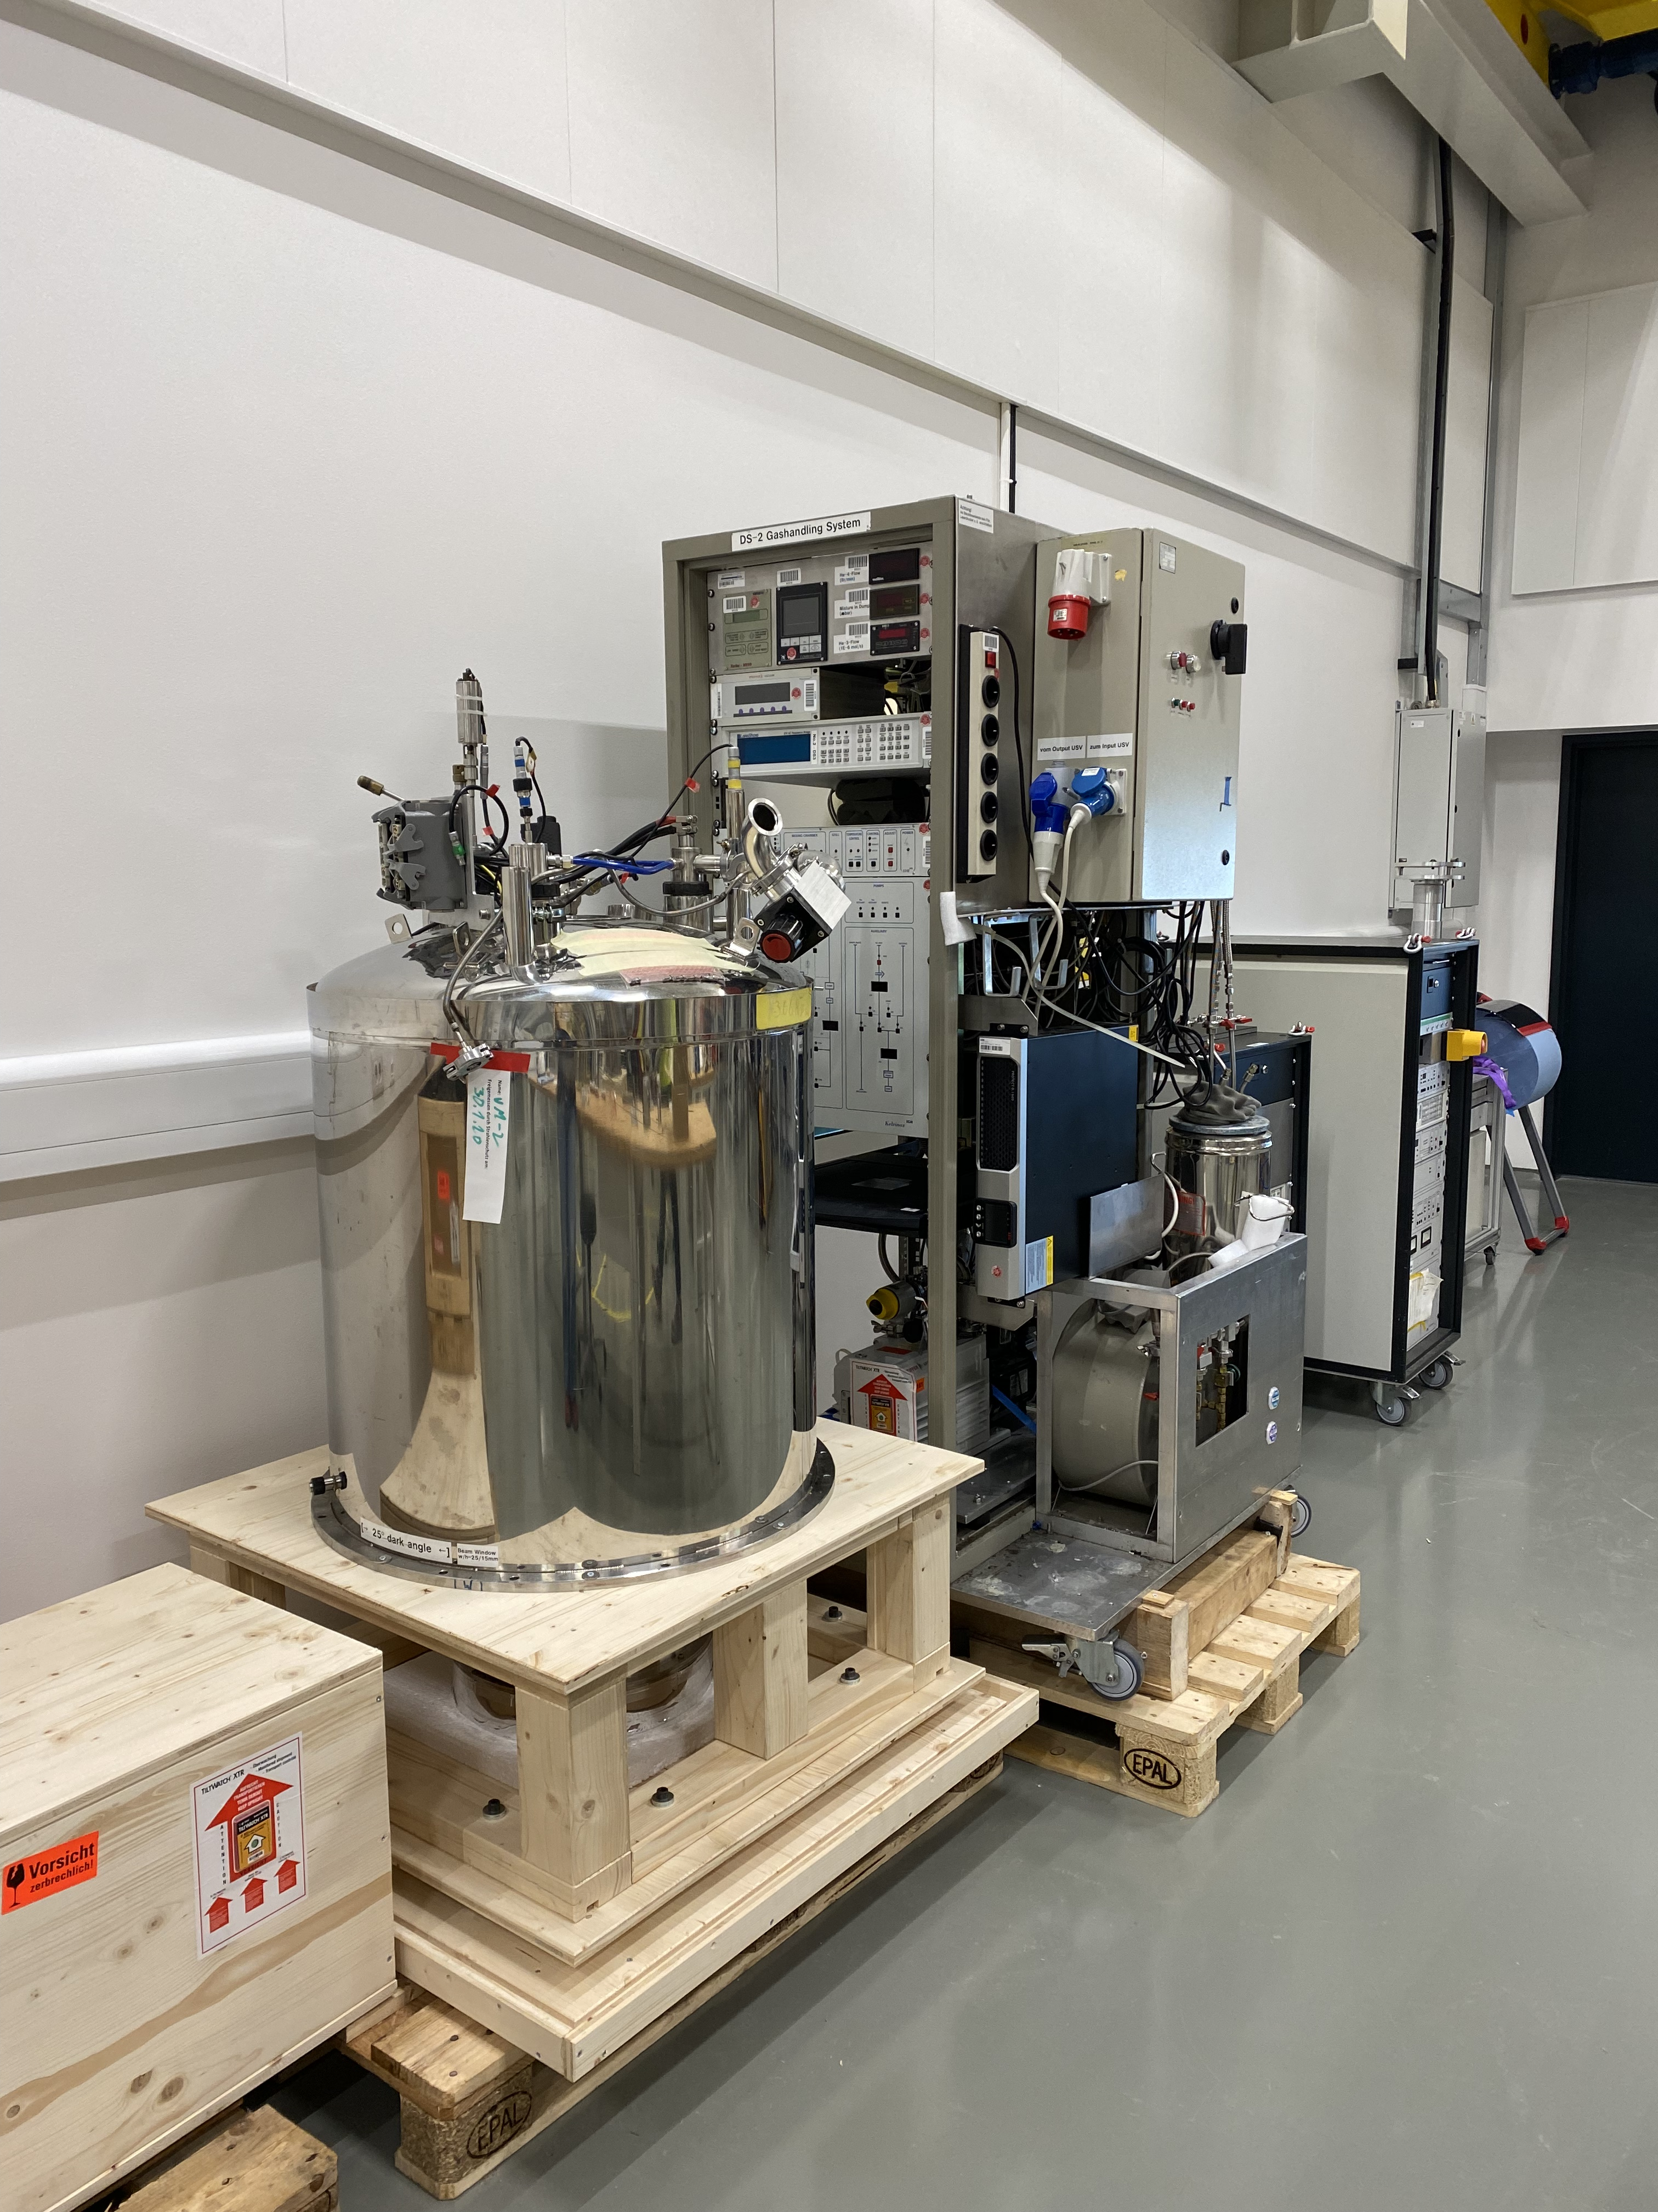
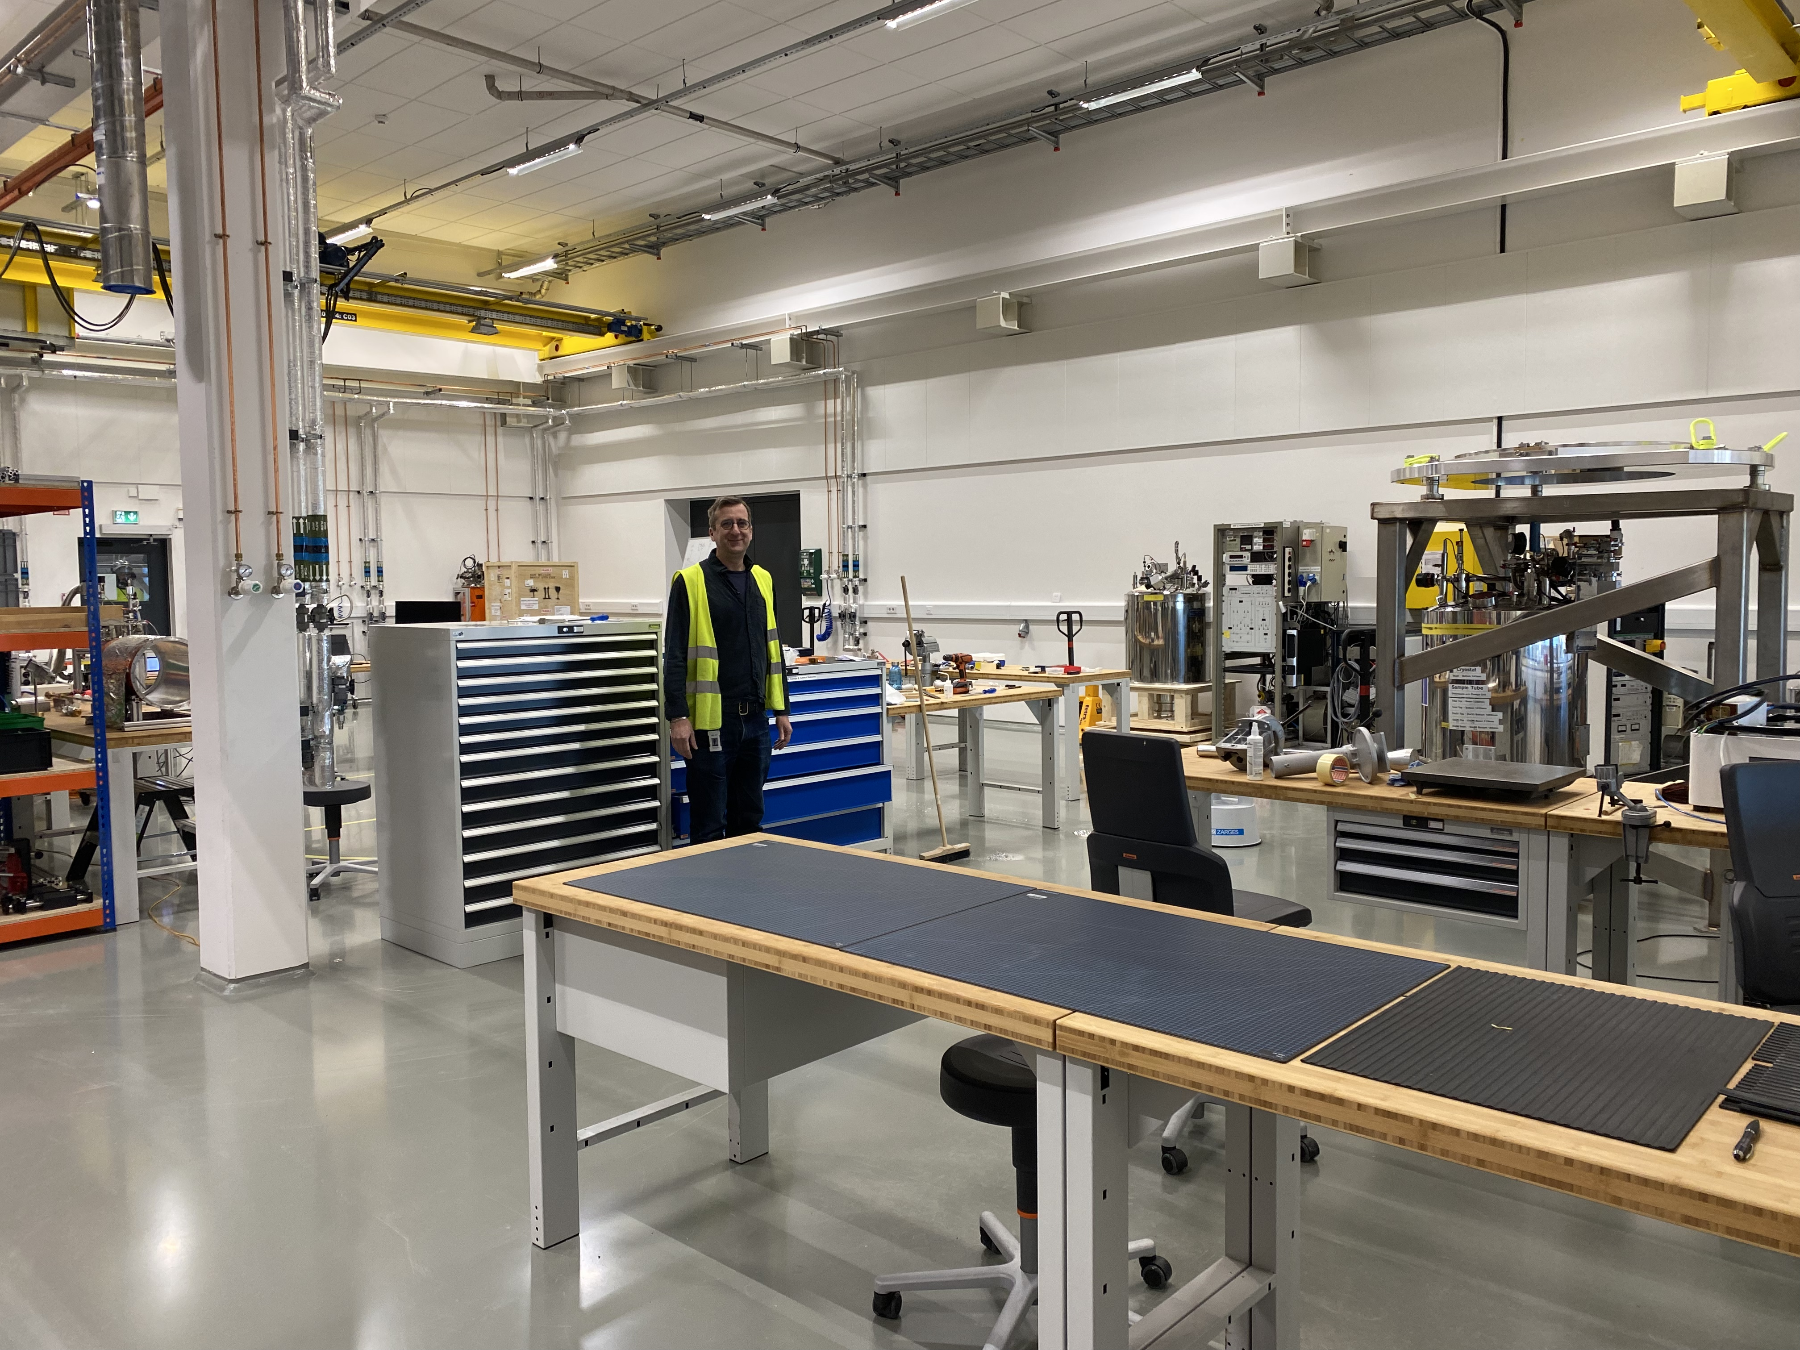
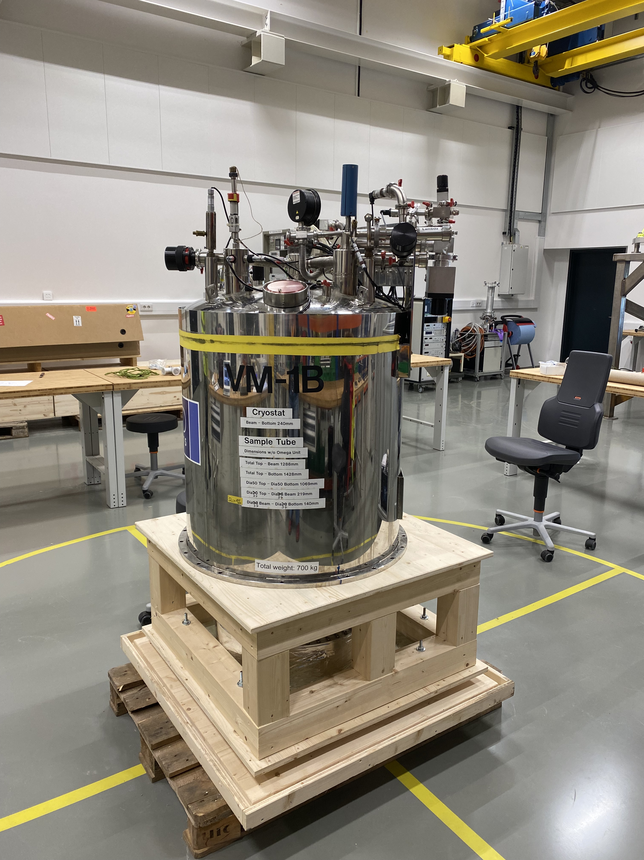
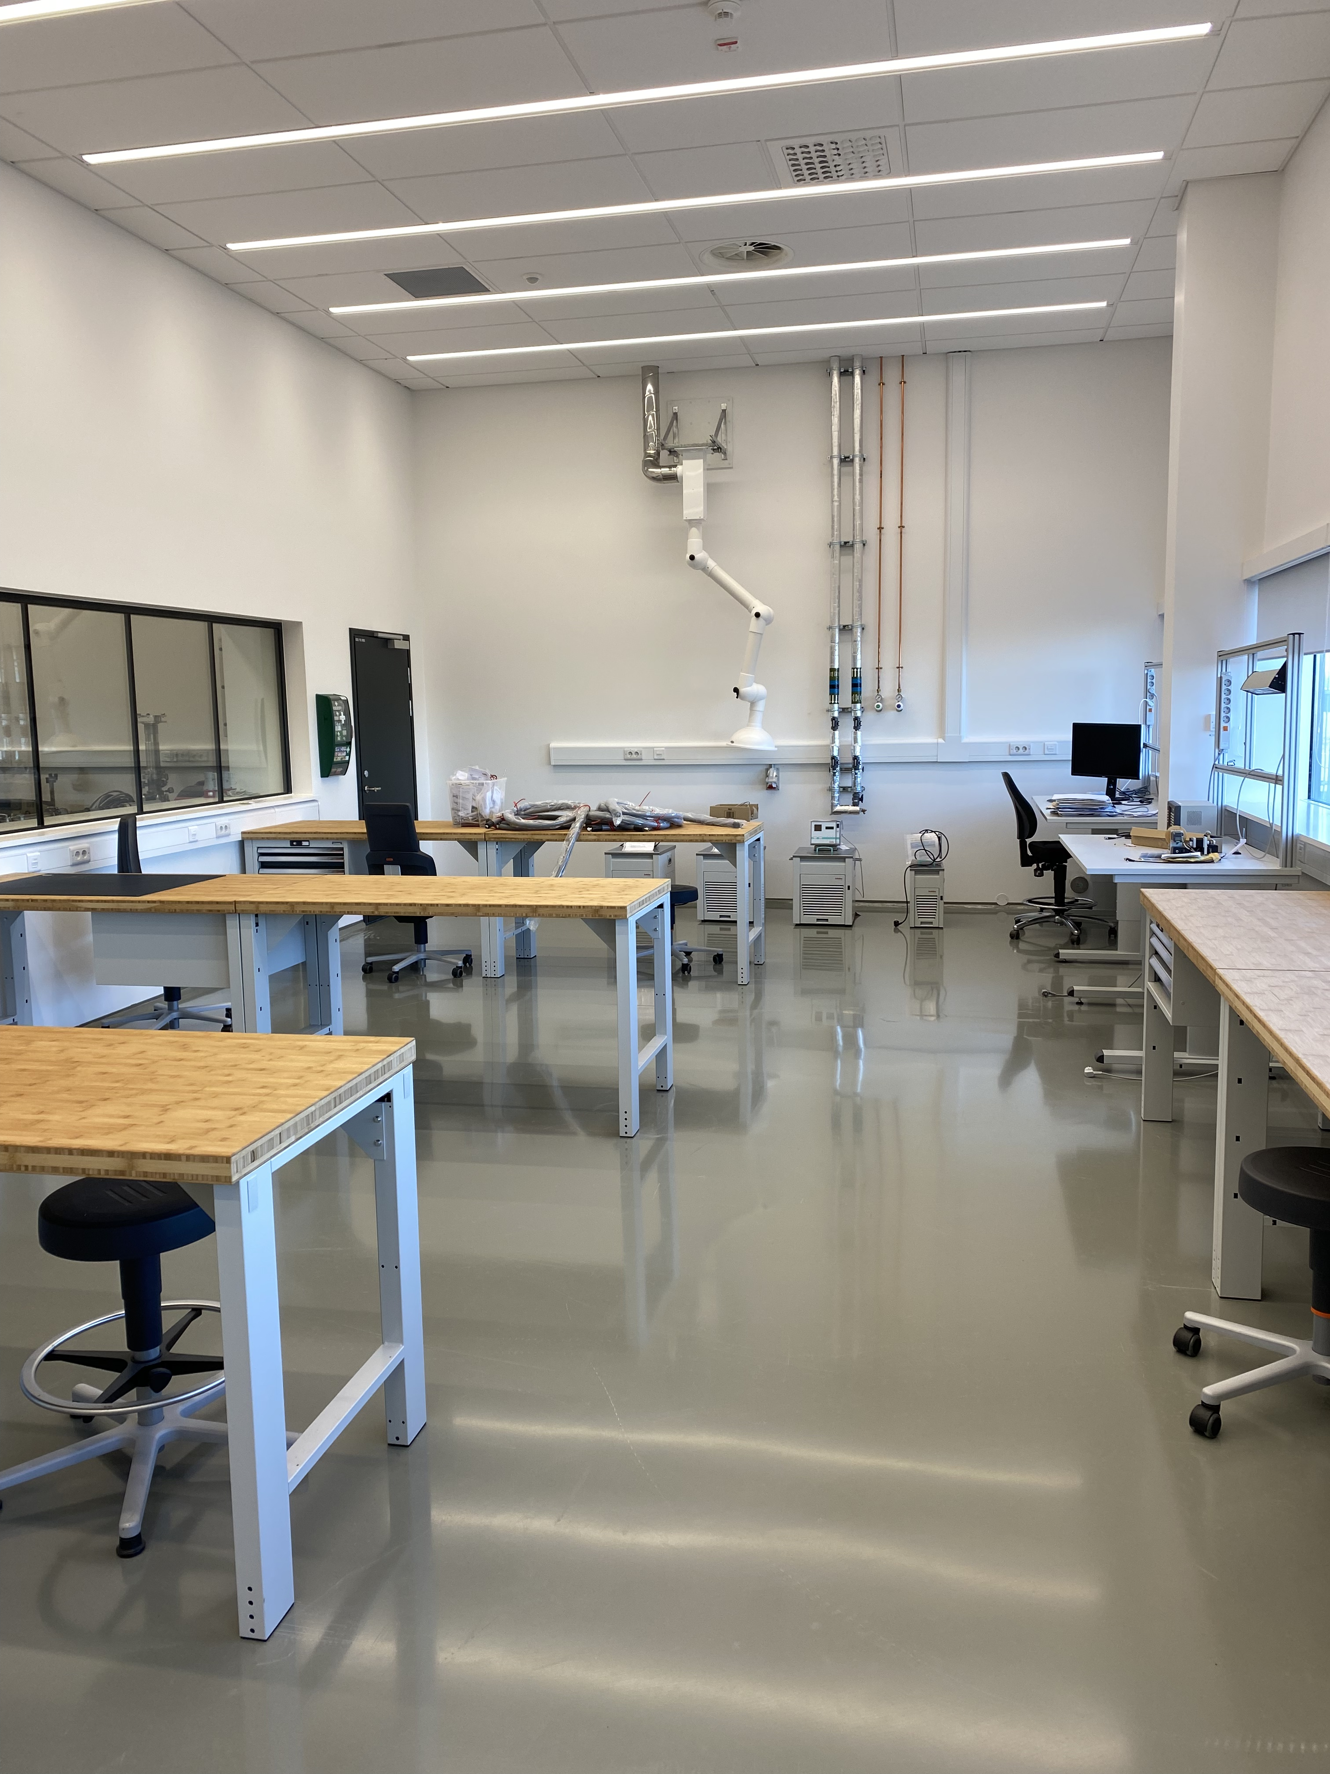
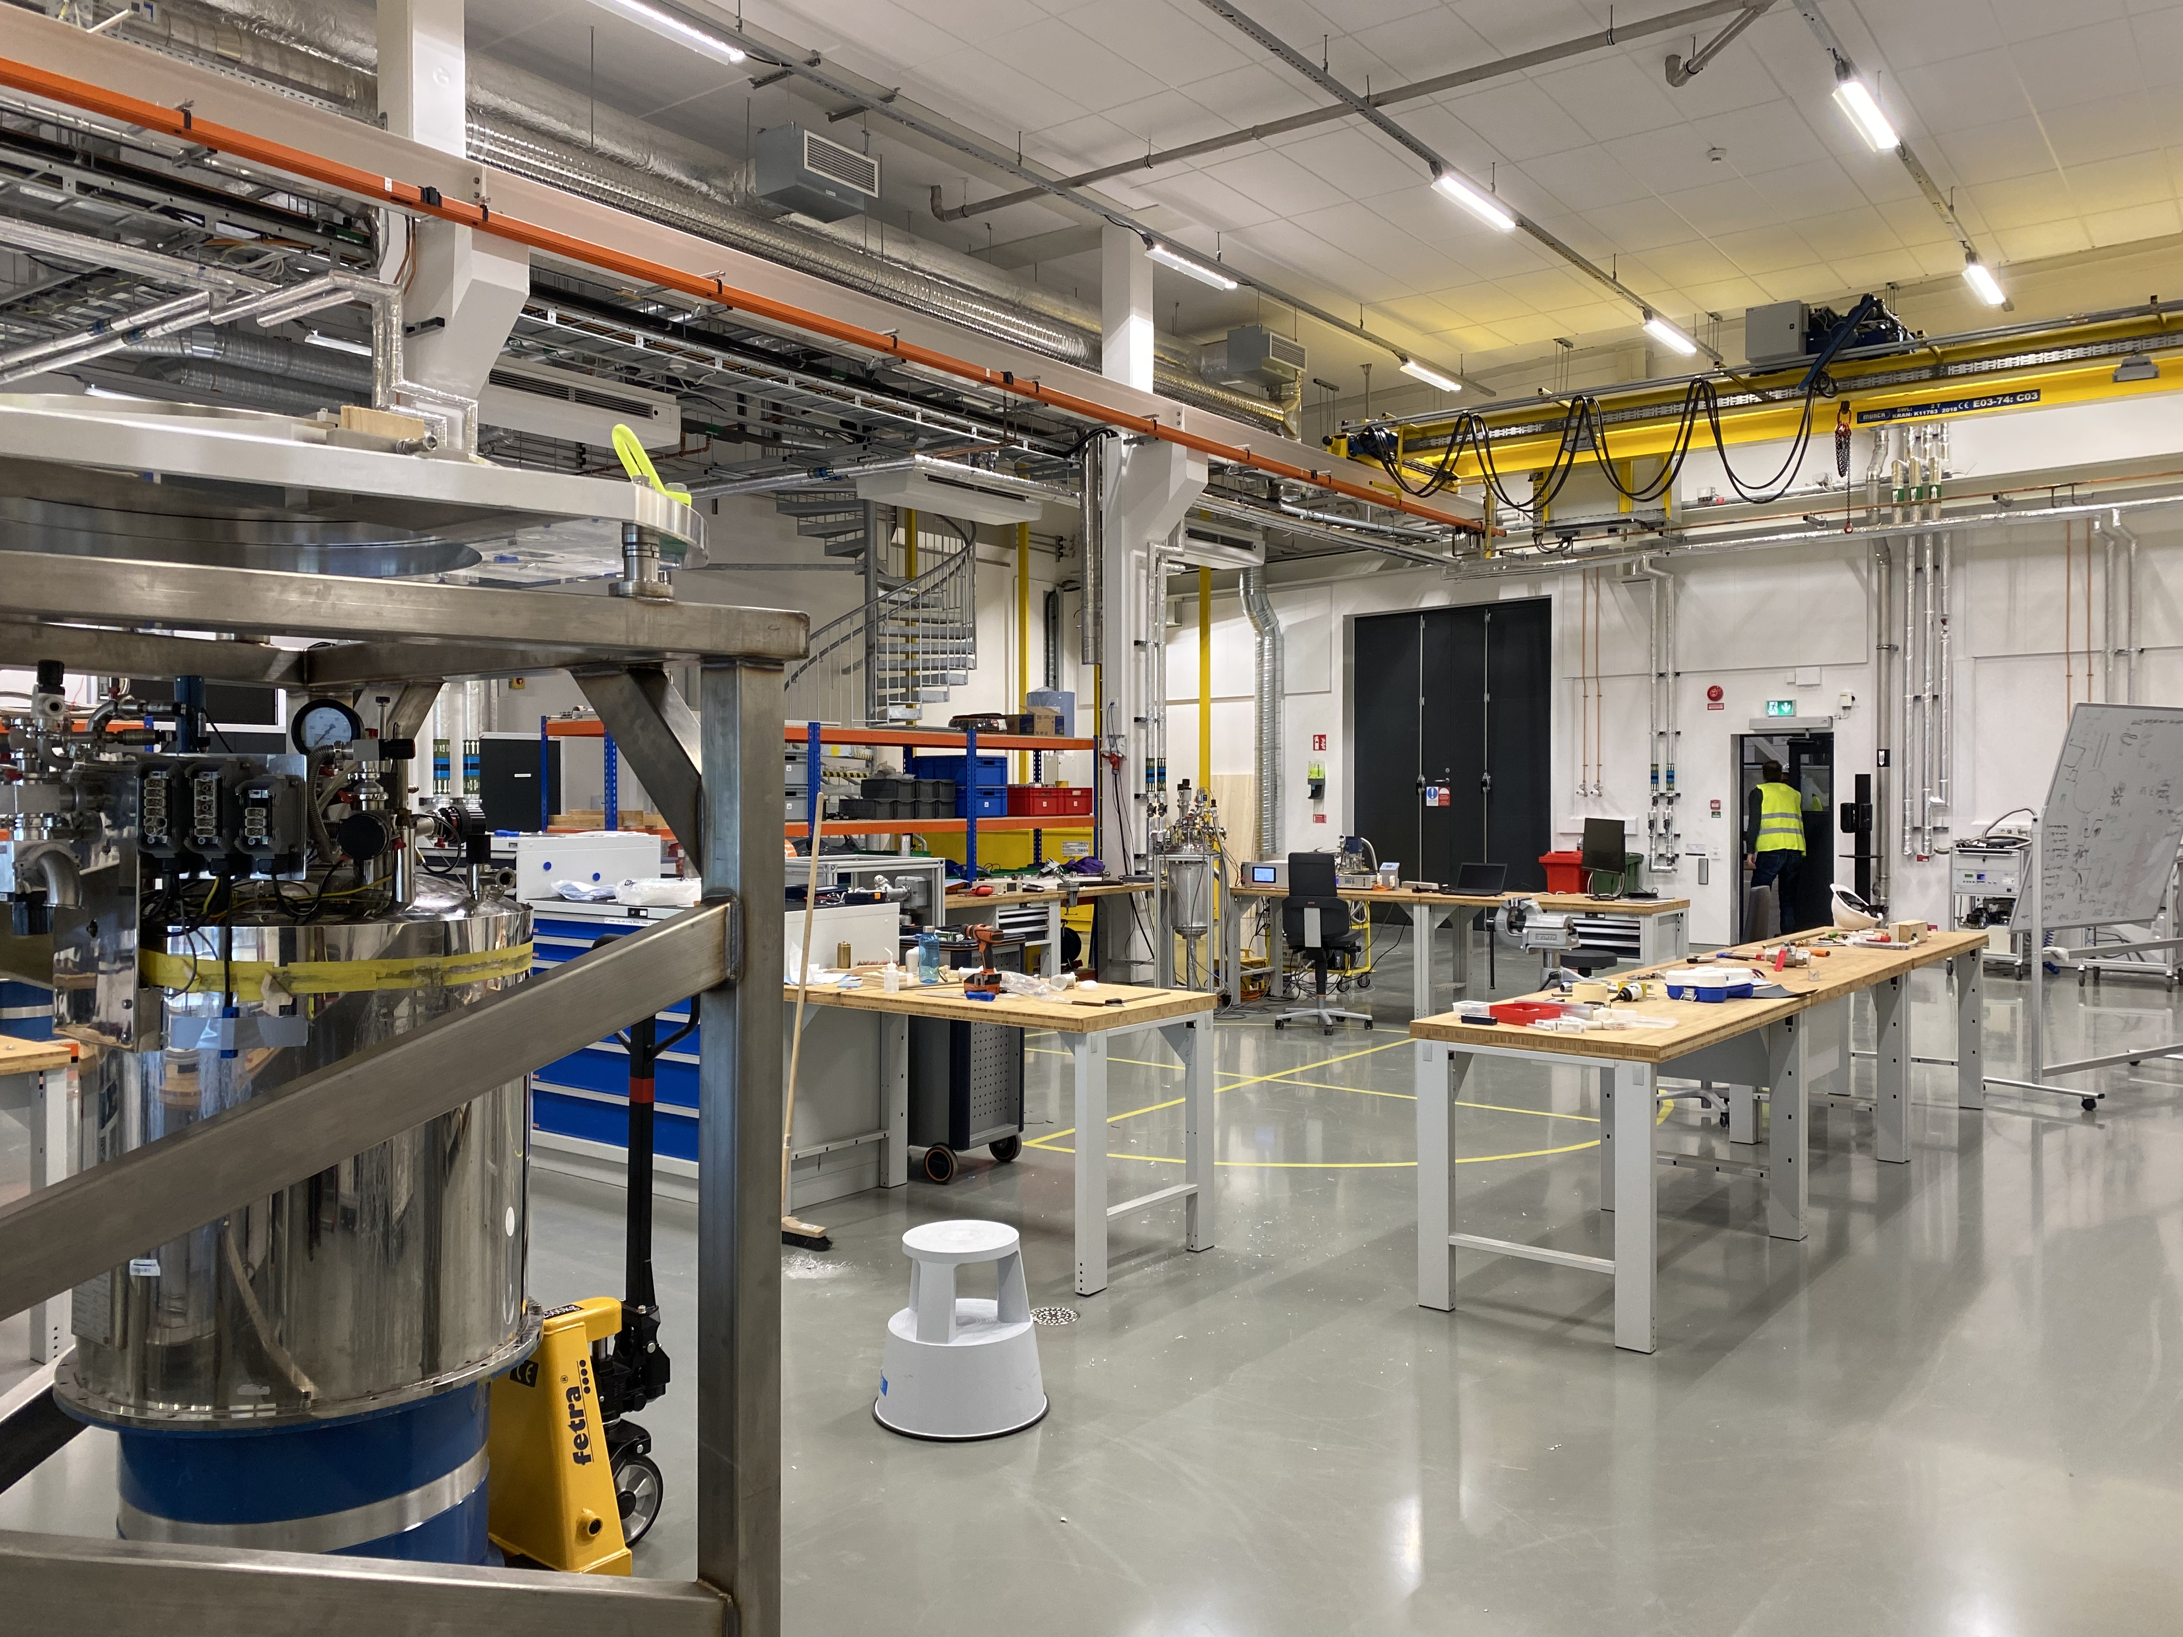
E03 = operational
Ground floor
Main area
For magnets (non-magnetic floor), cryogenics, furnaces and alignment
Sample Env. Techn. Lab
Sample Env. Techn. Lab
Loading Bay
2022-04-25
PRESENTATION TITLE/FOOTER
Quiet area
For delicate cryogenic work and electronics

Slide 21
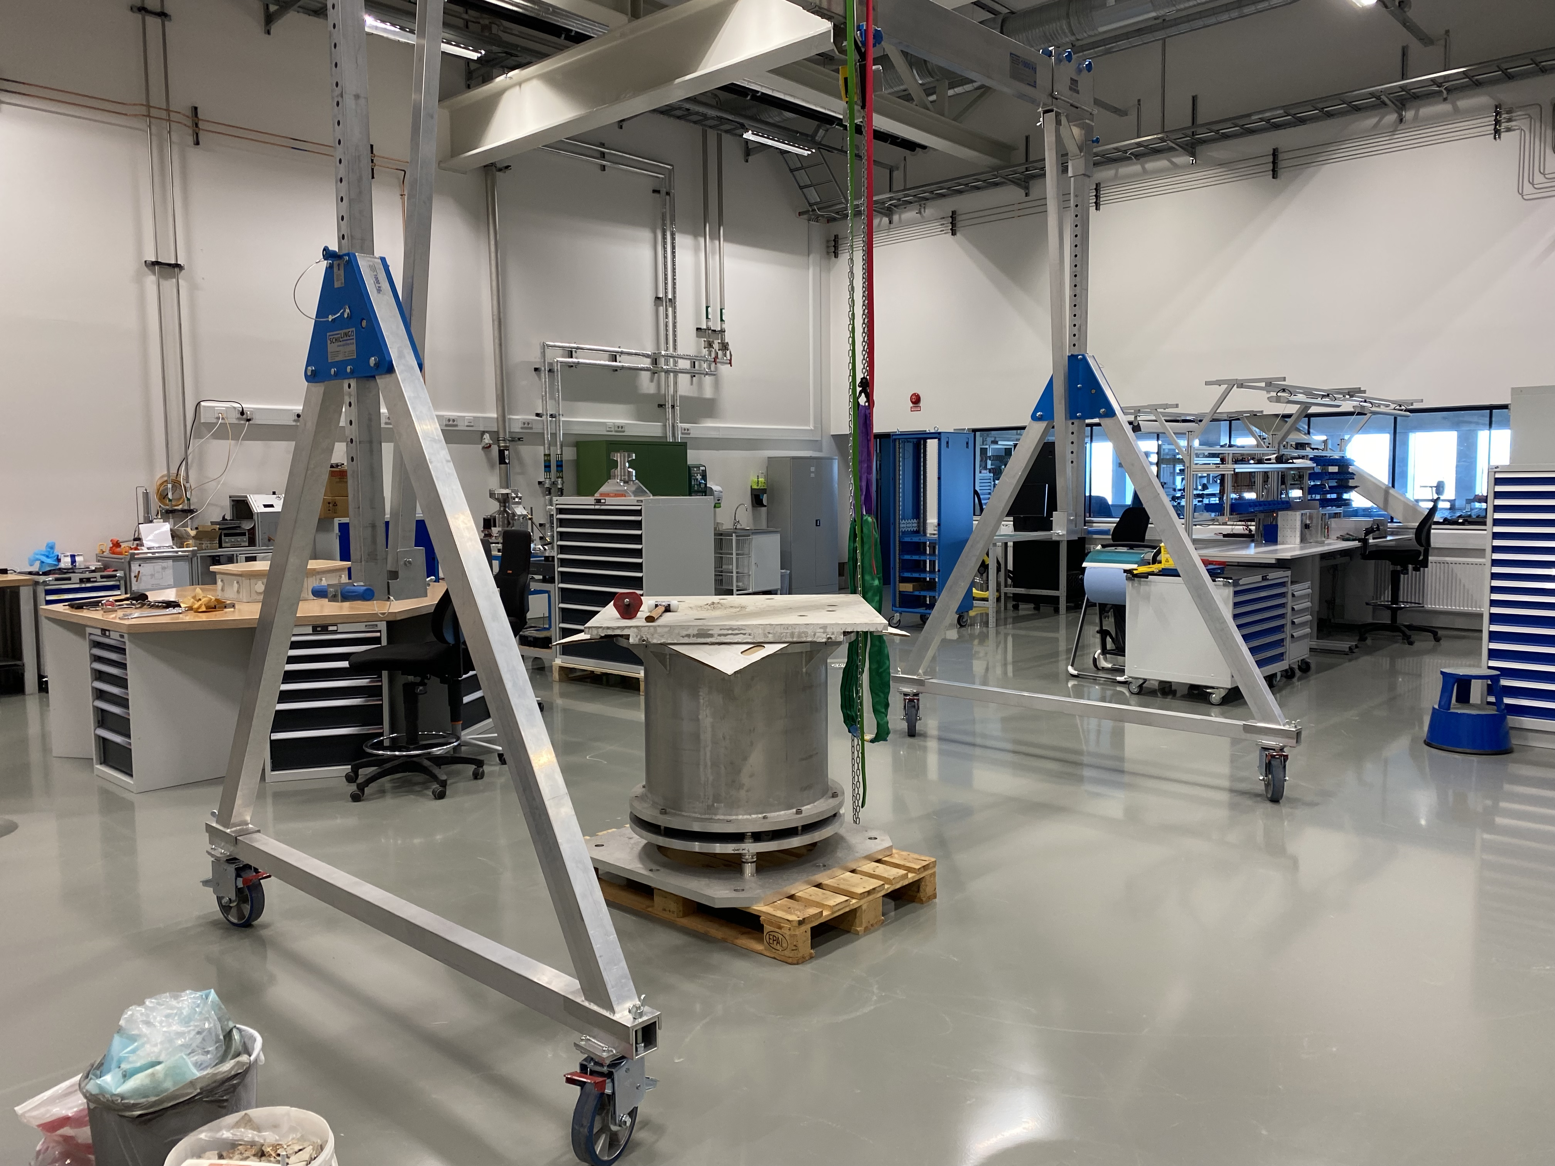
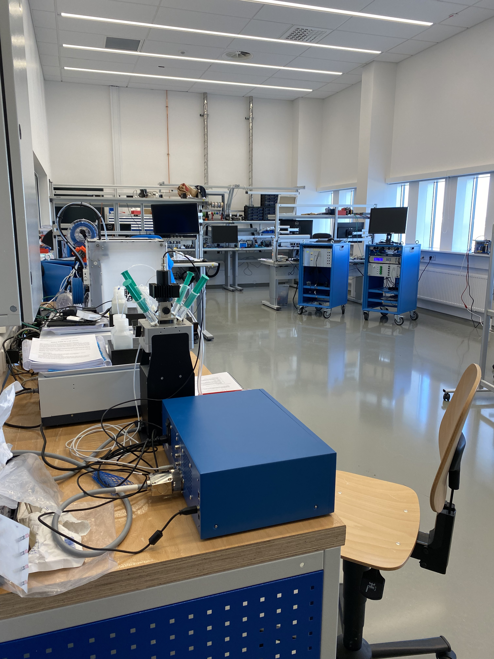
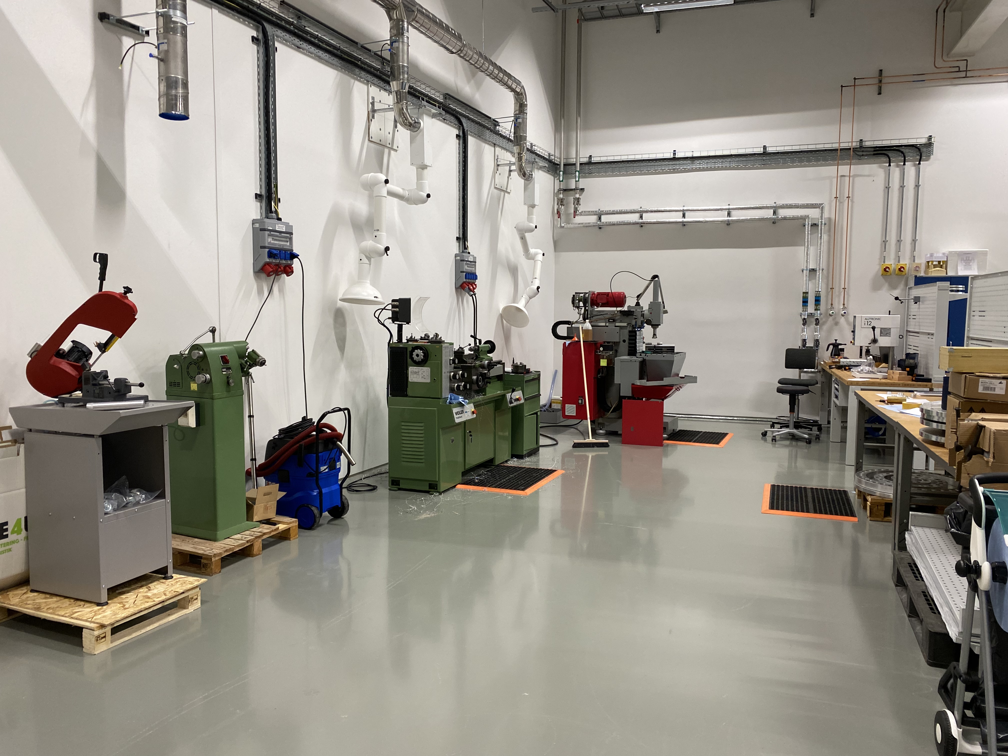
E03 = operational
First floor
Dedicated to high pressure, mechanical engineering, control integration and mechanical workshop with some space for soft matter
Quiet area
Main area

Slide 22
D04 – Ground floor
Sample Env.
Close to the life science lab for LOKI and ESTIA
Space dedicated for fluids, electrochemistry, lasers and soft matter sample environments ?
Beginning of installation planned for end of 22

Slide 23
D08 – Ground and first floor
Ground floor: Cryogenic, magnets and furnaces (only?)
1st floor: DAC lab (only)
Close to the Radioactive Materials Laboratory.
Dedicated to SE for DREAM and ODIN
Beginning installation: spring 22
Used temporarily by MCA for commissioning of motors
Sample Env. Techn. Lab
RML (rad. Mat. Lab)
DAC
Ground floor
First floor
23
23

Slide 24
Finish presentation

