Slide 1
Status of the ESS helium recovery system
Optional subtitle
PRESENTED BY Philipp Arnold

Slide 2
Agenda
1 Introduction
2 Cryoplant
3 Recovery System

Slide 3
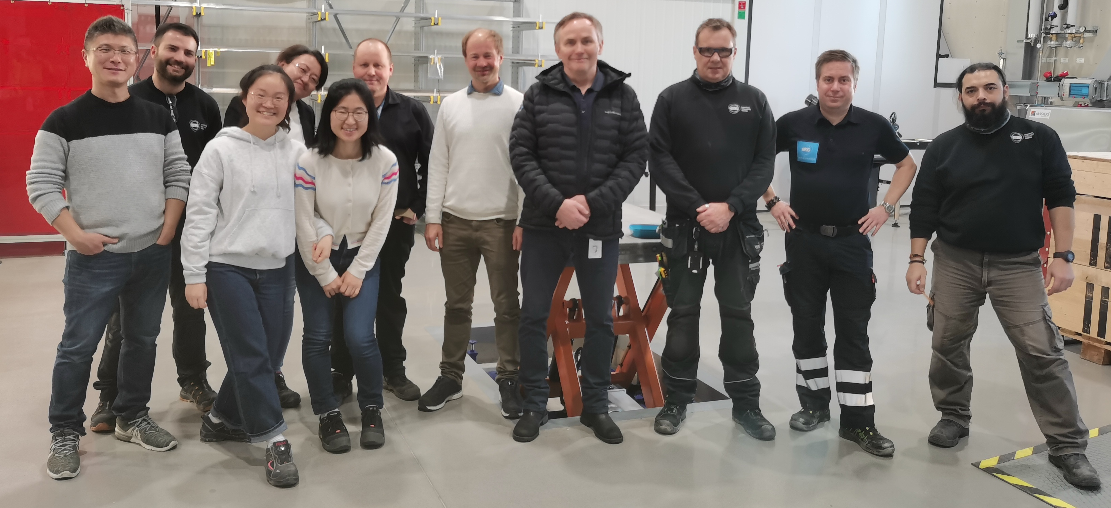
(1.1) Cryogenics Team
1 Leader,
3 Engineers,
5 Technicians
(1 Designer,
1 Student)
1 engineer for CDS in another group

Slide 4
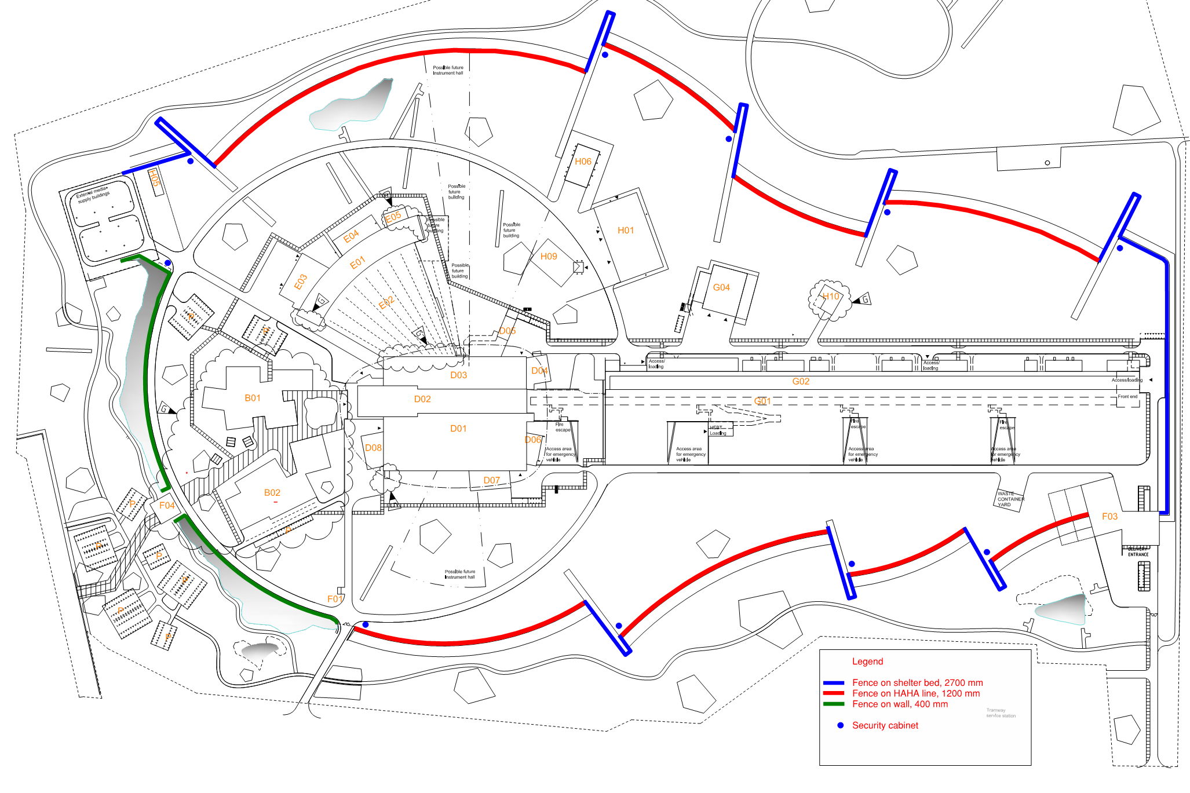
(1.2) Scope of Cryogenics Group
ACCELERATOR
Accelerator Cryoplant (ACCP) and Cryodistribution System (CDS) for sc linac
Test and Instruments Cryoplant (TICP) and Cryomodule (CM) teststand
TARGET
Target Moderator Cryoplant (TMCP) and helium CDS for Cryogenic Moderator System (CMS)
CMS and hydrogen CDS for moderators
NEUTRON SCIENCE ACTIVITIES
Side-wide helium supply and recovery
Side-wide liquid nitrogen supply
GENERAL
Helium purification, storage, handling
Liquefaction for external users (LU)
Notes:
Basis for collaboration with NSS: SLA between Cryo and SAD from 2017, originates from even much earlier

Slide 5
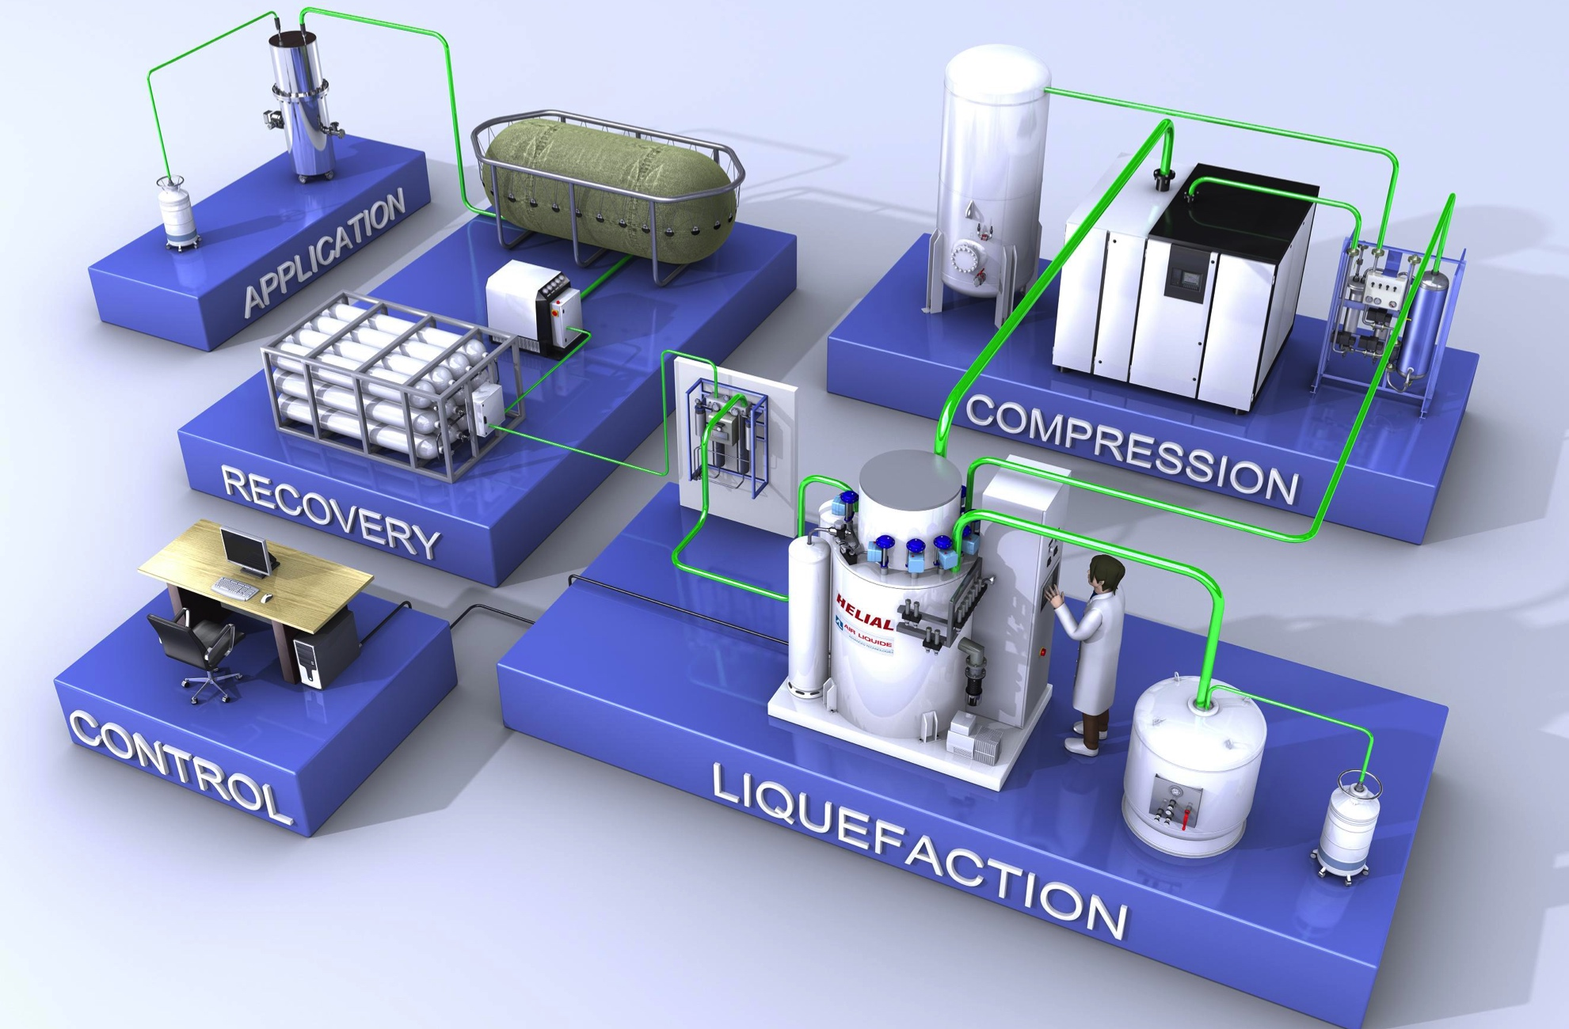
(2.1) The TICP
Test and (Neutron) Instruments CryoPlant
Main Components (acceptance test results)
Recycle compressor: 56 g/s, 14 bara, 70Hz
Coldbox as liquefier with internal purifier: 137 l/h, 1% N2
External purifier: 3.1 g/s, 1% N2
HP compressors: 2 x 60 m³/h
Gasbag: 100 m³
HP panel as 4 x 4 matrix
Impure HP bundle storage: 12 m³
LHe Dewar: 5500 l
2 x 120l + 1 x 250l LHe mobile Dewars
Semi-automatic filling station for 2 mobile dewars
boil
Special equipment for Teststand operation
4-fold transfer line connection, subcooler etc.
Process Vacuum Pumps: 5.4 g/s
Ambient heater for VLP return
*Cartoon from Air Liquide marketing material
Notes:
TICP design spec based on TS2, liquefaction for SAD and external users can be done along the way besides normal operation
Acceptance tested in 2018, since then routine operation incl as liquefier for external

Slide 6
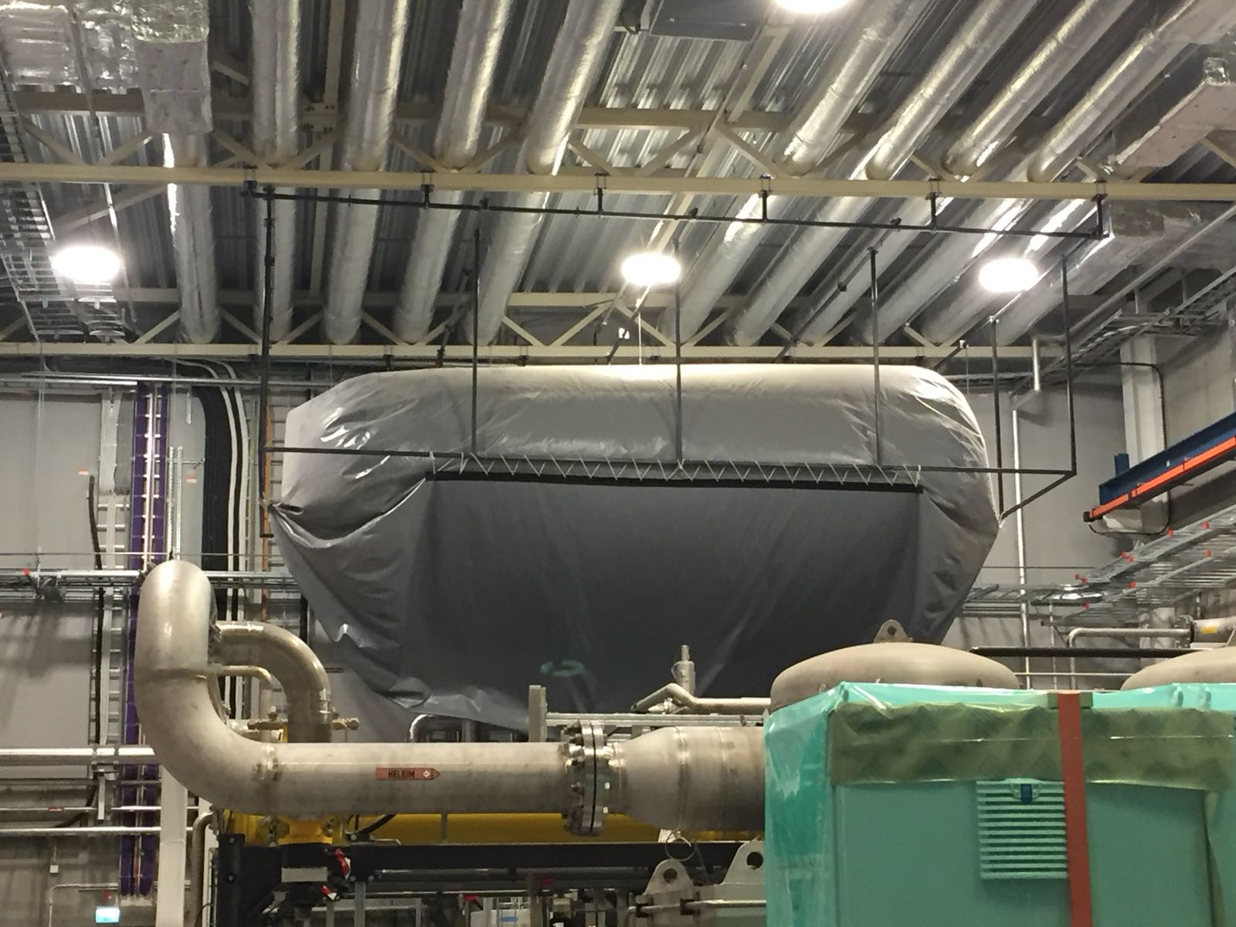
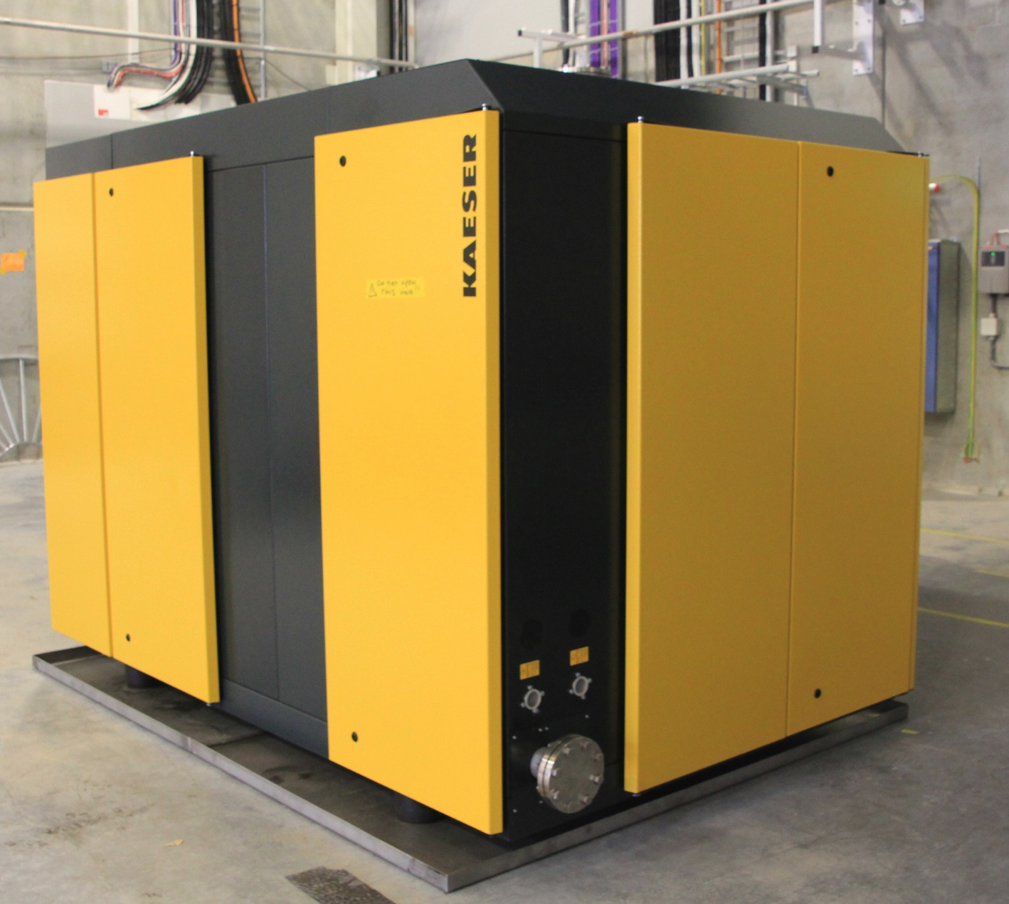
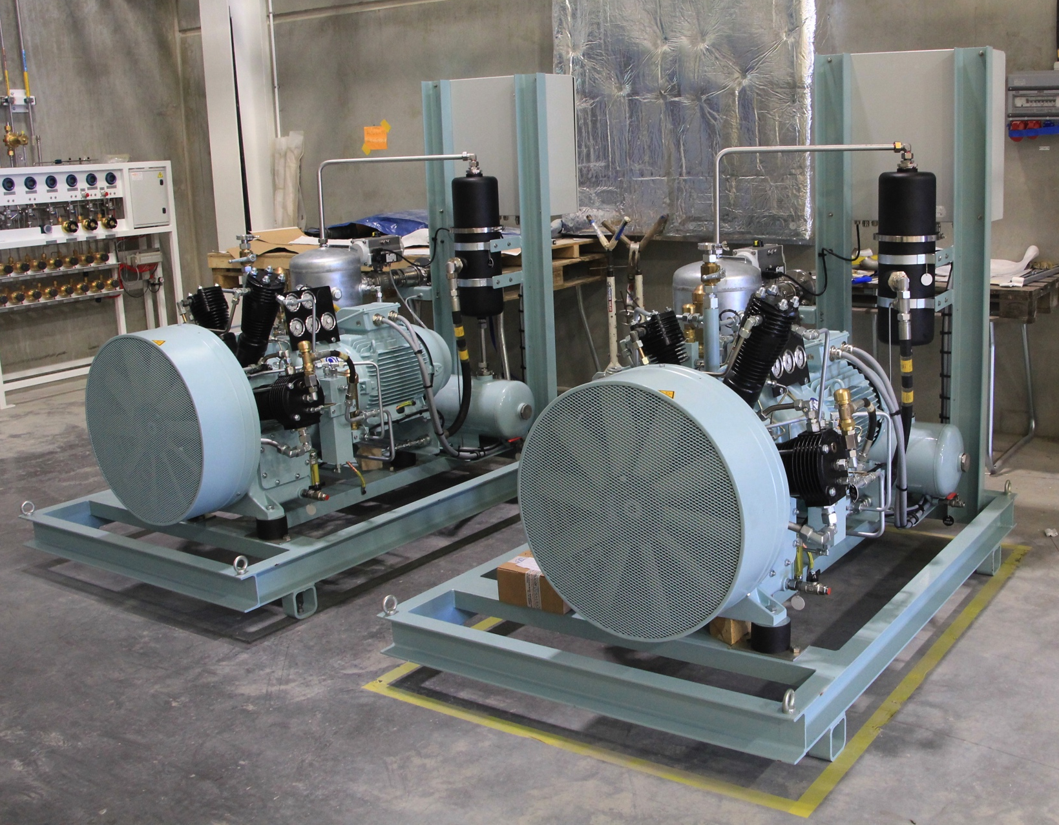
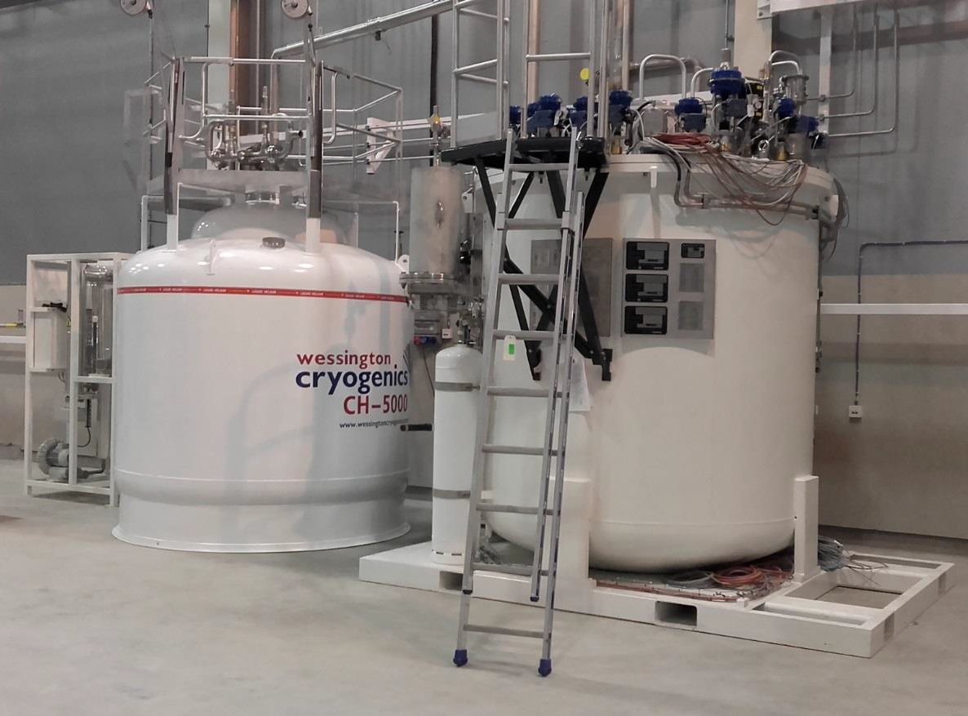
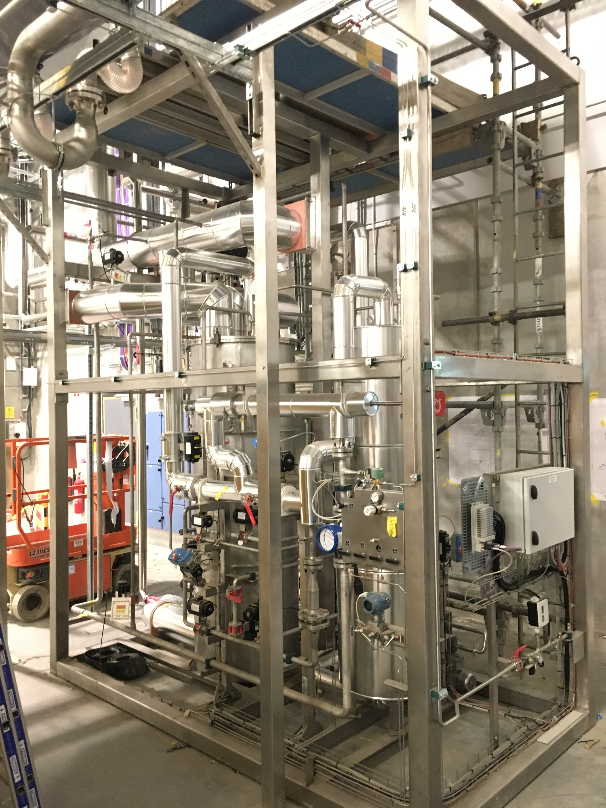
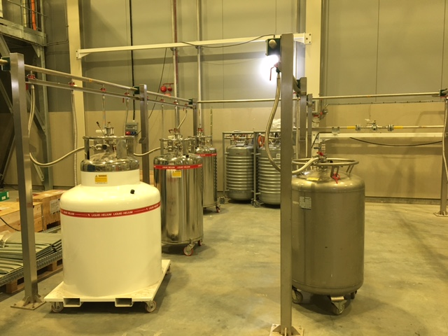
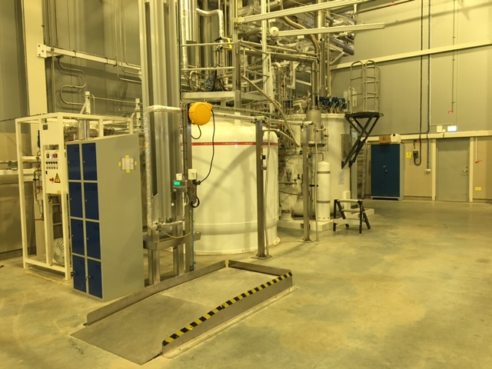
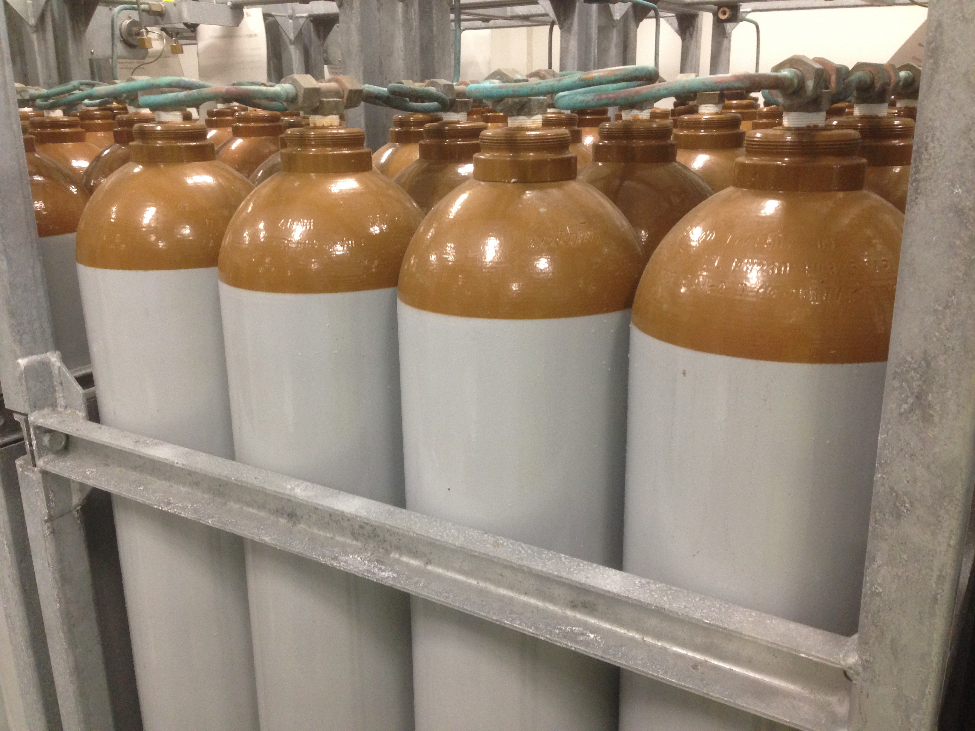
(2.2) The TICP
Test and (Neutron) Instruments CryoPlant
Notes:
Also connection for impure helium bundles from external clients
Extension possibiliy for another HP compressor

Slide 7
(3.1) Helium Recovery – current situation
Sub-headline to strengthen the headline above
Done 2021 - 2022, Target
Installation partially done, INFRA
Done 2017- 2018, AD
Done 2019, CF
Notes:
Very extensive km long piping network, organised with several parties and sponsors
Very long lasting effort because usually the system is low in the priority list

Slide 8
(3.2) Helium recovery Level 90
Notes:
This is how piping effort specification started some years ago

Slide 9
(3.3) Helium recovery Level 100

Slide 10
(3.4) Helium Recovery – overall P&ID
Conceptual Design: Cryo ✅
Detail Design: INFRA ✅
Procurement: INFRA ✅
Installation: Powerheat ☑️
Instrumentation: Cryo ☑️
Commissioning: Cryo
Notes:
First P&ID in 2019, almost 3 years ago. More than a year design effort (not as simple as the P&ID)

Slide 11
(3.4) Helium Recovery – INFRA status 2022
Conceptual Design: Cryo ✅
Detail Design: INFRA ✅
Procurement: INFRA ✅
Installation: Powerheat ☑️
Instrumentation: Cryo ☑️
Commissioning: Cryo
Notes:
3 main instrument stations. Instrument panels manufactured in Cryo workshop. Spools for flowmeters installed now.

Slide 12
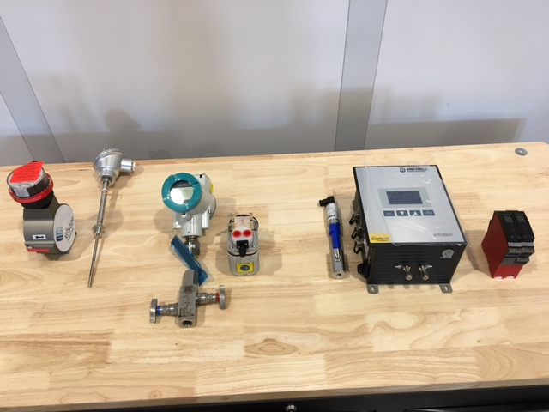
(3.5) Valve and Instrument Panels
Components assembly
In the main pipe
Turbine flowmeter
Temperature sensor
On the instrument panel
Pressure sensor and valveblock
Sample pump (housing yet to come)
(Rotameter for analyser flow, yet to come)
Dewpoint meter
Helium analyzser
Signal converter cards for flowmeter and temperature transmitter
… fuses, PSU, IO cards, fibre-optic network switch, terminal board, etc.
Notes:
Very long delivery times, we still don’t have all. Particularly difficult are PLC components, IO cards etc. Connecting to network not trivial.

Slide 13
(4) Summary
Helium recovery system at ESS is quite a large effort.
Helium liquefier and attached local recovery system components are in routine use for several years now.
Cryogenic team is used to operate, fill helium, leak test etc. due to experience on test stand and liquefaction for LU and MAX IV.
Helium recovery pipe network done to the largest extend, expected finish this summer.
Manufacturing instrument panels and commissioning system will take longer due to many other critical activities and long delivery time of key components.
Difficult for priorisation based on P6: Important for BOT? Important for Science?
Thanks for your attention.

Slide 14
Finish presentation / Back up slides

Slide 15
(2.1) The Test & Instruments Cryoplant
Block diagram and specification
Duty Specification
Liquefier Coldbox
  Cooling for CM Teststand: 76W @ 2K, 420W @ 40K, 6 l/h Liquefaction
  Liquefaction for NSS: 7500 l/month
  Recovery of evaporating helium in linac when ACCP stops
  Provide liquid helium to Lund University and MAX IV: 1000 l/month
Recovery System
  Helium returning from instruments
  Flash gas from mobile dewar filling, helium transfer operations
  Dewar boil off, purifier regeneration, purge operations
  Cryomodule safety valves discharge
  Compression, storage, distribution of impure helium
External Purifier
  Emptying HP buffer when internal purifier not available
  Make-up and back-up
Standalone Helium Purifier
Helium Recovery System
5 m³
LHe Tank
Test & Instrument Cryoplant
LHe Mobile Dewars
Test Stand Cryodistribution System
LN2 Storage Tanks
LN2 Mobile Dewars
Instruments & Experiments
Test Stand Lund 2

Slide 16
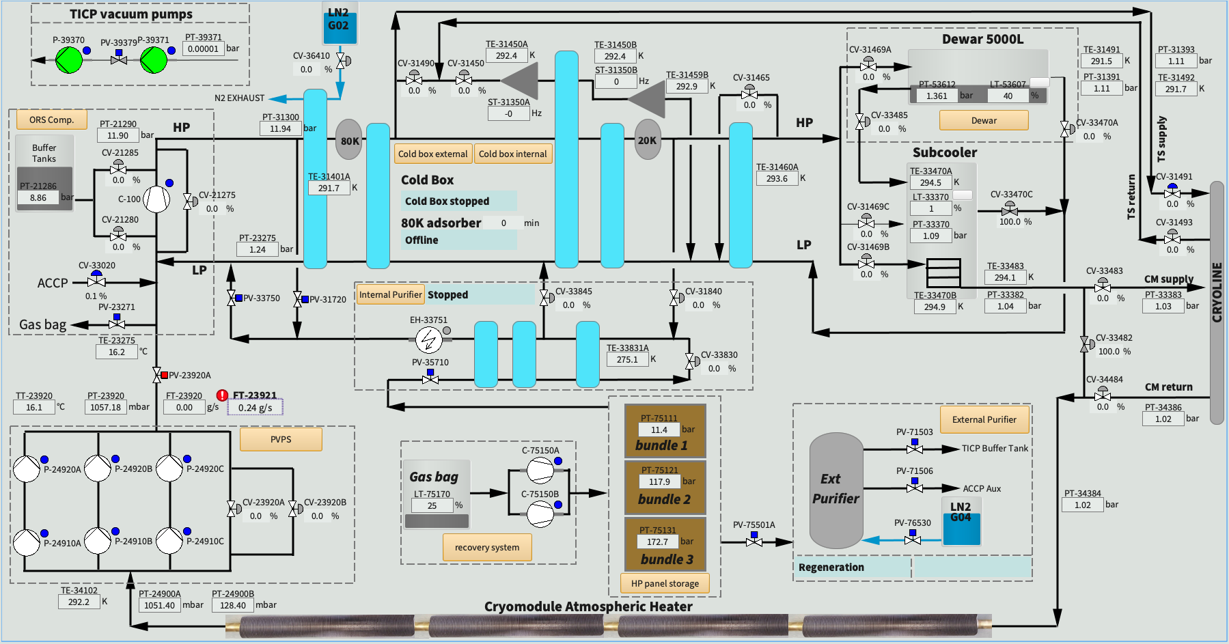
(2.1) The Test & Instruments Cryoplant
Overview OPI

Slide 17
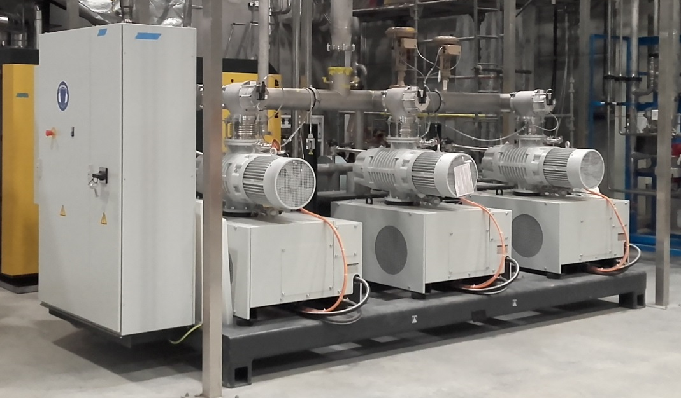
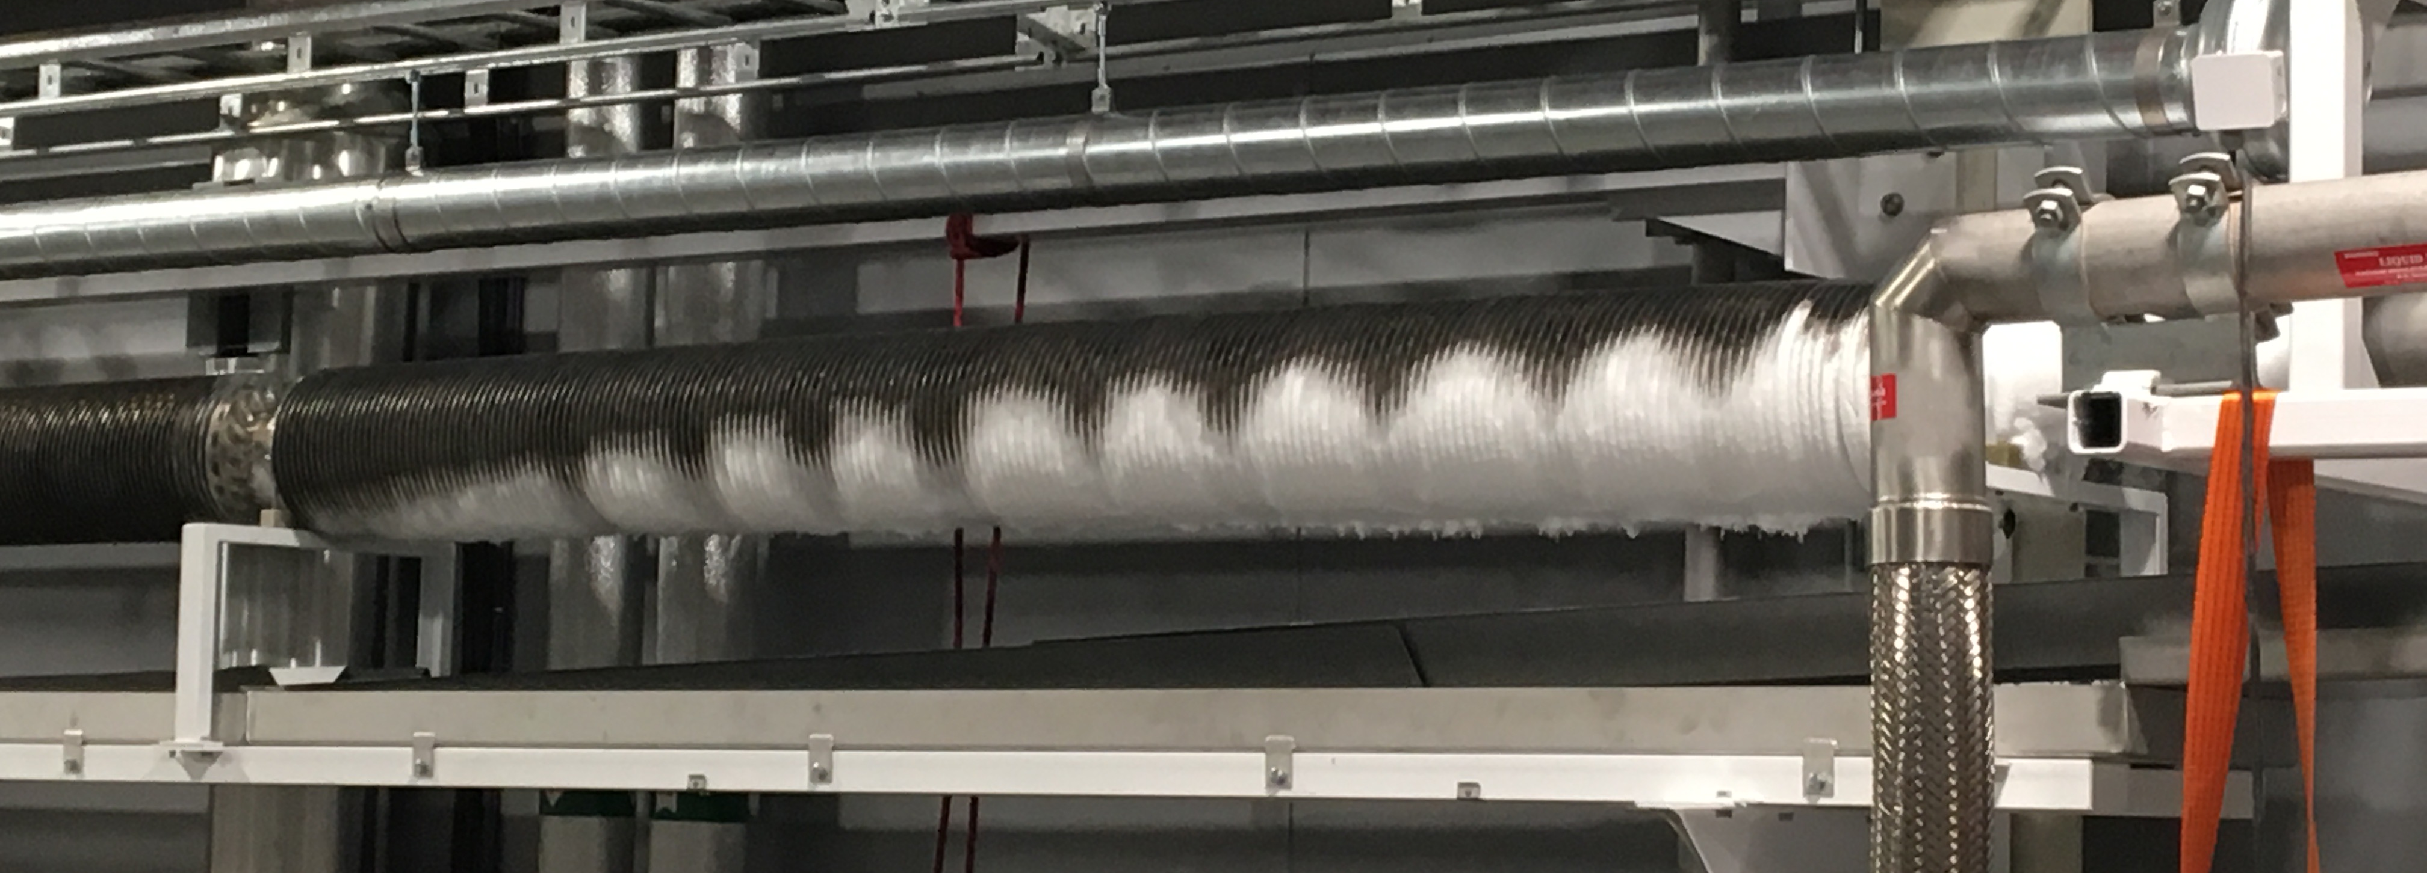
Acceptance testing
Acceptance testing of everything that can be tested
Recycle compressor
Coldbox as liquefier with internal purifier: 137 l/h, 1% N2
Coldbox in CM test mode
Process Vacuum Pumps: 5.4 g/s
Ambient heater for VLP return
External purifier: 3.1 g/s, 1% N2
HP compressors: 2 x 60 m³/h
Gasbag and HP panel
Semi-automatic filling station
Adsorber regeneration

