Slide 1


DREAM cryofurnace project
M. Feygenson¹, W. Schweika ^{1,2}, P. Harbott¹, A. Poqué¹, A. Schwaab¹,
F. Porcher³, S. Desert³, G. Fabreges³, B. Annighöfer³
¹ Forschungszentrum Jülich, Germany
² European Spallation Source ERIC, Sweden
³ Laboratoire Leon Brillouin, France

Slide 2
What is DREAM?
Diffraction Resolved by Energy and Angle Measurements
General use powder diffractometer with novel capabilities
In-kind contribution to ESS from Germany (FZJ – 76 %) and
France (LLB – 24 %)

Slide 3
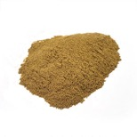
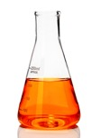
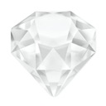
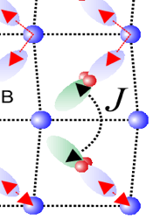
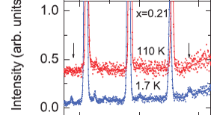

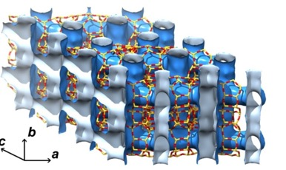
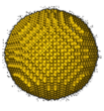
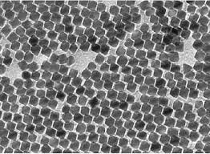
Magnetism
powders
single-crystals
nanoparticles
alloys
liquids
Ba_{1-x}K_{x}Fe₂As₂
weak moments
phase diagrams of superconductors
multiferroics
orbital ordering
charge ordering
distortion
magnetic exchange
Energy Materials
Large Unit Cells
multiphase
catalysts
in-operandi
batteries
MOFs
thermoelectrics
molecular sieves
H₂ - storage
Nanostructures
many novel samples come in np
magnetic nanoparticles
core-shell structures
self-assembly
synthesis
Additional scope (RAC funding):
SANS detector and
polarized neutrons
Notes:
For the experts, but clear message

Slide 4
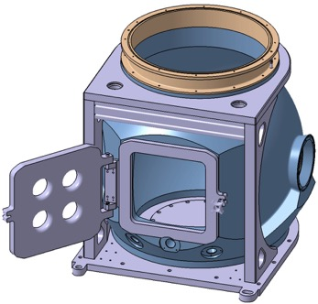
Sample access
Endcap
Day one coverage
Endcap
neutrons
Removable sample vessel
Common vacuum with guide
Adopted for L1 and L2 size
requirements
of SAD
Top & bottom load
Mantel
HR
Nano-SANS
(ex. funding)
L1
L2
Notes:
There are two options for the top flange. The Level 1 flange was designed according to the recommendation of SAD (drawing ESS-0197907) for the XL-type SEE (see ESS-0038078). The Level 1 flange will enable use of XL-type pool equipment. We note that we Level 1 flange a partial shadowing of the detectors will occur. The largest diameter of the flange that will allow to avoid shadowing and at the same time keep sample-to-flange distance to 600 mm is 700 mm. Using adaptor, the diameter of the flange can be reduced to standard Level 2 dimeter of 505 m. This smaller flange can be used for L-type of SEE. For both Level 1 and Level 2 flanges the distance from the top of the flange to the sample position is 600 mm, according with SAD requirements

Slide 5
Largest diameter without shadowing and with flange-to-sample distance of 600 mm
is 700 mm (L1 compatible)
L2 diameter is 505 mm
Additional flange to protect
the surface of the vessel
505 mm
600 mm

Slide 6
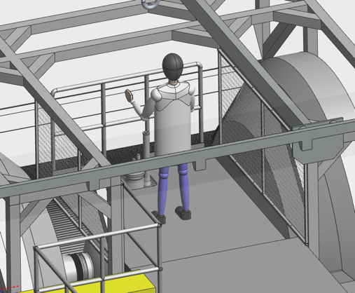
Sample position access
Hatch over the SE for sample change

Slide 7
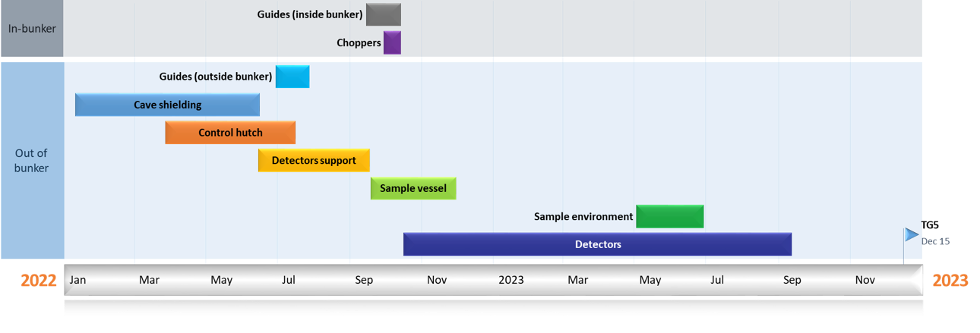
Where are we now
Pre-built at FZJ
TG3: June 2022
TG5: December 2023
BOT: 2024/2025
Built at FZJ
Notes:
Important for operation without sample vessel

Slide 8
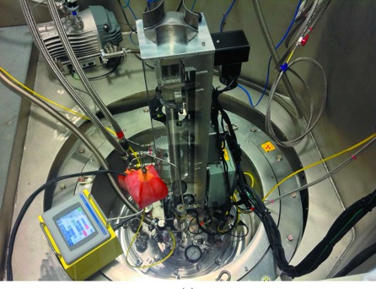
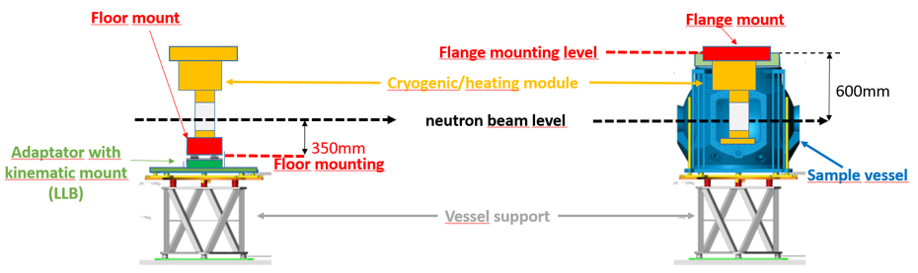
Minimum / Desired requirements
POWGEN@SNS (2011) 20 samples,
40 K in 30 min, only cryo option
T = 6 – 600 K / 4 – 800 K)
12 samples / 20 samples
Heating, no active cooling
Closed He circuit
Compliance with sample vessel & SAD dimensions
Top & bottom loading options
Positioning precision: < 1 mm, in vertical direction
Cooling from 300 K to 4 K in 90 min. / 60 min.
Shall be available for hot commissioning in 2024/2025
Vanadium windows
POWTEX@MLZ, 20 samples,
cryofurnace, under construction

Slide 9
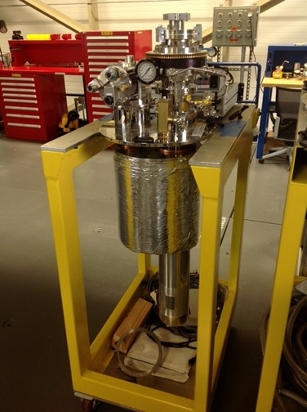
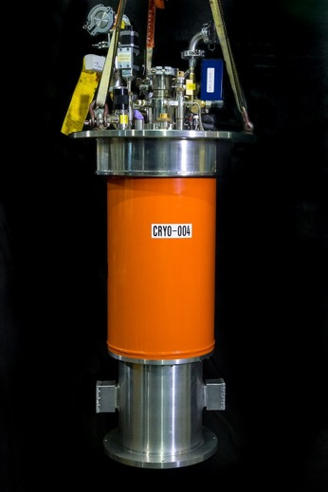
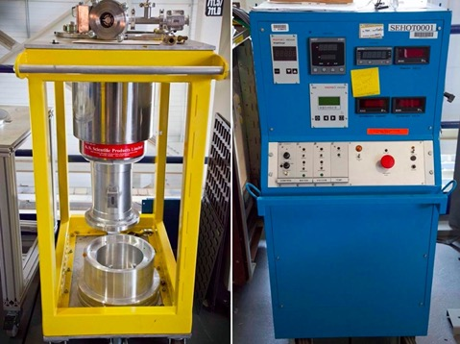
Vanadium windows are needed for diffraction instruments
SEE with Al in the primary beam will not work for diffraction without collimators
Radial collimator is out of scope of DREAM
Vanadium window SEE is used at SNS, ISIS and ILL for diffraction
50 mm Orange with
Vanadium Window
Vanadium Furnace
Janis 100mm CCR
V windows

Slide 10

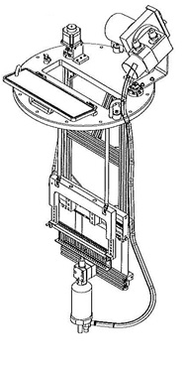
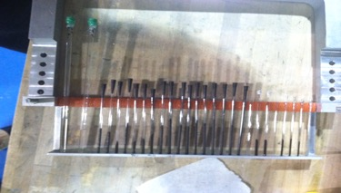
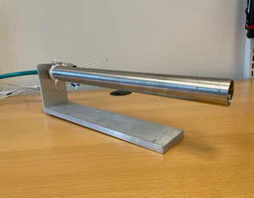
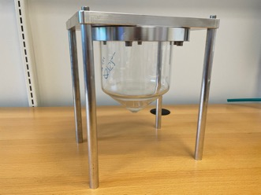
Procurement history
3 unsuccessful tenders
2 requirements were relaxed (longer cooling time, sample
position measurement along 3 axis with accuracy < 1 mm)
Schedule was relaxed
Last tender: One bidder. Price is too high
Fallback options
Linear stage with N cryostream (90 – 500 K)
Simple stage with cryo-jet and/or heat gun
Notes:
2 things were relaxed: cooling / heating time from 60 to 90 minutes; Highly desirbale to measure position along three axis with presicion better than 1 mm

