Slide 2
Soft Matter, Surface/Interfaces, In-situ & physical- chemistry
Some more updates
PRESENTED BY Caroline curfs

Slide 3
Agenda
1 Humidity chamber
2 Electrochemistry on behalf of Alice
3 Laser Pump and Probe
4 Gas handling

Slide 4
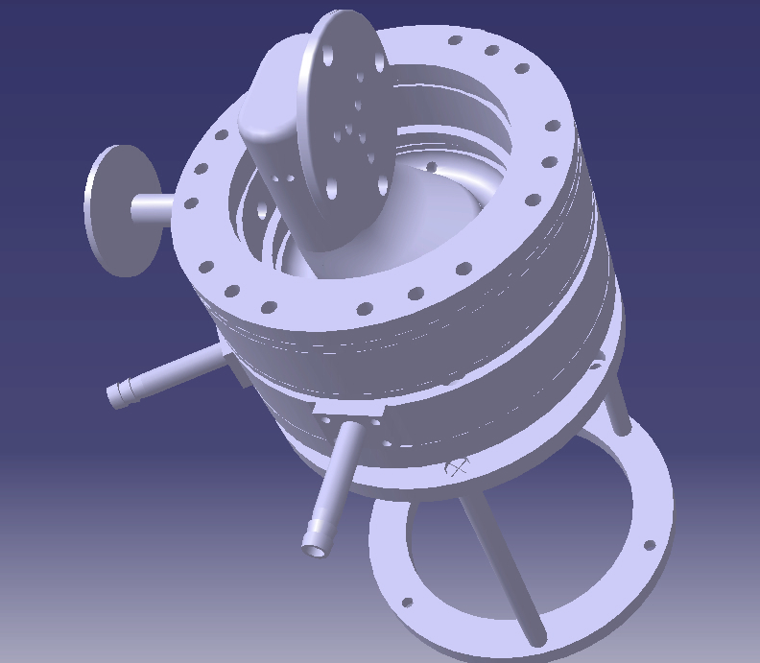
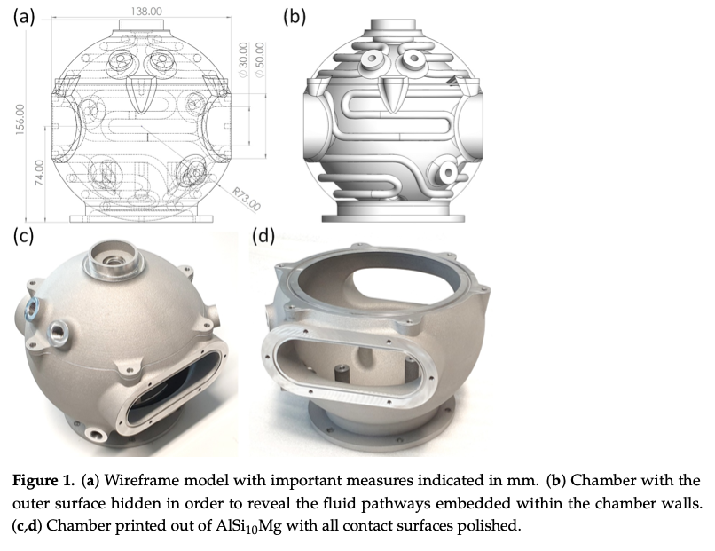
Humidity chamber
2 projects:
IK from Estonia
Production on going after feedback from Tobias
4 samples in transmission
Humidifier arrived but not tested and integration not started
Flexiprob (Peter Müller-Buschbaum et al.)
Drawings available
For GISANS
Collaboration initiated with Stefan Carlsson from MAX IV

Slide 5
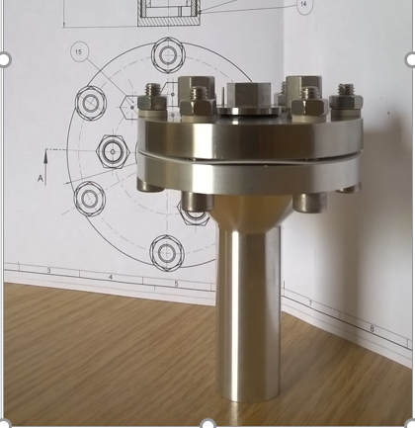
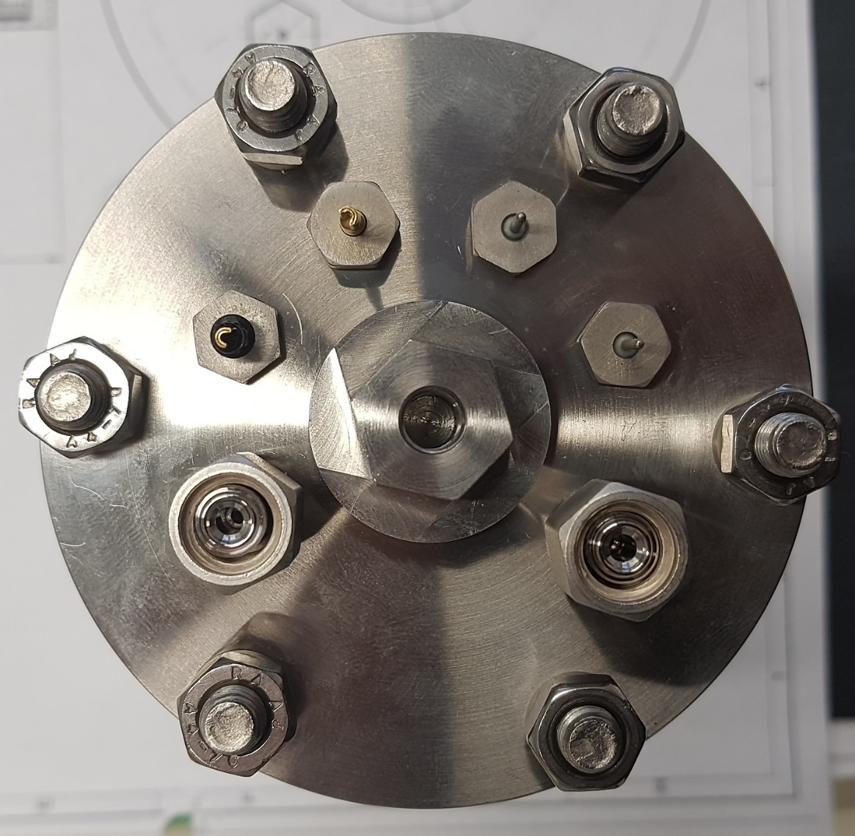
Electrochemistry
Sub-headline to strengthen the headline above
2 cell projects
with DREAM not started
with Estonia (IK)
All purpose cell
Specifications finalised
in construction but on hold until Alice is back
Cryostat
To be purchased before end of the year 2022 by Alex
Potentiostat
Control integration started
Has been used at MAX IV for experiments
Temperature
Sensor
Gas in-
& outlet
Reference Electrode
Working Electrode
Counter Electrode

Slide 6
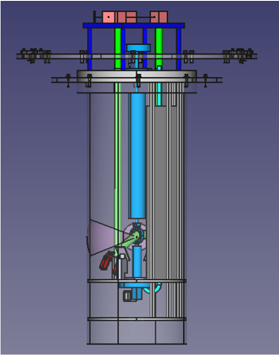
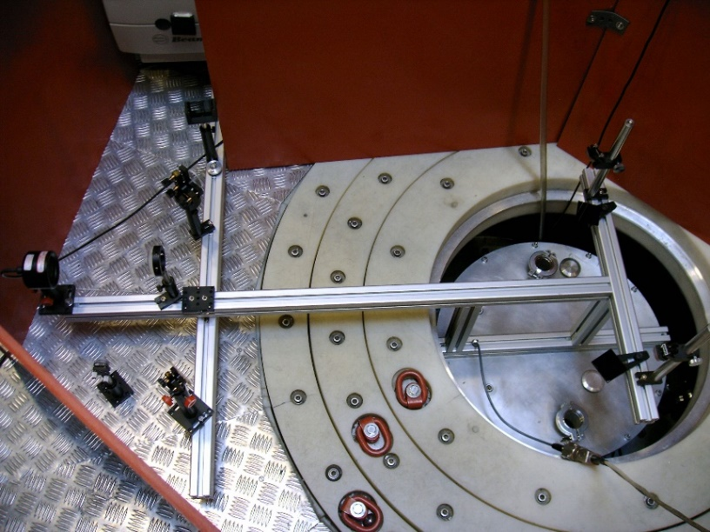
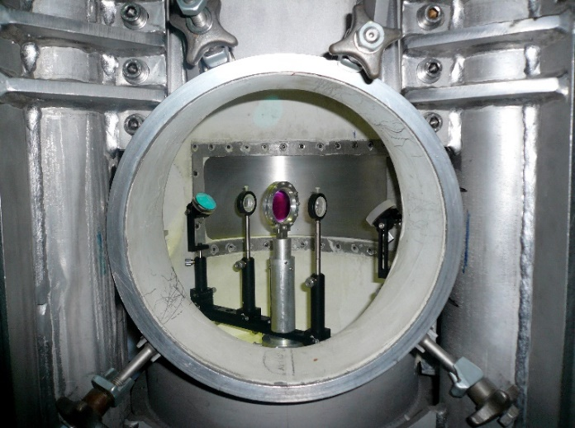
Laser Pump & Probe
Laser
IK from Estonia
One system already working and being used
Drawings reviewed by Tobias
ESS system in construction: available Q4/22
Laser beam
Irradiated sample

Slide 7
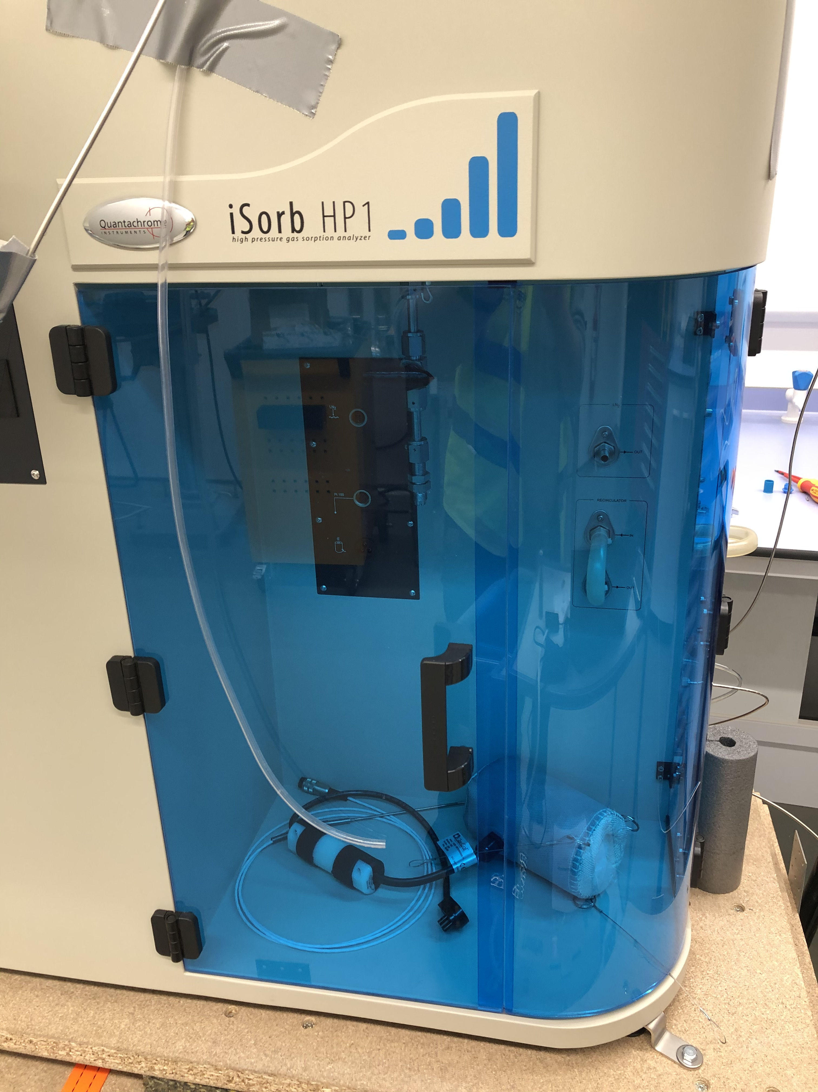
Gas handling
2 systems arrived : one for the SULF lab and one for instrument
Adsorption possible
Questions:
How should we work with this equipment? In-situ ?
How far integration should go?
Which kind of cells would be useful?

Slide 8
Finish presentation

