Slide 2
ESS and Science Directorate Update
STAP Meetings April 2022
PRESENTED BY Andreas Schreyer, Director FOR SCIENCE

Slide 3
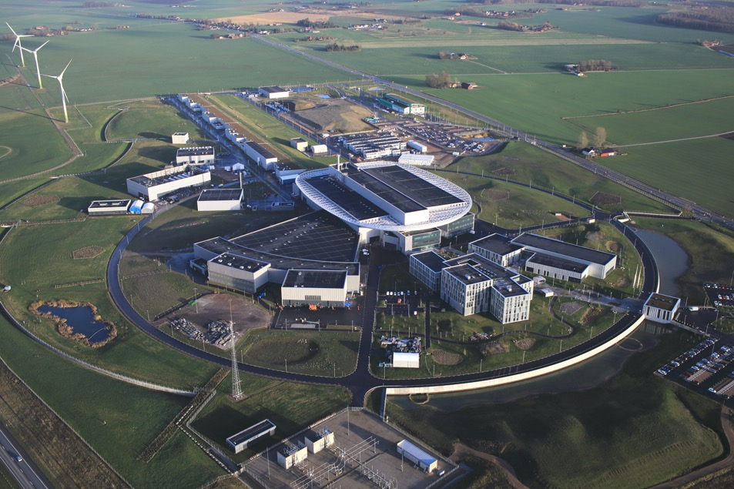
Project status
Time and costs update
  All 23 buildings finalised 2022
    On time in accordance with 2018 baseline
  Accumulated schedule slippage and extra costs for project as a whole
  Delays and costs caused by pandemic and technical challenges

Slide 4
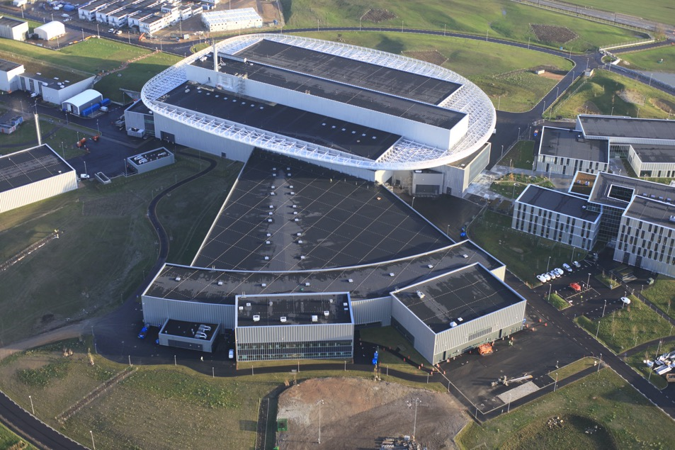
Project rebaselined
Time and costs update
  Thorough reassessment of schedule and additional costs
  Completion at earliest possible date in most economical way
  Revised plan entails a two-year-delay
    Full operation & open for users 2027
  The construction scope unchanged;
    15 instruments & 2MW accelerator
  Additional costs estimated to approximately 550 M€
    Inc. 2026-27 operations costs est. appr. 400 M€

Slide 5
Control Room: First protons accelerated
During commissioning of first parts of the Normal Conducting Linac

Slide 6
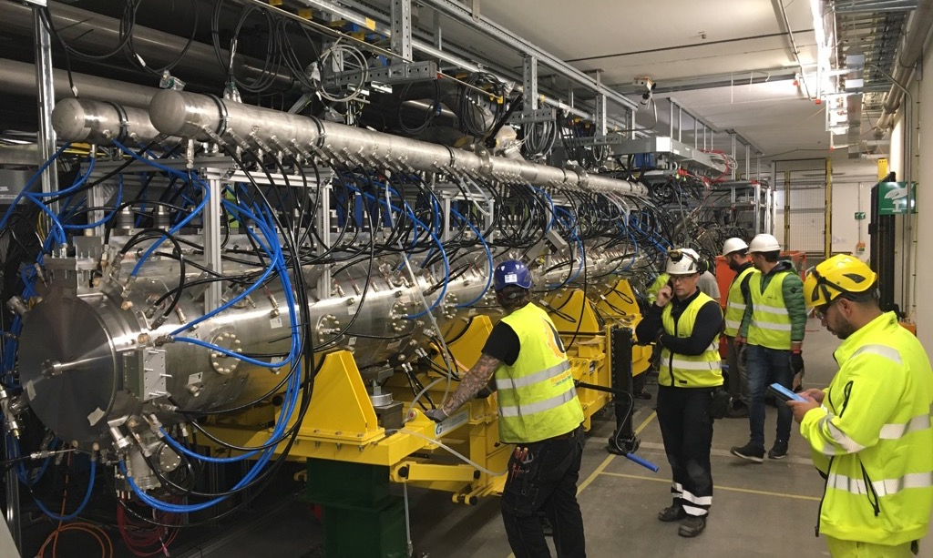
Drift Tube Linac tank 1
Installed in tunnel and integration is well under way

Slide 7
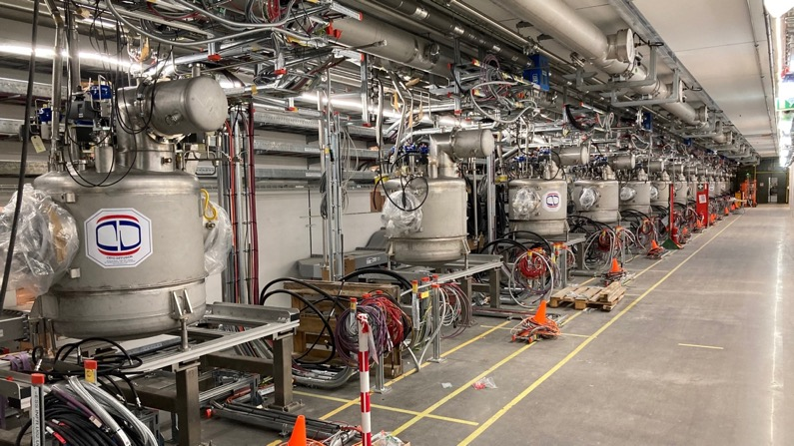
Progress in tunnel
Cryodistribution and magnets
All parts of spoke LINAC cryogenic distribution system delivered and and welding of header units under way
Elliptical cryogenic system completed
Cool-down planned for Q3 2022

Slide 8
CEA Elliptical Cryomodule
Assembly well under way

Slide 9
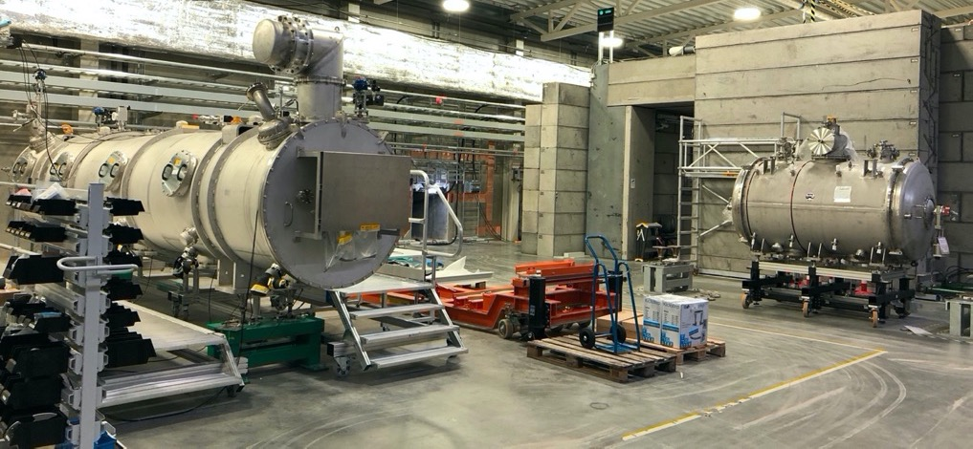
Cryomodule Testing under way at ESS
First medium beta elliptical cryomodules tested

Slide 10
Spoke Cryomodule testing in Uppsala
Well under way

Slide 11
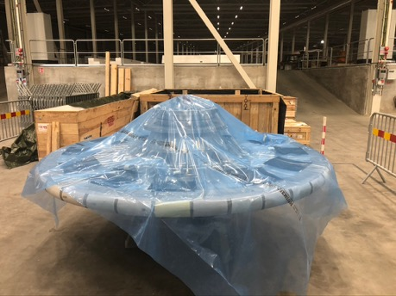
Target Vessel, Target wheel
neutron beam port blocks welded to target vessel, all tests passed

Slide 12
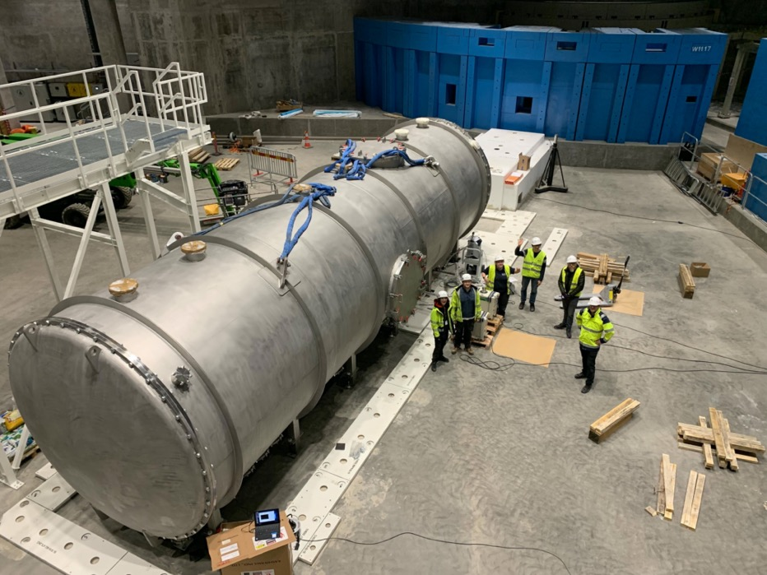
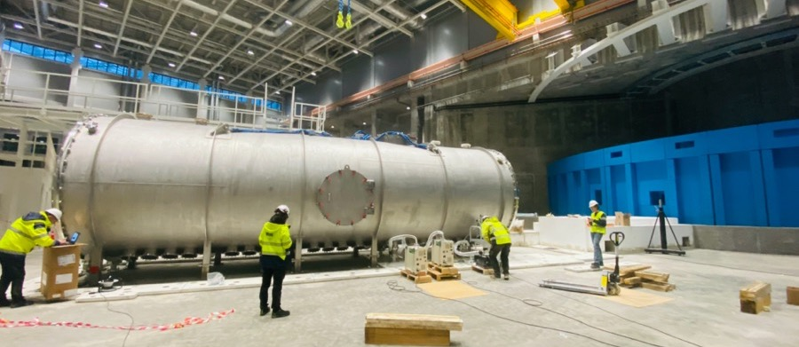
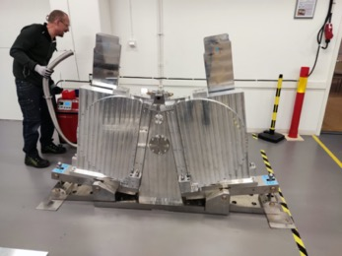
Loki Detector Tank
Installation and site acceptance test
Loki Chopper testing at ESS

Slide 13
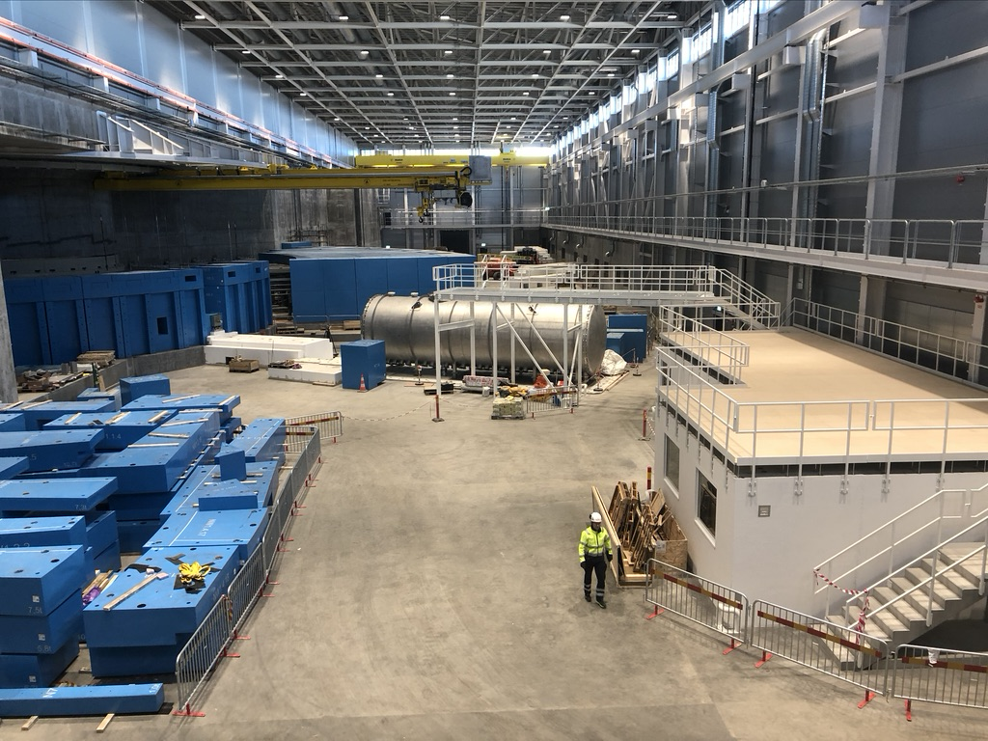
B03 Bunker Roof
1st Layer blocks delivered
Loki and Freia hutches

Slide 14
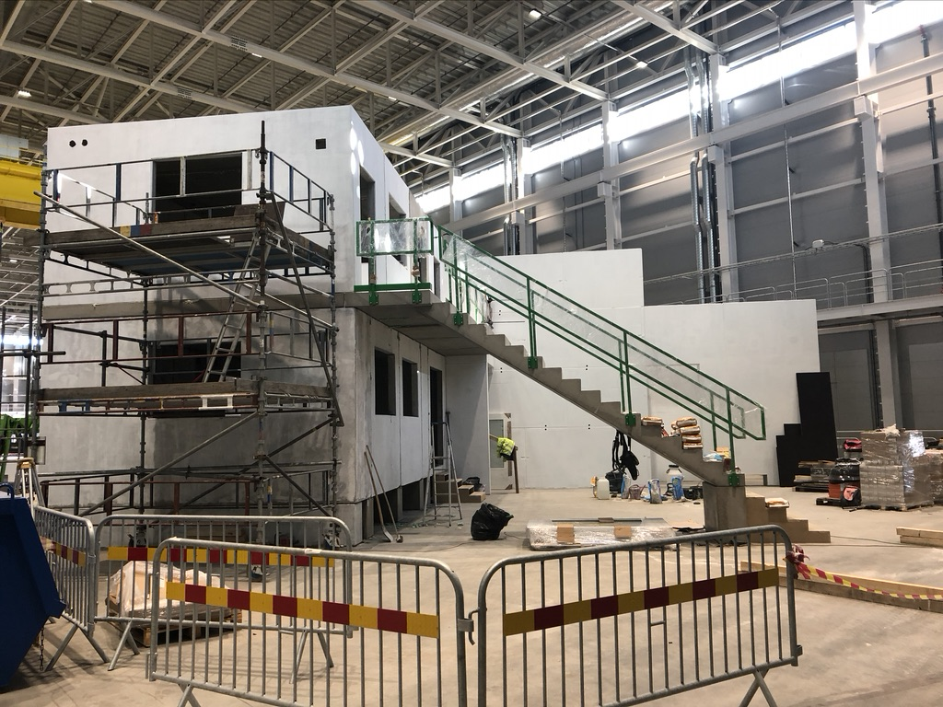
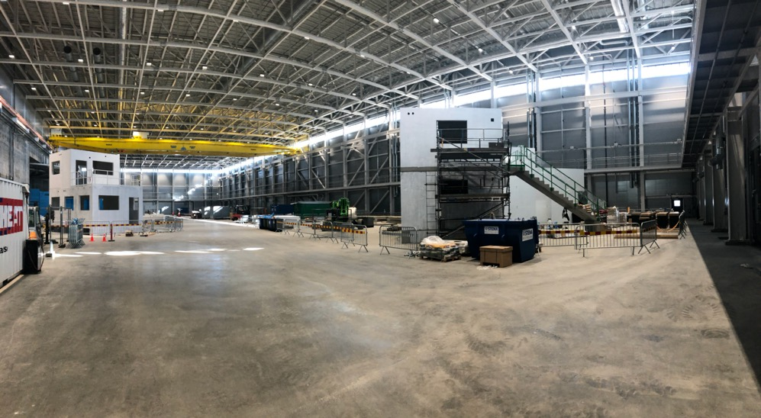
D01: DREAM and ODIN
Cave and hutch installation started, Status early March

Slide 15
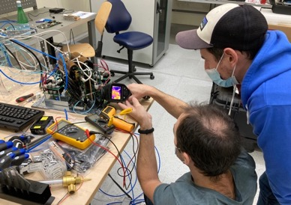
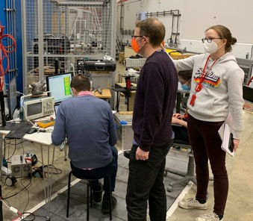
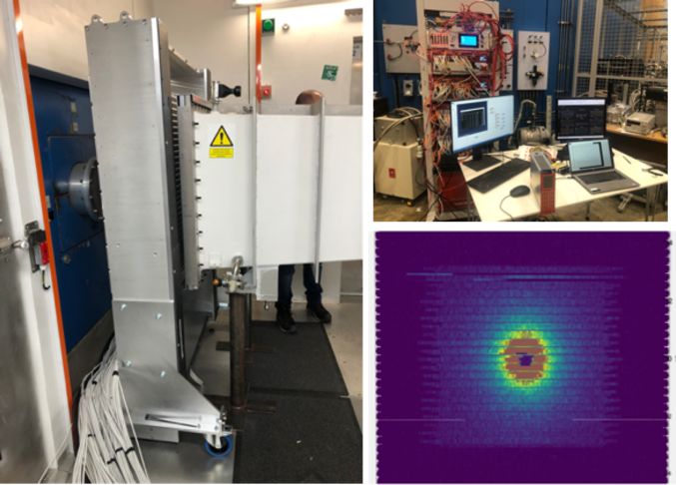
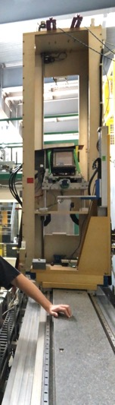
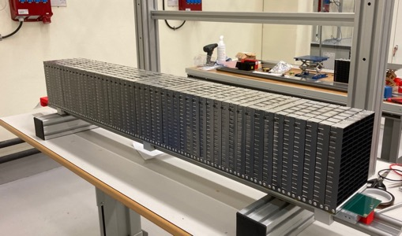
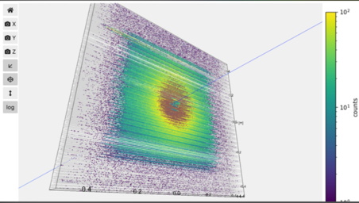
Highlights
Detectors and testing
Multigrid module construction
LET test May 22
Multiblade test Amor Dec 21
10B Straw test at ISIS March 22
End 2 End Test of 2/3 of low angle detector

Slide 16
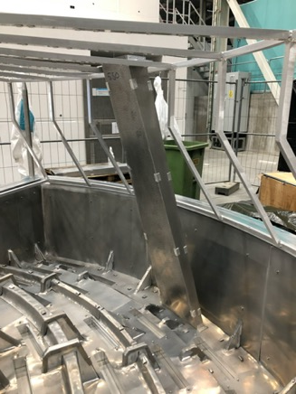
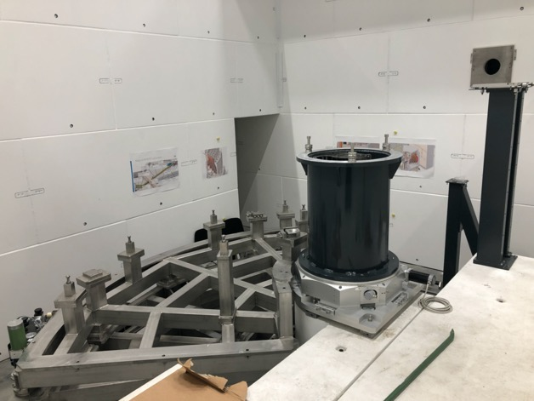
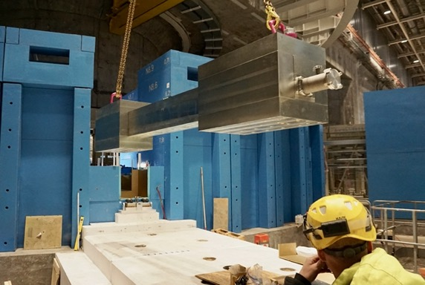
Highlights
Installation progress
Bifrost
Cross talk shielding & Cd shielding
sample position MCA systems
Installation of LOKI tank, cabin, bunker wall optics

Slide 17
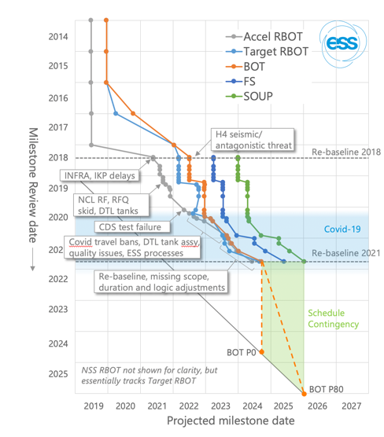
Rebaselining, Project Performance
2022 p6 plan is ambitious ~completing 200 activities per month
The plan is live since Jan 1st
PD level – increased evaluation of project performance.
- Use of detailed project dashboards
    Evaluate EV performance and understand variance
    Data driven from P6
    Formatted to match needs of subprojects
Subproject level - increased evaluation of project performance.
- New data driven focus for NPR meetings
    Evaluate previous month progress
    Forward look at +3 month activities
      Achievability and prioritisation as needed
    Input from across NSS, SD and In-kind partners

Slide 18
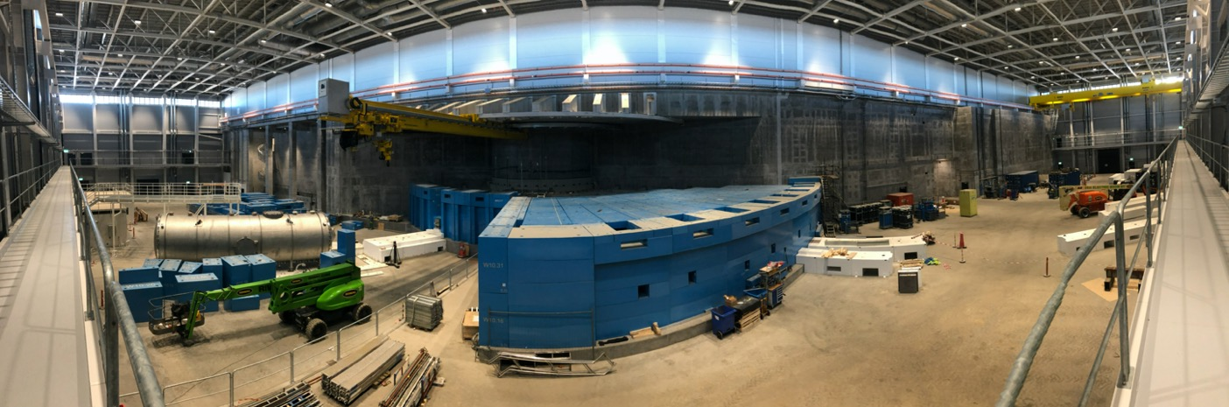
Other developments since last fall
ESS Subprojects: Accelerator, Target, Integrated Control Systems, NSS, Science
Technical scope within the Science Directorate (data management, sample environment, user labs, motion control, central polarisation service,…) will now be the 5th subproject
Subproject Leader: Oliver Kirstein
NSS project Leader Jonathan Taylor left ☹
Robert Connatser joining as new NSS subproject lead this week
Grants/External relations team has joined the Science Directorate

Slide 19
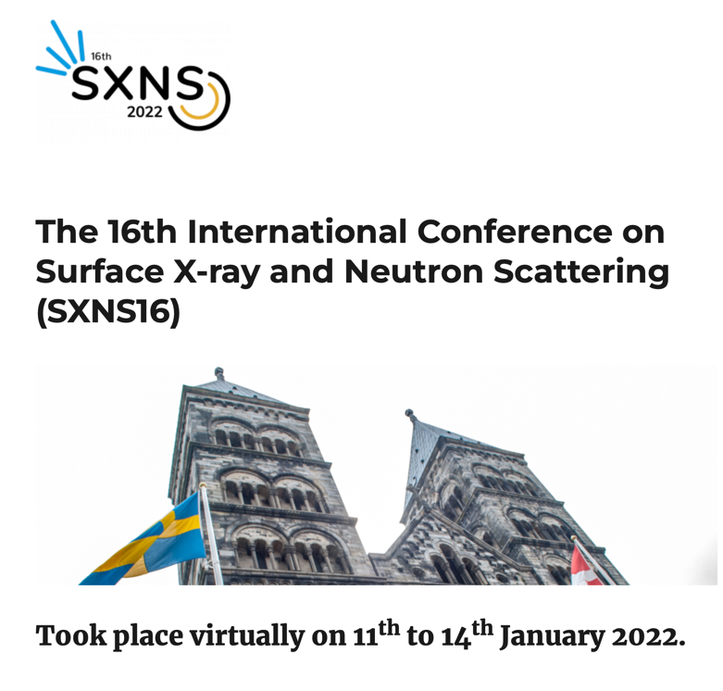
Science Directorate Activities
SXNS 16
Co-hosted and organised 16th edition of Surface Xray and Neutron Scattering with MaxIV.
Virtual only due to Covid, but had 180 registrants and a peak of 120 participants per session.
Thanks to Tom, Zsuzsa and Bea for their hard work making it a success.

Slide 20


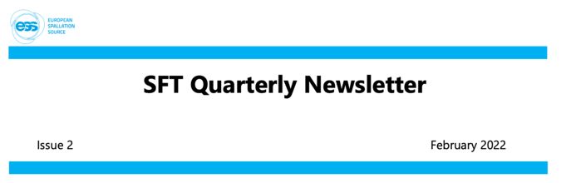
User Office and Scientific Coordination
Q4/2021 SFT newsletter released providing updates on scientific KPIs, news on grants, publication list, research highlights.
https://confluence.esss.lu.se/display/~carinalobley/2022/02/03/Science+Focus+Team+Quarterly+Newsletter?preview=/396788920/396788921/2021%20Q4%20SFT%20Newsletter.pdf
Publications:
  95 ESS-affiliated publications in 2021 total
  24 ESS-affiliated publications in Q4/2021

Slide 21
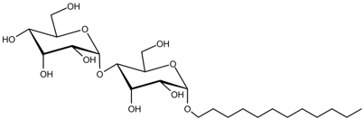
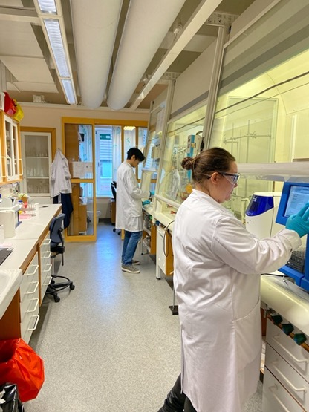
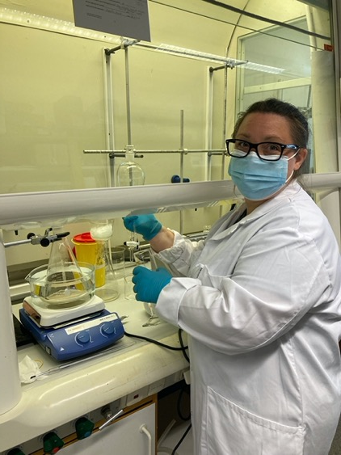
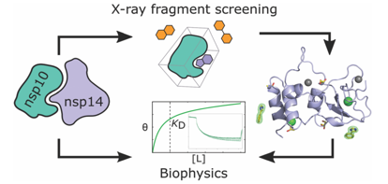



Deuteration & Macromolecular Crystallisation
Service: Completed two pilot user calls, delivered on 29 proposals for 56 users
Service: New pilot call 2b now open using ESS user office software; kudos to DMSC
Science: Deuteration activity led to 20+ papers already
Collaborations: C19 work continues
Collaborations: Hosting two and recruiting third externally funded PostDoc
Collaborations: Continued participation in several grants, outreach, teaching

Slide 22
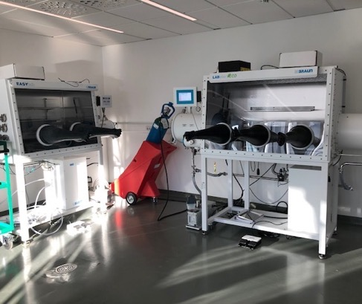
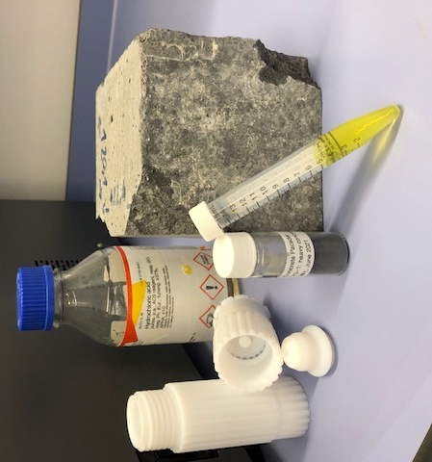

On-site Laboratory Services
Installation work: fume hood installation in D04 and D08 completed, D04 furniture delivered and fit-out to start in 2022; glove boxes moved to D08 (Radioactive Materials Lab)
Project support: luminescence coating prepared for deposition on first ESS target for test in high radiation environment; phase identification for concrete analysis continues: https://confluence.esss.lu.se/display/TH/2022/01/24/ICP-OES+to+Perform+Precise+Elemental+Analysis+of+ESS+Project+Materials
Capabilities: Rigaku x-ray powder diffractometer operational
Collaborations: HFSP PostDoc project continues
RML
concrete analysis

Slide 23
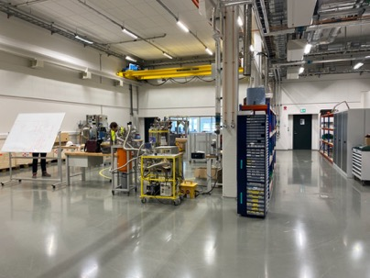
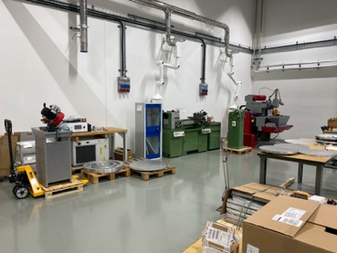
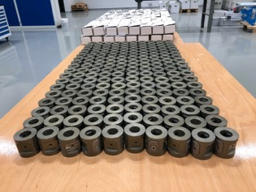
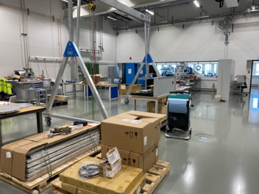
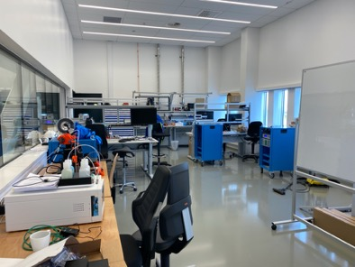
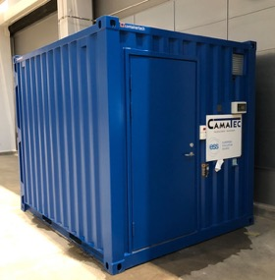
Sample Environment (SE)
  Workshops: E03 SE workshop operational; move from Utgård completed; electricity installed in B02 SE space
  Kipp kinematic mounts: delivered and available to instrument teams
  Octopy control integration: very successful demos
  High Pressure: pressure testing bunker delivered and placed in D01
Notes:
No photo: E03 SE main lab and workshop is nearly finished (last water-cooling pipes are being installed as well as the internet) and the SE Team is ready to move in October.
High pressure: with Malcolm gone, relying on IK partners on clamps and Paris-Edinburg; high pressure testing bunker in manufacturing and delivered before end 2021.
Rigs: Caroline working with partners on rigs
Cryogenics: list of magnets planned until finalized incl. spectroscopy magnet (FR IK TA worked on); 15T + 6.5T magnet incl dilution fridge from HZB (second hand) will be dismantled and shipped in October (5th to 13th).
Cryogenics: list of cryostats finalized. 5 wet cryostats (small angle scattering, BIFROST #2, HEIMDAL, TREX and MIRACLES), 4 dry cryostats (VESPA, spectroscopy, HEIMDAL and small angle scattering) and 2 cryofurnaces (TREX and HEIMDAL).

Slide 24
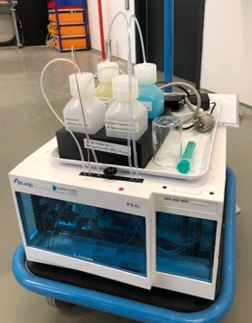
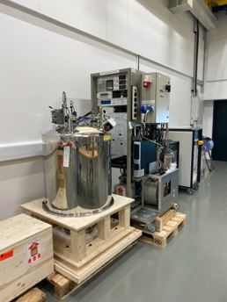
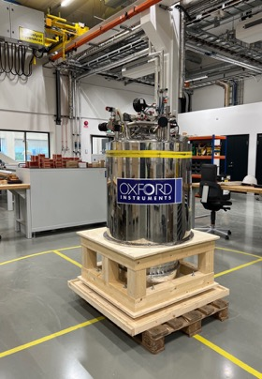
Sample Environment (SE)
  Soft matter equipment: Loki SANS changer and collaborative project on solid-liquid cells progressing; activities slowed down related to staff transfer, maternity leave (hand-over on-going)
  Magnets: HZB 2nd hand 15T + 6.5T magnet + dilution at ESS ready for remounting, commissioning, control and mechanical integration
  Cryostats: BIFROST cryostat arrived at ESS in Dec. 2021
  Mechanical processing: TA for transfer of NPI 100 kN stress rig in preparation
Notes:
No photo: E03 SE main lab and workshop is nearly finished (last water-cooling pipes are being installed as well as the internet) and the SE Team is ready to move in October.
High pressure: with Malcolm gone, relying on IK partners on clamps and Paris-Edinburg; high pressure testing bunker in manufacturing and delivered before end 2021.
Rigs: Caroline working with partners on rigs
Cryogenics: list of magnets planned until finalized incl. spectroscopy magnet (FR IK TA worked on); 15T + 6.5T magnet incl dilution fridge from HZB (second hand) will be dismantled and shipped in October (5th to 13th).
Cryogenics: list of cryostats finalized. 5 wet cryostats (small angle scattering, BIFROST #2, HEIMDAL, TREX and MIRACLES), 4 dry cryostats (VESPA, spectroscopy, HEIMDAL and small angle scattering) and 2 cryofurnaces (TREX and HEIMDAL).

Slide 25
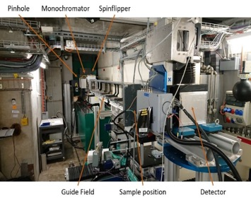
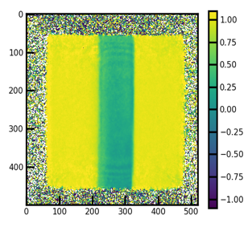
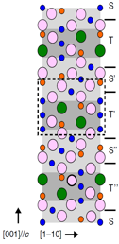
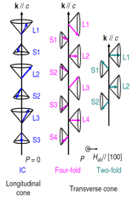
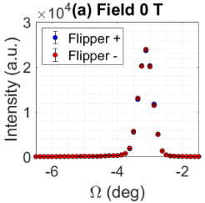
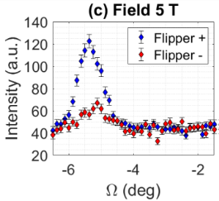
Neutron Optics & Polarisation
ESS rebaseline planning & externally funded collaboration
Polarisation has been implemented into the overall ESS rebaseline plan
  Potential for ILL - ESS collaboration
Grants supporting instrument construction projects :
  Cooperation with ISIS instrumentation and methods for ESS (2022-2024)
  Title: Wide-angle neutron polarisation analysis to study energy and quantum materials
    Prototype innovative supermirror and polarised ³He devices.
    Partially funds BIFROST wide-angle analyser or CSPEC polariser.
    Student and postdoc to support instrumentation development
    and related scientific experiments
  SREss3 project (LU, LoKI, SKADI, ODIN):
    Alex Backs and Annika Stellhorn have done
    experiments at ILL, PSI, and TUM, and also analysing existing data
    Joel Hagman’s work on uniform field coil
    design has a breakthrough result
c ≈ 43 nm

Slide 26
Neutron Optics & Polarisation
ESS rebaseline planning & externally funded collaboration
Polarisation has been implemented into the overall ESS rebaseline plan
  Potential for ILL - ESS collaboration
Grants supporting instrument construction projects :
  Cooperation with ISIS instrumentation and methods for ESS (2022-2024)
  Title: Wide-angle neutron polarisation analysis to study energy and quantum materials
    Prototype innovative supermirror and polarised ³He devices.
    Partially funds BIFROST wide-angle analyser or CSPEC polariser.
    Student and postdoc to support instrumentation development
    and related scientific experiments
  SREss3 project (LU, LoKI, SKADI, ODIN):
    Alex Backs and Annika Stellhorn have done
    experiments at ILL, PSI, and TUM, and also analysing existing data
    Joel Hagman’s work on uniform field coil
    design has a breakthrough result

Slide 27
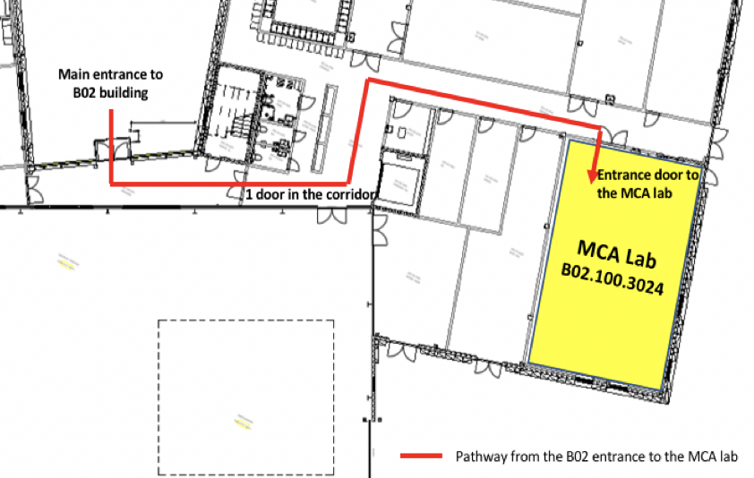
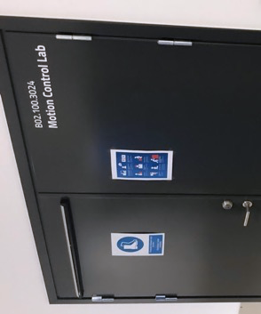
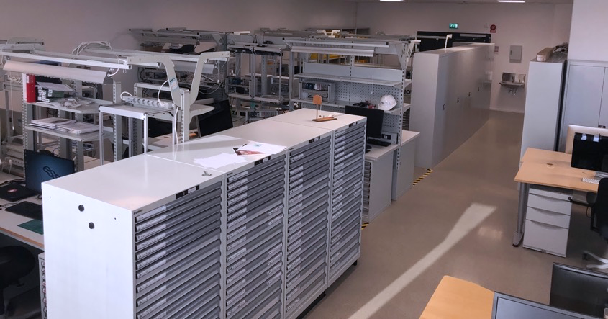
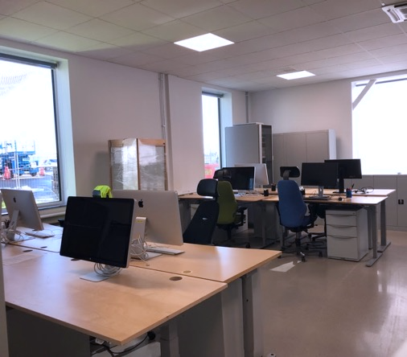

Motion Control
Labs and Workshops are ready!
  B02 - Motion Control Lab + office
    (Re-)population has started; you can find us here in B02
  Area responsible is Kristina; a big thank you to her for managing first the move from ship 6 and than the layout, equipment and opening of the area.

Slide 28




Motion Control
Our contribution to Target and ICS
  Target Wheel Control
    Spinning of the wheel with 23.3 RPM
    Synchronisation to the Proton beam pulse
    X-Y-Z adjustment of the position
  FAT in Spain in February 2022
    Running the motion control part (drive unit)
    Support FAT with eccentricity measurements
  A big thank to Anders as the key expert for this.

Slide 29



User Office Software
    Supporting DEMAX Call 2b with:
    Proposal submission
    Technical Review
    Scientific Review
    Used successfully at the Central Laser Facility (CLF) in the UK for their November call and is planned for rapid access call at ISIS in April.
    New developments:
    Module for generating statistics
    Visitor management
    Experiment safety report
    Sample shipment with integration to EAM
Central Laser Facility Call
Main Research Area
Visit Registration
Credit: Fredrik

Slide 30

Preparing infrastructure for commissioning
Step 1: Getting YMIR up running on production environment
  Provided infrastructure for running YMIR as a production instrument from H01. This covers all the ground work for cold commissioning from an infrastructure point of view and consists of
    Networks for running the instrument
    Network integration with instrument controls
    Deployment and provisioning
    Storage systems
    Virtualization system (interim solution at the moment).
    This work has been accomplished in collaboration with the ECDC group and with ICS INFRA.

Slide 31

ESS ILL user meeting in Lund
Good progress on organization
5th -7th October
Sessions on hot topics
Venue: Central Lund, AF Borgen
8 Plenary speakers from across Europe
Conference dinner in AF Borgen
ESS site visit including poster session and mingle

Slide 32


A lot has happened
Installation progress in all instrument halls, labs and workshops
Rebaselining
Challenges

