Slide 2
STAP presentation:
Sample and User Laboratory Facilities
Monika Hartl, Katrin Michel, Melissa Sharp, Harald Schneider
PRESENTED BY Monika Hartl

Slide 3


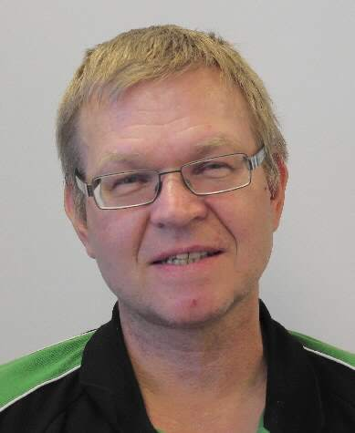



SULF Team
Distribution of Full-Time-Employee (FTE) on areas of work
Installation & Area Coordination
Lab operations & maintenance
ESS Project Support
1.5
FTE
CORE TEAM (4 FTE)*:
Monika
Hartl
Katrin
Michel
Harald
Schneider
Melissa Sharp
1
FTE
Grant / internship
Sophie
Ayscough
(Postdoc)
Janette
Zerna
(CTA intern 3 months)
1.5
FTE
Harald joined the team in January 2022: now 4 FTE
* 2026: 4.5 FTE -> 2028: 6 FTE
Notes:
The first two slides will give you an overview of the SULF team and the budget. The SULF team consists of 4 full time employees since Harald joined SULF in January of 22.

Slide 4
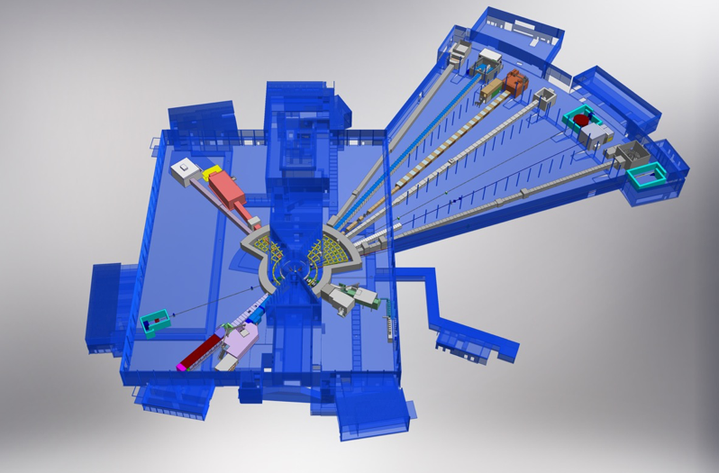
SULF Budget
Distribution of Budget on areas of work
Installation cost D04/D08 & D08 furniture (including Sample Environment areas)
Lab consumables (120 kEUR) & equipment renewal (60 kEUR)
ESS Project Support: consumables
692
k€
Lab AREAs (4 buildings):
E03
D08
E04
180*
k€/yr
D04
E04: SULF offices, current user labs (6 rooms)
E03: future imaging/engineering lab (1 room)
D04: future user labs (4 rooms)
D08: SULF offices, Radioact. Mat. Lab (RML), future user labs (4 rooms)
41
k€/yr
* Includes equipment D04/D08: dishwashers, fridges, freezers, ice machines, centrifuges, …. & basic glassware + maintenance service contracts for all labs
Notes:
Fixed budget to install labs and sample environment workshops in D08 and D04. Annual budget for …

Slide 5
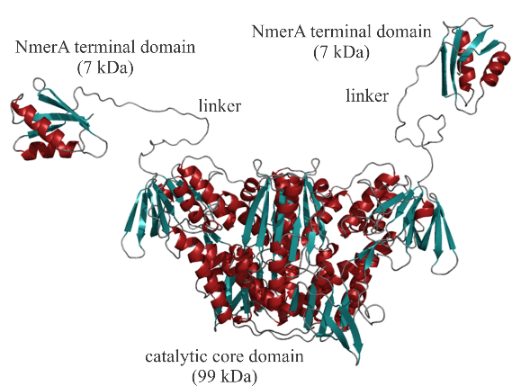
SULF- Melissa Sharp
Role: chemist soft matter and bioscience
PhD in physical chemistry
  Polymeric micelles using SANS, DLS, and NMR
  Beamtime at 5 neutron facilities
Instrument scientist for SANS, USANS and NSE (at GKSS, SNS, ILL)
  Supporting users from many science areas (soft and hard)
  Developing sample setups
  Writing software
Areas of scientific research:
  Polymers, proteins, vesicles
Experience relevant for ESS and SULF
  Characterisation using range of lab techniques e.g.:
    PFG-NMR, DLS, DSC, uv-vis, CD, …
  Instrument scientist / class coordinator for NSE
  Liaison with conventional facilities and NSS stakeholders
  Procurement of soft matter instruments
  On review committee for soft matter proposals at ILL 2018-2021

Slide 6
SULF - Katrin Michel
Role: Chemical Technical Assistant
Relevant experience:
Trained for work in chemistry and biology laboratories (Lette Verein in Berlin, Germany- 2011)
Cell culture S1 & S2 (LDH, MTS testing) and HPLC at HZG (HZ Hereon)
Freie Universität Berlin:
    Experience in organic synthesis namely functionalization of dPG-OH
    AFM trained (4 years experience)
    General lab organization (procurement, safety, equipment maintenance)
Relevant for SULF
Synthesis to support ESS and other projects
(e.g. Ce-YAG, GO, SBA-15)
Sample Preparation & Analysis with e.g. SEM, DSC-DTA, BET, AccuPyc, ICP-OES (skills with AFM useful for SEM)
Procurement & Fit out laboratories (knowledge of needs for labs in regard to standard chemicals and consumables; also for soft matter and biology)
Input and Advice regarding user needs coming from different fields (storage, workplace setup, e.g. sterile work, synthesis workplace, storage needs)
Day to Day routines (waste, hygiene, safety, deliveries, storage, equipment check and adjustment)

Slide 7
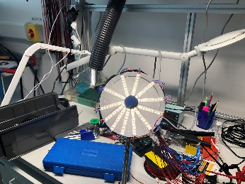
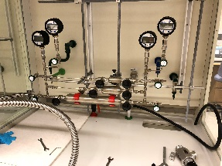
SULF – Harald Schneider
Role: engineer, electrical operations lead (aux. buildings)
Relevant Experience:
Dipl. Ing. Electronics & Pre-diploma Physics (low temperatures, neutron scattering)
Sample environment engineer in HZB(HMI) Berlin, Germany:
    (ultra) low temperatures sample environment for neutron scattering
Instrument design, hot/cold commissioning at MLZ Munich, FRM2, Germany
    Cold Triple Axis Spectrometer (TAS), ‘PANDA’ & Thermal TAS , ‘PUMA’
    Developing JCNS-sample environment @FRM2
ESS:
    Engineer for sample environment – soft matter
SULF supporting expertise:
materials preparation cc workshop - materials -> Materials Team
experimental support, cryogenics
3D printing , prototyping
Technical gases, e.g. H2
sample environment -> sample handling

Slide 8
SULF – Monika Hartl
Role: chemist, group leader
Relevant Experience:
PhD:
  Inorganic/analytical chemistry
  XAFS spectroscopy
Postdoc/staff @Los Alamos Neutron Scattering Facility LANSCE, user support:
  instrument (NVS/SANS)
  chemistry labs/safety reviews
ESS
  Target Division: material scientist, op-H₂, water loop reviews;
  VESPA instrument
SULF supporting expertise:
materials analysis/spallation sources (Materials Team@ESS)
X-ray diffraction, spectroscopy, thermal analysis, XRF, glove boxes
synthesis & lab stewardship
working with radioactive materials, activated samples
strong connection to neutron instruments and sample environment
experienced in review committees (scientific and safety)

Slide 9


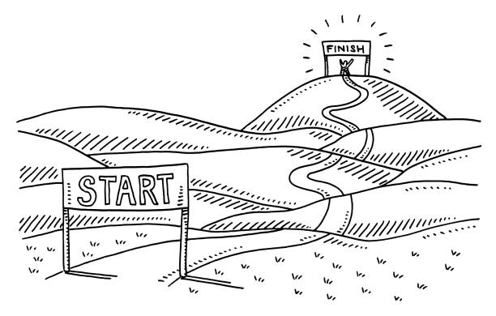
SULF in-kind projects
All in-kind projects have been completed
UK-in-kind: ISIS, STFC
Laboratory fit-out for buildings E04, E03 and the RML in D08: 1 M€
Start: January 2016
End: March 2021
Estonian in-kind: University of Tartu
Glove boxes for RML in D08: 70k€
Start: February 2016
End: December 2021
Brexit
covid
Both in-kind projects now officially completed and approved.
Further collaborations will be discussed in May 4th, 5th at workshop at ESS.

Slide 10
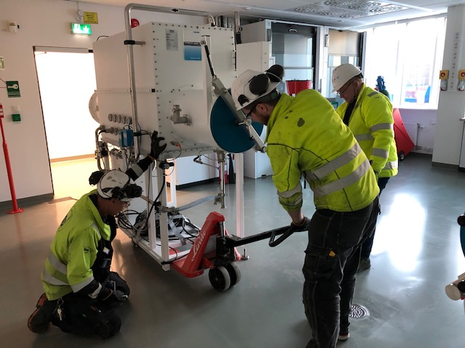
Installation & Area Coordination
Lab operations & maintenance
ESS Project Support
1
How do we best split our equipment and team members across 3-4 buildings while maintaining our functionality?

Slide 11
SULF Timeline -installation
Upcoming: installation of chemistry and sample environment labs in D04 and D08
Lab ready for
operations
Fume hoods
D04/D08
Continuation of installation – furniture, utilities, electric
installation
commissioning
in operation
Installation paused
D08
D04
RML-commissioning
E03/E04 - operating
2019 | 2020 | 2021 | 2022 | 2023 | 2024 | 2025 | 2026
-> First Science/
Start of User Program
Handover
E04 / E03
Handover
D04 / D08
Awarding tender for lab installation
BOT
Notes:
D04: hand-over March 30, 2021
D08: hand-over August 10, 2021
D08: partial access
NOW
Basic setups for chemistry incl. soft condensed matter and life science (E04) and engineering (E03).
Radiological Materials Laboratory (RML) for handling activated samples and materials
LATER
Fit-out of remaining labs in D04, D07 and D08
Capital investments into the specific science areas for the instruments to provide complementary lab equipment
ALWAYS
support the ESS project and operations with materials characterization (Accelerator, Target, Science)

Slide 12
SULF effort - installation & area coordination
1.5 FTE on installations + area coordination/lab coordination
FTE
Installation
1.5
Installation
D04 lab coordination
D04 lab coordination
1.0
D08 area coordination &RML
D08 RML lab coordination
E03 area coordination
D08 lab coordination
0.5
E03 – SLIME lab coordination
E03 – SLIME lab coordination
E04 area coordination
E04 lab coordination
2019 | 2020 | 2021 | 2022 | 2023 | 2024 | 2025 | 2026
Handover
E04 / E03
Handover
D04 / D08
-> First Science/
Start of User Program
Start installation
BOT
Area coordination = coordinating all ongoing maintenance, installation and work in building;
coordinating house hold & chemical waste, gases & cryogenic gases, house vacuum, cooling water, waste water
coordinating access, safety, and visits
Lab coordination = coordinating work in labs only, i.e. chemical operations incl. chemical waste & safety;

Slide 13

Installations finished: E04 Level 100/110
Level 100
Life science Lab
(NMX, CSPEC,
MIRACLES)
Detector lab
X-ray diffraction
Physcial Characterization
Spectroscopy room
Cold
room (later)
Level 110
Motion Control lab
storage
Cutting/ polishing
SULF Offices
Basic Chemistry lab (BIFROST, TREX, MAGIC, BEER,)
SEM
storage
2 offices in E04 (up to 4 seats)

Slide 14
Installations finished: E03 – SLIME
Level 100
SLIME (Scientific Laboratory for Imaging and Engineering):
Currently occupied by Target Safety Systems
Fitted with basic services
-> will be further developed with the BEER/ODIN beamlines
Sample Env. Techn. Lab
Optics Lab
SLIME – engineering and imaging (BEER/ ODIN)
Sample Env. Techn. Lab
Loading Bay
Liquid N2

Slide 15
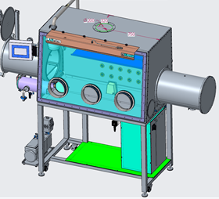
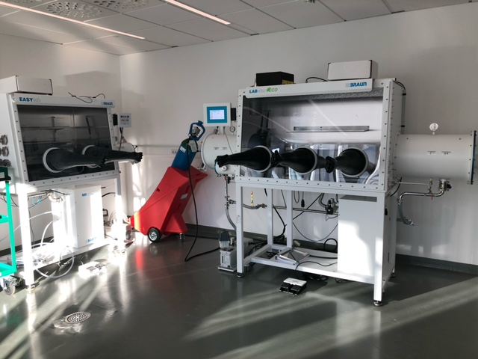
Installations finished: RML in D08
Commissioning of radioactive materials lab in summer/fall 2022
RML
Glove
box 1
Exp. halls
Changing
area
Glove
box 2
Radiation monitor
Test cases:
  Proton-irradiated luminescence screens (ESS/Beam diagnostics, fall 2022)
  Possibly collaboration on radioactive coating (2023 ?)

Slide 16
D04 Installations fall 2022
Furniture procured Dec. 2021, Tender June 2022, Installations fall 2022
Level 100
Level 110
Life science Lab (LOKI/ ESTIA)
Chem. Lab (VESPA, ESTIA, SKADI)
Sample Env.
spectroscopy
Detector lab
Cold room
appliances

Slide 17

D08 Installations 2023
Furniture procurement Q4/22-Q1/23, Installations summer 2023
Level 100
Level 110
2 offices in D08 (up to 4 seats)
Sample storage
Chem. Lab (DREAM/ ODIN)
Sample Env. Techn. Lab
H₂ lab
Optics Techn. Lab
storage
Furnace room
RML
SIN/ cond. matter
DAC
4 FTE taking care of labs in 3 buildings with 1310 m² lab space ….?

Slide 18
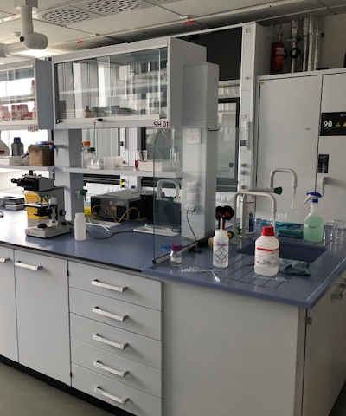
Installation & Area Coordination
Lab operations & maintenance
ESS Project Support
2
What can we do better when continuing to operate the growing labs and supporting the ESS with limited staff?

Slide 19
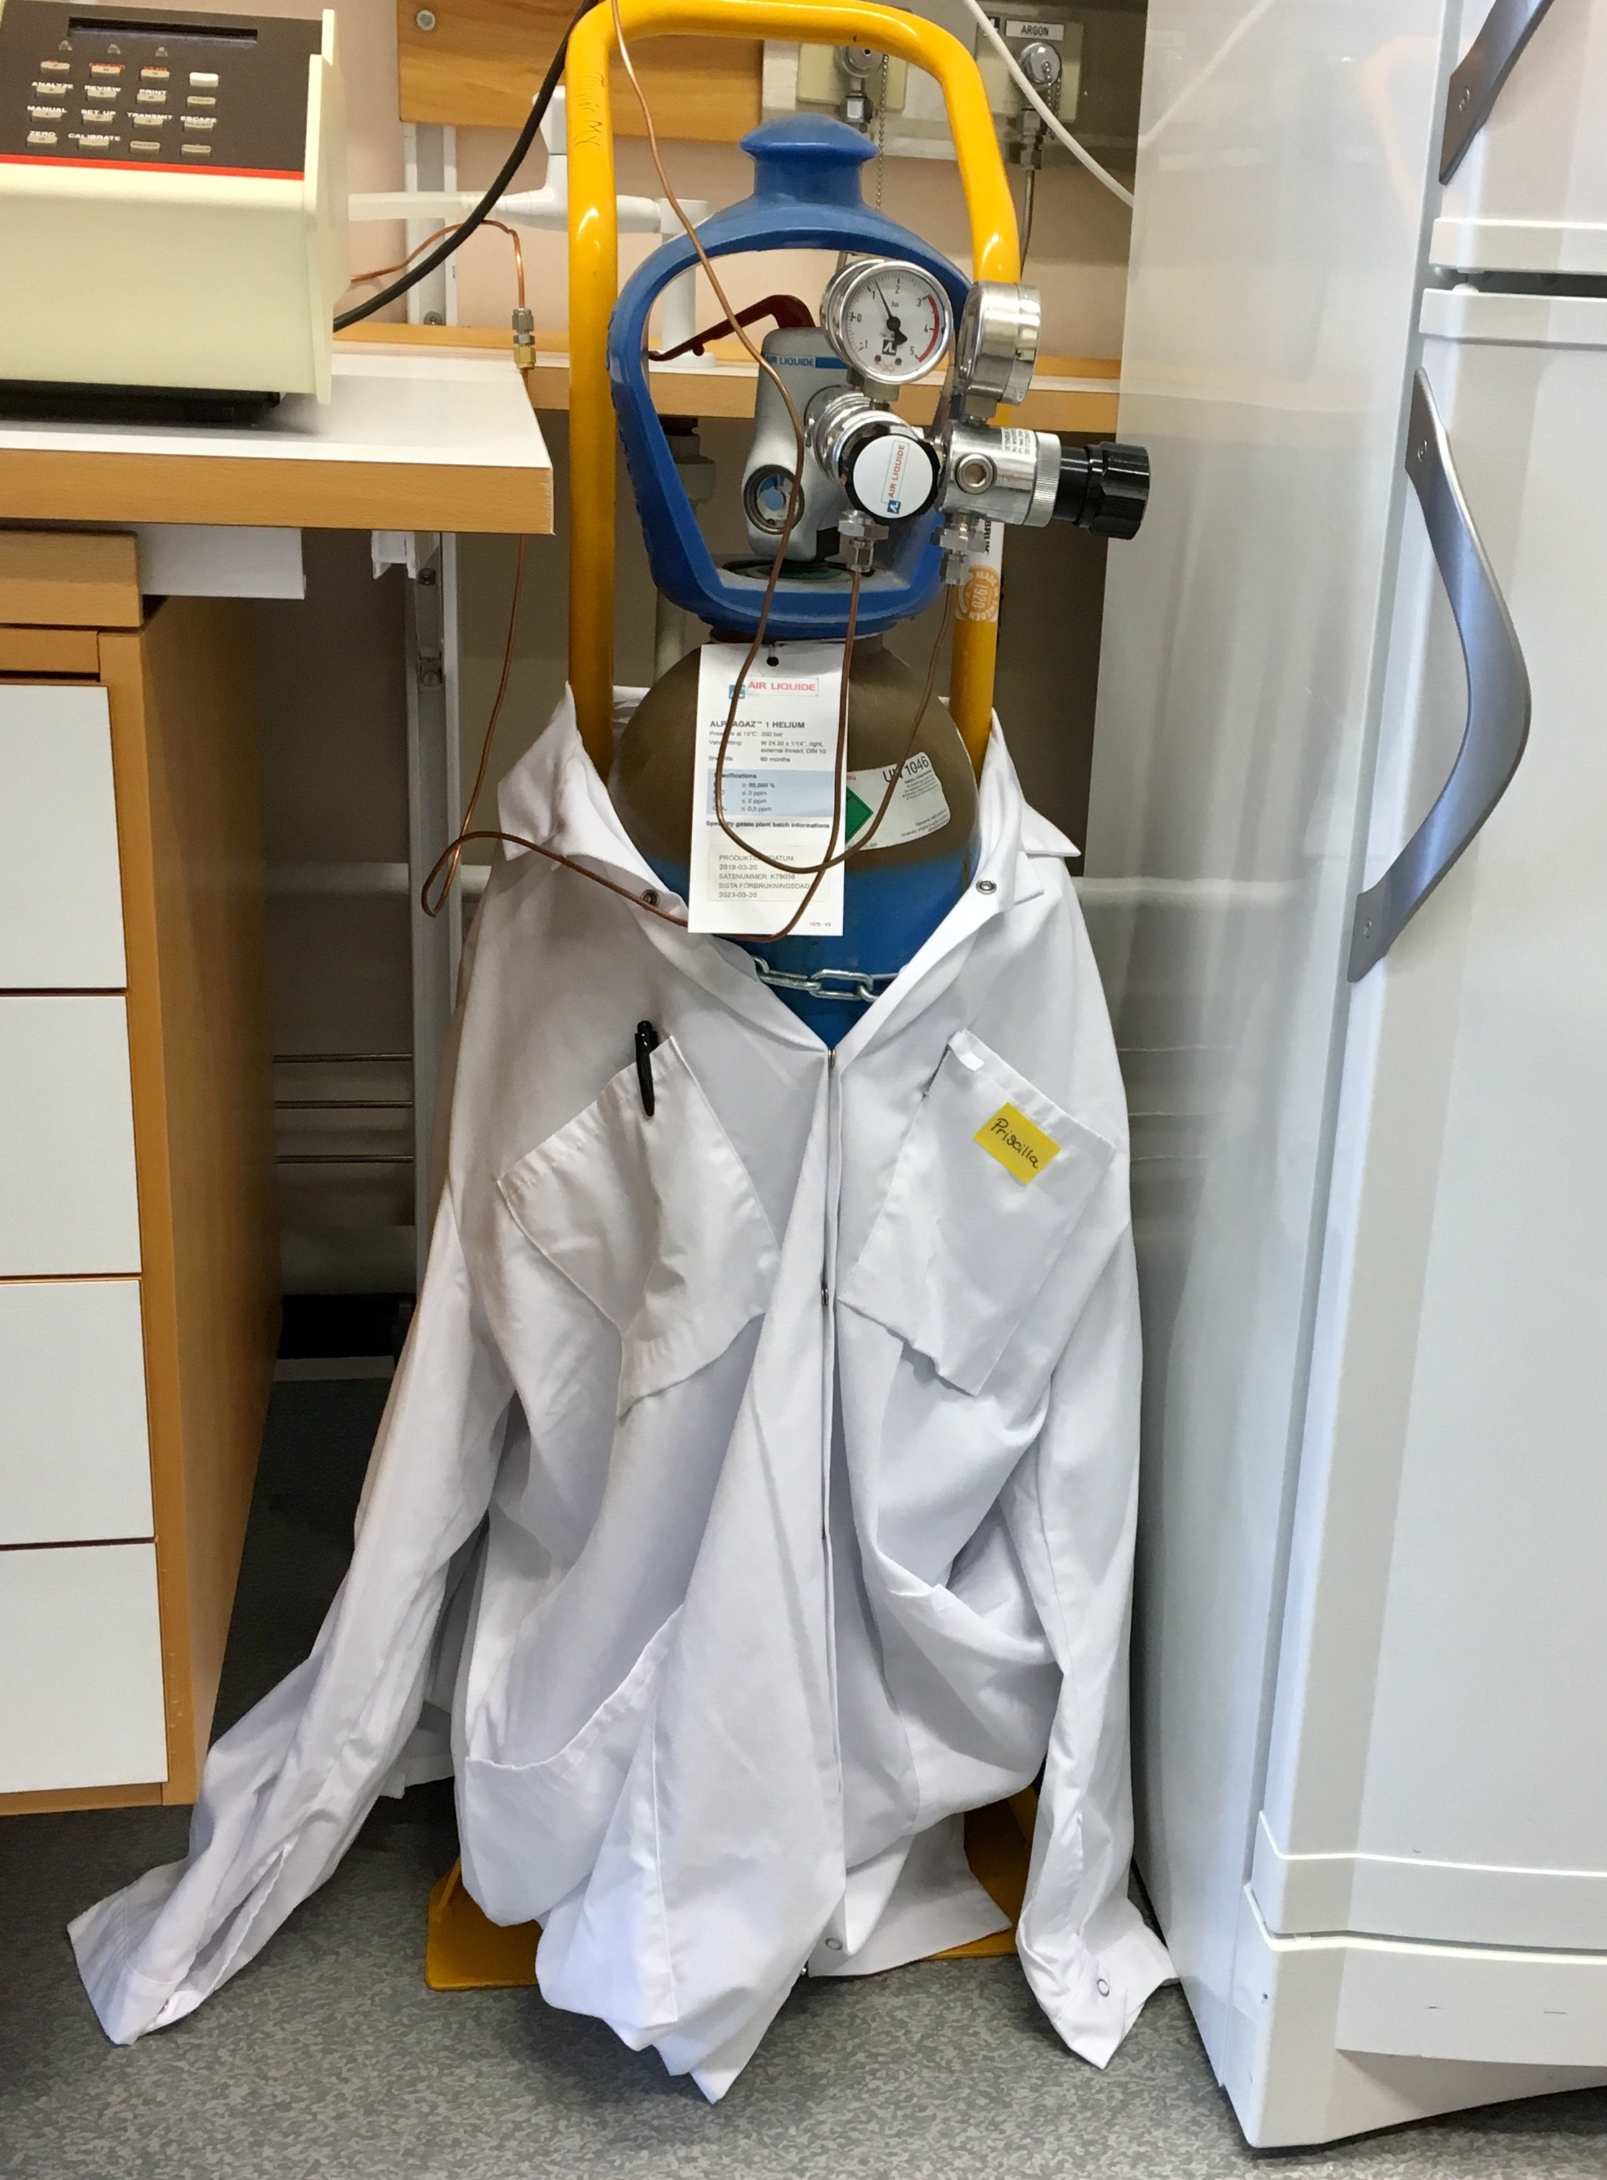
SULF – lab operations / core business
Main issue right now– long delivery times and unexpected shift of deliveries
Daily tasks (core business):
- keep instruments calibrated and maintained, write quick guides, train colleagues
- procure common chemicals (common compounds, solvents, acids, bases, indicators, buffers, standards…) to avoid delays
- update lab safety guidelines, perform safety walk-throughs
- keep chemical inventory up to date
- order l-N₂, gas cylinders, waste removal, check house vacuum
Unavoidable issues:
- single-point failure: train at least 2 of the 4 team members
- absence coverage for areas and labs

Slide 20

Getting SULF back to core business?
Issues raised at previous STAPS have been (mostly) solved
Working solutions:
- cleaning of lab floors and office area now possible
- cargo bike has been procured
- mail is delivered to our offices
- electrical engineer is still available for installation support
- FM and office support now react faster to our calls
Remaining Issues (time drain):
(1) no ownership of building by FM and office support (no automatic check if things are working, supplies are not automatic)
  Doors not working -> SULF submits ticket AND has to follow up to make sure it gets done. (replace door by lights, ventilation, …)
(2) change of procedures by support groups without enough warning/discussion with groups affected
  door alarms and badge readers
(3) Progress blocked by other groups not understanding details
  Insurance: need lids on waste bins; emergency response team: no 200 bar gas cylinders in labs; security: alarms on inner doors needed now…
  L-N₂ storage tank for l-N₂ and gas N₂ supply: rent deemed too expensive

Slide 21
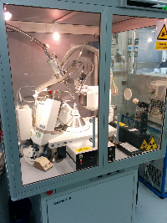
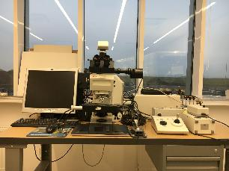
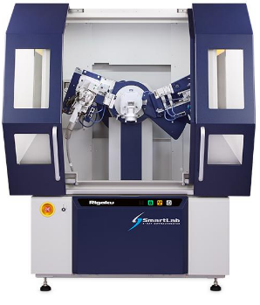
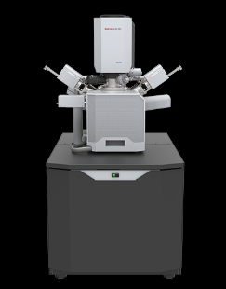
Diffraction equipment and microscopes
Operational: Single Crystal & Powder Diffraction, Optical microscopy, SEM
Agilent Single Crystal X-ray machine by RIGAKU– used/permanent loan:
CuK: 1.54056 Å
MoK: 0.70930 Å
Leica Optical microscope with indenter and camera
2022 ideas for procurement
New digital camera for microscope + PC
(grain size, debris)
X-ray optics to allow reflectometry on Rigaku
(neutron optics quality)
RIGAKU Smartlab SE Powder X-ray machine (Cu tube): sample changer
FEI Environmental Scanning electron microscope (EDAX):
Owned by Target, operated by Hossein Sina

Slide 22
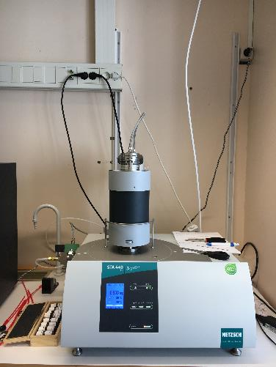
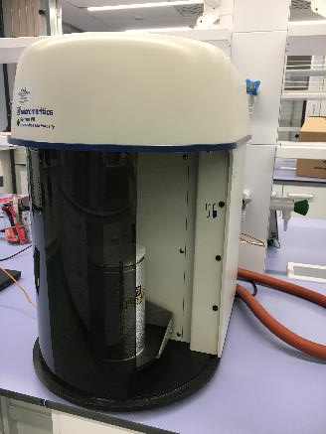
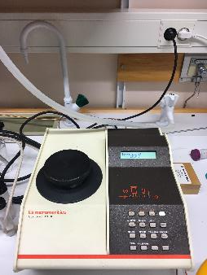
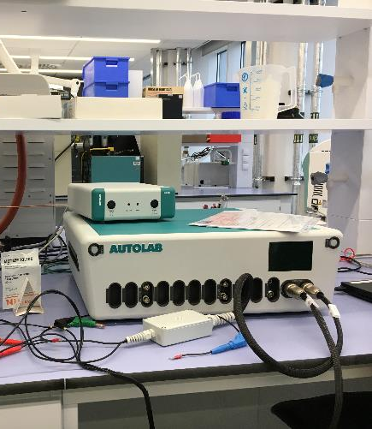
TG, BET, pycnometry and electrochemistry
Operational: DCS/DTA, BET, gas pycnometry, potentiostat
Netzsch Jupiter STA: DTA/DSC
T=30-1600 °C, sample size 1-30 mg
BET surface area determination
nitrogen
2022 ideas for procurement
low-temperature DSC (>100K, soft matter, water in materials)
DONE (procured with grant, 50%)
Expand electrochemistry for corrosion measurements?
Autolab potentiostat:
cyclic voltammetry
Hg-drop polarography
voltammetry:
Gas pycnometer (helium):
measuring the density of a solid material

Slide 23
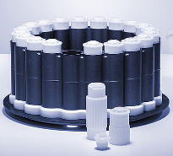
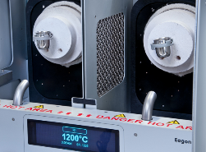
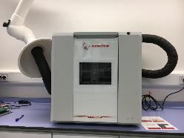
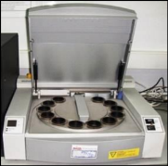
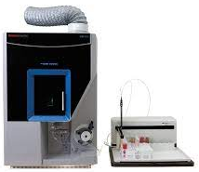
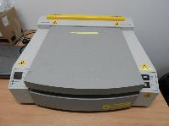
Elemental Analysis
Operational: XRF, Fusion furnace, ICP-OES, Digestion Microwave
Microwave digestions instrument:
Up to 20x50 ml Teflon cups, T<100 °C
Automatic fusion machine:
Up to 2 samples;
Pt crucibles, approx. 1200 °C
2022 ideas for procurement
CHN+S elemental analysis (lubricants, organics) ?
Ion-coupled-Plasma-Optical Emission Spectroscopy (ICP-OES): ppm/ppb range, up to a few mg
X-ray Fluorescence:
permanent loan from STFC

Slide 24
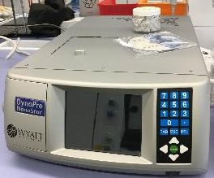
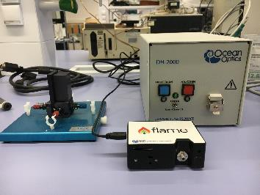
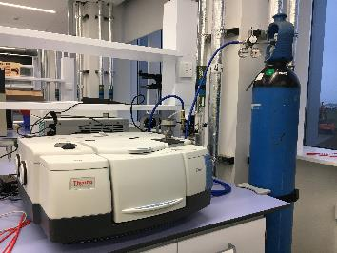
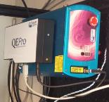
Spectroscopy equipment
Operational: UV/VIS, FT-IR, RAMAN, DLS
UV/VIS Spectrometer range: 200-850 nm
  D₂/W-halogen lamp: 230nm-2.5μm
Dynamic light scattering:
  - R= 0.18 nm - 2500 nm
  - 300 Da to 1MDa
2022 ideas for procurement
Bench-top NMR
FT-IR Spectrometer range: 450-4000 cm⁻¹
  -ATR for powders
  -hATR for liquids
Raman Spectrometer range: 20 - 4000 cm⁻¹ , Transmission and reflectance; can be performed at low temp (cryo – 10K)

Slide 25
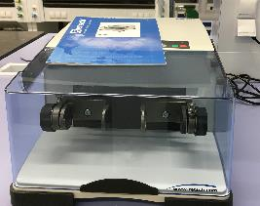
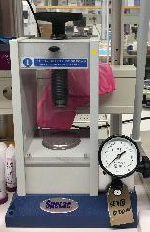
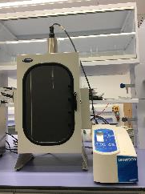
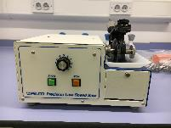
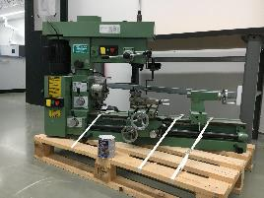
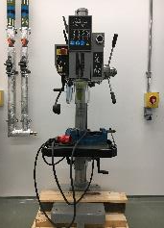
Mechanical preparation for analysis
“mechanical preparation” (also for larger samples/sample holders)
Ball mill
Press and
sonicator
2022 ideas for procurement
-Polishing machine for SEM preparation and microscopy
-spin coater
Diamond saw:
Drill and lathe

Slide 26
Equipment renewal and extension
What is the priority?
- CHN+S elemental analysis (approx. 80 k€)
-benchtop NMR (approx. 70 k€)
-reflectometry setup for XRD (approx. 100 k€, 2x 50k€)
-camera for microscope& software (15 k€)
-cutting/polishing setup (50 k€)
-spin coater (20 k€??)
-electrochemistry module for corrosion (???)
-database (ICDD) for XRD (10 k€ for 5 years)
Planned:
Turbidimeter (OHS) √
Dissolved oxygen (machine directorate?)
universal tensile machine (with Beam diagnostics)
Infrastructure grant application for soft matter ??
Budget per year 220 kEUR (flat):
€ 41k project support
€ 120k consumables
€ 60k equipment (renewal, small)

Slide 27
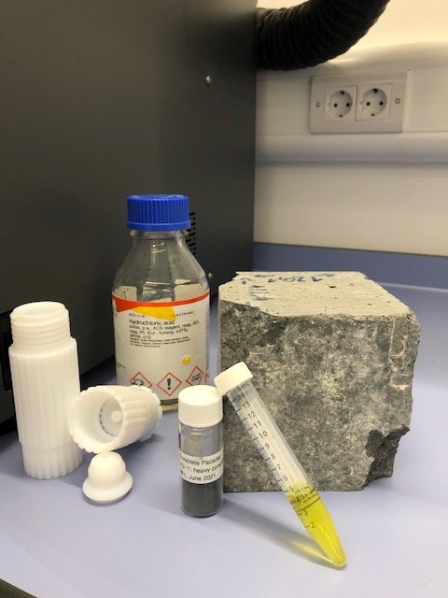
Installation & Area Coordination
Lab operations & maintenance
ESS Project Support
3
Research-heavy support & increasing SULF capabilities vs
necessary basic support & stagnating capabilities ?

Slide 28
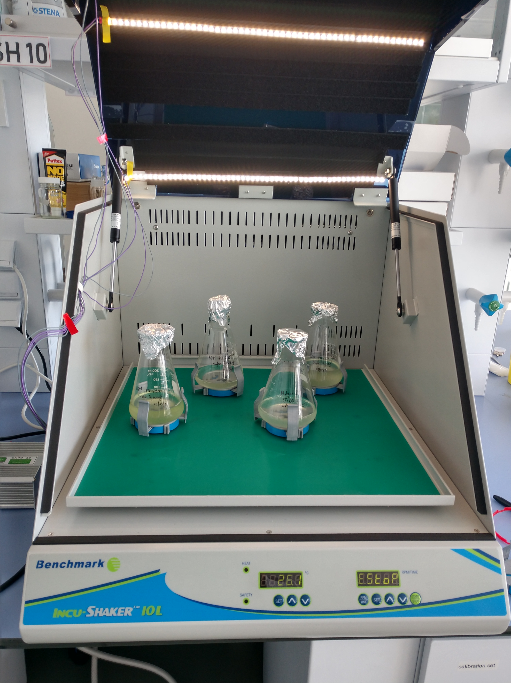
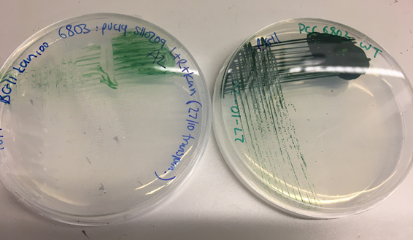
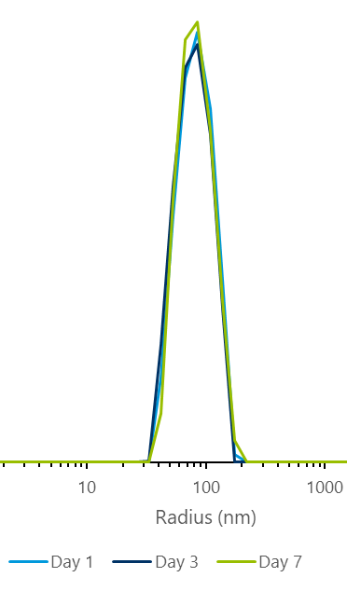
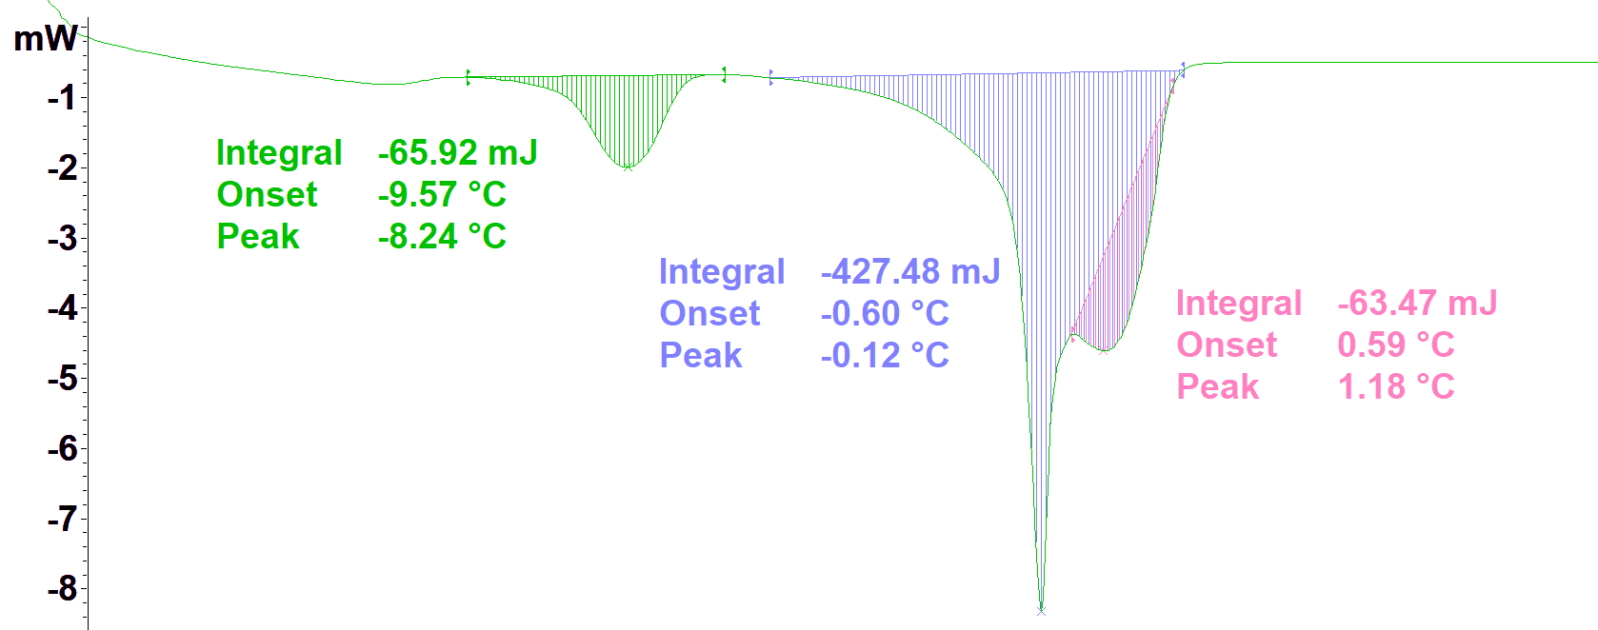
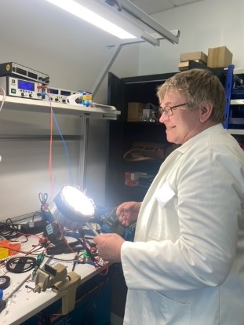
HFSP grant on cyanobacteria
ESS: Sophie Ayscough/ Melissa Sharp; ends Nov ‘22
International team (UK, NZ, Sweden/ESS)
”Effect of hydrocarbons on membranes of cyanobactria” (photosynthesis, alkane production, alkane removal)
Cyanobacteria (live cells and model systems): X-ray and neutron scattering at ILL, ISIS, DIAMOND using small-angel scattering, reflectometry, NSE
DLS – stability test
DSC – lipids, phase transition changes
Prepared and investigated at E04 using autoclave, shaker-incubator, DLS, DSC, h-ATR/FT-IR …..
Developed light setup for SANS/SAXS (with Harald)
SANS
illuminated
SULF established basis for soft matter work

Slide 29
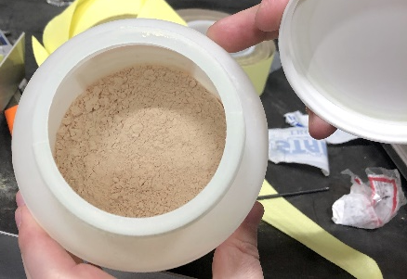
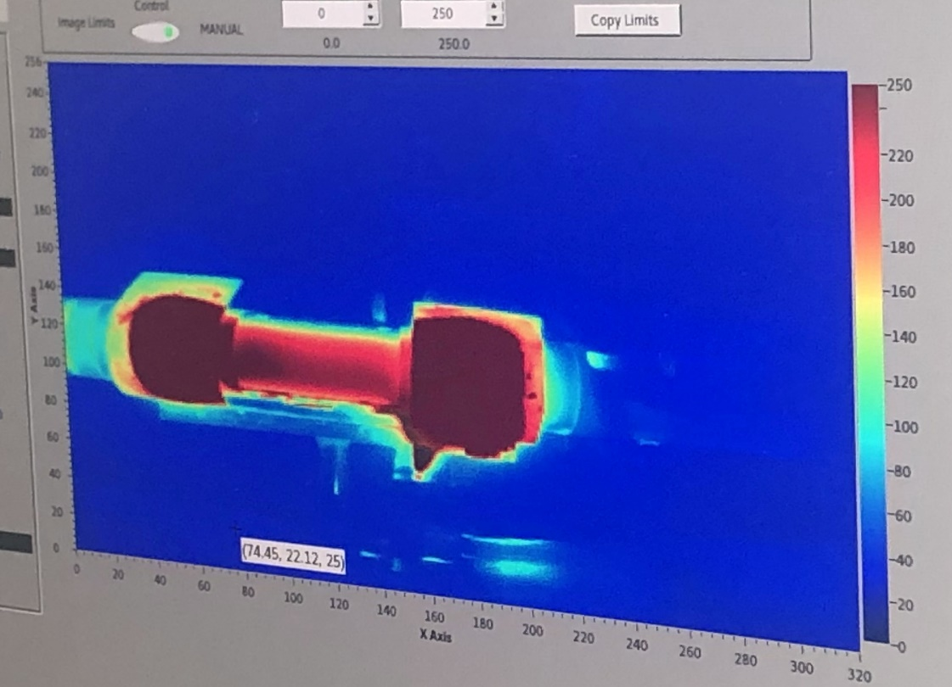
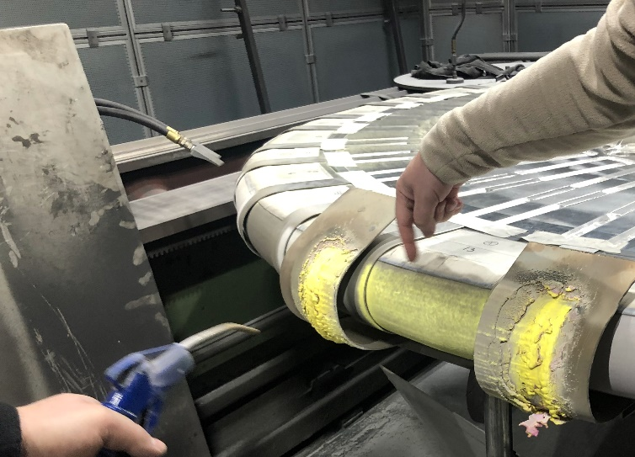
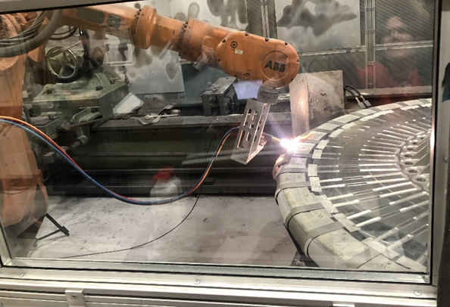
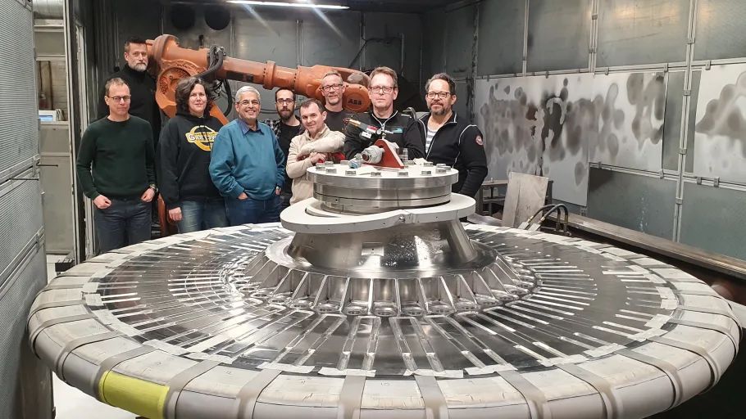
Luminescence Coating On ESS Target
ESS Beam Diagnostics Group & University West Trollhättan & SULF
Successful ESS-internal collaboration
Master thesis summer 2021 (synthesis & testing) in SULF labs
Scale-up of synthesis and test spraying (at U West, Trollhättan)
March 2022: spraying of the target wheel in Malmö
    33 sectors sprayed with commercial powder used at SNS
    3 sectors sprayed with ESS synthesized and optimized powders
Compressed air cooling

Slide 30
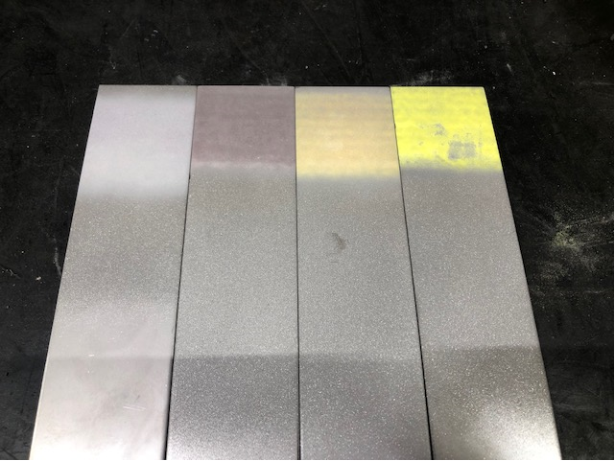
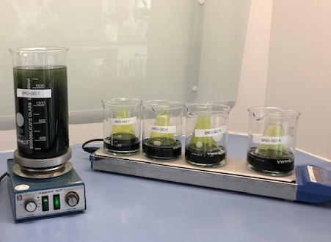
Future scientific support
Continuing collaborations for ESS project
Collaboration for Luminescence Coating (C. Thomas):
- test chips done during of spray-coating the ESS target will be investigated with XRD, SEM
- mechanical tests on proton-irradiated coatings in RML at ESS (stability for proton beam window)
- future development of new coating materials with SNS?
Collaboration for new neutron reflector material (D. diJulio):
- Synthesis of graphite-like materials with large d-spacing
- assisting in preparing for beamtime at PSI
- Brightness grant by V. Santorro

Slide 31
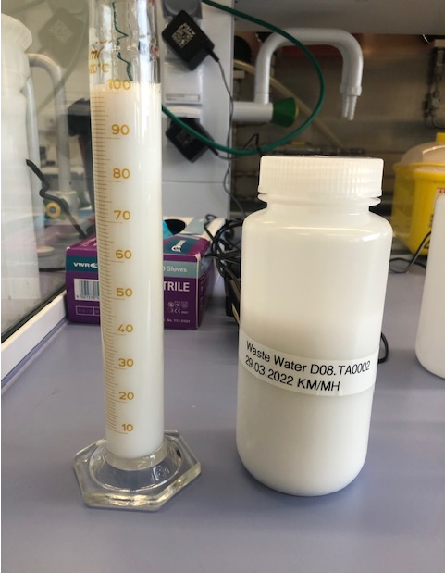
Waste water analysis
Online system not available – FM has not enough people to be trained
STATUS
- pH measurements, conductivity (usually once every two months, will increase as sinks in experimental hall lead to the lab tanks)
-no online system procured yet (ES&H budget)
IDEA (approx. 60k€):
- online conductivity and total organic carbon (TOC) monitoring to detect acids/bases/ions and solvents via BMS
- if any of the monitors alarm, SULF will test and investigate
Now is the best point in time as we have few lab users and can investigate the “background” e.g. detergents, dirt, rust in water

Slide 32
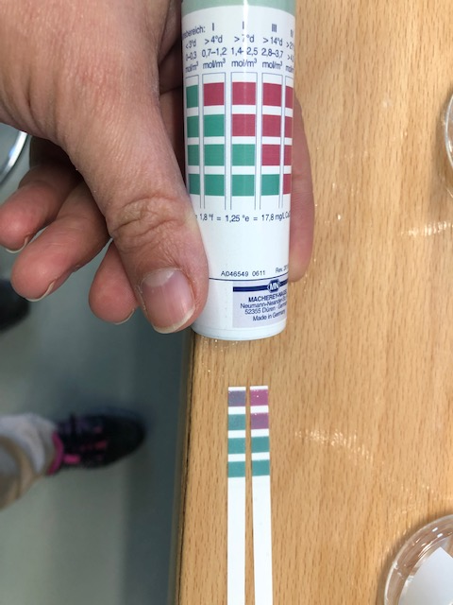


Materials Team
Cooling water issues in accelerator, concrete analysis for shielding
SMEs from Spallation Physics Group, SULF and Optic Group has been formed (3 chem., 3 phys., 1 mater. sci., 1 engineer – 50% of team is experienced)
- avoid duplicated requests for assistance & measurements
- avoid requests asking for a sledgehammer to crack a nut
- create searchable knowledge base to be able to understand what is going on
(1) Concrete analysis –moving steadily forward/ establishing routine
(2) Accelerator water analysis:
Complicated as 500 m³ water body, no heat exchangers between sections; currently: limits for Cu-detection 0-20 ppb in water using ICP-OES to see if problem continues;
(3) Grain size NBI (Al 6061)

Slide 33

We sulf problems
Handover E04 – December 2019

Slide 34

SULF input to safety and SSM
SULF supports establishing sample handling and SSM documentation
Entrances to supervised area: Samples that leave the area and have been in the beam need to be surveyed
Entrance to controlled areas.
Interactions
OHS/RP, user office & logistics: establishing sample handling at ESS starting from shipping to release/disposal
SSM documentation for normal operations, accident scenarios (now reduced to giving input)
Establishing procedures for RML (part of next SSM application)
All labs are in the same radiological zone as the instruments–
easy sample transfer
Radiological materials lab

Slide 35
Charge to STAP
In view of ESS current challenges and in view of our path towards Hot Commissioning and First Science, the STAPs are invited to comment and to provide advice.
Common Topics:
Considering the new baseline plan and long timeline to First Science, how do we operate labs, maintain scientific expertise, keep users & collaborators engaged in ESS and interested in using our services (deuteration, chemistry, life science, materials)?
How to build a line organisation with capabilities to tackle the operational challenges?
How to best attract and execute externally funded collaborative projects and how to sustain the resulting capabilities?
Sample and User Lab Services
After finishing the E-building installation, we are now starting to progress towards installation of the D-buildings. How do we best split our equipment and team members across 3-4 buildings while maintaining our functionality?
Our support capabilities to the ESS project are recognized and ramping up. How do we balance between more research-heavy support that will increase the SULF capabilities (e.g. development of luminescence coatings with the beam diagnostics group) and the easier, but work-intensive basic support that is necessary but will not further develop our capabilities (e.g. check pH/conductivity for waste water tanks)?
What can we do better when continuing to operate the growing labs and supporting the ESS with limited staff?

