Slide 1
Scientific Coordination and User Office
European Spallation Source
Carina Lobley

Slide 2
Agenda
Introduction to SCUO
Core Function 1: User Programme
  Pause for Thought
Core Function 2: Science Focus
  Pause for Thought
Core Function 3: Science Key Performance Indicators
Concluding Remarks
  Time for Discussion

Slide 3





How to generate a sense of urgency in stakeholders?
What strategy and timing are right to avoid disappointment?
How to support and grow a vibrant scientific environment?
How do we prepare for a future we don’t yet know?

Slide 4



KEY PERFORMANCE INDICATORS
USER PROGRAMME
SCIENCE FOCUS

Slide 5




Preparation:
software, policies, attract users
THE TIME IS NOW
THE TIME IS NOW
In progress:
DEMAX users, UOS,
User Journey
Preparation:
science core - SFTs, publication management, KPIs
In progress:
Promote science, user meeting,
science day

Slide 6
4
USER PROGRAMME
3
2
1

Slide 7
Scientific Evaluation and Access Policy
Awaiting ESS Council review.
Drafted with accompanying guidelines for all ESS.
Presentation at this SAC.
Policy for User Scientific Publications
Policy for Scientific Data
Small redraft after PaNOSC recommendations.
Presentation at this SAC.

Slide 8


Core Function 1: User Programme
The user will provide arrival details for the scientists who are coming to ESS
The visiting users will complete safety documentation and carry out training
The user will book required accommodation
The user will ship their samples
Access cards and any other required materials will be prepared
User to provide feedback about their experiment
User will provide a brief scientific report of their results
User expenses reimbursed and invoiced costs paid
User costs reported against the experiment
KPIs reported to management
Users will propose the scientific experiments they wish to carry out
This will be reviewed for feasibility, safety and excellence
The users will be notified of the success or otherwise for the proposal
Registration
Proposal
Scheduling
Planning
Performing & Analysing
Wrap-up & Harvesting
Users register with their personal information
By registering users ESS has a database of contact details for potential users
Users provide sufficient personal data for physical access to site and digital access to systems
User profile will link to radiation dosimetry records
Instrument scientists will schedule the accepted experiments
Scheduling will cover the instrument, a local contact, required sample environments and user labs
The user and all those involved will be notified of the final schedule
User have access to requested labs and prepare before instrument time
The user will collect data at the awarded instrument with the samples declared on the proposal
The user has access to automatic and manual data processing of their data

Slide 9
Core Function 1: User Programme
The user will provide arrival details for the scientists who are coming to ESS
The visiting users will complete safety documentation and carry out training
The user will book required accommodation
The user will ship their samples
Access cards and any other required materials will be prepared
User to provide feedback about their experiment
User will provide a brief scientific report of their results
User expenses reimbursed and invoiced costs paid
User costs reported against the experiment
KPIs reported to management
Users will propose the scientific experiments they wish to carry out
This will be reviewed for feasibility, safety and excellence
The users will be notified of the success or otherwise for the proposal
Registration
Proposal
Scheduling
Planning
Performing & Analysing
Wrap-up & Harvesting
Users register with their personal information
By registering users ESS has a database of contact details for potential users
Users provide sufficient personal data for physical access to site and digital access to systems
User profile will link to radiation dosimetry records
Instrument scientists will schedule the accepted experiments
Scheduling will cover the instrument, a local contact, required sample environments and user labs
The user and all those involved will be notified of the final schedule
User have access to requested labs and prepare before instrument time
The user will collect data at the awarded instrument with the samples declared on the proposal
The user has access to automatic and manual data processing of their data

Slide 10


Core Function 1: User Programme
GDPR
As little data as possible
As securely as possible
As short a time as necessary
SCUO
As much data as needed
Searchable by all users
As long as we can just in case

Slide 11
Core Function 1: User Programme
The user will provide arrival details for the scientists who are coming to ESS
The visiting users will complete safety documentation and carry out training
The user will book required accommodation
The user will ship their samples
Access cards and any other required materials will be prepared
User to provide feedback about their experiment
User will provide a brief scientific report of their results
User expenses reimbursed and invoiced costs paid
User costs reported against the experiment
KPIs reported to management
Users will propose the scientific experiments they wish to carry out
This will be reviewed for feasibility, safety and excellence
The users will be notified of the success or otherwise for the proposal
Registration
Proposal
Scheduling
Planning
Performing & Analysing
Wrap-up & Harvesting
Users register with their personal information
By registering users ESS has a database of contact details for potential users
Users provide sufficient personal data for physical access to site and digital access to systems
User profile will link to radiation dosimetry records
Instrument scientists will schedule the accepted experiments
Scheduling will cover the instrument, a local contact, required sample environments and user labs
The user and all those involved will be notified of the final schedule
User have access to requested labs and prepare before instrument time
The user will collect data at the awarded instrument with the samples declared on the proposal
The user has access to automatic and manual data processing of their data

Slide 12



B
P 10
C 10
B 10
P
C
P 30
C 30
B 30
C
B
P 8
C 9
B 13
P

Slide 13
Core Function 1: User Programme
The user will provide arrival details for the scientists who are coming to ESS
The visiting users will complete safety documentation and carry out training
The user will book required accommodation
The user will ship their samples
Access cards and any other required materials will be prepared
User to provide feedback about their experiment
User will provide a brief scientific report of their results
User expenses reimbursed and invoiced costs paid
User costs reported against the experiment
KPIs reported to management
Users will propose the scientific experiments they wish to carry out
This will be reviewed for feasibility, safety and excellence
The users will be notified of the success or otherwise for the proposal
Registration
Proposal
Scheduling
Planning
Performing & Analysing
Wrap-up & Harvesting
Users register with their personal information
By registering users ESS has a database of contact details for potential users
Users provide sufficient personal data for physical access to site and digital access to systems
User profile will link to radiation dosimetry records
Instrument scientists will schedule the accepted experiments
Scheduling will cover the instrument, a local contact, required sample environments and user labs
The user and all those involved will be notified of the final schedule
User have access to requested labs and prepare before instrument time
The user will collect data at the awarded instrument with the samples declared on the proposal
The user has access to automatic and manual data processing of their data
Notes:
The last thing I want to talk about on this user journey is something where the advice I’m seeking is about working with other stakeholders. This is user booking required accommodation. I haven’t really spent much time on this at the moment, and am just approaching stakeholders so it is good example to talk about theoretically as I don’t bring any emotions or thoughts about my colleagues to the table.
At Diamond, where I came from, the user office sorts the accommodation for all users in the guesthouse or local hotels and arranges for some bookings to be paid by Diamond and some by the user. Users are often unhappy about where they stay, how much it costs, they ask for some nights and not others but them want to stay at completely different times – all in all, I’m glad this falls to the ESS welcome function, not the user office.
However, experience to date also tells me users complain disproportionately about the practical aspects of their stay – showers, beds, food, travel. And I want happy users.

Slide 14






Core Function 1: User Programme
Buy tickets in Skånetrafiken app and send over
Sort own tickets in app or at airport/train station
Punchout to Booking.com business using ESS account
Punchout to Booking.com business using normal pay account

Slide 15
Core Function 1: User Programme
The user will provide arrival details for the scientists who are coming to ESS
The visiting users will complete safety documentation and carry out training
The user will book required accommodation
The user will ship their samples
Access cards and any other required materials will be prepared
User to provide feedback about their experiment
User will provide a brief scientific report of their results
User expenses reimbursed and invoiced costs paid
User costs reported against the experiment
KPIs reported to management
Users will propose the scientific experiments they wish to carry out
This will be reviewed for feasibility, safety and excellence
The users will be notified of the success or otherwise for the proposal
Registration
Proposal
Scheduling
Planning
Performing & Analysing
Wrap-up & Harvesting
Users register with their personal information
By registering users ESS has a database of contact details for potential users
Users provide sufficient personal data for physical access to site and digital access to systems
User profile will link to radiation dosimetry records
Instrument scientists will schedule the accepted experiments
Scheduling will cover the instrument, a local contact, required sample environments and user labs
The user and all those involved will be notified of the final schedule
User have access to requested labs and prepare before instrument time
The user will collect data at the awarded instrument with the samples declared on the proposal
The user has access to automatic and manual data processing of their data

Slide 16




Slide 17
4
SCIENCE FOCUS
3
2
1

Slide 18










Biochemistry
Cells, membranes and lipids
Food science
Medicine and pharmaceuticals
Surfactants and polymers
Amorphous and disordered materials
Foams and gels
STRUCTURAL BIOLOGY AND BIOPHYSICS
Bioengineering
Protein and macromolecular structure
Biophysics
SOFT CONDENSED MATTER RESEARCH
NEUTRON TECHNOLOGY & COMPUTATIONAL SCIENCE
Instrumentation materials
Instrument control
Sample environment
Callibration
MATERIAL CHEMISTRY & NANOSCIENCE
Catalysis
Organic chemistry
Physical chemistry
Materials science
Hard condensed matter – structure
Nano-scaled materials
MAGNETISM & SUPERCONDUCTIVITY
FUNDAMENTAL & PARTICLE PHYSICS
Nuclear physics
CULTURAL HERITAGE
EARTH & ENVIRONMENTAL SCIENCES
Aerospace engineering
Chemical engineering
Manufacturing
Materials engineering
Mechanical engineering
ENGINEERING

Slide 19
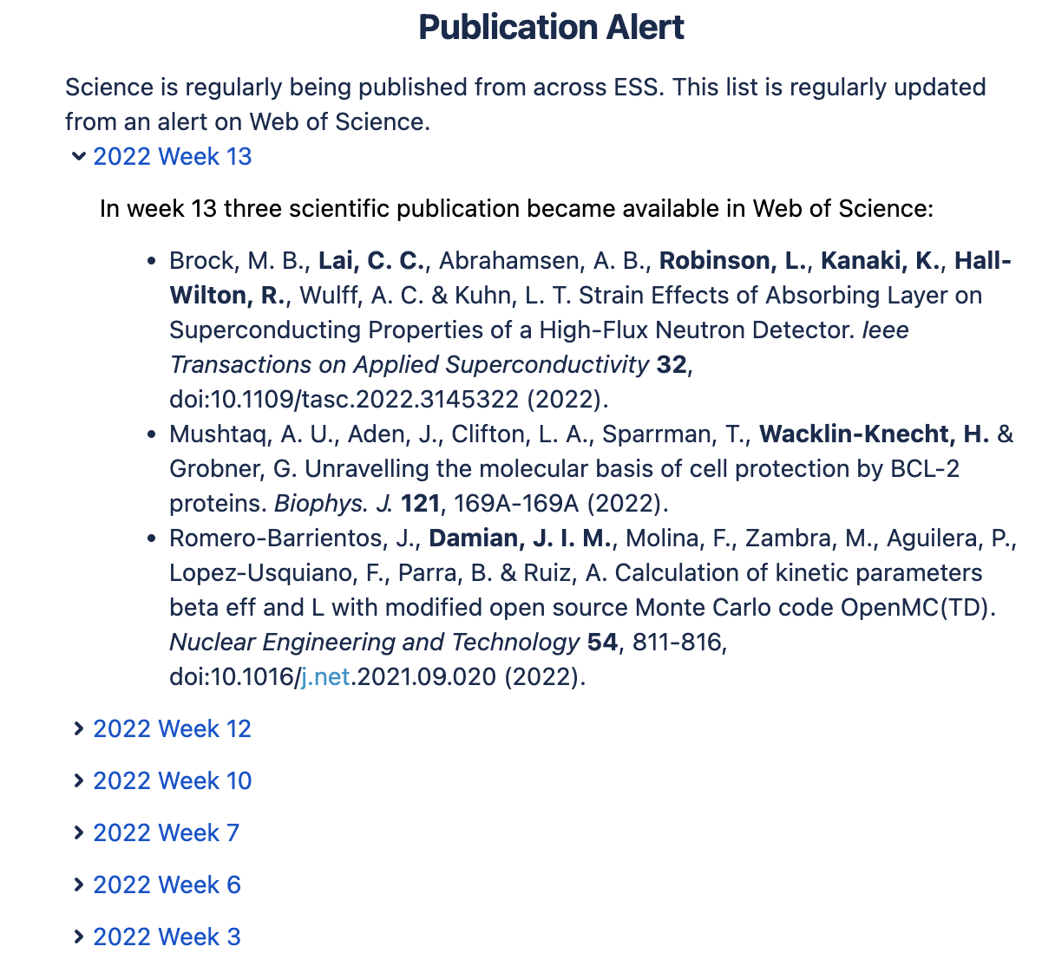
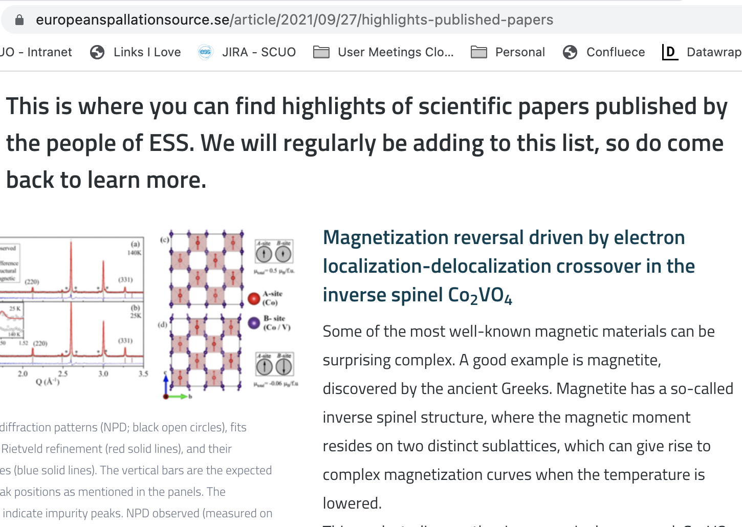

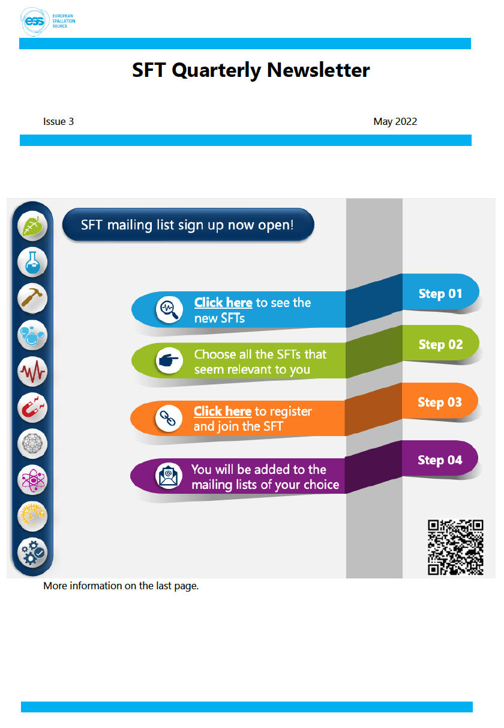
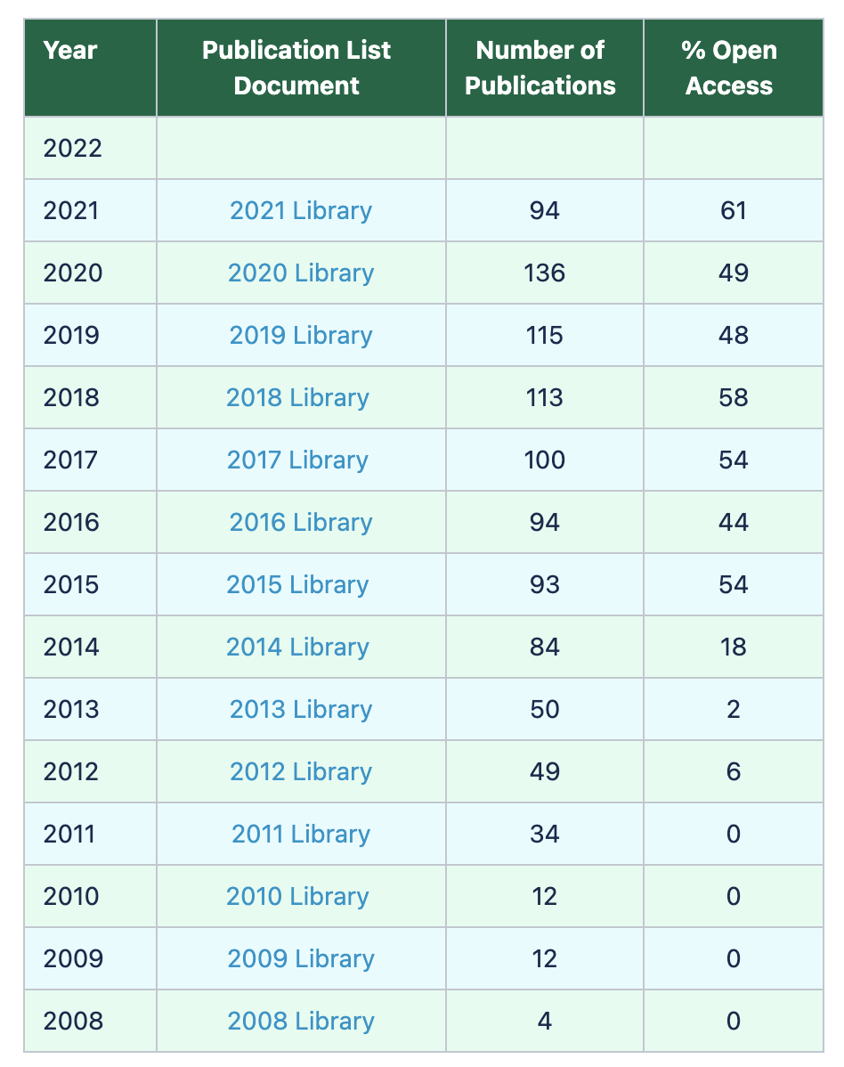
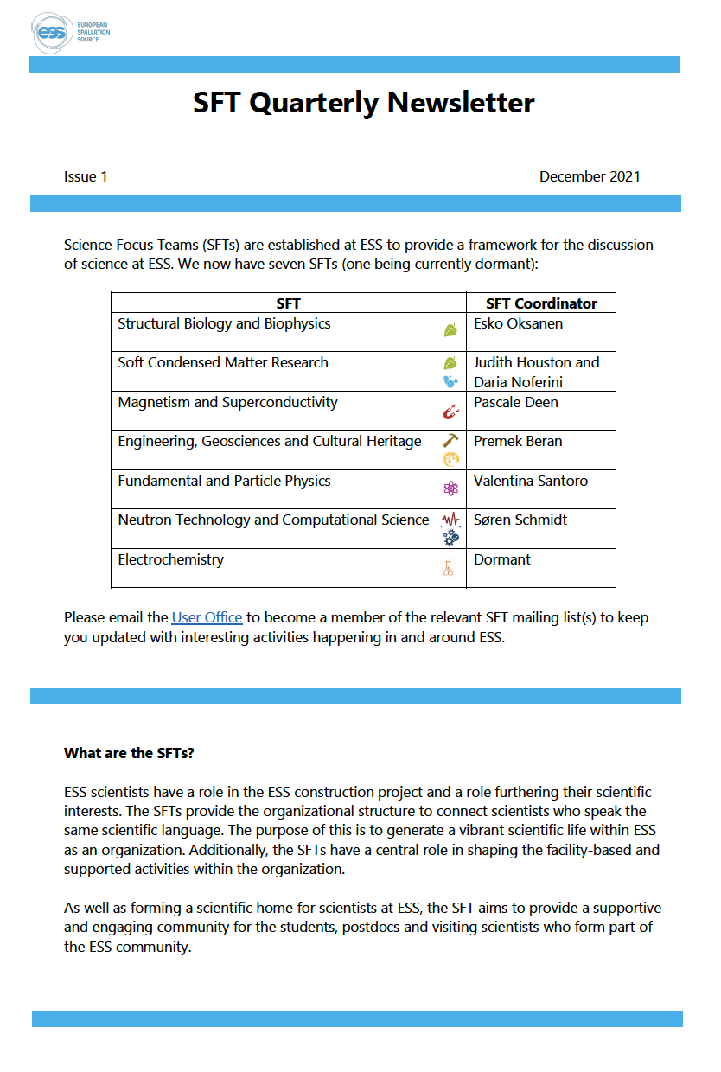
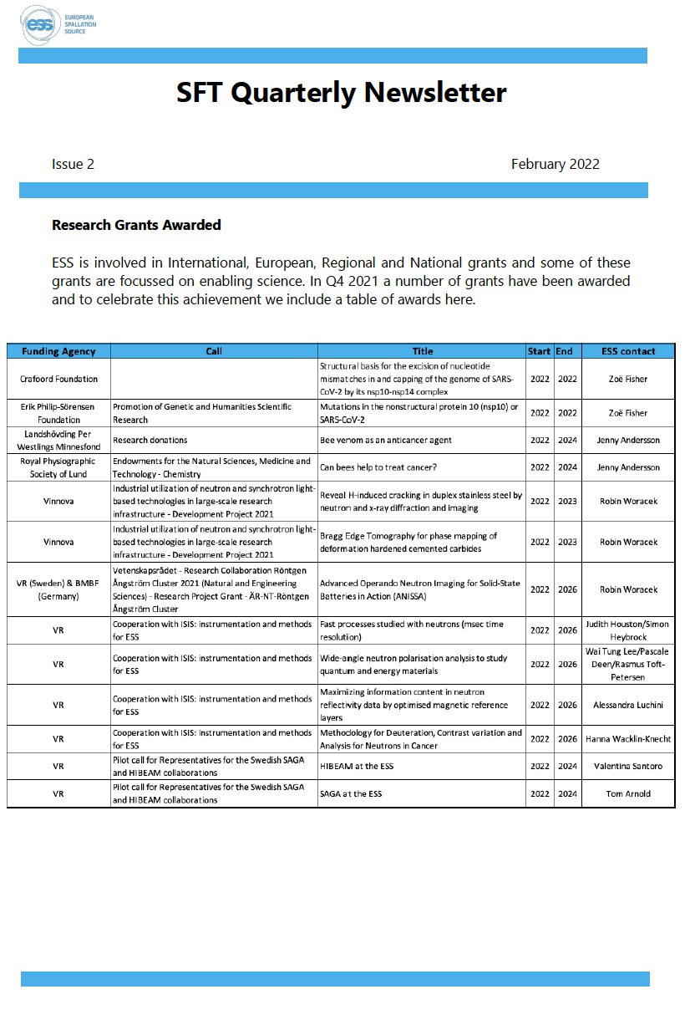
Weekly Publication Alert
Item on ess.eu 1 or 2 times per month
Quarterly Newsletter
Annual Publication List

Slide 20





14 x 15 minute
young scientist presentations
30 minute inspirational talk
30 minutes seminar from grants team
panel discussion:
career paths to neutron sources
social time:
coffee & lunch
social time:
BBQ

Slide 21







Wednesday
5 Oct
Thursday
6 Oct
Friday
7 Oct
09:00-10:30
Welcome & Plenary
09:00-10:30
Hot Topic 2
09:00-10:30
Parallel Workshops
10:30-11:00
Morning Coffee
10:30-11:00
Morning Coffee
10:30-11:00
Morning Coffee
11:00-12:30
Hot Topic 1
11:00-12:30
Plenary Talks
11:00-12:30
Plenary Talks
12:30-13:30
Lunch
12:30-13:30
Lunch
13:30-15:00
Parallel Workshops
13:30-15:00
Plenary Talks
15:00-15:30
Afternoon Coffee
15:00-15:30
Afternoon Coffee
15:00:19:30
ESS Site Visit
15:30-17:00
Parallel Workshops
19:00 - late
Conference Dinner

Slide 22


Committed Neutron Users
Will come to ESS as they would another neutron source. Likely to contain some users who will join us for hot commissioning.
Already aware of ESS and probably excited about First Science and SOUP.
Needs caution so they are patient of our delays and likely slow beginnings.
1
Neutron Aware Users
Perhaps have used neutrons a couple of times, possibly aware of ESS along with other facilities.
Need to encourage these users to try neutron techniques to solve their problems.
Can share scientific expertise and potentially collaborate on neutron time elsewhere
ESS is not ready to support these users.
2
3
New User Communities
Users maybe aware of neutron techniques but have never seen a benefit to trying for their work.
Will not be prepared to tolerate big challenges or changes in direction that might be required at SOUP.
Can connect with these users but afraid to excite them with new information and then ask them to wait.

Slide 23

Identify who is in this group
Start with present members and then back fill with people who have had interaction with ESS Science since the beginning
Contact people from this group
Ask whether they retain an interest in ESS and would like to be kept up to date with activities going on a ESS
Maintain regular contact
Perhaps through the science focus teams, keep quarterly contact to maintain awareness of ESS as we move from construction to operations
1
2
3

Slide 25
4
KEY PERFORMANCE INDICATORS
3
2
1

Slide 26

ESS
Key Performance
Indicators

Slide 27

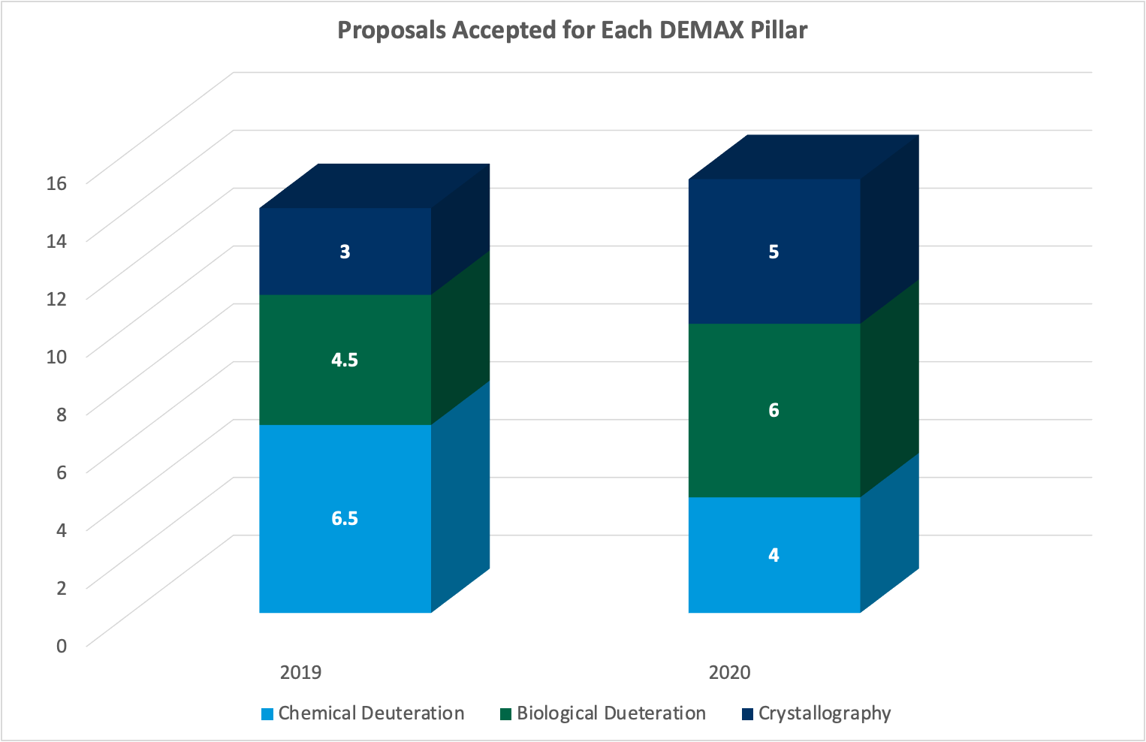
DEMAX has had two complete proposal calls, in 2019 and 2020.
14 proposals accepted in 2019 and 15 in 2020.
Fairly even split between the pillars.
DEMAX Proposals

Slide 28
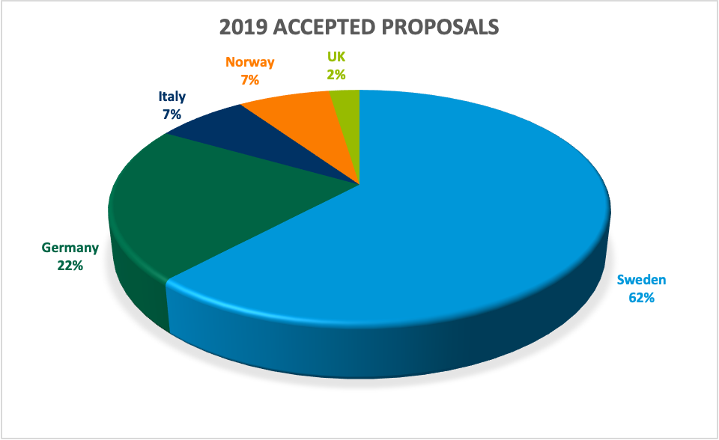
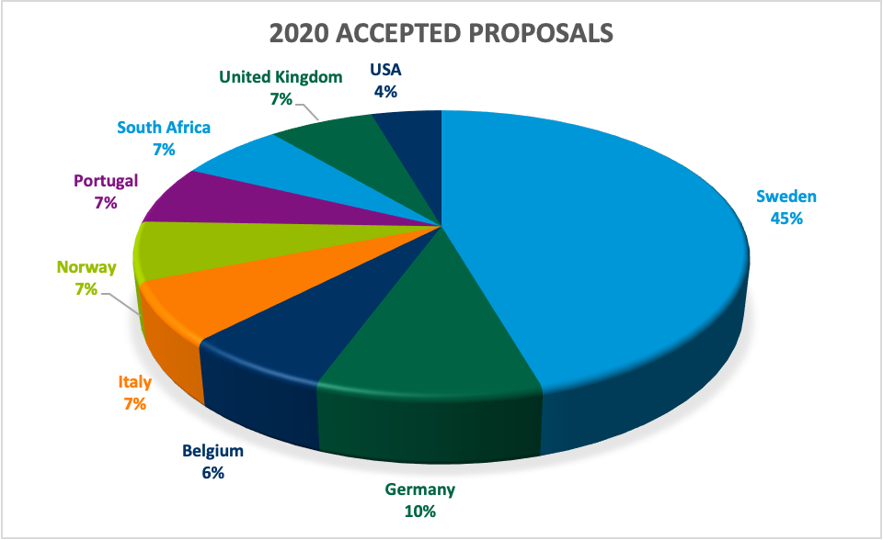
Countries were assigned using the method recommended by ESFRI.
In 2019 proposers represented 5 countries.
62% of proposals were linked to Sweden.
In 2020 proposals came from a larger range of countries – 9 in total are represented.
Most proposers were from Europe, but South Africa and USA are also present
The Swedish proportion is reduced to 45%
DEMAX Countries
DEMAX Countries

Slide 29
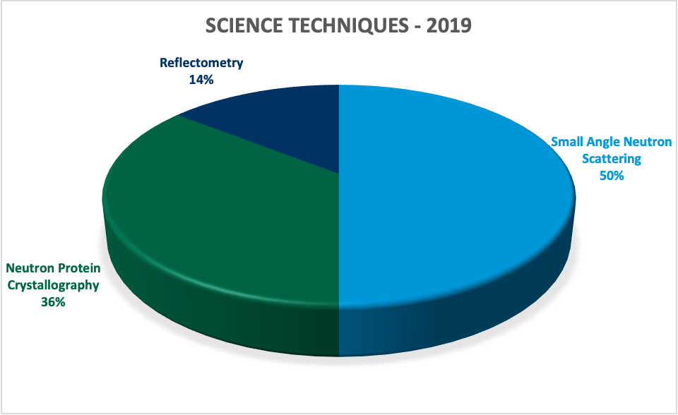
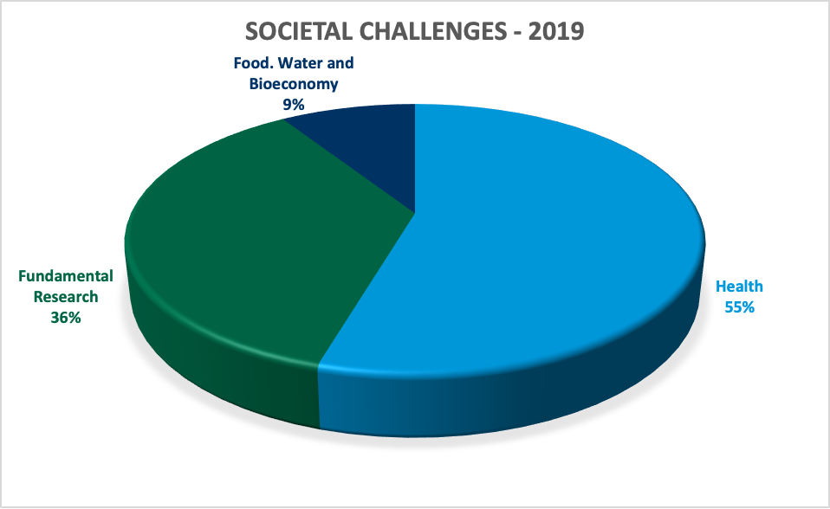
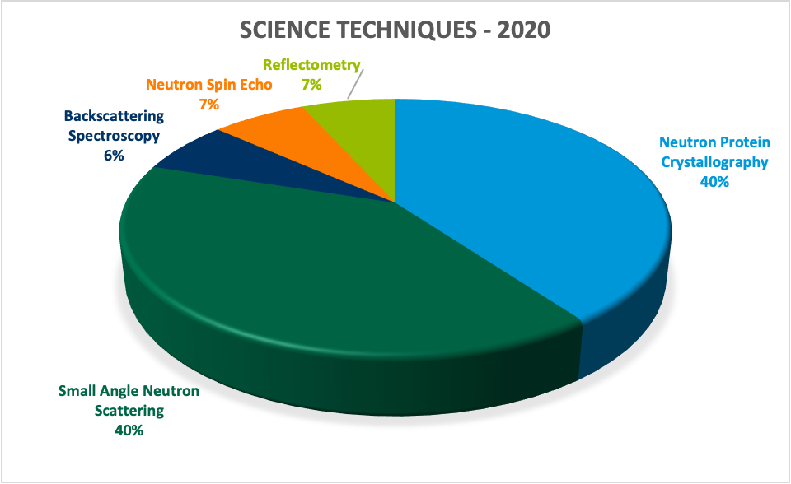
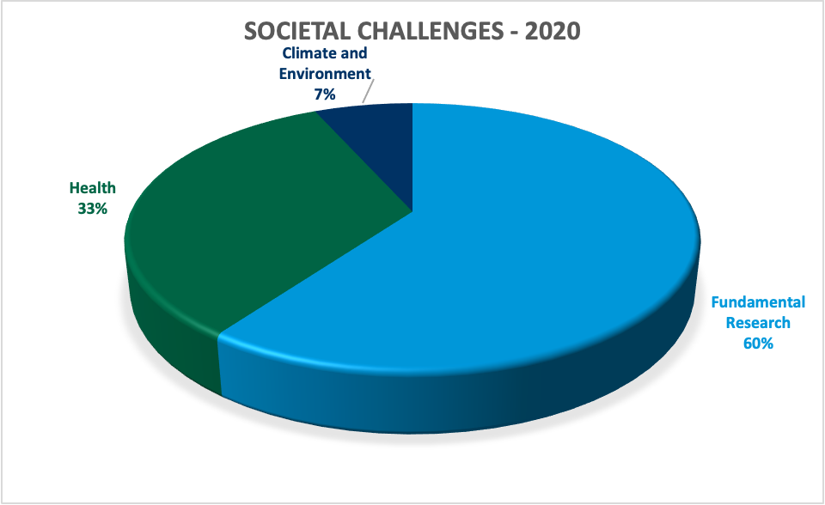
User stated science techniques are:
SANS
Neutron protein crystallography
Reflectometry
Backscattering spectroscopy
Neutron spin echo
User stated societal challenges are:
health
fundamental research
food, water & bioeconomy
climate & environment.
DEMAX Science
DEMAX Science

Slide 30
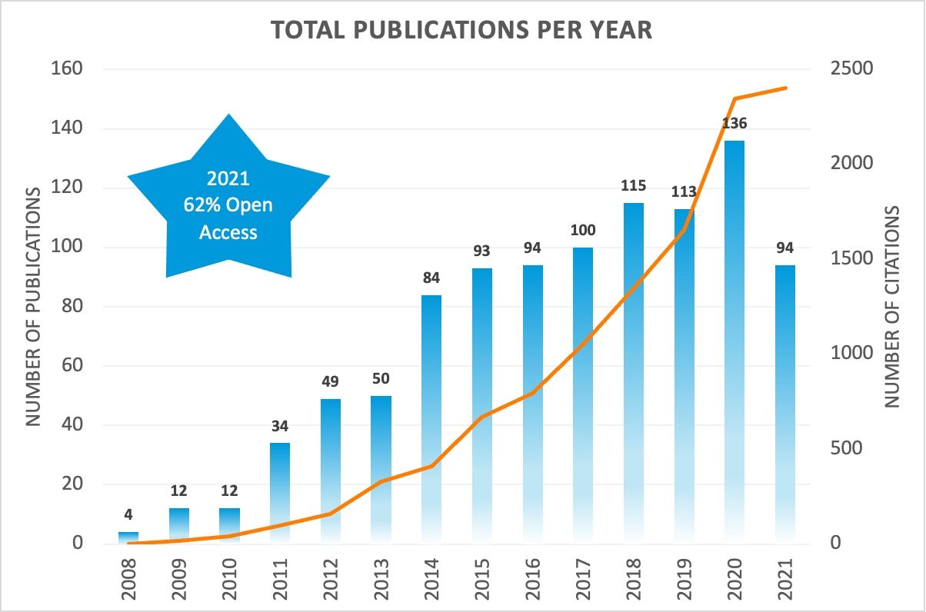
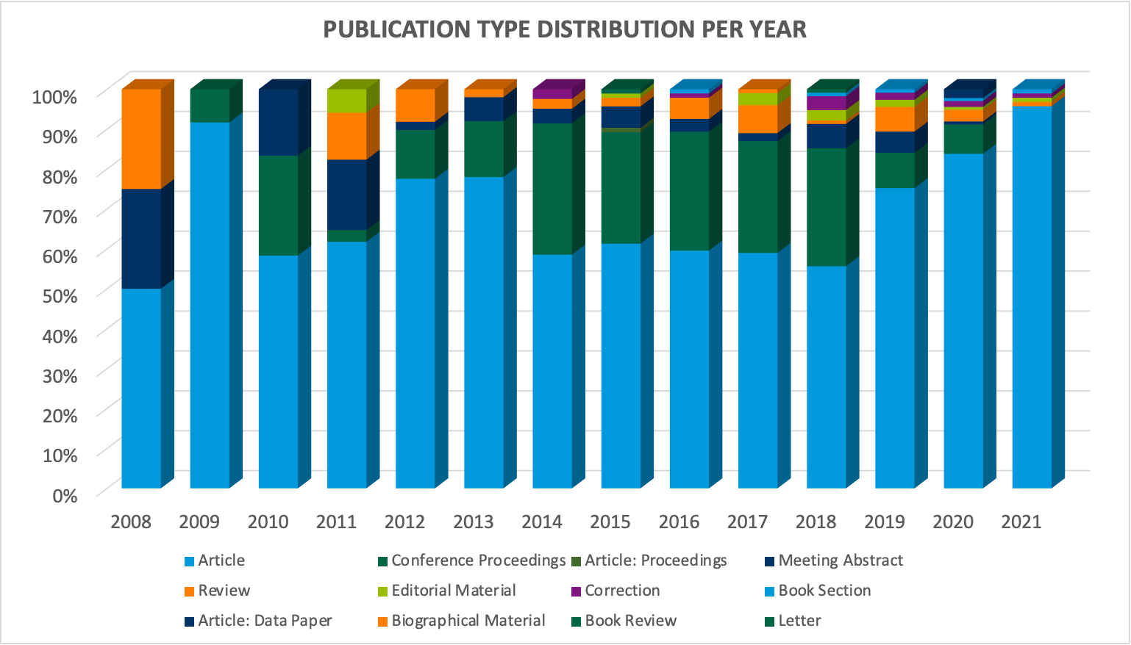
ESS is currently publishing around 100 items per year.
In 2021, 62% were open access publications.
Total citations is increasing, indicating the body of work is being used and valued by the community.
Looking deeper we see the proportion of different publication types.
Pale blue are articles while dark green are conference proceedings.
COVID-19 and the reduction in conferences may explain the small dip last year.
Publications
Publications

Slide 31
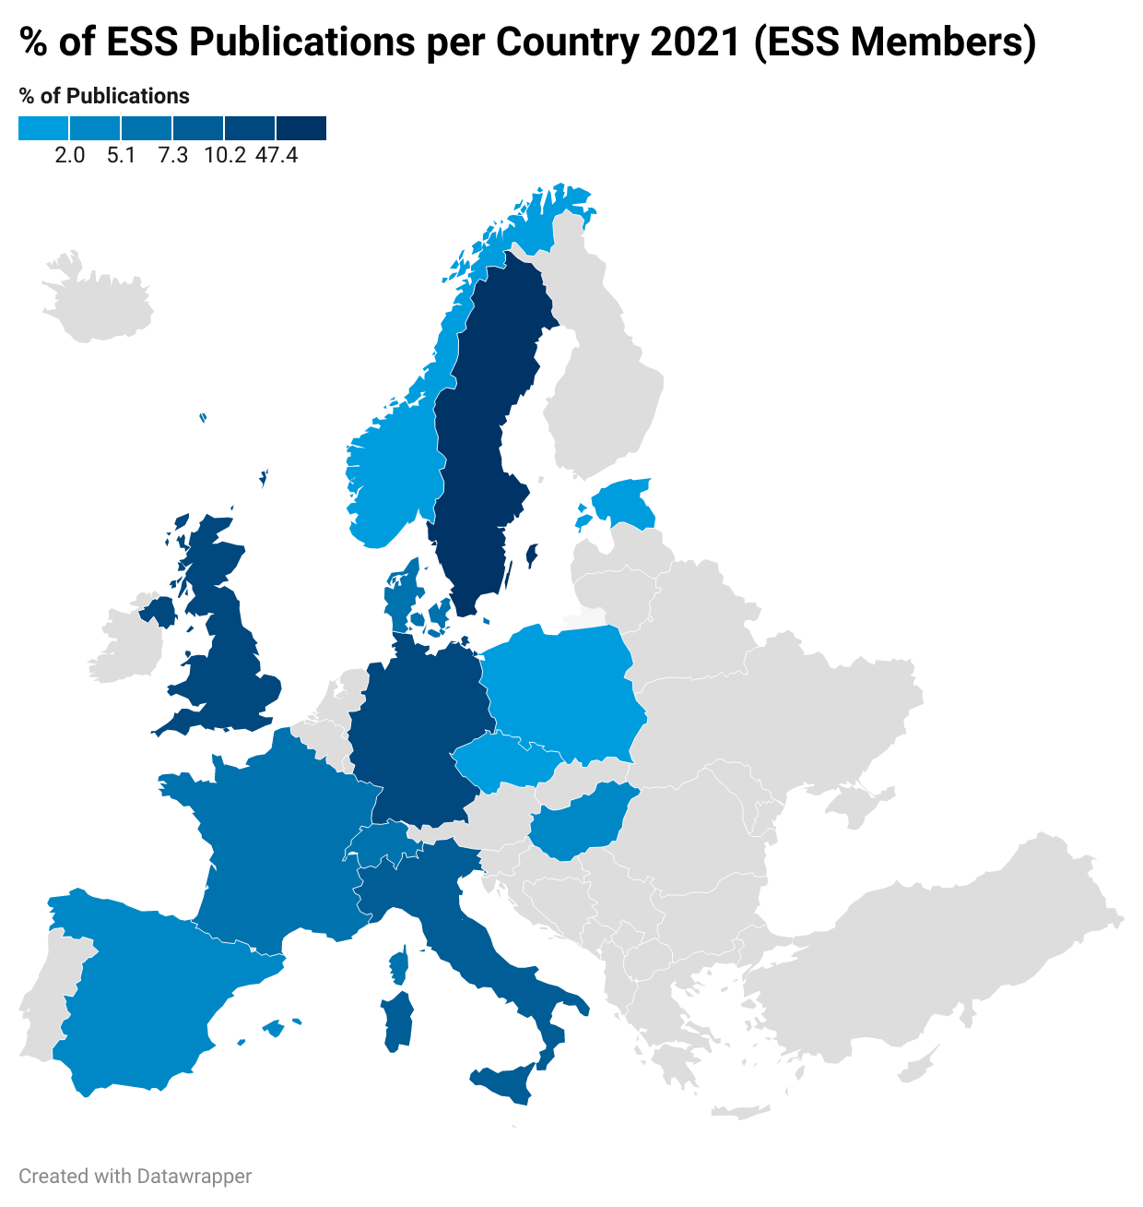
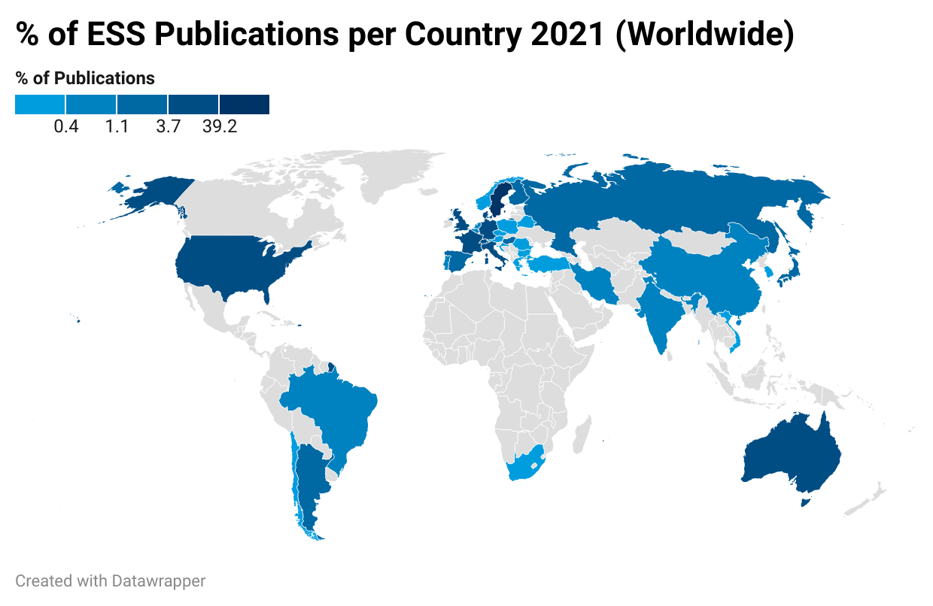
ESS publications are highly collaborative, reflected in the large number of countries represented by authors.
Dominated by Europe, the list encompasses much of the world.
Drilling in to the proportion of publications for ESS Member States, nearly 50% is assigned to Sweden.
Publications
Publications

Slide 32
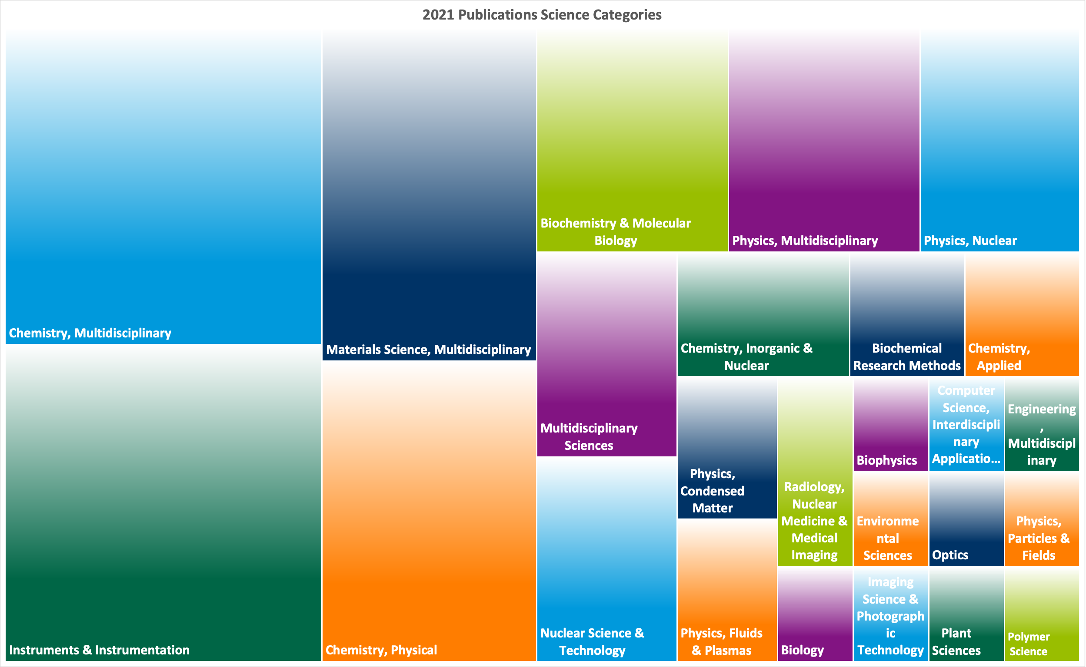
Science areas as assigned by Web of Science.
Do we need to be more sophisticated – tools like SciVal (Elsevier) or InCites (WoS)?
What are the merits for ESS and ESS Science employees of a greater understanding of our publications?
Publications

Slide 33

4
CLOSING
REMARKS
3
2
1

Slide 34

2011
2019
Joined ESS
Scientific evaluation and access policy
Access on innovative excellence
Joined Diamond
MX full remote access trialled in 2012
By 2019 half of all users were remote
User Programme
Must be prepared!
EUOM
2027
2022
STAP 2022
Remote access routine in all fields
New industrial payment model at ISIS

Slide 35
How to generate a sense of urgency in stakeholders?
What strategy and timing are right to avoid disappointment?
How to support and grow a vibrant scientific environment?
How do we prepare for a future we don’t yet know?

Slide 36


