Slide 1
Chemical Deuteration Update
Sample and Users STAP 2-3rd May 2022
PRESENTED BY anna leung

Slide 2
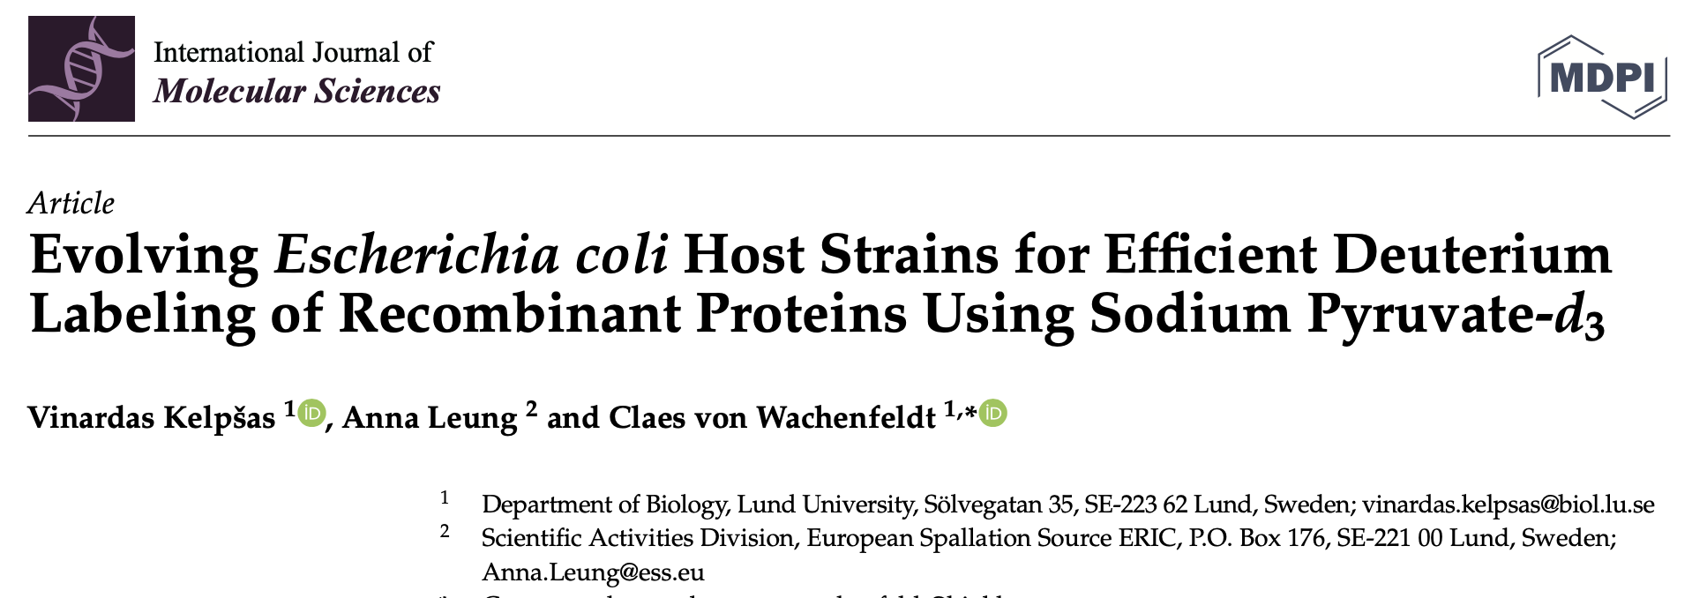
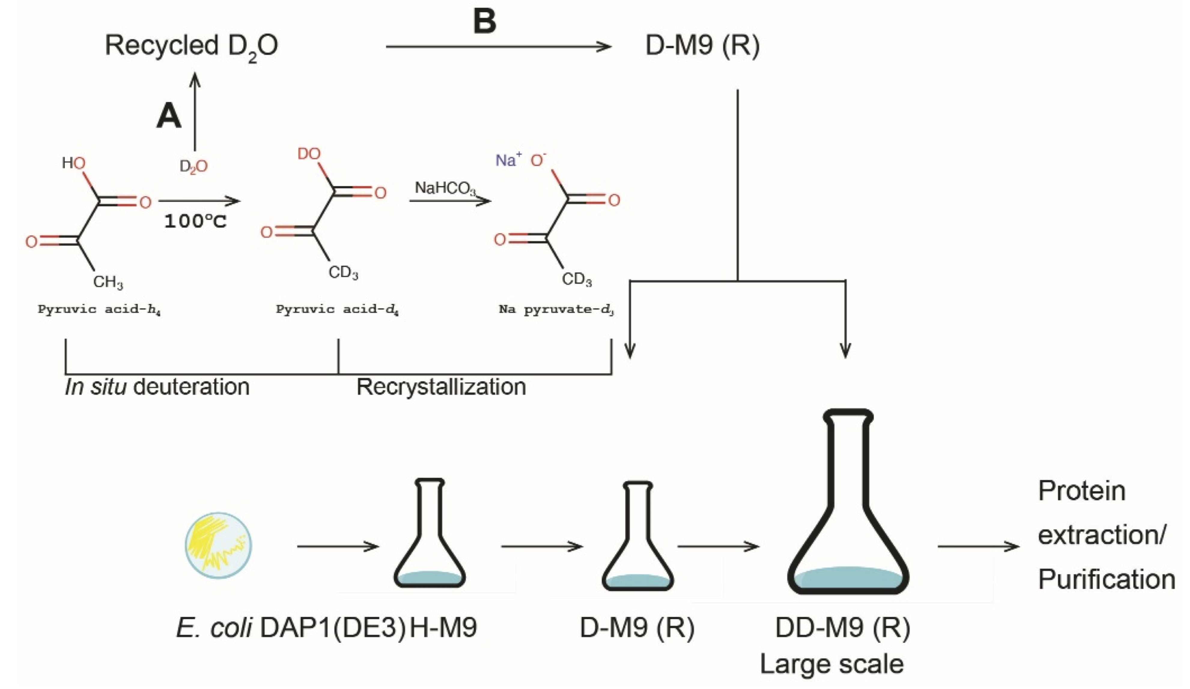
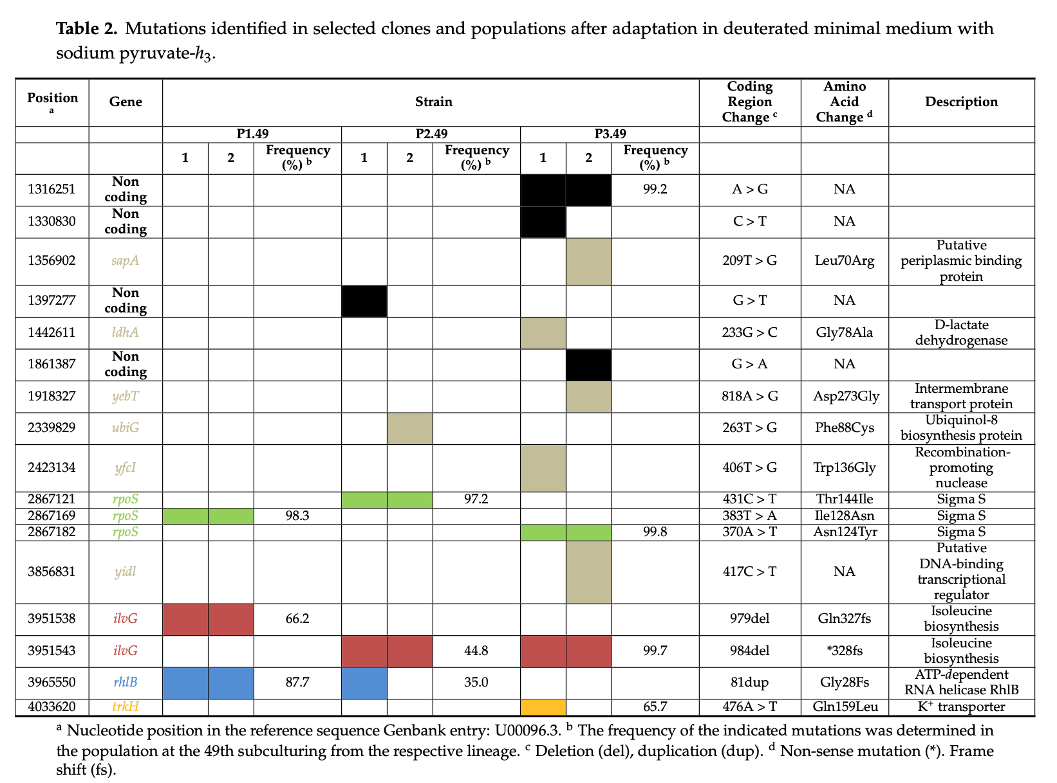
Science highlight from the first proposal call: Adaptive laboratory evolution of E. coli allowing use of pyruvate as carbon source
Deuterated pyruvate can be produced cheaply, and in situ, unlike classic carbon sources (glycerol-d₈; glucose-d₇)
However, E. coli typically grows poorly when pyruvate is used as carbon source
Characterization of E. coli strains with enhanced growth in pyruvate media revealed genetic changes for adaptation
One of the improved strains was used to make highly deuterated triose-phosphate isomerase for neutron crystallography
Kelpšas, V.; Leung, A.; von Wachenfeldt, C. Int. J. Mol. Sci. 2021, 22, 9678. https://doi.org/10.3390/ijms22189678

Slide 3
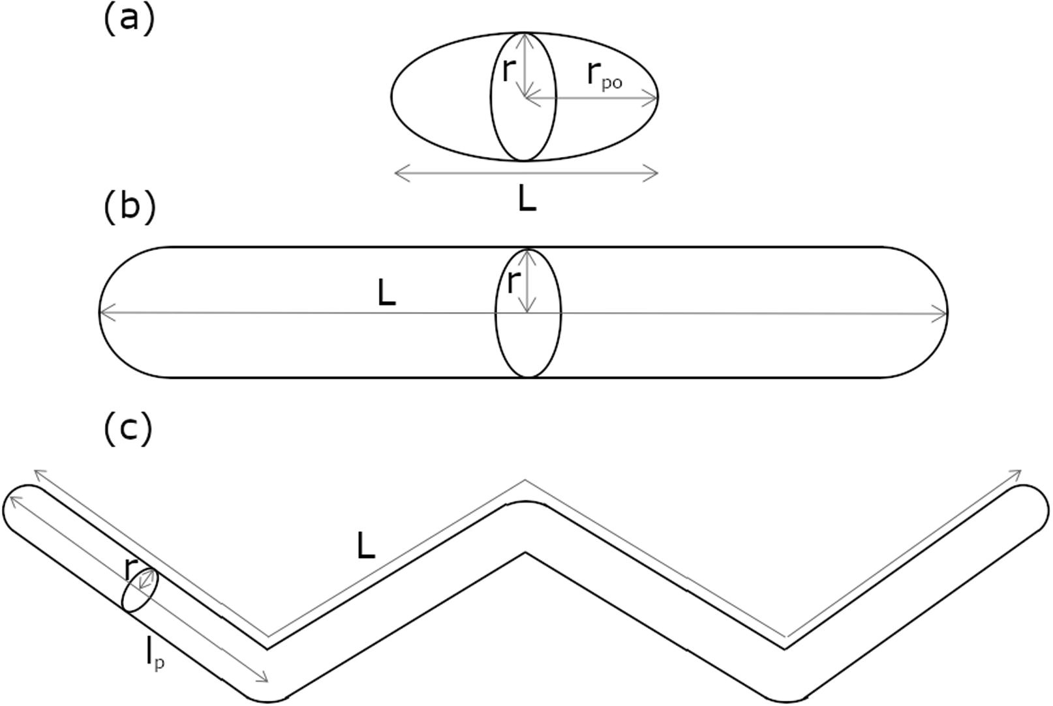
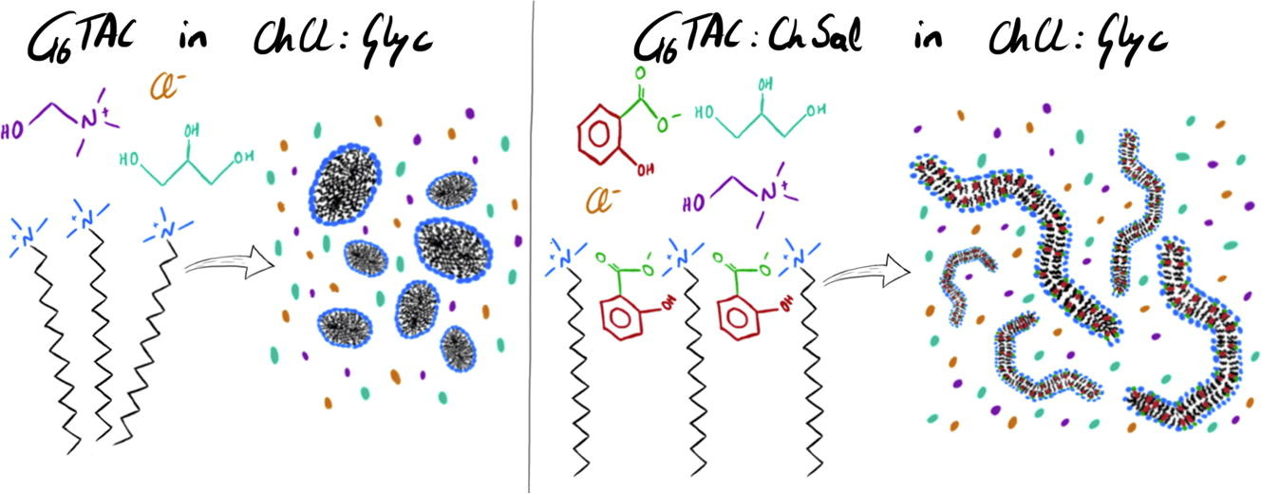
Science highlight from the second proposal call: Effect of choline salicylate, a hydrotropic salt, on the micellization of surfactants in DES
Schematic representation of the structures used to describe micelle morphology: (a) prolate ellipsoid; (b) cylinder; (c) semiflexible cylinder.
The self-assembly of ionic surfactants in deep eutectic solvents (DES) is affected by specific-ion interactions
Choline salicylate, a hydrotropic salt, affects the self-induced micellar growth of hexadecyltrimethyl ammonium chloride in choline chloride:glycerol, resulting in the formation of semiflexible cylinders (worm-like aggregates)
Contrast-variation SANS confirmed that the binding of the hydrotrope to the micelle induces micelle growth in DES, with increased micellar elongation with the addition of more salt
Sanchez-Fernandez, A., Leung, A.; E.; Kelley, E. G., Jackson, A. J. JCIS 2021, 581, 292. https://doi.org/10.1016/j.jcis.2020.07.077
Notes:
Hydrotrope: solubilises hydrophobic compounds in aqueous solutions by means other than micellar solubilisation. Weak van der Waals interactions with solute ie dipole-dipole

Slide 4
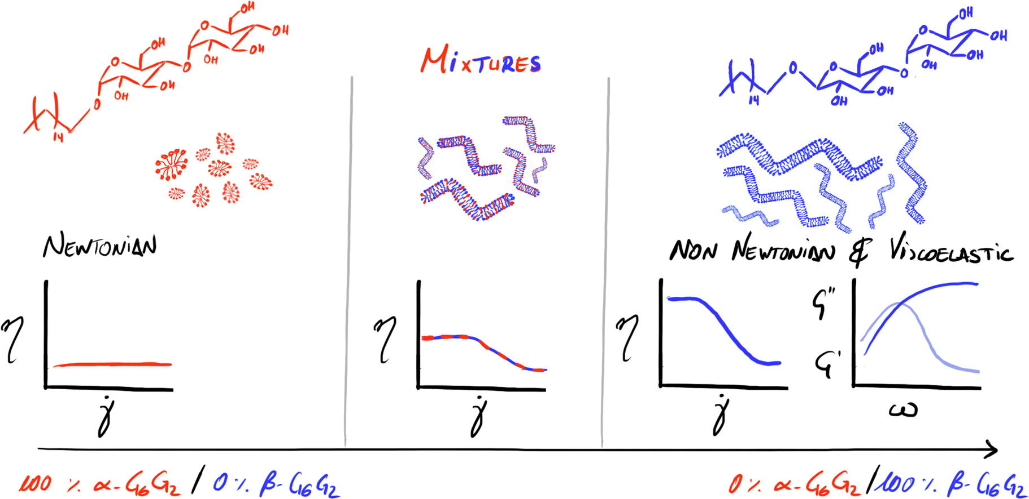
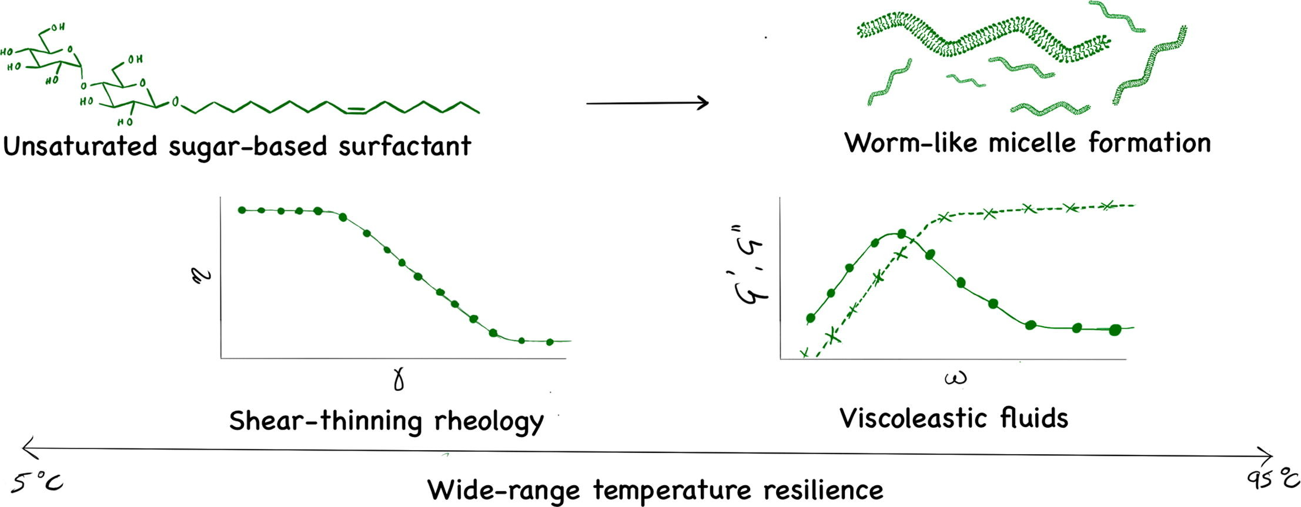
Team
Jia-Fei Poon joined the team in February 2021, shared between the Department of Food Technology, Engineering and Nutrition, Lund University (supervised by Professor Marie Wahlgren)
Synthesis and Analysis of a Library of Sugar-based Surfactants
Previous work: investigations into the effect of the anomeric configuration and tail unsaturation of maltoside surfactants on rheological behaviour
J. Larsson, A.E. Leung, C Lang, B. Wu, M. Wahlgren, T. Nylander, S. Ulvenlund, A. Sanchez-Fernandez, JCIS 585, 178-183 (2021) https://doi.org/10.1016/j.jcis.2020.11.063
J. Larsson, A. Sanchez-Fernandez, A.E. Leung, R. Schweins, B. Wu, T. Nylander, S. Ulvenlund, M. Wahlgren, JCIS 581, 895-904 (2021) https://doi.org/10.1016/j.jcis.2020.08.116
Notes:
Synthesising protiated and deuterated sugar surfactants for characterisation using rheological measurements, SANS, SAXS, DLS: linking the macroscopic response of the system to the molecular organisation of the surfactants. It was known that the surfactants prone to forming the most elongated micelles are thus the most viscous aqueous solutions are those with long (alkyl greater than or equal to 16C) so C16 was selected. Alpha and beta. Alpha: short cylindrical micelles, Newtonian behaviour. Beta: WLM; Non-Newtonian. Can mix to tailor the shape of the micelles and thus the resulting rheological behaviour. High Krafft point of both surfactants a problem (27 C). Added a degree of unsaturation to the C16 chain to reduce the Krafft point to (below 4 C); interesting rhelogical behaviour maintainted (small differences in cross-section/flexibility).

Slide 5
This work:
Investigations into the location and configuration of unsaturation
G₂-6-trans
G₂-6-cis
G₂-9-trans
G₂-9-cis
G₂-11-trans
G₂-11-cis
G₂-9-alkyne
G₂C₁₈
Notes:
Glucosides: low solubility under the desired conditions for rheology measurements

Slide 6
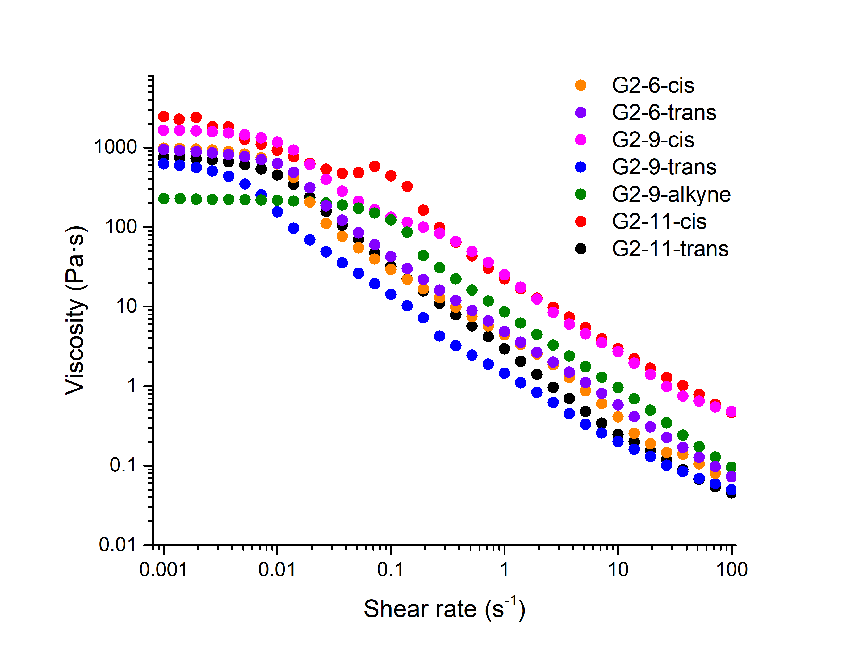
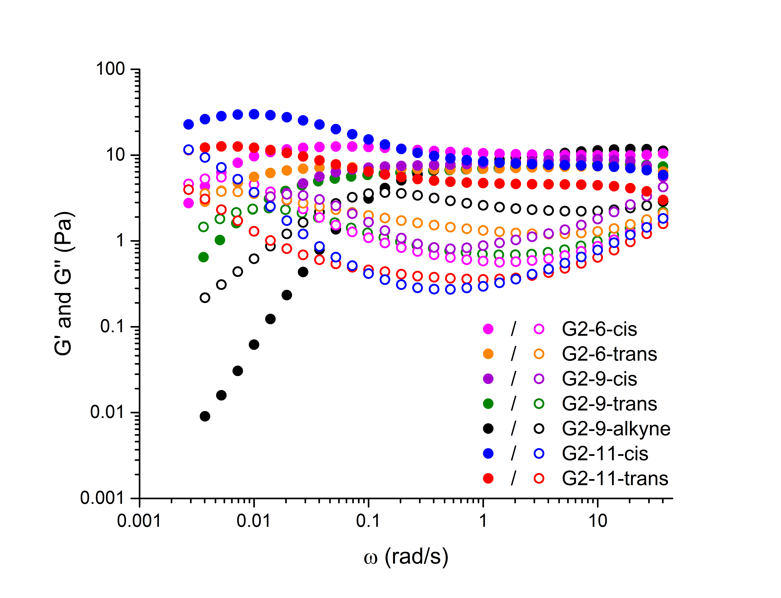
Rheology
Structure-property relationships will be established using linear and oscillatory rheology in combination with DLS, SAXS and SANS
Linear rheology Oscillatory rheology
Notes:
Shown on a log scale, so even though the differences in the data are not that big, they are noteworthy since, with the exception of the alkyne which differs by one hydrogen atom, they are all identical in chemical composition. Differences: in frequency response. Cis-11 is a gel while trans-11 is a viscoelastic gel.
Hopefully, SANS data will confirm that the structure of the micelles form are correlated to the rheology.

Slide 7
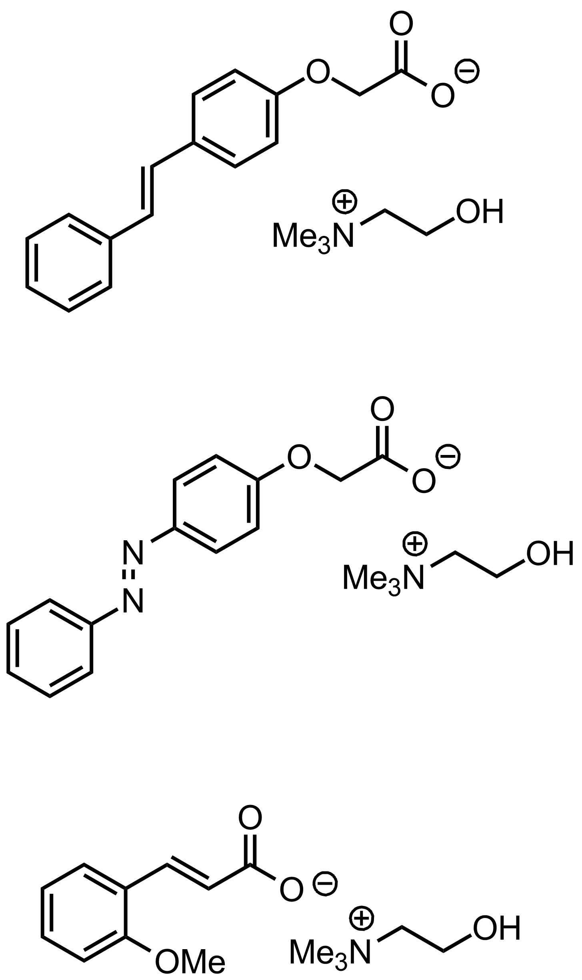
Collaborative research projects
Photo-switchable fluids
(with Dr Adrian Sanchez-Fernandez, CiQUS, University de Santiago de Compostela)
Development of new responsive systems using simple molecular switches where the switch is part of the solvent instead of part of the dispersed particles
Synthesis of novel photoresponsive molecules which undergo either reversible or irreversible isomerisation when exposed to light (and a corresponding change in viscosity)

Slide 8
Collaborative research projects
Hydrophobic deep eutectic solvents
(with Dr Adrian Sanchez-Fernandez, CiQUS, University de Santiago de Compostela)
Decanoic acid-d₁₉:tetrabutylammonium chloride-d₃₂, a DES with inverse polarity. Of interest for CO₂ capture, extraction from aqueous solutions, as a solvent for catalysis
Modifiers
(with Professor Tommy Nylander, Lund University)
N-octenyl-d₁₅-succinic anhydride, used to modify native starch to increase surface hydrophobicity and extend its utility as a stabiliser of oil-in-water food emulsions

Slide 9
Collaborative research projects
Lipids
(with Dr Michihiro Nagao, NIST/University of Maryland)
1-Stearoyl-d₃₅-2-oleoyl-d₃₂-sn-glycero-phosphocholine (SOPC-d₆₇) synthesised using the method established for POPC-d₆₃;¹ provided along with POPC-d₆₃ for NSE measurements of thickness fluctuations and acyl tail dynamics in model lipid bilayers
Monomers
(with Professor Michael Gradzielski, Technical University Berlin)
n-Octyl-d₁₅ acrylate, n-dodecyl-d₂₃ acrylate and n-hexadecyl-d₃₁ acrylate synthesised for use in the synthesis of well-defined amphiphilic block co-polymers
Bogojevic, O., Leung, A. E., ACS Omega 2020, 5, 22395. https://dx.doi.org/10.1021/acsomega.0c02823
Notes:
Building blocks in ionic assembly to construct more complexly-built polymer colloids, relevant as delivery vehicles (drugs, other bioactives)

Slide 10
Proposal call ‘2b’ – chemical deuteration
Molecule classes requested (by number/proportion of proposals), by proposal round
*Excluding in-house proposals

