Slide 1
Alessandra Luchini & Sven Schütz :: ESTIA Core Team :: Paul Scherrer Institut
Estia – Project Update
STAP meeting 03/05/2022

Slide 2
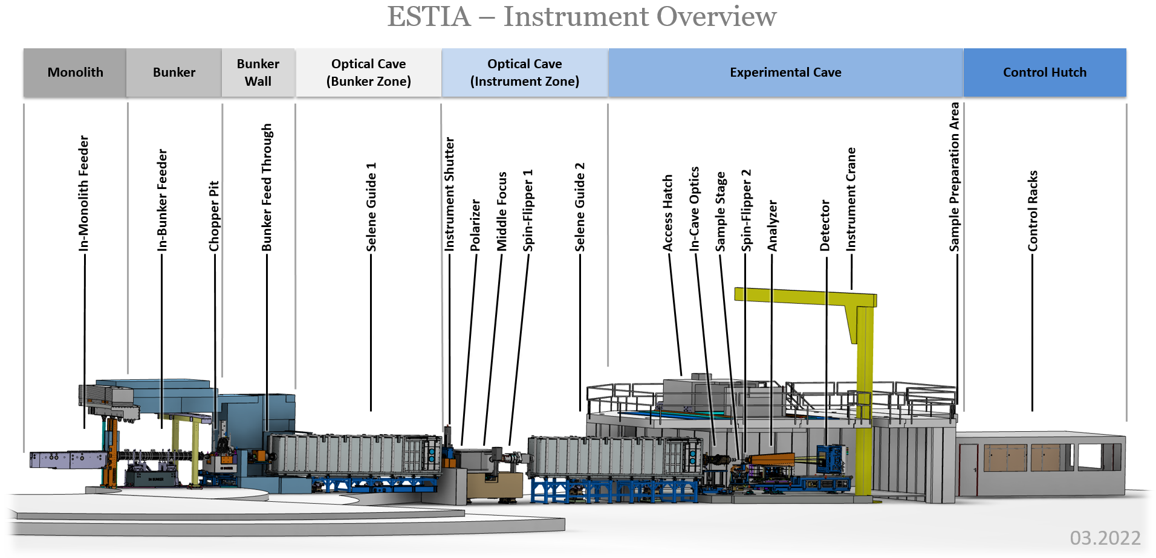
ESTIA instrument overview

Slide 3
ESTIA instrument overview
Shipped/ready to be shipped to ESS. Early in-bunker installation planned for summer 2022

Slide 4
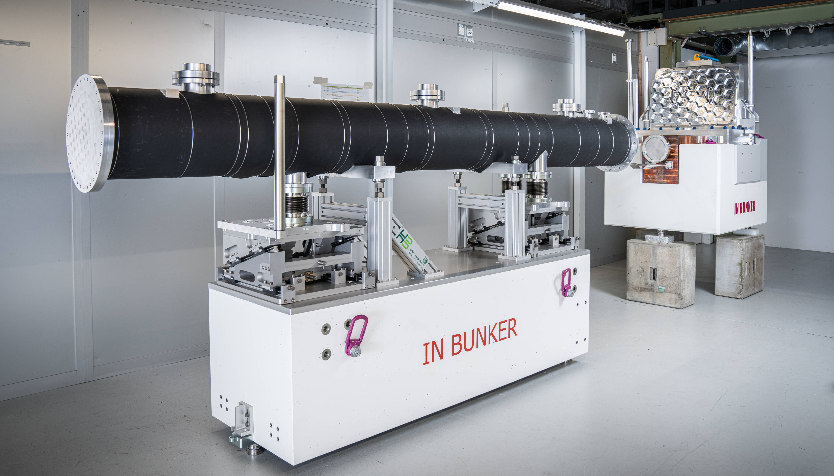
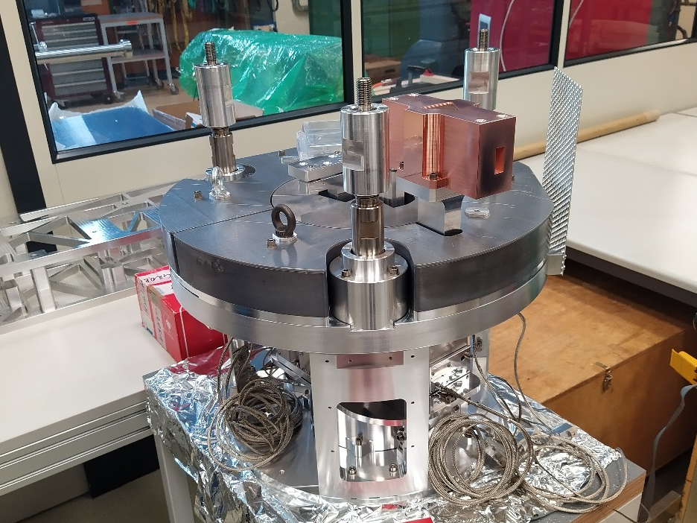
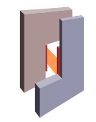
ESTIA- In-bunker Feeder
@ PSI
Mechanical tests at PSI completed in December 2021
Test with neutrons of the Virtual Source in May 2022
Chopper disk received from ISIS
@ ESS
Most components are ready to be shipped to ESS
Test of the Chopper at ESS coordinated by the ESS Chopper group
Early Installation of In-bunker Feeder and Chopper Pit at ESS
Final installation of in-bunker component Autumn 2022- beginning 2023

Slide 5
ESTIA instrument overview
Selene 1 and Selene 2 are at ESS, installation will be continue in Autumn 2022

Slide 6
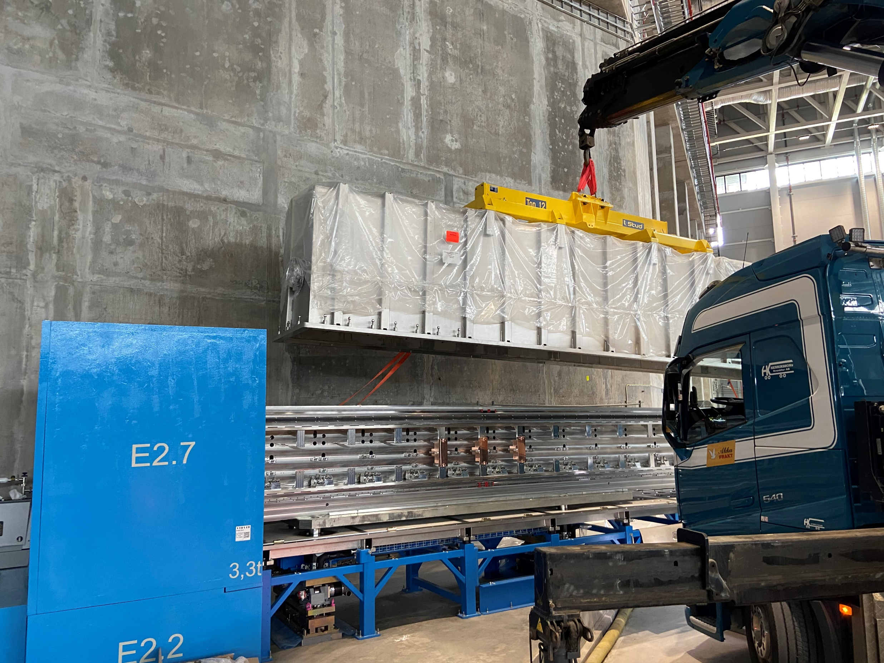
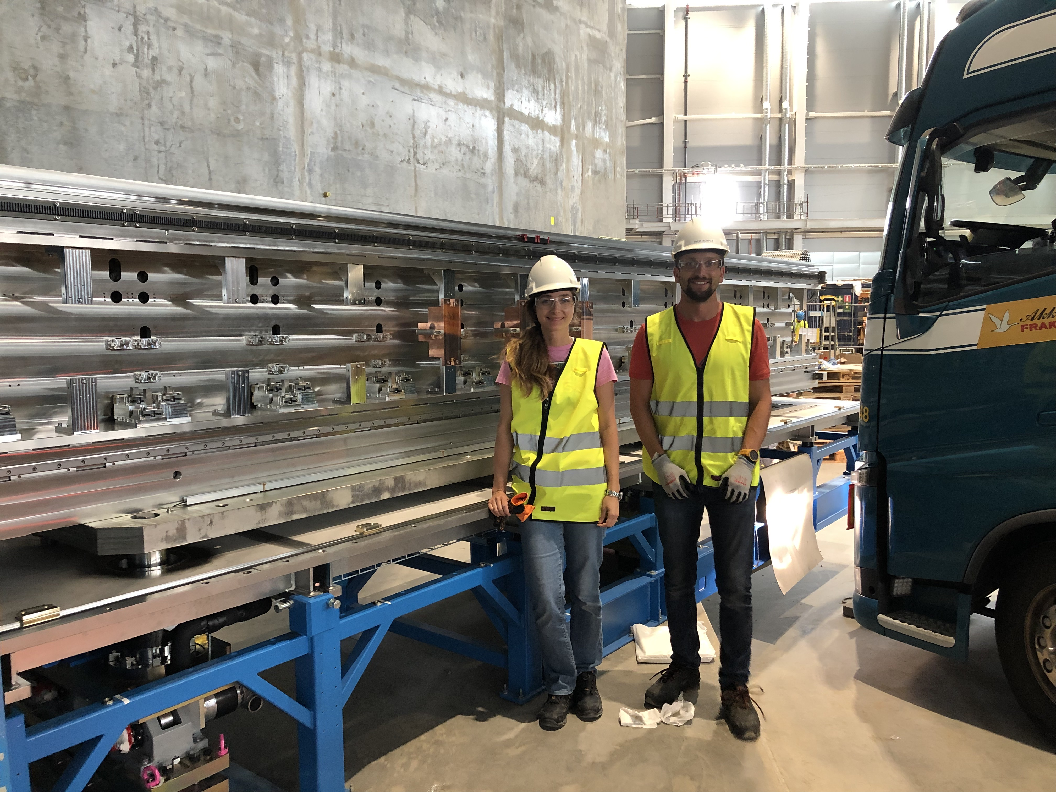
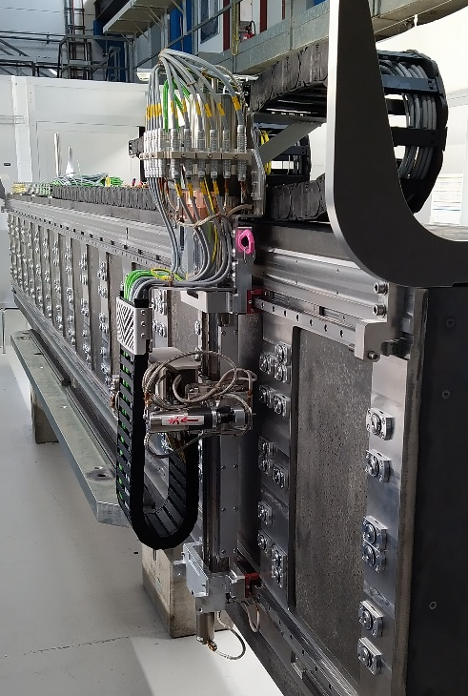
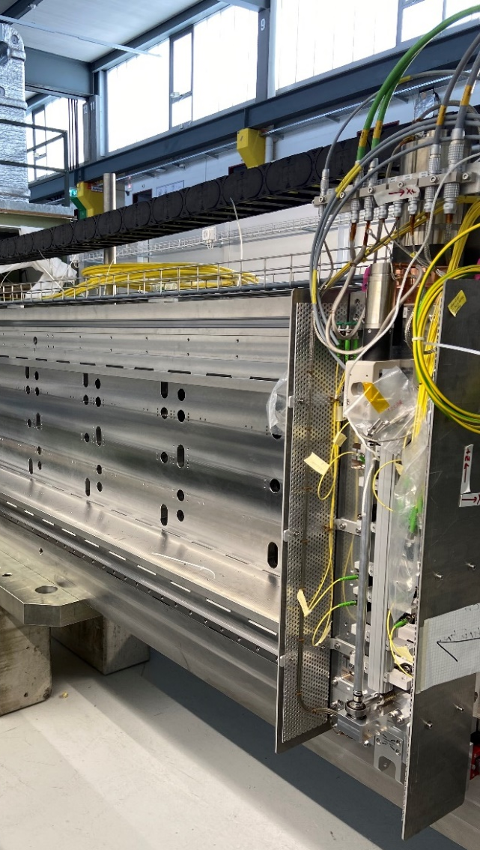
ESTIA – Selene 1
Selene guide 1 carrier and vacuum vessel are installed at ESS
Alignment robot
Metrology cart
47 of the 60 mirrors for Selene 1 and 2 were produced and accepted.
Production and characterization of the mirrors at PSI will continue in the coming months.
Installation of the mirrors and robots at ESS in autumn 2022

Slide 7
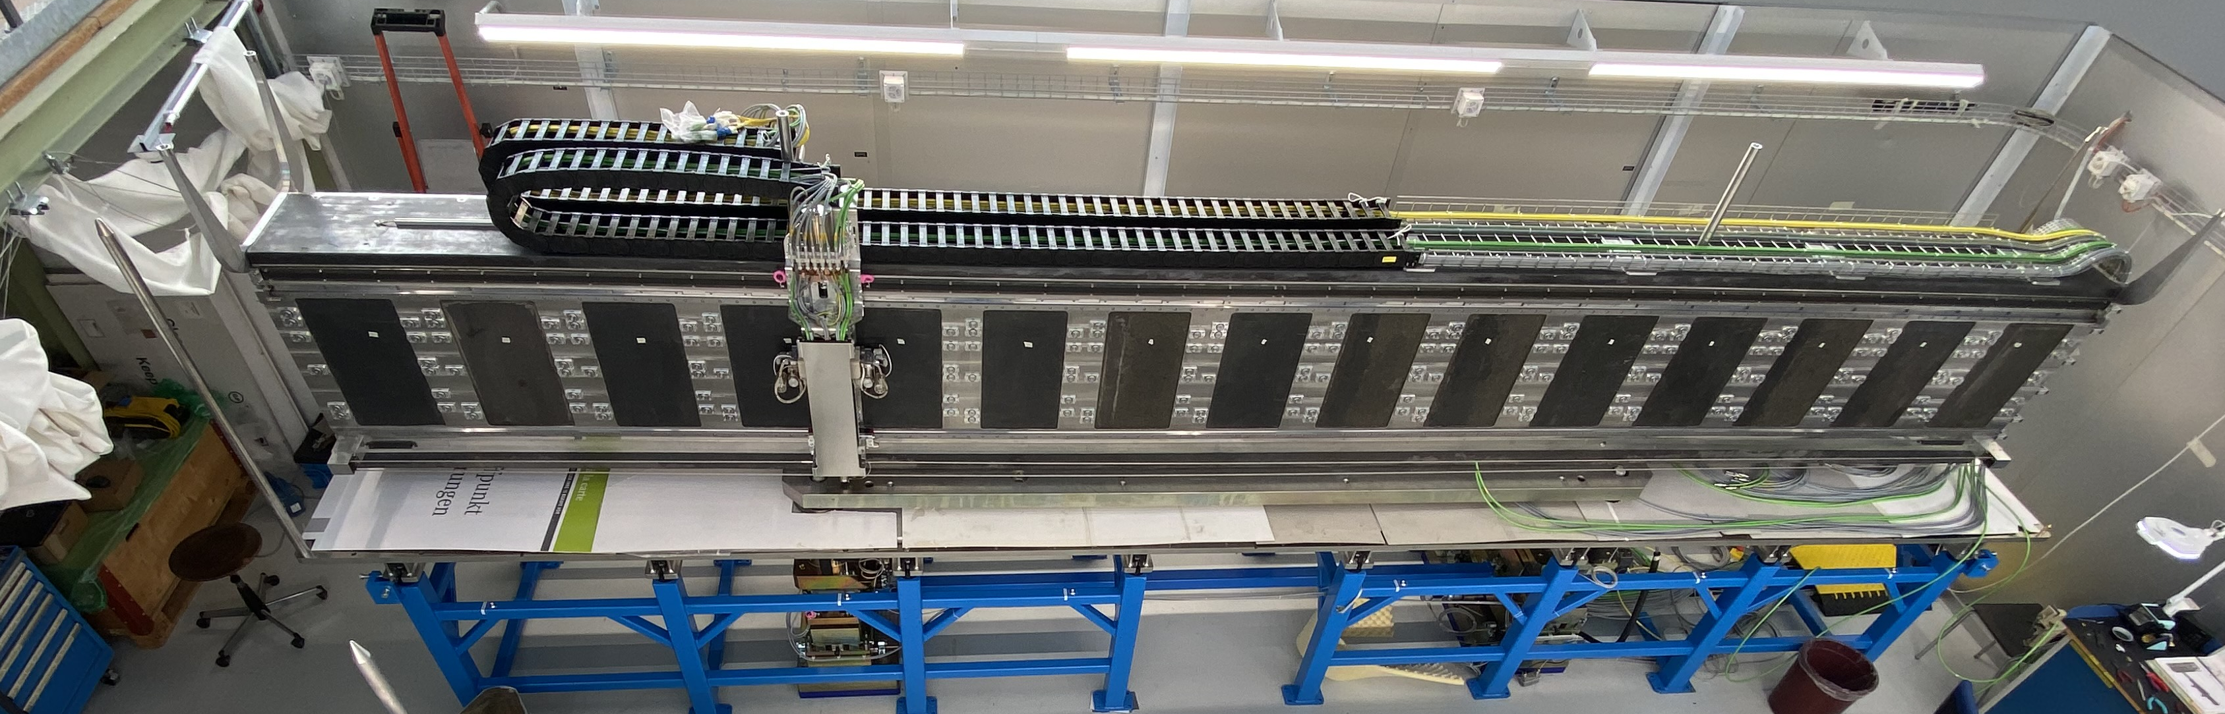
ESTIA –Selene 2
Pre-installation of the carrier at PSI completed in November 2021
Selene 2 carrier and vacuum vessel are currently at ESS
Installation at ESS in summer or autumn 2022 (depending on the timeline for the installation of the in-bunker components)

Slide 8
ESTIA - Middle Focus
Design of the Middle Focus almost completed

Slide 9
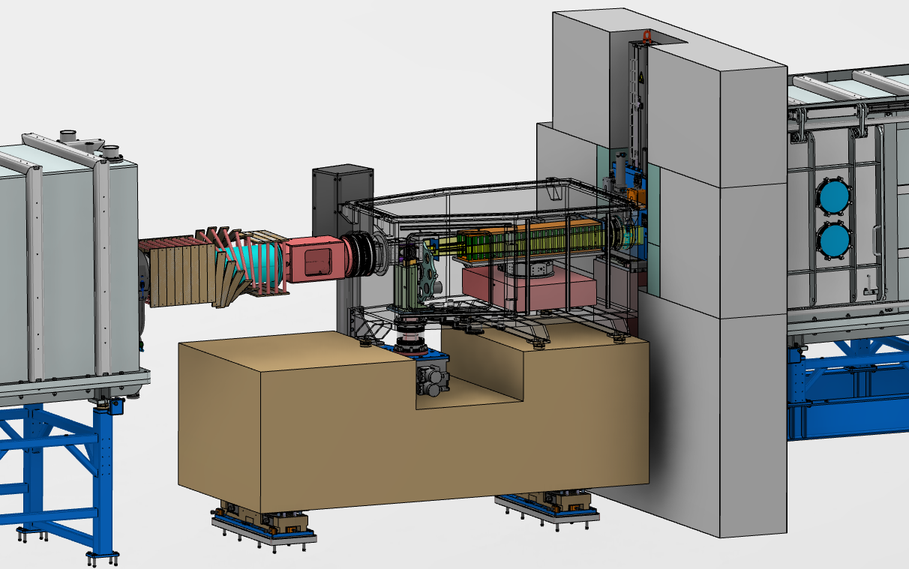
ESTIA-Middle Focus
Overview of the current design
Instrument shutter
Polarisers, FOM
Mask Changer
Spin-flipper
Selene 2
Selene 1

Slide 10
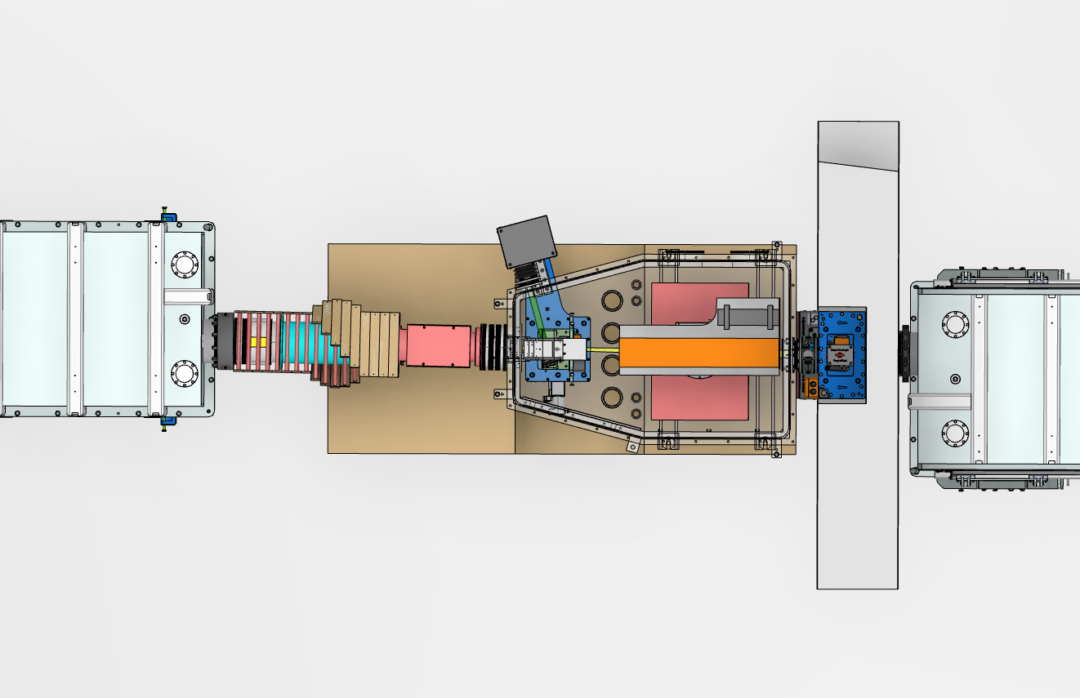
ESTIA-Middle Focus
Overview of the current design
Procurement of the polarisers, FOM and spin flipper: documentation is in preparation. The procurement will include final design and manifacture
Polarisers/FOM motorised support: design is completed (procurement will start ed soon)
Mask changer: Design completed (IDR in March) including motorised support. Procurement is ongoing
IDR for the complete MF is planned for beginning of June. SubTG3 in

Slide 11
ESTIA instrument overview
Call for tender published in February. Negotiation is in progress.

Slide 12
ESTIA instrument overview
Sample stage and detector arm design is progressing

Slide 13
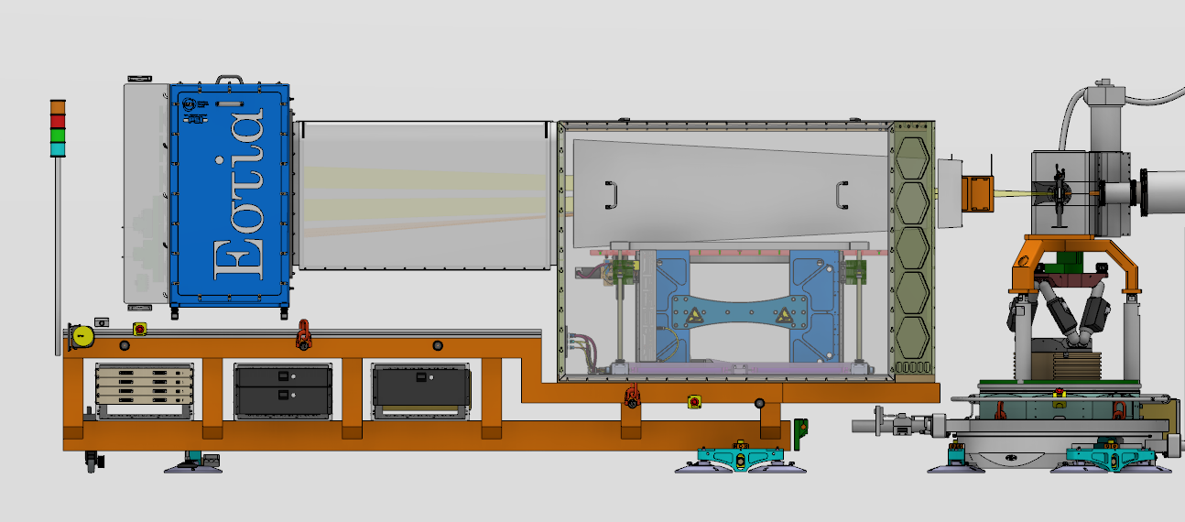
ESTIA – Sample Stage & Detector Arm
Overview of the current design
Flight tube
Analysers + Guide field
Spin-flipper
Detector
Detector electronics
Sample stage

Slide 14
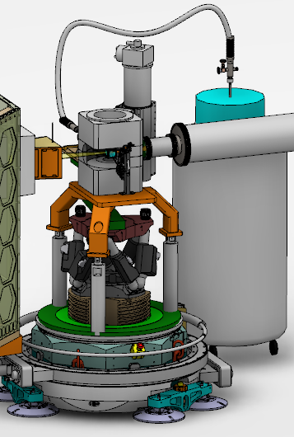
ESTIA – Sample Stage & Detector Arm
Warm Bore magnet (2.5T vertical): designed together with ESS polarisation and SE groups. To be procured by ESS
Overall sample stage design is ongoing
Sample holder for solid/air and small flow cryostat: design will start in the summer. The sample holder will be mounted directly on the hexapod
Compatibility of the sample stage with other magnets available at ESS currently under discussion
Hexapod (L2 interface):
Different products under evaluation for procurement
L1 interface: directly connected to the omega stage. Potential adapters for the magnet
Omega stage

Slide 15
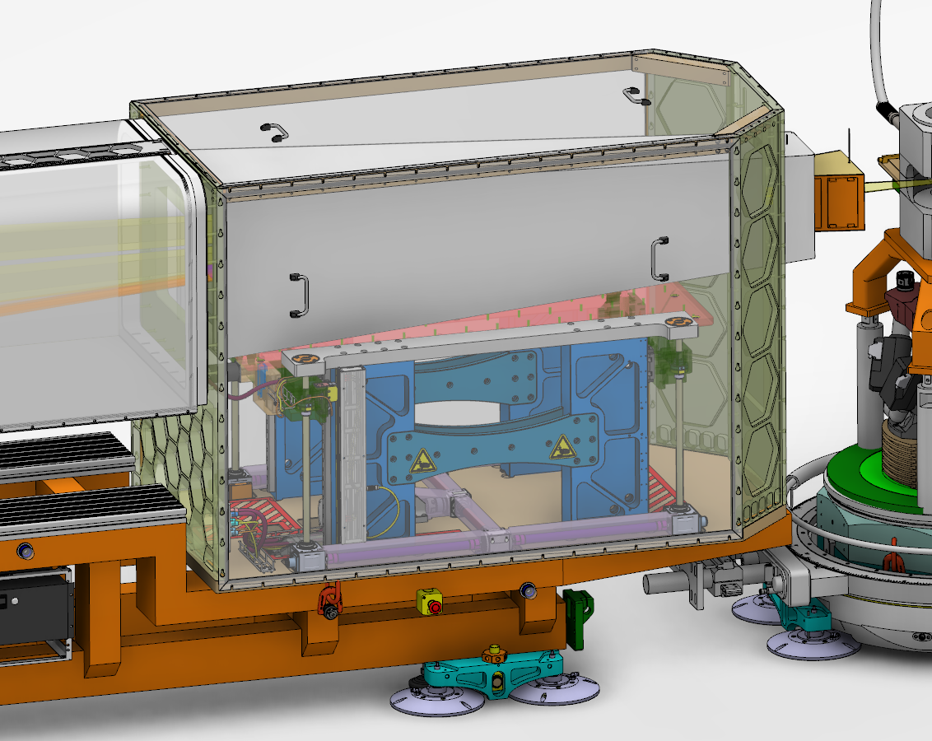
ESTIA – Sample Stage & Detector Arm
Analysers+guide field: design of the housing is ongoing. Preliminary design of the analyser mirrors (PSI) and guide field (ESS) already discussed with potential supplier
Motorised support for the analysers: design ongoing
A section of the guide field for the analysers will be placed outside the flight tube and integrated in the design of the spin-flipper
Spin-flipper: feasibility study currently ongoing

Slide 16
ESTIA instrument overview
Procurement of the control hucth through ESS

Slide 17
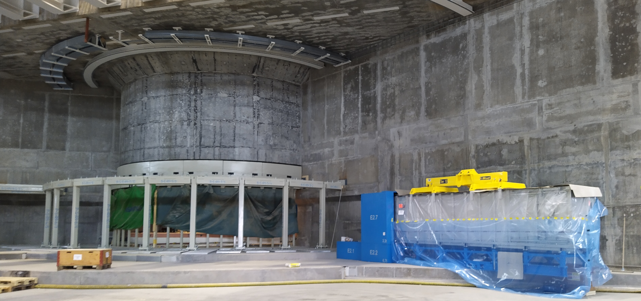
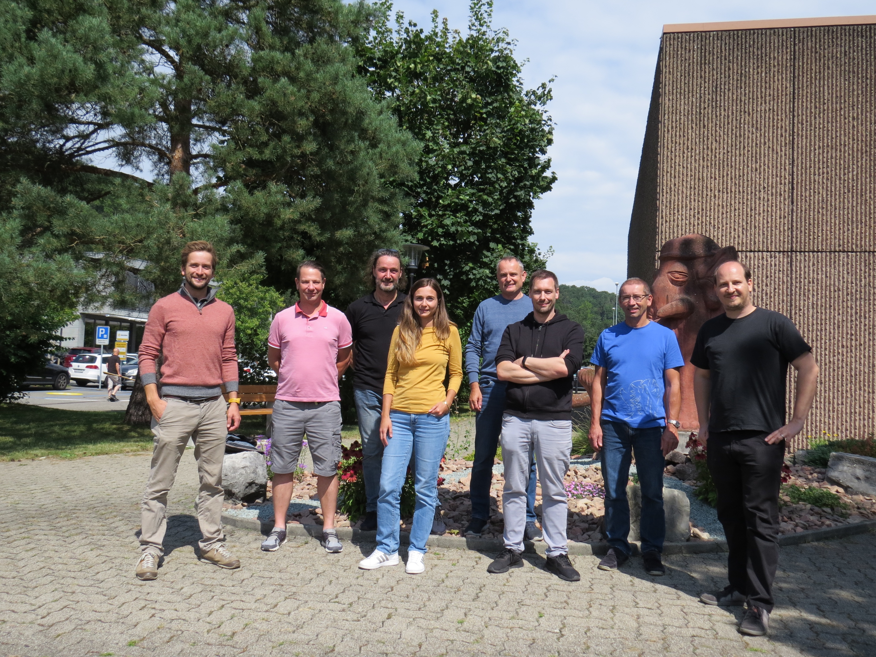
Thank you for your attention!
Any questions?
Page 17
Notes:
17

Slide 18
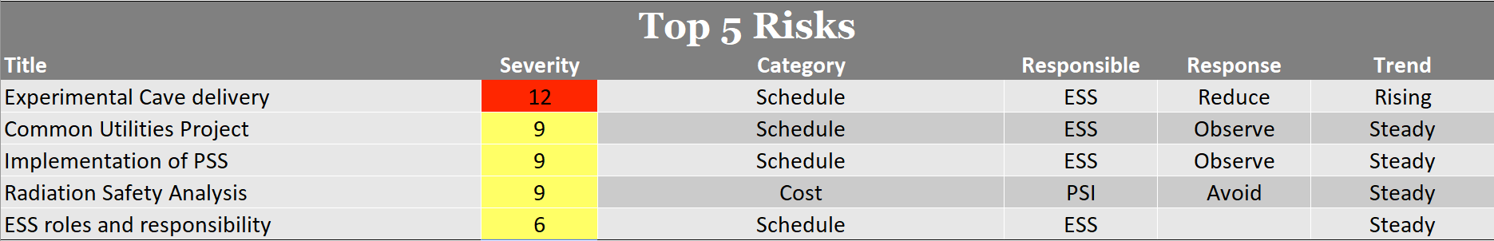
Risk Report
Current Risk Register
Risk Register from previous STAP meeting
Current Top 5 Risks
Title | Severity | Category | Responsible | Response | Trend
Activation Analysis | 12 | Cost | PSI | Avoid | Steady
Common Utilities Project | 9 | Schedule | ESS | Observe | New
PSS standards | 9 | Schedule | ESS | Observe | New
Experimental Cave delivery | 6 | Schedule | ESS |  | Falling
Communication to ESS | 6 | Schedule | ESS | Reduce | Steady

Slide 19
Financial Report

