Slide 1
FREIA STAP Update
Jon Elmer & Tom Arnold
3rd May 2022
Notes:
Status
Challenges
Schedule

Slide 2
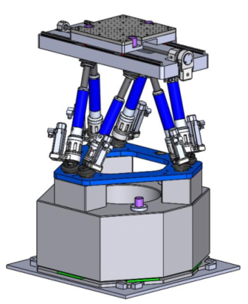
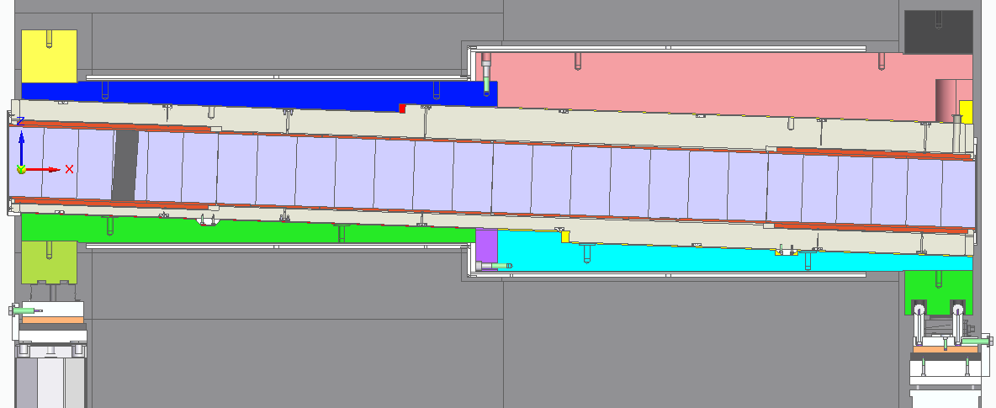
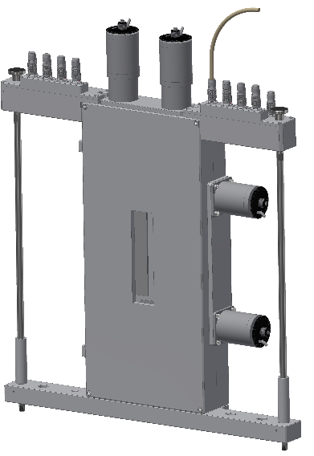
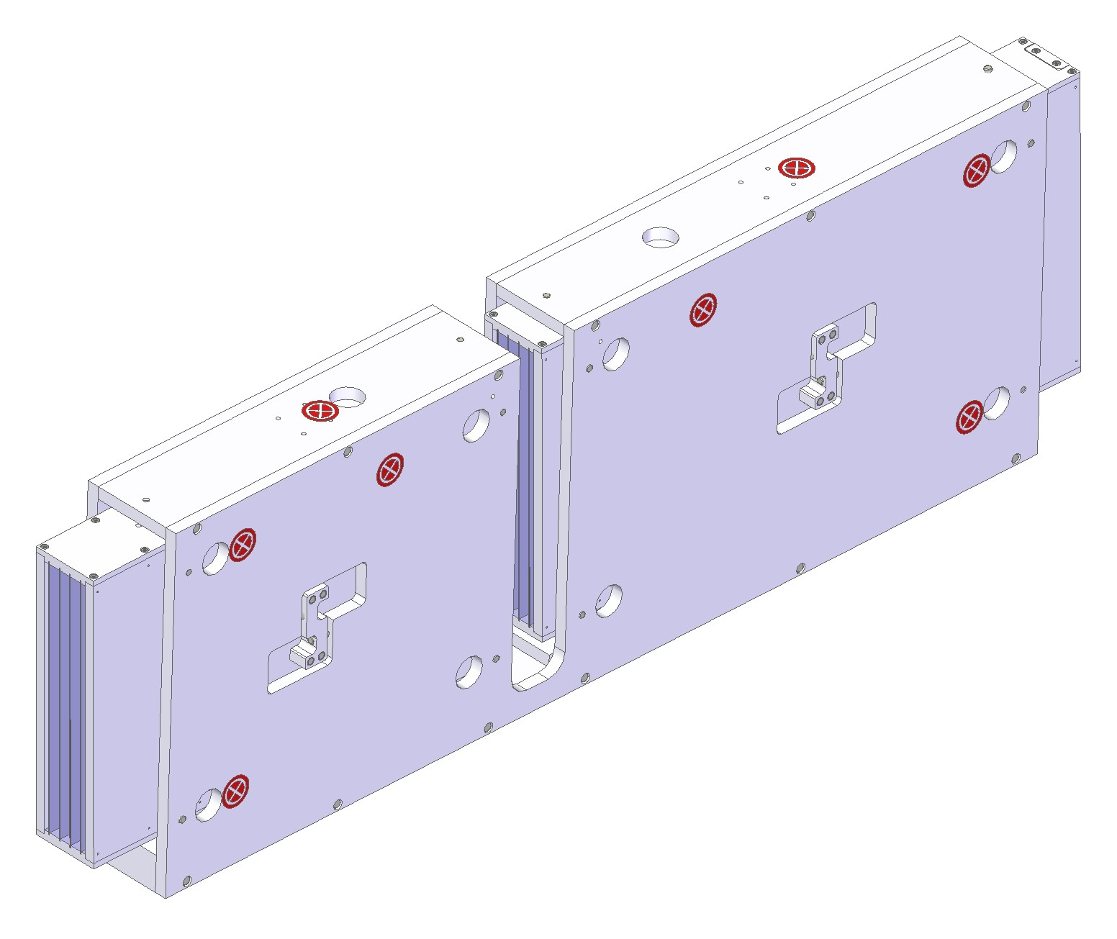
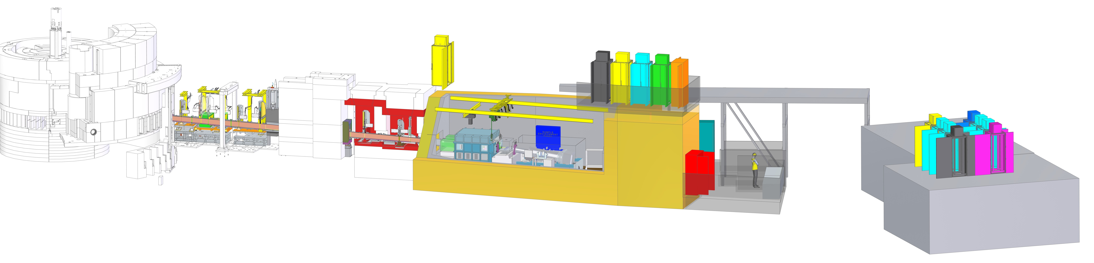
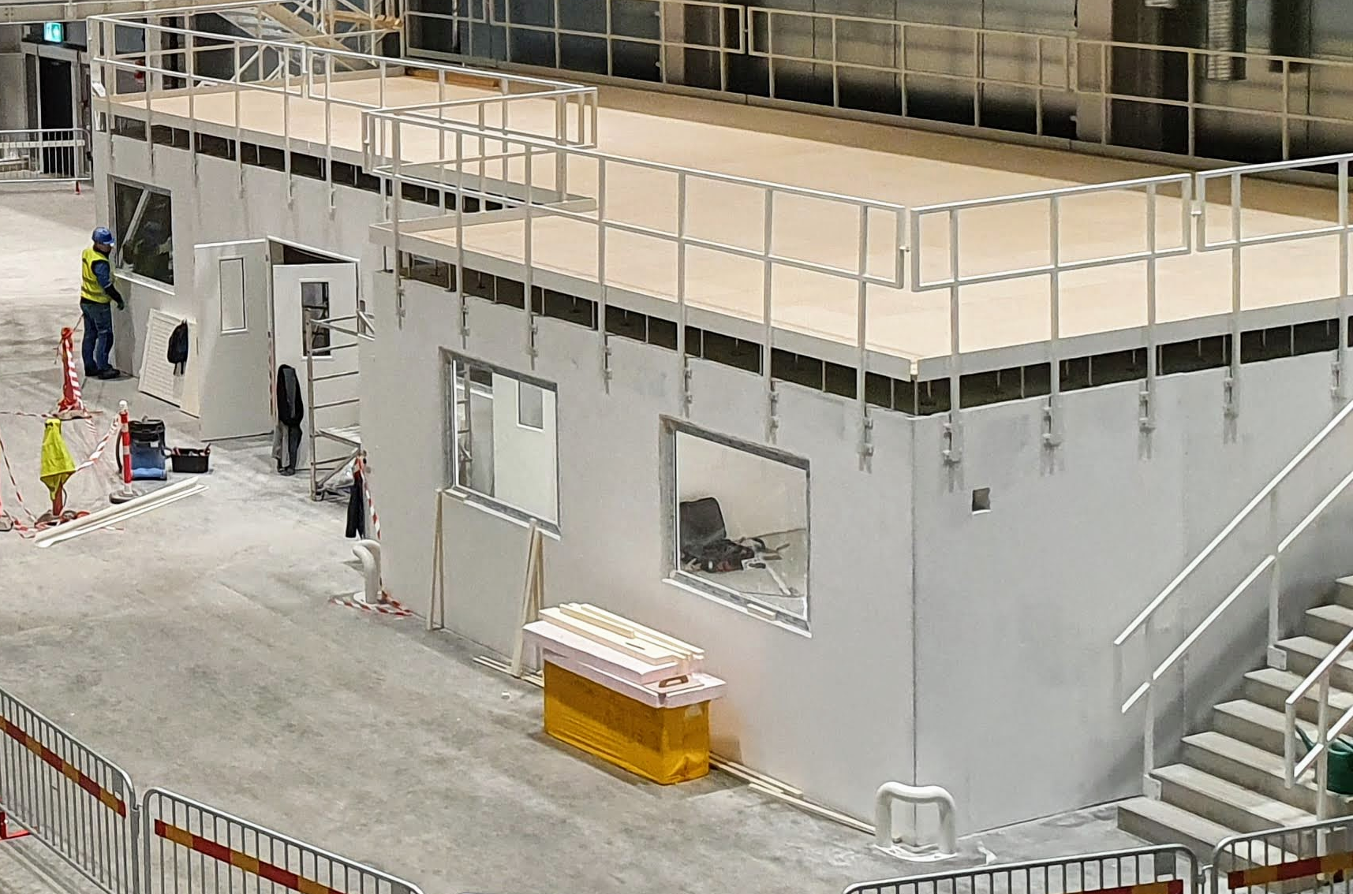
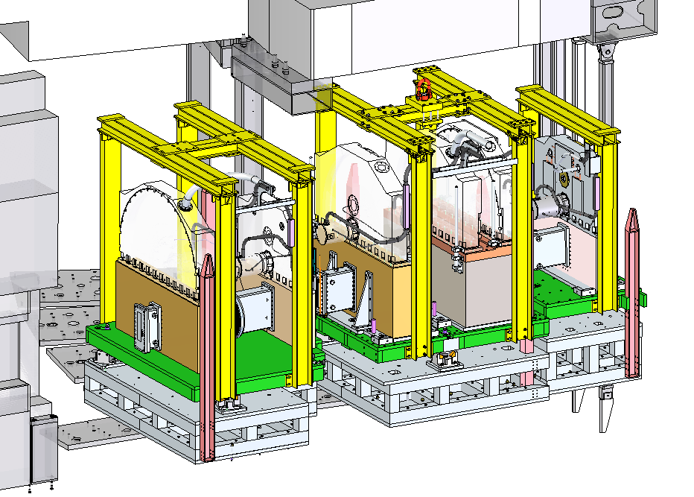
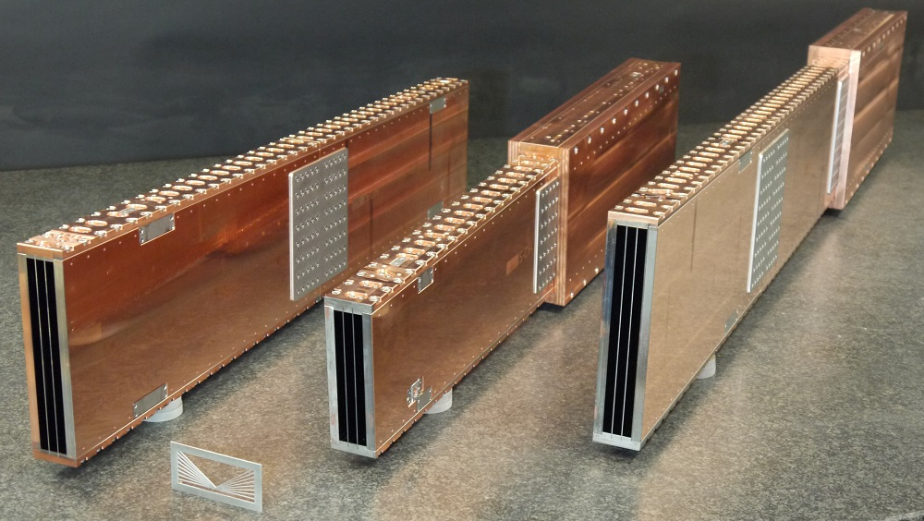
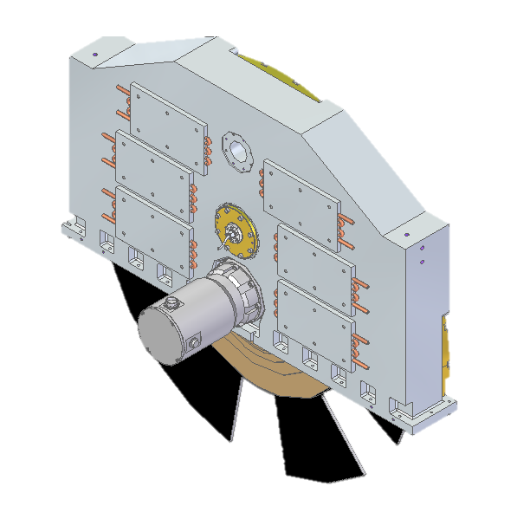
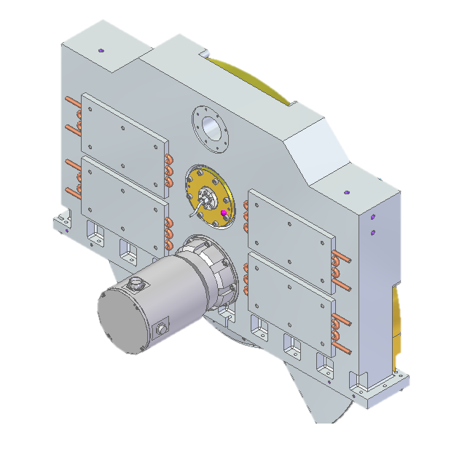
FREIA Status
Collimation System
Collimation guides ordered (SNAG)
Vacuum vessel tender complete
Guide (SNAG)
Design complete
Chopper Discs (ADSF)
Ready for shiping (x4)
Rework underway (x2)
Delivery to RAL Q2
Slits 1-3 (JJ X-ray)
Design complete
Bunker Wall Insert
Sample Positioning Sys. (Symetrie)
Design complete
Bunker Wall Insert
Design complete
S1 (JJ X-ray)
SPS (Symetrie)
Detector Bench
Detailed design progressing
In-bunker Guide
NBOA (S-DH)
FAT completed in Dec
Delivered to ESS
Installation in Q2/Q3
Bunker Modules
Design complete
Chopper housings & WBC discs
Design complete
Hutch installation
LOKI/FRIEA Hutches
Installation complete
NBOA
Bunker modules 3, 2, & 1
1.3m and 1m Choppers

Slide 3
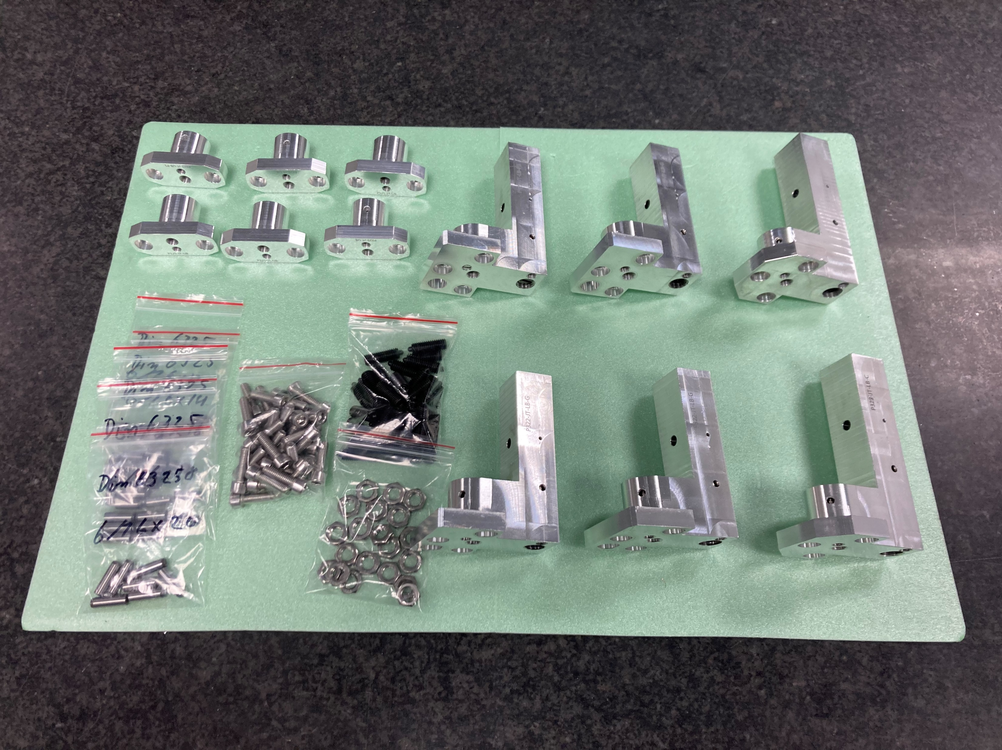
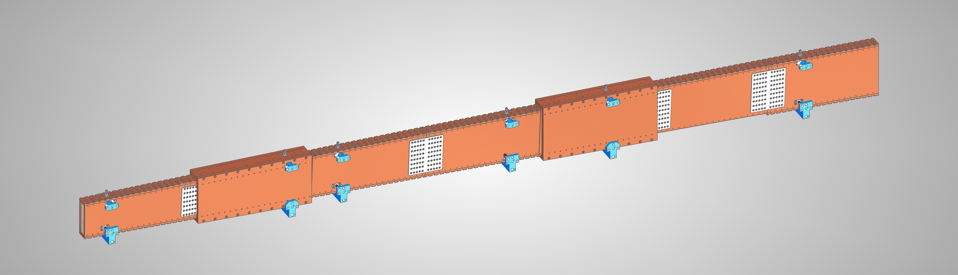
NBOA (S-DH)
Assembled NBOA Units
The first optics for FREIA were delivered to ESS in December ‘21 following successful FAT.
The optics will be installed in 2022 Q2/Q3, pending delivery of the NBPI (port insert) by ESS Target.
Alignment Devices
NBOA CAD Model

Slide 4
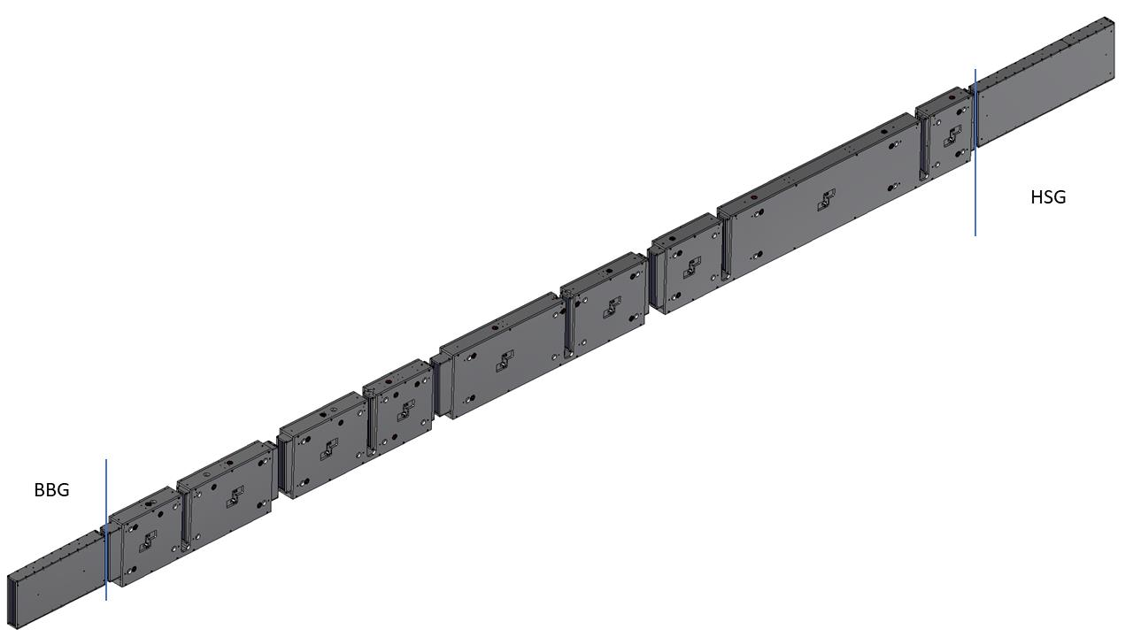
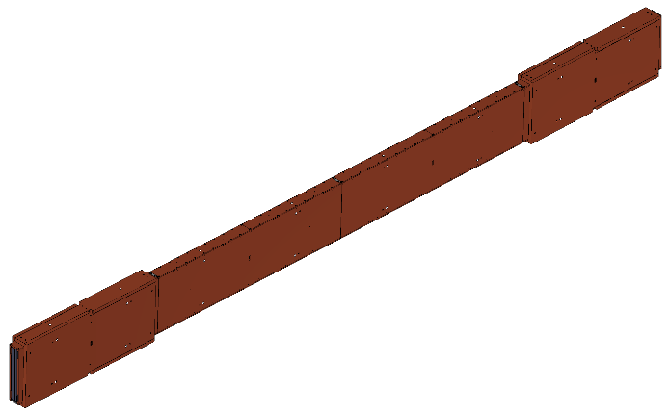
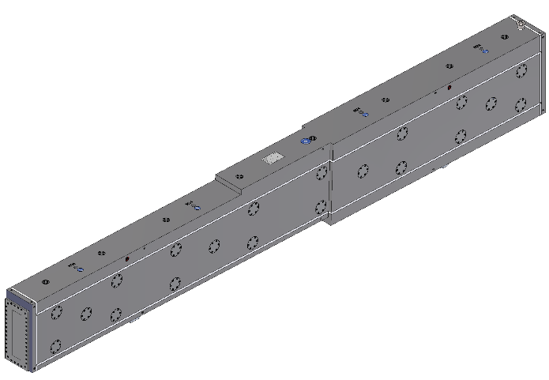
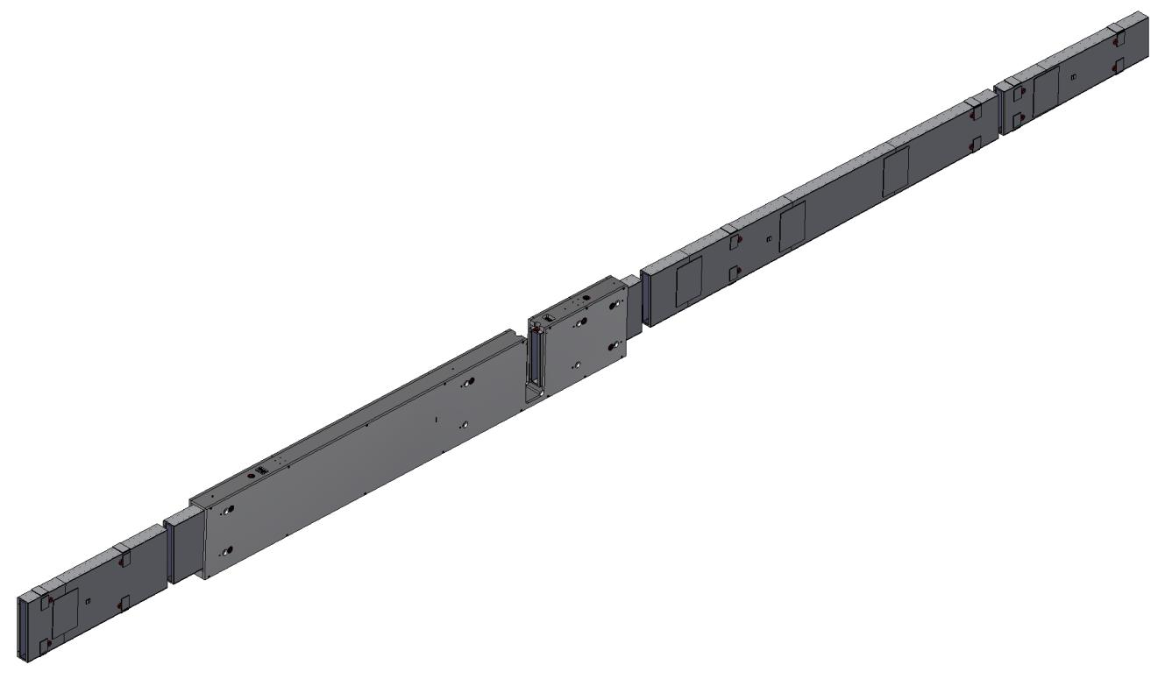
Guide (SNAG)
Horizontal geometry | S-bend R 174 m/R 200 m
Vertical geometry | 2° inclined ellipse 22.8 m focal length
Cross-section | Max 25 cm (h) × 3 cm (w)
Coatings | Top/bottom: m=3.5 to 6 Sides/vanes: m=3.2 or 3
Design completed in Jan ’22, ESS review complete
Delivery of BBG, Heavy Shutter and BWI guides have been prioritised to be ready for earlier installation.
Next steps:
Coating development (wafer waviness)
Manufacture of BWI vacuum housing
In bunker
Bunker wall
Out of bunker

Slide 5
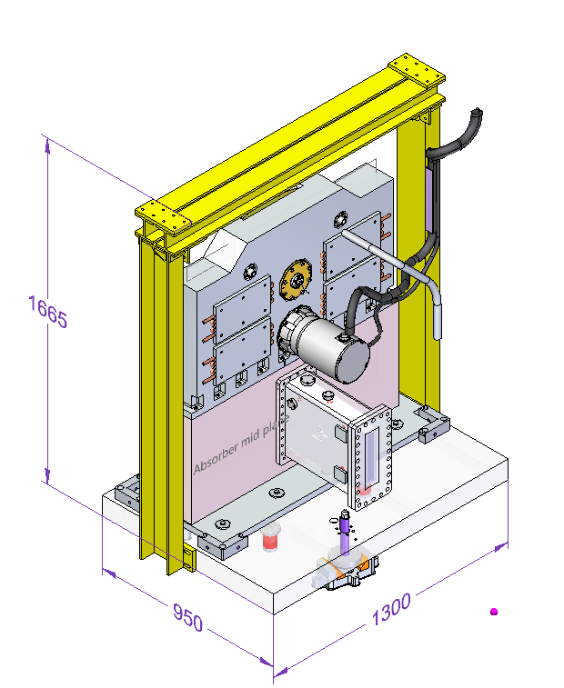
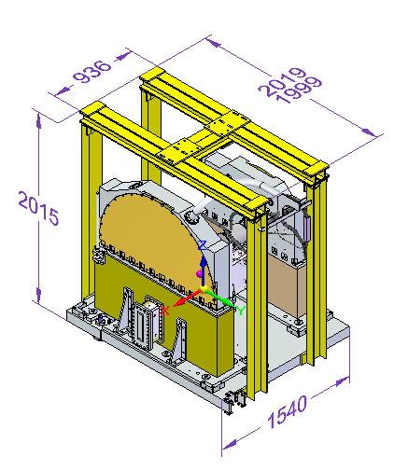
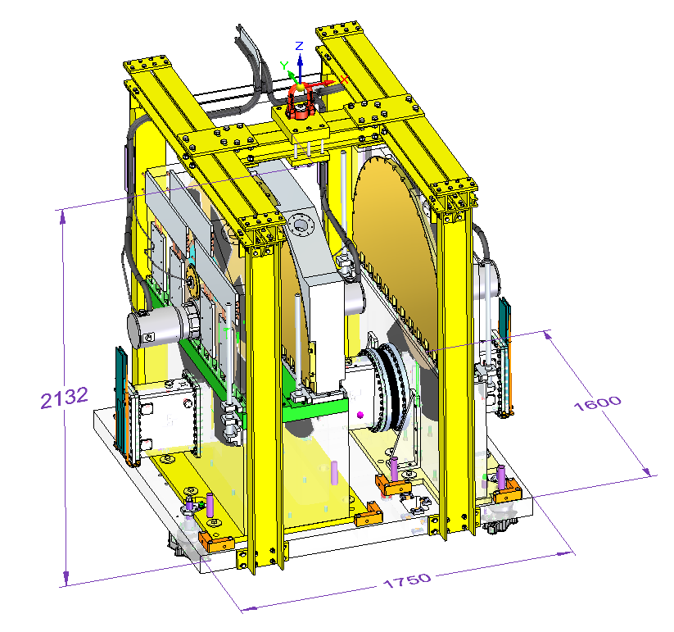
Bunker Modules
BEAM
Choppers and guide housings grouped into three independent “modules” to aid installation/ extraction, allowing maintenance activities to be performed outside of the bunker.
Design completed in April ’22 – under review by ESS
Module 1 (WBC1)
Module 3 (WBC2, FOC2)
Module 2 (WFM1&2, FOC1)

Slide 6
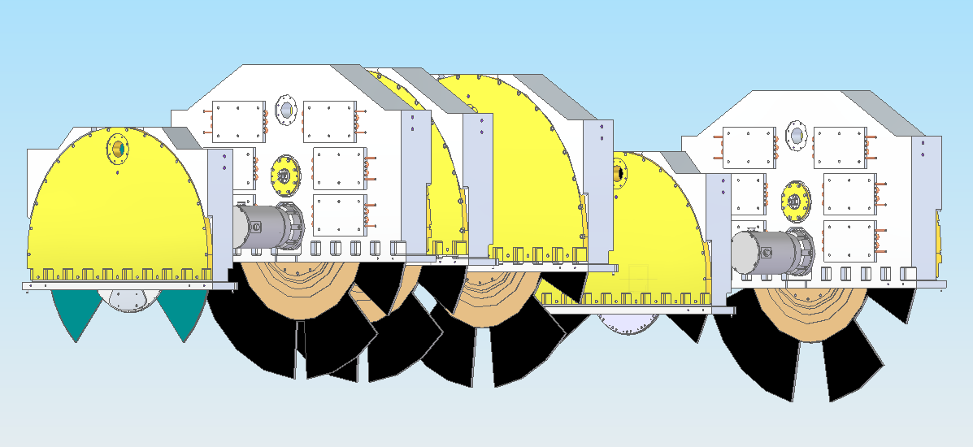
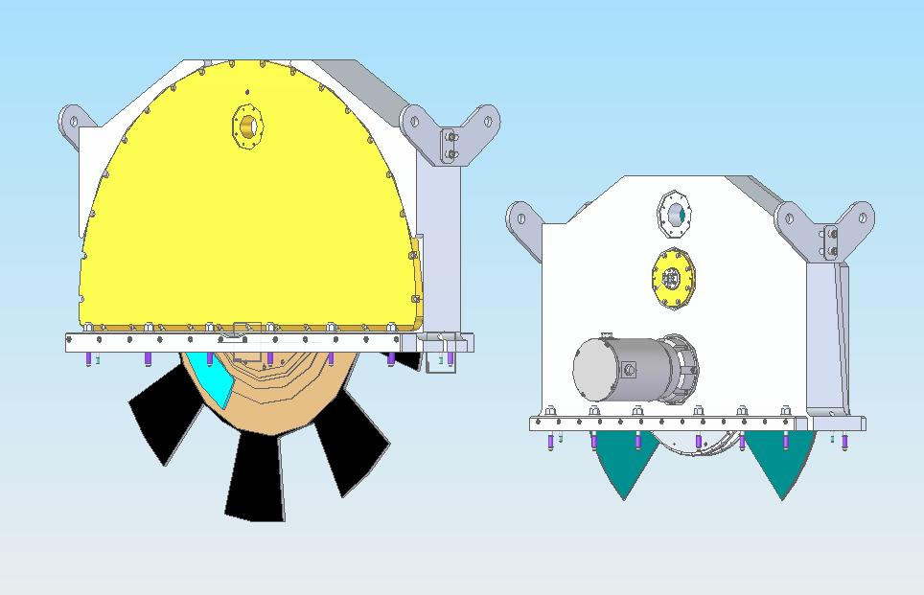
Choppers
Design completed in April ’22 – under review by ESS
Choppers to share common upper housings where possible:
Type A: ∅1m ISIS or ADSF disc; in-bunker
Type B: ∅1.3m ADSF disc; in-bunker
Type C: ∅1.3m ADSF disc; out-of-bunker
Type D: ∅1m ISIS or ADSF double disc; out-of-bunker
WBC1
Type A
WFMs, FOC1
Type B
WBC2
Type A
FOC2
Type B
FOC3
Type C
WBC3
Type D
Freia’s Chopper Suite

Slide 7
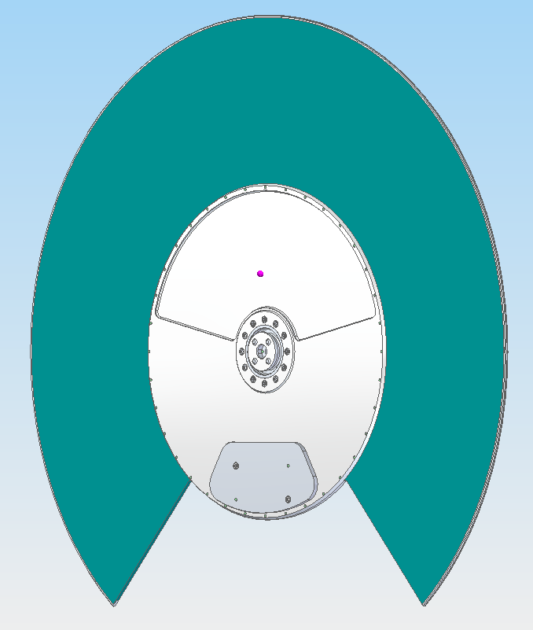
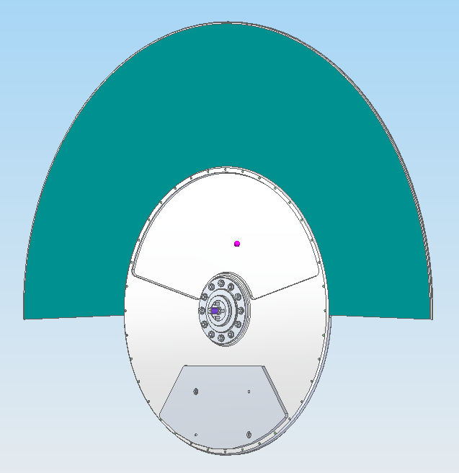
Chopper Discs (ISIS)
WBC1
Design completed in April ’22 – under review by ESS
New design for light-weight, single-sided ¹⁰B₄C coated aluminium disc to be used for WBC1 & WBC3.
Initial coating trials successful, with further trials ongoing.
¹⁰B₄C powder order significantly delayed, but not impacting manufacture schedule.
WBC3

Slide 8
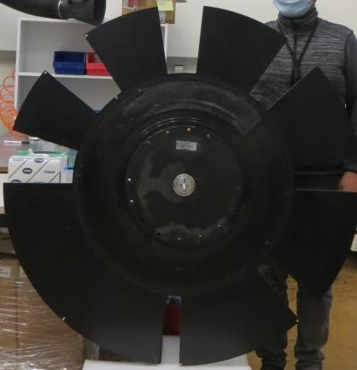
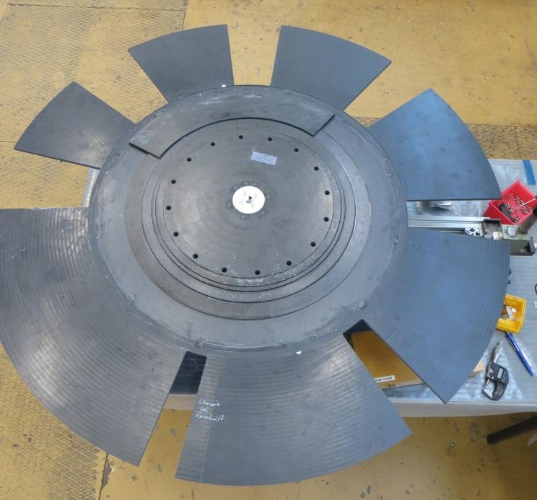
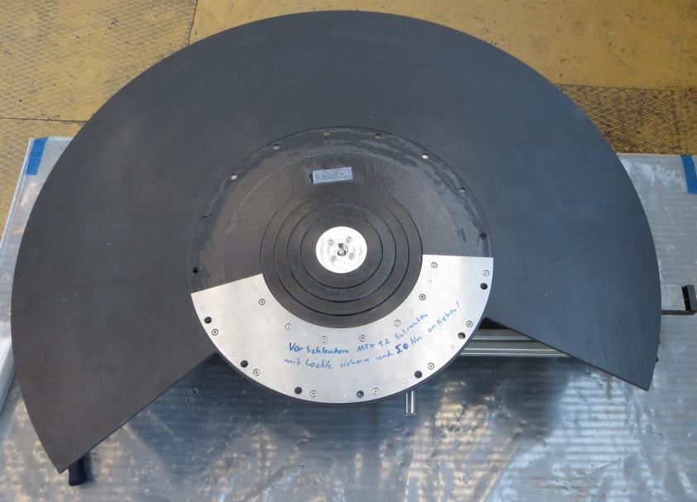
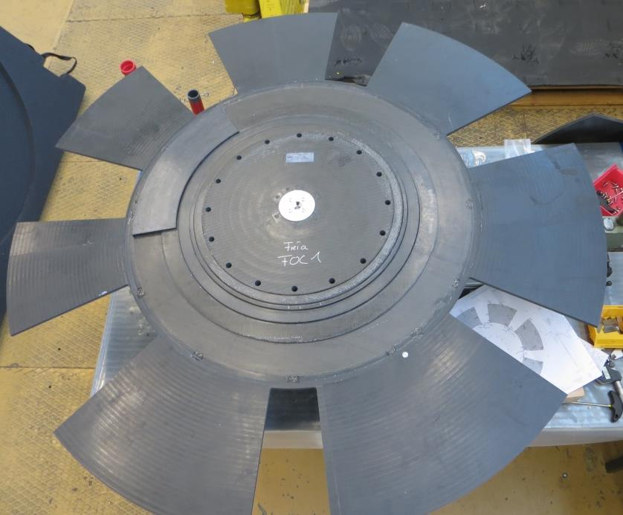
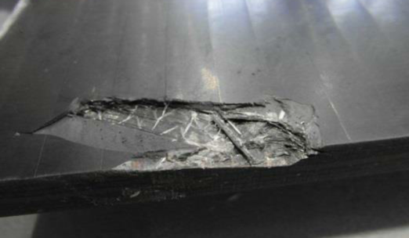
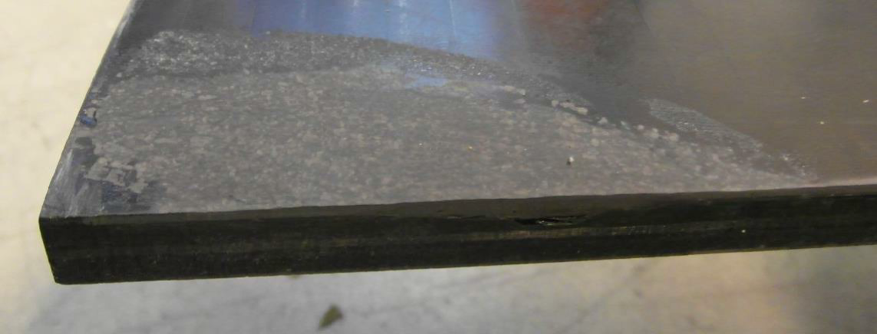
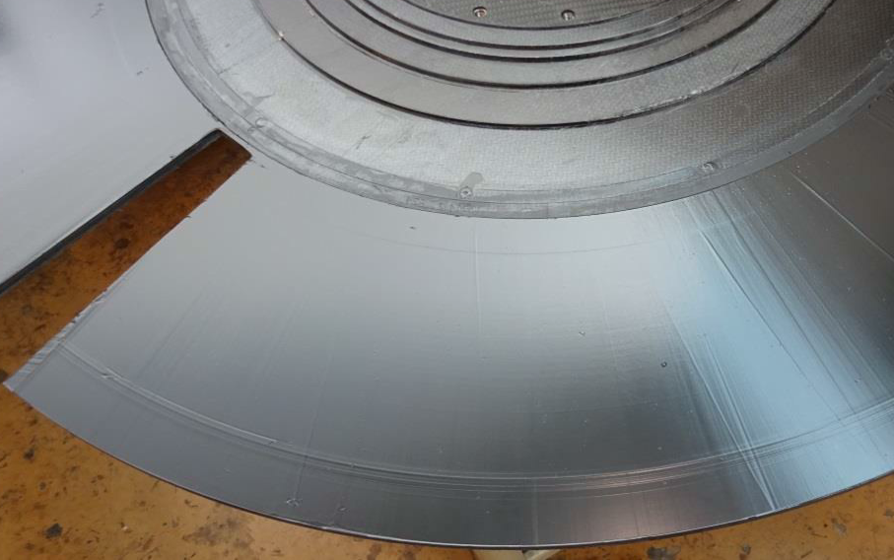
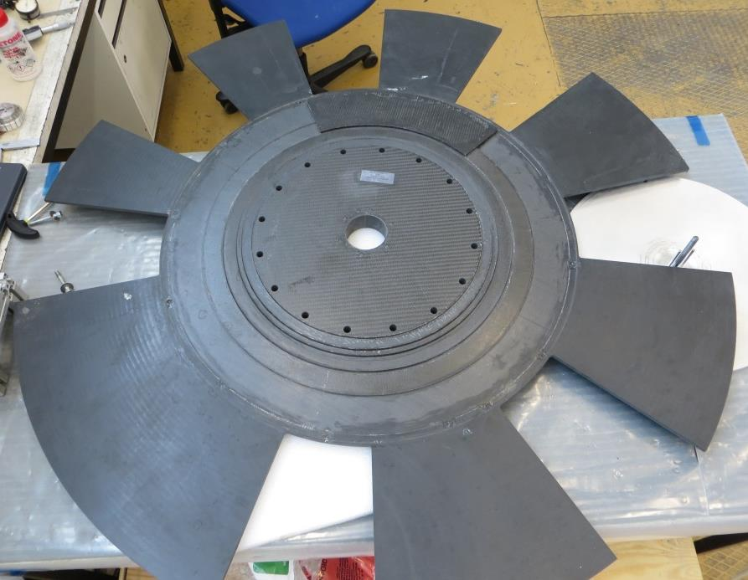
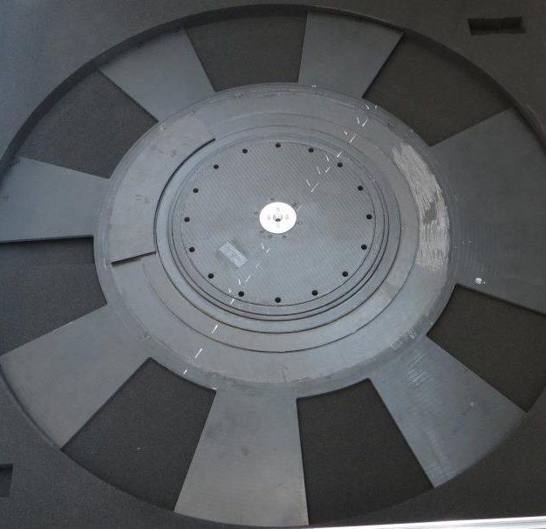
Chopper Discs (ADSF)
Ready for shipping (x4)
Rework underway (x2)
WFM1 – additional coating applied
FOC3 – accidental damage repaired
Delivery to RAL expected Q2
WFM1
WFM2 ✔
FOC3 Damage
Repair
WFM1 Post-coating
WBC2 ✔
FOC1 ✔
FOC2 ✔
FOC3

Slide 9
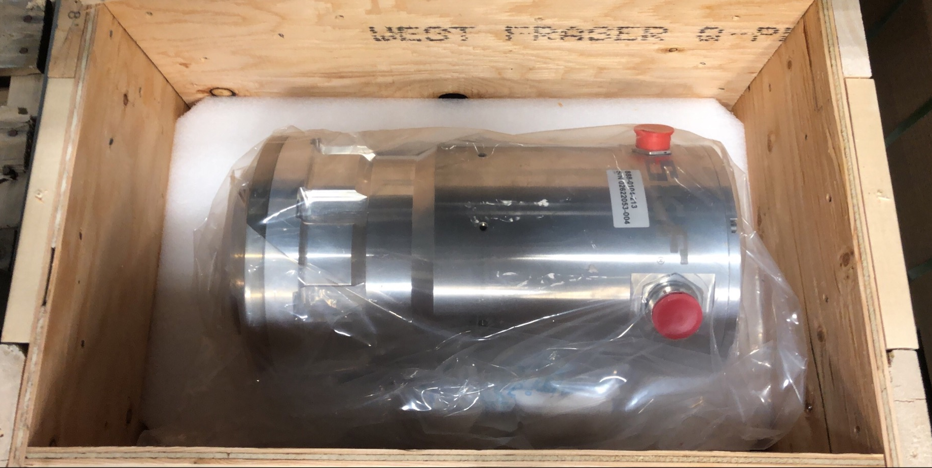
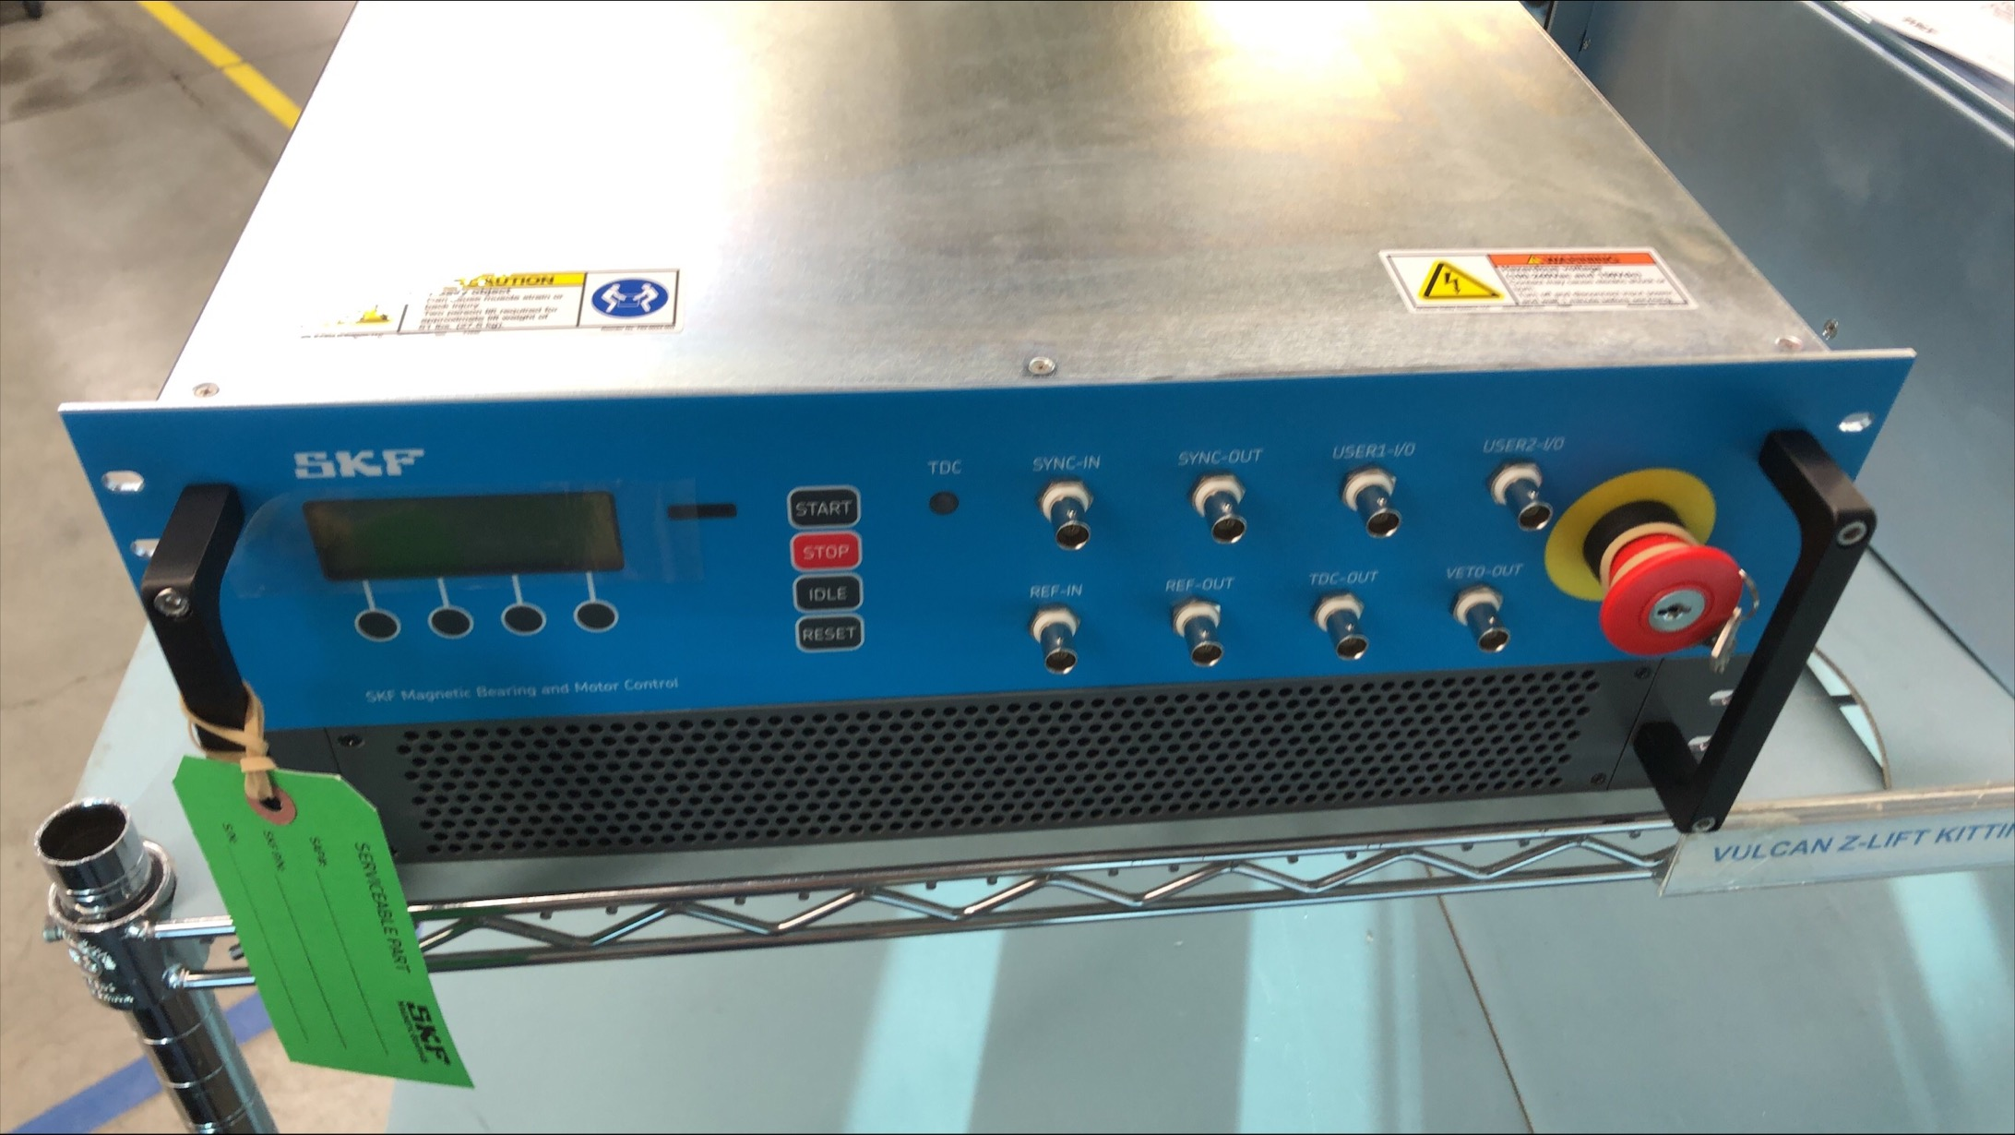
Chopper Spindles & Controllers
Ordered from SKF in July 2020, with delivery prioritised according to ESS’ schedule. Delayed substantially due to supplier overload and Covid.
Deliveries delayed:
2 sets due Nov ‘21
3 sets due Dec ‘21
3 sets due Jan ’22
Delivery status:
4 sets ready Feb ’22 ✔
4 sets due April ’22

Slide 10
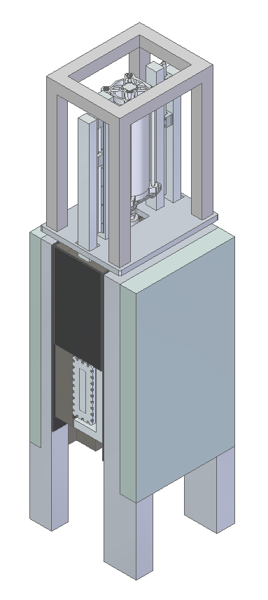
Heavy Shutter
Extraction frame
Pneumatic cylinder
Mechanical design loosely based on Loki’s heavy shutter, with substantially more mass in the beam dump necessary to sufficiently attenuate the beam.
Various materials evaluated for performance and activation – Copper, Tungsten and Molybdenum.
Met with ESS in September to discuss material selection. Concluded that the presented materials fulfil ESS’ requirements for shutter performance and activation – final material choice will be based on manufacturability & cost.
Design on hold until Q3 pending engineering resource.
Linear rails
Top plate
Fixed walls
Beam dump
Guide
Fast
Thermal
Heavy shutter concept

Slide 11
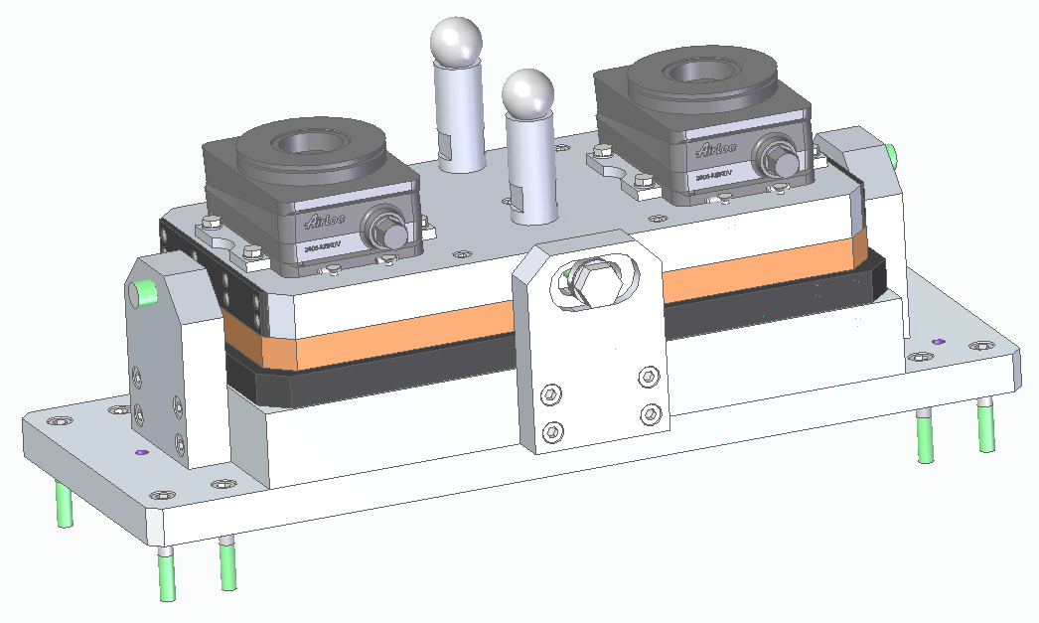
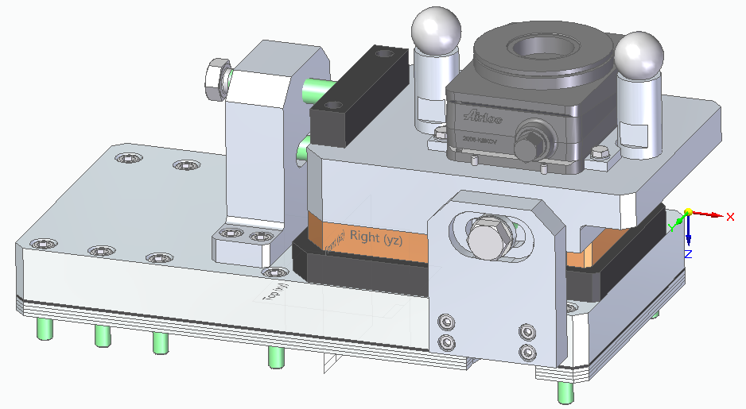
Bunker Wall Insert
Steel Shielding
Vacuum Housing (SNAG)
Guide (SNAG)
Design completed in April ’22 – under review by ESS.
Once manufactured, integration trial with the vacuum housing to be completed in 2022 Q4.
Upstream & Downstream Alignment Devices

Slide 12
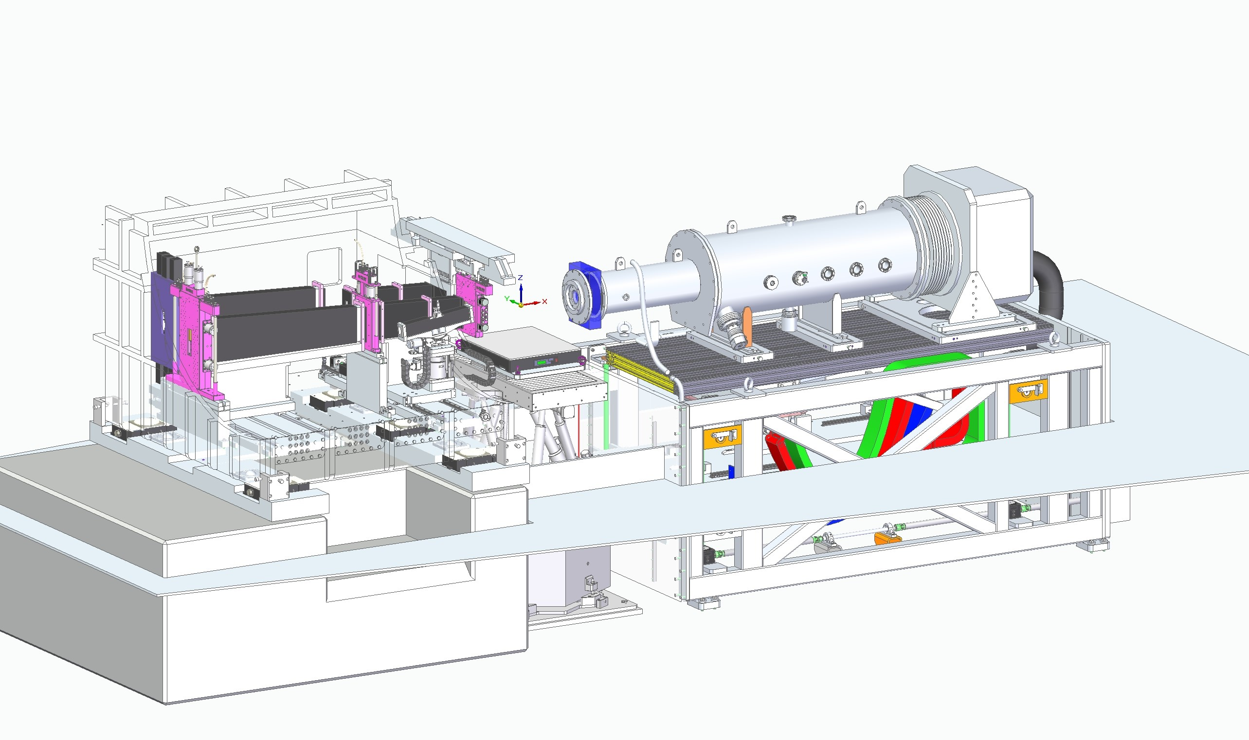
Collimation System
Slit 1
Slit 2
Slit 3
Sample Position
Collimation Guides
Contract awarded to SNAG
Kinetics Slits
Design underway
BEAM
Fast Shutters (Uppsala)
Beamline tests to be performed at ISIS
Vacuum Vessel
Tender complete, award TBC

Slide 13
Collimation Modes
Standard mode
Inverted mode
Kinetics mode

Slide 14
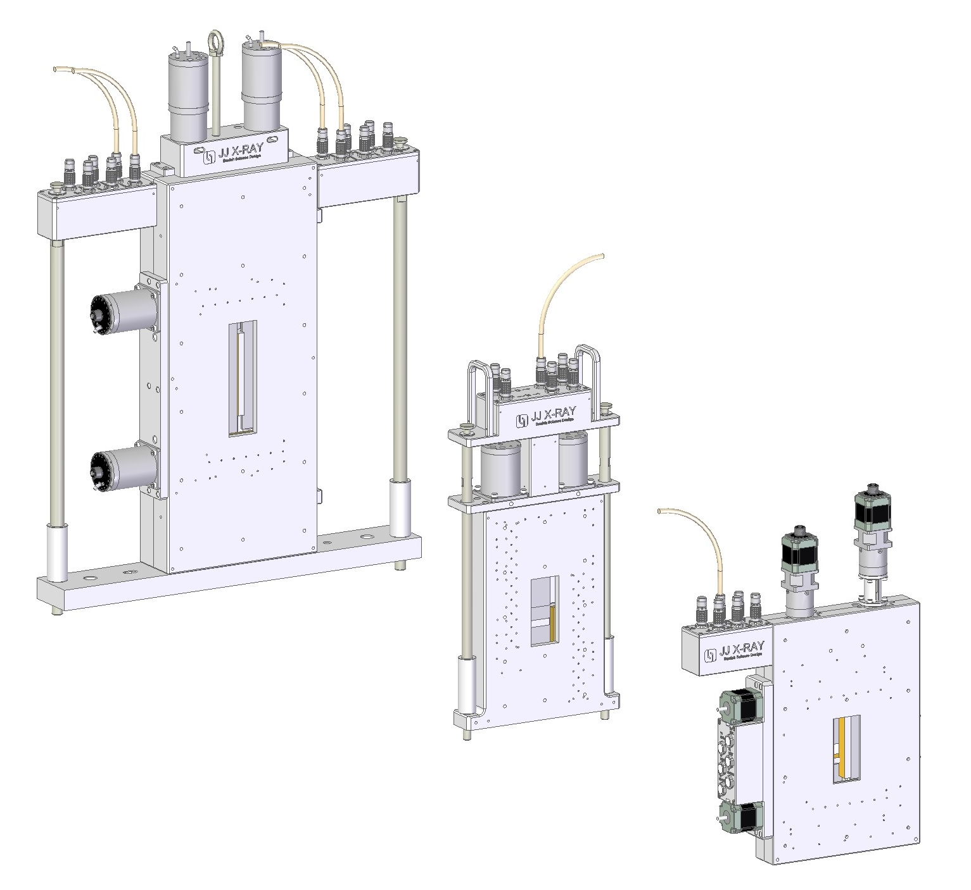
Slits (JJ X-ray)
Design completed in April ’22 – under review by ESS
Slit 1: YZ, in vacuum
Slit 2: Z, in vacuum
Slit 3: YZ, in air
Slit 1
Slit 2
Slit 3

Slide 15
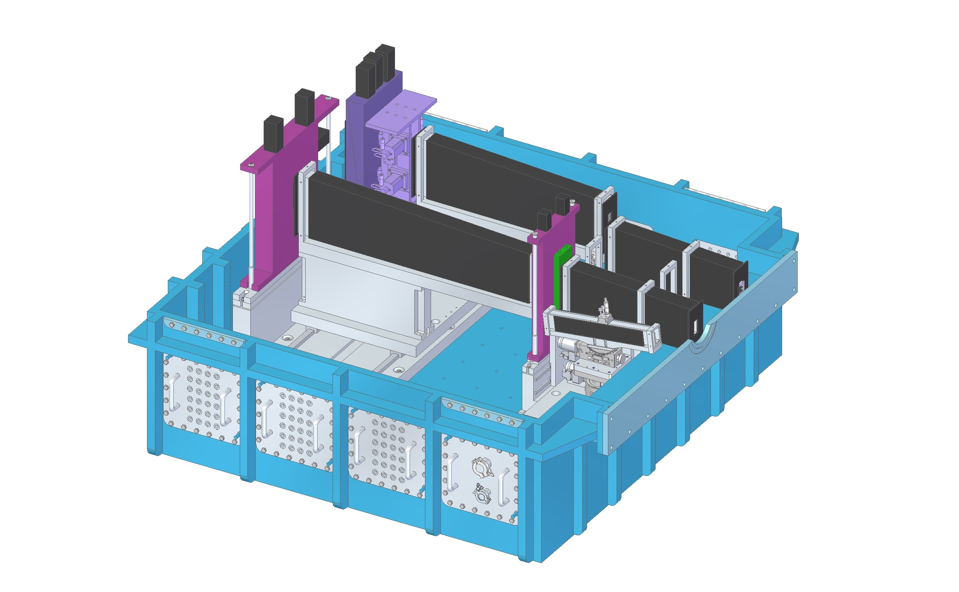
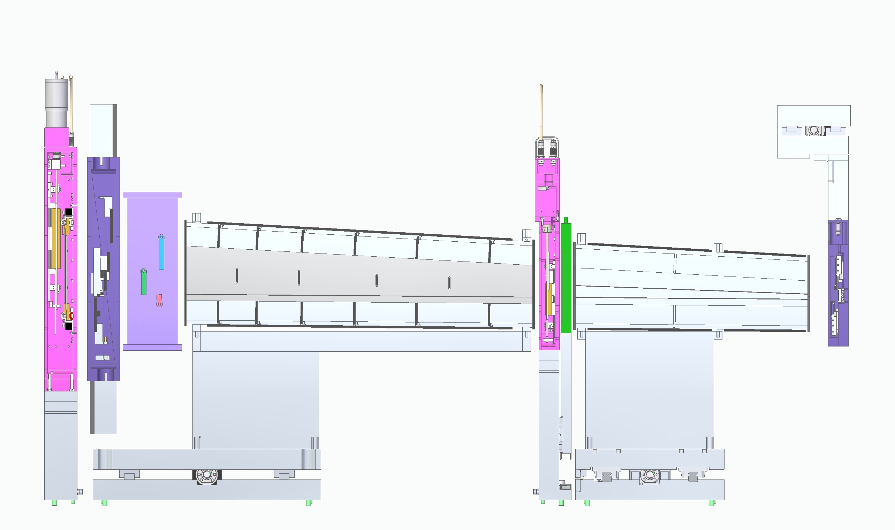
Collimation Guides
Reflectometry and Inverting guides ordered from SNAG – partitioned guides to be included in upgrade scope for ⁓30% flux increase.
Reflectometry
Guide 1
Partitioned Guide 1
Partitioned Guide 2
Reflectometry
Guide 2
Inverting Guide

Slide 16
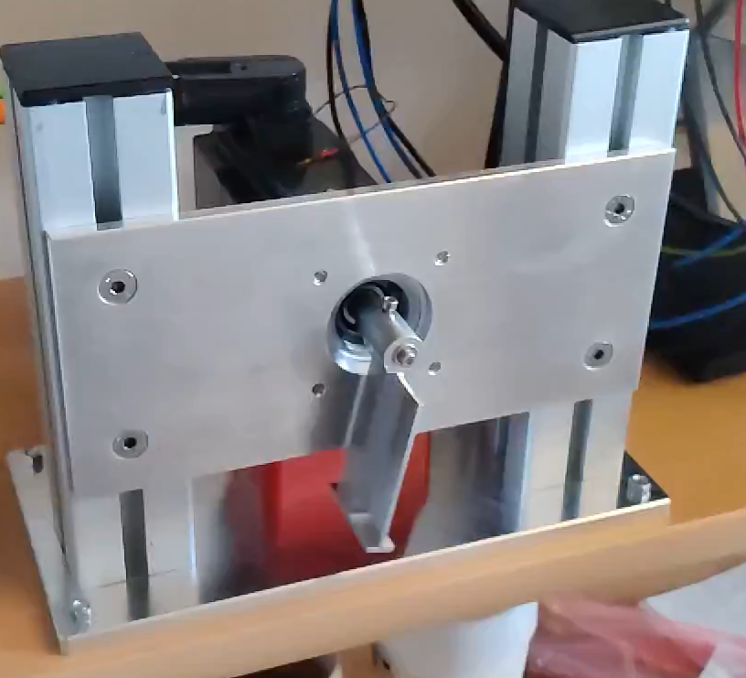
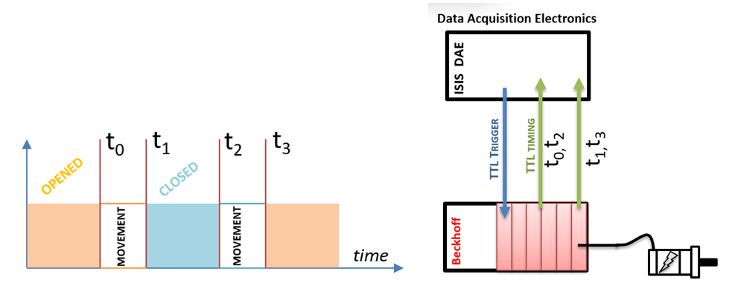
Fast Shutters
Slow-motion video
“Flipper” shutter prototype tested in vacuum at Uppsala University.
Offline timing tests to be carried out at ISIS in April, with beamline tests later in ‘22.
Initial vacuum tests show that servo motor operation in vacuum is feasible.

Slide 17
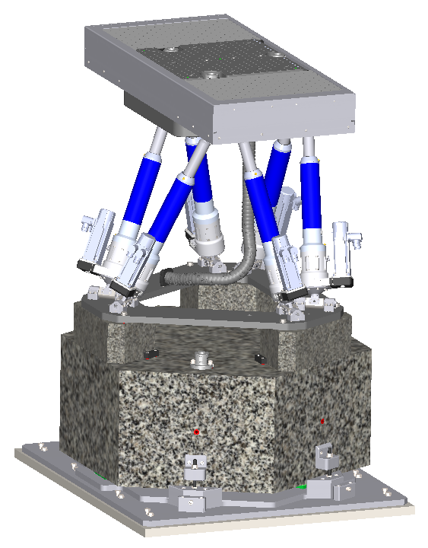
Sample Positioning System (Symetrie)
Design completed in April ’22 – under review by ESS
Hexapod system with integrated Y-translation stage for sample changing.
Protective bellows and gaskets to mitigate against spillages.
Provides mounting for standard interfaces
L2 – typical use case
L0 – rare use, no motion
L2
L0
SPS Hexapod

Slide 18
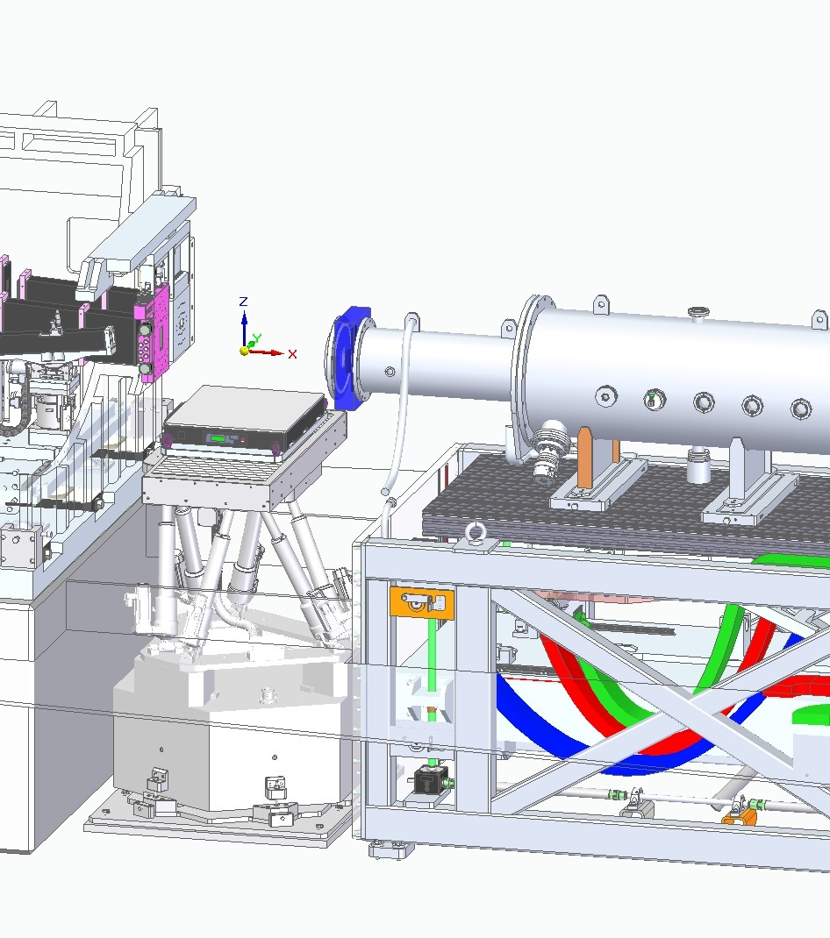
SPS Vibration Isolation
Active Vibration Isolation Table
Active vibration isolation table to be installed on top of the SPS for horizontal (free-liquid) samples.
Active VI platforms are incompatible with inclined samples, and must be locked or removed before tilting.
Passive VI pads installed beneath the SPS are unlikely to be effective below 60Hz, and may be detrimental.
Plan to test SPS frequency response (impact hammer test) with & without vibration isolation pads to determine best performance for the installed system.
Passive Vibration Isolation Pads

Slide 19
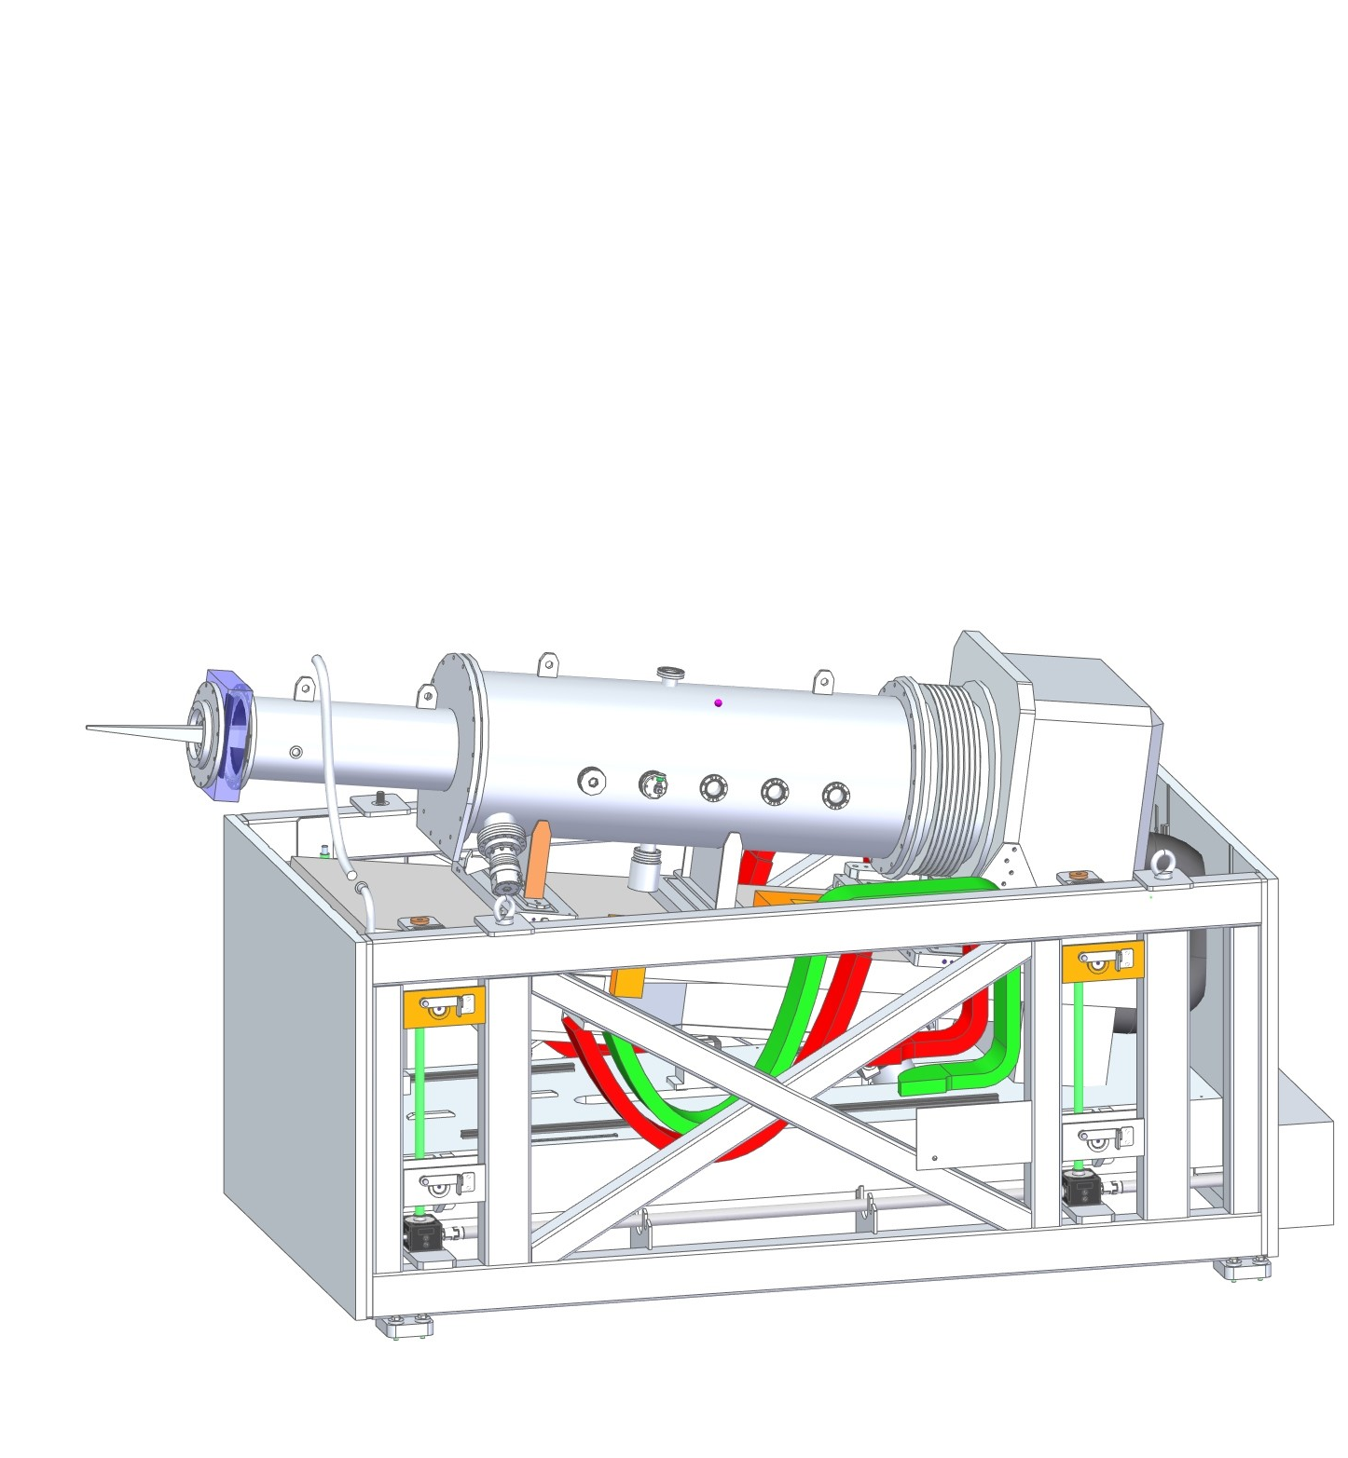
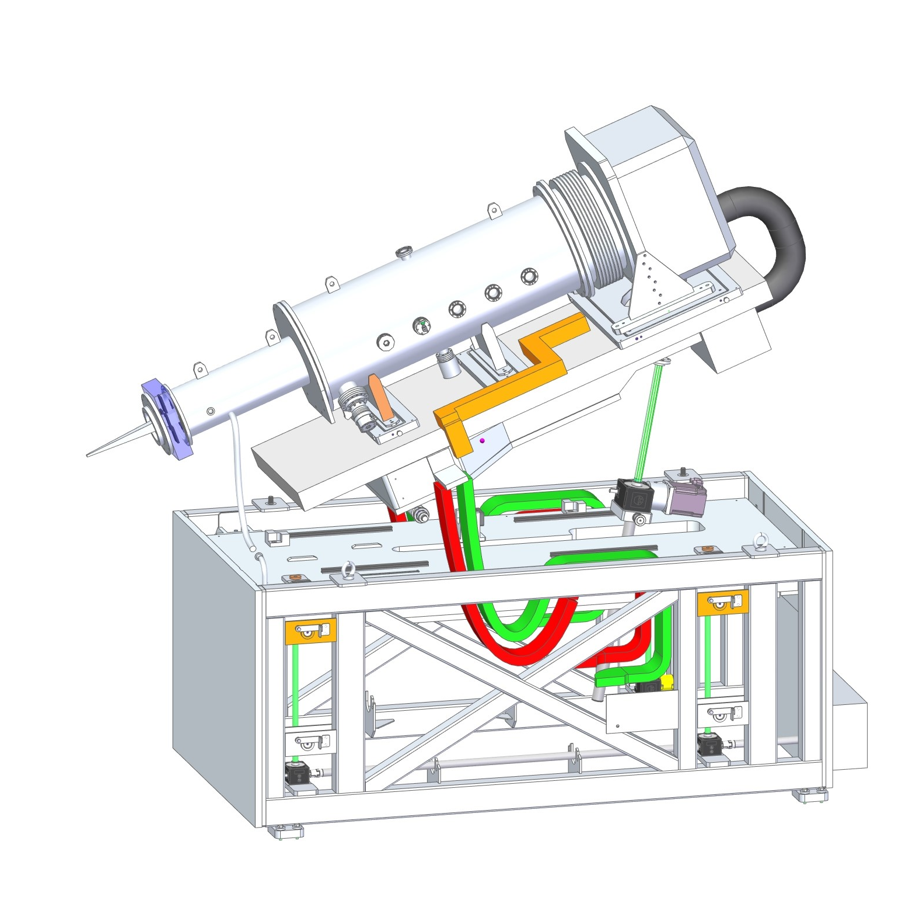
Detector Bench
FEA of design outsourced – stresses and deflections well within limits.
Natural frequencies low, implemented changes to stiffen frame and tables by adding cross braces and changing bolted structures to solid machined.
Design of cable management ongoing.
-7.5°
+21°

Slide 20
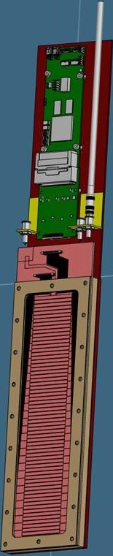
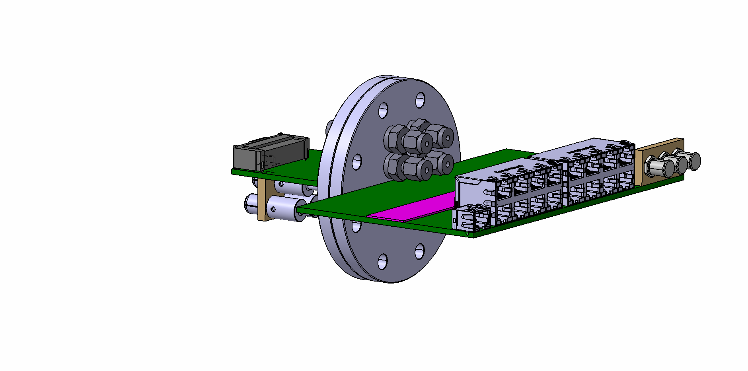
Beam Monitors (ESS)
BM2
BM1
6x GEM monitors delivered by ESS Beam Monitors Common Project, designed by Milano-Biccoca.
Segmented GEM foil used to cope with the very high count rates expected at full power.
Concept design to be adapted for in vacuum monitors (BM4 & BM5), using proven PCB based vacuum feedthrough technology.
In bunker monitors locations
on Module 2
Concept
Design
PCB based vacuum feedthrough

Slide 21
Challenges
Collimation Vessel Tender
First tender failed → budget revised
Lack of competition → engaged new suppliers
Second tender complete, award TBC
Resourcing challenges ongoing
Lost several key members of the instrument team
Recruitment ongoing + increased reliance on external contractors
Supply chain delays
Long lead components ordered with significant float
SKF components +3-4 months
¹⁰B₄C (for choppers) +4 months

Slide 22
Schedule
Today
TG3.1 ✔
TG3.2
TG3.3
TG3.4
TG3.5
TG3.6
2019
2020
2021
2022
2023
2024
2025
Choppers
Neutron Guide
Bunker Zone Shutters & Feedthrough
Shielding and Structures
Cave Internals
Services
Pre-build/commission
Shipping
Installation at ESS

Slide 23
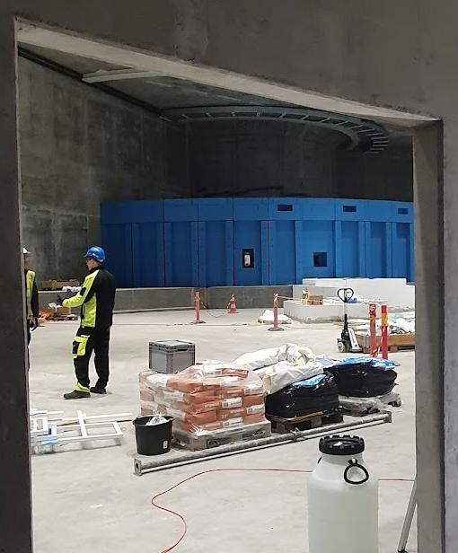
Thank you Questions?

