Slide 1

Multi-Blade detector status
Francesco Piscitelli
2022/05/03

Slide 2
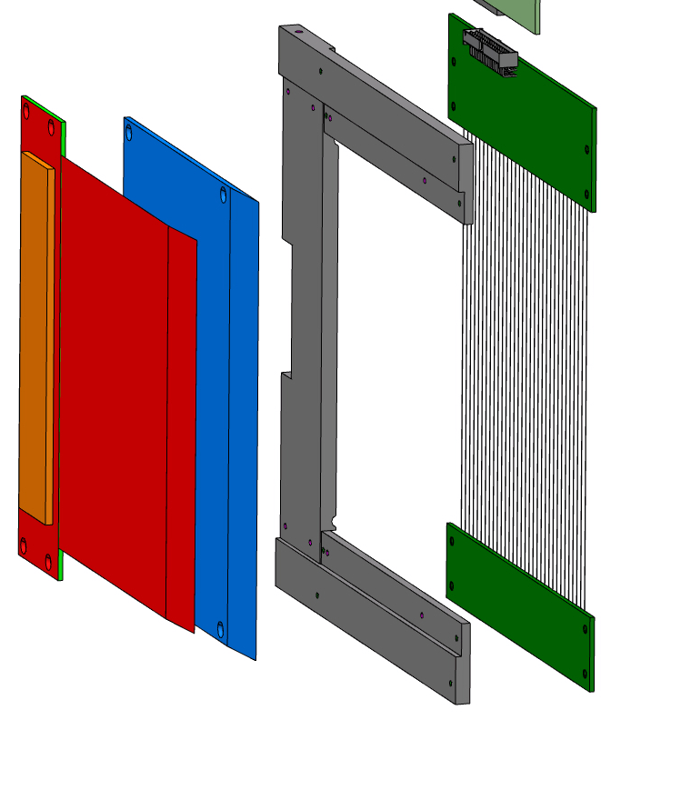
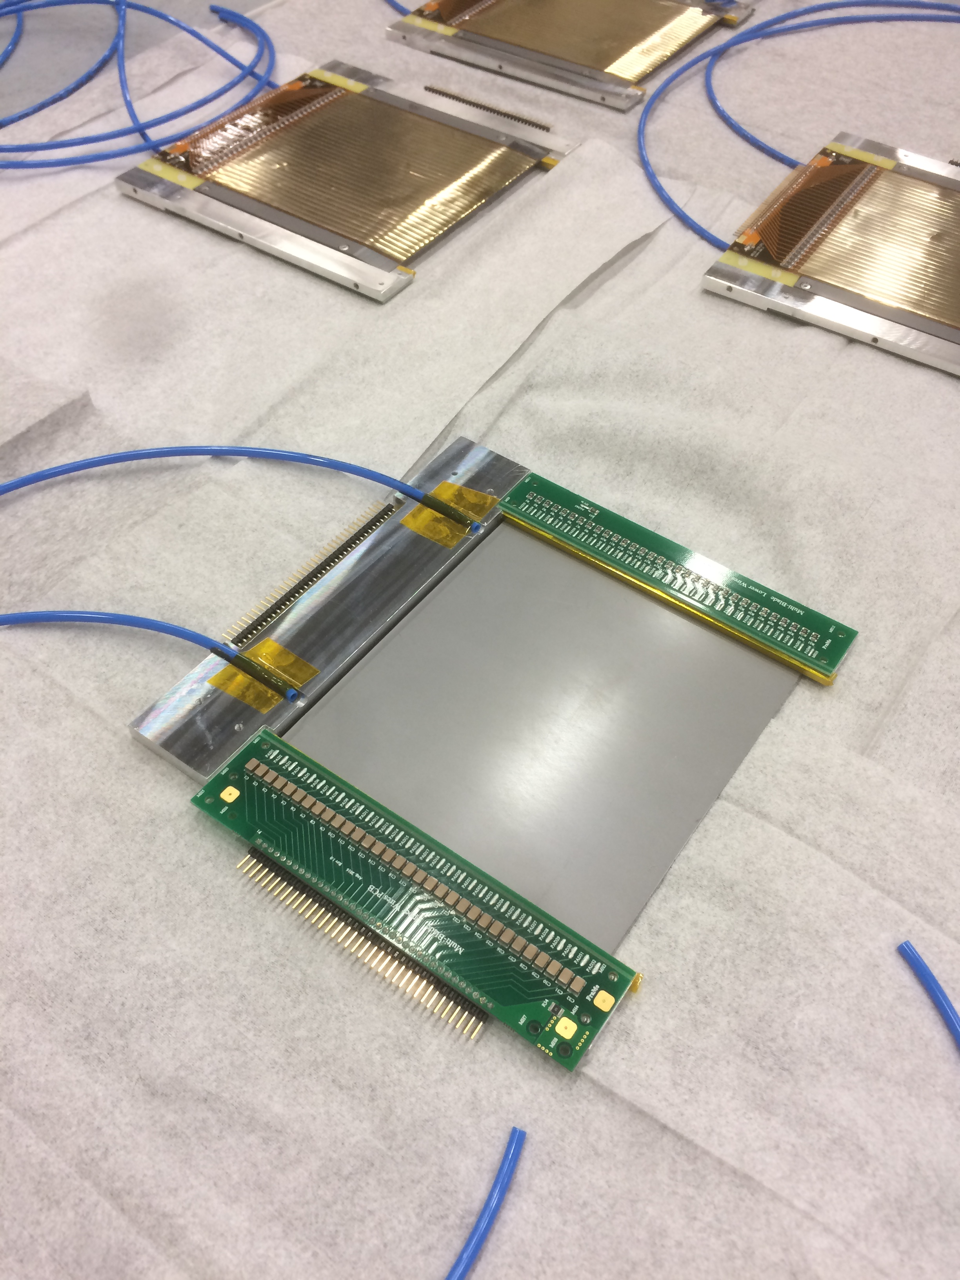
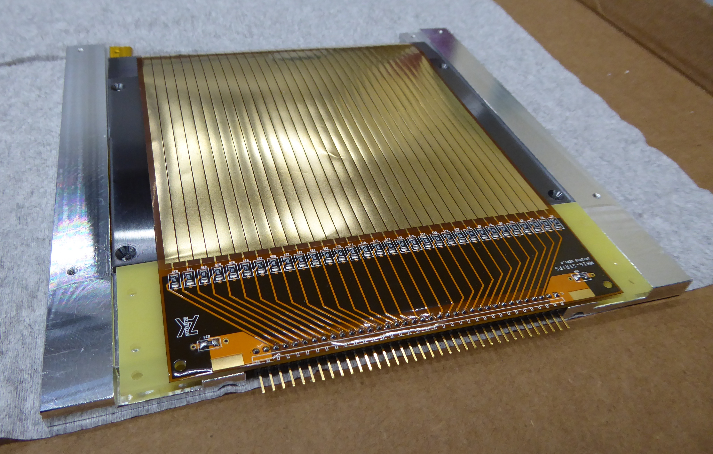
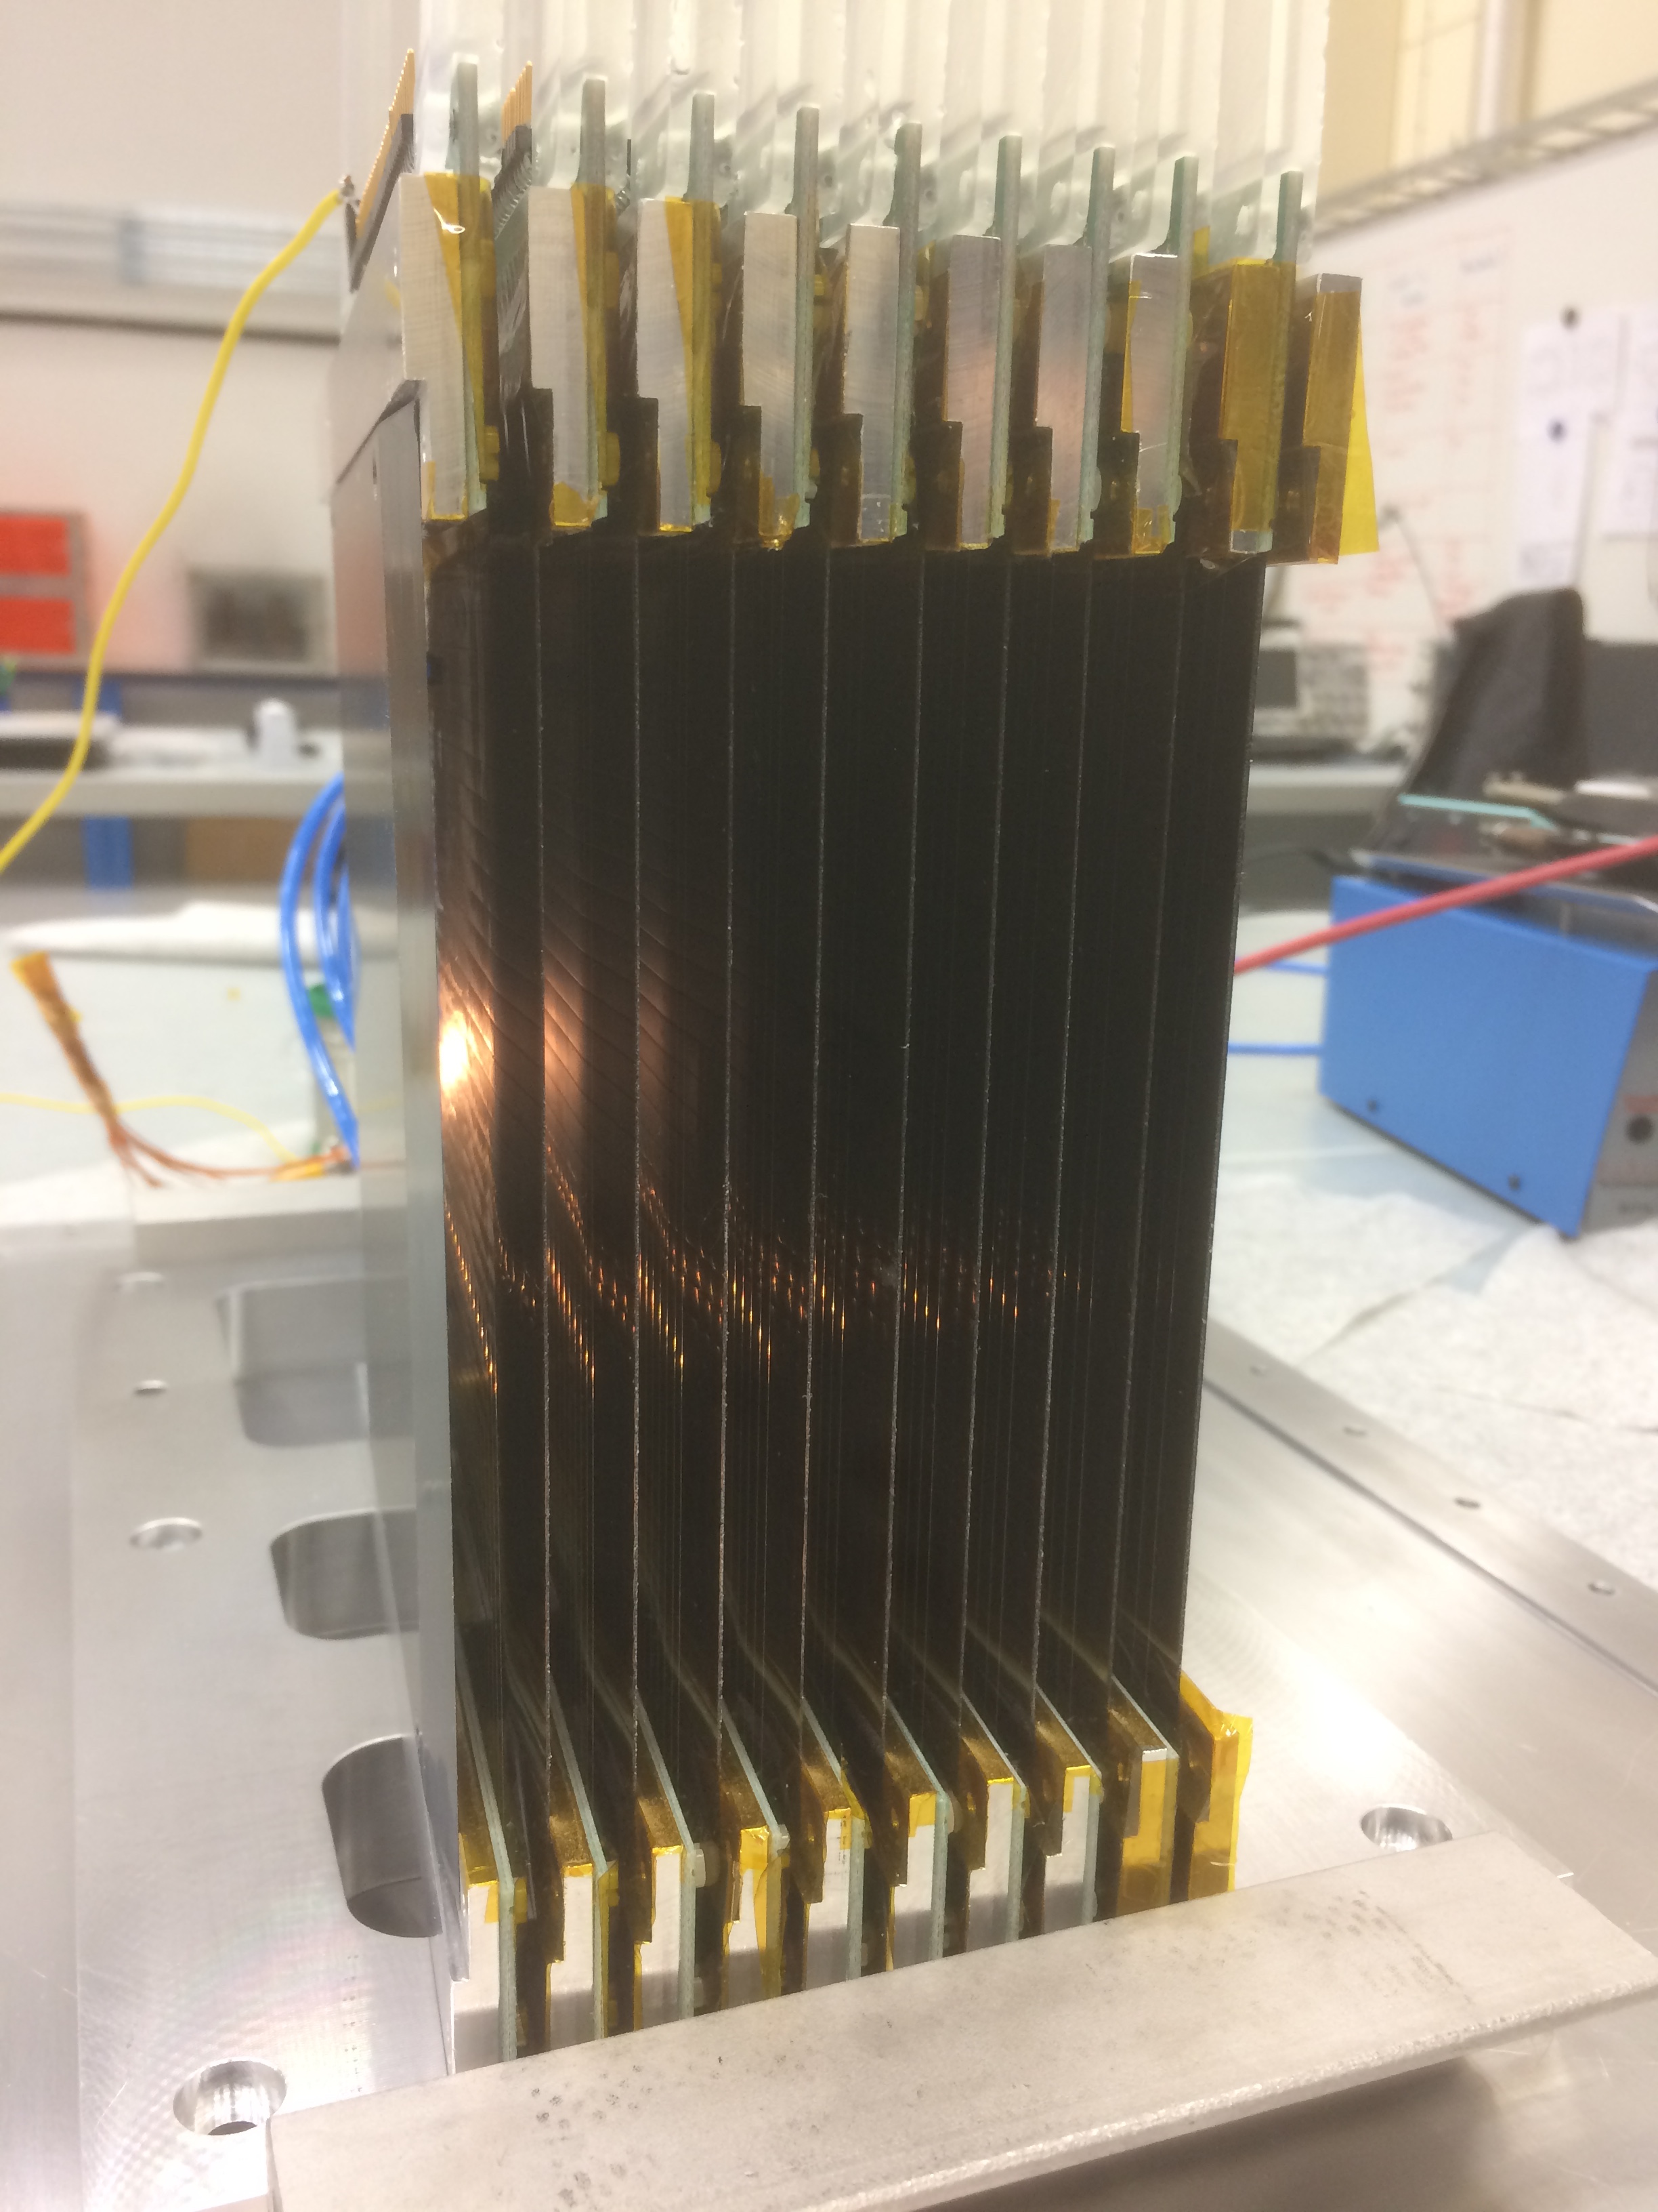
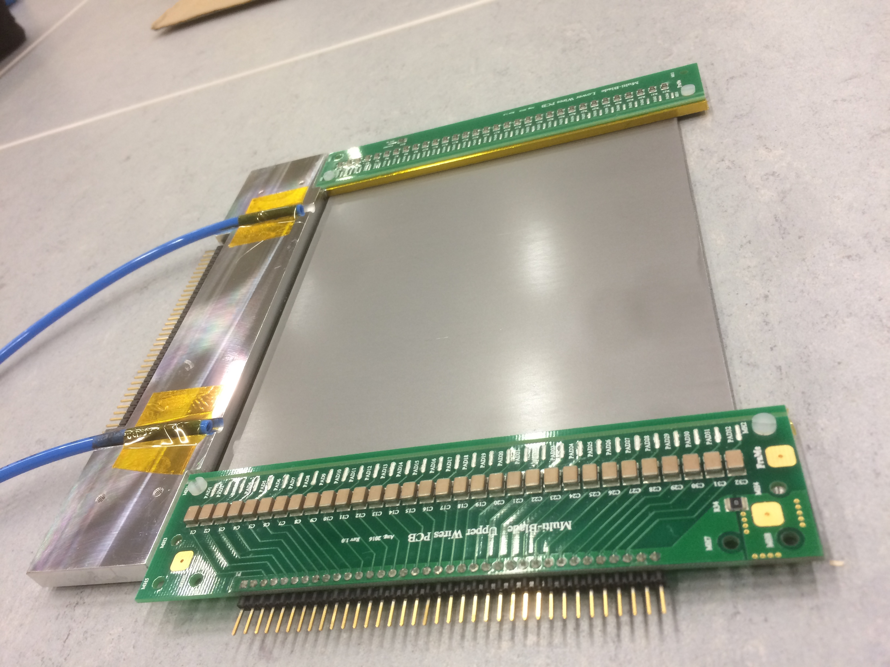

Detector Principle
wires X
¹⁰B₄C substrate
Ti substrate
¹⁰B₄C
holding frame
neutrons
strips Y
cathode strips
anode wires
θ
A unit
A unit
θ = 5 degrees
Unit
back
32 Wires
MWPC
130mm
Unit
front
neutrons
100mm
neutrons
Multi-Blade
sample

Slide 3
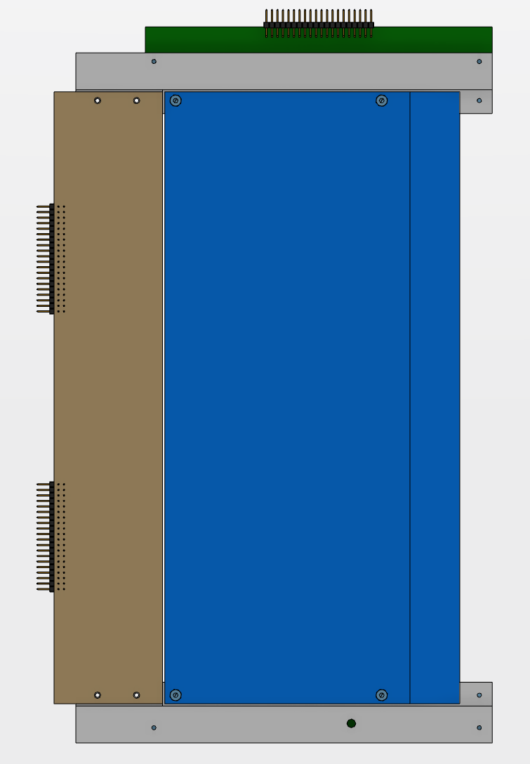
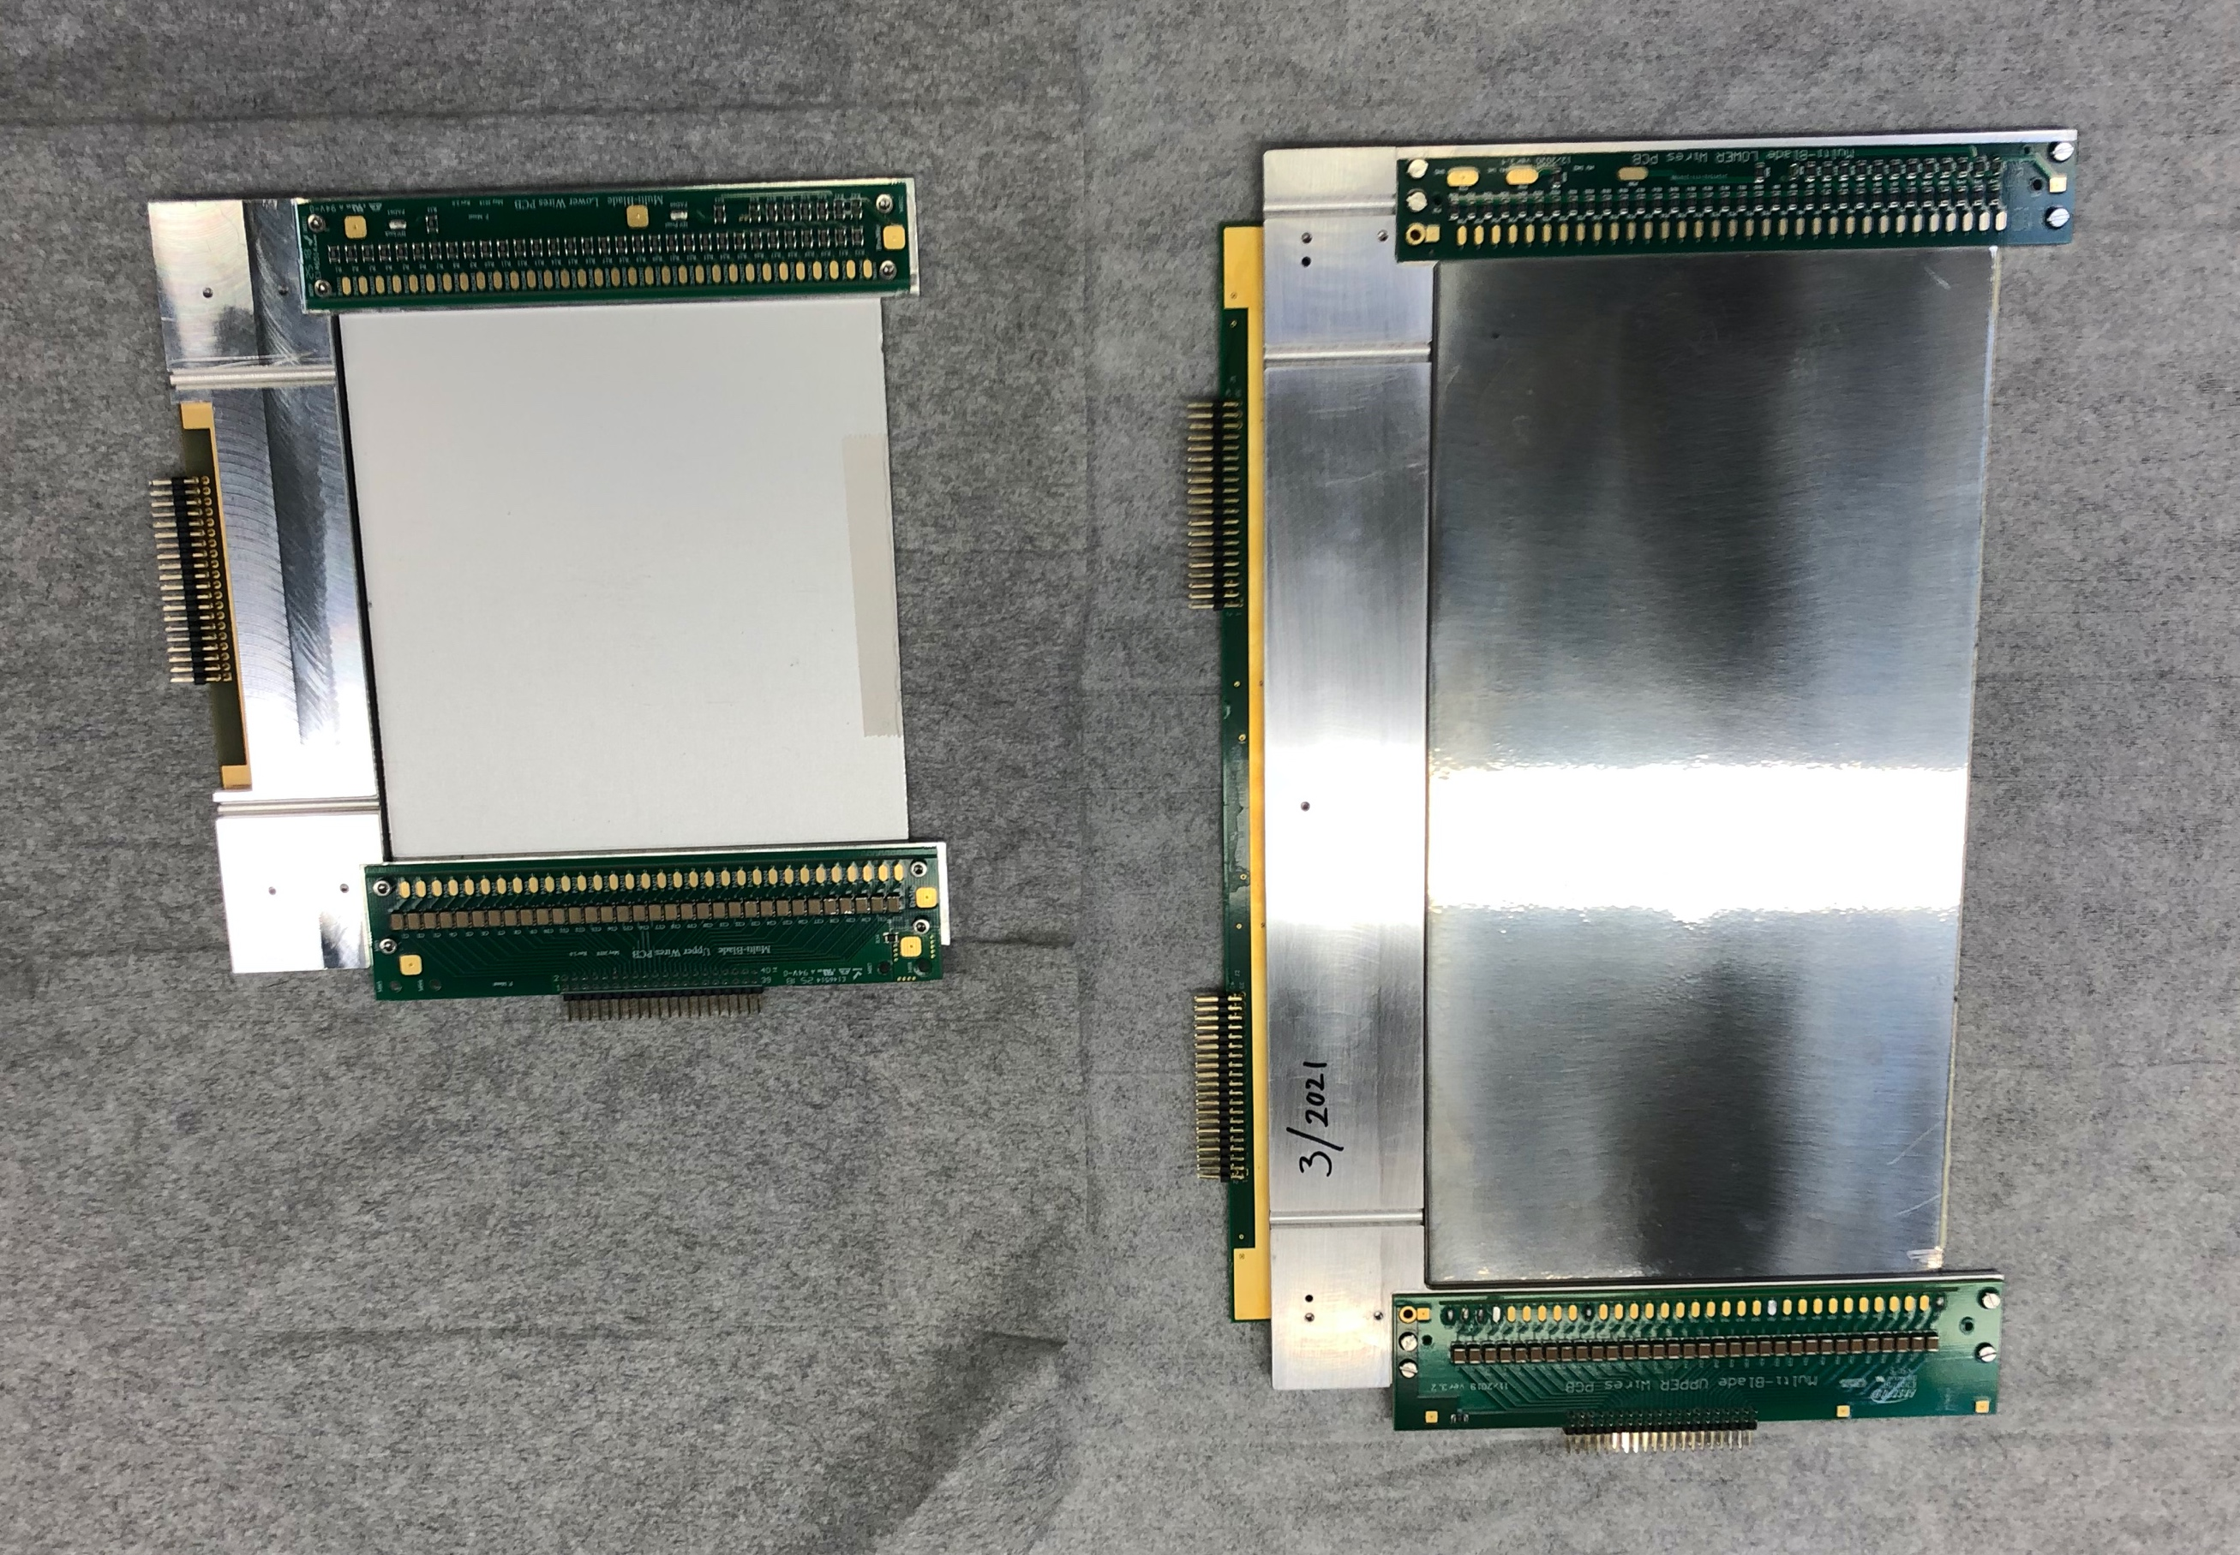
Multi-Blade
AMOR 14 units
Estia 48 units
FREIA 32 units
ALL IDENTICAL
Final unit
prototypes
130mm
260mm

Slide 4
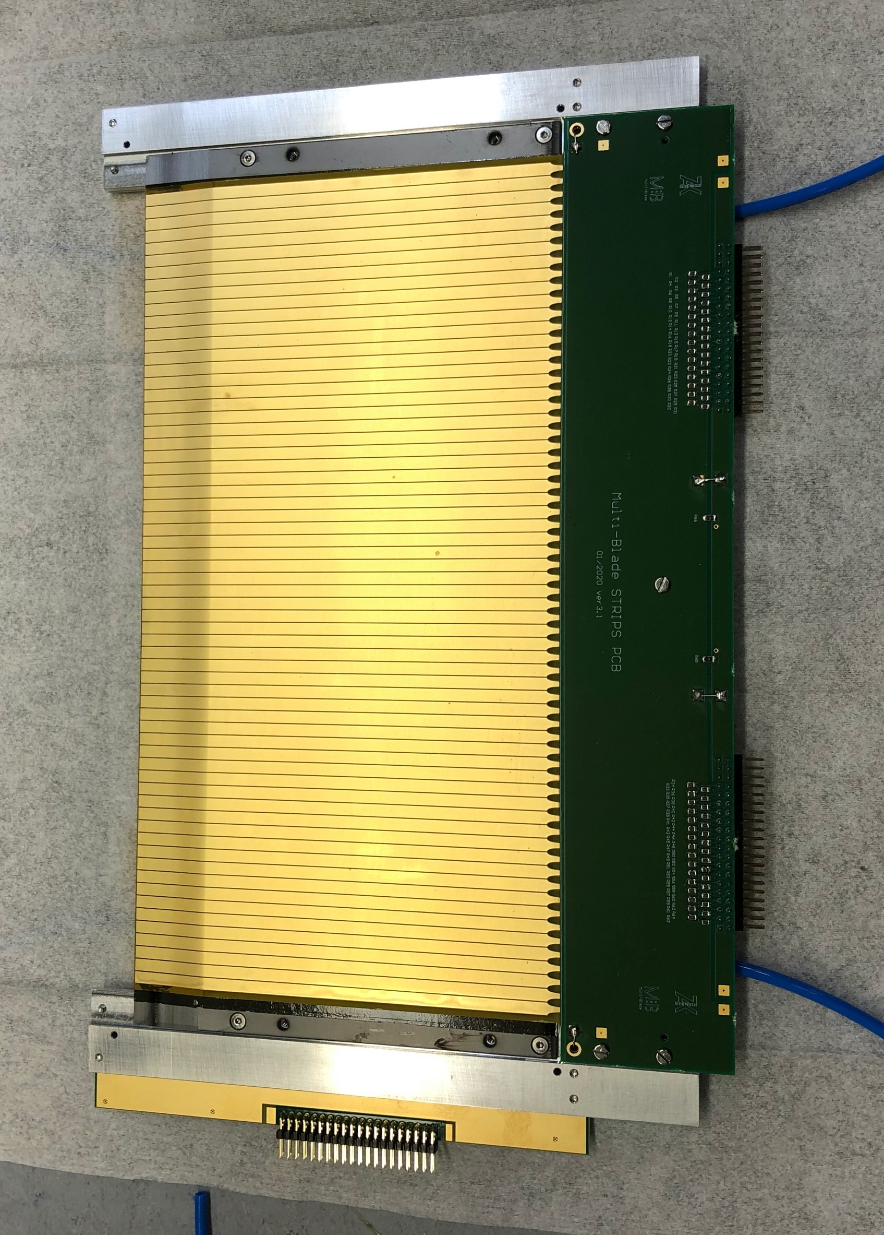
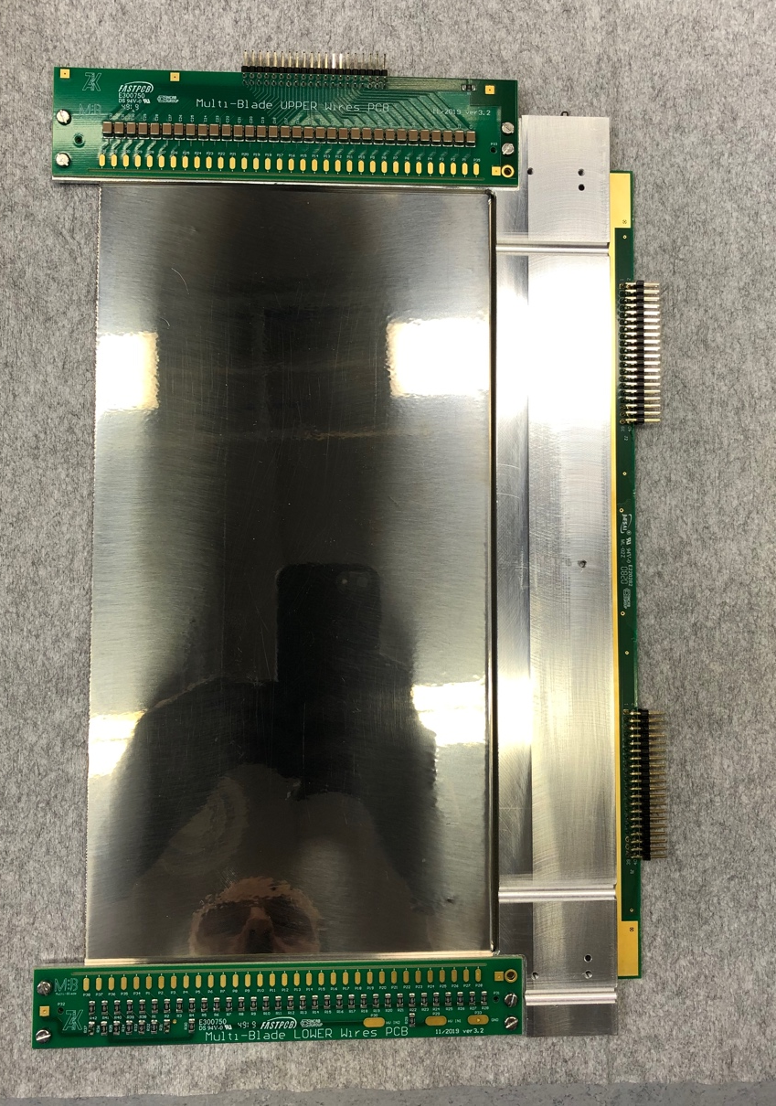

Final unit
Ti blade coated with 10B4C
cathode strips
anode wires
U-frame
260mm
FRONT
BACK

Slide 5
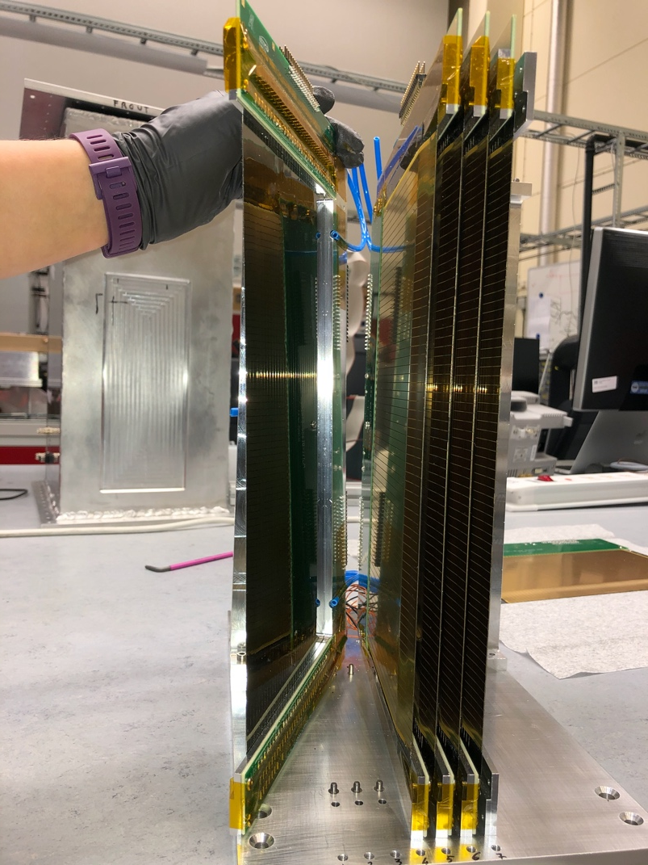
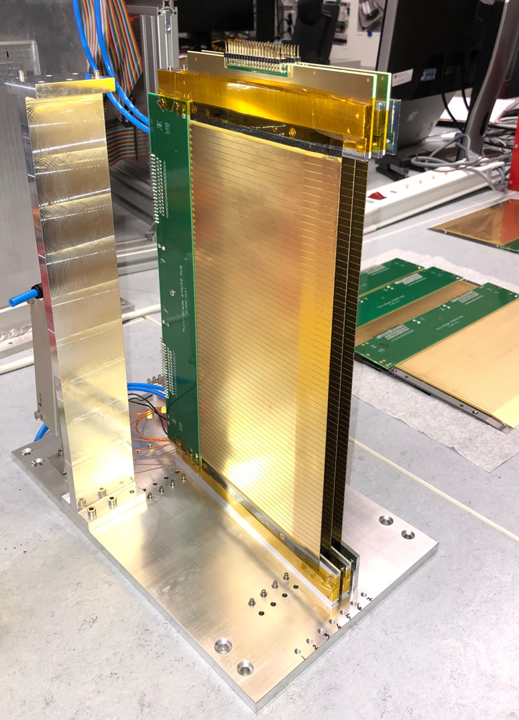
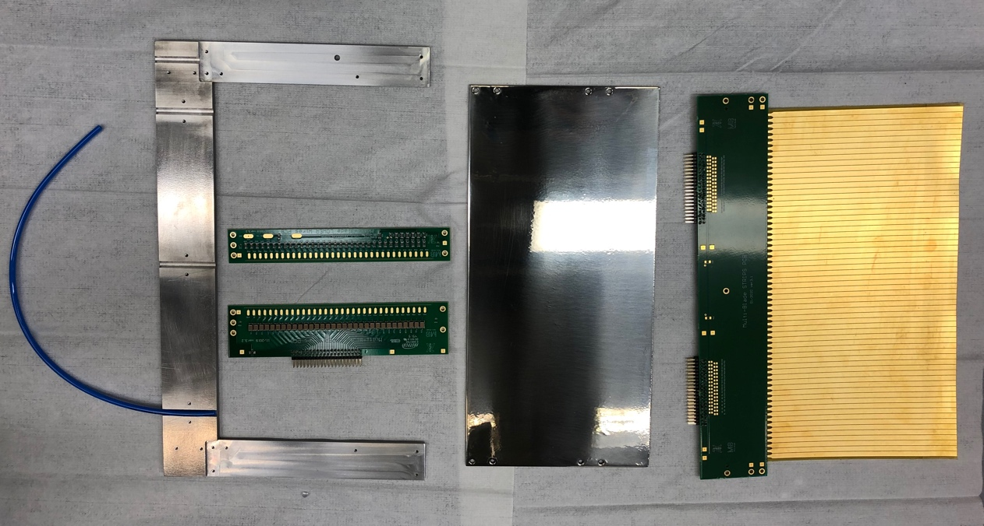
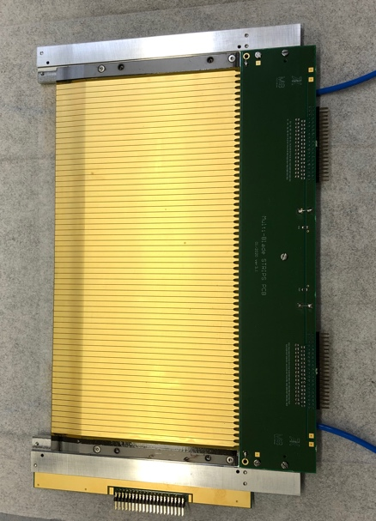
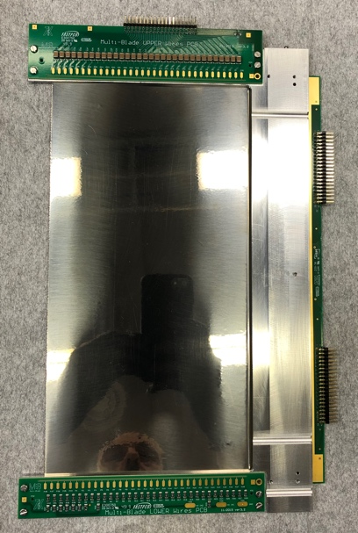
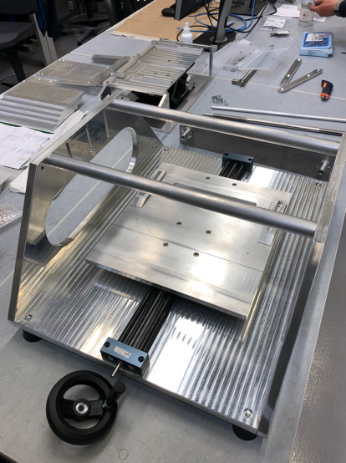
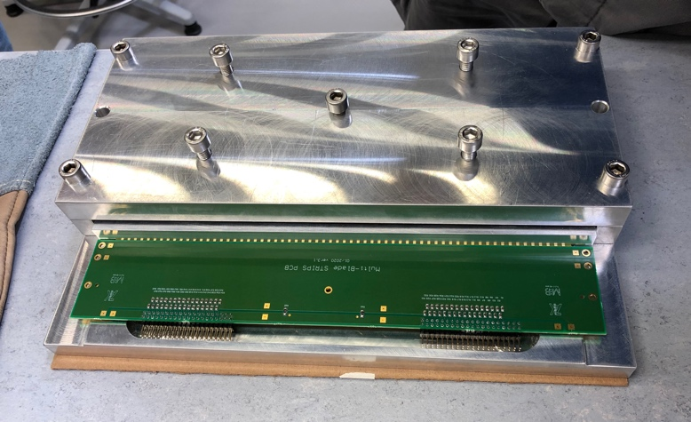
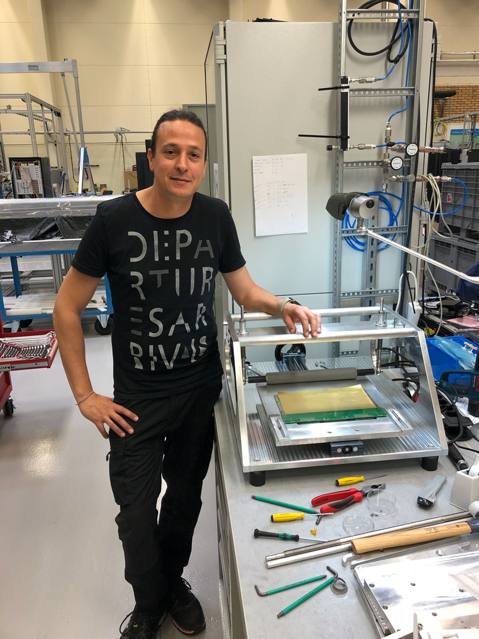
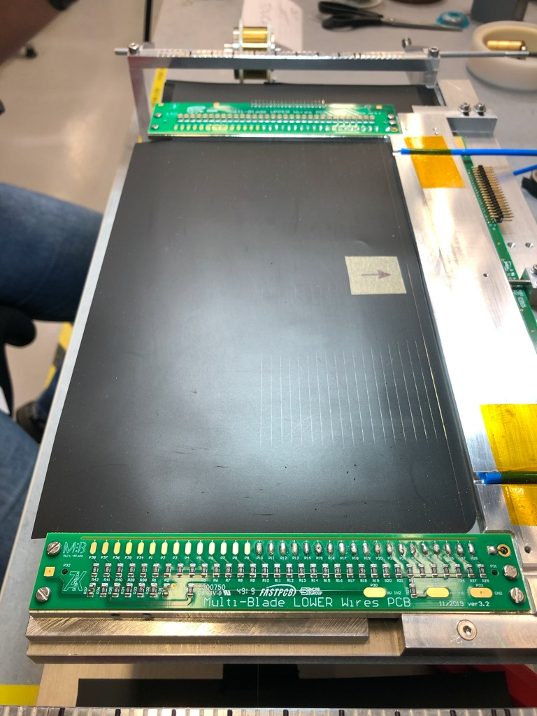
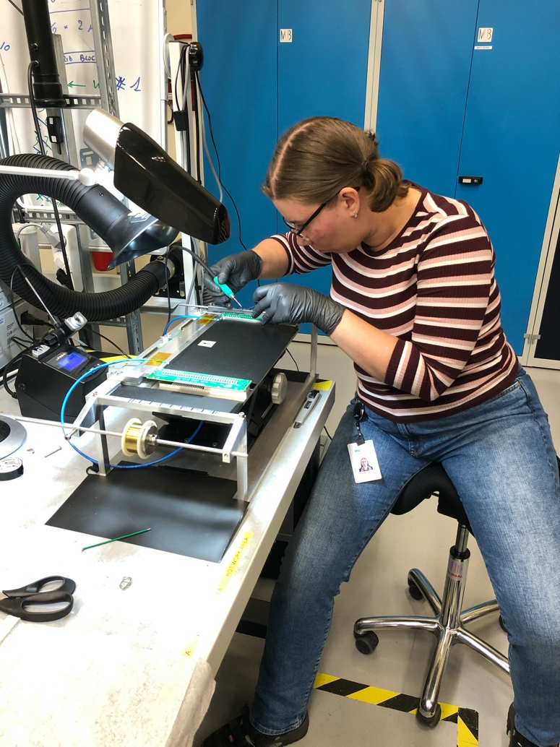
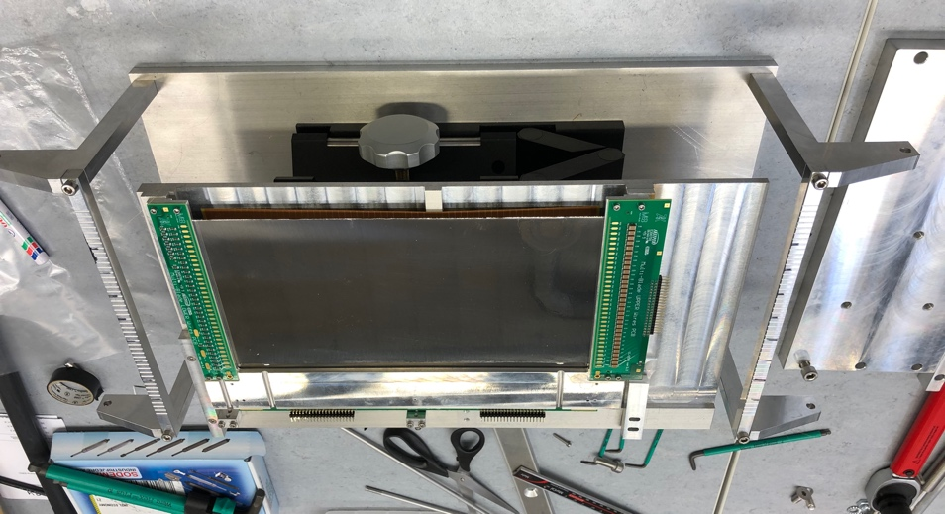
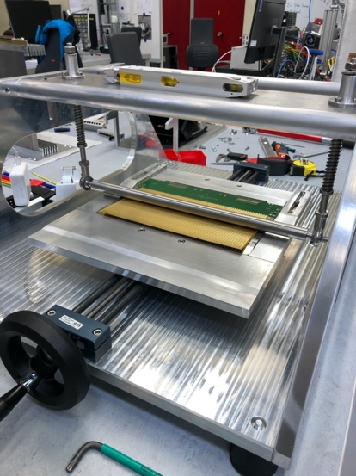
Multi-Blade: TOOLING is complete and tested on MB300L
parts
A unit
cathode strips
Gluing machine KV-1
Oven clamp
6-unit detector
Wiring machine K-7

Slide 6
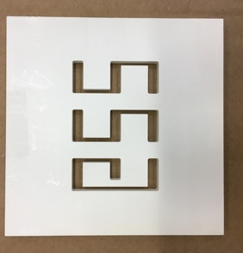
We built many prototypes that proved that MultiBlade is ready for science at the ESS. Until now, we have been using the electronics by CAEN, but on the ESS instruments, we will use the VMM because of number of channels.
Estia -> 4600ch
FREIA -> 3000ch
AMOR -> 1300ch
Efficiency
measured
calculated
Cassette shadowing
due to overlap
(not a dead area)
Shadows removed

Slide 7
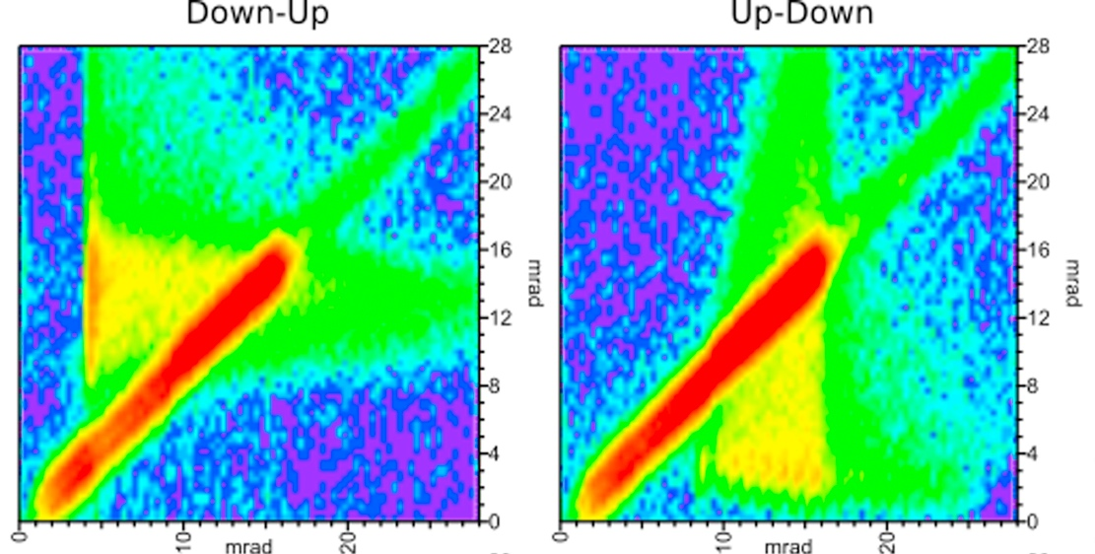

Neutron reflectometry measurements, scientific measurements (CRISP @ ISIS)
λ₁
detector
Ir sample: Dependance of the q-resolution on detector spatial resolution
λ₂
λ₃
sample
$$q= \frac{4π}{\text{l}}\sin{θ}$$
θ
θ
conventional 0D detector
2mm resolution detector
Ir sample
Si sample
Fe/Si sample
0.5mm resolution MB detector
Si sample: Collimated vs divergent mode
Fe/Si sample: Off-specular
COLLIMATED
Sample Horizon
DIVERGENT
COLLIMATED: 120 min measurement
DIVERGENT: 14 min measurement
A. Spin-flip scattering
signal from the layers
B. Correlated roughness
domains from the layers
(from SuperADAM at ILL)
G. Mauri et al., “Neutron reflectometry with the multi-blade 10b-based detector,” PRSA: Mathematical, Physical and Engineering Sciences, vol. 474, no. 2216, 2018.

Slide 8
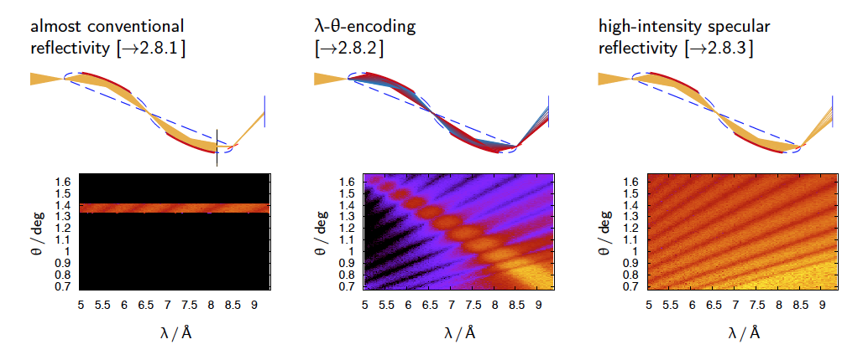
November 2018 - AMOR reflectometer @ PSI
NiTi Multilayer
Combination of 3 angles
ESTIA Selene guide and High intensity mode
Selene guide using the ReFocus principle
(θ,λ)
detector
(θ,λ)
sample
Multi-Blade
(ToF,y)
(θ,λ)
DIVERGENT
NiTi sample
(θ,λ)
θ
θ
Divergence of the beam : 1.6 degrees
Angle 1: 1.4deg
Angle 2: 2.2 deg
Angle 3: 3.2deg

Slide 9
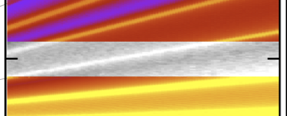
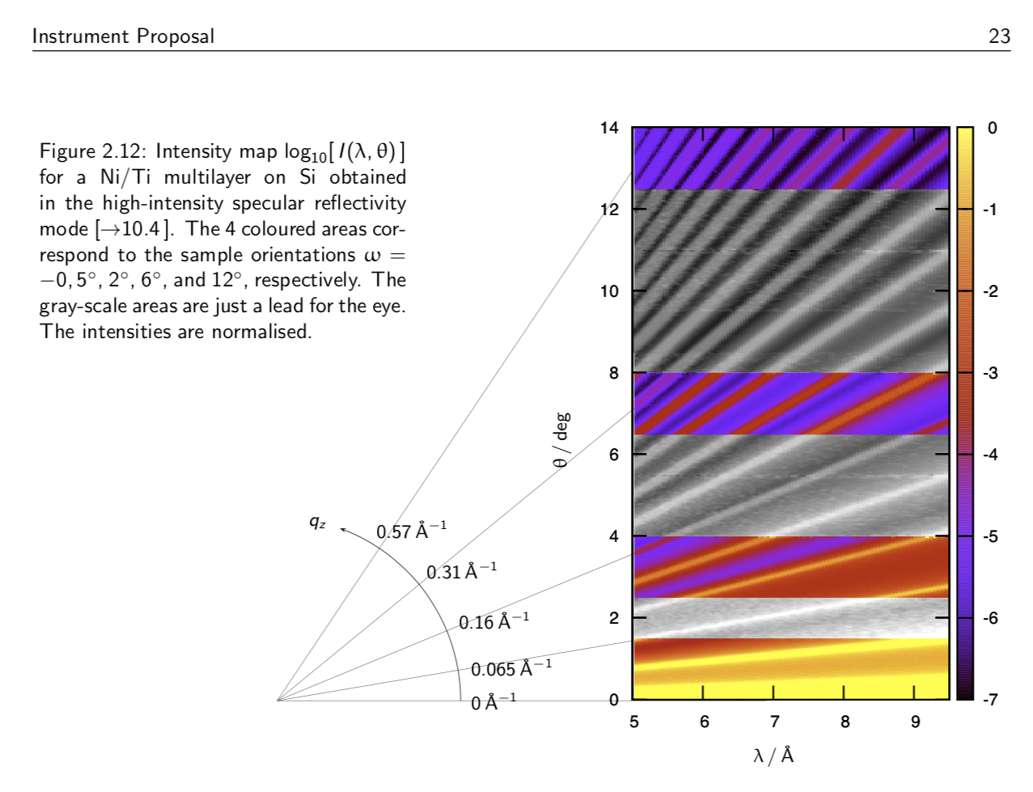
November 2018 - AMOR reflectometer @ PSI
NiTi Multilayer
Combination of 3 angles
ESTIA Selene guide and High intensity mode
5
5
(θ,λ)
4
4
ESTIA Instrument Proposal
(θ,λ)
3
3
0.065Å⁻¹
0.065Å⁻¹
2
2
1
1
Simulated
Measured
with Multi-Blade

Slide 10
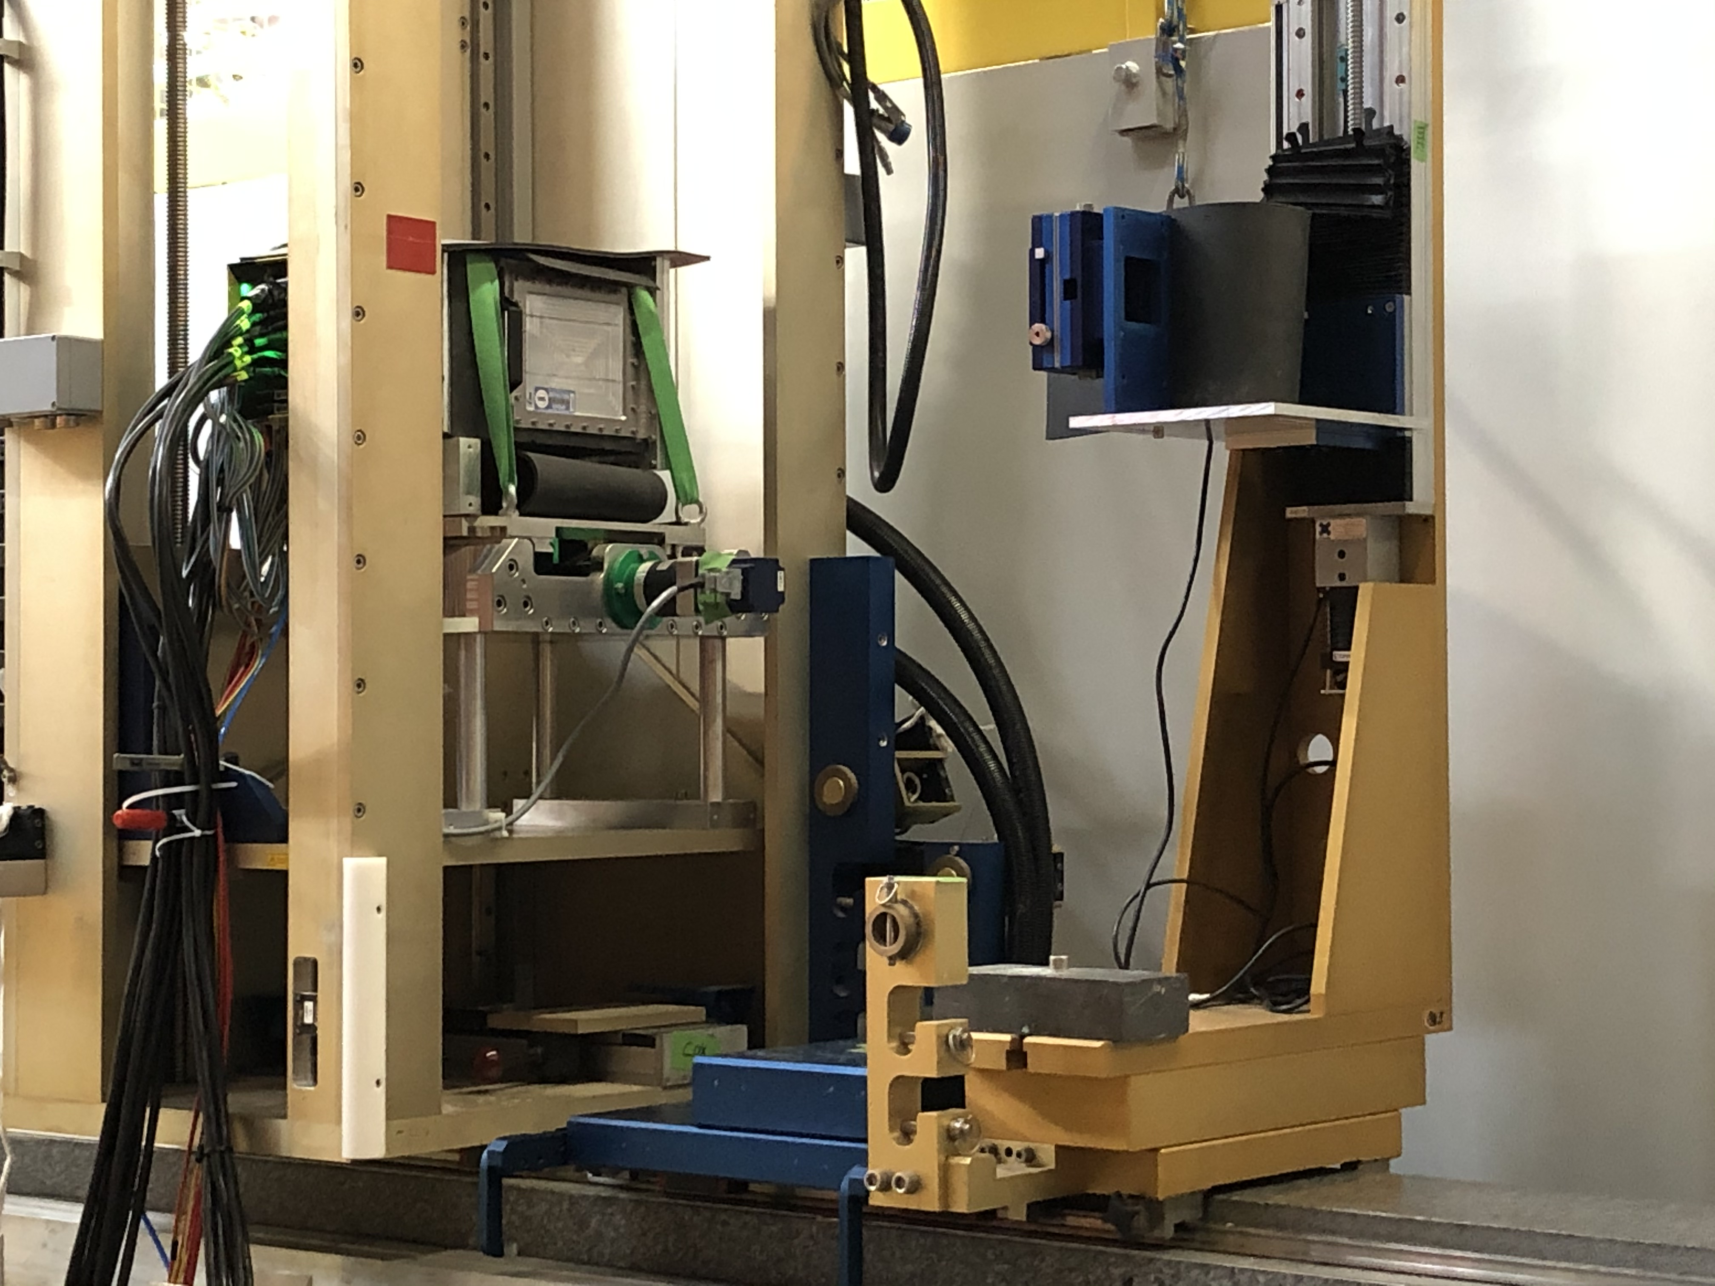
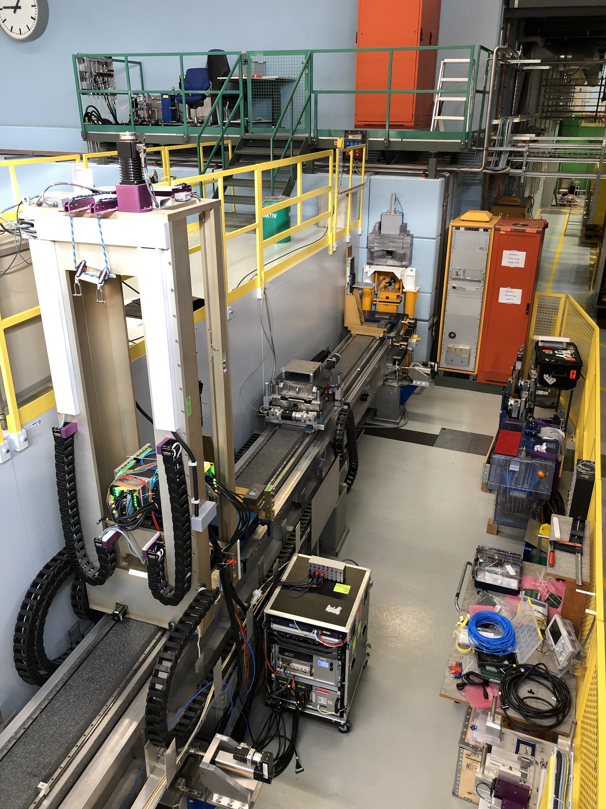
Tower
MB18 prototype operational during entire 2021 for operations and commissioning.
AMOR decided to have a permanent Multi-Blade detector for the instrument.
MB18

Slide 11
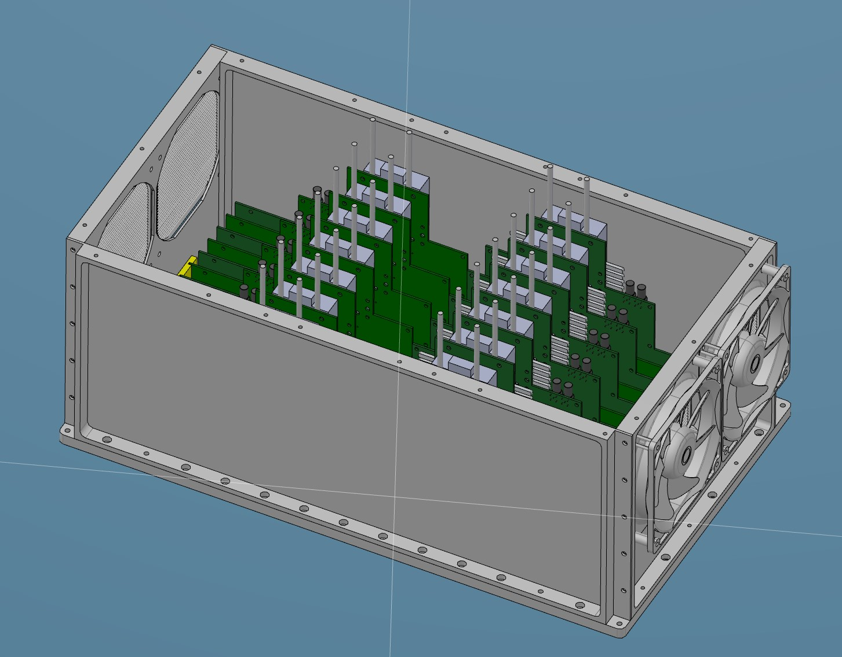
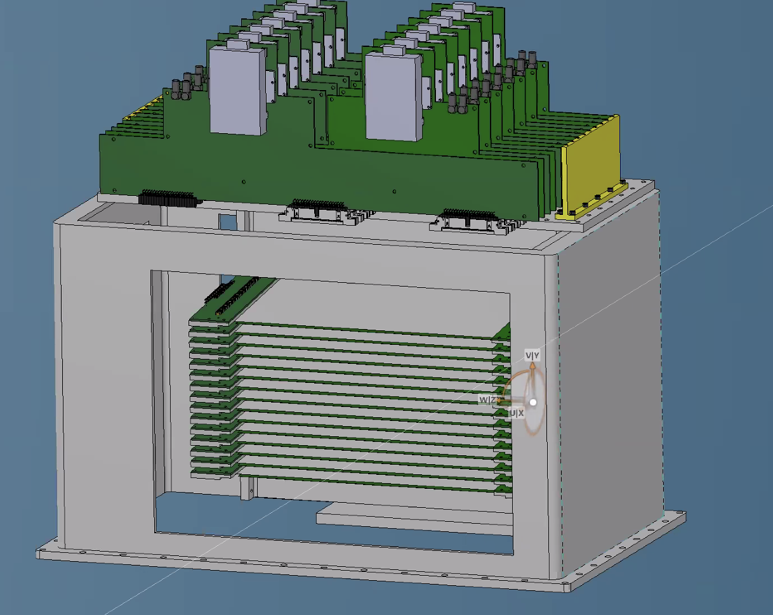
14 UNIT DETECTOR FOR AMOR, FINAL DETECTOR FOR THE INTRUMENT,
SAME UNITS AS ESTIA AND FREIA, SAME ELECTRONICS
This is the front end electronics, there is a box with fans to encapsulate them
BLADES
~340mm
Installation Dec 2021
neutrons
532mm
330mm

Slide 12
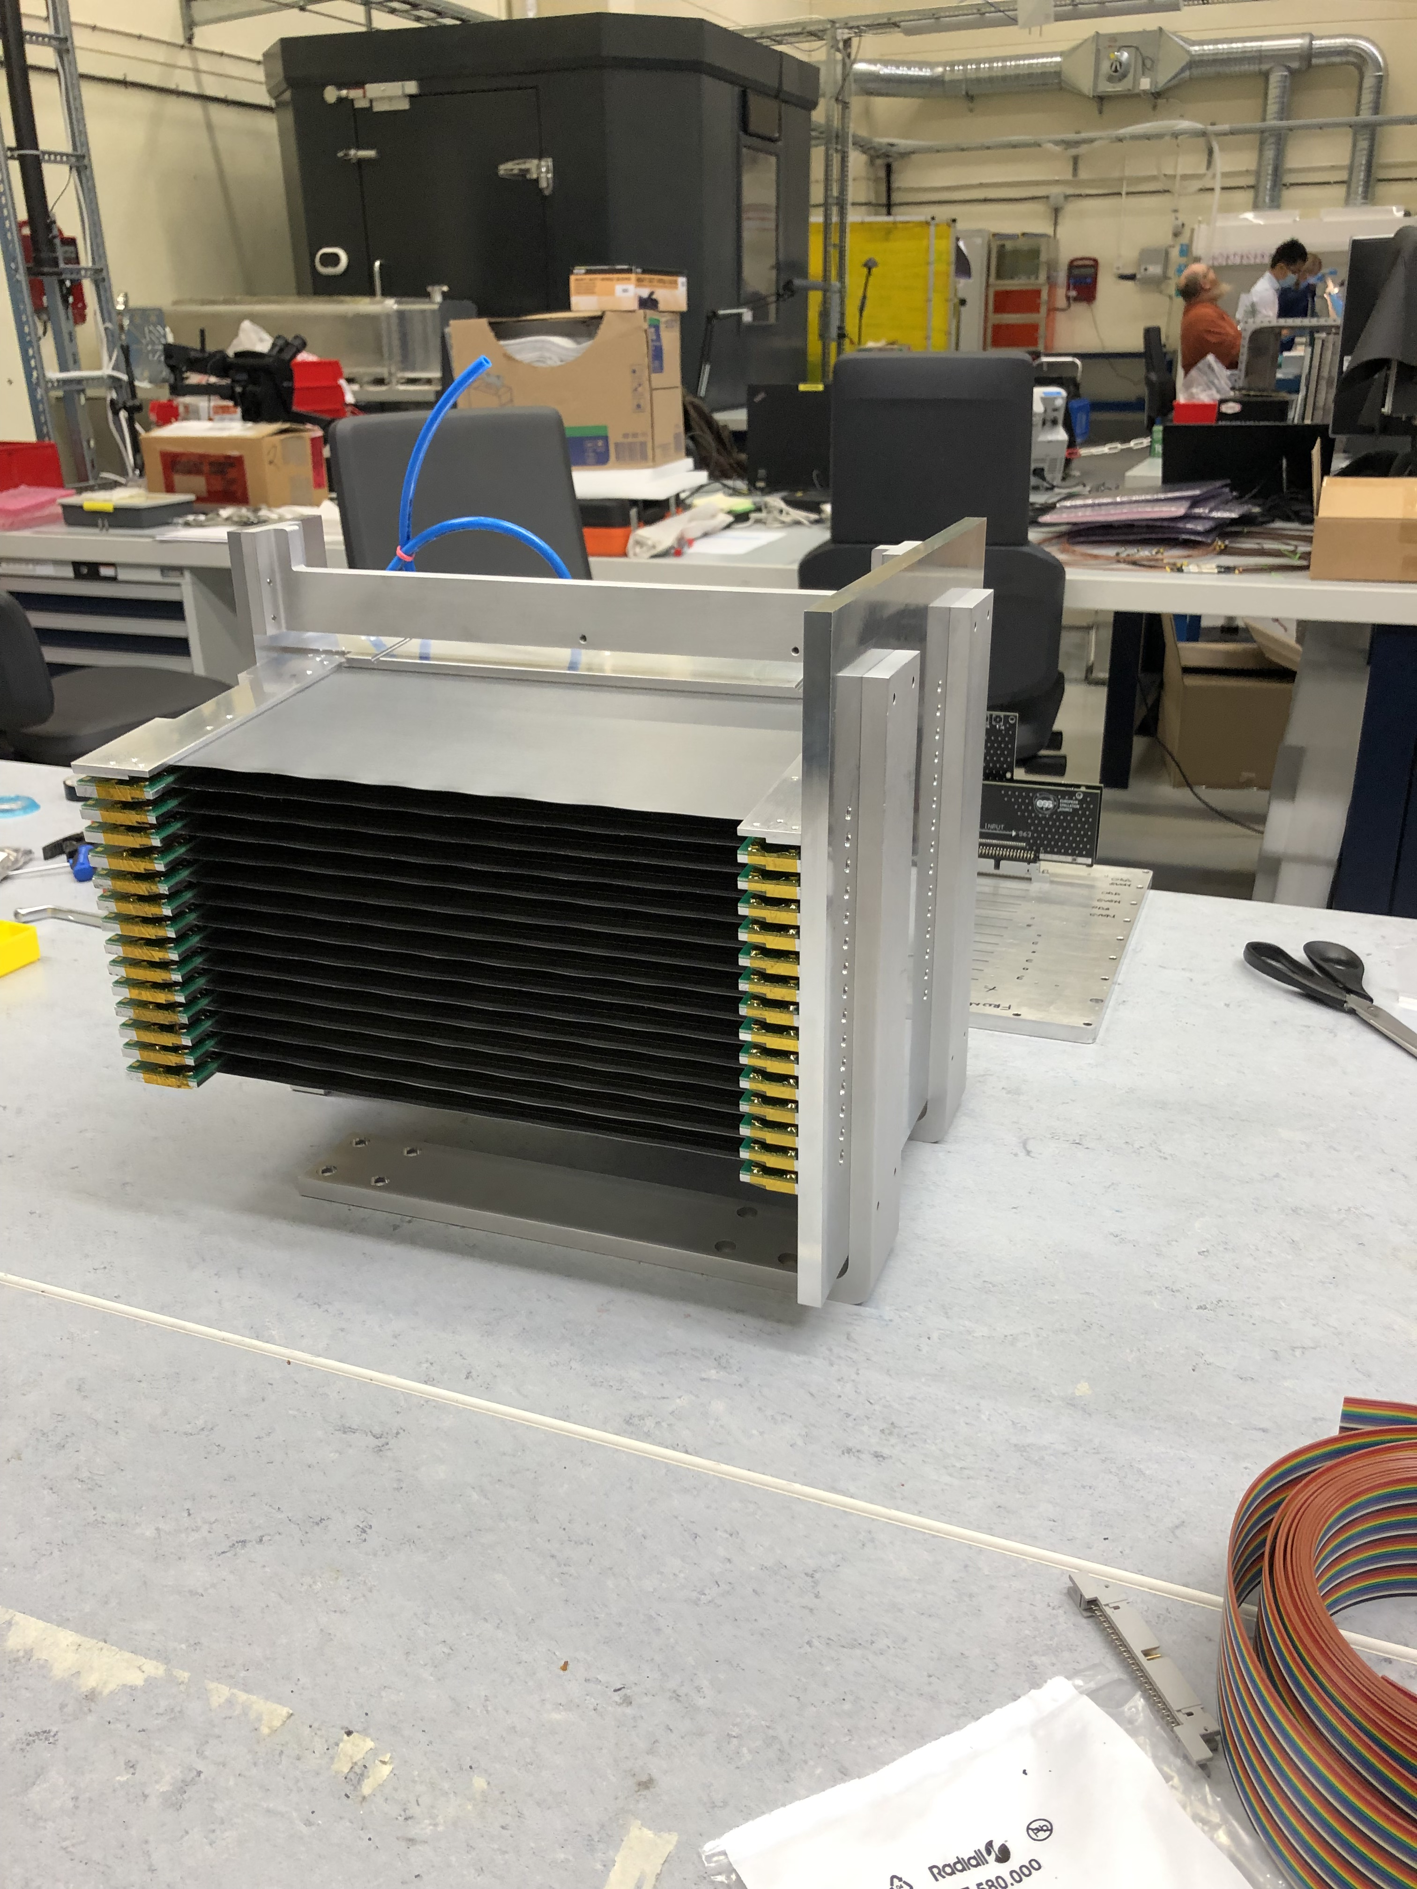
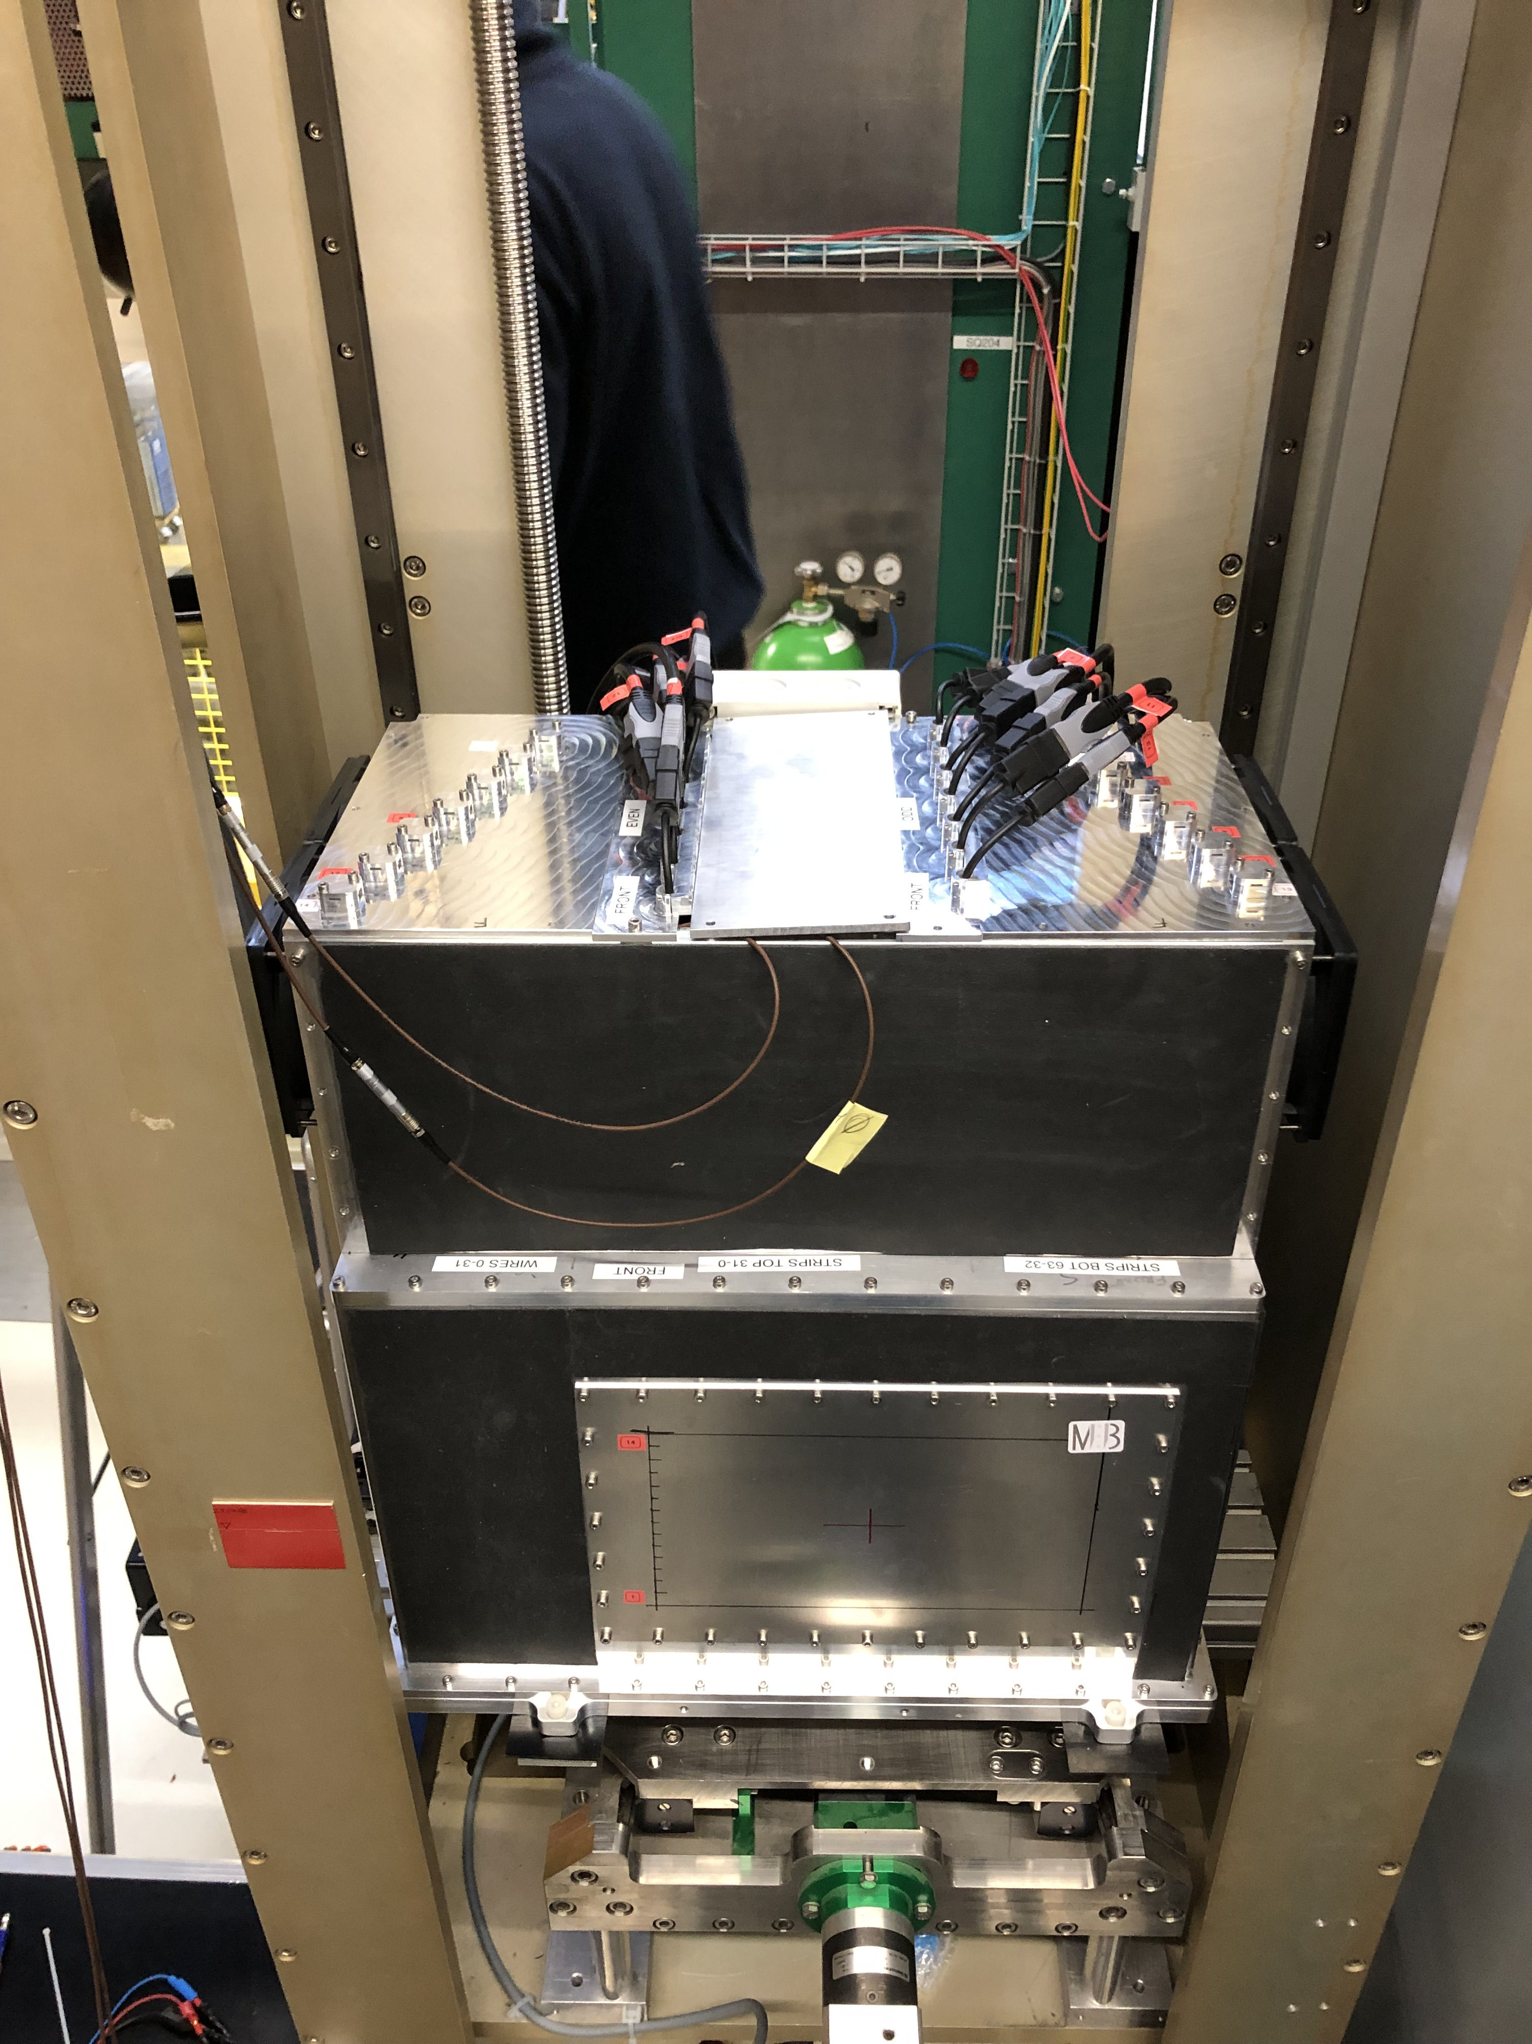
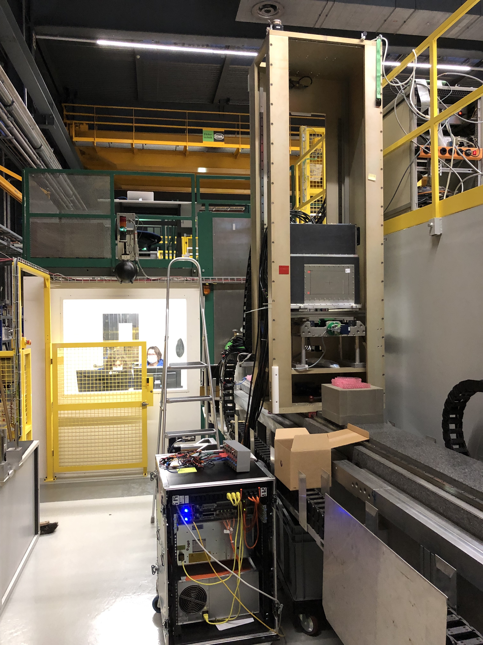
AMOR reflectometer @ PSI
It’s conceptually identical to Estia
14-unit detector for AMOR
(active area 260x140mm²)
Same units as Estia and FREIA
Multi-Blade @AMOR

Slide 13
Mechanics
Mechanics, problem with the manufacture of the Titanium blades
The plan is to buy all the blades for all detectors at once not to end up in manufacturing issues later on
We are working on this to solve the issue and there are currently 3 paths actively moving forward
One option is to change from Titanium to Stainless Steel, it has been tested and no issues on neutronic side
After this is solved the mechanics can be ordered for all instruments

Slide 14
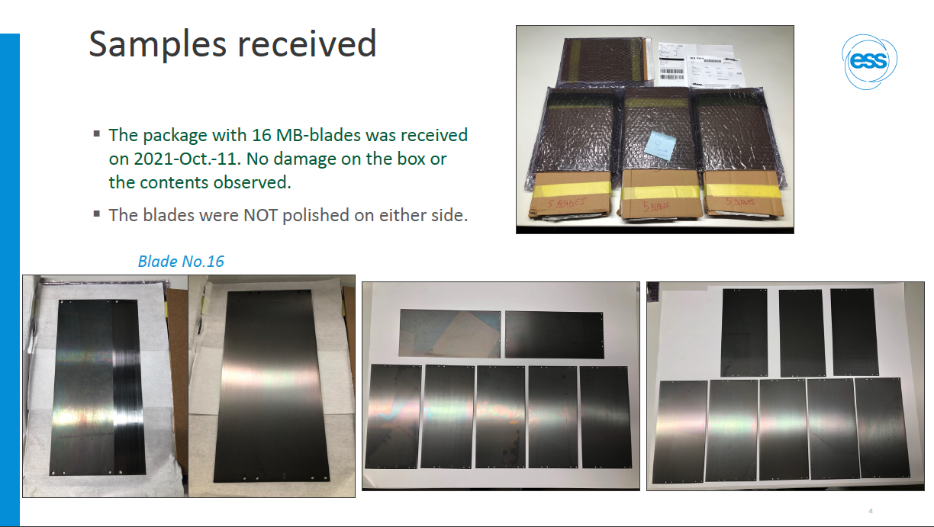

Slide 15
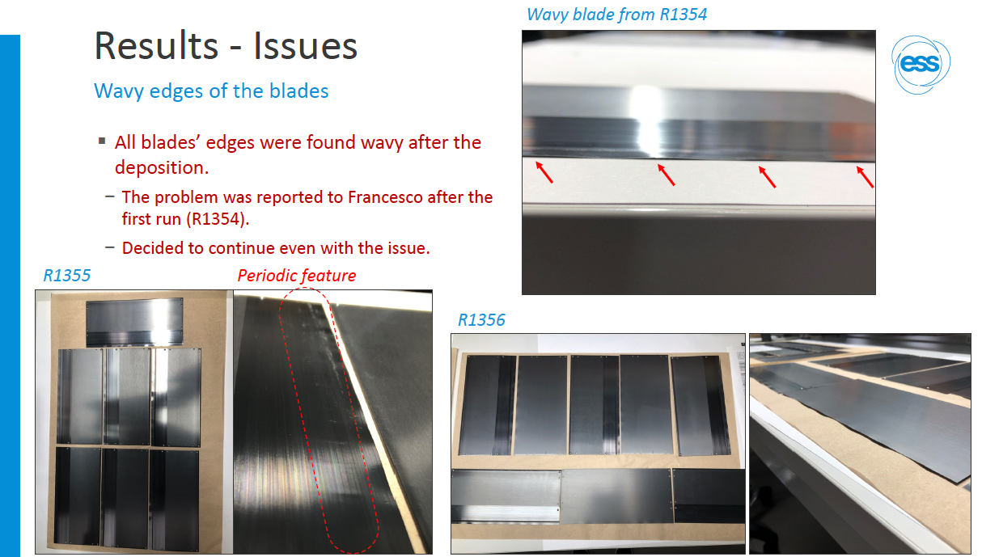

Slide 16
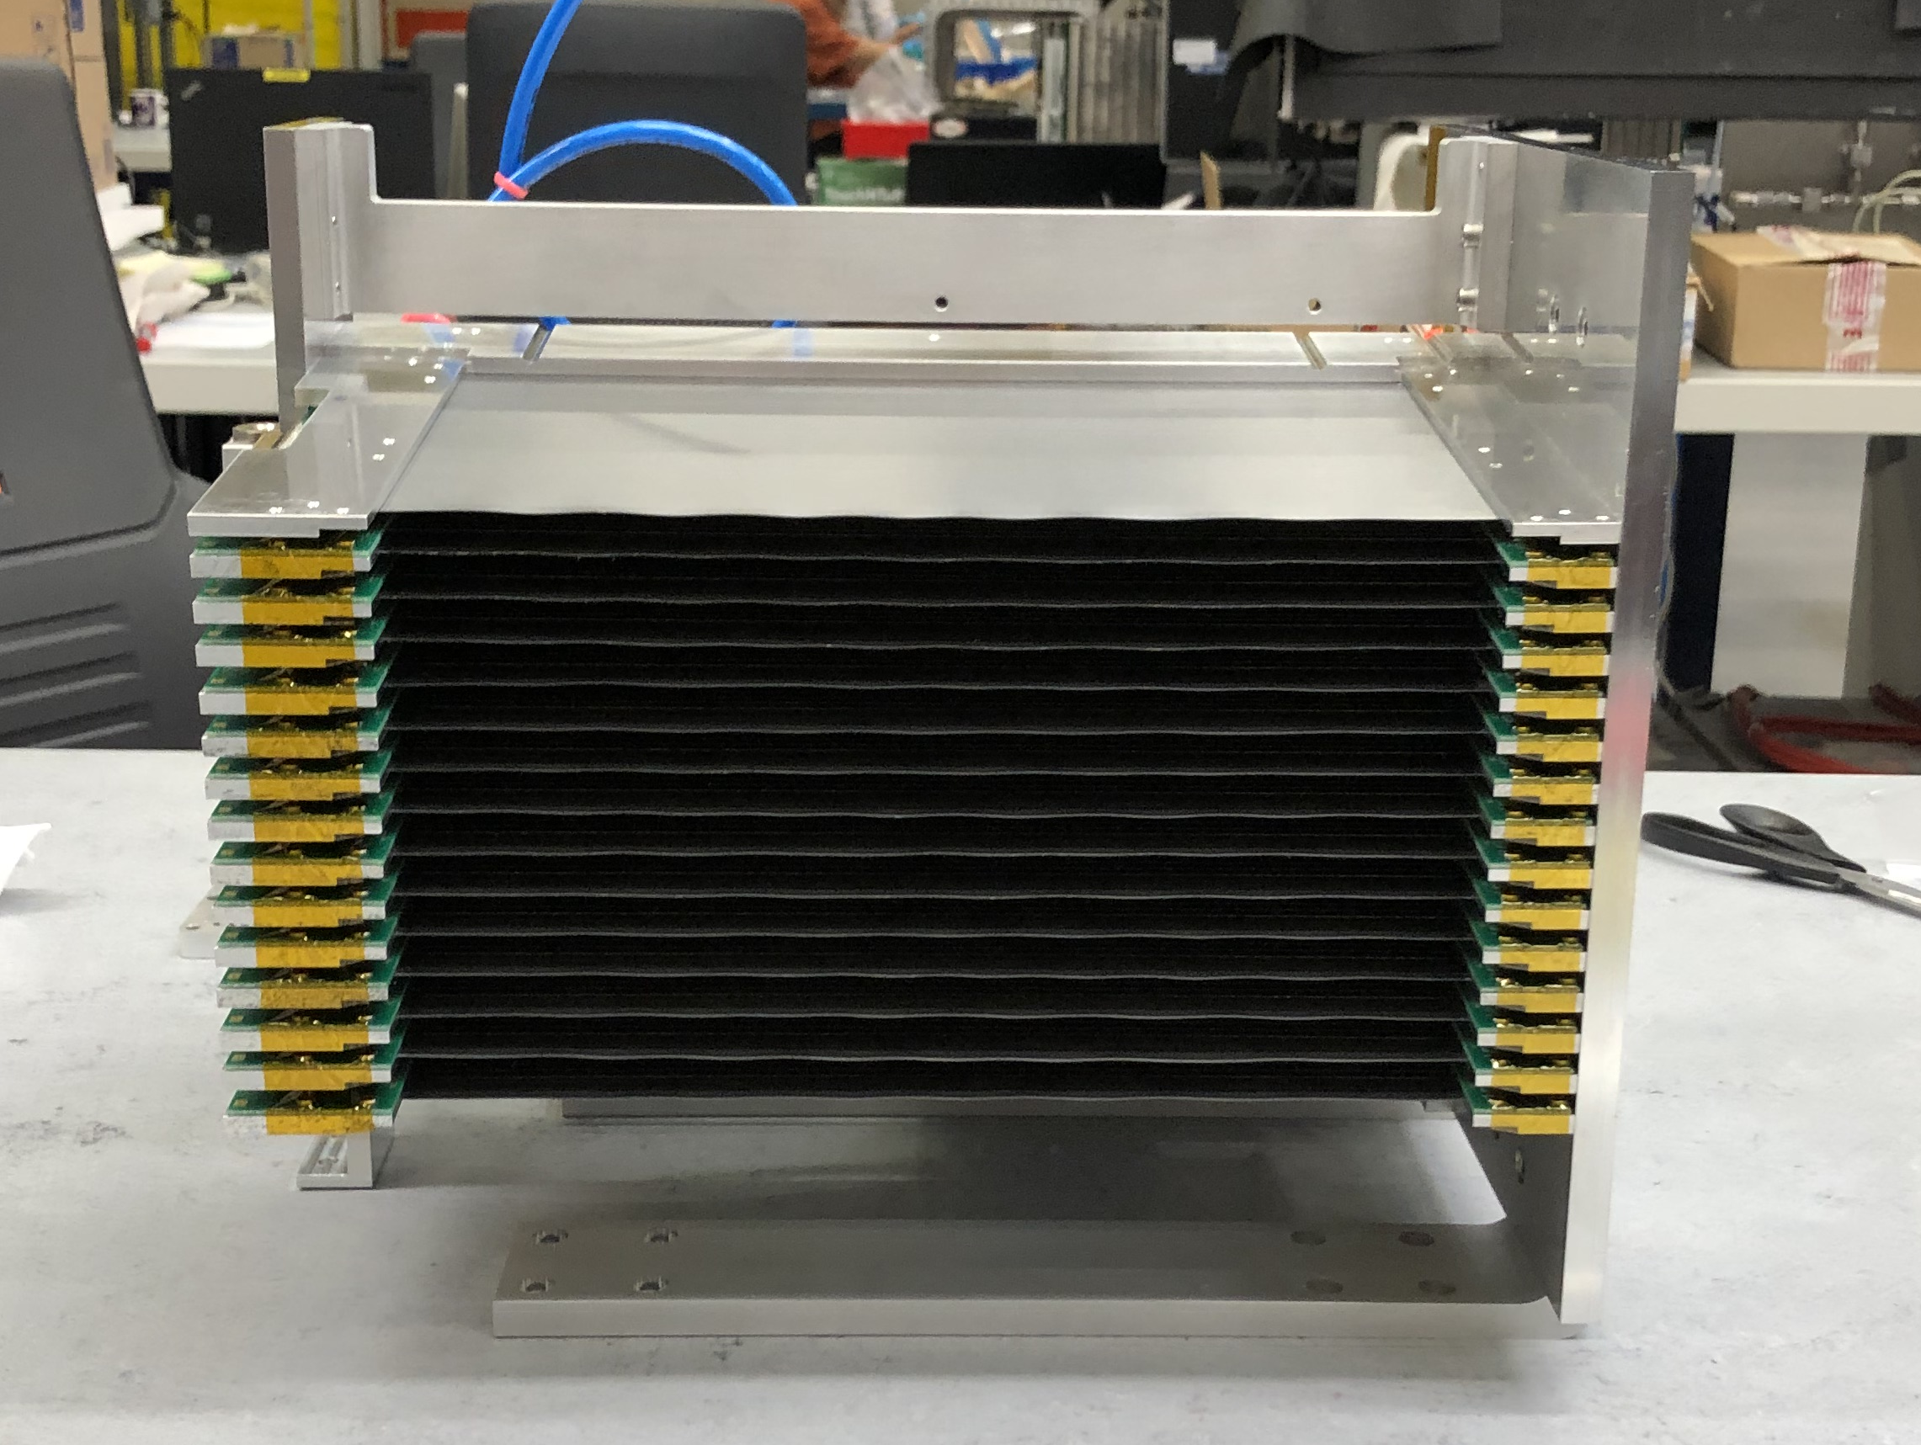
14 UNIT DETECTOR FOR AMOR

Slide 17
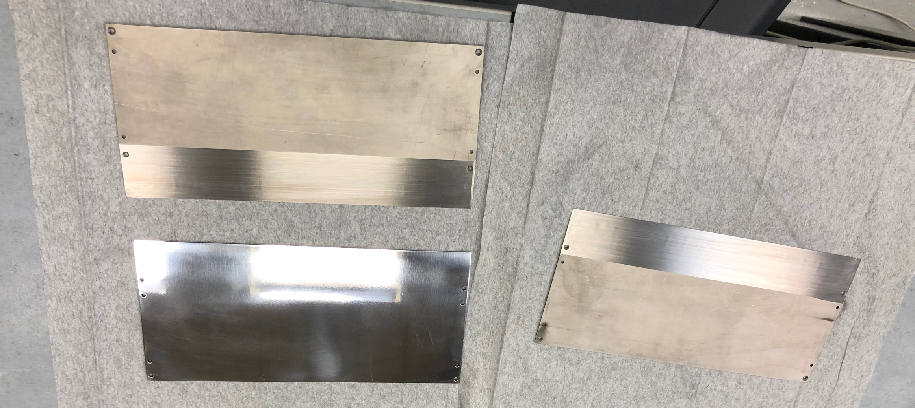
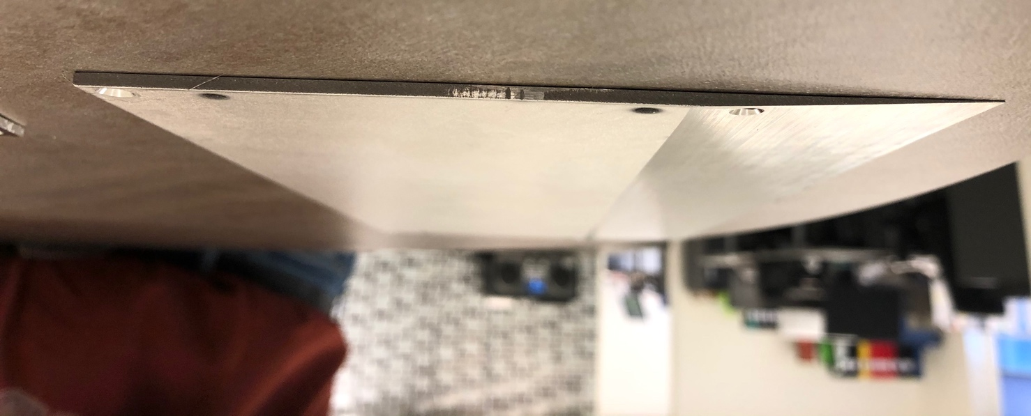
One option is to change from Titanium to Stainless Steel, it has been tested and no issues on neutronic side

Slide 18
Electronics
December 2021, MB AMOR installed with final VMM electronics showed some stability issues
Electronics: the VMM review (25th March 2022) pointed out some issues in the way we connect the VMM electronics on the detector -> problems identified and working on the solutions
MB AMOR will be operational on AMOR (PSI) from 9th of May 2022 using the old CAEN electronics -> any solution about the blades and the electronics with VMMs will be fitted at a later stage once ready.

Slide 19
Multi-Blade detector is compatible with both VMM electronics and CAEN test electronics :
1 TESTING ELECTRONICS: Athena single ended front-end based on FET and CAEN digitizers V1740D
2 VMM ELECTRONICS: Final ESS solution

Slide 20
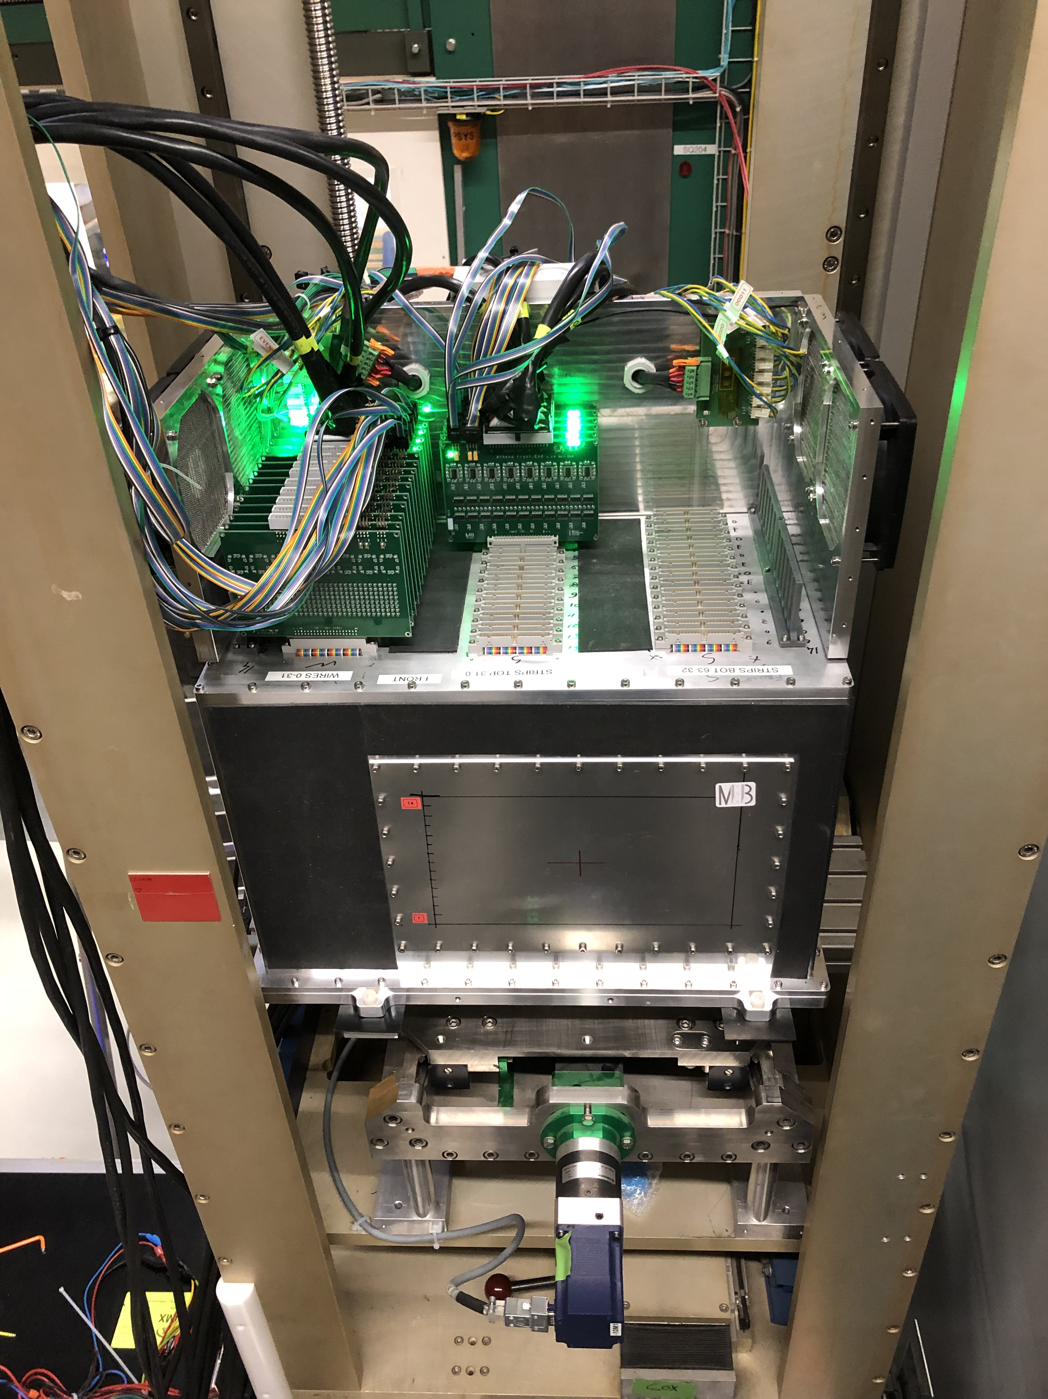
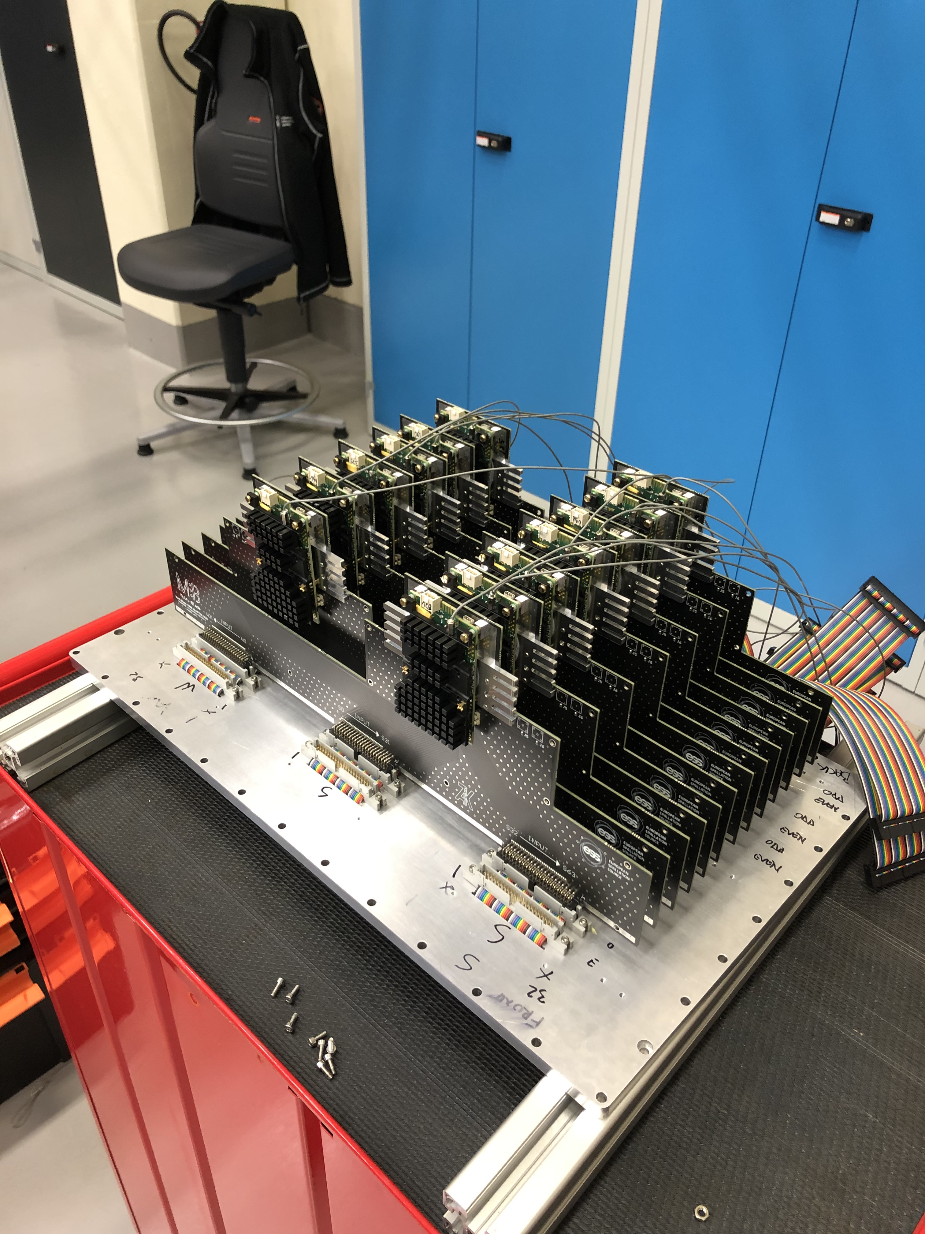
With Athena-CAEN electronics
With VMM electronics
Feed-through

Slide 21
Readout chain
Actual system architecture
Frontend Assistor card (FEA)
1 to n EFUs
DAQ software Event Formation Unit (EFU) at DMSC
1 GB UDP
Switch
Detector
Slow control
Kintex 7
2x 100 Gbit/s Ethernet (data)
FMC to HDMI
card, max.
5 hybrids
FMC to SFP+
card
Wire and/or grid channels
MFE
Ring 1
MFE
Connector/adapter
Backend
Master
module
VMM
VMM
Ethernet (config)
RD51 hybrid
FEA
Master frontends
FPGA
(MFE)
Ring n
LVDS - HDMI cable
2 x 400 Mbit/s (data/config)
ICS
Power
2V @ 2A
3V @ 200mA
FEA
Fibre 2 x 6 Gbit/s (data/config)
MFE
Ring 12
MFE

Slide 22
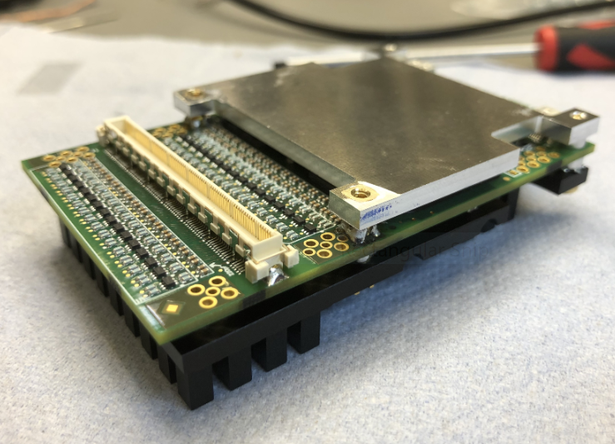
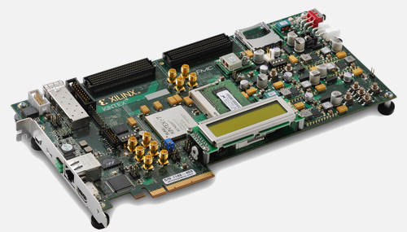
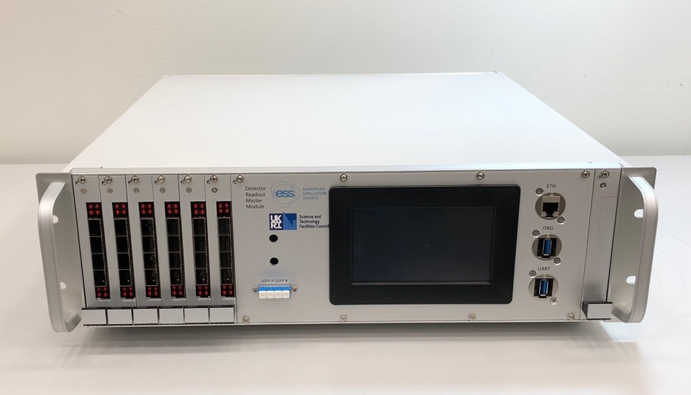
AMOR example
detector
N = 14
blade assembly
1 2 3 4 … 12 13 14 15
wires
wires
¹⁰B₄C
=
strips
half blade
(contains only strips,
no wires)
strips
half blade
(contains only wires,
no strips)
…
A blade assembly (unit)
substrate
cassette
One cassette 96ch
(32 of hybrid unused)
1 2 3 … 12 13 14
0
1
2
3
12
13
…
Hybrid
hybrids
VMM 0
VMM 1
HDMI
FEA = Front-End Assistor
FEA 0
FEA 6
…
FEA 1
Ring 0
Hybrid = one board
with 2 VMMs = 128ch
optical
Beam
Monitors
R0
R1
R2
R10
R11
Master back-end
(12 rings)

Slide 23
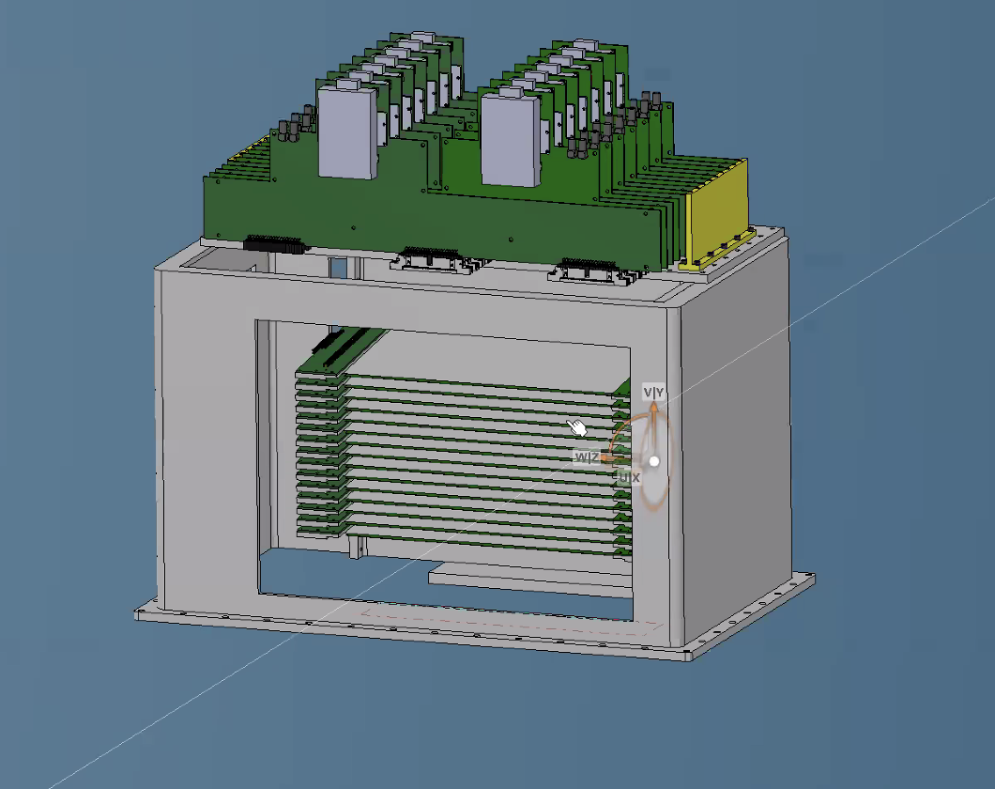
VMMs hybrids
AMOR detector
14 cassettes = 14 VMMs hybrids
In two rows 7 odd and 7 even
Electronics VMM: enclosure around the VMMs
blades
neutrons

Slide 24
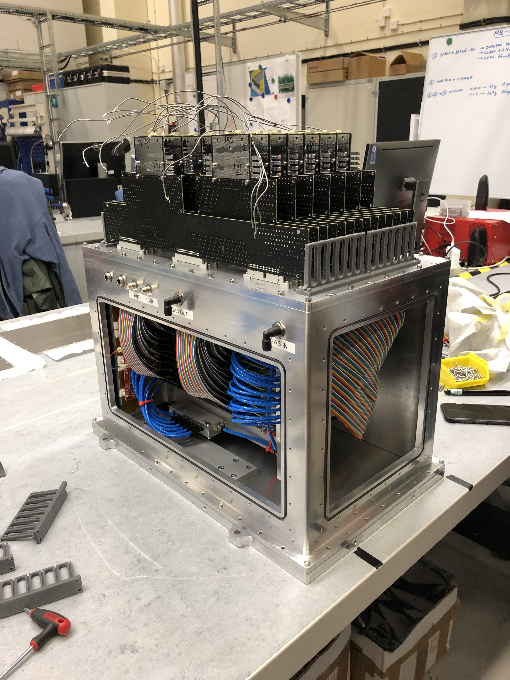
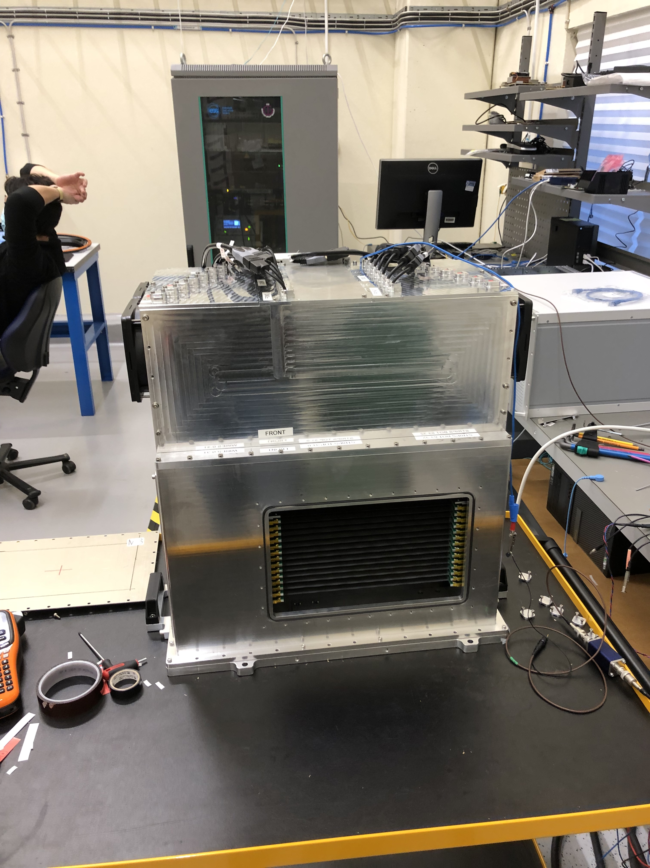
AMOR detector
14 cassettes = 14 VMMs hybrids
In two rows 7 odd and 7 even
HDMIs
enclosed
blades
neutrons
VMMs hybrids

Slide 25
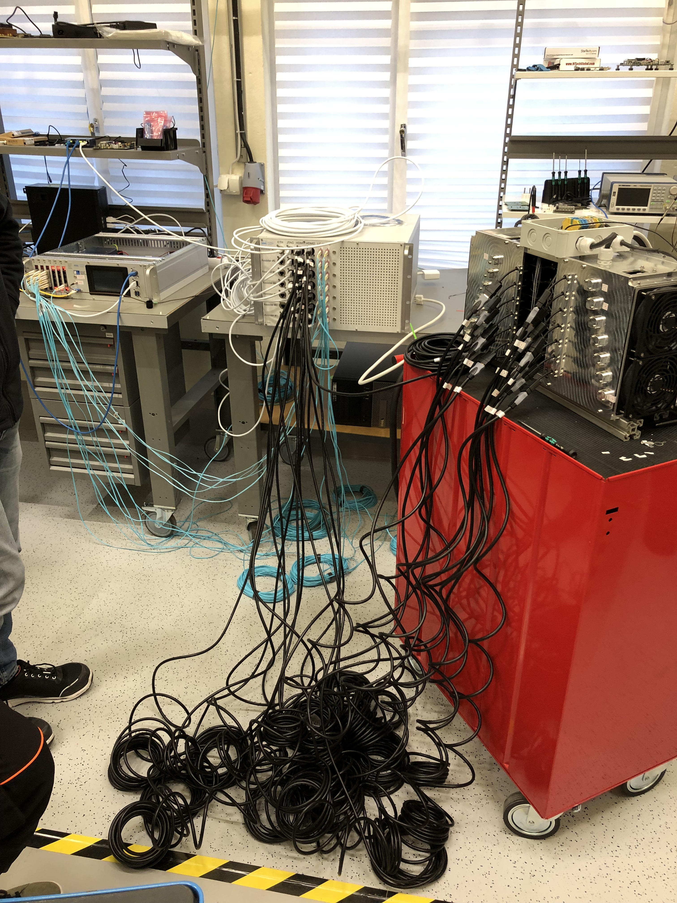
Front End Assiter crate (7 FEAs)
Master back-end
HDMIs
HDMIs
optical
blades
AMOR HDMI are 5 m
Tested fine up to 25m
HDMIs

Slide 26
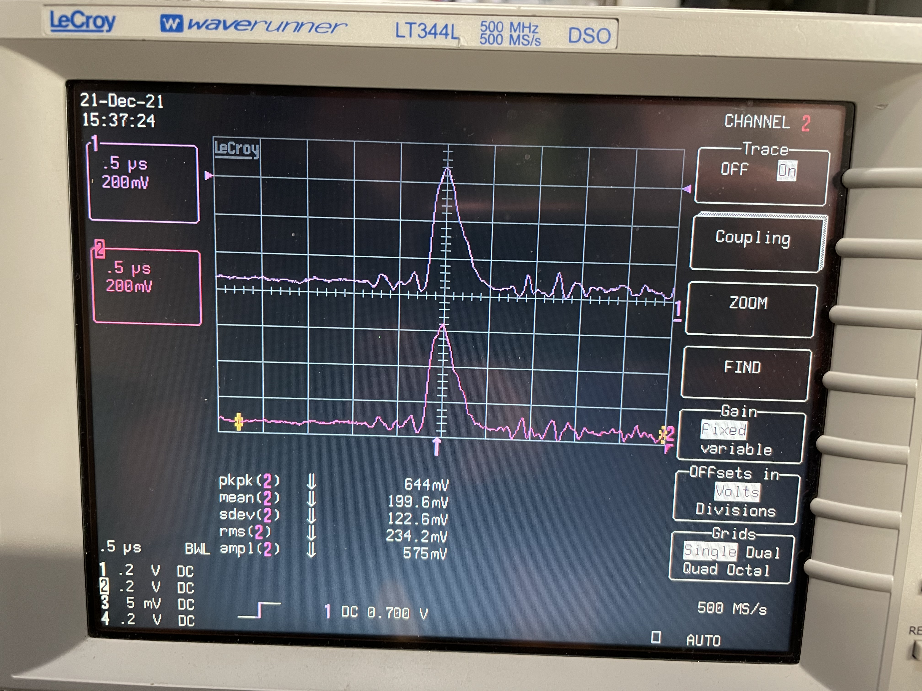
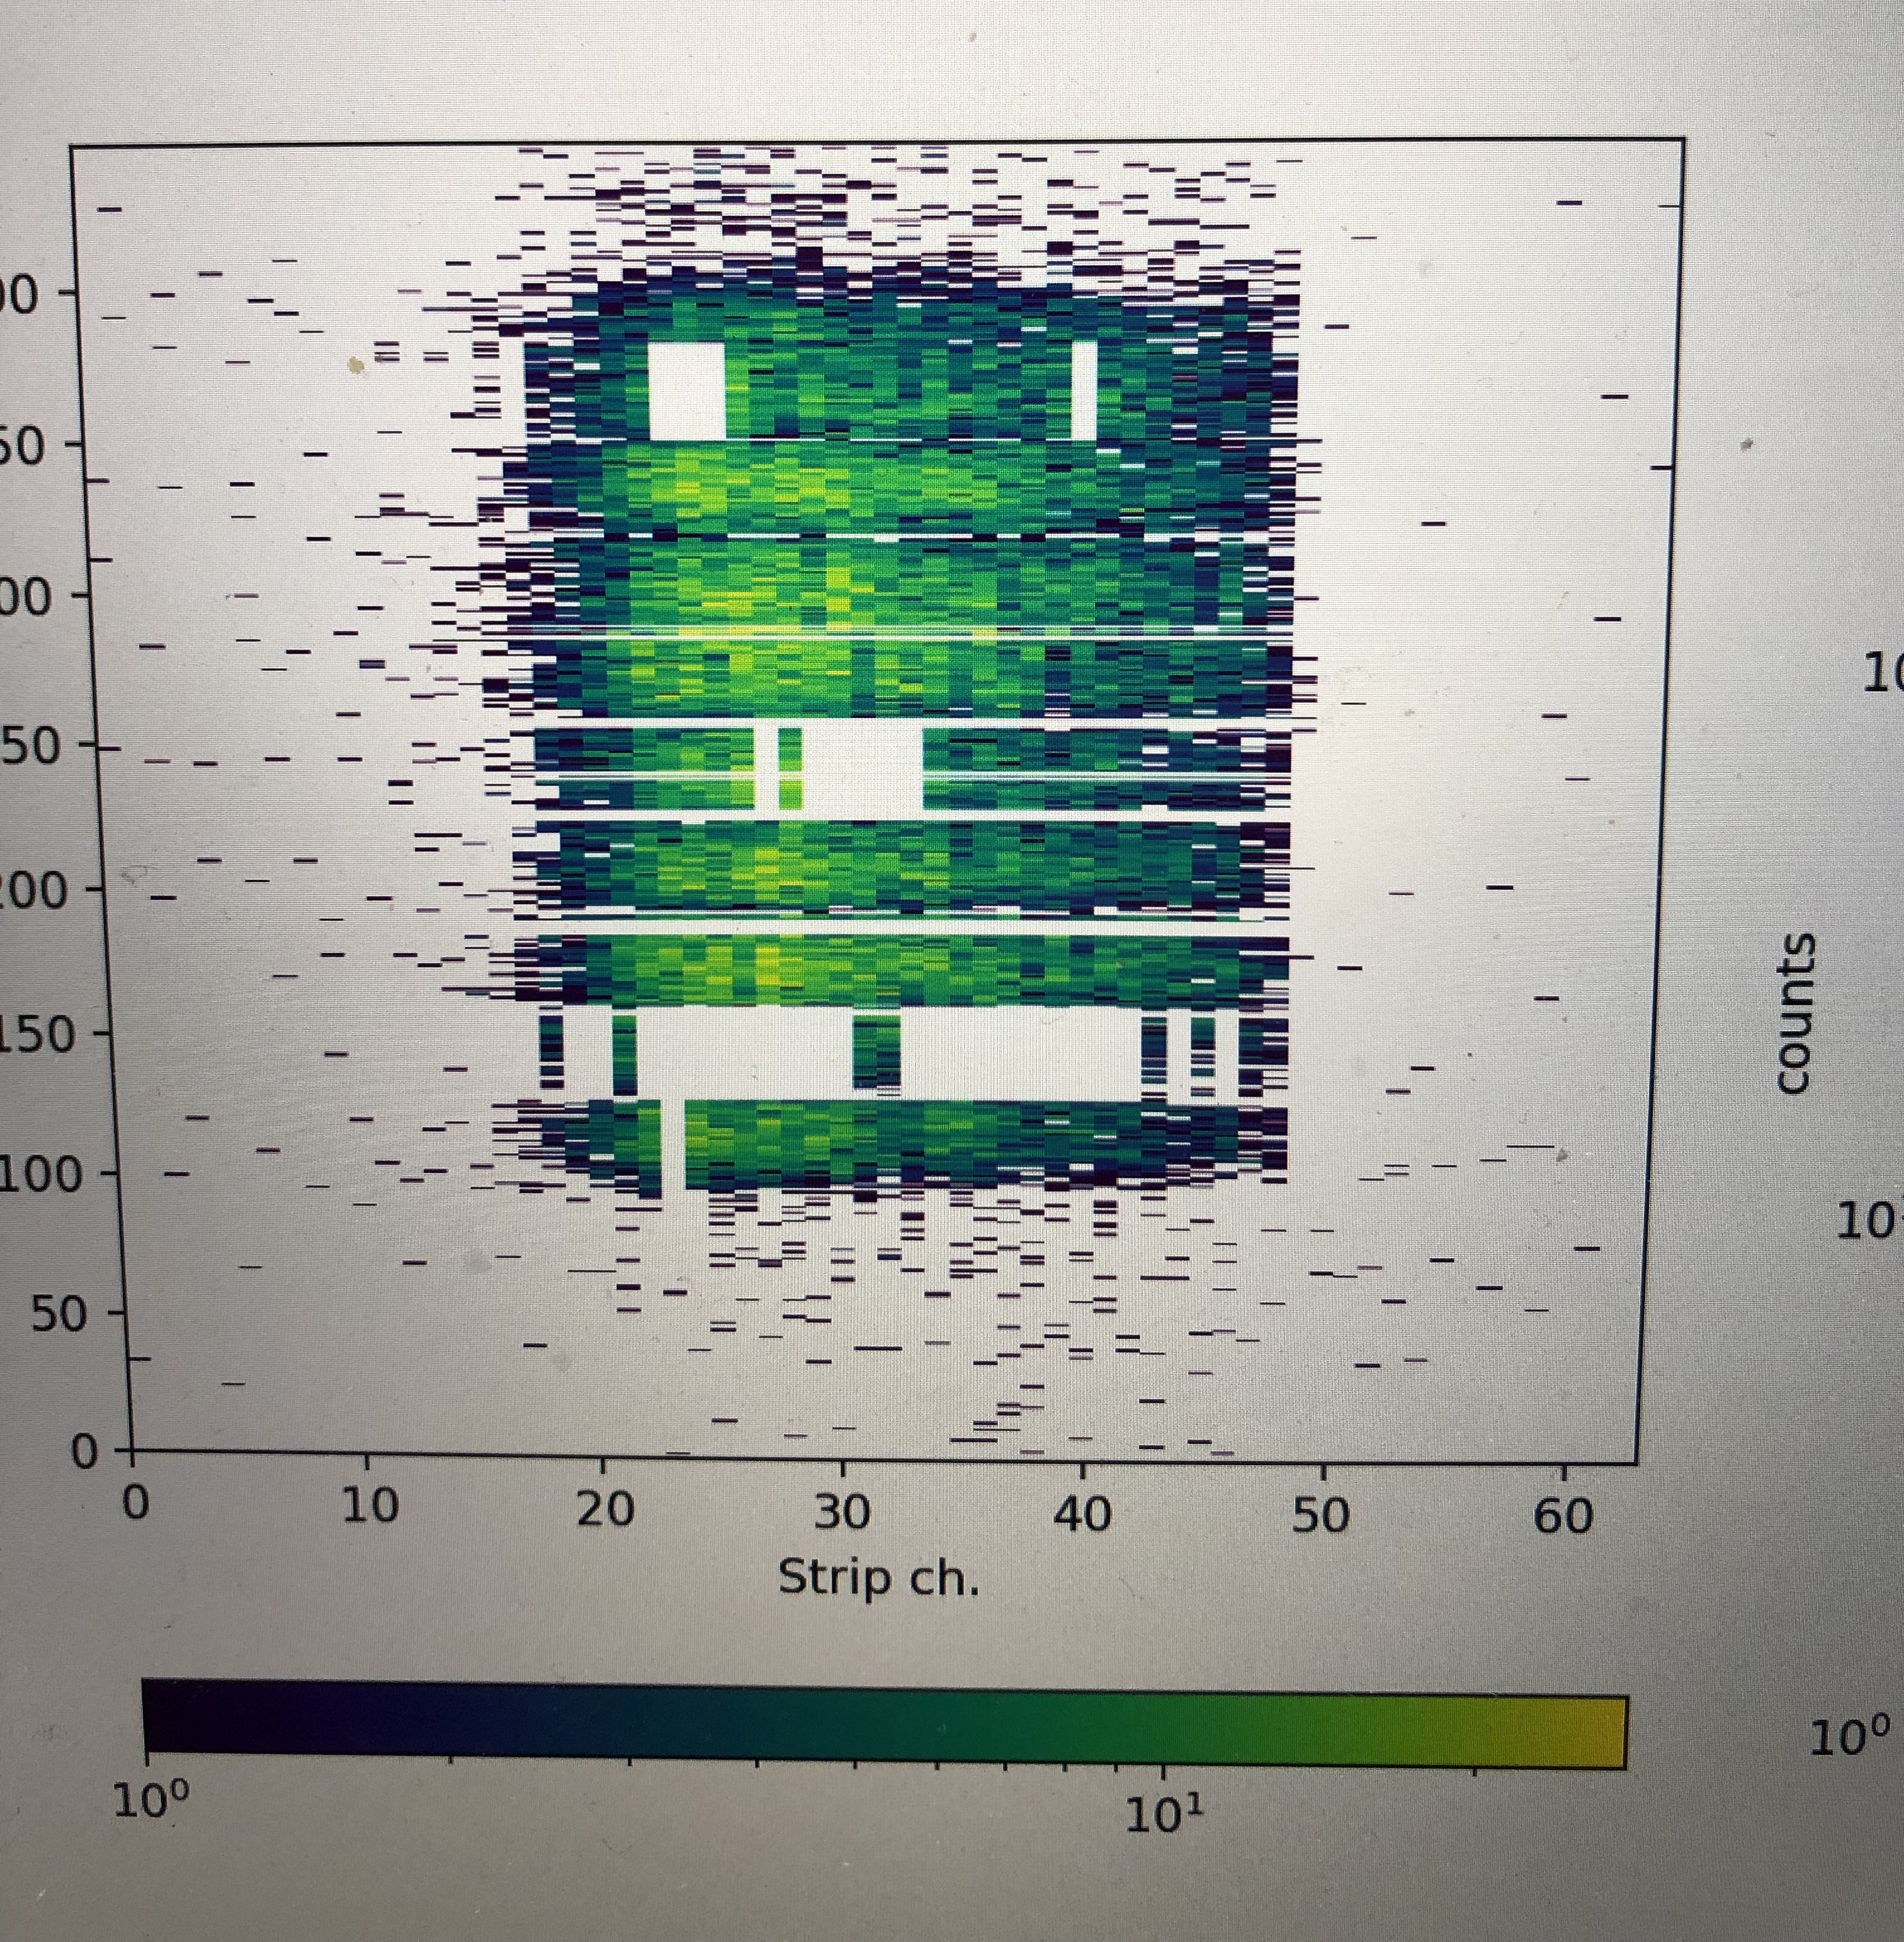
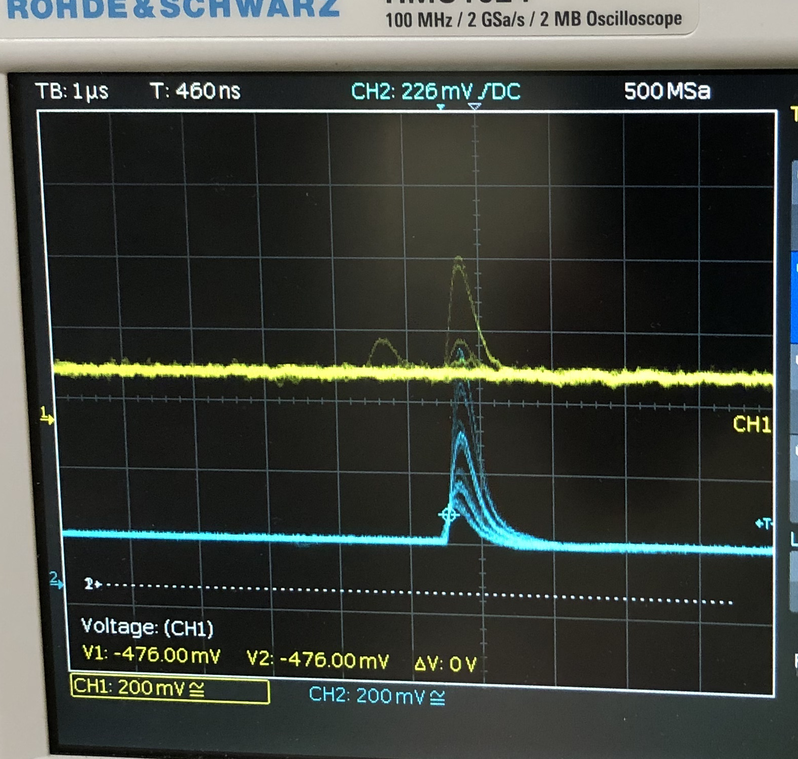

NOTES:
Direct beam on detector, missing pixels are due to changing noise over time.
No noise
strip
wire
noise
strips
wire

Slide 27

Electronics: the VMM review (25th March 2022) pointed out some issues in the way we connect the VMM electronics on the detector -> problems identified and working on the solutions
In contact with ILL and ISIS to get inputs
MB AMOR will be operational on AMOR (PSI) from 9th of May 2022 using the old CAEN electronics -> any solution about the blades and the electronics with VMMs will be fitted at a later stage once ready.

Slide 28
Estia vessel
Estia vessel and detector design ready, preparing CDR

Slide 29






48-unit Estia detector
(active area 480x260mm²)
Top view
Vessel designed and integrated with
Estia detector arm
It is designed to host 2 detectors including
the upgrade detector, but only one installed
on day 1
neutrons

Slide 30


TOP MB
UPGRADE TO
FULL SCOPE
BEAM 2
262mm
70MM
55MM
70mm
4 beams
262mm
BEAM 1
Design of blades adapted to reduce the dead area between two detectors below 55mm
BOTTOM MB
DAY 1
El. connections

Slide 31
Empty space at top
MB_ESTIA full scope
ARRAY PLATE
MB ESTIA day 1
vessel
Slotted U-frame
Slotted U-frame
COMB
U-frame
Top detector (upgrade)
Electronics connections
Bottom
detector
U-frame
U-frame
U-frame
pins
Some
fixture
50mm
ARRAY PLATE
Bottom detector
vessel
ARRAY PLATE

Slide 32
SUMMARY:
Mechanics, problem with the manufacture of the Titanium blades
The plan is to buy all the blades for all detectors at once not to end up in manufacturing issues later on
We are working on this to solve the issue and there are currently 3 paths actively moving forward
One option is to change from Titanium to Stainless Steel, it has been tested and no issues on neutronic side
After this is solved the mechanics can be ordered for all instruments
December 2021, MB AMOR installed with final VMM electronics showed some stability issues
Electronics: the VMM review (25th March 2022) pointed out some issues in the way we connect the VMM electronics on the detector -> problems identified and working on the solutions, In contact with ILL and ISIS to get inputs
MB AMOR will be operational on AMOR (PSI) from 9th of May 2022 using the old CAEN electronics -> any solution about the blades and the electronics with VMMs will be fitted at a later stage once ready.
Estia vessel and detector design ready, preparing CDR

