Slide 2
DMSC Update for SAC
Spring 2022
PRESENTED BY Thomas Holm Rod, ACTINg head of dmsc

Slide 3
Agenda
1 Introduction
2 Staffing and Planning
3 Data Systems & Technologies
4 Scientific Web Applications
5 Data Reduction, Analysis, and Modelling
6 Conclusion

Slide 4
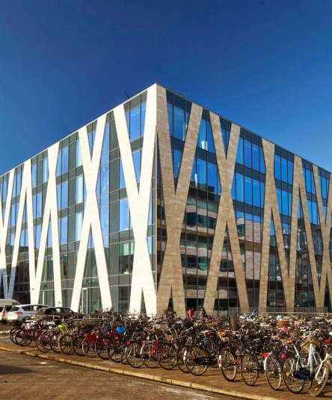
2
Introduction

Slide 5






Scope for scientific computing
Support users with scientific computing at modern open science facility
Technique
specific
Stream events & meta data
Data reduction & visualization
Data analysis
FAIR Data management
Experiment control
User office software
NSS scope
Including Compute infrastructure Remote access to compute infrastructure & services Live data reduction and visualization Live analysis for some techniques | Plus Support for and with instrument simulations User support for scientific computing (Instrument Data Scientists) Materials and molecular modelling and simulations (not prioritised so far)
Notes:
Summary: Scientific computing group that should support
Objectives
Strategy

Slide 6
Strategy for delivering
Standardization & Collaboration where feasible
(ISIS), ORNL?,
FZJ, PSI
ISIS
TUM, PSI
PSI, MAX IV
Technique
specific
Stream events & meta data
Data reduction & visualization
Data analysis
FAIR Data management
Experiment control
User office software
Focus on sustainability & usability
Standardize where feasible
Collaborate and promote collaborations
Modern & best practice software eng.
Be serious about user experience
Be as ready as possible; test, test, …
Technique | Software | Collaborators
SANS | SasView | NIST, ISIS, ILL, DLS, SNS
Reflectometry | BornAgain / easyRefl. | FZJ (ISIS), ORSO
Diffraction | CrysFML, CrysPy, easyDiff. | ILL, LLB
Spectroscopy | Mantid, SpinW, PACE | ISIS
Imaging | MuhRec / KipTool / TOFlib | PSI
MX | SCIPP, DIALS?, PHENIX | LU, STFC, DLS
Notes:
Summary: Scientific computing group that should support
Objectives
Strategy

Slide 7
Staffing & Planning

Slide 8
Rebaselined plan
Plan against P0
We accept higher risks
… but we also have opportunities
    … and contingency if needed
#FTEs @ DMSC (excl. ECDC)
#FTE: | Now excl. fixed term | Now incl. fixed term | 2027
Admin | 2 | 2.5 | 3
DST | 4 | 5.5 | 9
SWAP | 3 | 5.5 | 5
scipp | 3 | 3.5 | 6
analysis | 4 | 4.5 | 4
Instr. sim. | 1 | 2.3 | 2
IDS | 4 | 4.3 | 7
Bottom-up

Slide 9
Charge for DMSC STAP
How do we best and proactively manage the higher risk level?
…
We would like the STAP to give advice on how we best mitigate the risk of not being able to deliver requested scope in due time. In particular how we proactively can detect in due time if we need to request contingency for onboarding extra development resources. Here ‘due time’ should be understood in the context of the time it takes to recruit a suitable developer, which in challenging cases can exceed a year.
Stay focused
Prioritize
Monitor risks
Frequently reassess required effort

Slide 10
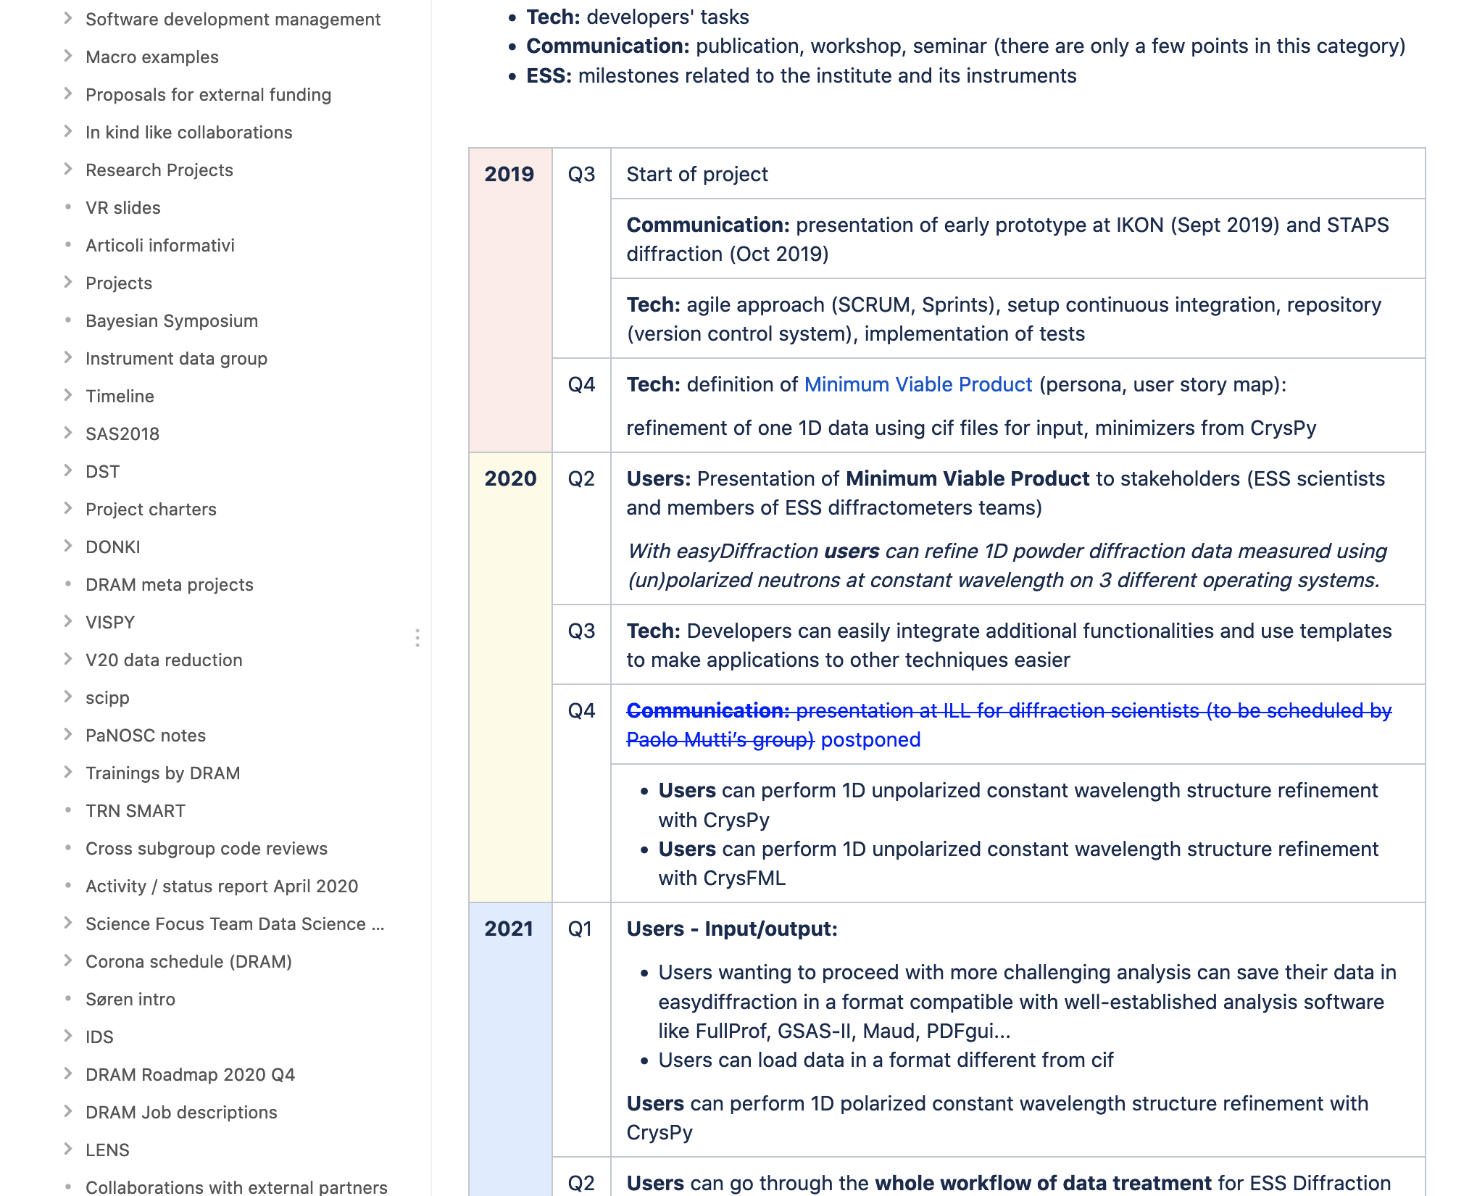
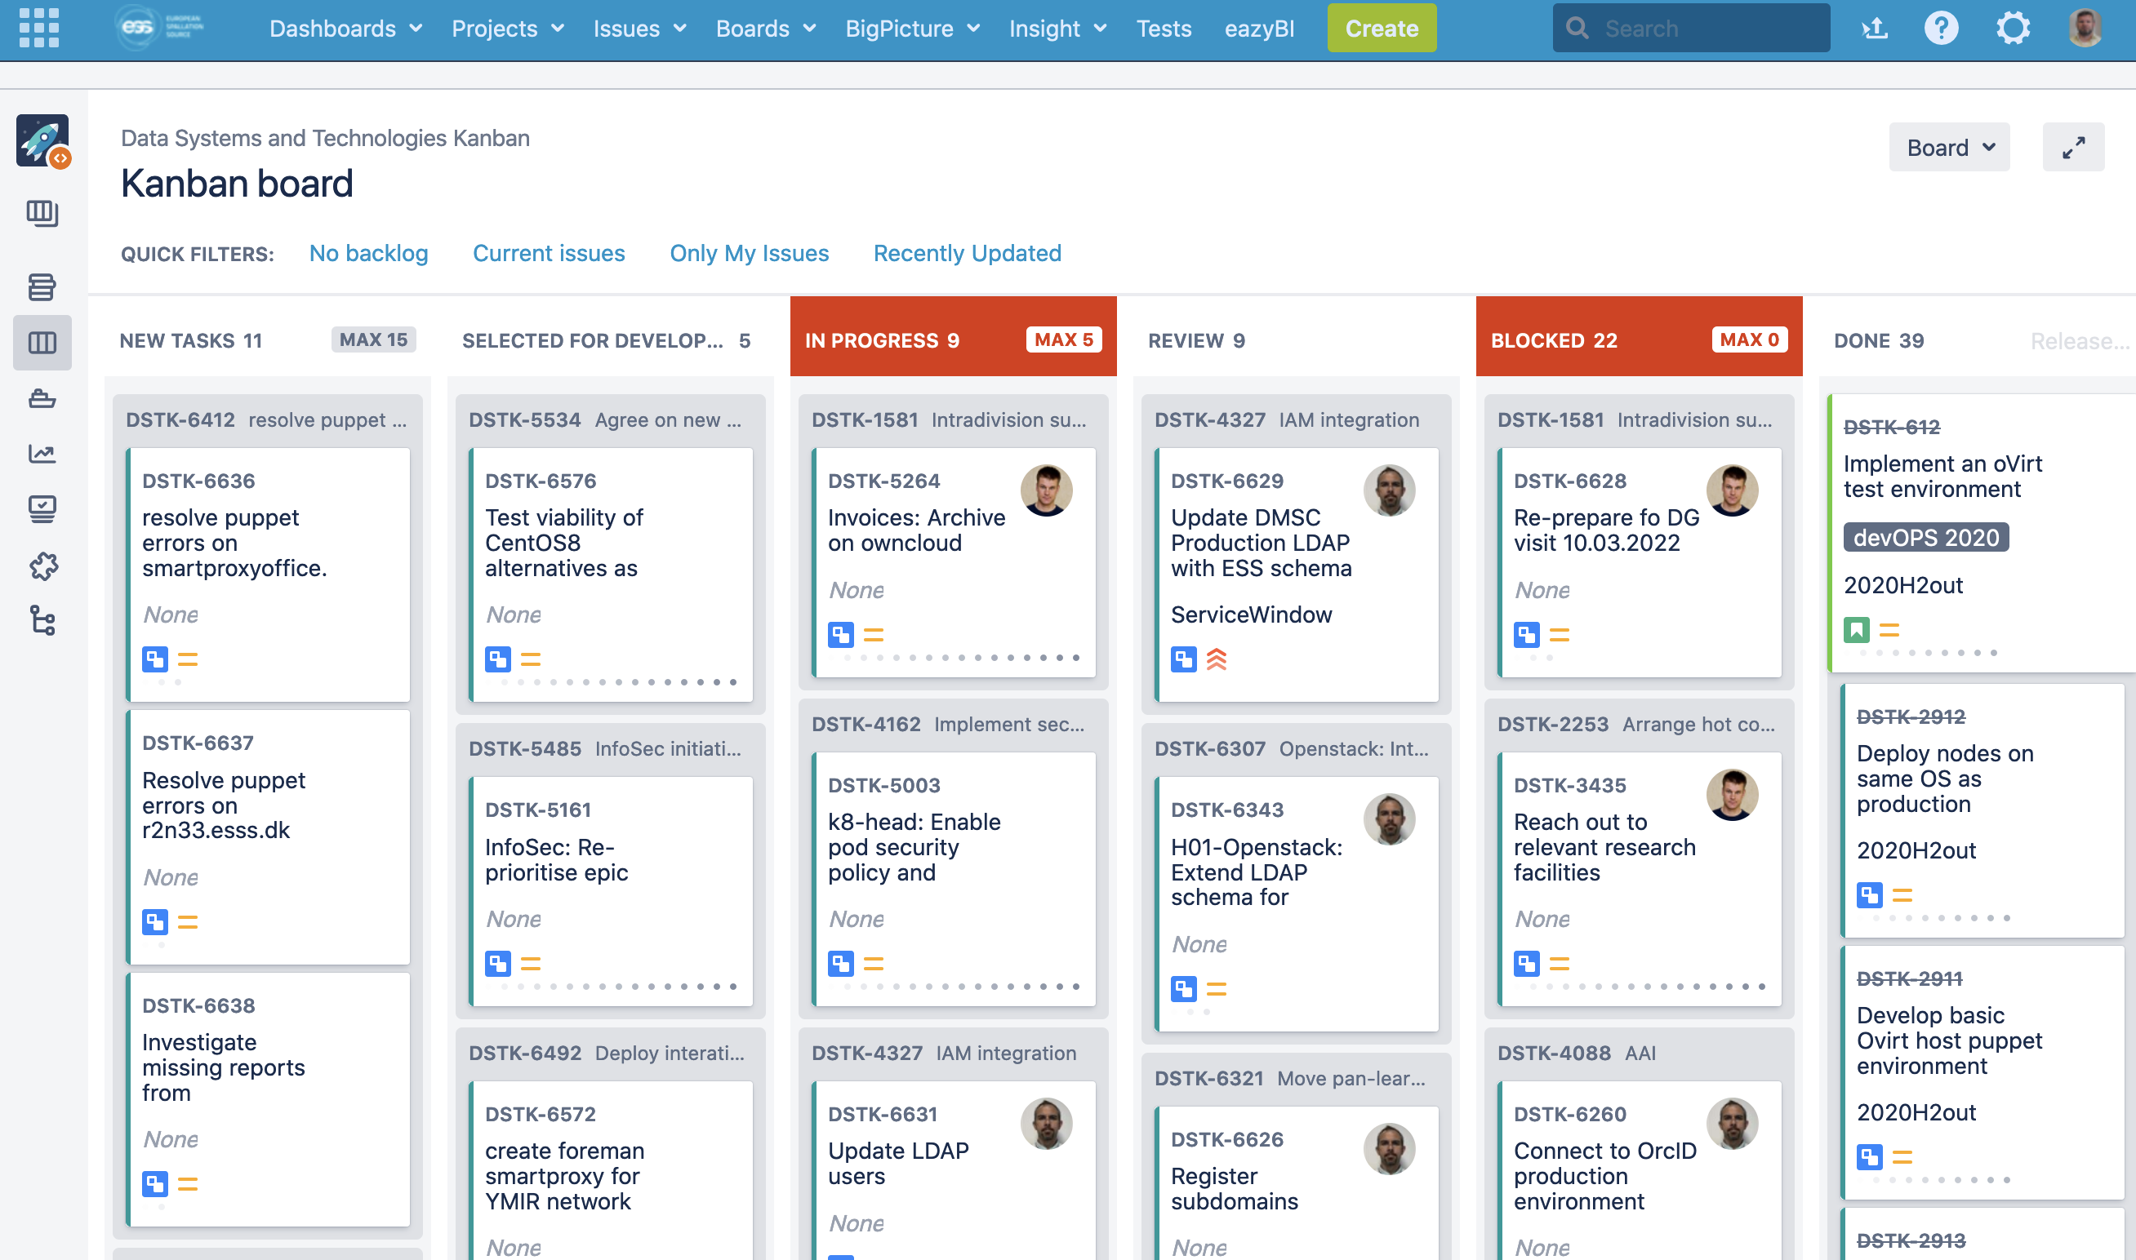
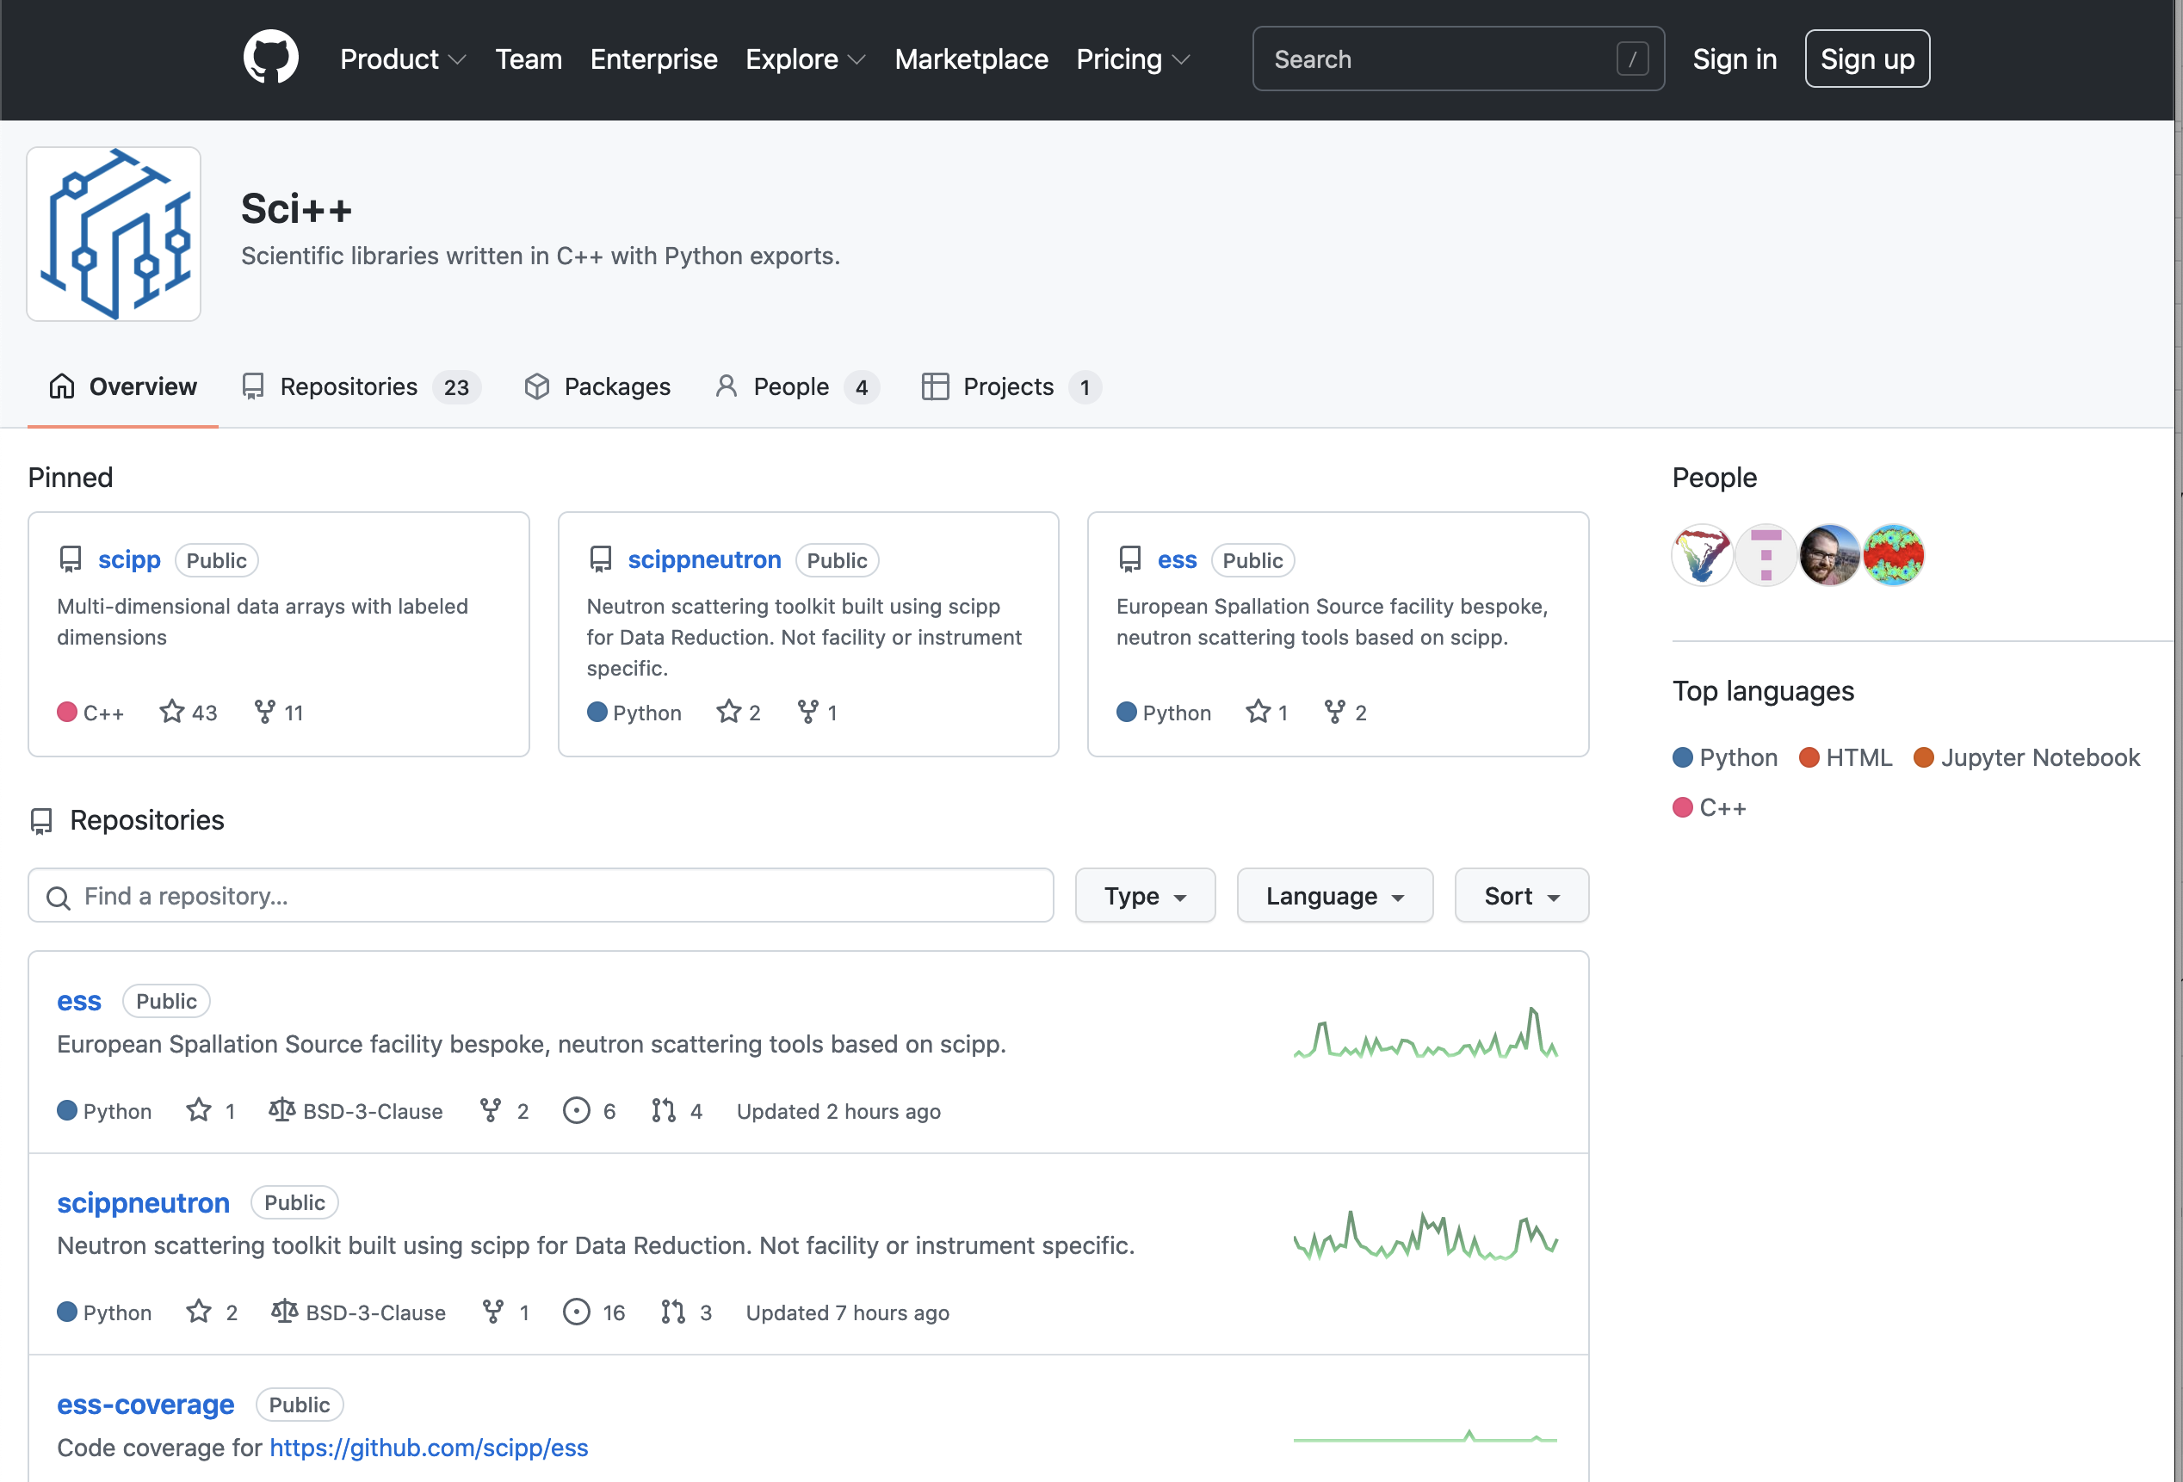
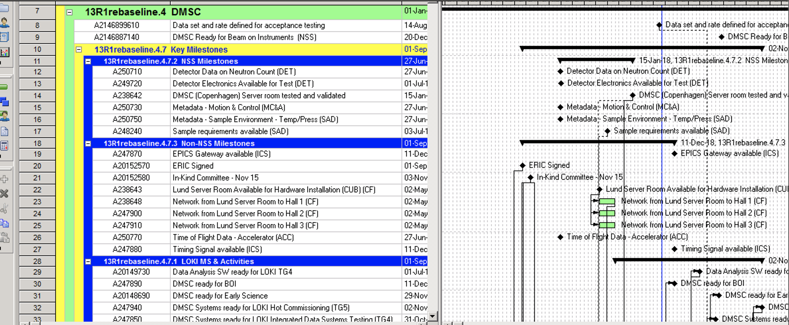
Agile scientific computing house
Use different project management tools than P6

Slide 11
Linking to ESS P6
Work in progress
DST
(JIRA)
SWAP
(GitHub/JIRA)
DRAM (GitHub/JIRA)
ECDC (GitHub/JIRA)
DMSC internal project planning and tracking
DMSC
(JIRA)
ESS/NSS/Science
(P6)
Risk register
Science project planning and tracking

Slide 12
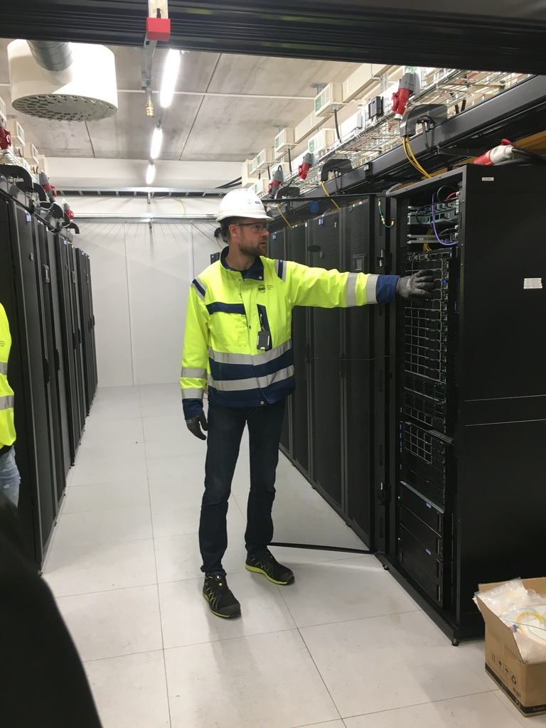
Data Systems & Technologies
Laying the foundation

Slide 13
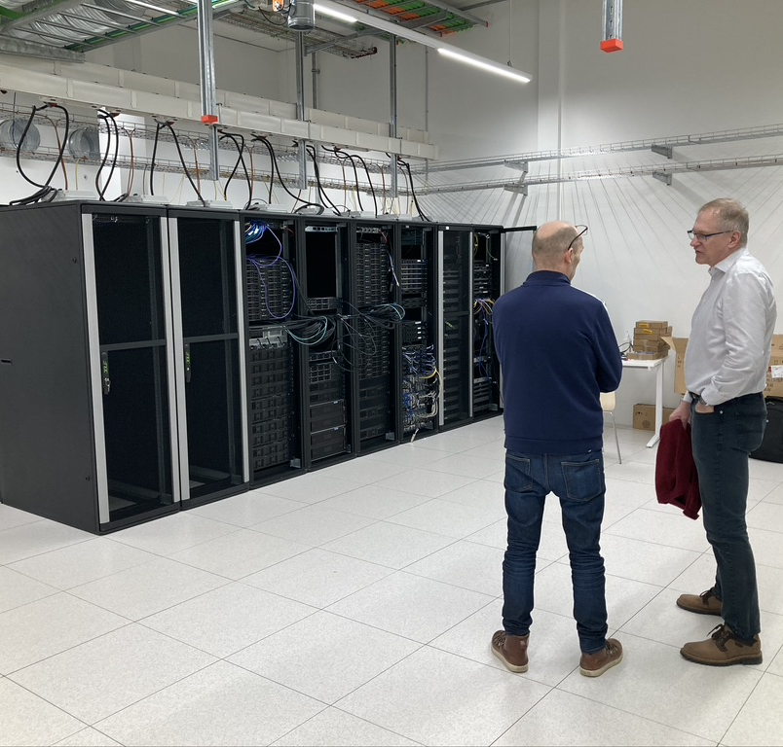
Two server rooms
Data Systems & Technologies
Copenhagen (COBIS)
Lund (H01)

Slide 14
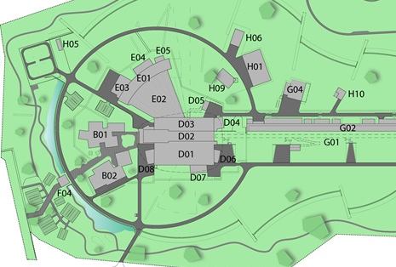
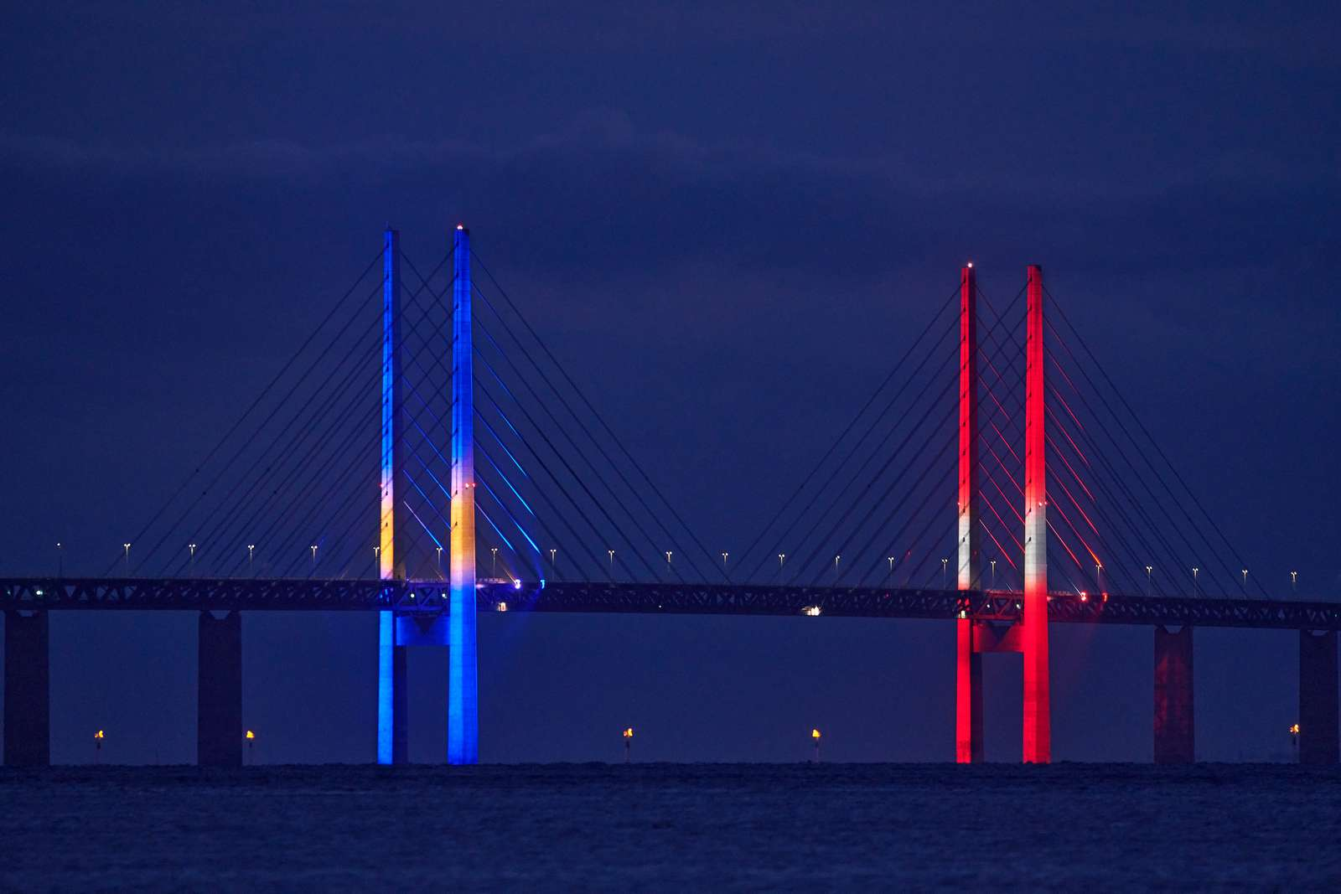
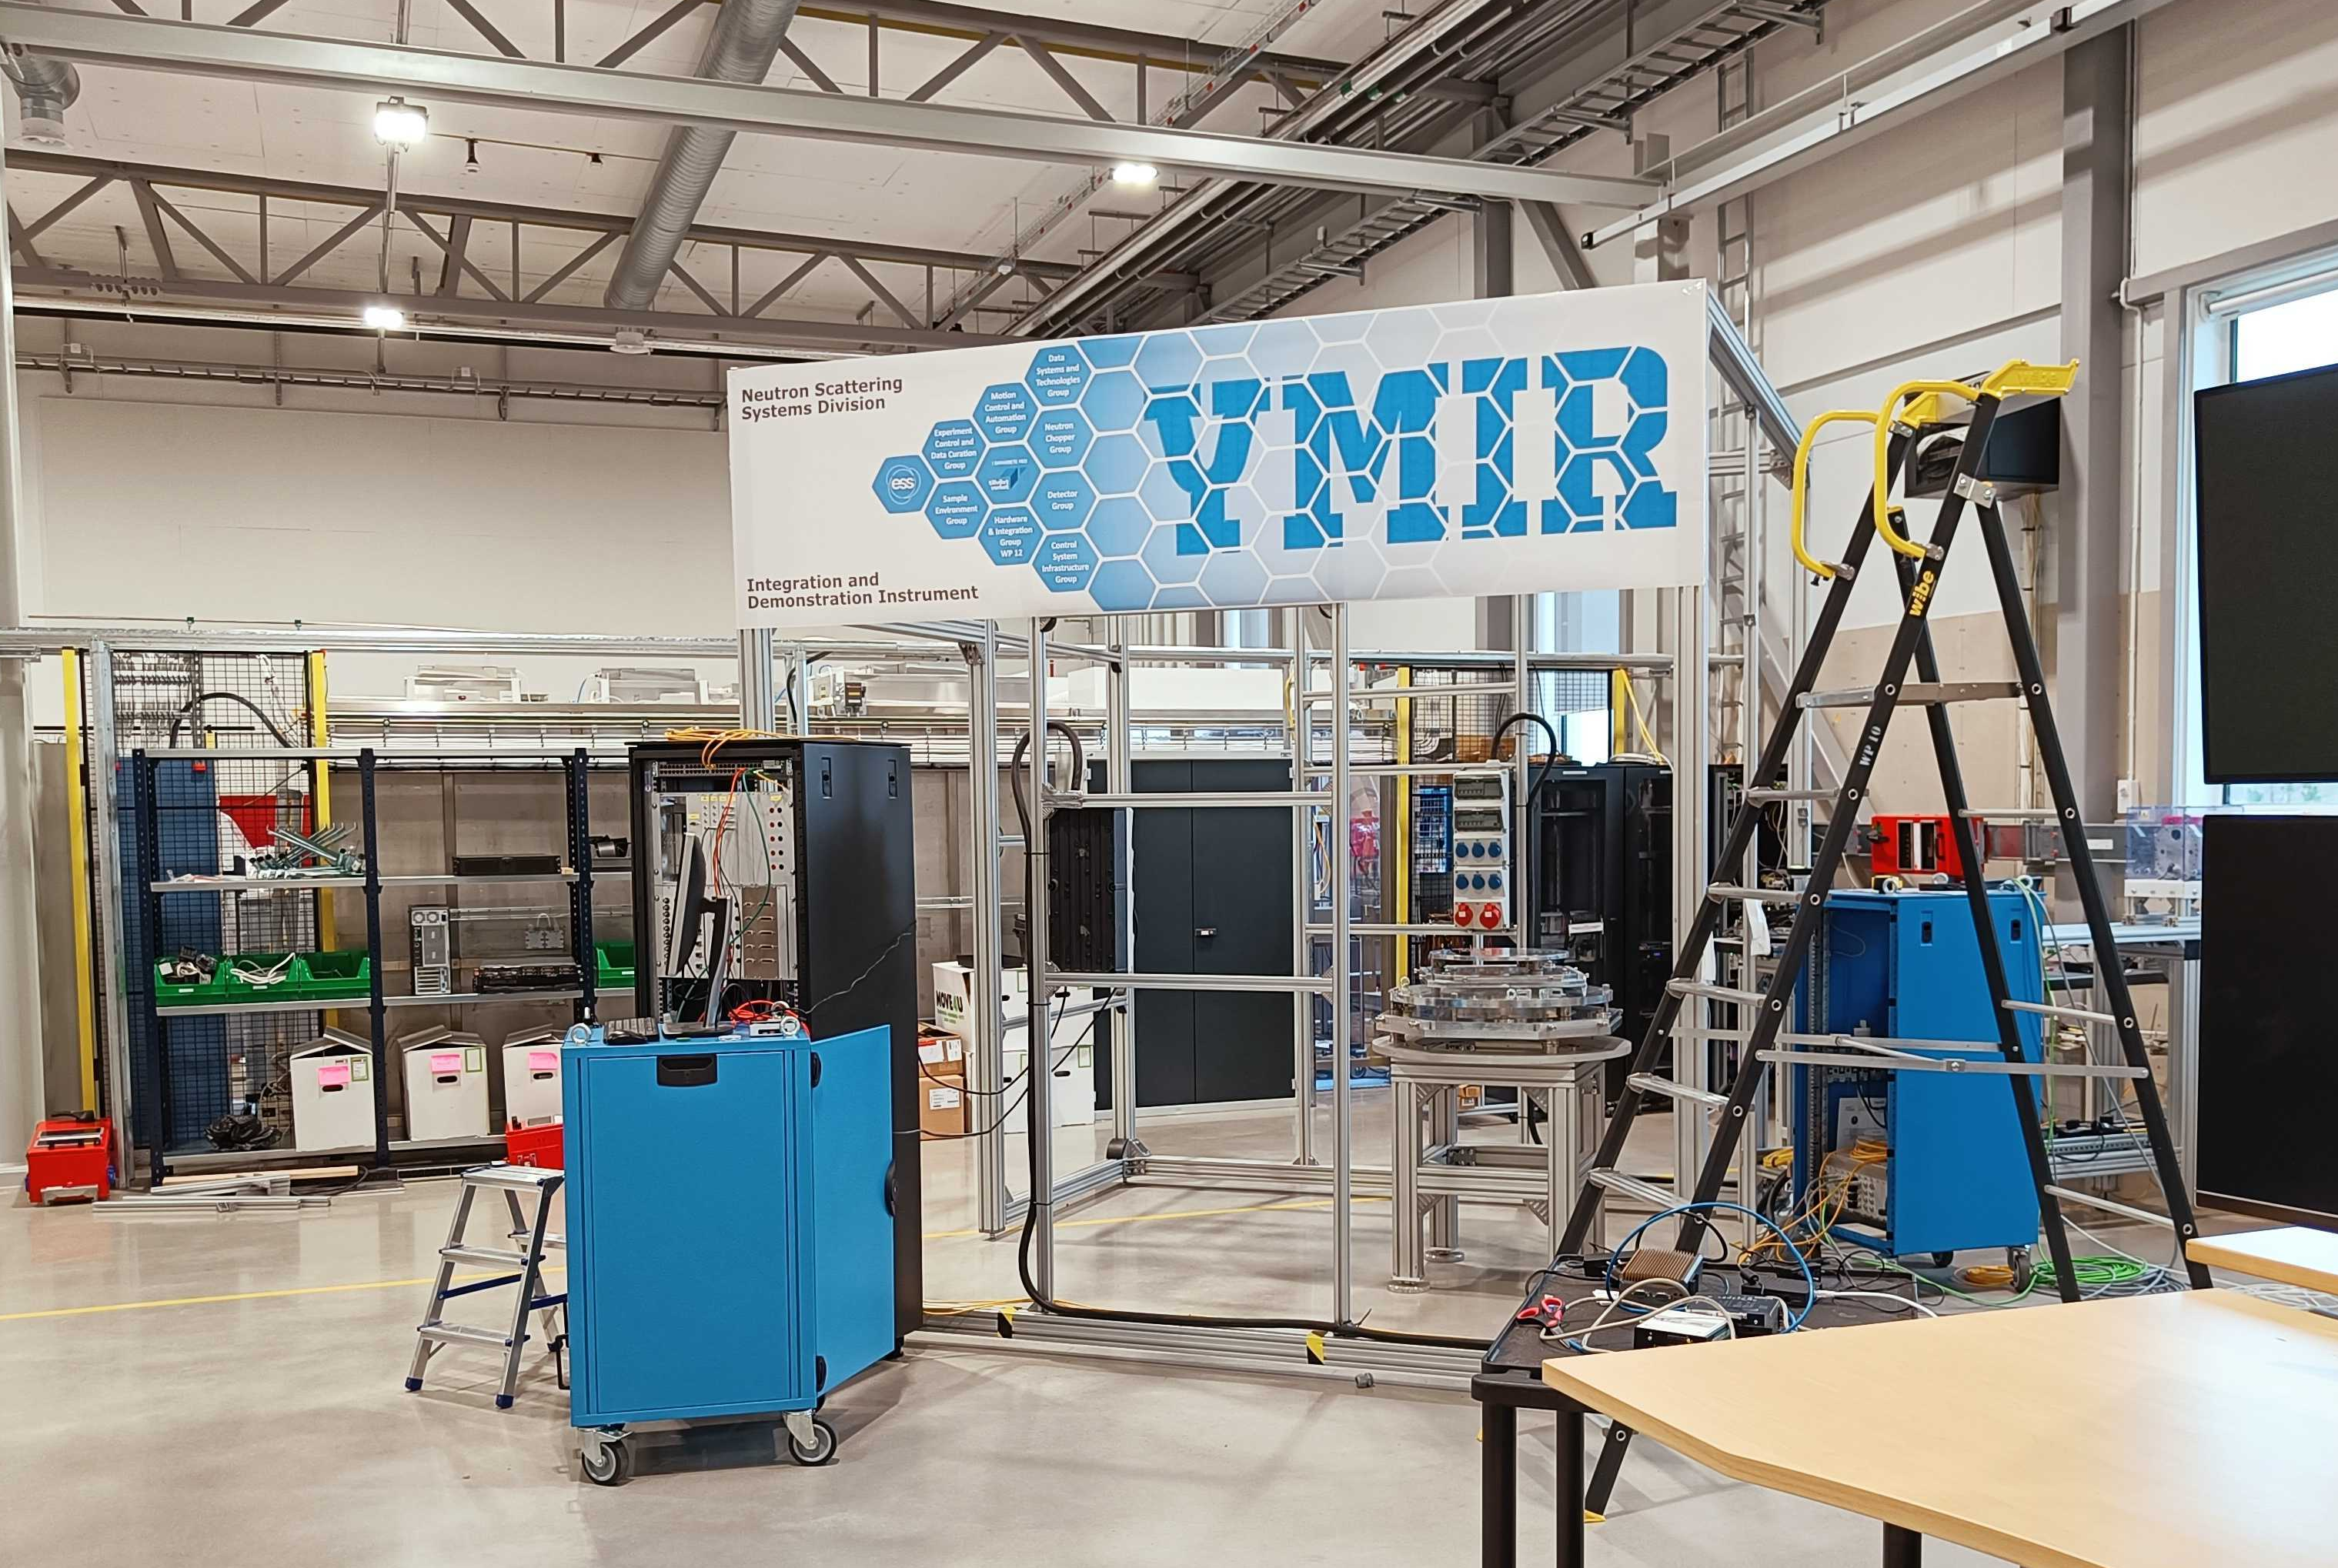
Getting ready for Cold Commissioning
YMIR connected and up running on production environment
Link to Copenhagen
Collaboration between ECDC, ICS, & DST

Slide 15
Plans for the rest of 2022
Capital investment plans for 2022 to 2027

Slide 16

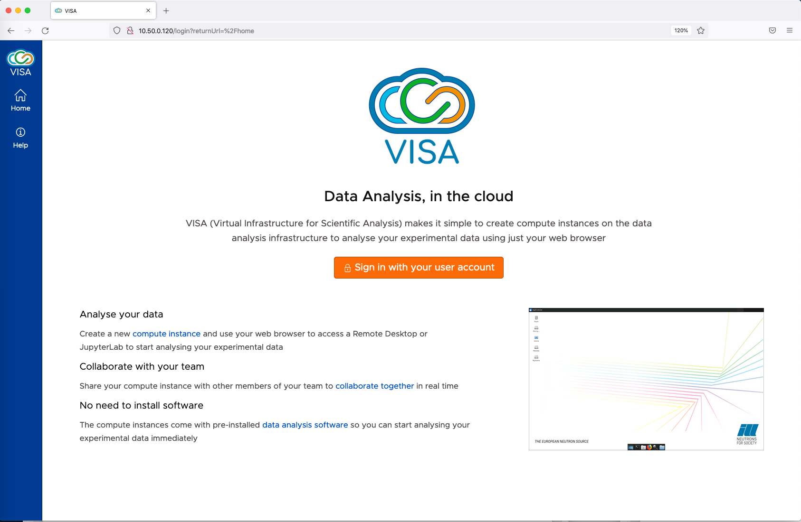
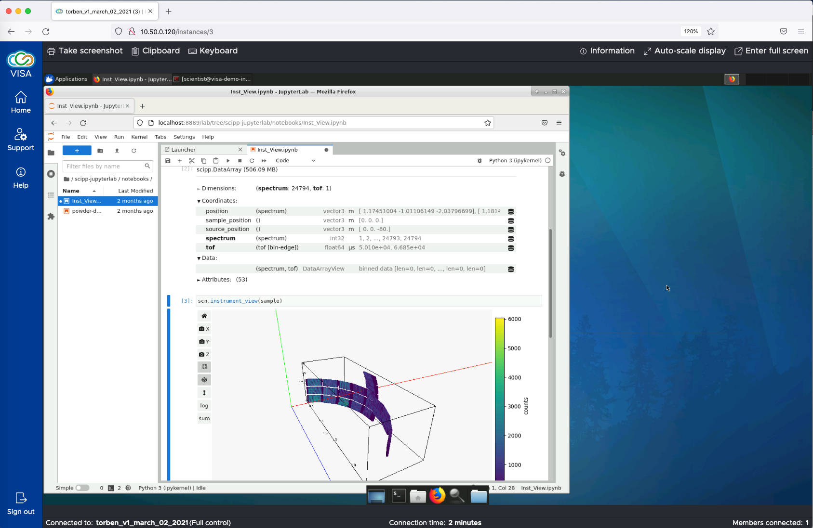
Testing VISA for remote acces
VISA is developed by ILL and endorsed by PaNOSC
Tested by DRAM group / Instrument Data Scientists
Used for LoKI detector test at ISIS

Slide 17
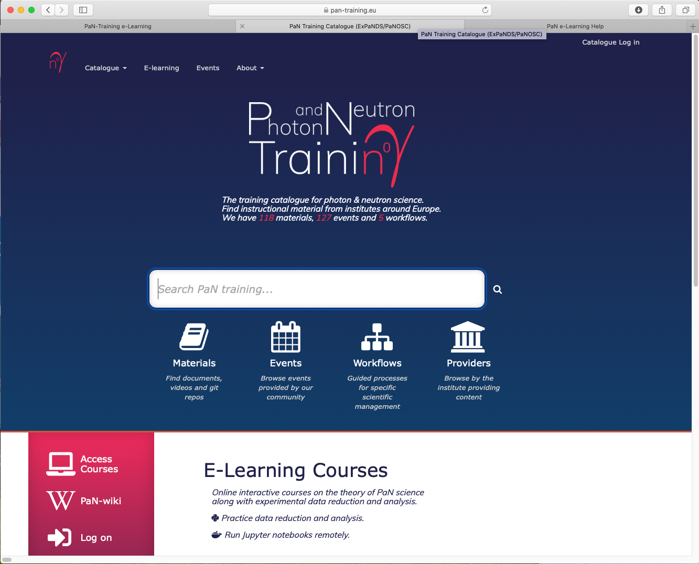
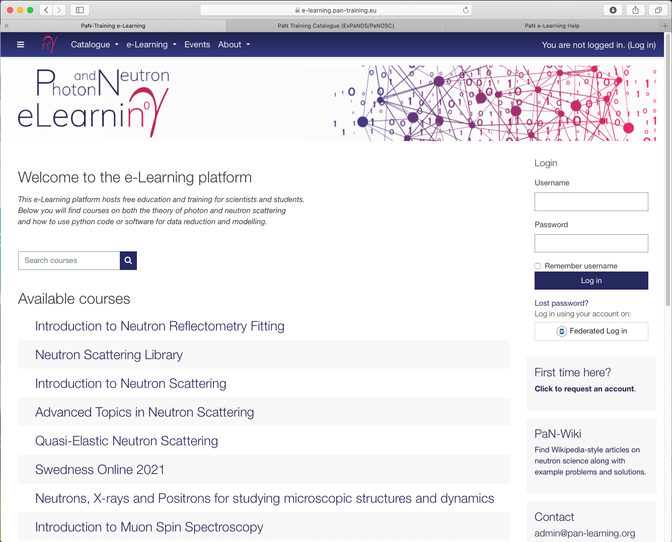
e-learning platform
Deliverable from PaNOSC WP8 / ExPaNDS WP5
Collaboration between HZDR, SOLEIL, ELI, and ESS (DST + DRAM)
Enables Jupyter to be run from moodle → hands-on simulations, analysis, coding, etc
Have been used at various courses
PaNOSC WP8 is now led by Instrument Data Scientist Andrew McCluskey

Slide 18
Registration
Wrap-up and harvesting
Planning
Performing & Analysis
Proposal
Scheduling
Scientific Web Applications
Supporting the User Journey

Slide 19
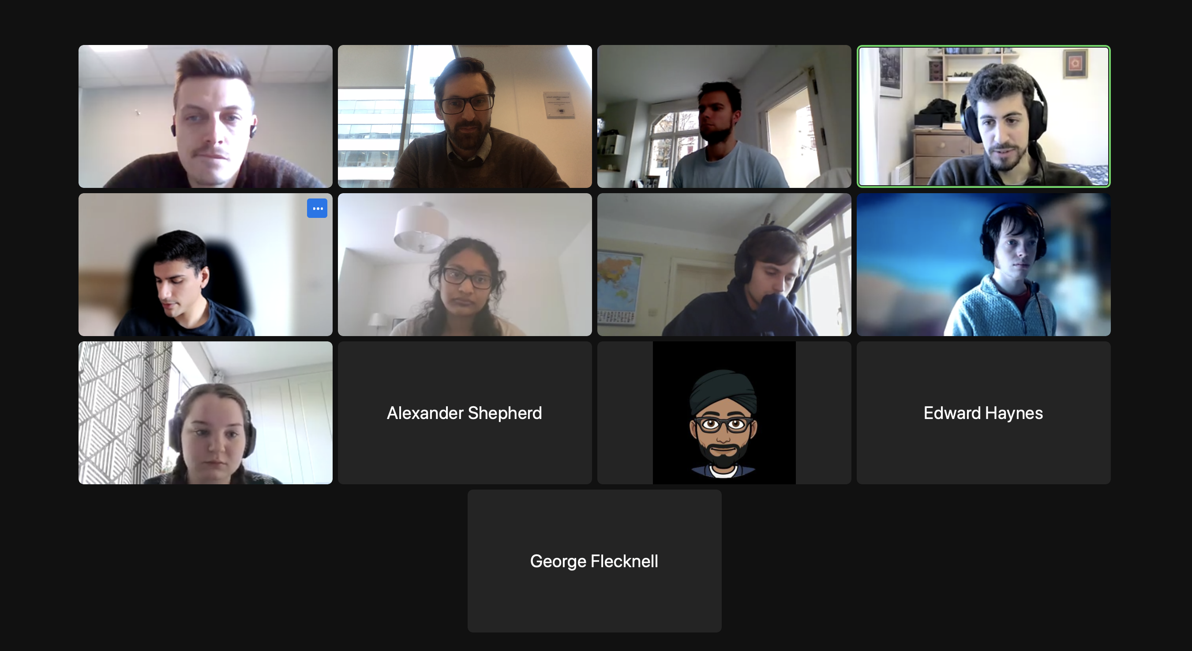
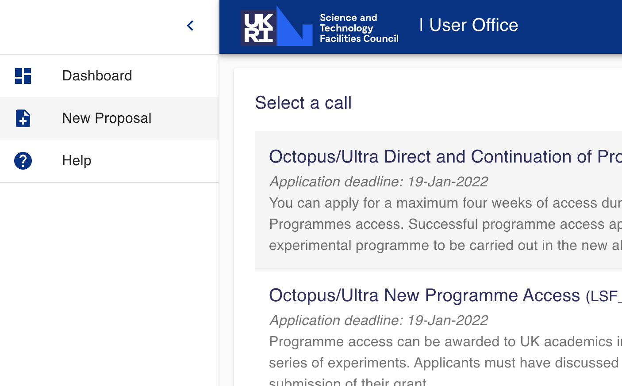
User Office collaboration with SAD
Adapted and co-developed by STFC
Meeting with STFC
Successful usages
@ESS: | DEMAX Call 2b: Proposal submission Technical Review Scientific Review
@STFC: | Central Laser Facility’s November call ISIS rapid access April call
Central Laser Facility Call
    New developments:
    Module for generating statistics
    Visitor management
    Experiment safety report
    Sample shipment with integration to EAM

Slide 20
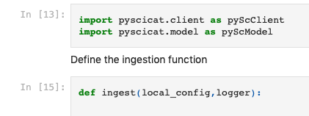
Data Curation
Supporting data journey in a FAIR way
Continue to develop SciCat & SciChat
Focused work on integration and inter-operability, e.g.:
PySciCat:
SciCat partner community continues to grow
PaNOSC API:
Advanced cross-facility search of data sets through PaNOSC API

Slide 21
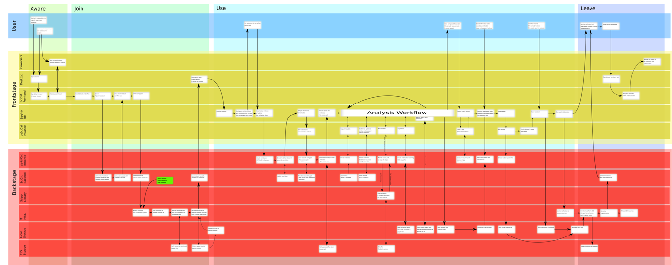
Supporting the user / data journey
Blueprint for data analysis journey result of User Experience workshop

Slide 22
Data Reduction, Analysis, and Modelling
Creating impact from experiments

Slide 23
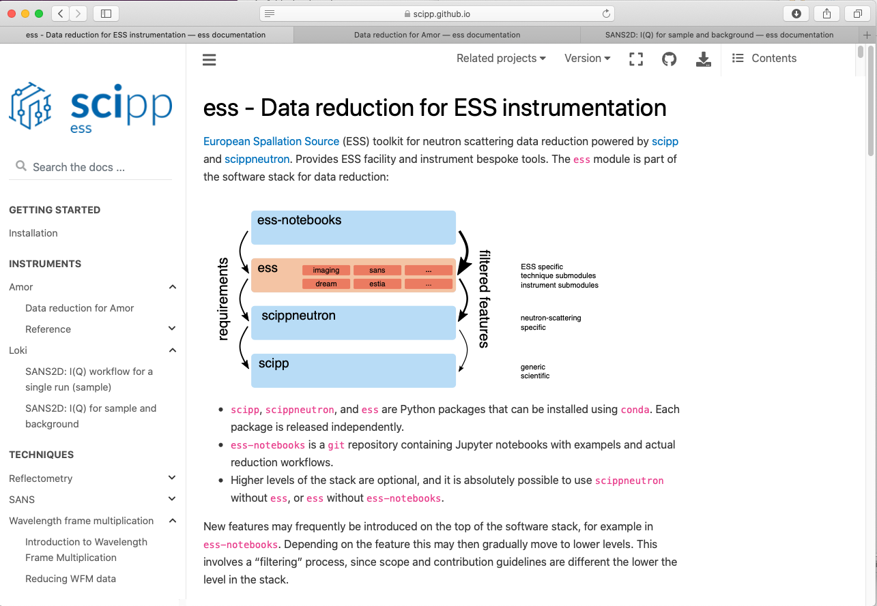
scipp
Continues to be developed and improved with input from Instr. Data Scientists
https://scipp.github.io/ess
Close collaboration between scipp team and instrument data scientists:
Requirements
Development of workflows
Joint meetings, pair-programming, and lively discussions on slack channel
Good progress:
new features, bug fixes, improved documentation & build systems
Used successfully for AMOR & LoKI detector tests
Increased interest from other facilities:
  ORNL, ISIS, FZJ

Slide 24
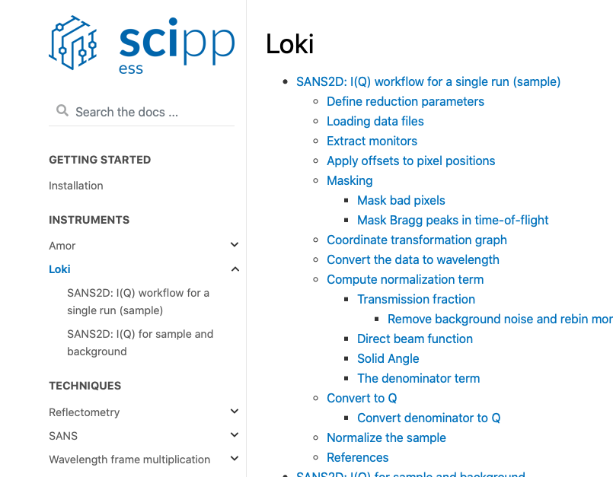
Good progress with workflows
… and associated documentation ☺
  SANS workflows and notebooks
  Reflectometry workflows and notebooks
  Diffraction workflows and notebooks (soon)
  Imaging workflows and notebooks (scheduled for development)

Slide 25
Staffing for scipp development
… and what about those user interfaces?
ESS budget
User interfaces for scipp
#core developers for scipp
2021 | 2022 | 2023 | 2027
3 + 2 (IK) | 3 → 4 | 5 → 6 | 6
Instrument teams need to master Python
  DRAM & IDS provides training for that!
  Python & Jupyter may be only workable UI for Hot Commissioning
GUI (widgets) ready for SOUP
What, when and how are too early to answer:
  Just rebaselined pushing BOT & SOUP
  Rapid technological development
  Who will collaborate?
  No consensus about GUI for data reduction
+ support from Instrument Data Scientists
External funding (Swedish Research Council):
Grant for NMX with LU (~4 PY @ ESS)
  Collaboration with DLS & STFC (DIALS)
Grant for event filtering with UU (~2 PY @ ?)
  Collaboration with ISIS

Slide 26
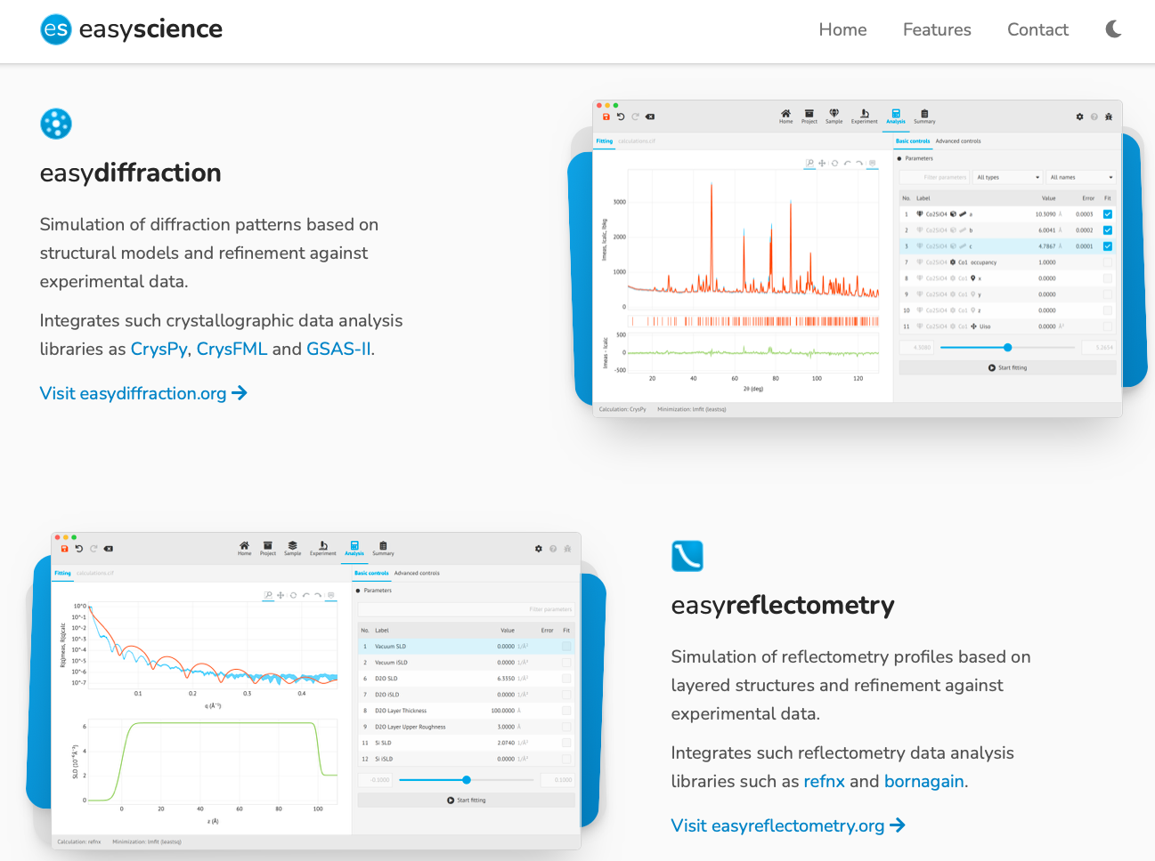
easyScience family
https://easyscience.software
Intuitive and user-friendly GUI (Apps) for simple tasks
Python API for advanced stuff, e.g. for Jupyter
Suitable for rapid GUI development for typical analysis workflows
Make use of existing engines (e.g. CrysFML, BornAgain, etc)
  easyDiffraction with ILL (CrysFML) & LLB (CrysPy)
  easyReflectometry with FZJ (BornAgain), DLS, (refnx), ORSO
  CSPEC team requests easyQENS
Collaboration with Chalmers (post doc) on statistical learning
Increased interest from other facilities:
ORNL, FZJ, ISIS, DLS, ORSO, Chalmers

Slide 27
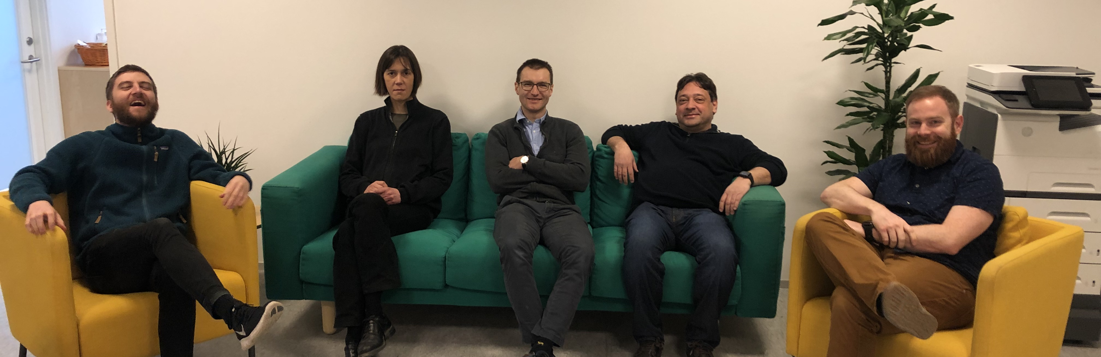
Staffing for Analysis and Instrument Data Scientists
Instrument Data Scientists (½ IDS instrument)
Data analysis core development
Technique | Instruments | Who or When
Imag. & Eng. | ODIN & BEER | Søren
Reflectometry | ESTIA & FREIA | Andrew M
SANS | LoKI & SKADI | Wojtek
Diffraction | DREAM & MAGIC | Céline
Spectroscopy | BIFROST & CSPEC | Greg
Diffraction | NMX & HEIMDAL | Jan 2024
Spectroscopy | TREX & MIRACLES | Jul 2026
Technique | Who or When
Manager (Atomic sim) | Piotr
Diffraction | Andrew S
Spectroscopy | Simon W
Imaging (& Eng) | Nov 2023
Ensure right expertise
Able to collaborate on all techniques
IDS for reflectometry and SANS contribute significantly to data analysis
Data analysis developers to support IDSes during Hot Commissioning
Conservative when using ESS budget
More visionary / researchy when using external funding

Slide 28
Conclusion
We have devised a plan aligned with instrument schedule
With existing staff plan we are very lean and continue to be so
      … too early to say we cannot make it ➔
  Good progress
  High level of collaboration with other facilities or interest from other facilities
  We benefit greatly from externally funded projects (EU, Swedish Research Council, Chalmers)
Closely monitor & prioritize

Slide 29
Questions

