Slide 1
LoKI STAP Update
Instrument progress
4th May 2022
PRESENTED BY Loki team

Slide 2

1
LoKI Instrument Update

Slide 3
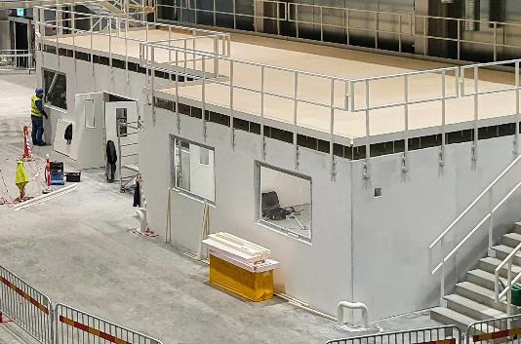
LoKI Status Overview
Choppers
Delivered and SAT complete
Cave Shielding
Steel is currently under pre-build at ISIS
Concrete roof in procurement
In-bunker
Components tested at ISIS and ready for shipping
Detectors
Vessel delivered
Detector modules complete
Mechanics in pre-build
BWI
Insert installed
Sample Area
Stack delivered
Snout system in prebuild
Door & roof manufacture started
Bunker-to-cave
Base structures installed
Collimator Selector currently under pre-build at ISIS
Shielding in manufacture
LOKI/FRIEA Hutches
Installation complete
Hutch installation

Slide 4
LoKI In-bunker Components
In-bunker components have completed SAT testing at ESS with the chopper racks and are currently awaiting installation
Guide vessels during Pre-build
In-bunker support structures with chopper 1
Guide and vessels delivered to ESS

Slide 5
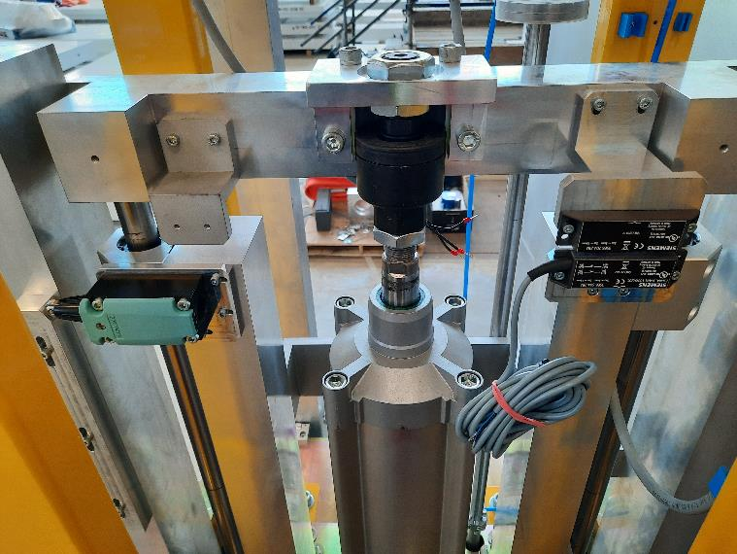
LoKI Heavy Shutter
Heavy shutter mechanism with PSS switches
Guide integration complete
Motion and kinematic testing complete
PSS switch integration complete
System is currently being disassembled and requires minor finishing before shipping to ESS
Heavy shutter in bunker mock-up at ISIS
Choppers @ ESS

Slide 6
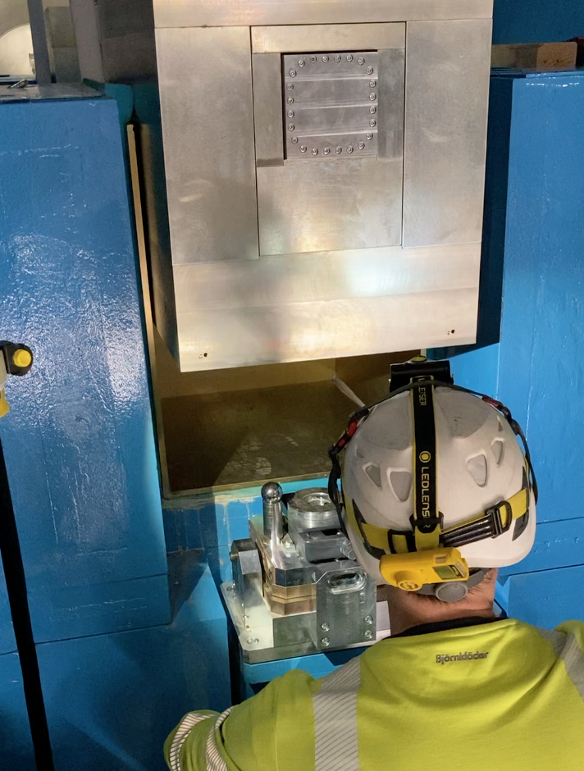
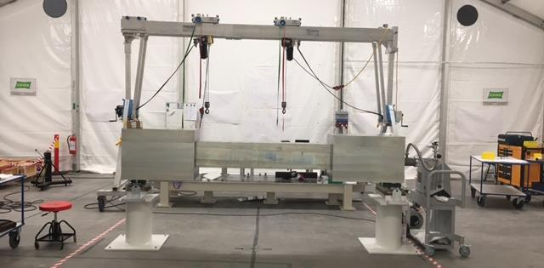
LoKI Bunker Wall Insert (BWI)
BWI guide integration at ESS
Guide integration complete
Alignment complete
Final installation complete
Installation of the BWI at ESS

Slide 7
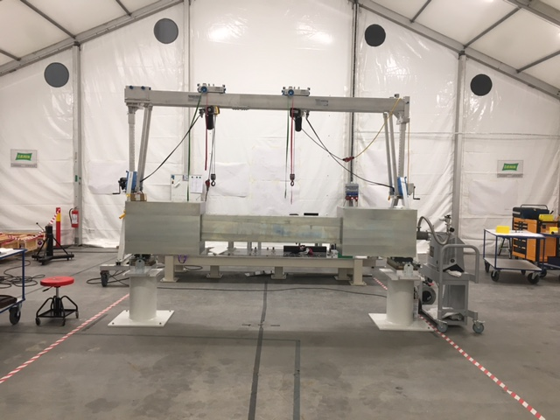
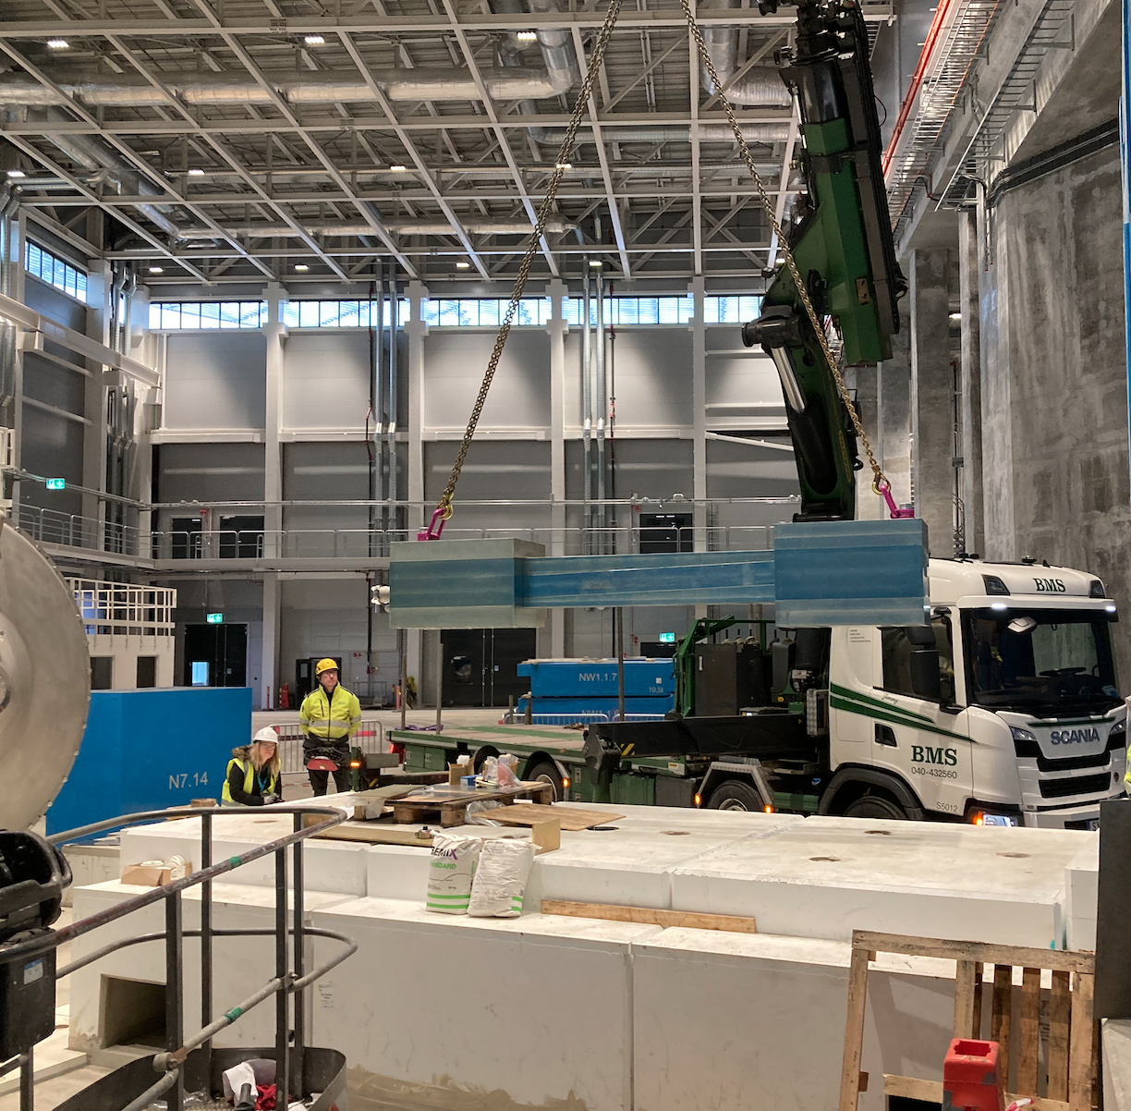
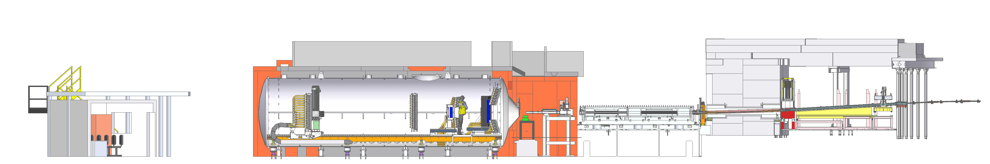
Bunker wall insert
Guide integration complete
Alignment complete
Final installation complete

Slide 8
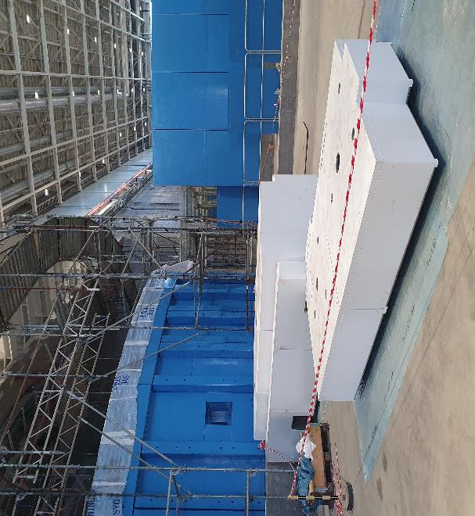
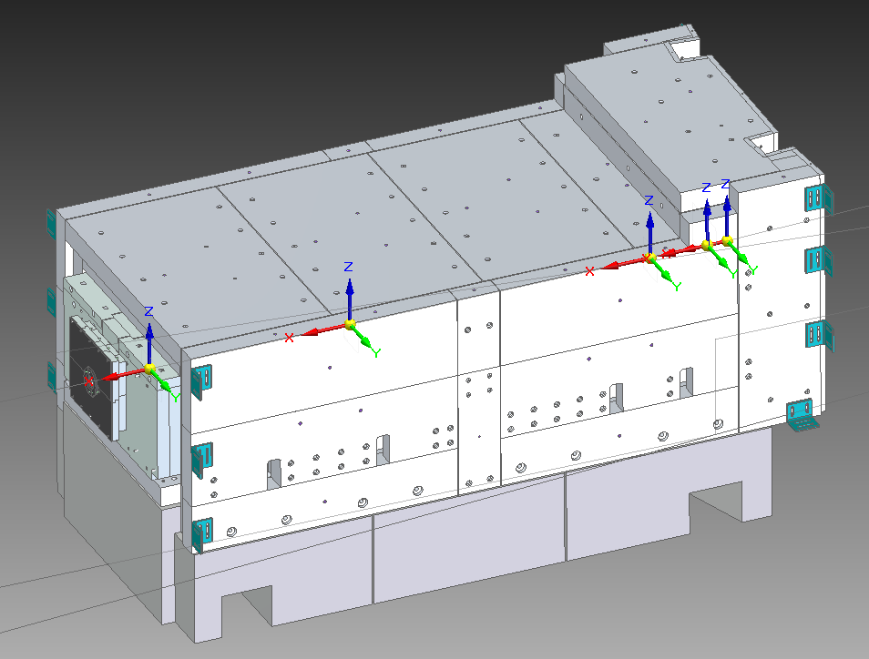
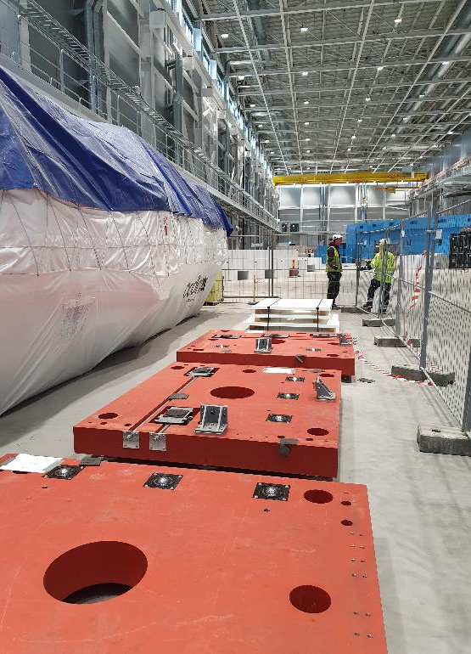
LoKI Bunker-to-Cave Components
Bunker-to-cave design
Concrete Base Installation
Concrete base installation complete
Collimator selector base steels delivered
Steel manufacture delayed, currently 30% complete
Collimator selector base steels at ESS

Slide 9
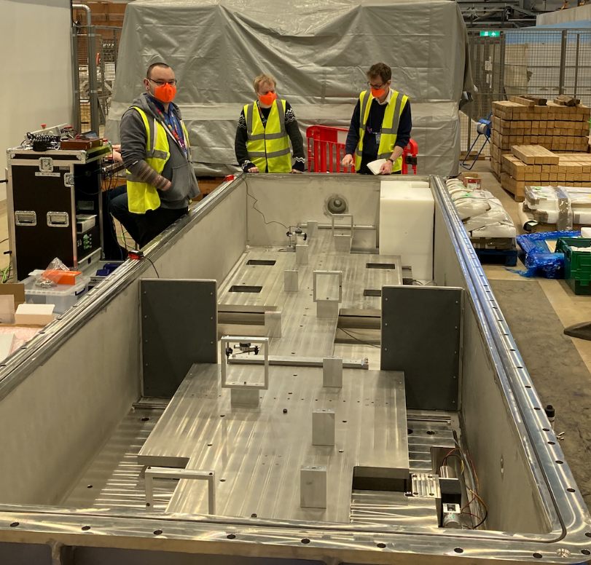
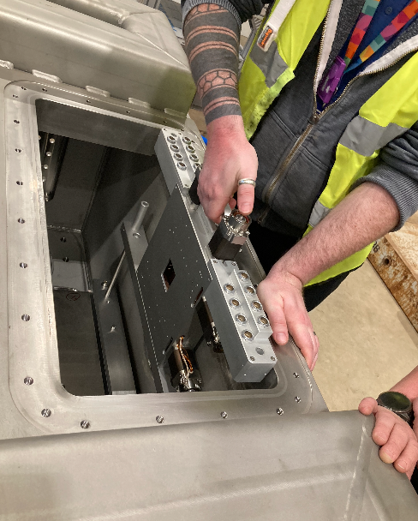
LoKI Bunker-to-Cave Components
Collimator selector motion testing at ISIS
Slit set integration
Slit-set trial integration at ISIS complete
Blade alignment metrology complete
Ongoing issue with motor specification
Modification to Collimator Selector stage 2 complete
Internals in manufacture – assembly expected to begin in May

Slide 10
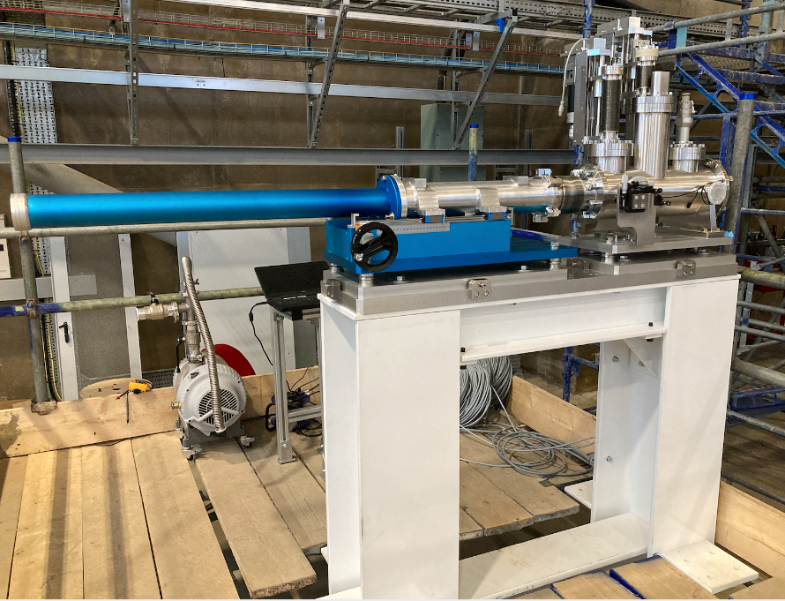
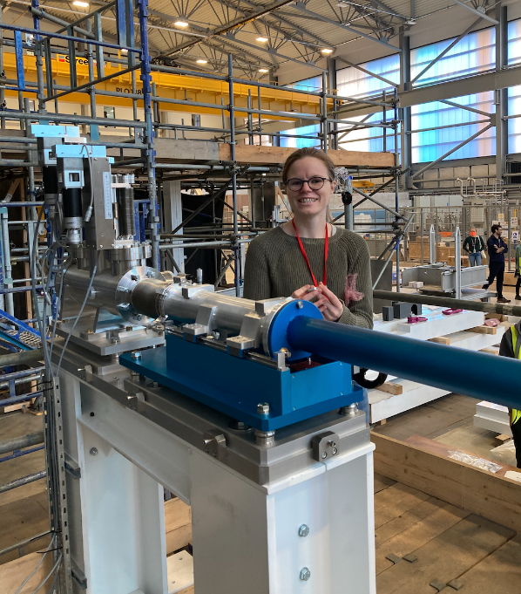
LoKI Sample Area
Snout system pre-build and testing at ISIS
Mk 2 snout system tested
Multiple length snouts ordered
Motion testing ongoing
Boron-lining in preparation

Slide 11
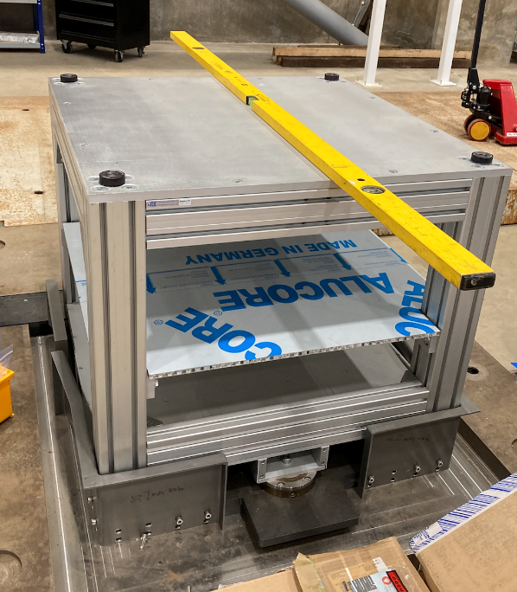
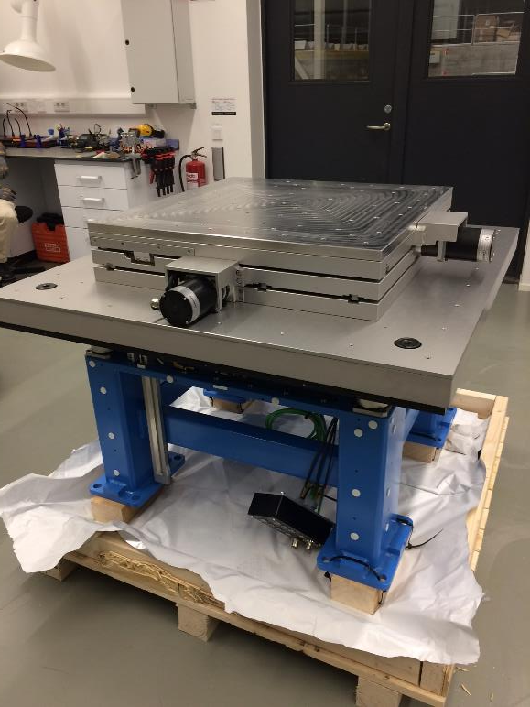
LoKI Sample Area
Sample Trolley testing at ISIS
Sample Stack Delivered to ESS
Sample trolley Mk2 manufacture ongoing
Testing expected in late May
Sample Stack delivery complete

Slide 12
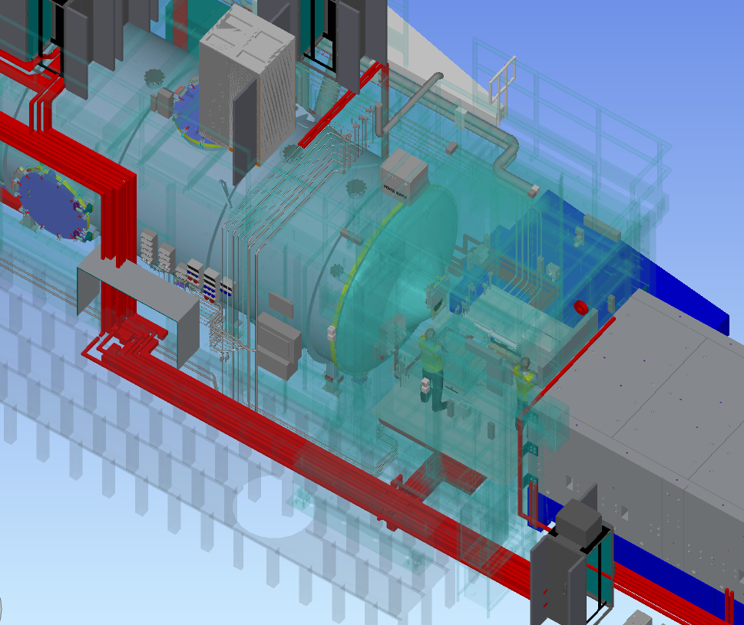
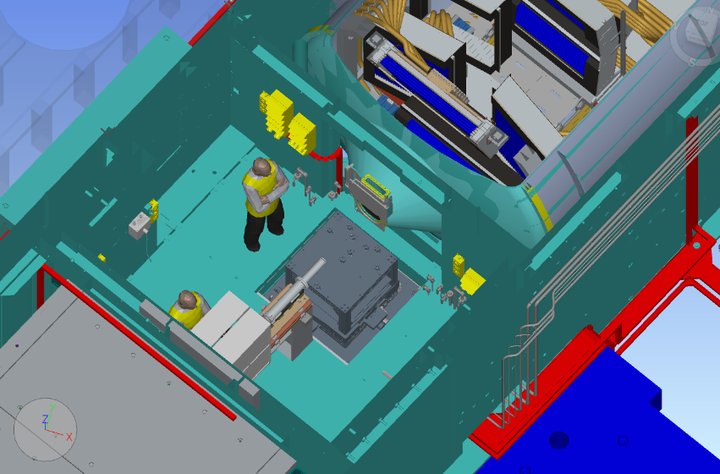
LoKI Sample Area
Loki sample area services layout
Loki Electrical Raceway design (in red)
Common Electrical Project – Final design near complete
Common Utilities Project – requirements document finalised

Slide 13
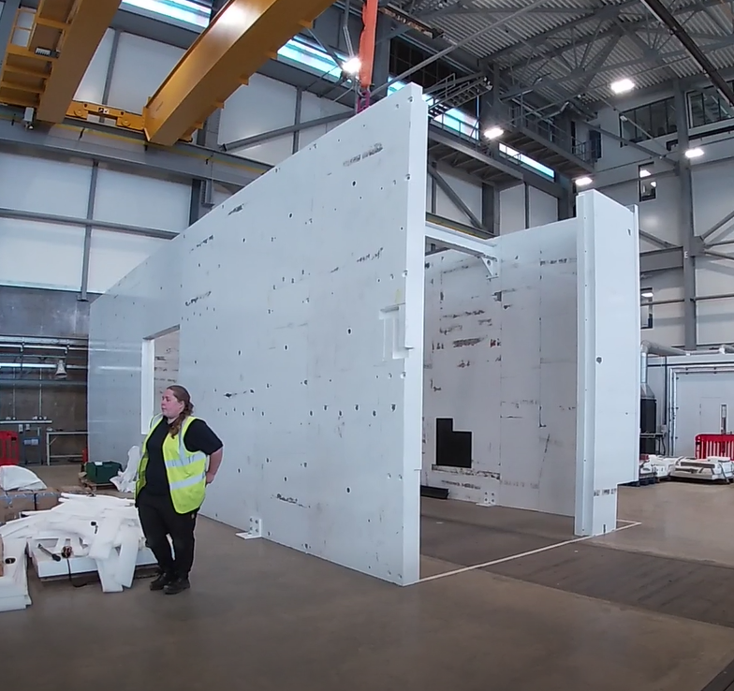
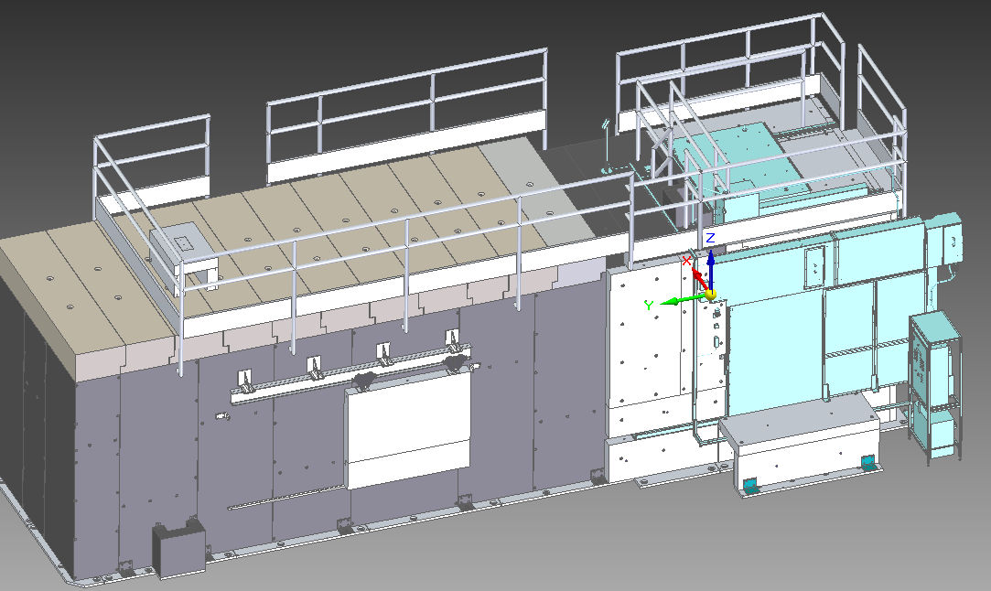
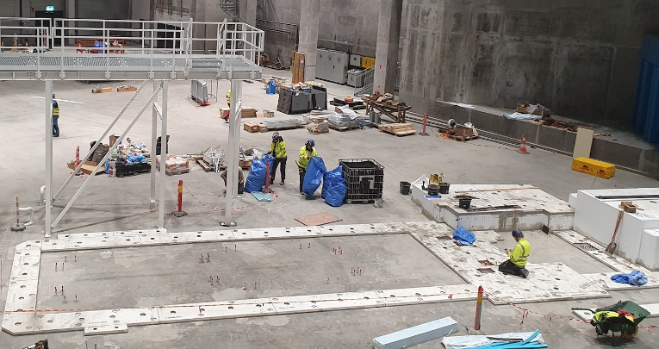
LoKI Cave
Cave CAD model. Door & Roof shown in blue
Baseplate installation at ESS
Cave pre-build at ISIS
Cave baseplate installed at ESS
Cave pre-build at ISIS – all steels delivered
Boron lining 50% complete
Roof tender started
Door & Roof manufacture started

Slide 14
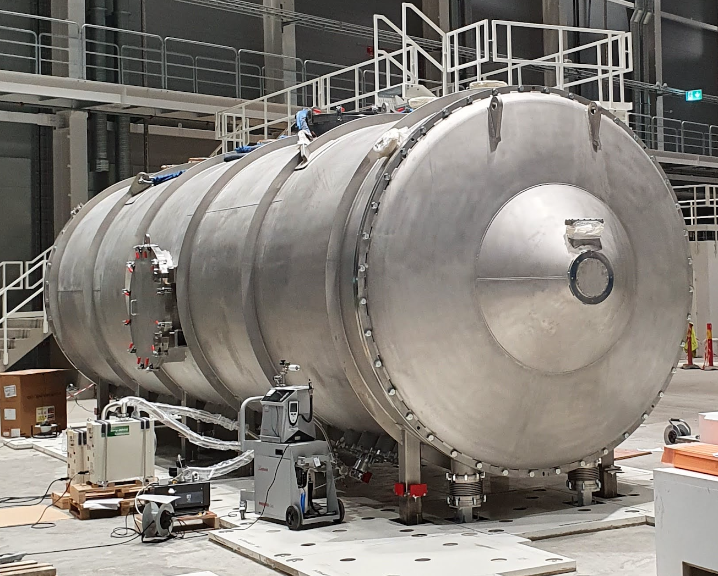
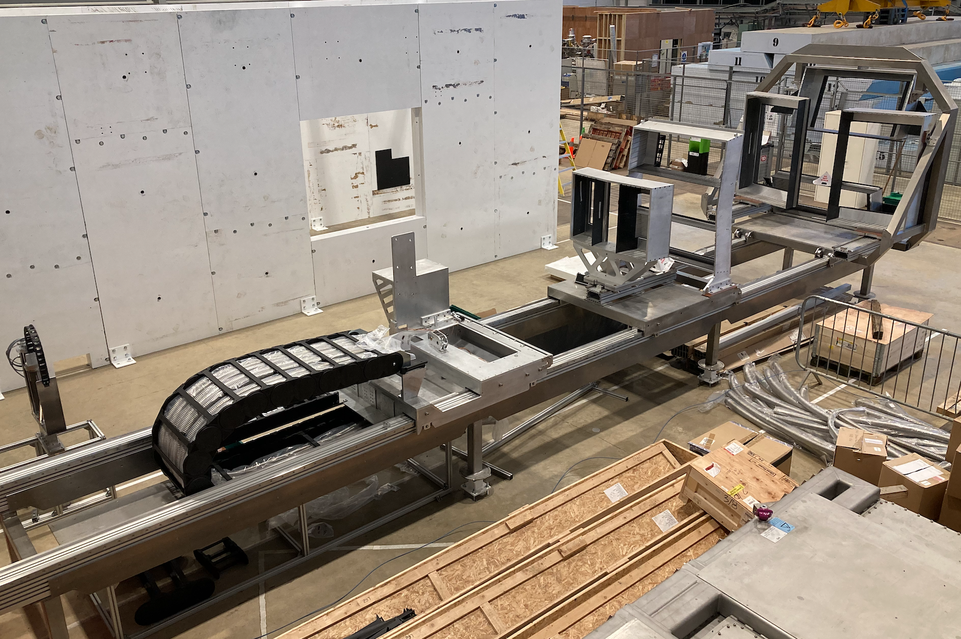
Detector Systems
Detector vessel installed at ESS
Vacuum tests complete
Detector mechanics prebuild at ISIS ongoing

Slide 15
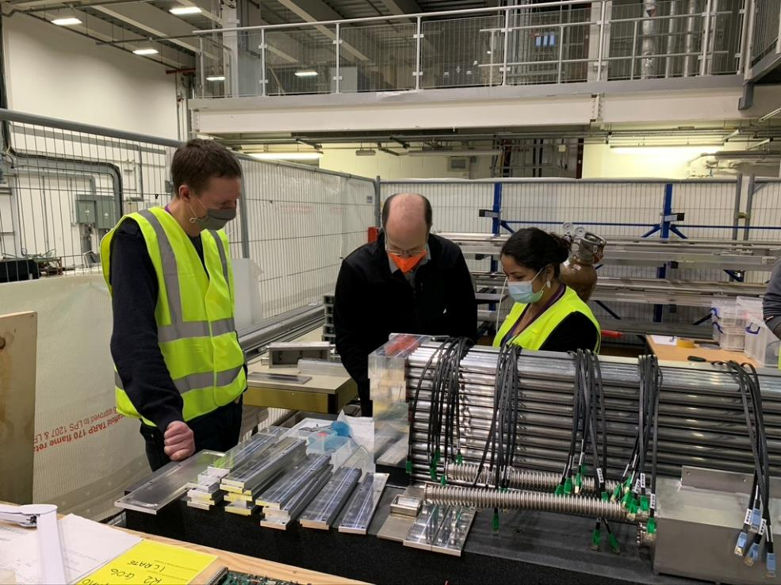
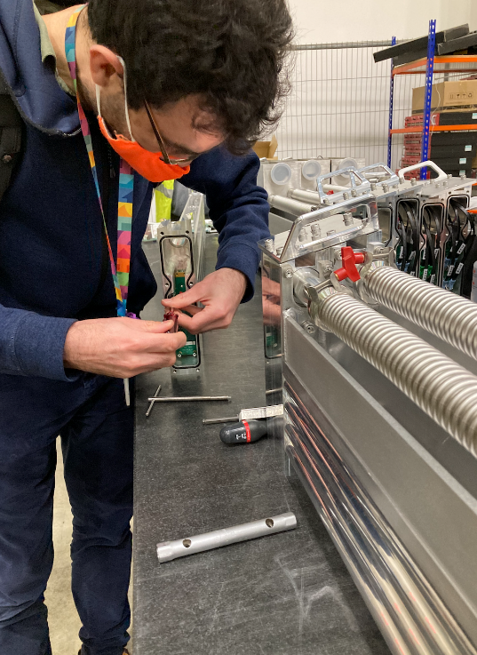
LoKI Detectors
Construction of all detector modules complete (Day 1 coverage)
Cable procurement and assembly ongoing
Detector electronics LV/HV procurement ongoing

Slide 16
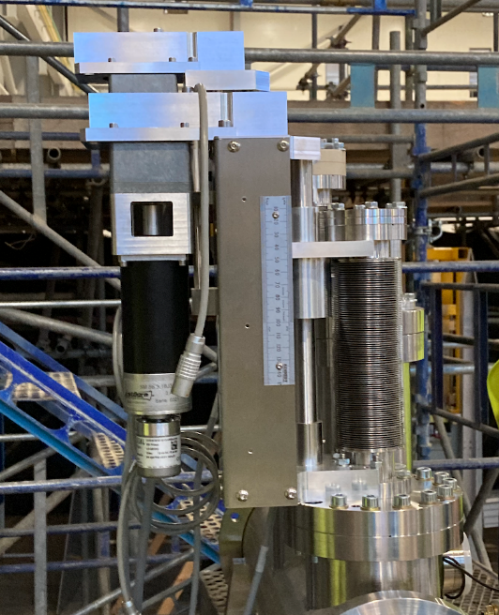
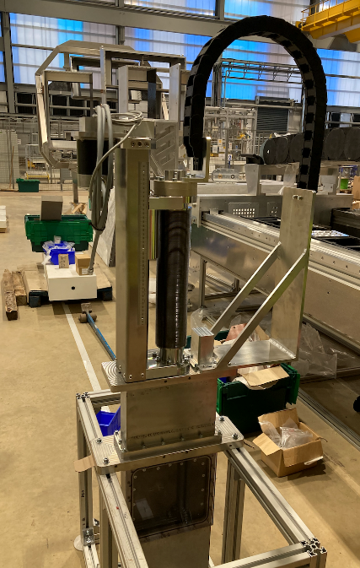
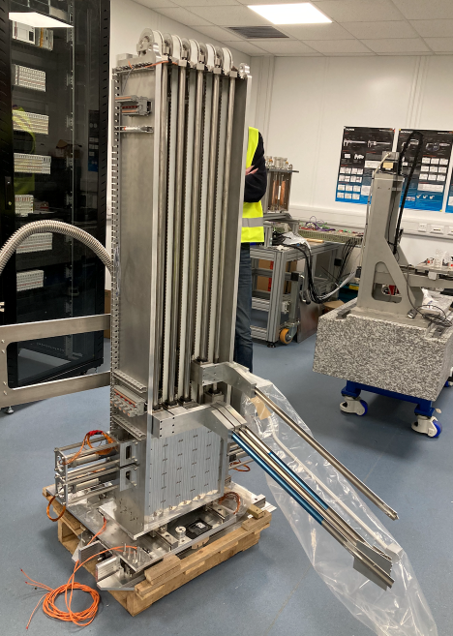
LoKI OVERVIEW
Beam monitors
Before the sample position
Trans mon in detector snout
Trans mon on a beamstop
Under prebuilding and testing at STFC

Slide 17
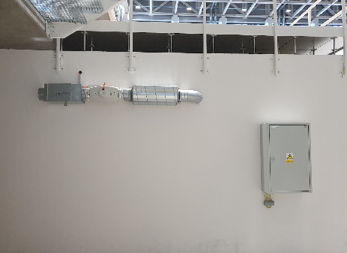
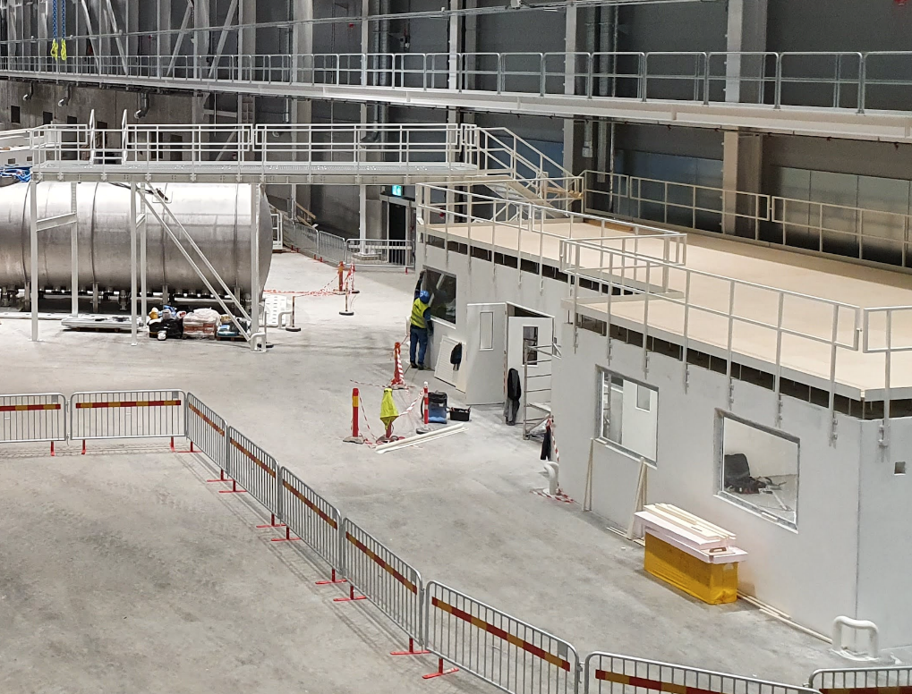
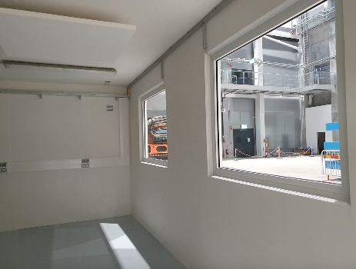
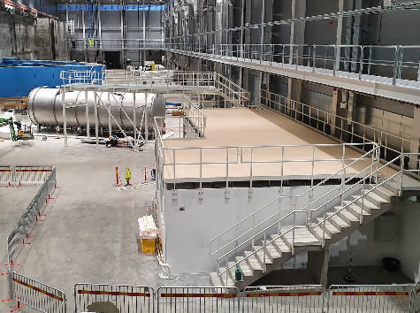
LoKI OVERVIEW
Hutch
Installed and under handover (SAT) @ ESS

Slide 18
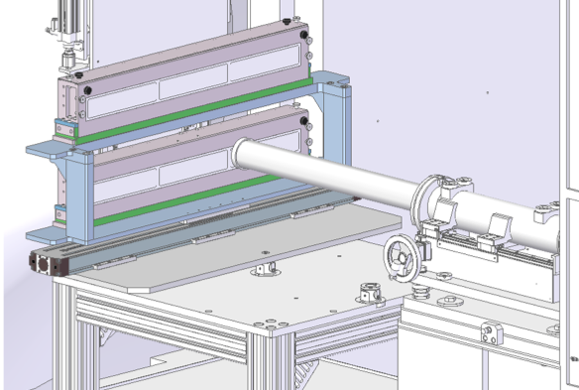
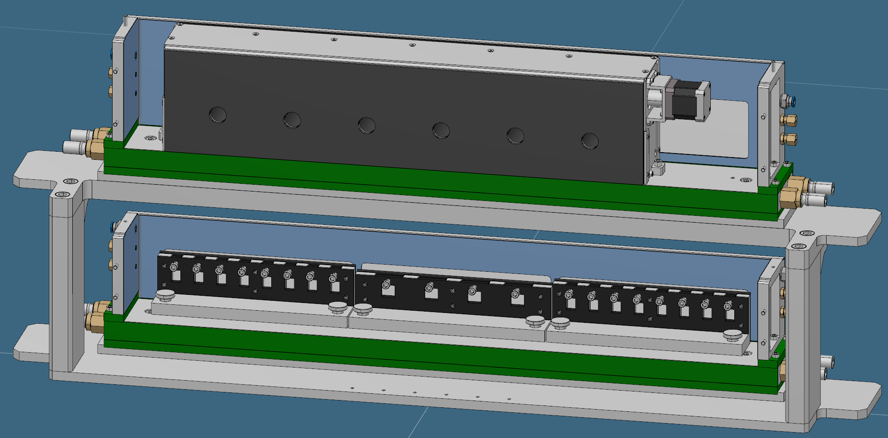
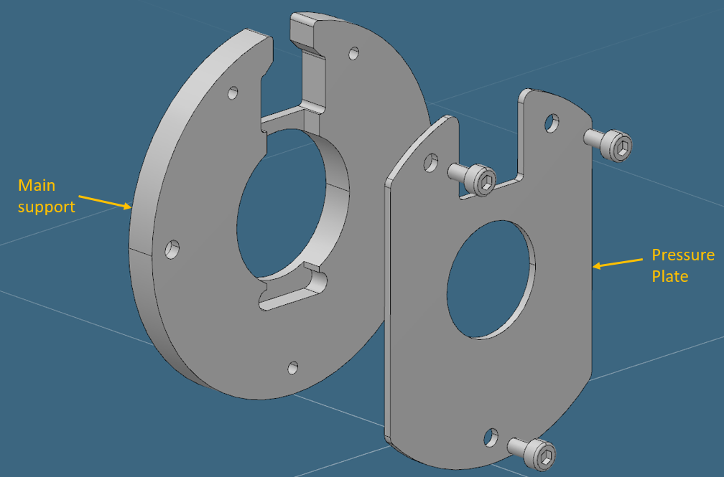
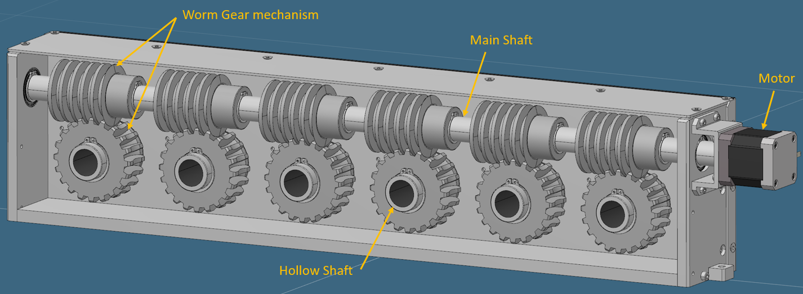
Sample environment
Full design review of the thermostated and rotating cell holder
Expected to be complete in the coming months.
2 rows of cell holders, each row will have independent temperature control via two Julabo water baths
4 interchangeable “cartridges” will be fixed onto each level of the rack. Multiple different cartridges will be available to accommodate narrow, wide and sandwich cells of different thicknesses
Minimum of 24 narrow cells per row, so 48 narrow cells can be loaded in total
45 degree scattering angle in all directions, with B4C shielding on the front and back of the cell holder

Slide 19
LoKI sample environments
Priority | Sample Environment System (SES) | Phase | Date Needed* | Status
1 | Thermostated sample changer for quartz cuvettes | HC | Q3 2022 | Detailed design almost complete - based on ISIS set-up
1 | Cell tumblers/rotating sample holders | HC | Q3 2022 | Detailed design almost complete
1 | Flow cell (including HPLC pumps) | HC | Q3 2022 | Jasco HPLC purchased undergoing integration
2 | In situ techniques, as spectrometer attachments to the flow-through cell | ES | Q1 2023 | Direct purchase (Ocean Insights). Integration underway
2 | Rheometer | ES | Q1 2023 | Procured (Anton Paar) undergoing testing and integration at ESS
3 | Stopped-flow cell | ES | Q3 2023 | In-kind device from Estonia (Biologic) awaiting testing at ESS
4 | Individually thermostated cuvette rack | ES | Q2 2023 | Prototype exists and integrated at ESS
4 | Goniometer(s) | ES | Q3 2021 | ISIS to purchase in ~2 months
4 | Dismountable ‘sandwich’-style cells (ESS) | ES | Q2 2023 | Designs exist. Just to be sent for manufacture
4 | Warm Bore Cryomagnet 2.5T | ES | Q2 2023 | ESS procurement underway (no longer in-kind)
4 | Stress/stretching rig (ESS) | ES | Q1 2023 | ESS colaboration(s) to develop different rigs
4 | Cryostat – dilution fridge less than 1K | ES
4 | Cryostat wet | ES | Q4 2022

Slide 20
2
Installation activities

Slide 21
LoKI Installation activities
Base supports for collimation system – May 2022
Delivery in bunker components to ESS - May 2022
Chopper assembly 2 + support base – fitting (not final installation) - May 2022
Local crane installation – May 2022
Bunker to cave shielding – June 2022
Preparation for in bunker access in September (IRR, Documentation,etc) – August 2022
Collimation vessel installation – September 2022

Slide 22
3
Challenges & Delays

Slide 23
Challenges & Delays
All systems shown in photos require some level of finishing, for example:
FAT report writing
Fully completeness of technical file
Disassembling and crating
ESS’s access dates to in bunker gives priority to work preparation
Jaw set AML motors have significant quality concerns – delaying delivery of the collimation selector
Team resources - loss of neutronics scientist and 3 engineers (including lead Will Halcrow) puts increased strain on our ability to meet ESS documentation requirements.
Remaining ESS design scope to be completed: CEP, CUP…
→ All Loki components will to be delivered to ESS this year.

Slide 24
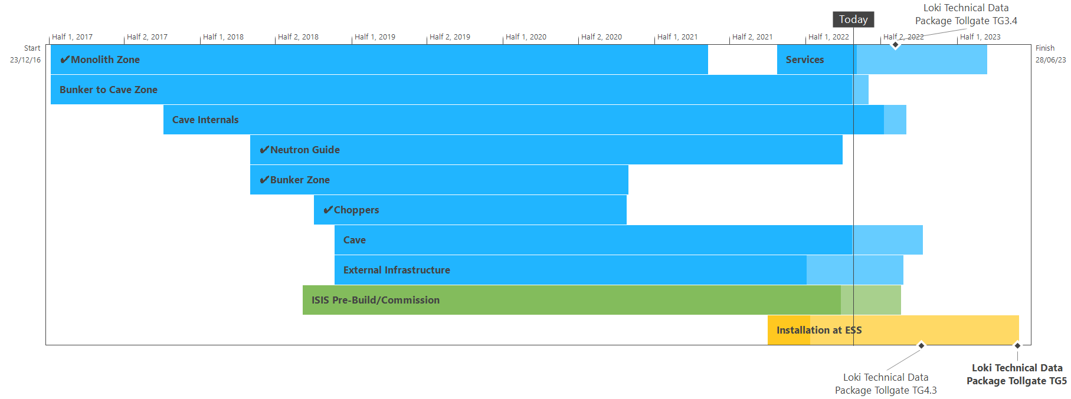
LoKI Schedule

Slide 25
4
Simulations
&
Detector Tests

Slide 26
Aims and methods
Support the development of calibration and data reduction routines:
Replicate measured data on other beamlines with simulation, and generate realistic data (for LoKI) for processing in Mantid/Scipp, to test calibration procedures and data reduction routines
Provide data to generate calibration files to be used at the beginning of the LoKI hot commissioning phase
Using multiple simulation/software tools:
Using a chain of Monte Carlo simulations to carry out the full simulation of a neutron scattering instrument using the adequate software at each part of the system
McStas for the beam transport and conditioning system
Geant4 through the ESS Detector Group Simulation Framework for the detector system
Mantid (later Scipp) for data reduction
MCPL tool to facilitate the transition between the software
Simulation and data workflow from moderator to data reduction
Simulation and data workflow from moderator to data reduction

Slide 27
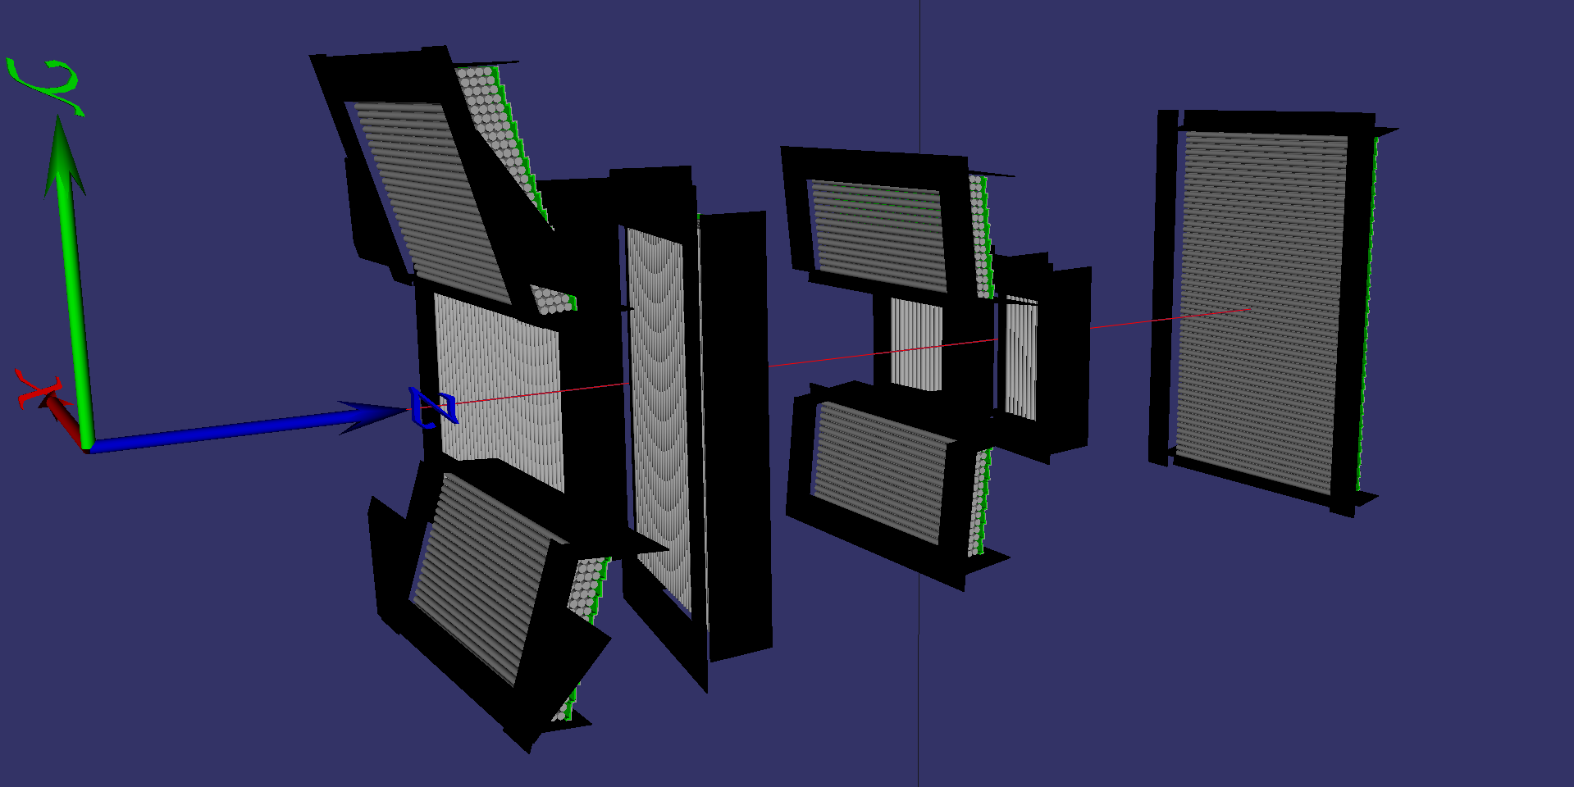
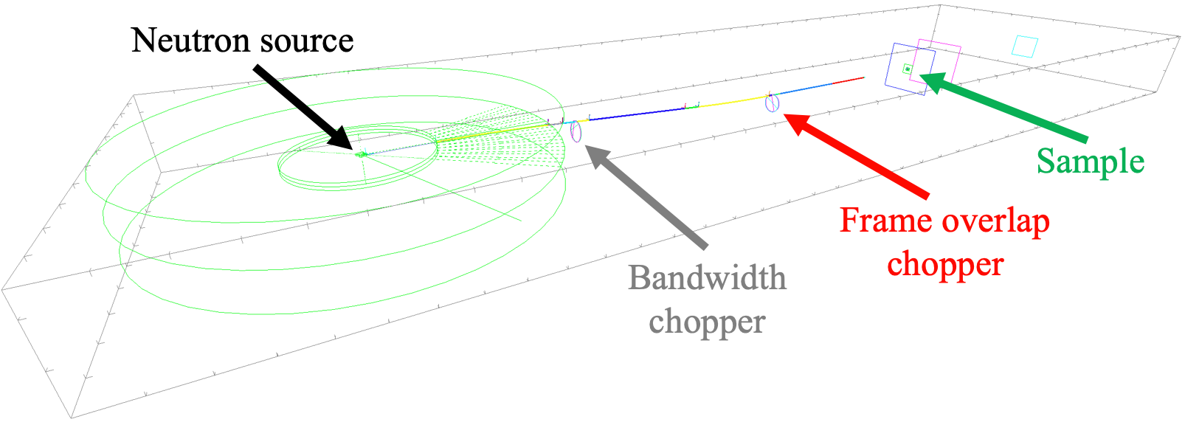
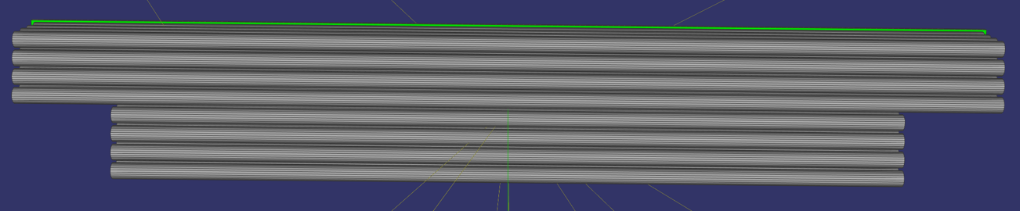
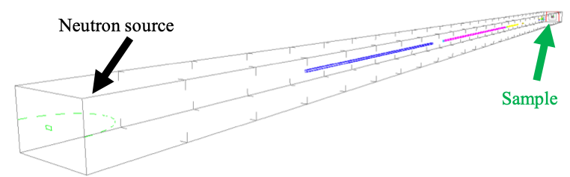
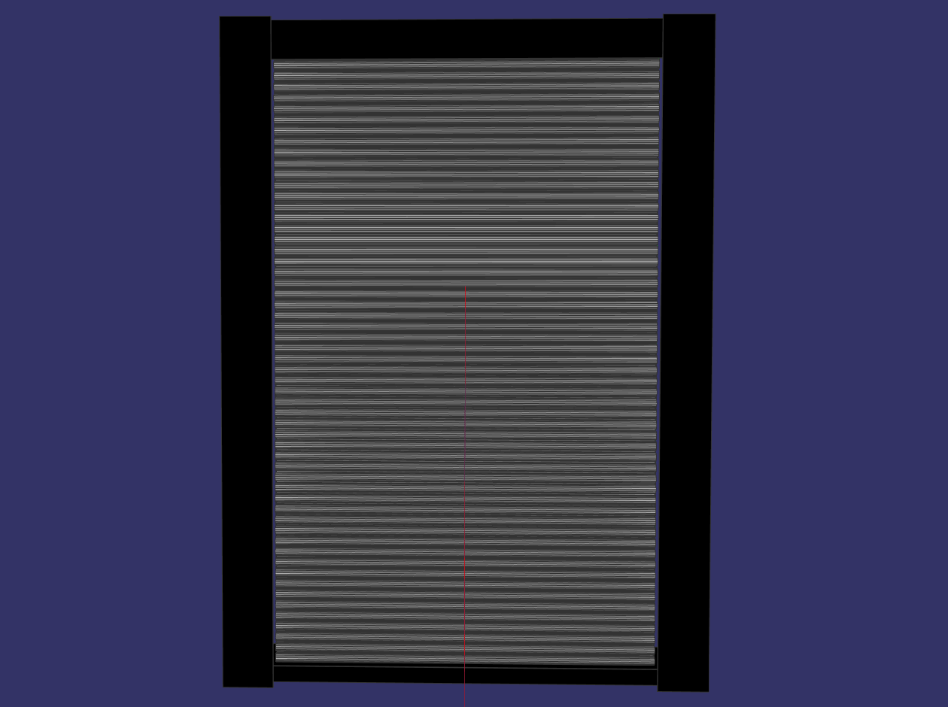
Simulation models
LoKI detector system Geant4 model
LoKI McStas model
Full model with all 9 detector banks
Including B₄C masks
Pixel numbering updated according to the ICD version 2
Detector test (2020 Dec) Geant4 model
Special model to replicate measured data
Larmor McStas model
Detector test (2022 March) Geant4 model
Using only the rear bank of the already implemented full model
Extracting data for the 16 packs of detectors used in the test

Slide 28
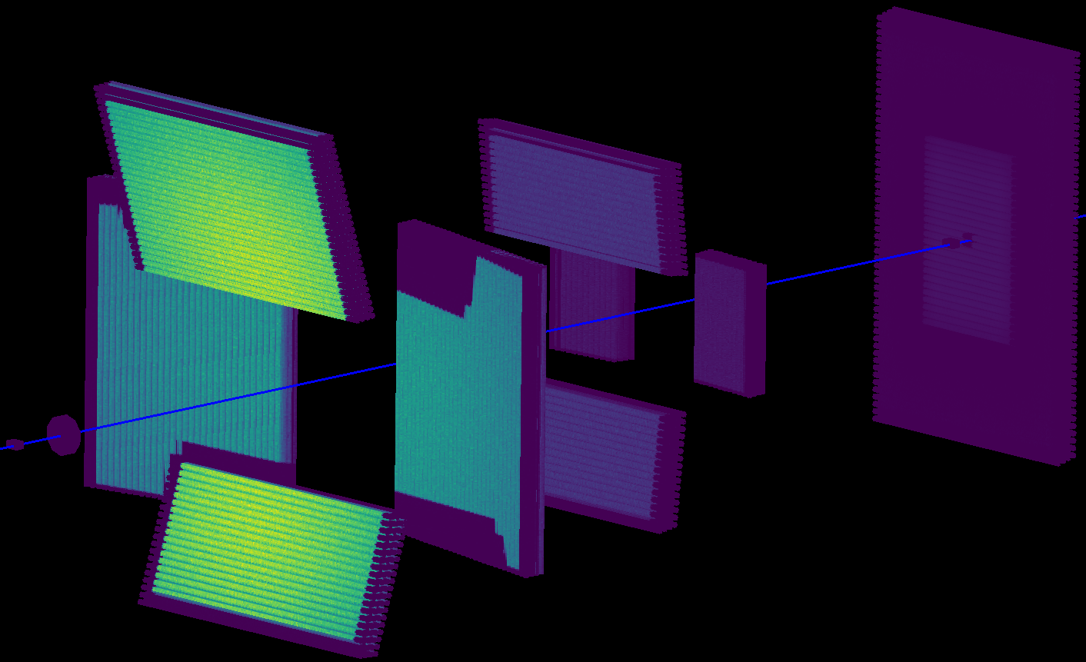
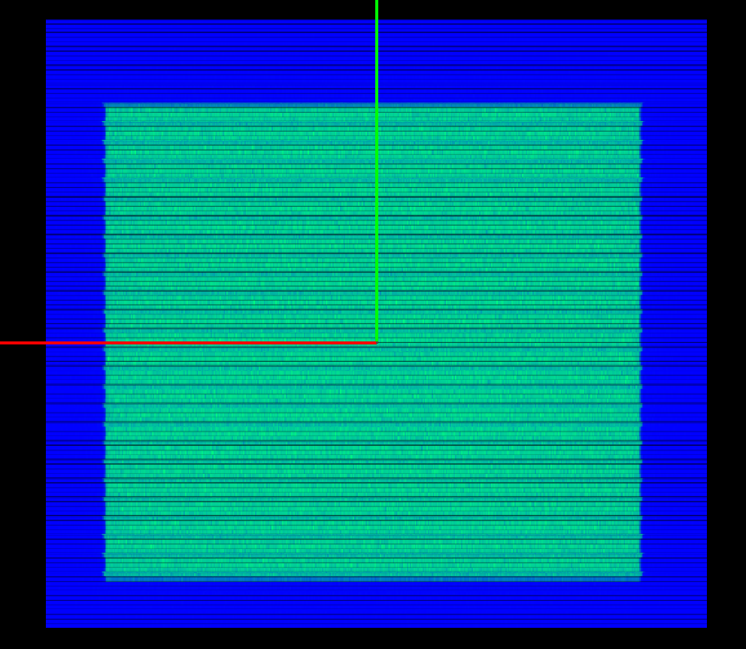
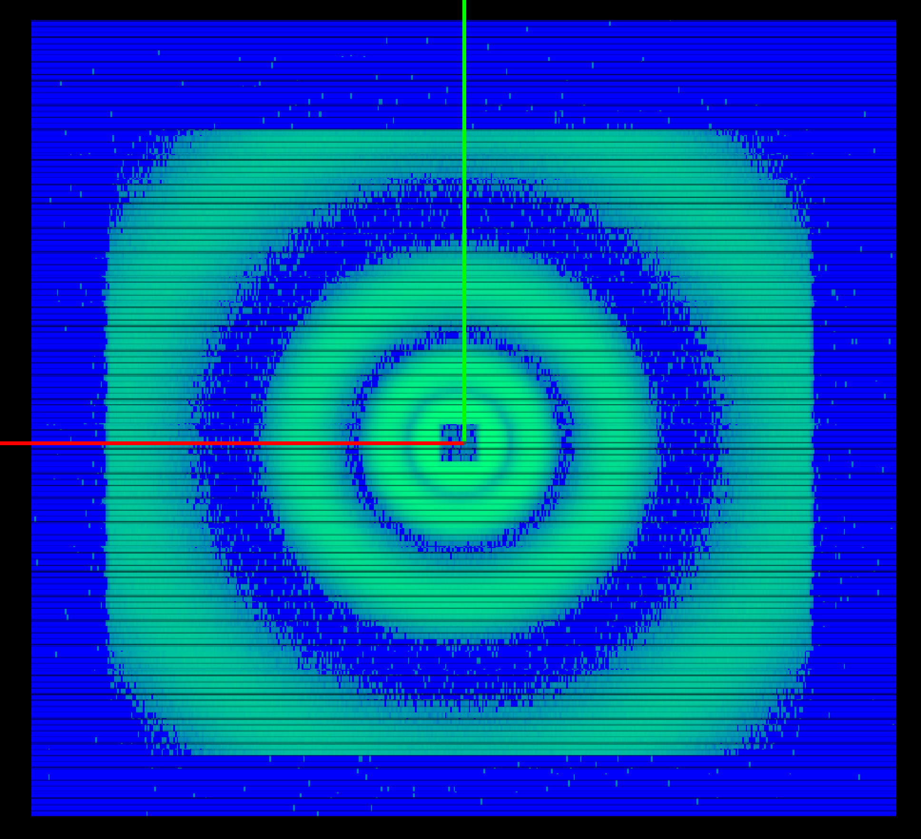
Sample types
Simulated data for LoKI in Mantid:
Isotopic (flat) scatterer
Isotropic_Sqw McStas component
Also done with a Geant4 particle generator
Logarithmically spaced series of sharp peaks in Q
SANS_benchmark McStas component (model=10)
Gaussian Coil
SANS_benchmark McStas component (model=18)
Monodisperse hard spheres
Sans_spheres McStas component
Empty beam
Simulated data for detector test (2022 March) in Mantid:
Isotropic scatterer
Sharp peaks in Q

Slide 29
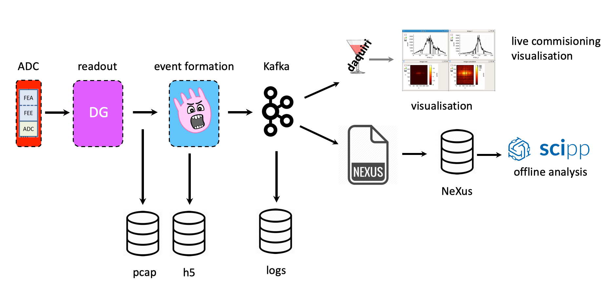
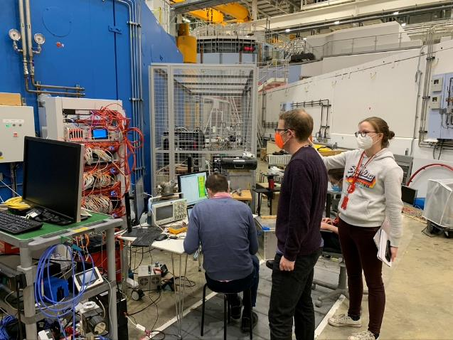
Final Detector Test on Larmor
Collected calibration data on the LoKI rear detector using the full ESS software stack: Excellent test for HC.
March 2022
Sample measured:
Cd stripped mask
Silver behenate
SDS powder
empty beam
blocked beam
ISIS standard polymer
Silica particles
Vanadium
NeXus file displayed in scipp

Slide 30
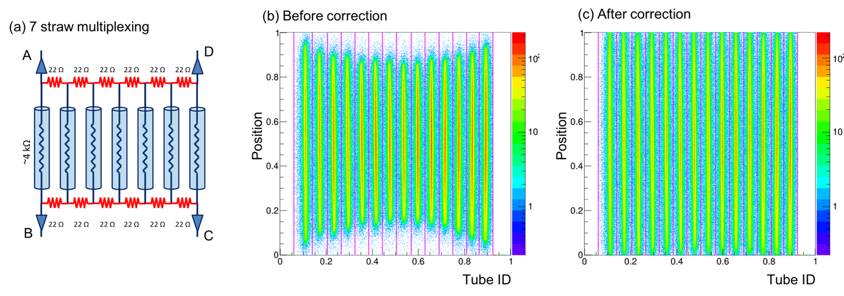
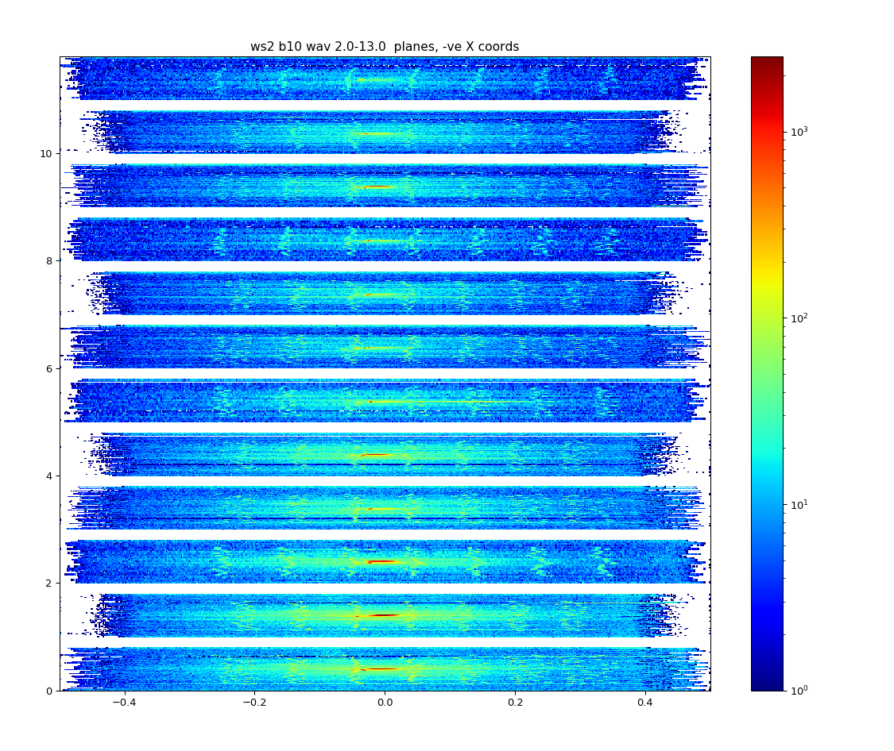
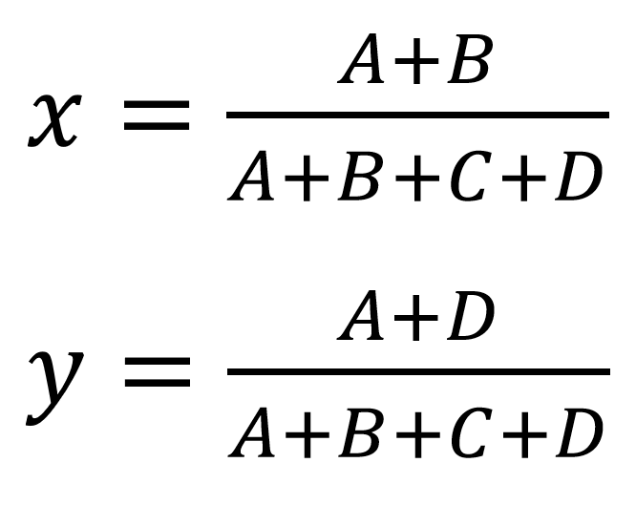
Creating position correction calibration file
To reduce the number of signals coming from so many straws
Resistive chain between both ends of the BCSs
7 BCSs in 1 tube are readout by four preamps connected at the corners (A, B, C, and D) of the circuit.
X axis is used to identify in which BCS a neutron was absorbed
Y axis is used to calculate where a neutron interacts along the length of the BCS
(d) with Cd slits
Sample measured:
Cd stripped mask
Silver behenate
SDS powder
empty beam
blocked beam
ISIS standard polymer
Silica particles
Vanadium

Slide 31


Creating position correction calibration file
Peaking fitting the Cd mask data – Davide progress
Position corrections from Davide will ideally be applied at the event formation unit stage (raw data saved and ready for re-streaming through EFU):
Fits complete… needed to correlated to correct Positions.

Slide 32

Challenges
Peaking fitting the Cd mask data
Used 3 mm slits in the Cd mask (Larmor mask), too narrow for descent peaks/statistics at the back of the panel making them challenging to fit.
Paralax effects of the peak positions from the front to the back of the detector – needs to be taken into account when the peak positions are being corrected.
FRONT
BACK

Slide 33


Calibration mask simulation
We need to identify pixels directly illuminated through the slits of the calibration mask for position calibration (parallax)
Implementing the calibration mask in Geant4
Simulating with geantinos instead of neutrons
Artificial particles propagated in a straight line without interactions
Filtering geantinos passing through the calibration mask
Collecting ids of pixels directly illuminated
Aiming multiple geantinos at each pixel instead of random direction sampling to increase efficiency
Turning the resulting pixel ids into a maskfile loadable by Mantid with MCPL files and scripts
Calibration mask in the LoKI rear bank Geant4 model:
Geantinos aimed at the LoKI rear bank:

Slide 34

Creating position correction calibration file
Peaking fitting the Cd mask data – Davide progress
Position corrections from Davide will ideally be applied at the event formation unit stage:
If this works – we will use this method for the full LoKI array
Milán’s positions

Slide 35


Creating position correction calibration file
Peaking fitting the Cd mask data in Mantid – Richard Heenan progress
Fits with partially simulated data on Mantid

Slide 36
Next: data reduction with Mantid/scipp
Davide to finalise the peak fitting and generate the position correction file. This will (hopefully) fully correct for multiplexing and any electronic effects.
All data collected at the beamtime will be rerun through the full ESS software stack to generate the corrected NeXus files.
Using Milán’s simulation in Geant4 of the flat scatterer we will run the “Direct Beam function” script to generate the correction for layers/straws/pixels.

Slide 37


Challenges
Peaking fitting the Cd mask data
Used 3 mm slits in the Cd mask (Larmor mask), too narrow for descent peaks/statistics at the back of the panel making them challenging to fit.
Paralax effects of the peak positions from the front to the back of the detector – needs to be taken into account when the peak positions are being corrected.
FRONT
BACK
→ Generate “correct” positions in a NeXus file using the Geant4 model (Milán Klausz) so can be combined with the peak fitting more easily.

Slide 38

Further mask simulation work…
In the full detector system, neutrons can reach supposedly not illuminated pixels due to scattering inside the detector system
These events are not supposed to be taken into account for the data reduction
A similar process used for the calibration mask can be used to create filters (maskfiles) for data reduction to handle:
Shading due to overlapping detector banks
B₄C masks shading the end of the detector tubes
Beamstops of different sizes

Slide 39
5
Any questions?

