Slide 1
SKADI
Current Status
STAP October 2021
Sebastian Jaksch, Romuald Hanslik, Tadeusz Kozielewski, Henrich Frielinghaus,
Alexis Chennevière, Sylvain Désert et al.
Notes:
----- Meeting Notes (28.02.17 13:13) -----
Welcome
First Presentation of TG2 for SKADI
Science Case, Top Level Requirements, Cursory Overview
Construction Schedule and Risk Analysis

Slide 2
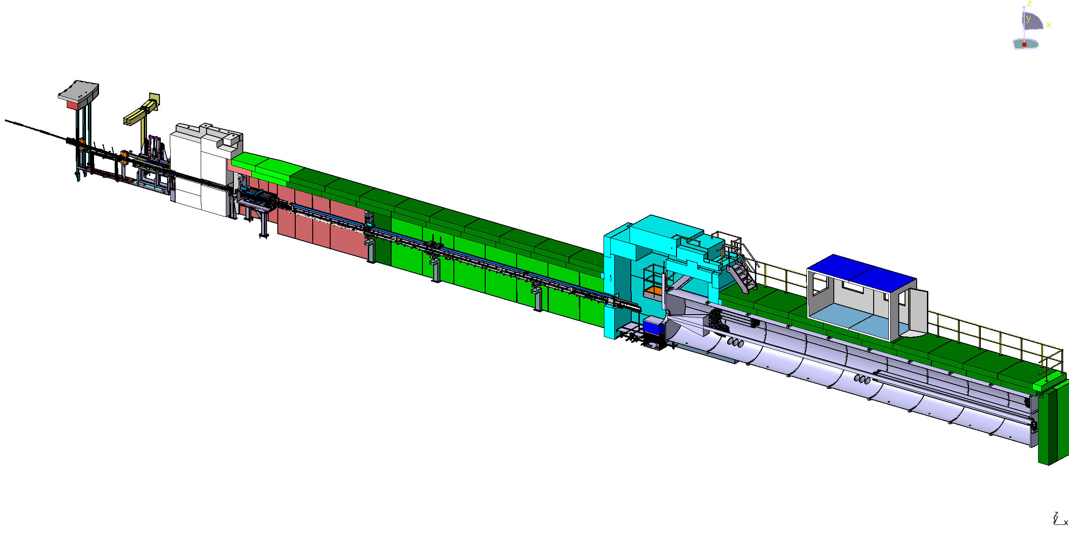
SKADI layout
13.6.7.1.1 Beam extraction System-
NBOA, BBG, Reflector
FZJ
13.6.7.1.4 Beam geometry conditioning-
Collimation and apertures +shielding
LLB
13.6.7.1.7 Flight tube
Feed Through bunker wall
FZJ
13.6.7.1.8.2 Heavy shutter
FZJ
13.6.7.1.5 Beam filtering system-
Polarizer, Spin Flipper
FZJ
13.6.7.1.3
Chopper System
FZJ
13.6.7.2 Sample Exposure System-
Sample area, shielding
FZJ
13.6.7.3.2 Neutron detector system Detectortube, detector vessel, shielding
LLB

Slide 3
Major Steps since last STAP
NBEX went through CDR/TG3
In-bunker components went through TG3
Sample Cave went through TG3
Collimation tanks are now contracted to manufacturer
Chopper positions have been (slightly) adapted due to manufacturer‘s request
Detector tank contracted to manufacturer
Shielding for detector tube and collimation is in tendering process

Slide 4
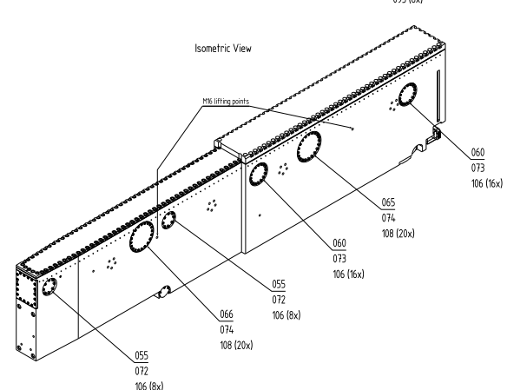
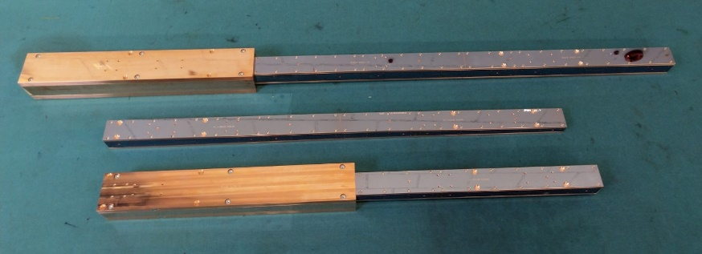
Integration of NBEX with NBOA
The NBOA has been delivered and is in storage at ESS, awaiting installation. NBEX CDR has taken place
This is in line with the overall installation scheme (end 2022). At the moment there are no expected issues concerning manufactuing or installation specific to SKADI.

Slide 5
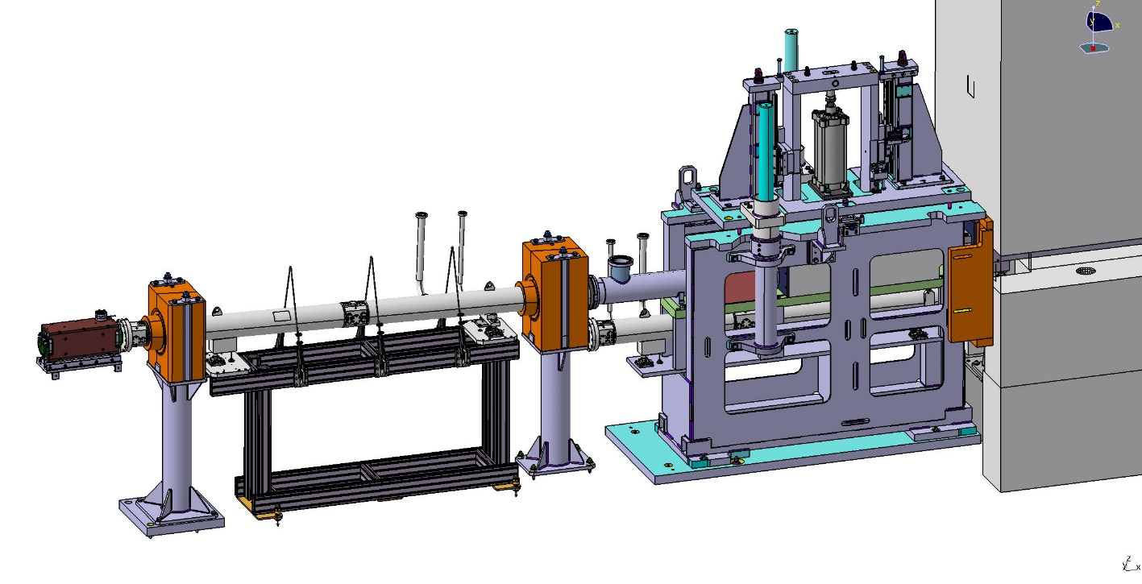
In-Bunker Beam Extraction
Delivery and installation contracted for late 2022
TG3 passed
Production started
The in-bunker installation comprises the guide segment in the light shutter, the reflector setup to offset the beam out of line of sight, the heavy shutter as well as the bunker wall feed through. All components except for the heavy shutter will be supplied by Swiss Neutronics.
Manufacturing process has started. Delivery to ESS expected in September 2022. Installation windows starts in November 2022.

Slide 6
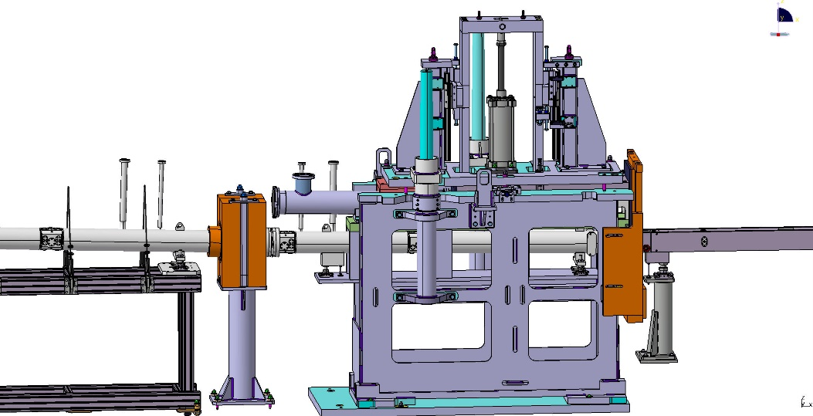
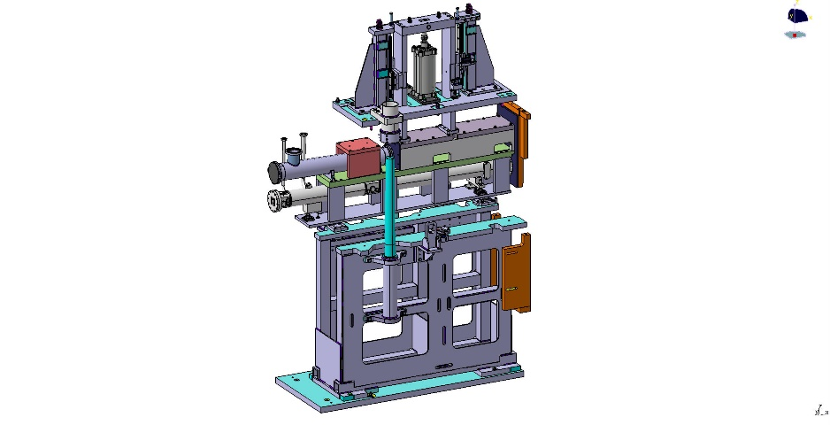
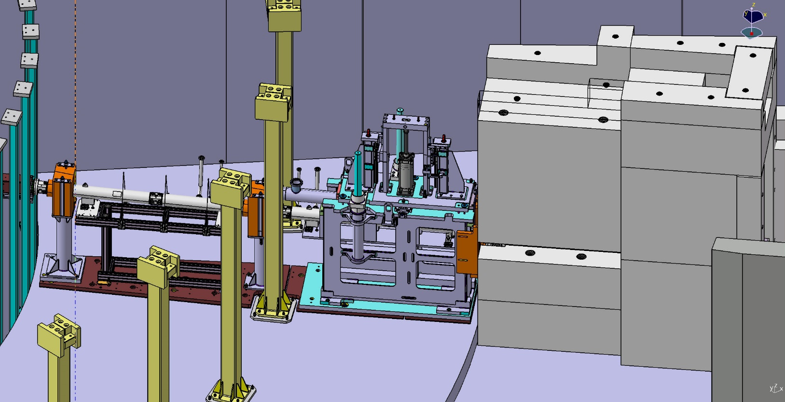
In-Bunker Ctd.

Slide 7
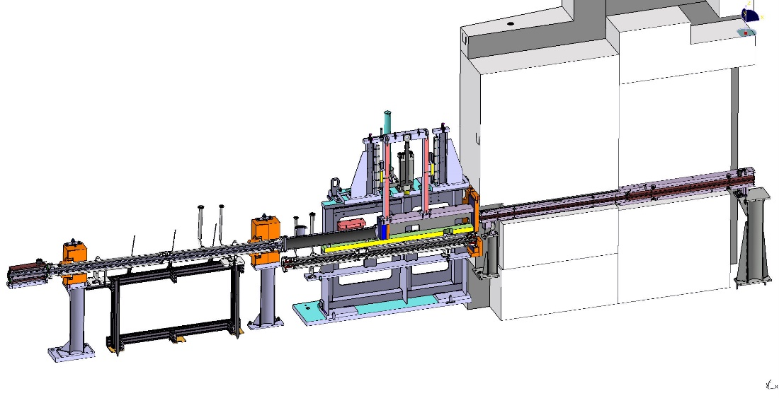
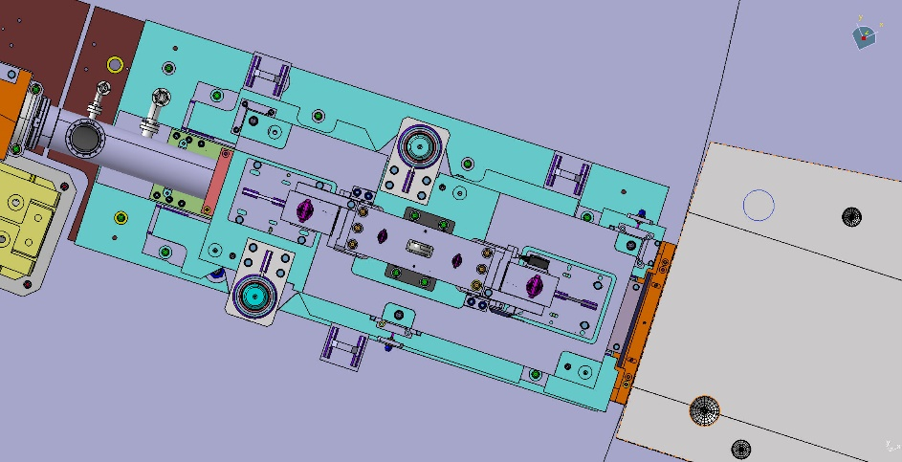
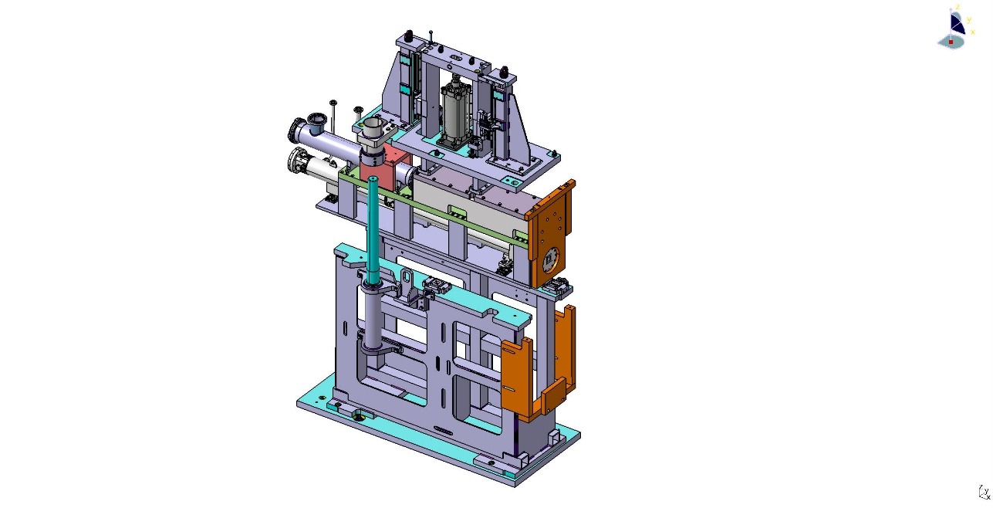
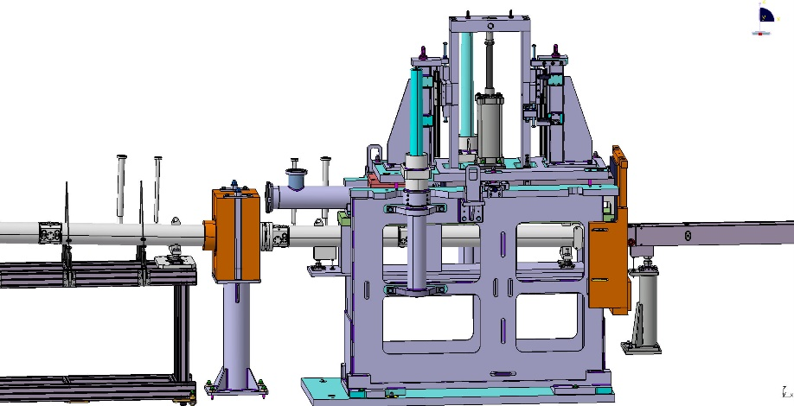
In-Bunker Ctd.

Slide 8
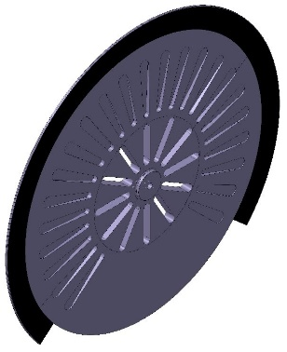
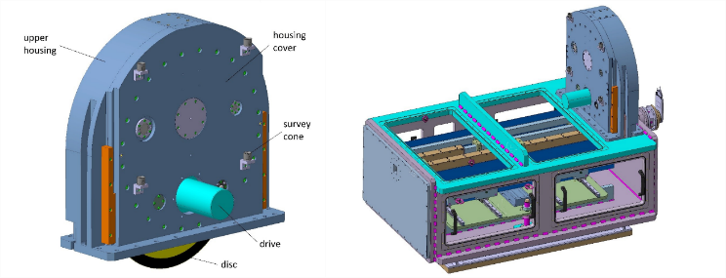
Chopper
Manufacturing process has started
Slight changes (no neutronic impact) to accomodate collimation manufacturer
Materials have been ordered or are already on stock. Housings, spindles (not SKADI specific components) will be ready early 2023. Disks will be manufactured during 2023. Installation foreseen in 2024.
This could be rushed, but since the collimation needs to be complete for the chopper installation, there is no impact of the longer timeline here.

Slide 9
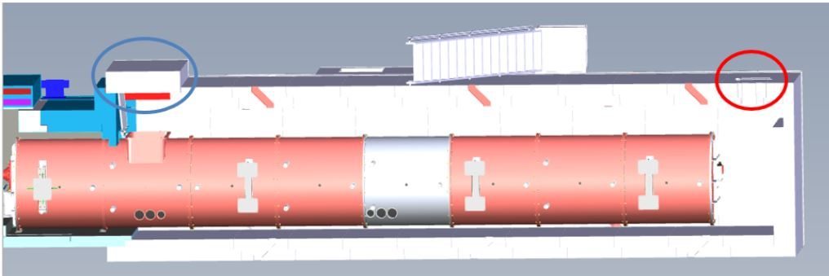
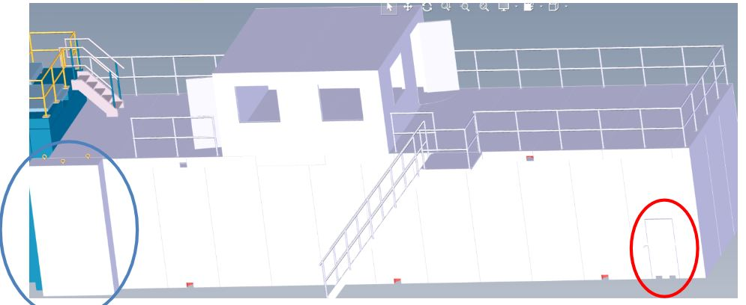
Shielding
Foreseen start of tender in Sept 2022 → contract early 2023
Installation interfaces with sample cave have been finalized (sequence of installation as well as physical interfaces)
Has short lead times

Slide 10
Collimator
Contract signed
Expected delivery time 10 month after contract
Installation planned to start mid 2023. We will stage the installation with the installation of the sample cave, which will take place around the same time.
Since the neutron guides as limiting components are all m=1 with 3 cm x 3 cm cross section there is little risk in production of those.
For this section we therefore do not foresee any problems with schedule or production.
VSANS testing still hampered by lack of neutrons throughout Europe.
10

Slide 11
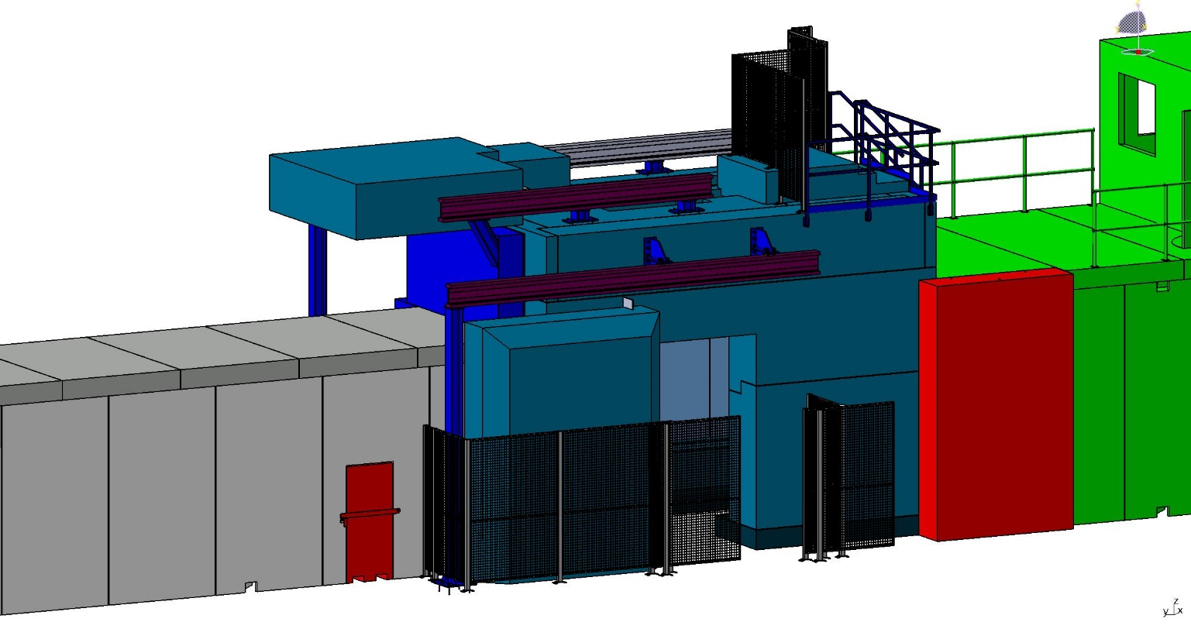
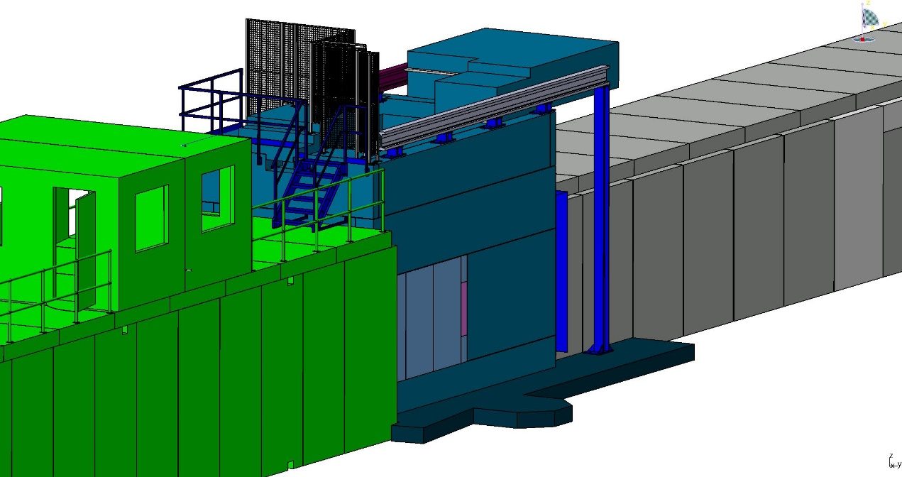
Sample Cave
Full installation contracted in 2023
Load spreading slab to be installed in 2022 (shared with ESTIA)

Slide 12
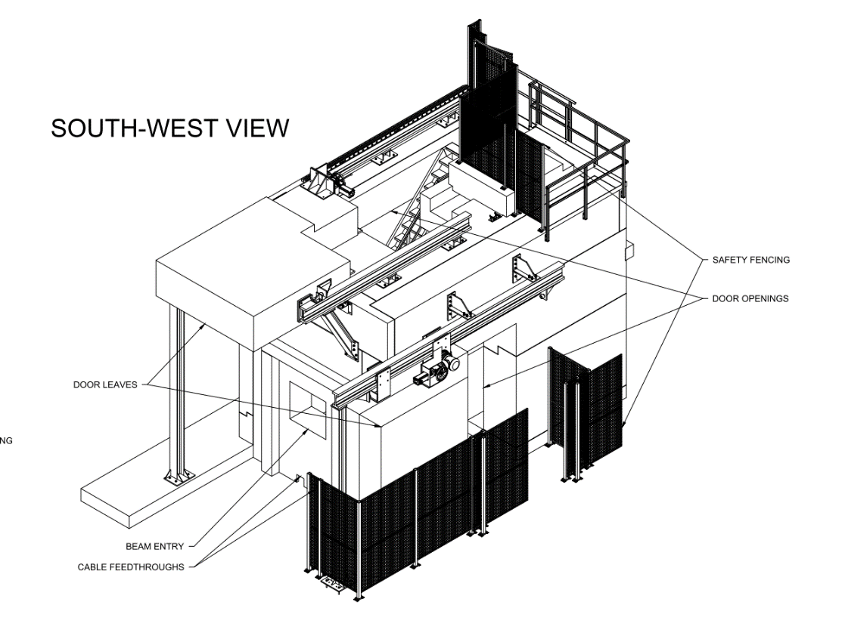
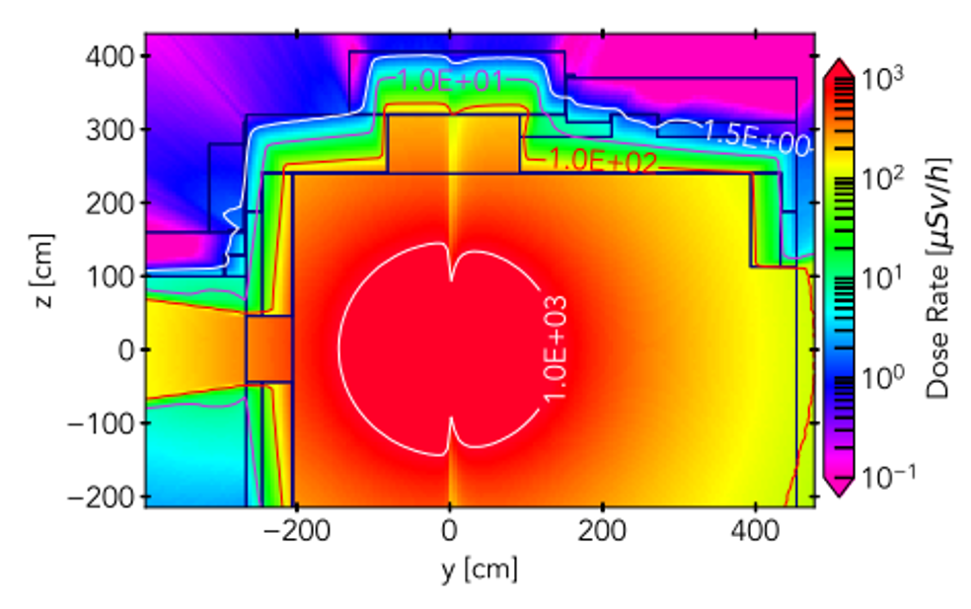
Sample Cave Ctd.
The common load spreading plate will allow ESTIA to load ist large roof partially into the SKADI area, keeping at 14 t/m². There is no impact on functionality of shielding from that.
Detailed work has been performed on shining paths for gamma attenuation while maintaining accessibility. In some areas „empty“ boxes were used in order to obtain sufficiently low surfaces doses.
Fences have now been included to protect users from moving parts, rather than having sensors around the instrument.

Slide 13
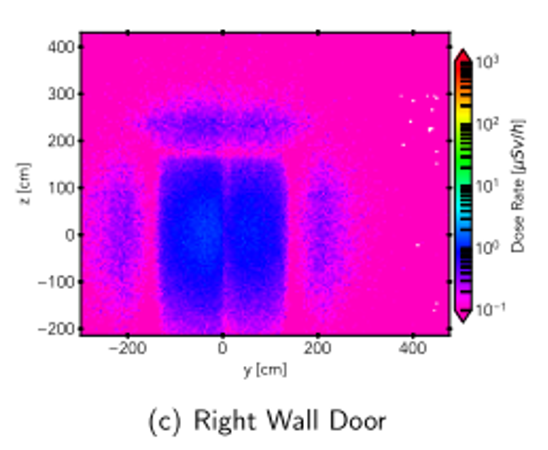
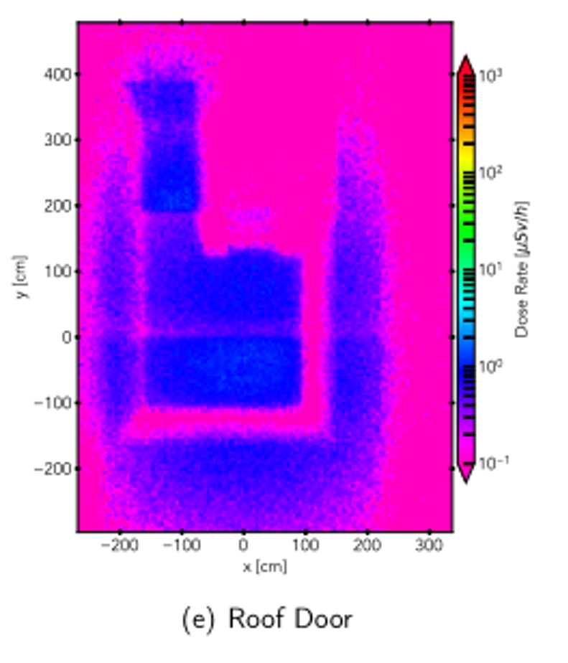
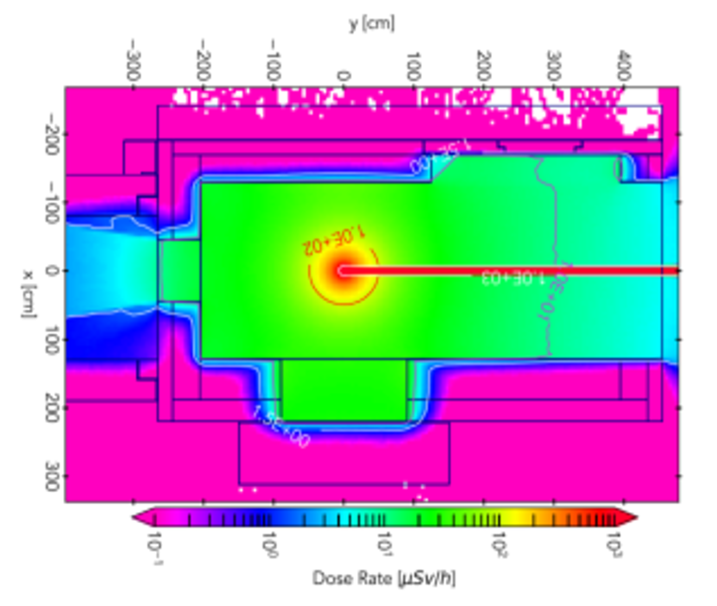
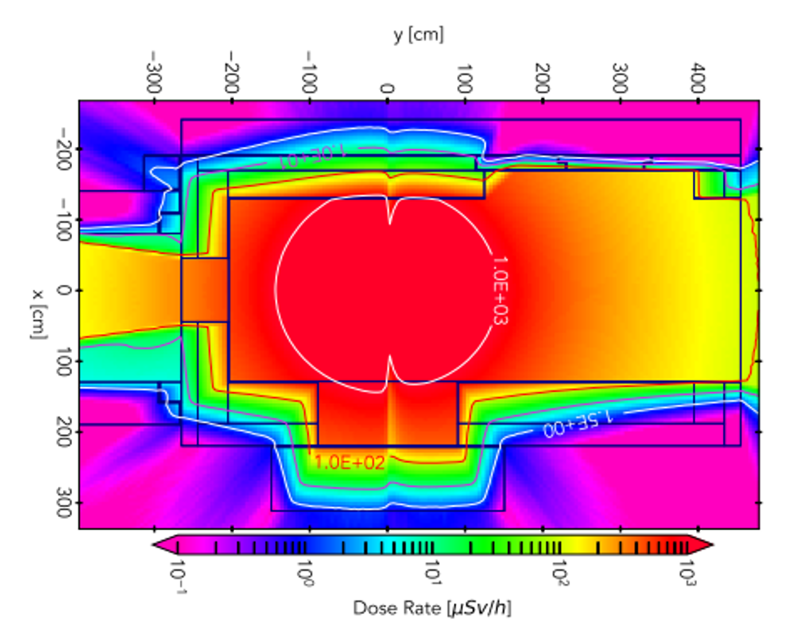
Sample Cave Ctd. (Shielding)
Neutrons
Gammas

Slide 14
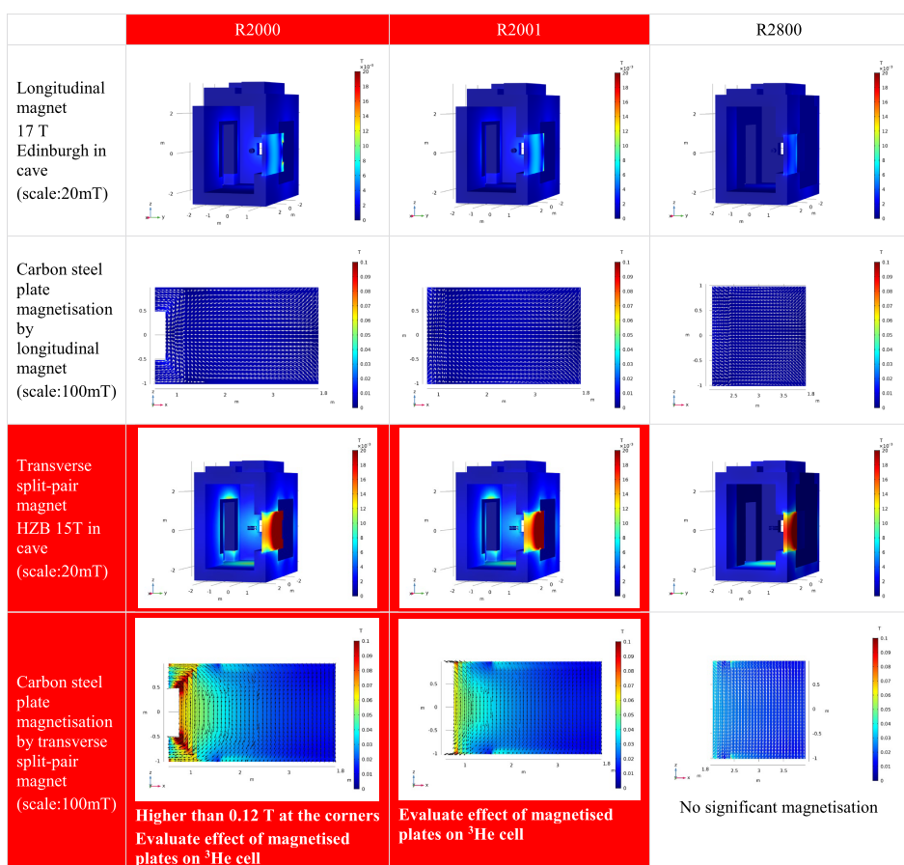
Sample Cave Ctd. (magnetic)
Several solutions for non-magnetic radii were considered (Radius 2000 mm, Radius 2000 with minor variations, Radius 2800 mm)
R2000 was finally selected
Longitudinal 17 T magnet is feasible for use with PA
Without PA also HZB magnet may be possible, if demagnetization scheme can be worked out

Slide 15
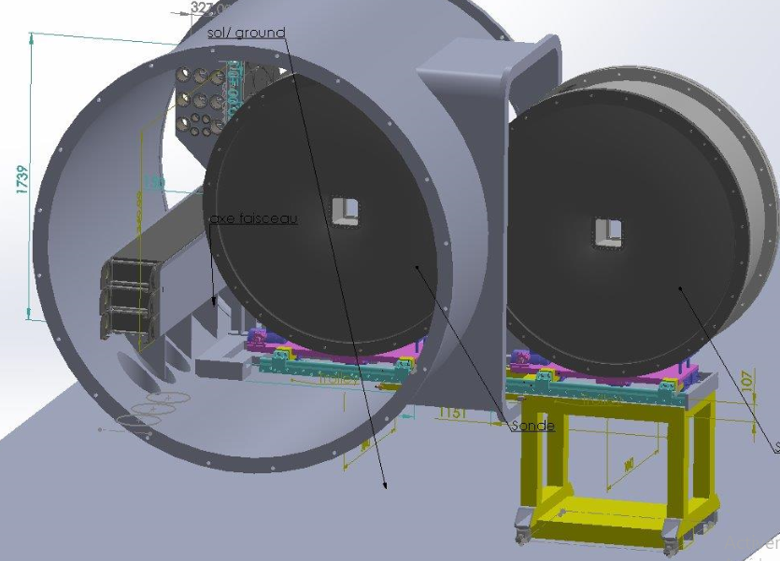
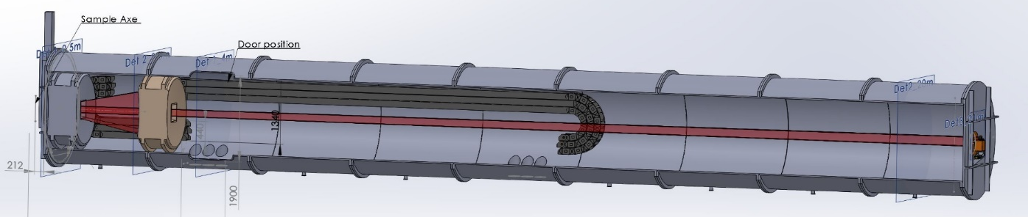
Detector and detector tube
Contract for manufacturer made
Detector electronics ready
Detector housing partially constructed awaiting details of tube design
Several beamtimes (ANSTO (DINGO) & ORNL (Imaging Beamline)) have been secured in order to perform proper testing of the final DAQ system.
Cooling system will be designed alongside detector tube.
Interfaces with detector, shielding and sample cave have been defined. Especially with the sample cave, there is a caveat to first install the forward section of the tube and then push it into the sample cave.

Slide 16
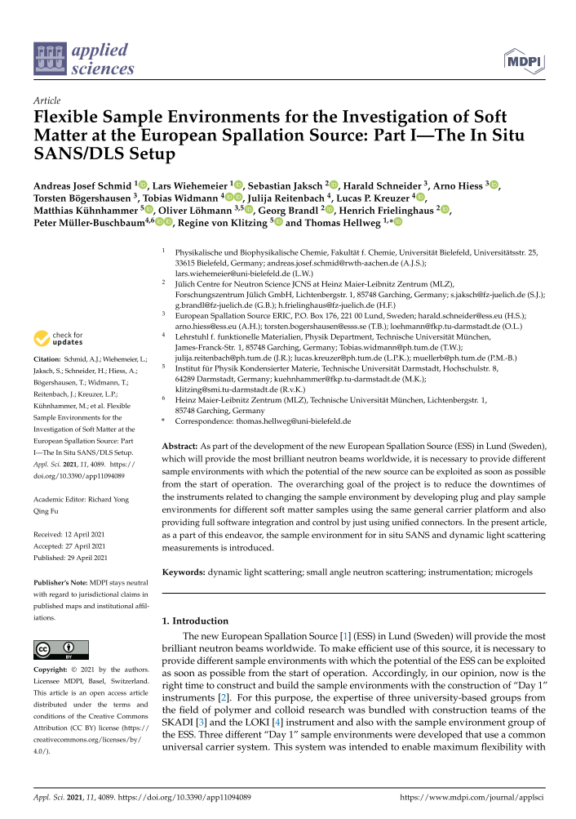
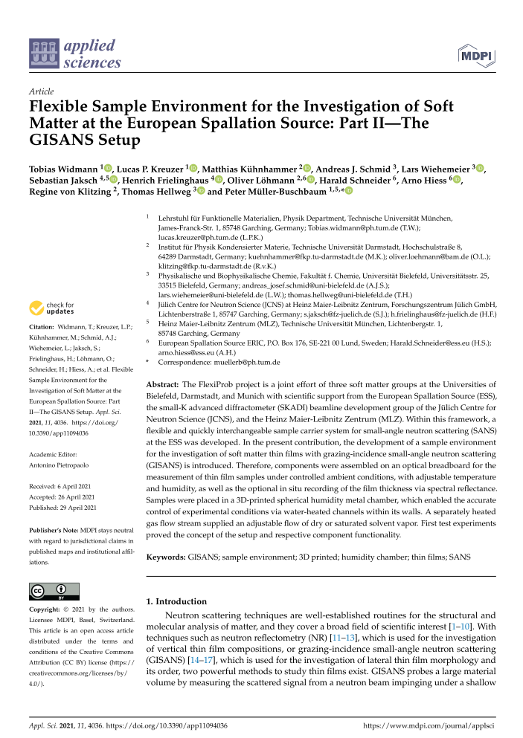
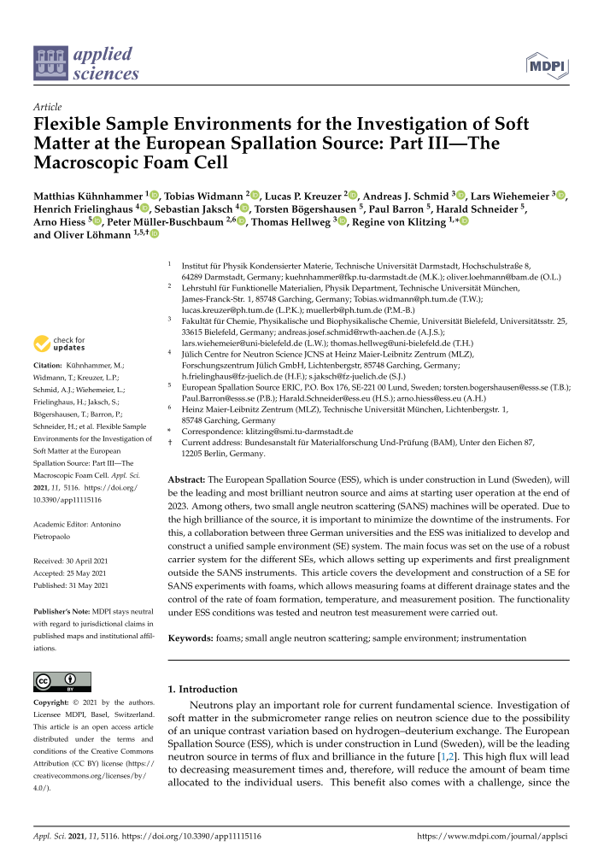
S/E & Flexiprob
Thanks to the groups of
Regine v. Klitzing
Thomas Hellweg
Peter Müller-Buschbaum
Three paper have been published on flexible S/E. Next meeting will take place ASAP.
Currently improving on usability and accessibility
Coordinations with Harald Schneider.

Slide 17
Schedule Overview
Component | Delivery and Installation last STAP | Delivery and Installation current
NBOA | Delivered | Delivered
In-Bunker | Q2/Q3-22 | Q4-22 (better planning window)
Collimator+Detector vessel+shield. | Q2-23 | Q2-24
Polarizer, Fast Shutter | Q1-23 | Q2-24
Choppers | Q3-23 | Q2-24
SCS | Q2-24 | Q3-24
Monitors | Q1-23 | Q1-23 (unclear due to personnel change at ESS)
Sample Area | Q2-23 | Q4-23
Hutch Area | Q4-23 | Q3-24
TG3-Full | Q4-21 | Q3-23 (rolling TG, most TGs done a lot earlier)
TG4-Full | Q2-24 | Q2-24
TG5-Full | Q3-25 | Q3-25
Schedule risks:
Covid delays
Manufacturer overload
Material shortages
Not under instrument team control, but we are monitoring the situation

Slide 18
General Comments
No fundamental issues precluding TG5 mid 2025
New increased risk of material shortage
Documentation:
  Focus on physical component to be able to order early (see risk above)
  Do minor changes after ordering
  Is this a shared risk?
Funding for the sample environment has been secured through a Röntgen-Anström-Cluster proposal (portGISANS).

Slide 19
Take Home
All external components have been subcontracted, apart from the shielding
Manufacturing of dedicated components is already running
Installation will start mid-2022 (NBOA, in-Bunker, bunkerwall, base plate for sample cave)
Components to be manufactured internally have started manufacturing
Only some small late install components still awaiting detailed design or procurement (polarizer housing and sample shutter)
Complete installation until 2025 is completely feasible

