Slide 1
Soft-Matter Sample Environment
For SANS & Reflectometry
Tom Arnold, Alessandra Luchini & Judith Houston

Slide 2
Soft-Matter Sample Environment
Current Status Summary
What is in construction scope (soft matter only):
    For SANS:
      Rheometer
      Stopped-flow equipment
    For LOKI (although can be shared with SKADI):
      Thermostated cell holder
      Flow cell with HPLC pumps
      Rotating cell holder
What is outside construction scope:
    All Sample environments for FREIA and SKADI
    Funding for these should come from operations funding and is included in the SAD budget.
    For ESTIA:
      Set of Solid liquid cells inc. plumbing and simple sample changer
    Some external collaborative projects for SANS
      In situ fluorescence, UV/vis absorption spectroscopies, densiometry on a continuous flow cell
      Easily switchable set-up between: in situ DLS, a foam cell and a humidity chamber for GiSANS
Currently resource in the Sample Environment group is severely limited. There is no soft-matter specialist for the short term future. Projects are being managed as a collaboration between Instrument Scientists and Sample Environment group.

Slide 3
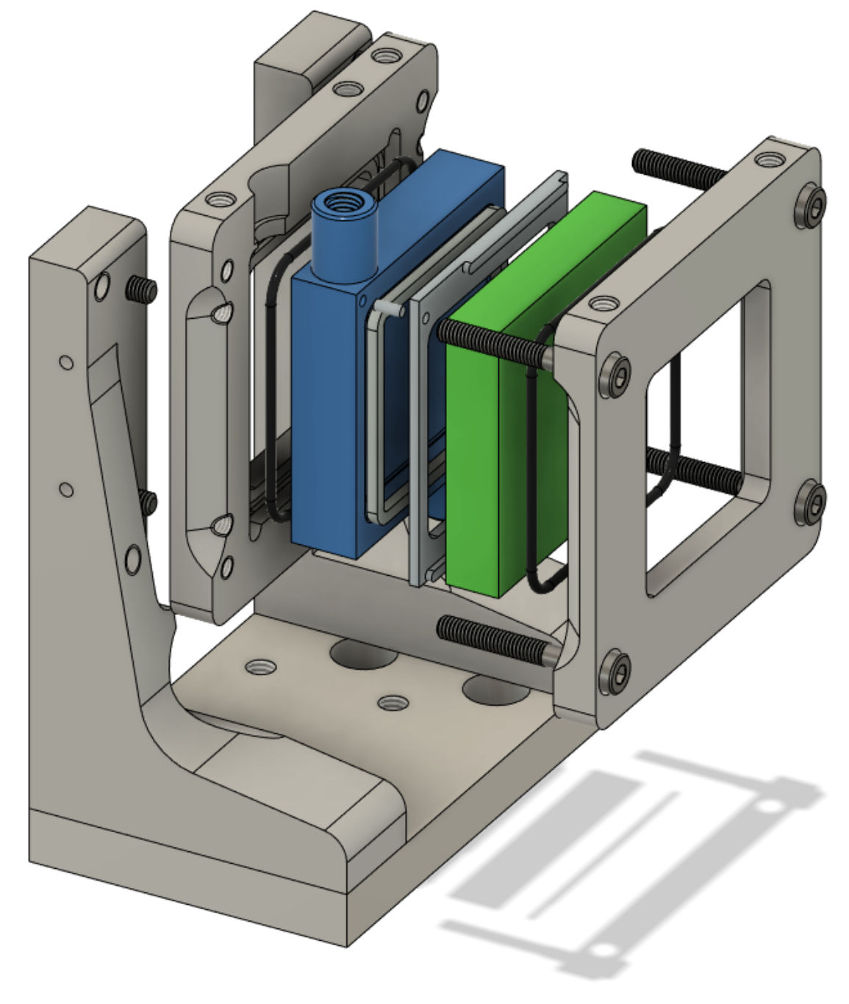
Solid-Liquid Cells
ESTIA scope + project SREss3 from Tillväxtverket (Adrian Rennie, Uppsala University)
Main characteristics of the cell:
Compatible with both FREIA and ESTIA
Internal volume
Transparent window on both sides (relevant for experiments requiring exposure to light)
The project also includes:
Manufacture of at least 5 solid/liquid cells and purchase of corresponding tubing and fittings
Purchase of a HPLC pump and a switch valve
Purchase of valves for selecting bottom/top injection (relevant for ESTIA)
Design and procurement of translation stage for ESTIA
Polycarbonate Back Piece
Back Frame
O-Ring
Gasket holder
Gasket
Outlet port
Crystal
(50 x 50 mm)
O-Ring
Gasket Pins
Front Frame
Right Support
Window
(42 x 42 mm)
Left Support
Base Plate

Slide 4
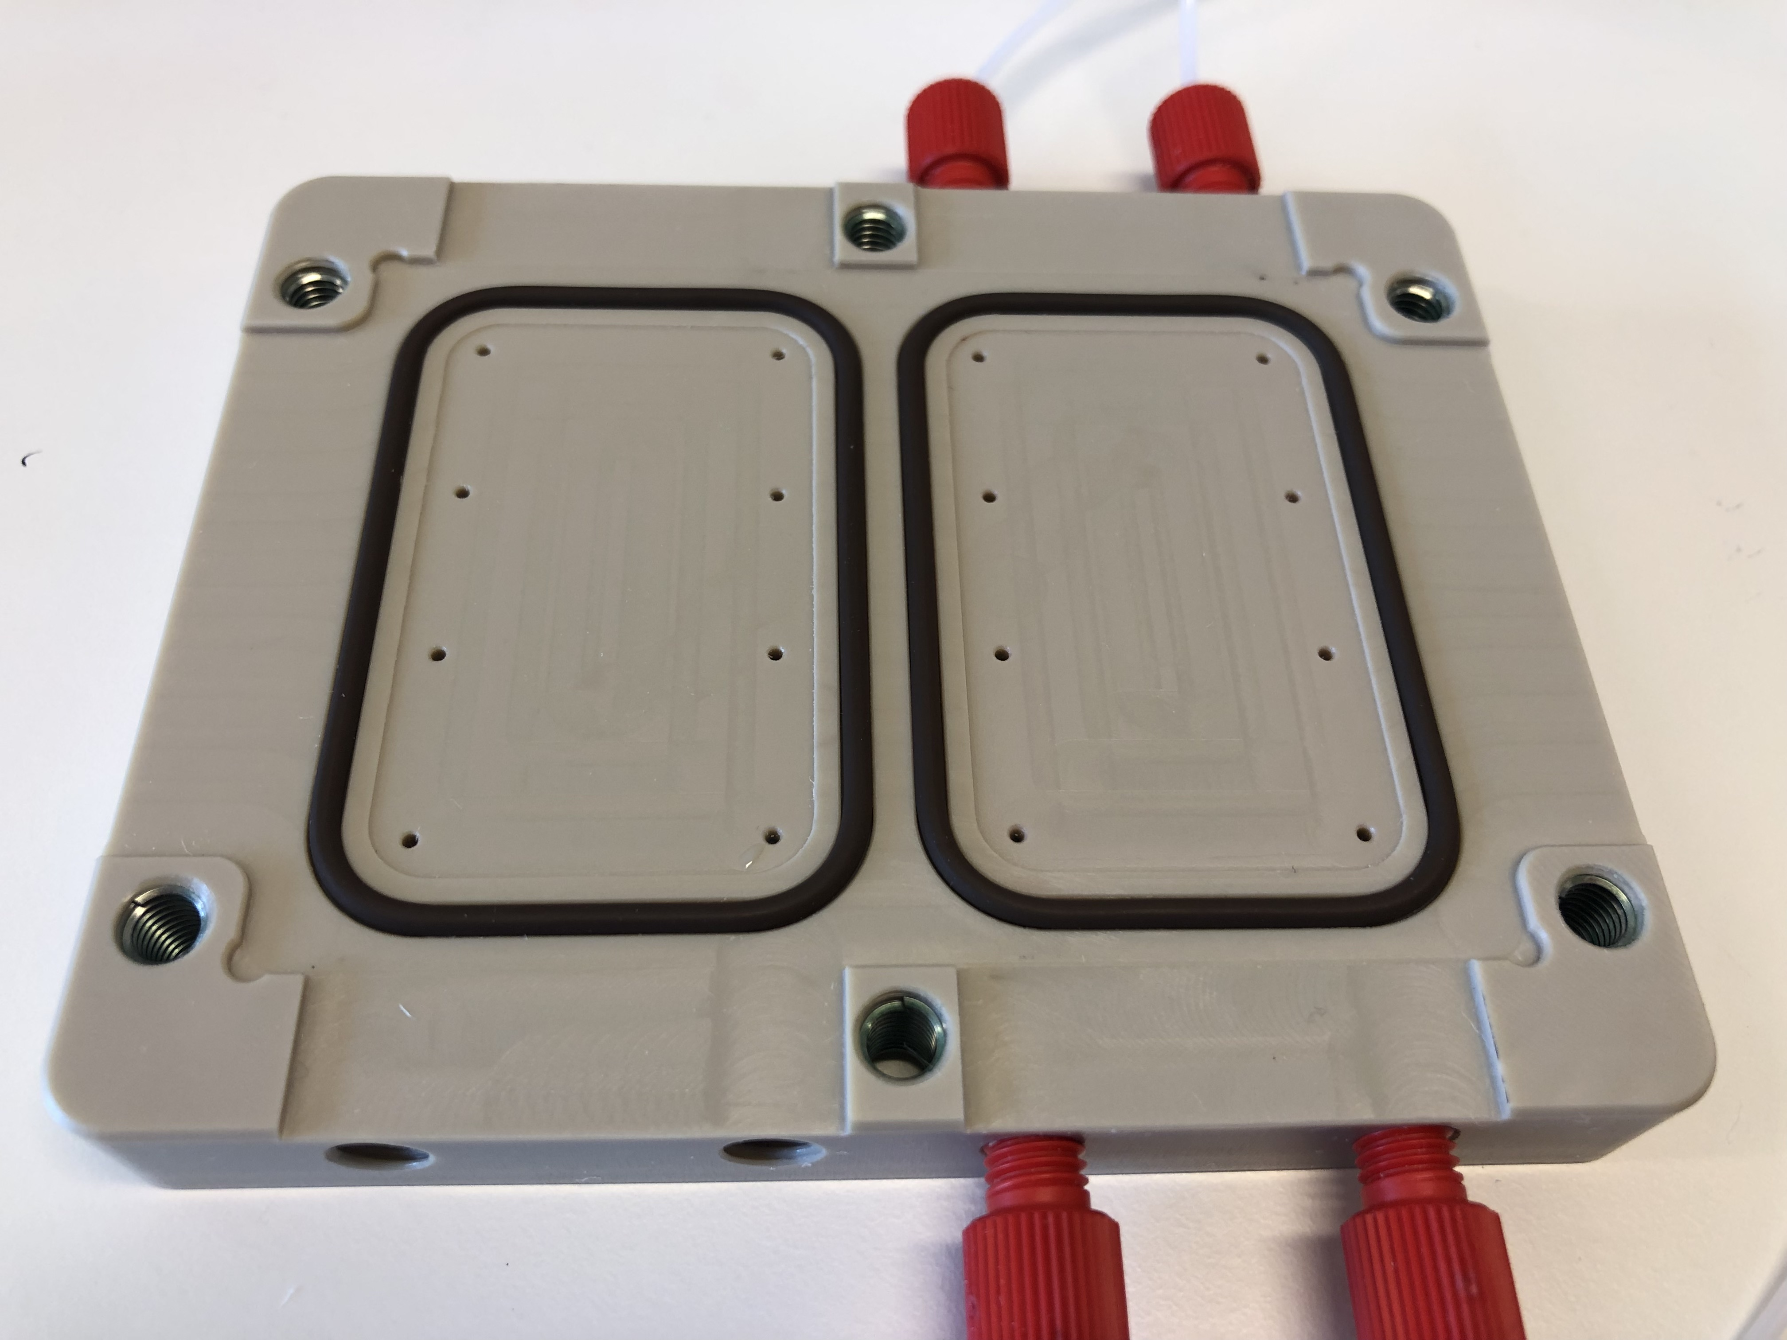
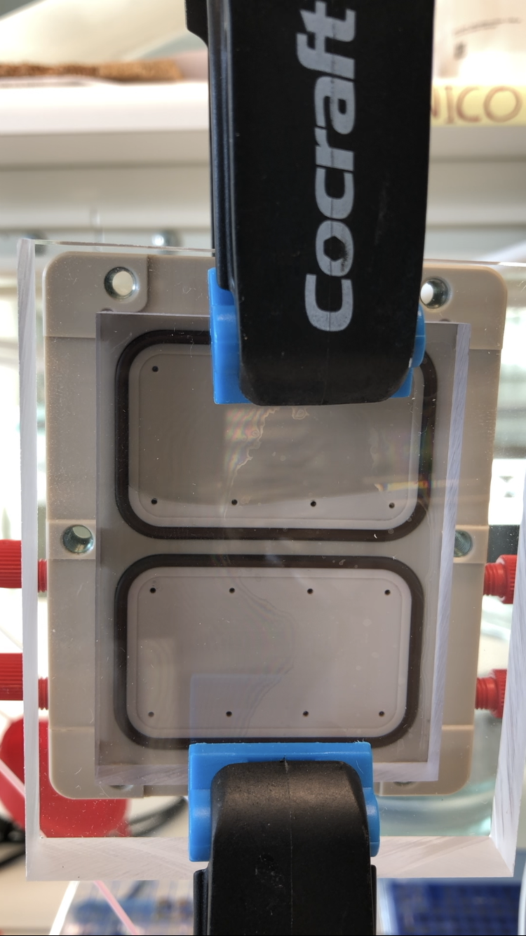
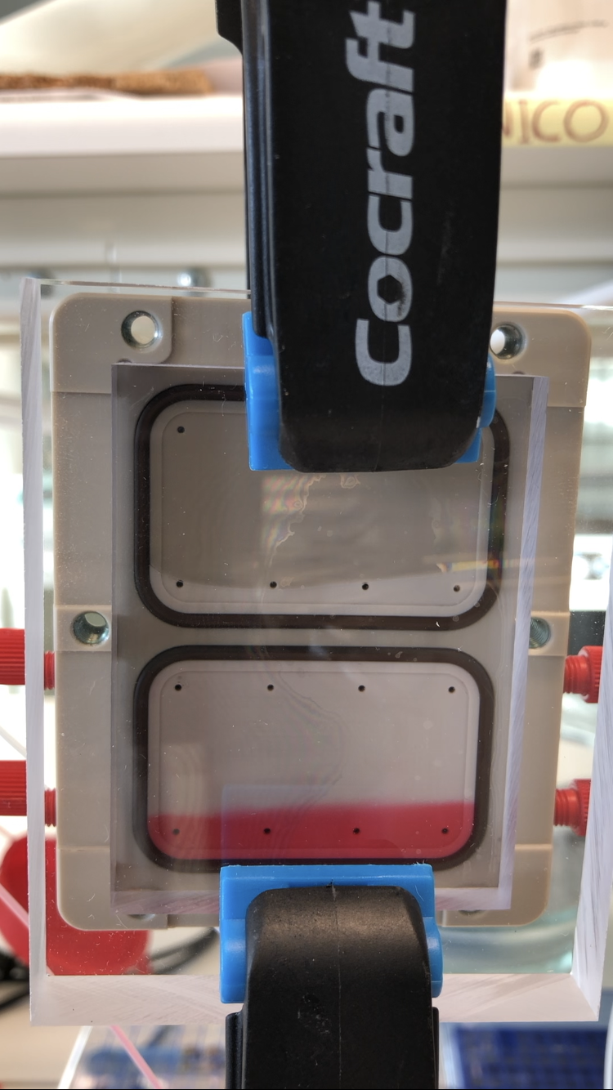
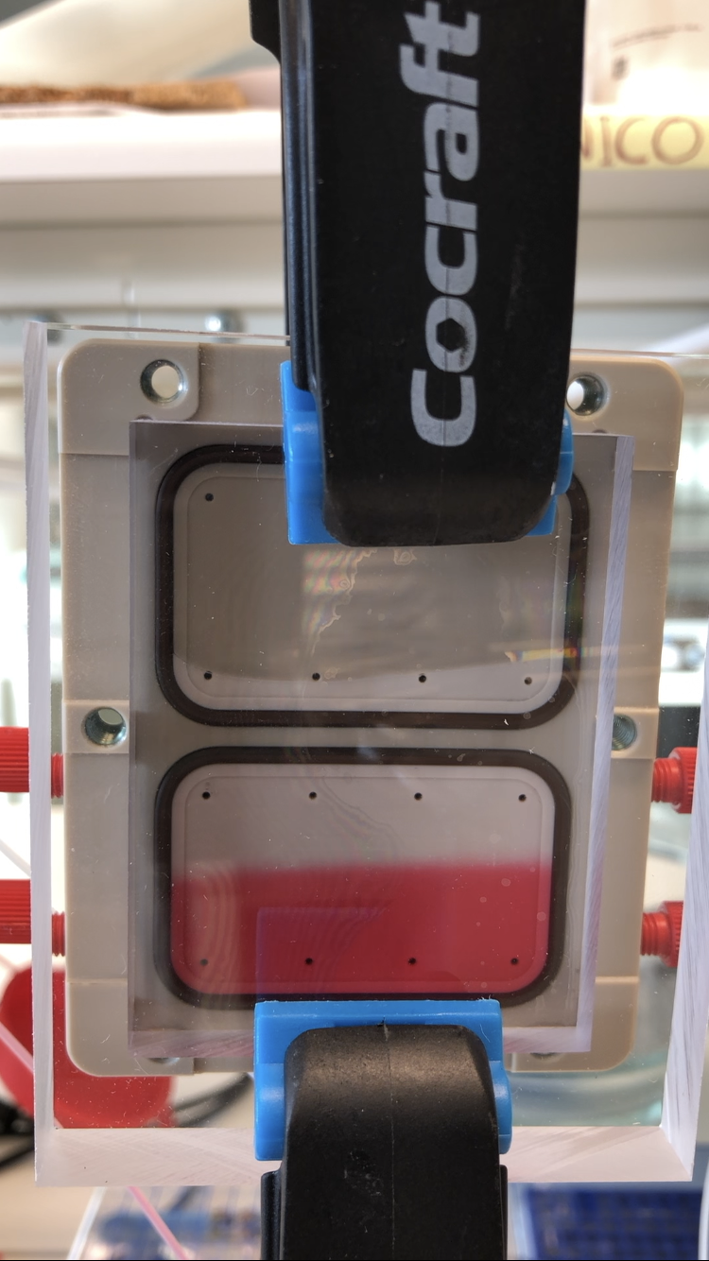
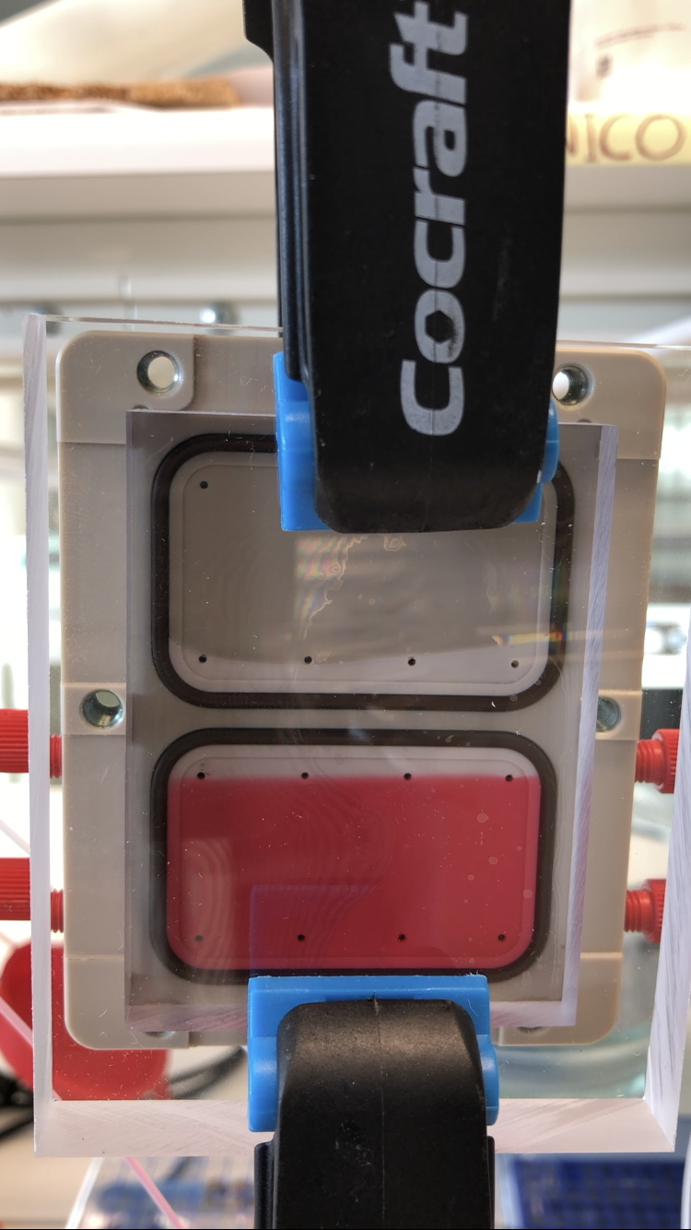
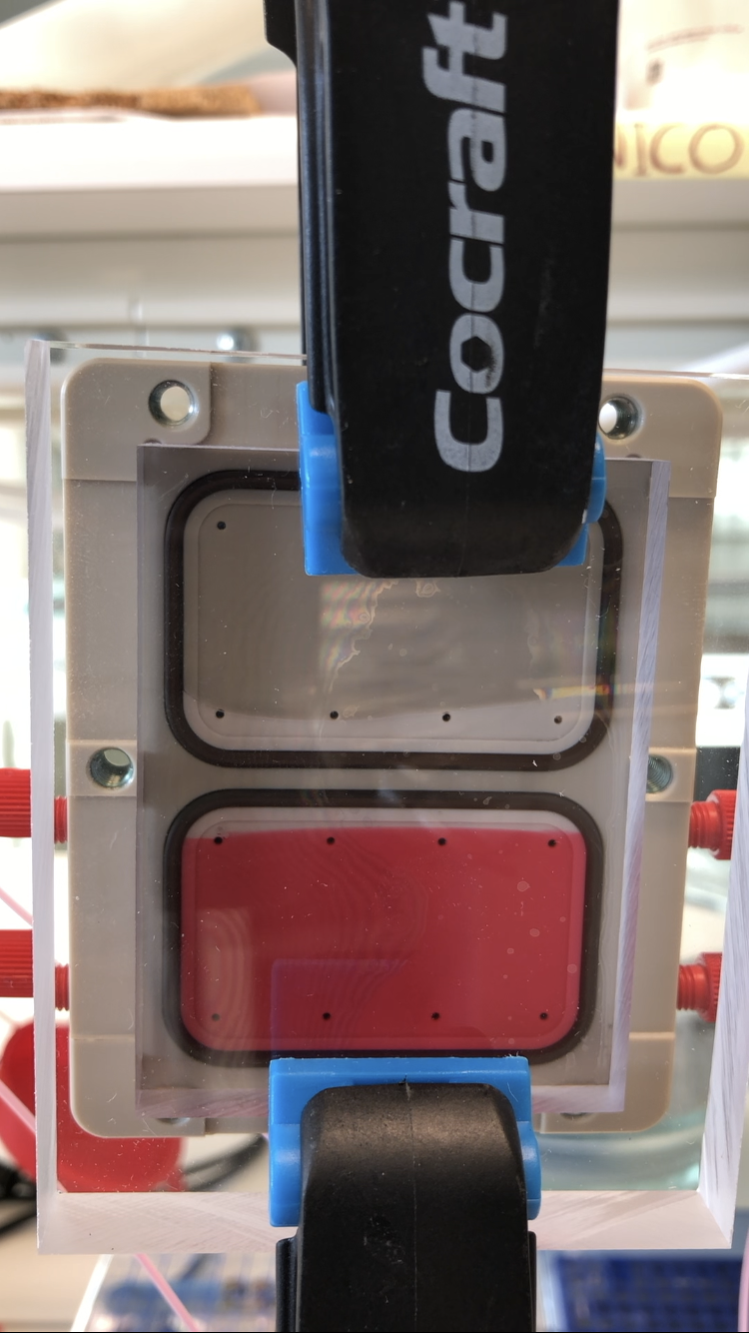

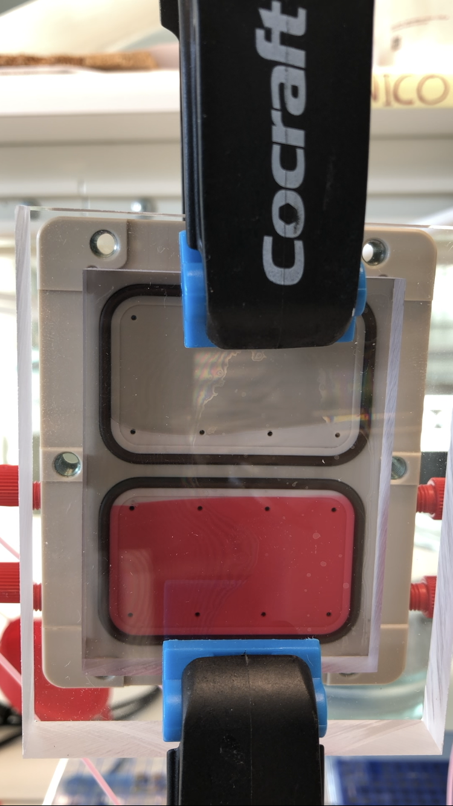
Multi-channel Solid-Liquid Cells
Project funded by Nordforsk (Nico Paracini, Malmö University)
SPLICS
Scientific application
For soft matter samples produced by LB/LS method, the SPICS cell allows to monitor two different conditions (etc. temperature, pH, ligand) on the same sample
Relevant for ESTIA
With the small beam available on ESTIA, SPLICs enables to investigate two different samples within the same cell. This will increase the number of samples that can simultaneously be placed on the sample stage.
0 s
10 s
20 s
30 s
40 s
50 s
60 s

Slide 5
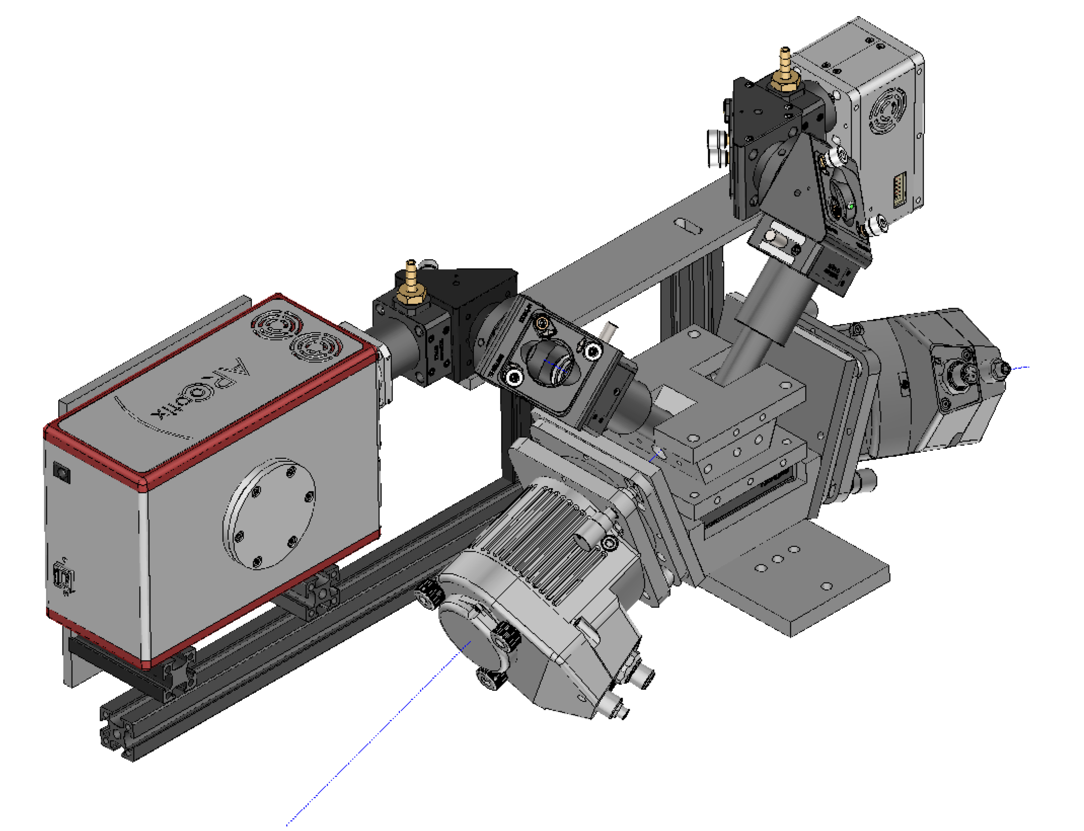
A combined IR and ellipsometry setup
As part of project SREss3 from Tillväxtverket (Thomas Ederth, Linköping University)
  Builds on an existing Röntgen-Ångström Cluster (RÅC) project
  Adapting the design of existing equipment to be compatible with both ESS reflectometers
  Will be compatible with standard solid-liquid cells where appropriate.
  Includes design to allow sample changer (translation change) i.e. change sample without moving the optics.
  Also includes co-fitting of ellipsometry & reflectomety data withing EasyReflectometry
IR detector
IR optics
IR source & interferometer
As mounted on ESTIA
Removable flow cell on kinematic base
Ellipsometer source & detector on tilt stages for angular adjustment

Slide 6
Maximizing information content in neutron reflectivity data
Project funded by Vetenskapsrådet (The Swedish Research Council)
Scientific case
Development of substrates with magnetic reference layer for the characterisation of soft matter sample (particularly biological membranes) by using magnetic contrast instead of solvent exchange, which might affect the sample structure
Timeline
First Kick-off meeting in March 2022
The project will run until 2026
The team:
Jens Birch (Lindköpping University)
Bjorgvin Hjorvarsson (Uppsala University)
Max Wolf (Uppsala University)
Alexei Vorobiev (Uppsala University & ILL)
Tommy Nylander (Lund University)
Alessandra Luchini (ESS)
Jos Cooper (ISIS)
Sean Langbridge (ISIS)
Design and production of the magnetic substrates and data analysis
Scientific cases and testing
Simulation and data analysis

Slide 7
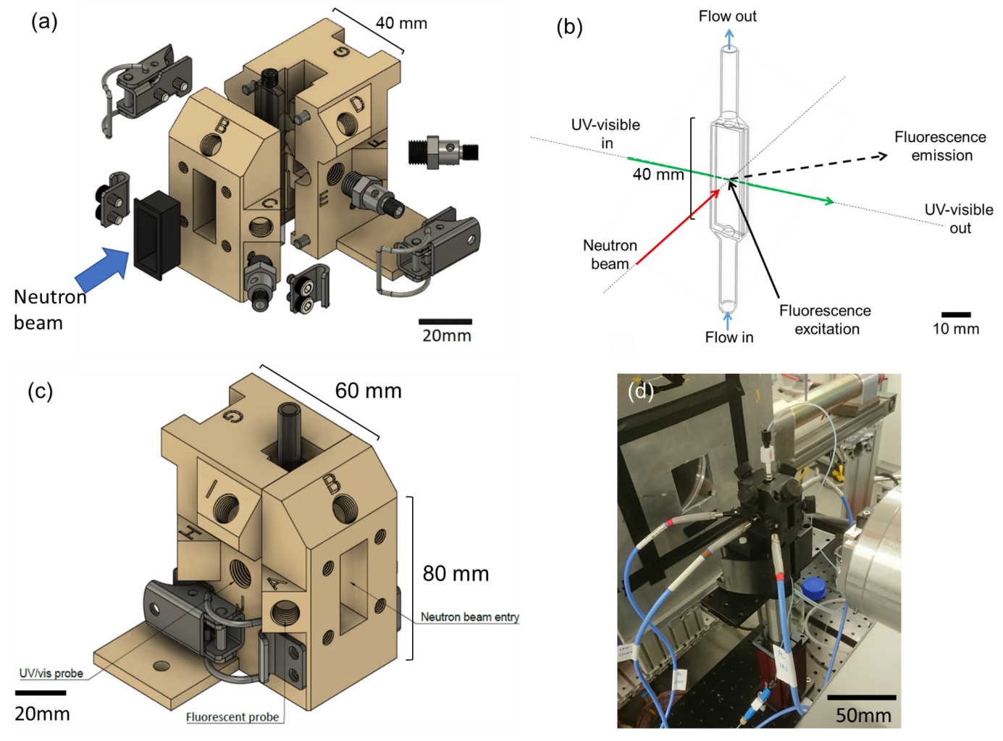
NURF – In situ fluorescence, UV/vis absorption spectroscopies, densiometry on a continuous flow cell
SREss3 project from Tillväxtverket (Lund Uni & Uppsala Uni)
Scientific case
Combined spectroscopy and scattering to resolve (bio)molecular processes, e.g. silk acid assembly processes
Aims
Equipment set-up and integration ready for first science on LoKI (on site – awaiting integration)
Organise the auxcillary data (e.g. spectra) into NXCanSAS standard format. ✔️
Include spectroscopy data in the SCIPP data reduction pipelines as a separate module ✔️
The team:
Cedric Dicko (Lund University)
Adrian Rennie (Uppsala University)
Andrew Jackson (ESS)
Judith Houston (ESS)
Hannah Burrall (Uppsala)
Gudrun Lotze (Uppsala/Lund)
Robert Dalgliesh (ISIS)
Lionel Porcar (ILL)

Slide 8
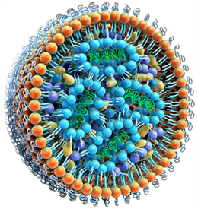
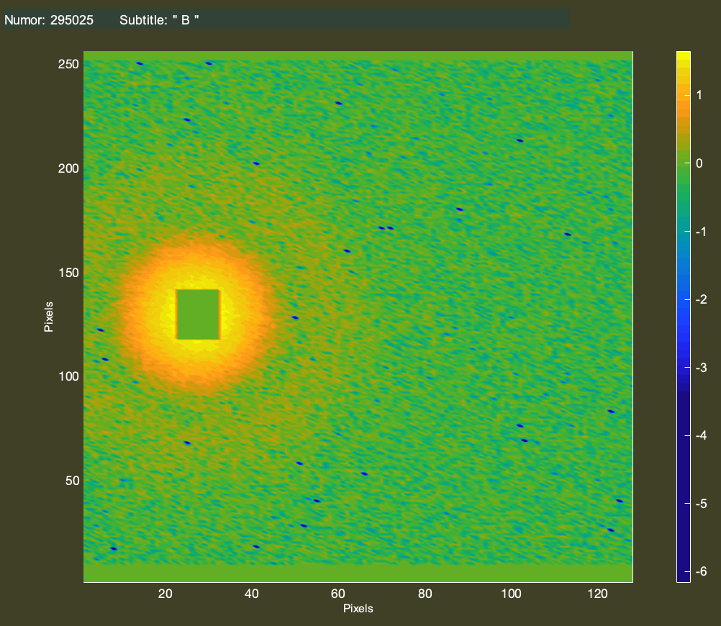
Microfluidics flow cell for SANS/SAXS
SREss3 project from Tillväxtverket (Federica Sebastiani, Malmö University)
Scientific case
Lipid nanoparticles in the blood stream and other structures under flow:
Develop a microfluidics flow cell set up to study LNPs experiencing a range of shear stress (100 – 5000 s-1). We aim to design a microfluidic flow cell that reproduces shear rates to mimic the blood flow as they change due to the diameter of the vessels in healthy and pathological conditions
The team:
Lead: Federica Sebastiani (Malmö University)
Marité Cárdenas (Malmö University)
Judith Houston (ESS)
Ann Terry (CoSAXS, MaxIV)
static
dynamic
?
Precision Nanosystems

Slide 9
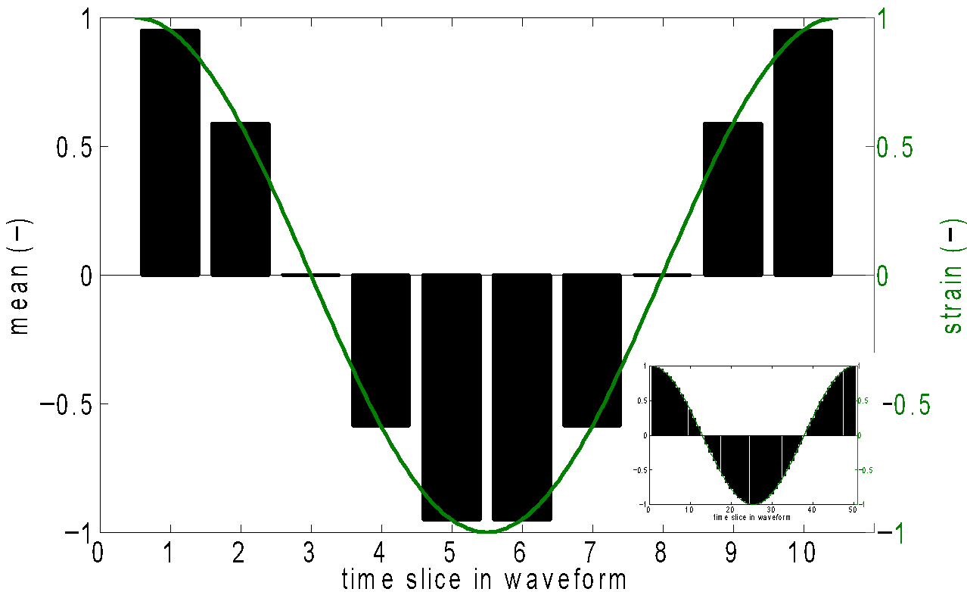
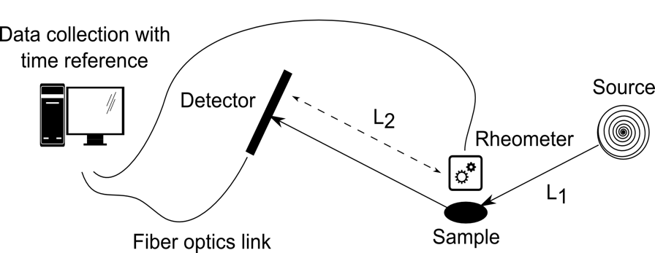
Fast processes studied with neutrons (msec res.)
ESS-ISIS grant funded by the Swedish Research Council)
Aim
Develop tools to analyse and visualise event mode neutron data sets for time-resolved measurements.
The detection/scattering time of the neutrons will be linked to external stimuli from sample environment.
This work will build on existing infrastructure for event filtering in SCIPP, including developing a higher level interface to process and link different types of raw metadata from the relevant sample environment, such as shear data from a rheometer.
The team:
Lead: Max Wolff (Uppsala University)
Judith Houston (ESS)
Sarah Rogers (ISIS)
Rob Dalgliesh (ISIS)
Simon Heybrook (ESS)
Wojciech Potrzebowski (LU/ESS)
Timeline
First Kick-off meeting in March 2022
The project will run until 2026
Notes:
We will do proof-of-principle studies on the re-arrangement of molecular structures under large amplitude oscillatory shear on SANS instruments.

Slide 10
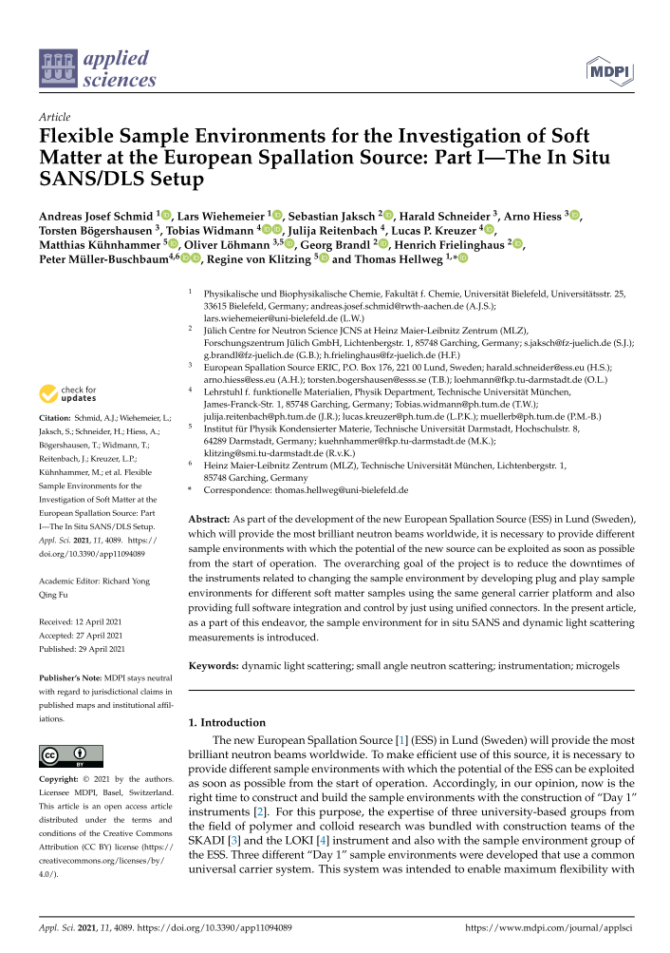
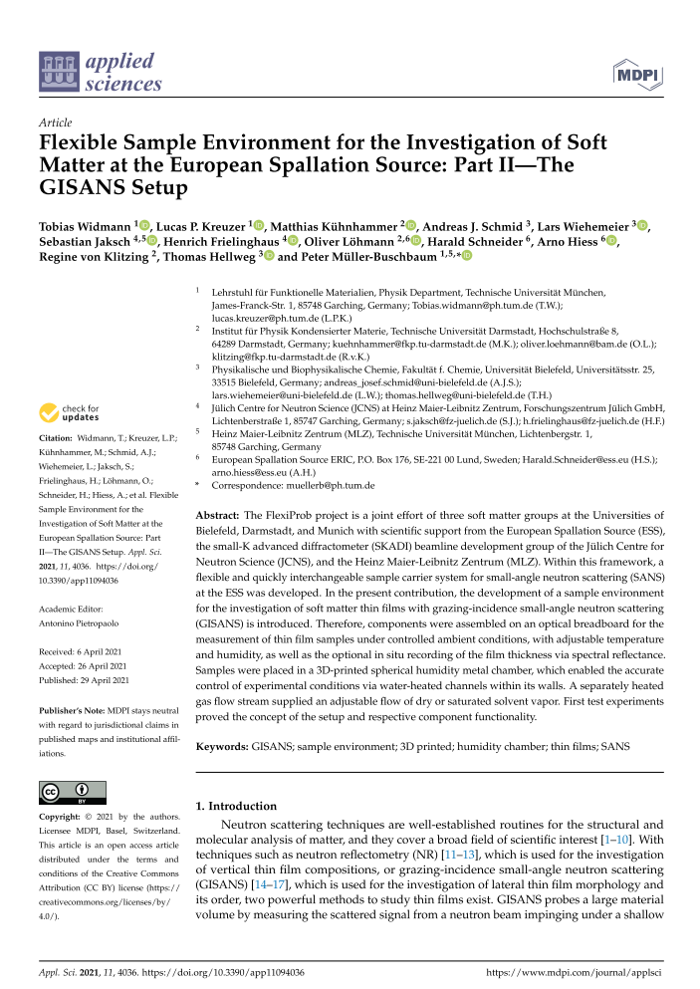
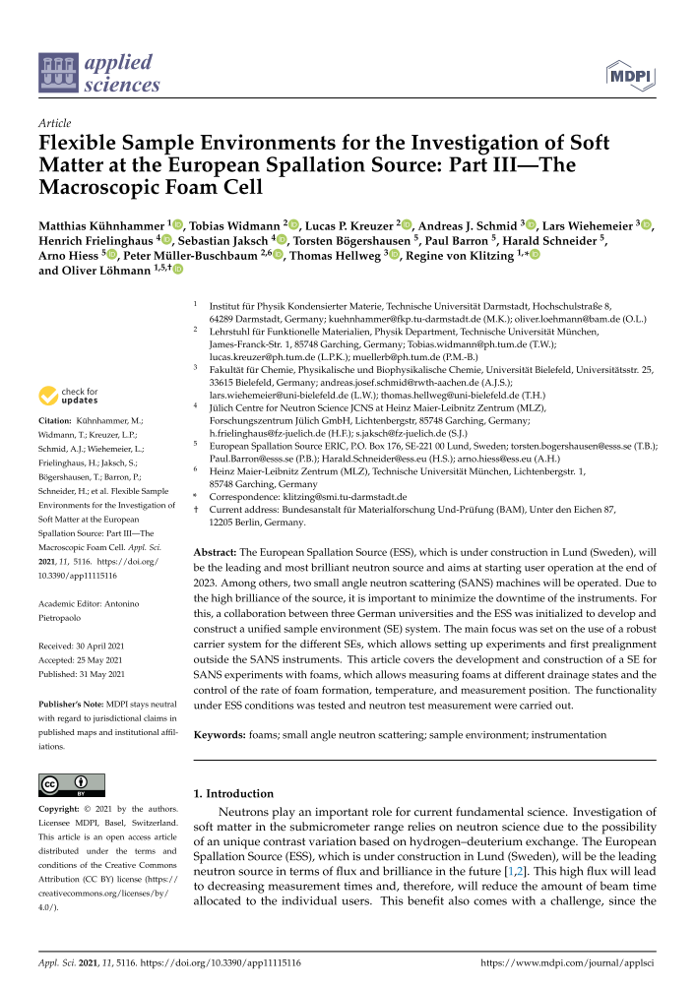
Flexiprob project
Easily switchable set-up between:
  in situ DLS
  Foam cell
  Humidity chamber for GiSANS
Three paper have been published on flexible S/E. Next meeting will take place ASAP.
Currently improving on usability and accessibility
Coordinations with Harald Schneider.
Thanks to the groups of
  Regine v. Klitzing
  Thomas Hellweg
  Peter Müller-Buschbaum

