Slide 1
Scientific and Technical Advisory Panel (STAP) Report for BEER and ODIN May 3, 2022
Panel Members: Sven Vogel (Chair), LANSCE, USA Javier Santisteban, CNEA, Argentina Francesco Grazzi, CNR, Italy Stephen Hall, Lund University, Sweden Nikolay Kardjilov, HZB, Germany Mark Daymond, Queens University, Canada
Zoom meeting with all six STAP members (Hall & Kardjilov present in Lund) and representatives of ESS, Hereon & NPI, TUM & PSI participating

Slide 2
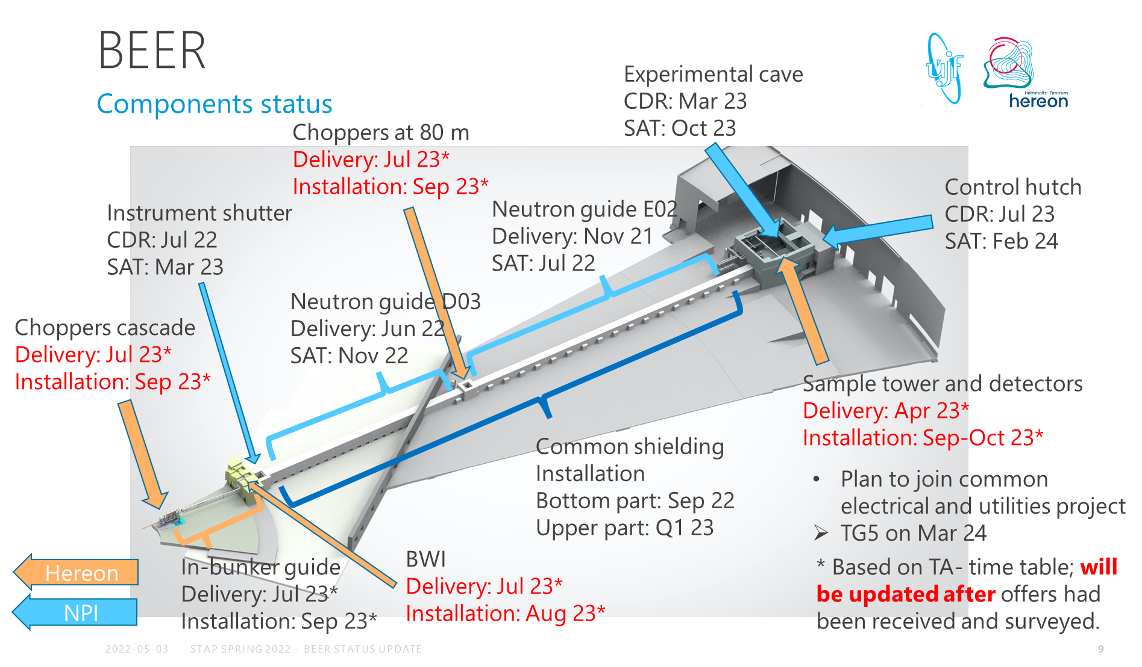
BEER: Inflation caused budget uncertainty
Final signatures resolving contract issues occurred October 14, 2021, but the delay in purchasing resulting from the late signature now leads to significant cost increase since major sub-systems (e.g. shutter price 60% higher than expected)
BEER will not be able to stay on budget
Design & construction already reduced to bare minimum, no further reduction in scope possible
Increased cost due to inflation will need negotiations between ESS and national funding institutions
Uncertainty about budget limits ability to sign purchase contracts (radial collimators, choppers etc.) by the BEER team
Retendering will further delay delivery & installation, discussion with ESS needed for in-bunker installations
Operation as one of the first eight ESS instruments in jeopardy
Dedicated engineer, Bojan Peric, has joined the BEER team in November 2021
Installation of major components about to start (out of bunker guide system) are planned for later in 2022 (common shielding)
Detector testing by Hereon team on-going
Decision if Hereon detector technology suitable for BEER was planned for late 2021, not decided yet
Beam time at PSI mid August 2022
Backup plan is commercial available ³He tubes, which had been tested 2017 at V20
TimePix3 camera-based detectors could be another alternative ⇒ STAP suggests to monitor this development and possibly test a demo TimePix3-system in the future
Summary: BEER project severely suffers from inflation leading to 30-60% higher cost for sub-systems, uncertainty of budget may lead to further delays and requires ESS intervention

Slide 3
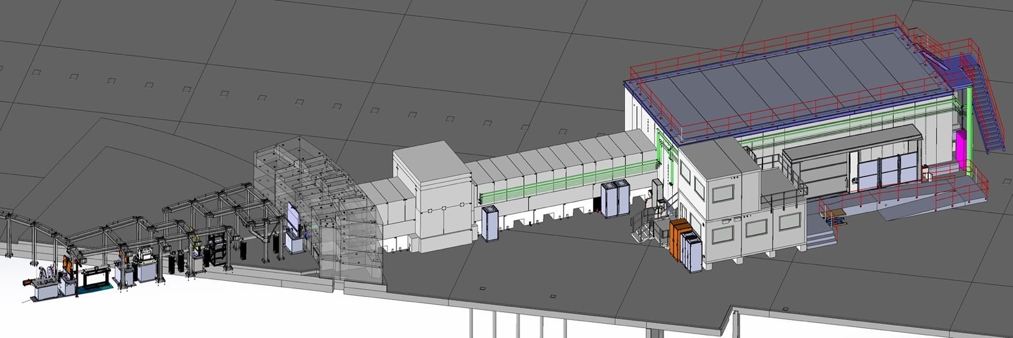
ODIN: On track
Installation on track to finish June 2023, final TG5 planned July/August 2023
Far before beam-on-target
Allows more time to test detector integration, motion control etc.
All big-ticket items except cave are under contract ⇒ much less issues with inflation
Cave construction is biggest issue for ODIN team, all foreseeable issues appear manageable
Choppers were tested at Airbus, motion tables for choppers were tested at TUM
New ESS detector lead should be made aware that ODIN detector requirements differ from other instruments ⇒ Big issues is time stamping for by definition white beam/not time stamped events
ODIN team heavily involved in YMIR test beam line as well as TimePix3 detector developments at TUM
X-ray source for X-ray CT to be installed in hutch
Will allow testing of data streams without TOF
Will require functioning PSS before beam-on-target
Contracts with in-kind partners end with TG5 and
options should be discussed/found on how partners
can engage post TG5.

Slide 4
DMSC
Test beamline YMIR is working on optical CT together with Lund University
Implementing and testing data streaming, data compression, and tomography recon, debugged network.
Tested positioning system tracking sample position, great boost in sample tracking, 40 microns.
BEER team should discuss sample positioning system developed by ODIN team and demonstrated at YMIR
Test of software stack for ODIN has started
Data reduction, analysis, visualization,
NICOS integration demonstrated, system allows to demonstrate and debug.
Use of X-rays source will give this another boost before neutrons.
Black-body and beam hardening corrections demonstrated at PSI are adapted for ODIN
WFM algorithms continue to be improved (fixing data in the gaps between frames)
Hot commissioning planning has started in fall of 2021 (Att tomography, Bragg edge, polarization)
Simulation to demonstrate step-by-step procedure for certain type of experiment on ODIN.
BEER data reduction started.

Slide 5
Charge for STAP
Comment on the progress of the instrument projects in the context of their schedule: ⇒ ODIN appears on track to finish construction before the (delayed) BOT ⇒ BEER greatly affected by inflation and uncertainty of budget requires interference ⇒ Saving potential by reducing scope appears to be exhausted ⇒ Decision of detector technology for BEER still needs to happen
Comment on the status and plans (technical solutions) for the Test beamline project ⇒ STAP was only able to receive a few minutes of briefing on the Test beamline. Plan to follow up by email.
Comment on progress of software developments and YMIR integration beamline ⇒ Testing of imaging data streams with optical imaging show great progress ⇒ Tight connection of ODIN team with TImePix3 camera detector systems likely to improve quality of availably imaging detectors as well as potential alternative for BEER out of plane diffraction detectors ⇒ Similar to test beam line at HZB, the YMIR test beamline is expected to reduce risk for production beamlines by testing of integral components
Provide feedback on the progress of the instrument class and any management actions that are needed to support the instrument projects. ⇒ ODIN is making excellent progress ⇒ BEER project suffers from challenges due to inflation that require ESS attention
⇒ STAP hopes to meet again in person in the autumn after two years which will greatly facilitate discussion on the instruments, hot commissioning, test beamline, YMIR, etc.

