Slide 1

ODIN:
Optical and Diffraction Imaging with Neutrons at the ESS
STAP – May 2022

Slide 2
Agenda
1 ODIN team
2 Instrument layout overview
3 Components status overview
4 Summary

Slide 3

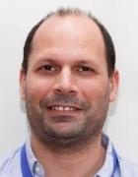



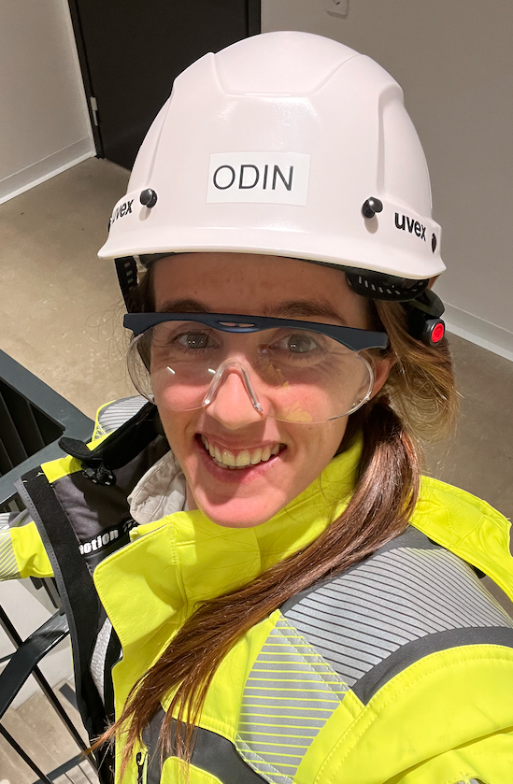

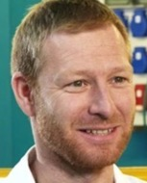
ODIN team
ODIN Extended Team
ODIN construction core team
Aureliano Tartaglione
ODIN Scientist (TUM)
Elbio Calzada
ODIN Lead Engineer (TUM)
Virginia Martinez Monge
ODIN Installation Engineer
(TUM)
Michael Schulz
Head of Imaging group
(TUM)
Manuel Morgano
ODIN Scientist
(PSI/ESS)
Markus Strobl
Head of Imaging
group (PSI)
Robin Woracek
Instrument Class Coordinator (ESS)
Søren Schmidt
Instrument Data Scientist for ODIN, BEER & TBL (ESS)
Jan Hovind
Technician of
Imaging Group
(PSI)
Alexandre Gonçalves Gerk
MCA Engineer for ODIN (ESS)

Slide 4
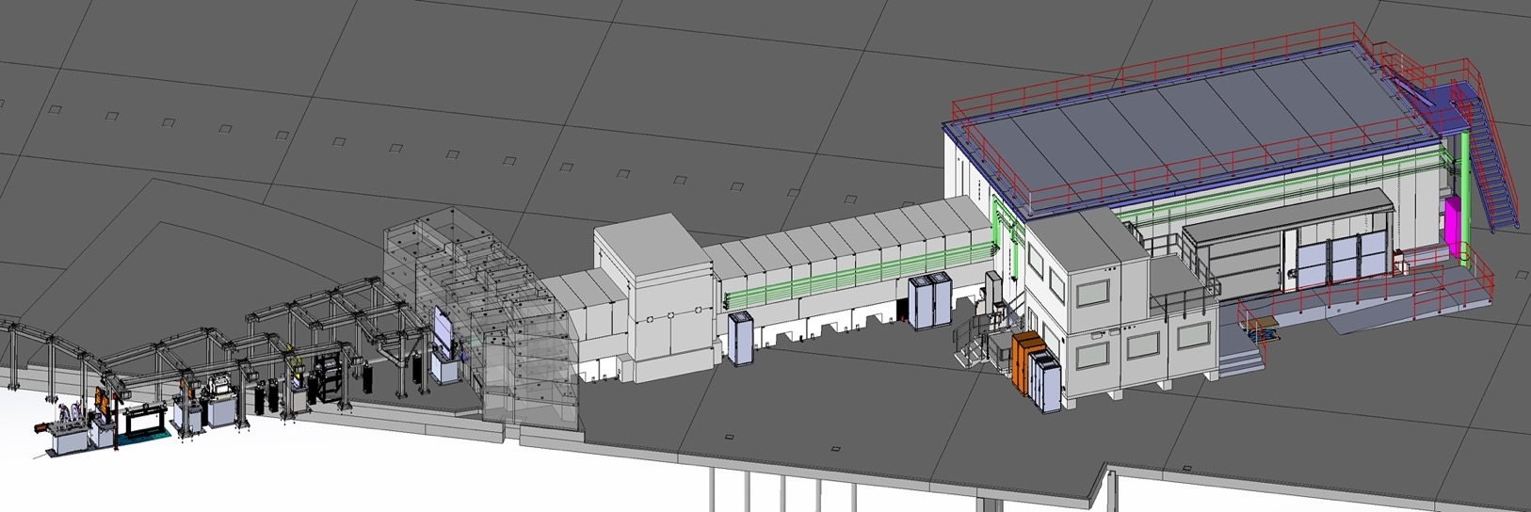
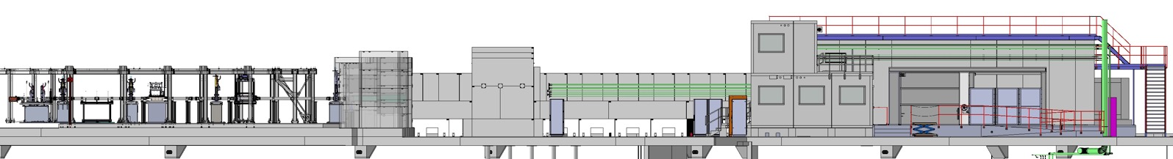
ODIN overview
Ex-Bunker
Bunker wall
In-Bunker
Cave
FOC3
FOC4
FOC5
FO&BP 1
T0
WFMC 1&2
FO&BP 2
Heavy shutter
BWI
Guide shielding
Control hutch

Slide 5
ODIN overview
 | Task no. | TA ID | Deliverables – Project Results | Delivery date | Status (milestones)
TUM | WU 03 | 2-8 | Heavy Shutter* | Dec 2021 | On site. Integration ongoing.
TUM | WU 04 | 9-15 | T0 Chopper* | Oct 2023 | Contract with ESS signed (CR approved)
TUM | WU 05 | 16-25 | Choppers* | May 2022 | FAT & delivery ongoing
TUM | WU 08 | 26-32 | Motion Control and Electric Engineering* | Dec 2022 | Detail design & procurement ongoing
TUM | WU 11 |  | Shielding* | - | -
TUM | WU 11.1 | 33-38 | Guide Shielding (common shielding project) | Jan 2022 | Delivery & Installation ongoing
TUM | WU 11.2 | 39-50 | Cave Shielding * | May 2022 – Apr 2023 | subTG3 Complete
TUM | WU 12 |  | Instrument Infrastructure | - | -
TUM |  | 51-56 | Control Hutch (TUM) * | Feb/Mar 2022 | Installed
TUM |  |  | Sample preparation area & storage (TUM) * | Feb/Mar 2022 | Installed
TUM/PSI |  |  | Power distribution (CEP) | Nov 2022 | Detail design ongoing
TUM/PSI |  |  | Utilities supplies (CUP) | Dec 2022 | Final requirements definition
TUM | AO01 | - | Bunker Wall Feedthrough | Apr 2022 | Integration done. Installation May 2022
TUM | AO02 | - | Chopper supplements | Nov2021 – Apr2022 | FAT complete. Delivery ongoing
TUM/PSI |  | 59 | FINAL TG3 | June 2022 | Ongoing
PSI | 02.1 | 1-4 | NBOA | Q4 2021 | On site
PSI | 02.2 | 5-16 | Neutron transport system (Guides) | Nov 2021 – Mar 2022 | On site
PSI | 06 | 17-32 | Cave interior # | Dec 2021 – Mar 2022 | subTG3 Complete
PSI | 09 | 33-43 | White beam detectors | Q2 2023 | Off-the-shelf
PSI | 10 | 44-48 | ToF detector | Q2 2023 | Readout pending
# Parts of this item agreed to be delivered by ESS for PSI
* Item agreed to be procured by ESS for TUM

Slide 6
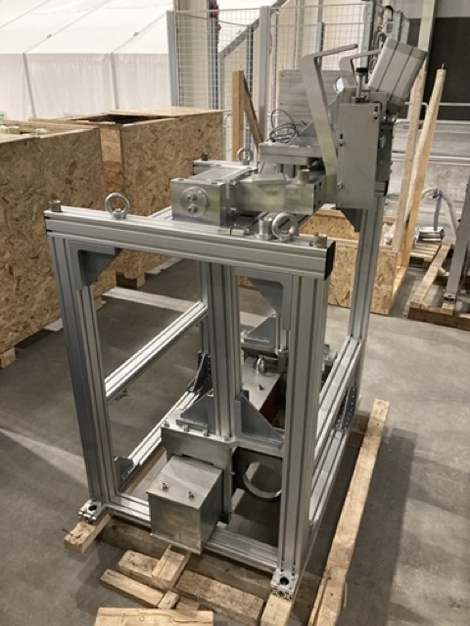
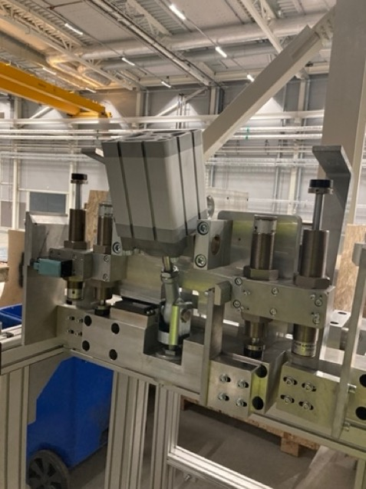
Heavy shutter
FAT completed
Heavy shutter On site
SAT including vacuum vessel – May/June 2022

Slide 7
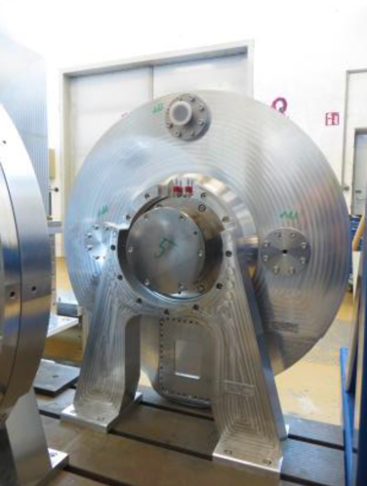
Disk choppers
All FOC/BPC housings assembled, discs mounted
WFMC1/2 fully assembled
Tests for leakage,lifting, guiding, balance check complete
Fine balancing, commissioning of first rack and choppers ongoing
Delivery of bottom part of housing: May 2022
Delivery of full assemblies: August 2022

Slide 8
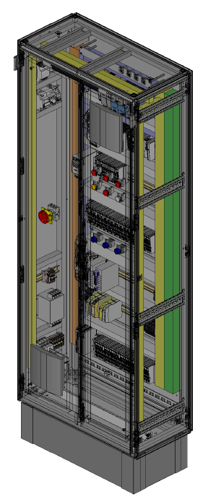
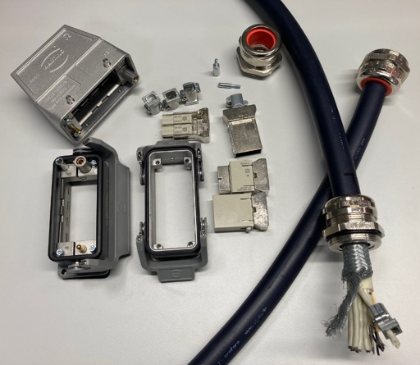
Motion Control
MC Cabinet
Prototype for the Optical Cave already ordered (framework agreement with Actemium).
Sub-Systems
Selection of all MC Components for every Sub-System is concluded – last MC-related Sub-TG3 still in March (Cave Interior).
Special cable and connectors tested.
FAT
FAT of the WFMC Motion Table performed in TUM (March 2022). Results were very satisfactory and the WFMC motion is ready for shipment to ESS after FRH FAT is approved.

Slide 9
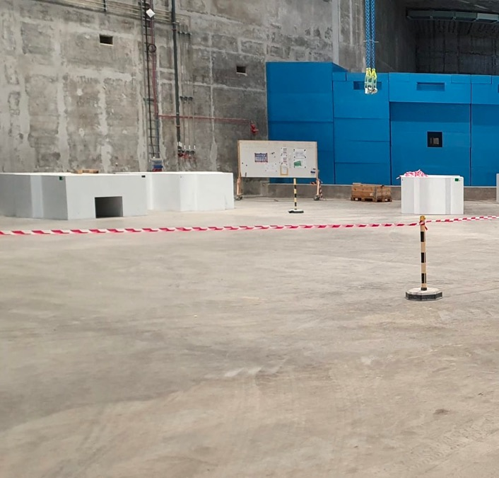
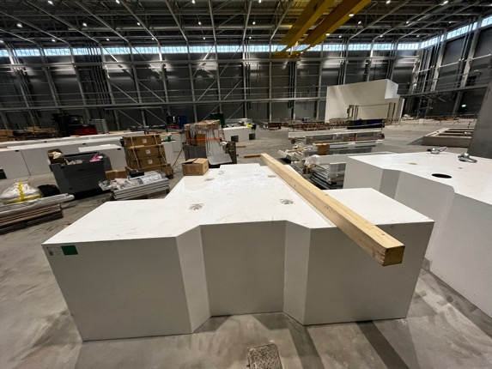
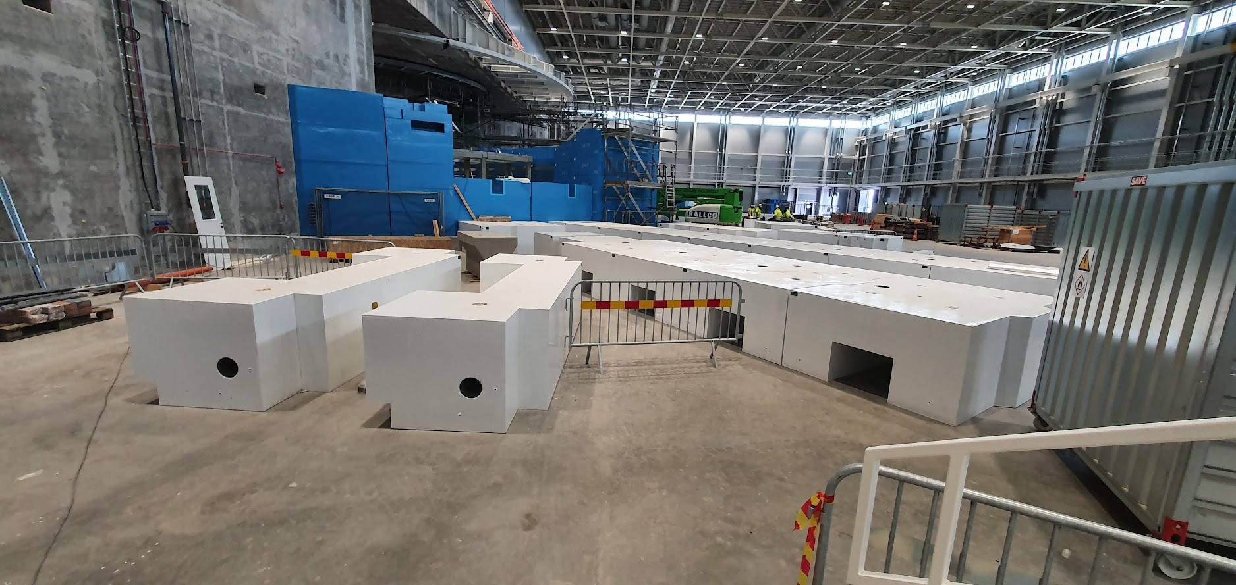
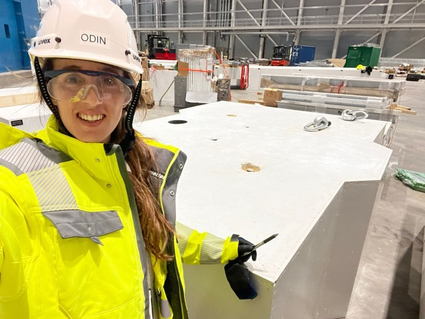
Guide shielding (Common project)
Manufacturing completed
Delivery and installation ongoing

Slide 10
Cave shielding
Detail design Montecarlo simulation report waiting for formal approval (CHESS)
SubTG3/CDR completed and approved
Installation begins May 2022 (baseplate)
Installation of walls Oct 2022 (delayed)
Installation ends April/May 2023 (delayed)
The war in Ukraine may cause longer lead times for materials and components and thus further delays

Slide 11
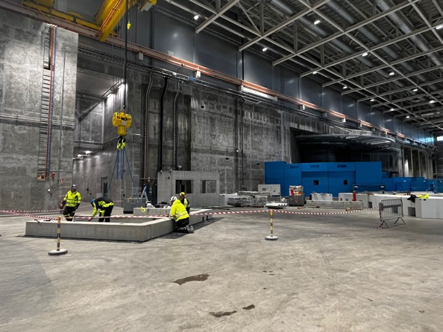
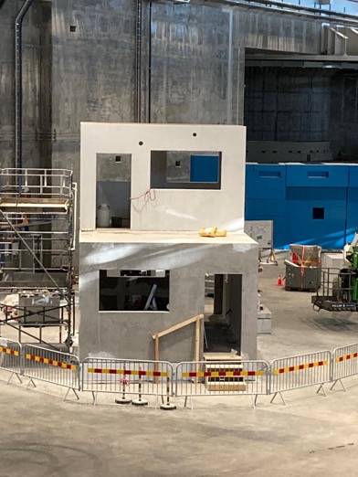
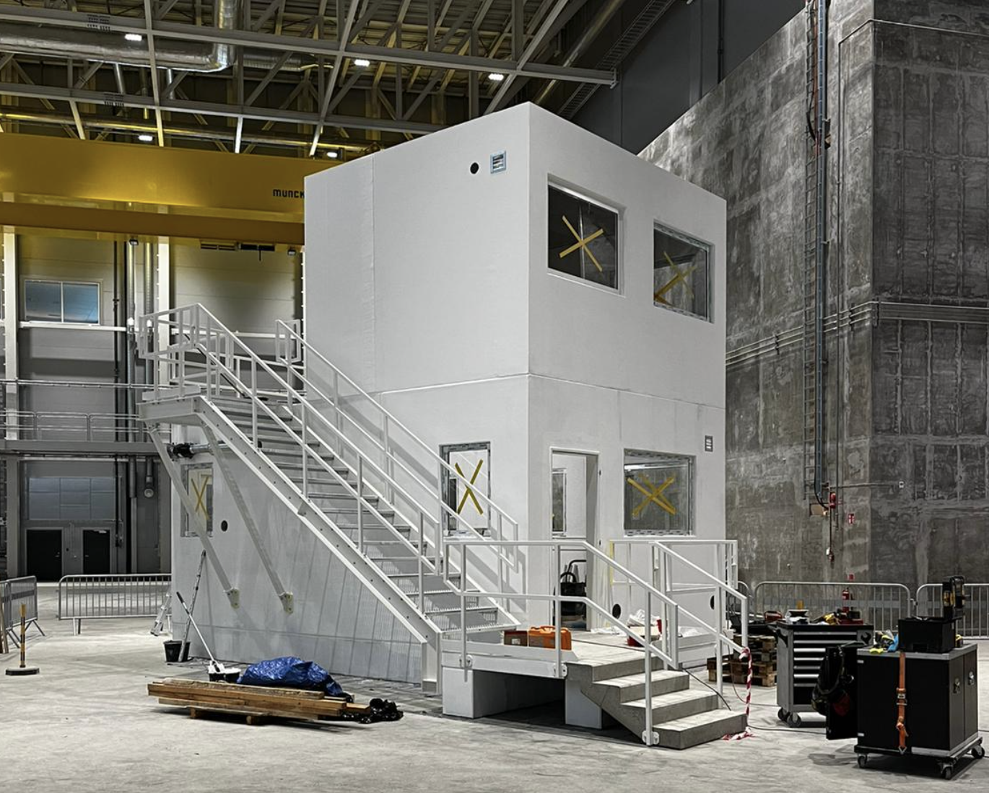
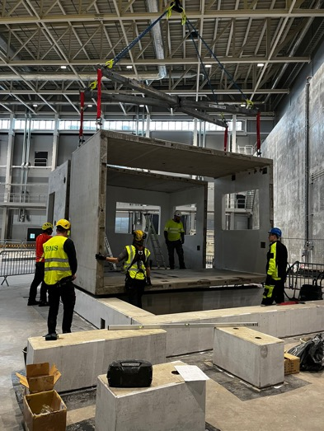
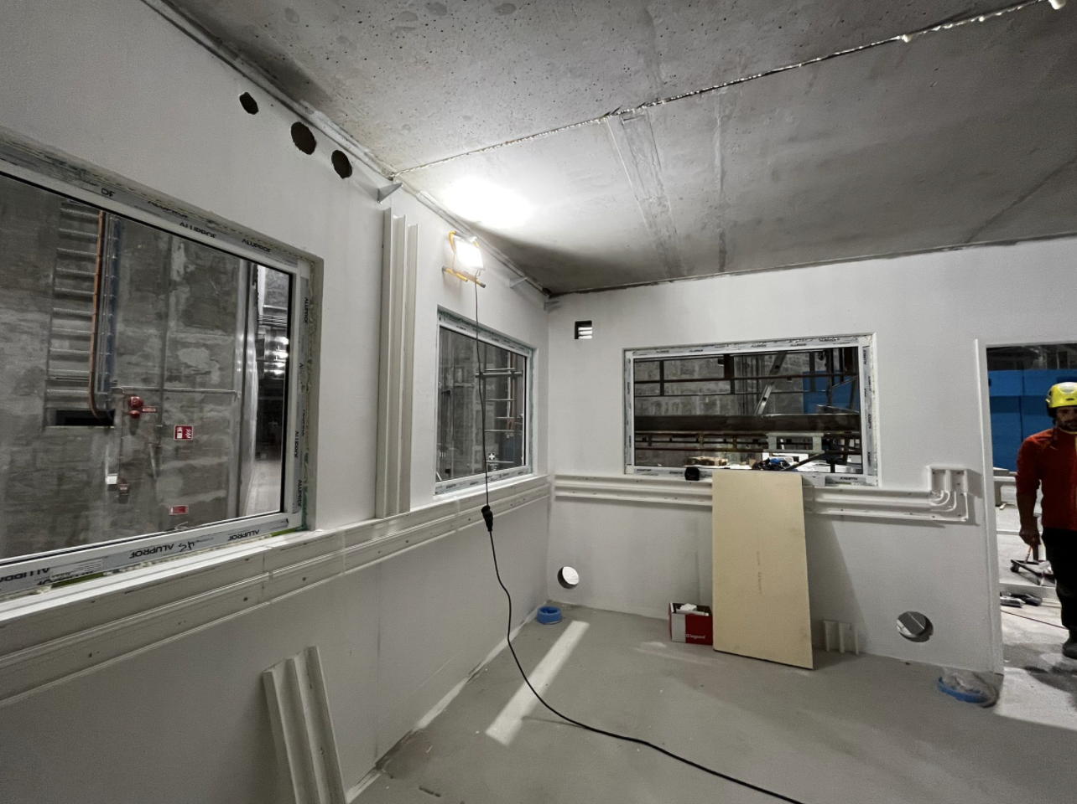
Control hutch
Installation progressing well in D01
SAT scheduled May 2022
Feb 21st
Mar 1st
Feb 22nd
Mar 17th

Slide 12
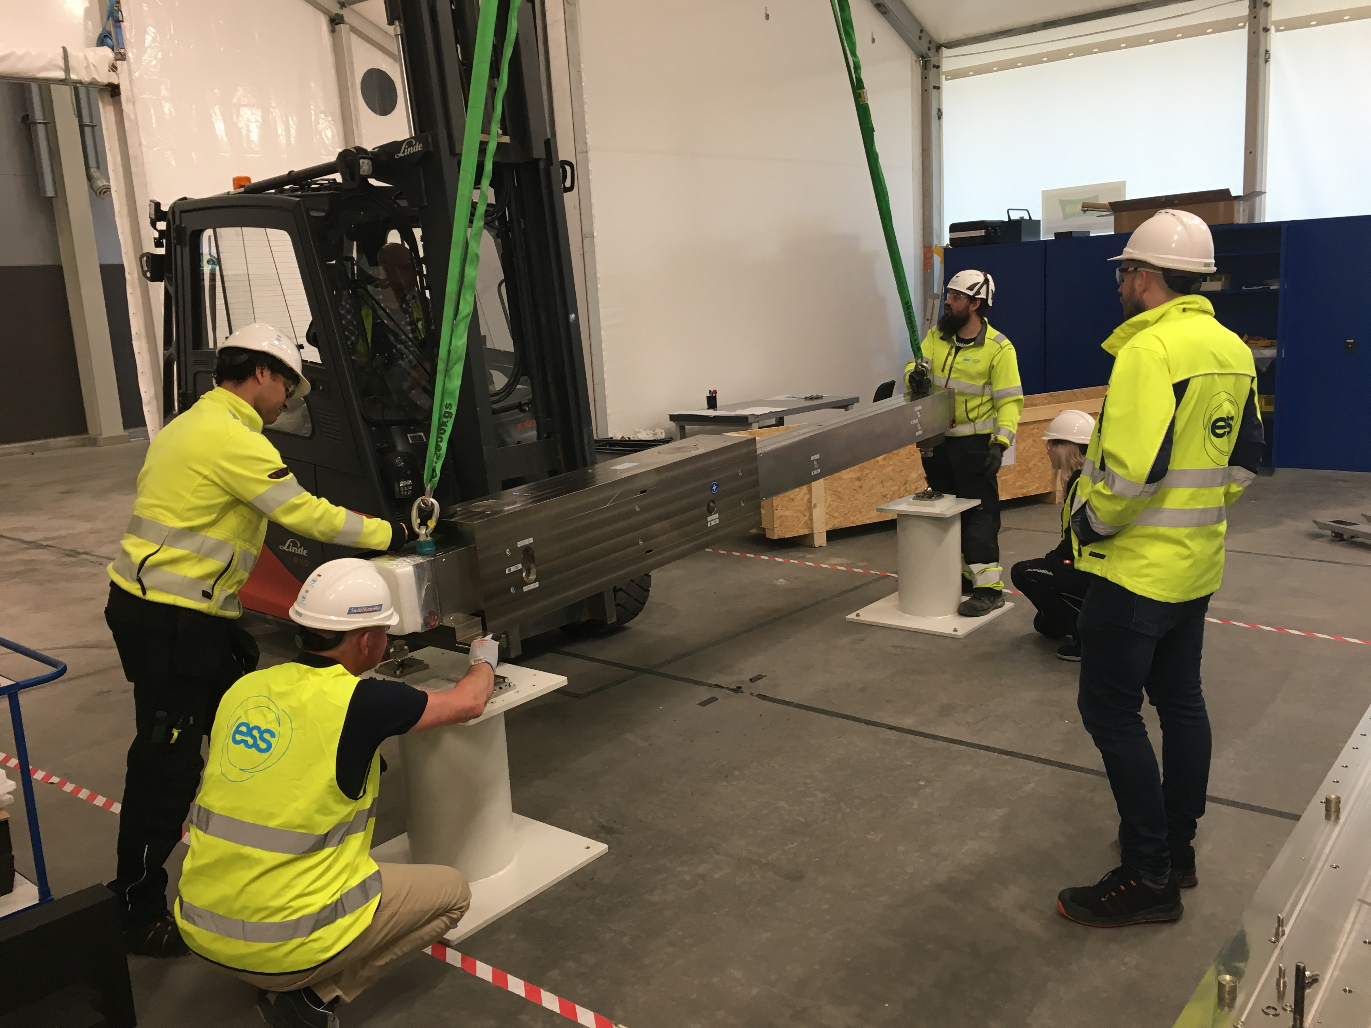
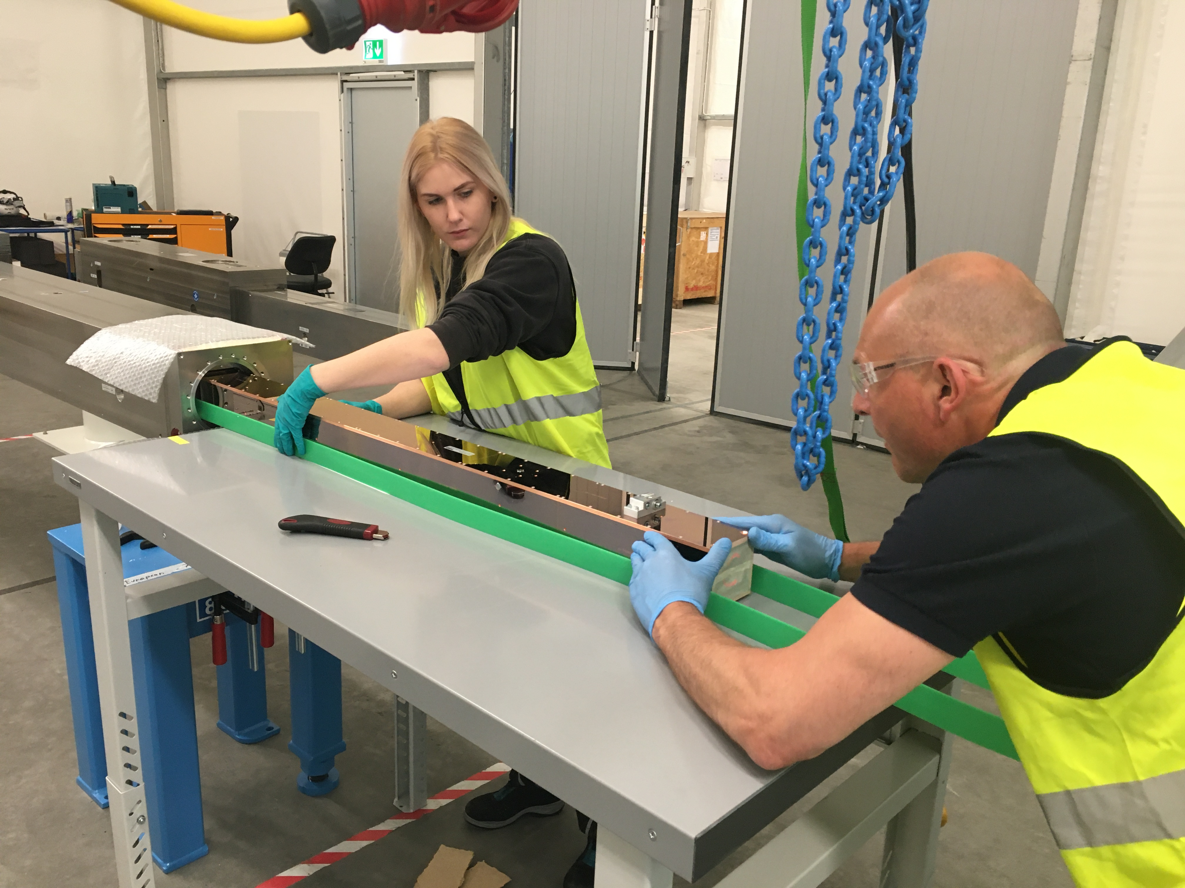
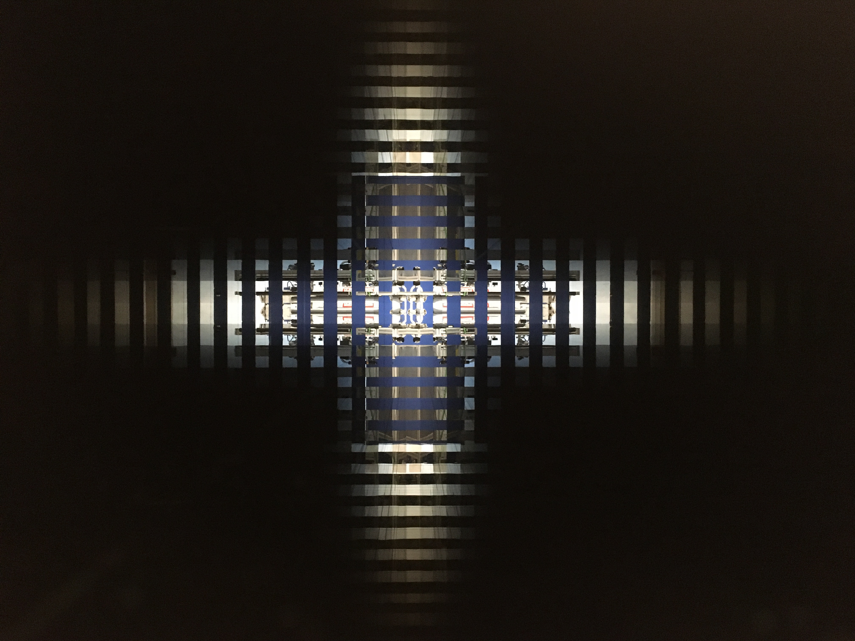
Bunker wall insert
Delivered to ESS
Integration of guides and vacuum SAT complete
Installation in bunker wall scheduled next week

Slide 13
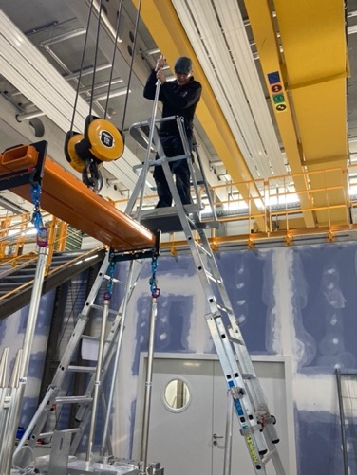
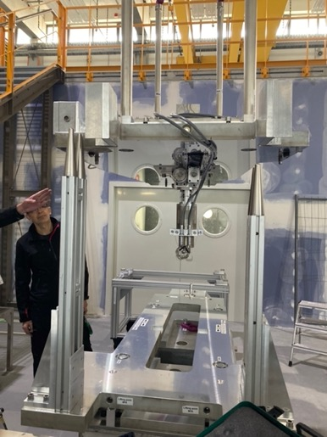
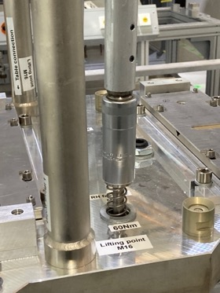
Chopper supplements
Dimensional and functional FAT completed.
Documents submitted to ESS
FOC 2, 3, 4, 5 chopper pedestals and interfaces in Lund
Installation in-bunker May / June 2022
MCA FAT complete
RH FAT complete
WFMC and FOC1 pedestals will be shipped to ESS in May 2022

Slide 14
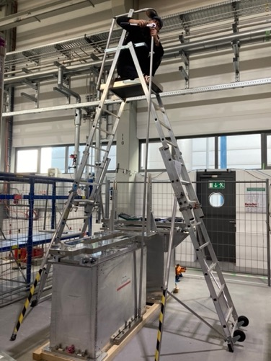
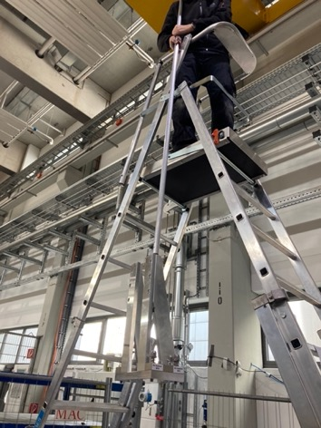
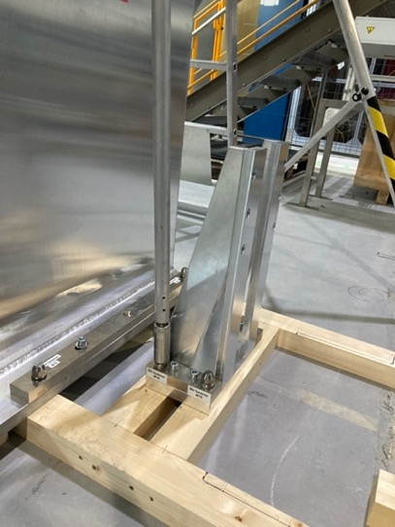
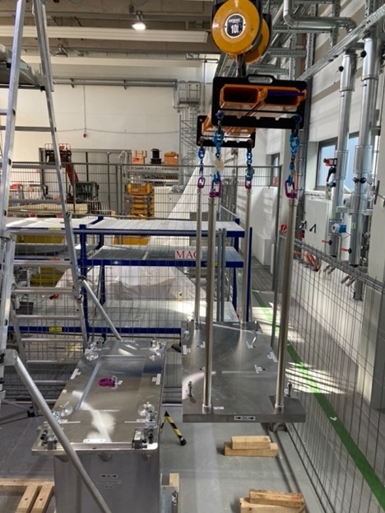
Chopper supplements
Dimensional and functional FAT completed.
Documents submitted to ESS
FOC 2, 3, 4, 5 chopper pedestals and interfaces in Lund
Installation in-bunker May / June 2022
MCA FAT complete
RH FAT complete
WFMC and FOC1 pedestals will be shipped to ESS in May 2022

Slide 15
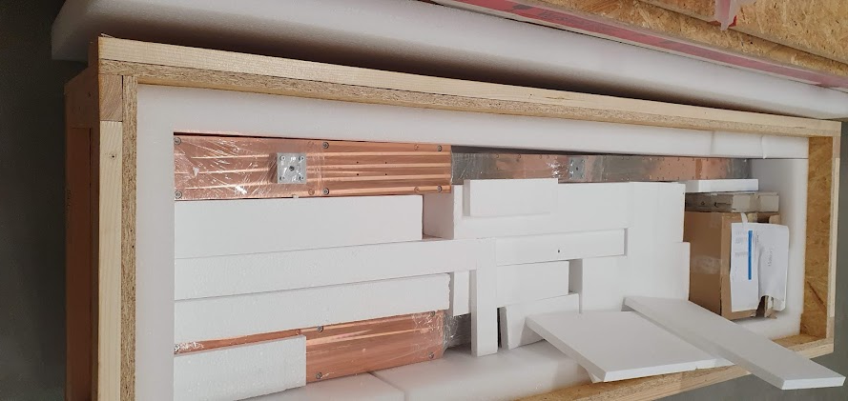
NBOA
In the integration tent in E01

Slide 16
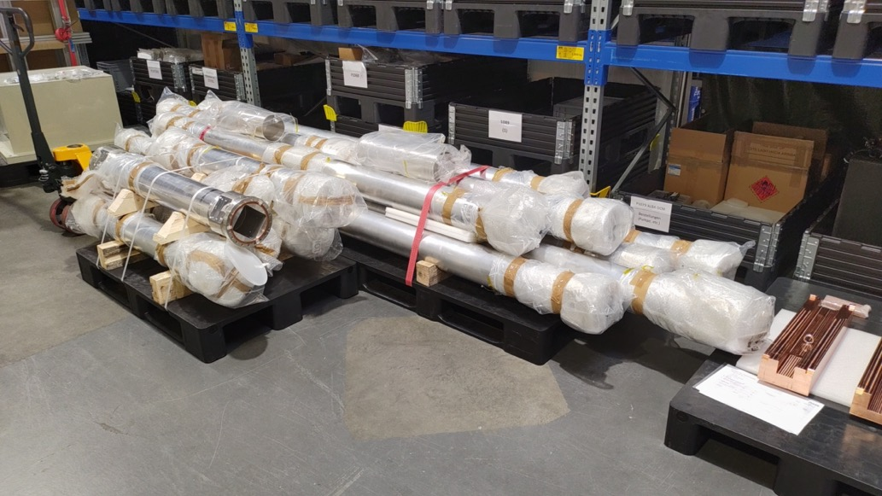
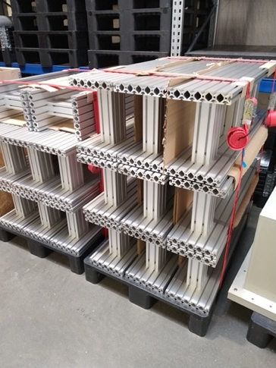
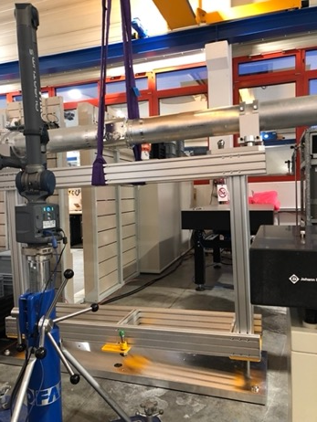
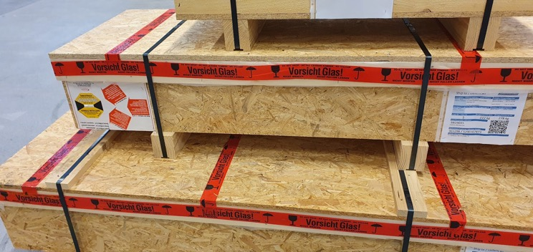
Neutron guides
Housing supports @ ESS
Vacuum housings @ ESS
Neutron guides @ RATS
Remote handling tests as part of the FAT

Slide 17
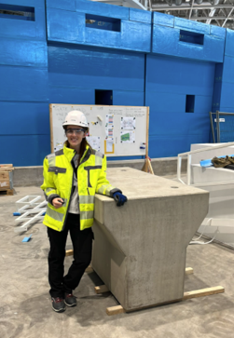
Cave interior
Detector box
Crane
Variable pinhole
Flight tubes
Large sample stage
Fast shutter
Small sample stage
Beam limiter
Metrology system
TG3 complete

Slide 18
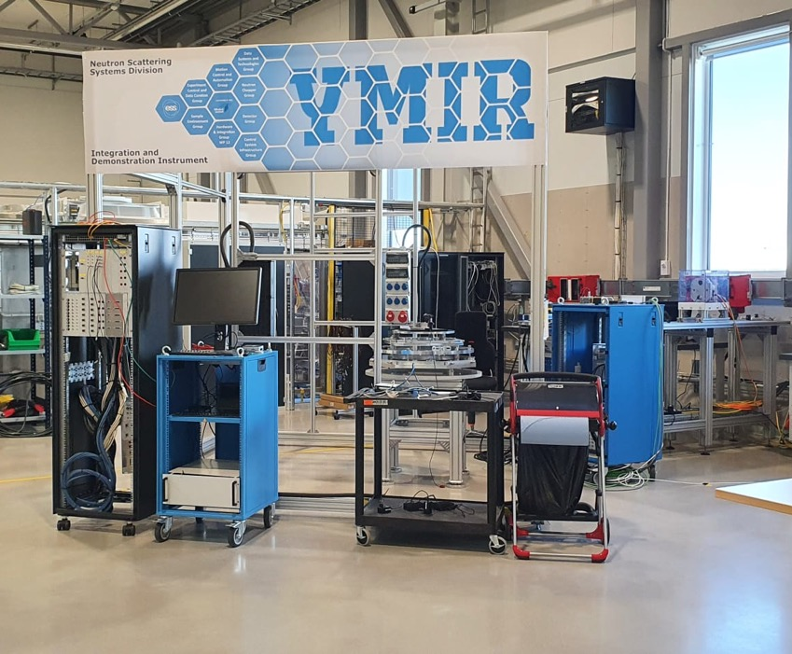
White beam detectors
WB detector (same as for ODIN) has been purchased and received, and is in the queue to be integrated in YMIR

Slide 19
ToF detectors
Current most promising candidate for day-1 detector: TPXCAM developed by TUM
3 of these detectors have been purchased and can be used to kickstart the integration within ESS:
Detector from TUM
Detector at PSI
Detector acquired from DTU within the Lighthouse Solid framework
EU-INFRATECH project submitted on 20/4/2022 to further develop it and with budget to acquire an own ESS one as hybrid imaging/diffraction

Slide 20
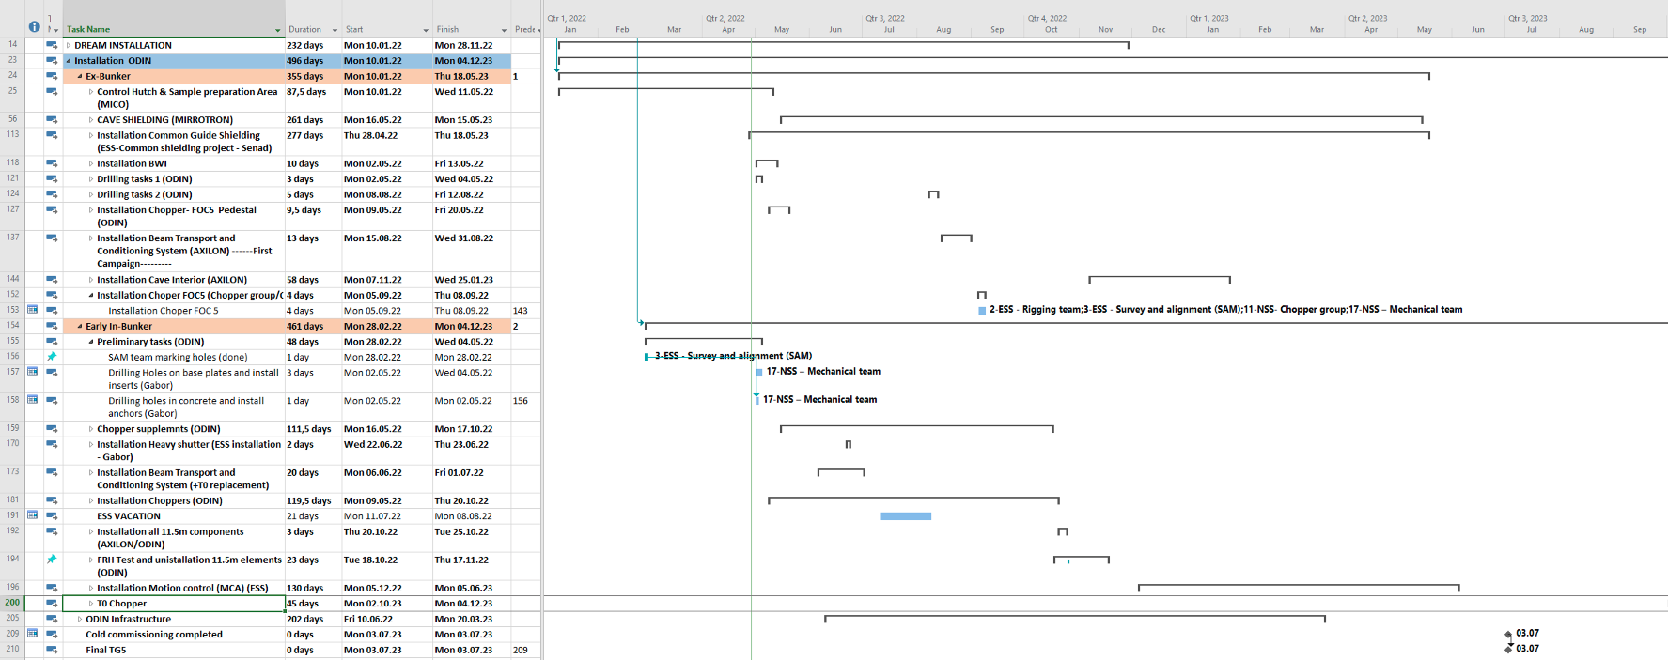
Installation
Installation plan

Slide 21
Installation
Lessons learned and future challenges
Lessons learned
Very good experience with ESS teams: Logistics, Rigging, Safety (OHS), Spatial integration and SAM
Support of NSS technician is very important during installation tasks: hot work and other unexpected tasks where special permits are needed
Working with suppliers used to move around in ESS environment helps a lot (MICo): they know the procedures and are used to deal with ESS rules
Lessons learned from other instruments (Loki) helped a lot to be aware of the risks involved
Challenges
Installation of the cave
The supplier MIR has only limited experience from previous installations at ESS
The installation is delayed (ends April 2023) pushing TG5
Grounding requirements: not clear if could or not be an issue not to comply with the insulation requirement (now turned into a “recommendation” from ESS)

Slide 22
Status of ODIN instrument: Summary
Installation of ODIN have begun and is progressing (Hutch, guide shielding, Bunker wall insert)
Drilling for supports and pedestals in-bunker ongoing (in concrete floor is done)
Components already delivered or on the way to Lund: NBOA, 4/6 Chopper pedestals, guides and vacuum vessels, heavy shutter, metrology system, Bunker wall insert)
Latest components with FAT complete (Choppers, WFMC table and RH pedestals)
1/6 MCA cabinet procured. Delivery ongoing
BWI integrated and installation in
Cave installation begins in May 2022 (baseplate). Resumes in Oct 2022 and should be completed by Apr 2023
Cave interior components (PSI and Axilon): Delivery October 2022
CEP: Detail design ongoing.
CUP: Requirements definition and compilation ongoing.
PSS design & Hazard Analysis: PSS design ongoing. IHA submitted.
T0 chopper will be integrated by ESS based on ESS prototype model. Delivery: end 2023. Mitigation in place to complete installation.
Final TG3 scheduled June 2022. Documents ongoing
Installation driven by the cave (delayed). TG5 now shifted to July 2023

Slide 23
Questions?

