Slide 1


BEER
Instruments status
PRESENTED BY Premek Beran & Jochen Fenske & Gregor Nowak

Slide 2


BEER
General status update
Reminder: NPI TA signed Jul 2021&Hereon TA signed in Oct 2021
Re-baseline
Uncertainty of the in-bunker components (tendering in the process)
TG5 was delayed from Jan/24 to Mar/24
Cost increase for all sub-systems!
New engineer
Bojan Peric started Nov 1, 2021
Hereon personnel update
Dr Jochen Fenske: Project lead @ Hereon
Dr Gregor Nowak: Instrument scientist (Texture analysis, Stress, …) @ Hereon
Software
Needed discussion about the data flow and the data reduction for BEER

Slide 3
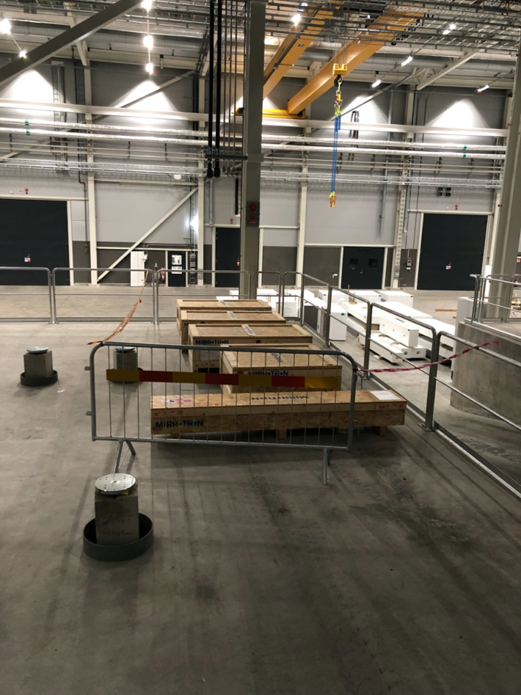
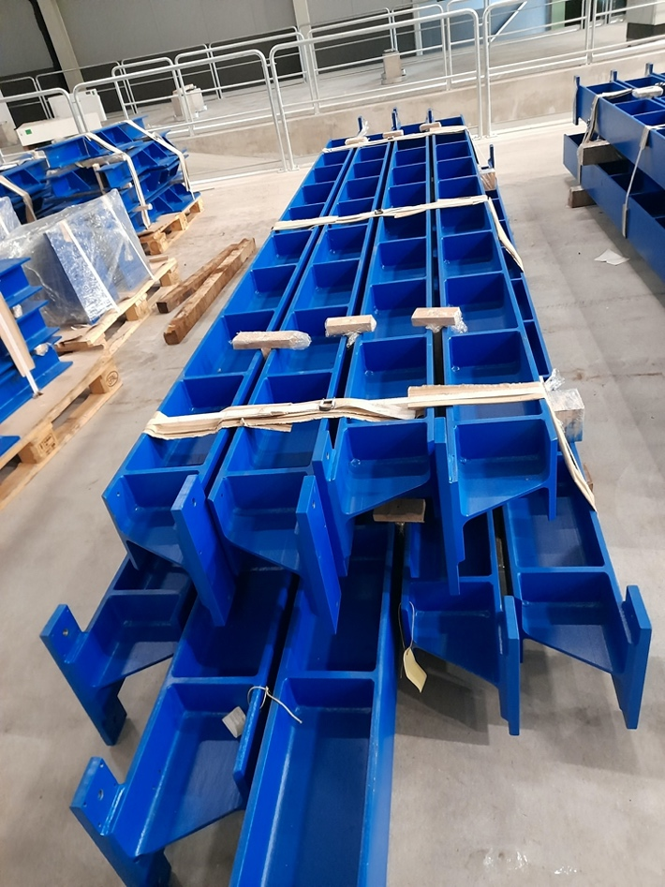
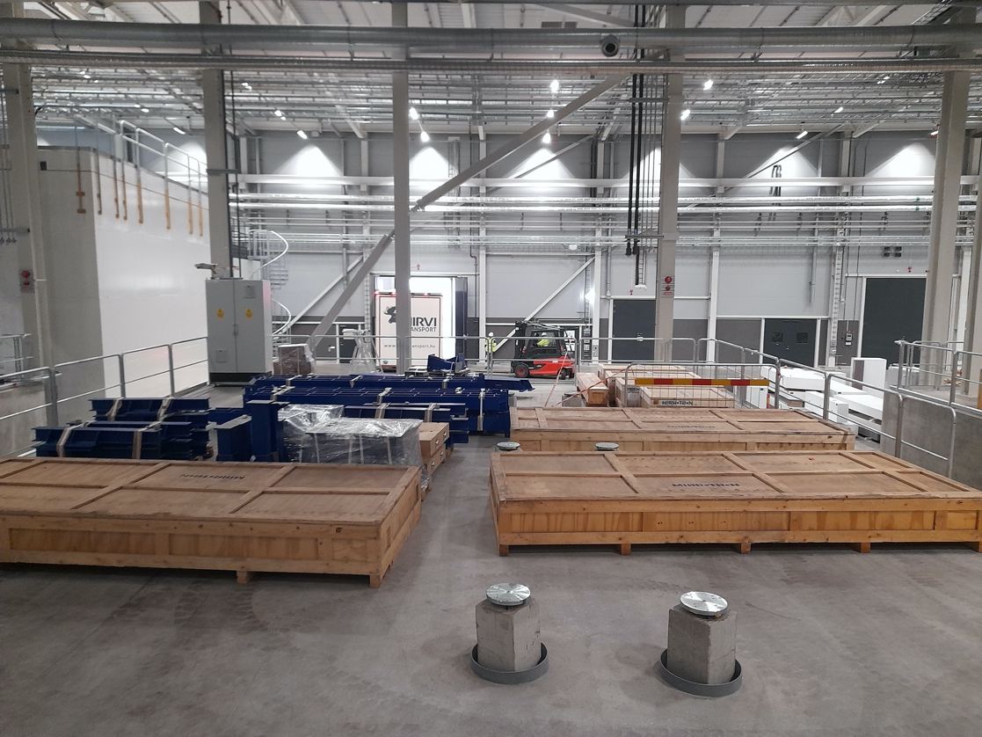

BEER
NPI update
Out-of-bunker guide (on truck + budget)
Sector 2 – Delivered within Nov/Dec/Feb (guide, support structure, vacuum housings)

Slide 4
BEER
NPI update
Out-of-bunker guide (on truck + budget)
Sector 2 – Delivered within Nov/Dec/Feb (guide, support structure, vacuum housings)
Preparation for the installation of Sector 2 (64.5 m of the guide in E02) – starts on May 31
FAT for the other Sectors, including slits and guide exchanger – June 7-10
Installation of Sector 1 (48.6 m of the guide in D03) – starts in October
Other parts (in the shutter and in and nearby the cave) need to wait for the sub-system ready
Sectors / boundaries | Shutter | End of pit throughput | Sector 1 | Chopper | Sector 2 | End of TG2 | Sector 3 | Slit 1 | Sector 4
Distances |  | 31.4 m |  | 80 m |  | 144.5 m |  | 152 m
Lengths | 3.4 m |  | 48.6 m |  | 64.5 m |  | 7.5 m |  | 5 m
Former sector notation | Part I, Shutter |  | Part I, D03, E02-2 |  | Part I, E02-1 |  | Part II, E02-1 |  | Part II, E01
Optics table components (ESS-0478295) | W02-13, W02-14 |  | W02-15, W02-16 |  | W02-17 |  | W02-18 |  | SL1, W02-19, SL2, W02-20, with exchanger
WP number in TA | WP02.7 |  | WP02.6 |  | WP02.4 |  | WP02.5 |  | WP02.5
Halls | D03 |  | D03, part of E02 |  | E02 |  | end of E02 |  | E01

Slide 5
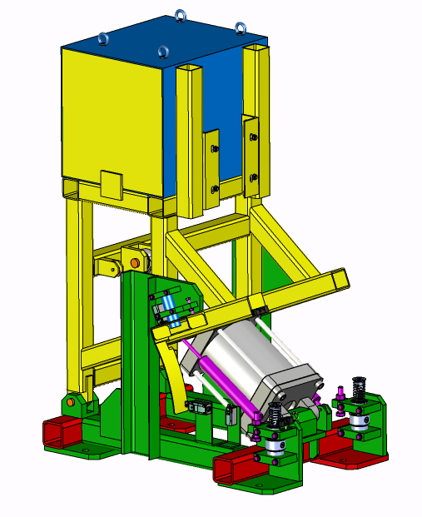
BEER
NPI update
Out-of-bunker guide (on truck + budget)
Sector 2 – Delivered within Nov/Dec/Feb (guide, support structure, vacuum housings)
Preparation for the installation of Sector 2 (64.5 m of the guide in E02) – starts on May 31
FAT for the other Sectors, including slits and guide exchanger – June 7-10
Installation of Sector 1 (48.6 m of the guide in D03) – starts in October
Other parts (in the shutter and in and nearby the cave) need to wait for the sub-system ready
Shutter (small delay + budget)
The tender concluded in April
Price 60% higher than expected
An update of the TA EV table delays the contract signature (+ VAT issue)
Installation planed for Mar 2023 (delayed by 1-2 months)

Slide 6
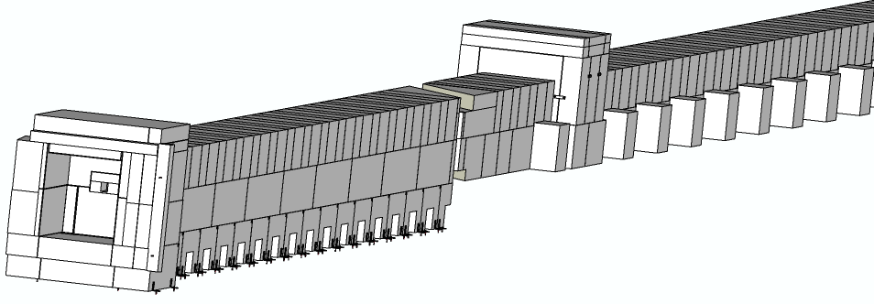
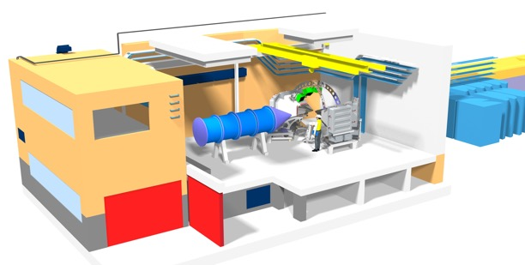
BEER
NPI update
Common shielding (small delay)
D03 support block will be delivered in June
E02 bottom parts delayed to September (better for guide installation)
The D03 should be ready for guide Sector 1 and the shutter installation
Challenge: integration issue with the shutter pit and the bunker cable traces
Cave (delay + budget)
CTV ready for submission
Radiation report update underway
Other work packages (detectors, guide, sample tower, …) relate to it
Hutch and utilities (budget)
Try to join the common projects (CEP, CUP)
Budget shrinkage! (an increase of the cost book value?)

Slide 7
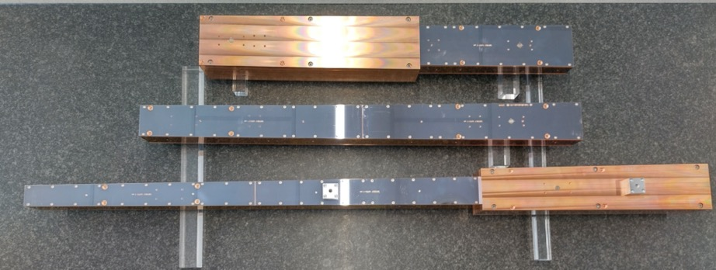
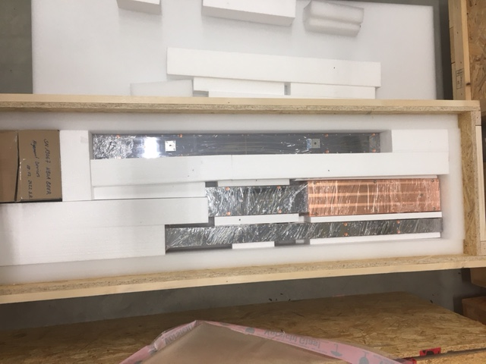
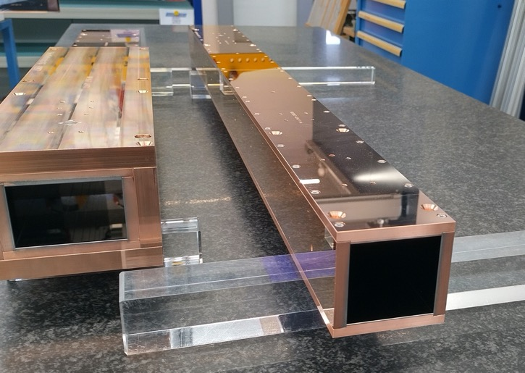

BEER
ESS/Hereon update
NBOA - NBPI (on truck)
FAT passed on February 28
Delivered to ESS mid-March
CDR for NBPI passed on 29 March

Slide 8
BEER
Hereon update
1) Radial collimators: tender published, retendering necessary
2) Choppers: tender published, retendering of parts necessary
3) Neutron optics/guide: tender published
4) Hexapod and sample robot: tender published
Significant cost increase for some components (about 30 % and more) caused by the increase in energy costs (inflation) and shortage of raw materials (Al, Cu, ….)
The issue has to be discussed with ESS. Further de-scoping of the instrument is not possible without a significant change in performance and scientific case
Retendering will delay the delivery of components
Discussion with ESS necessary on in-bunker installations

Slide 9
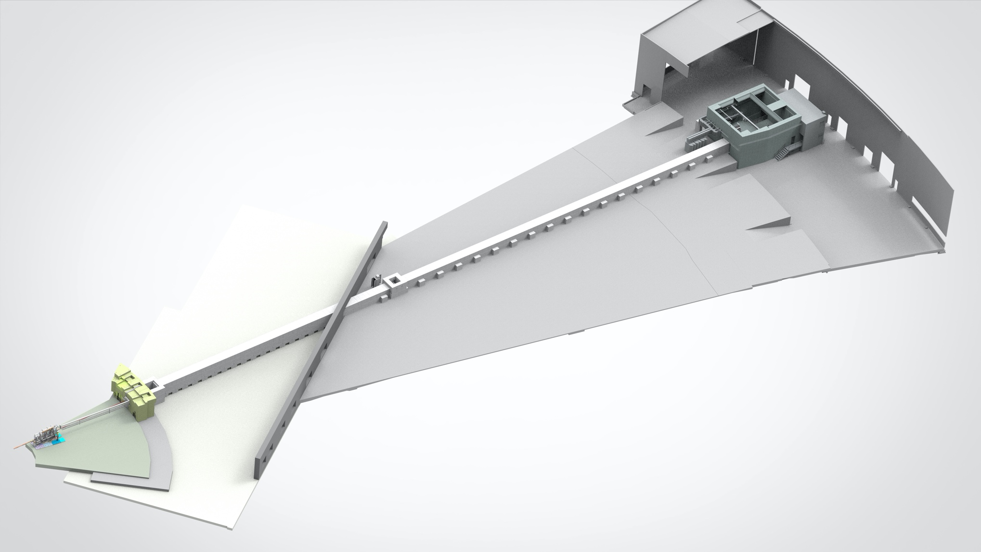
BEER
Experimental cave
CDR: Mar 23
SAT: Oct 23
Components status
Choppers at 80 m
Delivery: Jul 23*
Installation: Sep 23*
Control hutch
CDR: Jul 23
SAT: Feb 24
Instrument shutter
CDR: Jul 22
SAT: Mar 23
Neutron guide E02
Delivery: Nov 21
SAT: Jul 22
Neutron guide D03
Delivery: Jun 22
SAT: Nov 22
Choppers cascade
Delivery: Jul 23*
Installation: Sep 23*
Sample tower and detectors
Delivery: Apr 23*
Installation: Sep-Oct 23*
Common shielding
Installation
Bottom part: Sep 22
Upper part: Q1 23
Plan to join common electrical and utilities project
TG5 on Mar 24
Hereon
NPI
In-bunker guide
Delivery: Jul 23*
Installation: Sep 23*
BWI
Delivery: Jul 23*
Installation: Aug 23*
* Based on TA- time table; will be updated after offers had been received and surveyed.

Slide 10
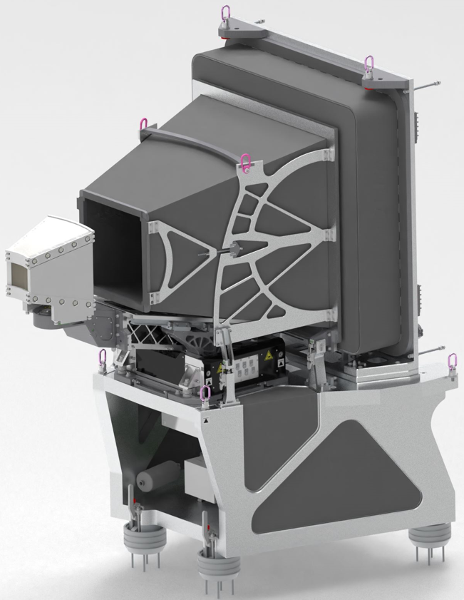
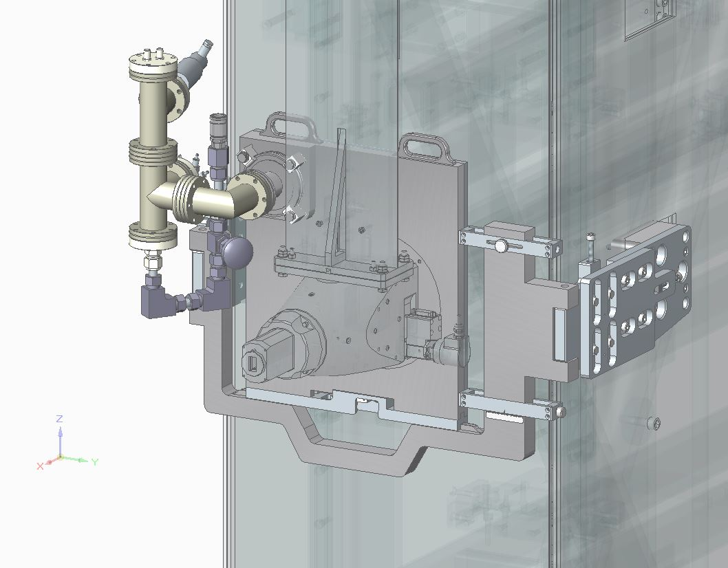
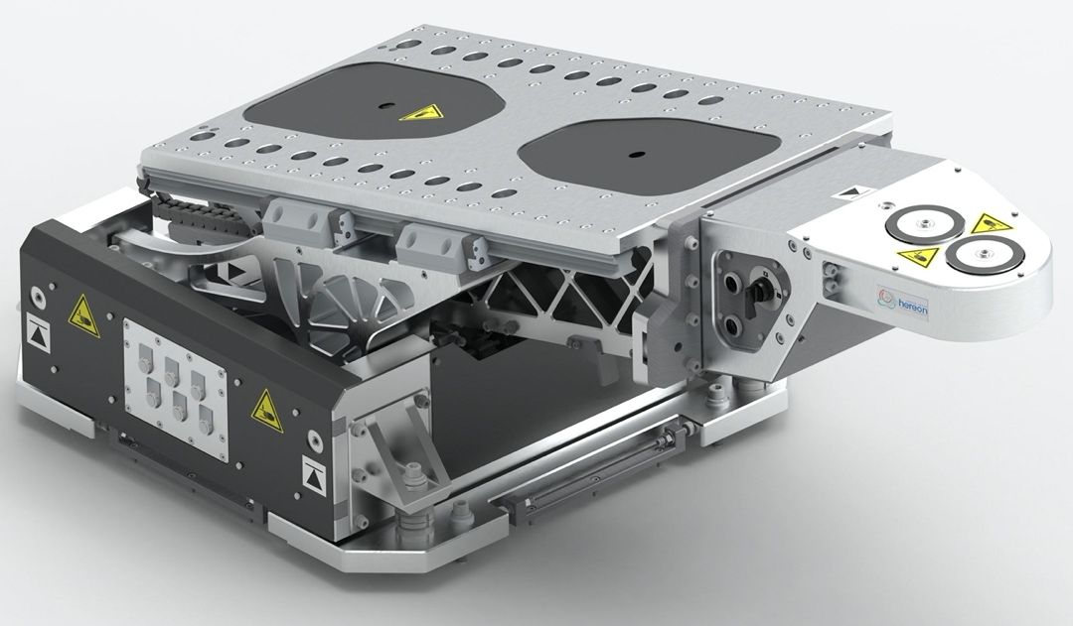
BEER
Aligmt. manipulator for
radial collimators:
Status of monitors
In-bunker monitor: common project
Sample monitor:
-¹⁰B₄C movable transmission MWPC
Degree’s of freedom of
RC-manipulator:
specs:
Active area 100 mm x 100 mm
2D-sensitive detection plane
position resolution 2 mm x 2mm
0.01-2 % @ 2 Å (adjustable by ¹⁰B₄C-thickness to power ramping-up)
global count rate: 10 MHz
2x rotation (yawing, rolling)
2x translation (radial, transversal)

Slide 11
BEER
Status of 1 m²-¹⁰B₄C-detector:
Still HV-instabilities ->Tests with neutron lab-source difficult
PSI-Test-beam time accepted for 09-15.08.2022 at POLDI (PSI):
Topic of proposal: Characterization of timing performance in neutron event formation of
a ¹⁰B₄C- demonstrator detector for ToF-diffraction
The characterization is planned as a side-by-side experiment (POLDI-detector vs. Demo) during diffraction
on Fe-powder, Plan ”B”- Stress measurement on stress-strain tested Al-samples (residual-stress gradient)
as standard for BEER
Data analysis will be conducted by Mantid-POLDI-Analysis Software package; First operation tests on Fe
and Si data worked
Decision regarding detector-technology will be made on the basis of the beam time results.

