Slide 2
Experiment Control and Data Curation
Overview / Keywords / DAQ & Controls
PRESENTED BY Tobias richter / DMSC instrument scientist workshop

Slide 3
Idea of Day 1 and this Presentation
interactive with hands-on
learn things that are valuable to have some idea of
    some things you may need day to day
    others are background knowledge useful for commissioning and diagnostics
    no need to remember everything
    there will be maintenance and support in operations
software will not be used in exactly the current format – feedback welcome
this presentation: concepts and general overview (fun comes later)
Ymir (B02) is soon ready for more in depth individual sessions

Slide 4
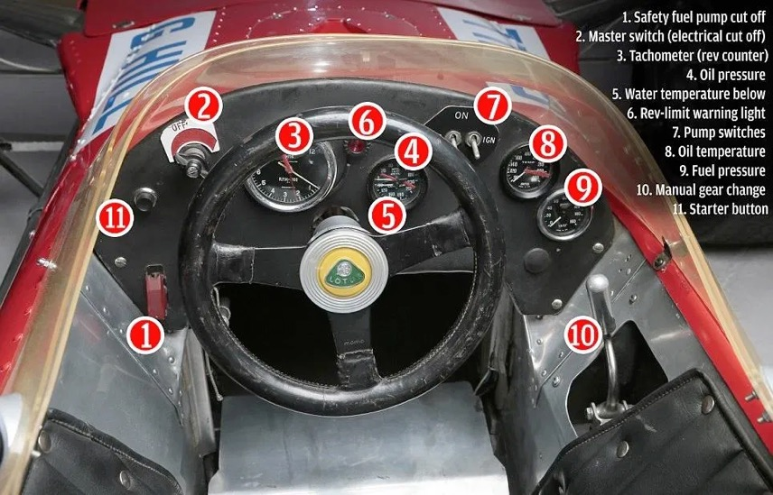
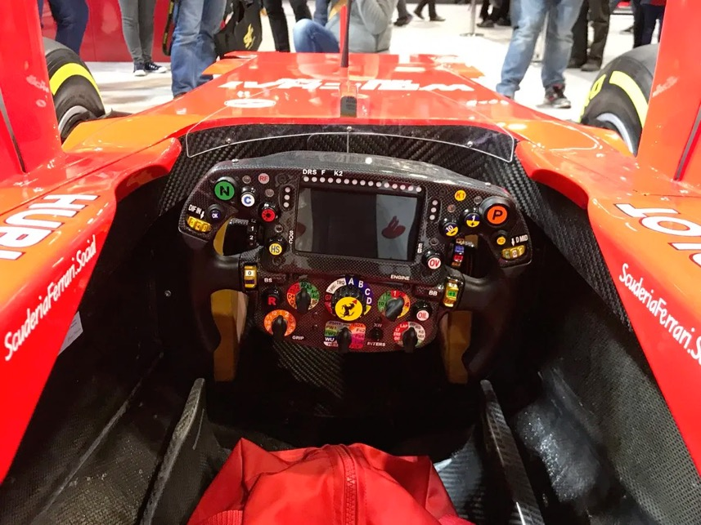
ECDC Scope
Experiment Control and Data Curation
  Experiment Control
  Beamline and Device Controls
  mostly via EPICS in collaboration with ICS WP12 and technology groups
  Data Acquisition –
  Readout and File Writing
  Detector Software Event Formation
  Data Management / Curation
Image credit: Jason Sultana
https://formulaoneinsights.com/the-formula-1-car-cockpit/

Slide 5
Low Level Control and Engineering Interfaces
Maintenance and Operations
Three types of interfaces:
User
The average facility user
Expert
An expert user, also often the instrument scientist
Engineering
ESS support staff with special needs outside of running an experiment
We aim to cater for users and experts in NICOS.
The ideal way to support engineering tasks for a specific device depends on many factors.
CSS/Phoebus/EPICS interface example

Slide 6
Flow of an Experiment
From an earlier UX workshop
Introduction to instrument
Set up initial measurement
Run measurement
Adjust settings
Start measurement
”Look” at data
Coffee time / analysis
Stop measurement
Prepare next measurement

Slide 7
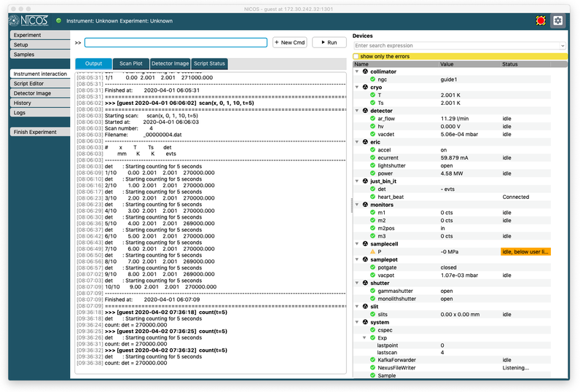

Experiment Control Programme
NICOS
Integrated high level interface and device abstraction to low level EPICS controls.
  Python CLI
  Qt user interface
  Extensible and customizable
Current activities:
  baseline UI delivery for
  ODIN and BIFROST
  filewriter control and configuration
  sample and proposal information

Slide 8
Motion Control
Standard Classes for Most Typical Applications
To simplify requirements and implementation common motion types have been classified and MCAG and ECDC have decided which functionality to implement at which level.
Until November the following standard options should be integrated and verified:
  Pneumatic Axis
  Discrete Positioning
  Continuous Motion
  Slit System
  Special Cases are allowed and instruments are encouraged to highlight them as soon as possible.
NICOS
EPICS IOC
Beckhoff PLC
Motor
Encoder

Slide 9
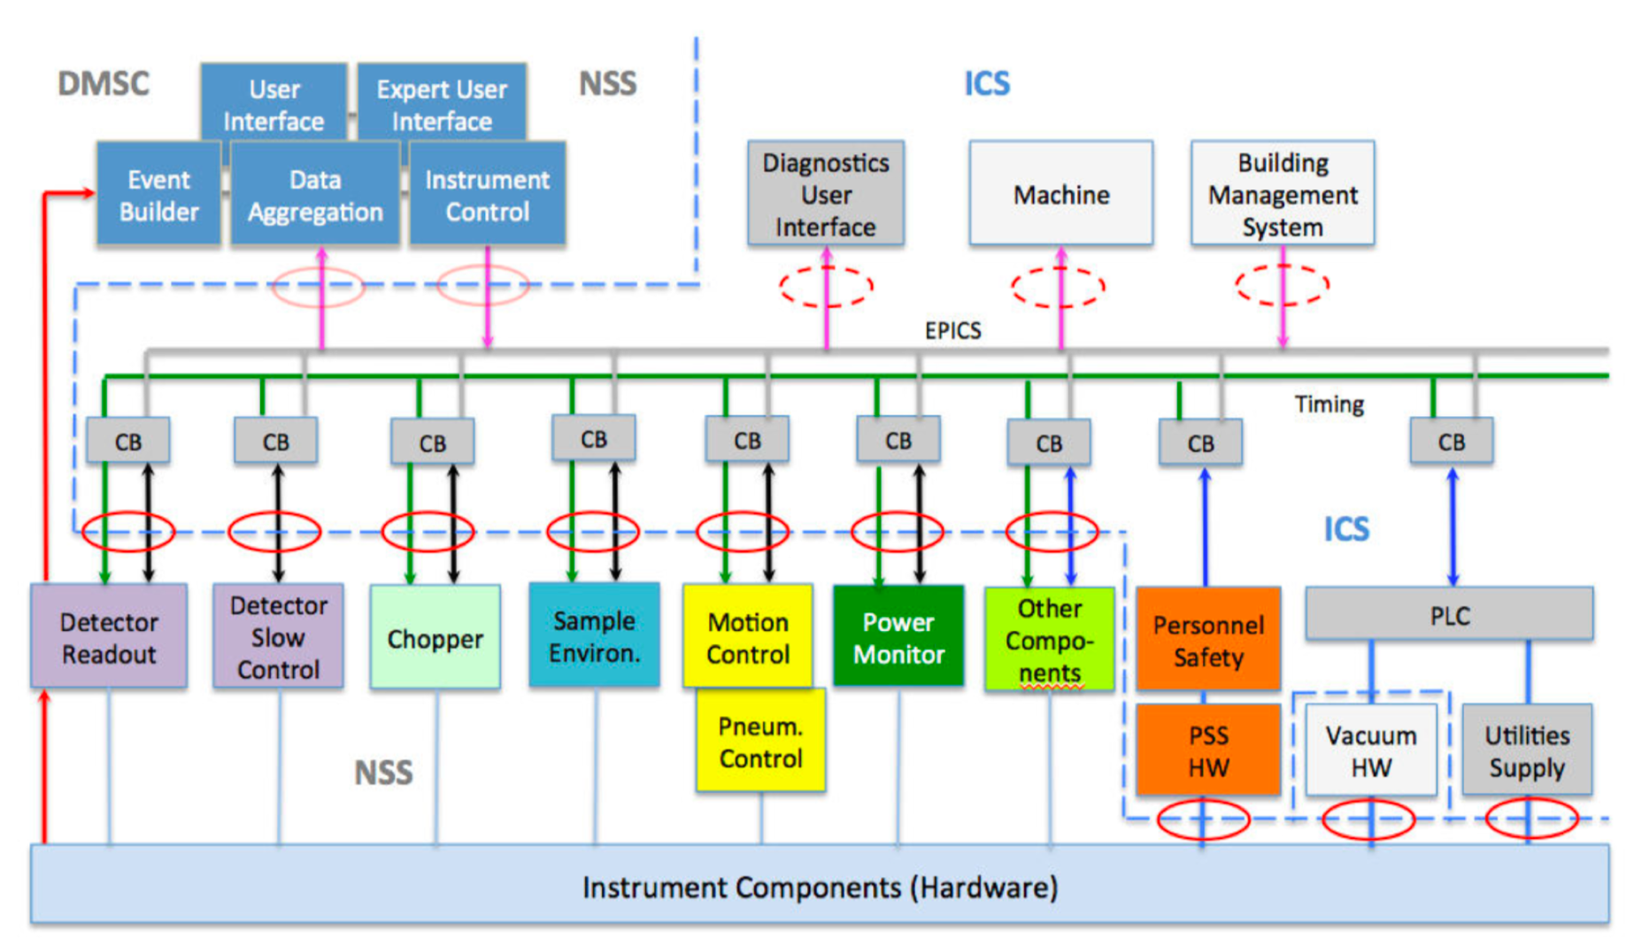
ESS Controls (and Readout) Architecture
Old, but still somewhat true

Slide 10
NSS/ICS Interface (Simplified)
BIFROST
CSPEC
ESTIA
MAGIC
BEER
NMX
HEIMDAL
TBL
SCADI
ODIN
FREIA
DREAM
TREX
LOKI
MIRACLES
DMSC DST
VESPA
DMSC DRAM
ECDC
ICS WP07
Infrastructure
Neutron Detectors
Sample Environment
ICS WP04
Hardware
Motion Control and Automation Group
ICS WP12
ICS WP03
Software
Neutron Choppers

Slide 11
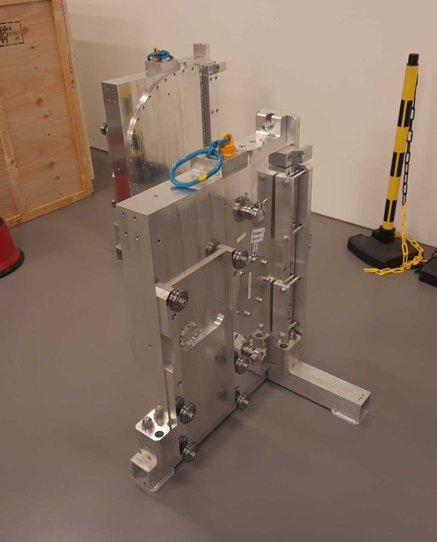
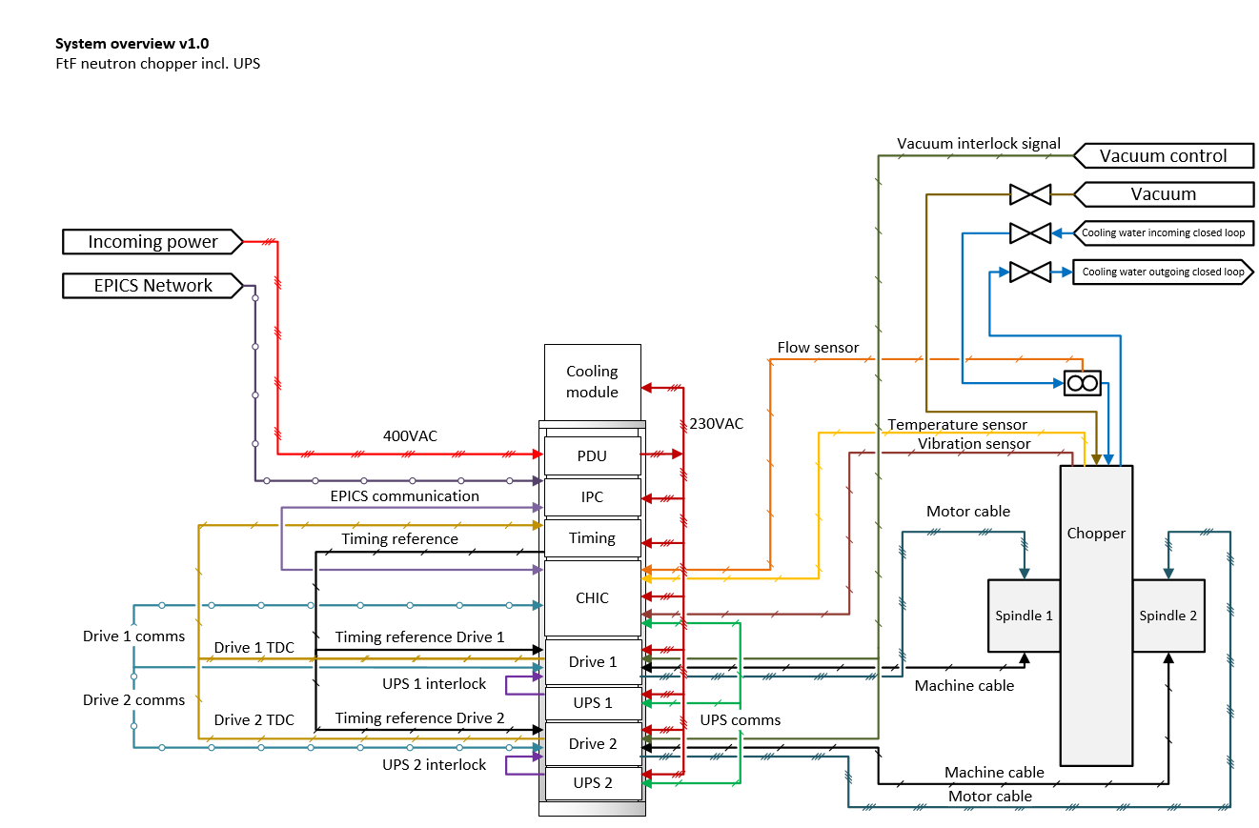
Choppers
Timing & Control
  Highly standardised ESS-PLC (CHIC)
  Interfaces with timing system
  Independent of spindle vendor
  Alarms and archiver needed for
  engineer use
  For users there will be a higher level interface for an entire chopper cascade
  Already quite well tested.
  Verified that commissioning can
  be done “cold” with light (laser).

Slide 12
Timestamping Chopper TDC pulses
Recorded in the EVR

Slide 13
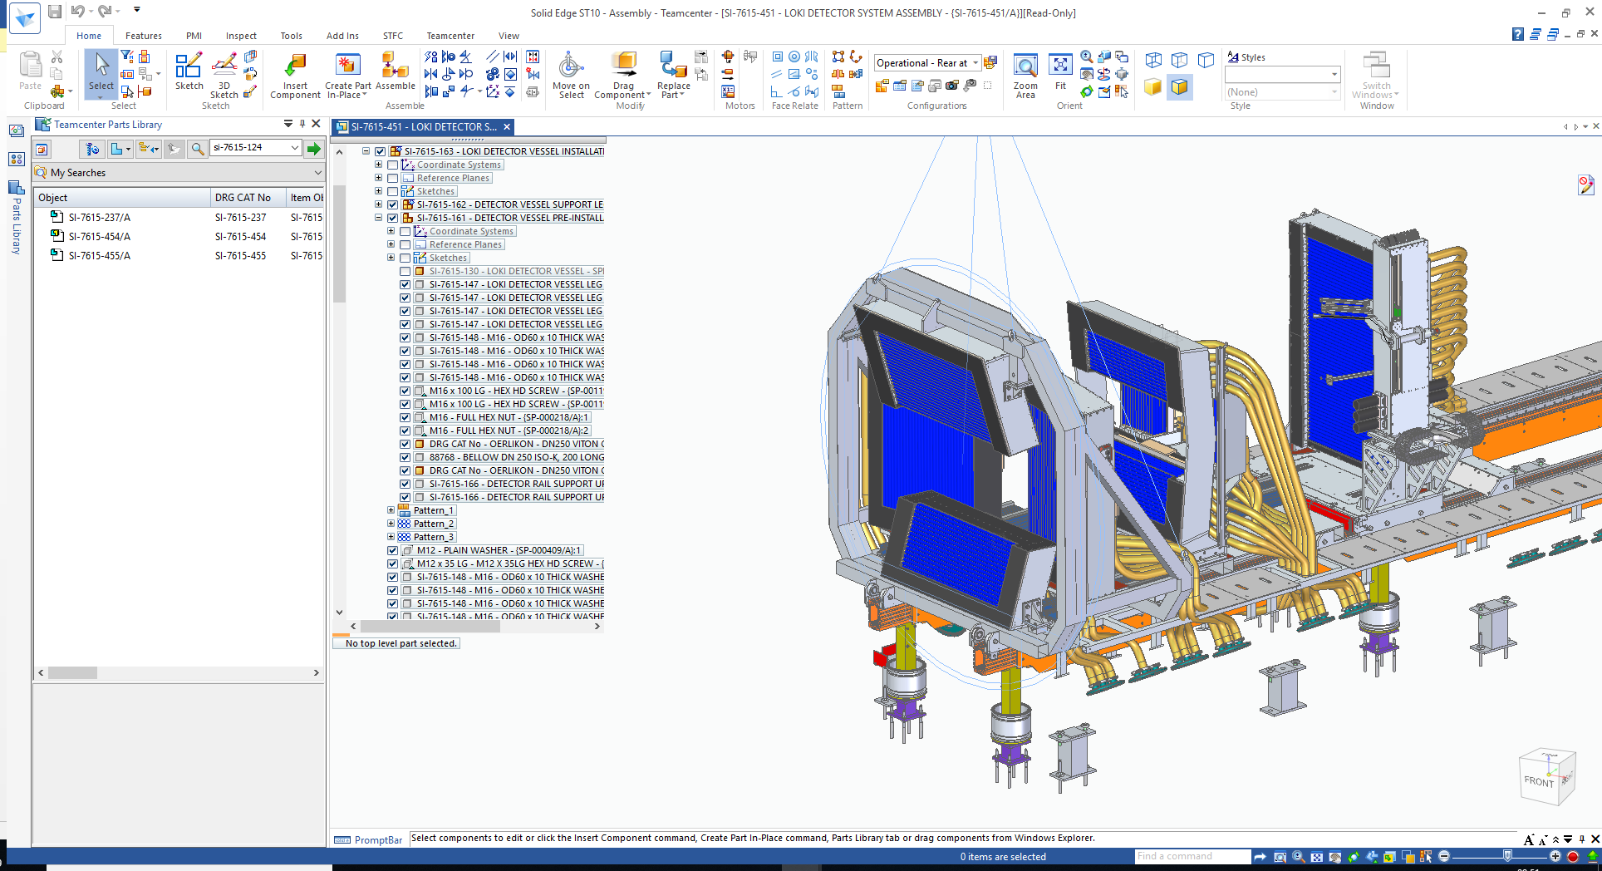
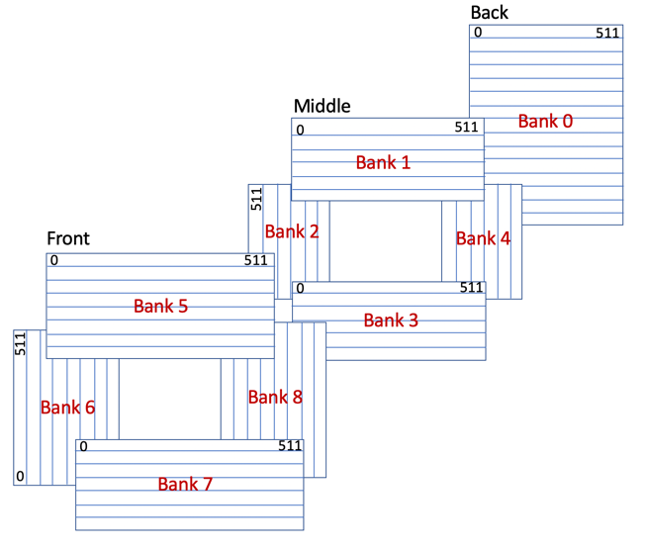
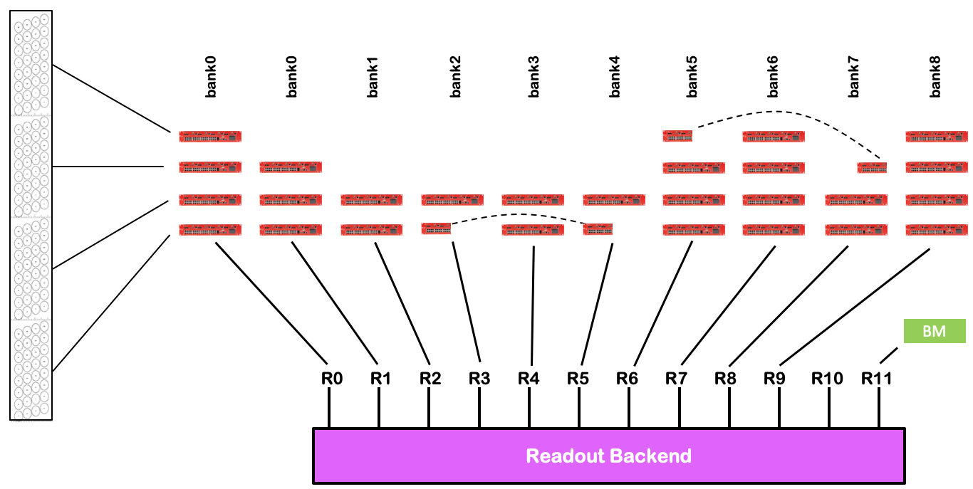
Detectors
Time-of-flight event-based
Also standardised interface:
Detector backend master by the NSS detector group
Provides:
  Timing integration with frontends electronics
  High rate data path – direct to DMSC/ECDC event formation
  Slow Control interface via EPICS
Beam Monitors (single pixel detectors) operate in a similar way.

Slide 14
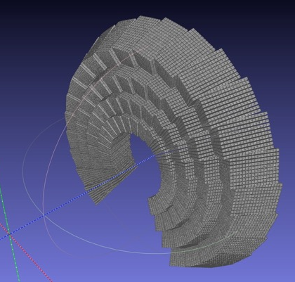
Detectors
Nexus geometry model for the DREAM detector
Event Formation and Slow Control
Detectors need software to do
  Control of the detector electronics, power supplies and other infrastructure (gases, etc)
  Online processing of detector output
  Store information about the pixel (voxel) positions in space at all times for downstream processing
In addition
  All other (meta-)data needs to have timestamps to be able to correlate neutron detection with other events
  Imaging (ODIN) will use cameras as well as time-of-flight detectors
EFU processed (and corrected/calibrated) data from LoKI tubes,
straight from the frontend electronics

Slide 15

Instrument Readout Streaming Architecture
Connects many different services and sub-systems
Instrument Hardware
Site Infrastructure
Experiment and File Writer Control
Time
Detector Backend
Event Formation Unit
100 GB/s fibre
NeXus File Writer
Data Aggregation Cluster (Kafka)
Chopper
Time
EPICS
EPICS FW
Live Feedback
Motion
BrightnESS is funded by the European Union’s Horizon 2020 research and innovation programme under grant agreement No. 676548

Slide 16
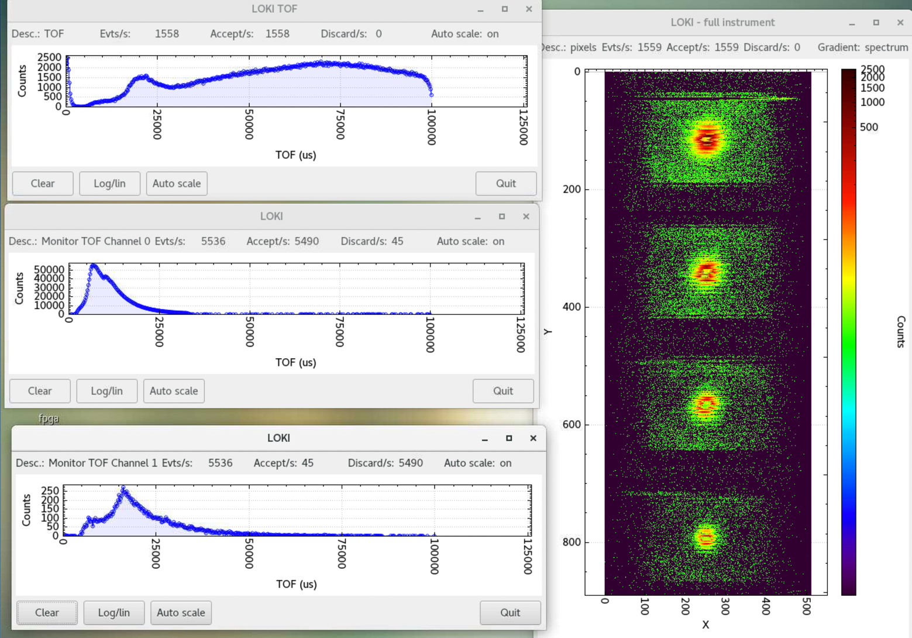
Live Operation Demonstrated
LoKI @ LAMOR
  Integrated LoKI detector and LAMOR beam monitors through readout master to Software Event Formation
  Diagnostics and commissioning tools available
  Was beneficial to have relatively well defined goals for the experiment.
  Three days of beamtime is short, which is a challenge. Thankfully no major problems.
  Learned various valuable lessons, mainly about what to agree, test and prepare in advance
  (mostly ECDC internal scope)
LoKI detector and LAMOR beam monitor data

Slide 17
Let’s talk about files

Slide 18
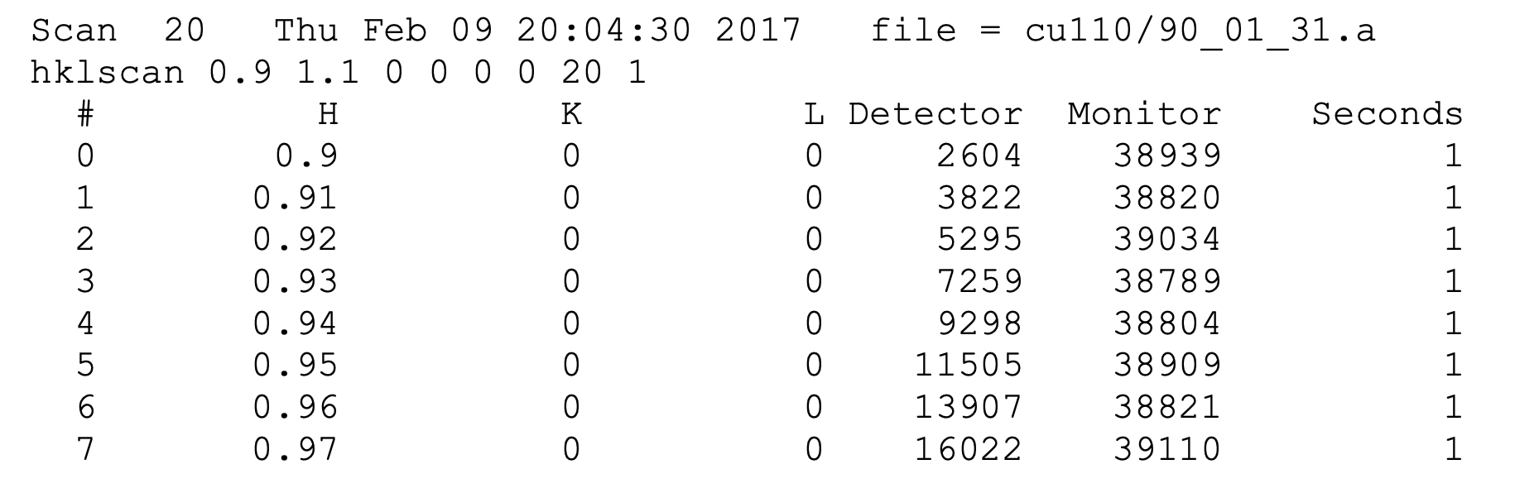
“Traditional Files”
One Aggregated Readout per Scan Point, Angle, or Setting

Slide 19
Data Acquisition
polarisation
rotation_angle
temperature
Asynchronous and Timestamped
time
Every data source sends their information independently asynchronously:
  detectors & beam monitors in event mode
  cameras
  choppers
  motion
  sample environment
  (temperatures, pressures, fields)
Data only updated on change.
Flexible, sparse efficient storage, little hardware support needed, adequate timing synchronisation is critical.
Post processing needed in most cases – but possible!
updated value
Timing synchronisation options:
  MRF EVR (Detectors, Choppers)
  PTP (Beckhoff: Motion, Sample Environment)
  NTP (Slow Sample Env, e.g. temperature)

Slide 20
How We Write Files
Creating NeXus Templates “With Ease” – Sprint Planned for November
  File contains all pertinent measurable facts about the experiment
  Contents can be interpreted and reduced (processed) without external information
Detector Voxel Geometry
Instrument Layout
Other Metadata (Proposal, Sample)
File Template
Live Data
Up to date Template sent to File Writer for each File
Neutron Events
Motion and Chopper Information
File Writer
NeXus File
Sample Environment Metadata
Live data streamed into file for entire duration of “exposure”

Slide 21
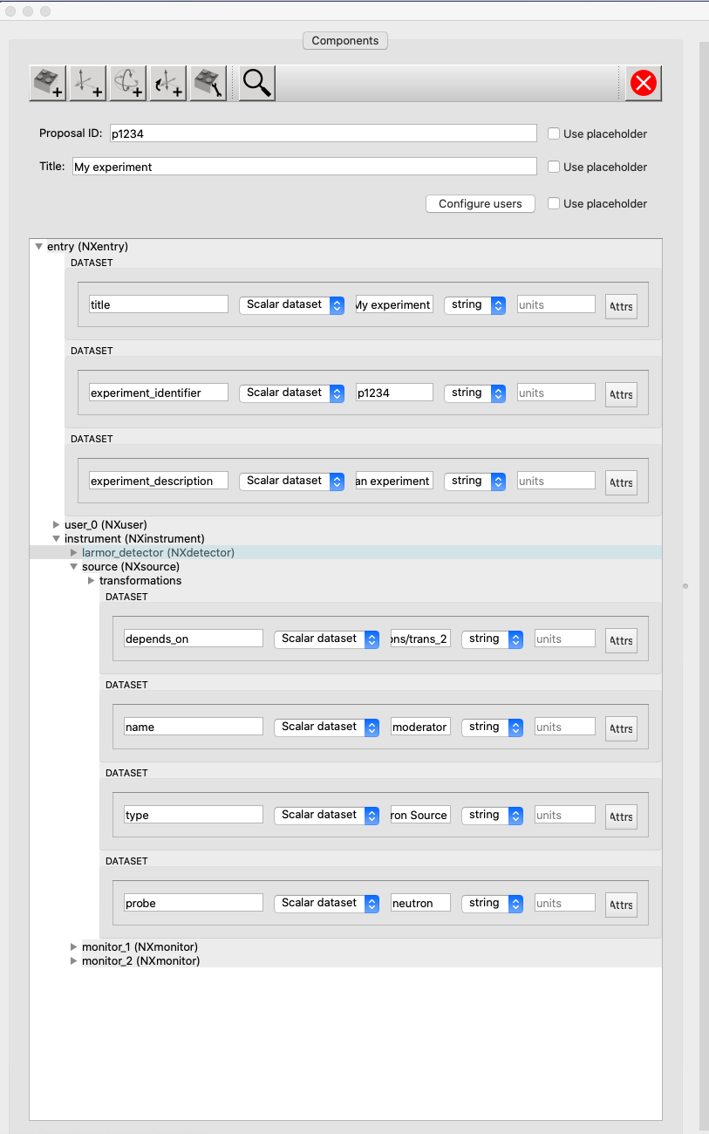
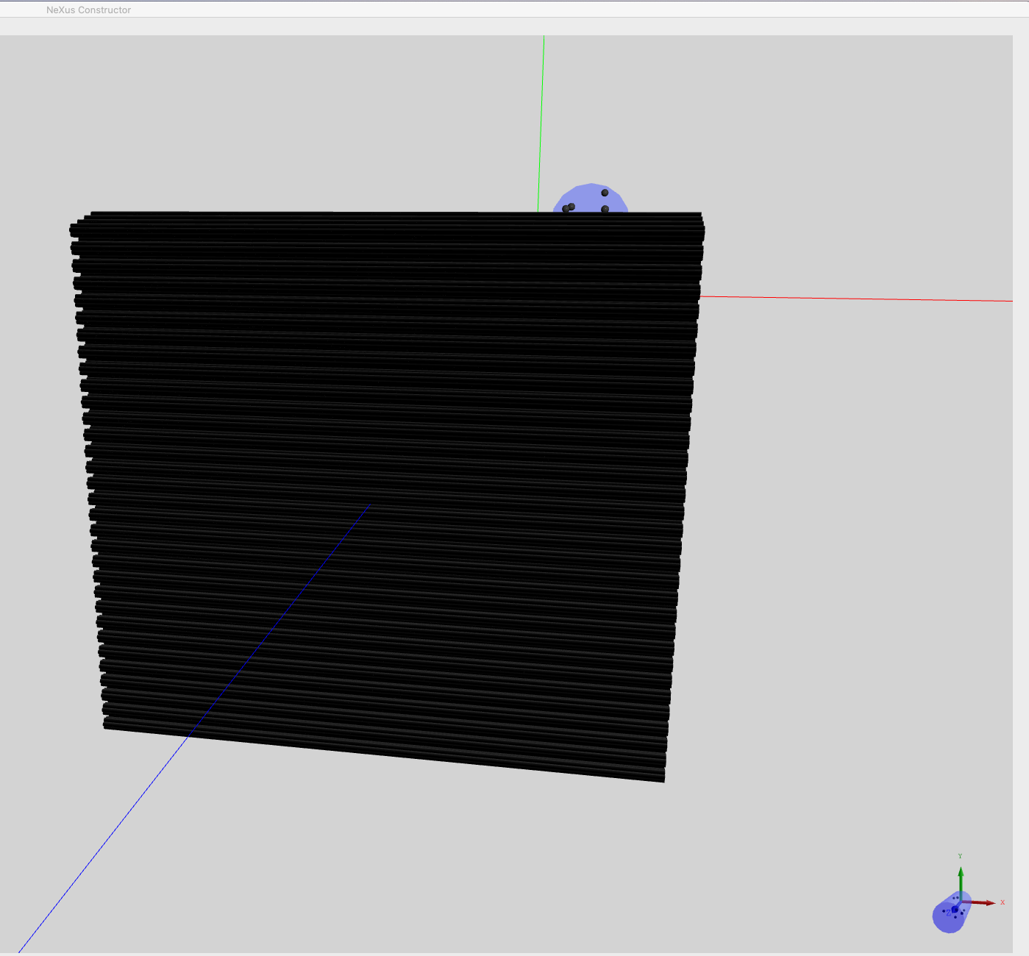
Embedded Geometry
NeXus borrowed from CIF

Slide 22
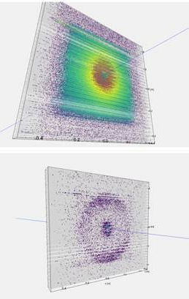
ESS NeXus Raw Data
Mini-Summary
Geometry Mapping to scipp
LoKI @ LAMOR
All instruments follow the same generic NeXus principles:
  No application definitions are being followed
  Application of base classes wherever possible. Extending them, where needed.
  Extensive use of NXlog for any parameter that could change during the experiment
  (as well as for the ones that definitely will)
  Event-based recording of neutron detection & time-stamp based correlation of images (with source pulse as reference)
Encoding of the full geometry information in NeXus (locations and orientation).
No need for Mantid IDF files, or any other external resources to understand the data.
Running a Monte-Carlo Simulation should be possible from the NeXus file.
NeXus

Slide 23
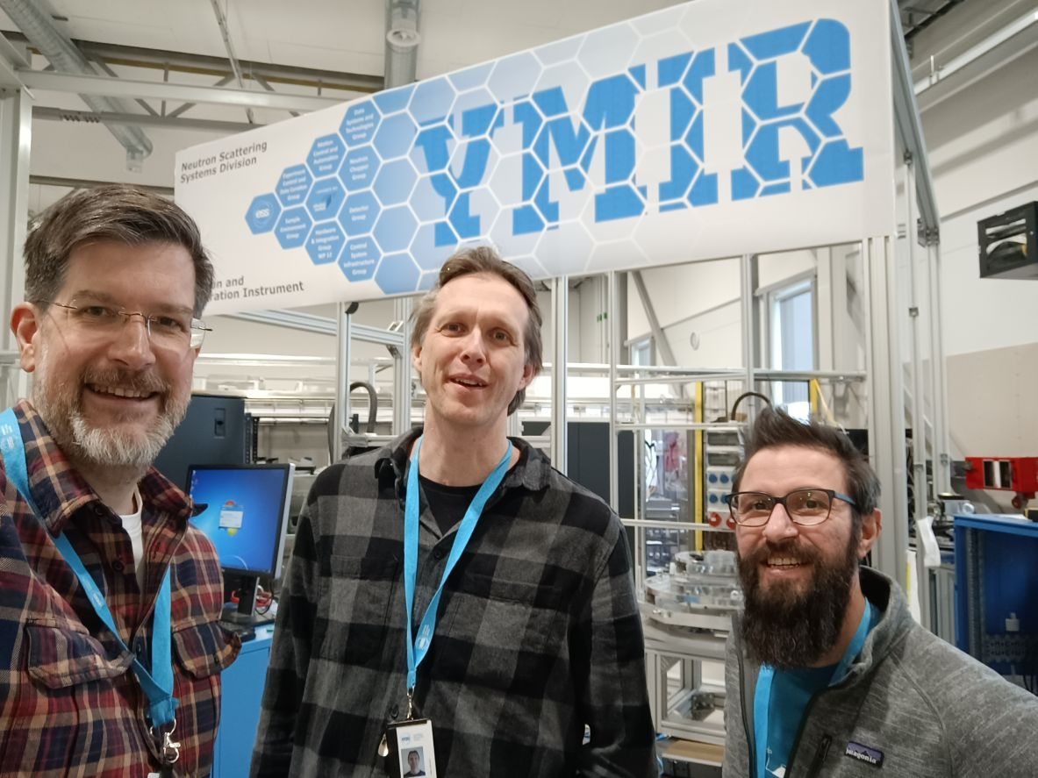
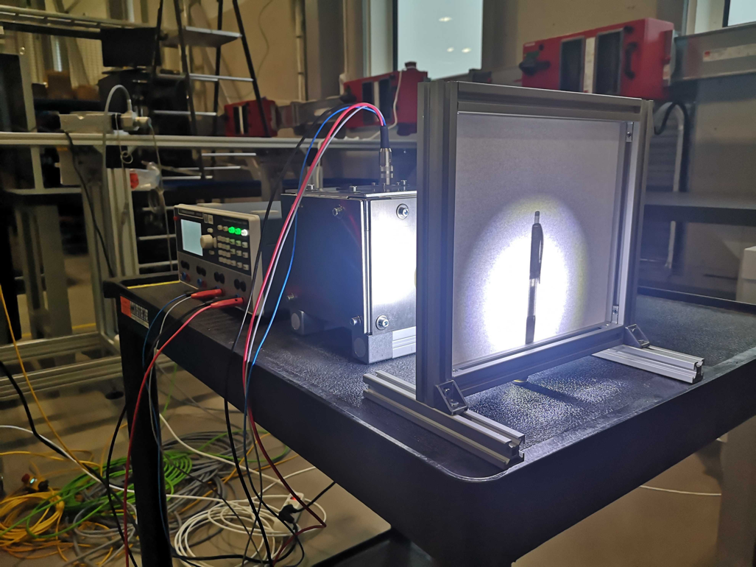
Development, Integration, Testing and Verification
167 m²
Ymir Integration Platform (Instrument) – moved to B02
  Main driver of progress across groups, through integration tests and demos
  Routinely used for engagement with instrument teams for feedback and evaluation
  Opportunity to run strawman experiments, like light tomography
  Site installation relies on production network and compute infrastructure and enables all groups to gain valuable experience
  Supported by 800 kEUR co-funding grant from Swedish Tillväxtverket

Slide 24
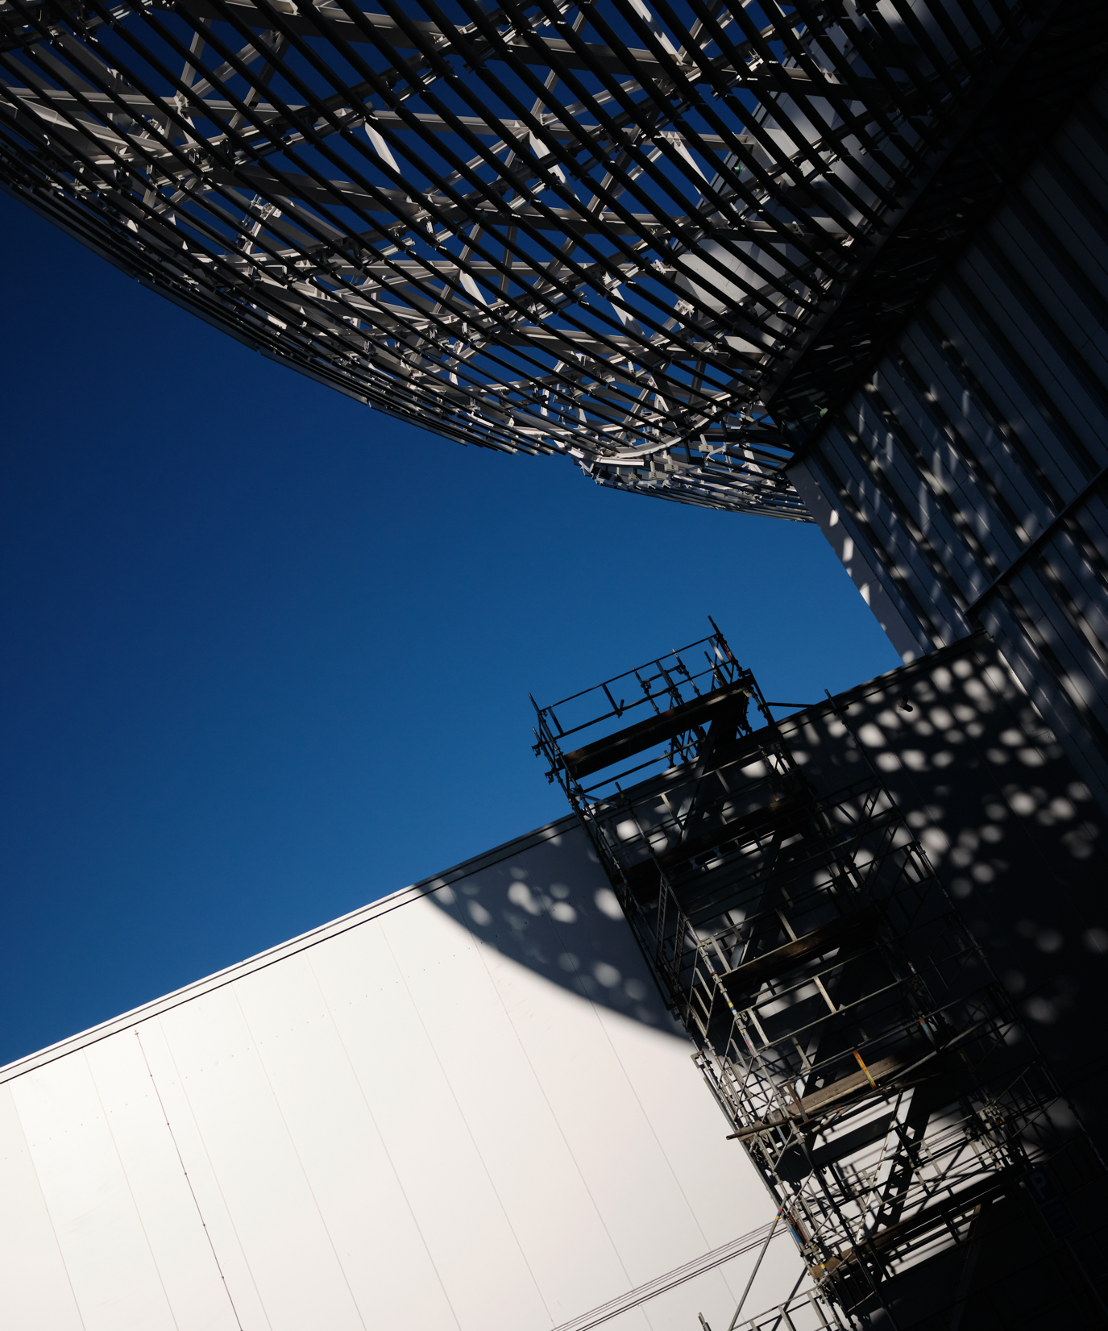
Questions?

