Slide 1
TB Org, TAC and annual review
Mats Lindroos
Head of accelerator
www.europeanspallationsource.se
March 5, 2015

Slide 2
Accelerator Division
Mats Lindroos
Head of Division
Håkan Danared – Deputy Head of Division
John Weisend II – Deputy Head of Acc Projects
David McGinnis – Chief Engineer
Andreas Jansson – Safety
Steve Peggs (C)
BEAM PHYSICS
Håkan Danared – GL
Mohammad Eshraqi – Deputy GL
Renato De Prisco
Ryoichi Miyamoto
Marc Munoz
Christine Darve
Yngve Levinsen
SPECIALIZED TECHNICAL SERVICES
John Weisend II – GL
Wolfgang Hees - Deputy GL
Frithiof Jensen
Anton Lundmark
Evangelia Vaena
Matthew Conlon
Georg Hulla*
Walter Wittmer (from 1 April)
RF
Anders Sunesson – GL
Morten Jensen - Deputy GL
Rihua Zeng
Rafael Montano
Caroline Prabert - Personal Assistant
Gunilla Jacobsson - Divisional Planning A.
Solveig Aas - Team Assistant
BEAM INSTRUMENTATION
Andreas Jansson – GL
Thomas Shea - Deputy GL
Benjamin Cheymol
Irena Dolenc Kittelmann
Hooman Hassanzadegan
Lali Tchelidze
Cyrille Thomas
Hinko Kocevar
Maurizio Donna
Viatcheslav Grishin
Michal Jarosz (oPAC)
Charlotte Roose (oPAC)
Luigi Esposito
Duy Phan
Beam Diagnostics Engineer
Beam Diagnostics Engineer
Scientist
INTEGRATION
David McGinnis - GL
Stephen Molloy – Deputy GL
Eugene Tanke
Nikolaos Gazis
CRYOGENICS SECTION
Philipp Arnold – SL
Xilong Wang
Jaroslaw Fydrych
John Jurns
Xiaotao Su (50%)
Ali Farsian
VACUUM SECTION
Peter Ladd – SL
Marcelo Juni Ferreira
Hilko Spoelstra
Giobatta Lanfranco*
Vacuum Systems Engineer
RF SOURCES SECTION
Morten Jensen – SL
Chiara Marrelli
Rutambhara Yogi
Stevo Calic
Solid State source Engineer
RF Engineer
RF Technician
POWER CONVERTERS SECTION
Carlos de Almeida Martins – SL
Göran Göransson
Electromechanical Technical Engineer
ENGINEERING SECTION
Stephen Molloy – SL
Aurélien Ponton
Enric Bargalló
Edgar Sargsyan
Inigo Alonso
Lead Engineer
57 employees (2015-02-28)
New staff to arrive during 2015 & ongoing recruitments in orange
3010
3010
3014
3015
3013
3012
3142
3011
3151
3121
3122
3141
* N.B. Transfer not yet formally approved
Notes:
*N.B. The transfers of Giobatta and Georg to/from the Vacuum section have not yet been formally approved and implemented.

Slide 3
Staff planning 2015 – growth per group
 | 2014 Q4 | Q1 | Q2 | Q3 | Q4 | Growth
Accelerator Division | 52 | 58,5 | 63,5 | 70,5 | 70,5 | 18,5
Divisional | 4 | 4 | 4 | 4 | 4 | 0
Beam Instrumentation | 10 | 12 | 13 | 14 | 14 | 4
Spec Technical Services | 15 | 17,5 | 18,5 | 19,5 | 19,5 | 4,5
Beam Physics | 7 | 8 | 8 | 9 | 9 | 2
RF | 9 | 9 | 11 | 13 | 13 | 4
Integration | 7 | 8 | 9 | 11 | 11 | 4
Number of employees at the end of each quarter. 2014 actuals, in blue.

Slide 4
Staff planning 2015 – growth per category
 | 2014 Q4 | Q1 | Q2 | Q3 | Q4 | Growth
Accelerator Division | 52 | 58,5 | 63,5 | 70,5 | 70,5 | 18,5
Management | 6 | 6 | 6 | 6 | 6 | 0
Scientists | 15 | 15 | 16 | 17 | 17 | 2
Engineers | 28 | 34,5 | 36,5 | 41,5 | 41,5 | 13,5
Technicians |  |  | 2 | 3 | 3 | 3
Admin | 3 | 3 | 3 | 3 | 3 | 0
Number of employees at the end of each quarter. 2014 actuals, in blue.

Slide 5
Staff planning 2015-2019 - staff forecast (draft)
 | 2014 Q4 | 2015 Q4 | 2016 Q4 | 2017 Q4 | 2018 Q4 | 2019 Q4
Staff inc. 2015 hires | 52 | 70,5 | 71,5 | 71,5 | 71,5 | 71,5
Staff inc. 2016-19 hires* | 52 | 70,5 | TBD* | TBD* | TBD* | TBD*
ESS staff in P6 | 68 | 77 | 86 | 100 | 108 | 110
Number of employees at the end of each quarter. 2014 actuals, in blue.
Recruitment plan for 2016-2019 is currently being reviewed.
The plan is to mainly recruit technicians up to the given staff plan goal from 2016 and onwards.

Slide 6
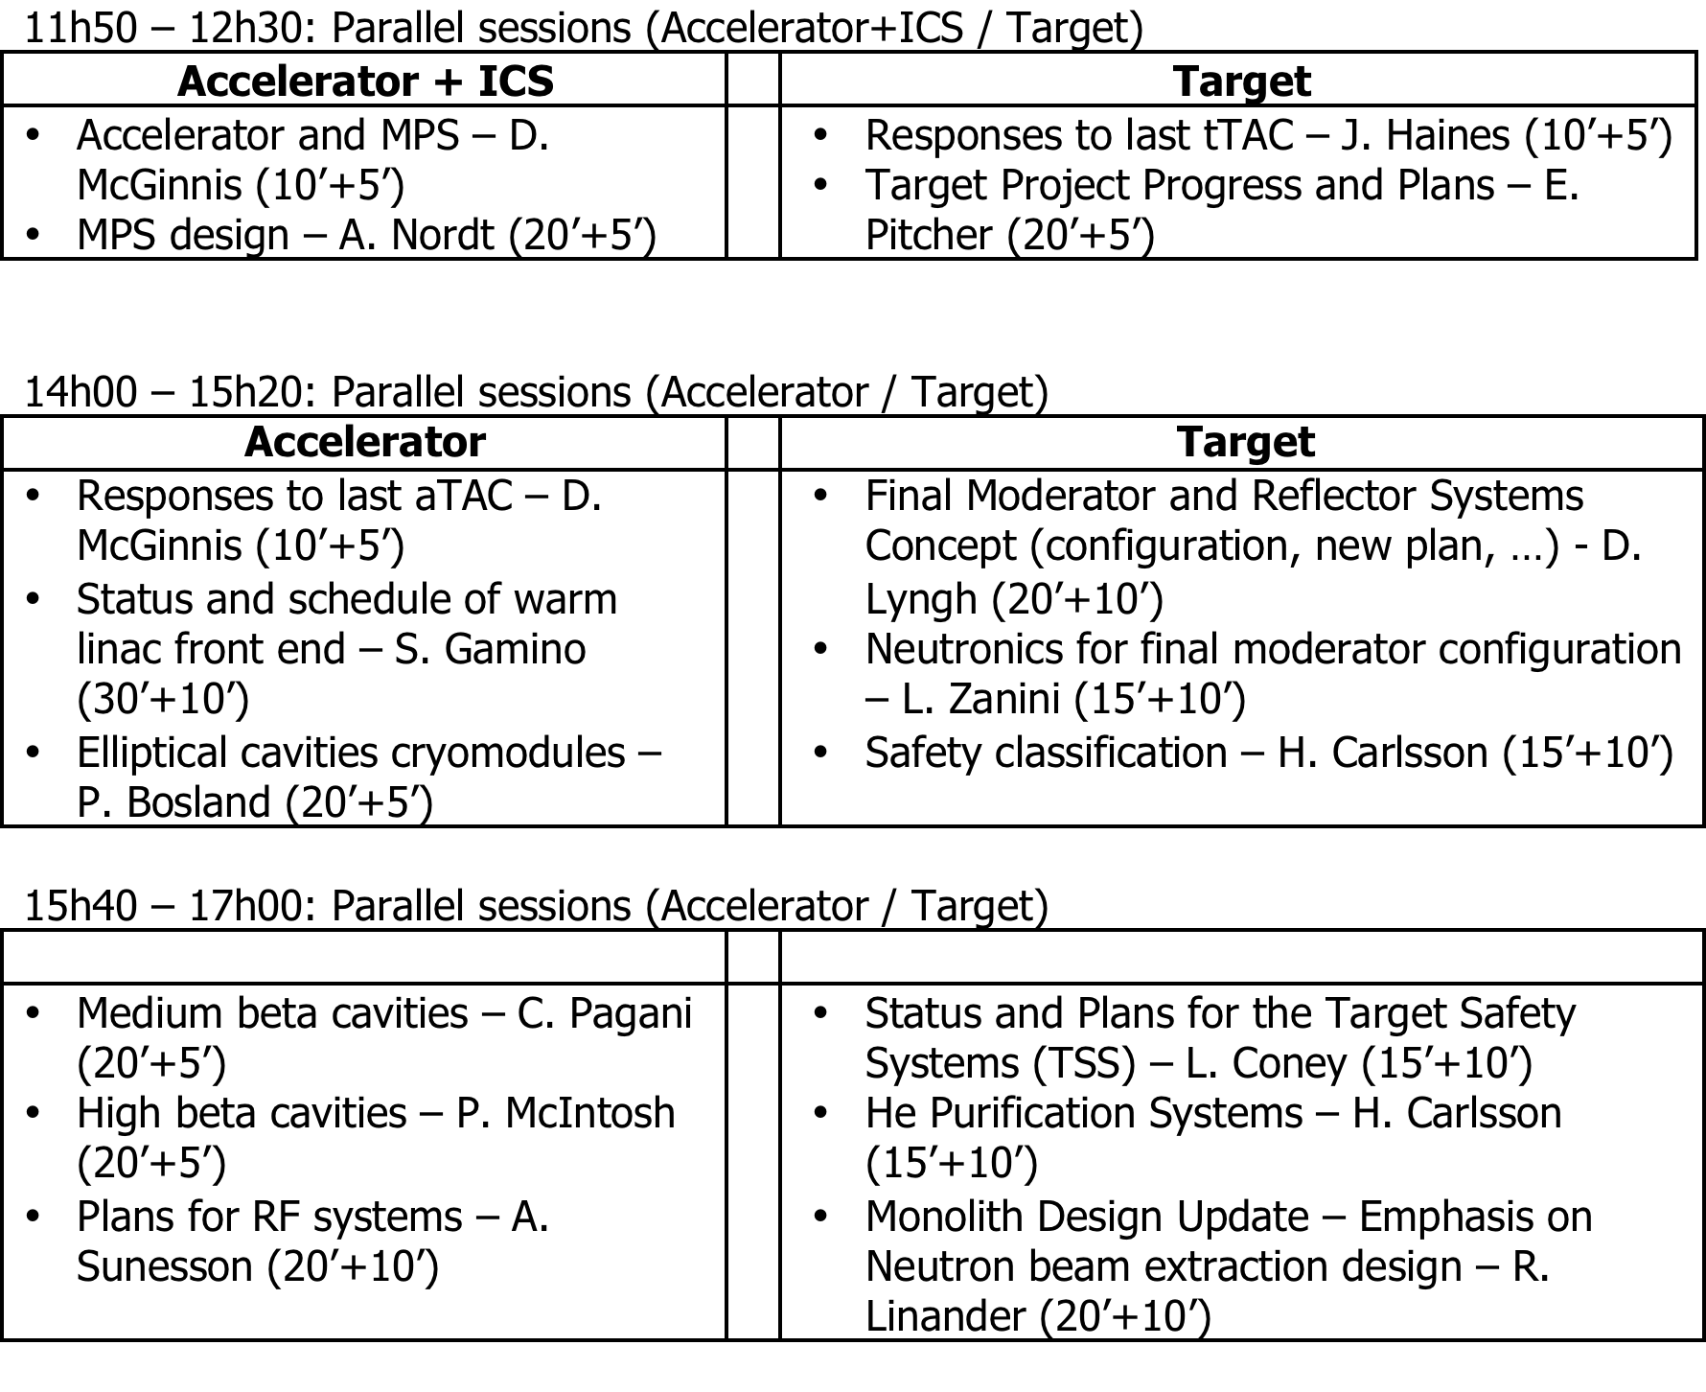
TAC 1-2 April 2015

Slide 7
Charge annual review, 21-24 April
Background: The 1st Annual Project Review was conducted in November 2013 and a follow up assessment in May 2014. These reviews focussed on readiness for construction. The primary focus of the 2nd Annual Project Review will assess general progress with increased emphasis on the project schedule.
We been advised to invite (main) in-kind contributors and demonstrate technical progress.
Dates: 21-24 April 2015
1. Committee Charge
1.1 Is the scope of work adequately defined and do plans include activities necessary to deliver the facility, including a reasonable breakdown of requirements and provision for design reviews and verification activities?
1.2 Is the schedule consistent with the major construction project delivery dates* and are the assumptions used for the schedule complete and reasonable?
1.3 Are in-kind deliverables and procurement contracts, including long lead items and procurements requiring R&D, properly identified and sufficiently planned and managed?
1.4 Is the transition from the Construction Phase into the Initial Operations Phase clearly and appropriately defined?
1.5 Are the risks and risk responses relevant and complete?
1.6 Does the organization match the needs of the construction project? Is the current staffing level and competencies appropriate to support the construction project?
1.7 Identify major issues that must be addressed in order to successfully deliver ESS and take the facility into operation.

Slide 8
Proposed reviewers

Slide 9
Review schedule (1/2)
Tuesday, April 21, 2015 – Auditorium, Medicon Village
8:00 Bus from Hotel Planetstaden to Medicon Village
8:30 Committee Executive Session Review Committee Chair
9:15 Welcome and ESS Overview and Status (25+15) J. Yeck
9:55 Science Objectives (15+10) D. Argyriou
10:20 Break
10:40 Facility Performance Objectives (15+10) R. Garoby
11:10 Accelerator System (20+10) M. Lindroos
11:40 Target System (20+10) J. Haines
12:10 Integrated Control System (15+10) G. Trahern
12:35 Lunch
13:30 Neutron Scattering System (20+10) O. Kirstein
14:00 Conventional Facilities (15+10) K. Hedin
14:25 Project Support & Administration (15+10). T. Welander
14:50 Cost, Schedule and In-Kind Management (20+10) J. Brisfors
15:20 ES&H and QA (15+10) P.Jacobsson
15.45 Break
16:15 Initial Operations (20+10) P. Carlsson
16:45 Conclusion of Plenary Presentations
17:00 Committee Executive Session Review Committee Chair
18:30 Bus to Restaurant
19:00 Reception and Dinner

Slide 10
Review schedule (2/2)
Wednesday, April 22, 2015 - Conference rooms according to detailed schedule, ESS
8:10 Bus from Hotel Planetstaden to ESS
8:30 Parallel Subcommittee Presentations/Discussions
12:15 Lunch
13:15 Parallel Subcommittee Presentations/Discussions
15:00 Tour to Construction Site K. Hedin
16:00 Review Committee Executive Session - Tänkartanken, 1st floor
Thursday, April 23, 2015 - Conference rooms according to detailed schedule, ESS
8:10 Bus from Hotel Planetstaden to ESS
8:30 Parallel Subcommittee Presentation/Discussions
12:15 Lunch
13:15 Parallel Subcommittee Presentations/Discussions
15:00 Subcommittee Working Sessions
16:00 Review Committee Executive Session - Tänkartanken, 1st floor
Friday, April 24, 2015 - Auditorium, Medicon Village
8:10 Bus from Hotel Planetstaden to ESS
8:30 Review Committee Executive Session - Auditorium, Medicon Village
10:30 Dry Run of Closeout Briefing
11:30 Closeout Auditorium, Medicon Village
12:30 Adjourn and/or Lunch
12:30-15.00 Transport to Copenhagen Airport/Lund Central station/Hotel Planetstaden

Slide 11
Break-out 22/4
8.30-12.15
  8.30: Visit to site
  9.45: Coffee before breakout session starts
  10.15: Intro, staffing, schedule and risk, Mats/John, 20+10
  10.45: Integration, Dave, 20+10
  11.15: Safety, Lali Tchelidze, 20+10
  11.30: Schedule, planning and procurement, Luisella Lari, 10+5
  11:45: QA/QC (including review plans), Matthew Conlon, 10+5
13:15-16:00
  13.15 In-Kind, Håkan, 20+10
  13.45: RF systems, Anders Sunesson, 20+10
  14.15: Beam instrumentation, Andreas Jansson, 20+10
  14.45: Specialized Technical Services, John Weisend, 20+10
  15.15: Transition to initial operation, Mamad Eshraqi, 10+5
  15.30: Discussion time

Slide 12
Break-out 23/4
8.30-12.15
  8.30: Requirements, Plant layout and installation, Eugene/Steven M/David M
  9.30: Ion source and LEBT, Santo Gammino or Luigi Celona, 15+5
  9.50: MEBT, Ibon Dustinbuy, 15+5
  10.10: Coffee
  10.40: RFQ, Bruno Potain, 15+5
  11.00: DTL, Andrea Pisent, 15+5
  11.20: Spoke, Sebastien Bousson, 15+5
  11.40: Elliptical CM, Pierre Bosland, 15+5
13:15-16:00
  13.15: Elliptical cavities, INFN/STFC, 10+10+10
  13.45: Beam distribution, Heine Dølrath Thomsen, 15+5
  14.05: Visit to LTH RF and modulator labs

