Slide 1
Integration Drawing Exchange Solution
[IDES]
david.mcginnis@esss.se
nick.gazis@esss.se
carljohan.hardh@esss.se
daniel.lundgren@esss.se
www.europeanspallationsource.se
Mar. 2015

Slide 2
Purpose
The ESS Linac will be built with contributions from 25 different institutions located throughout Europe
  Most of the components in the tunnel will be provided by in-kind partners
  With each partner possibly using a different CAD system to design their respective contribution
ESS needs to integrate all these contributions.
  ESS needs to assimilate all the different design packages into one design
  The ESS design is constituted out of Released contributions:
    A released contribution is defined as the currently agreed upon state of design between ESS & IKC
  Without requiring in-kind partners to use a specific CAD software
ESS needs current status and rapid feedback on the progress of in-kind partner designs.
  Civil construction of the ESS facility is well underway
  ESS needs to keep up with changes in designs as soon as they are available to assess impact on civil construction
  To keep track of changes, ESS uses file versioning and released revisions.

Slide 3
Platform
ESS uses Catia V6 as its CAD platform
  Decision was fixed in October 2014
  ESS does require in-house designs to use Catia V6
  ESS will not require in-kind partners to use Catia V6
  Accelerator Integration Group (AIG) is responsible to convert In-Kind partner CAD models to Catia V6 and integrate them in the ESS master model
ESS uses CHESS from Enovia as its PLM and document management system.
  AIG uses CHESS as the CAD file version and CAD model revision system
  In-Kind users will exchange ESS CAD designs in CHESS
  In-Kind users will need CHESS login’s.

Slide 4
LinacLego Organization
LinacLego is used to describe the ESS lattice
  It is the single-point-of-truth for tunnel components
  Available on the Web
    https://aig.esss.lu.se:8443/LinacLegoWebApp/
The lattice is described in the following hierarchy:
  Section (ISRC, LEBT, RFQ, DTL, SPK, etc…)
    Cell (SPK-01, SPK-02,… SPK-13)
      Slot (SPK-02-LWU, SPK-02-CRM)
        Beamline Element (SPK-02-LWU-QH01, SPK-02-LWU-QH02)
The ESS 3-D integration model will be based on slots
  Slots are considered installation sub-assemblies
  Definition of a Slot is flexible
  There will be one CHESS document to contain the 3-D model of each Slot design

Slide 5


Lattice hierarchy in LinacLego
SECTION
ISRC
LEBT
RFQ
DTL
SPK
MBL
etc…
CELL
SPK-01
SPK-02
SPK-03
…
SPK-13
SLOT
SPK-02-LWU
BEAMLINE ELEMENTS
SPK-02-LWU-QH01,
SPK-02-LWU-QH02, …
SPK-02-CM

Slide 6
Lattice hierarchy in LinacLego
SECTION
ISRC
LEBT
RFQ
DTL
SPK
MBL
etc…
CELL
SPK-01
SPK-02
SPK-03
…
SPK-13
SLOT
SPK-02-LWU
BEAMLINE ELEMENTS
SPK-02-LWU-QH01,
SPK-02-LWU-QH02, …
Level of exchange for the CAD files between IKC-ESS
SPK-02-CM

Slide 7
CHESS Organization
A CHESS Document contains a collection of files
  The files can be of any format Catia, Word, jpeg, pdf, etc
  For each file in a CHESS document, there can be many versions of the file
  A file history of a file in CHESS Document is tracked by a version number
The history of a CHESS document is tracked by the revision number
A CHESS document has three states:
  Released
  Preliminary – indicates a draft
  Obsolete
In kind partners will contribute to the Preliminary revision only
  Add files or modify files as often as they like (ENCOURAGED!!!).
  Old file versions will be kept and tracked.
ESS-AIG will determine when a document is released
  Review of the files in the document
If further changes are required to the Released
  ESS-AIG will make an new Preliminary revision
  Containing only the latest version of the files

Slide 8
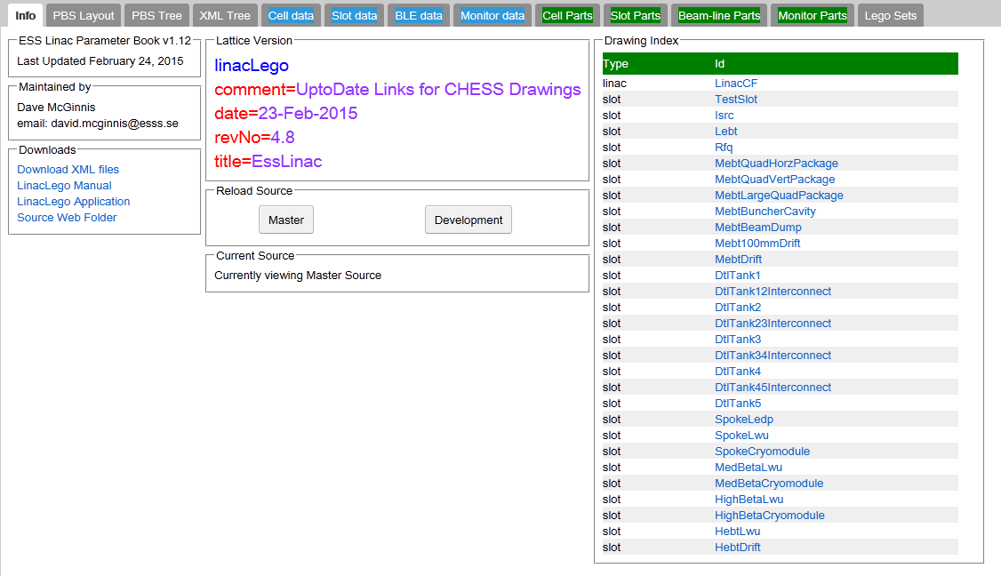
Go to LinacLego:
Once in LinacLego, you can click on the link that lead to the CHESS document describing a SLOT design

Slide 9
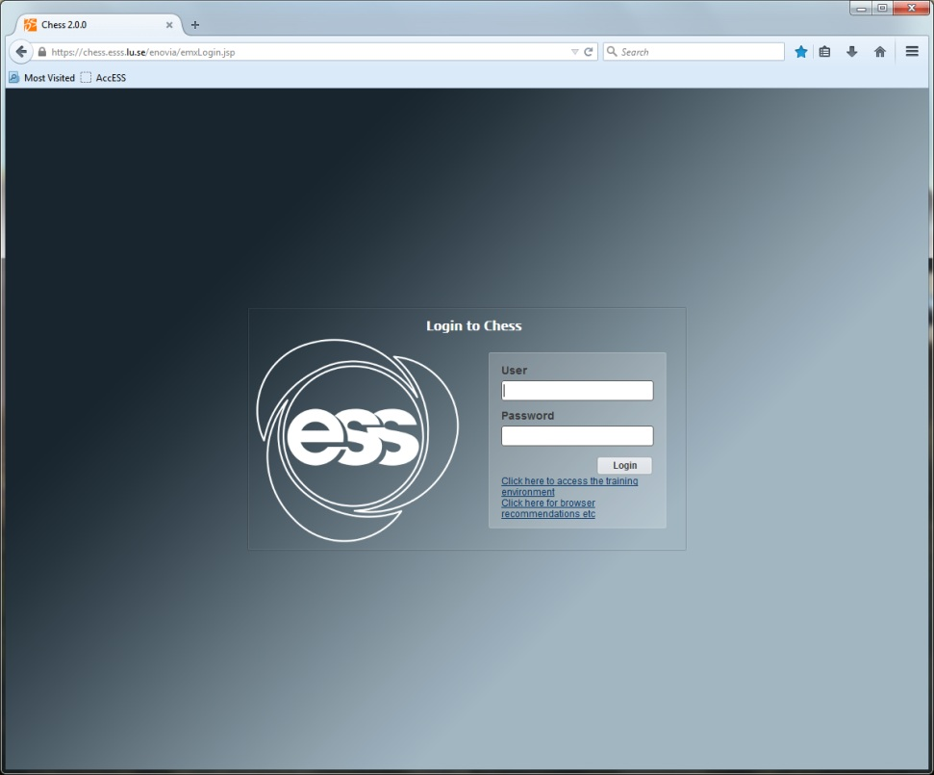
Logging-in CHESS
By clicking the LinacLego link, you get redirected to CHESS, where you login with your credentials

Slide 10
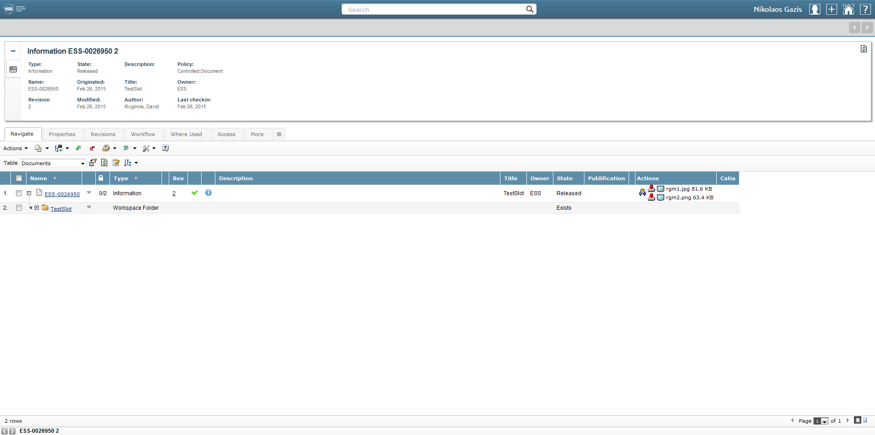
CHESS document
The link will direct you to your CHESS document, dedicated for the CAD exchange of your relevant Work Package
There is one CAD document (containing CAD data e.g. step, catproduct, packandgo or other) that each IKC uses to update their corresponding models

Slide 11
CHESS folder
The folder indicated below the CHESS document, is the actual folder in which you are currently

Slide 12

Subscribing to CHESS documents
Please, first subscribe to the CHESS document of interest so you can receive automatic updates for its changes

Slide 13
Preliminary & Released,
Revisions & Versions
The current revision of this document is #2
This document is released, which means that we have an agreed upon its design

Slide 14
Preliminary & Released,
Revisions & Versions
By clicking on tab More, we can view the history of the document

Slide 15
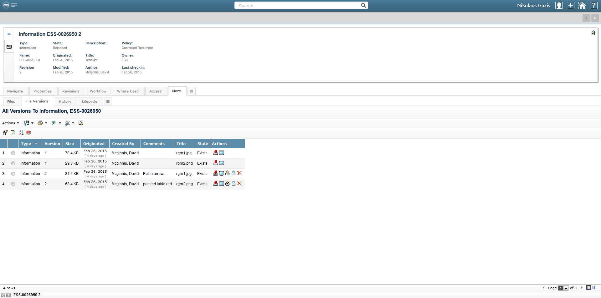
Preliminary & Released,
Revisions & Versions
Under the File Versions tab we can view all the history of the CHESS document (editors, dates, etc..)

Slide 16
Preliminary & Released,
Revisions & Versions
By clicking on the current revision number, we can view the revisions of the document

Slide 17
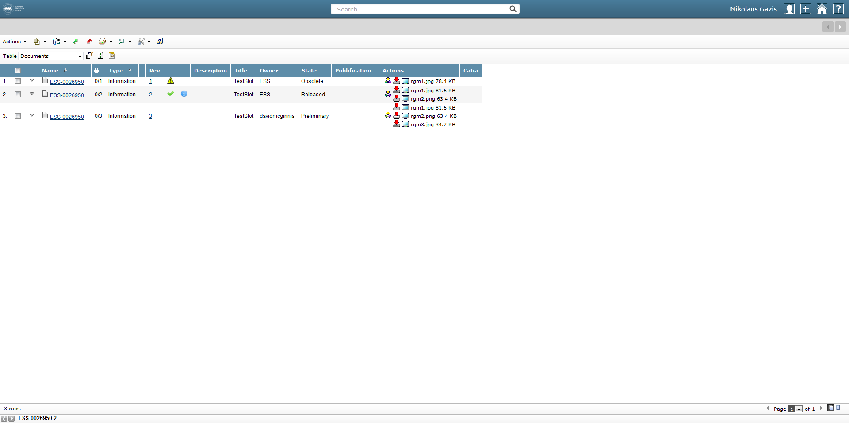
Preliminary & Released,
Revisions & Versions
Rev.1 is outdated and obsolete
Rev.2 is a Released on which ESS & IKC have agreed
Rev.3 is the model that contains work in progress, after the Release agreement
Changing the Revision of the document means changing its state

Slide 18
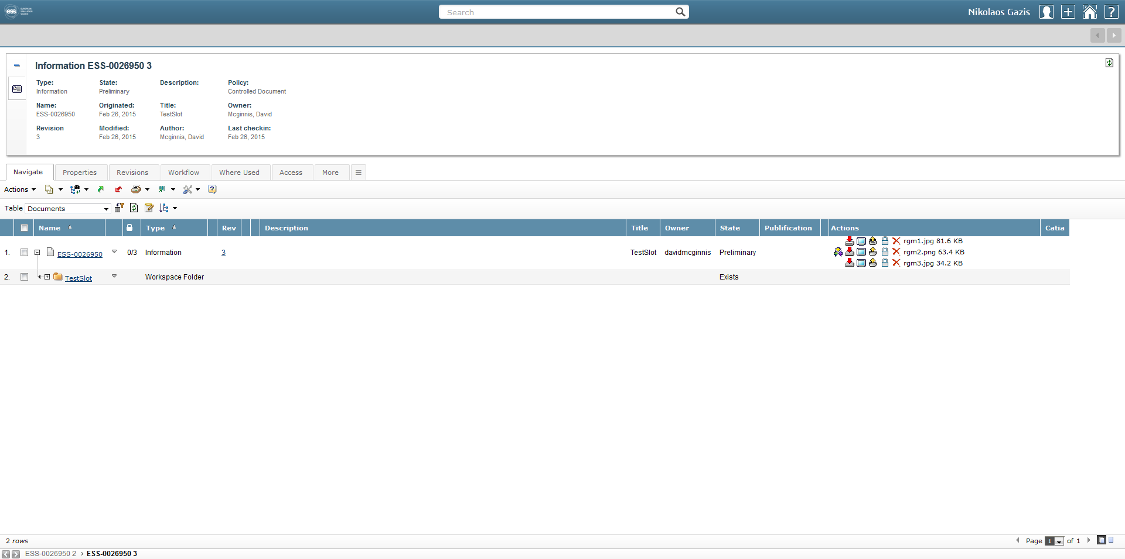
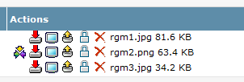
Check-Out:
Update 3D model
Navigate to the action icons (at the right of your screen) on the document containing the 3D-model and click on Check-Out.

Slide 19
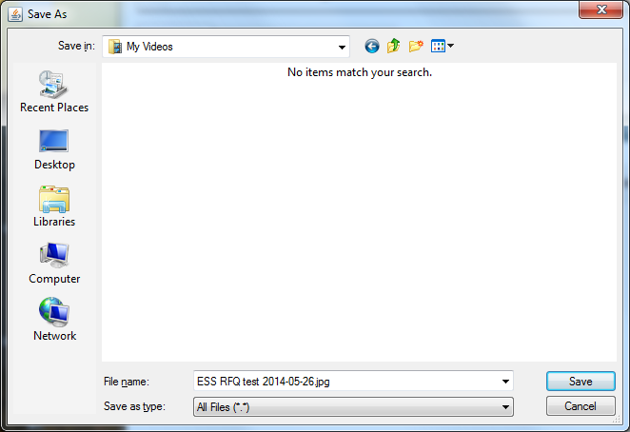
Check-Out:
Update 3D model
You will be prompted to choose where to save the 3D-model that you are Checking-Out:
Be careful not to save it on the same folder where you can have a 3D-model with the same name:
it could overwrite your 3D-model in case you are using the same filename!
Browse in your pc and click Save
The 3D-model will then be saved localy in your pc

Slide 20
Check-Out:
Update 3D model
You have now Checked-Out the 3D-model from CHESS and put it locally in your pc:
  You can either open and change/update the 3D-model
  or
  Your updates could already be included in a new 3D-model which is locally stored in your pc; therefore you need to upload (Check-In) this new 3D-model in the place of the old one
You can now Check-In (upload) your updated 3D-model in CHESS

Slide 21
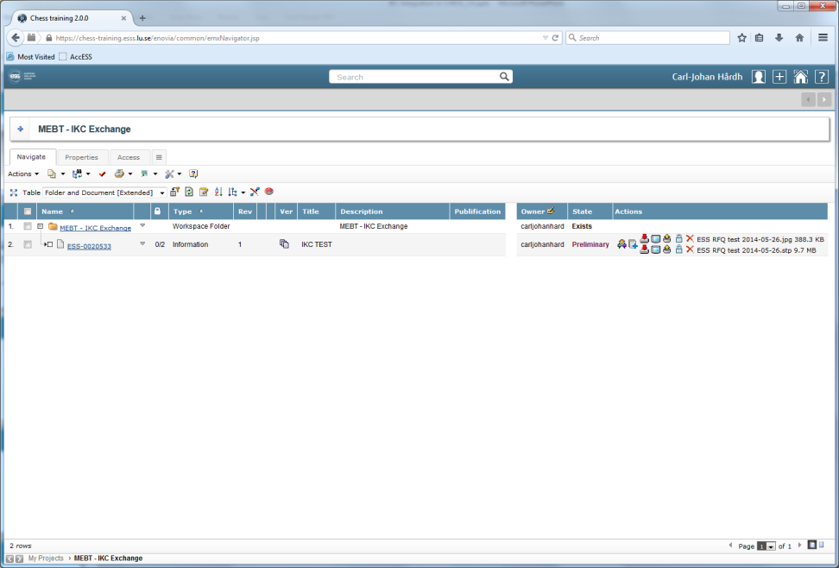
Check-In:
Save 3D model
The CHESS document can now be updated:
Click on the same icon

Slide 22
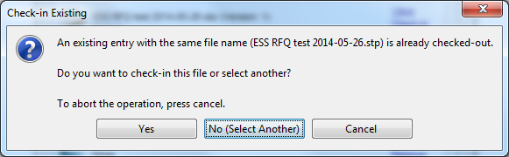
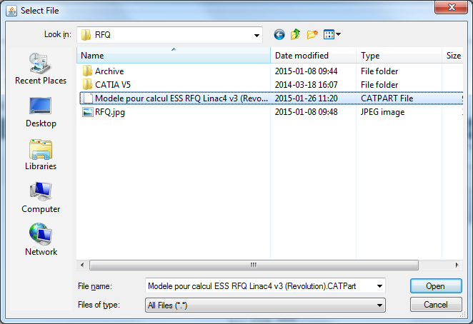
Check-In:
Save 3D model
CHESS will ask you to Check-In the same file that you previously downloaded or to choose another
Click on
No (Select Another)
Browse in your pc and choose your updated 3D-model that you want to upload and click on Open
1
2

Slide 23
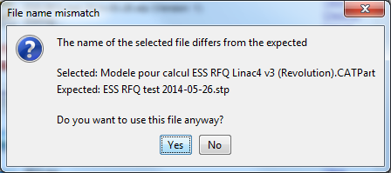
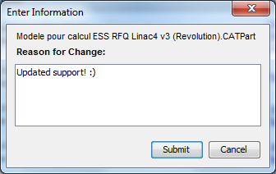
Check-In:
Save 3D model
CHESS recognizes if a file has a different name than before
Click Yes to upload your updated 3D-model
CHESS will prompt you to enter comments (with your comments you efficiently keep a track of your changes)
Type your comments an press Submit
3
4

Slide 24
End
Thank you for your updates!

Slide 25
SPARE SLIDE – Download file
You can Download any 3D-model (according to your given access rights) for information purposes
You can click the relevant button and Save it locally in your machine in a dedicated folder
Then you can view the file locally

Slide 26
SPARE SLIDE – Add a new file
To add a new file (not existing in CHESS yet), please click on the Check-In (button with the blue plus sign)
Then you will be able to browse in your pc and select the file you want to upload for the first time

Slide 27
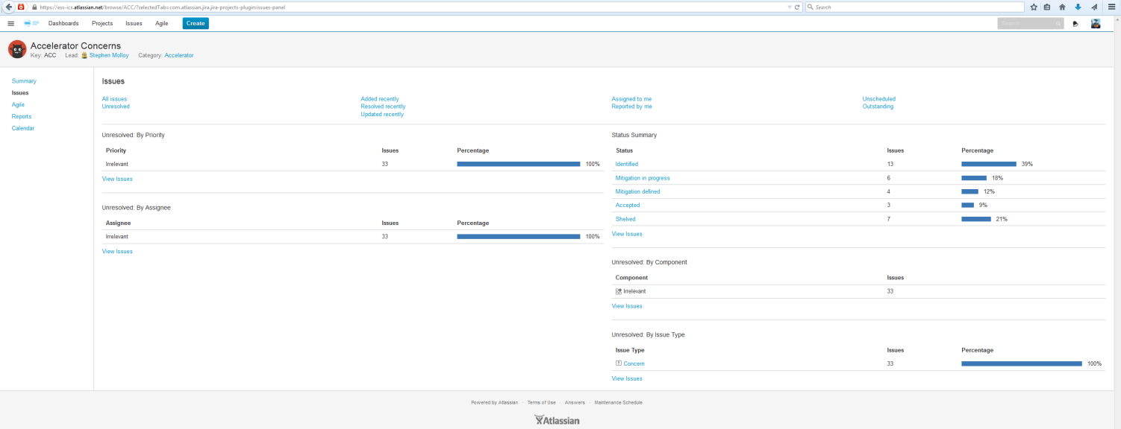
SPARE SLIDE – Comments on CHESS
If you have comments and requests for CHESS documents, please refer to the concerns JIRA database and write them down:
https://ess-ics.atlassian.net/browse/ACC-34?jql=project%20%3D%20ACC

Slide 28
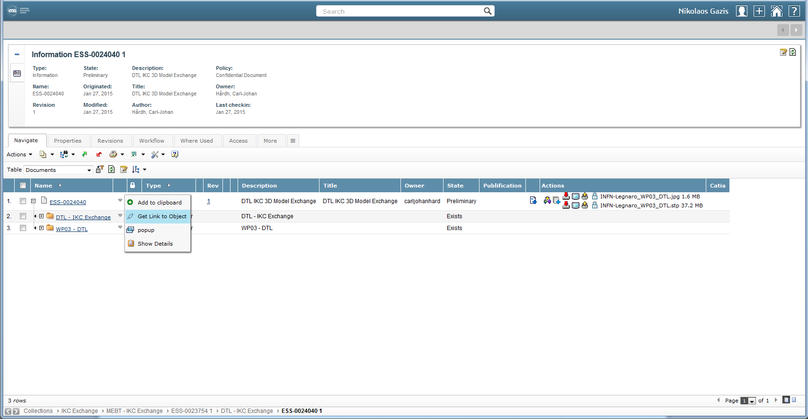
SPARE SLIDE – Link
To see the direct link of a CHESS document, hover your mouse pointer over the Arrow on the right of the CHESS document
Then click on the Get Link to Object

Slide 29
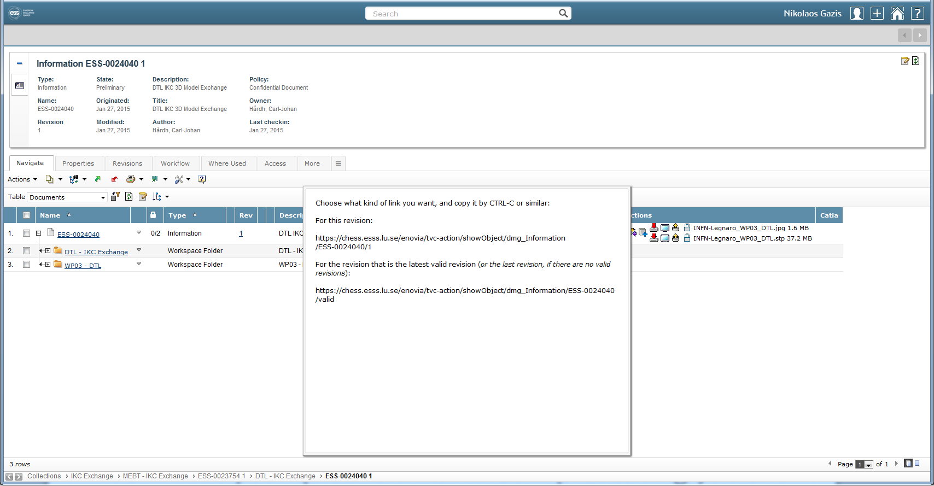
SPARE SLIDE – Link
You will be prompted with a window presenting you the link you requested

